Slide 1
Cloud-Operational Sentinel-3 Vegetation Trait Retrievals to Support FLEX L2/L3/L4 Products
Jochem Verrelst, David Kovacs, Emma De Clerck, Yuxin Zhang, Miguel Morata, Jose Luis Garcia, Pablo Reyes Muñoz
Notes:
Acknowledge, Pablo, Emma, David

Slide 2
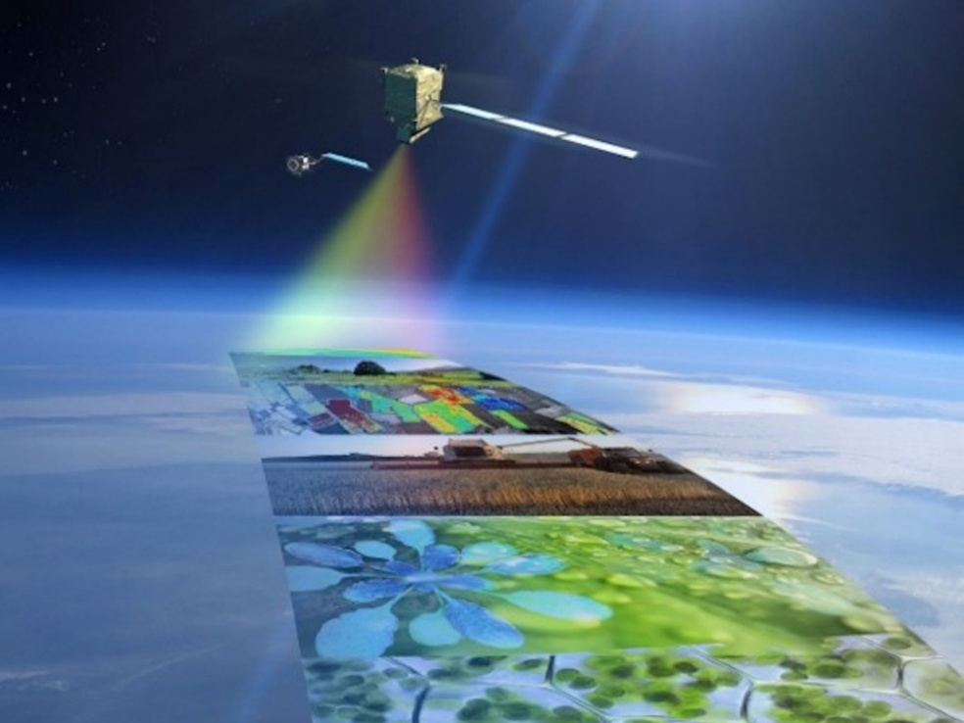
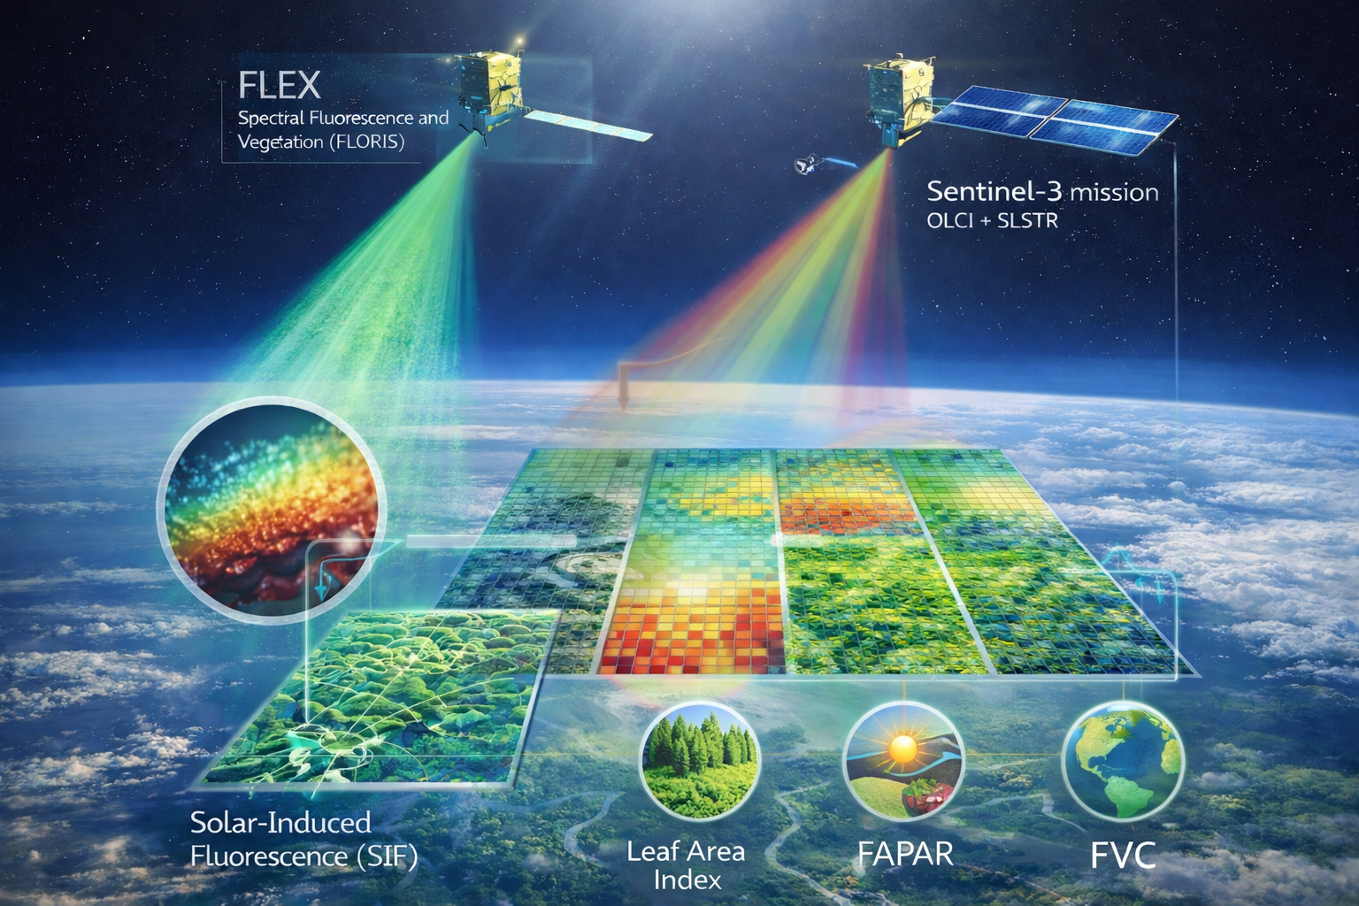





Background
🌍 FLEX–Sentinel-3 Synergy for Photosynthesis Monitoring
🛰️ FLEX mission: spectrally resolved SIF → Direct observation of photosynthetic function and plant stress
🌱 Sentinel-3: Essential Vegetation Traits (EVTs): → Structural, biochemical, and radiative vegetation context → Enables uncertainty-aware ecosystem characterization
🔗 Joint FLEX–S3 interpretation is essential: → EVTs support robust FLEX L2 SIF retrieval→ Foundation for L3/L4 products (e.g., GPP,stress, ecosystem productivity)
☁️ Cloud-native S3 access enables scalable processing: → Since 2016: OLCI L1 TOA radiance data in Google Earth Engine
→ Since ~2020: L2 SYNERGY surface reflectance in CDSE /openEO API
Notes:
CDSE: Copernicus Data Space Ecosystem

Slide 3
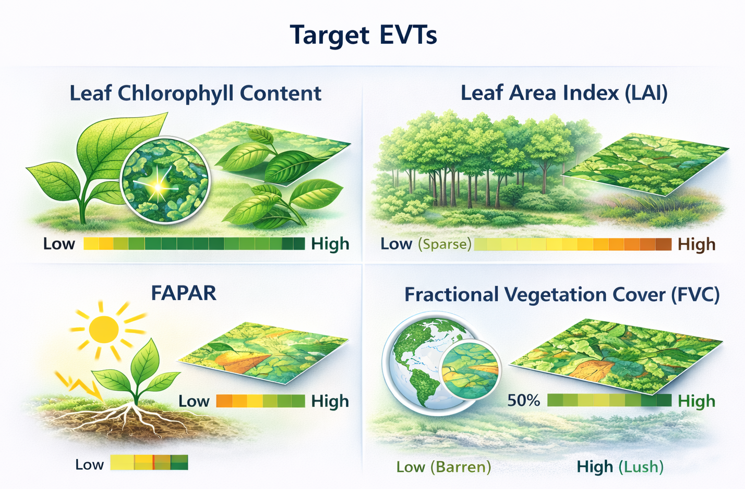
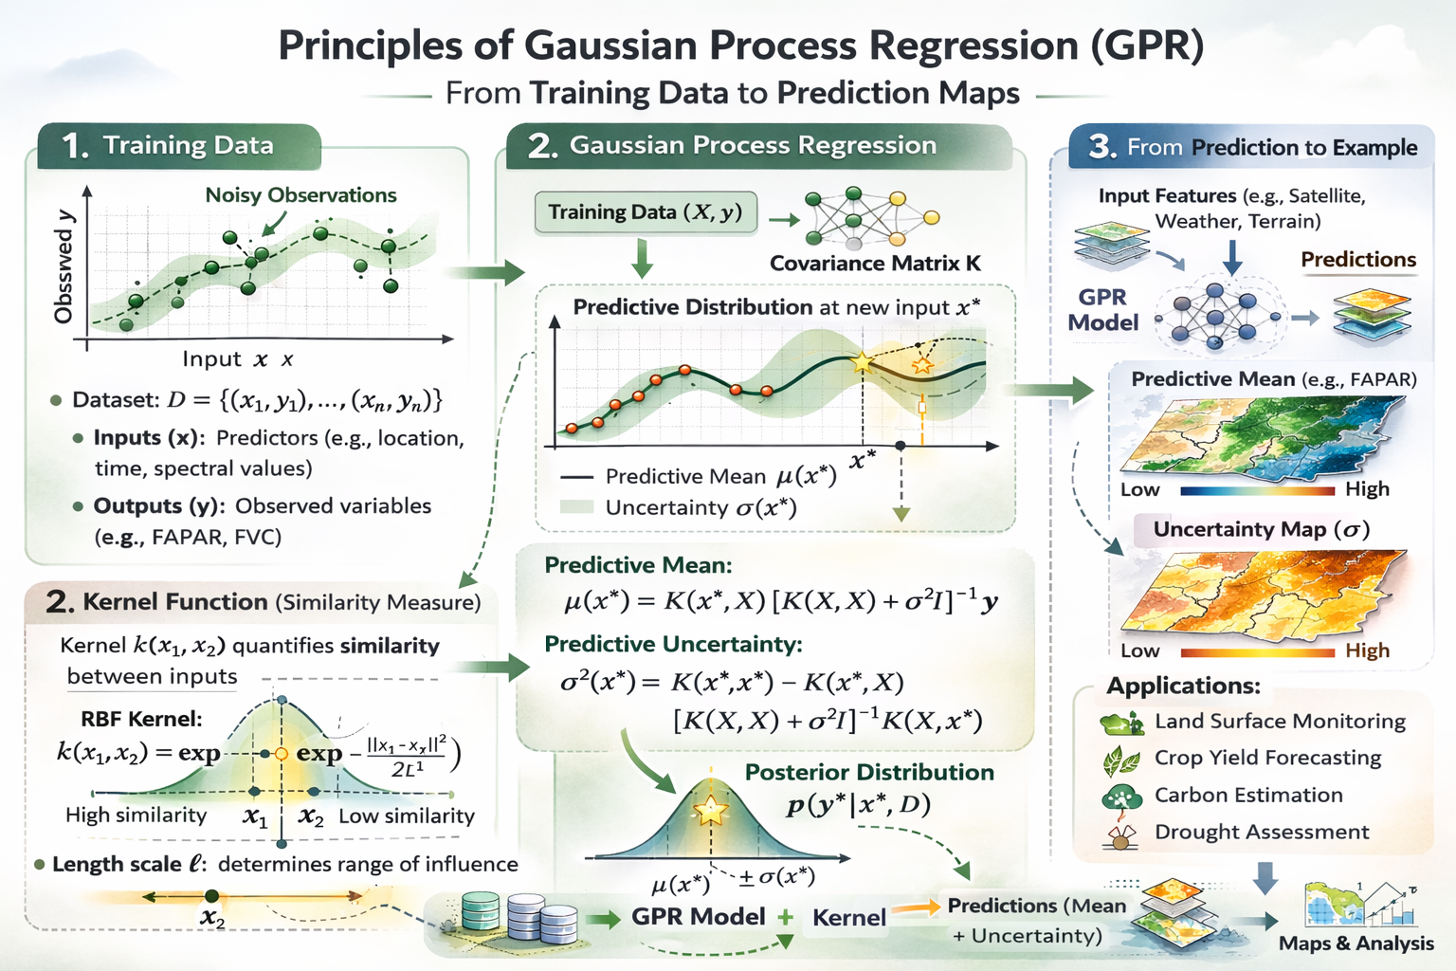
📊 Three GPR model families for S3 EVTs retrieval applicable in the cloud: (2022–2025 releases)
Gaussian Process Regression (GPR) → Designed for cloud-native S3 EVT retrieval:
🌍 S3-TOA-GPR hybrid → Simulation-based models (Top-Of-Atmosphere reflectance)
🌍 SCOPE-SYN-GPR hybrid → Hybrid models trained on S3 SYNERGY surface reflectance
🌍 GBOV-SYN-GPR empirical → Empirical models trained on SYNERGY and upscaled CLMS-GBOV reference data
Notes:
GPR: matrix algebra

Slide 4

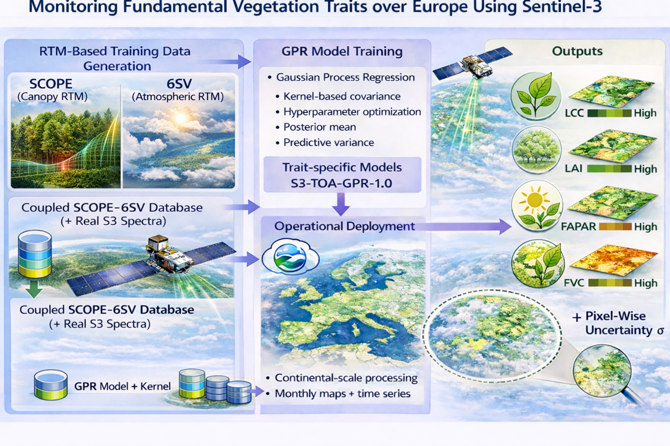
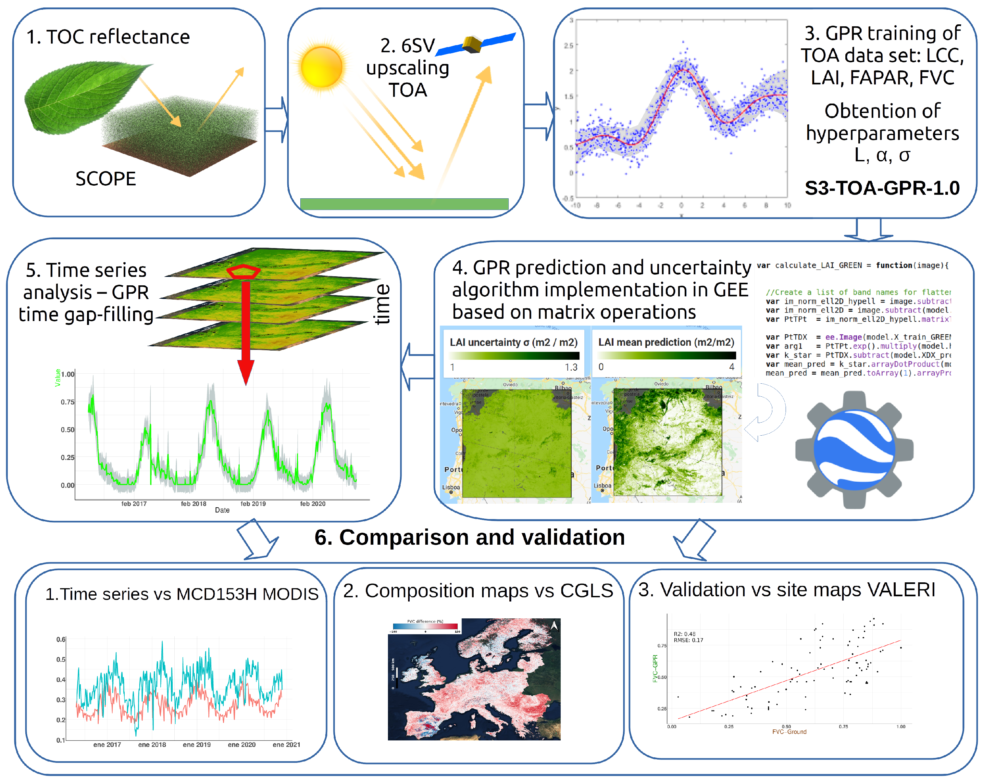

1: S3-TOA-GPR models
OLCI TOA radiance data in GEE since 2016
SCOPE-6SV-based hybrid models
Workflow
Reyes-Muñoz P, Pipia L, Salinero-Delgado M, Belda S, Berger K, Estévez J, Morata M, Rivera-Caicedo JP, Verrelst J. Quantifying Fundamental Vegetation Traits over Europe Using the Sentinel-3 OLCI Catalogue in Google Earth Engine. Remote Sensing. 2022; 14(6):1347. https://doi.org/10.3390/rs14061347
Notes:
CGLS: Copernicus Global Land Service

Slide 5
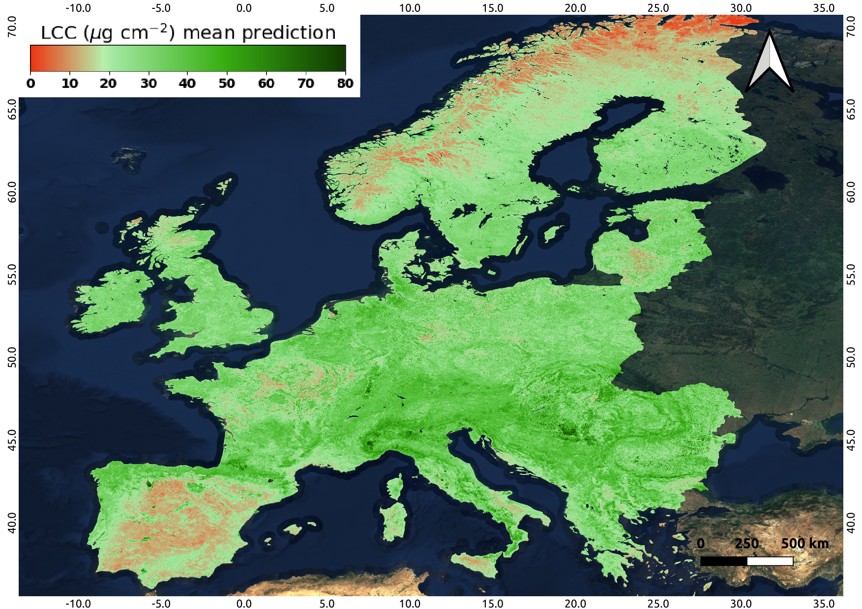
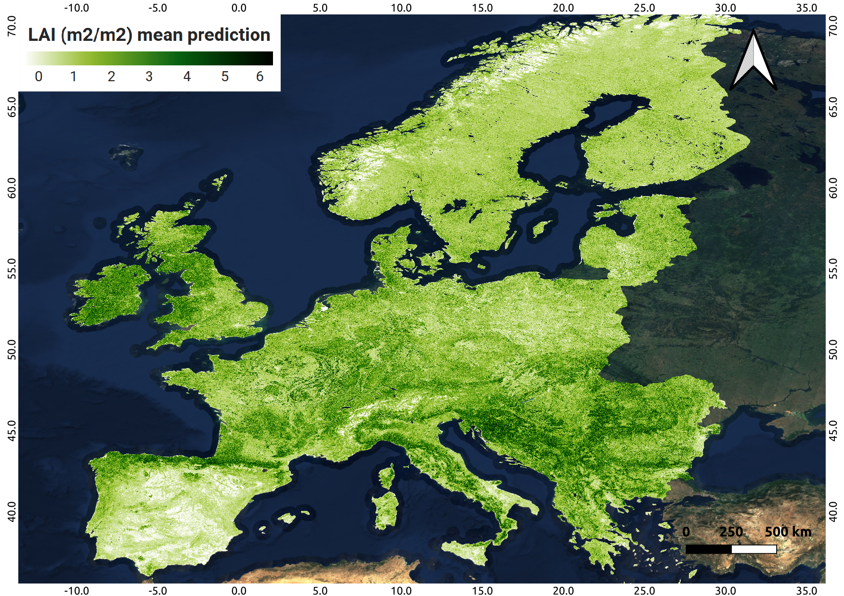
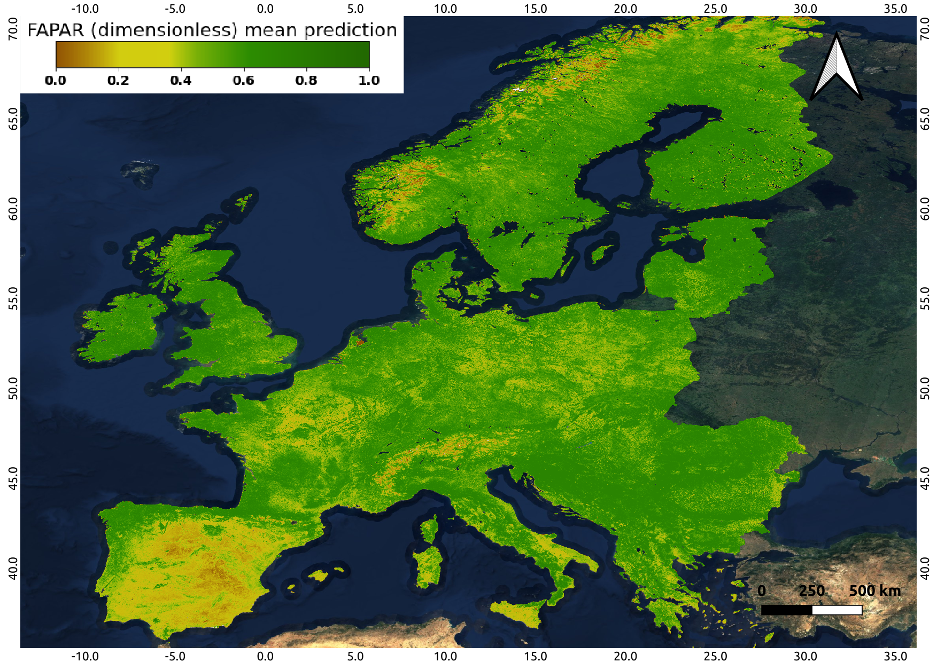
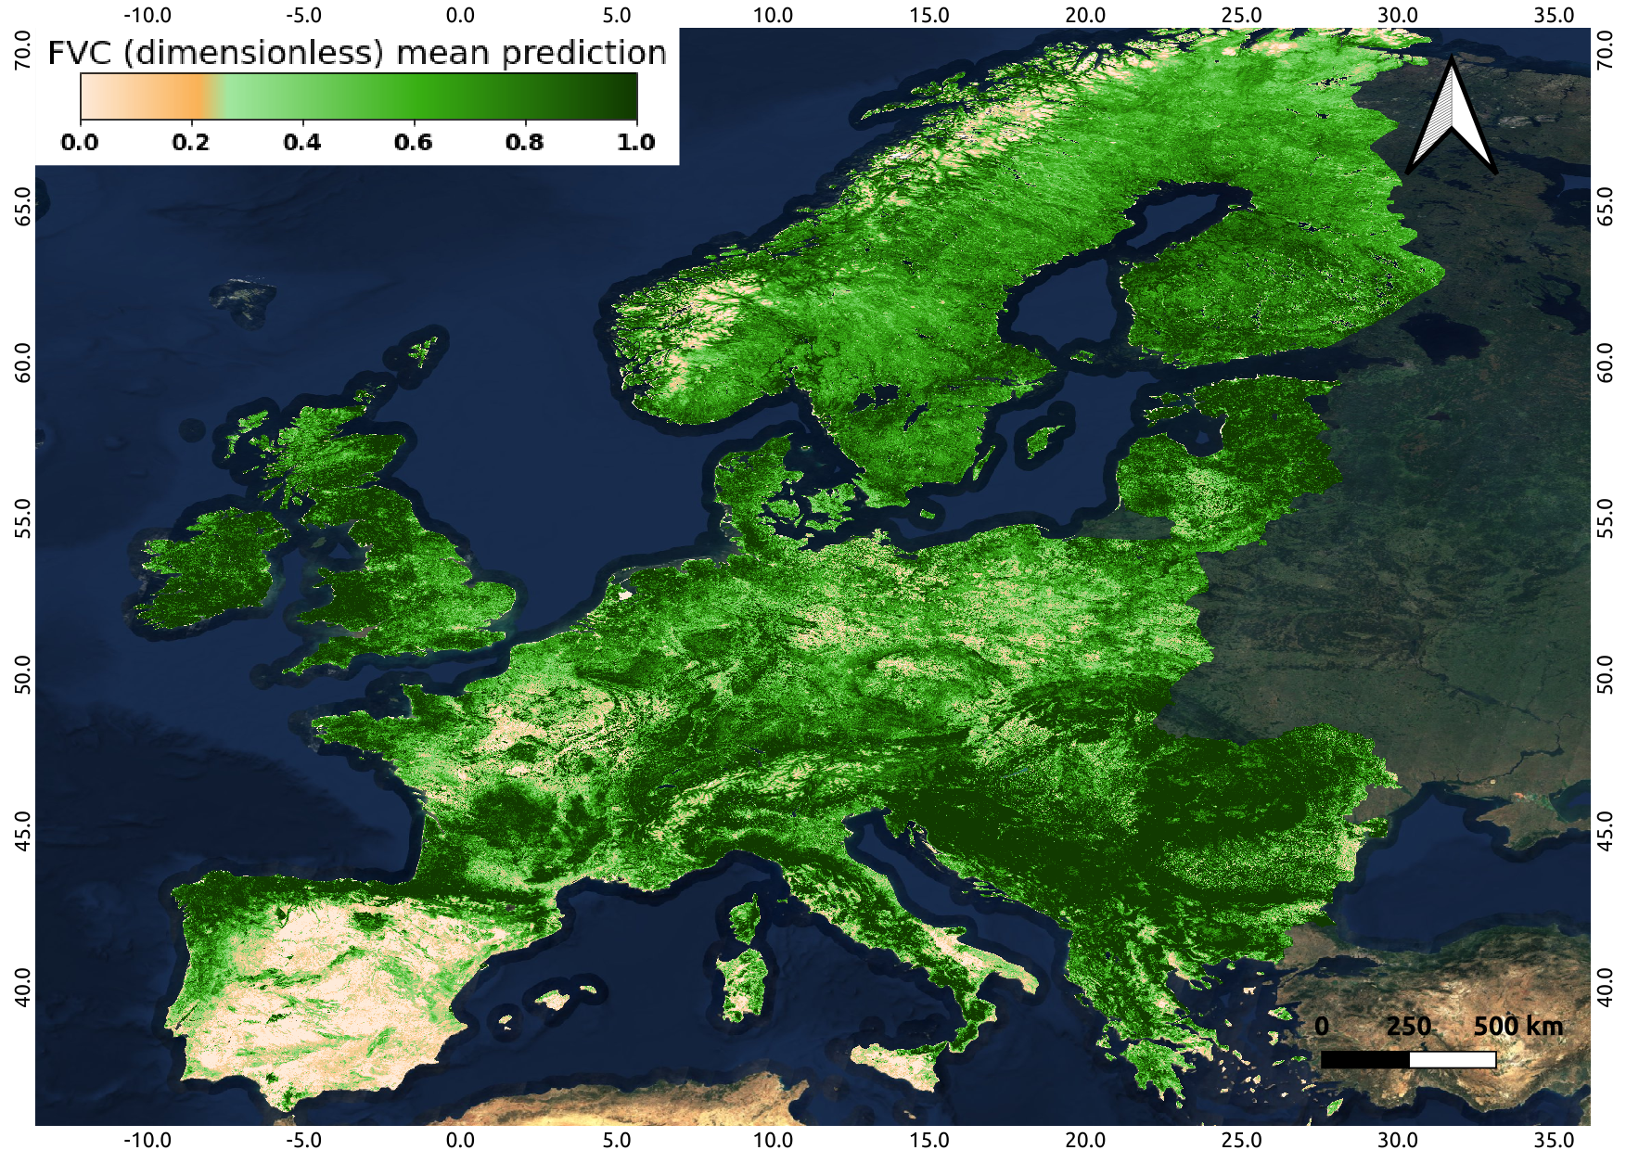
Monthly averaged over July 2018; 300m
LCC [μg cm⁻²]
LAI [m⁻²·m⁻²]
FAPAR [-]
FVC [-]
Notes:
Unlike OTCI which gives weird values, LCC give quantitative values, plus uncertainties.
The only problem of LCC is that there is little validation data

Slide 6
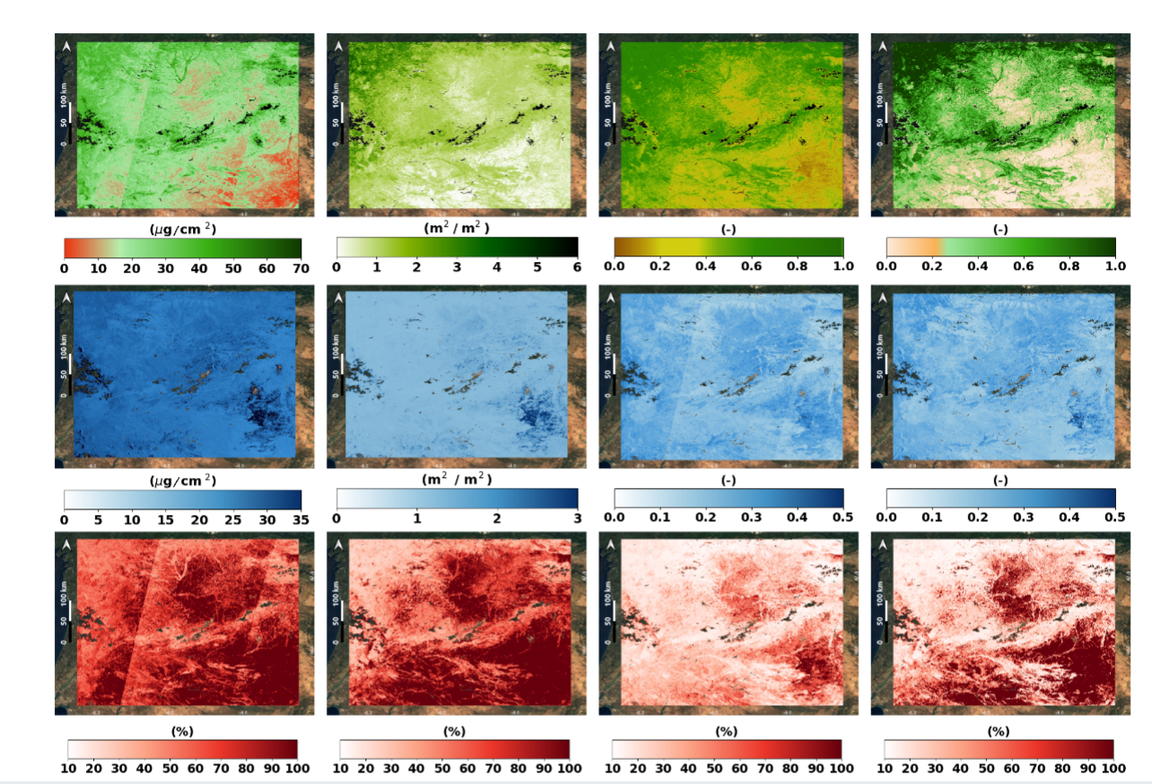
LCC [μg cm⁻²] LAI [m⁻²·m⁻²] FAPAR [-] FVC [-]
GPR delivers epistemic uncertainty (model-based)
Spatial distribution of absolute and relative uncertainties were investigated over part of the Iberian peninsula (20th June 2019)
Increase in relative uncertainties was especially evident in heterogeneous surfaces (e.g. multiple crops, fallow stages, bare soil)
Rel. uncertainty Abs. Uncertainty Estimate
20th June 2019
Notes:
The models were also explored at a regional scale, over part of the Iberian peninsula, and we found that the relative uncertainties, that is to say the absolute uncertainties divided by the estimate values were much higher on surfaces with scarce vegetation. On the other hand, we modelled time series, on 4 large areas, belonging to diverse land cover types: Non-irrigated arable lands, rice fields, pastures and broad-leaved forest. And here we found that the consistency of the time series improved significatively when applying a temporal smoother, based on the same GPR method but applied along the temporal dimension.
LAI and LCC are non-linearly correlated with radiances, meanwhile FAPAR and FVC are more correlated.
Scarce vegetated areas are subjected to changes in bare soil cover, unrecognizable by our models.

Slide 7
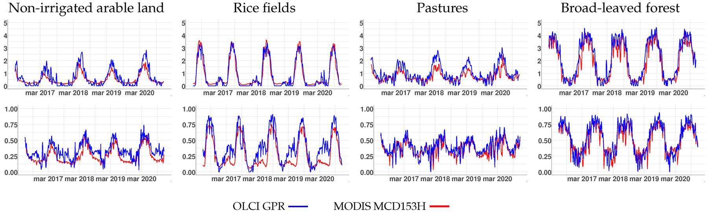
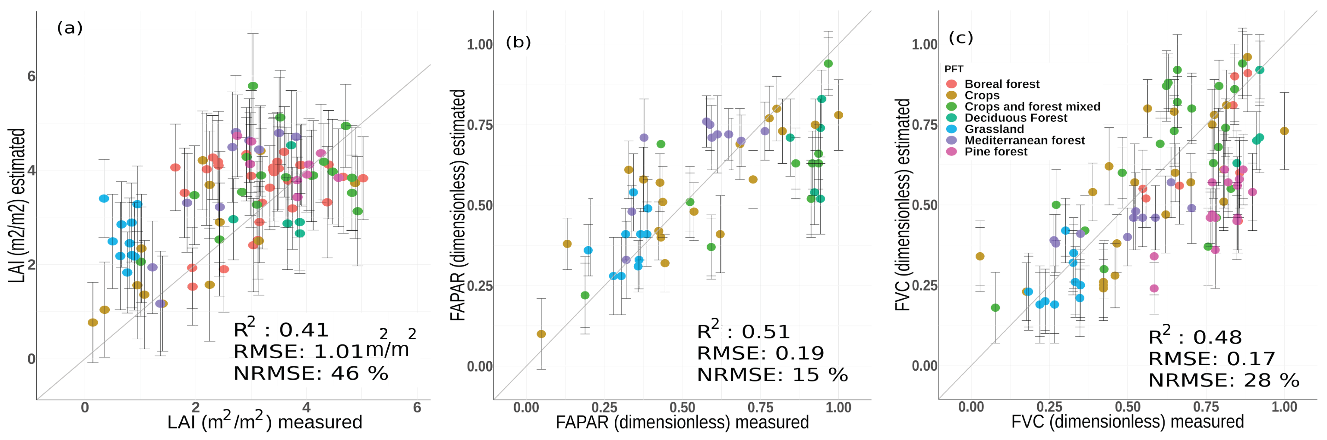
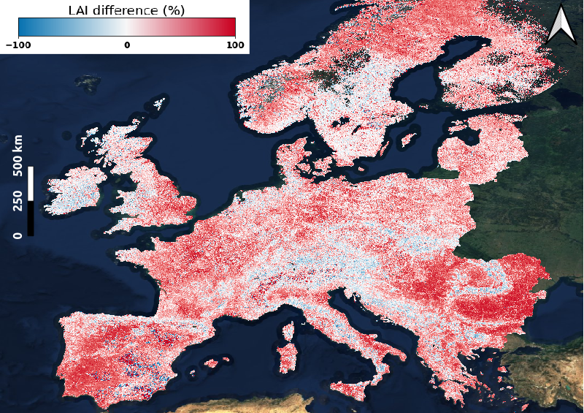
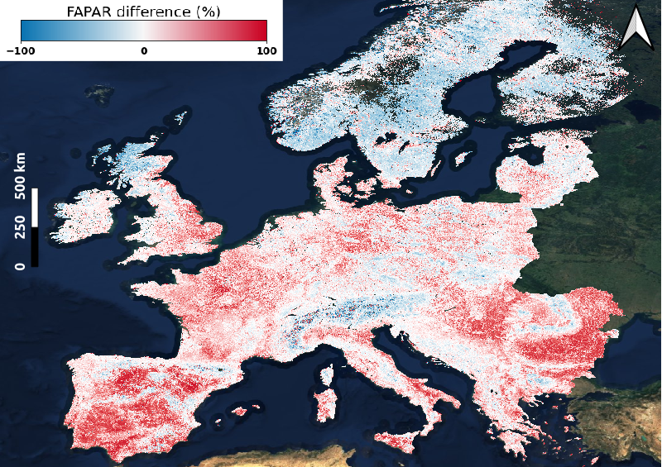
A threefold evaluation was conducted against:
MODIS-MCD15A3H,
Copernicus CLMS products
VALERI field campaigns
Overall, good seasonal and spatial agreement was found in surfaces well characterised (homogeneous vegetated surfaces), with marked seasonality and within the training range
(1) Temporal intercomparison S3-GPR-FVTs Vs MCD15A3H (2016 - 2022)
FAPAR [-] LAI [m⁻²·m⁻²]
(3) Scatterplots: S3-GPR-FVTs estimates and VALERI field campaigns
(2) Diff [%] S3-GPR Vs CLMS (2019)
LAI [m⁻²·m⁻²] FAPAR [-] FVC [-]
LAI [m⁻²·m⁻²] FAPAR [-]
Notes:
Are these differences maps also generated in GEE? Time series?
Spatial resolution? Also 300m
The time series of LAI and FAPAR were also intercompared against a MODIS product, reflecting overall a good temporal agreement, with the best matching on broadleaf forests and in the case of LAI, on rice fields, and with poorer matchings on non-irrigated arable land, which may be subjected to a more variable phenology (depending on climate inter-annual variability and human intervention), causing a different temporal response of the models.
So, further on, the models were intercompared locally against field-campaigns data coming from a nework called VALERI, standing as VAlidation of European Remote Sensing Istruments, and which provide pixel-upscaled LAI and FAPAR, that were used to compare our model output at pixel scale. However, due that these campaigns were previous to the S3 launch, we had to indirectly use Landsat images which were spectrally and spatially resampled to fetch S3 features, providing therefore rather an indirect validation.
Assessment of TS outputs on other areas (e.g. typically evergreen vegetation such as olive groves or some fruit trees) were linked with higher variability when intercompared. On these land covers, diverse factors such as understory dynamics, observation geometries, phenology, pathogens, etc may play a major role in the dynamics of the biophysical parameters, which are disparetely captured by different models and sensors.
Landsat data were matching the exact footprint of provided VALERI data and that is because they were used.

Slide 8


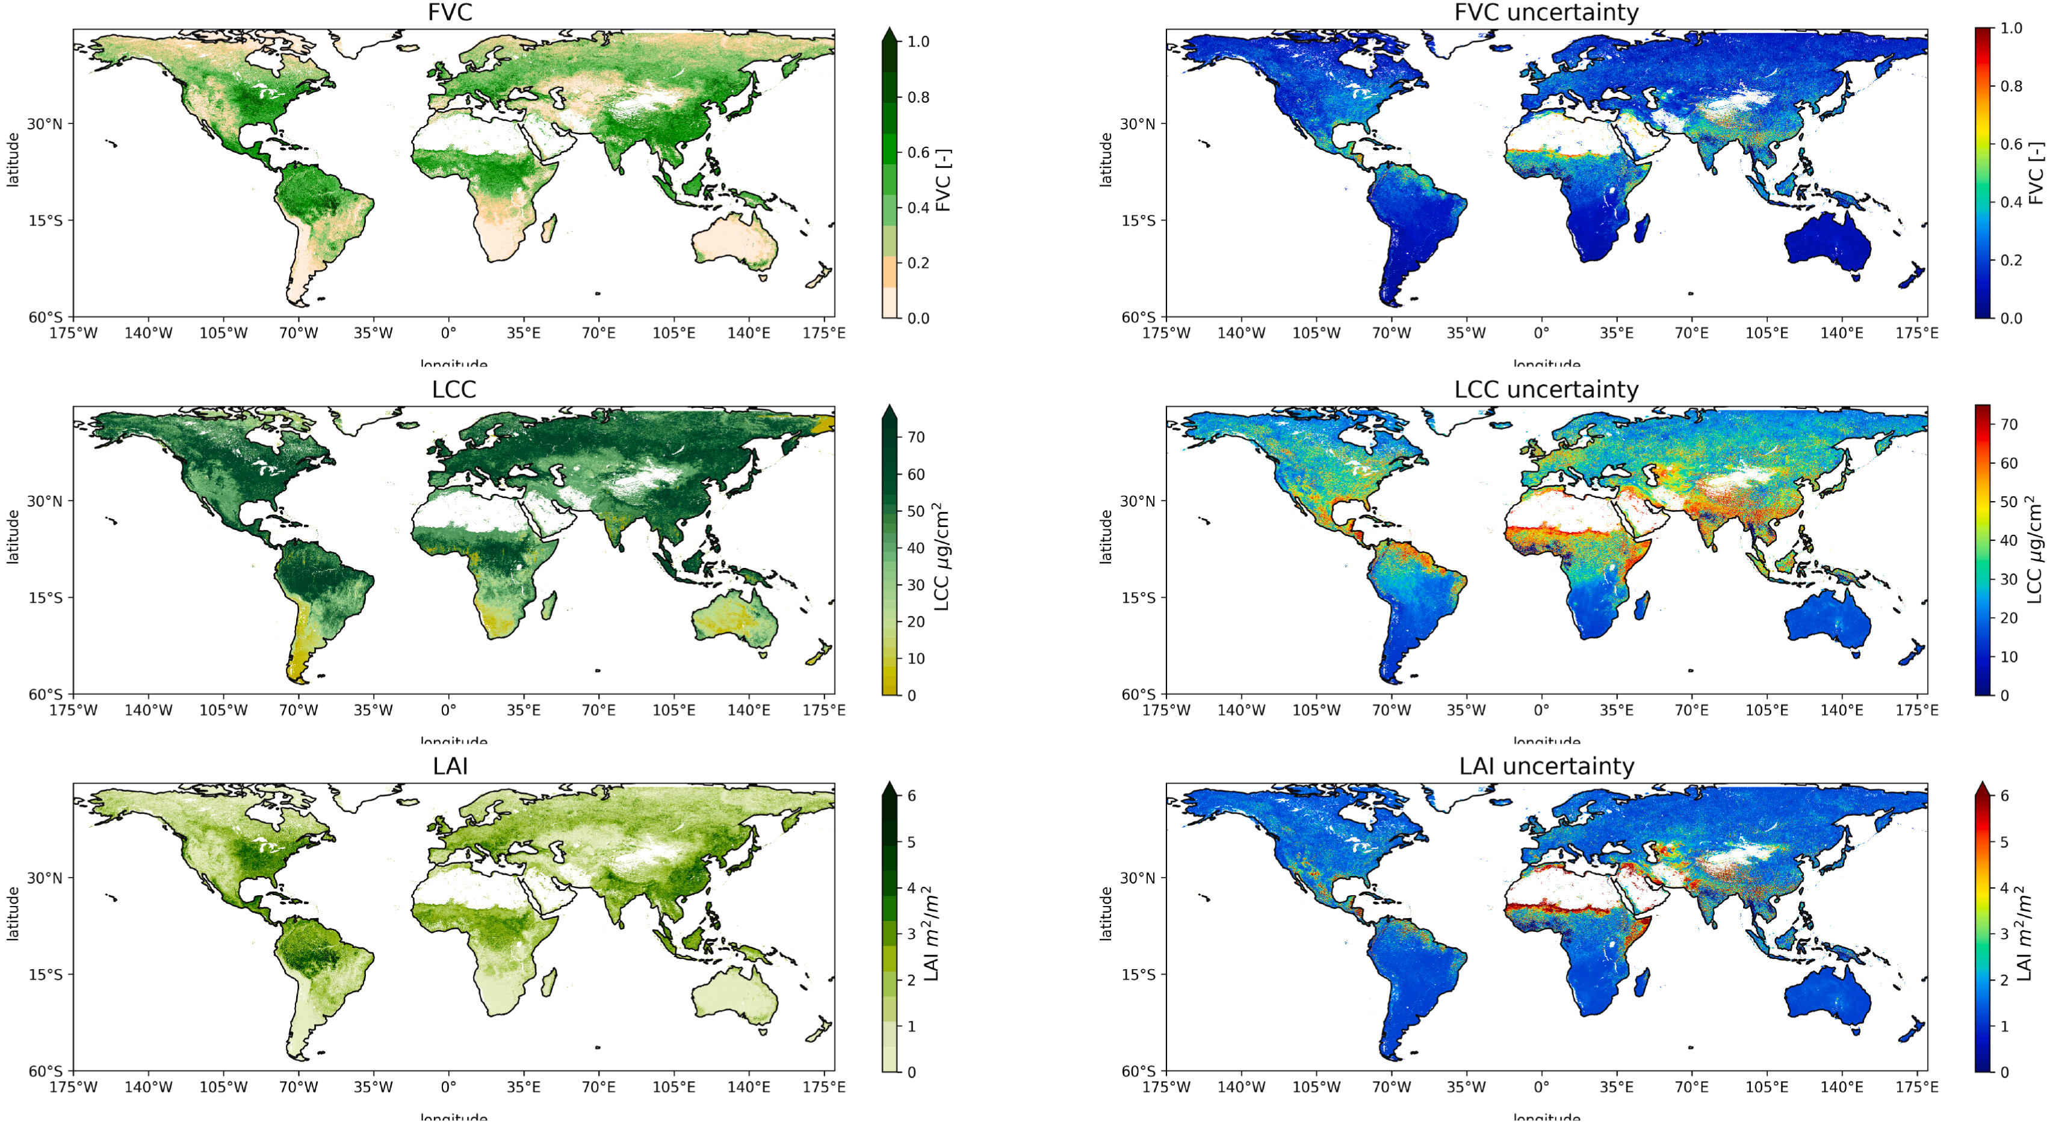
Implementation of the S3-TOA-GPR models into PyEOGPR
Monthly temporal composite 1-31st July 2020 (5 km)
Kovács, D. D., De Clerck, E., & Verrelst, J. (2025). PyEOGPR: A Python package for vegetation trait mapping with Gaussian Process Regression on Earth observation cloud platforms. Ecological Informatics, 92, 103497
Notes:
Only one line of code: model, spatial box, and temporal window

Slide 9
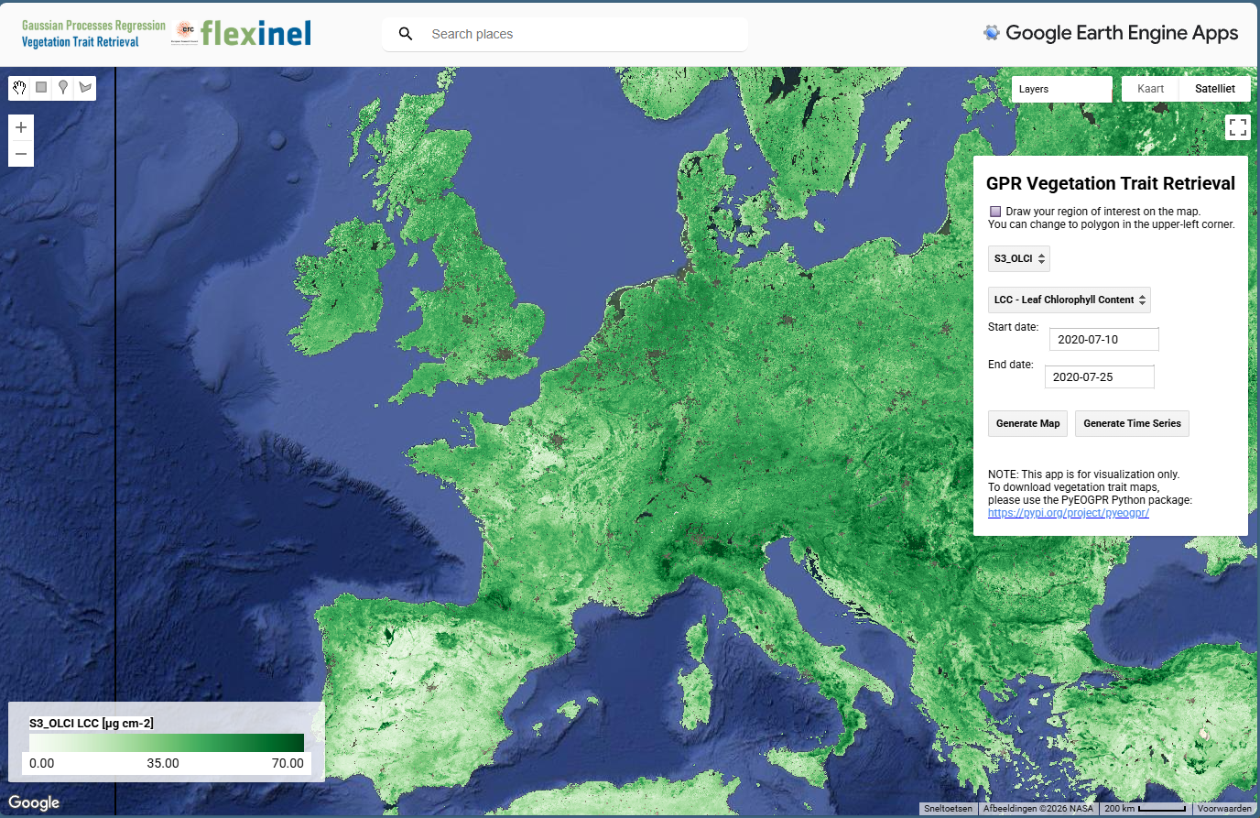

GEE vizualization tool
https://declerckemma.users.earthengine.app/view/gpr-vegetation-trait-retrieval
De Clerck, E., & Verrelst, J. (2026). A user-friendly Google Earth Engine Web Application for vegetation trait mapping and time series analysis from Sentinel-2 and Sentinel-3 imagery. IEEE Geoscience and Remote Sensing Letters.

Slide 10
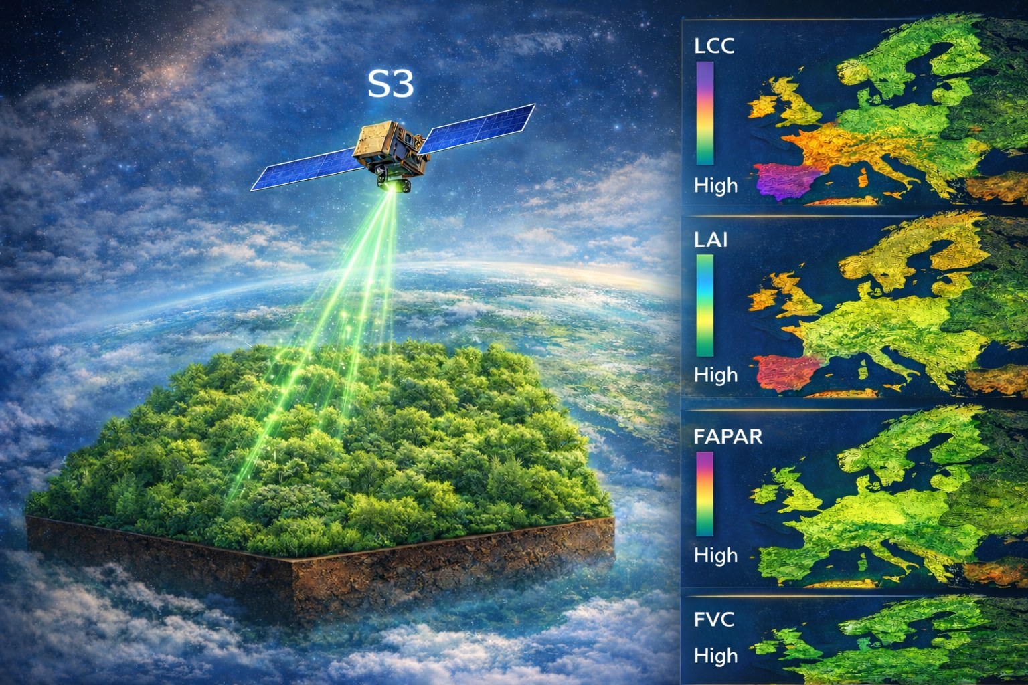

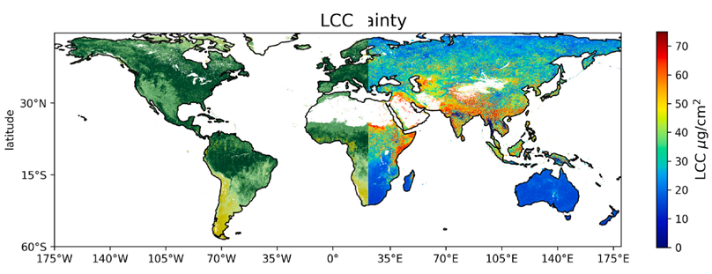





Summary S3-TOA-GPR models
SCOPE-GPR-FVTs models were successfully implemented in GEE, reproducing consistently spatiotemporal dynamics over Europe and globally.
The provided GPR epistemic uncertainties indicate conditions linked with low model responsiveness, allowing for continuous improvement.
GPR epistemic uncertainties depend on the distance between conditions at training and prediction points.
Assumptions of the RTM -> 1D homogeneous turbid medium
Sub-pixel heterogeneity
Clouds and atmospheric conditions
Optimization and size of the training data to keep a balanced light model avoiding memory problems
LCC
uncertainty
Operational cloud implementation
Notes:
Finally, We also analyzed the spatial distribution of the GPR models in comparison with the CGLS vegetation products, yearly aggregated, and we found that the GPR LAI model overestimated Copernicus LAI, especially in croplands, evergreen forests and heterogeneous landscapes over Europe, and with FAPAR and FVC providing more balanced outputs, with however some marked discrepancies in areas composed of mixed land cover types, which is also observed in the uncertainties layers, especially in FAPAR and LAI.
In general, models uncertainties increase as the conditions deviate from the ones included in the training data set, with special attention on high solar geometries, high heterogeneity, high proportion of bare soils, or deviations of atmospheric conditions.
There may be a problem of S3-TOA data in

Slide 11
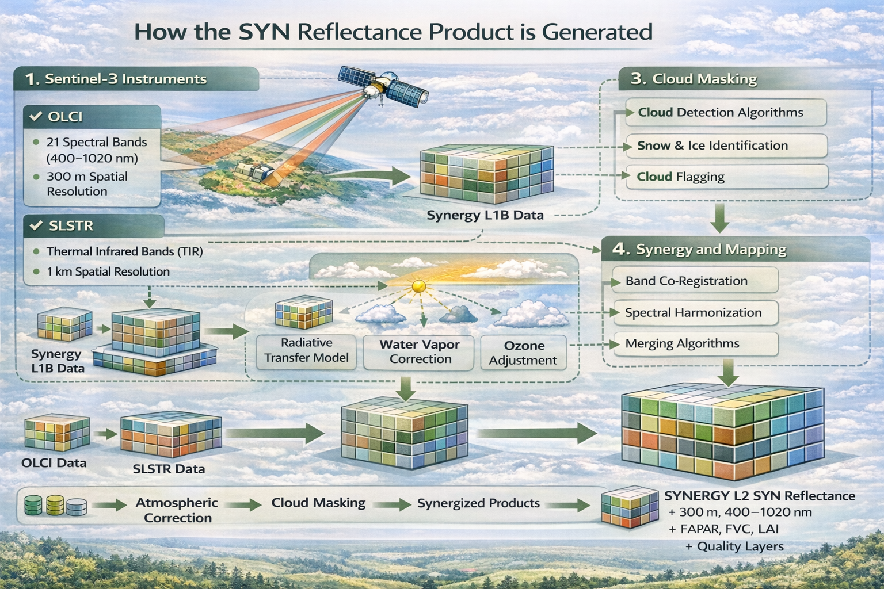
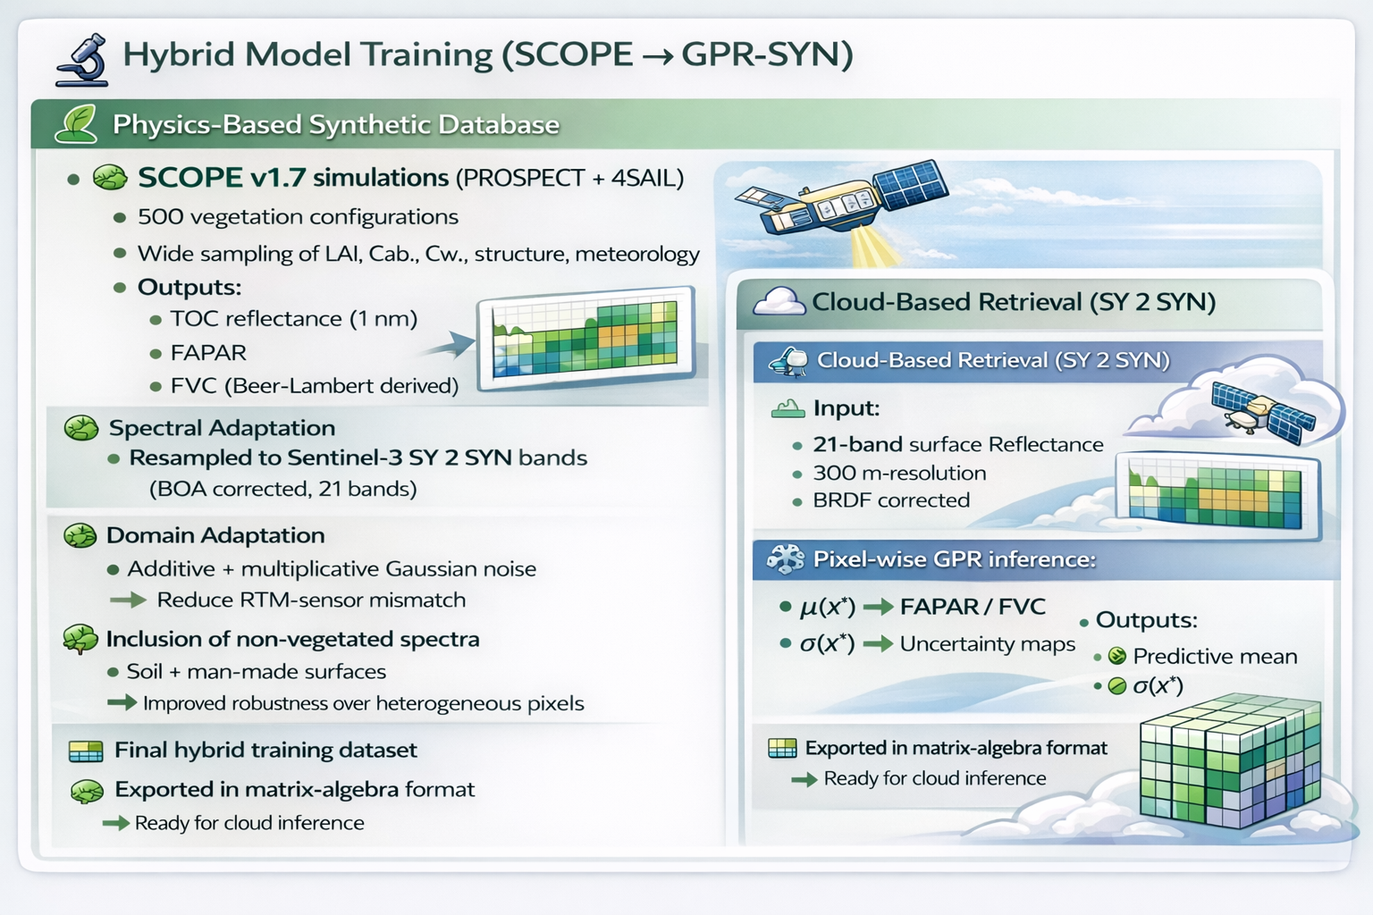
2: SCOPE-SYN-GPR
SYNERGY surface reflectance data in openEO/CDSE since 2020
Hybrid models trained on S3 SYN surface reflectance
Kovács, D, De Clerck, E., Brown L., Reyes-Muñoz., P., Verrelst J. Hybrid FAPAR and FVC retrieval from Sentinel-3 SYNERGY with Gaussian processes: development, validation. In review.
Notes:
Here we mention the 2 novelties:
Release of SYN data made need for developing models specific for SYN. Not in GEE, so we needed to make the models applicable in OpenEO
GBOV dataset for validation
GBOV: Ground-Based Observations for Validation

Slide 12
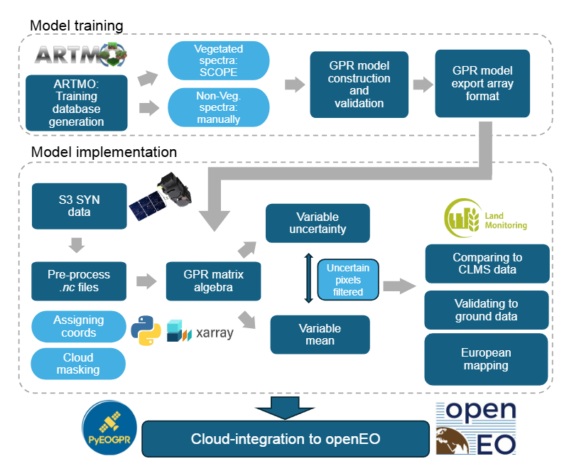
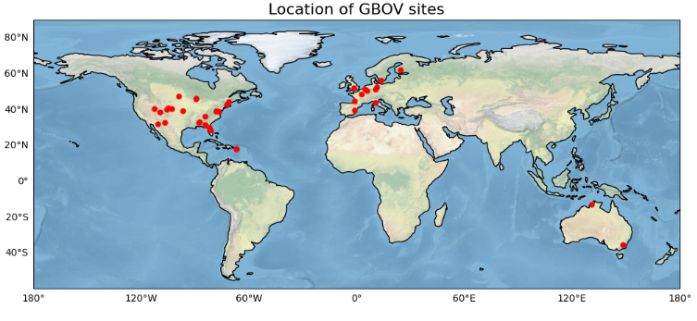

Method SCOPE-SYN-GPR models
🚀 Operational Deployment of GPR Models
🌱⚙️ SCOPE training
🛰️ S3-SYN ingestion (NV spectra)
🧮 Matrix-based GPR models
📊 Pixel-wise uncertainty estimation
🗺 Continental mapping
☁ Cloud integration (openEO)
📍 GBOV validation & CLMS comparison
Workflow
Notes:
CLMS: Copernicus Land Monitoring Service

Slide 13
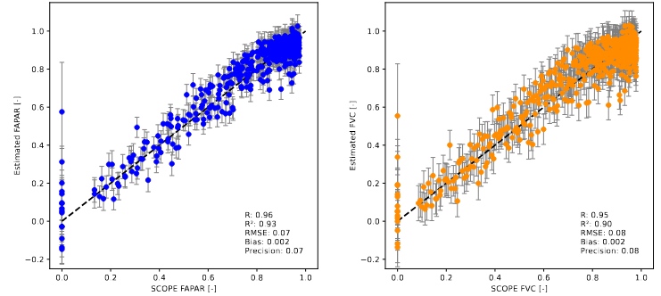
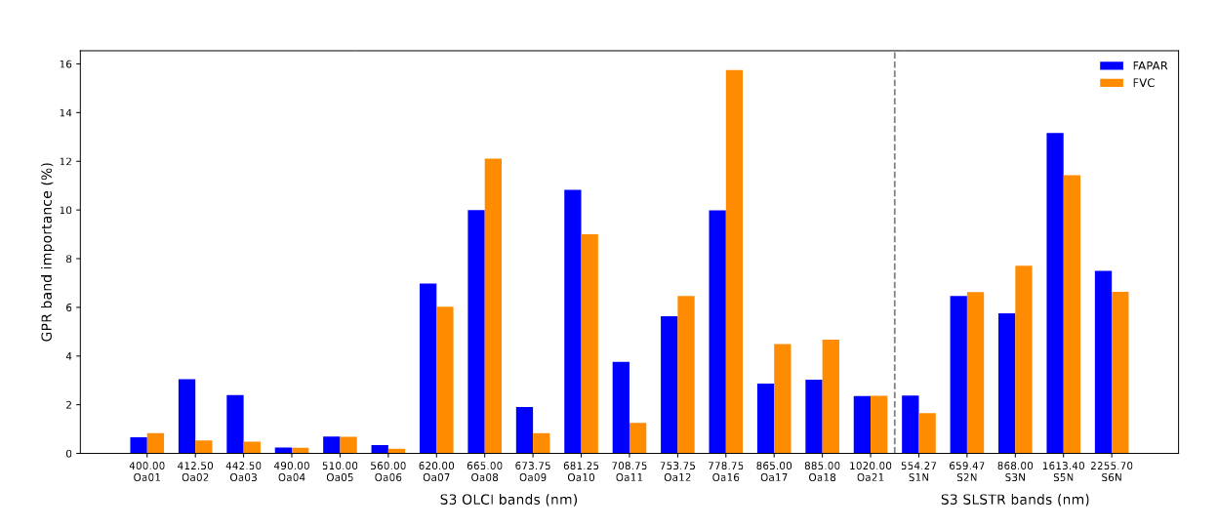
Results: GPR training SCOPE-SYN
FAPAR
FVC
SYN Band Relevance (GPR ARD Importance)
🔴 Red & Red-Edge Dominate:
Oa08 (665 nm), Oa10 (681 nm), Oa16 (778 nm) most influential
Capture chlorophyll absorption + red-edge slope
Core drivers of both FAPAR and FVC
💧 SLSTR SWIR Adds Structural Power:
S5N (1613 nm) & S6N (2256 nm) highly relevant
Sensitive to water content & canopy structure
Confirms added value of SLSTR bands
⚖️ FAPAR vs FVC Differences:
FAPAR → slightly stronger red absorption influence
FVC → stronger red-edge & SWIR sensitivity
Reflects absorption vs structural canopy effects
🛰️ Key Takeaway
SY 2 SYN synergy (OLCI + SLSTR) improves trait retrieval beyond OLCI alone
GPR relative band relevance (%)
OLCI
SLSTR

Slide 14
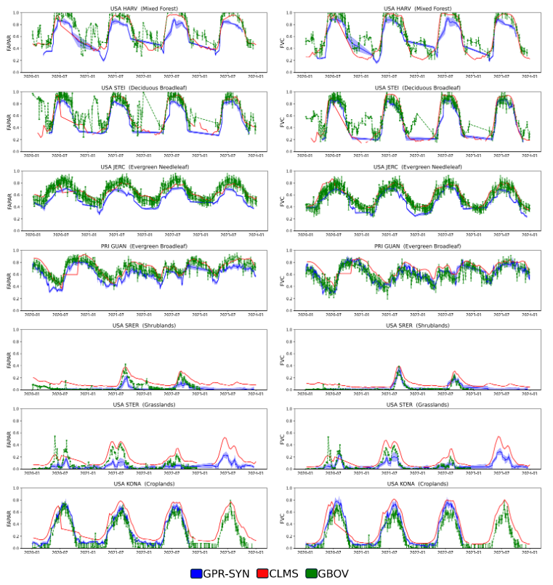
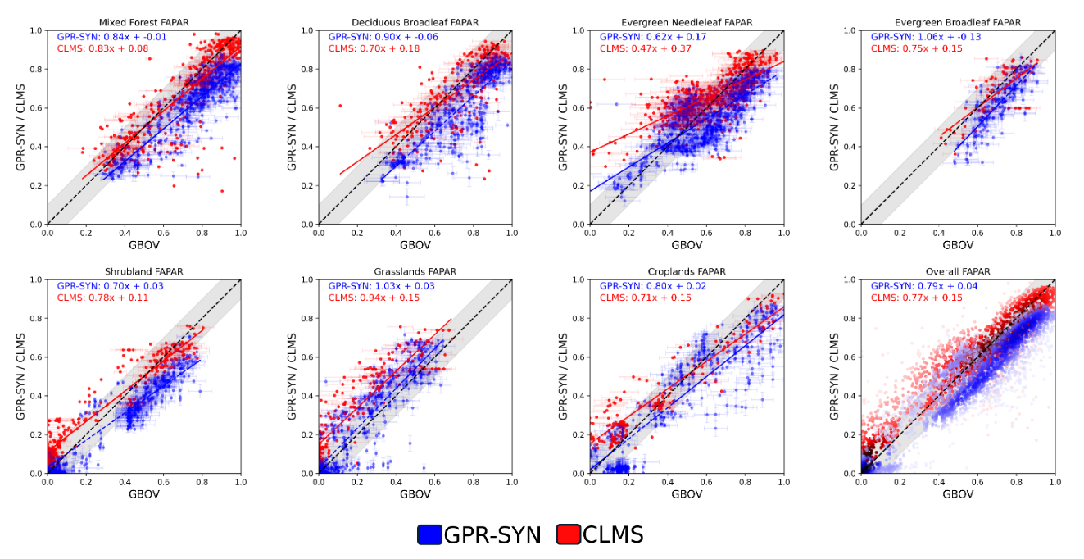
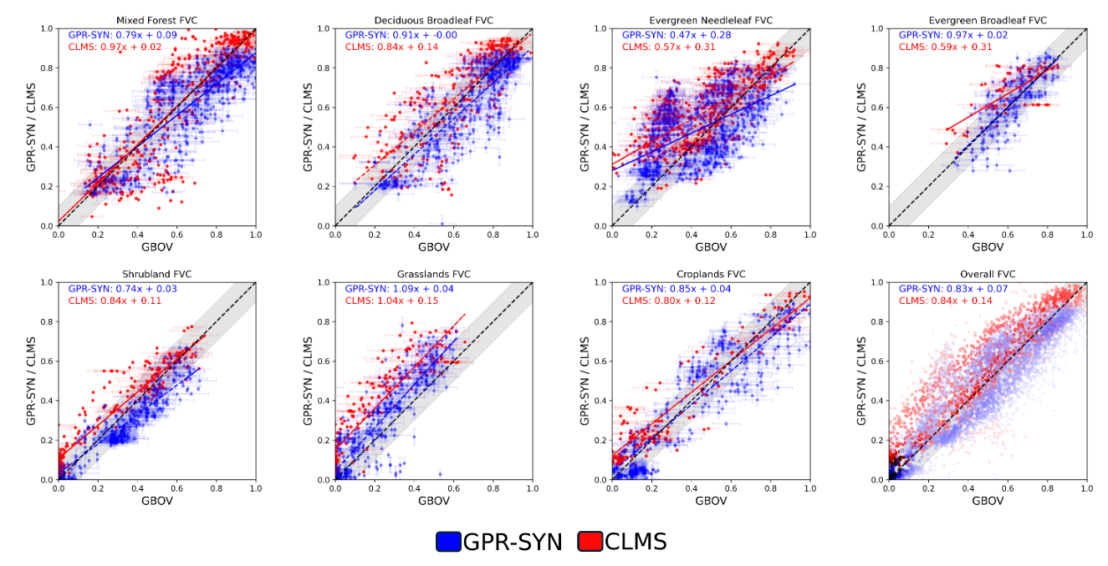
Intercomparison GPR-SYN against CLMS and GBOV per PFT
GPR-SYN and CLMS validated against GBOV data per PFT
FAPAR
FVC
FAPAR
R2: 0.81
R2: 0.88
R2: 0.74
R2: 0.64
R2: 0.50
R2: 0.52
R2: 0.88
R2: 0.59
All
R2: 0.88
R2: 0.90
R2: 0.85
R2: 0.83
R2: 0.86
R2: 0.92
R2: 0.89
R2: 0.87
FVC
R2: 0.69
R2: 0.79
R2: 0.71
R2: 0.69
R2: 0.21
R2: 0.40
R2: 0.79
R2: 0.71
All
R2: 0.88
R2: 0.85
R2: 0.86
R2: 0.83
R2: 0.90
R2: 0.92
R2: 0.83
R2: 0.81
Notes:
Rigorous validation

Slide 15
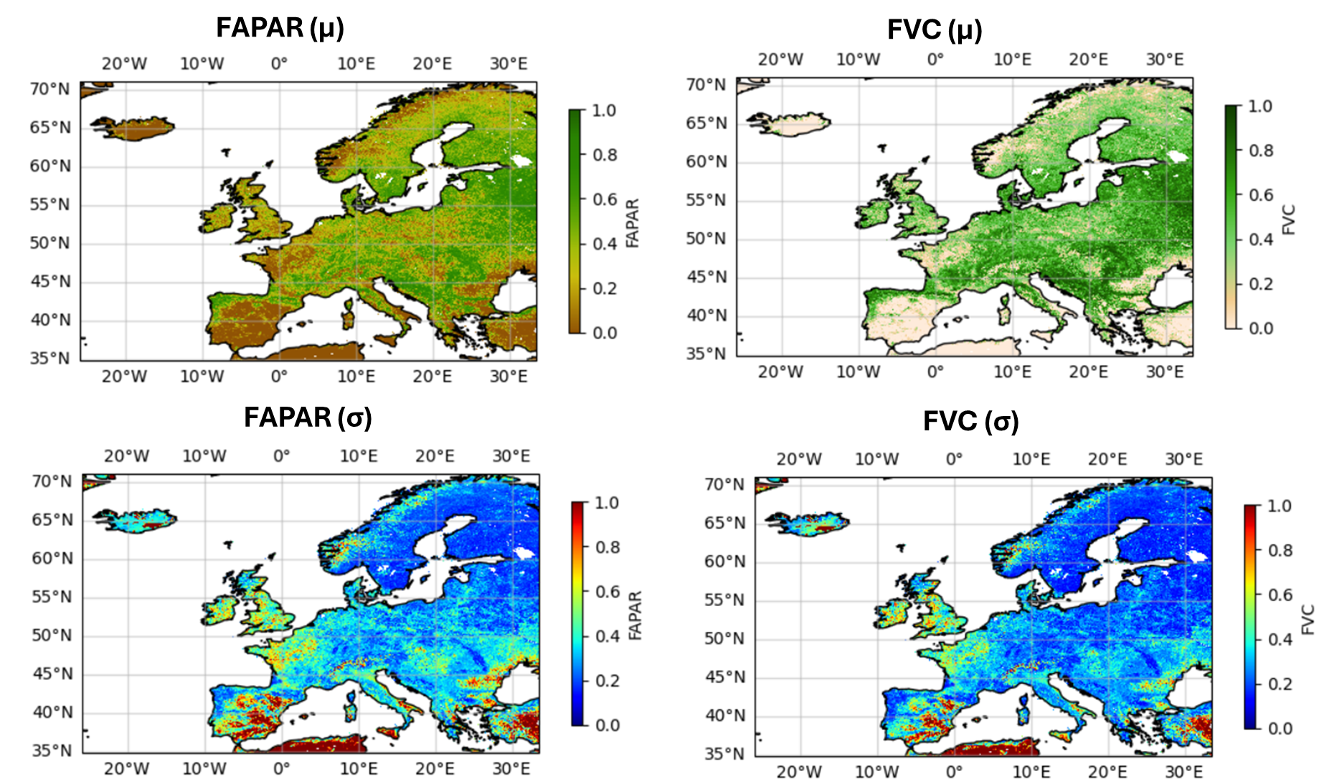


Summary: SCOPE–SYN–GPR Framework
🌿 Hybrid Physics–ML Approach is Effective
SCOPE-driven synthetic training ensures physical consistency
GPR provides accurate retrievals and uncertainty estimates
Robust performance across multiple vegetation types
🛰️ SYNERGY Adds Value
Red-edge + SWIR bands strongly improve retrieval
OLCI + SLSTR combination enhances structural sensitivity
Clear benefit over OLCI-only approaches
📊 Validation Confirms Product Quality
Strong agreement with GBOV reference maps
Comparable or improved performance vs CLMS
Uncertainty estimates consistent with reference uncertainty
☁️ Operational & Scalable
Fully cloud-deployable (openEO)
Continental-scale 300 m mapping demonstrated
Efficient processing (~4.5 h Europe-wide)
🚀 Overall Message:
SCOPE–SYN–GPR enables physically consistent, uncertainty-aware, and scalable retrieval of FAPAR and FVC from Sentinel-3 SYNERGY.
Operational cloud implementation
Notes:
Check what type of maps they are… monthly composite?

Slide 16
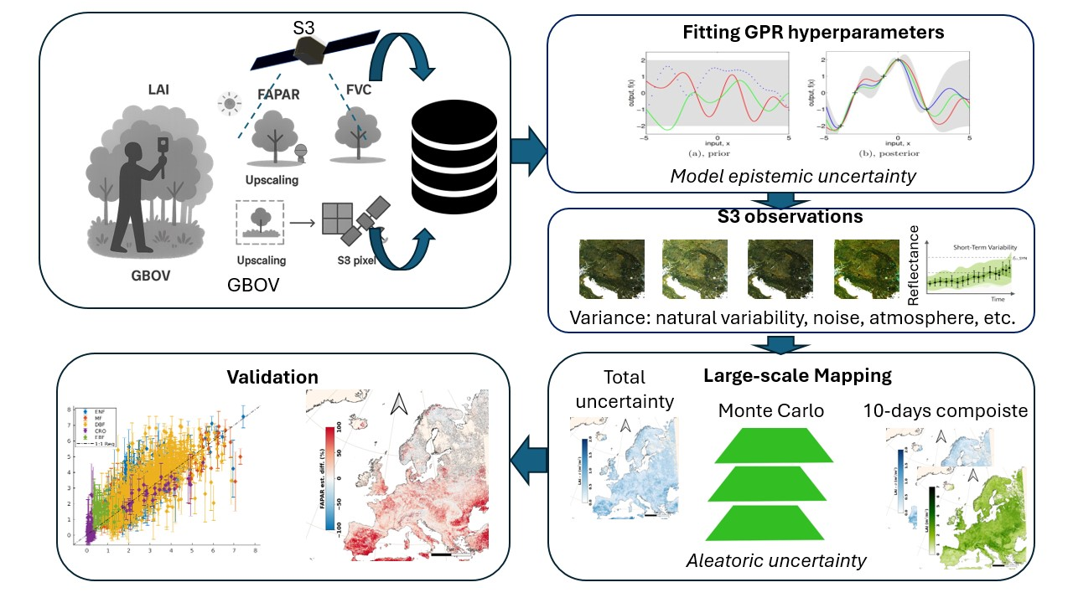
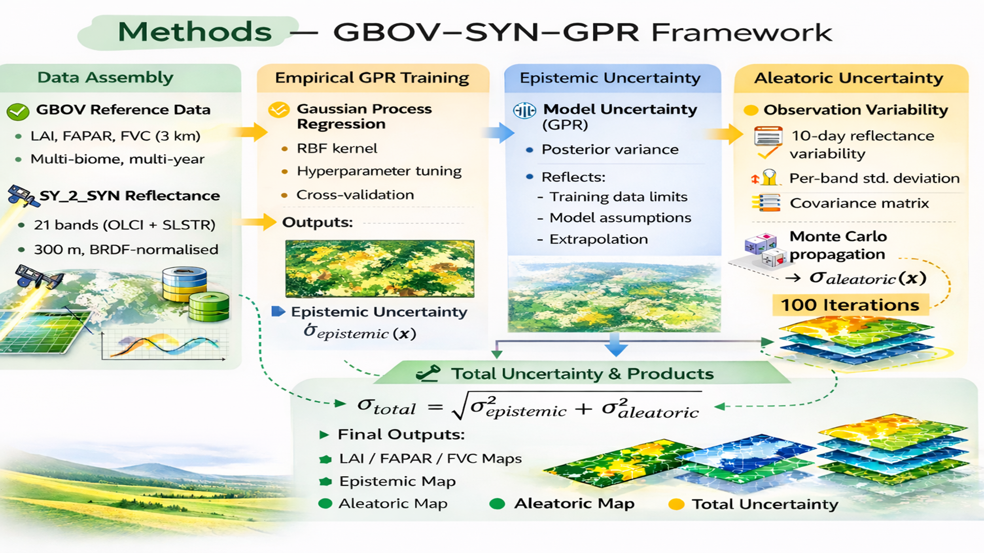
3. GBOV-SYN-GPR
Workflow
→ GPR empirical models trained on upscaled GBOV reference data
🛰️ Sentinel-3 SYNERGY (SY_2_SYN)
OLCI + SLSTR fusion at 300 m
BRDF-normalized surface reflectance
Improved basis for vegetation trait retrieval
🌿 Vegetation Traits Need Reliability
LAI, FAPAR, FVC critical for ecosystem monitoring & FLEX
Users require uncertainty-aware products
📏 GBOV as Training Resource
Harmonized, upscaled in situ reference data
Multi-biome, multi-year coverage
Enables empirical model calibration
🤖 Uncertainty propagation
Train GPR models directly on GBOV + SY_2_SYN
Explicit decomposition of:
🌫️ Aleatoric uncertainty: radiometric measurement (noise)-based
🧠 Epistemic uncertainty: model-based
🎯 Goal: Deliver scalable, uncertainty-quantified vegetation trait products from SY_2_SYN.
Reyes-Muñoz P., De Clerck E., Zhang Y., García Soria J.L., Brown L., Morata M., Tenjo C., Verrelst J. GBOV-Trained Gaussian Process Models for Sentinel-3 SYN Vegetation Traits with Decomposed Uncertainty Quantification. In review.
Notes:
Two novelties:
Inspired by the S2 community, used GBOV for training. More realistic, with realy SYN reflectance data. GPR perfectly suited
Explore also the image noises for uncertainty propagation asuming vegetation stationary

Slide 17
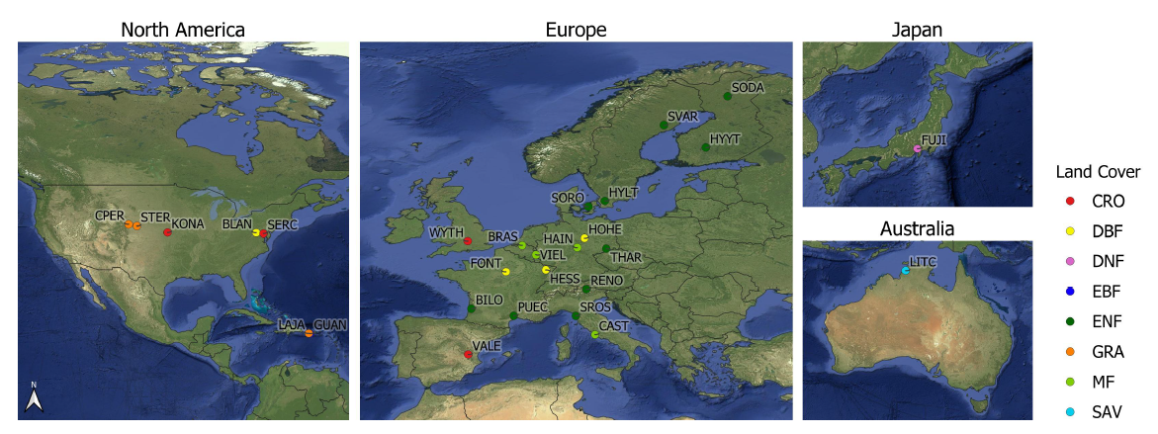
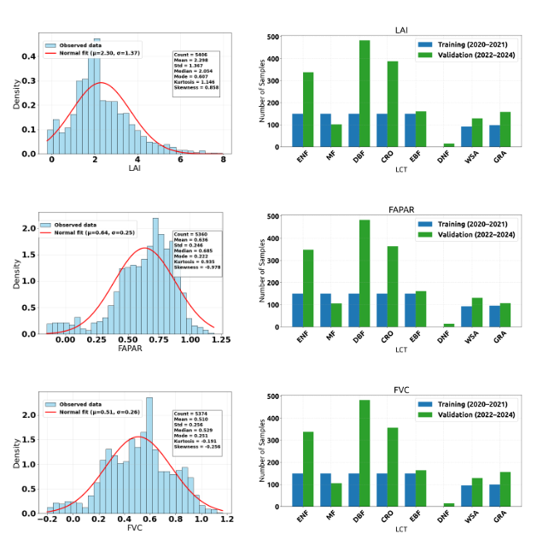
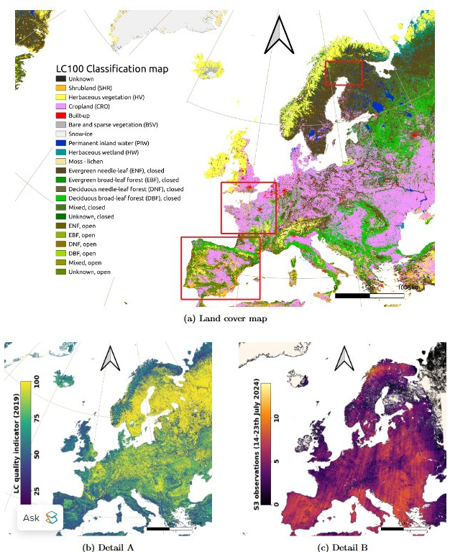
GBOV data distribution
GBOV sites
All data: #5350 (2022–2024)
Spread training (#3650) /testing (#1700) per PFT
Selected areas for aleatoric uncertainty propagation
Quality indicator
Number of cloud-free S3 observations per pixel within the 10 day temporal range 14-23 July 2024
Notes:
Quality indicator map: It gives you the percentage of reliability that a pixel is actually a let's say crop pixel
Over 3,650 GBOV samples for training
over 1,700 for validation
(2022–2024)

Slide 18
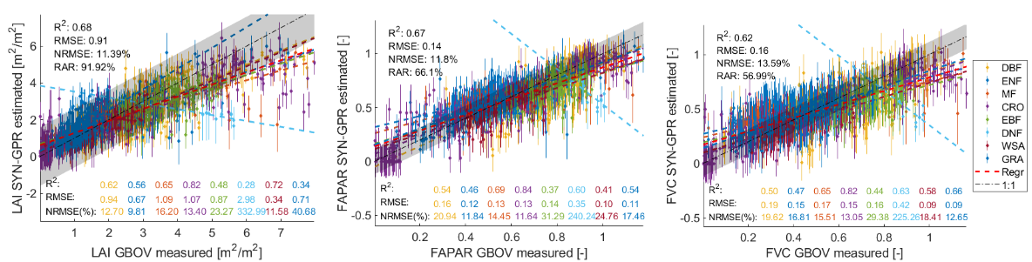
Validation against independent GBOV data (#1700)
LAI (µ, σ)
FAPAR (µ, σ)
FVC (µ, σ)
📈 Strong Overall Agreement
LAI: R² ≈ 0.68 (RMSE ≈ 0.91)
FAPAR: R² ≈ 0.67 (RMSE ≈ 0.14)
FVC: R² ≈ 0.62 (RMSE ≈ 0.16)
⚖️ Expected Saturation Behaviour
Slight underestimation at high values
Typical reflectance-based saturation effects
🌍 Robust Across Biomes
Good performance in forests (DBF, ENF, MF)
Larger spread in croplands & grasslands
Increased variability at high vegetation density
Epistemic uncertainty is Consistent
Notes:
We should ask Pablo how come there are values higher tan 1

Slide 19
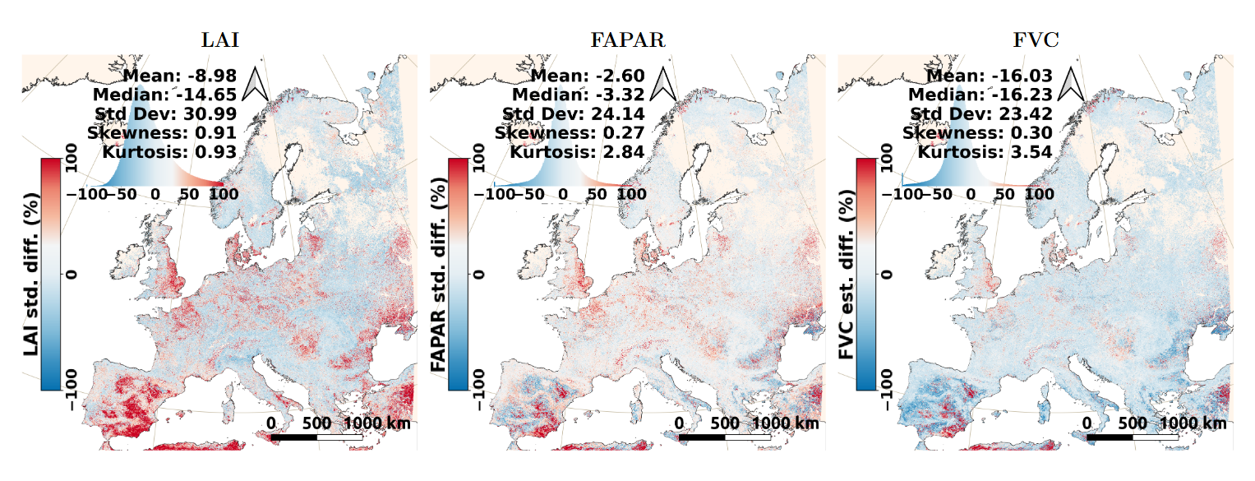
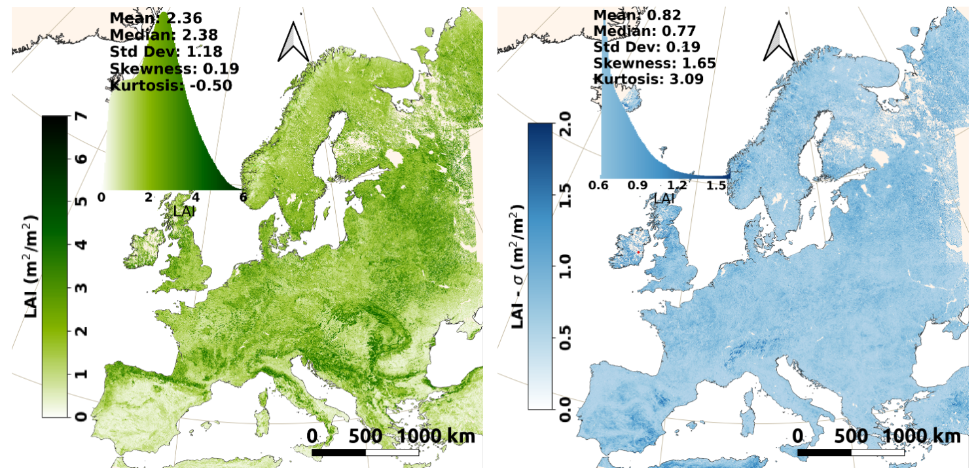
Comparison vs CLMS
LAI (µ)
LAI (σ)
14-23 July 2024
Notes:
CGLS: Copernicus Global Land Service
Processing done

Slide 20
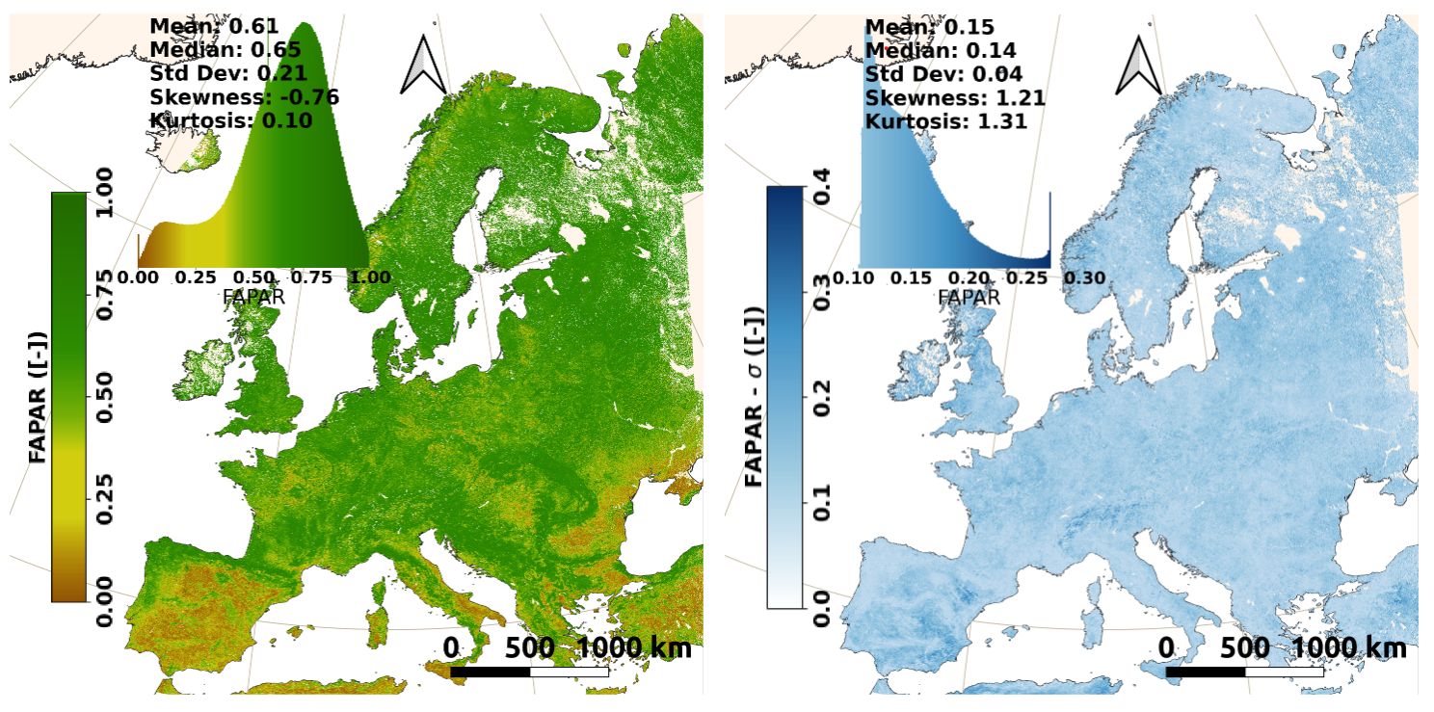
FAPAR (µ)
Comparison vs CLMS
FAPAR (σ)
14-23 July 2024

Slide 21
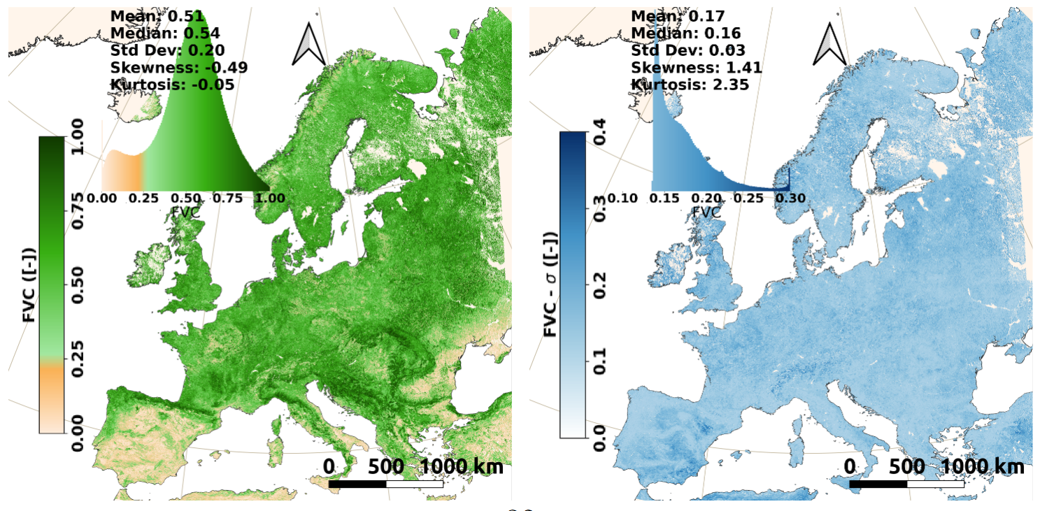
Comparison vs CLMS
FVC (µ)
FVC (σ)
14-23 July 2024

Slide 22
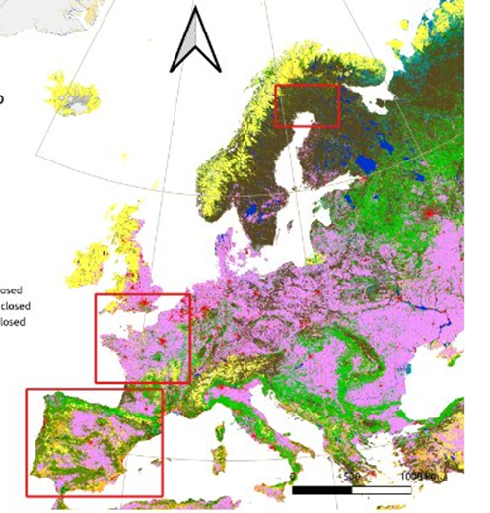
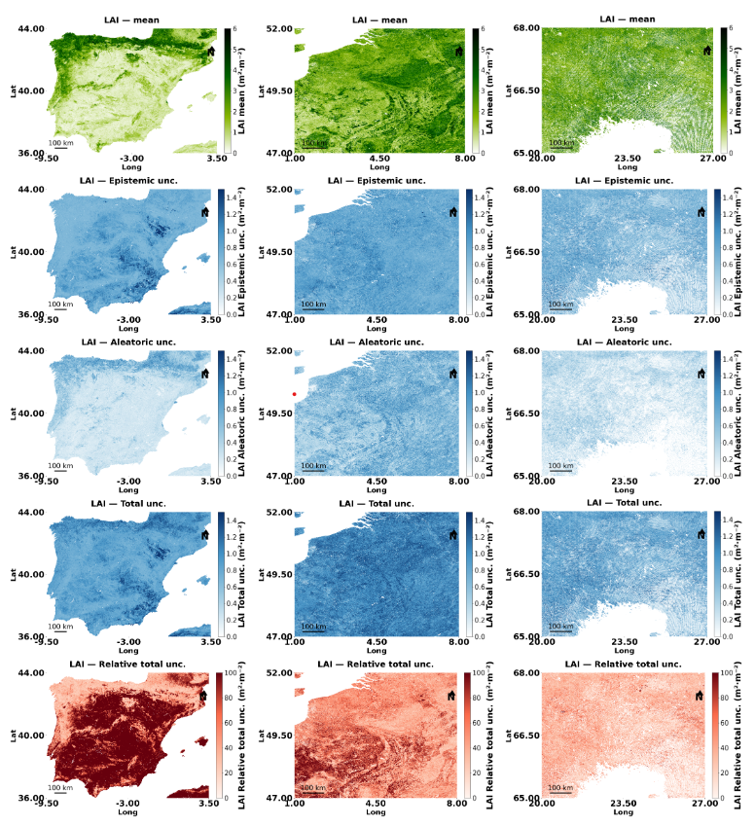
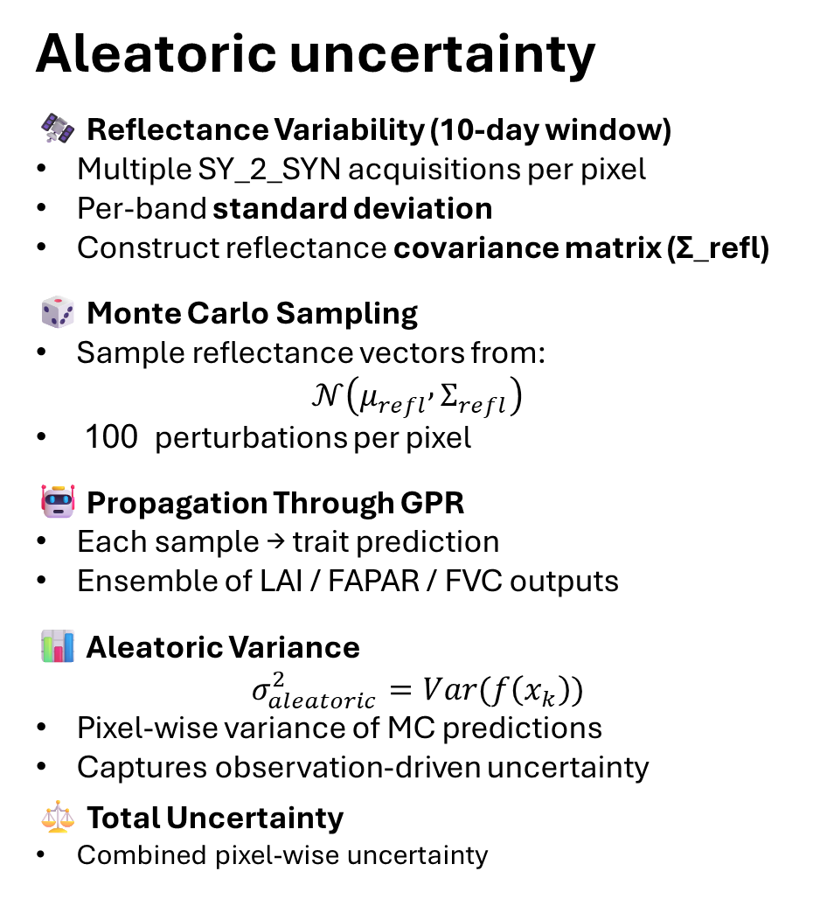
LAI
Aleatoric uncertainty
🛰️ Reflectance Variability (10-day window)
Multiple SY_2_SYN acquisitions per pixel
Per-band standard deviation
Construct reflectance covariance matrix (Σ_refl)
🎲 Monte Carlo Sampling
Sample reflectance vectors from:
$$𝒩\left(μ_{refl} , Σ_{refl}\right)$$
100 perturbations per pixel
🤖 Propagation Through GPR
Each sample → trait prediction
Ensemble of LAI / FAPAR / FVC outputs
📊 Aleatoric Variance
$$σ_{aleatoric}^{2}=Var(f\left(x_{k}\right))$$
Pixel-wise variance of MC predictions
Captures observation-driven uncertainty
⚖️ Total Uncertainty
Combined pixel-wise uncertainty
Iberian peninsula
West Europe
North Finland
Estimate
Epistemic
aleatoric
Total
Rel. total

Slide 23
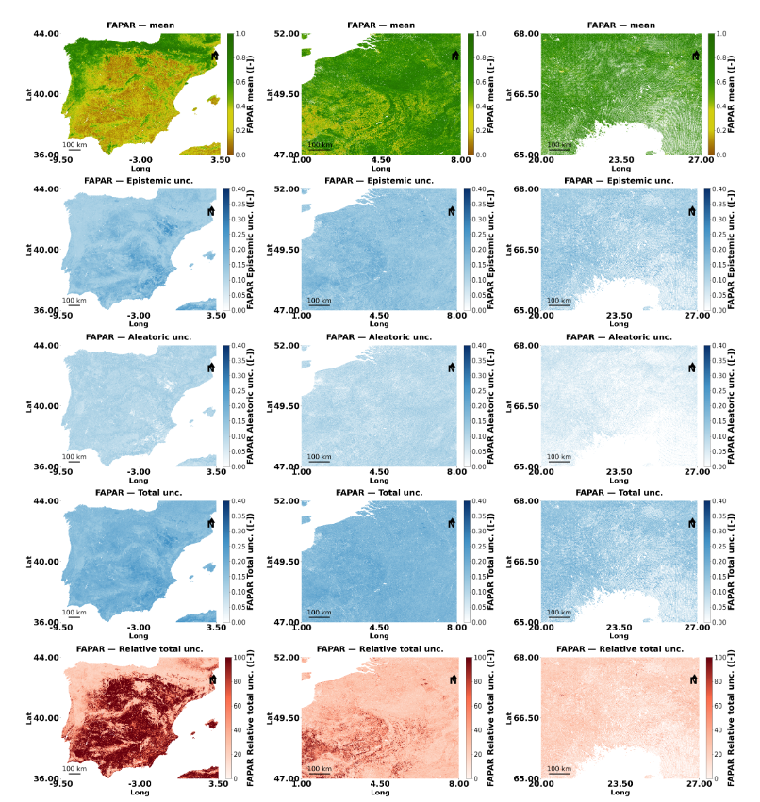
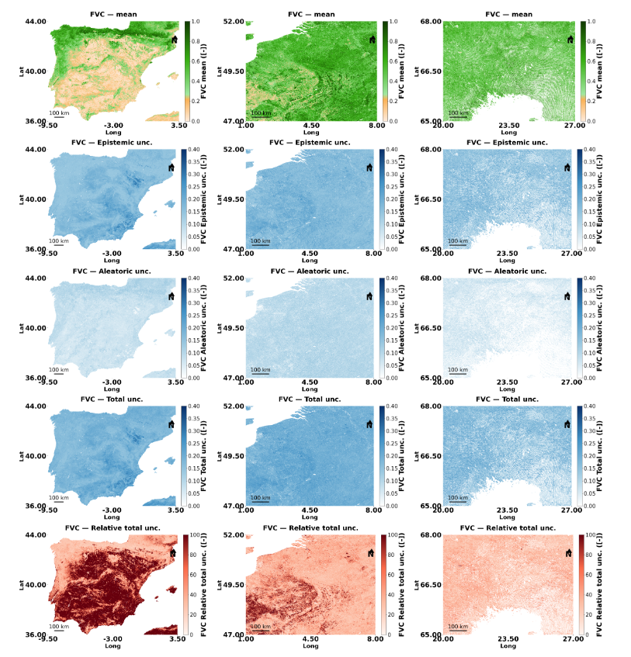
FAPAR
FVC
Estimate
Estimate
Epistemic
Epistemic
aleatoric
aleatoric
Total
Total
Rel. total
Rel. total

Slide 24
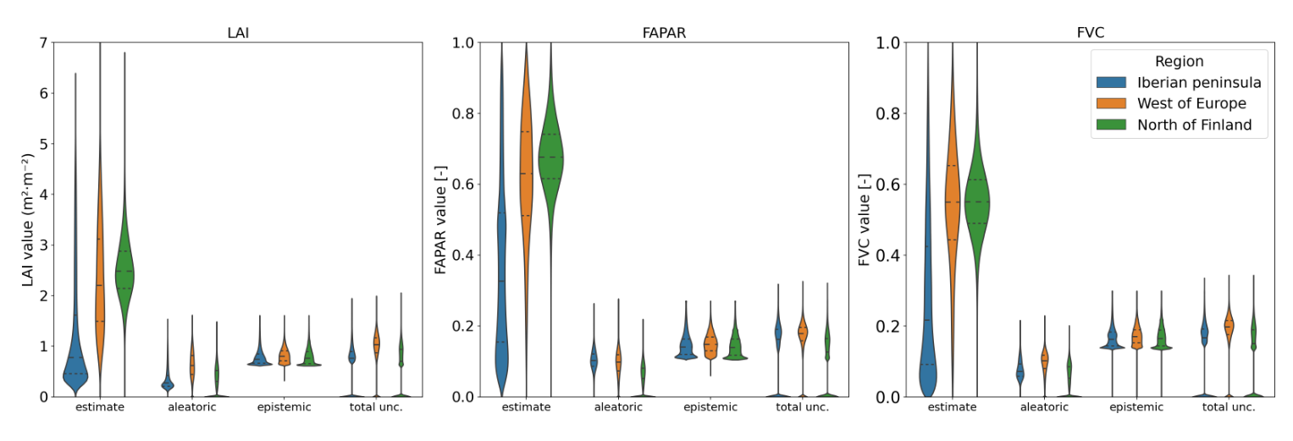



🌍 Clear Regional Gradient in Trait Estimates
🌊 Iberian Peninsula: lowest LAI / FAPAR / FVC
🌳 West of Europe: intermediate values
🌲 North of Finland: highest vegetation levels
➡️ Retrieval captures expected biogeographical contrast
🌫️ Aleatoric Uncertainty is Smaller
Lower magnitude across all traits
Slightly higher in heterogeneous regions (Iberia)
Reflects observation-driven variability
⚖️ Total Uncertainty Follows Epistemic Pattern
Total ≈ strongly driven by epistemic term
Regional differences preserved in total uncertainty
🧠 Epistemic Uncertainty Dominates
Generally larger than aleatoric component
Indicates model/training limitations remain primary source
More pronounced at higher trait values
See also: Verrelst, J., García-Soria, J. L., Reyes-Muñoz, P., De Clerck, E., Morata, M., & Rivera-Caicedo, J. P. (2026). Epistemic and aleatoric uncertainty in optical vegetation trait retrieval: Concepts, Methods, and Outlook. ISPRS Journal of Photogrammetry and Remote Sensing, 234, 20-45.
Operational cloud implementation
Notes:
Perhaps here we canalso mention the theoretical framework uncertianty

Slide 25
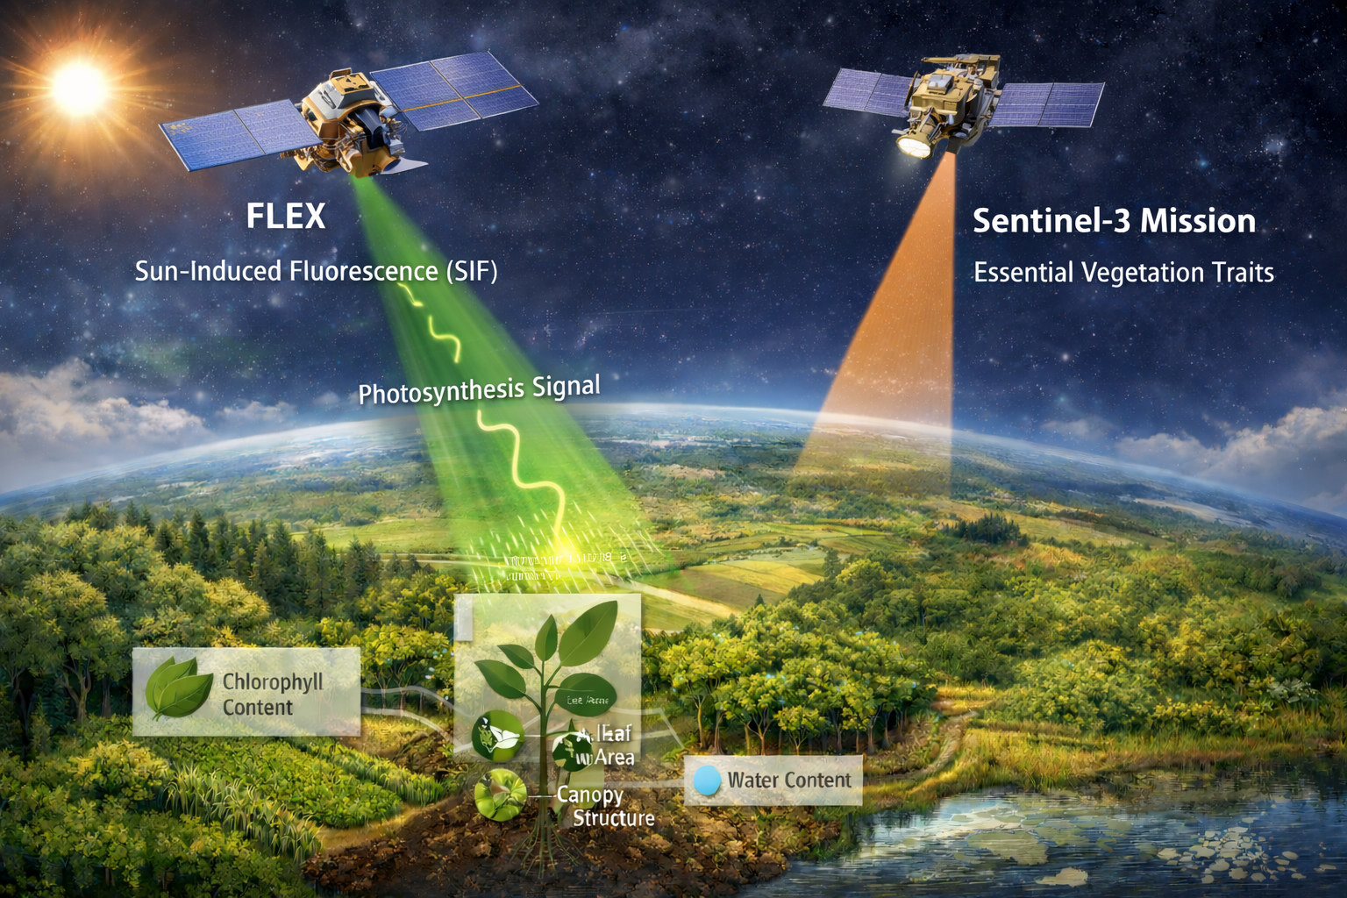
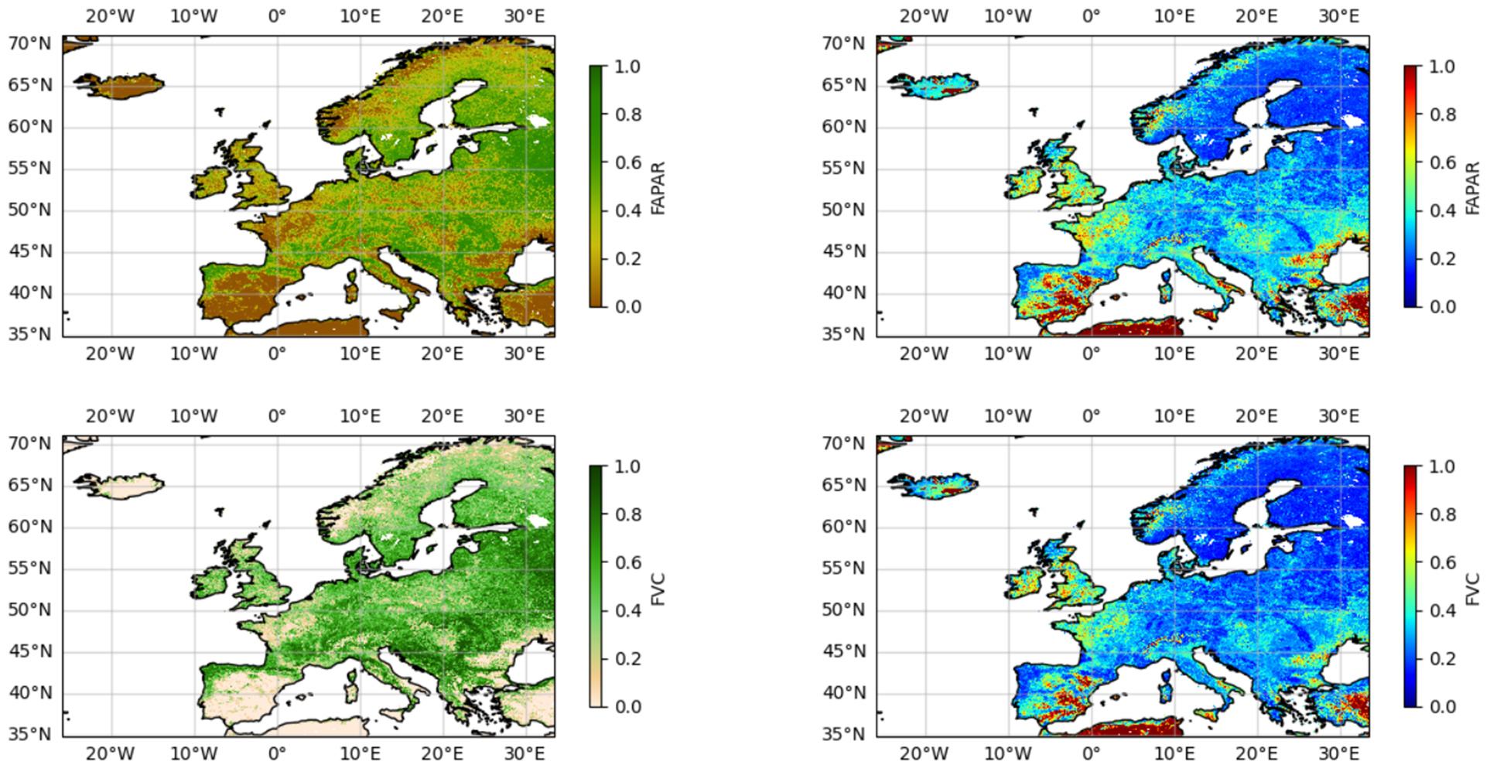

Conclusions
📊 Three GPR model families validated and publicly operational:
🛰️ S3-TOA-GPR → Hybrid models trained on SCOPE Top-Of-Atmosphere reflectance): LCC, LAI, FVC, FAPAR
🌍 SCOPE-SYN-GPR → Hybrid models trained on SCOPE surface reflectance (SYN S3): FAPAR, FVC
🌱 GBOV-SYN-GPR → Empirical models trained on upscaled GBOV reference data (SYN S3): LAI, FAPAR, FVC
☁️ All models are globally applicable in the cloud through PyEOGPR
⚖️ All models provide epistemic uncertainty; we move towards propagating aleatoric uncertainty
⚙️ The products can support FLEX L2/L3/L4 products
https://pypi.org/project/pyeogpr/
Notes:
GEE: needs EE access; noncommercial research is allowed but now monthly quota-limited; commercial/operational use is paid on Google Cloud (compute+storage+platform fee).
openEO/CDSE: needs CDSE account; free tier with monthly credits/quotas; scale-up via paid credits/subscriptions.

Slide 26
Thanks

