Slide 1
Retrievals of Solar Induced Chlorophyll Fluorescence from Chinese Satellites
Yongguang Zhang and Zhaoying Zhang
Nanjing University, China
Max Planck Institute for Biogeochemistry , Germany

Slide 2
Outline
Satellite-Based SIF Remote Sensing
SIF Retrieval Based on Goumang Satellite
Integrated Satellite–Airborne–Ground Validation Experiments for SIF Remote Sensing

Slide 3
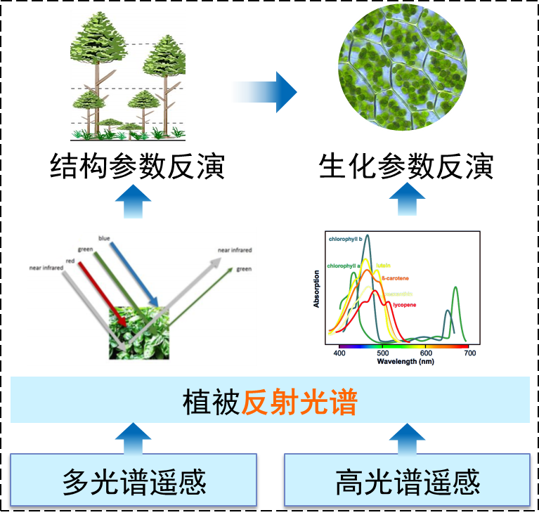
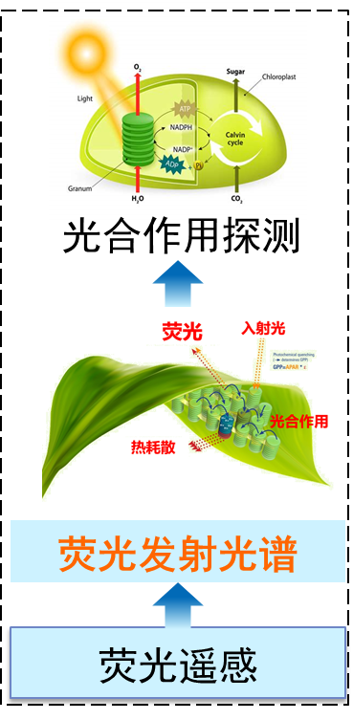
1. Vegetation Photosynthesis
Structural Parameter
Biochemical Parameter
Photosynthesis Detection
Fluorescence
Incident light
Thermal dissipation
Photosynthesis
Fluorescence Emission Spectrum
Vegetation Reflectance Spectrum
Multispectral Remote Sensing
Hyperspectral Remote Sensing
Fluorescence Remote Sensing
Traditional RS indirectly reflects photosynthesis
Fluorescence directly reflects photosynthesis

Slide 4
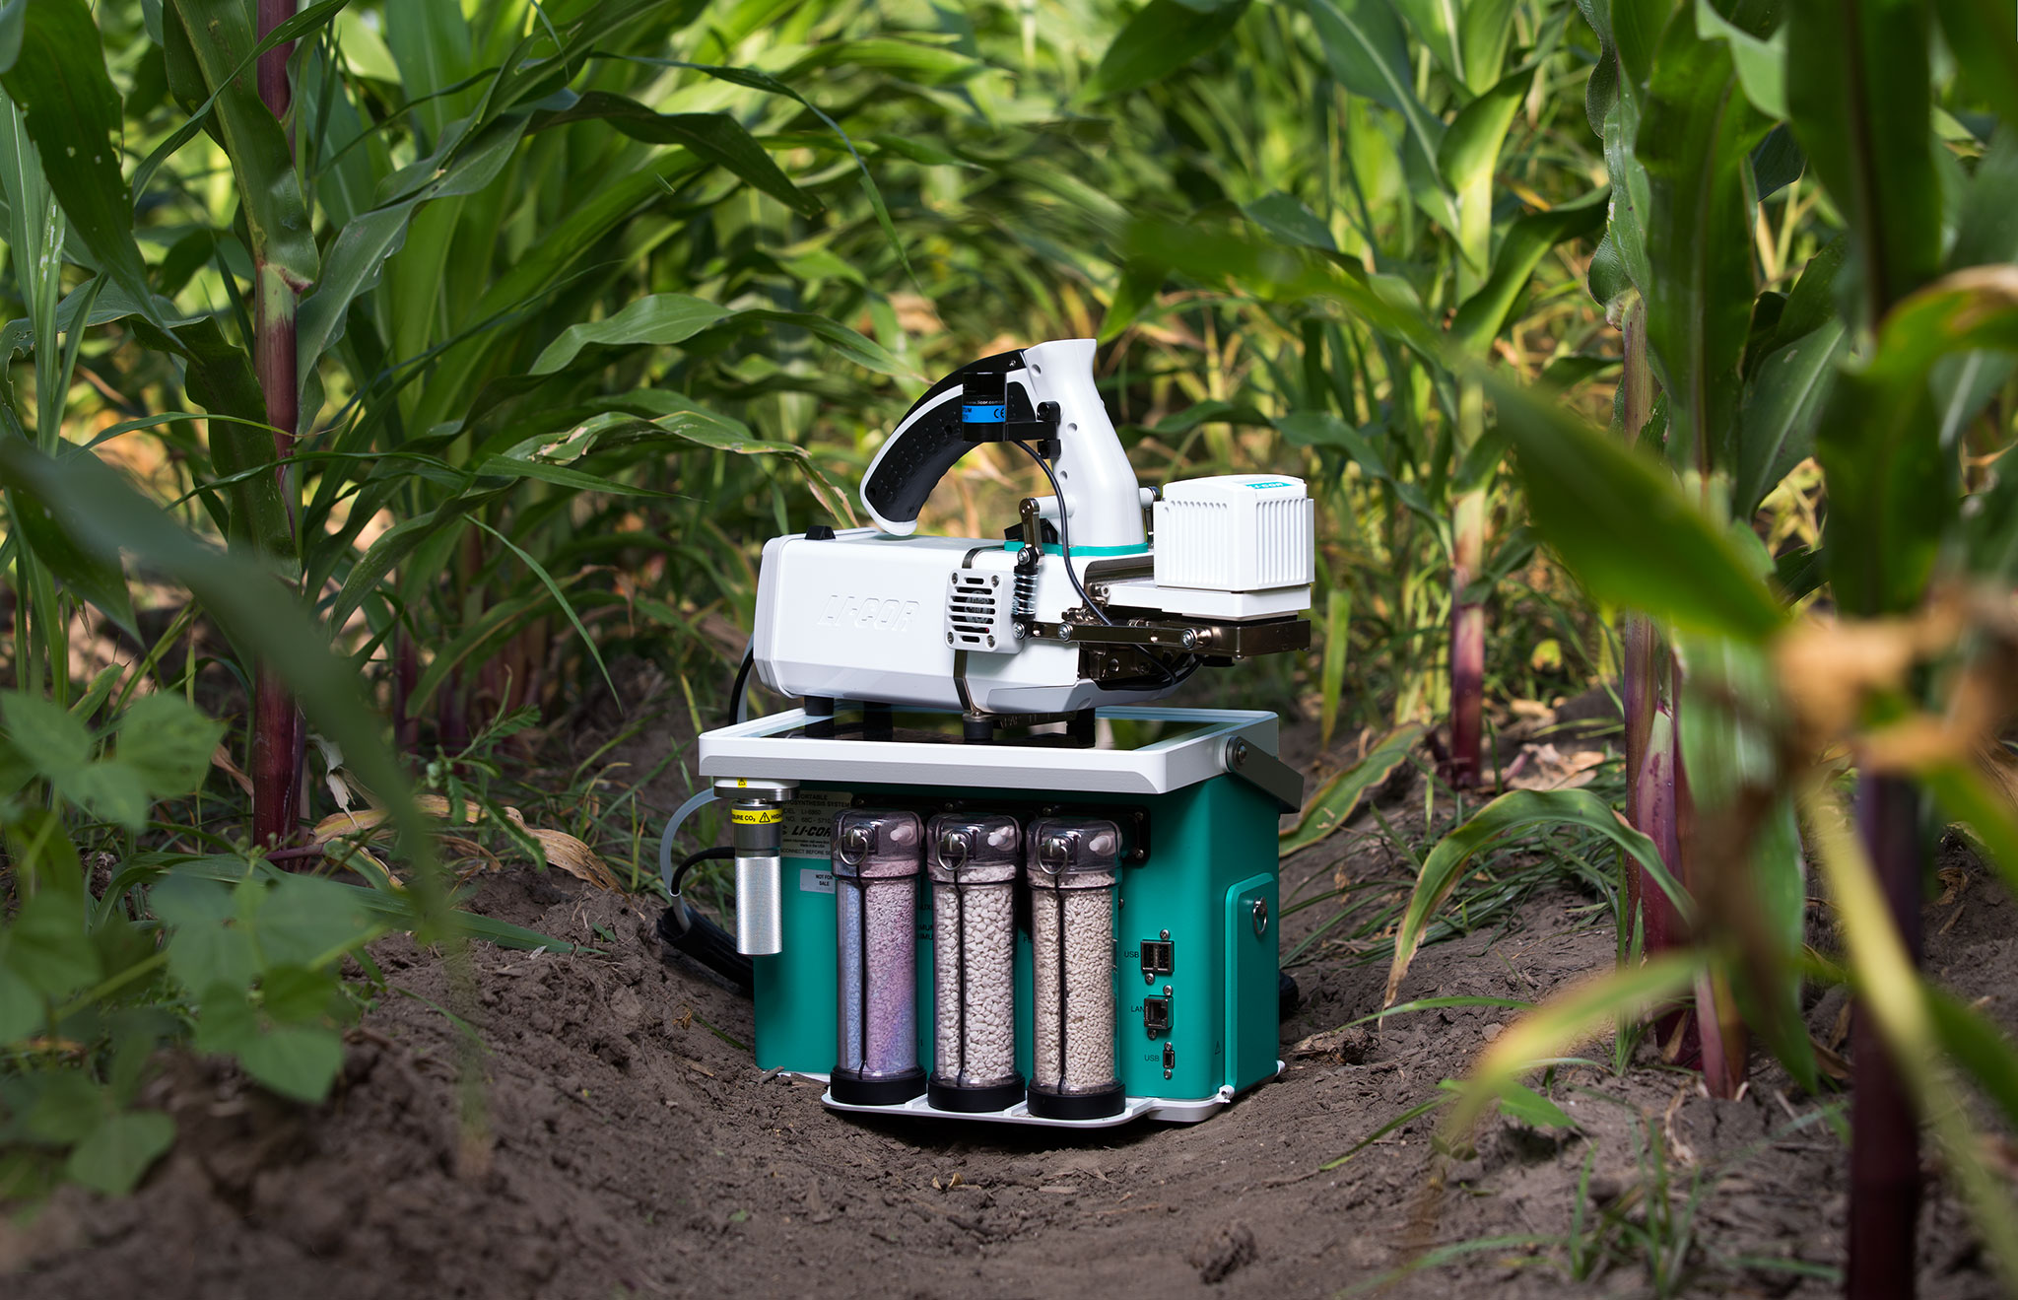
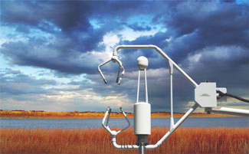
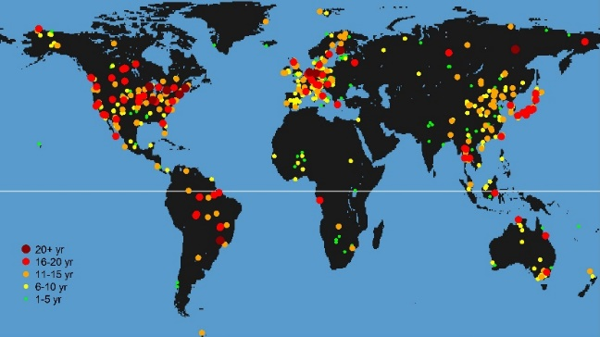
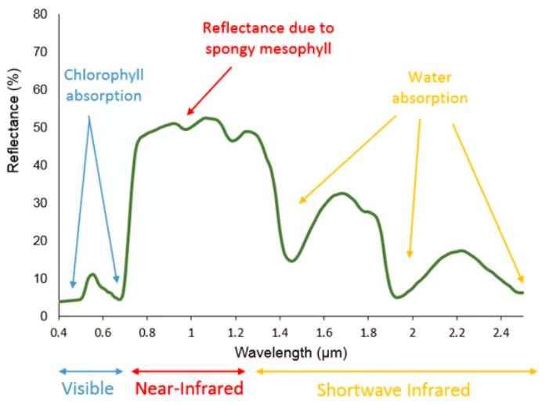
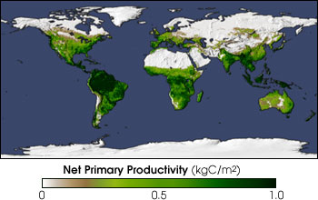
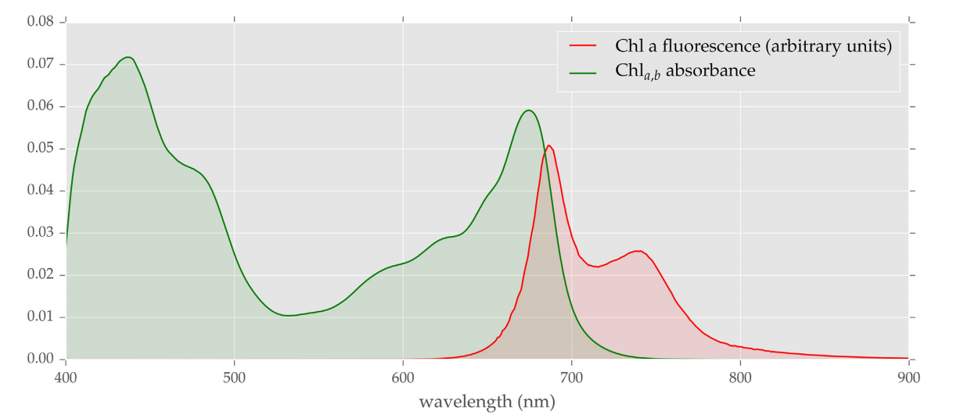
1. Vegetation Photosynthesis
Monitoring the dynamics of plant photosynthesis remains a major challenge.
Leaf level，LiCor 6800
Landscape，Eddy covariance
FLUXNET
(Berry et al., 2018)
Global Scale. Reflectance->APAR Remote sensing->MODIS NPP
Vegetation Fluorescence-direct

Slide 5

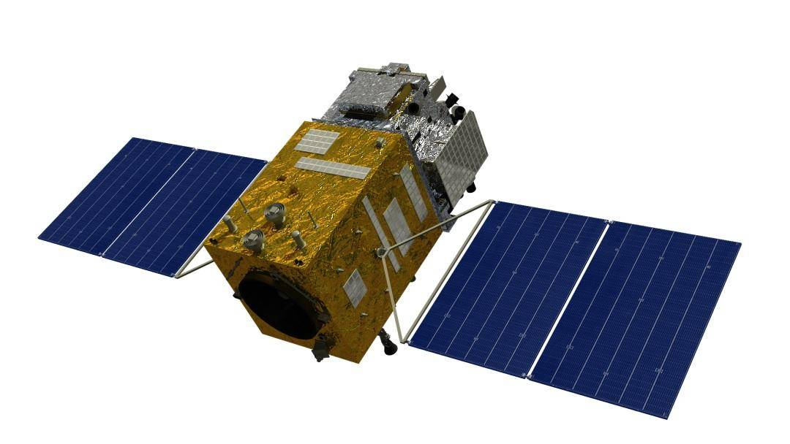
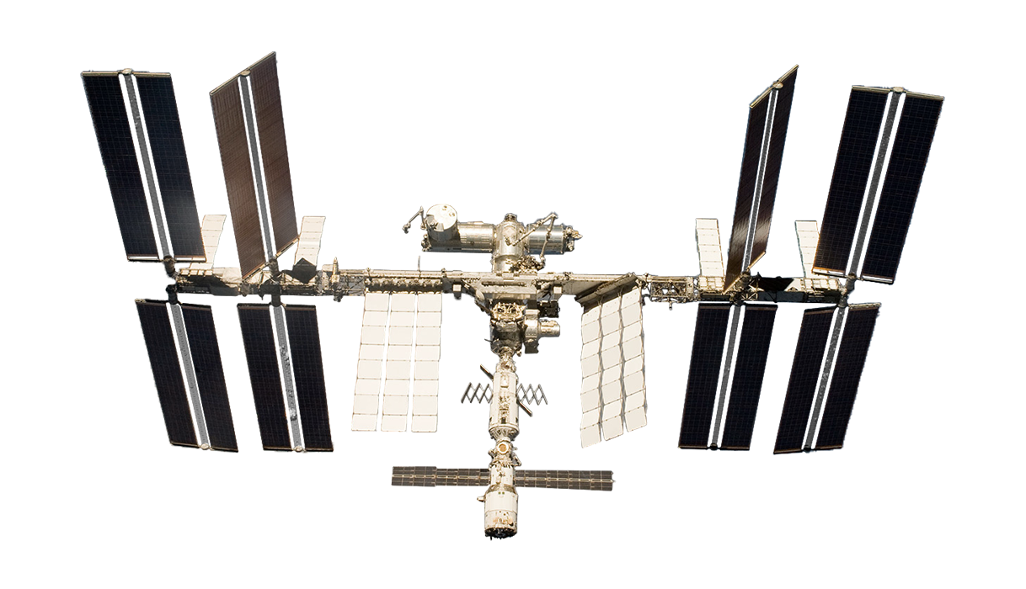
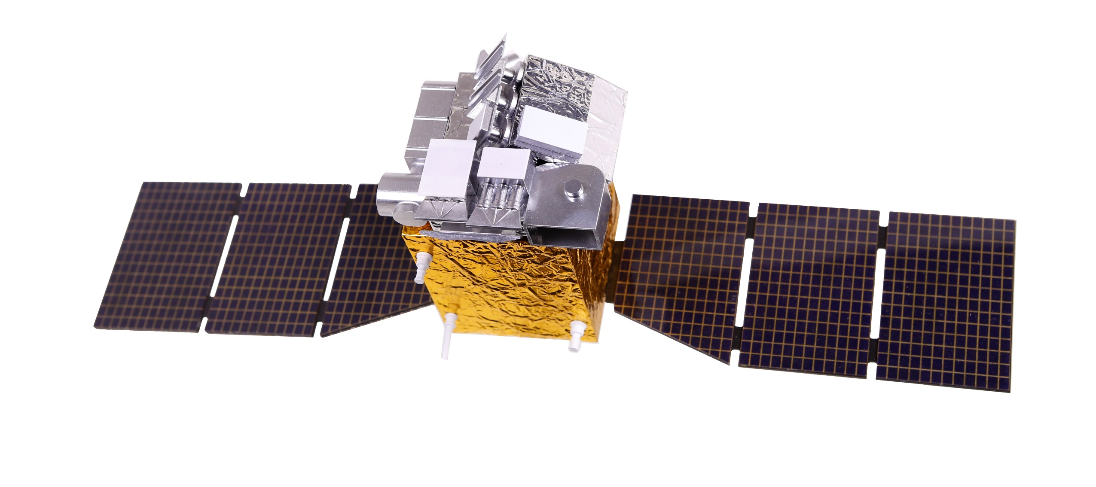
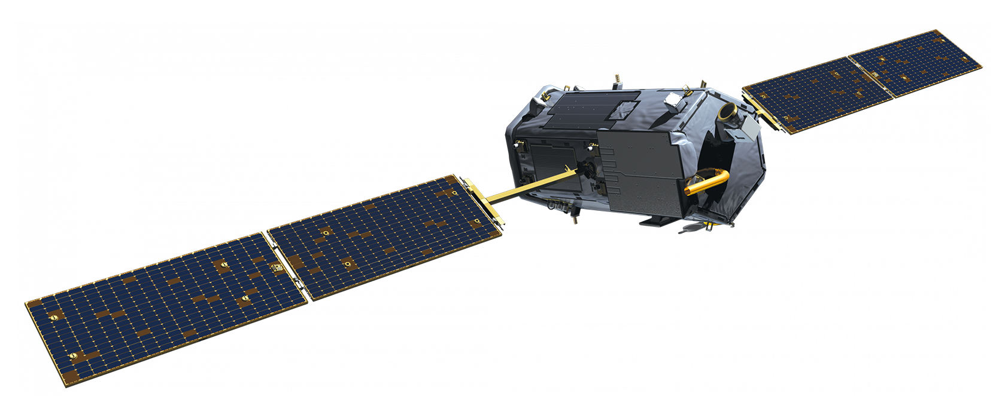
1. Satellite-Based SIF
All the satellites are orginally designed for atmospheric component monitoring.
FLEX satellite – red & near-infrared canopy SIF at 300 m spatial resolution
Various vegetation indices: NDVI, PRI (related to NPQ), etc.
International Space Station (ISS)-mounted
High temporal resolution for diurnal monitoring
2026
2022
FLEX
2019
Goumang
First Chinese satellite for SIF retrieval
2017
OCO-3
Chinese terrestrial ecosystem carbon inventory satellite
650-800nm
800*370m
red & near-infrared SIF
vegetation indices
2016
TROPOMI
2014
Low spatial resolution (>10 km)
TanSat
2009
OCO-2
5 km
1 day
675-775 nm
near-infrared SIF
2007
GOSAT
2002
GOME-2
2.3 km
16 days
SIF
1995
SCIAMACHY
GOME-1

Slide 6
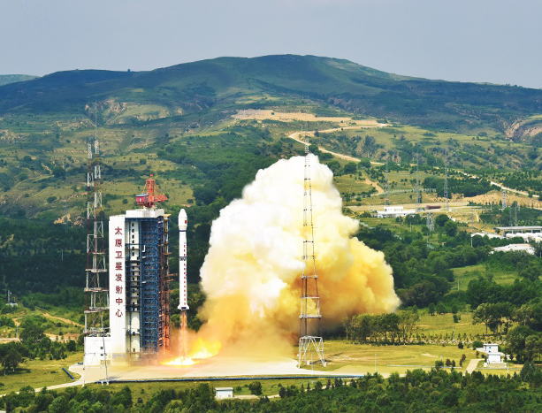
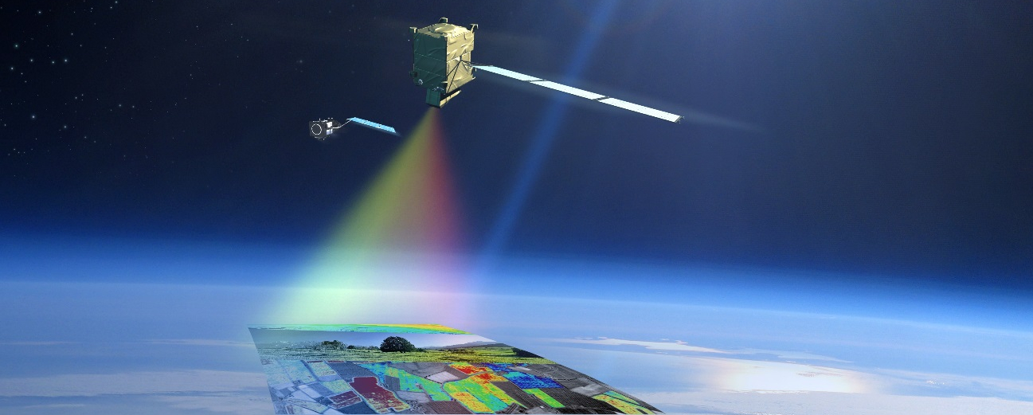
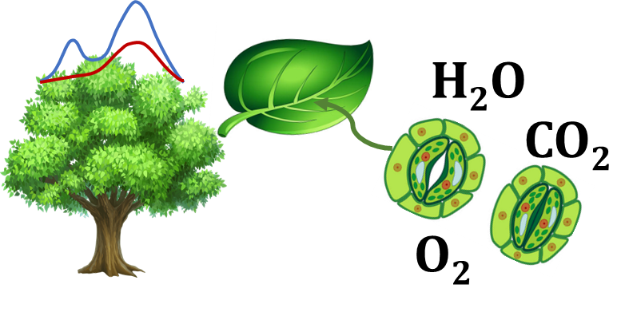
1. China's Carbon Sink Monitoring Enters the Space-Based Era: the “Goumang” Satellite
SIF
On August 4, 2022, the Terrestrial Ecosystem Carbon Inventory Satellite (TECIS) “Goumang” was successfully launched from Taiyuan Satellite Launch Center.
The satellite carries a unique SIF Imaging Spectrometer (SIFIS), the first spaceborne hyperspectral sensor specifically designed for global SIF retrieval.

Slide 7
1. Hyperspectral payload parameters of Goumang
Parameters of the TECIS Goumang
Satellite code | CM-1
Orbital altitude | 506 km
Orbital inclination | 97.421°
Orbital node period | 94.716 min
Revisit cycle | 5 days
Parameters of the hyperspectral payload (FSI)
Spectral range | 669.88 ~780.33nm
Spectral resolution | ~ 0.23 nm
Spectral sampling interval | 0.1 nm
Spatial resolution | 0.8 km × 0.3 km
Swath | 33.7 km

Slide 8
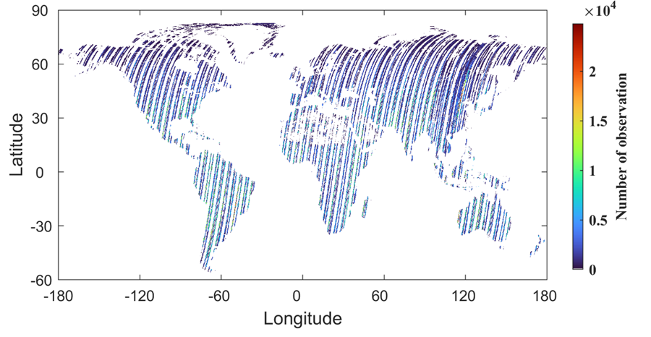
1.4 Observation of SIFIS on Goumang
Effective observation performance of the hyperspectral sensor payload
Number of observations at each 0.05° grid of SIFIS from 1 January to 31 December, 2023.

Slide 9
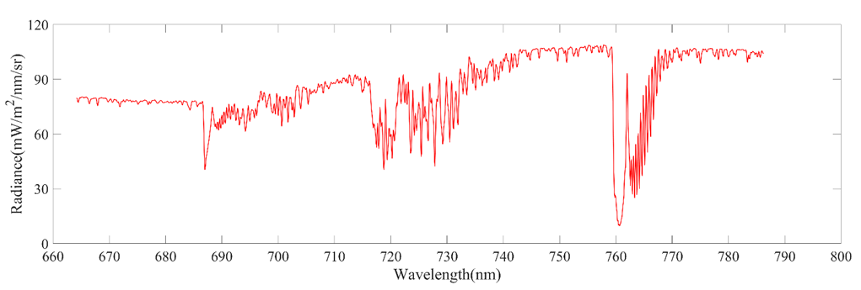
2.1 Satellite-based retrieval methods for SIF
Examples of observed radiance spectra from the Goumang’s hyperspectral payload
O₂A
O₂B
H₂O
The radiance spectra clearly show multiple absorption lines, with high data quality suitable for SIF retrieval.

Slide 10
Outline
Satellite-Based SIF Remote Sensing
SIF Retrieval Based on Goumang Satellite
Integrated Satellite–Airborne–Ground Validation Experiments for SIF Remote Sensing

Slide 11
2.1 Satellite-based retrieval methods for SIF
Traditional atmospheric radiation transfer Model
Data driven Model
TOA radiance
TOA radiance
Look up table from MOTRAN model
Narrow window
Earth Atmospheric Absorption lines
Solar Fraunhofer lines
Atmospheric parameters
Data driven model
Surface radiance
Non-vegetation pixels
SIF
SIF
Difficulties in obtaining atmospheric parameters;complex model structures
Mainstream satellite SIF
retrieval algorithms

Slide 12
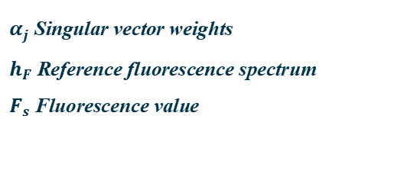
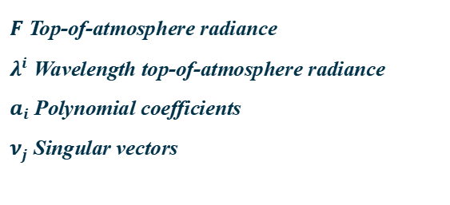
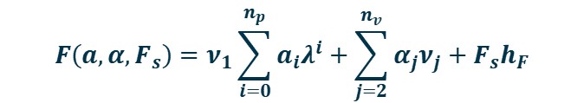
2.1 Satellite-based retrieval methods for SIF
A data-driven SVD retrieval algorithm was developed for FSI’s high spectral and spatial resolution, optimizing the retrieval window (743–758 nm) and improving retrieval accuracy.
$$F\left(a,α,F_{s}\right)=ν_{1}\sum_{i=0}^{n_{p}}{a_{i}λ^{i}}+\sum_{j=2}^{n_{v}}{α_{j}ν_{j}}+F_{s}h_{F}$$
$F$ Top-of-atmosphere radiance
$λ^{i}$ Wavelength top-of-atmosphere radiance
$a_{i}$ Polynomial coefficients
$ν_{j}$ Singular vectors
$α_{j}$ Singular vector weights
$h_{F}$ Reference fluorescence spectrum
$F_{s}$ Fluorescence value
Retrieval steps:
Auxiliary data preprocessing: clouds, land cover
Training pixel extraction(non-fluorescent pixels: snow, desert, thick clouds)
Singular vector decomposition and determination of the number
Fluorescence retrieval and uncertainty analysis
Zhang et al., Geophysical Research Letters (in revision)

Slide 13
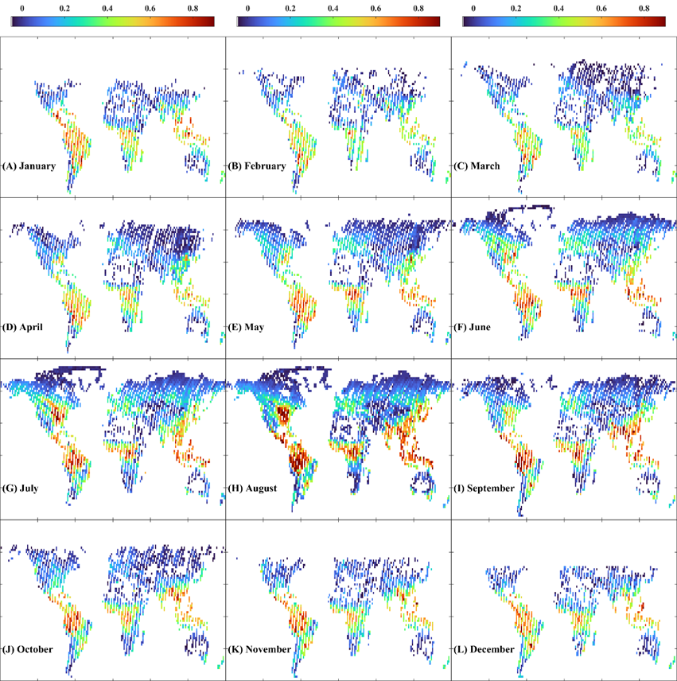
2.2 Global Retrieval of SIF— Monthly Spatial Distribution Map
Jan
Feb
Mar
Apr
May
June
Jul
Aug
Sep
Oct
Nov
Dec

Slide 14
2.2 Global Retrieval of SIF— Spatial Distribution Map
The global annual averaged SIFIS SIF over 2023 at the spatial resolution of 2°

Slide 15
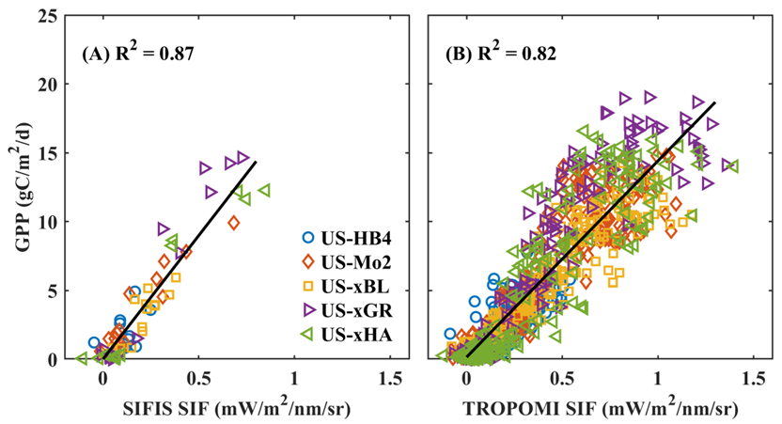
2.2 Global Retrieval of SIF— Comparison between SIFIS SIF and flux tower GPP
Higher spatial resolution of SIFIS may better capture local vegetation photosynthetic activity

Slide 16
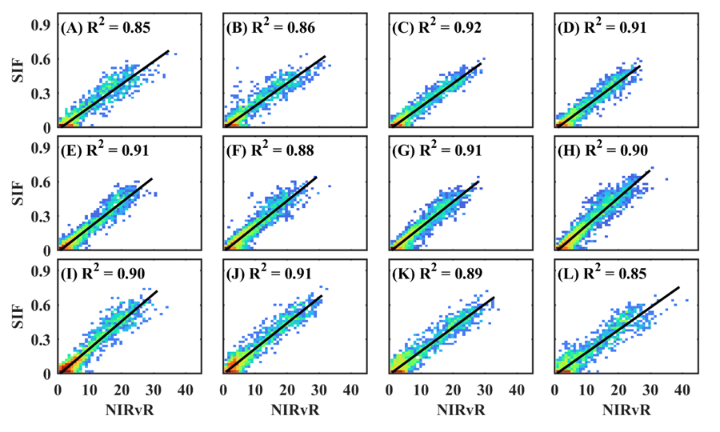
2.2 Global Retrieval of SIF— Comparison between SIF and NIRvR
Jan
Feb
Mar
Apr
May
June
Jul
Aug
Sep
Oct
Nov
Dec
Goumang SIF shows strong agreement with NIRvR

Slide 17
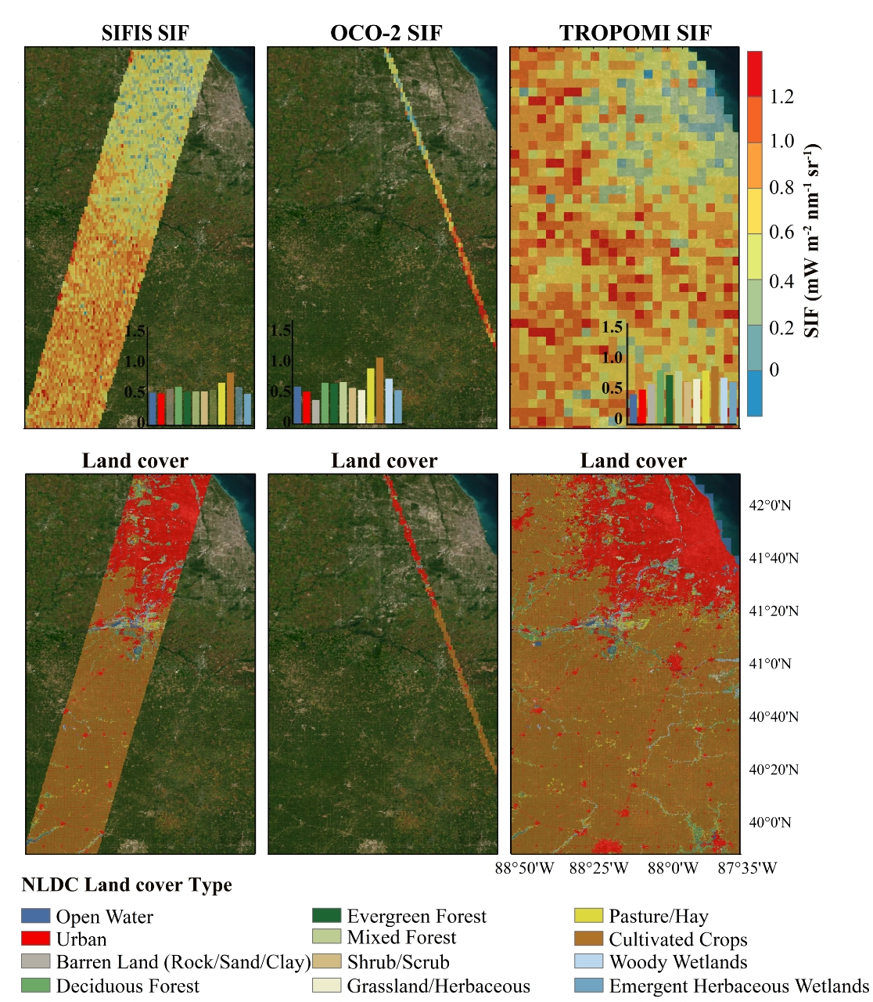
2.3 Comparison of Goumang SIF with other satellite products
On July 31, 2023, the Goumang, OCO-2, and TROPOMI satellites captured data along an ecological gradient transecting from Indiana to the suburbs of Chicago, Illinois.
Goumang satellite outperforms OCO-2 and TROPOMI in its ability to resolve fine-scale ecological gradients.

Slide 18
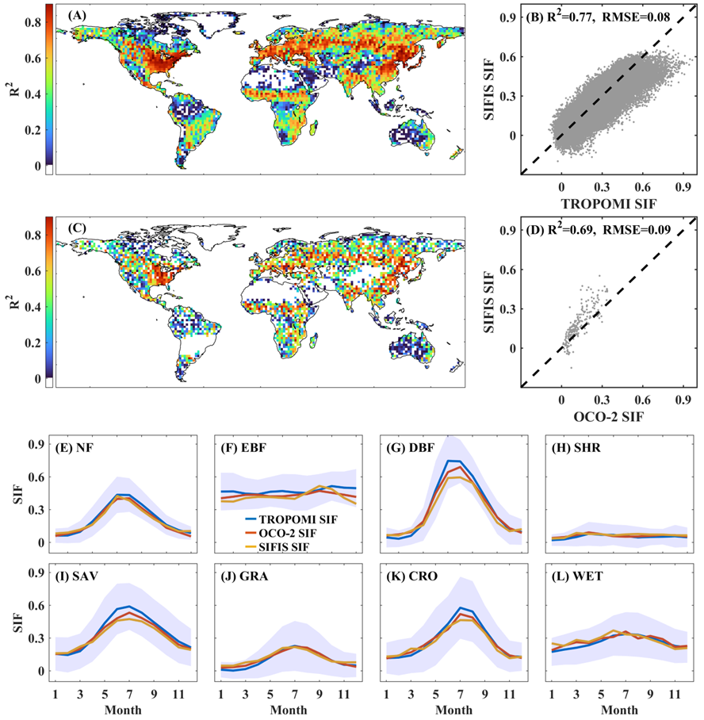
2.3 Comparison of Goumang SIF with other satellite products
R2 Spatial Distribution between Goumang SIF and TROPOMI SIF
R2 Spatial Distribution between Goumang SIF and OCO-2 SIF
Goumang SIF shows strong spatiotemporal agreement with TROPOMI and OCO-2 SIF across most regions of the world.

Slide 19
2.3 Comparison of Goumang SIF with other satellite products
Across various vegetation types, Goumang SIF showed strong agreement with OCO-2 and TROPOMI SIF in their seasonal patterns.

Slide 20
Outline
Satellite-Based SIF Remote Sensing
SIF Retrieval Based on Goumang Satellite
Integrated Satellite–Airborne–Ground Validation Experiments for SIF Remote Sensing

Slide 21
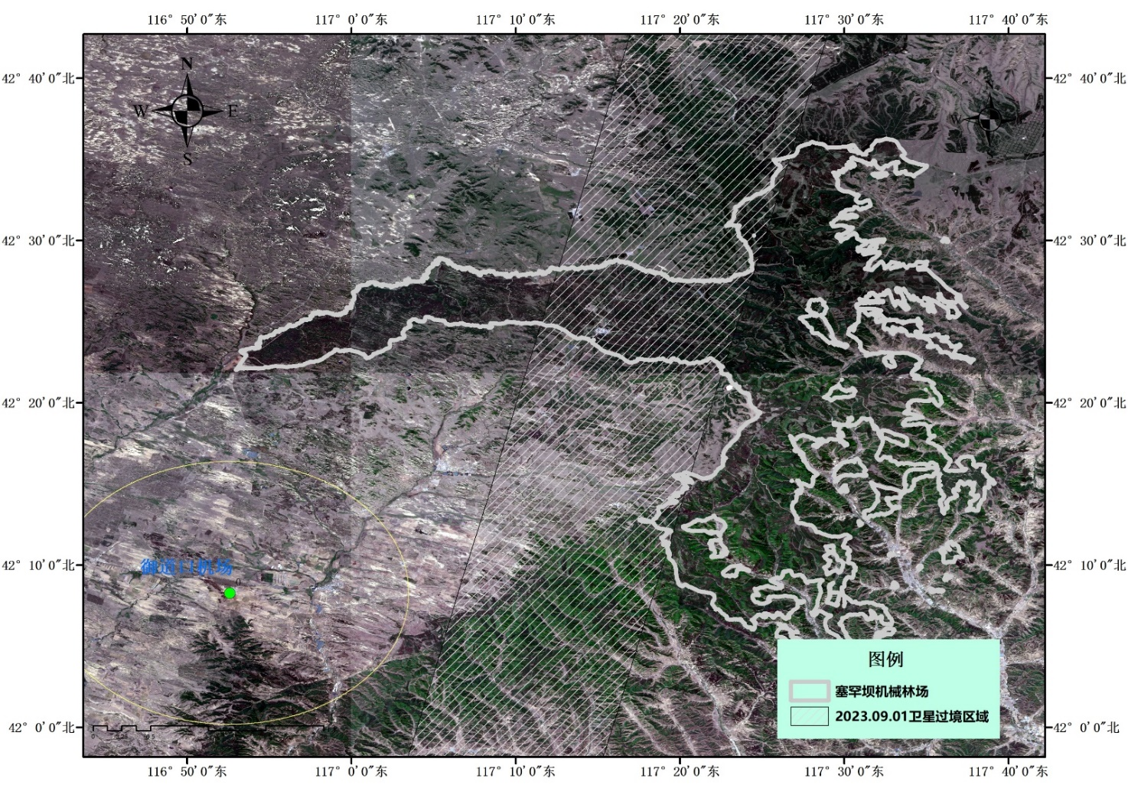

3.1 Satellite-Airborne-Ground Experiments for Satellite SIF
Conducted Satellite-Airborne-Ground Validation for Goumang FSI radiance & SIF
Experiment Period：2023.08.22-09.02
Goumang satellite
overpass regions
2023.09.01 11:10am Goumang passed over Saihanba

Slide 22
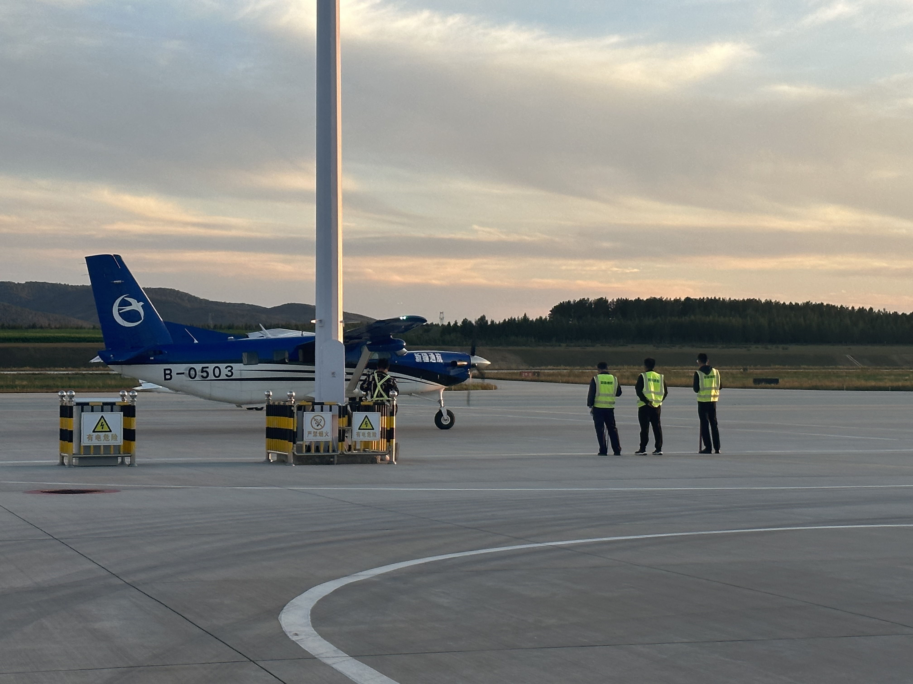
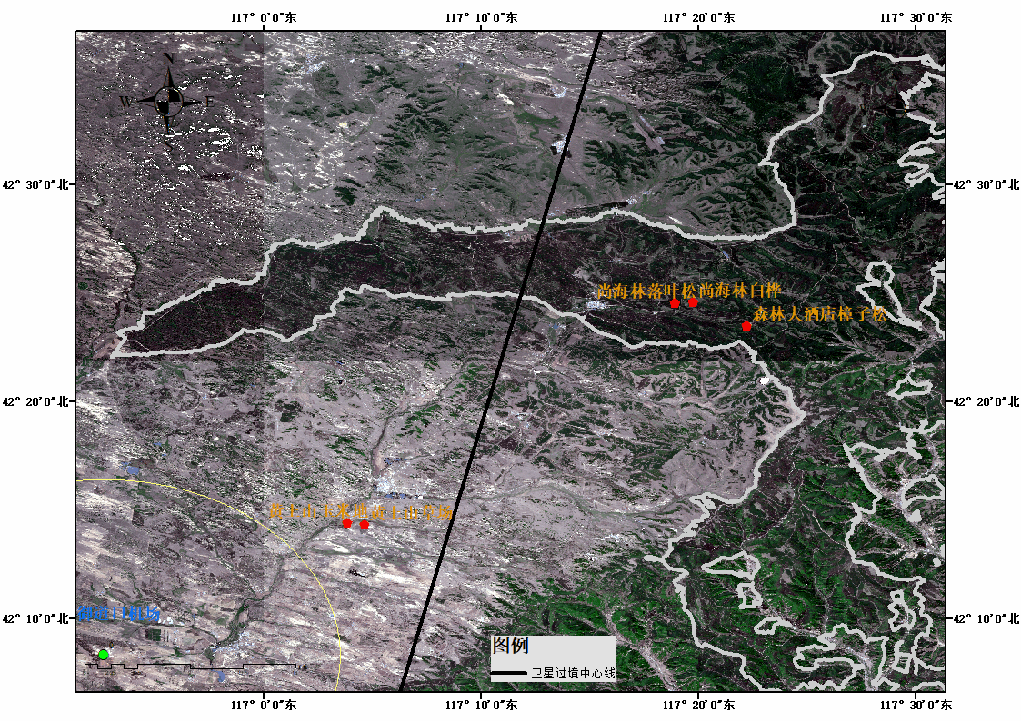
3.1 Satellite-Airborne-Ground Experiment—Manned Flight Plan
The overpass route of Goumang
Airborne route
The Airborne flies along the satellite’s track at the same time.
Flight Plan: Four routes established (Route 1 repeated x4)
Flight time for all routes: 8:00am – 12:00am

Slide 23
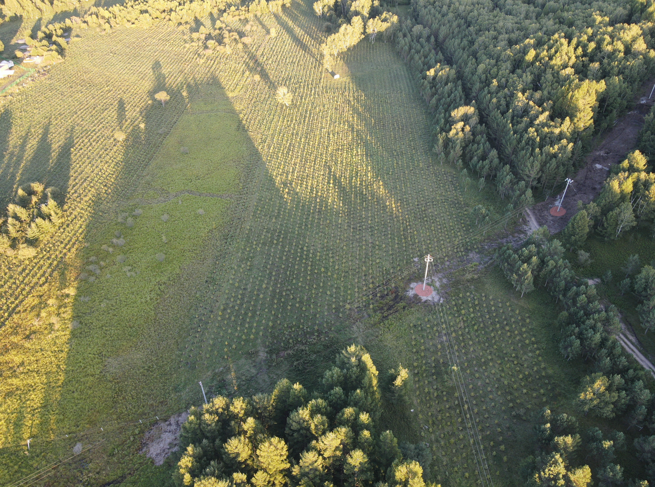
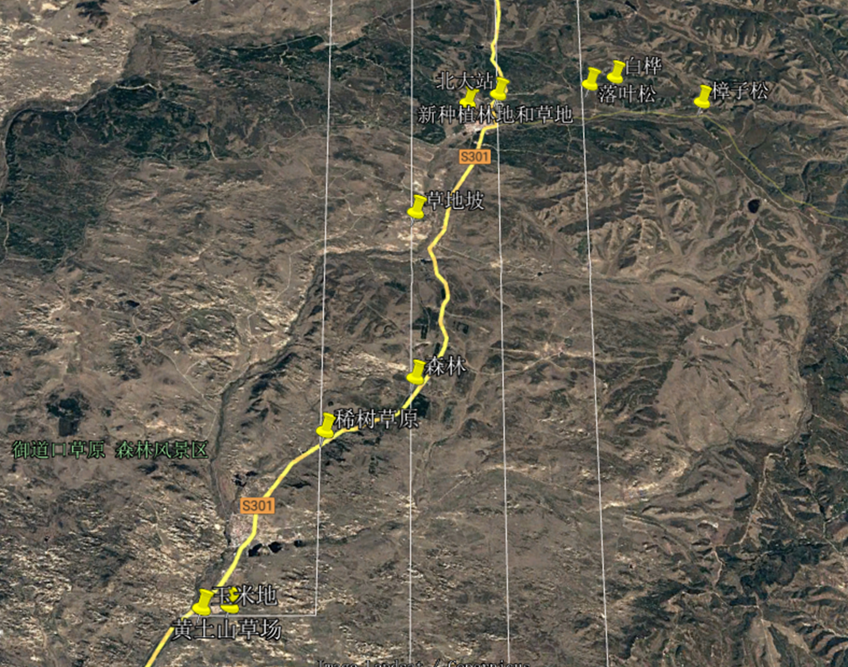
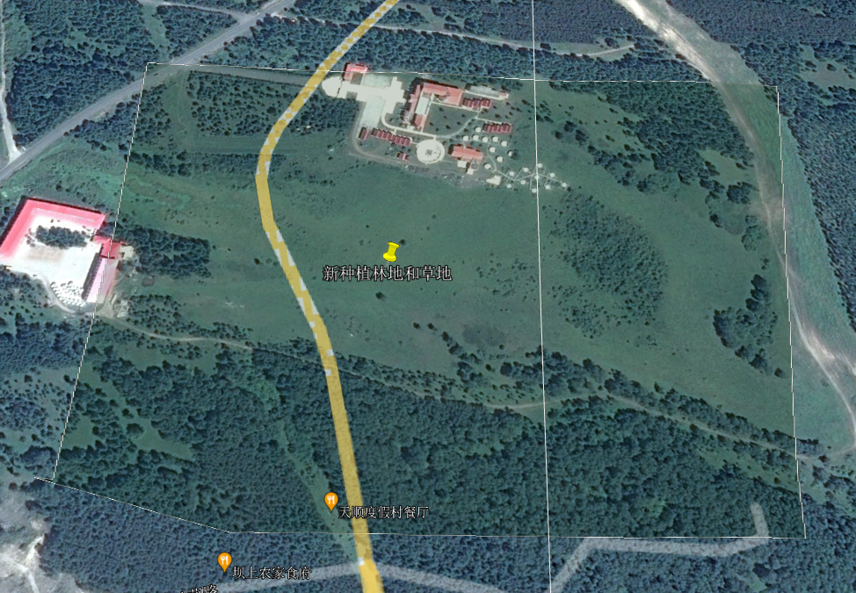
3.1 Satellite-Airborne-Ground Experiment—UAV and Tower Observation Location Selection
Main Experimental Area: Saibei Courtyard
Sapling
Meadow
We selected two sites (a homogeneous meadow and a sapling stand) for
the tower-based SIF observation platform.

Slide 24

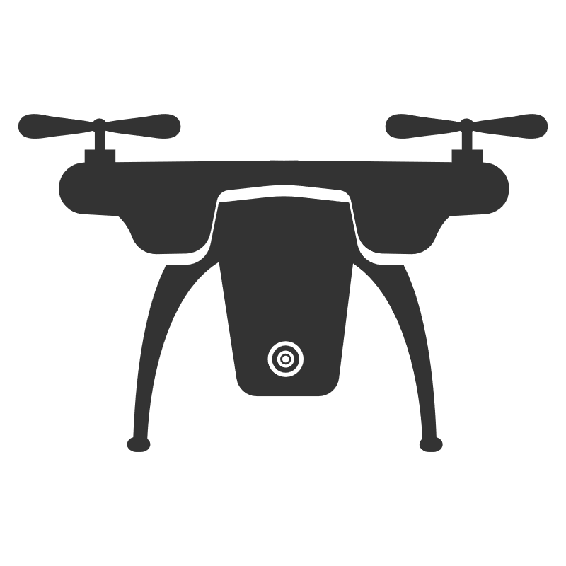
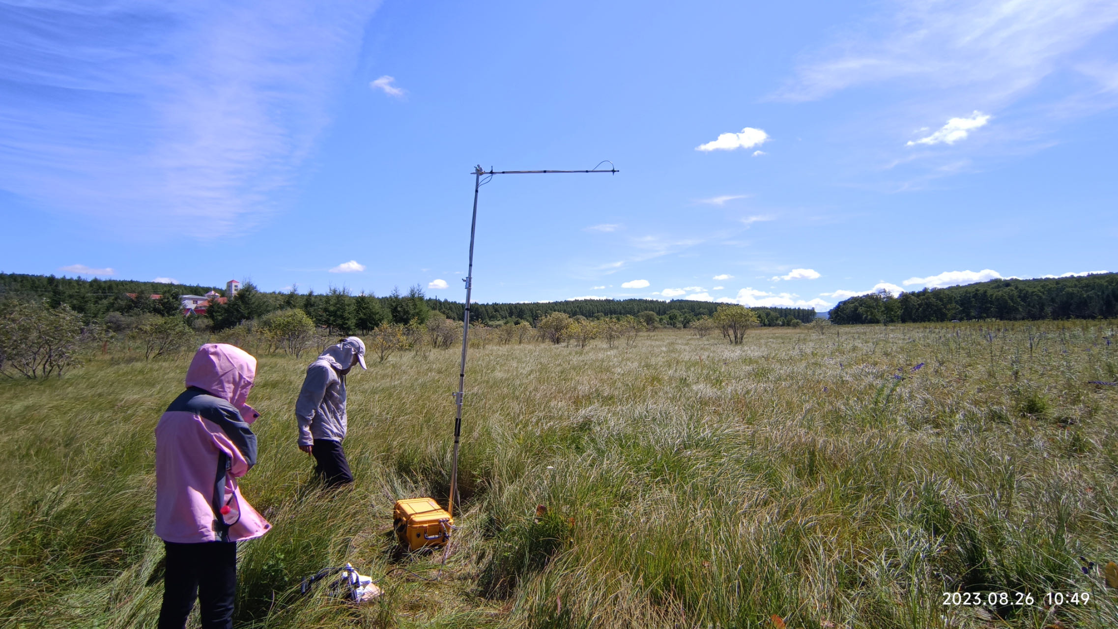
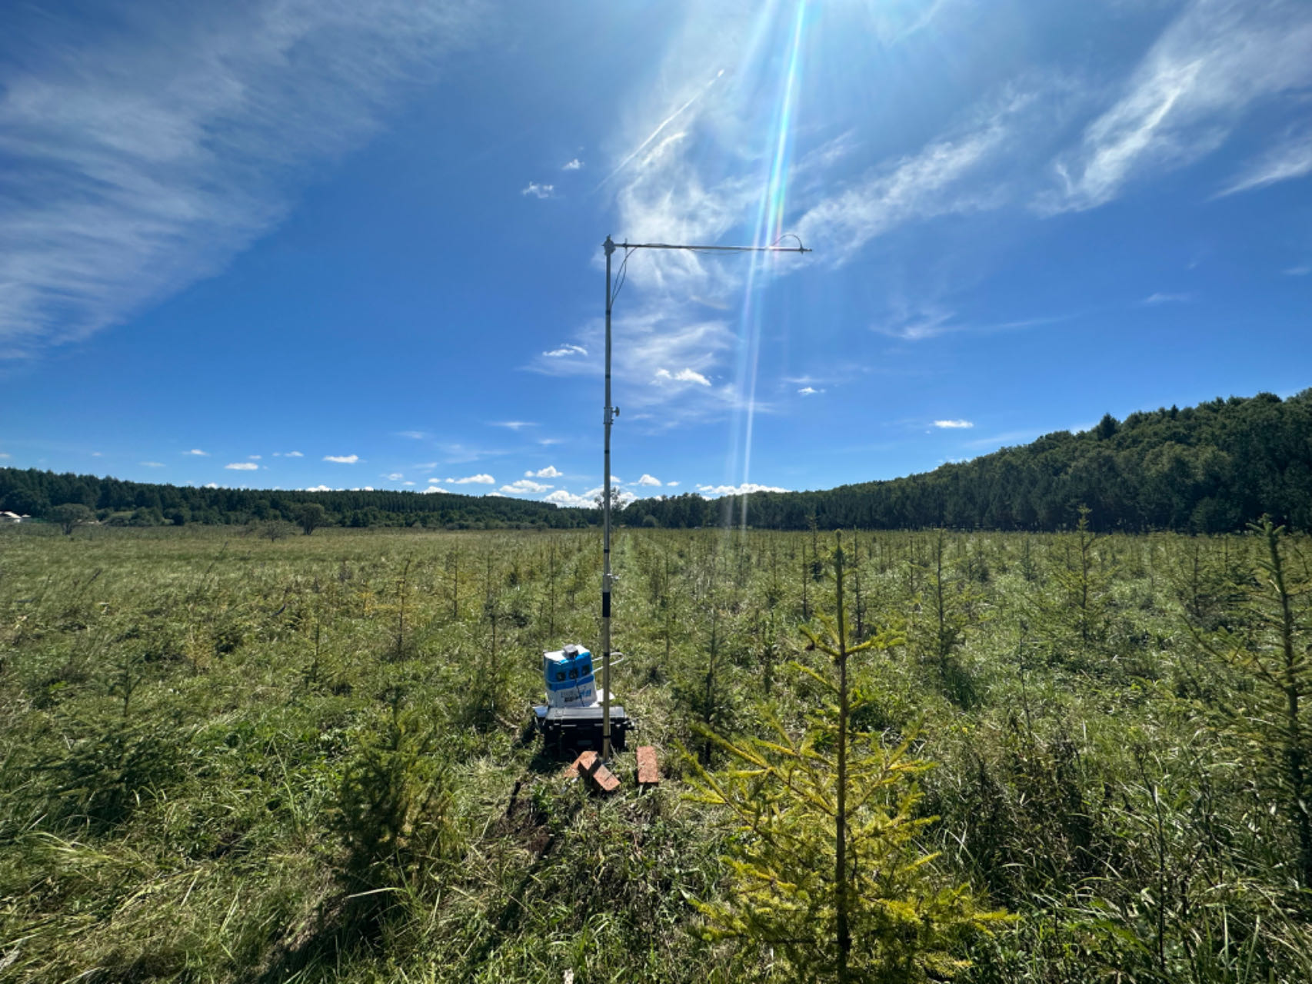
3.1 Satellite-Airborne-Ground Experiment—UAV and Tower Data Acquisition
meadow
meadow
sapling
sapling

Slide 25
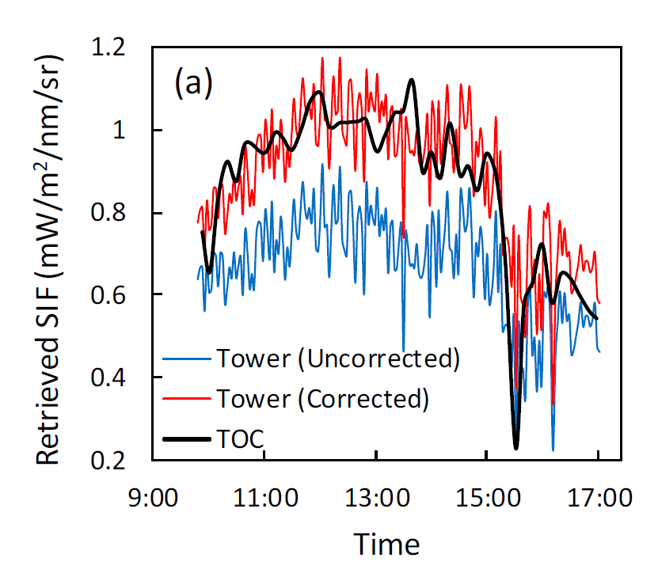
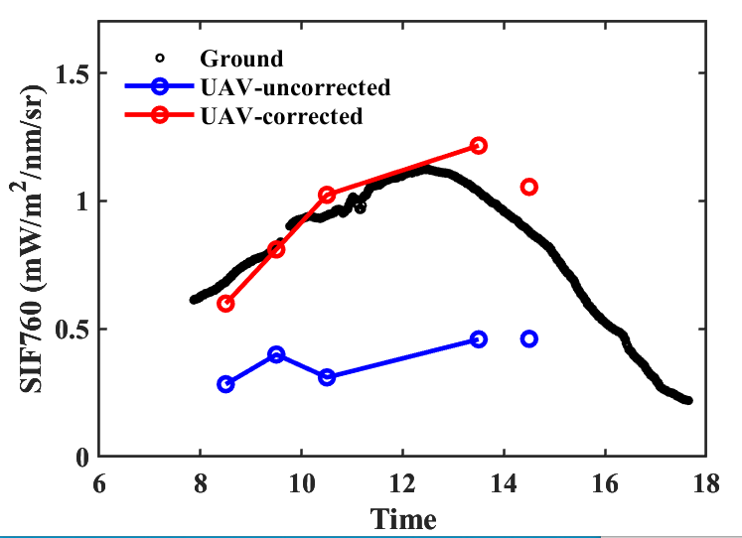
3.2 Drone and Tower-Based—SIF Retrieval Comparison
Comparison of the Satellite-Airborne-Ground Validation for FSI SIF
Sapling 2023.09.01
The SIF derived from the atmospherically corrected drone data showed better agreement with the ground-based SIF measurements, demonstrating that the drone data after atmospheric correction can be used to evaluate the quality of airborne data.

Slide 26
3.3 Airbone Remote Sensing— IBIS Hyperspectral Data
To ensure whether the airborne platform detected the fluorescence signal.
Crop
Forest
Grass
O₂ A band clearly demonstrates the chlorophyll fluorescence filling-in effect

Slide 27

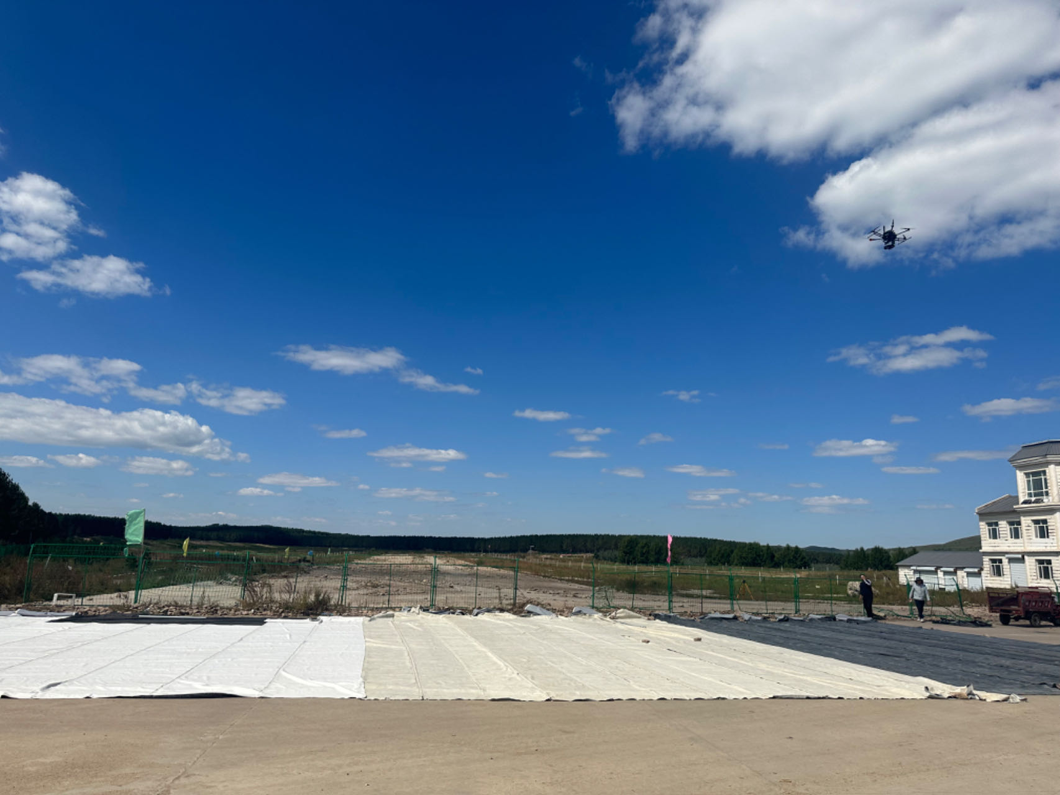
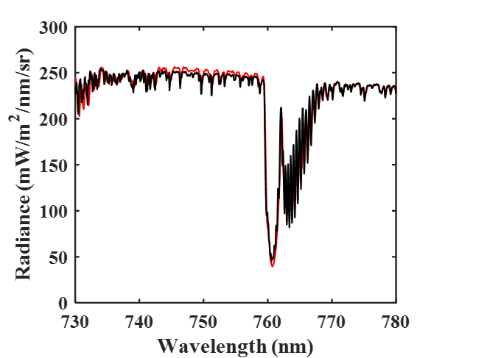
3.3 Airborne Remote Sensing vs UAV Hyperspectral Platforms
Evaluate the accuracy of the airborne radiance measurements

Slide 28
3.3 Airbone Remote Sensing—Remote Sensing Retrieval of SIF
Satellite-Airborne-Ground validation of FSI SIF: Airborne Results
09:00
10:09
10:58
11:15
Airborne data captured the diurnal variation in SIF
diurnal variations of airborne SIF.

Slide 29
3.3 Airbone Remote Sensing—SIF Spatial Mapping
Satellite-Airborne-Ground validation of FSI SIF: Airborne Results
False Color Composite (Red-Near Infrared-Red)
0 1
NDVI
-0.5 0 0.5 1 1.5 2
SIF
Airborne SIF can capture the high photosynthetic values of crops, and unlike NDVI, SIF shows no saturation phenomenon.

Slide 30
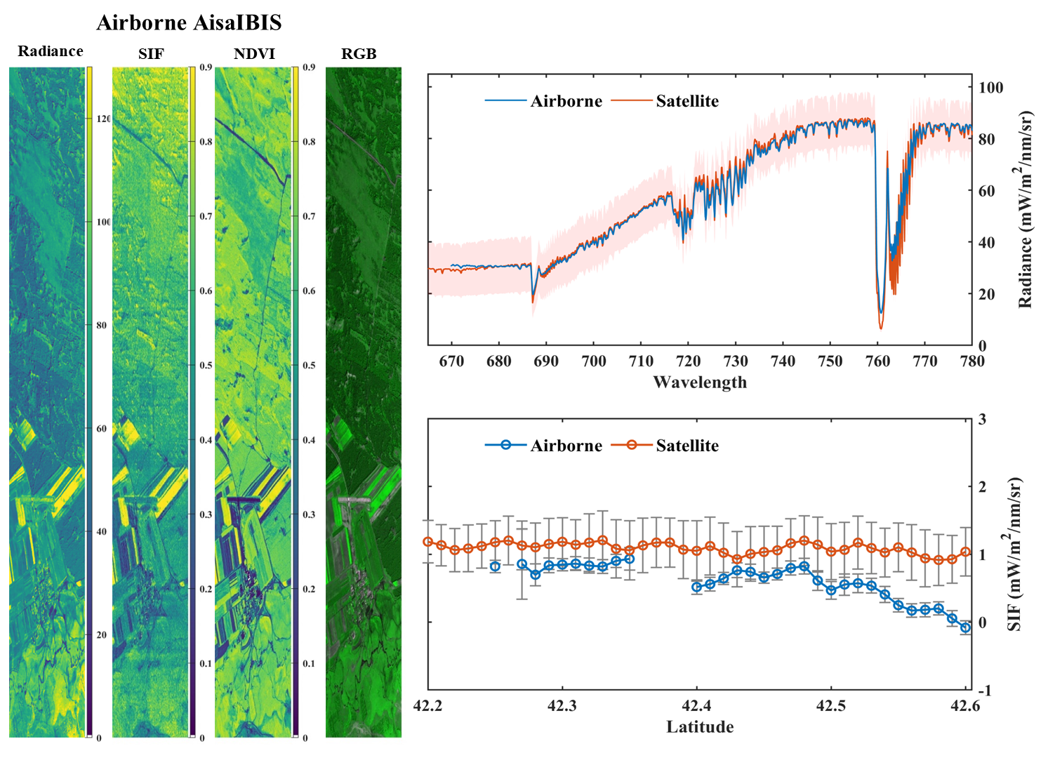
3.3 Airbone Remote Sensing

Slide 31
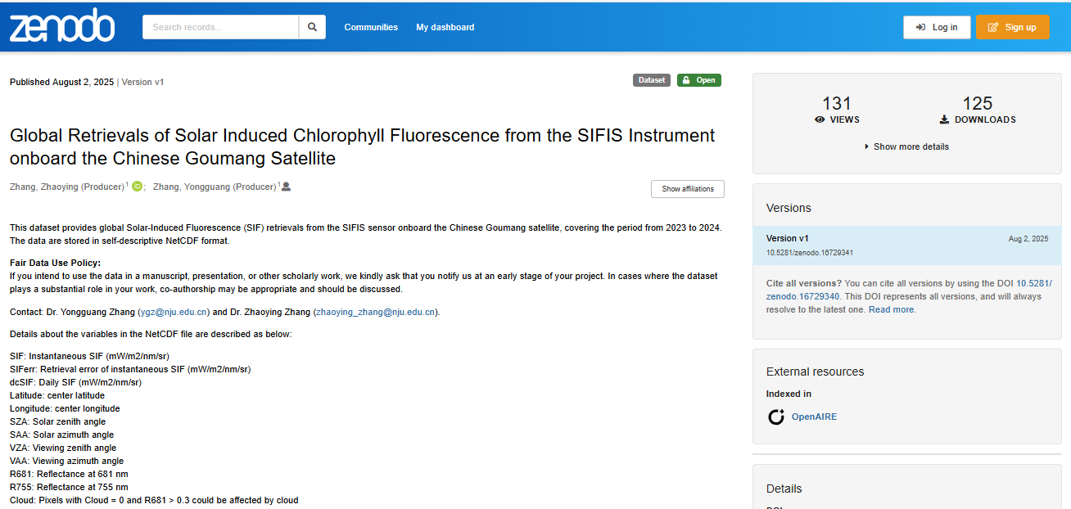
3.4 Dataset
https://zenodo.org/records/16729341

Slide 32
4. Future Prospects
Sentinel-5 (ESA/Copernicus): >2026, similar to TROPOMI
Sentinel-4 (ESA/Copernicus): >2026, Geostationary orbit
ESA Earth Explorer 8th: FLEX , launch >2026
Terrestrial Carbon Satellite (China), 2022
GeoCARB and TEMPO, Geostationary orbit?
China’s geostationary orbit SIF satellite?

Slide 33
Retrievals of Solar Induced Chlorophyll Fluorescence from Chinese Satellites
Yongguang Zhang and Zhaoying Zhang
Nanjing University, China
Max Planck Institute for Biogeochemistry , Germany
Thanks！

