Slide 1
FLEXvalGER – in situ, UAV, Airborne & Satellite Validation of FLEX L1C-L2C Products in Germany
Bendig, J.; Bachmann, M.; Buffat, J.; Brede, B.; Burkart, A.; Carmona, E.; Chabrilat S.; Duveiller, G.; Goeritz, A.; Herold M.; Kleppert, I.; Knohl, A.; Koehler, C.; Kuehl, K.; Lee, S.-C.; Magnabosco, D.; Markwitz, C.; Maier, S.; Meyerhoff P.; Milewski, R.; Pato, M.; Preidl, S.; Putzenlechner, B.; Rascher, U.; Richter, R.; Siegmann, B.; Storch, T.; Walz, S.; Wieneke S.

Slide 2











Project Partners
Forest in-situ+UAV
Crop in-situ+UAV
Airborne – all sites
Satellite – all sites
Instrument calibration

Slide 3
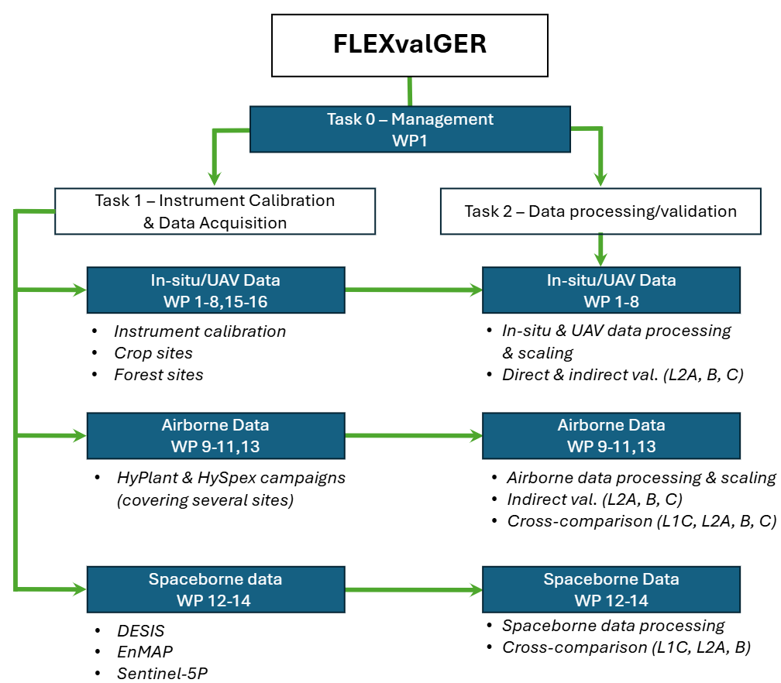
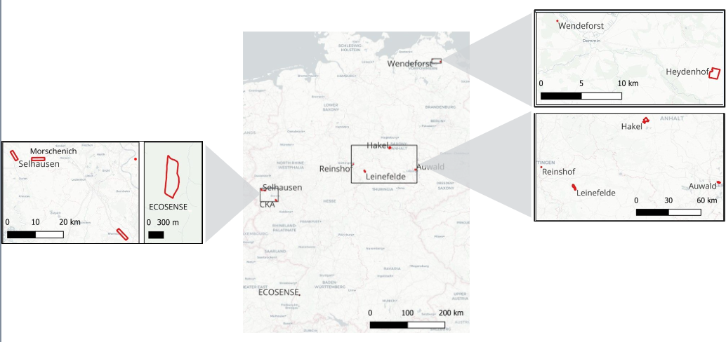
Work Packages – crops – in-situ/UAV
Notes:
Agriculture
Selhausen /Campus Klein Altendorf (FZJ): Monitored crop sites with FloX & EC-Towers
Reinshof (UniGö): FLUXNET agricultural site with ICOS flux tower
Heydenhof (GFZ): Large-scale crop fields with HYPSTAR & UAV hyperspectral data

Slide 4
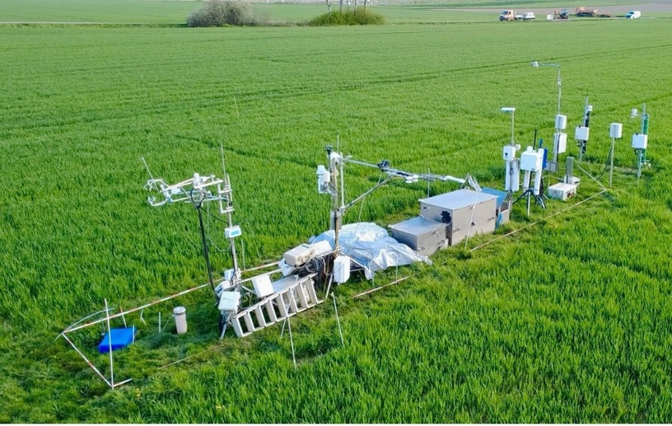
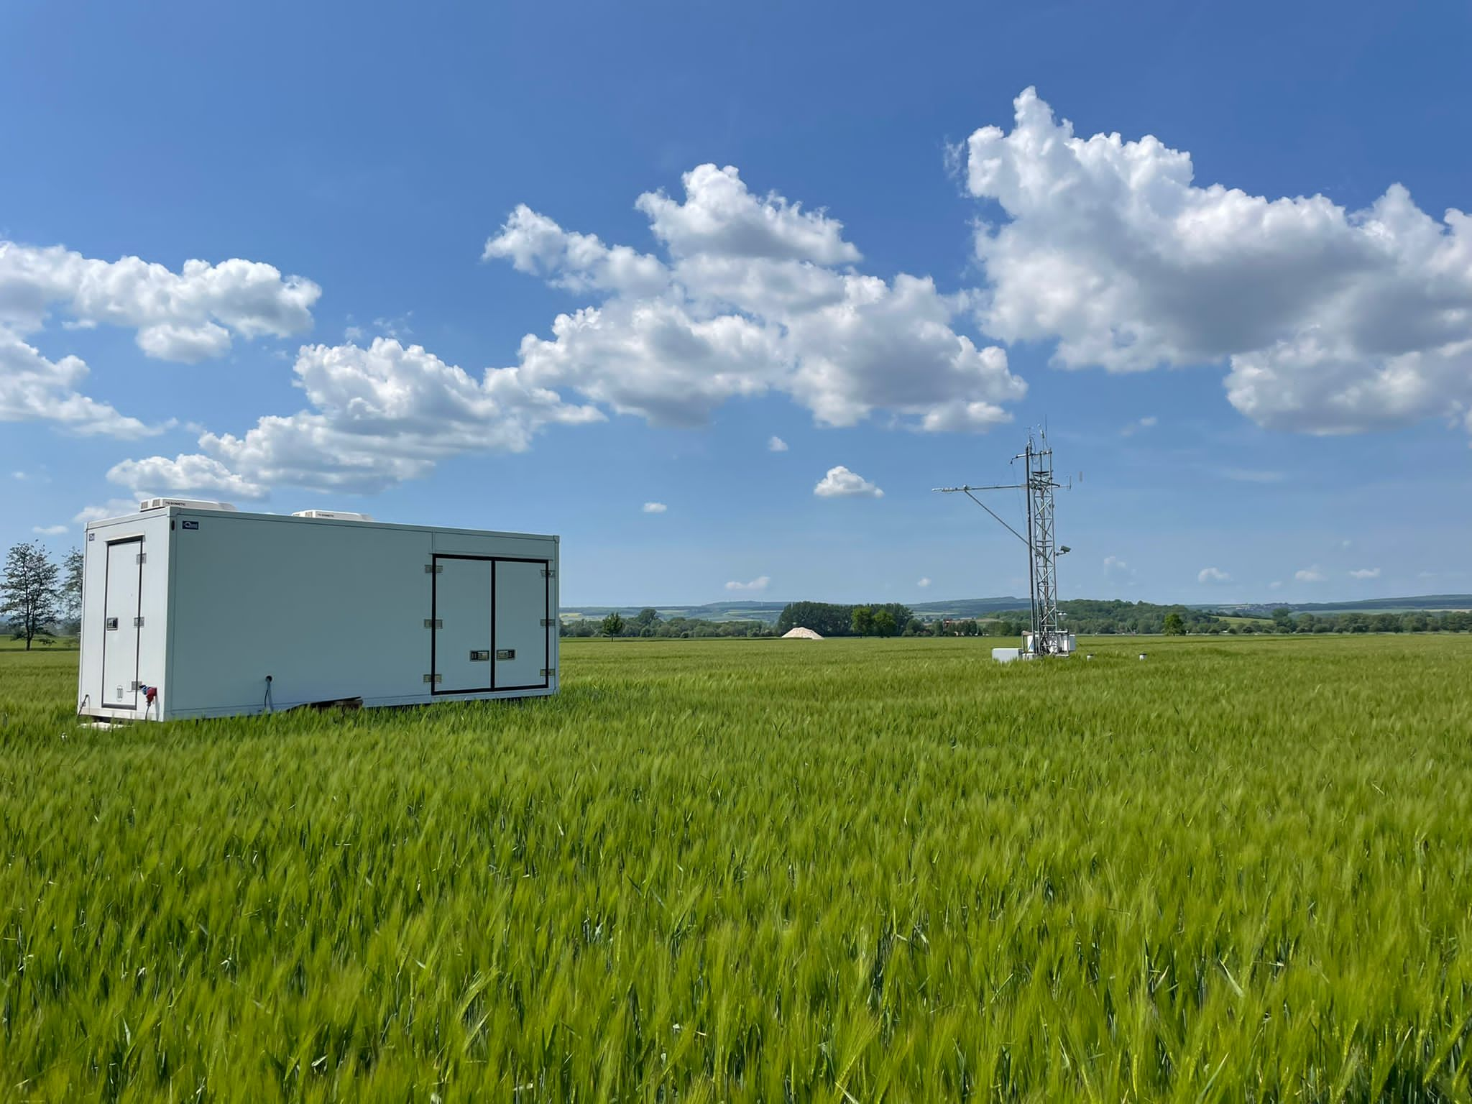
Work Packages – crops – in-situ/UAV
FZJ – CKA, Selhausen, Morschenich:
<4 m FloX towers, next to EC tower (Selhausen – ICOS DE-RuS)
mobile FloX, UAV AirFloX
MONI/MICRO-PAMs, LAI, LCC, LCARC
UniGö - Reinshof:
2 m FloX tower, next to EC flux tower
LAI, leaf fluorescence, UAV multispectral+thermal
GFZ - Heydenhof:
HYPSTAR, atmospheric parameters, LAI, LCC, LST
UAV HySpex (hyperspectral) and FluorSpec (SIF)
Leaf fluorescence (LI-6800)
Selhausen image: FZJ
Reinshof

Slide 5
Work Packages – forest - in-situ/UAV
Notes:
Forest
ECOSENSE (UniFr): Mixed forest with 45m EC tower & continuous FloX
Leinefelde (UniGrö): Homogeneours beech forest, long-term flux measurements
Auwald (LU): Floodplain forest with canopy crane & crane-mounted FloX
Wandeforst (GFZ): Mixed forest with hyperspectral monitoring
Hakel (JKI): Oak-hornbeam forest reserve for structural validation

Slide 6

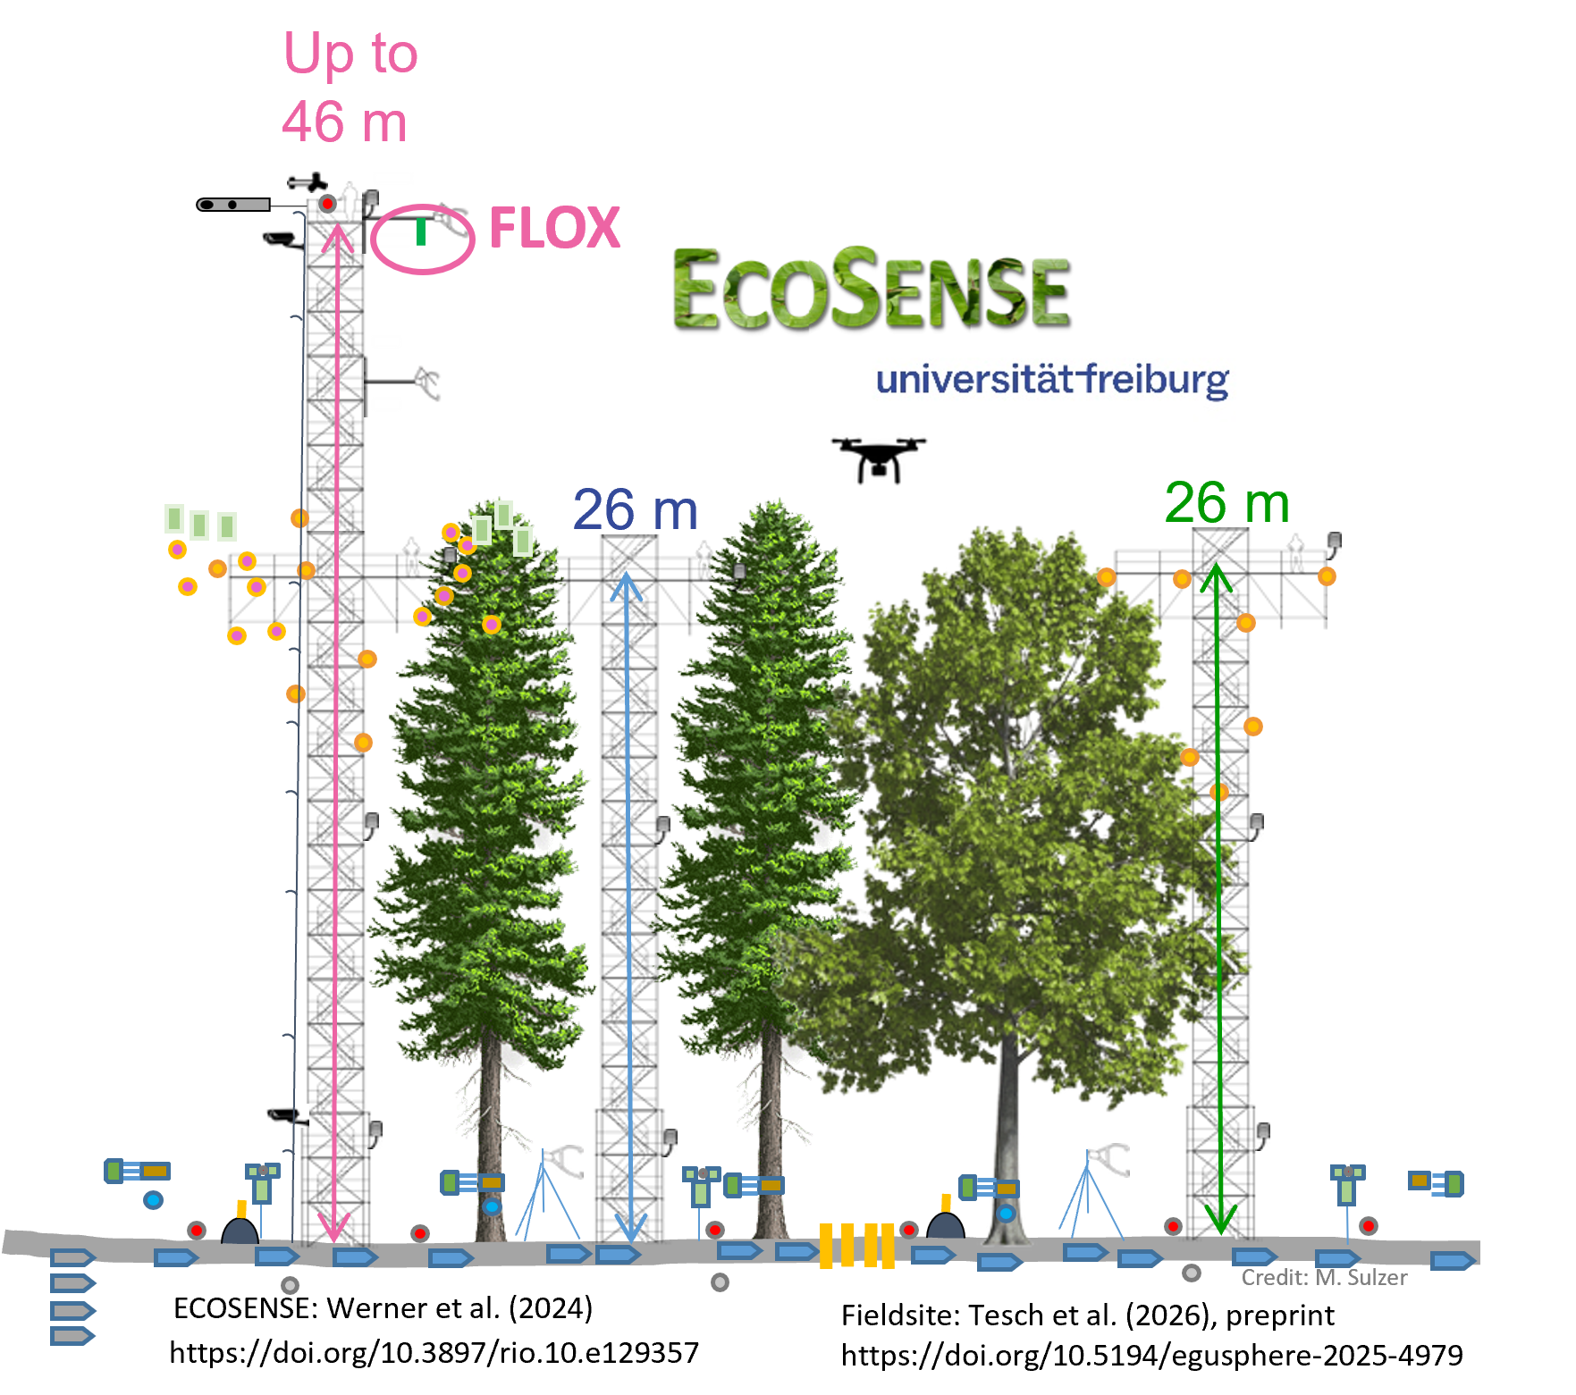
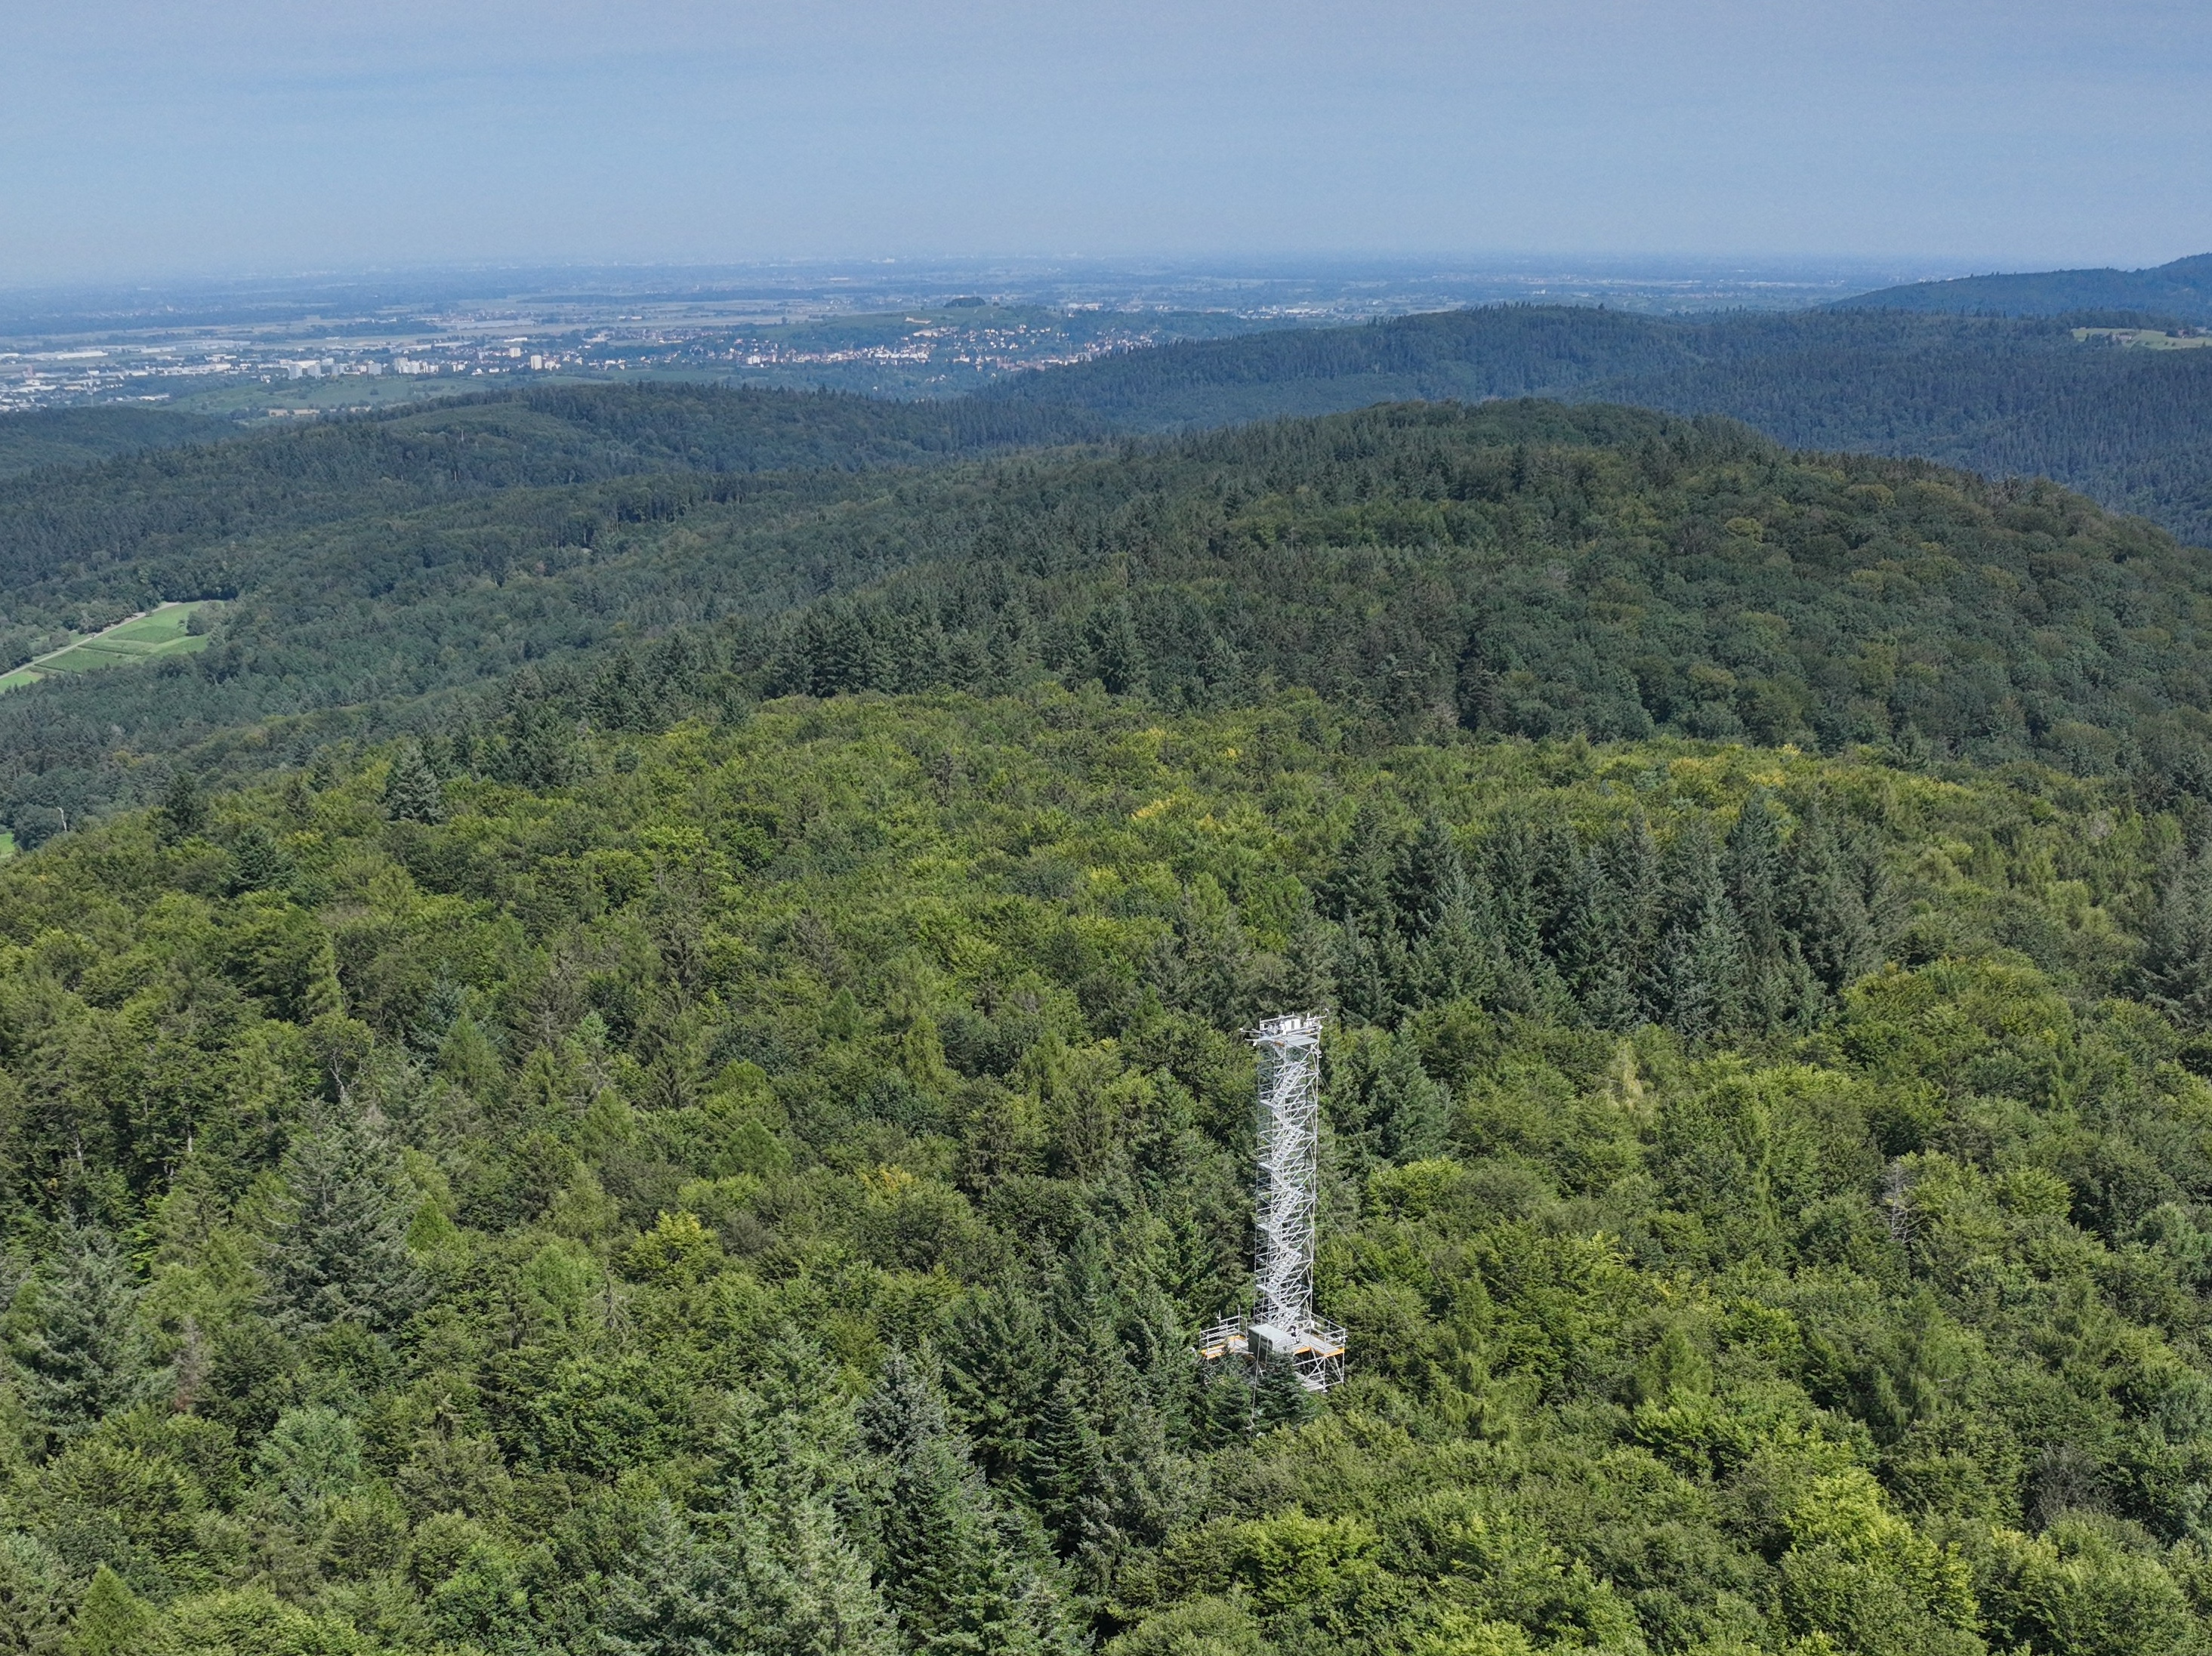
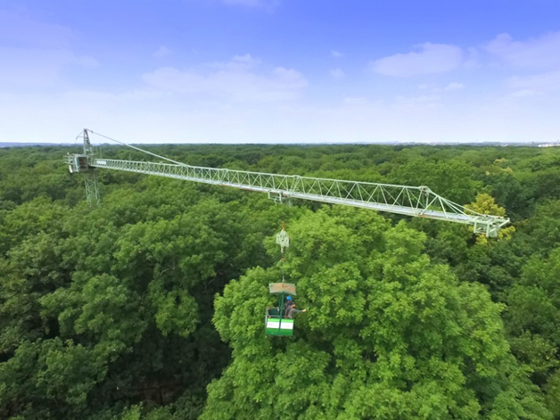
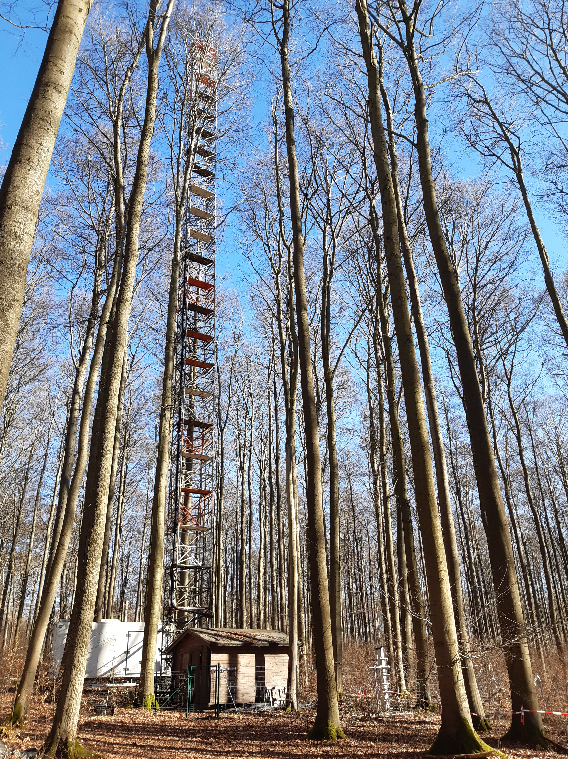
Work Packages – forest – in-situ/UAV
UniFr - ECOSENSE:
FloX on 46 m EC flux tower
PAM, LAI, leaf pigments
UAV LiDAR, multispec, thermal, digital site modeling
planned atmospheric monitoring
UniGö - Leinefelde:
FloX on EC tower
PAR, fAPAR, LAI, leaf fluorescence, UAV multispectral+thermal
LU - Auwald:
movable crane-mounted FloX (40 m)
PAM, FLUOWAT, PAR, LAI, LCC, CARC
GFZ - Wendeforst:
HYPSTAR & RoX movable crane-mounted
UAV HySpex (hyperspectral) and FluorSpec (SIF), Leaf fluorescence (LI-6800)
Atmospheric parameters
JKI - Hakel:
LAI, fAPAR sensor network, UAV LiDAR & optical imagery
Wendeforst

Slide 7
Work Packages – instrument calibration
JB Hyperspectral:
On-site FloX calibration; MoMo real‑time data links
unified processing chain feeding INSIF network
Walz:
Central PAM calibration laboratory, regular device cross-calibrations
maintains calibrated loan units for continuous fluorescence measurements

Slide 8
Work Packages - airborne
FZJ:
HyPlant overflight of each field site once per vegetation period
L2 reflectance, & fluorescence products
DLR:
HySpex (VNIR & SWIR, 400-2500 nm), spectral resolution of 3-5 nm, complements HyPlant observations
L1C + L2 radiance & reflectance products
Spatial & spectral resampling and harmonisation

Slide 9
Work Packages – spaceborne
DLR:
DESIS & EnMAP match ups (weather, orbits, ground targets)
FLEX spatial & spectral scaling & L1C/L2 product validation
DLR, Maitec, FZJ:
O₂A SIF retrieval HyPlant & DESIS (SFMNN) with uncertainties
MPI-BGC:
Sentinel‑5P/TROPOMI footprint‑level L2 products incl. SIF, FQE & FLEX comparison
Sentinel‑2 NIRv to FLEX fesc comparison
Notes:
SIF Retrieval
O2-A-based SIF retrieval framework
Application to HyPlant & DESIS airborne and satellite data
Consideration of measurement errors
Estimation of retrieval uncertainties
Comparison with FLEX SIF products
TROPOMI
Use of Sentinel-5P SIF time series
Large validation areas (10 x 10 km)
Support from Sentinel-2 data
Analysis of radiation and vegetation effects
Comparison with FLEX products

Slide 10
FLEX Products to be Validated
Data type | Core Science |  | Supporting Science |  | Experimental Science
L1 | TOA reflectance | C | FLORIS spec. central wavelength/FWHM | B
L2 | FLORIS apparent reflectance | A,C | Direct/diffuse irradiance | A
 | SIF (O2A/B, peaks, peak positions, full spectrum | A,C | LCC, fAPAR fAPAR_chl, APAR_chl, LAI, LCARC | A | RED, ETR, PSI/PSII | A
 |  |  | Land surface temperature | A | FQE, fesc | A, C
 |  |  | Aerosol optical thickness, CWV | A | Angstrom exponent, Asymmetry parameter | A
Validation type (CEOS)
A: Direct validation (Satellite vs. in-situ comparison)
B: Indirect validation through numerical RTMs
C: Inter-comparison with space products
TOA: top of atmosphere, LCC: Leaf Chlorophyll Content, LAI: Leaf Area Index, fAPAR: Fraction of absorbed PAR, fAPAR_chl: fAPAR by chlorophyll, APAR_chl: absorbed PAR by chlorophyll, fesc: escape fraction of fluorescence, LCARC: Leaf Carotenoid Content, FQE: Fluorescence Quantum Efficiency, ETR: Electron Transport Rate (ETR), RED: Regulated Heat Dissipation (NPQ proxy), CWV: Columnar water vapor

Slide 11
Unique data from FLEXvalGER
Multi-scale flourescence data
Concurrent Leaf, tower, UAV and airborne, satellite
Complemented with spectral, structural, & in-situ reference data
Spatial scaling to FLEX pixels
L2 novel photosynthesis parameters
FQE, ETR, RED, APARchl, fesc
Cross-mission datasets tailored for FLEX validation
Airborne & spaceborne hyperspectral data matched to FLEX spectral characteristics
Spatial scaling from high-resolution airborne data to FLEX pixel size
Characterized uncertainties

