Slide 1
The FLEX Collaborative Platform: Enabling Data Processing, Validation, and Scientific Exploitation of FLEX Fluorescence Products
Pedro Pereira Gonçalves
Simone Vaccari
Terradue

Slide 2
Collaborative Platform
Data Accessibility: Provide users with access to EO products and auxiliary data, including historical and simulated datasets
Processing Capabilities: Offer computational resources and tools for processing EO products (multiple programming languages, containerized applications, and scalable processing workflows)
Collaboration and Sharing: Collaborative code development, data visualisation, data sharing.
Supervised Systematic Processing: Configuring and managing supervised systematic processing workflows defined by researchers and monitored by operators.
User Support and Outreach: Provide comprehensive support resources, including documentation, tutorials, and user forums.

Slide 3
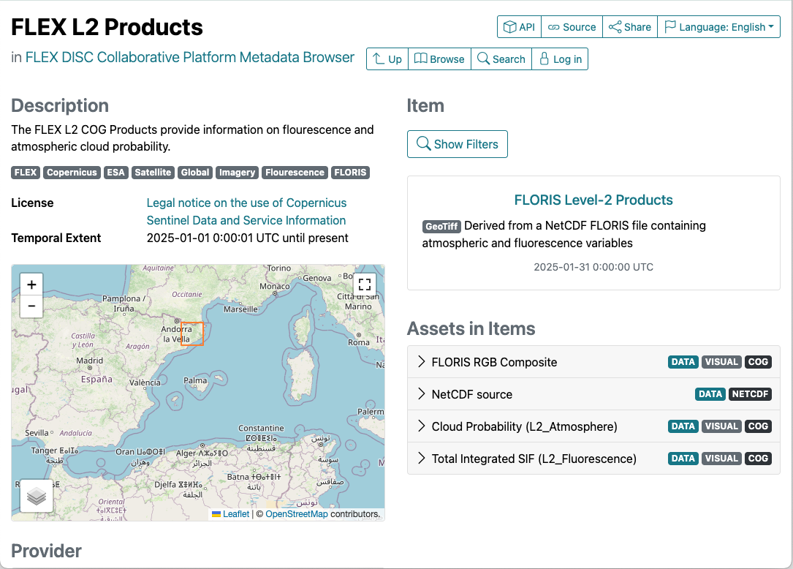

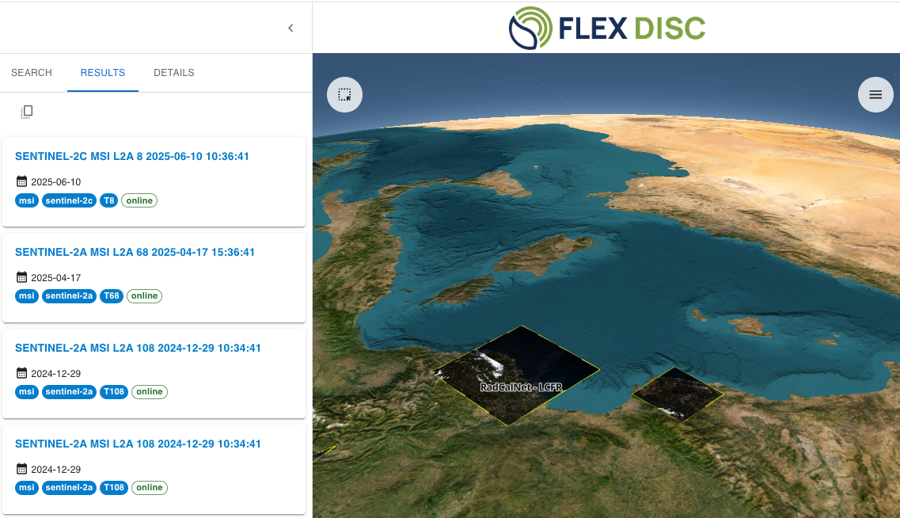
Data Explorer
Discover, access and explore EO data
Needs geospatial tools to browse datasets, analyse metadata and download assets (e.g. NetCDF, PDF quality reports)

Slide 4
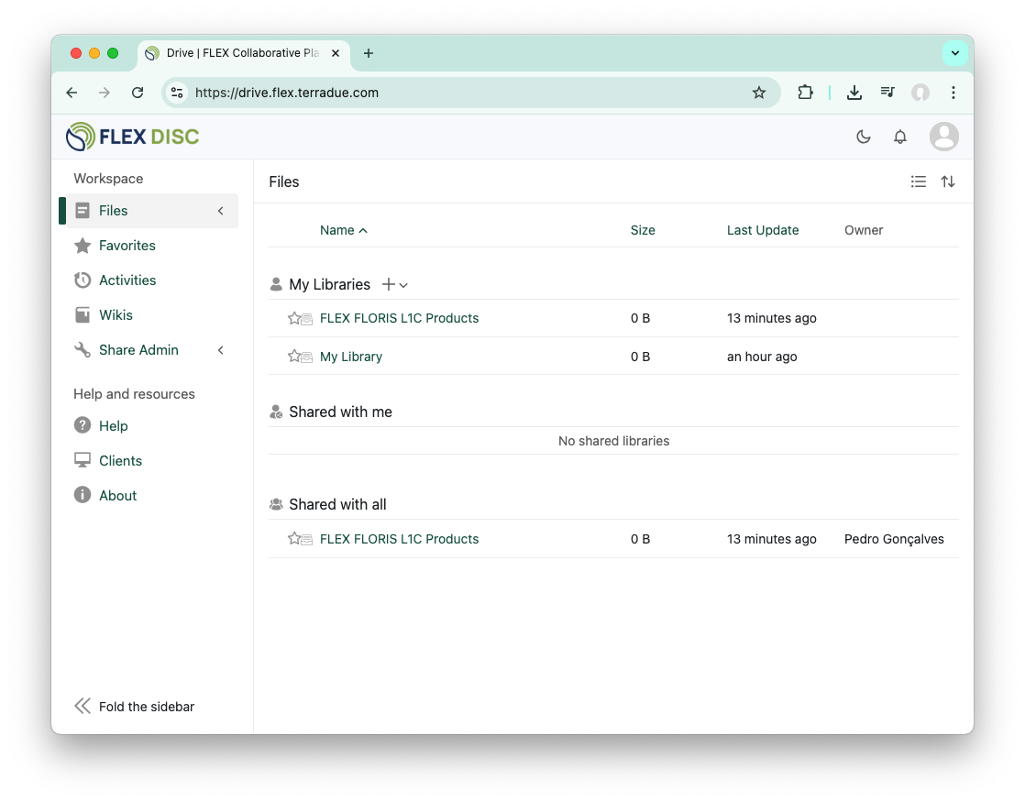
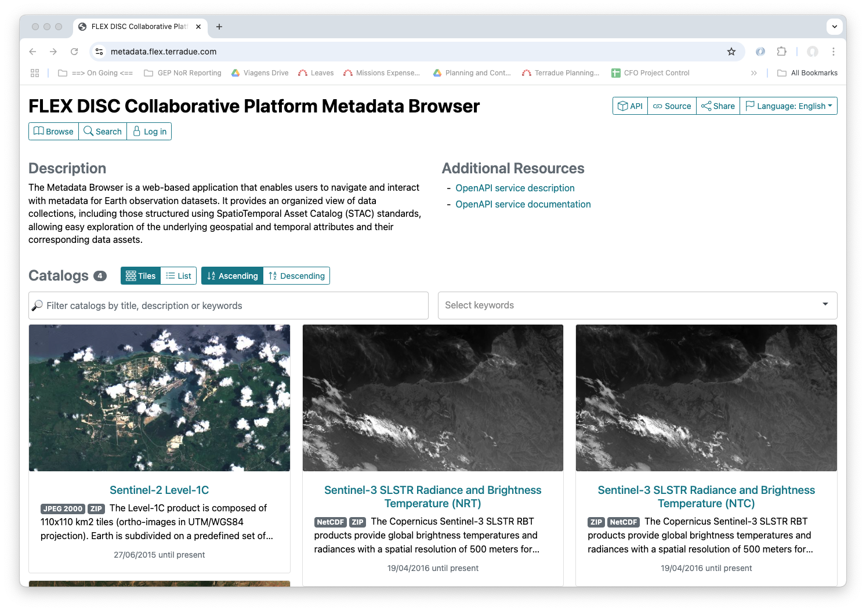

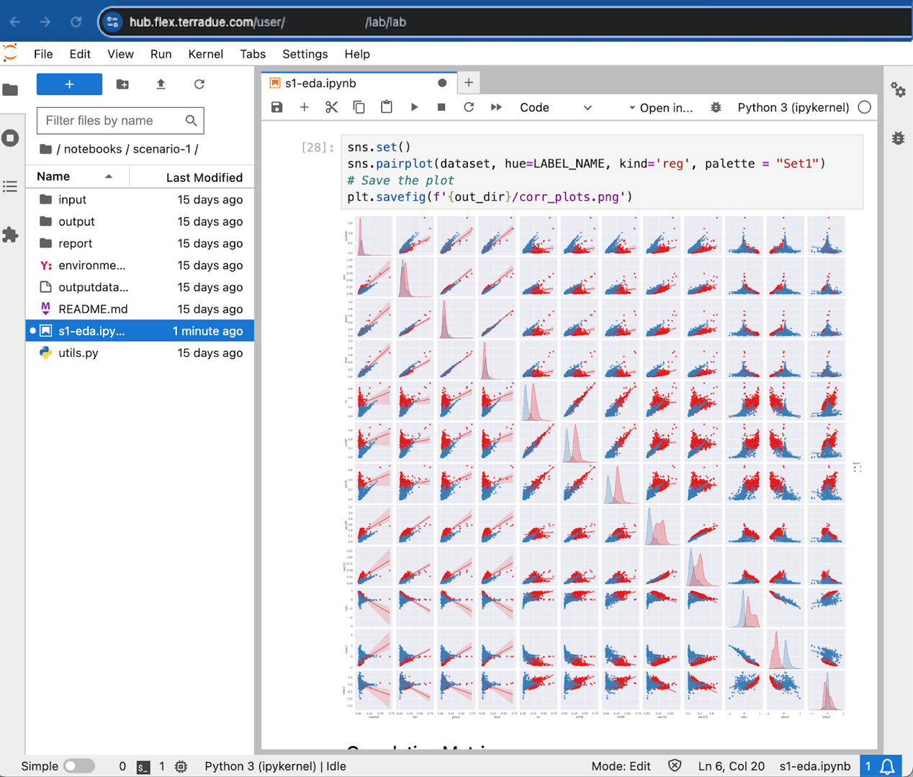
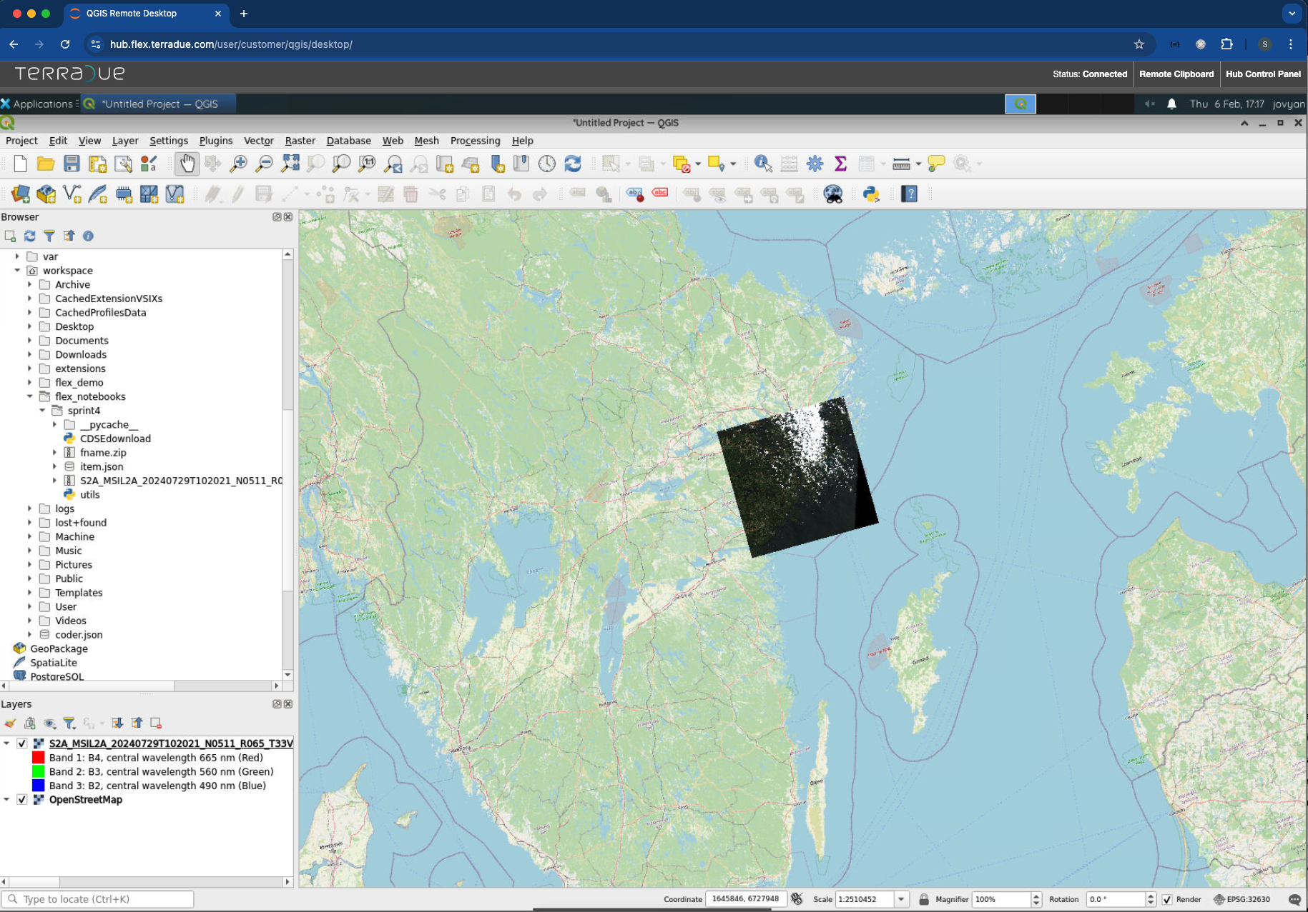
Data Specialist / Expert
Data analysis to support cal/val and research activities.
Needs access to shared data, notebooks and desktop applications with computational resources for data processing and analysis

Slide 5
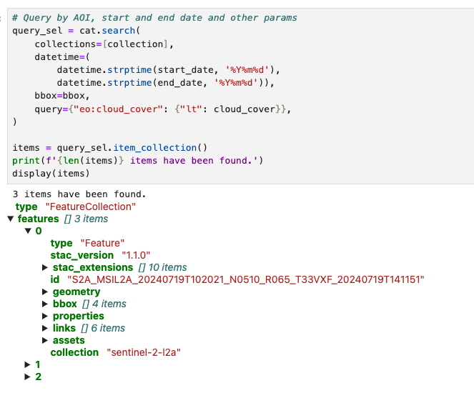
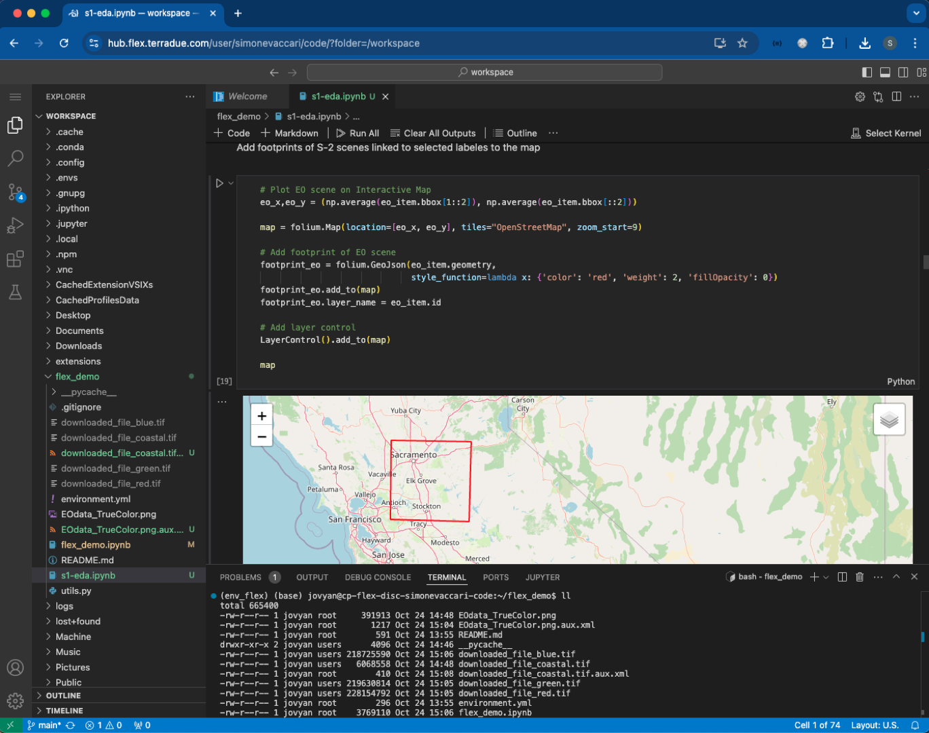
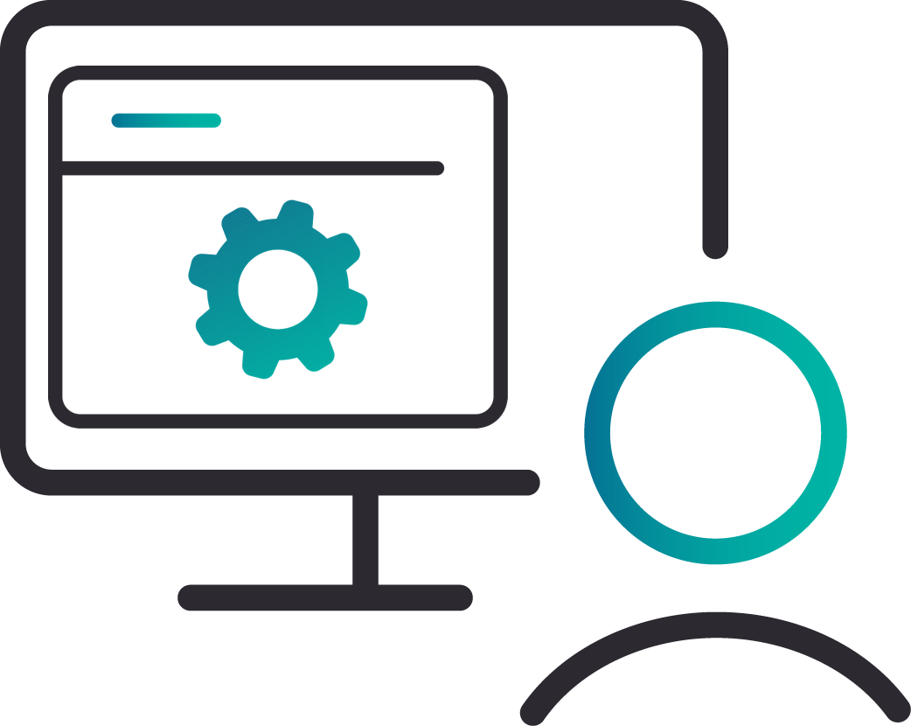
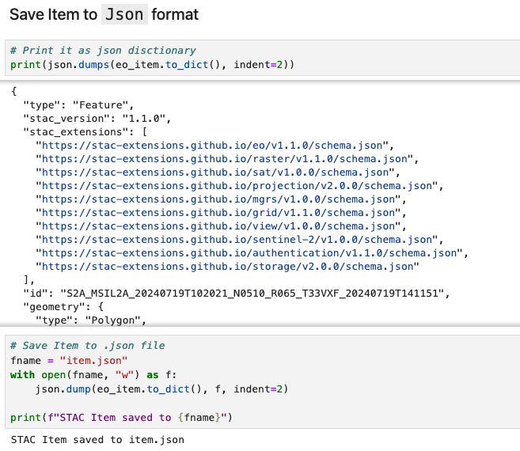
Developer
Develops and packages algorithms for processing FLEX data
Needs access to an IDE, and computational resources to support algorithm development, debugging and testing.

Slide 6
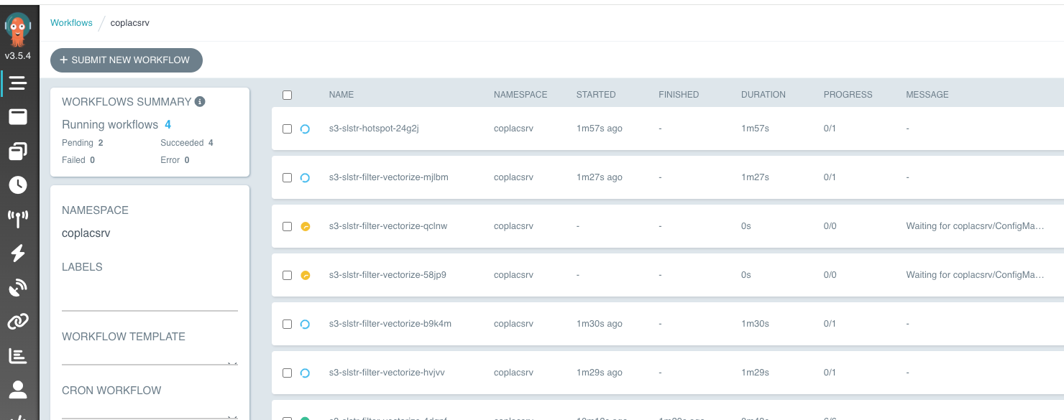
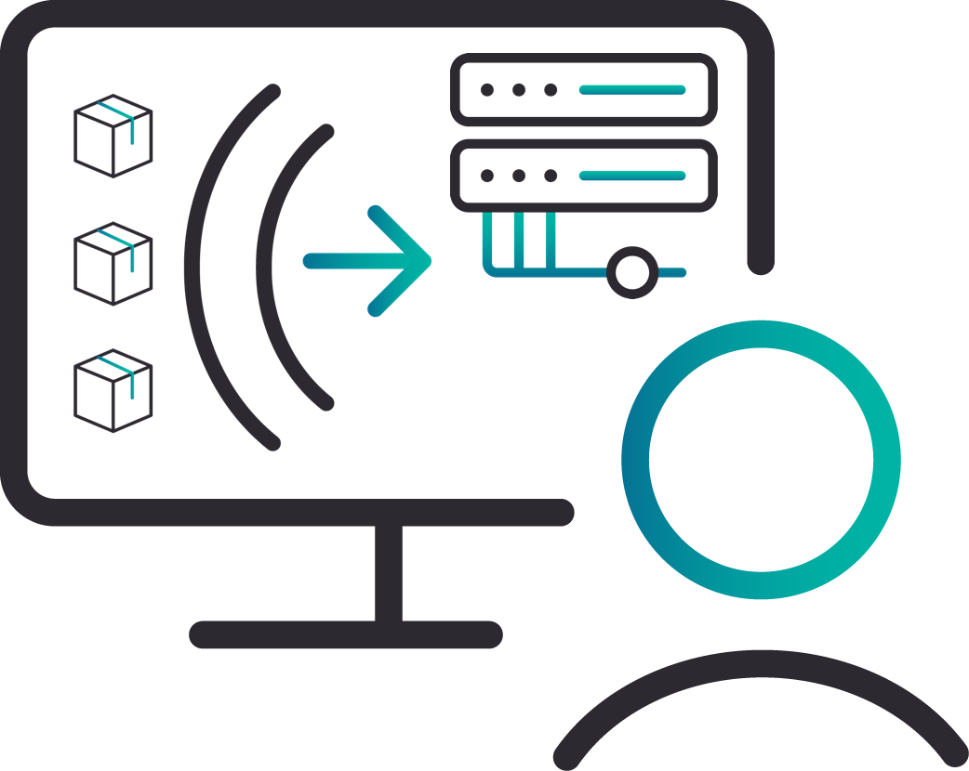
Operator
Deploy tools and oversee systematic processing workflows
Needs tools for application deployment & management, adjust processing workflows with real-time monitoring and feedback

Slide 7
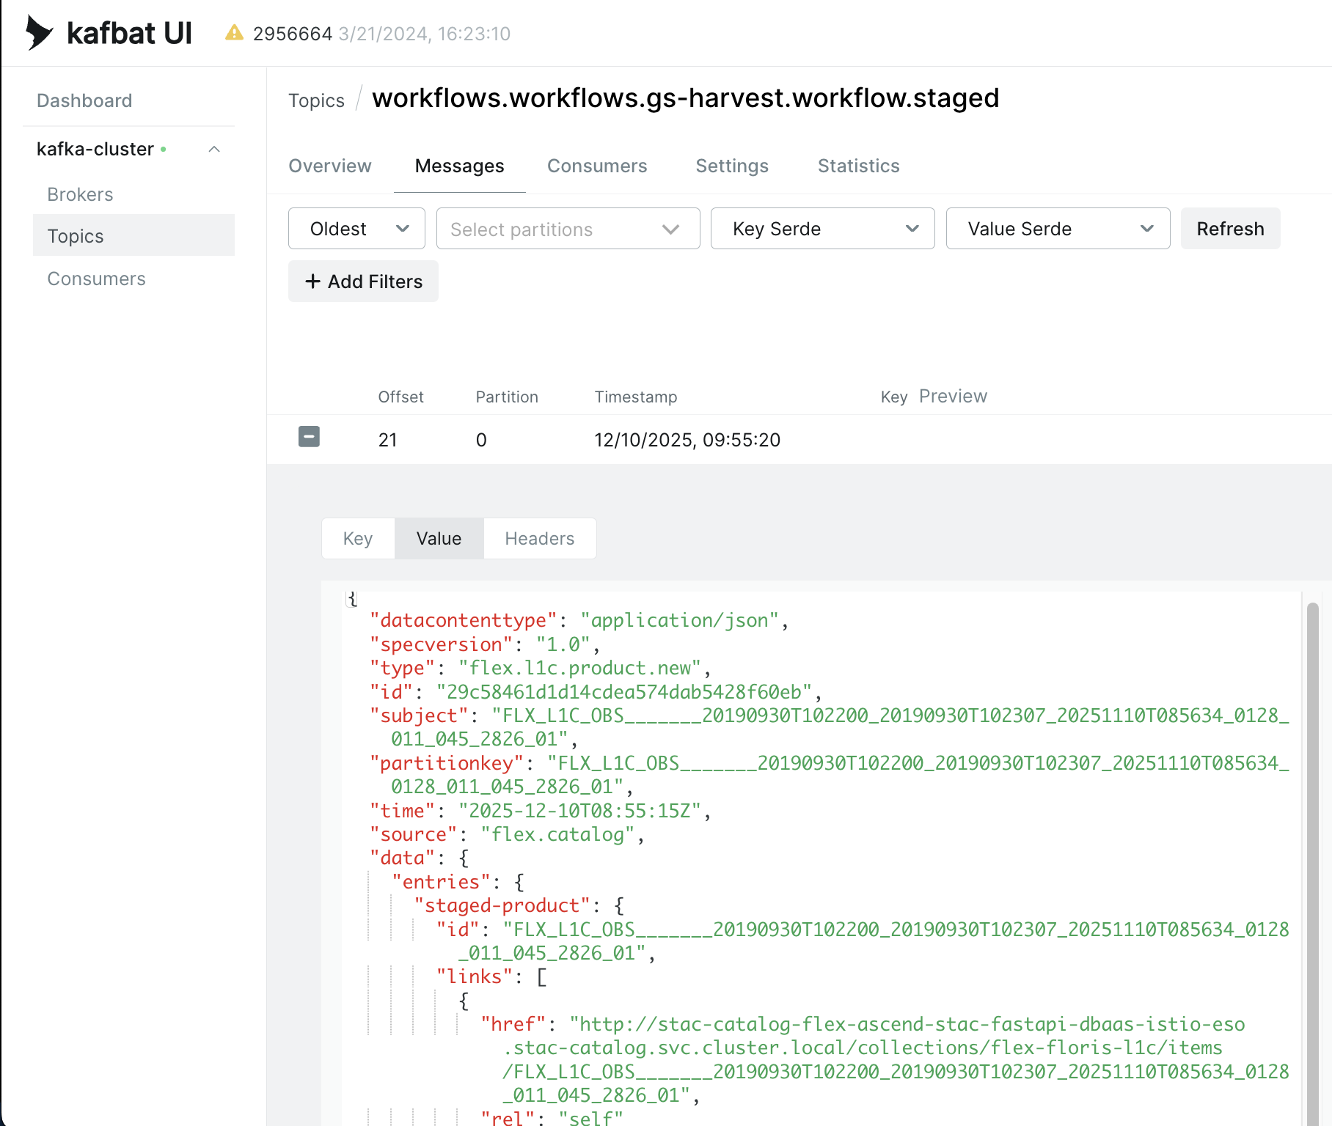
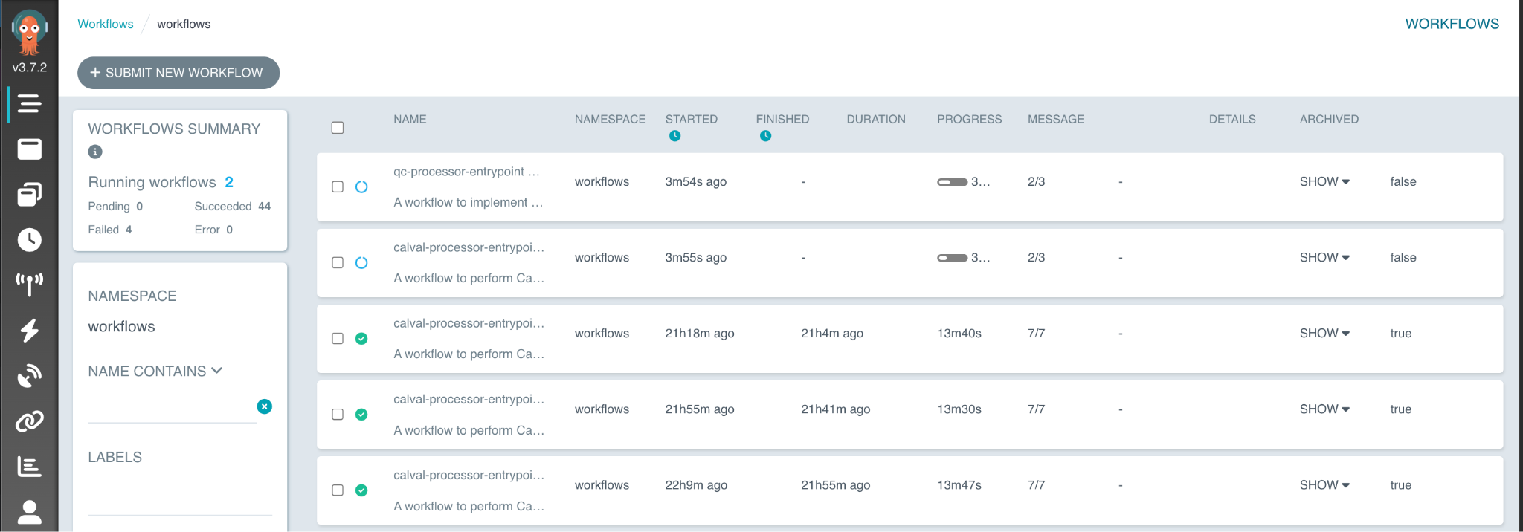
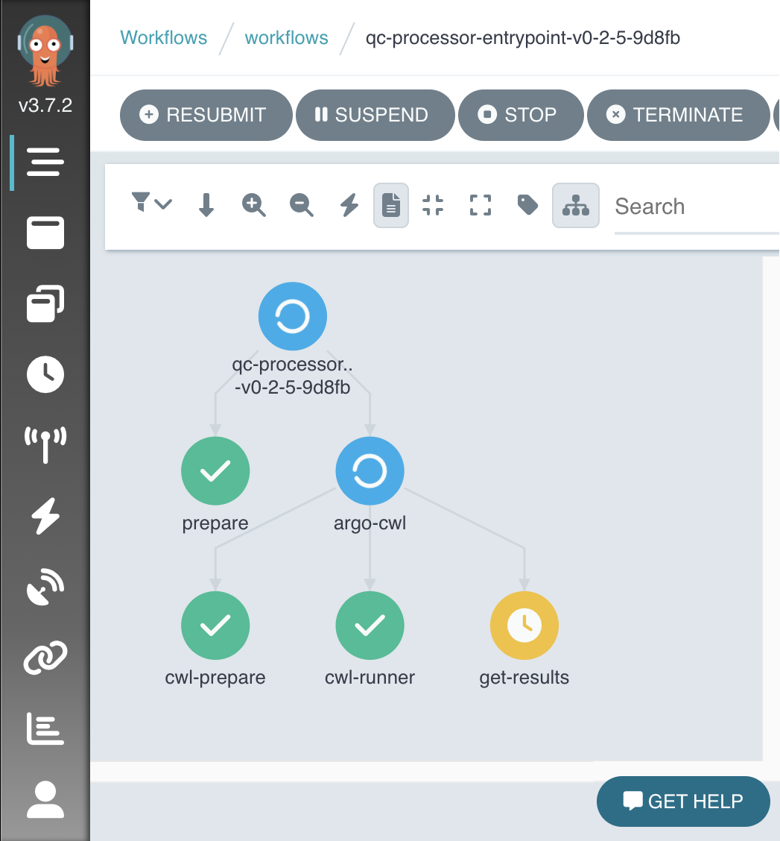
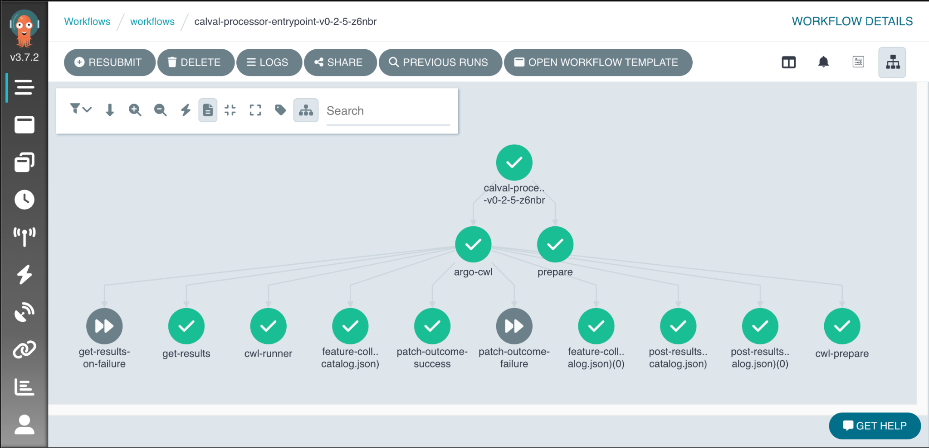
Operator
Deploy tools and oversee systematic processing workflows
Needs tools for application deployment & management, adjust processing workflows with real-time monitoring and feedback

Slide 8
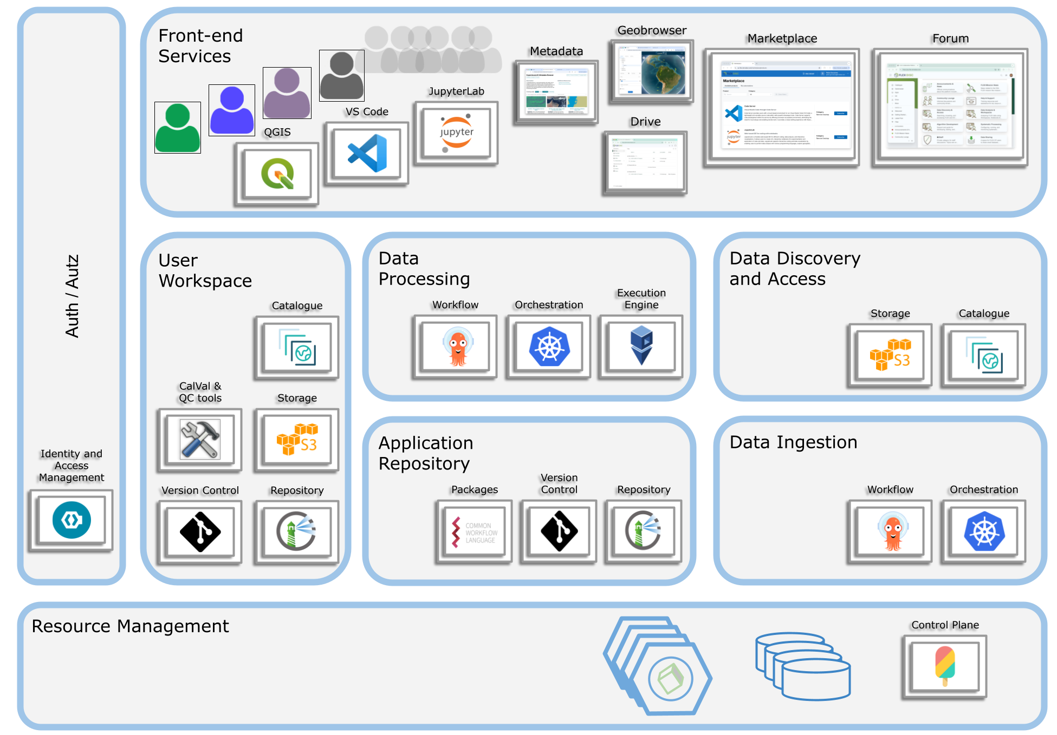





Architecture
Open source tools and protocols designed to streamline operational processes involved in data management and application development
Provides an EO data hosting & exploitation environment delivered as a cloud-agnostic PaaS

Slide 9
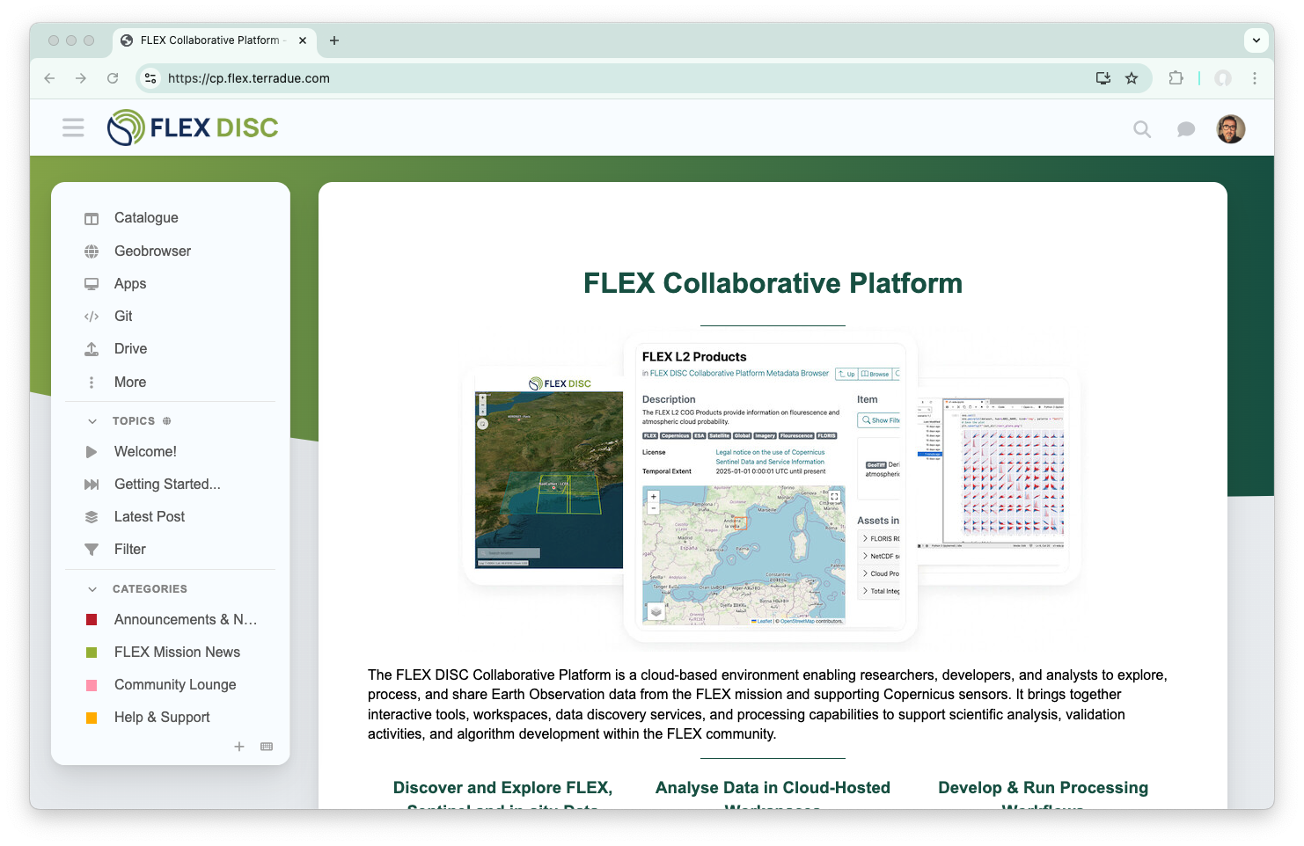
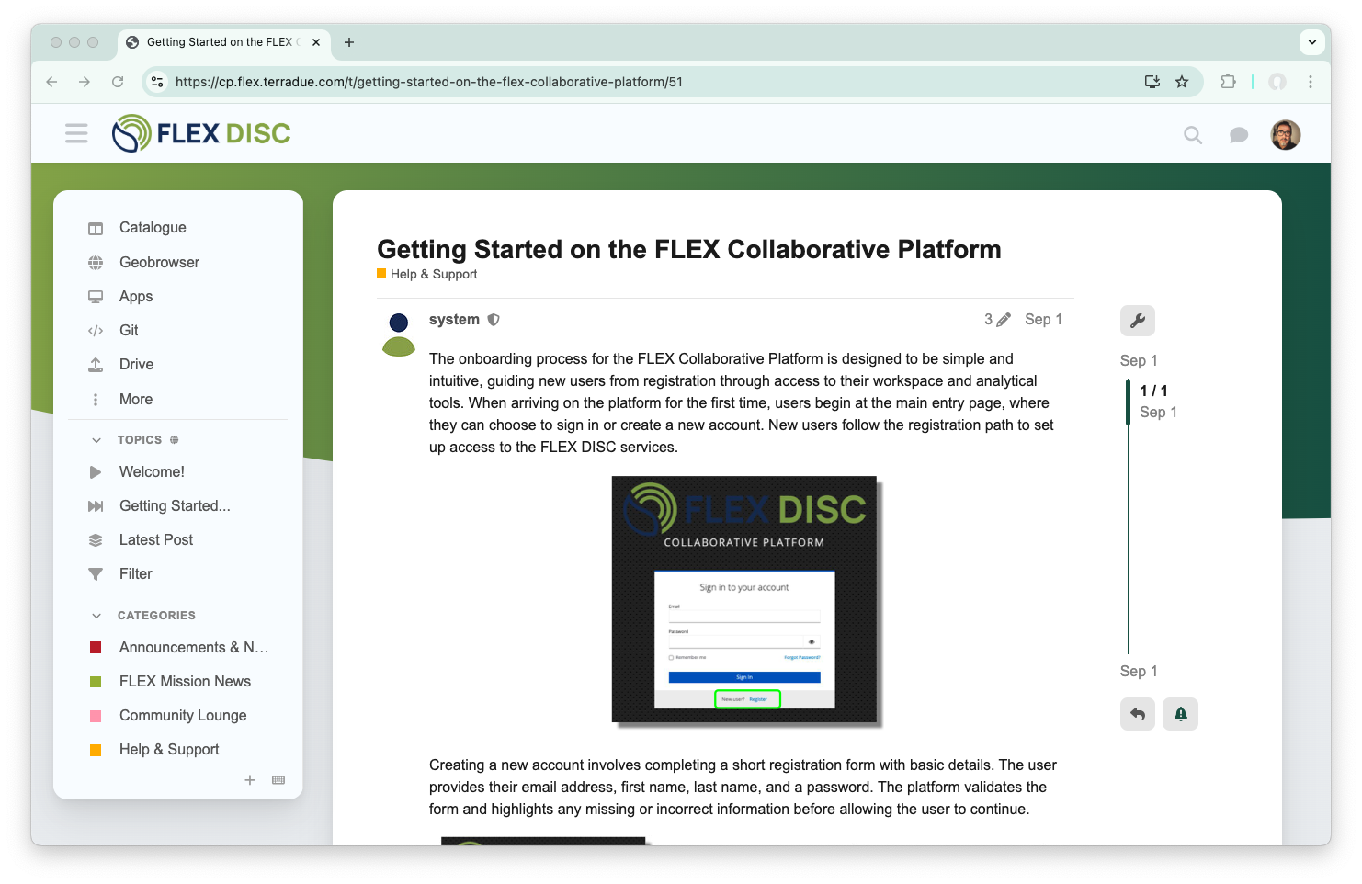
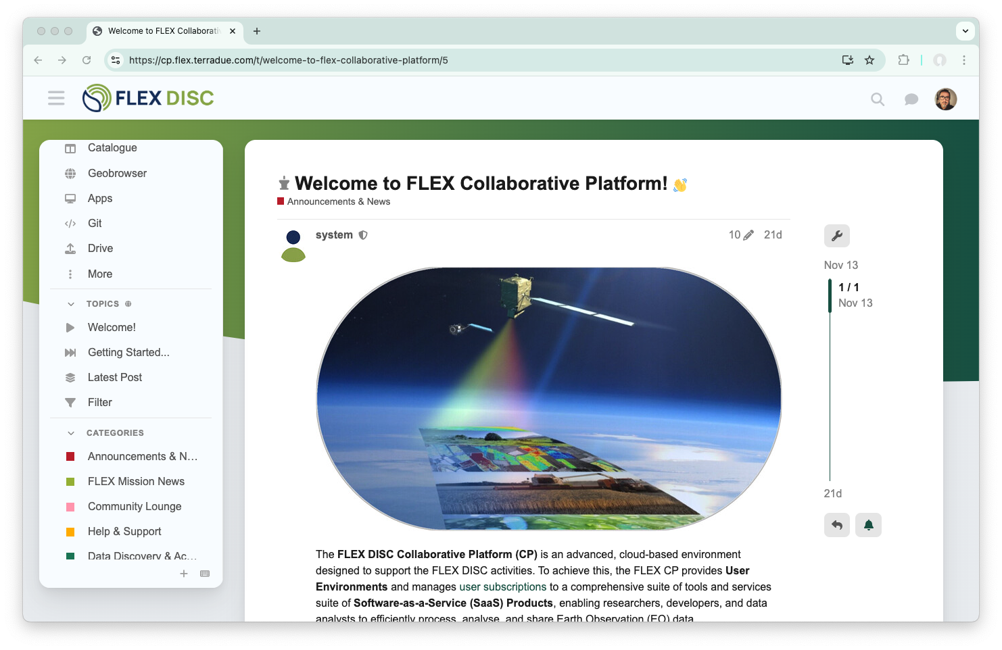
Collaborative Platform

Slide 10
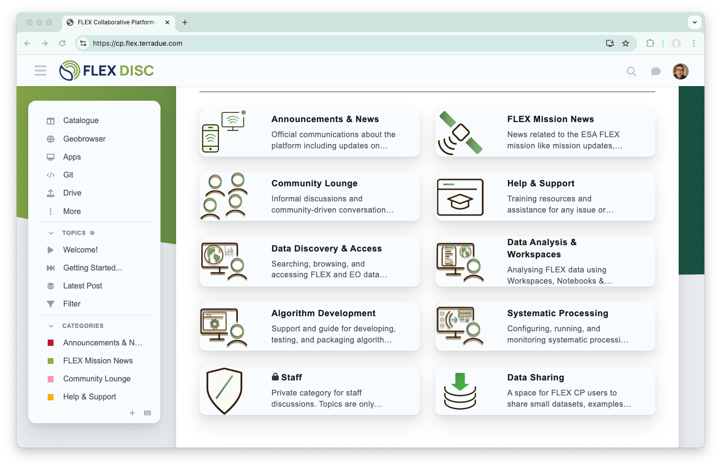
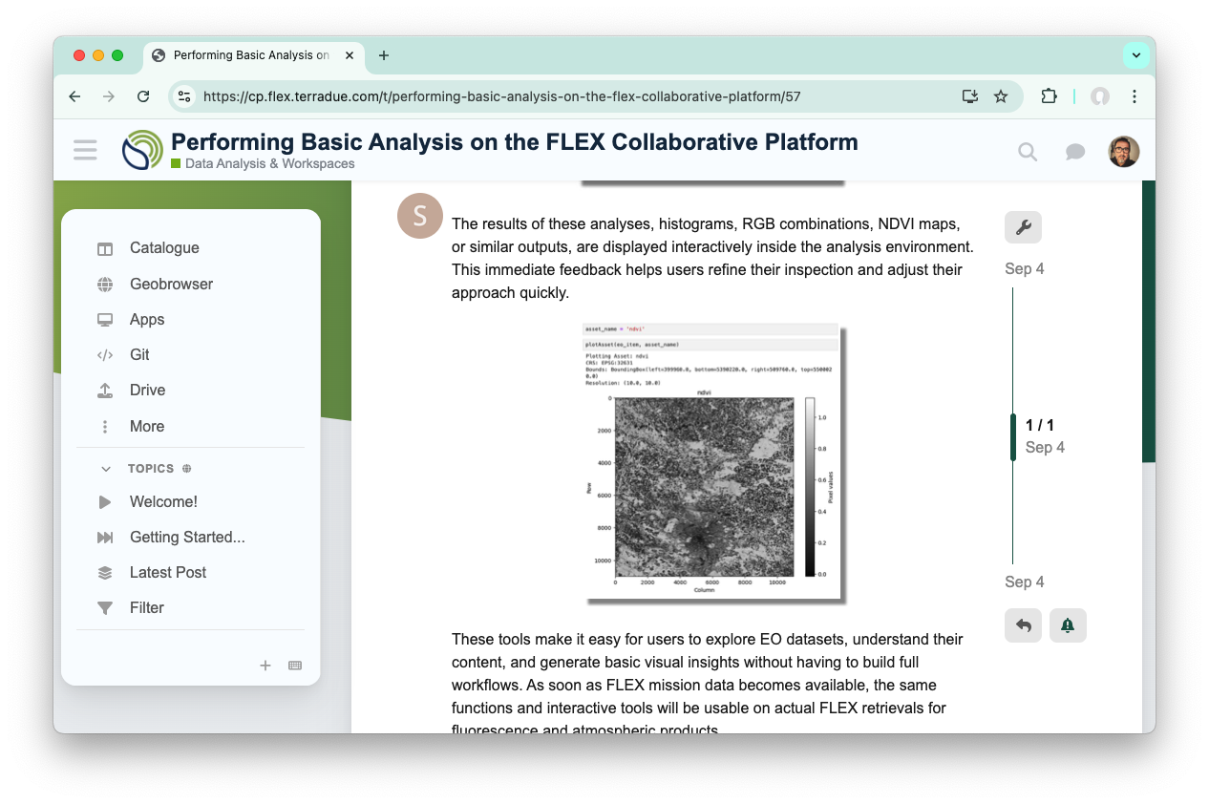
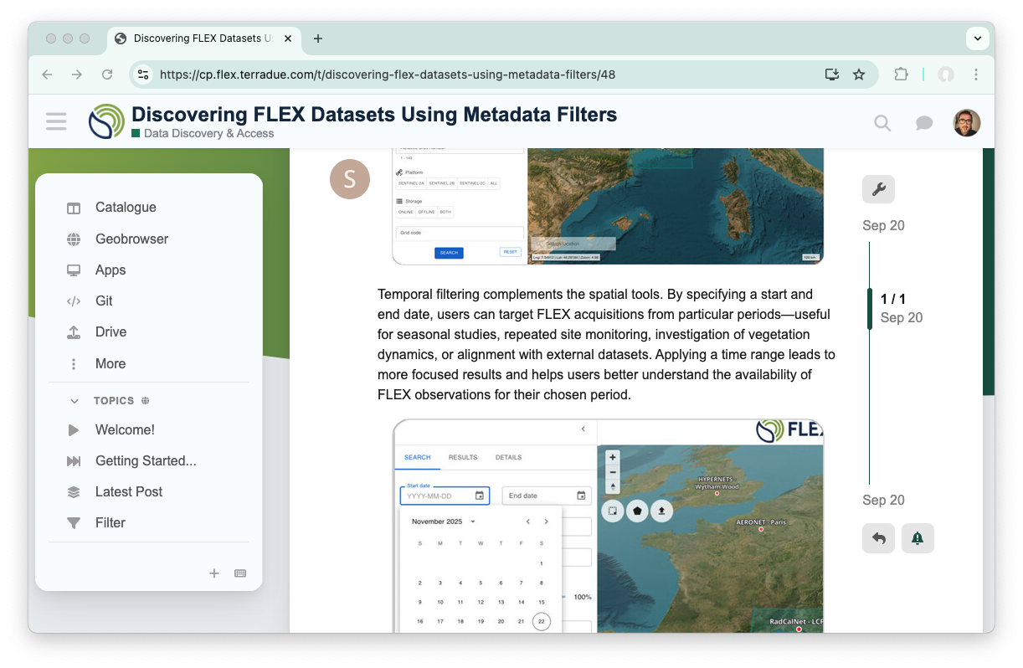
Collaborative Platform: Community Forum

Slide 11
Collaborative Platform: Community Forum
Community space to share insights about the platform
Topics in different categories
Questions & answers and chat messaging
Aggregates the links to all the components of the platform

Slide 12
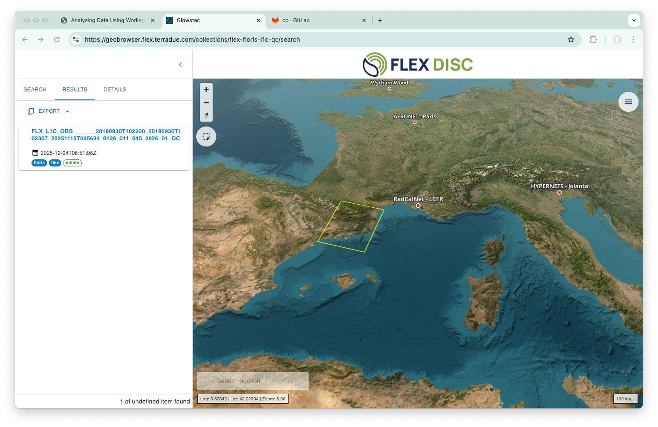
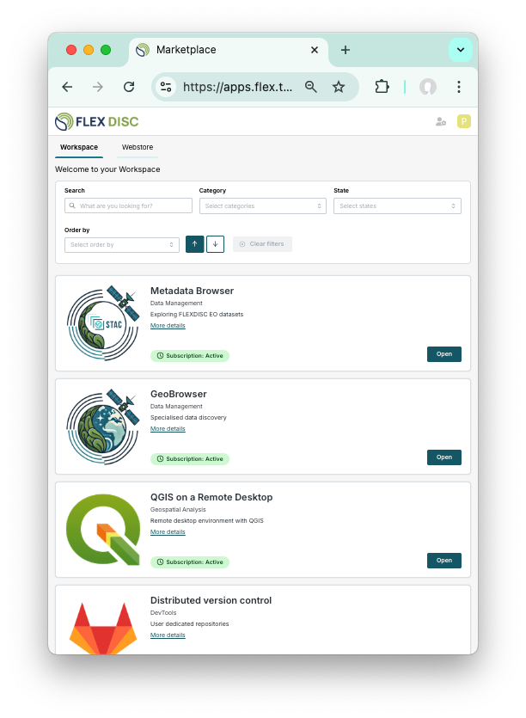
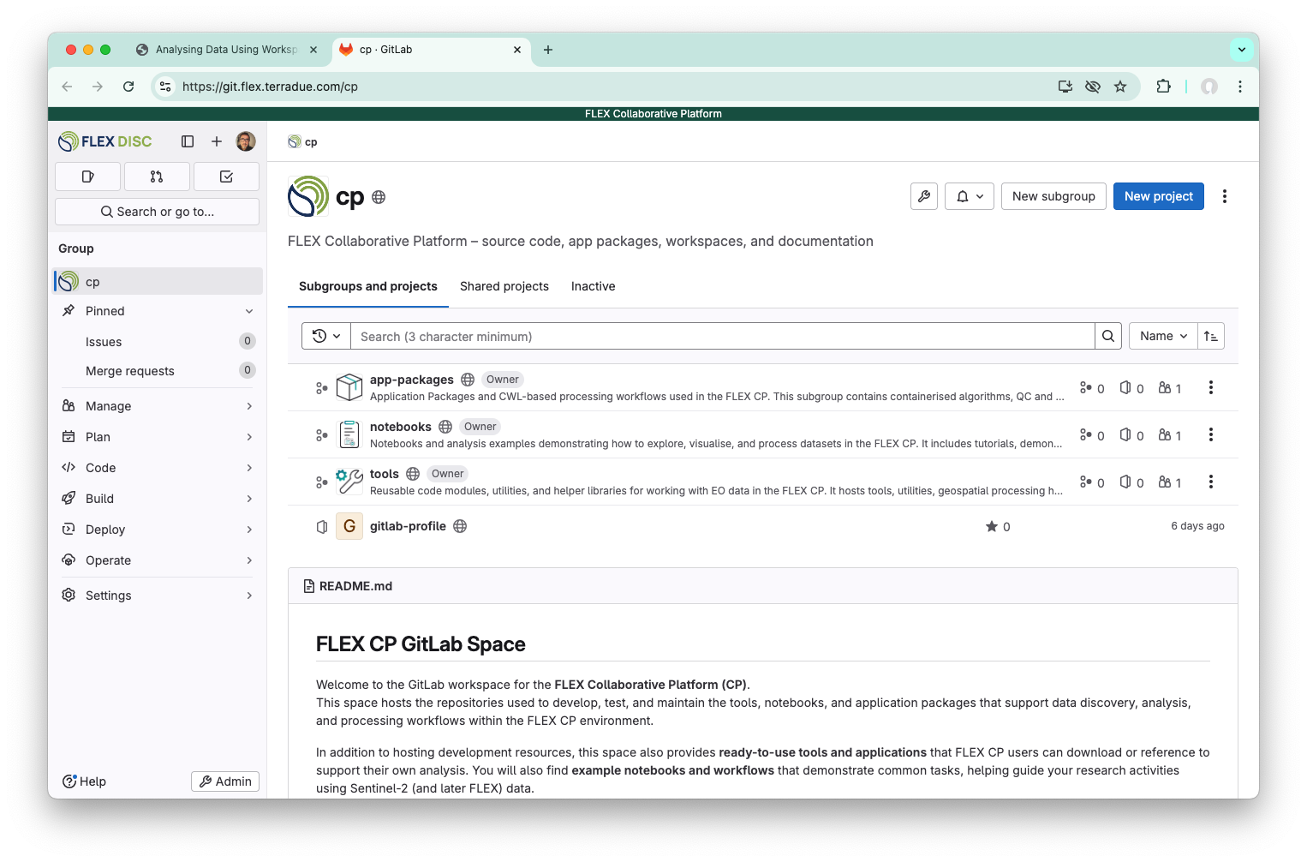
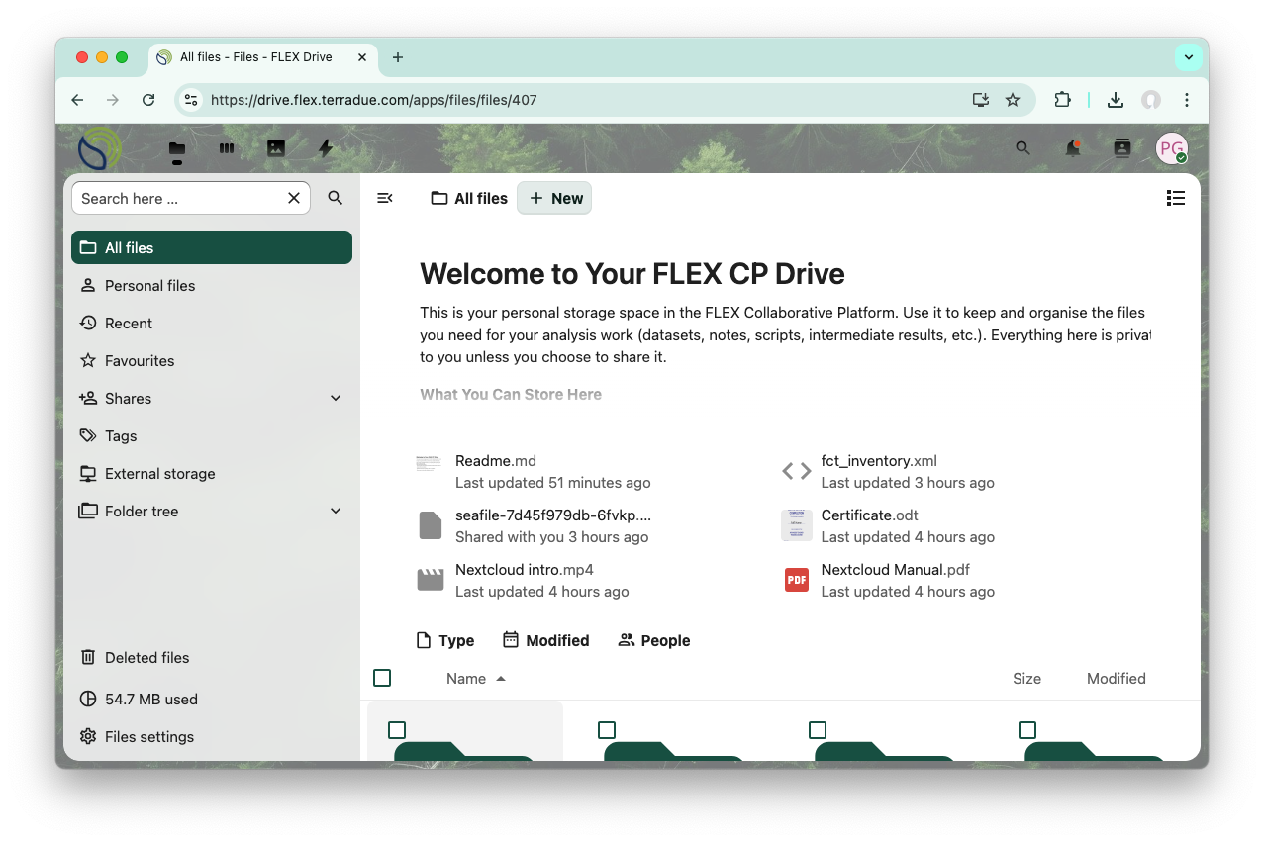
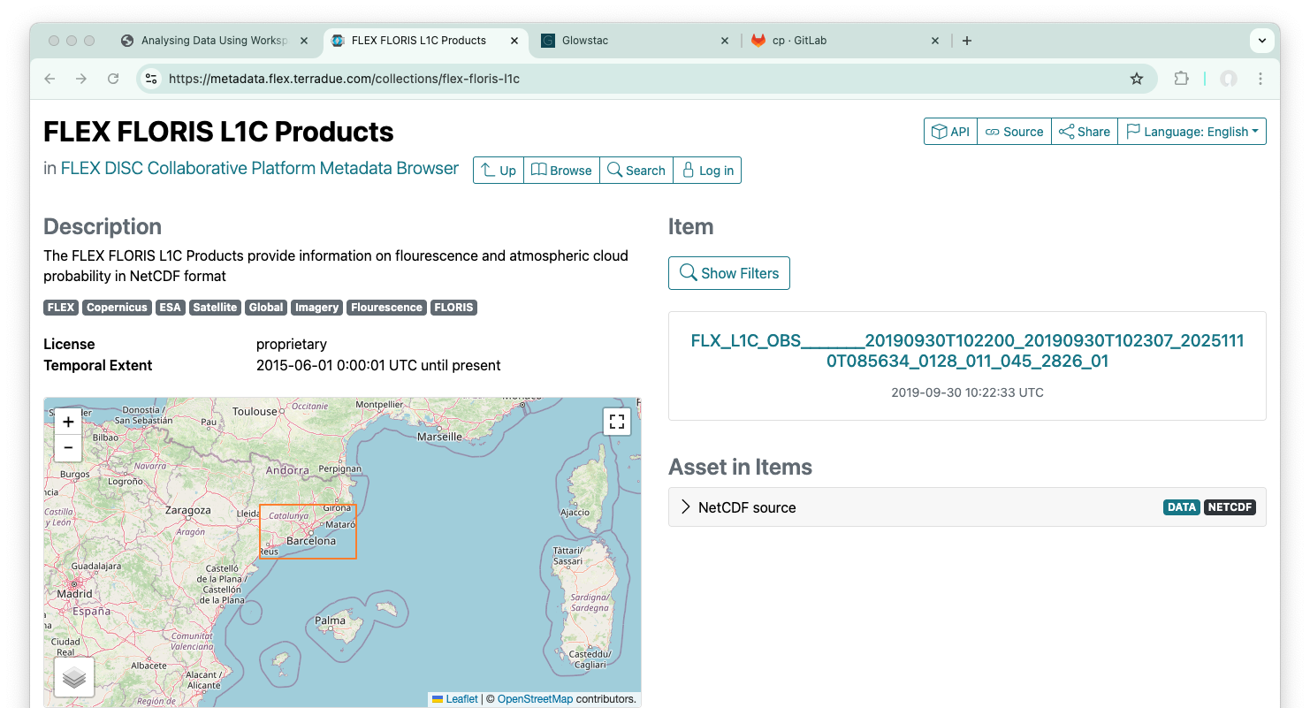
Collaborative Platform
Geobrowser
Apps
Gitlab
Drive
Catalogue

Slide 13
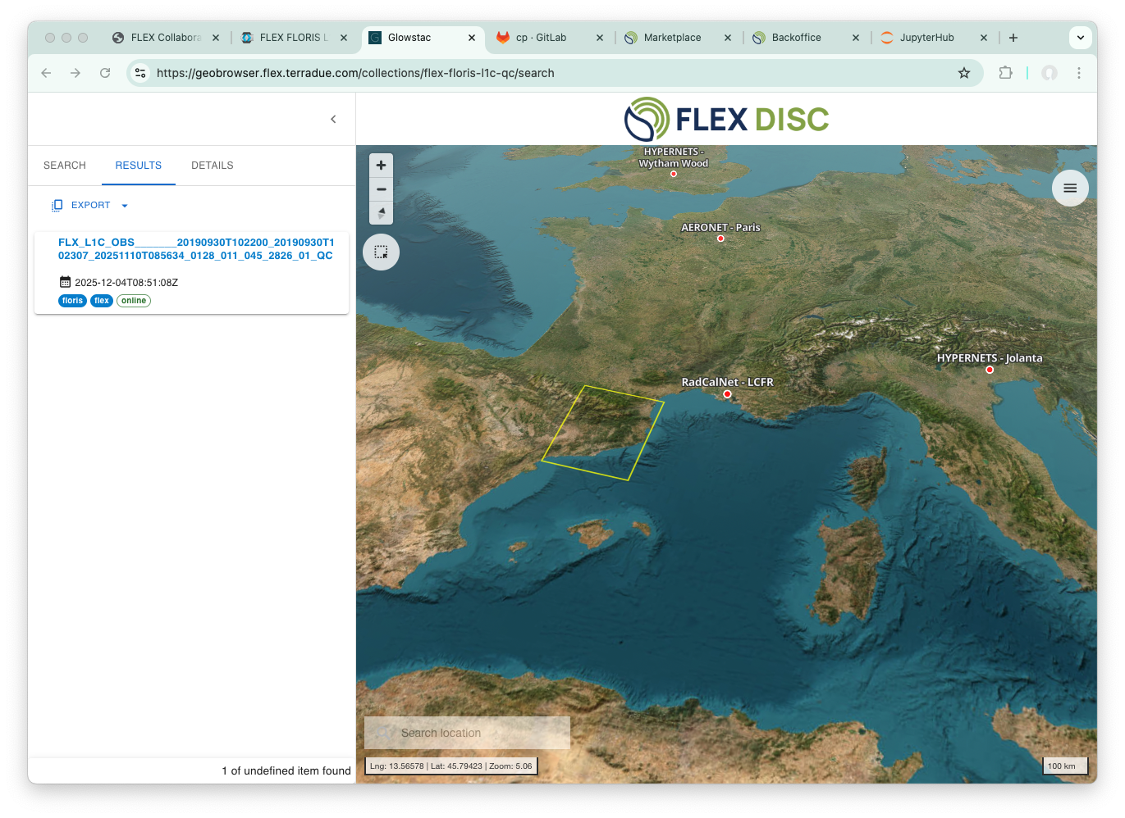
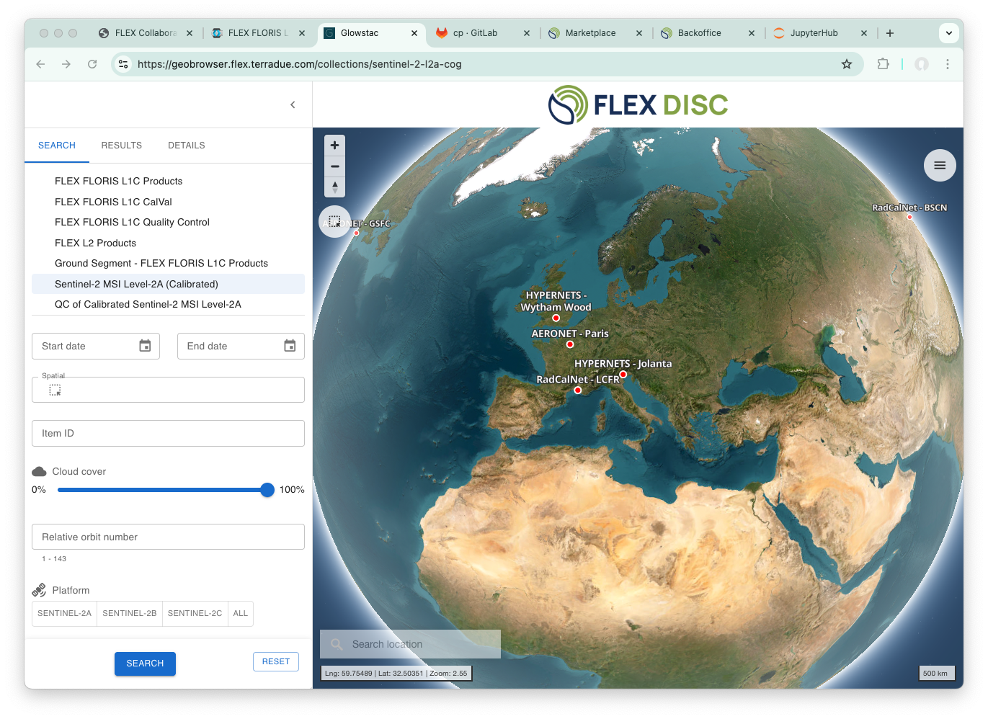
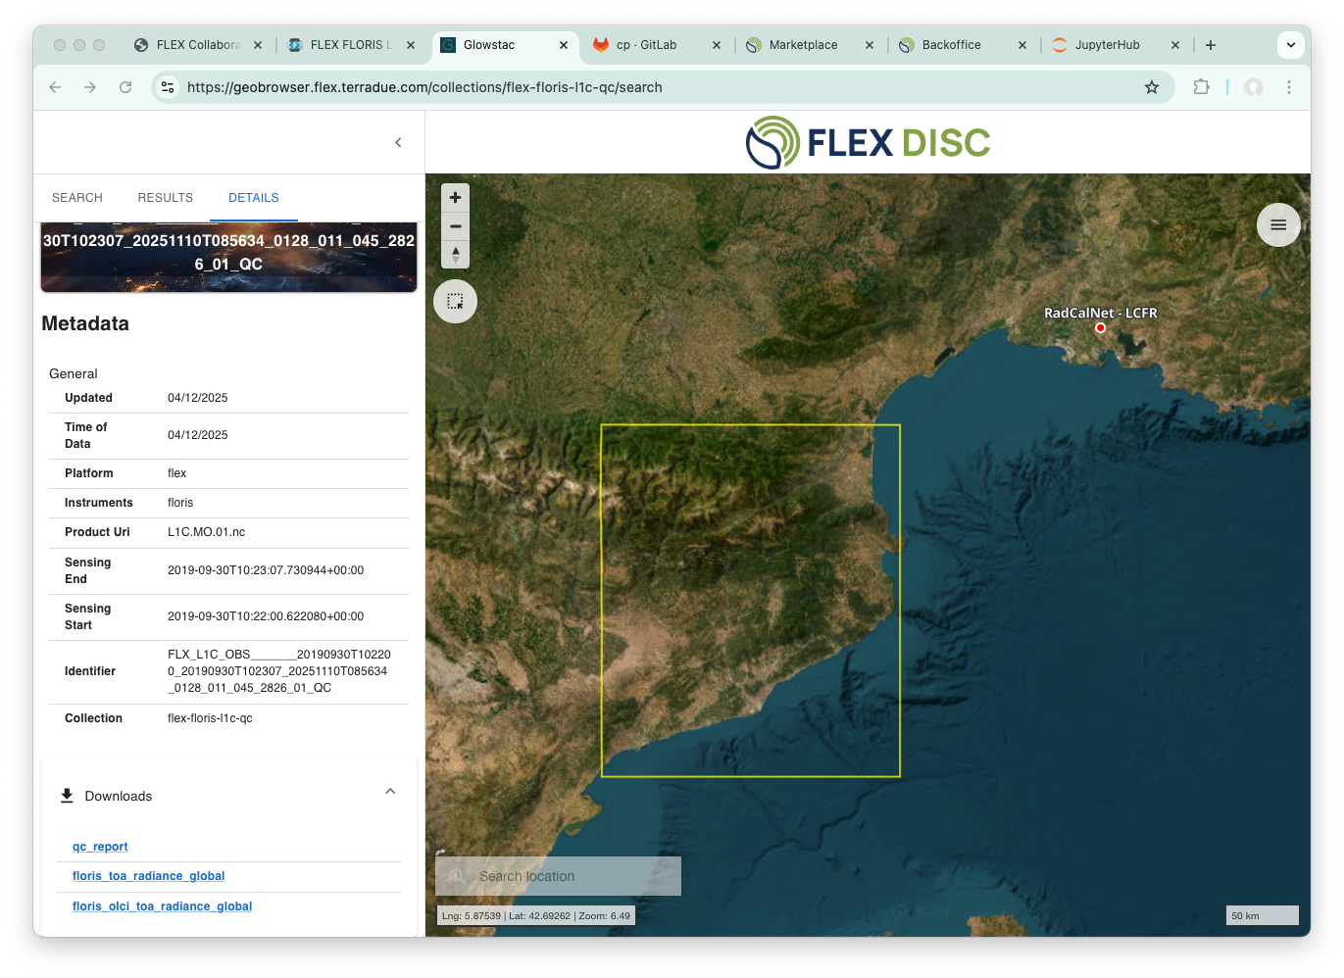
Collaborative Platform: Geobrowser
A specialised interface for registered users, the GeoPortal provides tools for data discovery, visualisation, and basic analysis.
Provides geospatial and metadata filters, visualise different geographic layers, and conduct preliminary analyses.

Slide 14
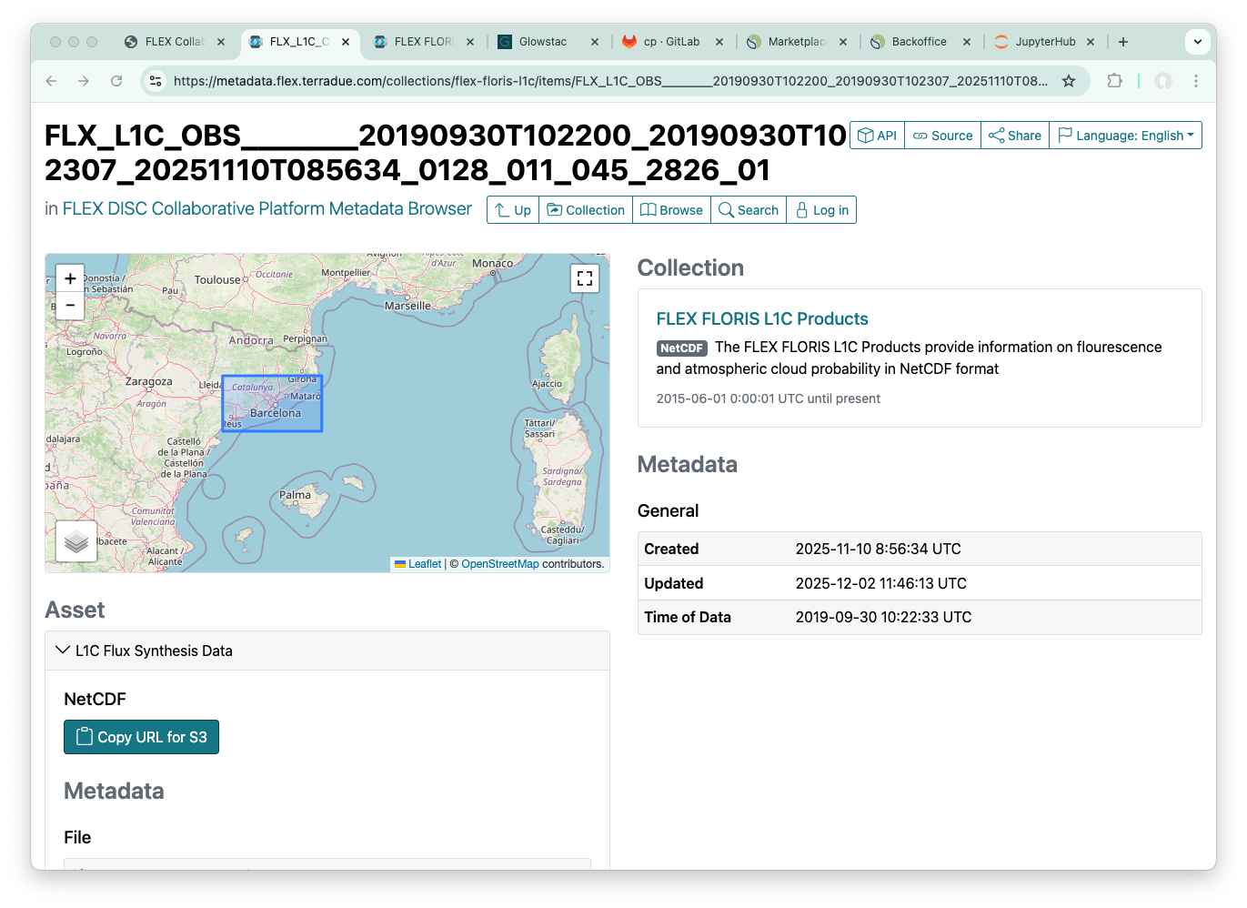
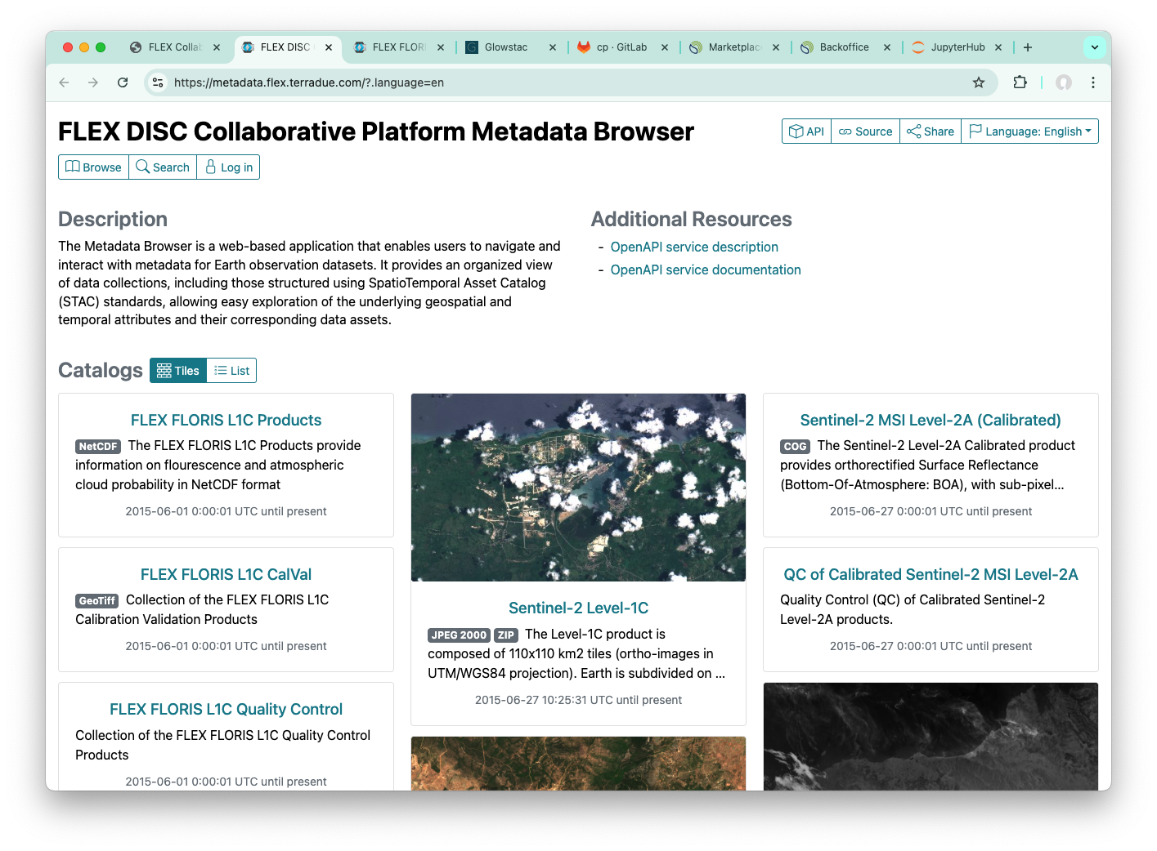
Collaborative Platform: Catalogue
Organises and indexes all available data on the platform, supporting advanced search and filtering options to help users locate relevant datasets.
Provides mechanisms for users to efficiently locate and utilise the data they need in S3 object storage.

Slide 15
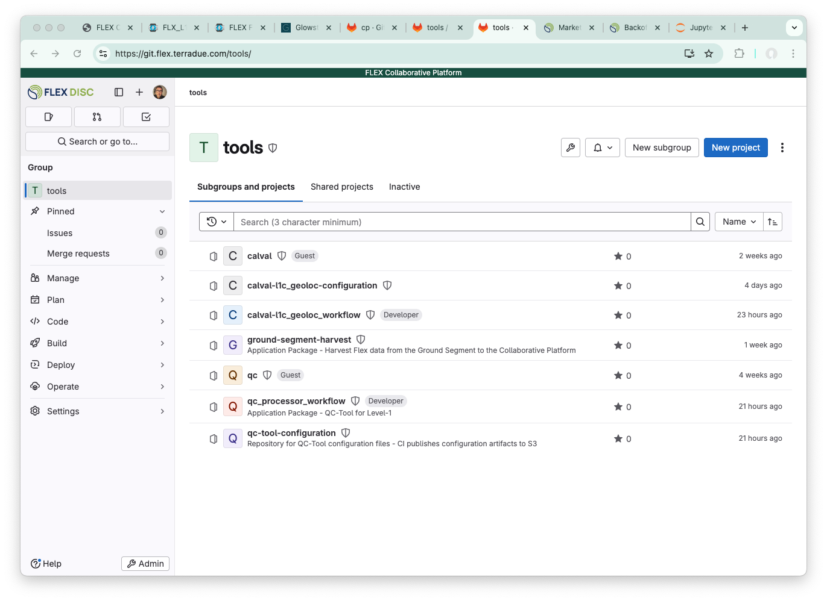
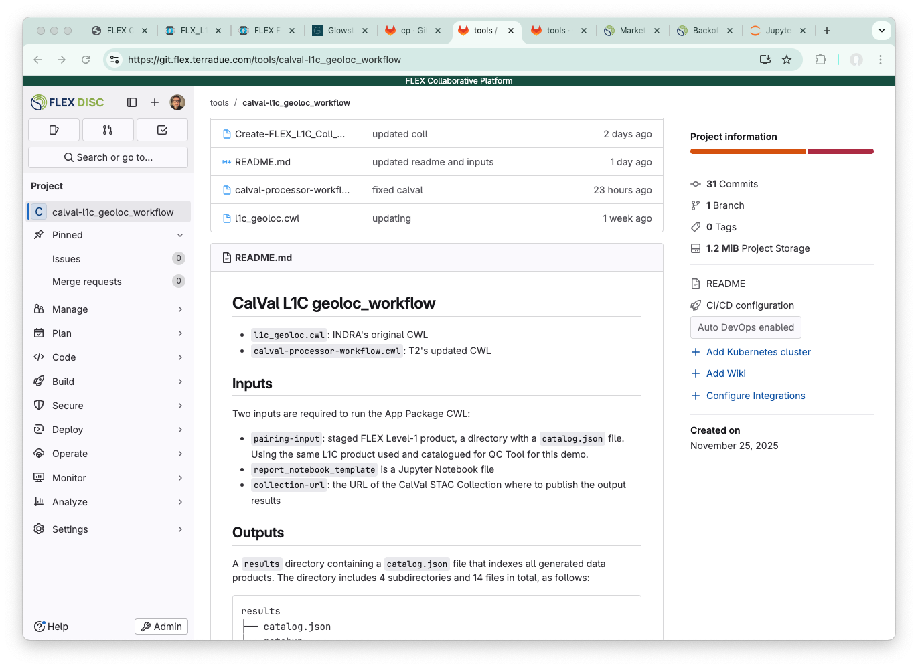
Collaborative Platform: Git
Contains the tools, notebooks, and application packages developed for the FLEX Community.
The repositories here support data analysis, workflow prototyping, algorithm development, and preparation for systematic processing.
Currently the access is limited to authorised project contributors.

Slide 16
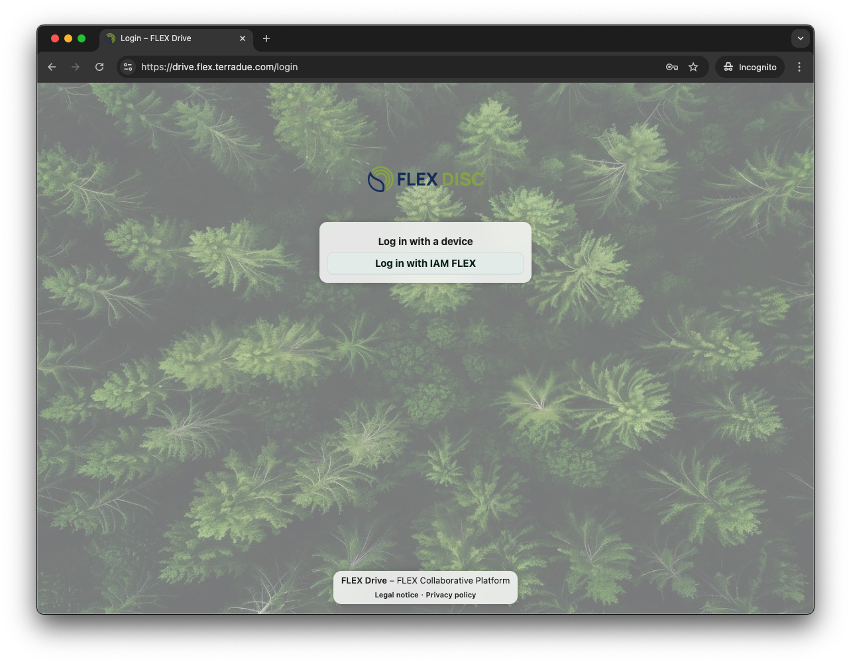
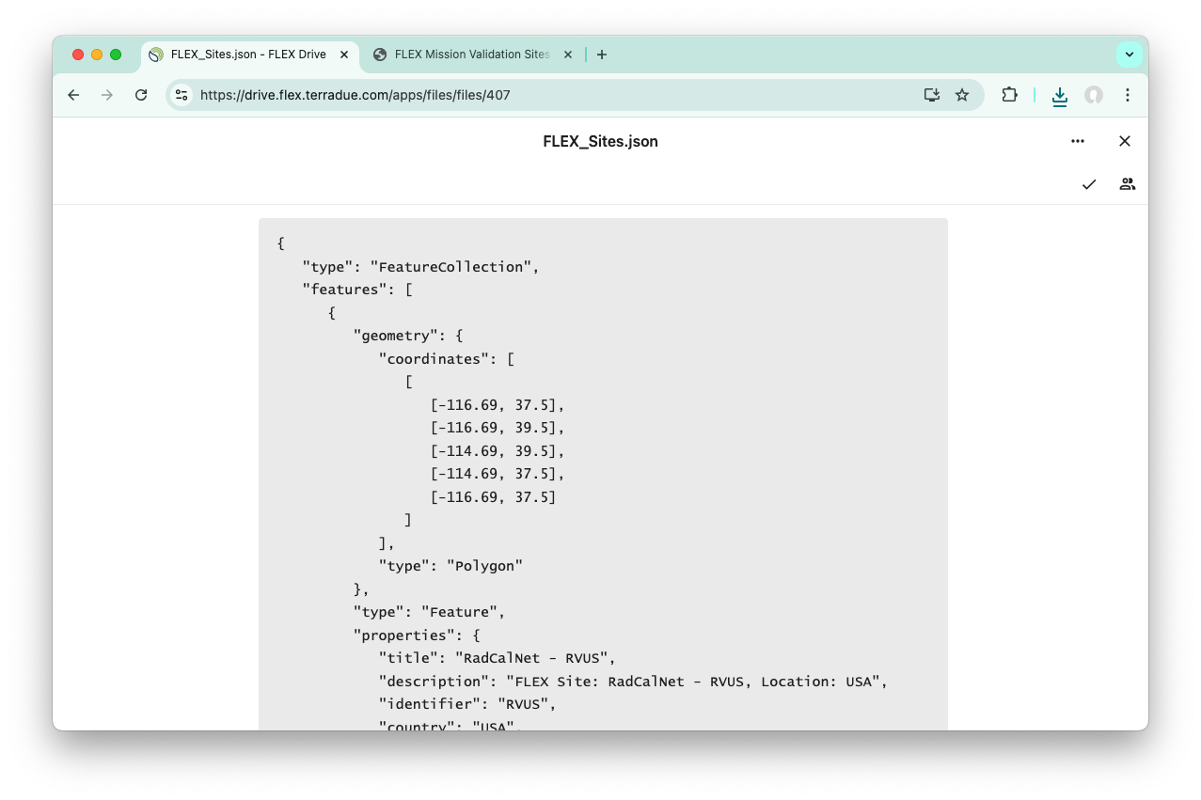
Collaborative Platform: Shared Drive
Personal storage space to keep and organise the files you need for your analysis work (datasets, notes, scripts, intermediate results, etc.).
Everything here is private and can be shared with other users.
Includes project wide shared folders

Slide 17
Workspace Environments
Users request and manage their computational environments and services.
Software-as-a-Service offering a range of products, including Web Apps, Notebooks, Interactive Graphical Applications (e.g. QGIS), and other work environments

Slide 18
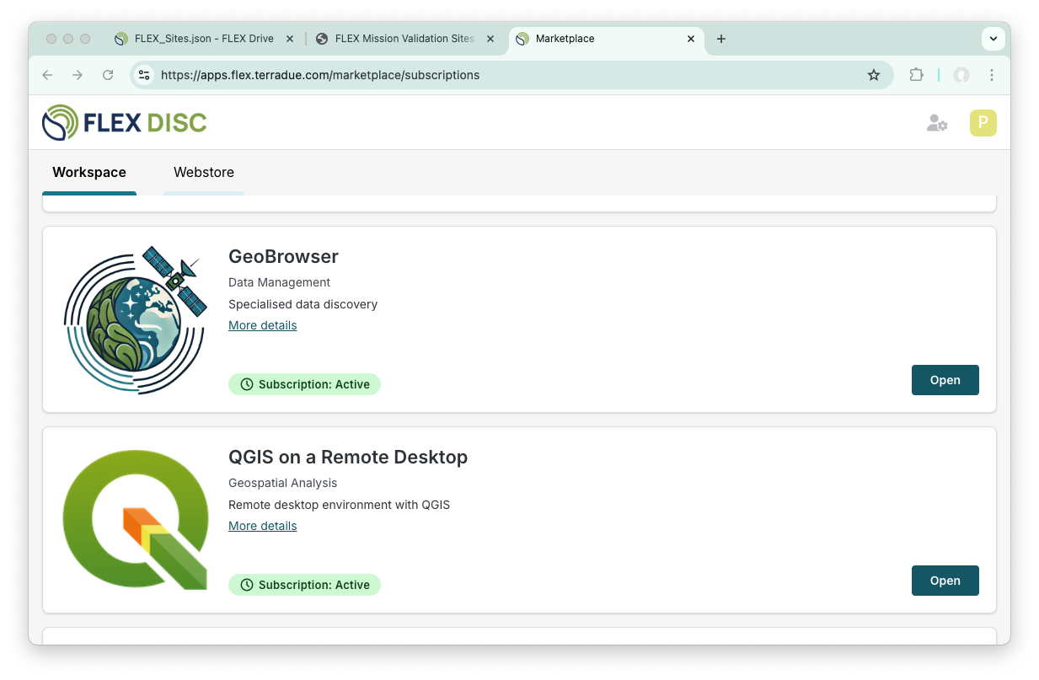
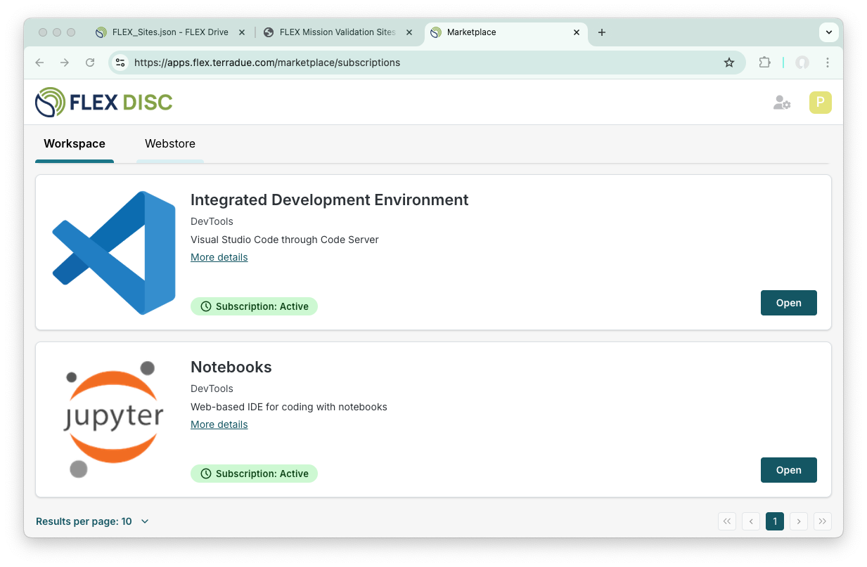
Collaborative Platform: User Apps

Slide 19
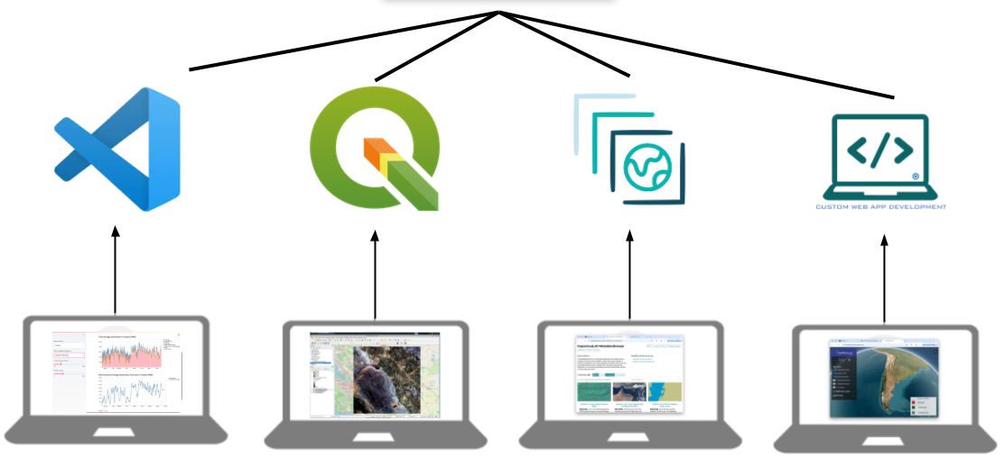
Workspace Environments
Secured, personalised computational & storage resources are shared between workspaces and SaaS offering

Slide 20
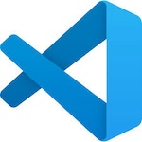




Environments ...
Code Server: allow users to develop FLEX data processing and analysis application using VS Code (a lightweight and versatile source code editor)
Jupyter Notebooks: flexible web-based IDE for efficient coding, data analysis, and interactive visualisations
QGIS: remote desktop access to QGIS allowing users to view, edit, and analyse geospatial data in their workspace
Dedicated repositories: provide a structured environment where users can discover, store, and manage resources
GeoPortal and Metadata Browser: web apps designed for accessing and navigating metadata from cataloged data collections hosted on the CP
... and more to come …

Slide 21
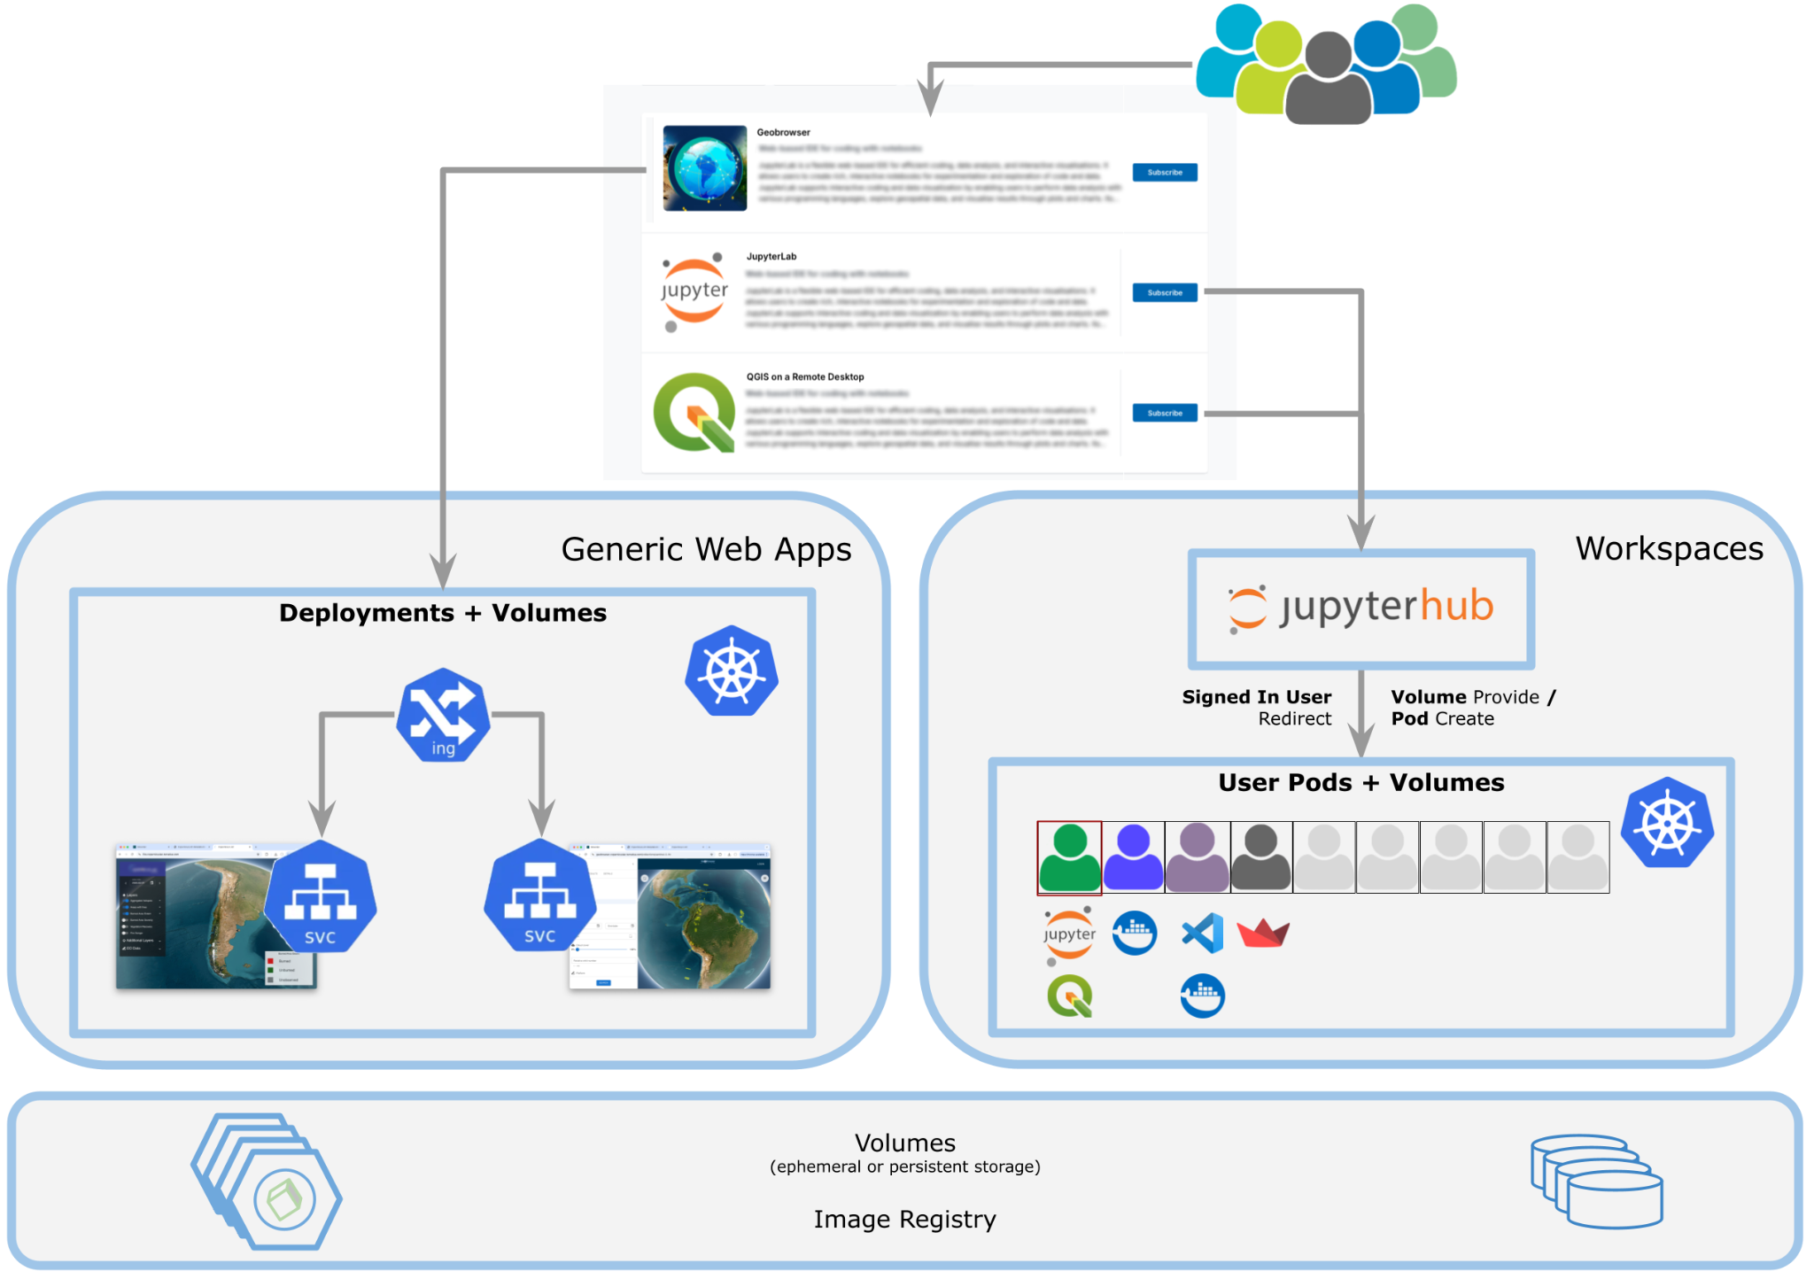
User Environments
Extensible architecture allowing the deployment of additional work environments
Remote desktop tools, web apps, dashboards, CLI, toolboxes, workflows ...
Secure accessed through the marketplace

Slide 22
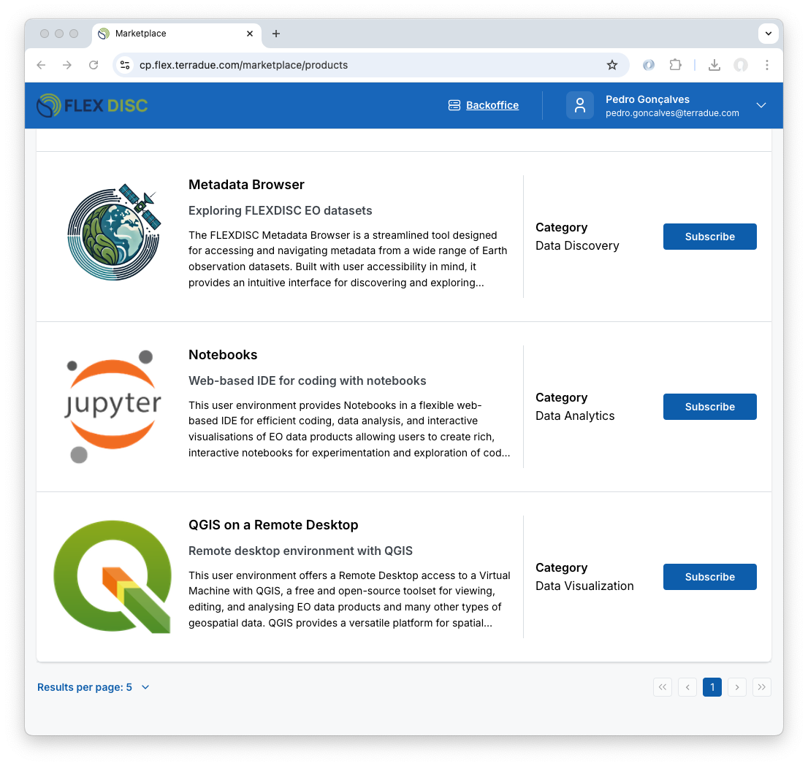
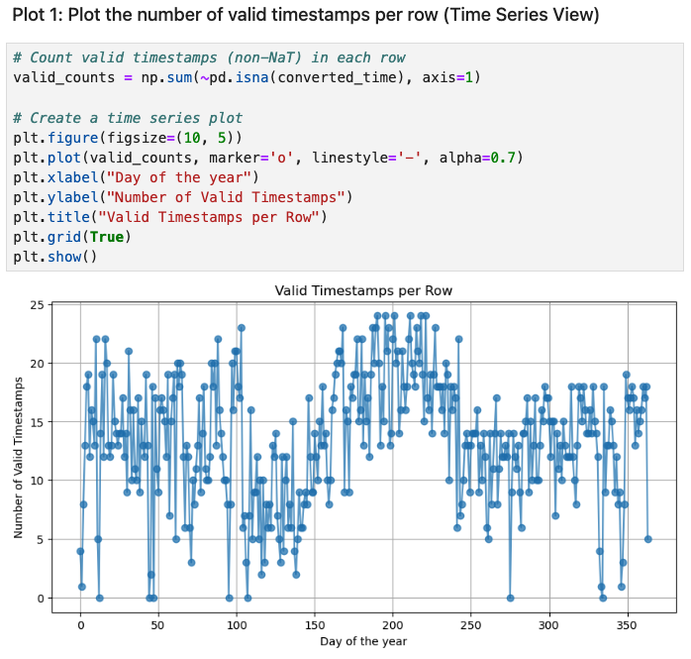
User Environments
Algorithm development, data catalogues and discovery tools, analytics and processing ... all in the user workspace

Slide 23
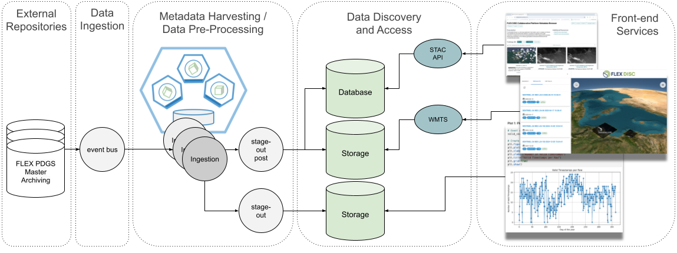
Data Harvesting/Ingestion
Compliant with different data access scenarios supporting multiple ingestion levels, event-driven automation, workflow orchestration
Harvesting: Register products and metadata
Metadata + Copy: Downloads, validates, and stores products
Preprocessing: Applies transformations like format conversion
Access facilitated by ASCEND

Slide 24
Demonstration
Collaborative Platform Webportal
Documentation and User forum supporting the community
Geobrowser functionalities
Search & filter and visualise Sentinel-2 and FLEX L1 & L2 products
Copy search parameters and selected products IDs/URLs
Interaction between Workspaces
Search on Geobrowser and visualise / exploit in a notebook
... process it in the notebook and visualise in QGIS and Panoply
... do a time series analysis on notebook

