Slide 1
INSIF, International Network of Sun-Induced Chlorophyll Fluorescence

Slide 2




CONRIBUTORS
Tommaso Julitta, Mitchell Kennedy, Andreas Burkart, Paul Naethe, Agnieszka Bialek, Pieter De Vis, Astrid Zimmermann, Ashley Ramsay, Thomas Storm, Laura Mihai, Javier Pacheco-Labrador, Dirk Schuettemeyer, Marin Tudoroiu, Marco Celesti
JB Hyperspectral Devices, Düsseldorf Germany
National Physics Laboratory. Teddington, United Kingdom
Brockmann Consult. Hamburg, Germany
INFLPR. Magurele, Romania
Environmental Remote Sensing and Spectroscopy Laboratory (SpecLab),
Spanish National Research Council (CSIC)
ESA. European Space Agency

Slide 3







THANKS!!!!

Slide 4
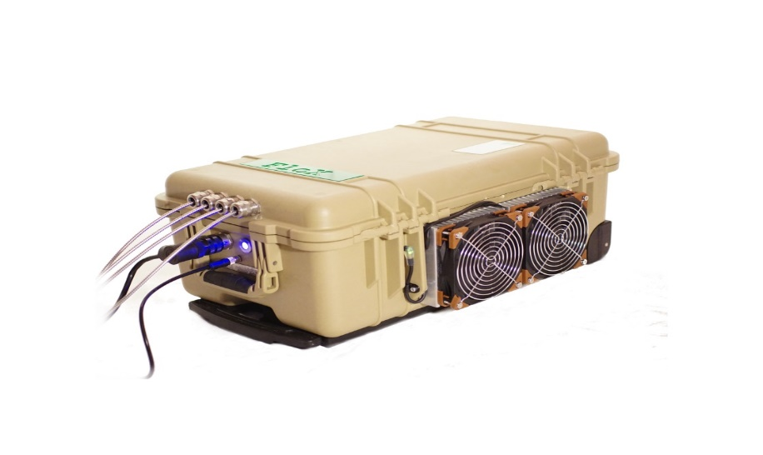
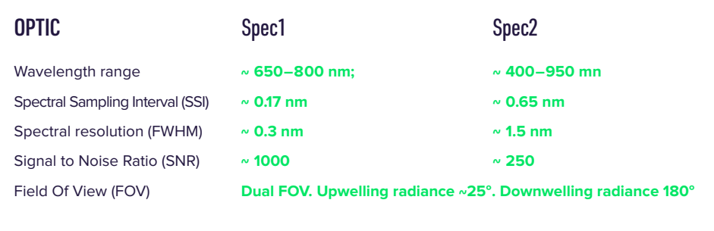
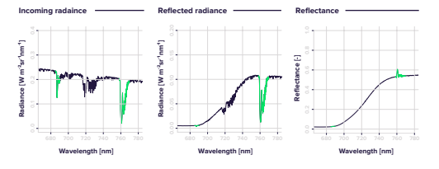
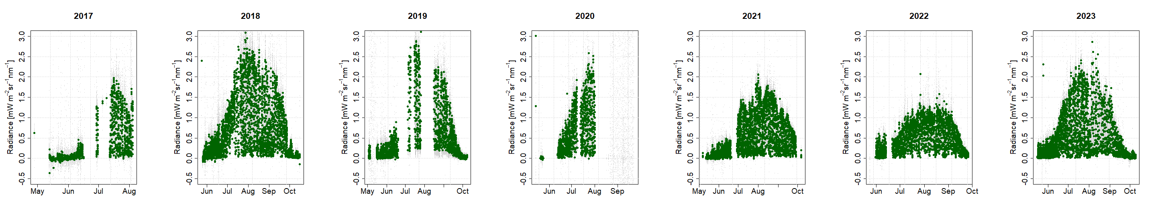
FloX: The Fluorescence boX
Courtesy: John Gamon

Slide 5
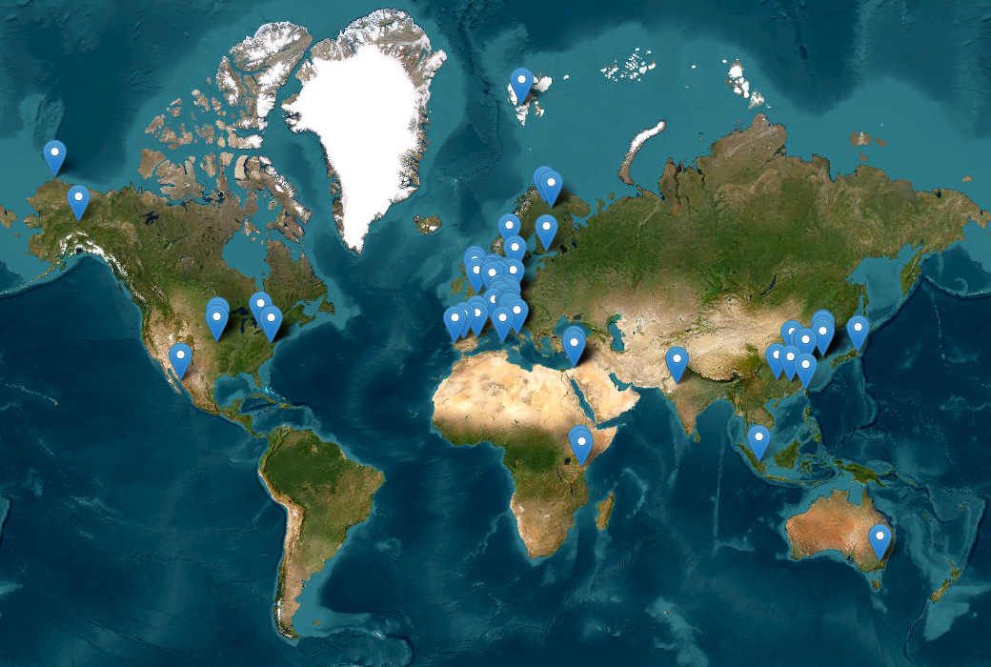
INSIF
Two years ESA funded project to implement a network. Main focus FLEX validation.
Automatic processing & Uncertainty propagation
Database implementation & Online portal
Data policy definition
Longer terms plans(in situ Calibration)

Slide 6
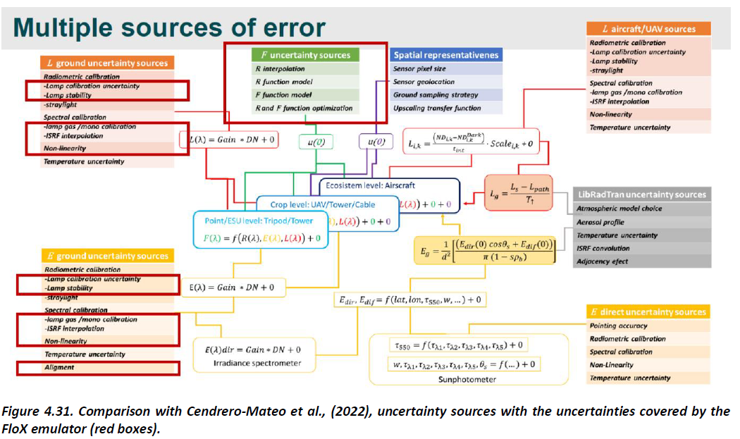
UNCERTAINTY PROPAGATION
CREDIT: Cendrero et al., 2022

Slide 7

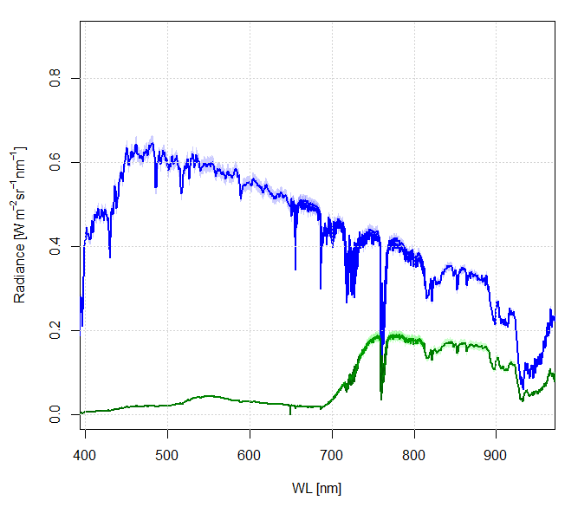
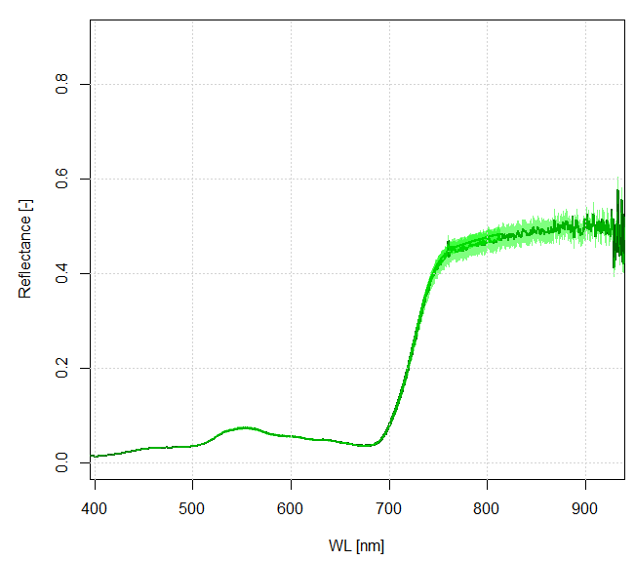
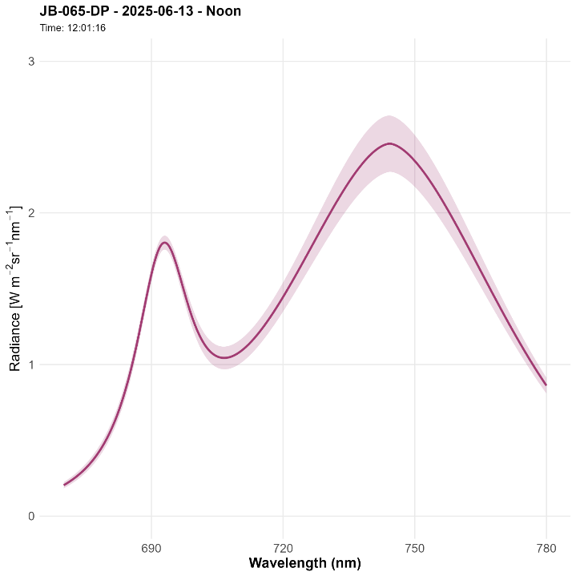
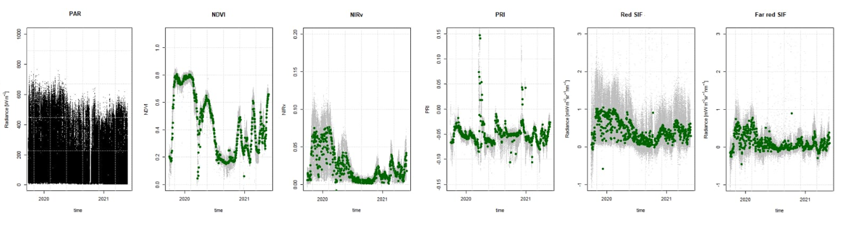
DATA PROCESSING
Level 0. RAW
Level 1. RADIANCE
Level 2A. REFLECTANCE
Level 2B. SIF
Oxygen B
Oxygen A
Level 2C. VIs
+
Quality Flag Criteria

Slide 8
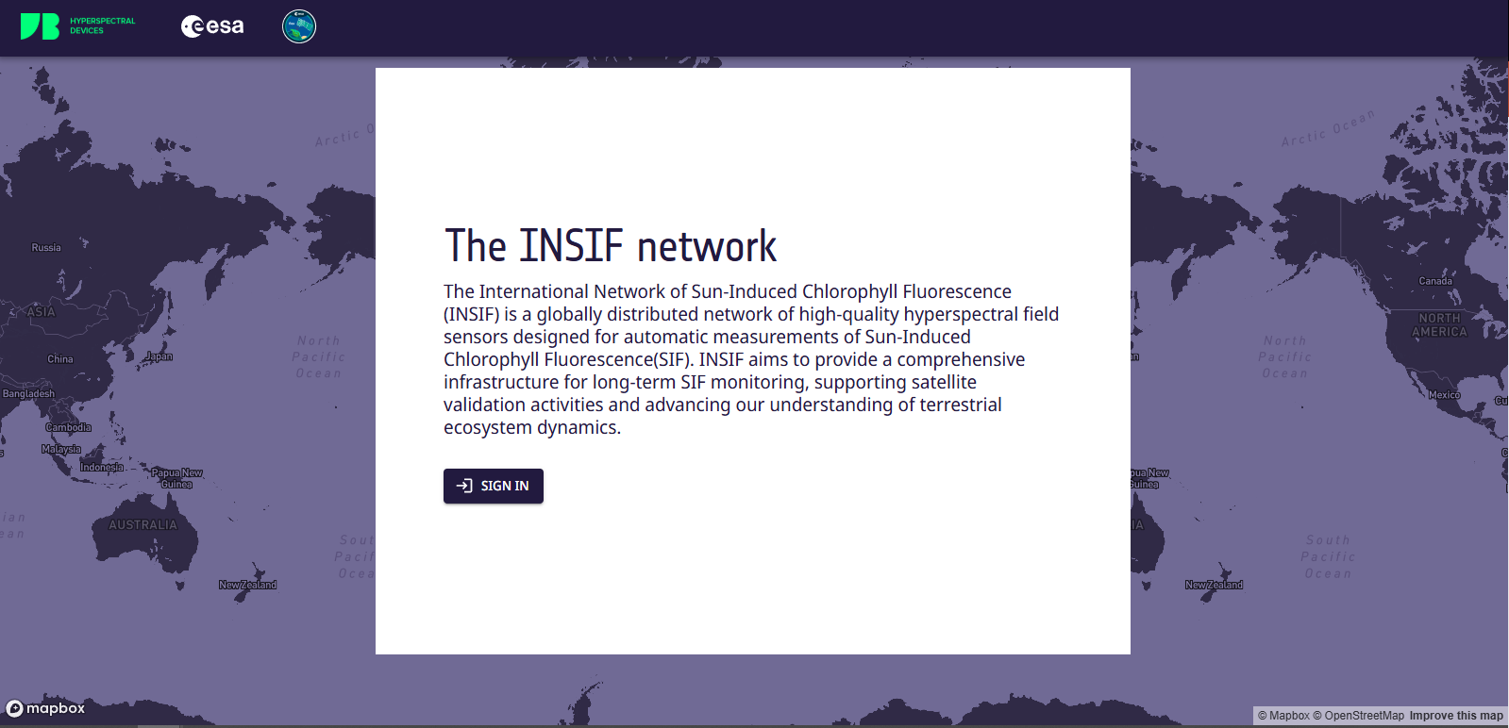
OUTLOOK

Slide 9

OUTLOOK

Slide 10
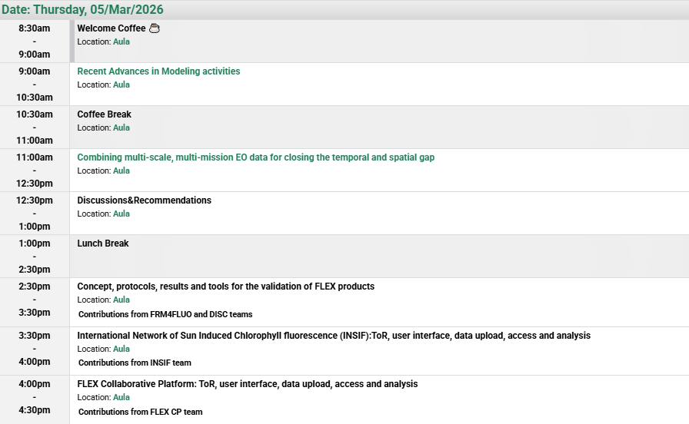

OUTLOOK
INSIF
The International Network of Sun Induced chlorophyll Fluorescence
…………..

Slide 11
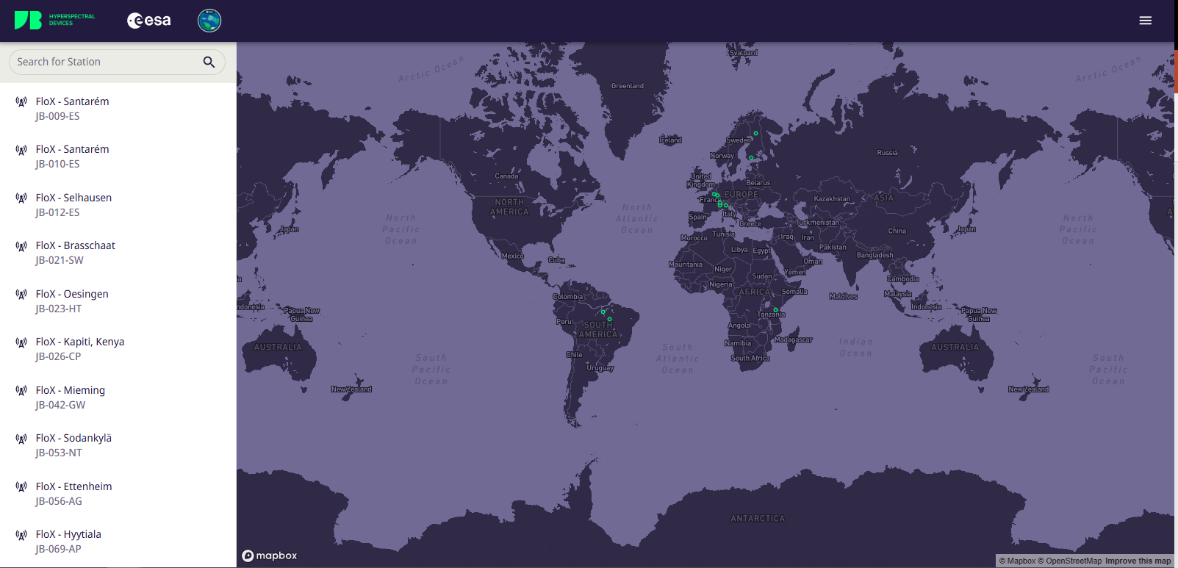
OUTLOOK

Slide 12
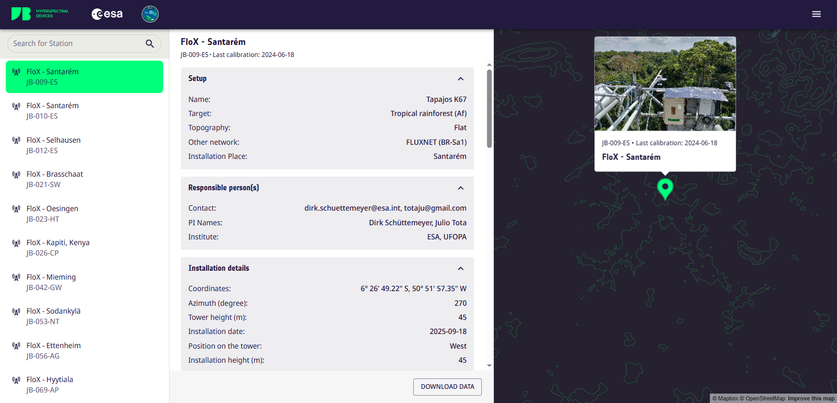
OUTLOOK

Slide 13
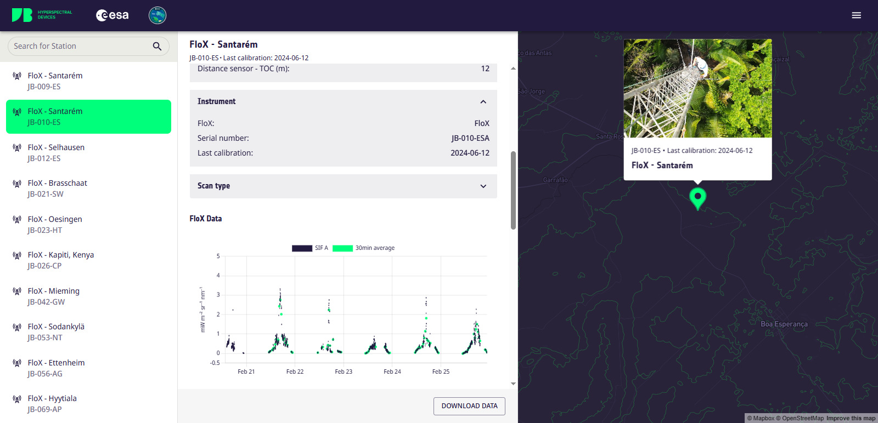
OUTLOOK

Slide 14
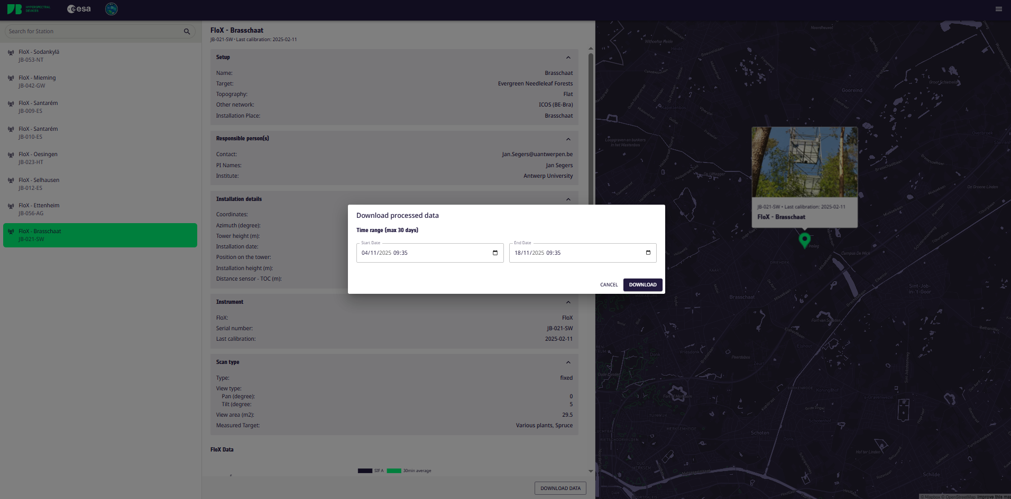
OUTLOOK

Slide 15
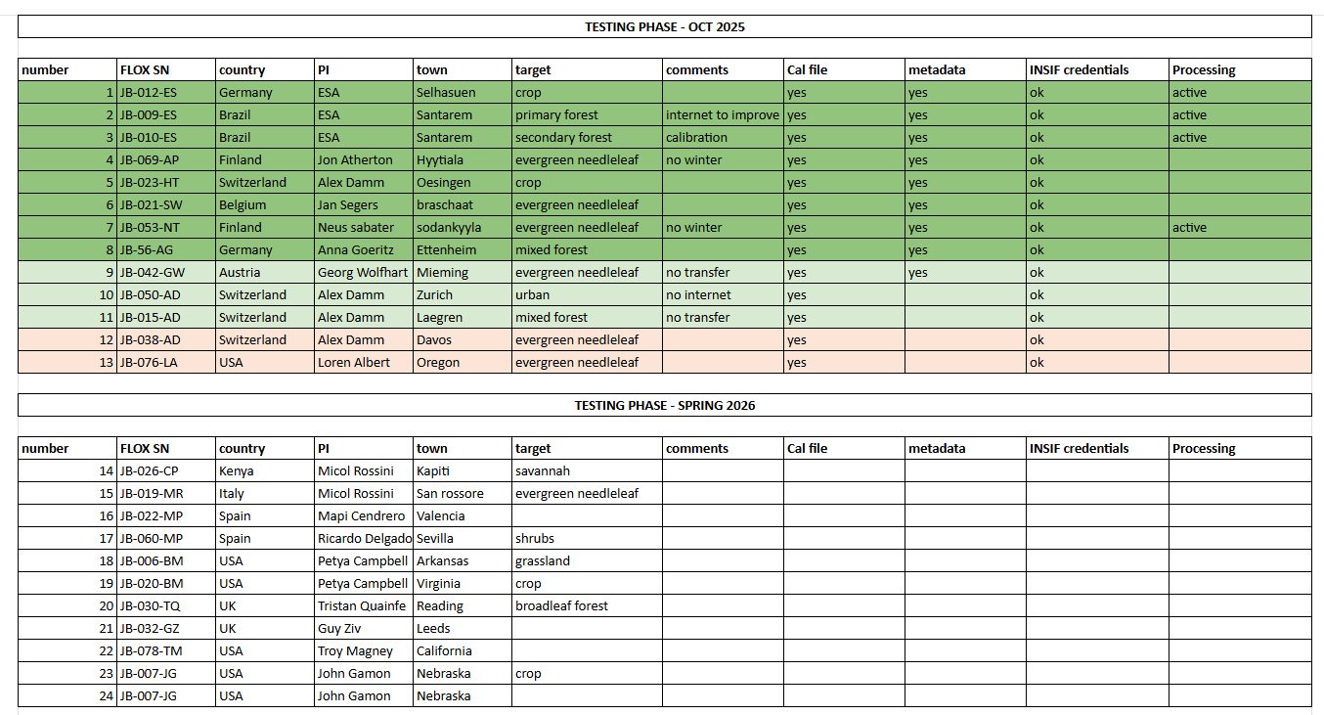
INSIF building up

Slide 16
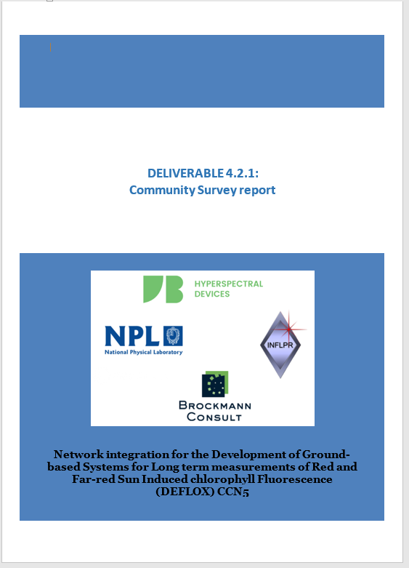
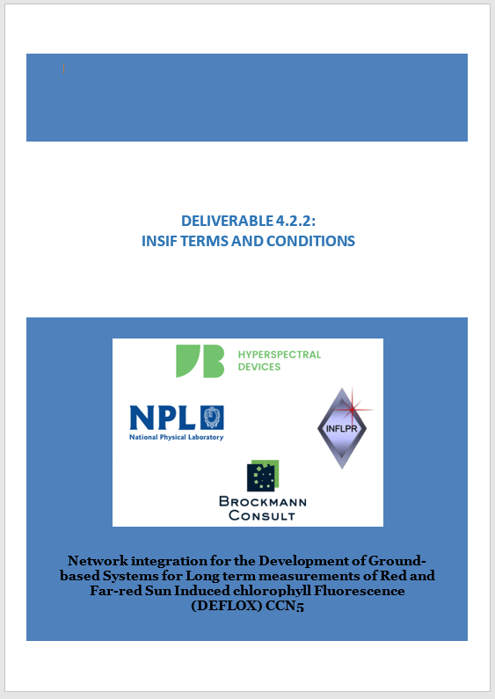
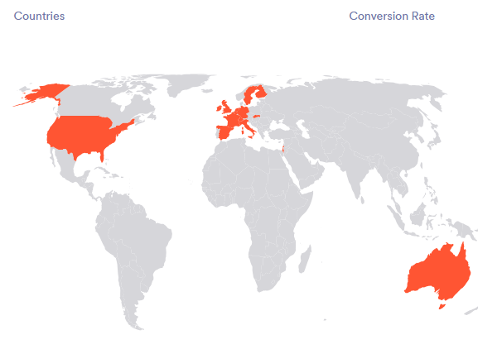
INSIF TERMS AND CONDITIONS
Community survey launched at PLS 2025
About 80 replies

Slide 17
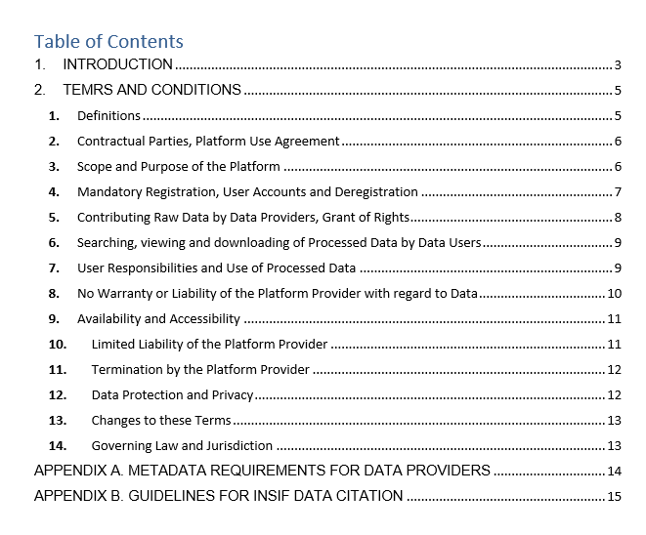
INSIF TERMS AND CONDITIONS

Slide 18
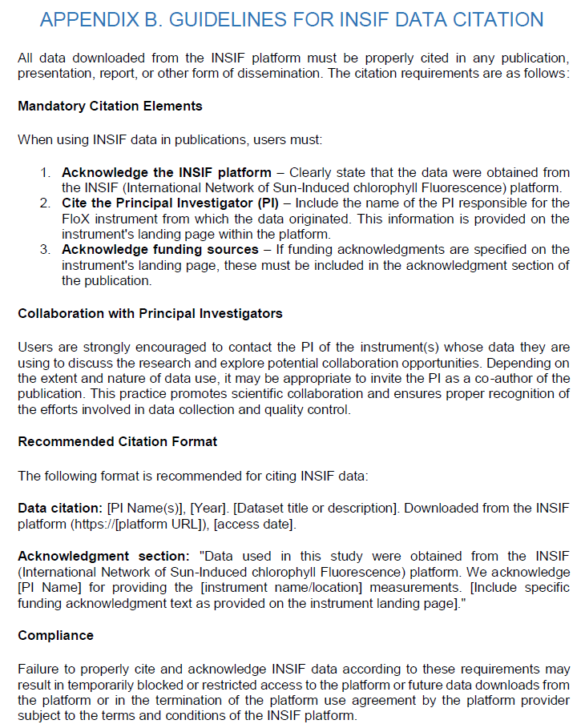
INSIF TERMS AND CONDITIONS

Slide 19
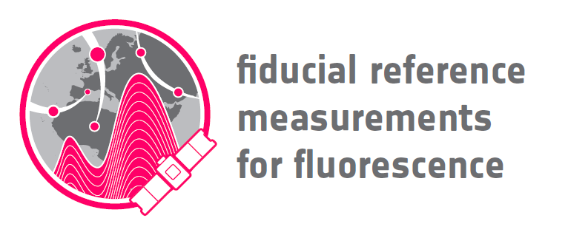
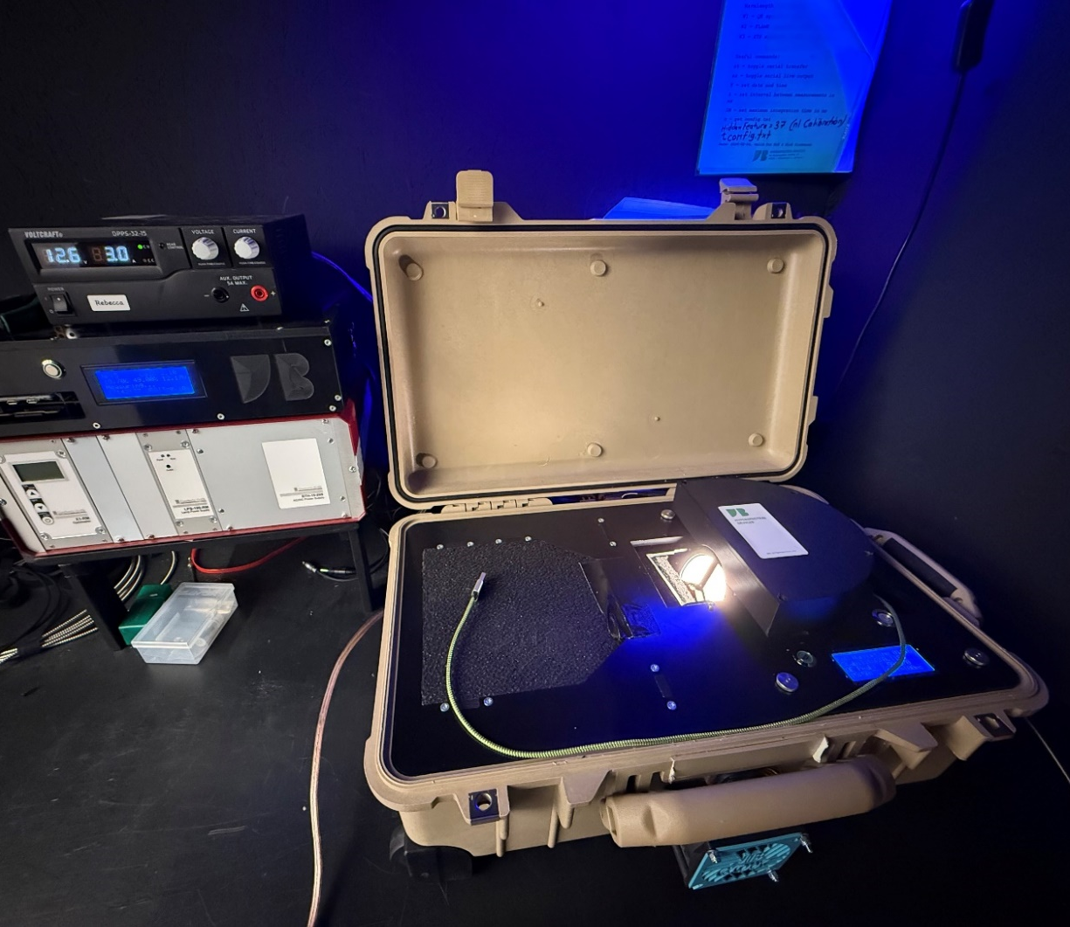
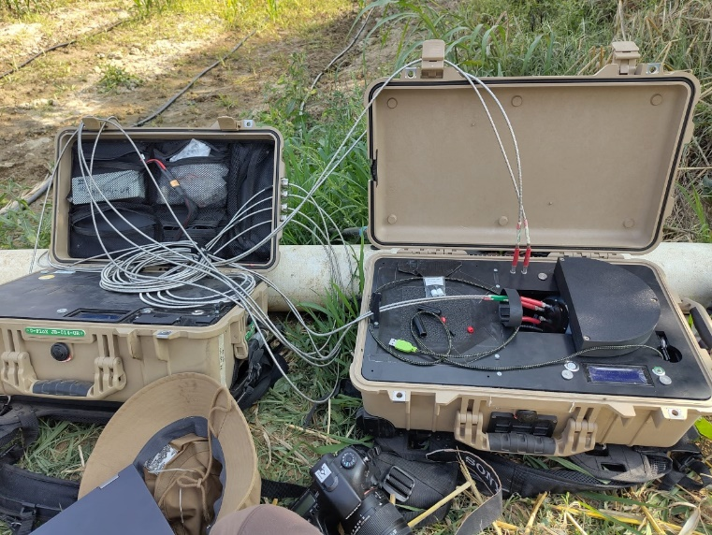
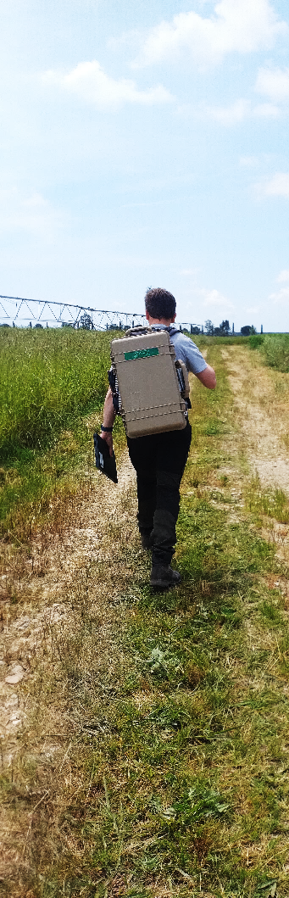
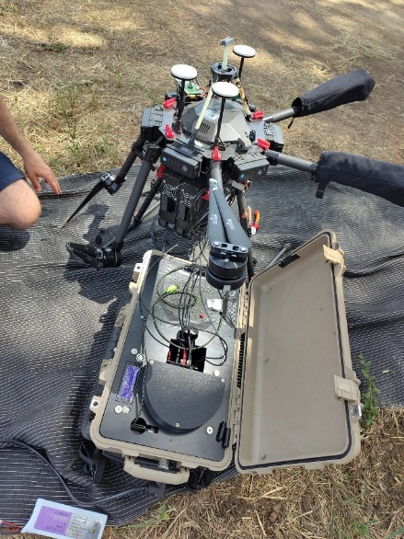
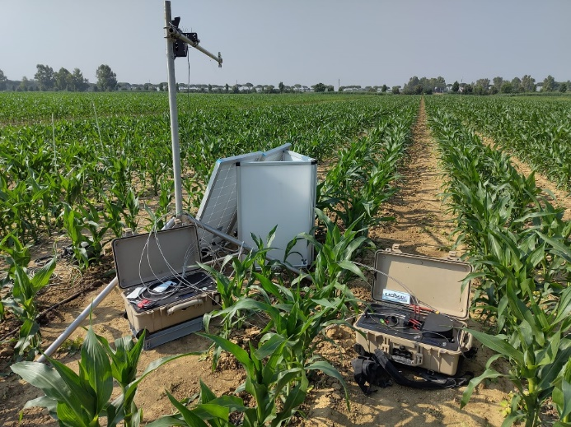
LONGER TERMS
MOVABLE CALIBRATION DEVICE BOX (MOX)

Slide 20
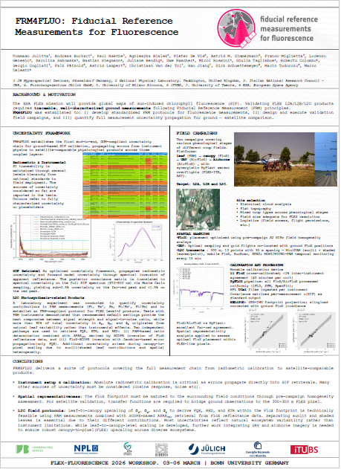
LONGER TERMS
MOVABLE CALIBRATION DEVICE BOX (MOX)

Slide 21
CONCLUSIONS
INSIF is getting ready. Beta version is now under test on 10 systems (number can increase in spring 2026)
Standard processing pipeline at different levels (L1, L2), including uncertainty is implmeneted.
Terms and conditions (e.g. Data policy) ready(shaped from the survey feedback)
Longer term plan under discussion. Goal of covering at least the FLEX mission duration
Benefit for the scientific community to explore the data for better ecological process understanding.
More update after August 2026!

Slide 22
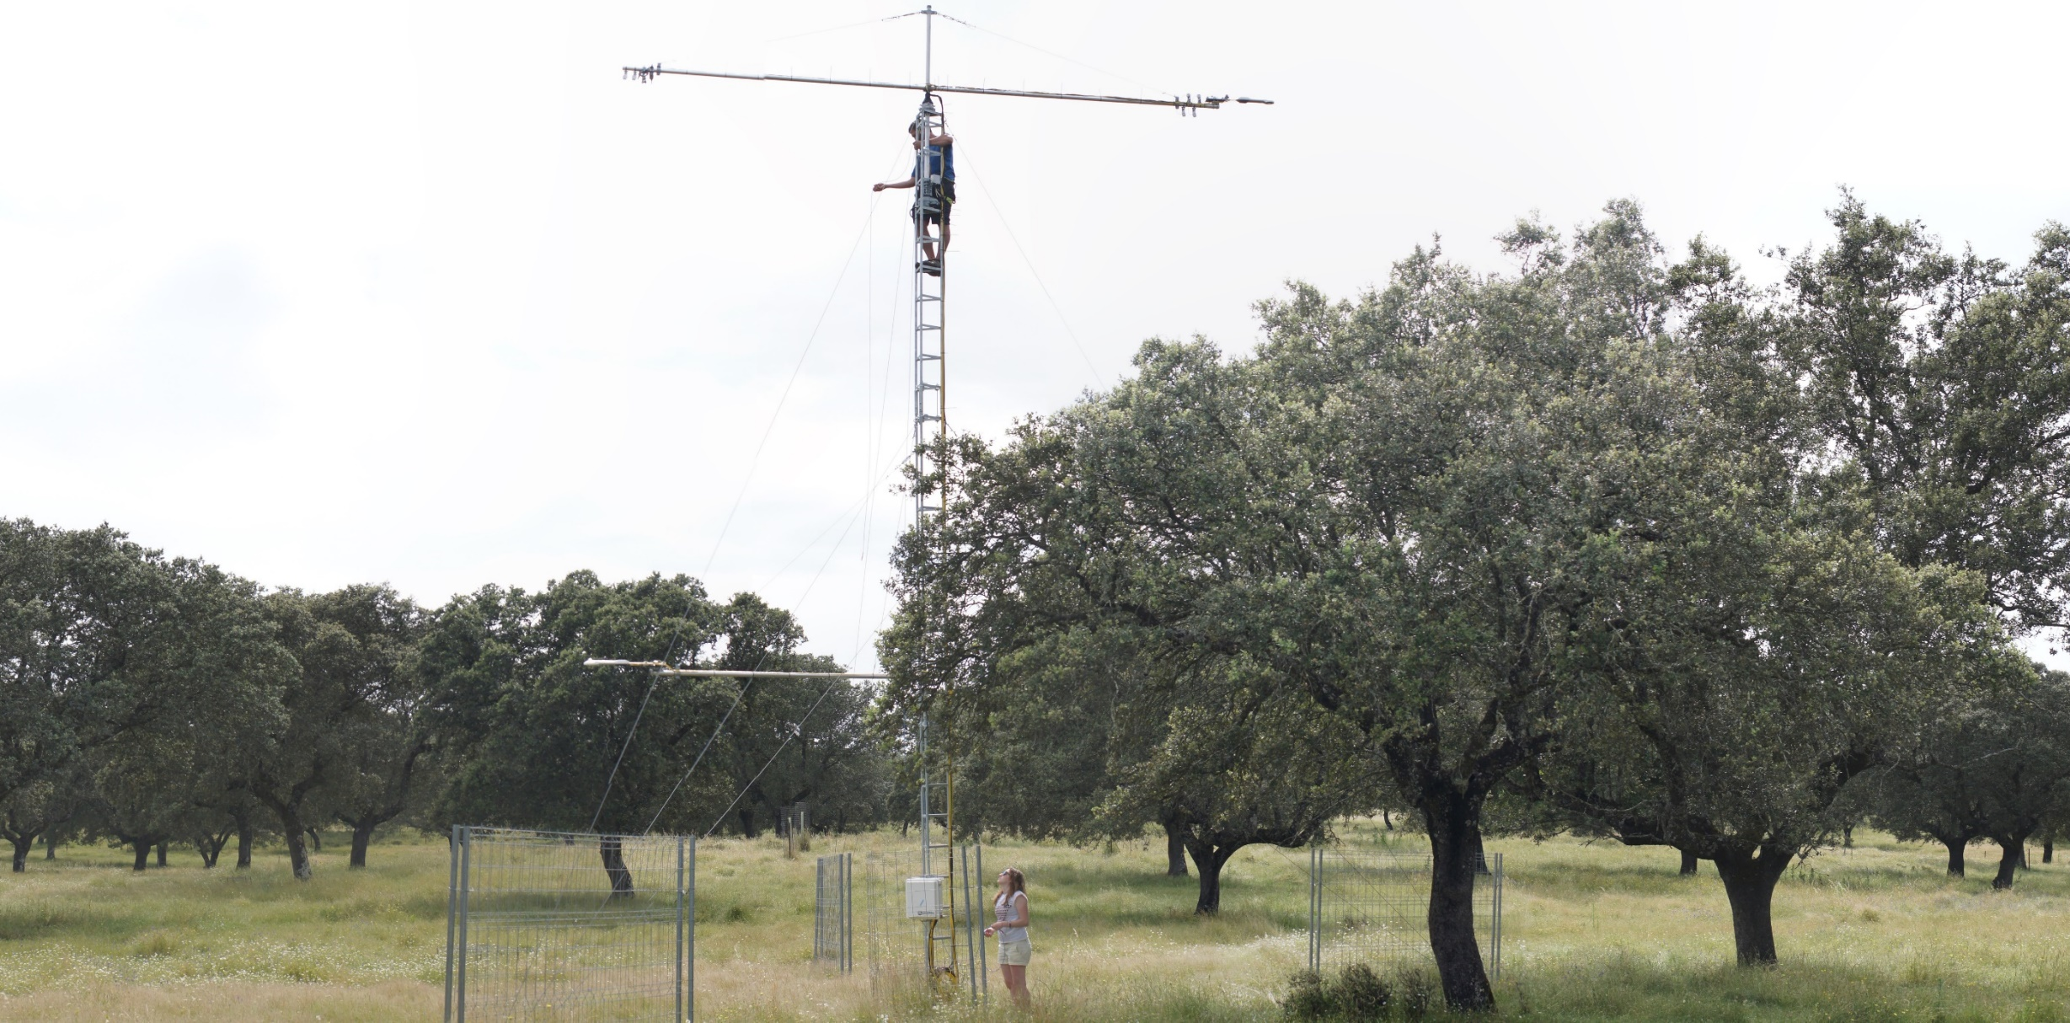
HANK YOU FOR LISTENING
www.jb-hyperspectral.com
info@jb-hyperspectral.com

