Slide 1
AMLEC-2: Atmospheric Radiative Transfer Emulation Challenge (FLEX Mission Edition)
Jorge Vicent Servera, Gabriele Meoni, Gustau Camps-Valls

Slide 2
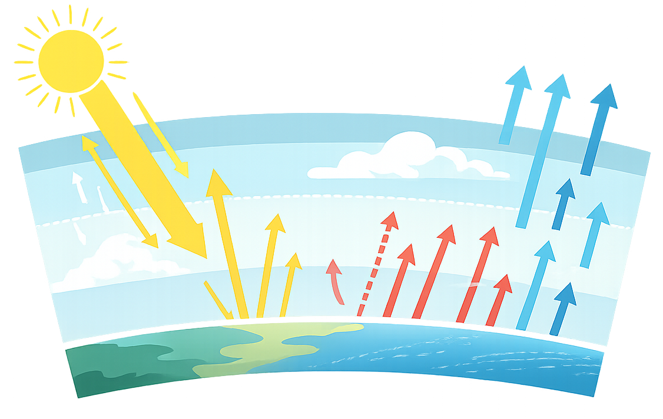
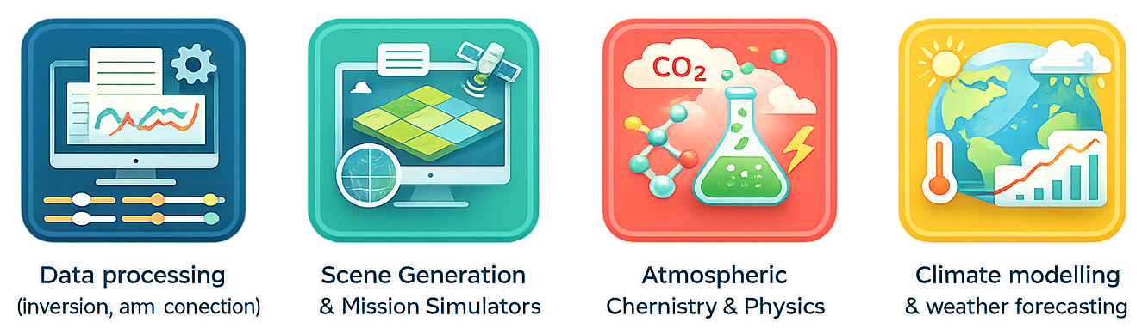
Atmospheric radiative transfer models
Atmospheric radiative transfer models (RTMs) are computer codes that describe the physical interaction of light with atmospheric constituents.
Widely used in Earth Observation scientific and technological applications.
Applications:
Data processing (inversion, atm. correction)
Scene generation and mission simulators
Atmospheric chemistry and physics
Climate modelling and weather forecasting
Characteristics
Accurate physics-based implementation
Plethora of models based on various approximations
Slow for operational use → LUT interpolation
Question: Can we use machine learning to improve accuracy, computational efficiency, and flexibility?
Short answer: yes

Slide 3
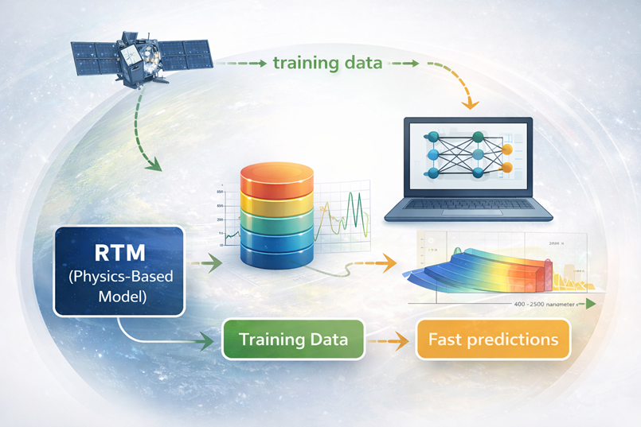
Surrogate modeling: Emulators
Emulators are machine-learning algorithms that approximate RTM outputs through statistical regression. Their high accuracy and computational efficiency offer a flexible alternative to classical LUT interpolation.
The challenge
High dimensionality in input variables and output spectra
Physical complexity of absorption and scattering processes
Diverse emulation approaches:
regression algorithm,
architectures,
machine-learning methods,
other design choices.
testing
The idea: benchmark emulators for atmospheric RTM under common evaluation protocols and datasets.

Slide 4


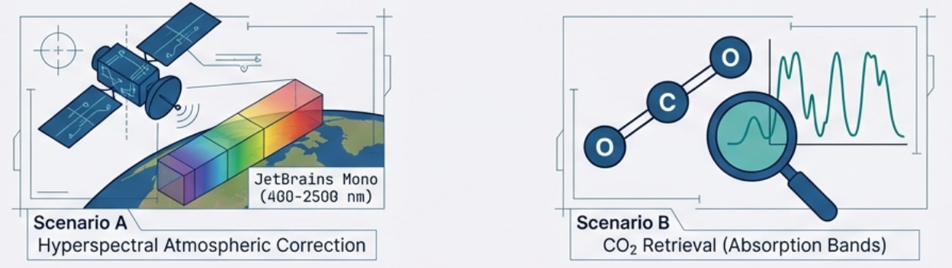
AMLEC-1: Challenge overview
Atmospheric Machine Learning Emulation Challenge (AMLEC-1)
Benchmark emulators for atmospheric RTMs.
Foster scientific progress and share advanced design concepts.
Community building for future editions.
Activity funded under EU’s Horizon programme
(grant agreement 101120237)
Key information
Duration: 2 months (May-June 2025)
Participants: 8 models
Venue: ECML PKDD 2025 (ecmlpkdd.org/2025)
Metrics: accuracy (MRE)
huggingface.co/datasets/isp-uv-es/rtm_emulation
2 scenarios and 2 tracks (interpolation & extrapolation)

Slide 5
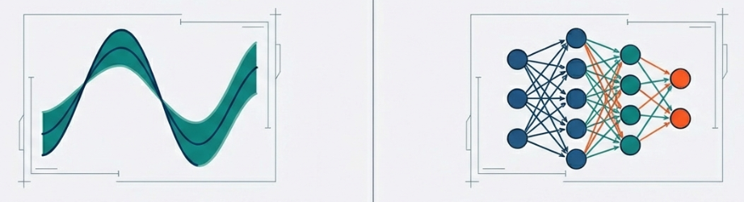
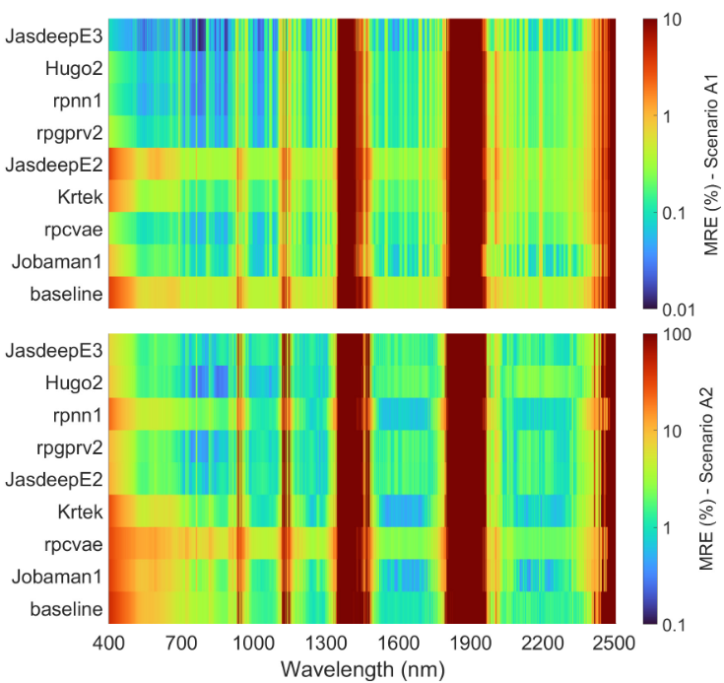
AMLEC-1: Results
GP-based models: JasdeepE3, Hugo2, rpgprv2, Krtek
Differ in kernels (Gaussian, Matérn, ARD-Gaussian) and # of PCs for dimensionality reduction
Efficient under scarce training data (<2000 samples)
NN-based models: rpnn1, JasdeepE2, rpcvae, Jobaman1
Deep architectures (RNN/GRU, CVAE)
Competitive against GP-based models when enough training data (>10000 samples)
Score | Model | MRE (%) |  |  |  | Time (s)
 |  | A1 | A2 | B1 | B2
1.5 | JasdeepE3 | 0.09 | 3.1 | 0.57 | 6.1 | 89.4
2.3 | Hugo2 | 0.14 | 2.9 | 0.61 | 5.0 | 5.4
2.5 | rpnn1 | 0.13 | 5.9 | 0.58 | 5.6 | 19.1
4.0 | rpgprv2 | 0.18 | 3.8 | 0.64 | 7.1 | 35.7
5.6 | JasdeepE2 | 0.89 | 3.9 | 0.77 | 6.2 | 2.1
6.5 | Krtek | 0.55 | 7.7 | 0.82 | 7.9 | 0.8
6.7 | rpcvae | 0.19 | 12.0 | 0.92 | 15.3 | 0.5
7.7 | Jobaman1 | 0.30 | 10.1 | 0.94 | 23.3 | 6.2
8.2 | Baseline | 1.00 | 12.6 | 1.08 | 7.1 | 0.2

Slide 6






AMLEC-1: Lessons learned & path to AMLEC-2
Lessons learned
Value and successes
Narrow participation:
Technical specialization limited appeal to broader communities ➔ Prizes and industrial sponsorship to increase visibility and technology transfer.
Constrained timeline
The short window before launch restricted outreach ➔ Promotion and partnership with ESA’s Φ-lab.
Platform visibility
Move to Φ-lab’s competition platform to automate evaluation.
Educational Impact
Fostered collaborations between academia and industry.
Successful integration into Master’s theses and industrial internships.
Technical Foundation
First benchmark for atmospheric RTM emulators. Curated datasets and automatic evaluation protocols.
Research Output
Led to scientific publications in IEEE GRSM and ECML PKDD.
Key Takeaway: AMLEC-1 proved the scientific viability of emulators; AMLEC-2 shifts focus toward operational readiness (accuracy, uncertainty, and runtime).

Slide 7
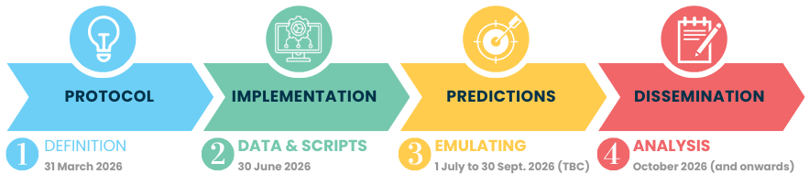
AMLEC-2: FLEX mission scenario
From benchmarking to operational conditions
AMLEC-1: first standardized benchmark for atmospheric RTM emulators.
AMLEC-2: mission-oriented edition (FLEX hyperspectral scenario).
Objective: operationally viable ML surrogates in terms of accuracy, uncertainty, and runtime.
In a nutshell
Organisers: UVEG/ISP + ESA’s phi-lab
Start: July 2026 (TBC)
Metrics: accuracy + uncertainty + runtime
Scenario: FLEX atmospheric correction
Four phases of AMLEC-2 organisation
Join AMLEC-2
https://platform.ai4eo.eu/

Slide 8





AMLEC-2: Workflow for participants
ACCESS
Register at ESA’s AI4EO platform: platform.ai4eo.eu
TRAINING
Select dataset size based on model needs.
CONFIGURE
Optimize for accuracy, uncertainty, and speed
⚠️ Max. 2 models per participant
SUBMISSION
Upload your model to the hosting platform.
Automatic execution and runtime ranking.
Small (1k samples)
Medium (3k samples)
Large (1k samples)
Platform features
Fully containerized submissions.
Automatic execution and evaluation.
Public leaderboard.

Slide 9



AMLEC-2: Assessment process
ACCURACY
Mean relative error (MRE)
in surface reflectance after atmospheric correction of FLEX-like data.
UNCERTAINTY
Mean Absolute Calibration Error (MACE)
Self-awareness check: does the model know when it’s wrong?
EFFICIENCY
Runtime
Critical for operational satellite data processing.
Measured on platform execution.
Ranking procedure
Metric Ranking: For each track (interpolation/extrapolation), submissions are ranked separately on each metric. Ties receive the average rank.
Track Score: Ranks are combined using a weighted average: 0.5 (accuracy), 0.3 (runtime), 0.2 (uncertainty).
Final Score: Weighted average of track scores, prioritizing interpolation (0.65) over extrapolation (0.35).

Slide 10







AMLEC-2: Planning and status
Ideation
Preparation
Implementation
Ideating first challenge idea*
Refinement of challenge idea
Definition of datasets, metrics, and prizes*
Preparing datasets
Ingesting data to EOTDL
Preparing Jupyter Notebook*
Setting up the live scoring tool*
Preparing the website*
Preparing outreach material*
Implementing outreach
Maintain platform
Support to participants*
After preparation and prices
* UVEG contribution
Ideation | Nearly finished
Preparation | On-going (data preparation). Other activities to start in May 2026
Implementation | Challenge start date (TBC): July 2026
Organized by:
Supported by:

Slide 11
References
J. Vicent et al., “Evaluating Machine Learning Emulators for Atmospheric Radiative Transfer: The AMLEC Challenge,” IEEE GRSM, 2026 (in review).
R. Poirier et al., “Neural network for radiative transfer emulation,” in 2025 European Conference on Machine Learning and Principles and Practice of Knowledge Discovery in Databases (ECMLPKDD), Porto, Portugal, Sep 2025, pp. 183–185.
J. Verrelst et al., “RTM Surrogate Modeling in Optical Remote Sensing: A Review of Emulation for Vegetation and Atmosphere Applications,” Remote Sensing, vol. 17, no. 21, 2025
J. Vicent et al., “Comparative analysis of atmospheric radiative transfer models using the Atmospheric Look-up table Generator (ALG) toolbox (version 2.0),” GMD, vol. 13, no. 4, 2020.
J. Vicent et al., “Emulation as an accurate alternative to interpolation in sampling radiative transfer codes,” IEEE JSTARS, vol. 11, no. 12, pp. 1–14, 10 2018.

