Slide 1

DESIS and EnMAP imaging spectroscopy data in support of the FLEX Mission
FLEX-Fluorescence 2026 Workshop 03 – 06 March | Bonn University, Germany
Emiliano Carmona¹, Martin Bachmann¹, Uta Heiden¹, Laura La Porta², Miguel Pato¹
¹ German Aerospace Center (DLR), Earth Observation Center (EOC), Germany ² German Aerospace Center (DLR), German Space Agency, Germany

Slide 2
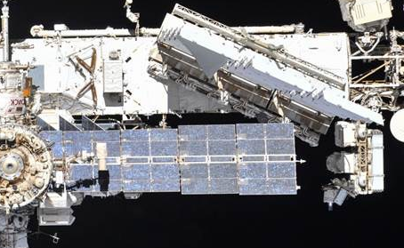
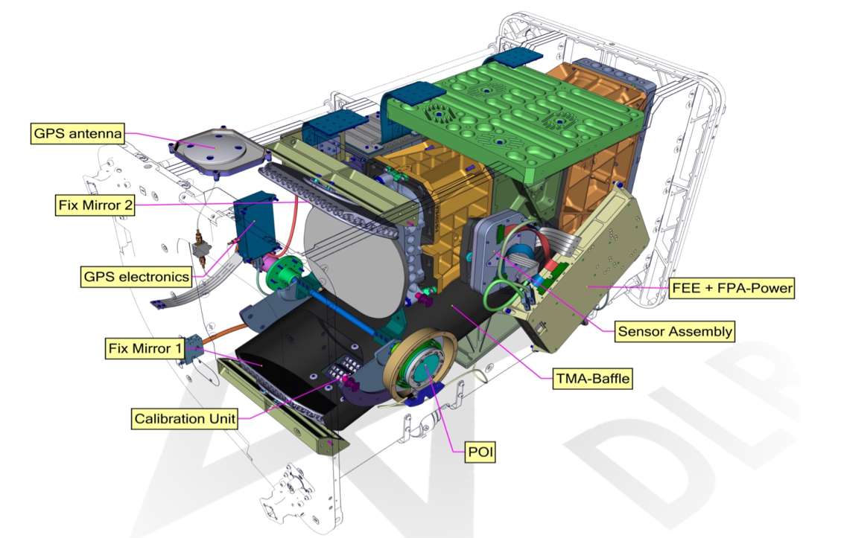
DESIS instrument
Collaboration between TBE (platform, operations) and DLR (instrument, processors)
DESIS Specification
Spectral range | 400 nm to 1000 nm
Spectral Sampling (res., acc.,bands) | 2.55 nm, 0.5 nm, 235 bands
Software Binning (sampling distance, number bands) | Binning 2 (5.1 nm, 118 bands) Binning 3 (7.6 nm, 79 bands) Binning 4 (10.1 nm, 60 bands)
Spectral response | Gaussian shape, 3.5 nm FWHM
Spectral accuracy, stability | ~0.5 nm
Radiometry (res., acc.) | 13 bits, ~10% (typically <5%)
Off-nadir tilting (across-track, along-track) | -45° (backboard) to +5° (starboard), -40° to +40° (by MUSES and DESIS)
Spatial (res., swath) | 30 m, 30 km (@ 400 km nadir)
Geometric accuracy | <1 pix (30 m) GCPs
SNR (signal-to-noise) | 195 (w/o bin.) / 386 (4 bin.) @ 550 nm
Swath length | 3000 km / orbit; >7000 km / day
Product size | 30 km x 30 km
FEE: Front End Electronic
FPA: Focal Plane Array
TMA: Three Mirror Anastigmat
POI: Pointing Unit
Sensors 2019, 19(7), 1622; https://doi.org/10.3390/s19071622

Slide 3

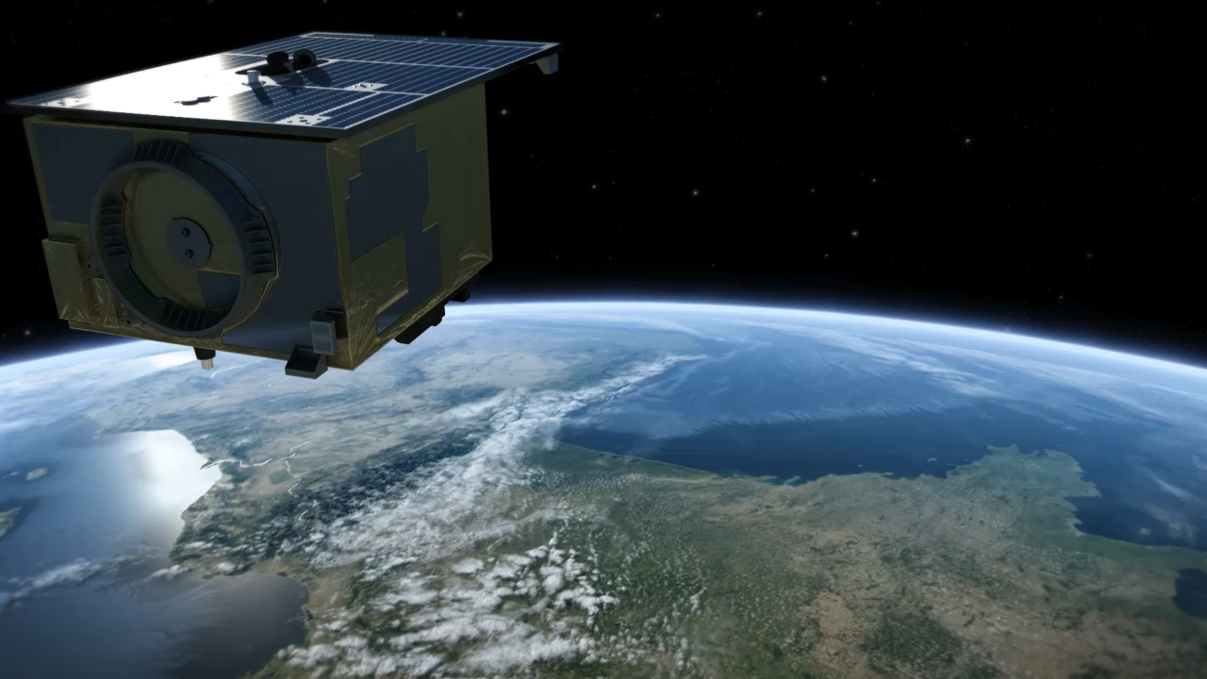
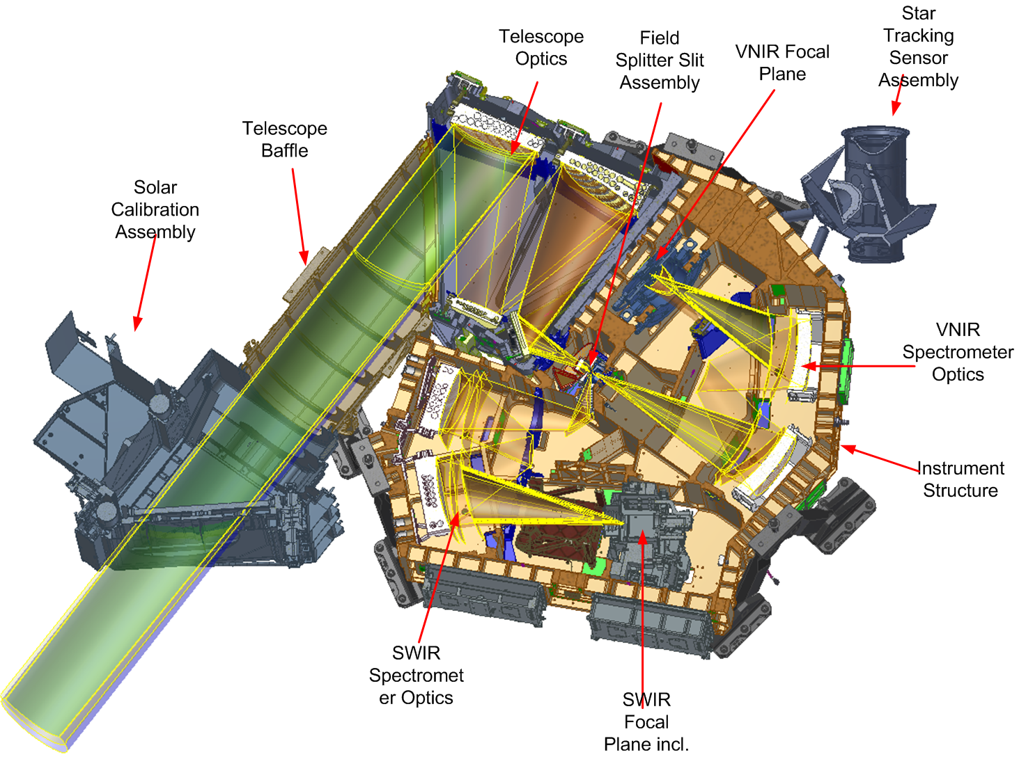
EnMAP Instrument
EnMAP specification | VNIR | SWIR
Spectral range | 420 – 1000 nm | 900 – 2445 nm
Number of spectral bands | 91 | 133
Spectral sampling distance | 6.5 nm | 10 nm
Spectral full width at half maximum | 6 – 11 nm | 7 – 11 nm
Spectral accuracy | 0.5 nm | 1 nm
Spectral stability | 0.5 nm
Spectral smile | <0.2 pix
Signal-to-noise ratio | >500 (at 495 nm) | >150 (at 2200 nm)
Radiometric accuracy | <5%
Radiometric stability | <2.5%
Geometric accuracy | 1 pix (30 m) with GCPs, otherwise 100 m
VNIR/SWIR co-registration | 0.2 pix
Off-nadir tilting (across-track, along-track) | -30° to +30° across-track
Ground sampling distance | 30 m (at nadir; sea level)
Swath width | 30 km (2.63° across track)
Swath length | 1000 km / orbit; >5000 km / day
Product size | 30 km x 30 km
Source: DLR
Source: L. Guanter et al., Remote Sens. 2015, 7, 8830-8857. https://doi.org/10.3390/rs70708830

Slide 4
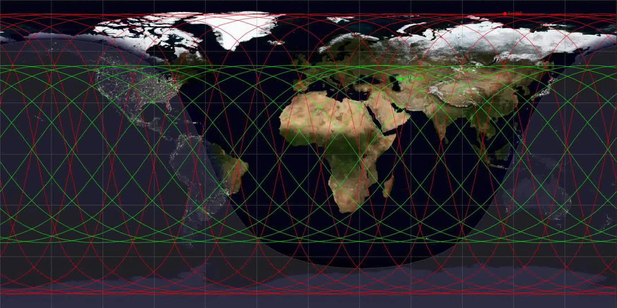
DESIS orbit details
> Lecture > Author • Document > Date
Mission Instrument | ISS/MUSES DESIS
Target lifetime | 2018-2023 (nominal), 2026 in operation*
Orbit type, altitude and inclination | not Sun-synchronous, 51.6°, 400-420 km no repeat cycle
Orbit period and repeat cycle | ~93 minutes, no repeat cycle
Revisit time | 3 – 5 days but depends on latitude and can be 10-12 days
Coverage | 55° N to 52° S

Slide 5
EnMAP orbit details
> Lecture > Author • Document > Date
Mission Instrument | EnMAP
Target lifetime | 04.2022-09.2027 (nominal), extension under consideration
Orbit type, altitude and inclination | Sun-synchronous, 653 km, 97.96°
Orbit period and repeat cycle | 1.6 h, 398 revolutions in 27 days
Local time descending node | 11:00 h ± 18 min
Revisit time | 4 days (±30° off-nadir tilt) 21 days (±5° off-nadir tilt)
Coverage | 84° N to 84° S

Slide 6
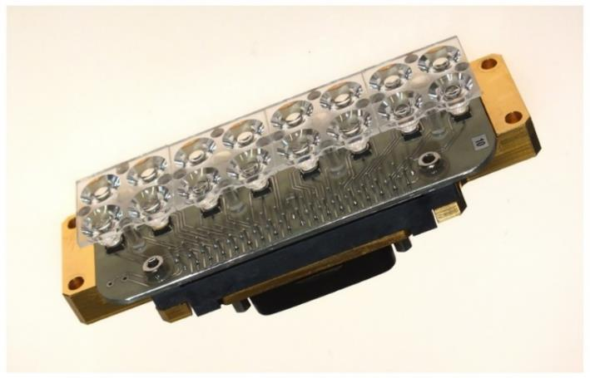
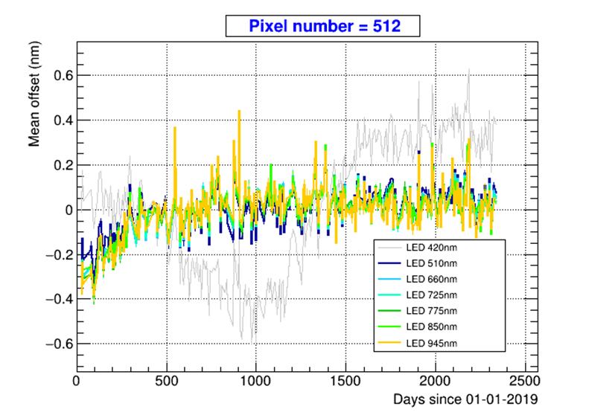
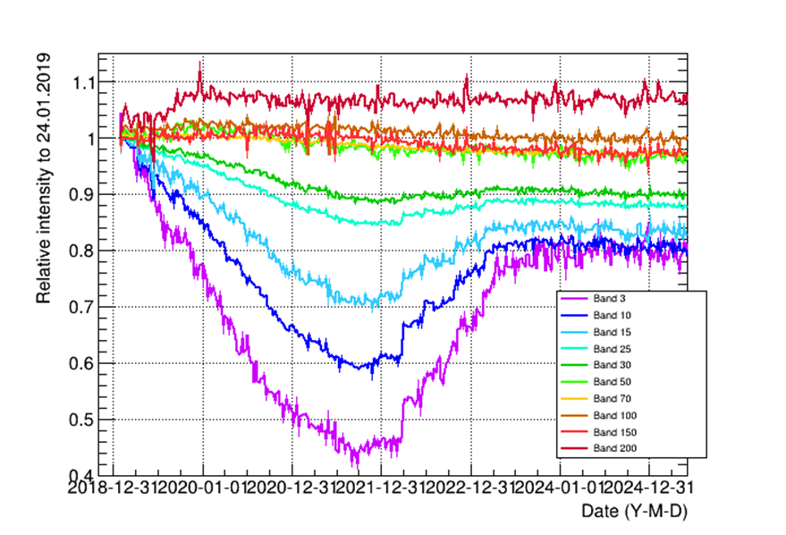
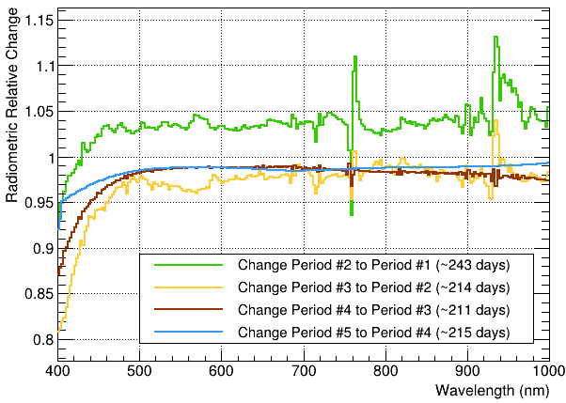
DESIS Calibration
Calibration unit equipped with 9 different LEDs. Weekly measurements. Used for spectral calibration
Spectral calibration after corrections better than ~0.5 nm. RMS ~0.1 nm
Vicarious radiometric calibration with RadCalNet sites used as reference. High variability for wavelengths below 480 nm. More stable above 500 nm
On-board calibration
Vicarious calibration

Slide 7
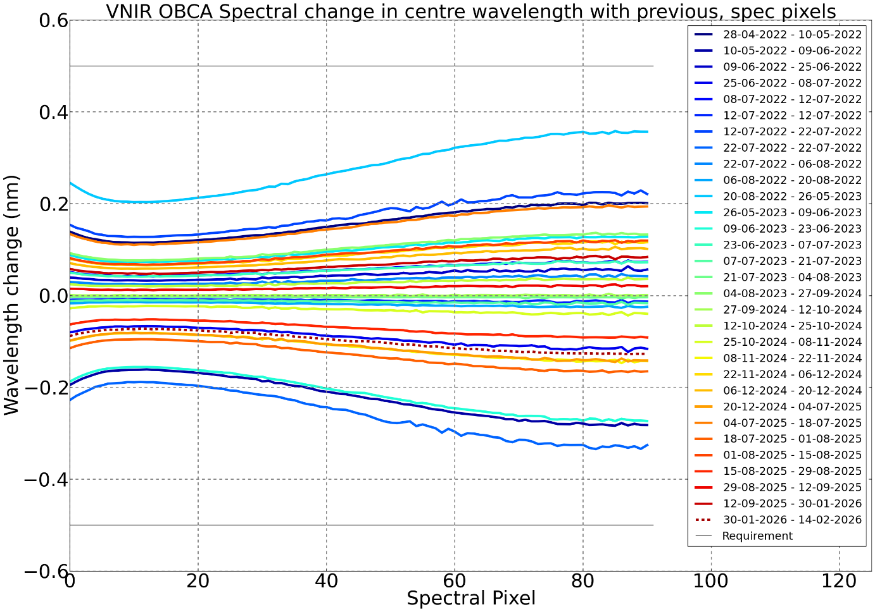
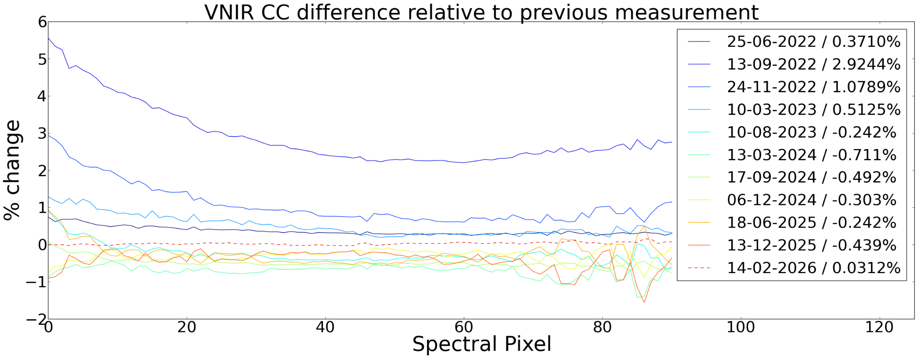
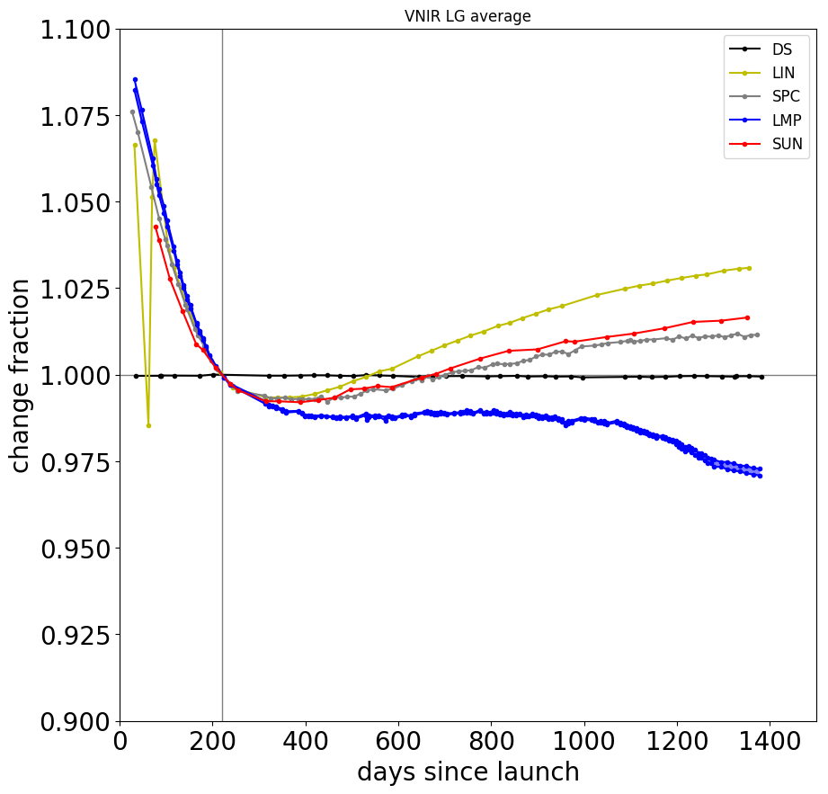
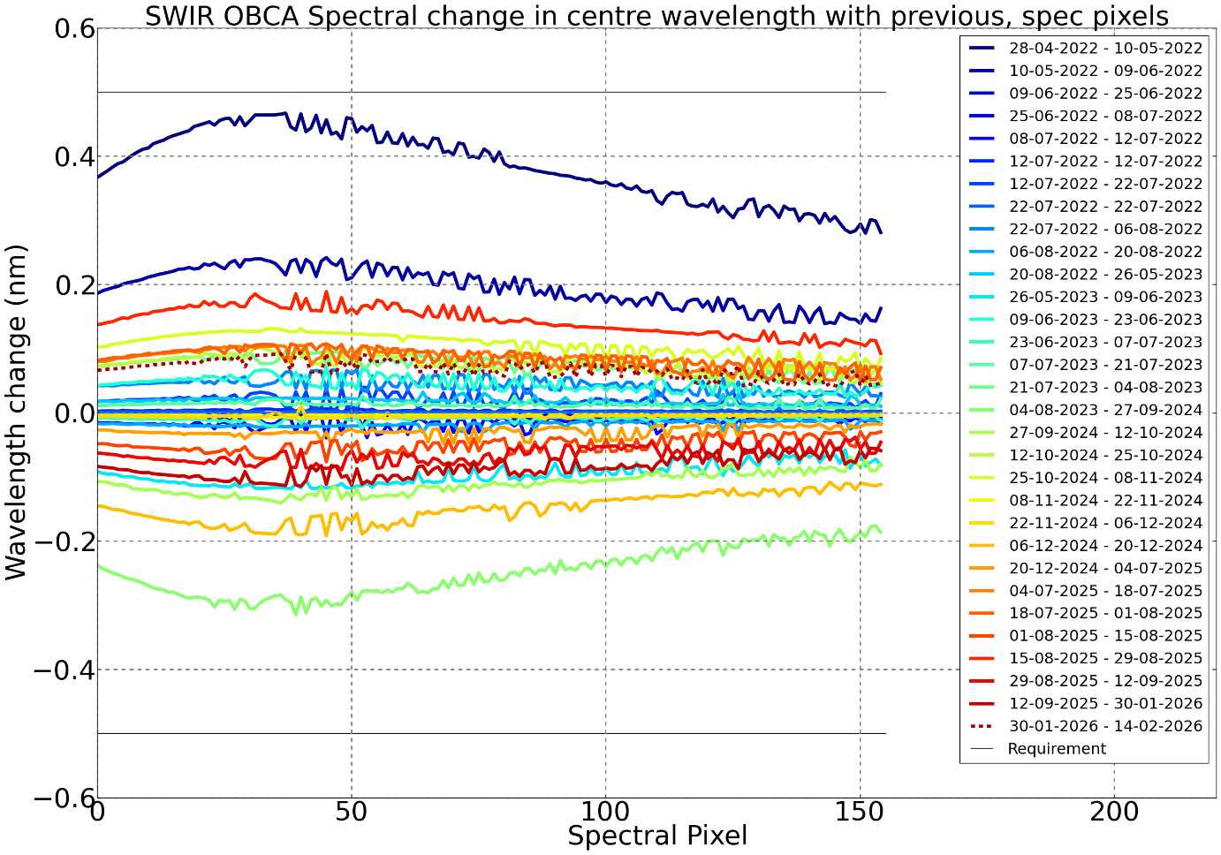
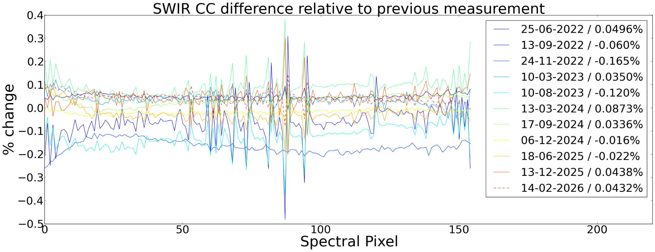
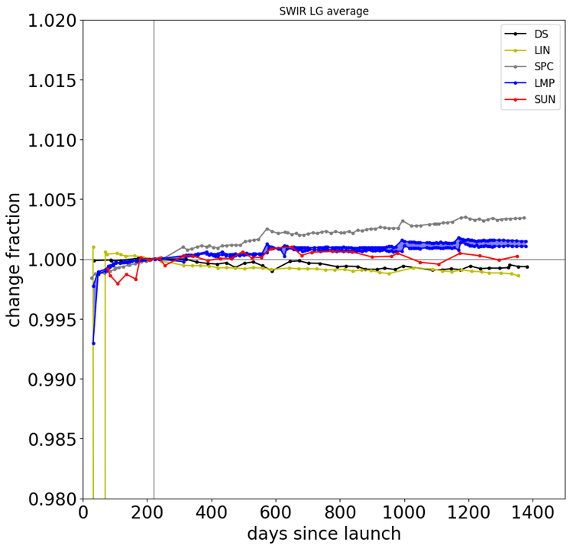
EnMAP Calibration
EnMAP equipped with 5 on-board calibration/monitoring methods (spectral, radiometric, lamp, linearity, deep-space calibrations)
Spectral calibration
Radiometric calibration
Instument monitoring
VNIR
SWIR

Slide 8
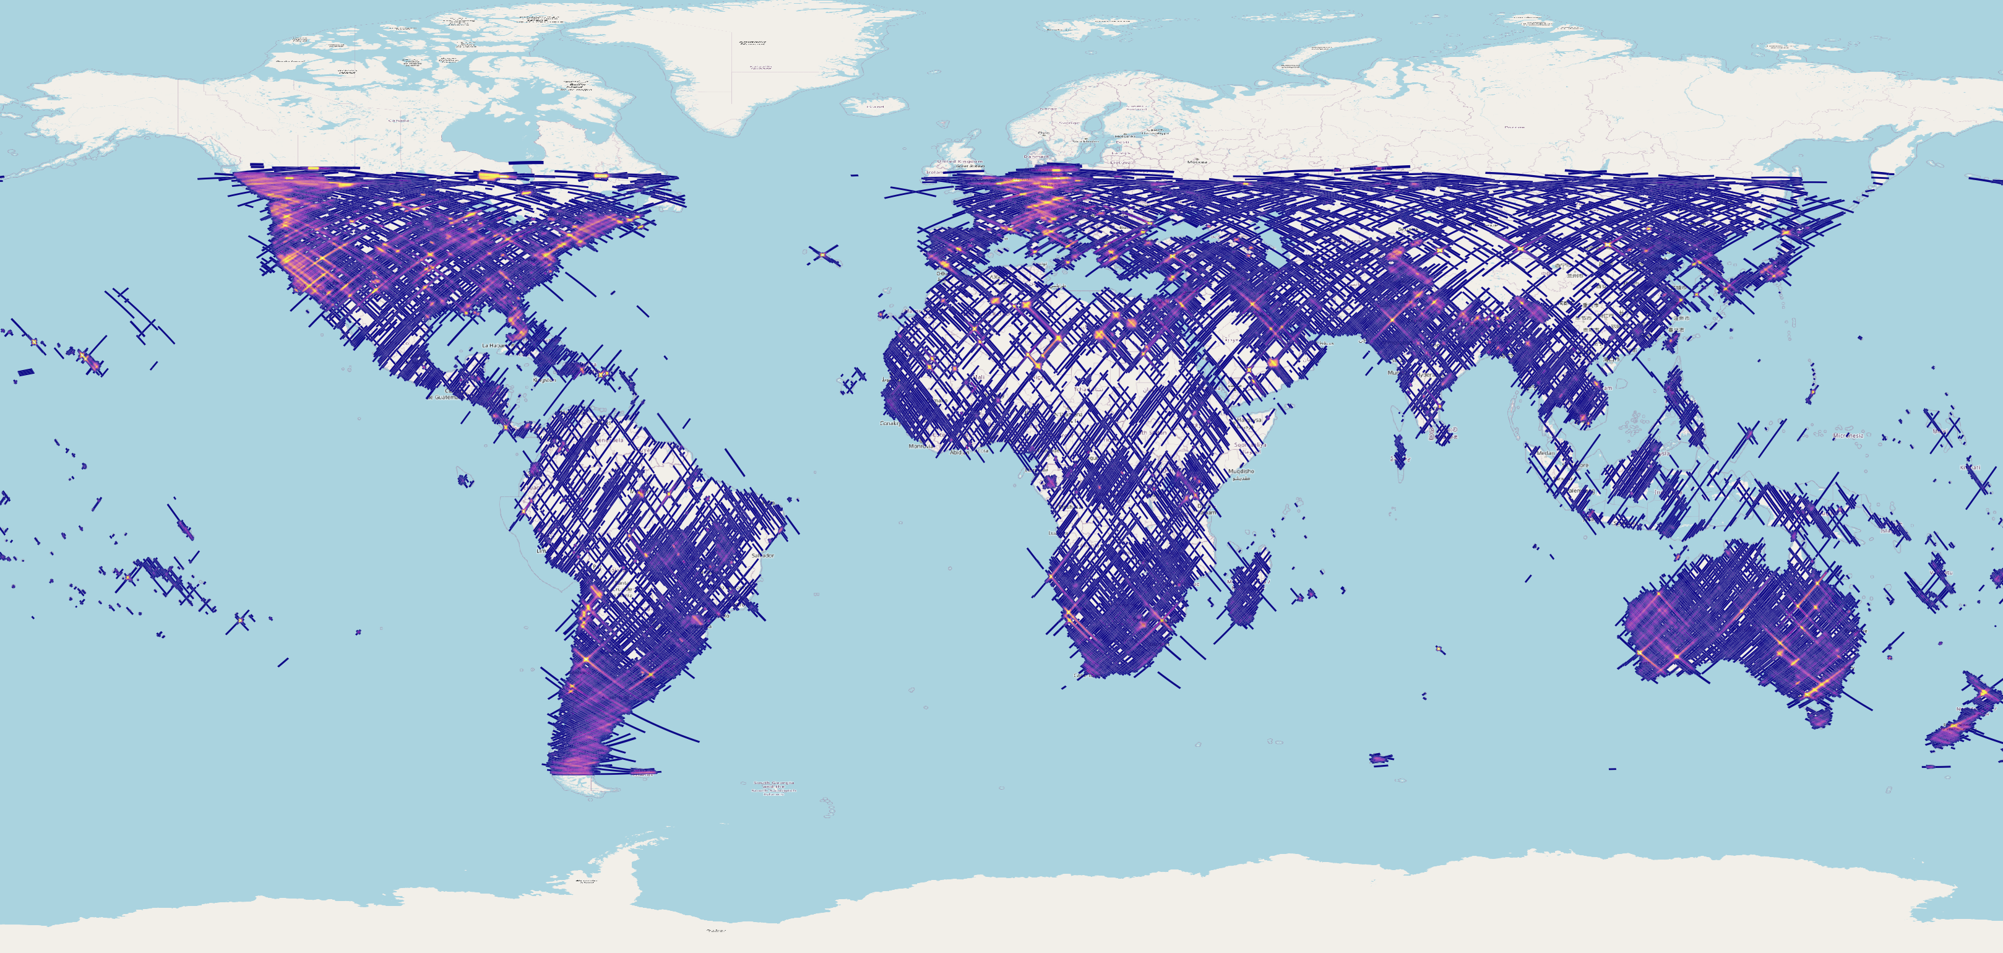

DESIS 6 years of acquisitions
N° of available scenes
Data since 2018. Certain areas imaged as much as 120 times
> 240000 products until 2024

Slide 9
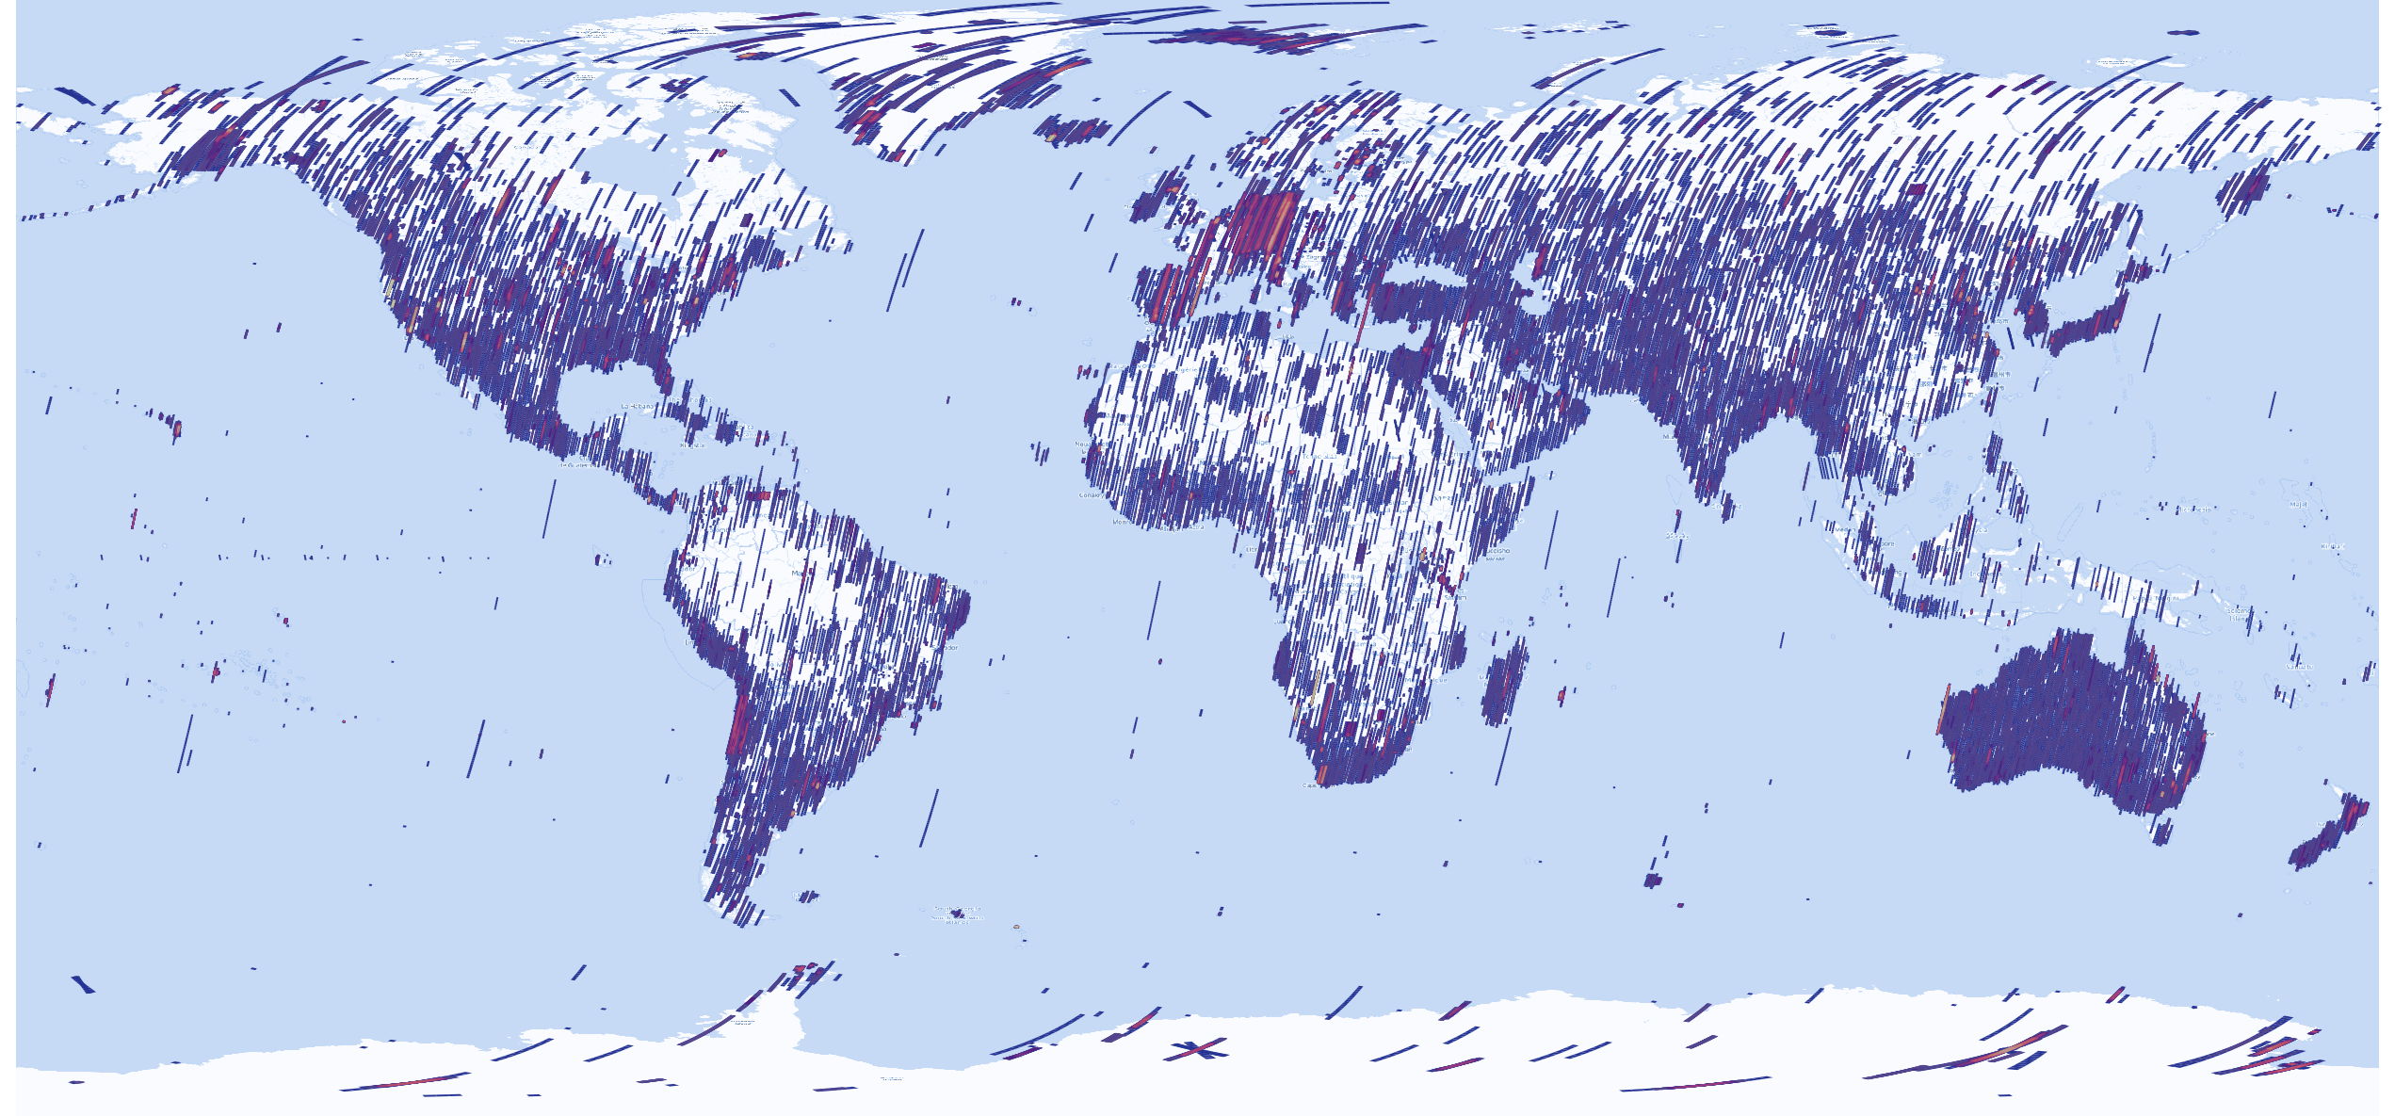
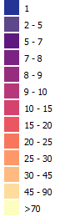
EnMAP 4 years of acquisitions
N° of available scenes
Source: DLR
More than 22200 Earth datatakes (DTs) since April 2022
More than 202500 Earth products archived and available for ordering. Some areas imaged > 70 times

Slide 10
DESIS – Operational processors (DLR + Amazon Cloud)
Raw Data
Same processing logic. EnMAP data has richer metadata annotation and better georeferencing
Processing Levels:
Level 0 (EnMAP) / Level 1A (DESIS)
Tiled images, metadata, quality flags
Level 1B (L1B)
Top of Atmosphere (TOA) radiance (W·m⁻²·sr⁻¹·μm⁻¹)
Radiometric correction, Spectral referencing (DESIS extra corrections: rolling shutter, spectral, etc.)
Level 1C (L1C)
Level 1B data ortho-rectified, re-sampled to a specified grid
Global DEM (DESIS SRTM 1arcsec, EnMAP Copernicus DEM GLO-30), sensor model refinement using global reference image (DESIS Landsat-8 PAN with acc. 18m CE90, EnMAP Sentinel-2, acc. 10m)
Level 2A (L2A)
Ground surface reflectance (i.e. after atmospheric corrections)
EnMAP includes a dedicated L2A-water product

Slide 11


DESIS Data products
Archive
Absolute radiometric calibration is well
within ~5% at the Top-of-Atmosphere (TOA)
radiance and TOA reflectance level
when validated against RadCalNet
L1A Raw Data
(prepared for selection & ordering & processing)
Geometric accuracy with respect to
Landsat-8 reference is ~20 m (~0.7 pixel)
linear RMSE
Analysis Ready Data
L1B Top-Of-Atmosphere (TOA) Radiance
L1C Geocoded & Orthorectified (TOA) Radiance
L2A Bottom-of-Atmosphere (BOA) Reflectance
Agreement of Bottom-Of-Atmosphere (BOA) reflectance within ~ 5% to RadCalNet sites, significant agreement within uncertainties with other sensors processed with DESIS L2A processor (PACO)
Alonso et al., Data Products, Quality and Validation of the DLR Earth Sensing Imaging Spectrometer (DESIS) Sensors, 2019
L2A data is CEOS-ARD at threshold specification

Slide 12

EnMAP Data products
Archive
Absolute radiometric calibration is well
within <5% at the Top-of-Atmosphere (TOA, validated)
Radiance requirement. Additionally <<2% difference between consecutive calibrations (~1 or ~2 months)
L0 Raw Data
(prepared for selection & ordering & processing)
Geometric accuracy with respect to Sentinel 2 reference
<0.5 pixel RMSE
VNIR-SWIR Co-registration <0.1 pixel (mean)
Analysis Ready Data
L1B Top-Of-Atmosphere (TOA) Radiance
L1C Geocoded & Orthorectified (TOA) Radiance
L2A Bottom-of-Atmosphere (BOA) Reflectance (Land and water)
Agreement of Bottom-Of-Atmosphere (BOA) reflectance within Mission requirements:
Land ρ Uncertainty
< 0.01 for ρ < 0.1 and
< 0.02 for 0.1 ≤ ρ < 0.3 and
< 0.05 for 0.3 ≤ ρ ≤ 0.6
Water Rrs Uncertainty
< 0.01 for ρ < 0.1 and
< 0.02 for 0.1 ≤ ρ < 0.3 and
< 0.05 for 0.3 ≤ ρ ≤ 0.6
L2A data is CEOS-ARD at threshold specification
Storch et al., The EnMAP imaging spectroscopy mission towards operations. Remote Sensing of Environment, 294, 113632.

Slide 13
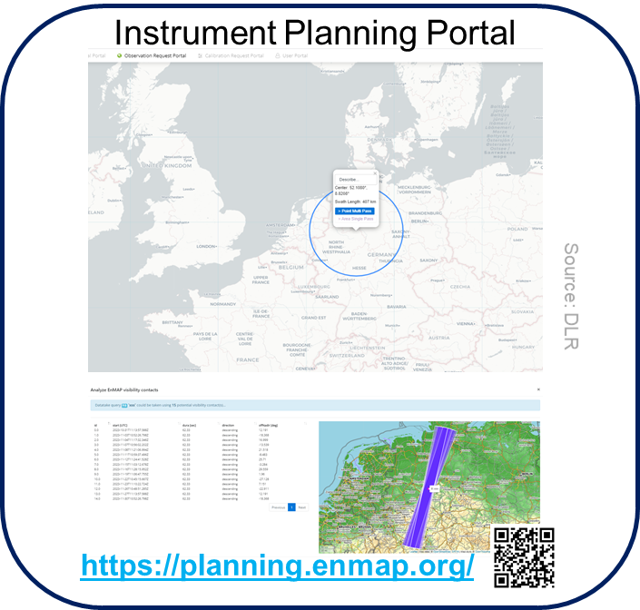
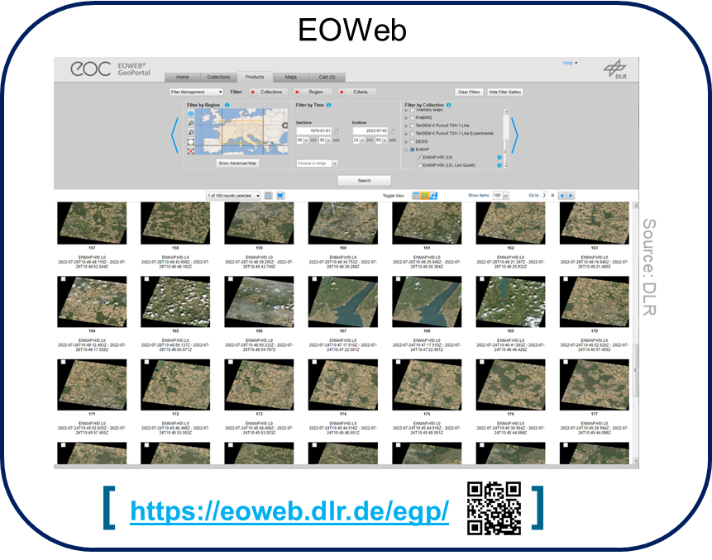
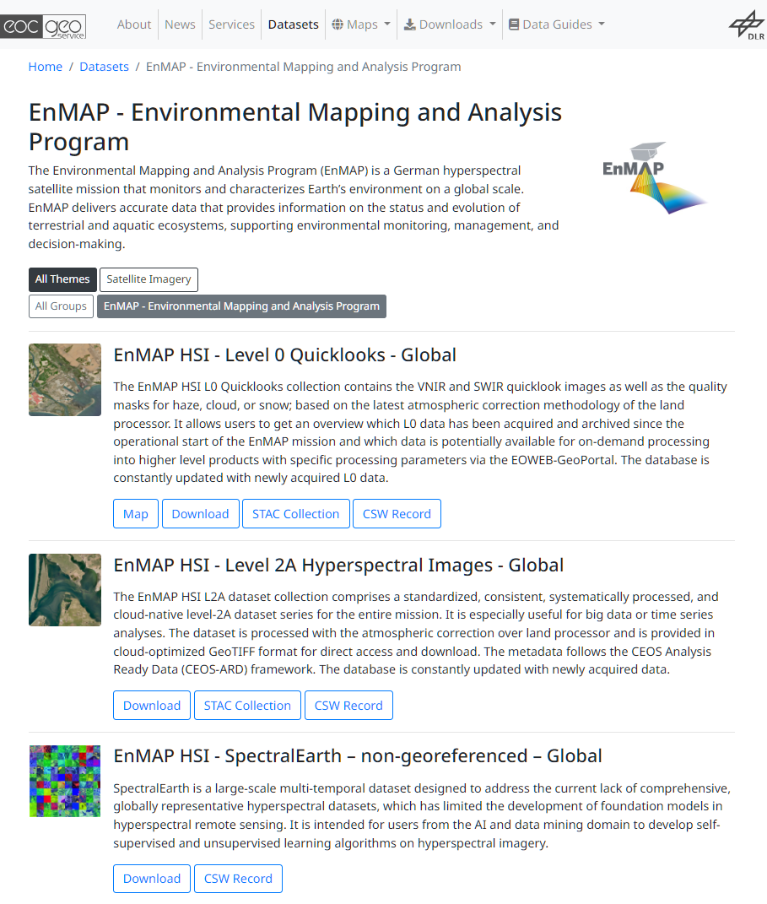
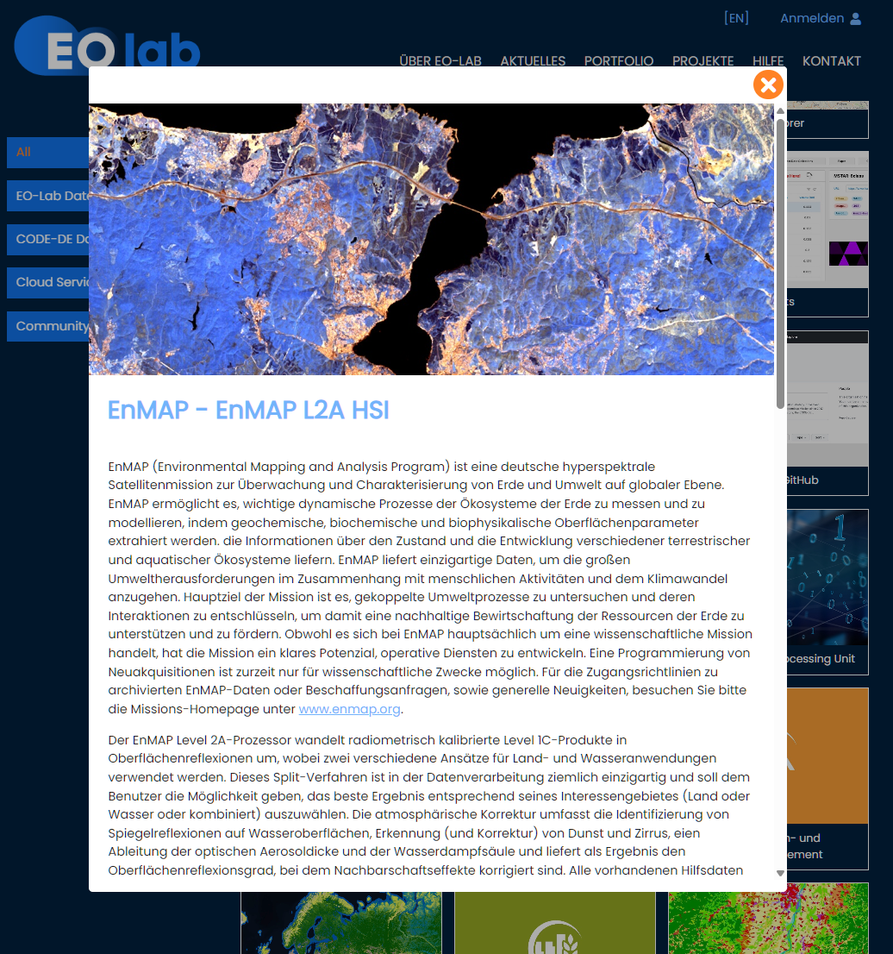

EnMAP Tasking and Data Acces
Acquisition plan based on user’s requests plus acquisitions planned from the Foreground Mission program and the Background Mission program
EOC Geoservice / EOLab
Instrument Planning Portal registration, proposal submission and tasking of EnMAP
EOWEB access to catalogue for on-demand processing of L1B, L1C, L2A products
EOC GeoService / EOLab provide access to archived processed EnMAP L2A ARD

Slide 14
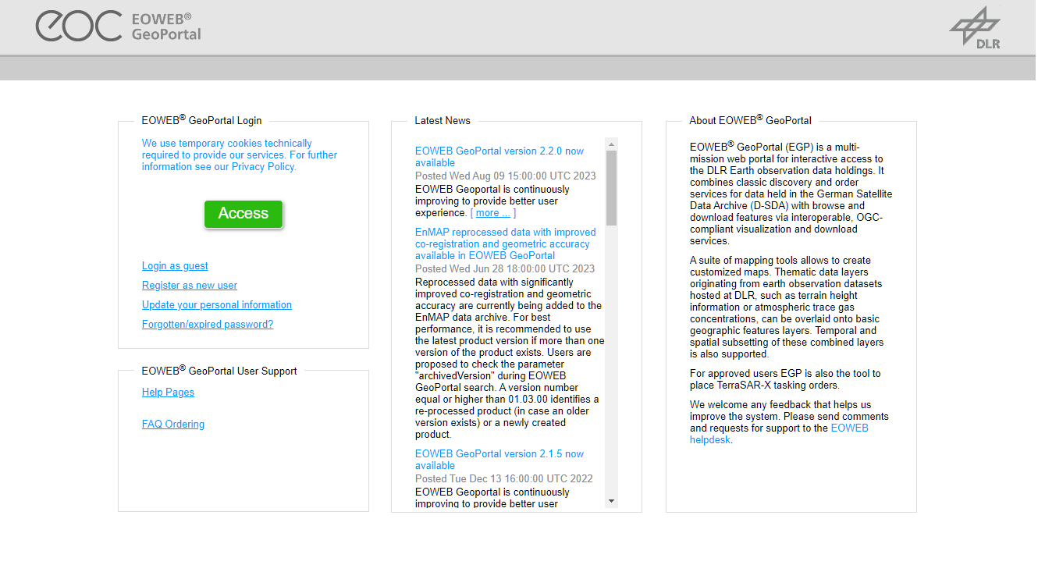
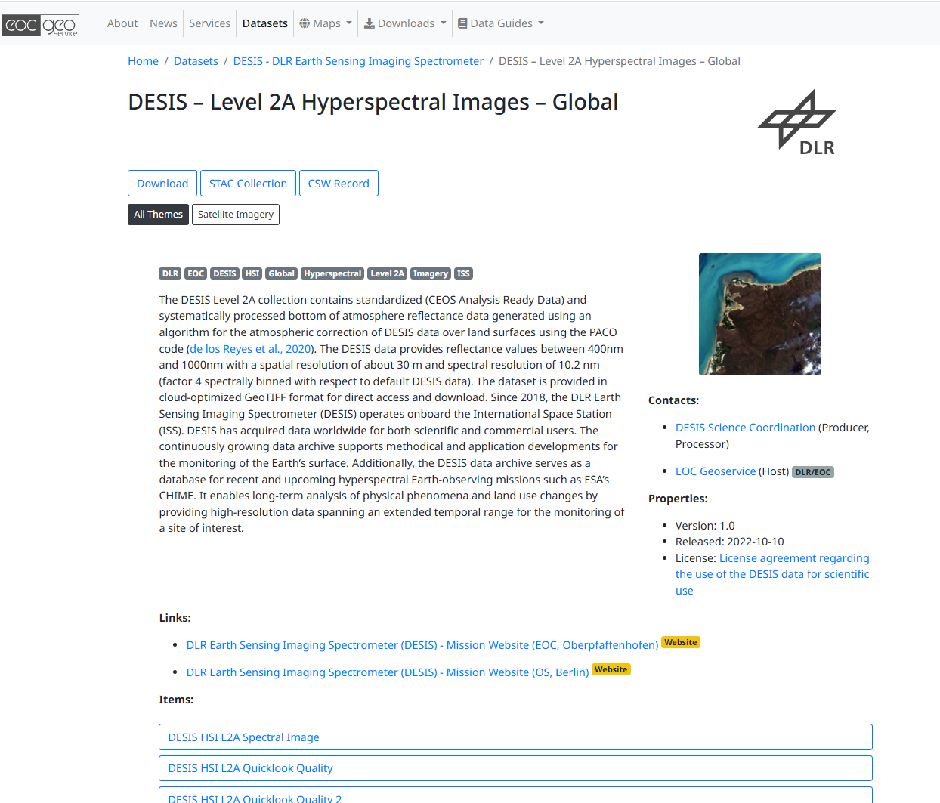
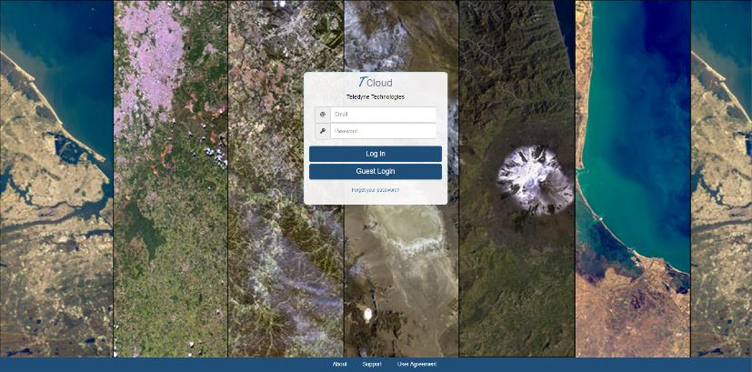
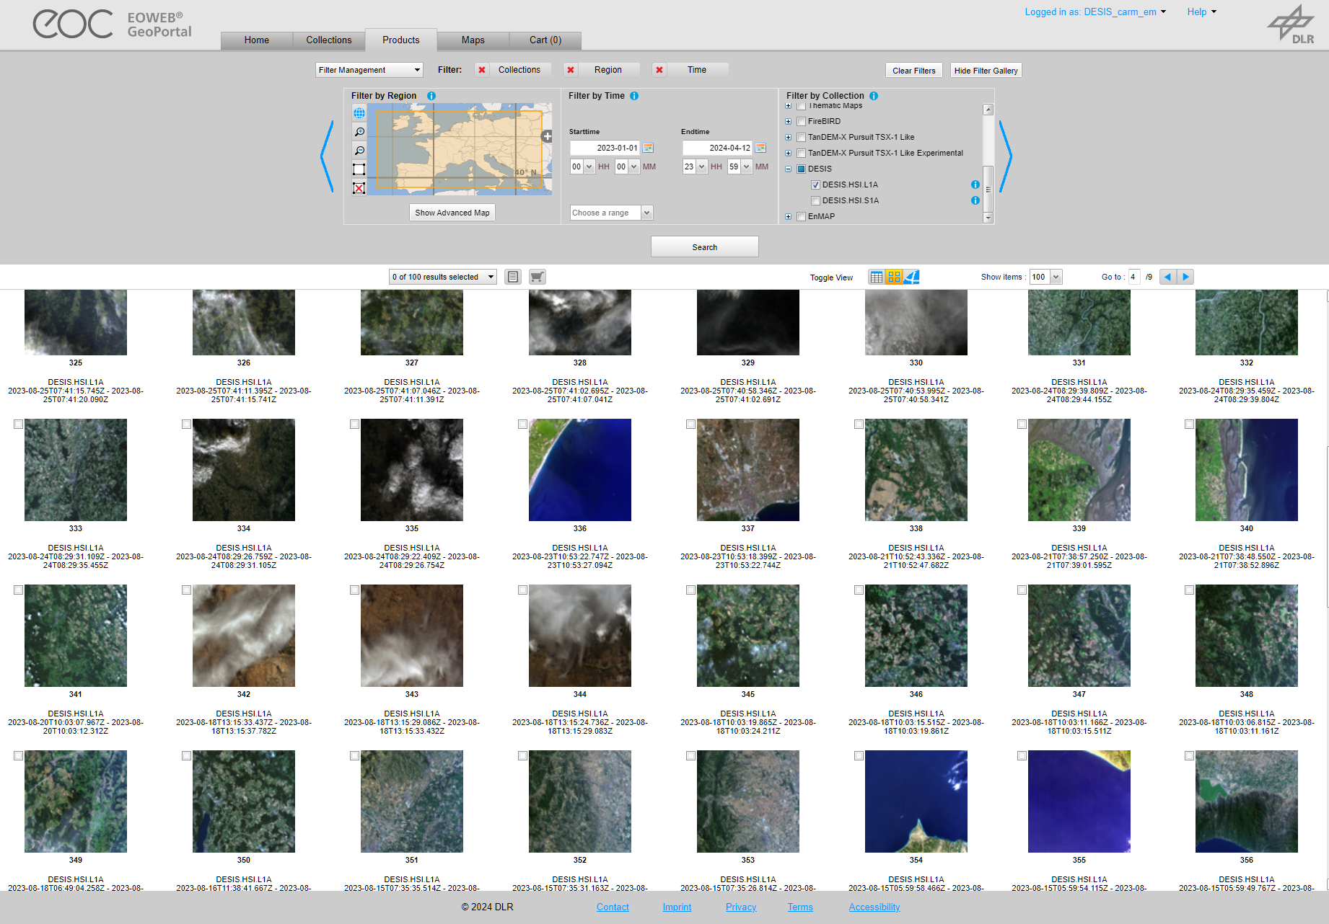
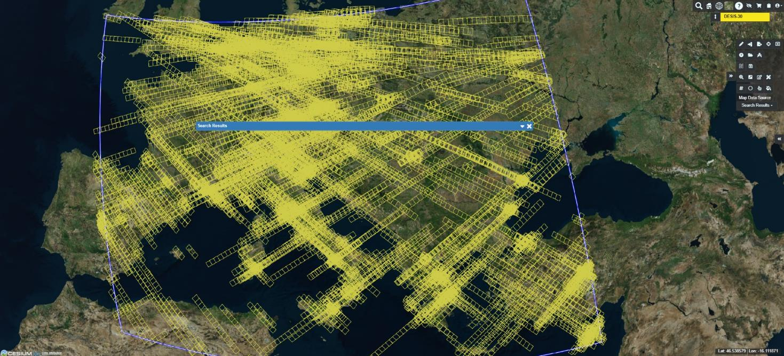



DESIS Tasking and Data Acces
Tasking only possible using TBE tasking tool. Access to archived data using TBE catalogue or DLR catalogue, but DLR catalogue contains ~12% of total DESIS products
TCloud Portal
EOWEB
EOC Geoservice
https://teledyne.tcloudhost.com/
https://eoweb.dlr.de/egp/
https://geoservice.dlr.de/web/datasets/desis

Slide 15
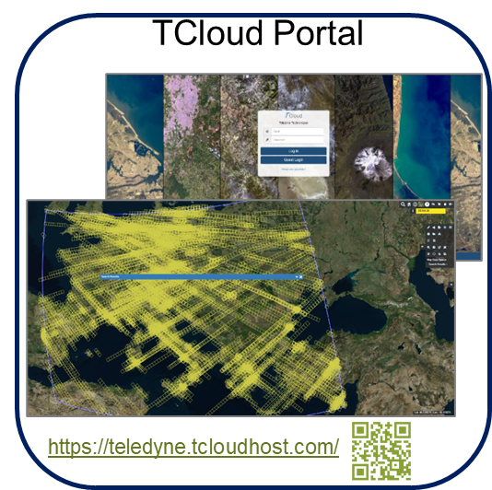
DESIS Tasking and Data Acces
Tasking only possible using TBE tasking tool. Access to archived data using TBE catalogue or DLR catalogue, but DLR catalogue contains ~12% of total DESIS products
EOWEB
EOC Geoservice
https://eoweb.dlr.de/egp/
https://geoservice.dlr.de/web/datasets/desis
Since 31/05/2024, Teledyne has stopped the DESIS tasking portal. Instrument still operational
Services at DLR (archive + processing) are available and will continue to be
Access to full catalogue and tasking is still possible but only through DLR: desis-scientific@dlr.de

Slide 16
Synergies with the FLEX Mission
Comparison of TOA radiance and BOA reflectance products with well and long validated instruments and processing software
The EnMAP / DESIS 30 m finer spatial resolution can help overcome FLEX limitations with 300 m pixels over heterogeneous areas
Stress indices, chlorofyll, pigments, leaf/canopy structure could be studied on DESIS/EnMAP data for interpretation or uncertainty estimation of FLEX data
Endmember libraries or F-Cover estimates at 30 m resolution
Create denser time series by tasking EnMAP / DESIS with new acquisitions. With days difference (EnMAP/DESIS) but potentially same day at different hours with DESIS. Availability of long-term archived data (~4 years EnMAP, ~7 years DESIS)
Opportunities for data fusion
Readers for EnMAP L1/L2 data in EnMAP-Box as well as DESIS, PRISMA L1/L2, EMIT L2A, Landsat L2, Sentinel-2 L2A and Planetscope L1/L3

Slide 17
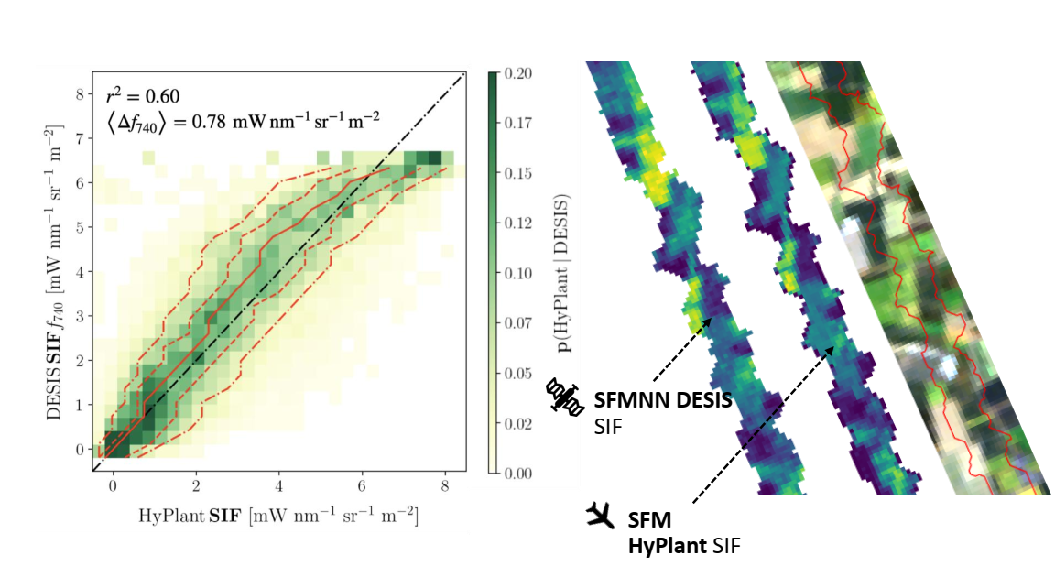
SIF estimates with DESIS
DESIS data has been successfully employed to derive SIF over the O₂-A band making use of a realistic sensor simulation framework for DESIS (and HyPlant)
Buffat, J. et al. (2024). Computer Vision – CVPPA 2024. https://doi.org/10.1007/978-3-031-91835-3_6
+ M. Pato et al. RSE 330 (2025) 114944
See Contribution by J. Buffat et al. at this workshop “Towards an emulation-based SIF retrieval method for FLEX data”
See Contribution by M. Pato et al. at this workshop “Physics-based emulation of at-sensor radiances as a tool for novel SIF retrieval schemes”

Slide 18
Summary
DESIS and EnMAP offer common characteristics:
Possibility of matchups or close-in-time observations with FLEX
Large volume of hyperspectral historic data (from 2018 DESIS, from 2022 EnMAP)
Very similar processing chains (in particular L2A)
Free access (scientific use) through DLR’s multi-mission platforms (EOWEB, EOC-Geoservice)
But also complementary characteristics:
EnMAP: high SNR, very stable , SWIR range
DESIS: high spectral sampling distance, successfully employed to derive SIF products
See: J. Buffat et al. and M. Pato et al. contributions in this Workshop
Passage local time fix (EnMAP) and variable (DESIS)
High potential to support FLEX observations: from validation to improved data interpretation, denser time series and data fusion

Slide 19
EXTRA

Slide 20
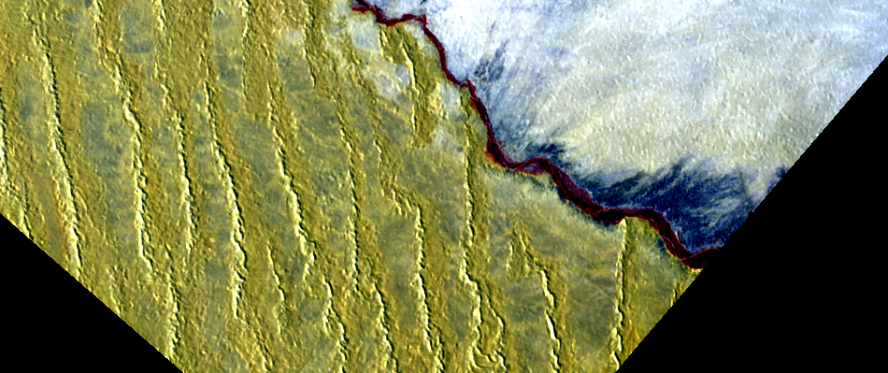
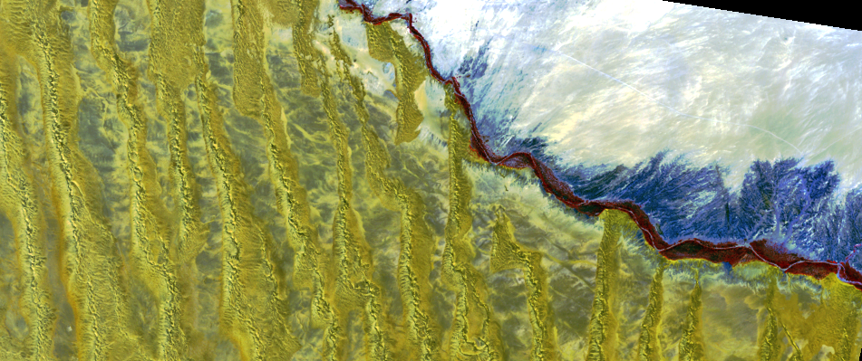
3 ● DESIS Data Products Synergies – DESIS & EnMAP
Gobabeb, Namibia; DESIS + EnMAP cal/val site,
DESIS: SAA 72°, SZA 47°, 02/10/2022, 07:52 (UTC)
EnMAP: SAA 40.9 xx°, SZA 25.6°, 02/10/2022, 09:43 (UTC)
Same L2A processing pipeline: PACO
BRDF correction: DESIS none, EnMAP – yes
RGB both sensors: R: 801/801 nm, G:675/672 nm, B: 501/501 nm
A
B
A
B
C
C
DESIS
EnMAP
E. Carmona et al., 13th EARSeL Workshop on Imaging Spectroscopy, 17.04.2024

Slide 21
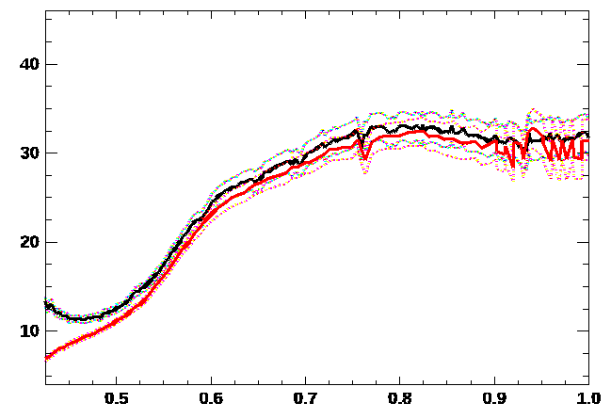
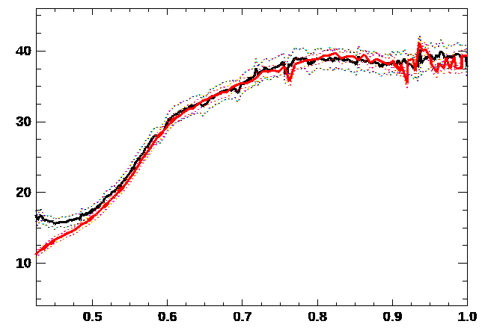
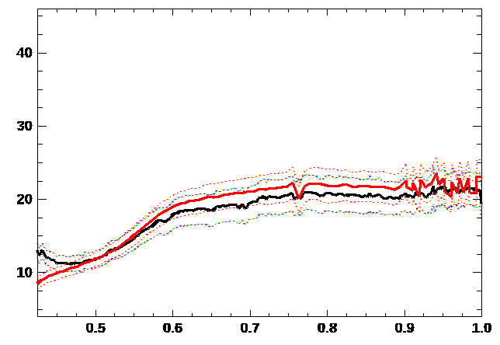
Synergies – DESIS & EnMAP
DESIS
EnMAP
A
B
C
Reflectance (%)
Reflectance (%)
Reflectance (%)
Wavelength (μm)
Wavelength (μm)
Wavelength (μm)
A
B
A
B
C
C
DESIS
EnMAP
E. Carmona et al., 13th EARSeL Workshop on Imaging Spectroscopy, 17.04.2024
Notes:
Hot potato to Emiliano
L1 calibration issue of DESIS
Problem coming from TOA, not a problem with ATM correction – deviation from RADCALNET
Not systematic – other scenes does not have this effect
Unclear
Emiliano:
Below 480 not so much reliable – calibration difficult, previously it was degrading, that stopped
First 6 bands careful

Slide 22
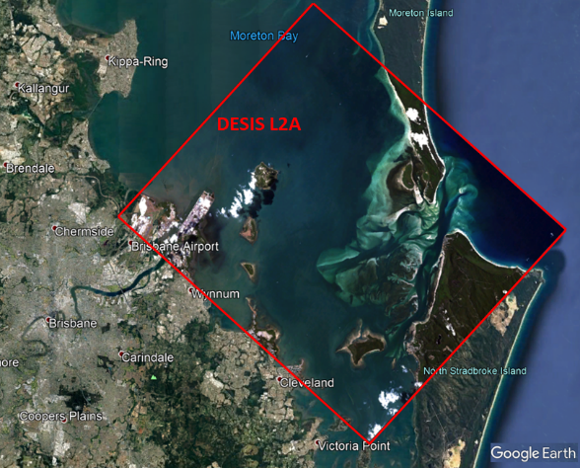
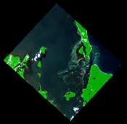
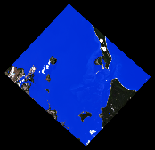
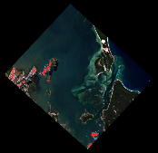
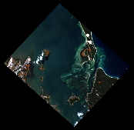
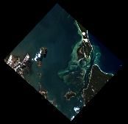

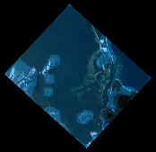
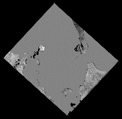
3 ● DESIS Data Products Data products
Archive
L1A Raw Data
(prepared for selection & ordering & processing)
Analysis Ready Data
L1B Top-Of-Atmosphere (TOA) Radiance
L1C Geocoded & Orthorectified
L2A Bottom-of-Atmosphere (BOA) Reflectance
Cloud Shadow
over land
Land Mask
Water Mask
Cloud Mask
Haze over land
Haze over water
AOT Map
WV Map

Slide 23
Processing chain and EnMAP Products
In-flight calibration observations are processed to generate updated calibration tables
Three level of users products can be ordered (L1B / L1C / L2A) from Earth observations. Dedicated L2A water processor (2 types of water products)
Processing on demand with user defined parameters
User products annotated with quality information (metadata) plus periodic quality and validation reports
Quality Control (GS) and Independent Validation (GFZ) performed on user products
EnMAP L2A data complaint with CEOS CARD4L at threshold specification
+ EnMAP Box coordinated by Science Segment

Slide 24
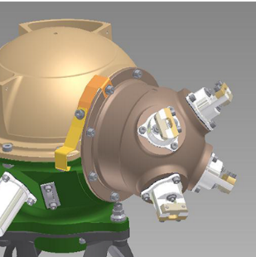
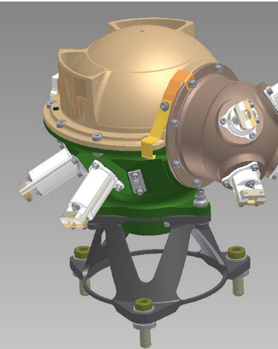
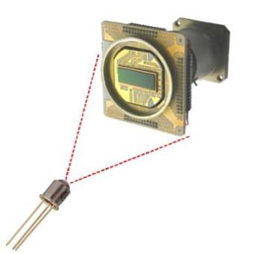
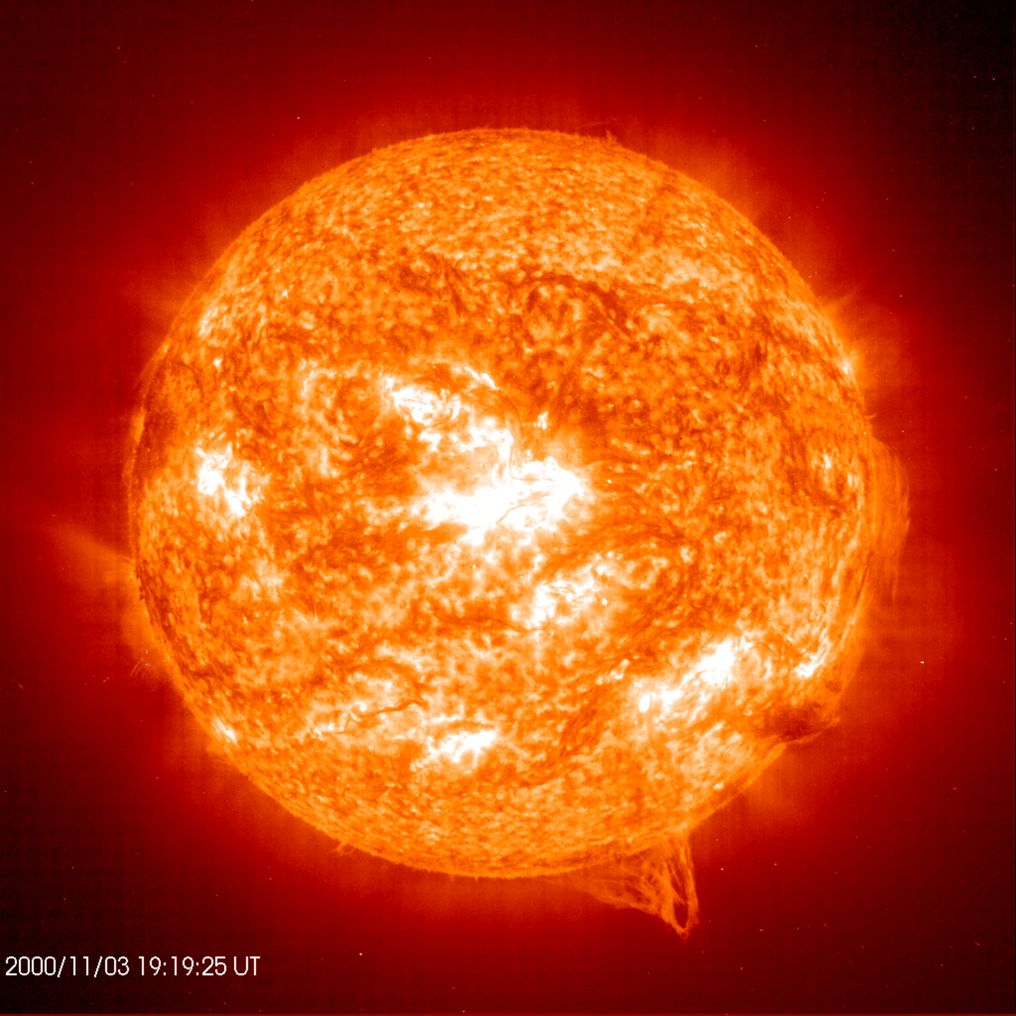
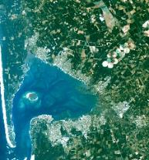

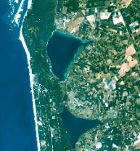
EnMAP Onboard Calibration
2.
Source: OHB
1.
White
OBCA-Radiometric Stability Lamp calibration with white spectralon sphere, frequency: weekly
OBCA-Spectral Spectral calibration with doped spectralon sphere, frequency: 2 weeks
Absolute Radiometric Sun calibration with sun diffuser, frequency: monthly
Linearity Calibration with LEDs in front of focal plane, frequency: monthly
5A. Shutter Calibration Mechanism Deep Space calibration, frequency: monthly
5B. Shutter Calibration Mechanism dark measurement, frequency: before and after every image acquisition
4.
3.
Source: OHB
Source: OHB
5B.
Source: ESA
5A.
Source: DLR, GFZ
Source: NASA

