Slide 1
Bridging the Gap to the FLEX Era:
A Cloud-Computing Framework for 300 m Global SIF Retrieval from Sentinel-3 and TROPOSIF
Yuxin Zhang, Pablo Reyes-Muñoz, Jochem Verrelst
Image Processing Laboratory (IPL), University of Valencia, Spain
Notes:
Good morning.
I’m Yuxin Zhang, from the University of Valencia, Spain. Today I will present a cloud-computing framework we developed to generate the first global 300-metre, 4-day SIF product by fusing Sentinel-3 OLCI data with TROPOM SIF using a Random Forest model on Google Earth Engine.

Slide 2
Motivation & Research Gap
Why do we need S3-based 300 m SIF products?
🌍
⏳
💻
Coarse Resolution
FLEX Not Yet Available
Scalability Challenge
ESA's FLEX mission will provide dedicated 300 m SIF. The scientific community urgently needs preparatory sub-km datasets NOW to maximize FLEX's impact.
Generating and managing large-scale high-resolution SIF datasets is computationally intensive—traditional local workflows cannot handle petabyte-scale S3 archives.
Most satellite SIF products (e.g., OCO-2, TROPOMI, GOME-2, and their downscaled datasets) are limited by their spatial resolution or regional coverage, preventing their effective use in fine-scale ecosystem studies and precision agriculture.
Our Solution:
Fuse Sentinel-3 OLCI (300 m) with TROPOSIF₇₄₃ via Random Forest on Google Earth Engine → first global 300 m, 4-day SIF product operational from 2016.
Notes:
As we know SIF is one of the most powerful indicators for photosynthetic activity.
The problem is resolution which limits their use for monitoring spatially heterogeneous landscapes like irrigated fields. While there have been many downscaled SIF products, they all have limited resolution or spatial coverage.
FLEX mission will address this by its full-spectrum SIF at 300 m. But until then, the scientific community urgently needs sub-kilometre datasets to develop the methods, workflows, and benchmarks that will maximise FLEX’s scientific return
Another challenge is the computational cost of working with global, high-resolution data.
Our solution addresses these issues at once: we fuse Sentinel-3 OLCI — which already has 300 m resolution — with TROPOMI SIF through a Random Forest model running entirely within Google Earth Engine, producing a global 300 m, 4-day SIF product.

Slide 3
Research Objectives
Generate S3-SIF₇₄₃
Validate the Product
01
First global 300 m, 4-day SIF product derived from Sentinel-3 OLCI fused with TROPOSIF₇₄₃ via Random Forest on Google Earth Engine.
02
Validate against ground-based tower SIF observations across diverse ecosystems (savanna, cropland, mixed vegetation) and compare to TROPOSIF
Demonstrate Spatial Heterogeneity
Bridge to ESA FLEX
04
Provide a preparatory dataset and operational framework for the upcoming FLEX mission (launch 2026) at matching 300 m spatial resolution and using Sentinel-3 data that FLEX will fly in tandem with.
03
Show the ability of the 300 m product to resolve sub-kilometer variability — irrigated croplands, climate zones, ecosystem boundaries.
Notes:
So in this study, first we generate our data the validate it against ground-based tower SIF measurements as well as against the TROPOSIF satellite reference.
Then we show that the 300 m resolution resolves landscape features — including irrigated croplands, and contrasting phenological patterns across climate zones.
our product matches FLEX's 300 m footprint, uses Sentinel-3 data that FLEX will fly in tandem with, and provides a baseline for upcoming FLEX cross-validation.

Slide 4
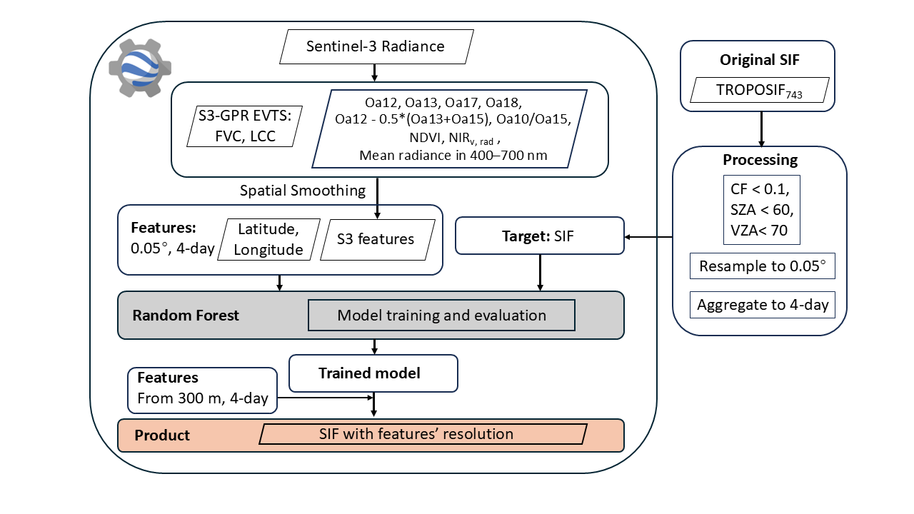
Methodology: Downscaling Framework
S3 OLCI Bands
Oa17 (865 nm)
Oa12 (753.75 nm)
Within TROPOSIF₇₄₃ retrieval window
Atmospheric/background correction
Oa13 (761.25 nm)
Oa18 (885 nm)
TROPOSIF₇₄₃ → reference target
O₂-A absorption — fluorescence proxy
Atmospheric/background correction
Vegetation monitoring
S3 radiances + indices
S3-GPR vegetation traits
Random Forest regression
Global prediction
Spectral Indices
GEE cloud-computing platform
NDVI
k = Oa10 / Oa15
70,
60
SIF-sensitive ratio (681 nm / 767 nm)
Vegetation greenness (Oa17 vs Oa08)
L = Oa12 − 0.5×(Oa13+Oa15)
NIRvR = NDVI × Oa17
O₂-A absorption depth
Near-infrared radiance of vegetation
Ancillary Features
Mean rad 400–700 nm
LCC (GPR model)
Photosynthetically active radiation band
Leaf Chlorophyll Content from S3-GPR
FVC (GPR model)
Latitude & Longitude
Fractional Vegetation Cover from S3-GPR
Geographic context for global generalization
Workflow for downscaled 300 m resolution S3-SIF₇₄₃ generation integrating S3 OLCI andTROPOSIF₇₄₃.
Training: Europe, April–November 2019 | Prediction: Global, 2016–
Notes:
To generate the data, the target is the retrieved TROPOSIF using the 743–758 nm spectral fitting window. We chose this window because its higher quality. Before training, we applied quality filtering, The filtered data were resampled to a 0.05-degree grid and aggregated into 4-day
All features are from Sentinel-3 OLCI at its native 300 m resolution include:
- Bands 12 and 13, which fall within or nearby the TROPOSIF retrieval window and the O2-A absorption region — these are the most SIF-sensitive bands.
- Then the bands 17 and 18, which help correct for background reflectance and atmospheric effects.
- Then we calculated 4 indices, one is the ratio between band 10 and band 15, which are located in the two peaks of SIF respectively. Another one is the O2-A absorption depth, then NDVI and NIRvR which have strong relationship with SIF
- Mean radiance across 400–700 nm, capturing the photosynthetically active radiation region.
- Then Leaf Chlorophyll Content and Fractional Vegetation Cover — retrieved also from S3 using our previously developed Gaussian Process Regression models.
- Finally, latitude and longitude, to give geographic context

Slide 5
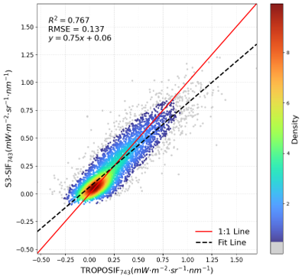
Model Performance: European Test Set
Key Observations
Strong positive linear relationship with TROPOSIF₇₄₃.
Good agreement across the dominant value range when TROPOSIF₇₄₃ > 0.
Underestimation at high SIF values (>0.8 mW m⁻² sr⁻¹ nm⁻¹) — typical RF regression-to-mean behavior.
Limited reproduction of negative TROPOSIF₇₄₃ values (noise-driven artifacts).
Scatter Plot: S3-SIF₇₄₃ vs TROPOSIF₇₄₃
Notes:
On the test set, the model performs well, with an R2 of 0.76 against the TROPOSIF. Predictions closely follow the 1:1 line when TROPOSIF is positive.
However high SIF values are underestimated, likely due to the property of Random Forest models called regression-to-mean, where the ensemble average compresses extreme predictions toward the centre of the training distribution, and negative TROPOSIF values—mainly caused by retrieval noise —are not well reproduced. The latter can be viewed positively, as it suggests that S3-SIF₇₄₃ captures physically meaningful SIF patterns rather than noise. These effects together result in a fitted slope less than 1

Slide 6
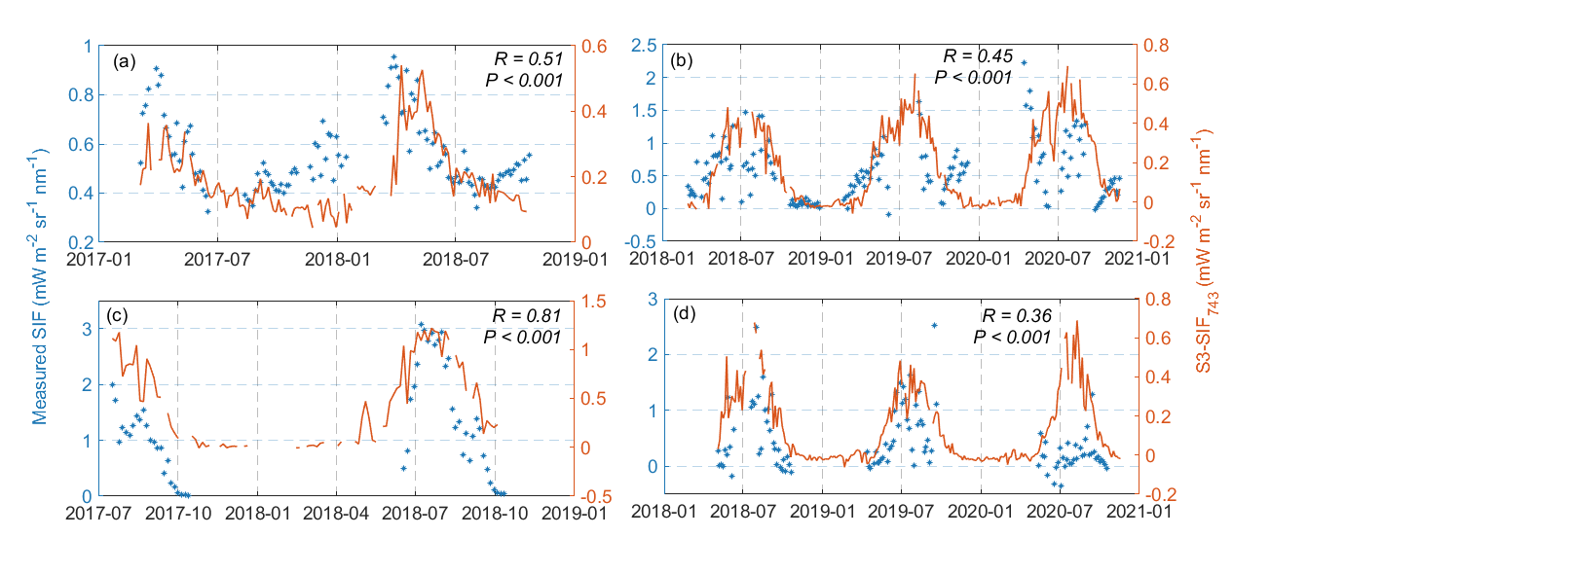
Temporal Validation Against Tower-Based SIF
Site | Time period | Position | Observation system | Ecosystem type
(a) Majadas de Tiétar | 2017/03 - 2018/10 | 39.9°N, 5.8°W (Spain) | FloX | Savanna
(b) XiaoTangshan | 2018/03 - 2020/11 | 40.2°N, 116.4°E (China) | AutoSIF | Cropland (winter wheat and maize rotation)
(c) US-Ne2 | 2017/07 - 2018/10 | 41.2°N, 96.5°W (USA) | FluoSpec2 | Cropland (Corn-soy rotation)
(d) HuaiLai | 2018/05 - 2020/11 | 40.3°N, 115.8°E (China) | AutoSIF | Mixture of grassand crabapple trees
Notes:
To validate seasonal dynamics we compared S3-SIF743 with tower-based SIF measurements at four sites span three continents and three ecosystem types:
Majadas de Tiétar in Spain: a Mediterranean savanna
XiaoTangshan cropland in China
US-Ne2 also cropland in the US
HuaiLai, a mixed grassland and trees ecosystem in China
Across all four sites, S3-SIF consistently captures the seasonal phenological cycle— matching the timing and shape of the observations, and all p-values are below 0.001.
Here S3-SIF743 values are consistently lower in absolute magnitude than the tower measurements. it is an expected consequence of spatial scale mismatch and observation view. A 300 m pixel will aggregate heterogeneous surface conditions including non-photosynthetic elements, while the tower observes a point-scale canopy footprint. On the other hand, only parts of the canopy SIF can be captured by satellites, which we call the escape probability. The value of this comparison lies in the timing and shape of the seasonal signal, that agreement is significant at all sites.

Slide 7
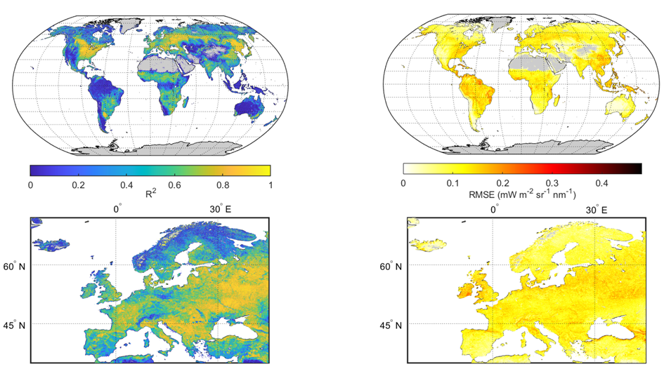
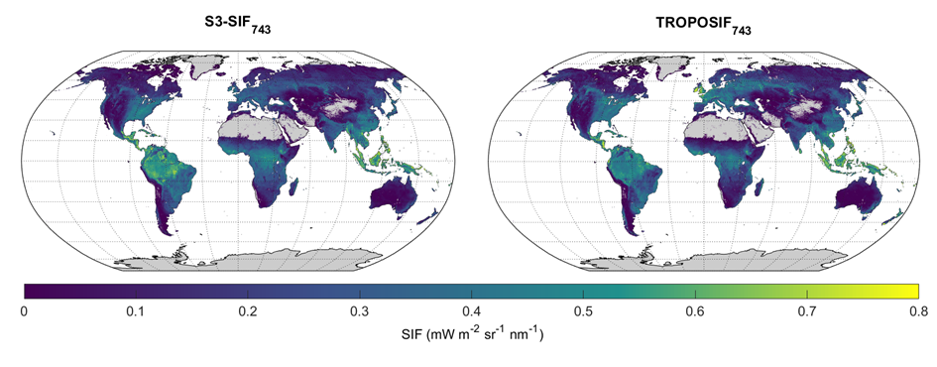
Spatial Distribution (0.05°, 2020 annual)
Spatial patterns of yearly-averaged S3-SIF₇₄₃ and TROPOSIF₇₄₃ at 0.05°in 2020.
SIF Hotspots
S3-SIF₇₄₃ vs TROPOSIF₇₄₃
Intra-annual R² and RMSE between S3-SIF₇₄₃ and TROPOSIF₇₄₃ in 2020.
Highest SIF >0.6 mW m⁻² sr⁻¹ nm⁻¹: Amazon, Central Africa, SE Asia, US Corn Belt
Slightly higher Amazonian values; slightly lower in Europe
Pixel-wise Agreement
Temperate Croplands R² > 0.8
Boreal Forests
R² 0.4–0.6
Low-SIF regions:
Grasslands
Sahara, Arabian Peninsula, Arctic/Antarctic (< 0.2 mW m⁻² sr⁻¹ nm⁻¹)
Arid Regions
R² < 0.4
Tropical Forests
RMSE < 0.1 mW m⁻² sr⁻¹ nm⁻¹ across most global regions
Notes:
Moving to spatial validation: The S3-SIF and TROPOSIF have good consistency at the global scale. Both identify the same SIF hotspots and low-SIF regions.
But also some differences: S3-SIF tends to show slightly higher values in the Amazon, and slightly lower values over Europe.
According to the pixel-wise R² map,
- The highest agreement is in the temperate croplands, achieve R² above 0.8
- In Boreal forests and grasslands the R2 fall in the 0.4–0.6 range.
- In Arid regions and tropical forests drop below 0.4, may reflect the fundamental challenge of optical satellite retrievals in these environments.

Slide 8
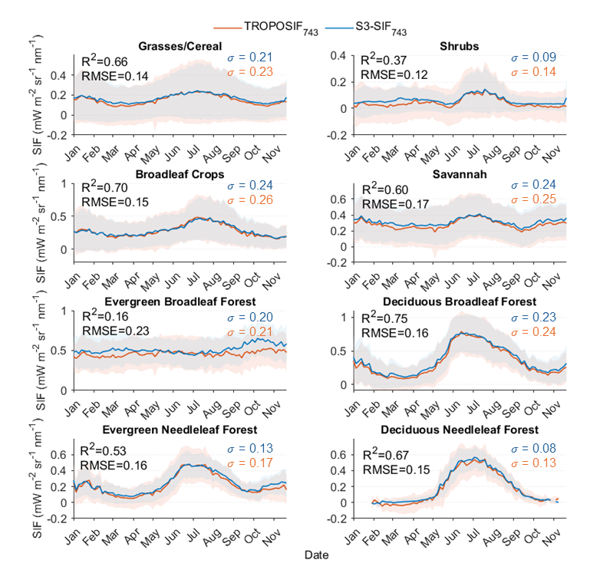
Seasonal Cycles by Vegetation Type
Vegetation Type | R² | RMSE | σ S3-SIF₇₄₃ | σ TROPOSIF₇₄₃ | Agreement
Deciduous Broadleaf Forest | 0.75 | 0.16 | 0.23 | 0.24 | High
Deciduous Needleleaf Forest | 0.67 | 0.15 | 0.08 | 0.13 | High
Broadleaf Crops / Croplands | 0.70 | 0.15 | 0.24 | 0.26 | High
Grasses / Cereal | 0.66 | 0.14 | 0.21 | 0.23 | Good
Savannah | 0.60 | 0.17 | 0.24 | 0.25 | Good
Evergreen Needleleaf Forest | 0.53 | 0.16 | 0.13 | 0.17 | Moderate
Shrubs | 0.37 | 0.12 | 0.09 | 0.14 | Moderate
Evergreen Broadleaf Forest | 0.16 | 0.23 | 0.20 | 0.21 | Low
S3-SIF₇₄₃ consistently exhibits lower spatial std. deviation,
indicating reduced retrieval noise across all biomes.
Comparison between S3-SIF₇₄₃ and TROPOSIF₇₄₃ for each vegetation type.
Notes:
Over the annual cycle across eight main vegetation types, the blue line is S3-SIF743 and the orange line is TROPOSIF743, with the shaded band of ±1 standard deviation. The S3-SIF shaded bands are consistently narrower than those of TROPOSIF across all vegetation types, which indicate a reduction of retrieval noise.
the strongest R² values appear where seasonal dynamics are sharpest. Like in deciduous broadleaf needleleaf forests, croplands, and grasses. where spring green-up and autumn fading create large, clearly SIF swings that the Random Forest can learn reliably.
The weakest agreement appears in evergreen broadleaf forests —probably the complex tropical environment with a relatively flat seasonal SIF signal, making both training and prediction challenging.

Slide 9
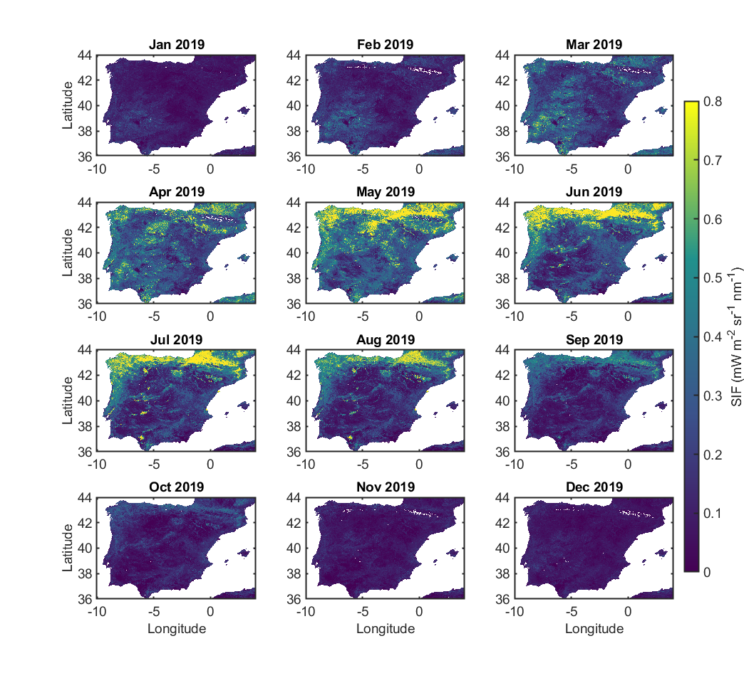
Fine-Scale Spatial Heterogeneity — Iberian Peninsula
Annual Phenological Cycle (Monthly S3-SIF₇₄₃)
Jan–Mar
Dormant — Near-zero SIF
Apr–May
Green-up — Rapid SIF increase
June
Peak — Regional maximum
Jul–Aug
Drought stress — Sharp decline (Med. interior)
Sep–Oct
Recovery — Gradual decrease
Nov–Dec
Senescence — Return to dormancy
Irrigated croplands remain green islands during summer drought
Monthly-averaged S3-SIF₇₄₃ in the Iberian Peninsula at 300 m resolution in 2019.
Notes:
Here we show the monthly SIF maps at 300 m resolution in Iberian Peninsula for a fine-scale detailed spatial study.
In 2019, January to March: SIF is near-dormant across the peninsula
April to June: A rapid green-up as temperatures rise.
July to August: This is the most striking transition. In the central and southern — the classic hot-summer Mediterranean domain — SIF values decreases sharply, photosynthesis is downregulated due to water stress.
In these summer maps. Scattered across the otherwise stressed landscape, you can see bright parts of elevated SIF — these are irrigated agricultural zones. This demonstrates the capability of the 300 m product to capture water management effects.

Slide 10
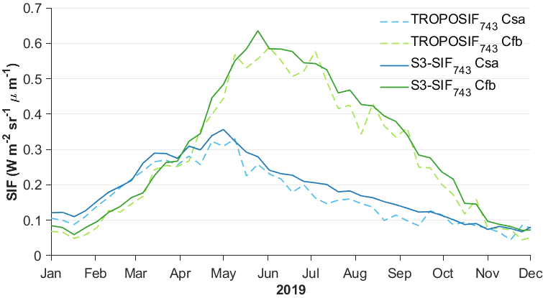
Fine-Scale Spatial Heterogeneity — Iberian Peninsula
Köppen Climate Types — Iberian Peninsula 2019
Hot-Summer Mediterranean
Csa
S3-SIF₇₄₃: Sharp spring peak (Apr–May), pronounced summer decline
TROPOSIF₇₄₃: Dampened peak, less-defined summer decline
Temperate Oceanic
Cfb
S3-SIF₇₄₃: Higher peak magnitude, sustained plateau, rapid senescence
TROPOSIF₇₄₃: Prolonged persistence, masks climatic sensitivity
SIF in the Iberian Peninsula for different climate types in 2019.
Notes:
This slide highlights the climatic sensitivity of S3-SIF by comparing two contrasting Köppen climate zones in the Peninsula:
hot-summer Mediterranean in the central and southern Peninsula, which experiences wet winters and dry summers with strong water limitation, and temperate oceanic along the northern Atlantic coast, which has more evenly distributed rainfall.
S3-SIF743 clearly captures their phenological contrasts more clearly.
While TROPOSIF reproduces the general seasonal pattern, but less distinct signal, with a weaker summer decline in hot-summer Mediterranean and a flatter, prolonged peak in temperate oceanic due to coarser resolution and higher noise.

Slide 11
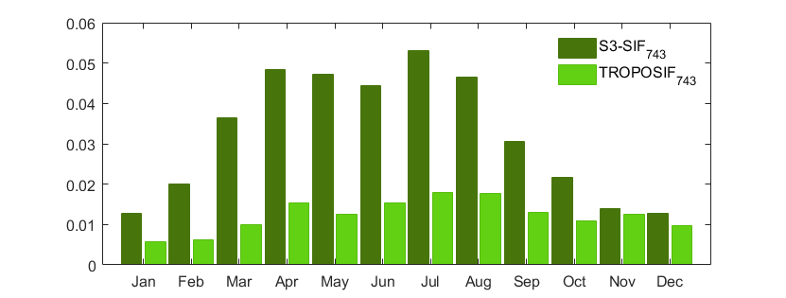
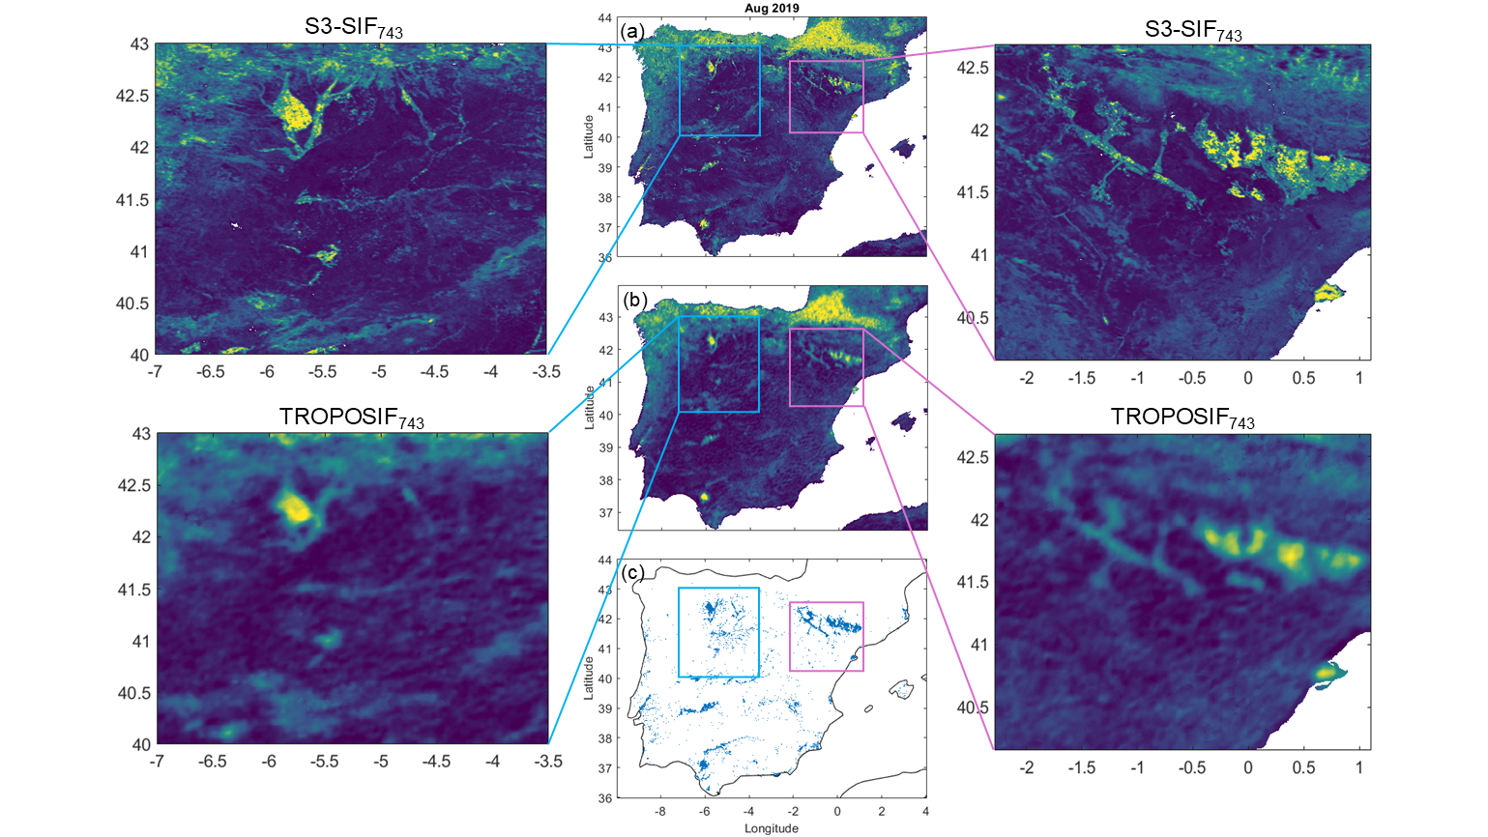
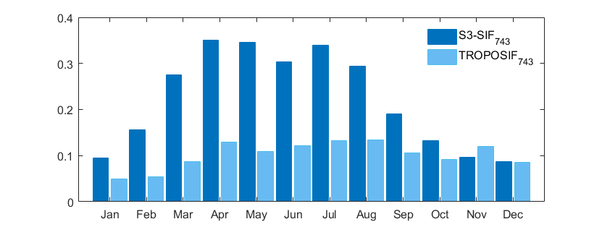
Fine-Scale Spatial Heterogeneity — Iberian Peninsula
σ̄_{area} (Internal variability)
Ḡ_{edge} (Boundary sharpness)
Monthly-averaged SIF in the Iberian Peninsula in Aug, 2019. (a) S3-SIF₇₄₃ (b) TROPOSIF₇₄₃
(c) Irrigated or post-flooding croplands in the Iberian Peninsula
Notes:
We quantified the spatial advantage of S3-SIF using two metrics in irrigated croplands. The first, standard deviation, represents the average local spatial variability and reflects how much internal detail is preserved within the land cover.
The second, the Sobel gradient magnitude along boundaries between irrigated and non-irrigated areas, indicating edge sharpness, how clearly the product distinguish the transition between field and surrounding landscape.
Across the year S3-SIF shows consistently higher variability and sharper edges. The monthly-averaged SIF map for August on the right provides a more visual example.
So S3-SIF743 is not a resampled version of TROPOSIF743 but contains sub-kilometer spatial information derived from 300 m Sentinel-3 observations

Slide 12
Strengths, Limitations & Future Work
Methodological Advantages
Known Limitations
Future Work
First global 300 m SIF product built entirely within GEE — scalable, reproducible, open-access
RF regression-to-mean: underestimates very high SIF (> 0.8 mW m⁻² sr⁻¹ nm⁻¹)
Extend to full-spectrum SIF
OpenEO / CDSE for greater transparency & reproducibility
Finer spatial resolution (300 m) vs. all existing products that rely on MODIS (~500 m–5 km)
Training limited to Europe: potential bias in tropical & arid extrapolation
Synergistic integration with ESA FLEX data (launch 2026)
S3 OLCI spectral richness (21 bands) + FVC/LCC vegetation traits improve model predictors
Inherits TROPOSIF₇₄₃ 743–758 nm window; no full spectrum
Scalable: can generate 2016–present global time series operationally
S3 data quality on GEE degraded post-2021, limiting temporal continuity
Notes:
In conclusion, the key strength of this work lies in its full implementation in Google Earth Engine, enabling the generation of 300 m global SIF product without local computing. The framework is scalable and openly accessible. By using Sentinel-3 OLCI—consistent with the FLEX mission flying in tandem—it provides a natural bridge toward the FLEX SIF monitoring.
However, The Random Forest model shows regression-to-the-mean at high SIF values, leading to underestimation of extremes. Training was restricted to European data because TROPOSIF retrieval quality in tropical and arid regions is relatively poor, which would introduce large uncertainties. In addition, the current product retrieves only far-red SIF, and post-2021 Sentinel-3 data quality issues in GEE limit temporary continuity.
Future work will focus on full-spectrum SIF reconstruction using all 21 bands, enhancing transparency through platforms such as openEO or CDSE, and finally developing a fusion framework with FLEX.

Slide 13

Conclusions
1
First global 300 m, 4-day SIF product (S3-SIF₇₄₃) derived from Sentinel-3 OLCI via Random Forest on Google Earth Engine — operational 2016–present
2
Good temporal agreement with ground-based towers across 4 sites and spatial consistency with TROPOSIF₇₄₃
3
Resolves sub-kilometer heterogeneity: irrigated croplands, climate boundaries
4
Reduced retrieval noise vs TROPOSIF₇₄₃ across all biomes
5
Direct bridge to ESA FLEX mission: matching 300 m footprint provides a historical SIF baseline for upcoming FLEX cross-validation
🔗 github.com/YuxinZhang1998/S3-SIF
Notes:
So in this study we developed our SIF data which has good agreement with both ground based and TROPOMI SIF data, our data resolves sub kilometer heterogeneity and shows a reduced retrieval noise compared to TROPOMI SIF. We hope that our product can be a direct bridge to FLEX mission by matching the resolution and providing a baseline for data cross validation.

Slide 14
Thank
You
Questions & Discussion Welcome
Questions & Discussion Welcome
Yuxin Zhang, Pablo Reyes-Muñoz, Jochem Verrelst
Image Processing Laboratory (IPL), University of Valencia, Spain
🔗 github.com/YuxinZhang1998/S3-SIF
Funded by ERC · FLEXINEL · 101086622
Notes:
Thank you. I am happy to take questions.

