Slide 1

The Atmospheric Correction Processor of the FLEX Sentinel-3 Tandem Space Mission
Pekka Kolmonen¹, Neus Sabater¹, Timo H. Virtanen¹, Sergio Cogliati², Pietro Chierichetti², Théo Paccoud³, Jorge Vicent^{3,4}, Gwennaël Matot³, and Marin Tudoroiu⁵
¹Finnish Meteorological Institute, ²University of Milano Bicocca, ³Magellium Artal group, ⁴University of Valencia, ⁵European Space Agency

Slide 2
Purpose of the Processor
Perform the atmospheric correction to the FLORIS-measured radiance to enable reliable SIF retrieval – Exploit the Sentinel-3 tandem mission data/algorithms
TOA radiance
TOC apparent reflectance
(irradiance)
Atmospheric Correction
FLEX
Clouds
Aerosols
Water vapor
Atm. correction
FLEX
S3
TOA: Top Of Atmosphere
TOC: Top Of Canopy

Slide 3
Purpose of the Processor
Interfacing with the FLEX L1C data
Cloud screening
  Reliable atmospheric/spectrally resolved SIF retrieval can be done only for clear skies (S3 SLSTR/OLCI)
Characterization of the atmosphere
  Retrieval of the properties of the atmospheric aerosols (S3 SLSTR + FLEX FLORIS)
  Retrieval of the columnar water vapor (S3 OLCI)
  Contingency in the potential absence of S3 data (CAMS + MACv2 climatology)
Atmospheric inversion
  FLORIS Apparent reflectance for SIF retrieval, S3 reflectance, irradiance
Feasible uncertainty determination (full error covariance – atmosphere, FLORIS instrument)

Slide 4
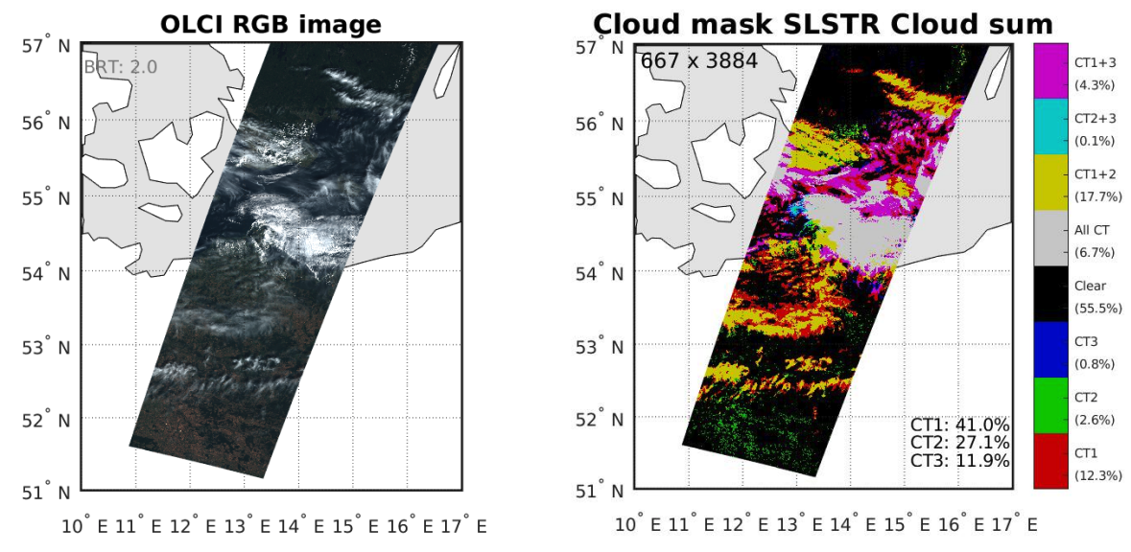
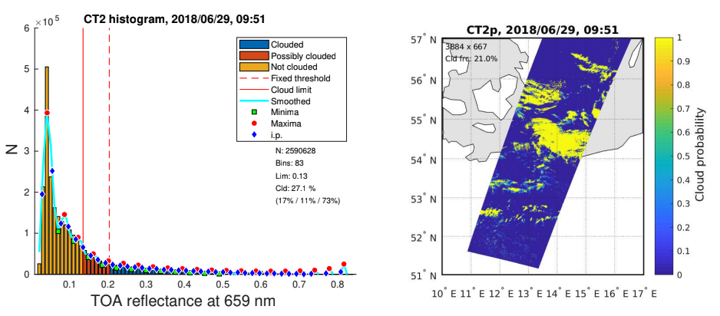
Cloud screening
Based on a combination of various threshold criteria applied to OLCI and SLSTR L1C data.
Cloud mask for the atmospheric correction purposes
Output: cloud probability
Combination
of cloud tests
Cloud test 2
cloud probability

Slide 5
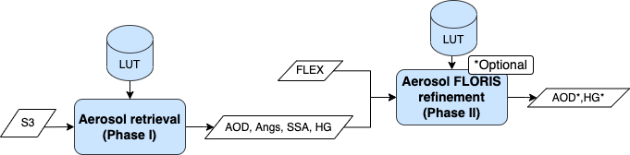
Characterization of the atmosphere – Aerosol retrieval
Aerosols scatter and absorb light at wavelengths overlapping with the SIF emission spectral range → major source of uncertainty in the apparent reflectance
Two-phase process
Retrieve the aerosol optical properties using the Sentinel-3 SLSTR data with approximation error augmentation. SLSTR dual-view: no assumptions about the surface reflectance amplitude
For the SIF retrieval, fine-tune mainly the asymmetry (HG) of the aerosol particles using the FLEX FLORIS data at the O₂A band. Method: minimize spectral distortions caused by errors in the retrieved aerosol at the absorption band
Angs*, HG*
FLEX
SLSTR

Slide 6
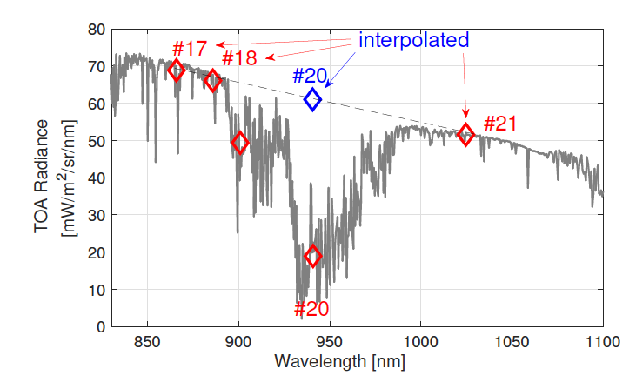
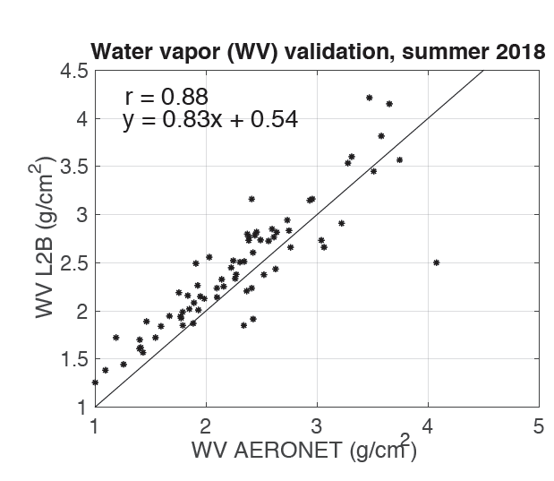

Characterization of the atmosphere – Columnar water vapor retrieval
The H₂O vapor retrieval strategy using Sentinel-3 OLCI data. Implemented strategy based on a differential absorption technique with solver options:
Function evaluation – Fast
MAP solution – Provides contribution to the full atmospheric uncertainty covariance
WV retrieved (g/cm²)
WV AERONET (g/cm²)

Slide 7
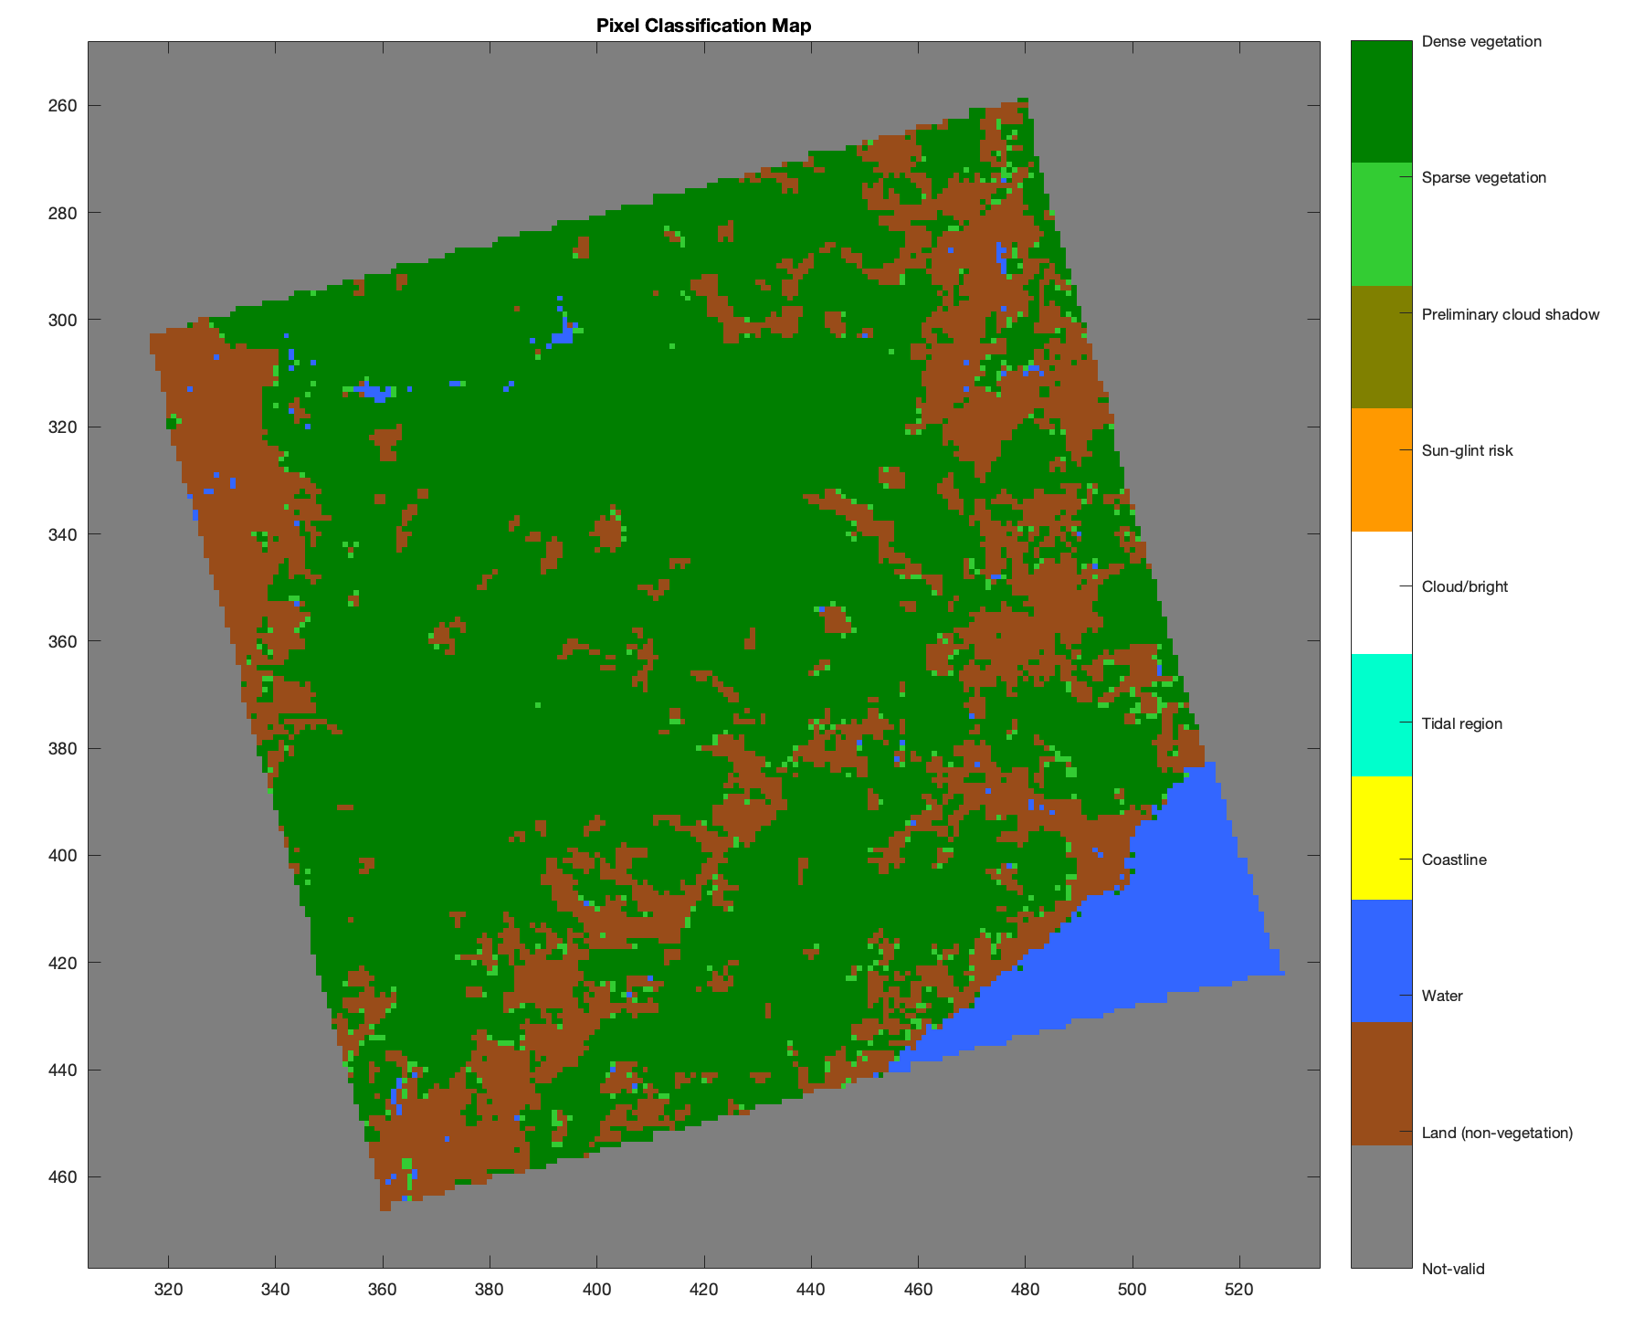
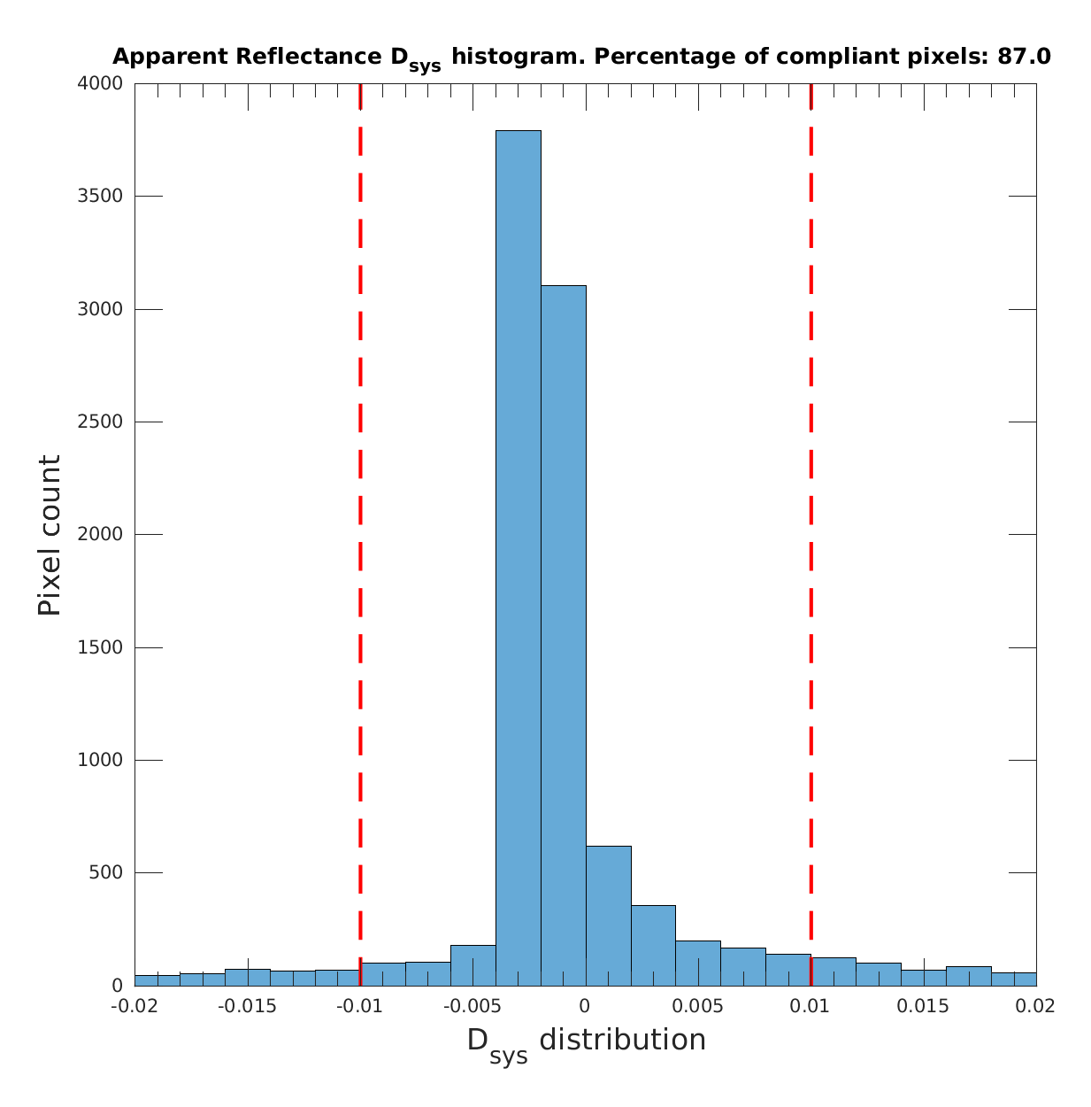
Performance Evaluation
Performance of the atmospheric correction module has been evaluated throughout the development process with simulated Test Data Sets
Example: simulated scene in Catalonia, Spain
Pixel classification
Columnar water vapor and aerosol evaluation
Apparent reflectance Mission Requirement evaluation
Apparent reflectance uncertainty

Slide 8
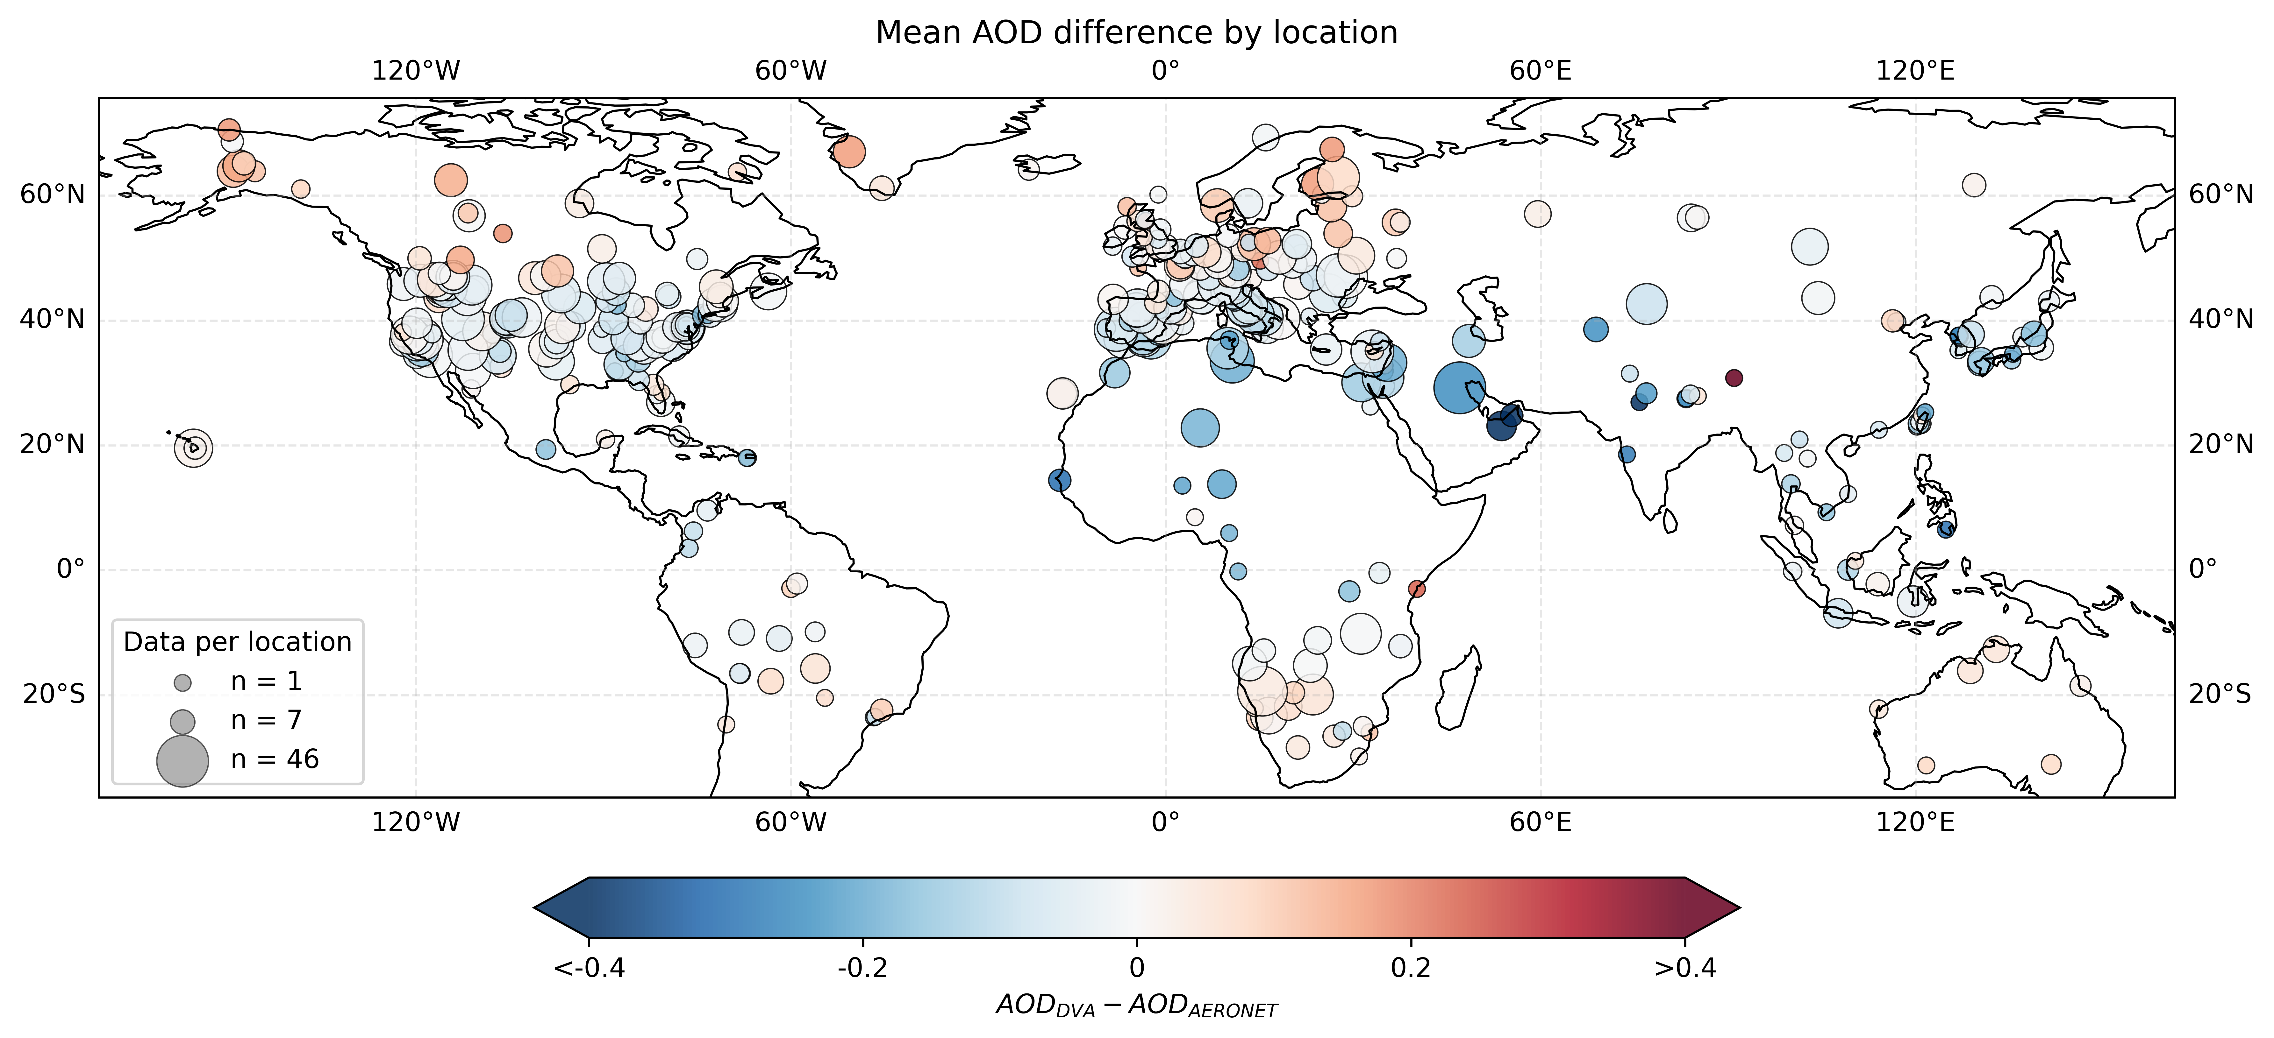
Performance Evaluation
🚀 Getting ready for launch
The Phase I of the aerosol retrieval is being tested with SLSTR data from the currently operational Sentinel-3s
AERONET ground reference
Atmospheric correction → Analyze results based on surface properties
For vegetation/urban land classes, the retrieval gives generally bias-free AOD estimates

Slide 9
Contingency – Sentinel-3 data unavailable
The Contingency process
S3 cloud screening replaced by applying FLORIS data to some of the SLSTR cloud tests
S3 SLSTR aerosol retrieval replaced with CAMS forecast product (AOD, Ångström) and MACv2 global aerosol climatology (asymmetry, SSA)
  Phase II aerosol retrieval with FLORIS data run as normal
S3 OLCI columnar water vapor retrieval replaced with CAMS forecast product

Slide 10
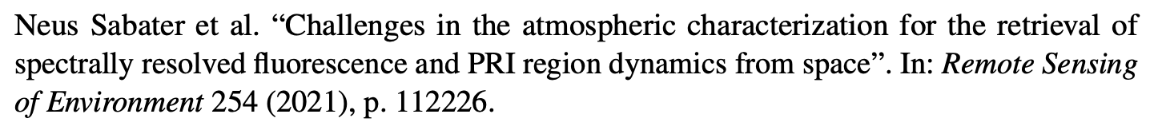
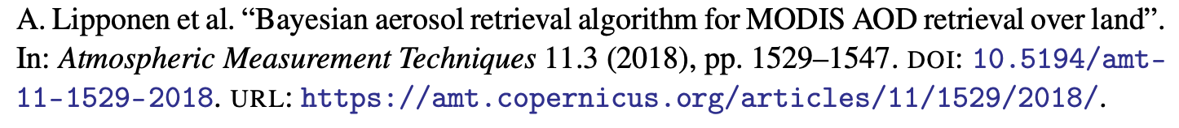
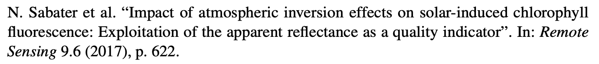
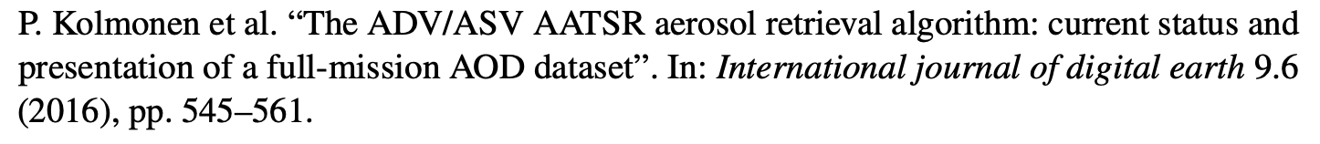
Summary
The FLEX atmospheric correction module
Fully tailored to the specific characteristics of the FLORIS instruments and demands for a reliable SIF retrieval
Takes advantage of the tandem-flying Sentinel-3
  Contingency: the module can be run without SLSTR and OLCI data
The resulting apparent reflectance has complete uncertainty characterization to support the SIF retrieval

Slide 12
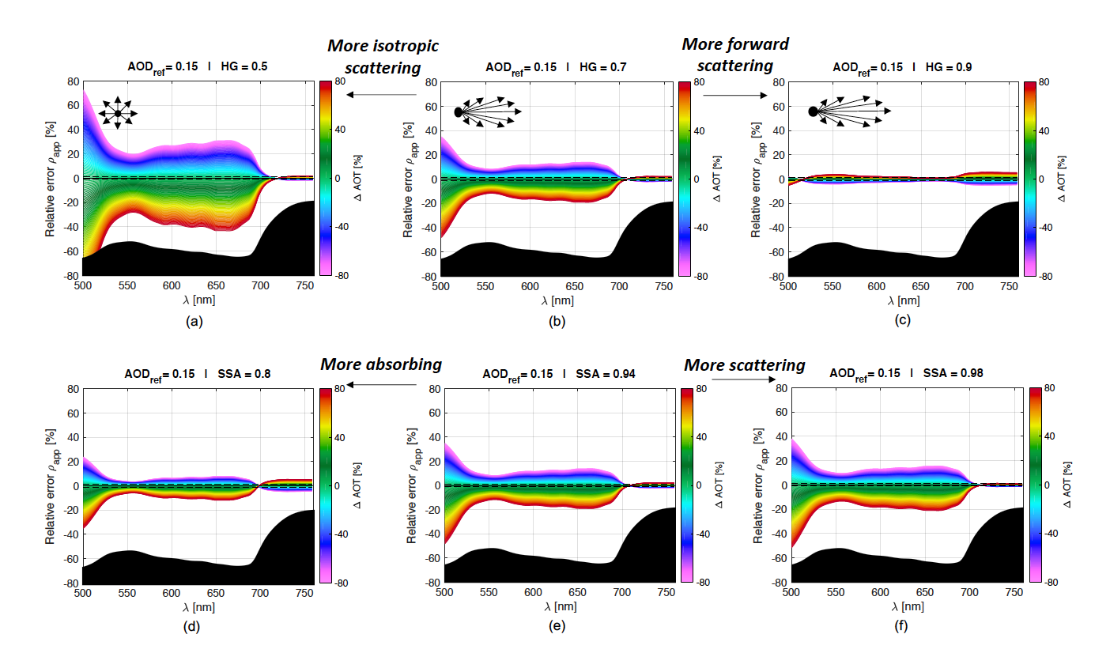
Characterization of the atmosphere – Aerosol retrieval
Aerosols scatter and absorb light at wavelengths overlapping with the SIF emission spectral range → major source of uncertainty in the apparent reflectance
Phase function
Absorption vs
scattering

Slide 13
Atmospheric inversion – Apparent reflectance + error covariance/uncertainties

Slide 14
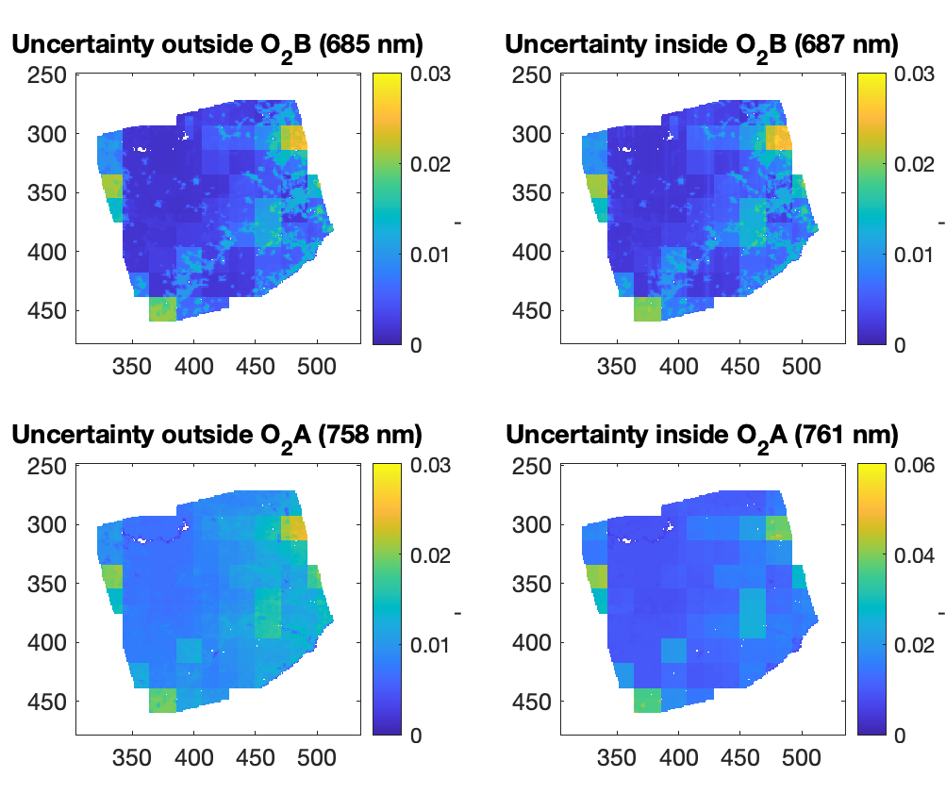
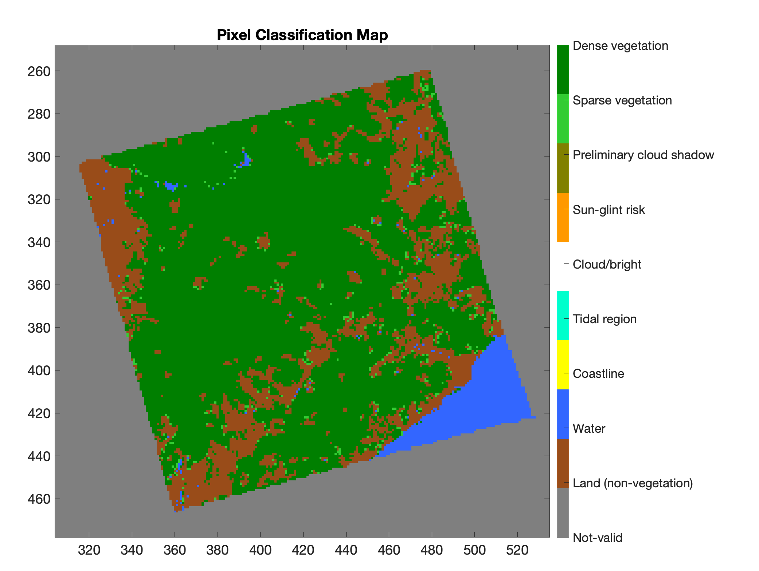
Atmospheric inversion – Apparent reflectance uncertainties

Slide 15
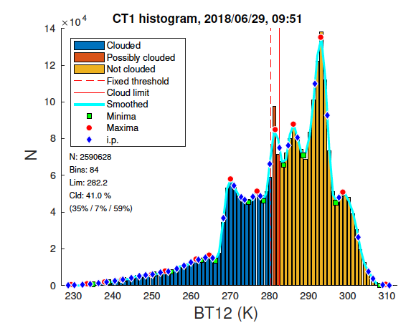
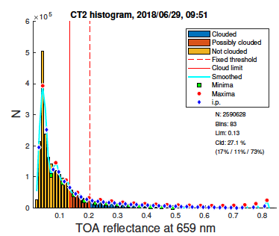




Clouds
Aerosols
Water vapor
Atm. correction
Using dynamic threshold criteria associated with the whiteness, brightness and coldness properties of clouds.
No cloud
No cloud
Cloud
Cloud
%
Histogram regions within the (0-100%) probability range
%
Histogram regions within the (0-100%) probability range
Example: histogram and dynamic threshold applied to SLSTR Brightness Temperature and Brightness

Slide 16



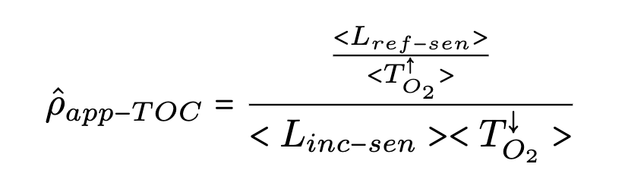
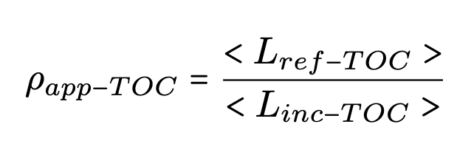

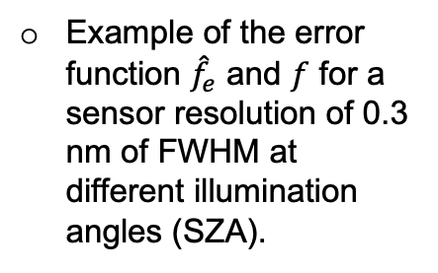

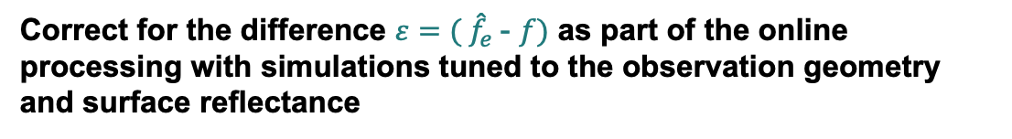
Atmospheric correction on tower-based measurements
${\hat{f}}_{e}$(error function)
$f$ (function)
Example of the error function ${\hat{f}}_{e}$ and $f$ for a sensor resolution of 0.3 nm of FWHM at different illumination angles (SZA).
Correct for the difference ${ε=( \hat{f}}_{e}$- $f)$ as part of the online processing with simulations tuned to the observation geometry and surface reflectance

Slide 17
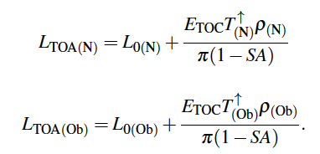


Proposed atmospheric correction scheme for FLEX
Step 1: SLSTR dual view exploitation

Slide 18
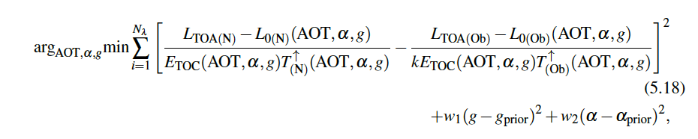
Proposed atmospheric correction scheme for FLEX
Step 1: SLSTR dual view exploitation
Nadir
Oblique
No assumption regarding albedo, just the assumption regarding the nadir and oblique relationship
A priori
A priori

Slide 19

Need for atmospheric correction when aiming to estimate spectrally-resolved fluorescence

