Slide 1
FLEX mission products and validation status
Jorge Vicent Servera, Theo Paccoud, Pekka Kolmonen, Neus Sabater Medina, Sergio Cogliati, Pietro Chierichetti, Christiaan van der Tol, Gwennael Matot, Roberto Colombo, Brice Mora, Marco Celesti, Marin Tudoroiu

Slide 2
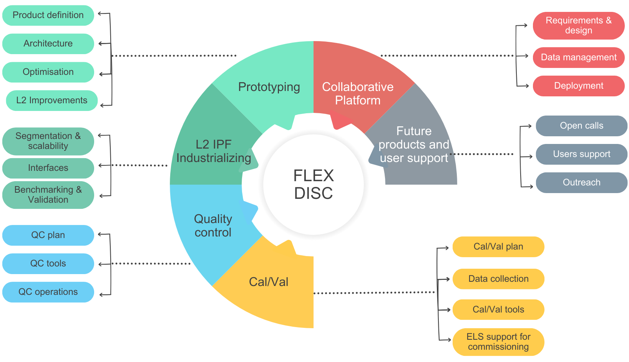
FLEX DISC activities: current status
FLEX Data Innovation and Science Cluster (DISC) goals: (1) develop and industrialize retrieval algorithms, (2) ensure efficient mission operations with the best data quality, and (3) involve future FLEX data users.
Specifically:
■
■
■
■
■
Consolidate the scientific algorithms into an industrialized IPF
Develop a collaborative platform for data exploitation (P. Goncalves)
Run Cal/Val activities for commissioning & operations (R. Colombo)
FLEX data quality monitoring
Enable users to contribute with novel algorithms

Slide 3




FLEX DISC activities: current status
Status of activities
We have recently finished with Phase 1:
solid prototyping of L2 algorithms (L2PP v3.1),
conception of Cal/Val strategy and industrialization of tools,
preparation of CP…
We are entering into Phase 2:
finalisation of tech. developments (robustification and industrialization of L2 prototype),
preparation for commissioning: rehearsing CalVal plan, test CalVal tools
Prototyping (Phase 1) | Industrialization (Phase 2) | Rehearsal (Phase 2) | Commissioning (Phase 3)
21 months 6 months 3 months 3 months

Slide 4
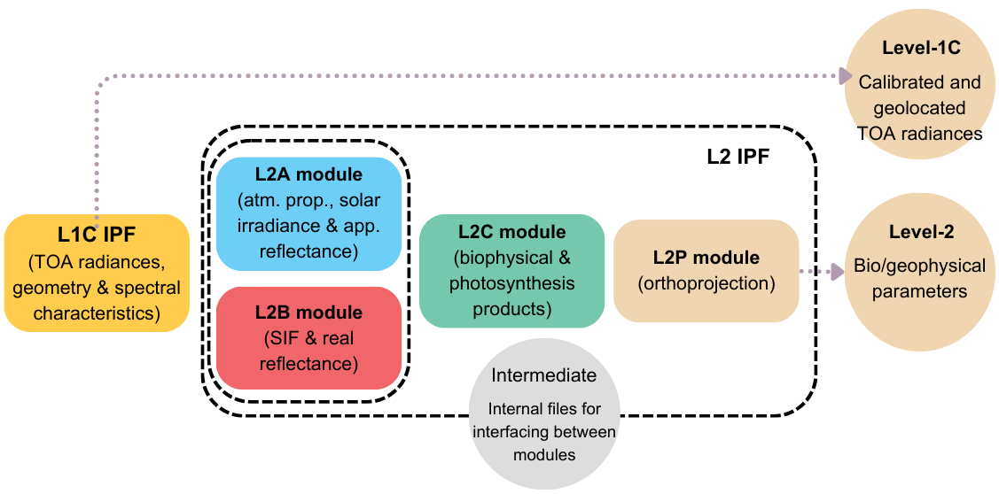
FLEX DISC activities: current status
Level-1C and Level-2 IPF
Two IPF in charge of generating Level-1C and Level-2 products
L1C IPF projects FLEX and Sentinel-3 data into a common working frame (FLORIS-HR) and harmonises radiances to account for different pointing of HR and LR spectrometers
L2 IPF is divided into 4 high-level modules: L2A, L2B, L2C and L2P
■
■
■
■
L2A: characterises atmosphere (CWV, aerosols, clouds) and retrieves surface app. reflectance (P. Kolmonen)
L2B: retrieves SIF spectrum (P. Chierichetti)
L2C: obtains biophysical properties of vegetation and photosynthesis related parameters (C. van der Tol)
L2P: orthorectifies data in UTM grid

Slide 5
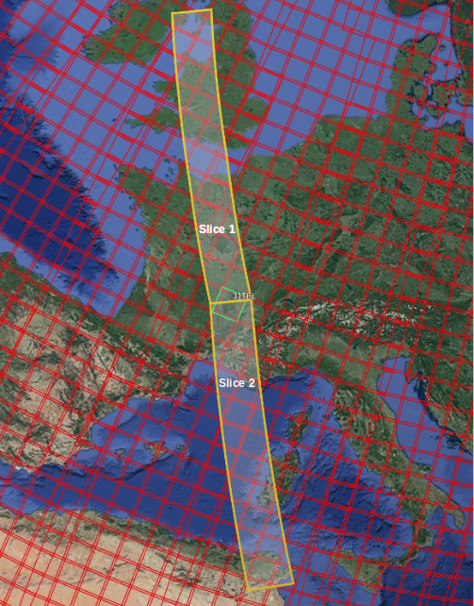
Level-1C (L1C) products overview
Level-1C products consists of calibrated TOA radiances for FLEX (HR-LR merged), OLCI, and SLSTR. These are spatially resampled and projected into the FLORIS-HR focal plane geometry, with appended information (spectral, meteo, quality, uncertainties)
Characteristics |  | Value/description
Size |  | 161 x 1397km² (536x4656 pixels) ← ~3min/slice + margin
Pixel size & spatial sampling distance (SSD) |  | 300x300 m², 300 m
Local observation time |  | 10:00 LTDN, 9:00 to 12:00 (south/north pole)
Accuracy |  | <0.1 SSD (geometric), 2-5% (abs. radiometric), <1% (rel. accuracy)
SNR@Lref |  | 175-1015
FLORIS spectral configuration |  | Range: 500-780 nm (580 spectral channels) Spectral sampling/resolution: 0.1/0.28 nm (inside O2)
OLCI/SLSTR spectral configuration |  | OLCI: 400-1020 nm (21 channels) SLSTR: 555-10850 nm (9 channels)
Data volume |  | 6.5 GB
flx_l1c_flxsyn_20270314T101206_20270314T101521_20270314T120248_0195_005_179_2339_01.nc

Slide 6
Level-1C (L1C) products overview
Level-1C product: main variables
FLORIS TOA radiance: Merged HR and LR hypercubes, w/ appended spectral information (and uncertainties) and radiometric uncertainties (absolute/relative radiometric accuracies and photon noise)
FLORIS instrument flag Identified source spectrometer after merging
OLCI TOA radiance, SLSTR nadir & oblique TOA radiance (spectral channels S1 to S8)
SLSTR nadir TIR TOA radiance (spectral channels S7 to S9)
FLORIS, OLCI and SLSTR extraterrestrial solar irradiance (TSIS-1)
Geolocation and geometry, including surface elevation/slope/aspect and view/solar angles
Meteorological data, extracted from FLEX L1B product ECMWF meteorological data and CAMS forecasting data (CWV, O3, sea level pressure, AOT at 550/670/865 nm)

Slide 7
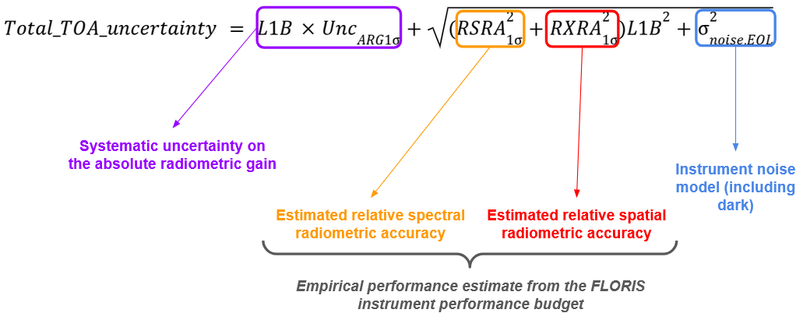
Level-1C (L1C) products overview
Uncertainty information in L1C allows for propagation to L2 products. We treat uncertainties spatially uncorrelated, but spectrally we differentiate between fully correlated■■ and fully random■■
L1C product comes along with Quality Indicators and meteorological information (ECMWF + CAMS forecasting):
Temperature/pressure profile
Columnar water vapor
Aerosol optical depth at 3 wavelengths
⇒ meteo is used for no-S3 contingency scenario
Quality indicator |  | Key Flags / Insights
Common Surface pixel_classification |  | Land/Water types, Cloud/Shadow detection, Vegetation density (NDVI-based).
FLORIS Quality quality_flags_floris |  | Validity in O2-A, O2-B, and PRI bands; Saturation & Dubious pixels.
OLCI Quality quality_flags_olci |  | Full 32-bit L1B legacy flags; Stray light and per-band saturation.
SLSTR Quality quality_flags_slstr |  | High-level status; Passed vs. Degraded/Failed processing.

Slide 8
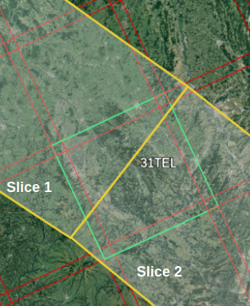
Level-2 (L2) products overview
Bio/geophysical variables, projected in UTM (S2 tiling), with appended information (spectral, quality, uncertainties). Divided into 3 groups: L2_atmosphere (atm. variables, clouds, surf. app. reflectance, at-surface solar irradiance, Land Surf. Temperature), L2_fluorescence (SIF spectrum and real surf. reflectance) and L2_vegetation (LCC, LAI, fAPAR_Chl…), photosynthesis-related parameters (RED, PSI/PSII…)
Characteristics |  | Value/description
Size (per tile) |  | 110 x 110 km² (366x366 pixels)
# of tiles per L1C slice |  | 18 to 21
Minimum # of valid pixels |  | 1340 (i.e., 1% of a UTM tile)
Pixel size and SSD |  | 300x300 m², 300 m
Surf. apparent reflectance |  | 500-780 nm at FLORIS resolution/sampling
Spectral range, sampling |  | SIF: 670-780 nm at 1 nm sampling Real refl.: 500-780 nm at 1 nm sampling
Data volume |  | 950 MB
flx_l2_flxsyn_20270314T101206_20270314T101521_20270314T120248_31sdd_005_179_01.nc

Slide 9
Level-2 (L2) products overview
Level-1C product (L2_atmosphere) (P. Kolmonen)
Cloud type (cirrus) and probability
Atmospheric properties: columnar water vapor and aerosol optical properties (AOD, Angstrom, Asymmetry)
FLORIS surface apparent reflectance in the SIF spectral region (670-780 nm)
OLCI and SLSTR (nadir) surface reflectance
Land surface temperature
Direct/diffuse at-surface solar irradiance from 400-780 nm
Level-1C product (L2_fluorescence) (P. Chierichetti)
Sun-induced fluorescence (SIF) in the 670-780 nm spectral region at 1 nm sampling
Real surface reflectance in the 500-780 nm spectral range at 1 nm sampling
Note: all variables come with uncertainties and spectral information

Slide 10
Level-2 (L2) products overview
Level-1C product (L2_vegetation) (C. van der Tol)
Biophysical parameters: LCC, LCCAR, LAI, FAPAR
Photosynthetic Active Radiation Absorbed by Chlorophyll
Fraction of Absorbed Photosynthetic Active Radiation by Chlorophyll (FAPAR_Chl)
Reversible energy dissipation (RED) expressed as the unnormalized portion of the photon flux of APAR_Chl (μmol m-2 s-1)
Fluorescence Quantum Efficiency (FQE) dimensionless ratio of SIF_photons over APAR_Chl_photons
Electron Transport Rate (ETR) through PSII, expressed as a molar flux density per unit of land surface
Escape probability (fesc) is the probability (in sensor direction times pi) that a SIF photon escapes the leaf and vegetation canopy towards the sensor. Provided in the same wavelengths as the SIF spectrum
PSI relative contribution

Slide 11
Validation results
L2 prototype (L2PP v3.0) has been validated within an E2ES framework
Several test datasets of synthetic simulation allowed us testing performance under various instrument configurations, atmospheric conditions, surface variability, and topography.
Results are fully described in the RPER v3.0. Further insight is given in the next session presentations
Variable | Requirement | Result | Comments
App. reflectance | Systematic: 0.01 | 0.0005 to 0.01 ✅ | Direct propagation from L1B abs. calibration bias (3.5%)
 | Random: 0.002 | 8e-4 to 0.01 ❌ | Any minor noise makes the requirement unreachable
Solar irradiance | 5% to 10% | <1.5% ✅
SIF at O2 | 0.2 mW/m2/sr/nm (if SIF<2mW/m2/sr/nm) or 10% | O2-B: 0.1 to 0.4 mW/m2/sr/nm O2-A: 0.05 to 0.5 mW/m2/sr/nm | ✅ in noise-free scenarios but ❌ mainly due to calibration bias
SIF peak values | idem | Red: 0.1 to 0.4 mW/m2/sr/nm Far-red: 0.1 to 0.3 mW/m2/sr/nm | idem
SIF peak positions | 5 nm | Red: 0.1 nm ✅ Far-red: <0.5 nm ✅
Integrated SIF | 10% | 10.5% (C1) to 30% (C4) | idem

Slide 12
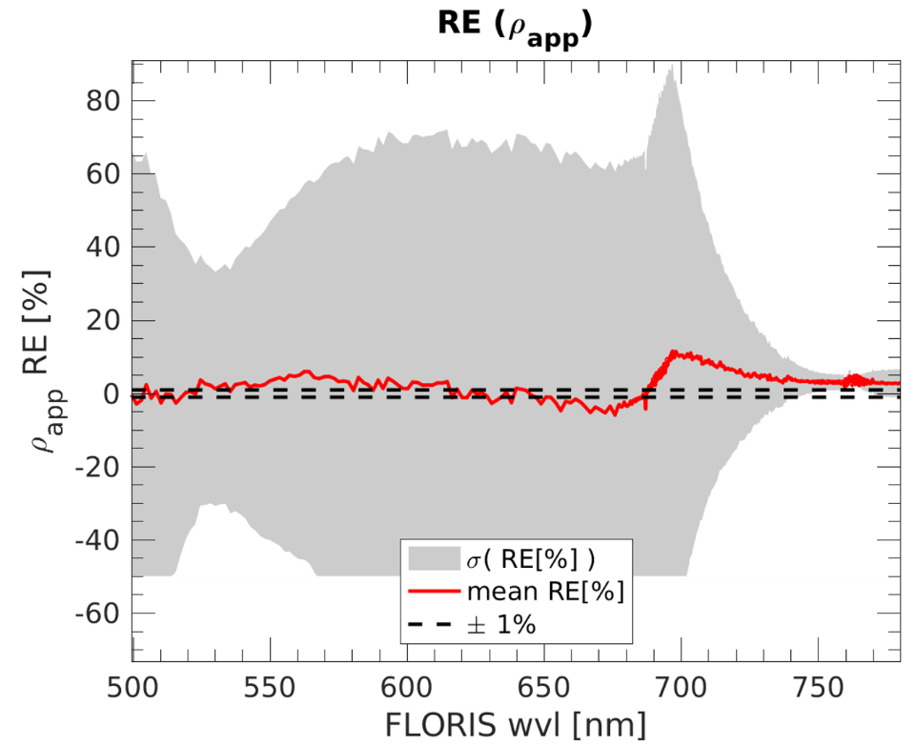
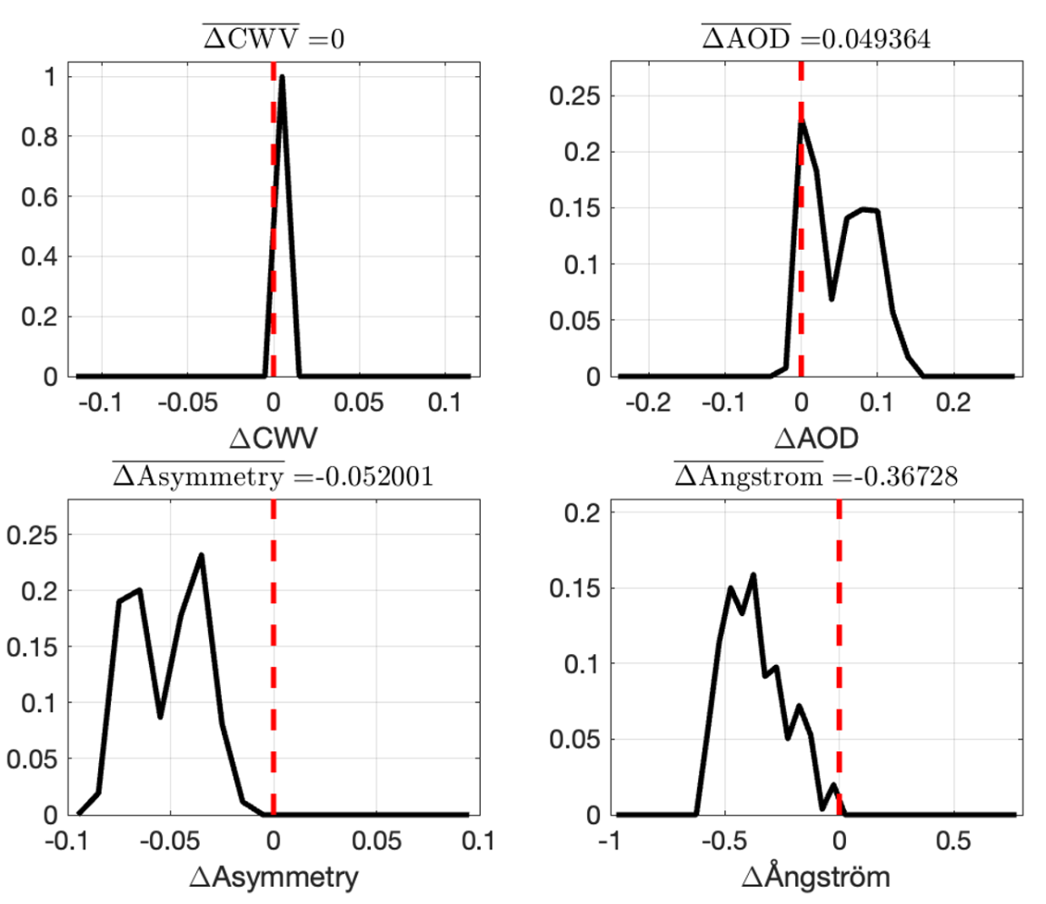
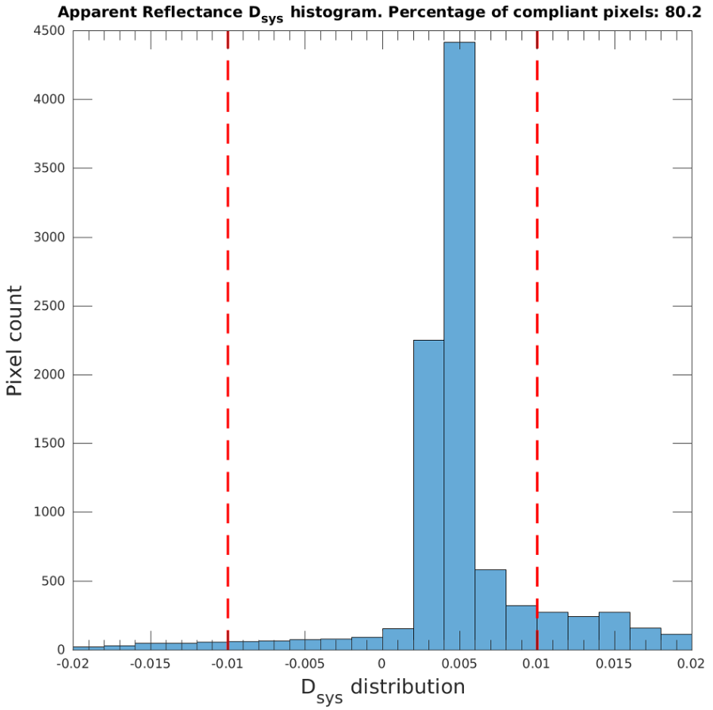
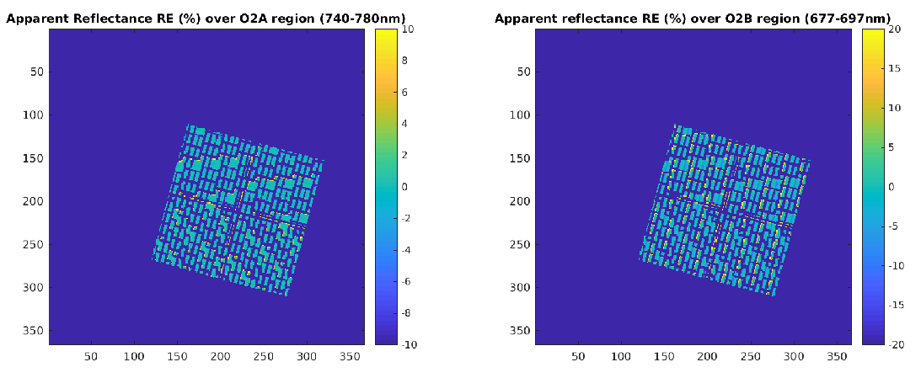
Validation results
Illustrative results for L2_atmosphere validation
Histogram of systematic error
Relative error in reflectance spectra (mean and std) w/ 2D map of errors in O2A region
Error distribution of atmospheric parameters

Slide 13
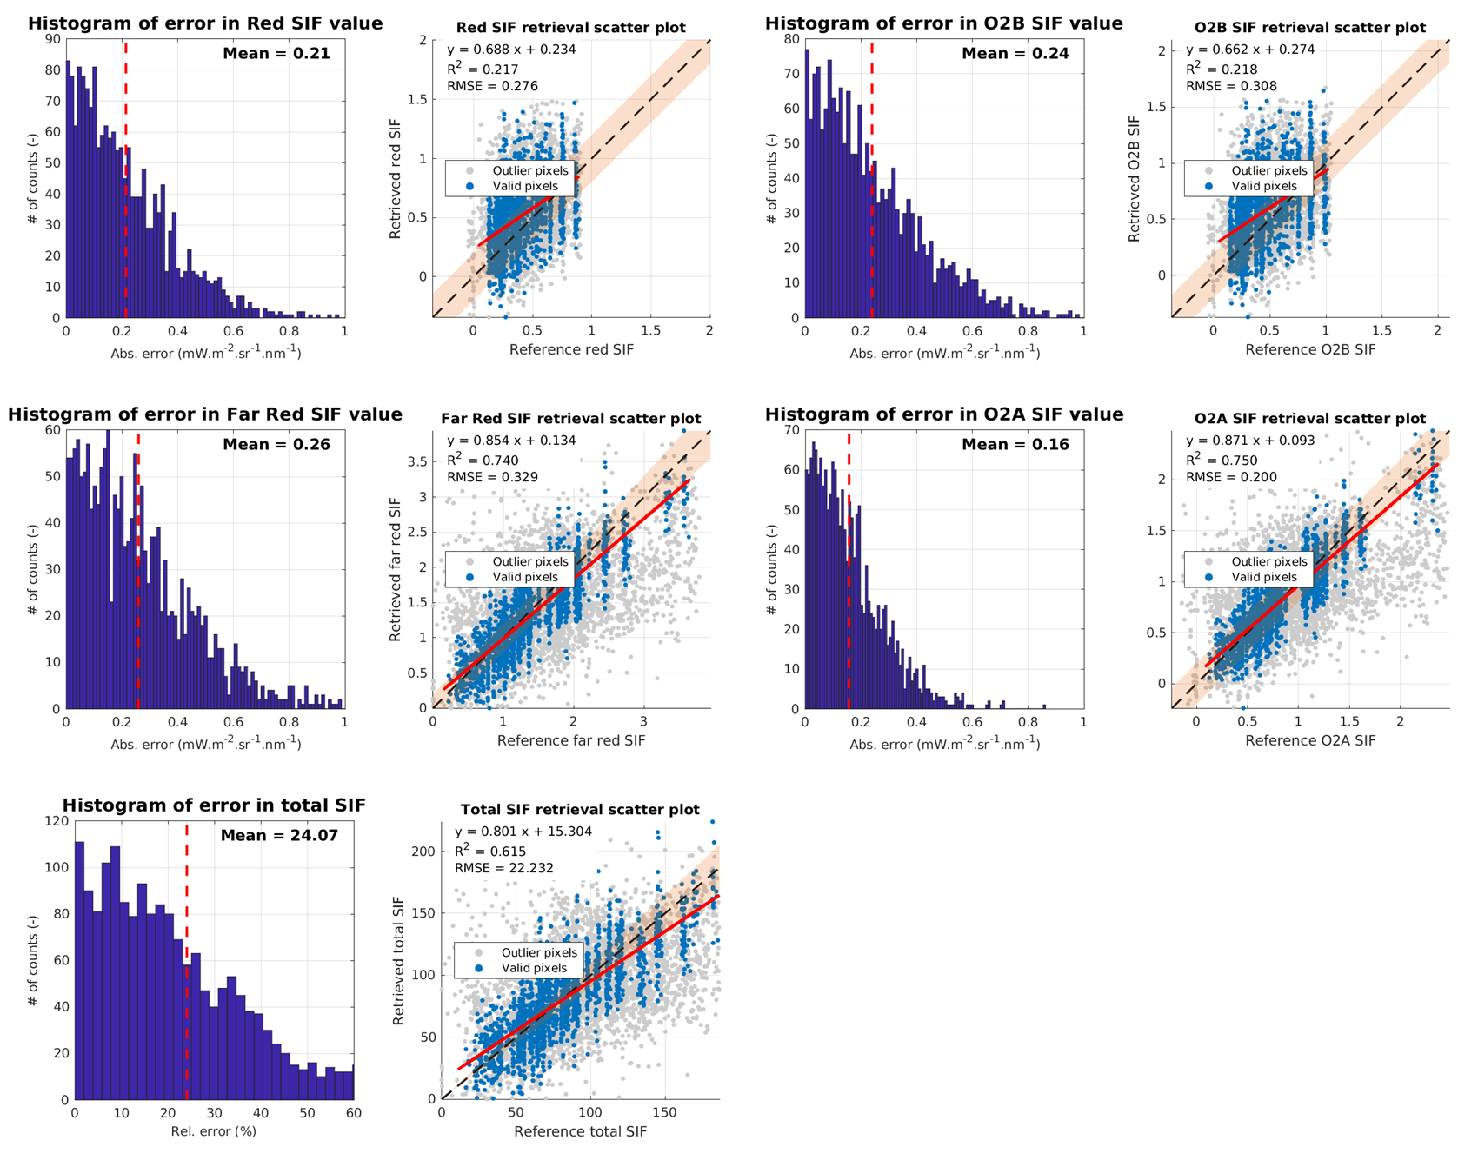
Validation results
Illustrative results for L2_fluorescence validation
Histogram and scatter plots of errors in SIF parameters (O2, peaks, total SIF)
Results for C6 instrument configuration (noisy but no bias in abs. calibration)
Errors close to requirements, particularly in longer wavelengths (O2A, far-red peak)
Sensitivity for O2B and red peaks values
Large dispersion due to random noise/calibration but no bias

Slide 14
Validation results
BACK-UP SLIDES
full product description -

Slide 15
Level-1C (L1C) products overview
📁 L1C product file (.nc) root
├── 📂 Measurement_data: 📄 floris_toa_radiance 📄 floris_toa_radiance_coregis_uncertainty 📄 floris_toa_radiance_noise_uncertainty 📄 olci_toa_radiance 📄 olci_toa_radiance_uncertainty 📄 slstr_nadir_toa_radiance 📄 slstr_nadir_toa_radiance_uncertainty 📄 slstr_oblique_toa_radiance 📄 slstr_oblique_toa_radiance_uncertainty 📄 slstr_nadir_brightness_temperature 📄 slstr_nadir_brightness_temperature_uncertainty
├── 📂 Annotation_data
└── 📂 Instrumental_information: 📄 floris_spectral_channel_central_wavelengths 📄 floris_instrument_flag 📄 floris_spectral_channel_fwhm 📄 floris_spectral_channel_central_wavelengths_uncertainty 📄 floris_spectral_channel_fwhm_uncertainty 📄 olci_spectral_channel_central_wavelengths 📄 slstr_vswir_spectral_channel_central_wavelengths 📄 slstr_tir_spectral_channel_central_wavelengths 📄 crosscalibration_coefficients 📄 hr_lr_scaling_coefficients
│ ├── 📂 Meteorology: 📄 aerosol_optical_thickness 📄 total_columnar_water_vapor 📄 tie_pressure_levels 📄 total_ozone 📄 temperature_profile
│ ├── 📂 Geometry: 📄 surface_slope 📄 surface_aspect 📄 surface_elevation 📄 sun_zenith_angle 📄 viewing_zenith_angle 📄 sun_azimuth_angle 📄 relative_azimuth_angle 📄 latitude 📄 longitude 📄 average_coregistration_uncertainty
│ ├── 📂 Quality: 📄 quality_flags_hr1 📄 quality_flags_hr2 📄 quality_flags_lr 📄 quality_flags_olci 📄 quality_flags_slstr
│ ├── 📂 Datation: 📄 time_stamp
│ └── 📂 Ancillary_data: 📄 floris_extraterrestrial_solar_irradiance 📄 olci_extraterrestrial_solar_irradiance 📄 slstr_extraterrestrial_solar_irradiance 📄 pixel_classification

Slide 16
Level-2 (L2) products overview
📁 L2 product file (.nc) root
├── 📂 L2_Atmosphere: 📄 cloud_probability 📄 cirrus_cloud_mask 📄 floris_apparent_reflectance 📄 floris_apparent_reflectance_uncertainty 📄 olci_apparent_reflectance 📄 slstr_apparent_reflectance 📄 floris_spectral_channel_central_wavelengths 📄 olci_spectral_channel_central_wavelengths 📄 slstr_vswir_spectral_channel_central_wavelengths 📄 land_surface_temperature 📄 direct_irradiance 📄 direct_irradiance_uncertainty 📄 diffuse_irradiance 📄 diffuse_irradiance_uncertainty 📄 irradiance_wavelength_grid 📄 integrated_par 📄 aerosol_optical_thickness 📄 asymmetry_parameter 📄 angstrom_exponent 📄 columnar_water_vapor
├── 📂 L2_Fluorescence: 📄 sif_emission_spectrum 📄 sif_emission_spectrum_uncertainty 📄 sif_wavelength_grid 📄 total_integrated_sif 📄 total_integrated_sif_uncertainty 📄 sif_peak_values 📄 sif_peak_values_uncertainty 📄 sif_peak_positions 📄 sif_peak_positions_uncertainty 📄 sif_O2_bands_value 📄 sif_O2_bands_value_uncertainty 📄 floris_real_reflectance 📄 floris_real_reflectance_uncertainty 📄 reflectance_wavelength_grid ├── 📂 L2_Vegetation: 📄 leaf_area_index 📄 leaf_area_index_uncertainty 📄 leaf_chlorophyll_content 📄 leaf_chlorophyll_content_uncertainty 📄 leaf_carotenoid_content 📄 leaf_carotenoid_content_uncertainty 📄 fraction_of_absorbed_photosynthetically_active_radiation 📄 fraction_of_absorbed_photosynthetically_active_radiation_uncertainty 📄 reversible_energy_dissipation 📄 apar_chlorophyll_photons 📄 apar_chlorophyll_photons_uncertainty 📄 fapar_chlorophyll 📄 fapar_chlorophyll_uncertainty 📄 fluorescence_quantum_efficiency 📄 fluorescence_quantum_efficiency_uncertainty 📄 electron_transport_rate 📄 electron_transport_rate_uncertainty 📄 fluorescence_escape_probability 📄 fluorescence_escape_probability_uncertainty 📄 PSI_PSII_relative_contribution
├── 📂 Ancillary_information: 📄 longitude 📄 latitude 📄 elevation 📄 sun_zenith_angle 📄 viewing_zenith_angle 📄 relative_azimuth_angle
└── 📂 Quality: 📄 pixel_classification 📄 quality_flags_atmosphere 📄 quality_flags_floris_app_reflectance 📄 quality_flags_s3_reflectance 📄 quality_flags_sif 📄 quality_flags_lst 📄 quality_flags_<biovar> (lcc, lca, lai, fpar, fparch, fesc, fparchfesc) 📄 quality_flags_fqe 📄 quality_flags_npq 📄 quality_flags_photo 📄 quality_flags_psi

