Slide 1

Analyzing the global role of TROPOMI-derived SIF and Sentinel-3 fundamental vegetation traits as proxy predictors in GPP models
u
Pablo Reyes Muñoz, Dàvid D. Kovacks, Yuxin Zhang, Jochem Verrelst - University of Valencia

Slide 2
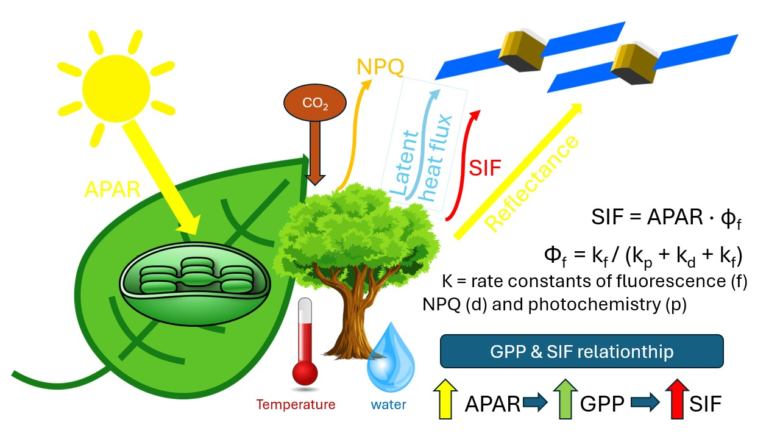
Introduction
SIF, the most direct measurable indicator of photosynthesis activity from satellite, represents a physiological response (energy regulation).
At canopy, SIF and GPP have positive correlation with APAR (Absorbed Photosynthetically Active Radiation)
APAR depends on canopy structural variables: LAI, FAPAR and meteorology (PAR)
LAI and FAPAR, derivable from Sentinel-3, flying in tandem with FLEX are crucial therefore for the interpretation of the SIF signal and GPP.

Slide 3
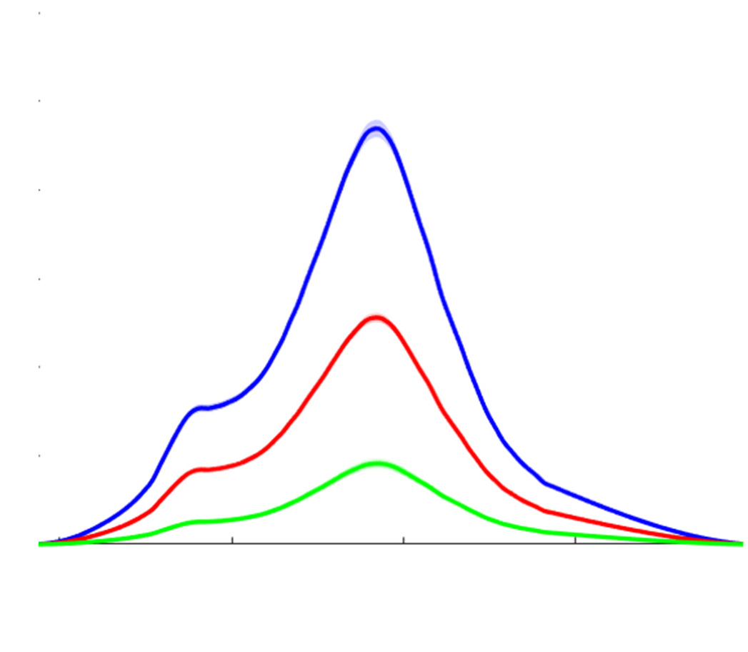




Introduction
Assessing SIF as a proxy variable for prediction of GPP
Meteorology influences vegetation dynamics, including SIF and GPP
SIF is measureable from satellite and it is correlated with GPP and indirectly controlled by meteorology.
Meteorology
SIF
PAR
Soil water
GPP
Vegetation dynamics
T
Energy fluxes
C₆H₁₂O₆

Slide 4

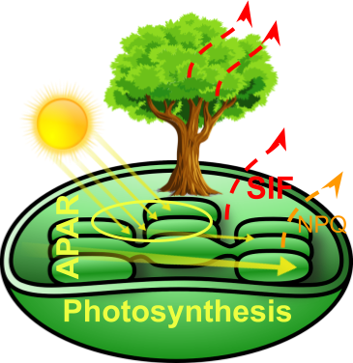

Objectives
Interpretation of the link between SIF, GPP and meteorological constraints through satellite-derived products.
Intercomparison of GPP products driven by diverse inputs, including satellite-SIF and soil meteorological information.
To analyse the correlation/causality of diverse meteorological constraints on satellite-SIF response at large scale.

Slide 5
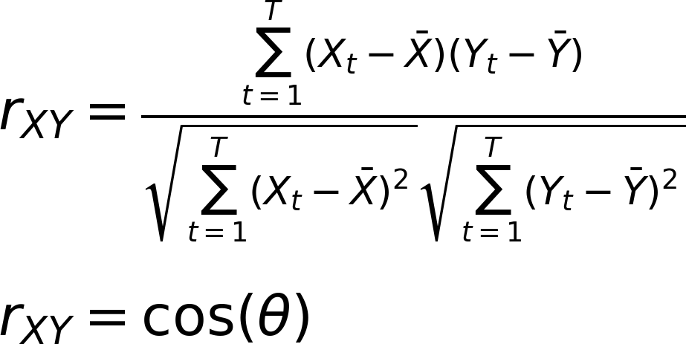
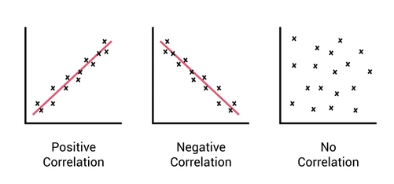
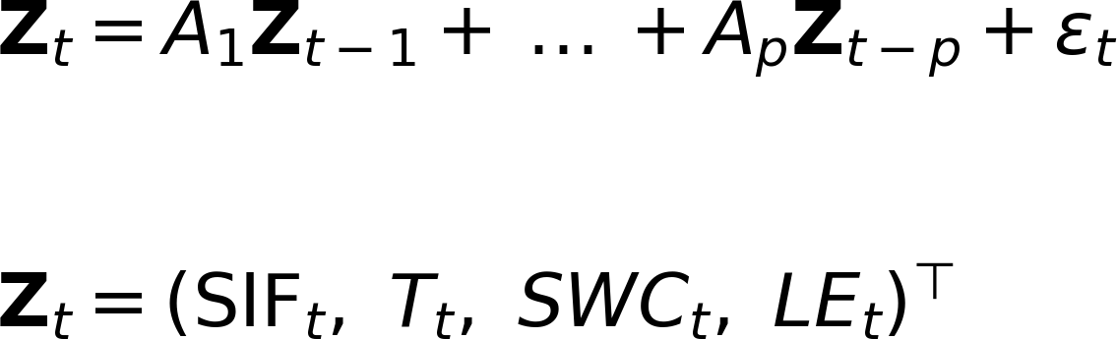
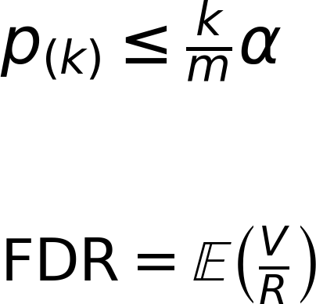
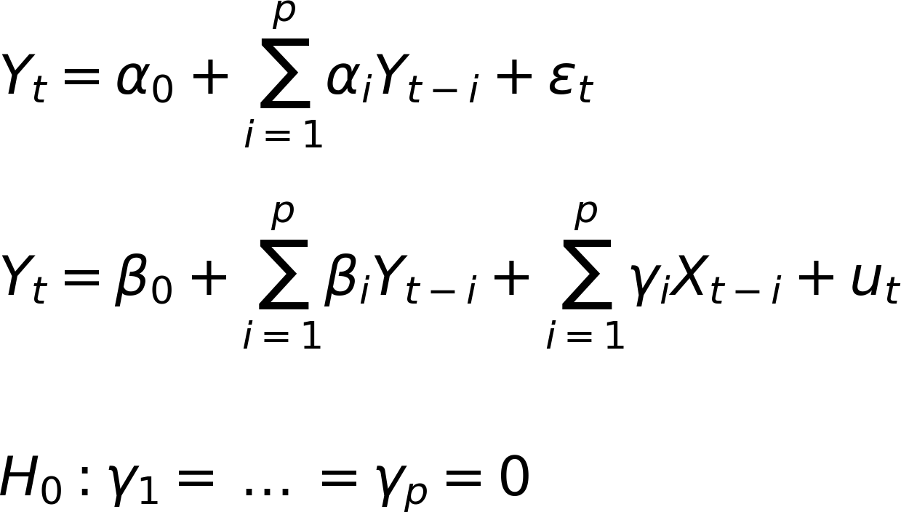
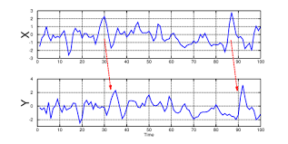
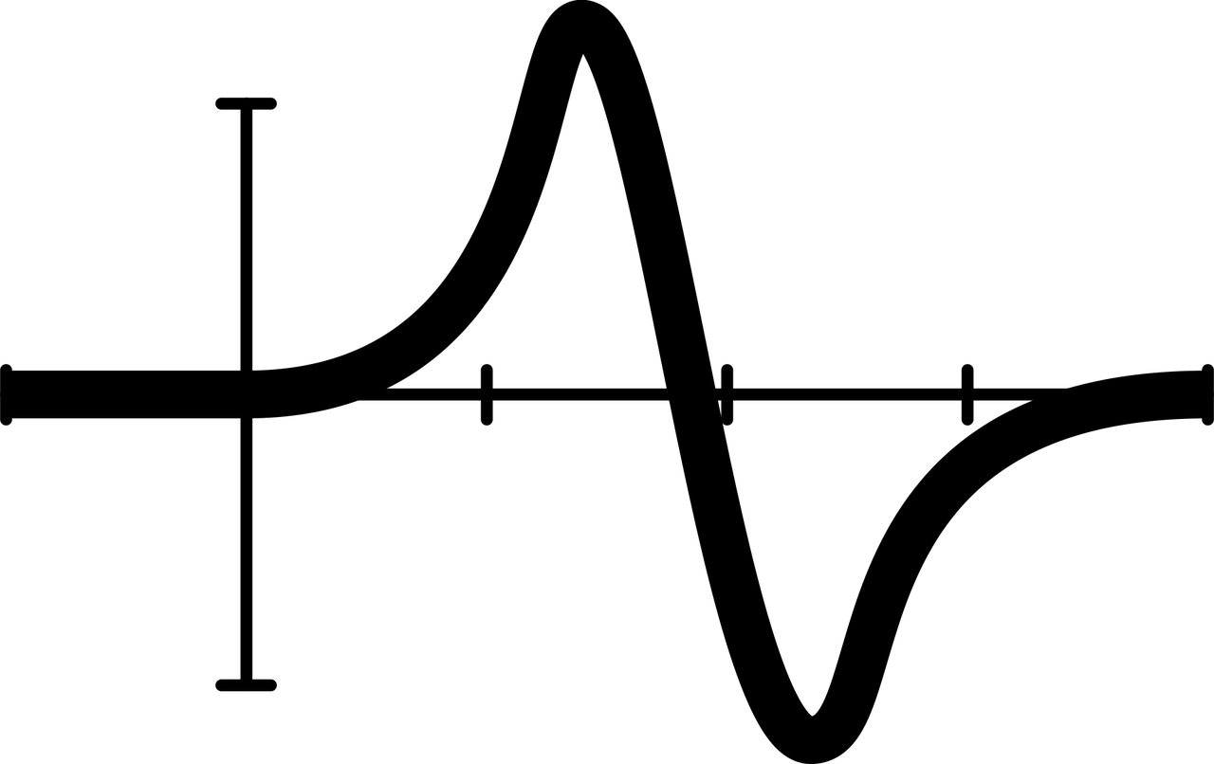
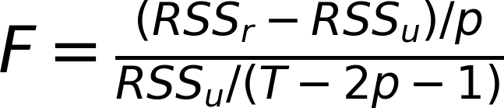
Methods - Predictive causality
Analyzing inter-variables relationships:
1) Pearson Correlation: Measures linear co-variation (symmetric):
2) Granger Causality: Test prediction information flow
(directionality, autoregression).
3) Multivariate Granger
4) Statistical significance through multiple tests: Benjamin Hochberg

Slide 6


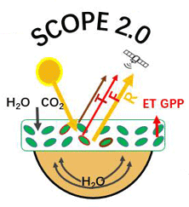

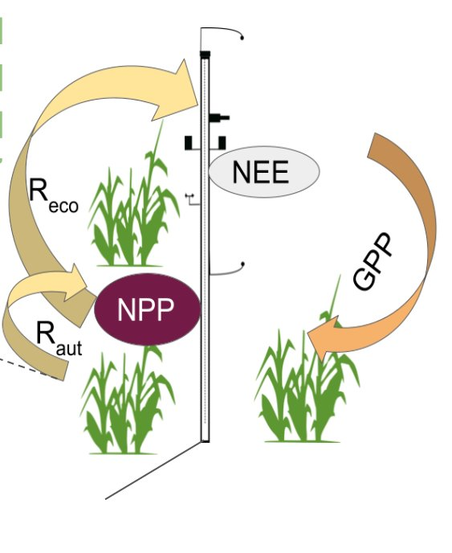

Methods - Data
Data used in this study:
TROPOSIF¹: daily scaled at 7 x 3.5 km, global coverage
ERA5-Land: reanalysis product ~9Km, global coverage, meteorology
SCOPE-GPR-GPP²: Hybrid model of GPP driven by TROPOSIF, S3-derived vegetation traits and ERA5-Land as input features
EC-GPR-GPP³: Data-driven model of GPP with ERA5-Land and MODIS-derived LAI
TROPOSIF
ERA5-Land Meteo
Workflow
SCOPE-GPR-GPP
Eddy-covariance
EC-GPR-GPP
¹Guanter et al., 2021
²Reyes-Muñoz et al., 2024
³Reyes-Muñoz et al., 2025

Slide 7



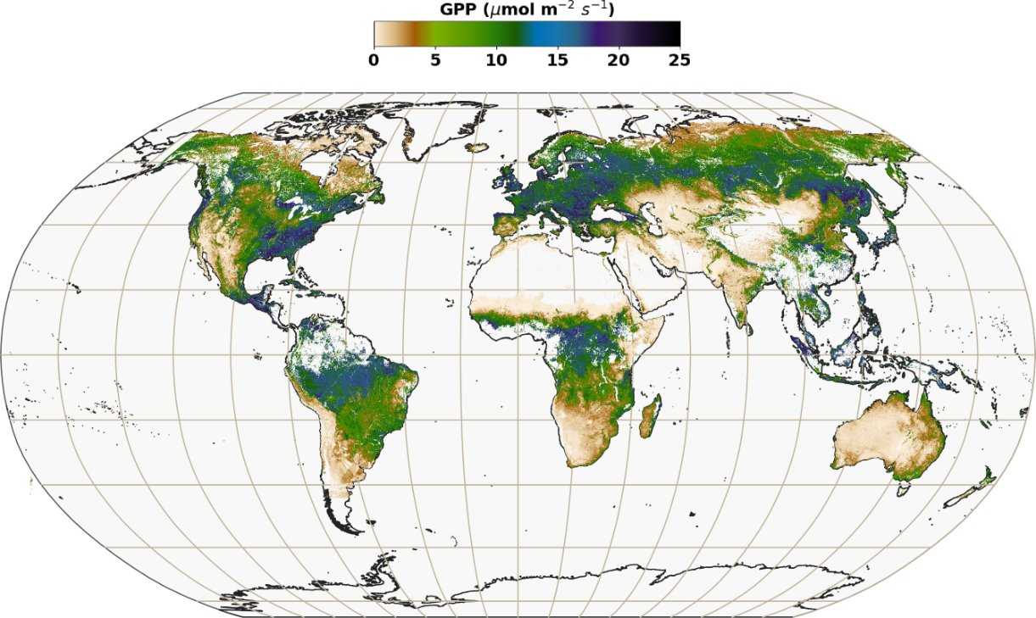
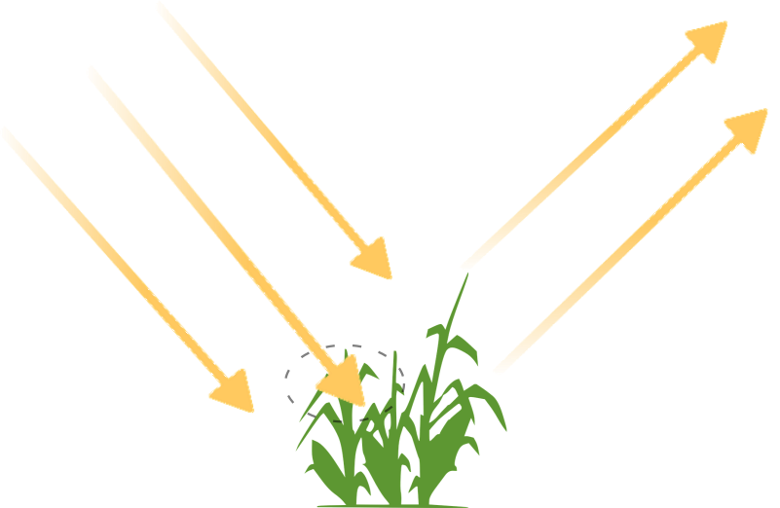
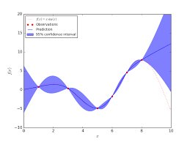
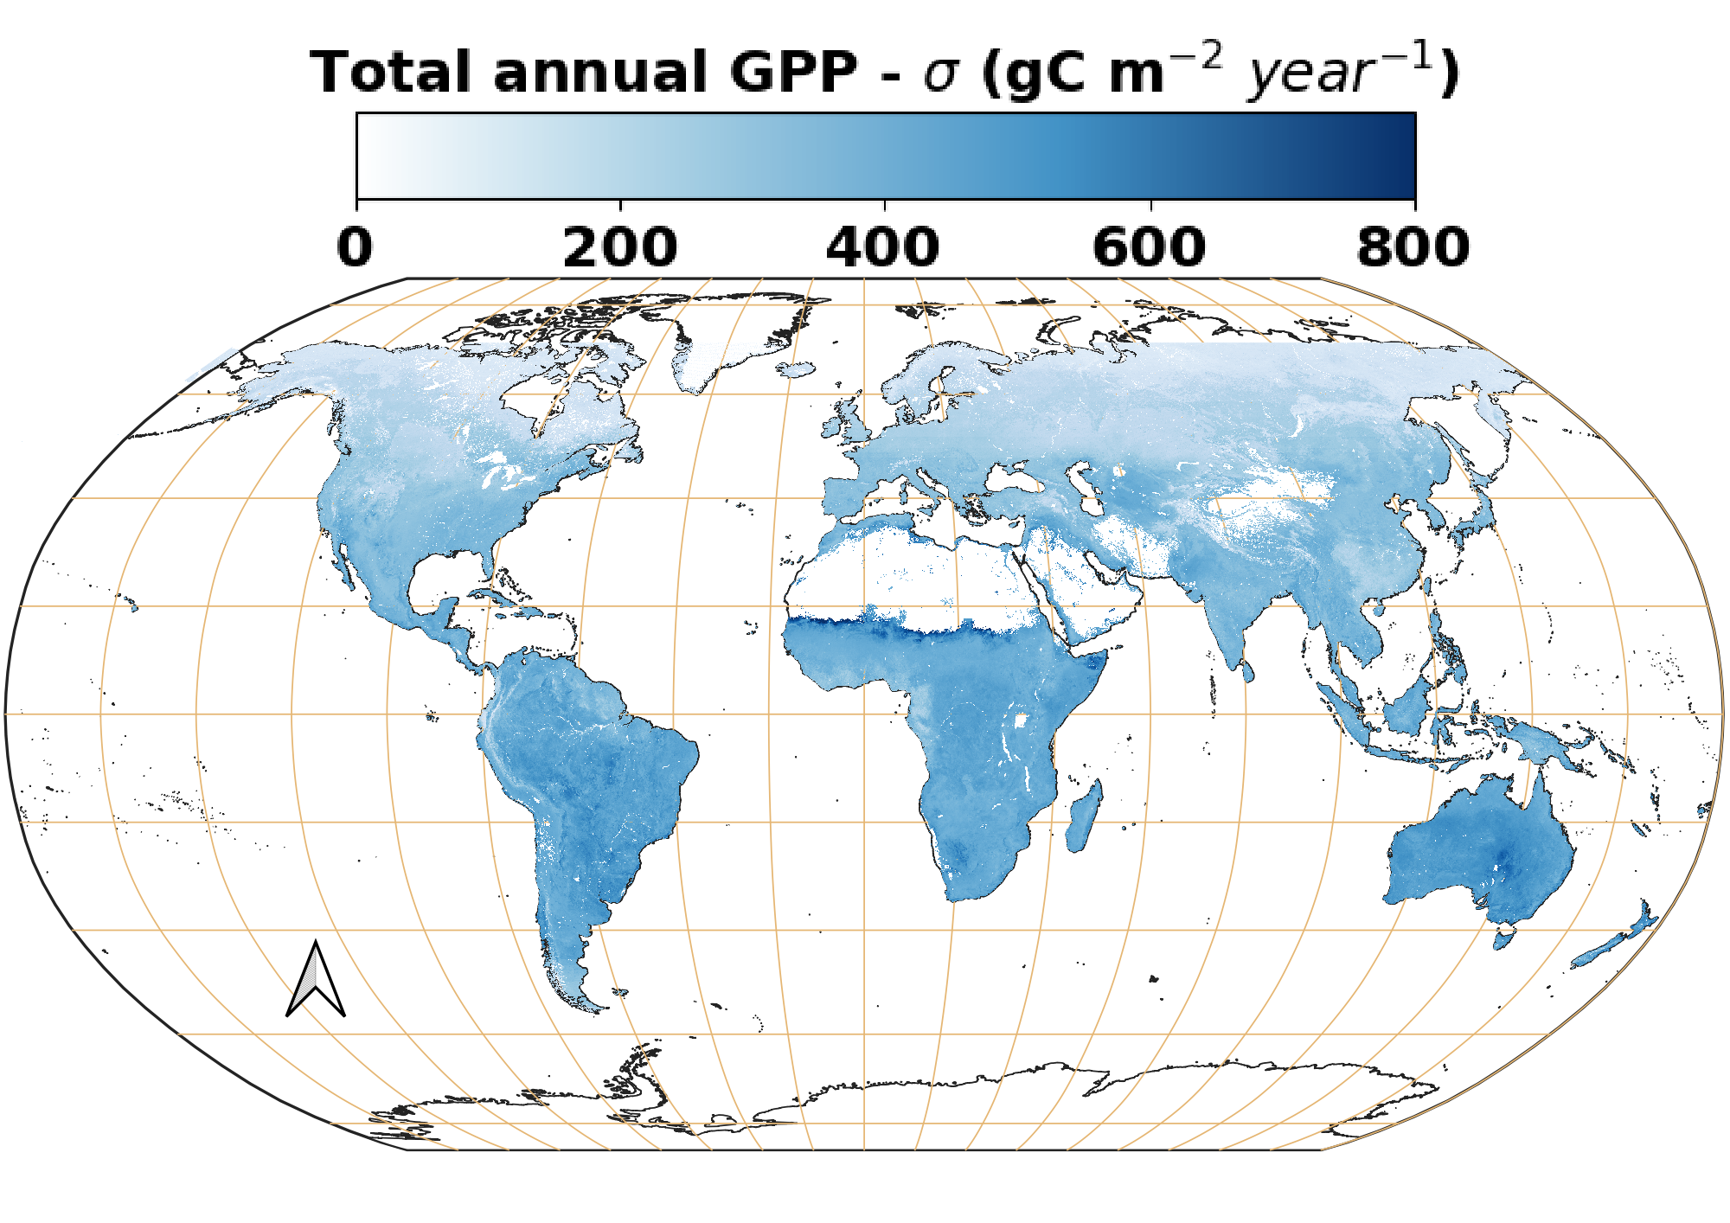
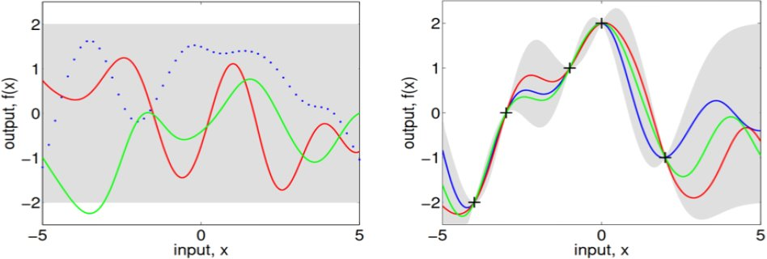
Methods - Gaussian process regression
A probabilistic approach implemented through kernel functions.
The model is applied in Google Earth Engine through algebra of multidimensional arrays.
GPR facilitates band ranking analysis and provides epistemic uncertainty estimates
S3, S5P products
Model estimates
GPR model
Model uncertainties
Meteo data
Large scale processing
SCOPE-GPR-GPP: Global time series 2019, 8-days steps. Driven by TROPOSIF, S3-derived vegetation products and ERA5-Land (3 variables)
2) EC-GPR-GPP: Global time series 2004-2023, 8 days steps. Driven by LAI and ERA5-Land (9 variables)
Reyes-Muñoz, Pablo, et al. "Inferring global terrestrial carbon fluxes from the synergy of Sentinel 3 & 5P with Gaussian process hybrid models." Remote Sensing of Environment

Slide 8
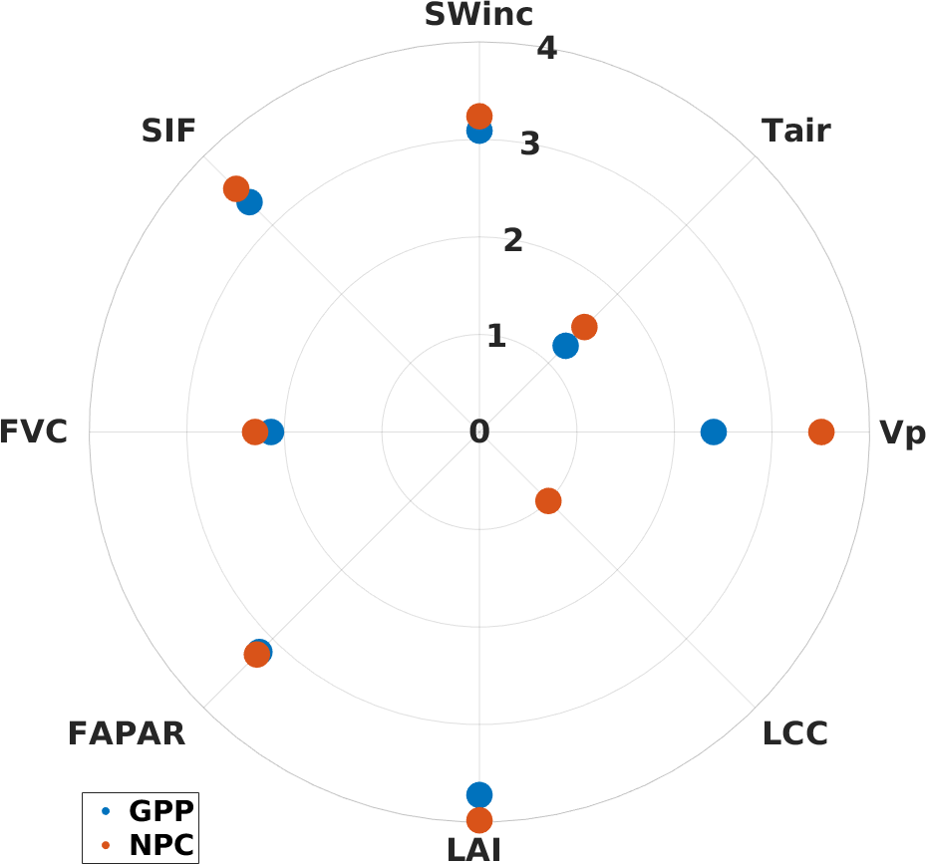
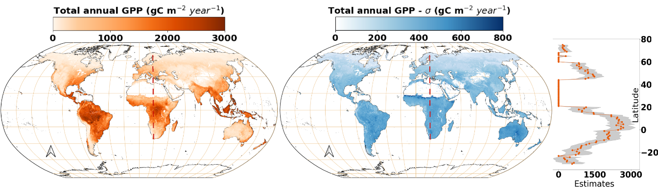
Results – Intercomparing GPP products
GPR-based GPP products:
- SCOPE-GPR-GPP¹ -> A hybrid physically-informed model trained with GPR.
It includes 8 predictors -> 5 vegetation products (with SIF)
SCOPE-GPR – band ranking relevance
Estimates
Uncertainties
Yearly GPP (g C ·m⁻² · year⁻¹) 2019
Reyes-Muñoz, Pablo, et al. "Inferring global terrestrial carbon fluxes from the synergy of Sentinel 3 & 5P with Gaussian process hybrid models." Remote Sensing of Environment

Slide 9
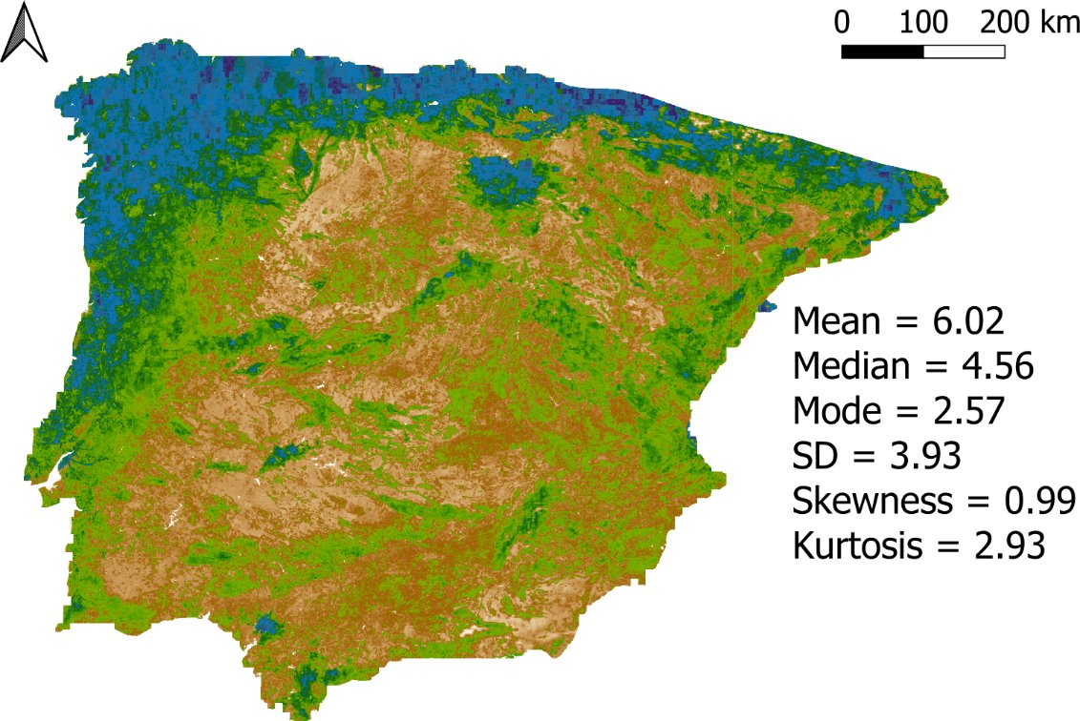
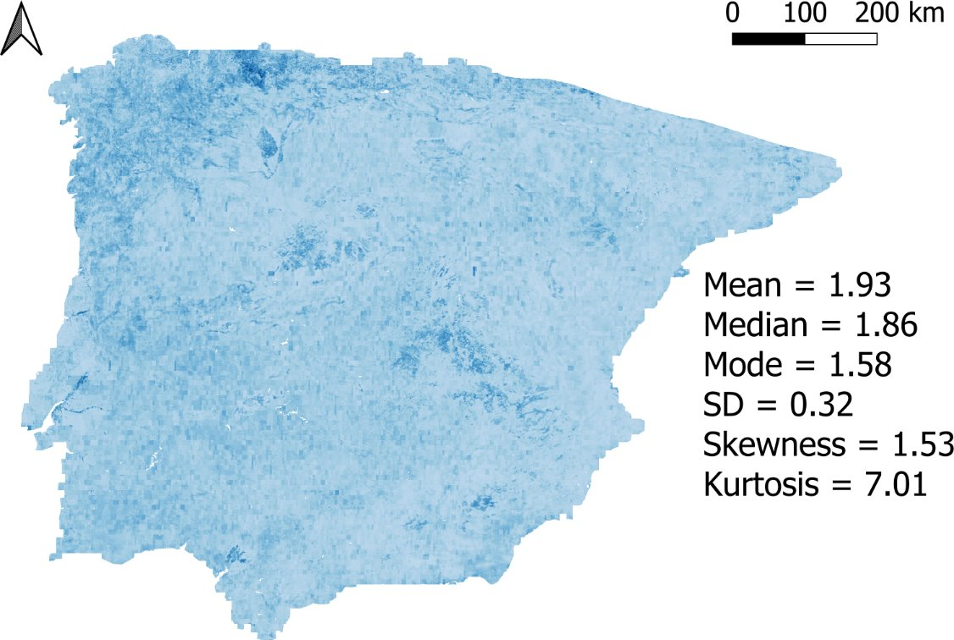
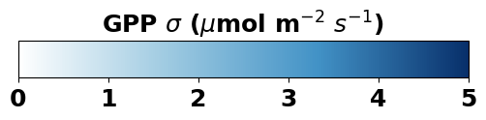
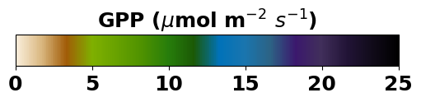
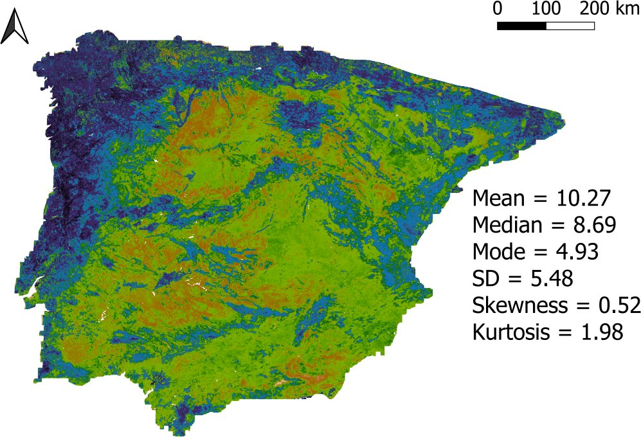
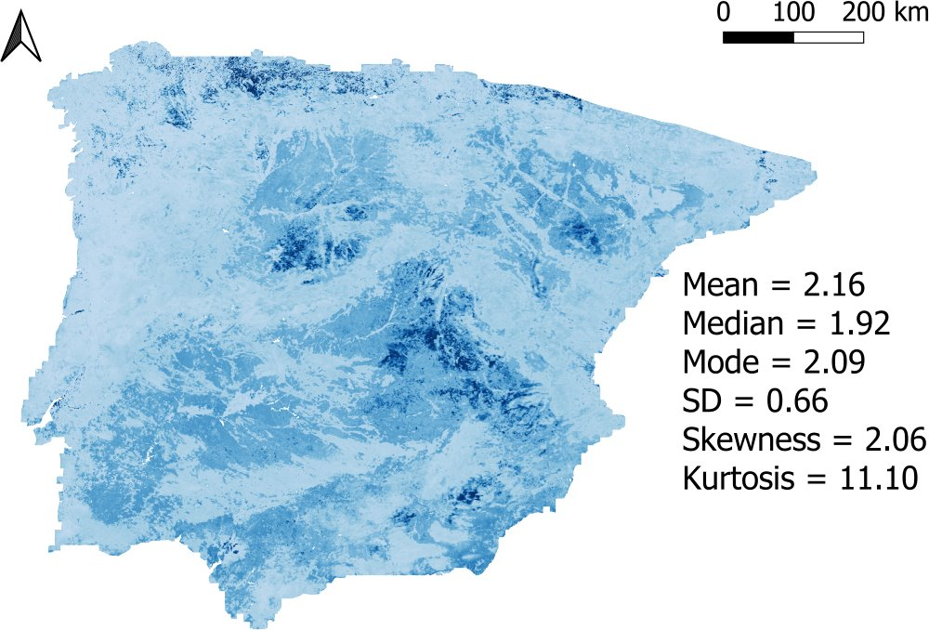
Results – SIF and hybrid GPP model
GPR-based GPP products:
- SCOPE-GPR-GPP¹ -> An hybrid physically-informed model trained with GPR
Estimates (μmol C · m⁻² · s⁻¹)
Uncertainties (μmol C · m⁻² · s⁻¹)
SCOPE-GPR-GPP models were applied at the Iberian peninsula at 300 m resolution.​
Hourly – 19-06-2019
Reference – 8 Vars
At the production stage the importance of predictors were tested through versions of the model excluding these predictors. ​
Without SIF
¹Reyes-Muñoz et al., 2024

Slide 10
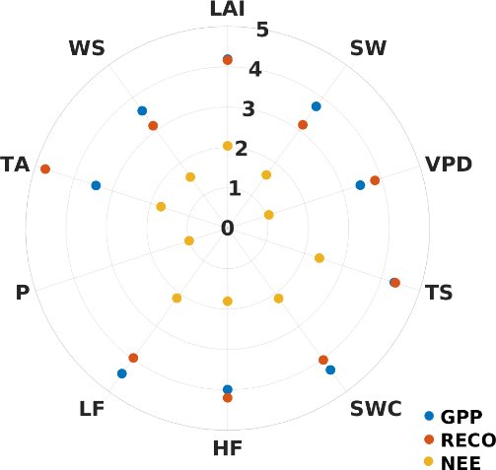
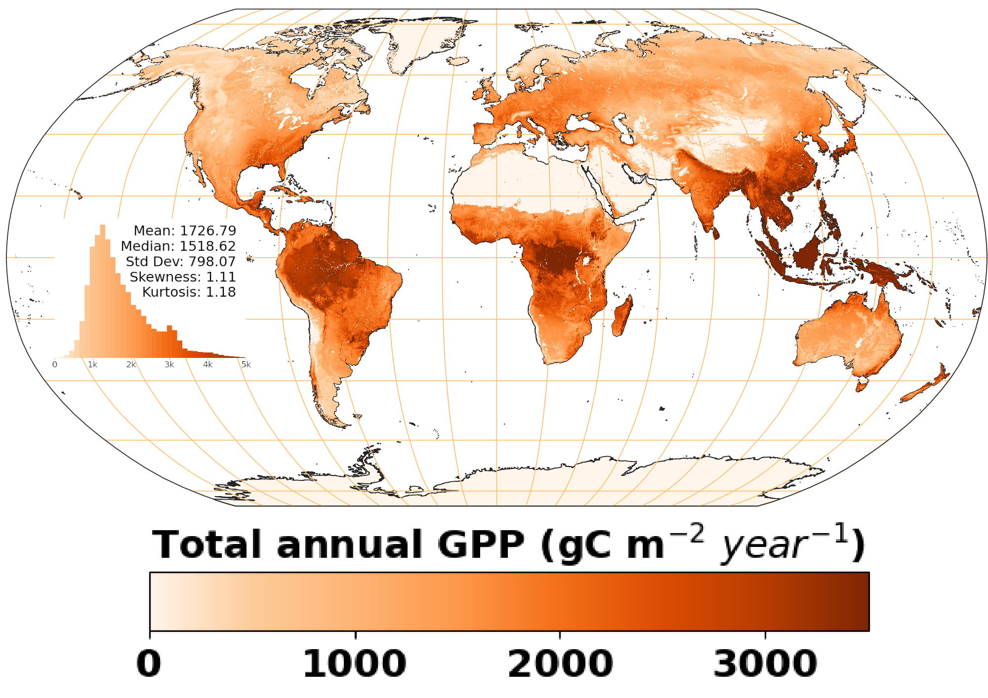
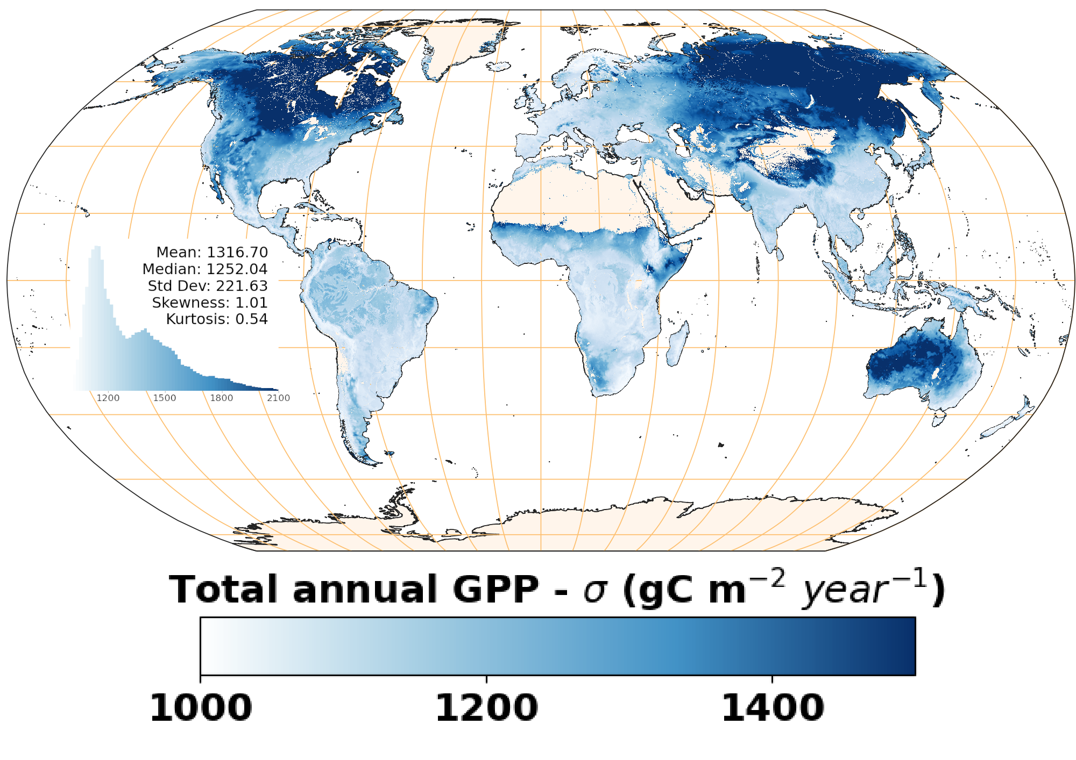
Results – Tower-based models
GPR-based GPP products:
- EC-GPR-GPP² -> A data-driven empirical model trained with GPR
It includes 10 predictors -> 9 meteorological variables
GPR – training polar plot
Estimates
Uncertainties
Yearly (g C ·m⁻² · year⁻¹) 2004-2023
Reyes-Muñoz, Pablo, Dávid D. Kovács, and Jochem Verrelst. "Tower-to-global upscaling of terrestrial carbon fluxes driven by MODIS-LAI, Sentinel-3-LAI and ERA5-Land data." Ecological Indicators

Slide 11
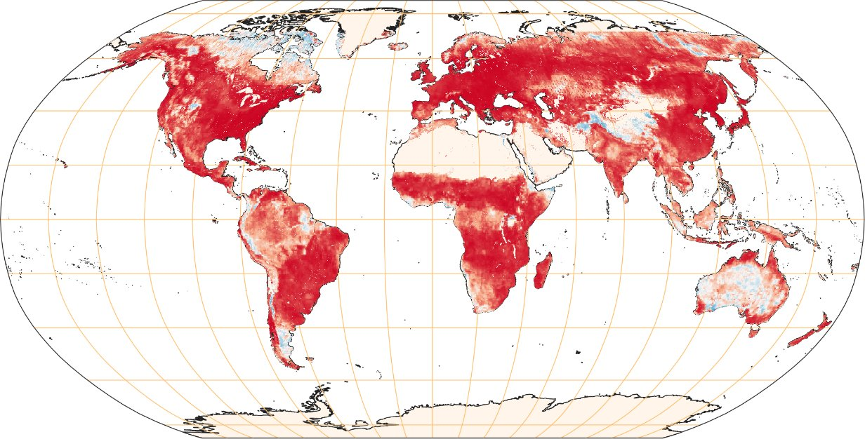
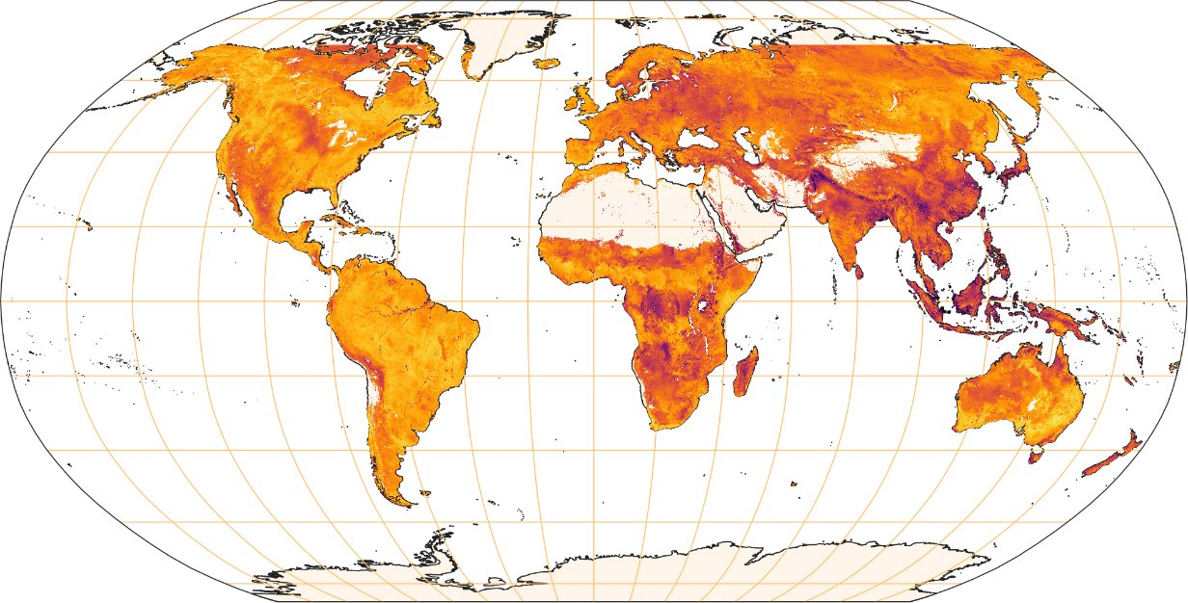
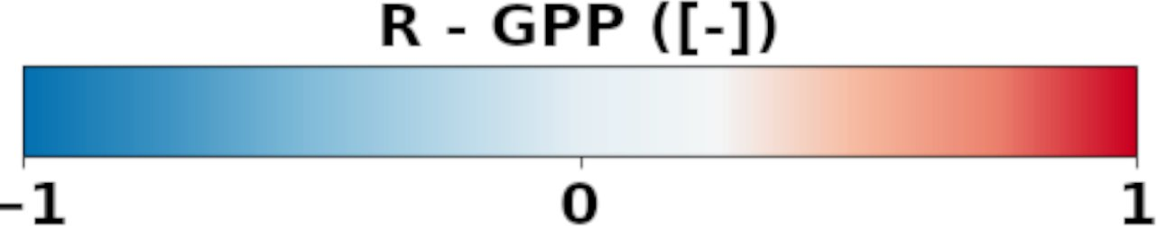
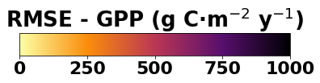
Results – Intercomparison between GPP products
Intercomparison between GPR-based GPP products (2019):
Agreement between SCOPE-GPR-GPP and EC-GPR-GPP suggest that TROPOSIF along with S3-derived vegetation products may act as proxies of meteorological variables for predicting GPP
R EC-GPR Vs SCOPE-GPR
RMSE EC-GPR Vs SCOPE-GPR
Median = 0.76 Std. dev. = 0.33
Median = 500 g C·m⁻² y⁻¹ Std. dev. = 300 g C·m⁻² y⁻¹

Slide 12

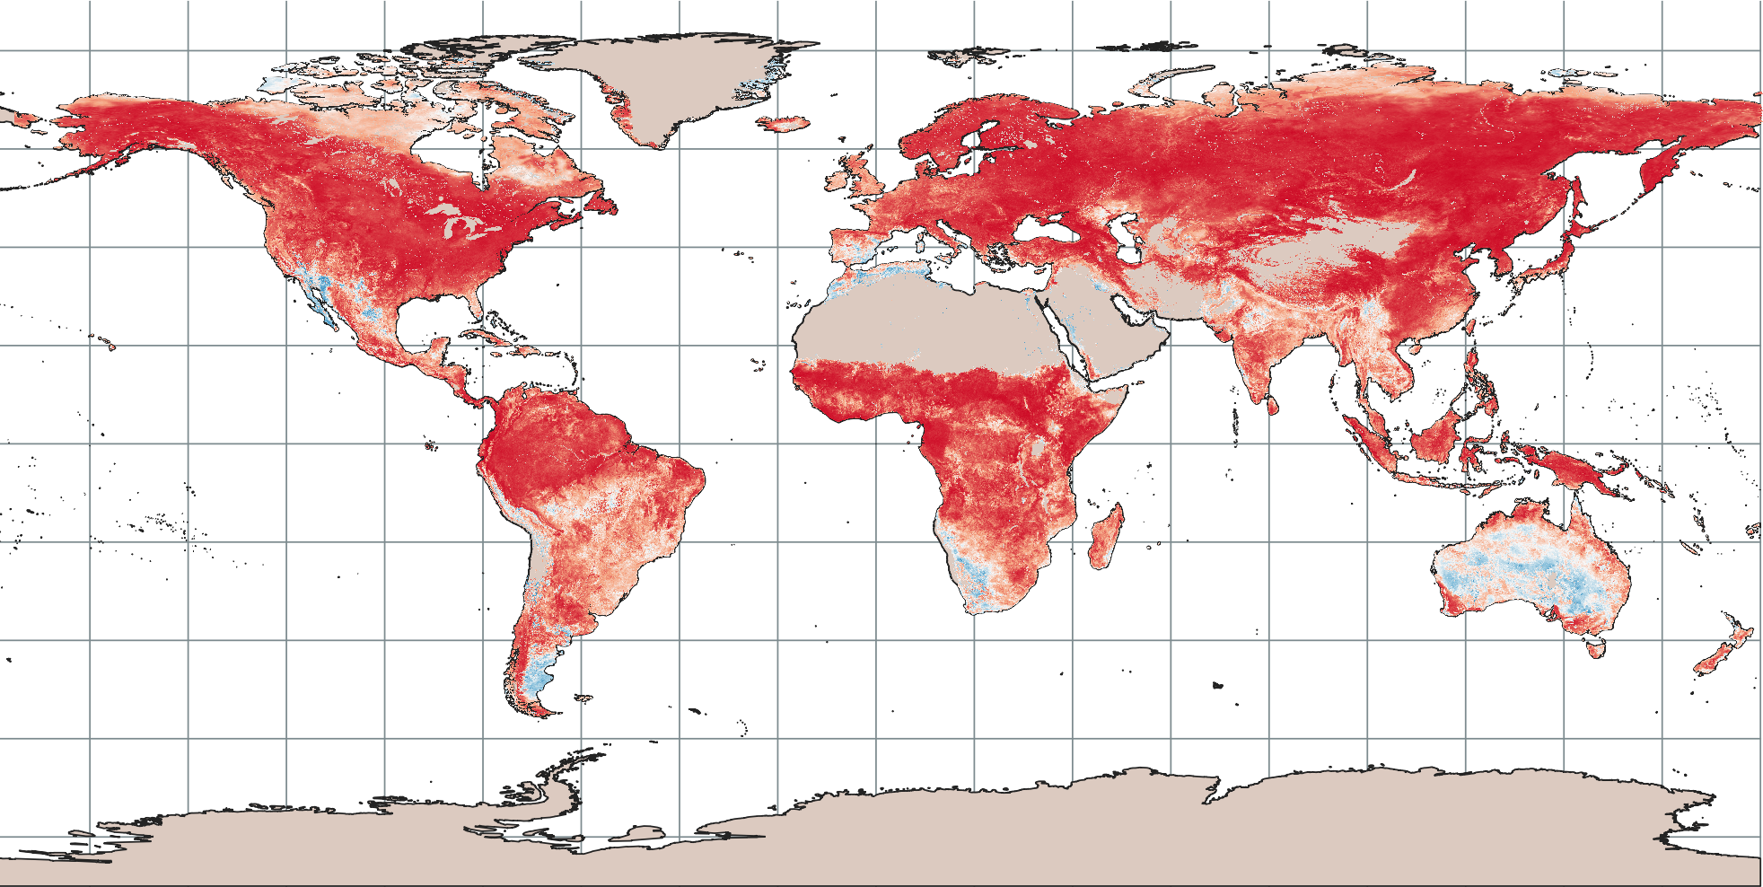
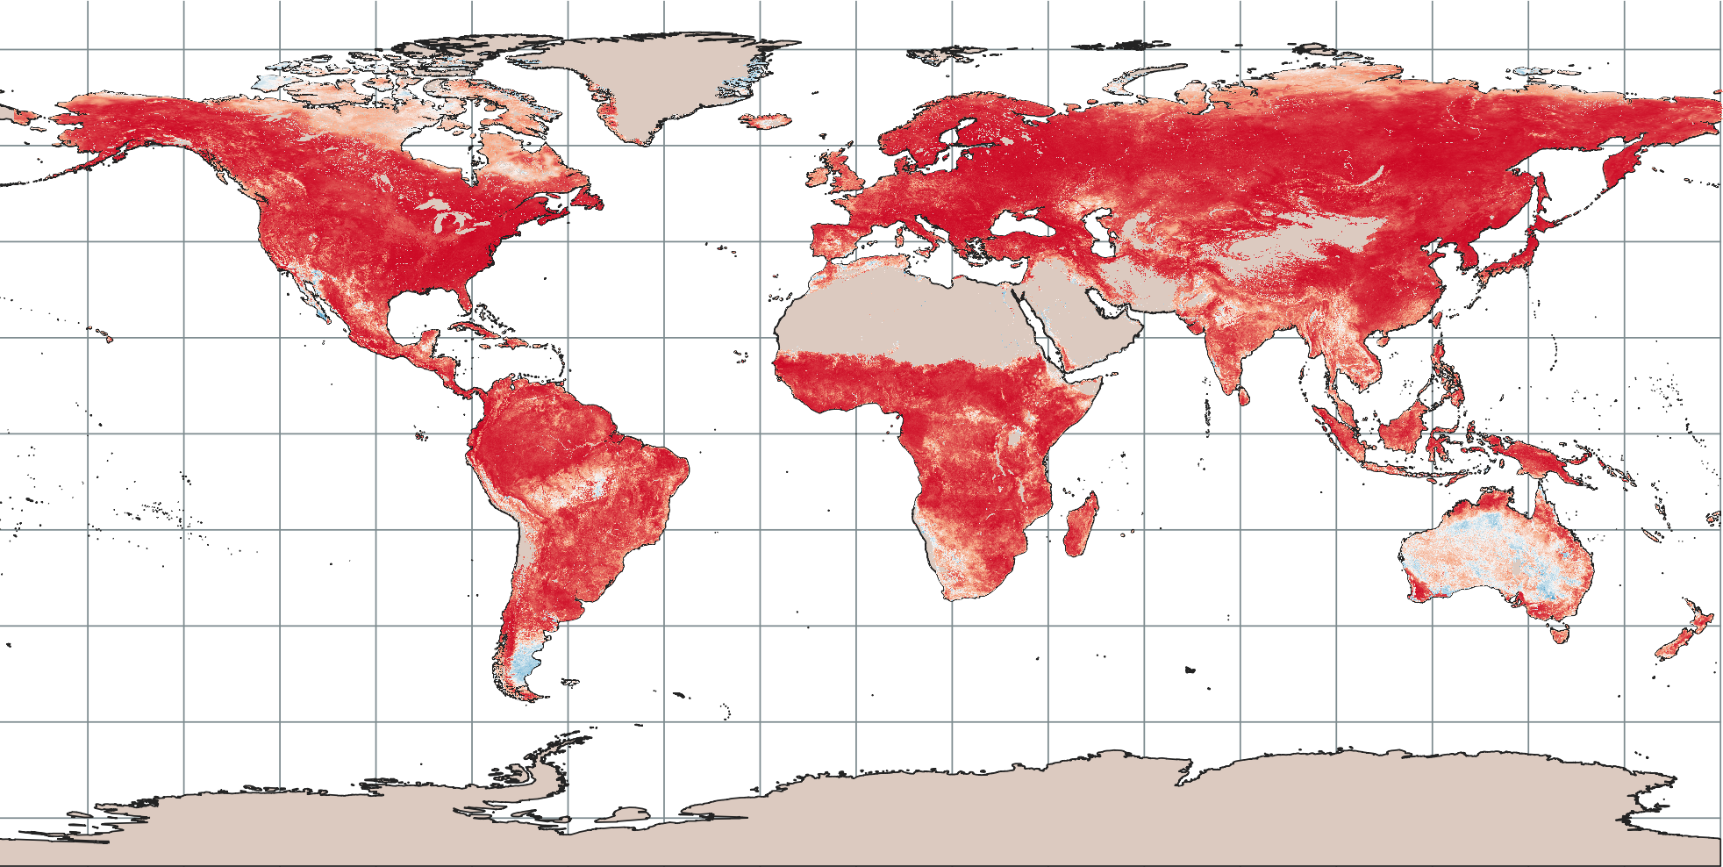
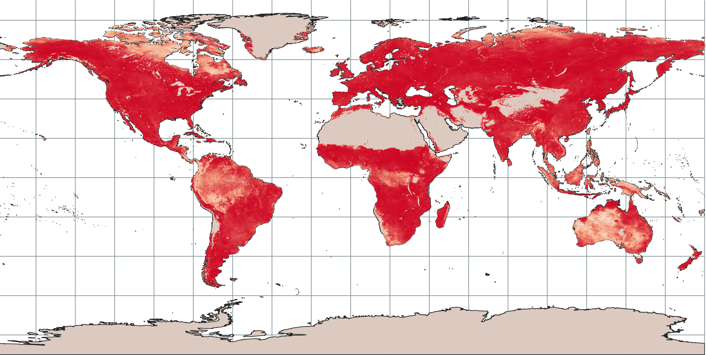
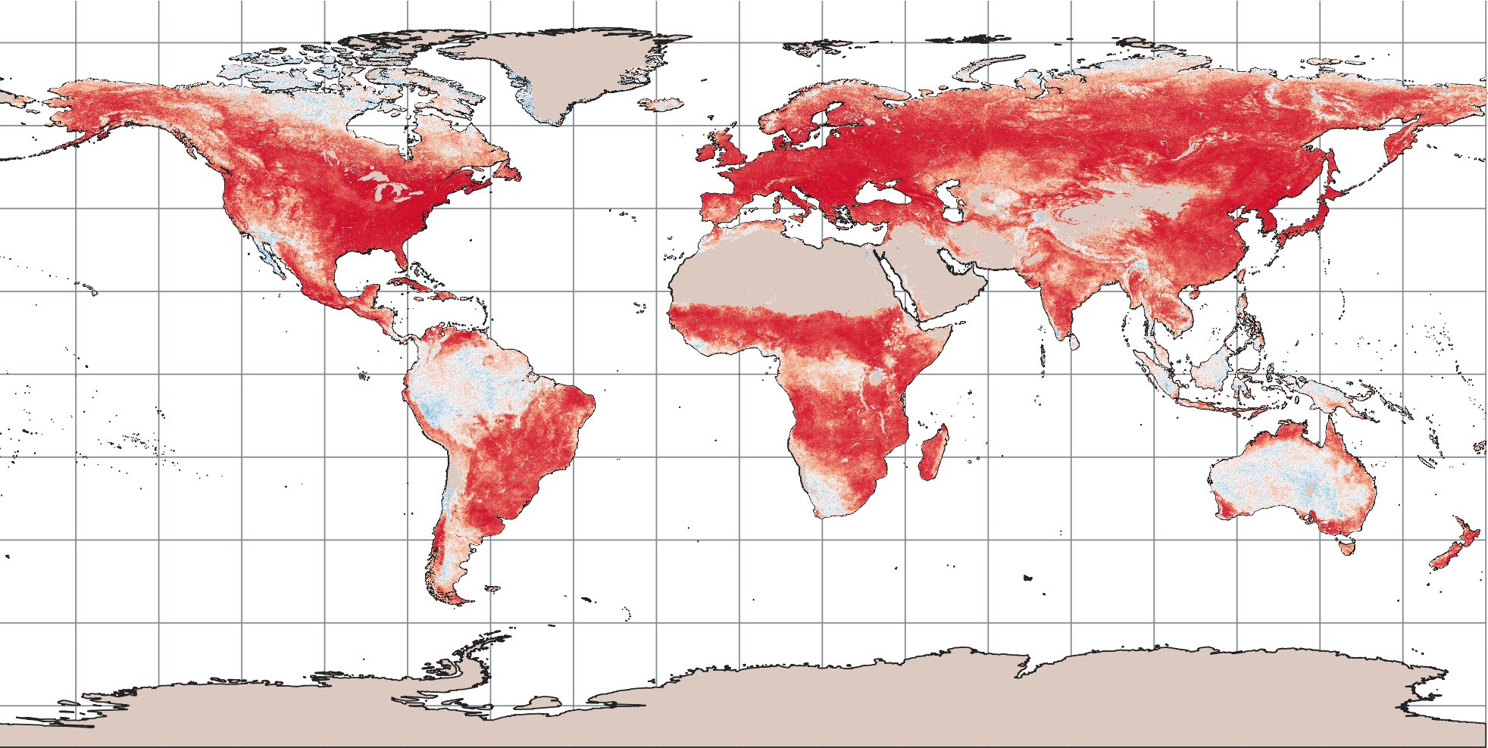
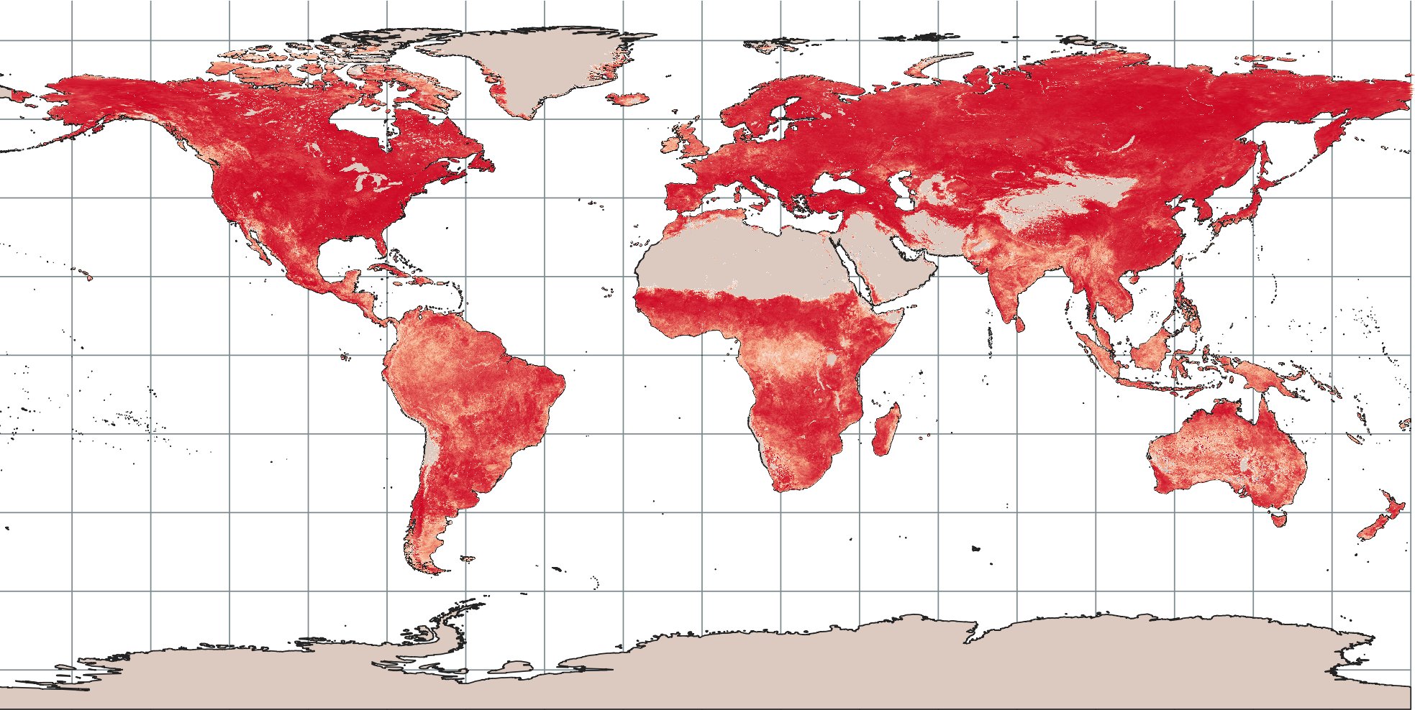
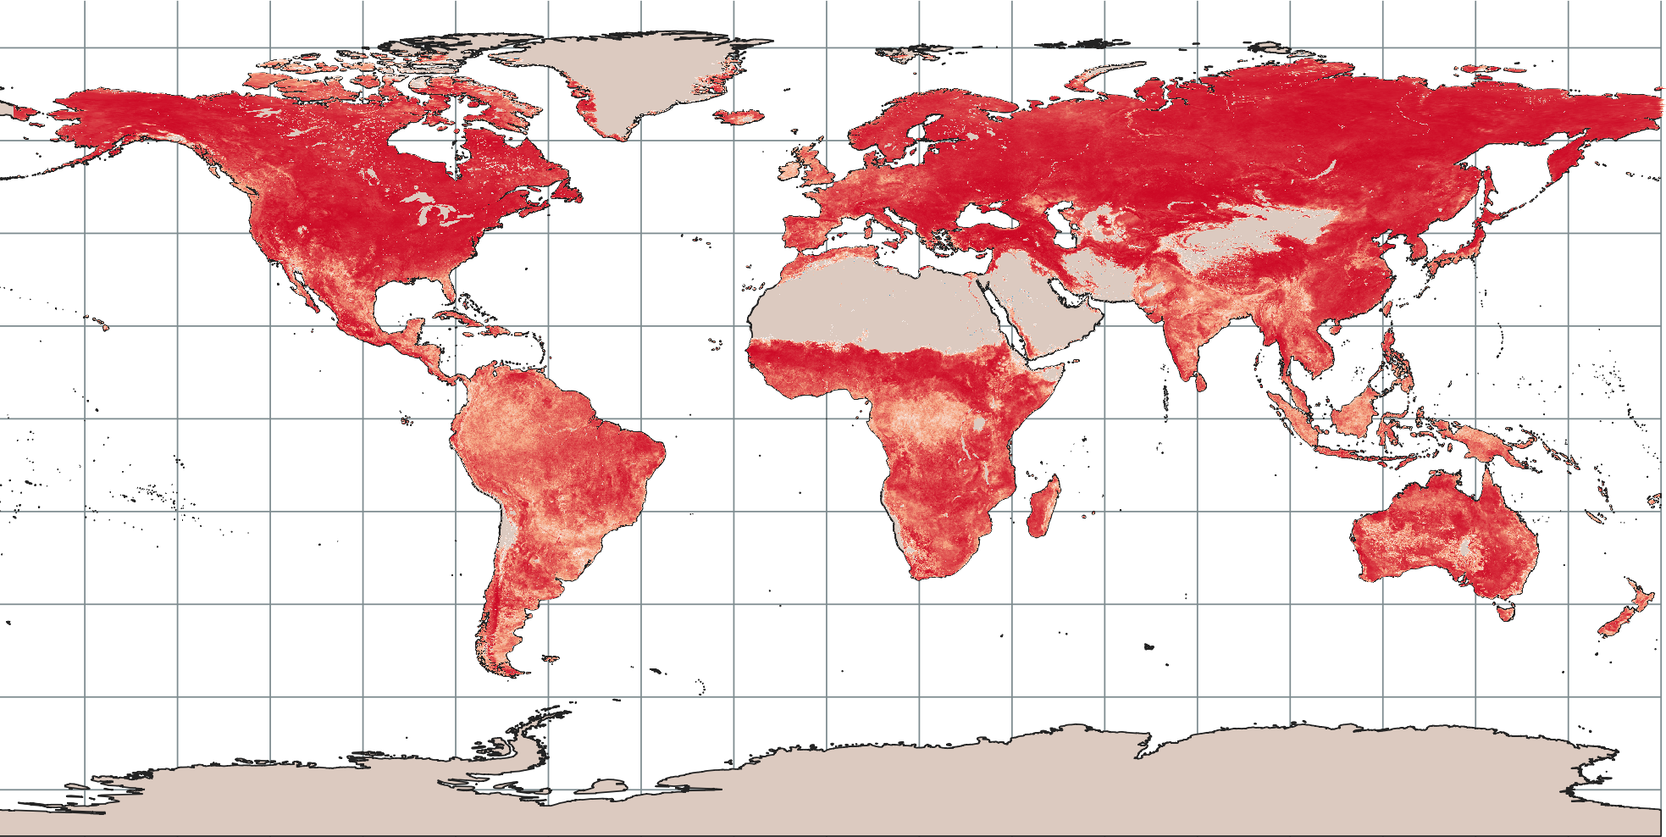
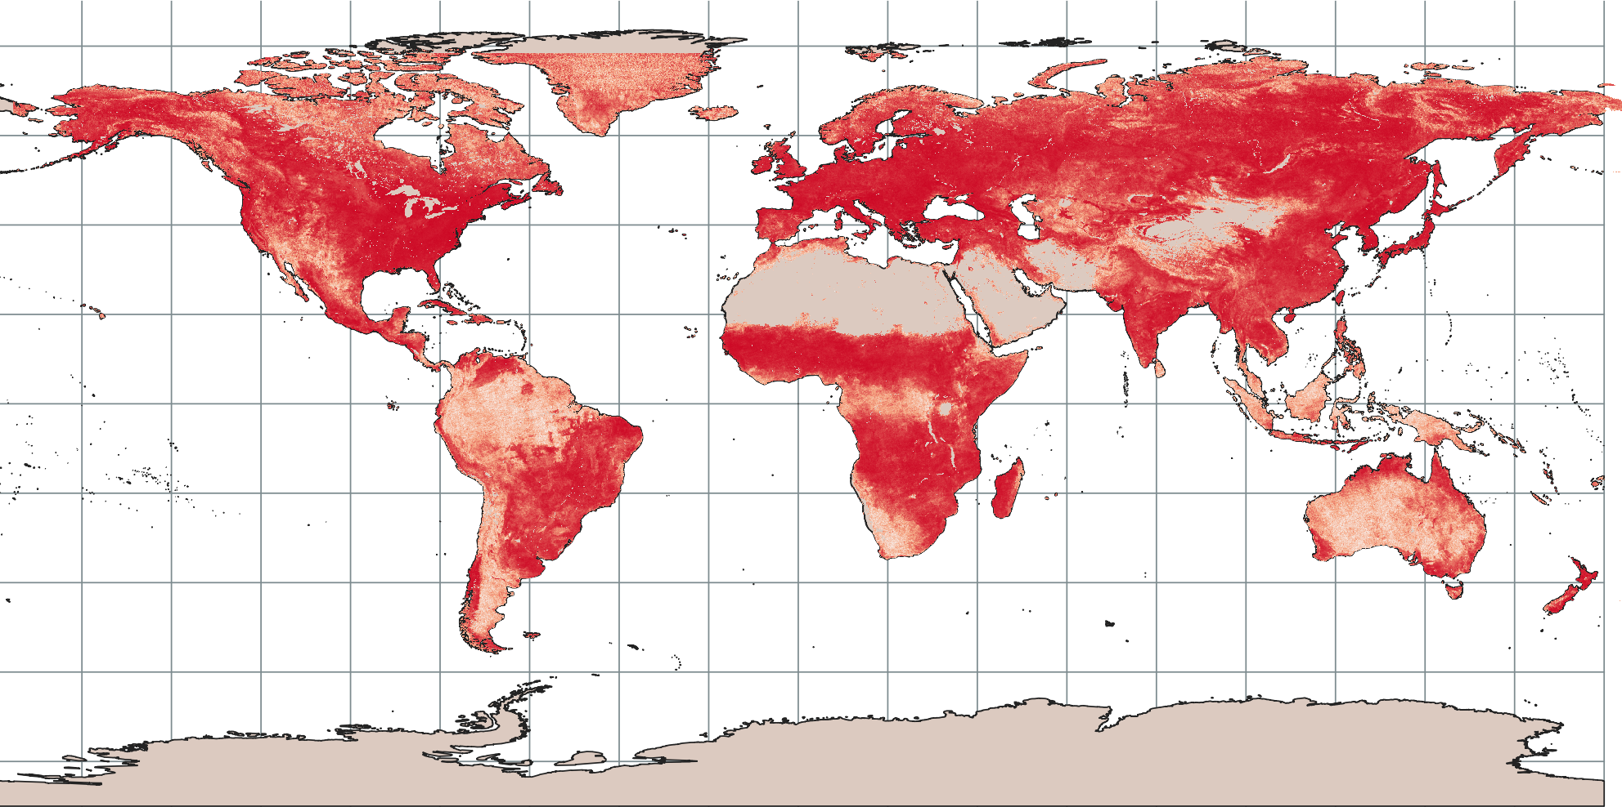
Results – Multiple correlation (year 2019)
EC-GPR-GPP Vs FAPAR
GPP
EC-GPR-GPP Vs LAI
EC-GPR-GPP Vs ERA5
EC-GPR-GPP Vs SIF
Correlation all Vs EC-GPR-GPP
Vegetation
Multivariate correlation LAI/FAPAR/SIF Vs meteo
Meteo/ERA5 (SW, T, SWC, LE)
LAI Vs ERA5
SIF Vs ERA5
FAPAR Vs ERA5
VPs/SIF

Slide 13
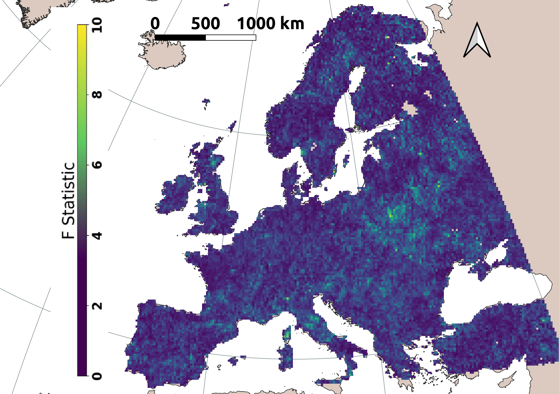
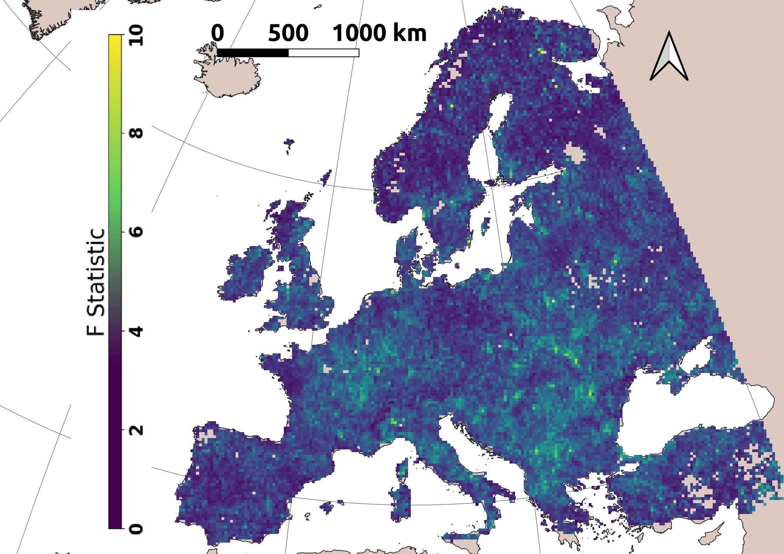
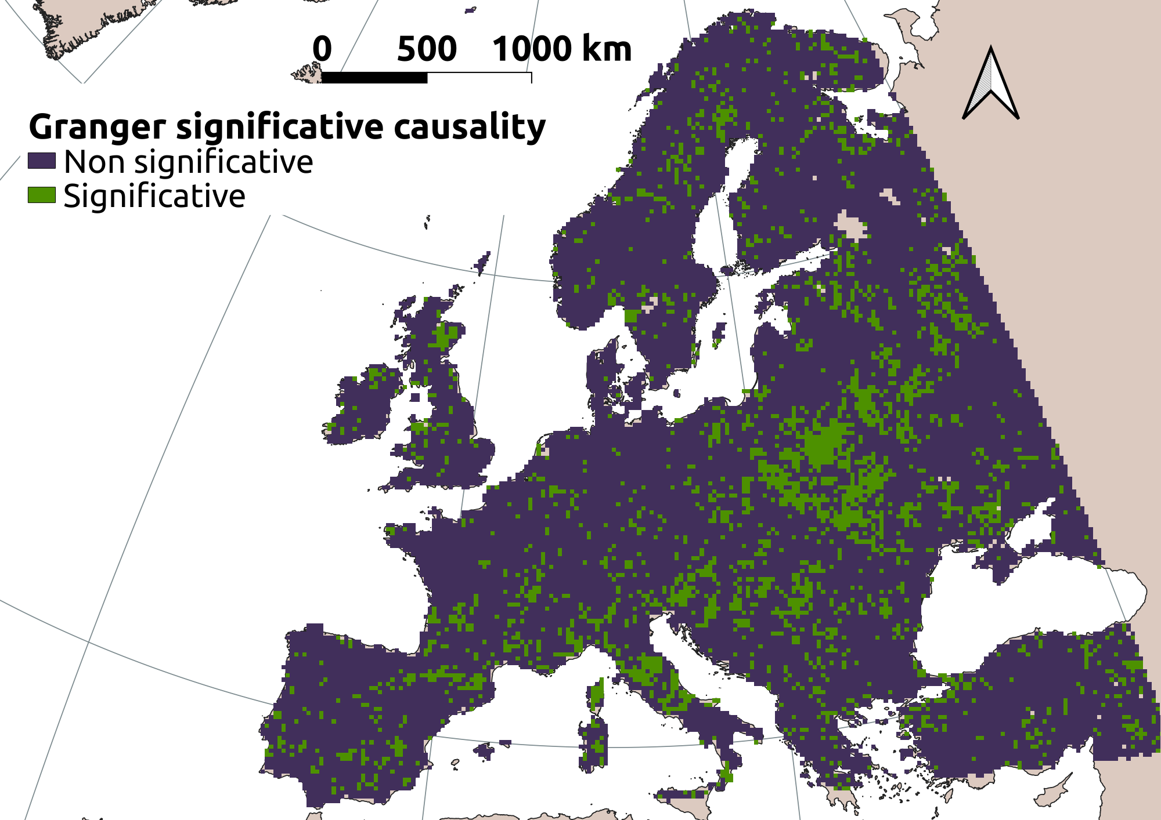
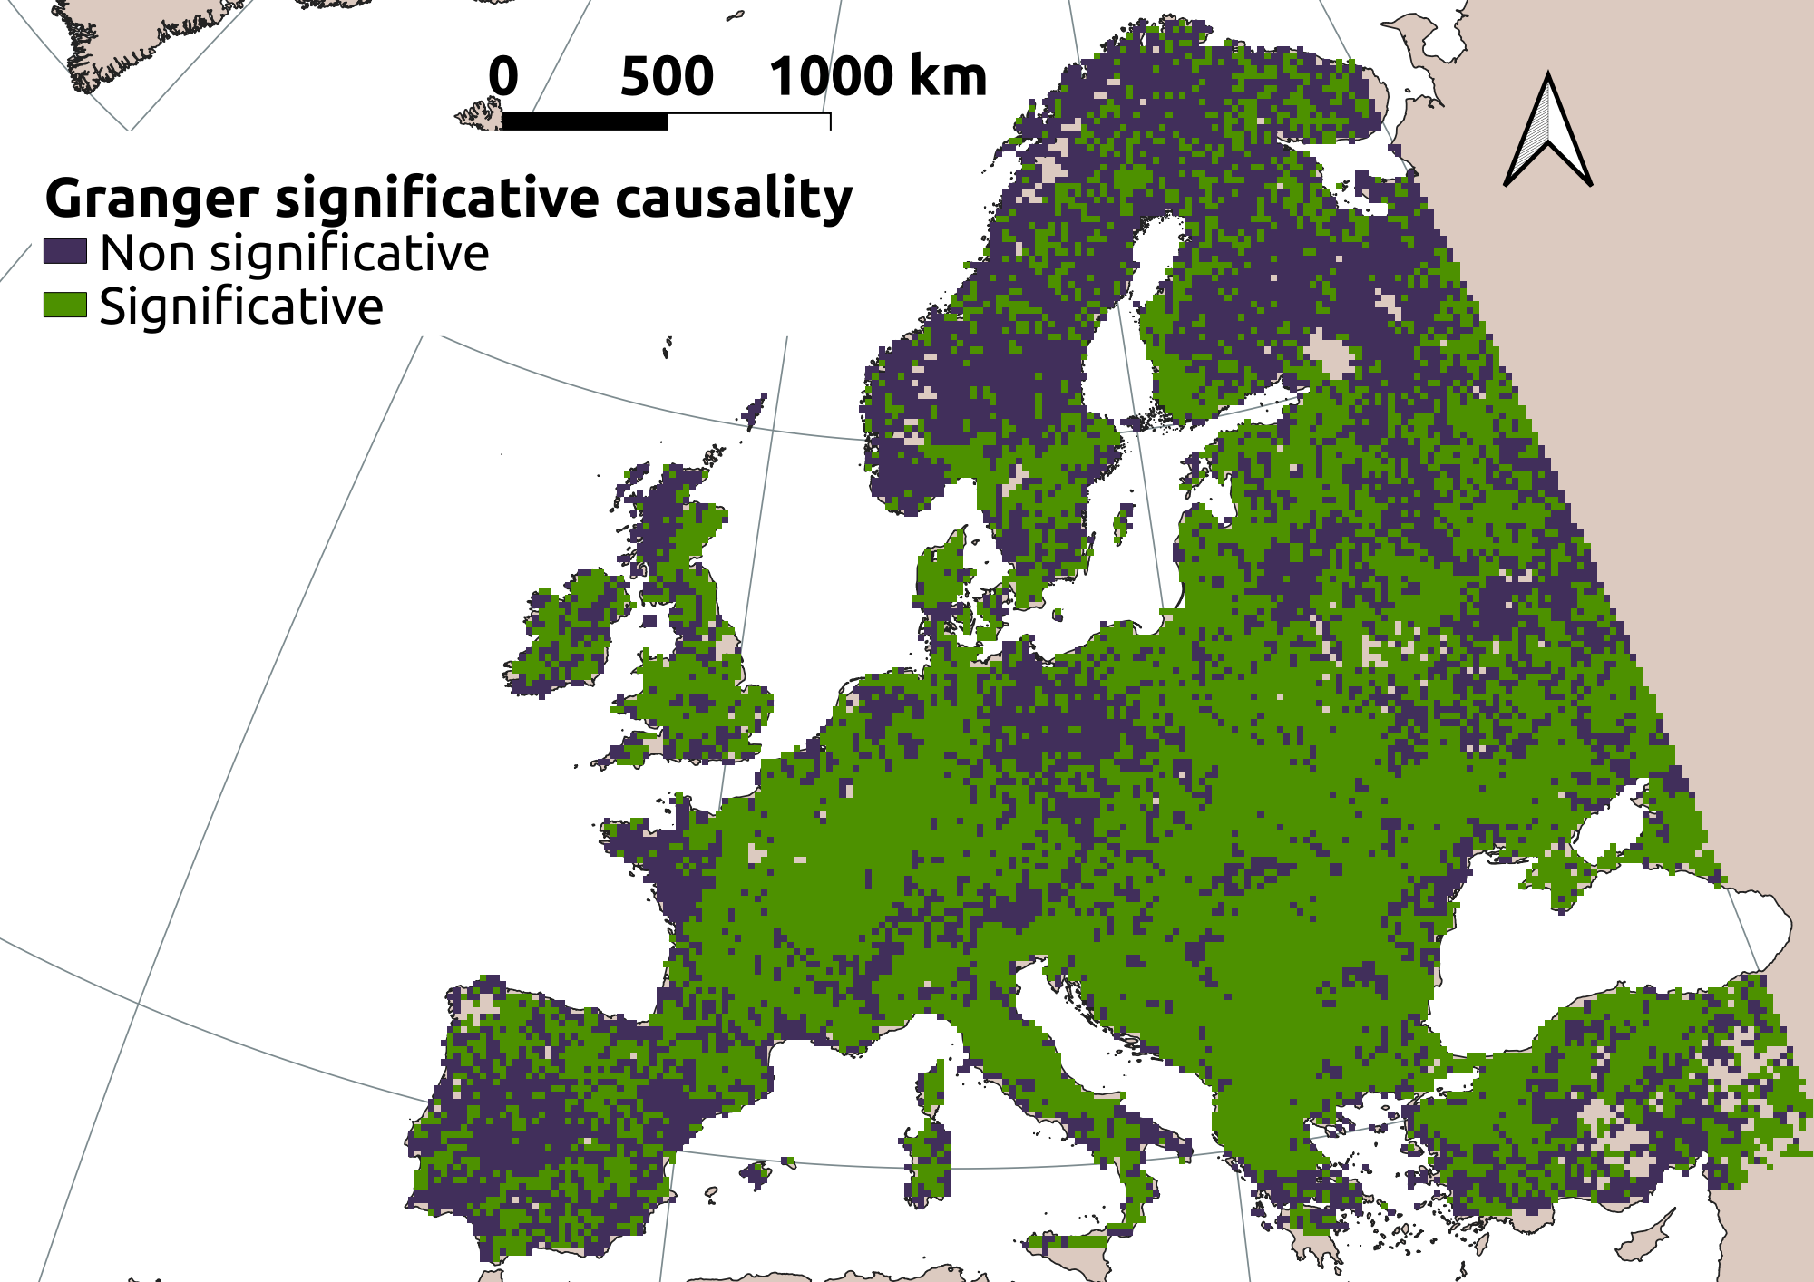
Results – Granger causality of SIF
ERA5-Land -> SIF
ERA5-Land + LAI -> SIF
Multivariate Granger F statistic: ERA5-Land data: shortwave incoming radiation - soil temperature – soil water content – latent heat flux) and LAI causality on SIF
Significance of test causality drastically expanded when adding LAI as predictor
F- statistic
Statistical significance

Slide 14
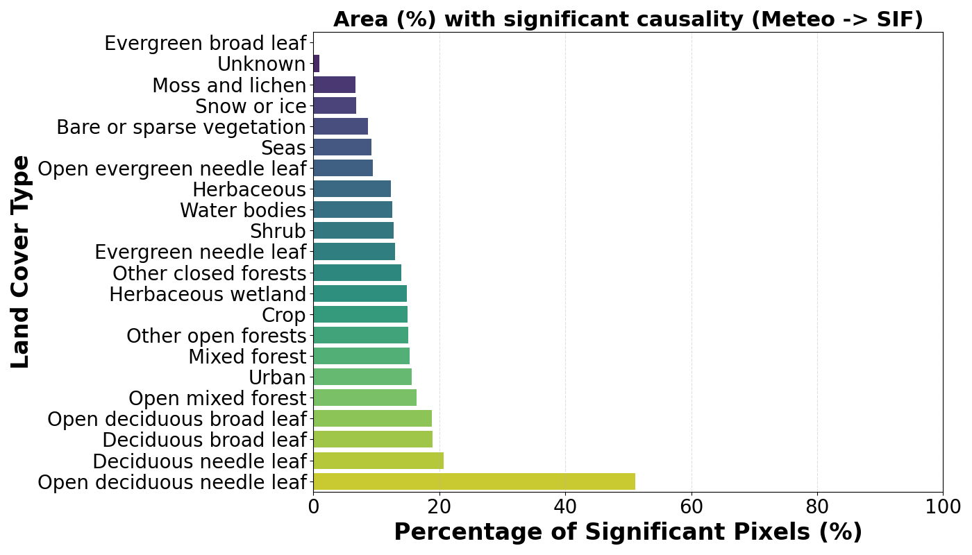
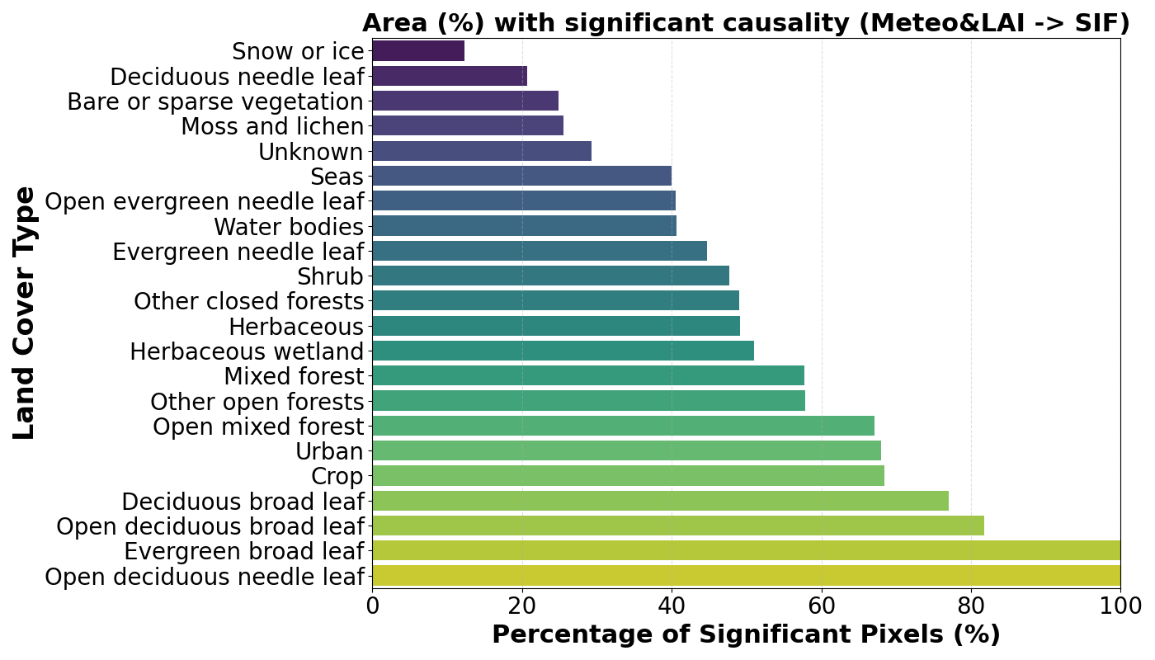
Results – Granger causality of SIF
Multivariate Granger - Causality significance (Meteo -> SIF) was more frequent on open deciduous forests, with maximum of ~50% in open deciduous needle leaf. The areas linked with significant causality drastically increase when adding LAI (right plot) in the multivariate Granger analysis.

Slide 15
Outlook and future work
In preparation for FLEX, this study advances in the interpretation of the SIF dynamics from satellite data, particularly as a predictor of GPP.
The analysis of this work highlighted a good match between two GPP models, suggesting that TROPOSIF and S3-derived vegetation products proxy meteorological information for prediction of GPP.
TROPOSIF data enhanced the consistency of the hybrid GPP models, reducing the epistemic uncertainty.
Granger causality helps to identify sites where satellite-SIF dynamics are caused by combined-meteorological dynamics.
The analysis was experimentally conducted with TROPOSIF for one year of data (2019). The workflows will be applied to improved SIF data from FLEX.
1
2
3
4
5

Slide 16
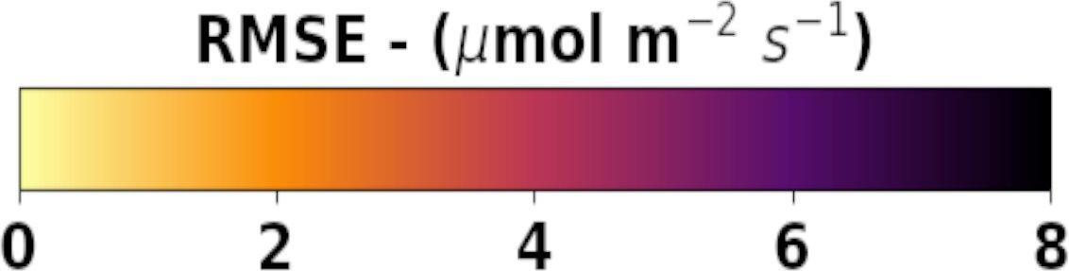
Questions
Thanks for your attention
pablo.reyes@uv.es

