Slide 1
Atmospheric dryness effects on canopy chlorophyll fluorescence and Gross Primary Production (GPP) in a deciduous forest during heat waves
Zhaohui Li, Gabriel Hmimina, Gwendal Latouche, Daniel Berveiller, Abderrahmane Ounis, Yves Goulas, Kamel Soudani
Ecologie Société Evolution (ESE), Université Paris-Saclay, CNRS, France
Laboratoire de Météorologie Dynamique (LMD), Sorbonne Université, IPSL, CNRS, École polytechnique, France
Notes:
Hello everyone. I’m Zhaohui Li, and today I’m honored to present our work titled ‘Atmospheric Dryness Effects on Canopy Chlorophyll Fluorescence and Gross Primary Production in a Deciduous Forest During Heat Waves’.

Slide 2
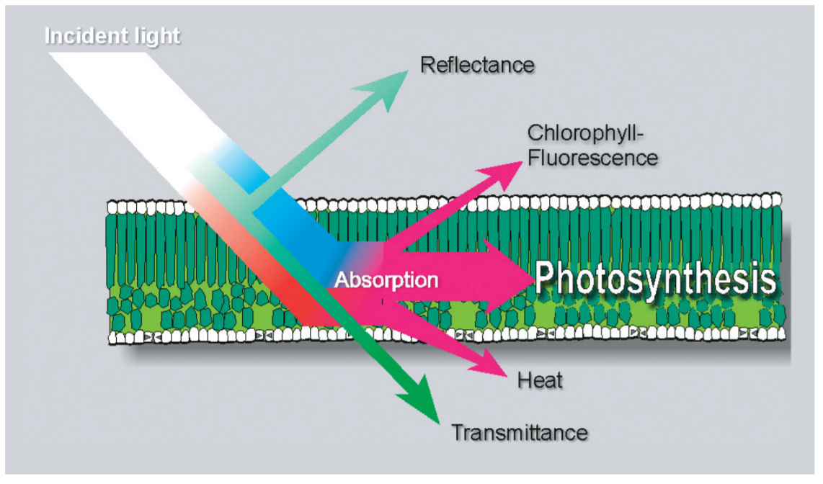

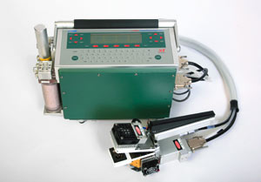
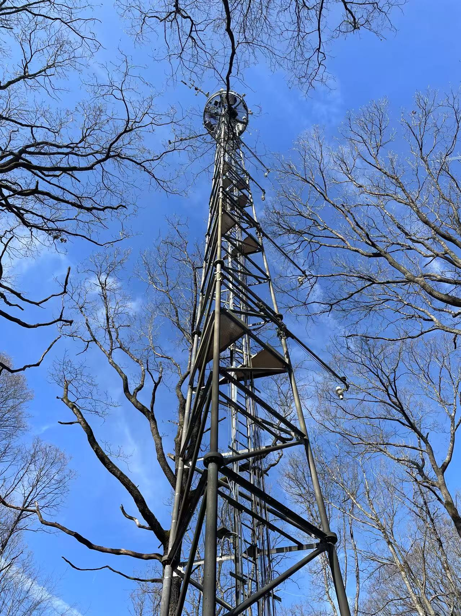
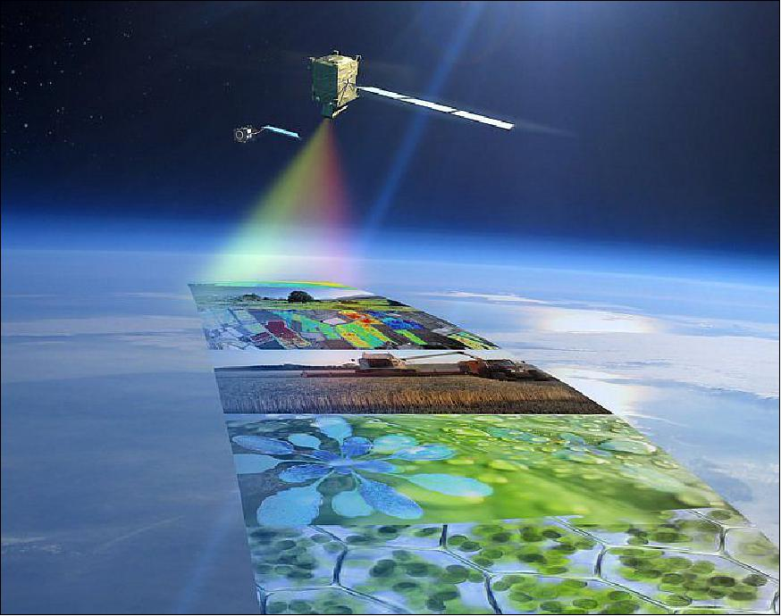
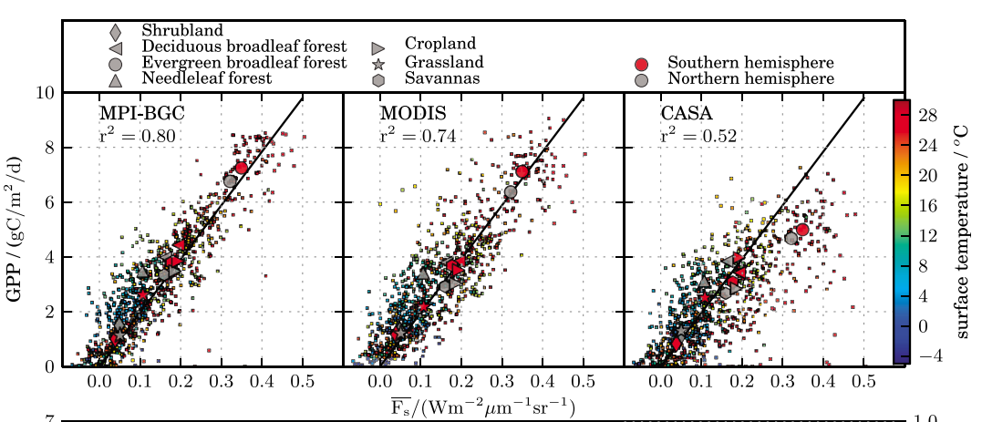
Chlorophyll Fluorescence (ChlF) and its relationship to GPP
Chlorophyll Fluorescence (ChlF) is an optical signal strongly related to photosynthesis and can be monitored across multiple scales: leaf, canopy and global scales
(Smorenburg et al., 2002)
leaf scale
canopy scale
global scale
Active
Active & Passive
Passive
GPP (gCm⁻²d⁻¹)
(Frankenberg et al., 2011)
💡 Continuous high-temporal resolution measurements
💡 Bridges the leaf-level measurements and global-scale remote sensing, supporting upscaling and model calibration.
💡 Can be measured using both passive (sun-induced) and active (laser-induced) techniques, providing more perspectives for chlorophyll fluorescence measurements.
ChlF (Wm⁻²μm⁻¹sr⁻¹)
Notes:
Chlorophyll Fluorescence is an optical signal directly linked to photosynthesis. Previous studies have reported its strong correlation with GPP across multiple scales. As shown here, we can measure this fluorescence at three levels: leaf, canopy, and global levels. Canopy-level is especially useful because it can measure high-temporal fluorescence continuously, and it can connect leaf-level measurements and global-level measurements. Last, we can use both passive and active sensors to get around some of the limitations of using just one method.

Slide 3
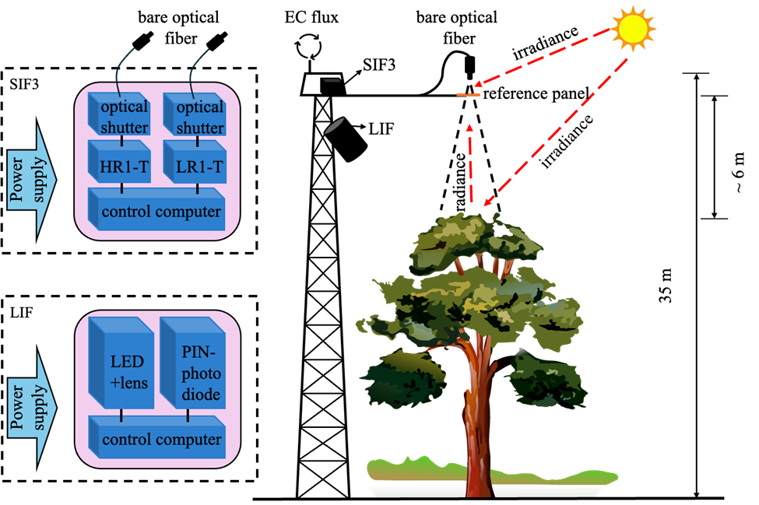

Passive (SIF) and active (LIF) ChlF measurement in Fontainebleau-Barbeau forest (ICOS FR-Fon)
SIF: Sun-Induced chlorophyll Fluorescence, LIF: Laser-Induced chlorophyll Fluorescence
Passive instrument (SIF3)
SIF = PAR x fAPAR x FY x Fesc
Active instrument (LIF)
microlidar
PAR : Photosynthetically Active Radiation
fAPAR : fraction of Absorbed PAR
FY : Fluorescence Yield
Fesc : fraction of SIF escaping the canopy
(Li et al., 2026)
F_{yieldLIF}: apparent FY measured by LIF
How do SIF and F_{yieldLIF} vary under different atmospheric dryness conditions?
How SIF and F_{yieldLIF} are linked to GPP under high atmospheric dryness conditions?
Notes:
In this study, we measured the chlorophyll fluorescence using both passive and active methods: one that captures sun-induced fluorescence (SIF), and another that captures the laser-induced fluorescence (LIF). Similar to the light use efficiency model, SIF can be expressed by the product of PAR, fAPAR, FY and Fesc. LIF focuses more directly on the fluorescence yield, and we call that FyieldLIF. FyieldLIF gives us fast, detailed data and isn’t affected by reflected sunlight, which is great when we’re trying to understand how plants react to stressful weather. So our main questions are: How do SIF and FyieldLIF vary under different atmospheric dryness conditions? And How SIF and FyieldLIF are linked to GPP under high atmospheric dryness conditions?

Slide 4
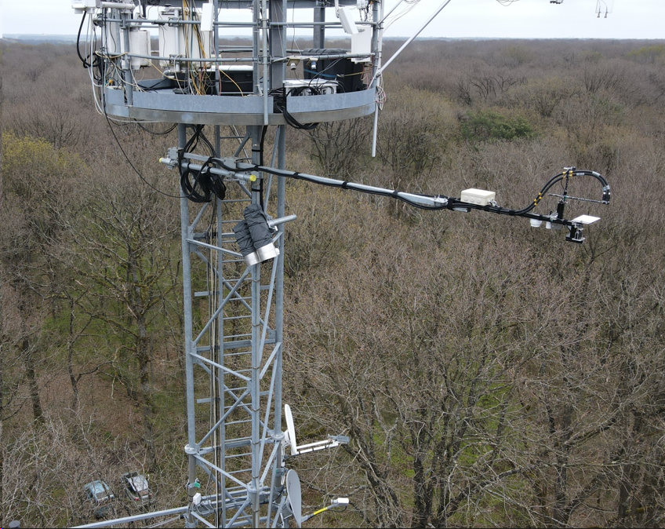
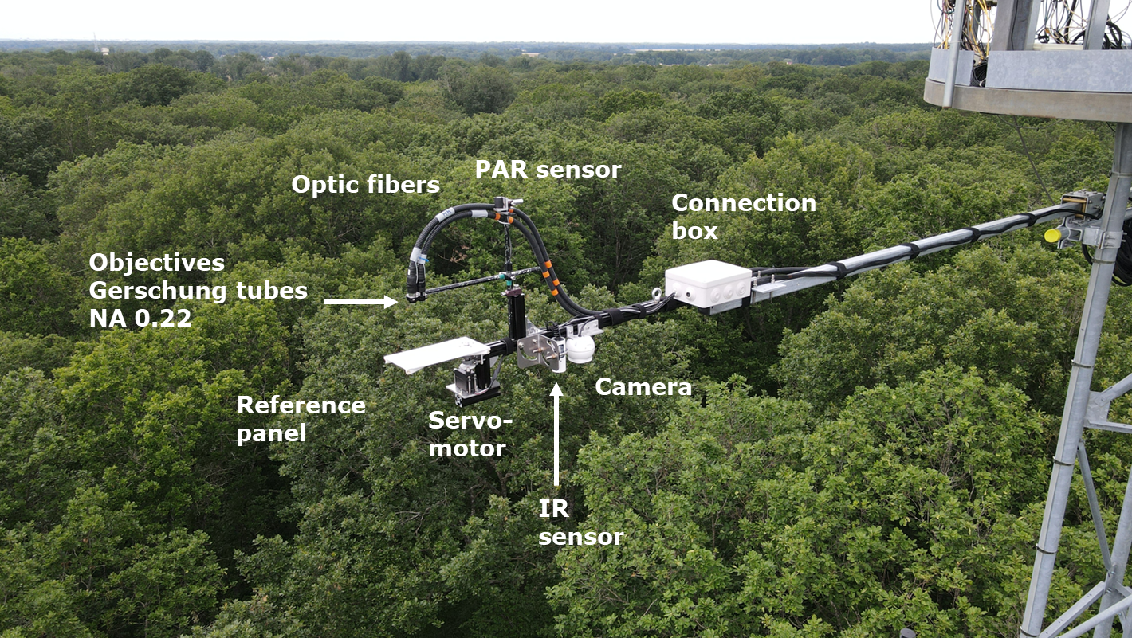
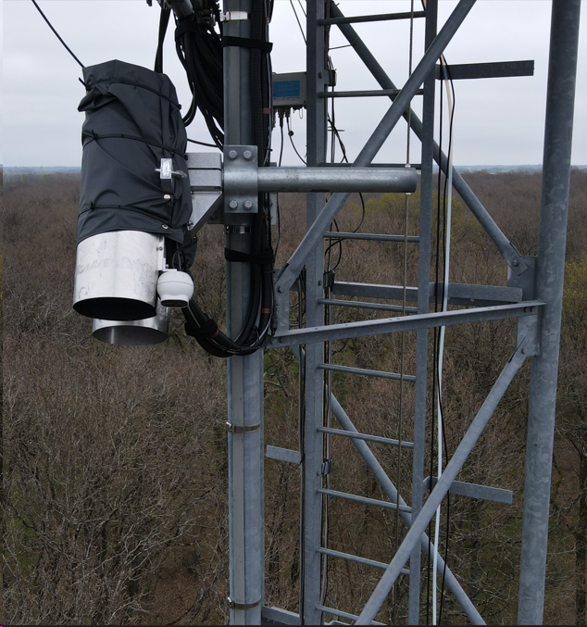
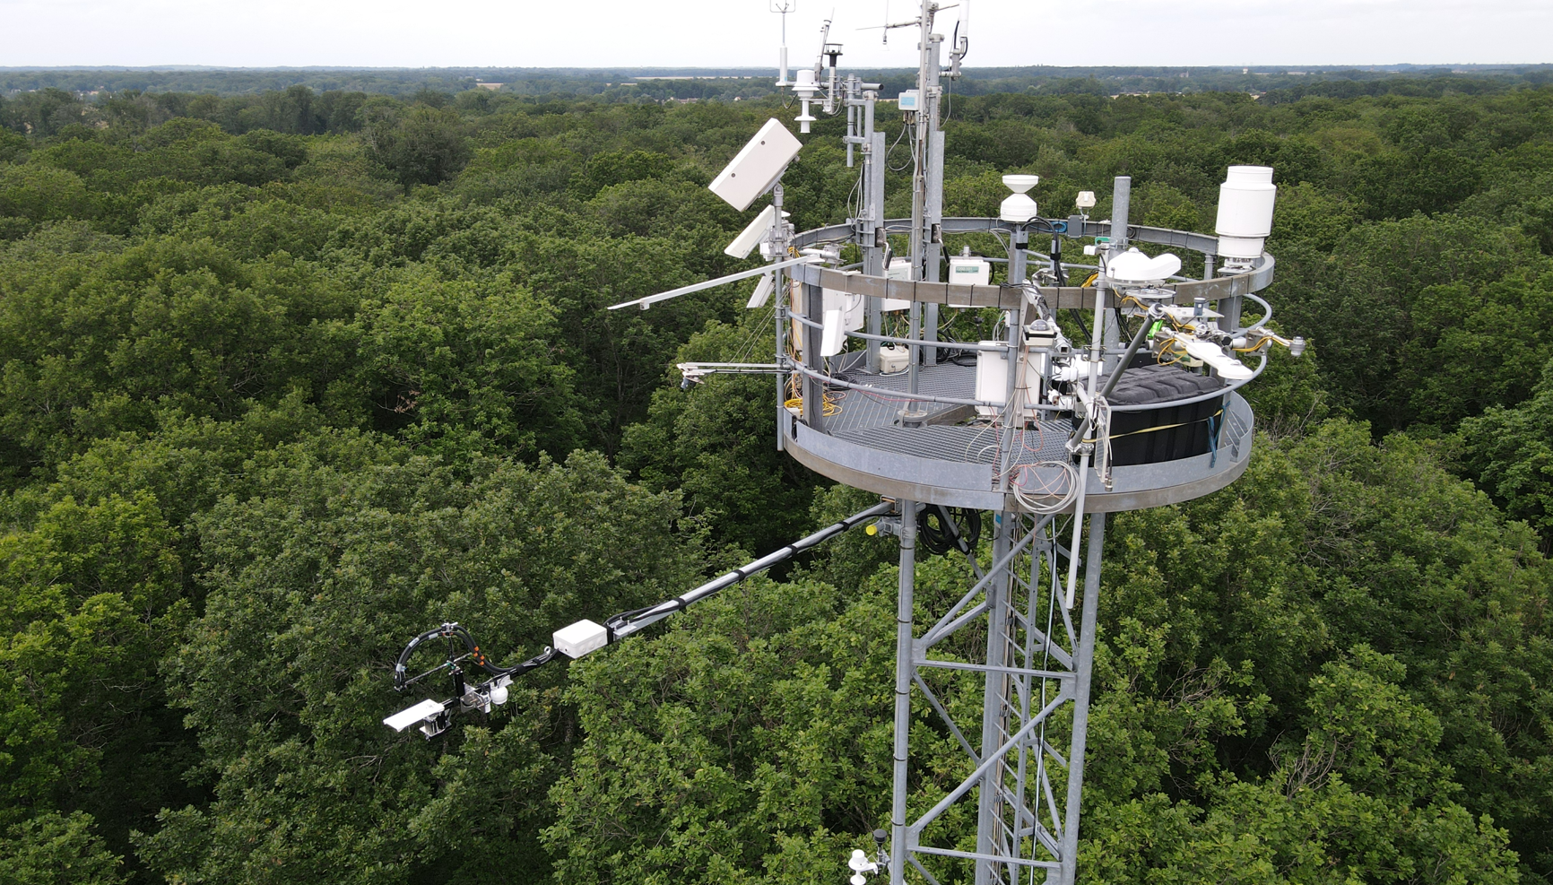

The Fontainebleau-Barbeau Forest (ICOS FR-Fon) Research Station (France)
EC flux
(SIF3)
LIF
Active ChlF
SIF3
Passive ChlF
(EC flux)
(LIF)
https://barbeau.ese.cnrs.fr
4
Notes:
We did our measurements in the Barbeau station during a heatwave in 2022. This station is part of the ICOS network in France. At the top of the tower, we had three things: a eddy covariance system to measure carbon flux, a passive fluorescence sensor – SIF3, and an active fluorescence sensor - LIF.

Slide 5
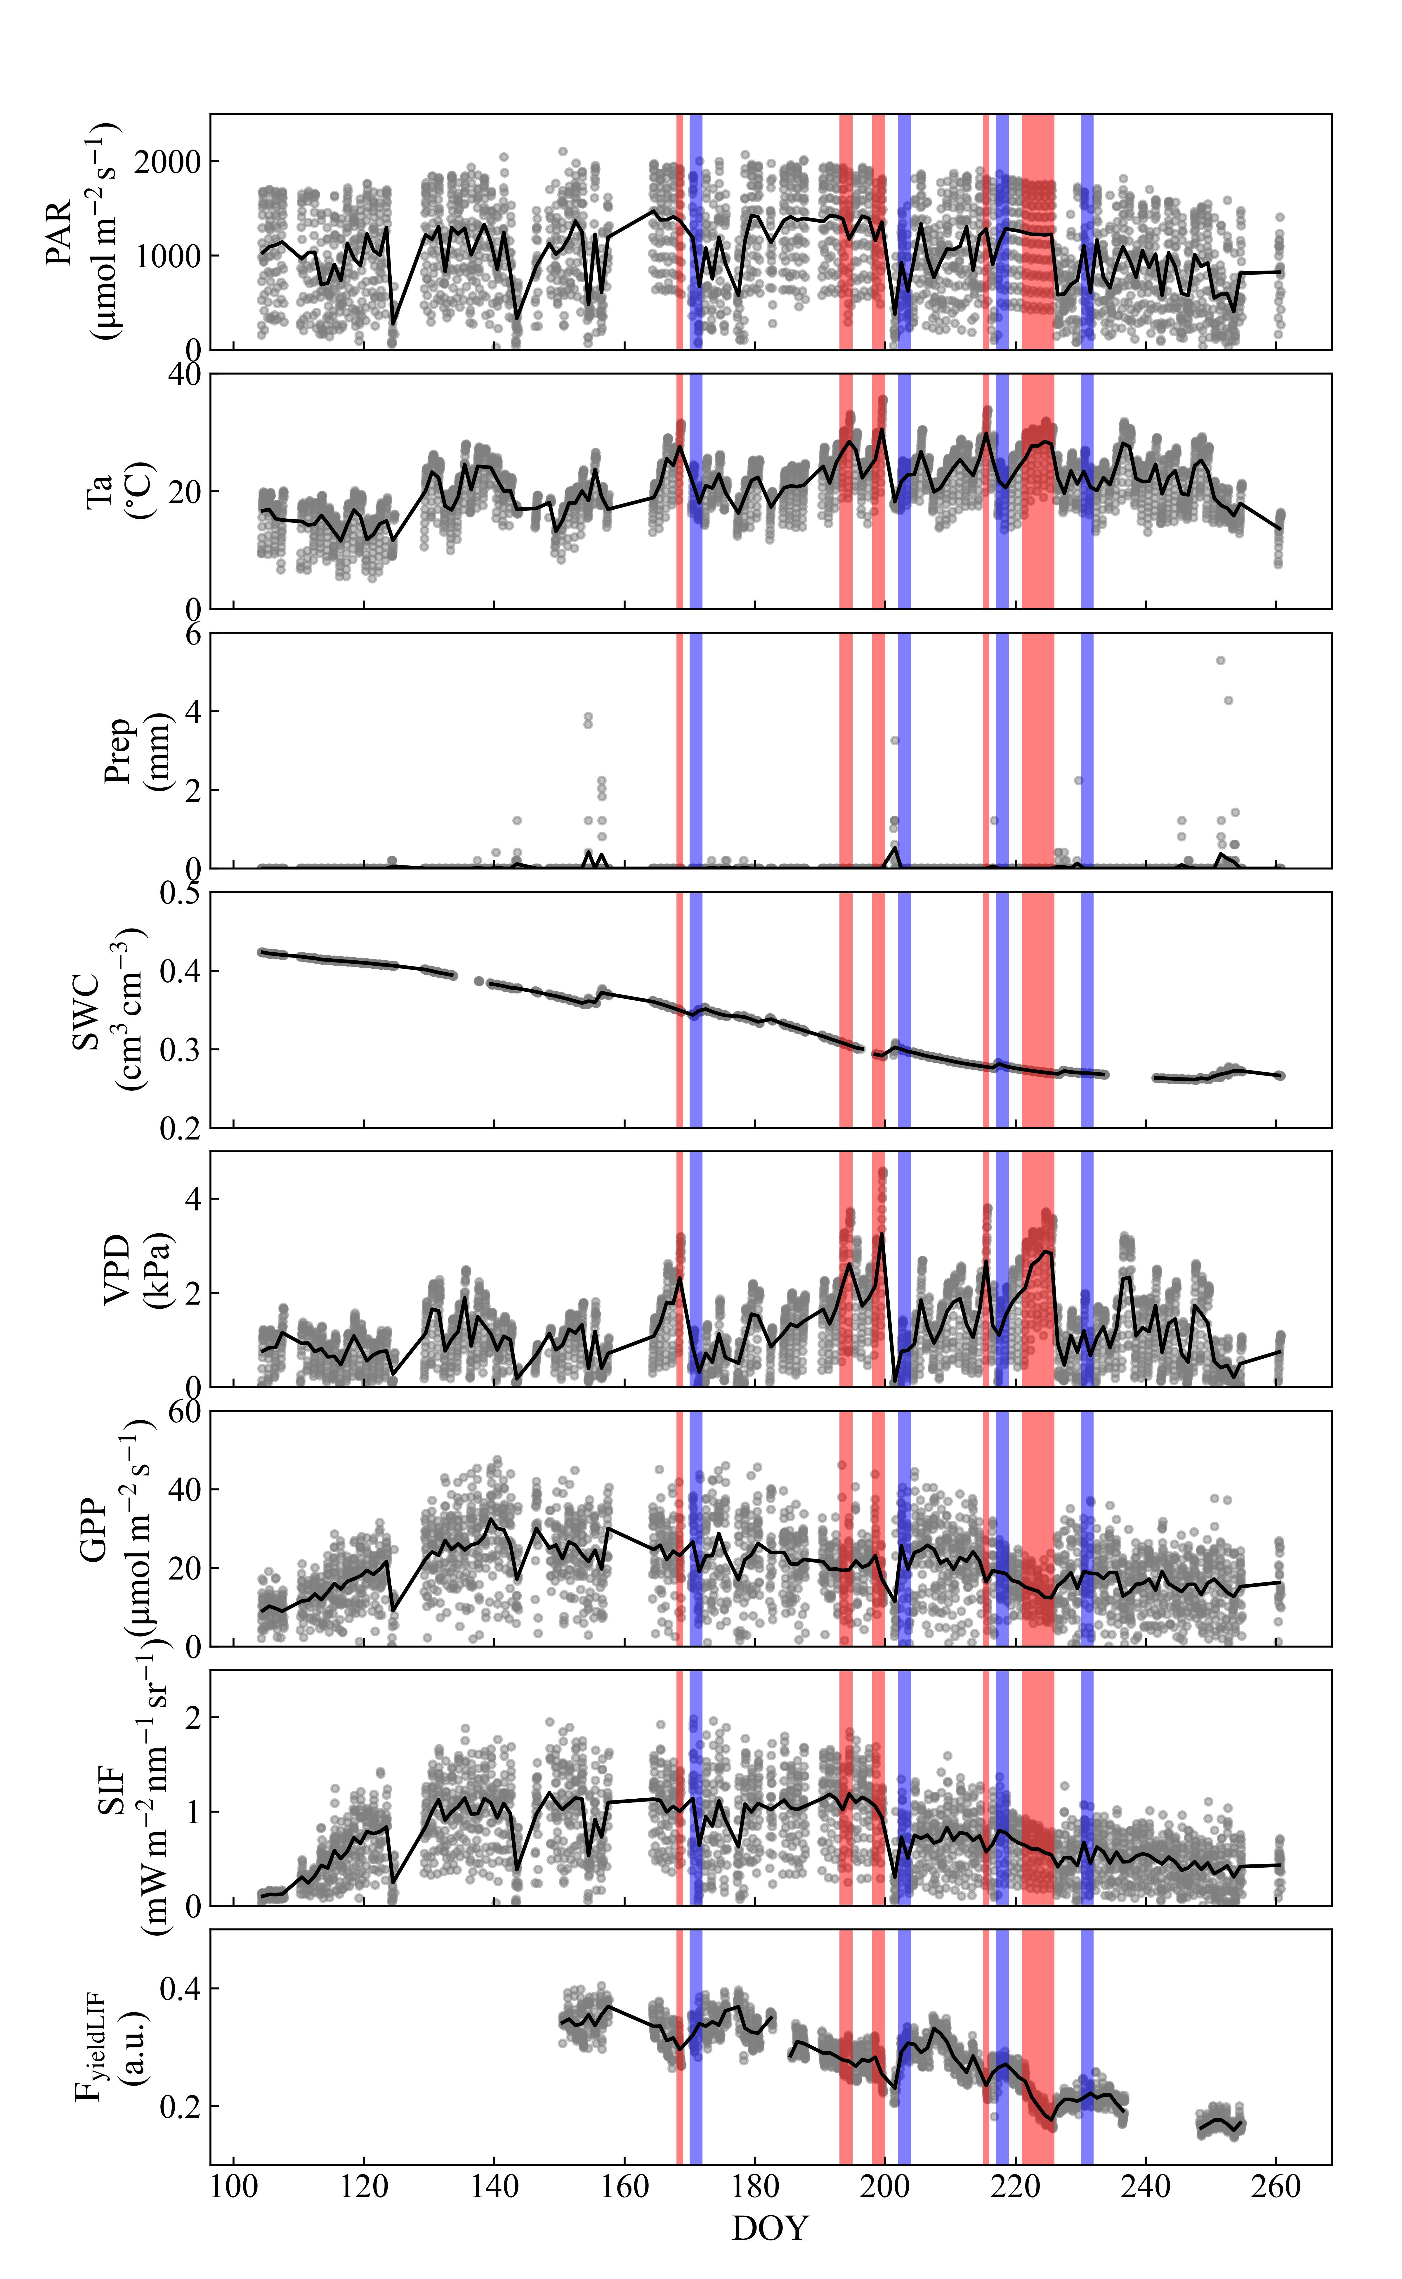
High Atmospheric Dryness and No Atmospheric Dryness
The temporal variation of Vapor Pressure Deficit (VPD) over FR-Fon forest in summer 2022
High Atmospheric Dryness (HAD): Consecutive days of high Vapor Pressure Deficit (VPD)
No Atmospheric Dryness (NAD): Two consecutive days after HAD and without rainfall.
Notes:
We picked two types of dry air situations: High Atmospheric Dryness (HAD) and No Atmospheric Dryness (NAD). Consecutive days of high VPD were selected as HAD, and two consecutive days after HAD and without rainfall were selected as NAD.

Slide 6
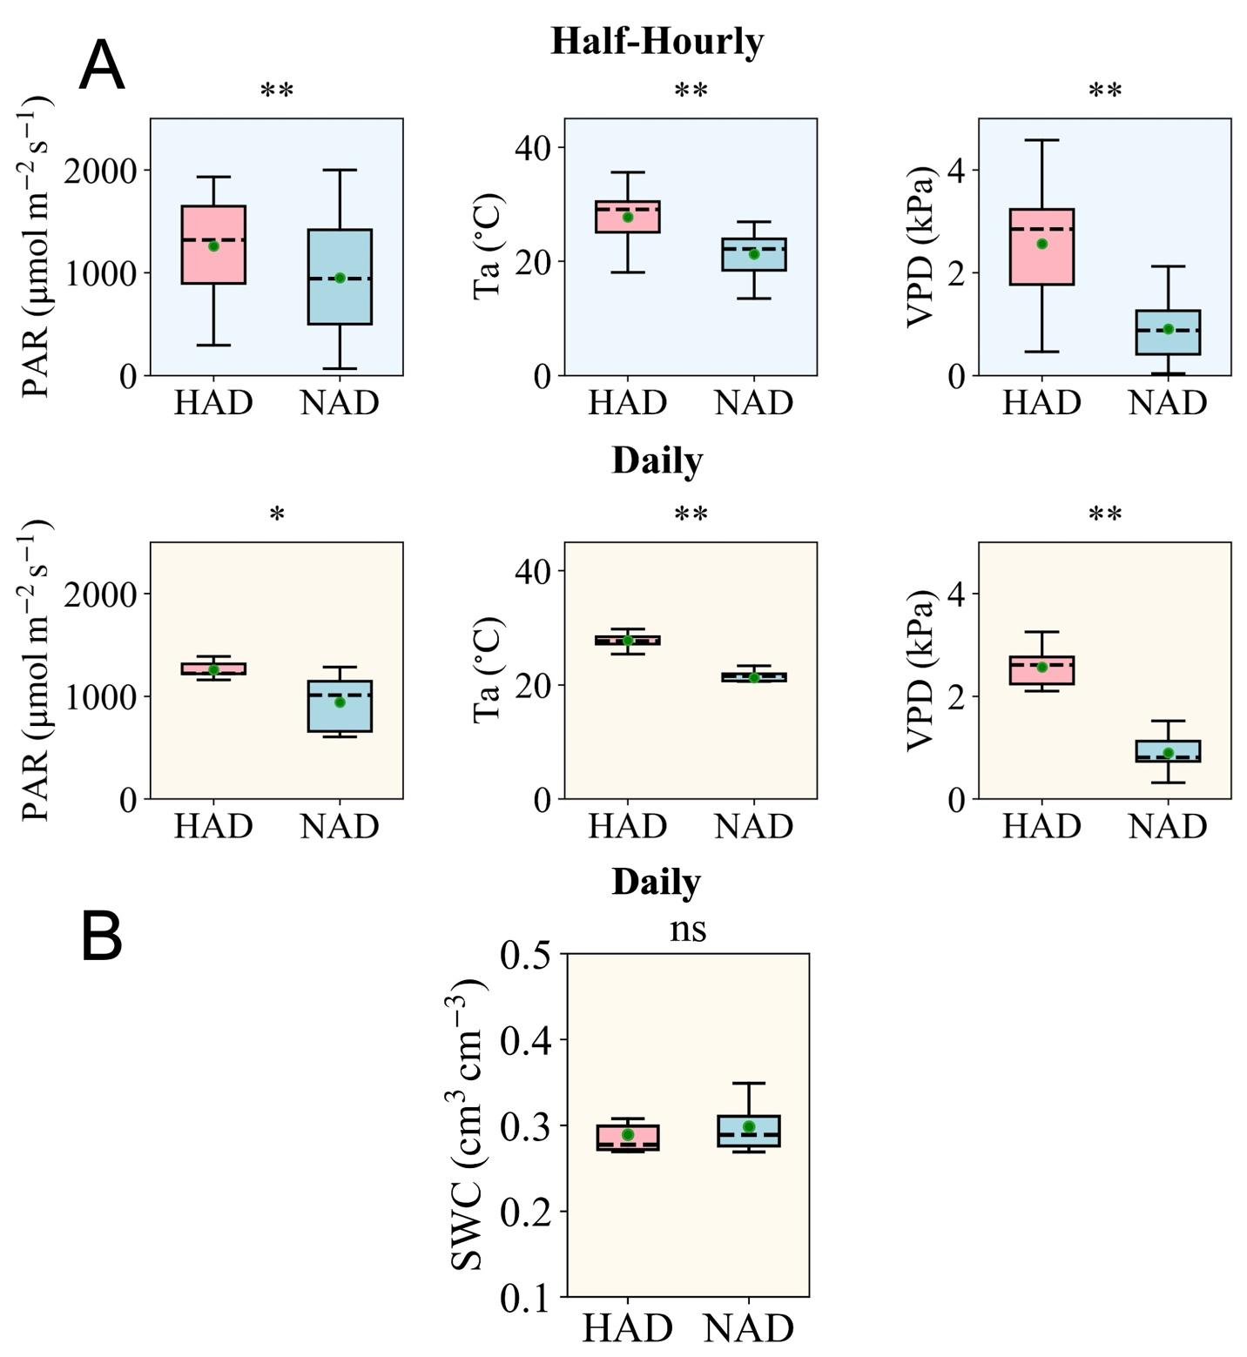
Environmental differences, soil water availability, and phenological stability
PAR: Photosynthetically Active Radiation
Ta: Air temperature
VPD: Vapor Pressure Deficit
SWC: Soil Water Content
Significant differences in environmental conditions (PAR, Ta, VPD), while similar SWC levels between the HAD and NAD periods.
→ Soil moisture (SWC) remained relatively stable across both periods and was unlikely to be a limiting factor of our study.
Notes:
We analyzed the difference of abiotic factors between HAD and NAD conditions. Significant differences in PAR, Ta and VPD can be observed at both the half-hourly and the daily scales. However, Soil moisture (SWC) remained relatively stable across both periods. Therefore, it was unlikely to be a limiting factor of our study.

Slide 7
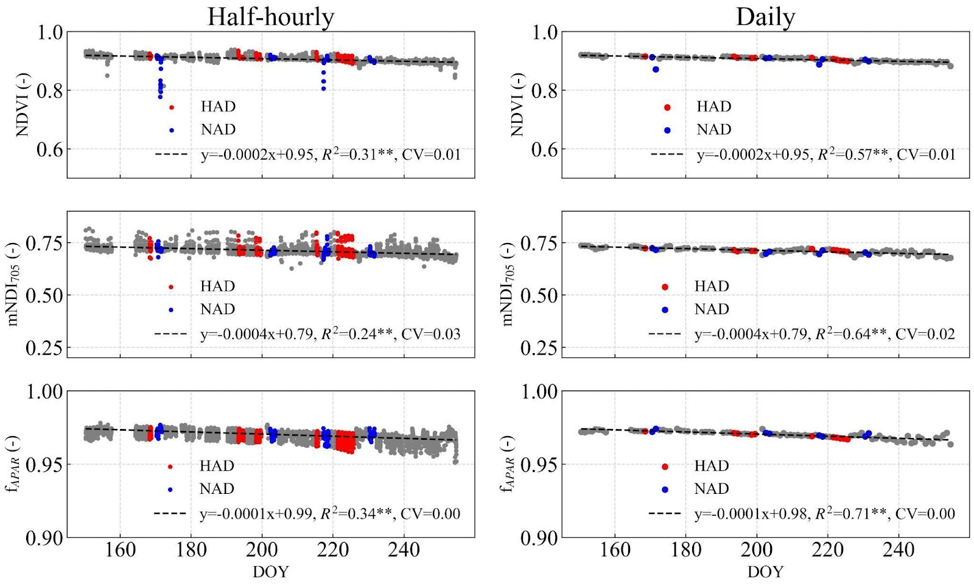
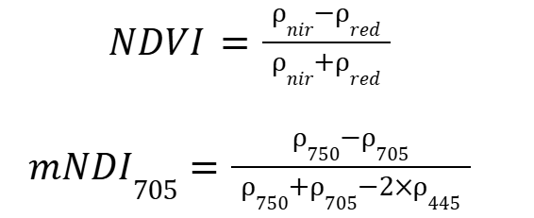

Environmental differences, soil water availability, and phenological stability
Representations of canopy properties:
Canopy structure:
Chlorophyll content:
Light absorption capacity:
The plants did not undergo substantial phenological changes during the study period.
Notes:
This figure shows the variations of canopy structure, chlorophyll content, and light absorption capacity during the study period. CV is the coefficient of variation, which is quite small. Therefore, the plants did not undergo substantial phenological changes during the study period.

Slide 8
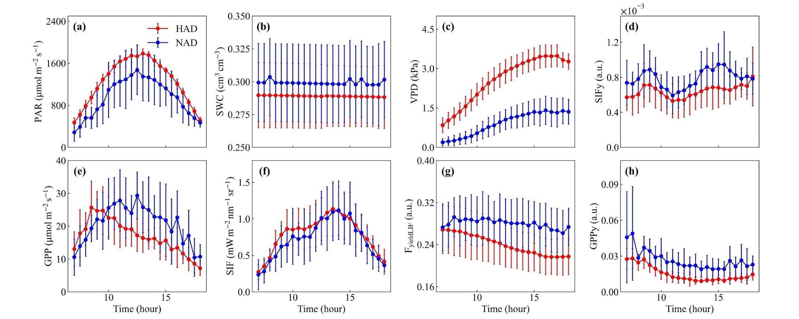
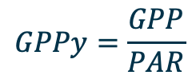
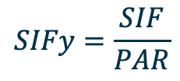
Diurnal variations of SIF, F_{yieldLIF}, GPP and environmental variables
$$SIFy=\frac{SIF}{PAR}$$
(Li et al., 2026)
$$GPPy=\frac{GPP}{PAR}$$
(Each dot represent mean values of data at each same half-hour interval)
Under HAD, GPP peaked earlier than both PAR and SIF, indicating a stress-induced decoupling of photosynthesis from light availability.
F_{yieldLIF} was stable under NAD, but showed a marked decline under HAD, reflecting dynamic downregulation of fluorescence yield.
Notes:
Here are some results. Under HAD conditions, GPP peaked early in the day—before light (PAR) and SIF peaked, it indicates the stress-induced decoupling of photosynthesis from light availability. FyieldLIF dropped a lot on those dry days, showing the plant was downregulating its efficiency. But on NAD conditions, FyieldLIF stayed pretty stable all day.

Slide 9
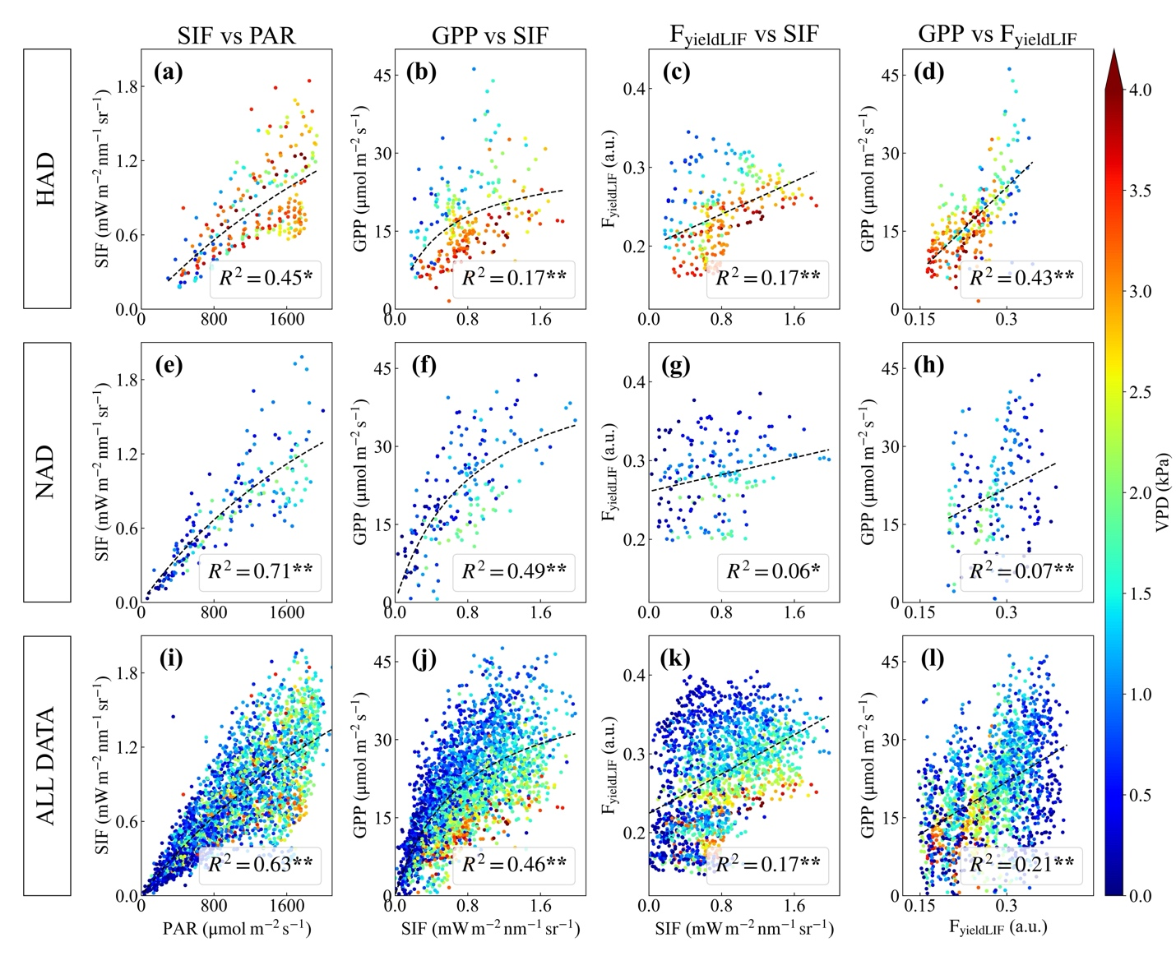
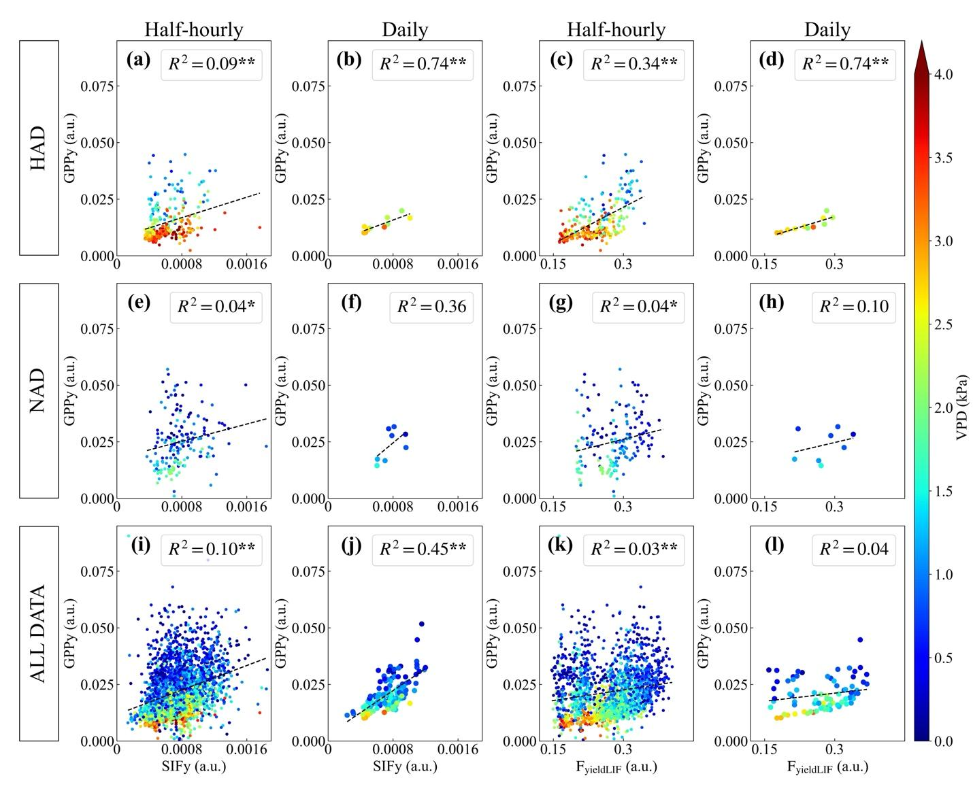

Correlations in different conditions of atmospheric dryness at the half-hourly scale
SIF vs PAR, SIF vs GPP are compared to previous studies (Dechant et al., 2020; Miao et al., 2018)
Strong impacts of atmospheric dryness stress
Influence of the diurnal variation of PAR on both SIF and GPP
VPD (kPa)
(Li et al., 2026)
It’s noisy at the half-hourly scale due to the influence of diurnal variation of PAR.
How about the daily scale?
Notes:
Here we compared four relationships under varying dryness at half-hourly scale. Our results are comparable to previous studies. We can see that the difference of these correlations between HAD and NAD conditions, indicating the strong impacts of atmospheric dryness stress. However, it looks noisy at the half-hourly scale because we have the influence of diurnal variation of PAR.

Slide 10
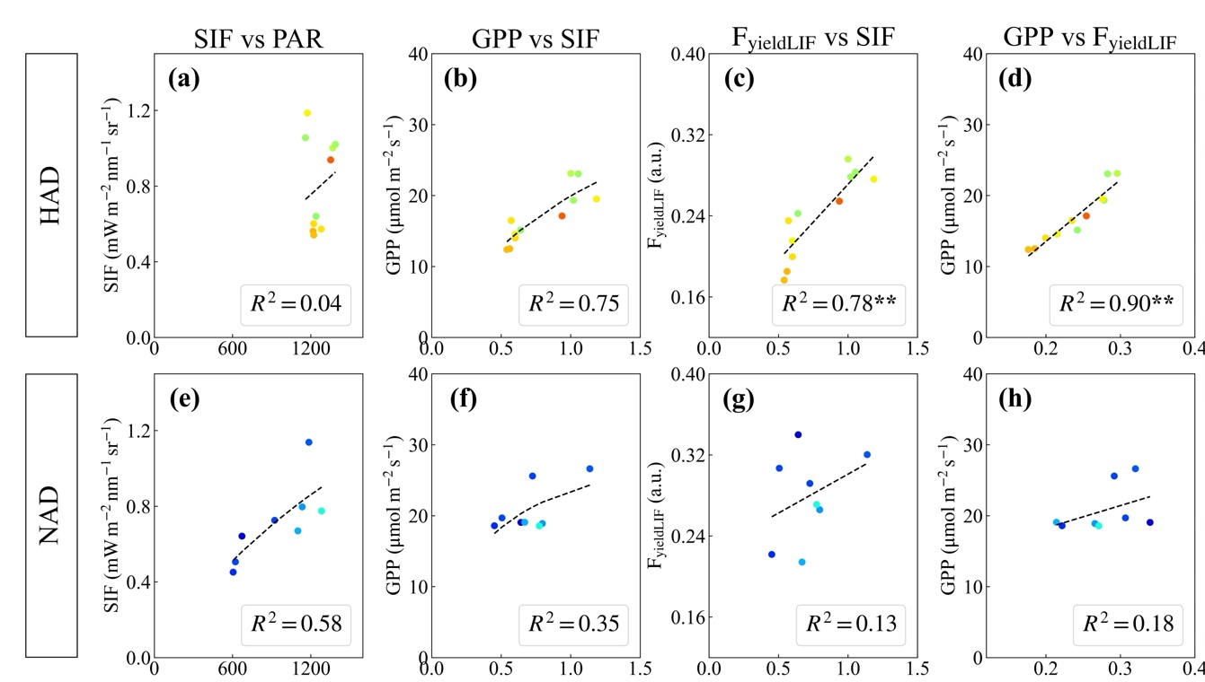
Correlations in different conditions of atmospheric dryness at the daily scale
The correlations of F_{yieldLIF} vs SIF, F_{yieldLIF} vs GPP under HAD conditions improved markedly from half-hourly to daily scale.
Stronger correlations of F_{yieldLIF} vs SIF (c), GPP vs F_{yieldLIF} (d) under HAD than NAD
Stronger correlations of GPP vs F_{yieldLIF} (d) than GPP vs SIF (b) under HAD condition
VPD (kPa)
(Li et al., 2026)
F_{yieldLIF} exhibited the strongest correlation with photosynthesis under HAD conditions
Notes:
To get rid of the influence of PAR and focus on the physiological effects of atmospheric dryness , let’s look at the daily scale. We can see stronger correlations of FyieldLIF vs SIF, GPP vs FyieldLIF under HAD than NAD. And FyieldLIF was more closely related to GPP than SIF was when the plants were under stress. So overall, FyieldLIF exhibited the strongest correlation with photosynthesis under HAD conditions.

Slide 11
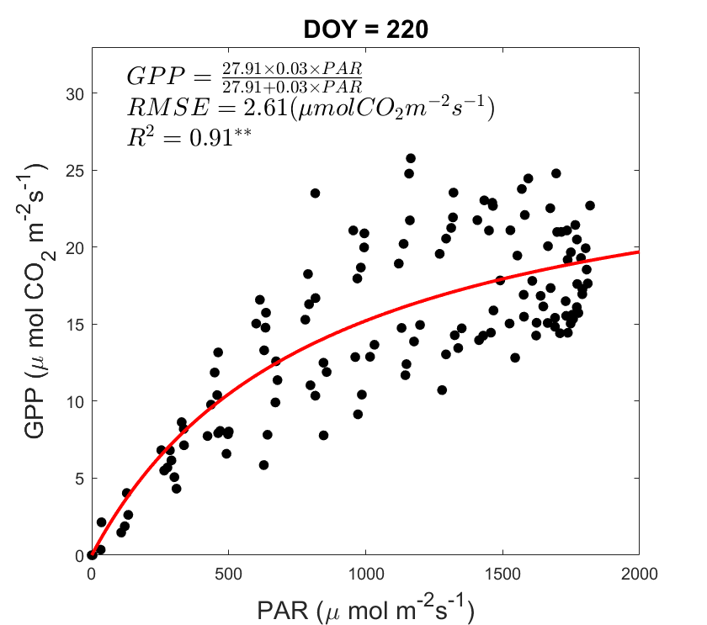

Analysis of the differences between F_{yieldLIF} and SIFy in detecting plant responses to abiotic constraints
The relationship between GPP and PAR in Fr-Fon
The maximal rate of photosynthesis (Amax) was derived using a photosynthetic light-response curve fitting model
$$GPP= \frac{Amax × α×PAR}{Amax+α×PAR}$$
Amax is a “proxy” of physiological response of GPP to abiotic constraints
Notes:
To dig deeper, we want to get rid of the influence of both diurnal and seasonal variation of PAR. Here we used a light-response curve to estimate Amax, the max rate of photosynthesis. This helps us separate light from other environmental effects.

Slide 12
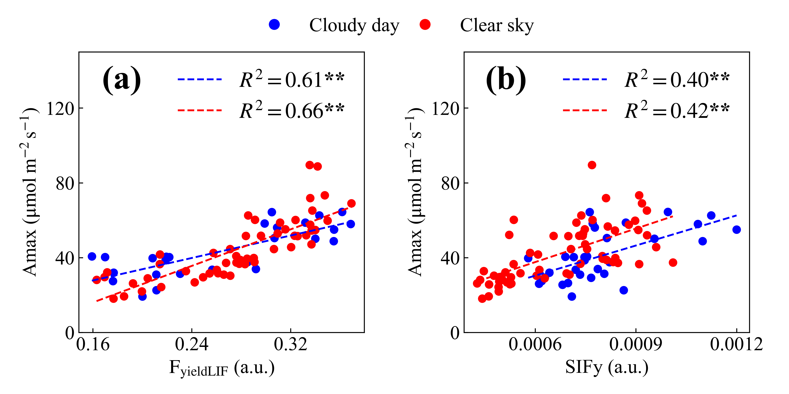
Analysis of the differences between F_{yieldLIF} and SIFy in detecting plant responses to abiotic constraints
Higher correlations of Amax vs F_{yieldLIF} than Amax vs SIFy.
The highest correlation was observed between Amax and F_{yieldLIF} under clear sky conditions (R² = 0.66).
(Li et al., 2026)
The significant and strong relationship of Amax vs F_{yieldLIF} underscores the advantages of F_{yieldLIF} in capturing plant photosynthetic responses to abiotic constraints
Notes:
Here we separate cloudy and clear sky conditions. We can see higher correlations of Amax vs FyieldLIF than Amax vs SIFy. And the strongest link was between Amax and FyieldLIF under clear sky conditions. This shows that FyieldLIF is a powerful tool for understanding how plants respond to stress conditions. FyieldLIF directly reflects how efficiently the plant is working—even when it’s stressed. That makes it a great way to track how photosynthesis changes under tough conditions.

Slide 13





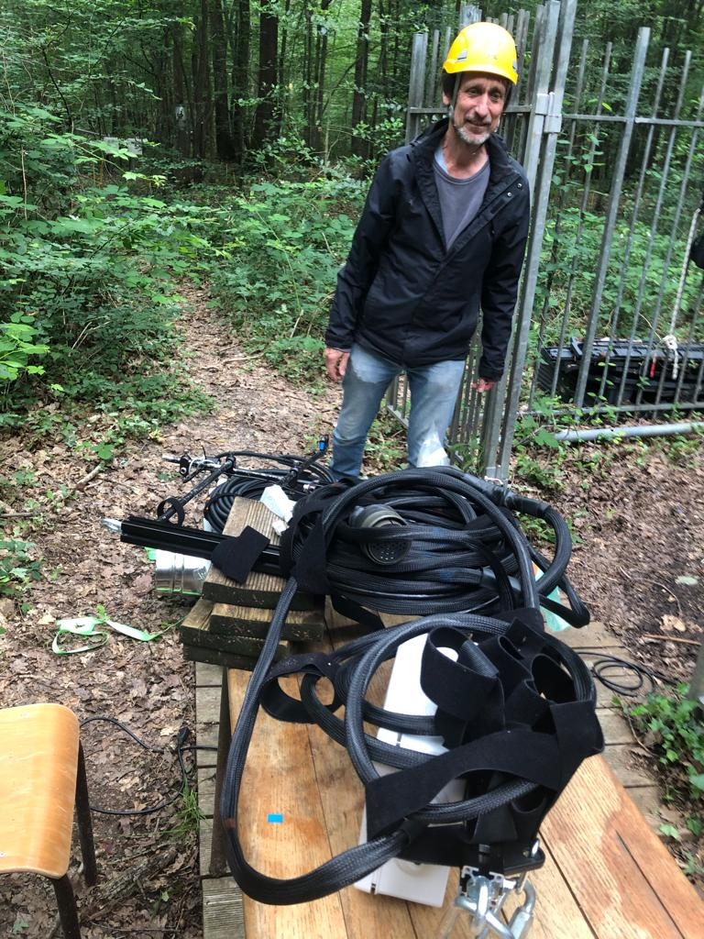
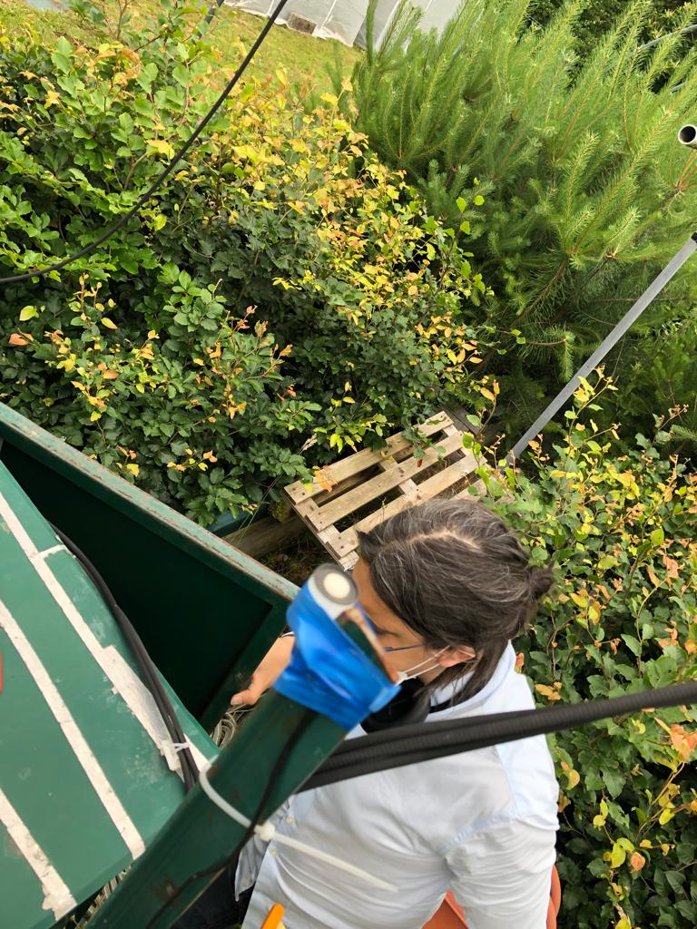
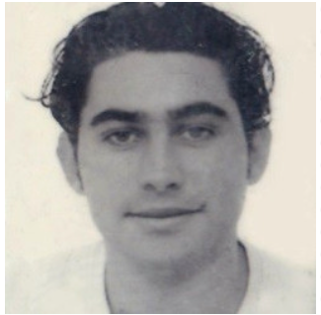
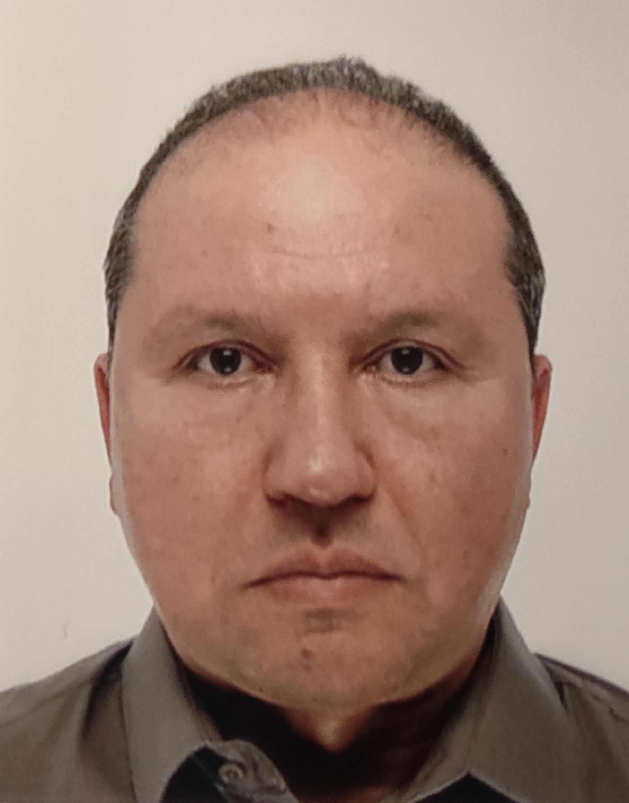
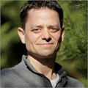






Take-Home Messages and Future Work
The correlation between SIF and GPP weakens under increasing atmospheric dryness, while the relationship between F_{yieldLIF} and GPP strengthens.
F_{yieldLIF} outperforms passive ChlF yield (SIF/PAR) in tracking photosynthetic capacity (Amax), especially under conditions of high atmospheric dryness.
More measurements at other ecosystems
Modeling photosynthesis inhibition by abiotic factors
For more details, see Li et al., RSE, 2026.
This work is supported by Centre National d’Etudes Spatiales (CNES) and Climate change and land use convergence institute (Cland)
Pr. Kamel
SOUDANI
Dr. Yves
GOULAS
Dr. Gabriel
HMIMINA
Dr. Gwendal
LATOUCHE
Dr. Abderrahmane
Ounis
Dr. Daniel
Berveiller
zhaohui.li@universite-paris-saclay.fr
https://www.researchgate.net/profile/Li-Zhaohui-3?ev=hdr_xprf
Notes:
At the end of my presentation, here are two take-home messages I want to share with you. First, The correlation between SIF and GPP weakens under increasing atmospheric dryness, while the relationship between F_{yieldLIF} and GPP strengthens. Second, F_{yieldLIF} outperforms passive ChlF yield (SIF/PAR) in tracking photosynthetic capacity (Amax), especially under conditions of high atmospheric dryness.
Our future’s work will focus on having more measurements at other ecosystems and also simulating the photosynthesis inhibition by abiotic factors using models.
Big thanks to my co-authors and to our supporters at CNES and CLAND. Thank you for your attention!

Slide 14
Correlations among SIFy, GPPy and F_{yieldLIF} in different conditions of atmospheric dryness
The strong correlation of F_{yieldLIF} vs GPP under HAD conditions can largely be attributed to the strong correlation of F_{yieldLIF} vs GPPy (b, d)
Stronger correlation of GPPy vs F_{yieldLIF} than GPPy vs SIFy under HAD conditions at half-hourly scale.
F_{yieldLIF} outperforms SIFy to capture high-temporal-resolution variations in photosynthesis efficiency under HAD conditions

Slide 15
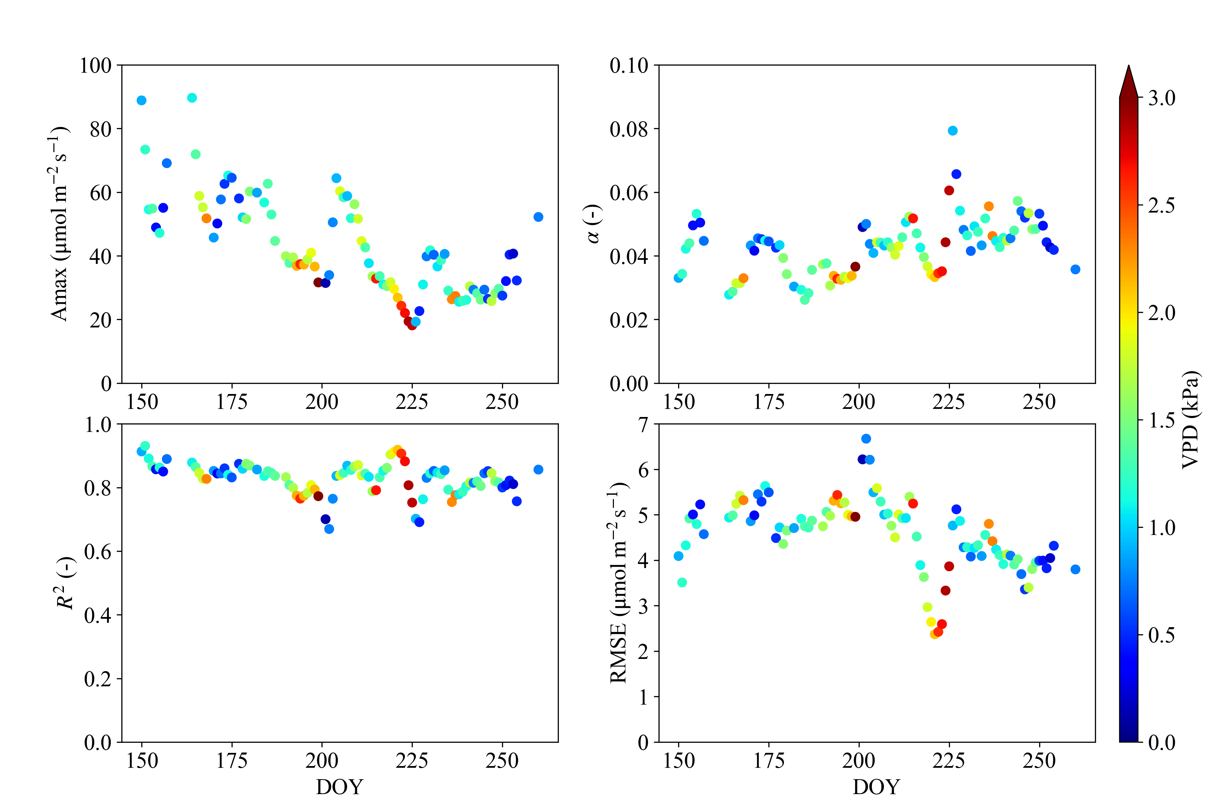
The light-response curve fitting model

Slide 16
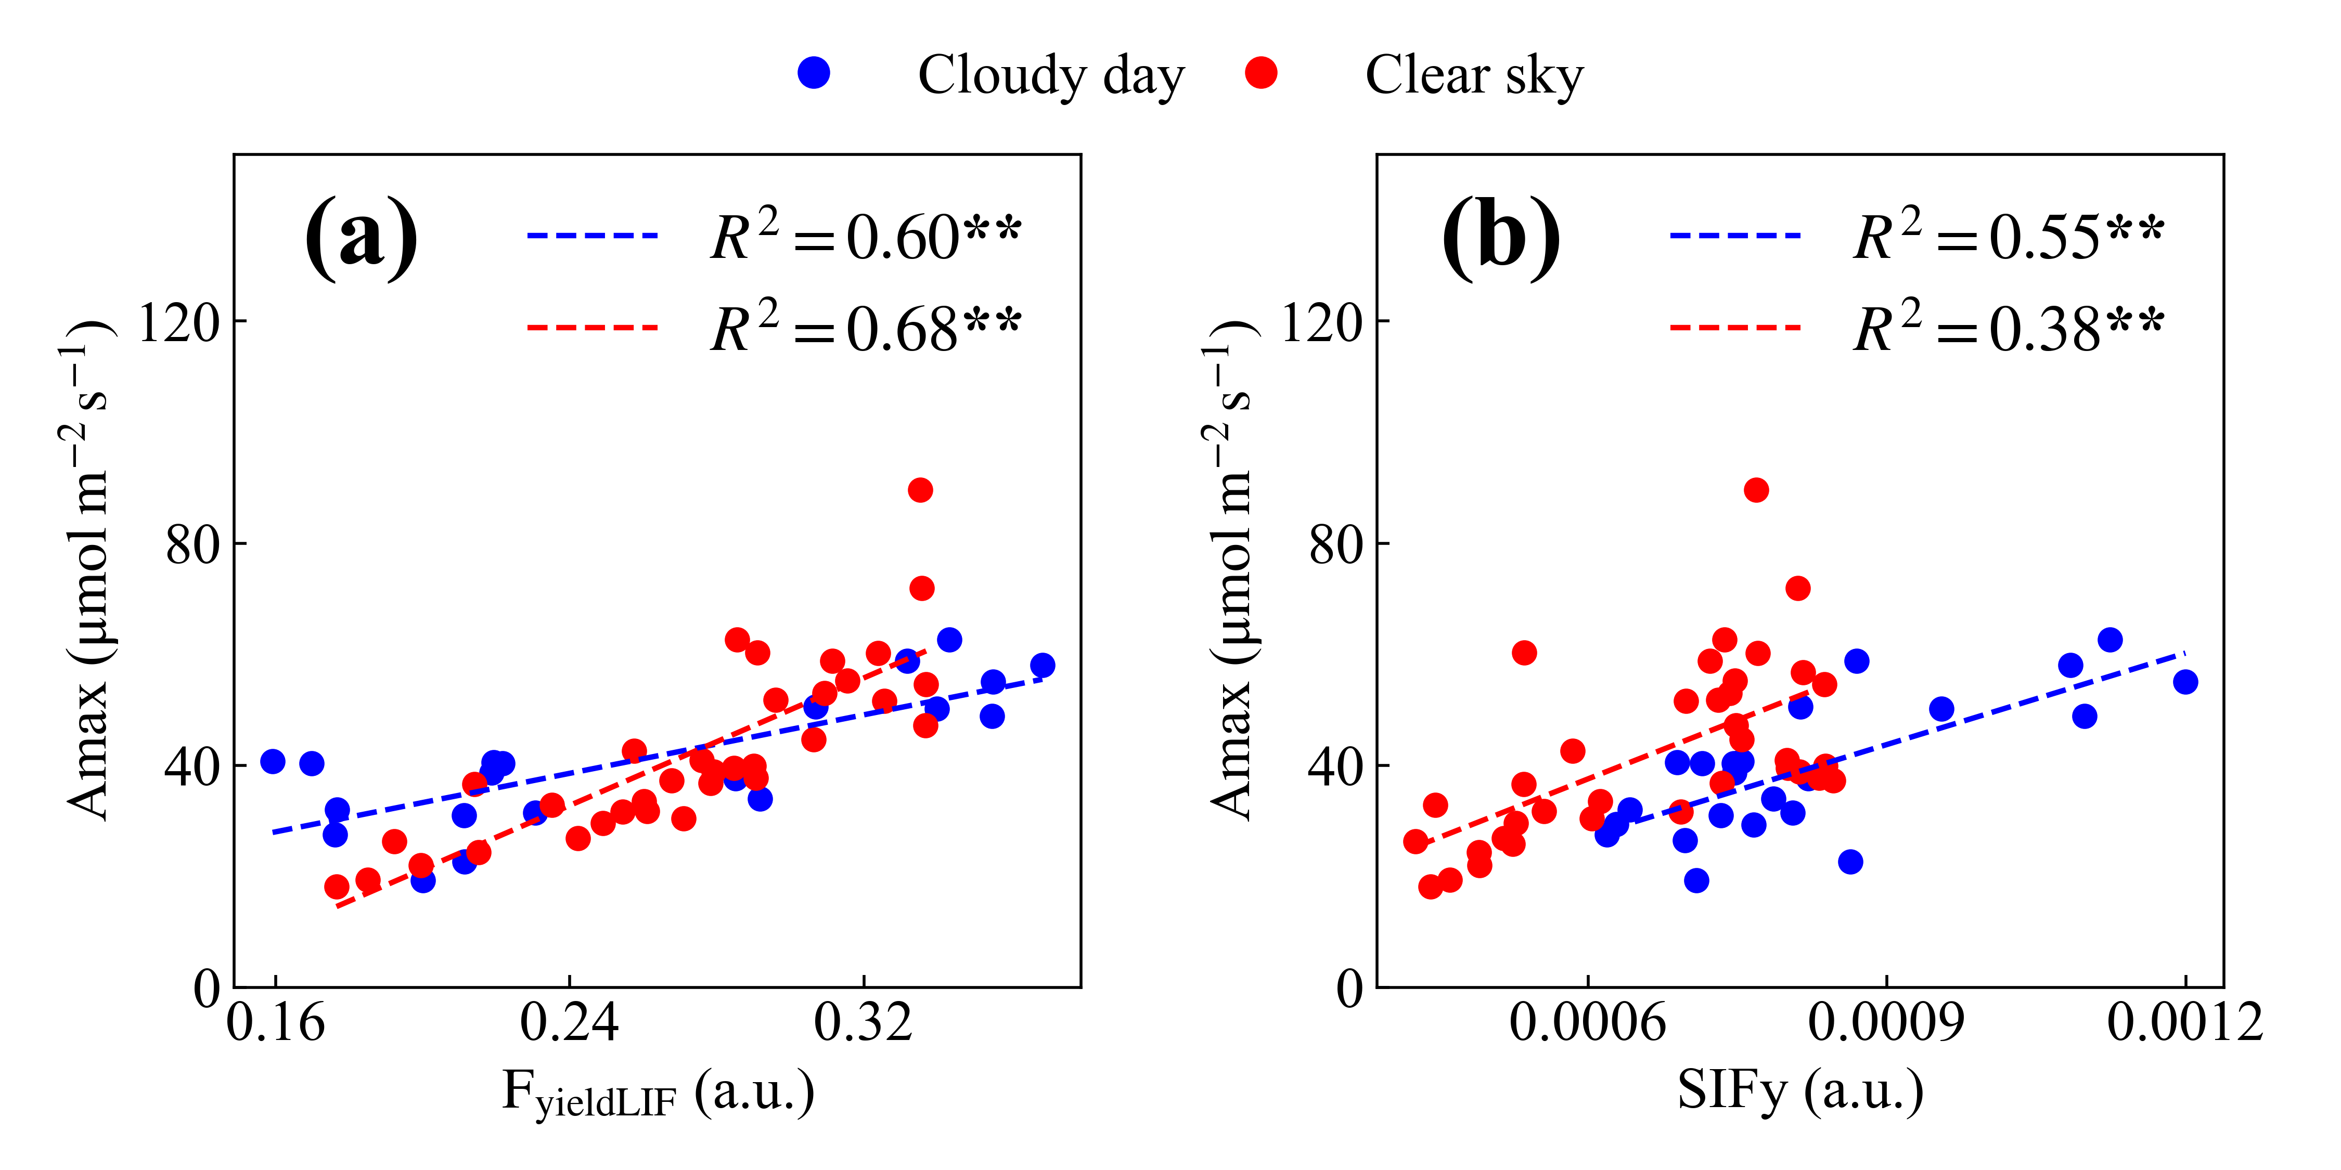
Analysis of the differences between F_{yieldLIF} and SIFy
Cloudy day: PAR_{diffuse}/PAR_{total} >0.6
Clear sky: PAR_{diffuse}/PAR_{total} <= 0.3

Slide 17
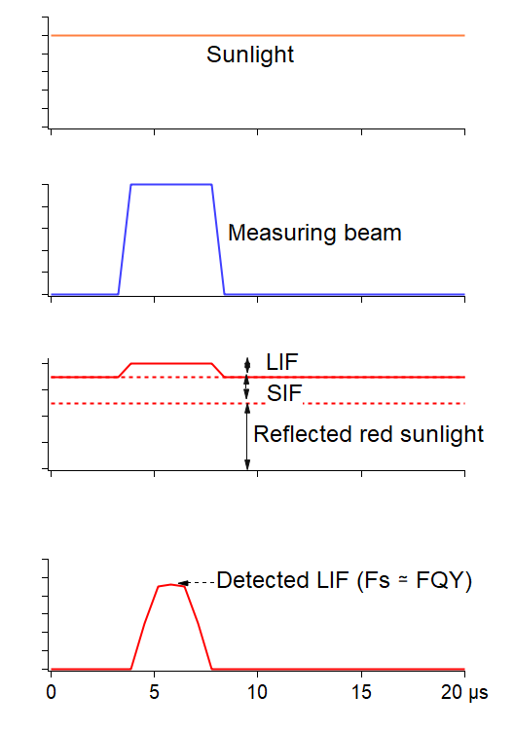

Active ChlF measurement
Pulsed light from
Light Emiting Diodes
Leaf
Detector
Actinic light
e.g. sunlight
Fluorescence signal
Amplifier
Red optical filter
Photodetector
Highpass electronic filter
Detected signal is the sum of :
Reflected sunlight in the spectral band of the filter
Sun-Induced fluorescence (SIF)
LED-Induced Fluorescence (LIF)
Amplifier

Slide 18
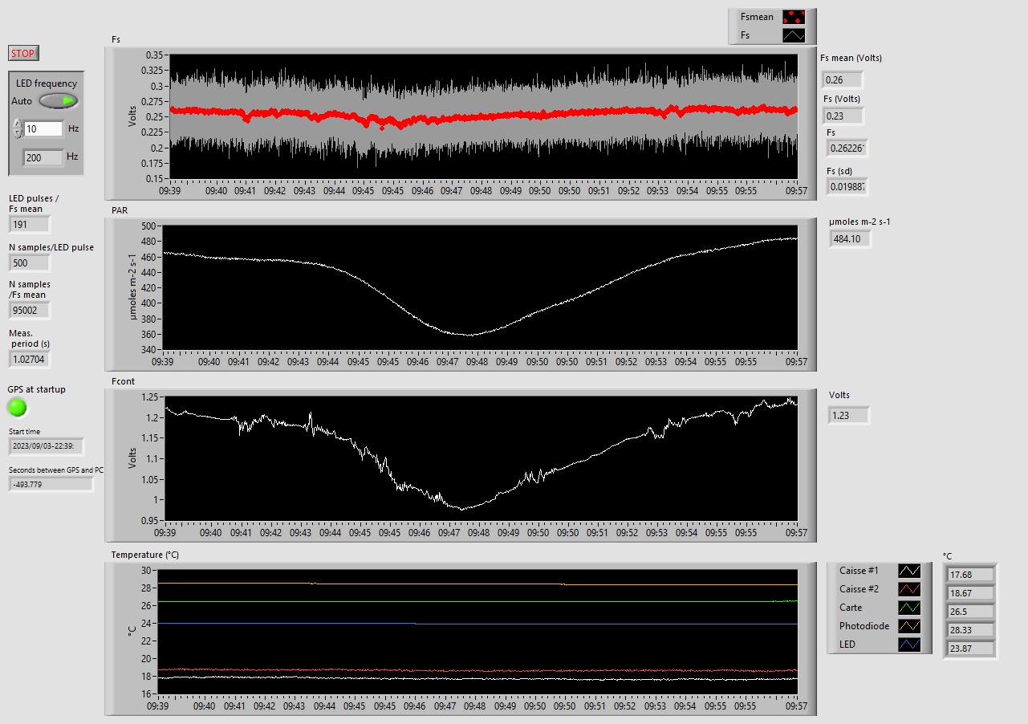
Active ChlF measurement
Acquisition and control-command software written in Labview
Frequency control
Fluorescence (Fs)
Data sampling information
PAR
Time and GPS information
Background light
Temperatures (LED, photodiode, box)

Slide 19
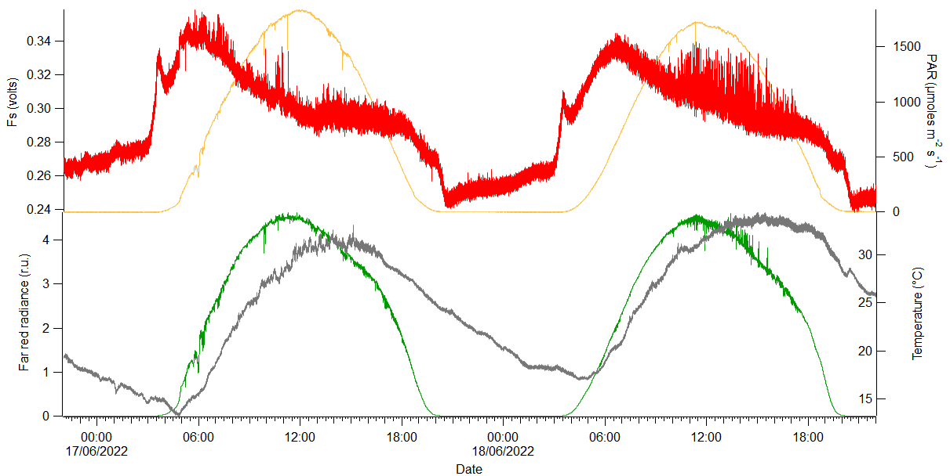
Diurnal cycle of fluorescence yield

Slide 20
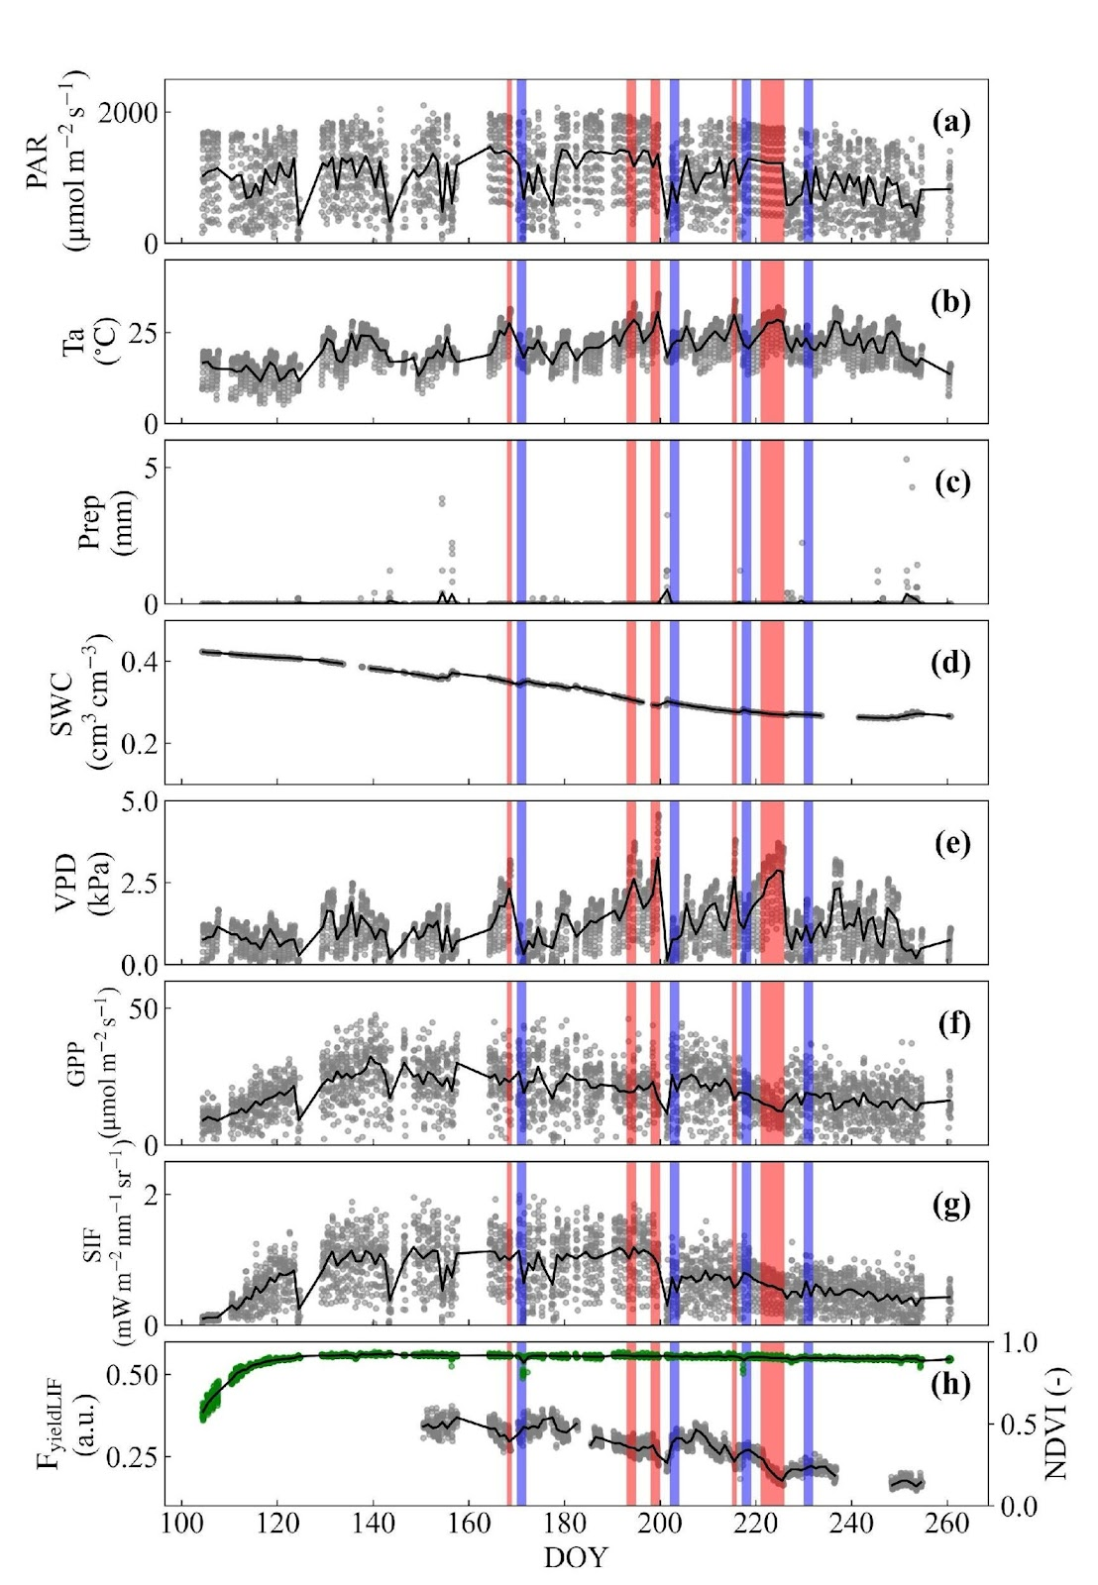
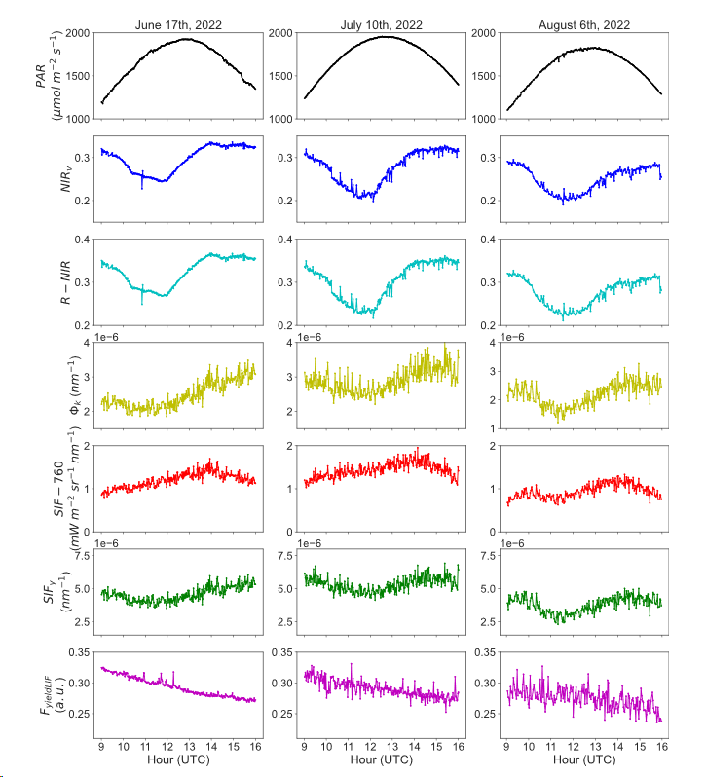
Diurnal and seasonal cycles
Balde et al., 2023

