Slide 1
The Role of Species-Specific Physiology and Diurnal Phase in Interpreting SIF
Sebastian Wieneke, A. Bastos, G. Duveiller, T. Kattenborn, J. Pacheco-Labrador, R. Richter, C. Wirth, M. D. Mahecha

Slide 2
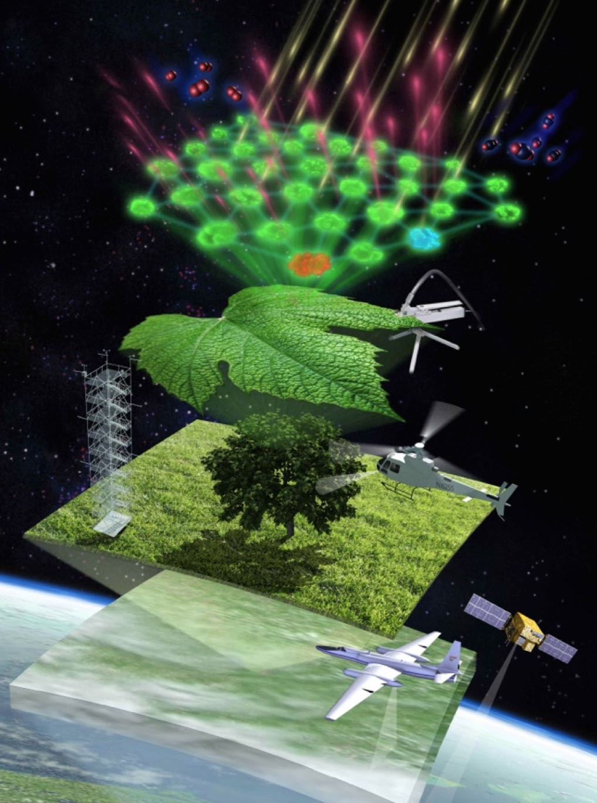
Key Challenges in SIF Retrieval & Interpretation
Signal Uncertainty
Instrument/measurement noise
Retrieval uncertainty
Vegetation Structure Effects
Scattering & reabsorption artifacts
Shadow effects
3D canopy complexity
Scaling Complexity
From satellite (or canopy) → photosystem (spatial/temporal mismatch)
Complex SIF–Photosynthesis Relationship
Non-monotonic relationships
Context-dependent interpretations (diurnal & seasonal dynamics)
Signal Uncertainty
Instrument/measurement noise
Retrieval uncertainty
Vegetation Structure Effects
Scattering & reabsorption artifacts
Shadow effects
3D canopy complexity
Scaling Complexity
From satellite (or canopy) → photosystem (spatial/temporal mismatch)
Complex SIF–Photosynthesis Relationship
Non-monotonic relationships
Context-dependent interpretations (diurnal & seasonal dynamics)
Source: Pat Rawlings, Keck Institute for Space Studie

Slide 3
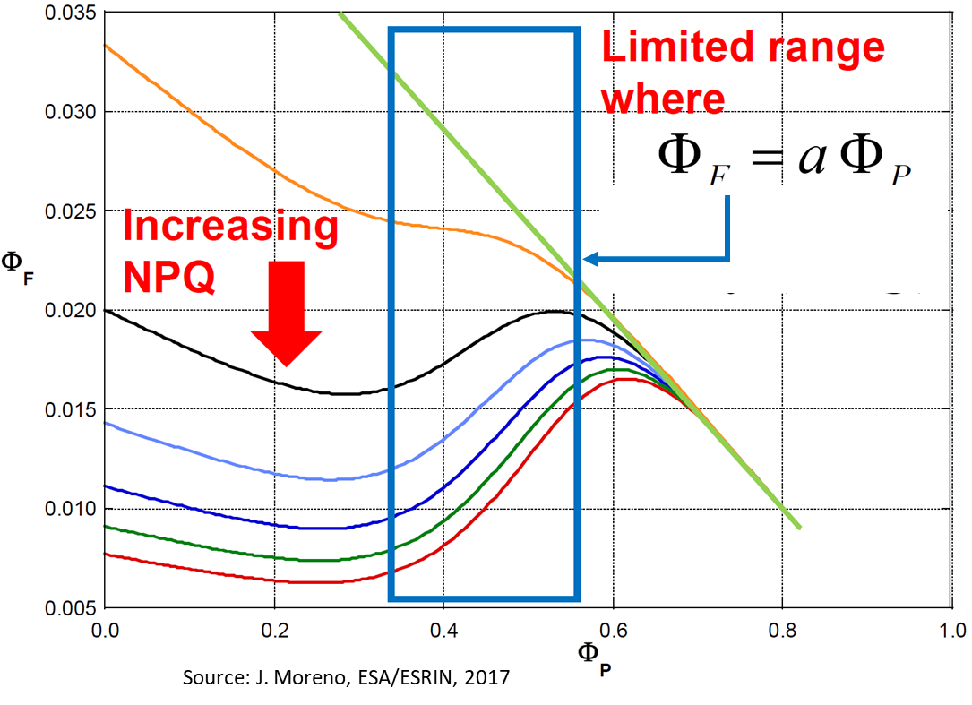

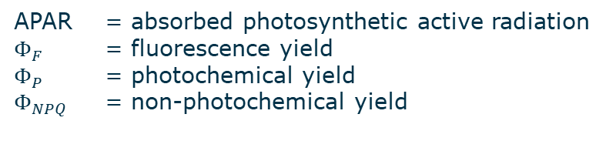


Complex SIF–Photosynthesis Relationship
0.5-2%
17.5-98%
0-82%
How does the relationship between $Φ_{F}$ and $Φ_{P}$ changes over day, season and between two different tree species?
$$APAR=Φ_{P}+Φ_{NPQ}+Φ_{F}$$
$Φ_{F}=Φ_{P}$ changes with $Φ_{NPQ}$
APAR = absorbed photosynthetic active radiation
$Φ_{F}$ = fluorescence yield
$Φ_{P}$ = photochemical yield
$Φ_{NPQ}$ = non-photochemical yield

Slide 4
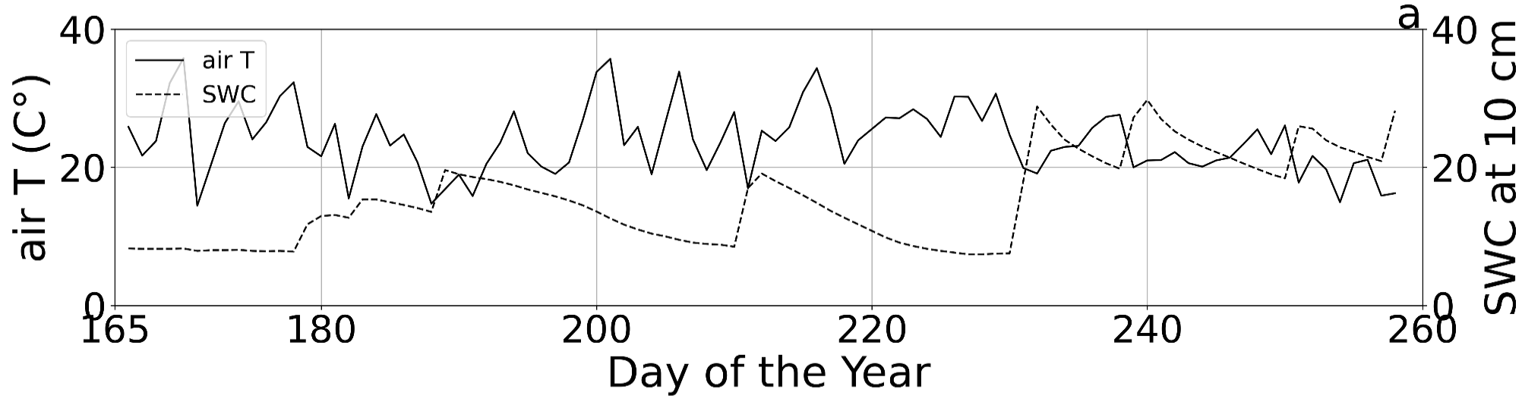
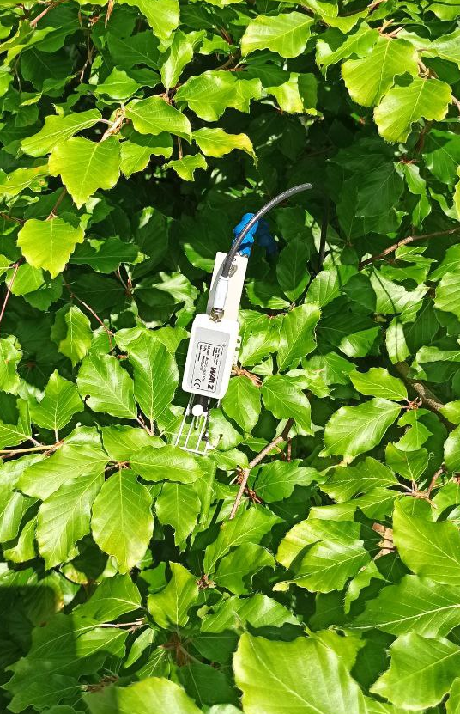
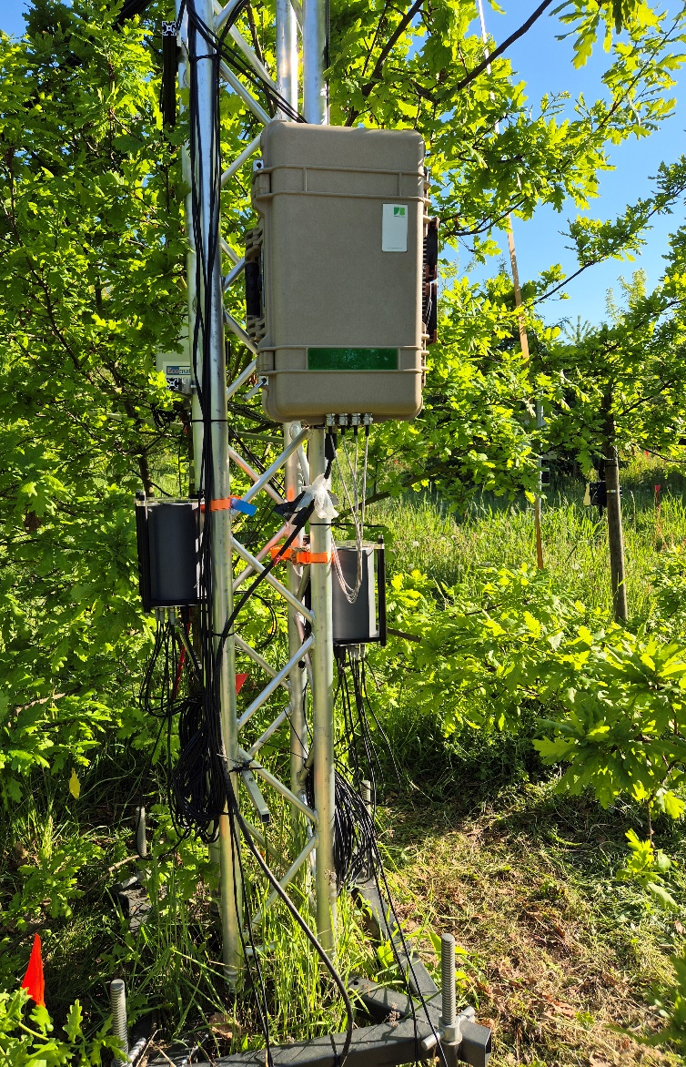
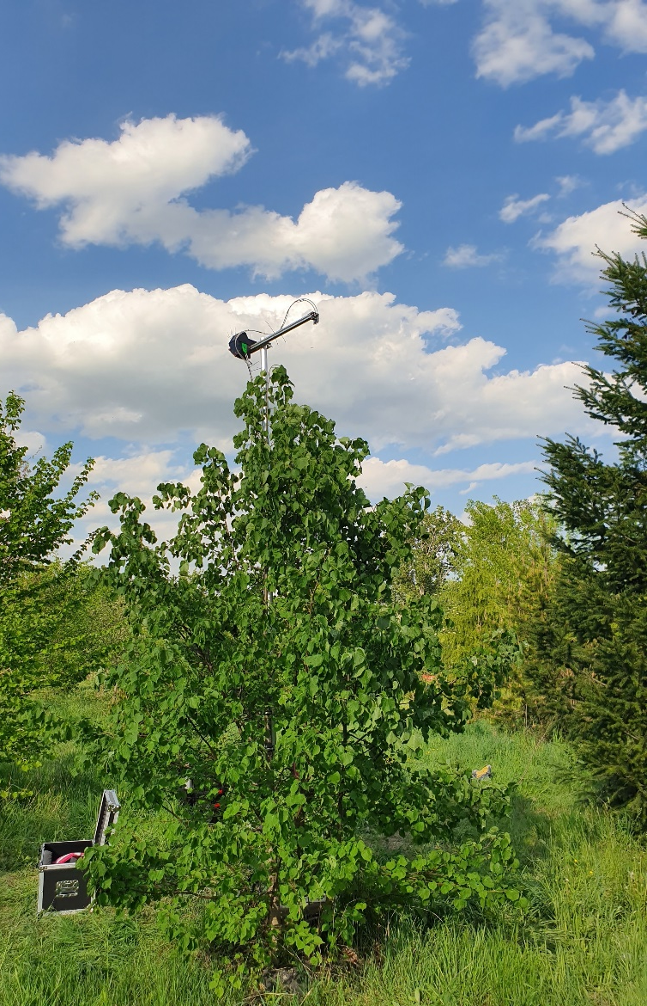
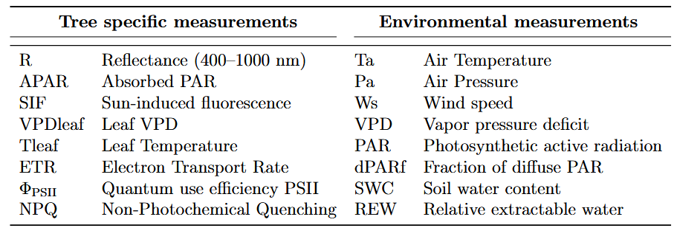
Measurement campaign 2022 (Fagus sylvatica & Tilia Cordata)

Slide 5
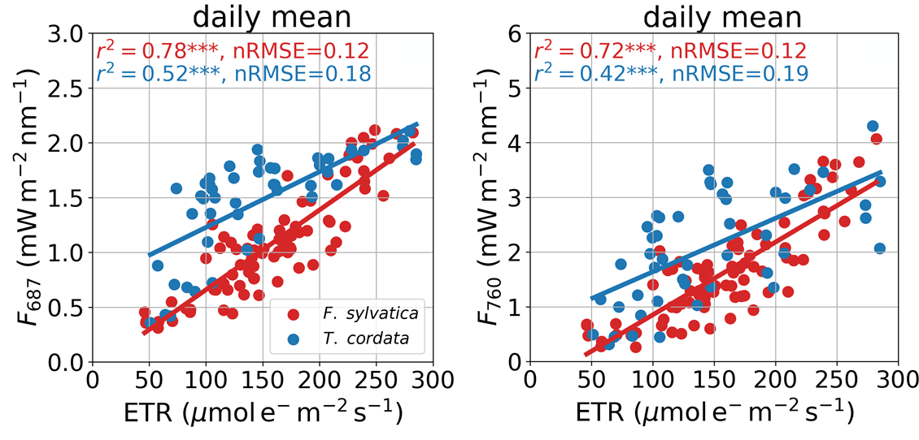
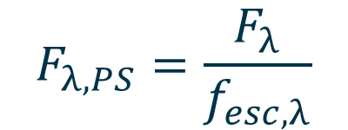
Observed daily mean F_{red} & F_{far-red} vs. ETR
$$F_{λ,PS}=\frac{F_{λ}}{f_{esc,λ}}$$
λ = wavelength
F_{λ} = observed sun-induced fluorescence at λ
F_{PS,λ} = F_{λ} emitted by the photosystems
f_{esc,λ} = escape probability at λ
ETR = electron transport rate

Slide 6
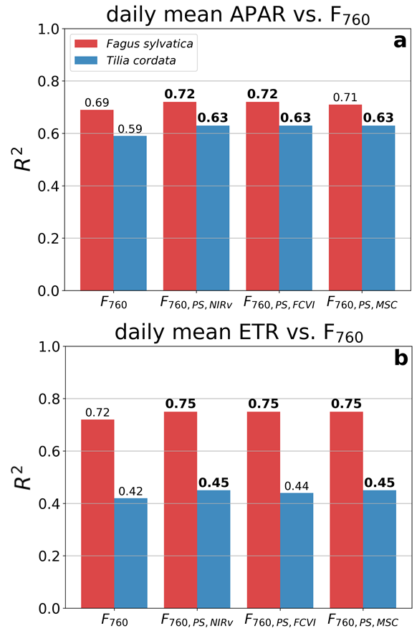
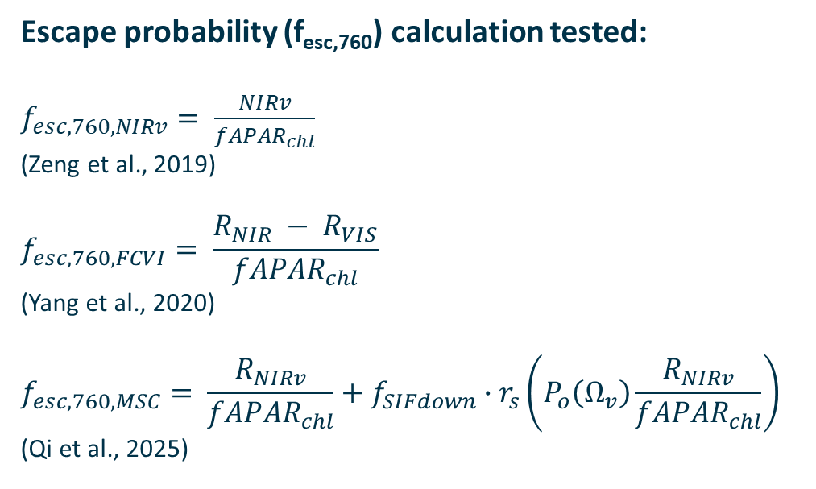
Calculation of the escape probability (f_{esc,760})
Escape probability (f_{esc,760}) calculation tested:
$f_{esc,760,NIRv}= \frac{NIRv}{{fAPAR}_{chl}}$
(Zeng et al., 2019)
$$f_{esc,760,FCVI}= \frac{R_{NIR} − R_{VIS}}{{fAPAR}_{chl}}$$
(Yang et al., 2020)
$$f_{esc,760,MSC}= \frac{R_{NIRv}}{{fAPAR}_{chl}}+f_{SIFdown}∙r_{s}\left(P_{o}\left(Ω_{v}\right)\frac{R_{NIRv}}{{fAPAR}_{chl}}\right)$$
(Qi et al., 2025)
Wieneke et al. (in preparation)

Slide 7
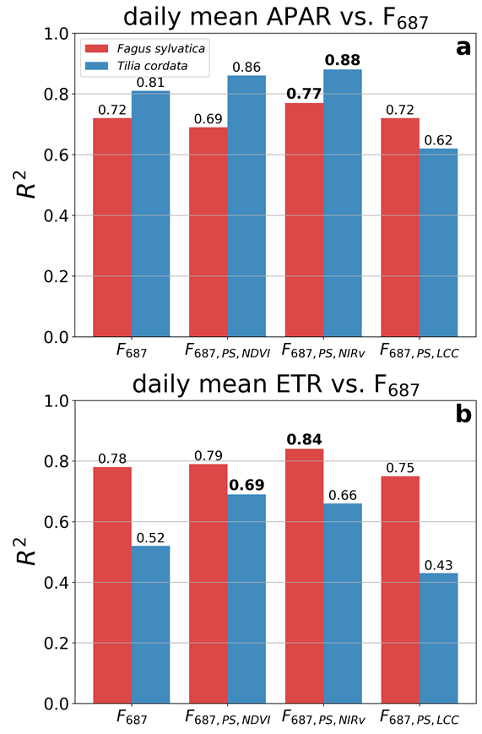
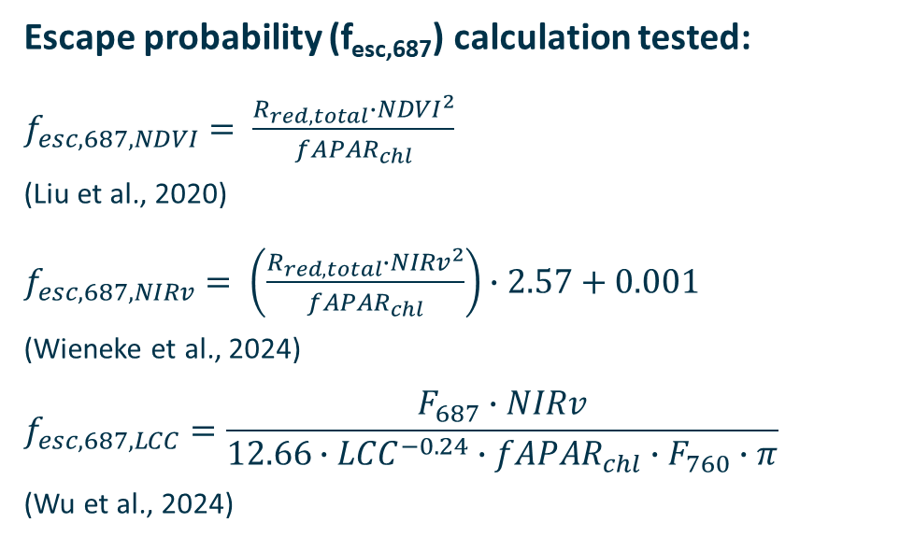
Calculation of the escape probability (f_{esc,687})
Escape probability (f_{esc,687}) calculation tested:
$f_{esc,687,NDVI}= \frac{R_{red,total}∙{NDVI}^{2}}{{fAPAR}_{chl}}$
(Liu et al., 2020)
$f_{esc,687,NIRv}= \left(\frac{R_{red,total}∙{NIRv}^{2}}{{fAPAR}_{chl}}\right)∙2.57+0.001$
(Wieneke et al., 2024)
$$f_{esc,687,LCC}=\frac{F_{687}∙NIRv}{12.66∙{LCC}^{−0.24}∙{fAPAR}_{chl}∙F_{760}∙π}$$
(Wu et al., 2024)
Wieneke et al. (in preparation)

Slide 8
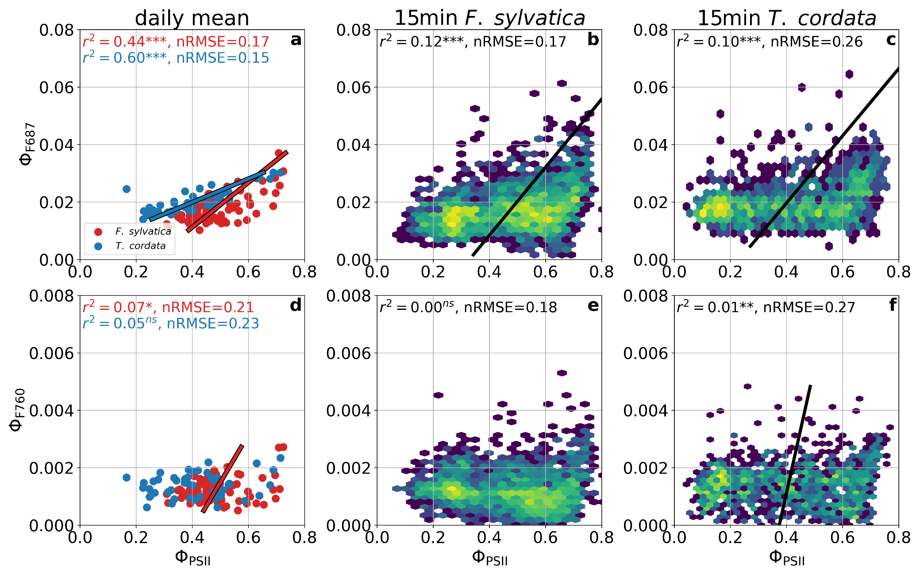
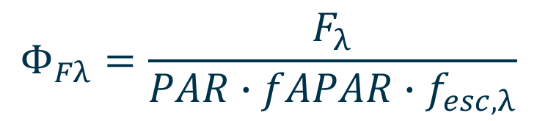
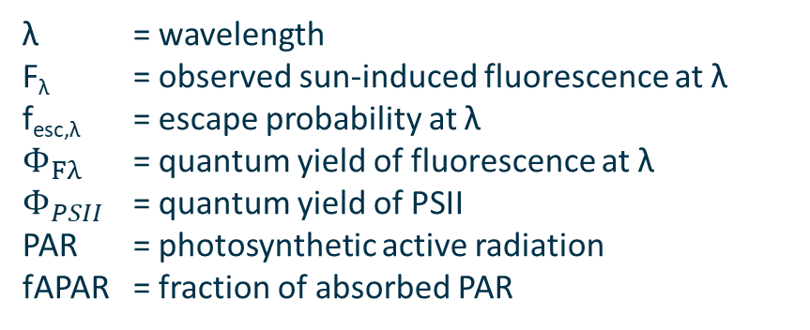
Seasonal Φ_{F687} and Φ_{F760} relationship with Φ_{PSII}
$$Φ_{Fλ}=\frac{F_{λ}}{PAR∙fAPAR∙f_{esc,λ}}$$
λ = wavelength
F_{λ} = observed sun-induced fluorescence at λ
f_{esc,λ} = escape probability at λ
$Φ_{Fλ}$ = quantum yield of fluorescence at λ
$Φ_{PSII}$ = quantum yield of PSII
PAR = photosynthetic active radiation
fAPAR = fraction of absorbed PAR
Wieneke et al. (in preparation)

Slide 9
Seasonal Φ_{F687} and Φ_{F760} relationship with Φ_{PSII}
Wieneke et al. (in preparation)

Slide 10
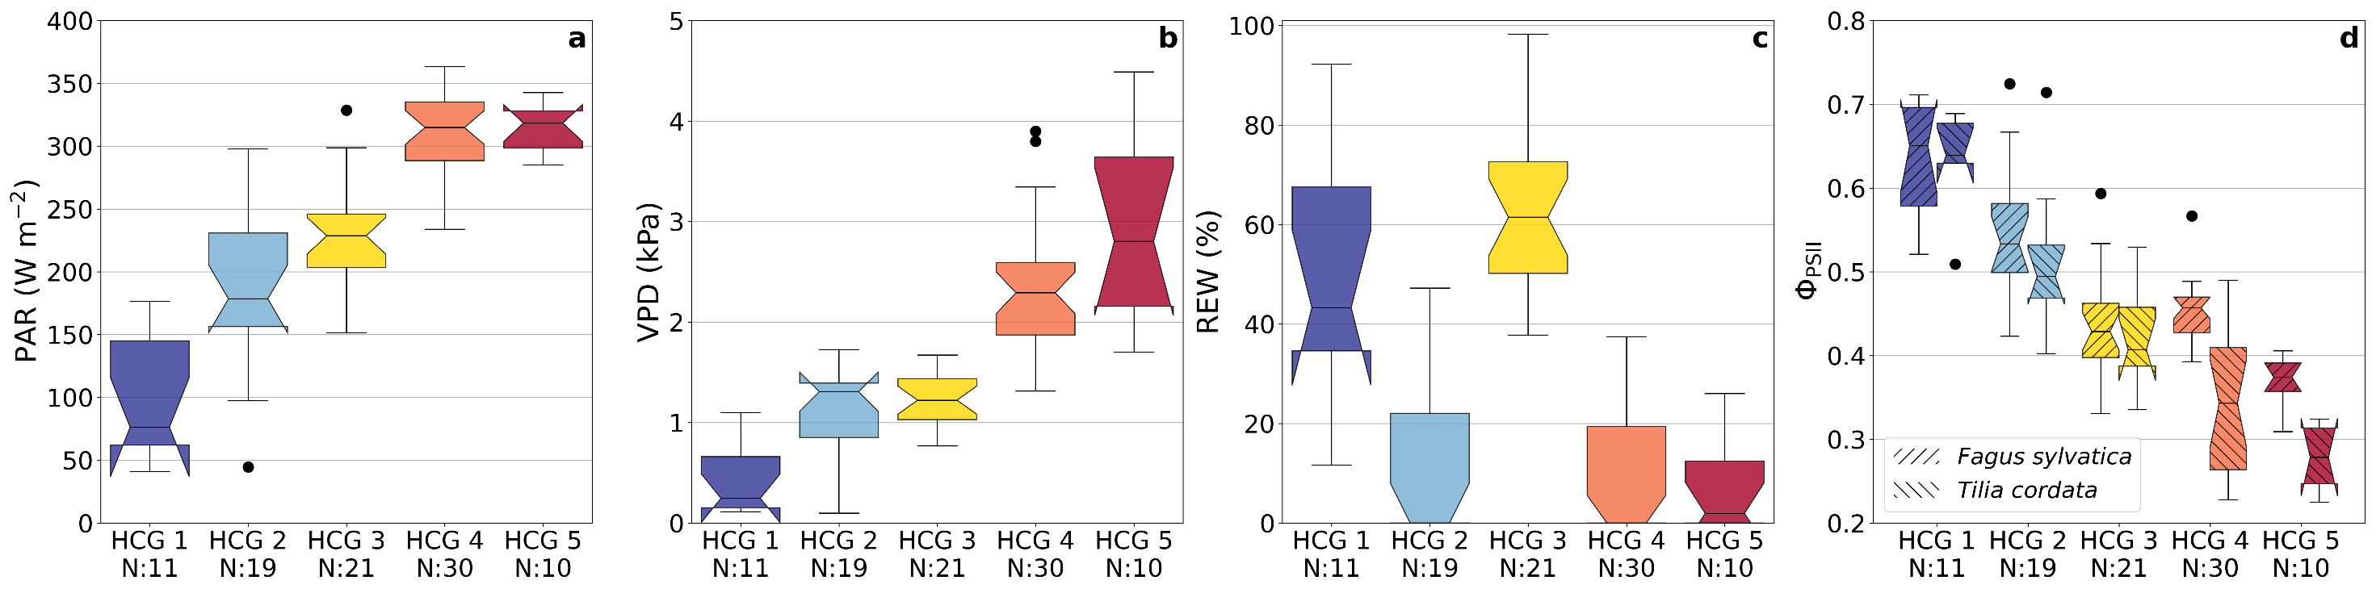
Clustering into Hydrometeorological Condition Groups (HCG)
Wieneke et al. (in preparation)
HCG 1 → grey sky & wet
HCG 2 → diffuse light & dry soil
HCG 3 → clear sky & wet
HCG 4 → clear sky & dry
HCG 5 → clear sky & driest days
First 3 PCA of environmental measurements as
input for k-means clustering
Lowest quantile of HCG4 Φ_{𝑃𝑆𝐼𝐼}

Slide 11
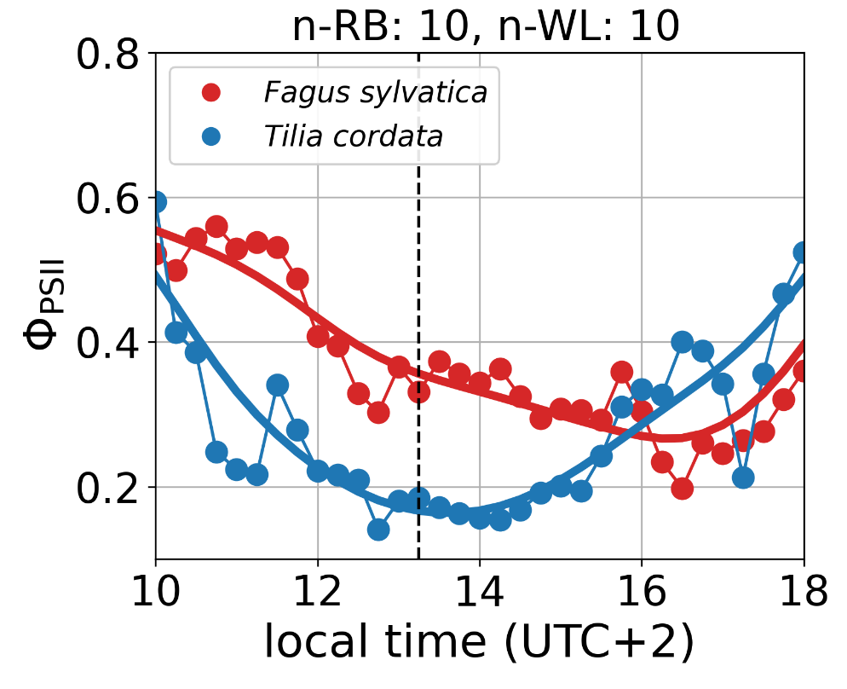
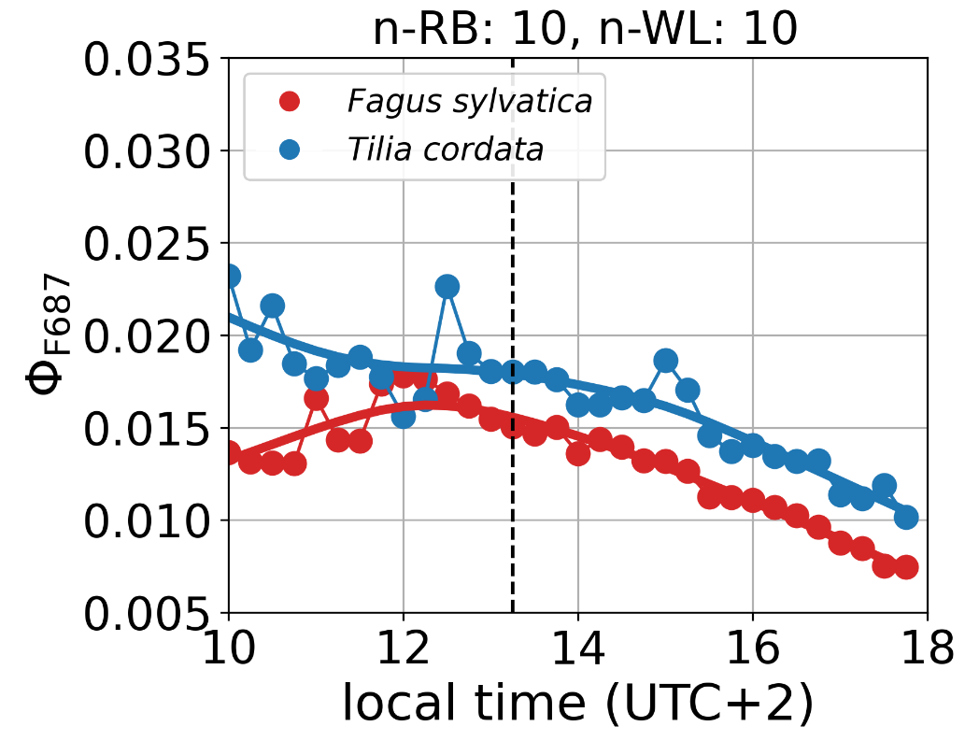
Mean diurnal cycles (HCG5)
HCG 5 → clear sky & driest days
Tilia cordata (Isohydric): Rapid stomatal closure under stress prioritizes water conservation, limits CO₂ uptake and photosynthesis.
Fagus sylvatica (Anisohydric): Maintains open stomata longer, sustaining photosynthesis at the cost of higher hydraulic risk.

Slide 12
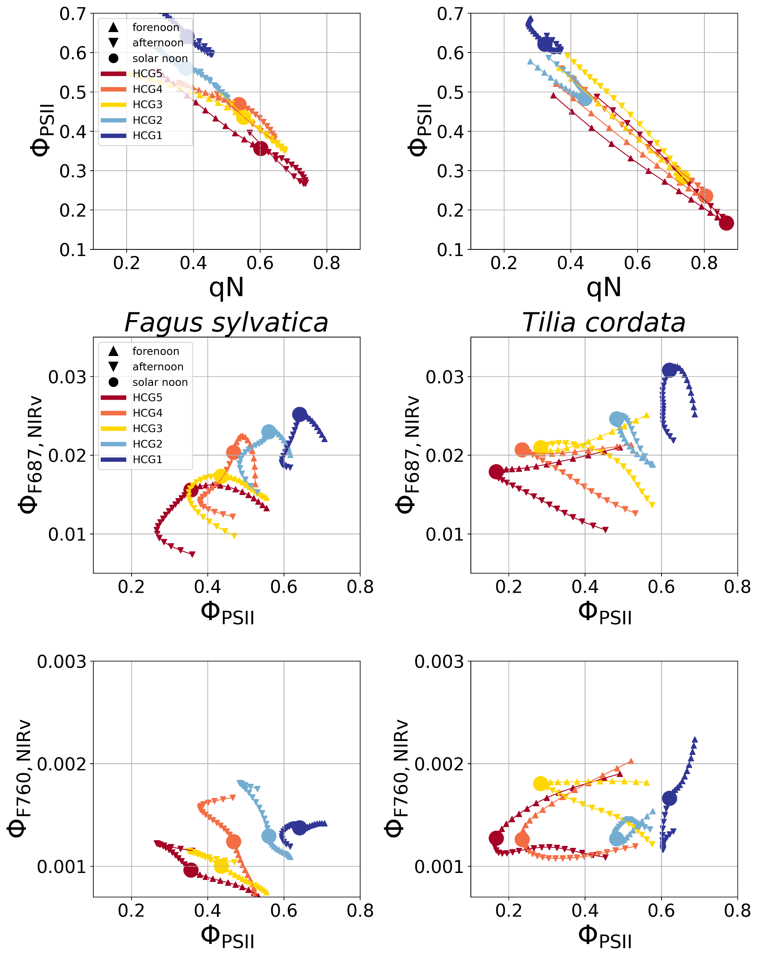
Diurnal Φ_{F687} relationship with Φ_{PSII}
HCG 1 → grey sky & wet
HCG 2 → diffuse light & dry soil
HCG 3 → clear sky & wet
HCG 4 → clear sky & dry
HCG 5 → clear sky & driest days
Wieneke et al. (in preparation)

Slide 13
Diurnal Φ_{F687} relationship with Φ_{PSII}
HCG 1 → grey sky & wet
HCG 2 → diffuse light & dry soil
HCG 3 → clear sky & wet
HCG 4 → clear sky & dry
HCG 5 → clear sky & driest days
Wieneke et al. (in preparation)

Slide 14
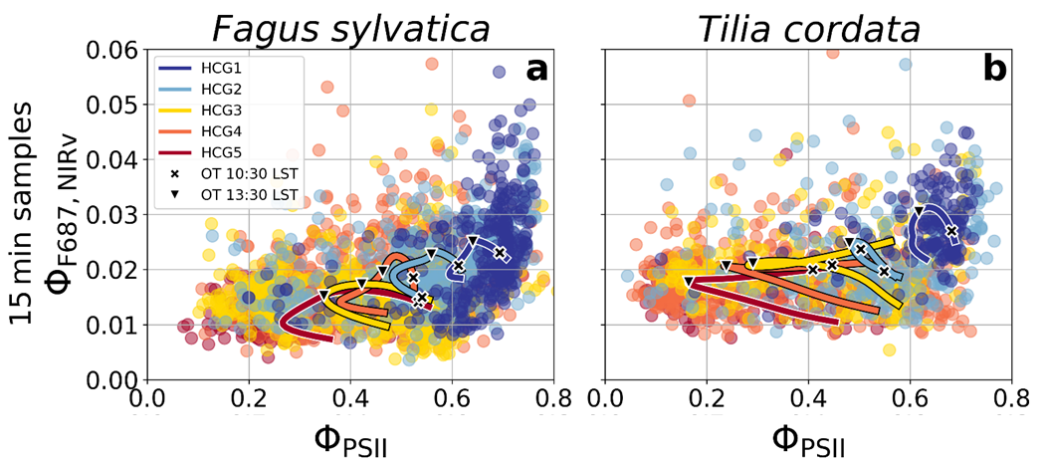
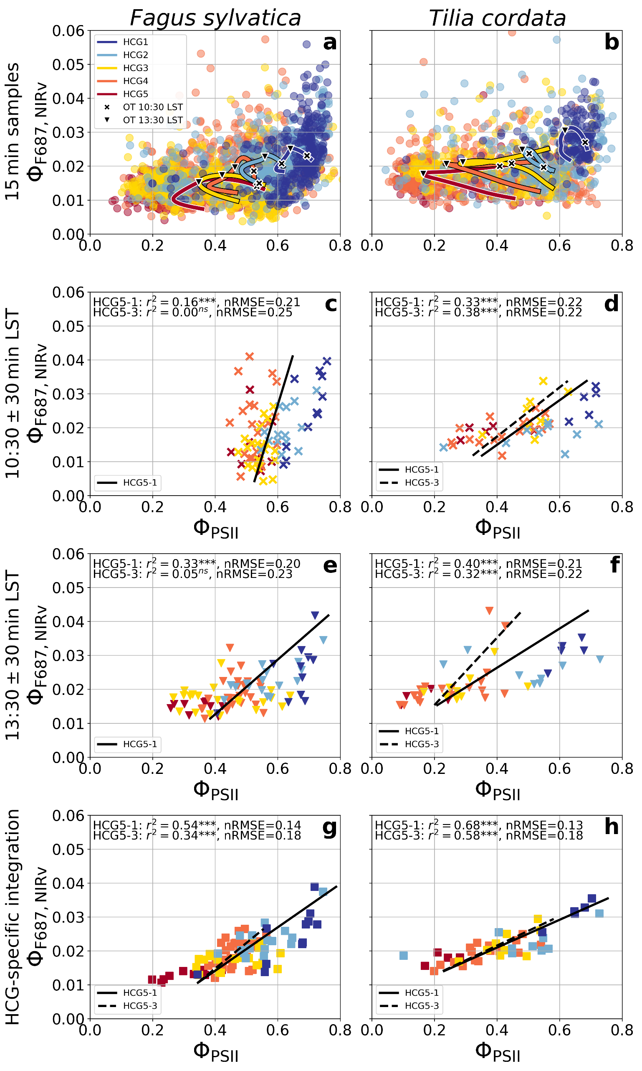
Impact of observation time on seasonal Φ_{F687} to Φ_{PSII} relationship
Wieneke et al. (in preparation)

Slide 15
Summary & Outlook
Red vs. far-red SIF: Φ_{F₆₈₇} was in our experiment a stronger predictor of Φ_{PSII} than Φ_{F₇₆₀}, which had weaker physiological coupling.
Non-linear dynamics: Diurnal Φ_{PSII}–Φ_{F} relationships are non-monotonic and species-specific.
Remote sensing implications: Single overpasses often capture dynamic transitions, yielding poor Φ_{PSII} predictions. Spatial averaging across functionally diverse vegetation might masks physiological signals.
Possible solution – Sensor integration: Geostationary platforms (diurnal context), high-resolution sensors (functional diversity), and FLEX (full-spectrum SIF), to close temporal-spatial gaps.

Slide 16
Thank you for your attention
Sebastian Wieneke, A. Bastos, G. Duveiller, T. Kattenborn, J. Pacheco-Labrador, R. Richter, C. Wirth, M. D. Mahecha

Slide 17
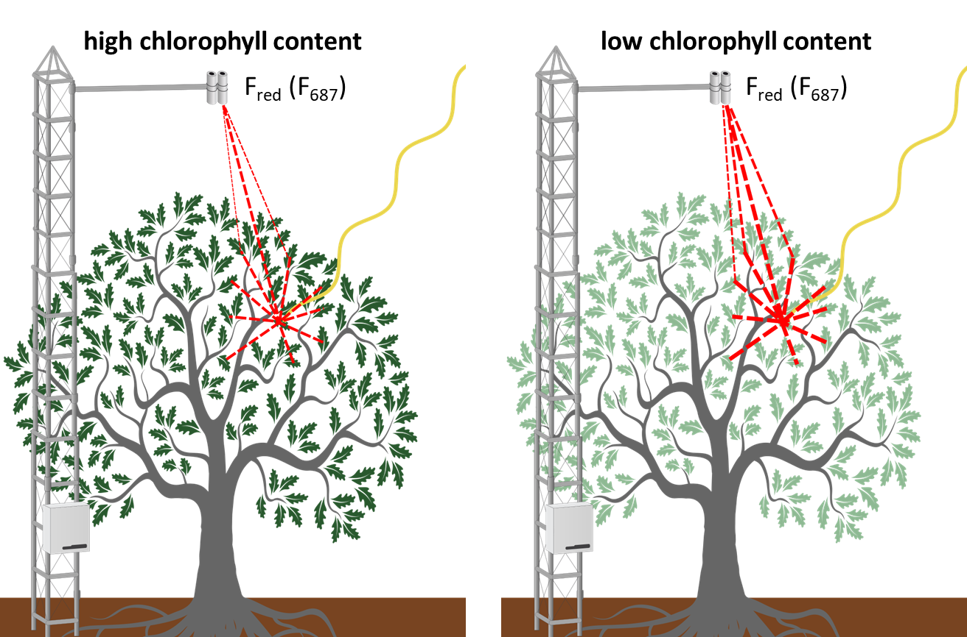
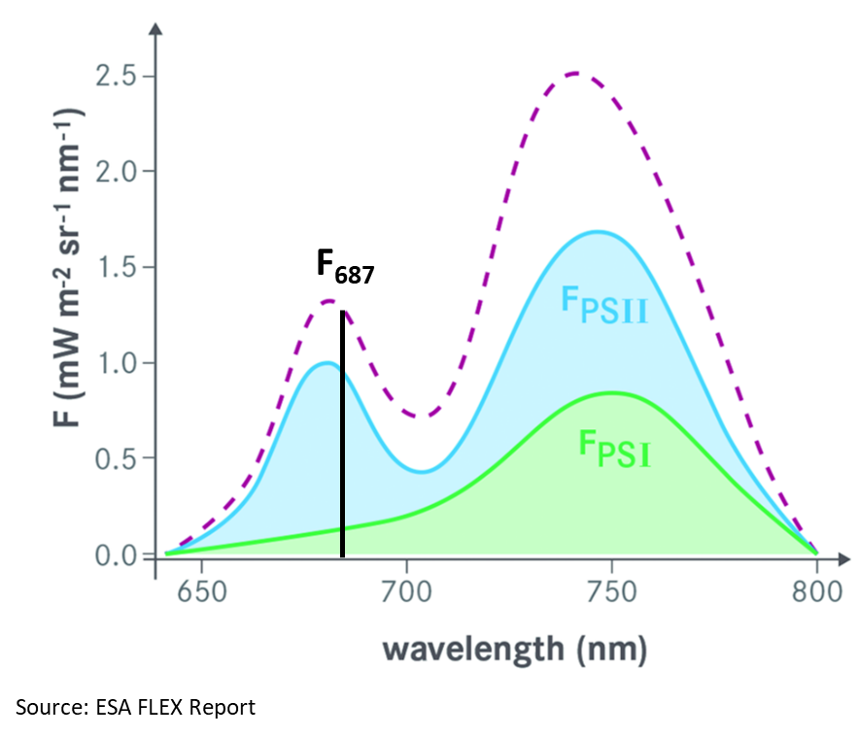
Reabsorption effects on red fluorescence

Slide 18
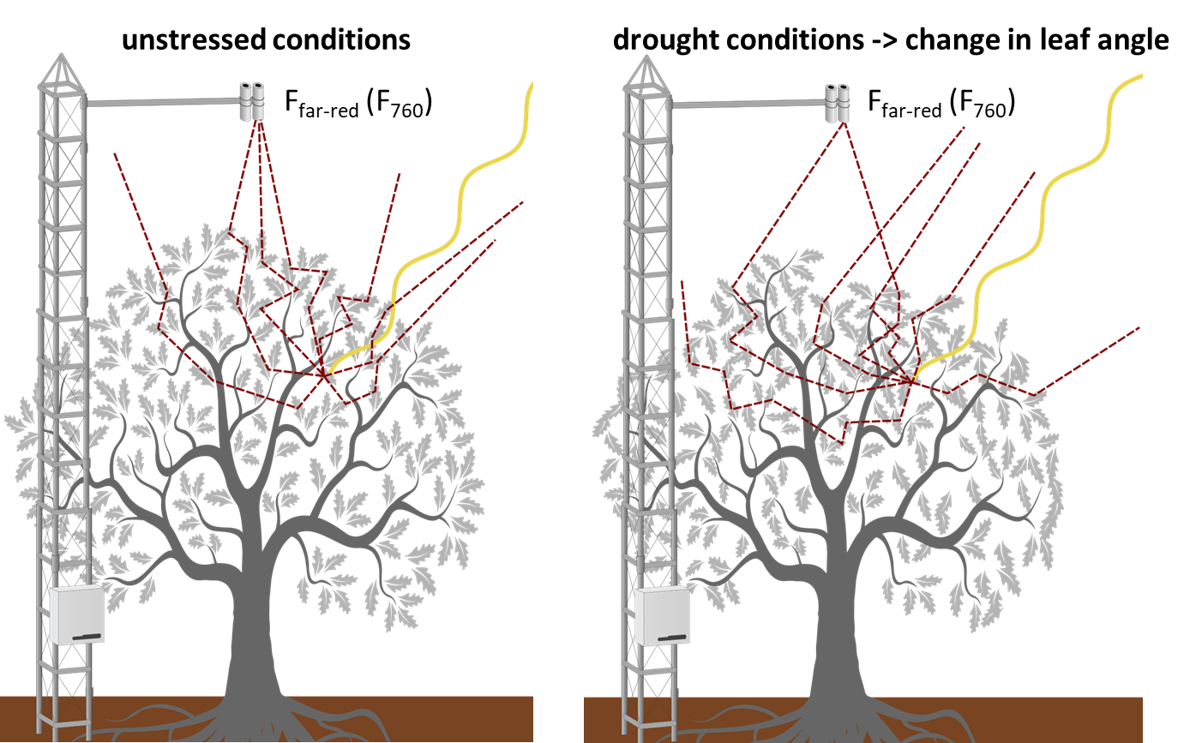
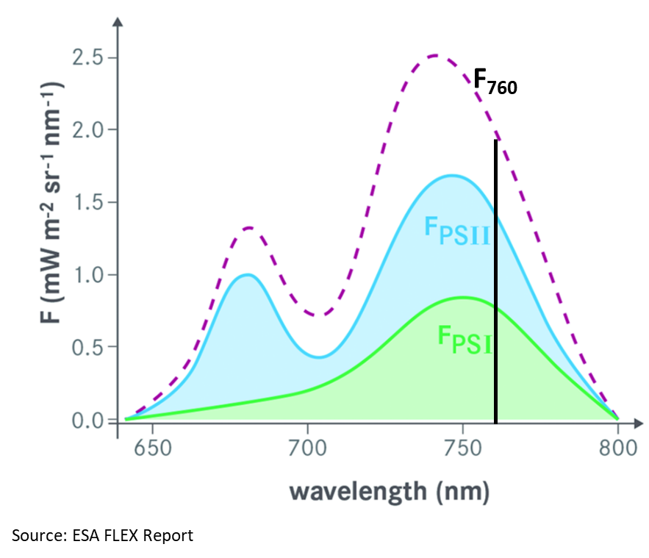
Scattering effects on far-red fluorescence

Slide 19


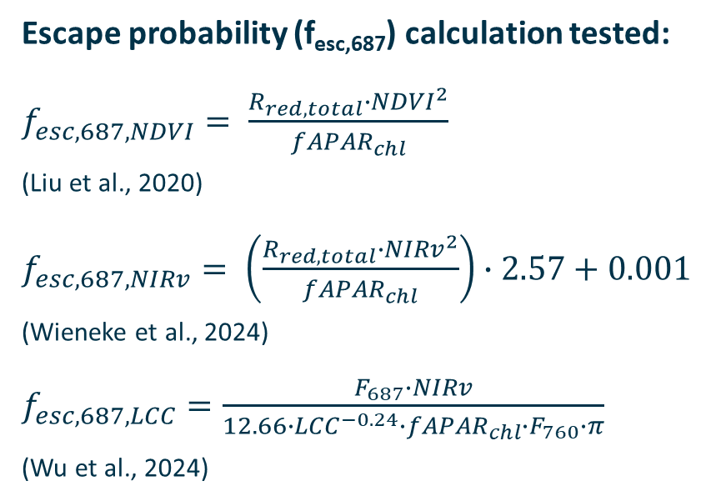
Reabsorption effects on red fluorescence
Escape probability (f_{esc,687}) calculation tested:
$f_{esc,687,NDVI}= \frac{R_{red,total}∙{NDVI}^{2}}{{fAPAR}_{chl}}$
(Liu et al., 2020)
$f_{esc,687,NIRv}= \left(\frac{R_{red,total}∙{NIRv}^{2}}{{fAPAR}_{chl}}\right)∙2.57+0.001$
(Wieneke et al., 2024)
$f_{esc,687,LCC}=\frac{F_{687}∙NIRv}{12.66∙{LCC}^{−0.24}∙{fAPAR}_{chl}∙F_{760}∙π}$
(Wu et al., 2024)

Slide 20

Calculation of the escape probability (f_{esc,λ})
Reabsorption effects on F_{far-red}
Correction methods used:
$f_{esc,760,NIRv}= \frac{NIRv}{{fAPAR}_{chl}}$
(Zeng et al., 2019)
$f_{esc,760,FCVI}= \frac{R_{NIR} − R_{VIS}}{{fAPAR}_{chl}}$
(Yang et al., 2020)
$f_{esc,760,MSC}= \frac{R_{NIRv}}{{fAPAR}_{chl}}+f_{SIFdown}∙r_{s}\left(P_{o}\left(Ω_{v}\right)\frac{R_{NIRv}}{{fAPAR}_{chl}}\right)$
(Qi et al., 2025)

Slide 21
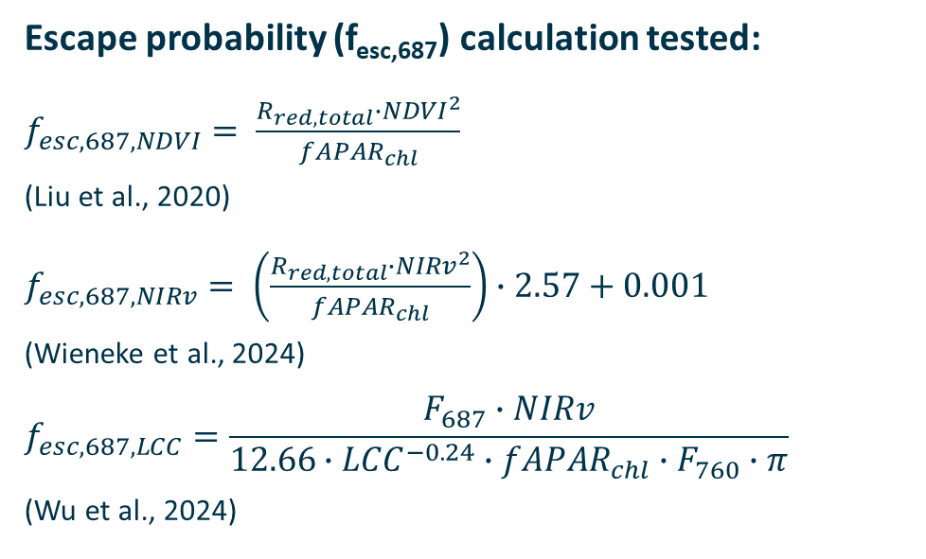
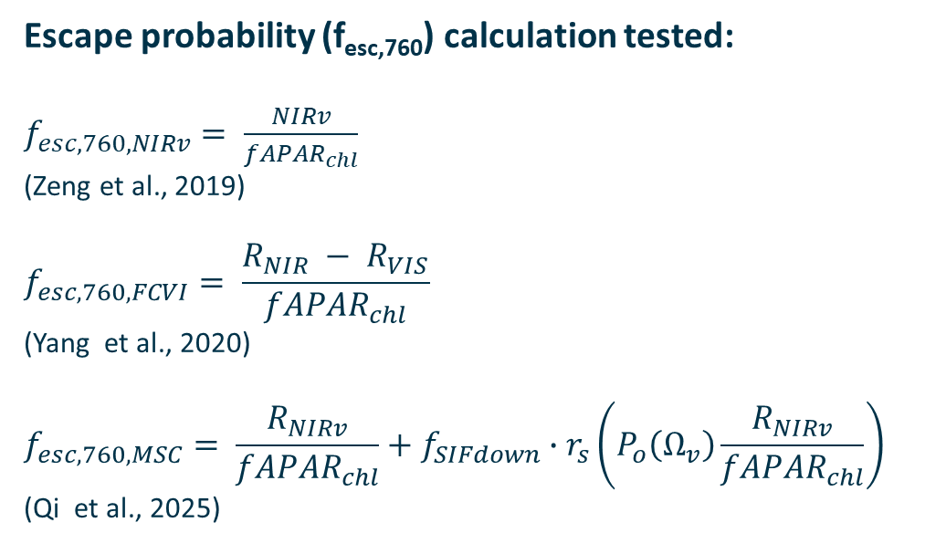
Calculation of the escape probability (f_{esc,λ})
Escape probability (f_{esc,687}) calculation tested:
$f_{esc,687,NDVI}= \frac{R_{red,total}∙{NDVI}^{2}}{{fAPAR}_{chl}}$
(Liu et al., 2020)
$f_{esc,687,NIRv}= \left(\frac{R_{red,total}∙{NIRv}^{2}}{{fAPAR}_{chl}}\right)∙2.57+0.001$
(Wieneke et al., 2024)
$$f_{esc,687,LCC}=\frac{F_{687}∙NIRv}{12.66∙{LCC}^{−0.24}∙{fAPAR}_{chl}∙F_{760}∙π}$$
(Wu et al., 2024)
Escape probability (f_{esc,760}) calculation tested:
$f_{esc,760,NIRv}= \frac{NIRv}{{fAPAR}_{chl}}$
(Zeng et al., 2019)
$$f_{esc,760,FCVI}= \frac{R_{NIR} − R_{VIS}}{{fAPAR}_{chl}}$$
(Yang et al., 2020)
$$f_{esc,760,MSC}= \frac{R_{NIRv}}{{fAPAR}_{chl}}+f_{SIFdown}∙r_{s}\left(P_{o}\left(Ω_{v}\right)\frac{R_{NIRv}}{{fAPAR}_{chl}}\right)$$
(Qi et al., 2025)

Slide 22
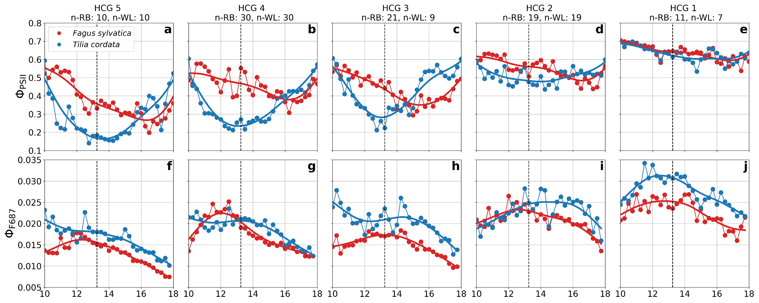
Mean diurnal cycles

Slide 23
