Slide 1

FLEX-Fluorescence 2026 Workshop 03 – 06 March | Bonn University, Germany
Cal/Val Activities for the FLEX Mission: Approach and Current Status
Colombo R., Mahmoodi A., Berthelot B., Matot G., Vicent Servera J., Nanushi O., Tixier L., Sabater N., Kolmonen P., Virtanen T., Zimmermann A., Bialek A., De Vis P., Rossini M., Tagliabue G., Chierichetti, Cogliati S., Bendig J., Siegmann B., Rascher U., Prikaziuk E., van der Tol C., Jasdeep A., Ghent D., Barrio Guillo R., Julitta T., Celesti M., Drusch M., Schüttemeyer D., Tudoroiu M.
ESA UNCLASSIFIED - For ESA Official Use Only
1

Slide 2
Main aim and outline
To provide an overview of the FLuorescence EXplorer (FLEX) strategy for validation of the operational Level 1C and Level 2 science data products - as part of the FLEX Data Innovation and Science Cluster (DISC) project
FLEX products and Cal/Val framework;
Validation Approaches for L1C and L2 Products in Commissioning and Operations phases;
Cal/val sites and distribution;
Documentation and validation timeline
Conclusions

Slide 3
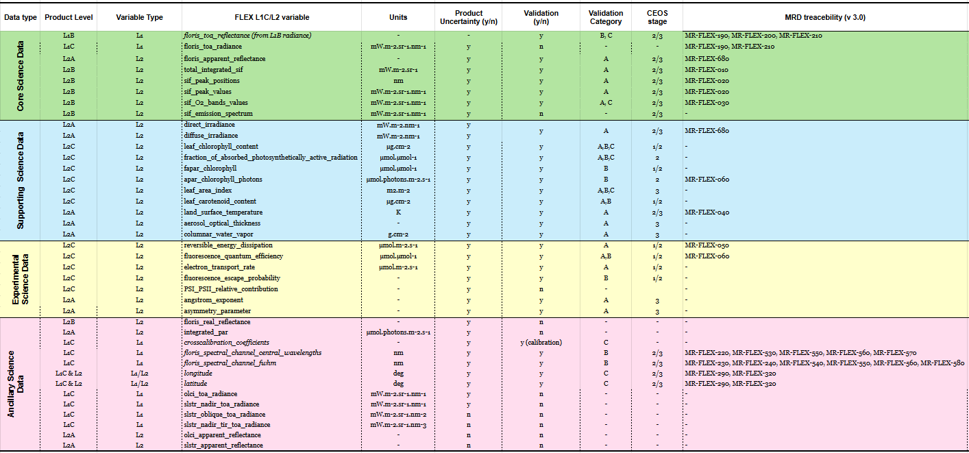
FLEX science products and validation process

Slide 4
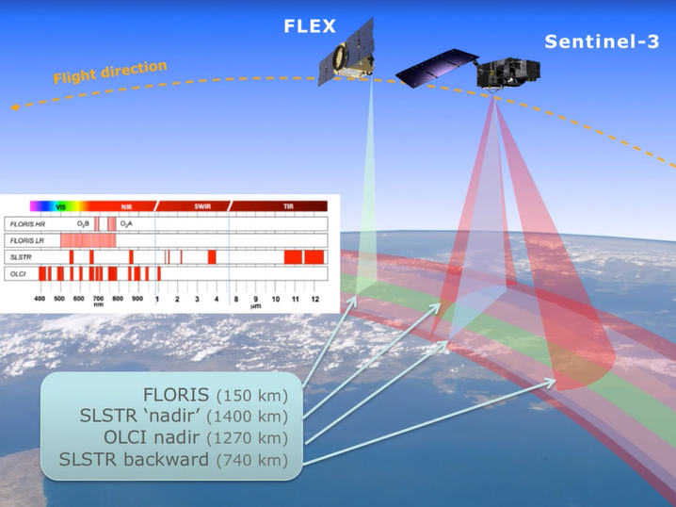
Basic information, useful for Cal/Val of FLEX
FLORIS will acquire data in the 500 - 780 nm spectral range with a spectral resolution between 0.3 nm (HR) and 1.8 nm (LR). Imaging spectroscopy mission;
Spectral sampling interval/spectral binning, from 0.1 nm in the oxygen absorption bands (748-769 nm and 686–697 nm) up to 2 nm outside the atmospheric absorption bands;
Spatial resolution is 300 m;
Observation time around 10:00 LTDN; 150 km swath; 27 days repeat cycle;
FLEX will fly together with Sentinel-3;
FLEX will generate different products and for each product the corresponding validation procedure must be defined
Notes:
Speaker: Roberto

Slide 5
Overview of the FLEX cal/val
Main components of the FLEX validation process for radiance, reflectance, fluorescence and higher-level products
There are no satellite fluorescence products with a better geometric resolution than FLEX, and therefore it is not possible to rely on comparisons with other satellites for an upscaling of the field measurements
Important points to be considered
Selection of the L1B, L1C, L2 Products to be validated;
Site requirements according to the specific product (e.g. spatial homogeneity, acceptable topography, meteo..);
Ground instruments and available networks (spectral/atmo, imaging vs non imaging);
Site classification and sites category (e.g. one/two or more components, core vs support sites);
Sampling approach protocols (e.g. platforms, single/multiple points, image sampling);
Definition of the validation approach (direct, RTM, satellite inter-comparison) and validation stage;
Set-up of different cal/val tools, processing chain, traceability and match-up uncertainty;

Slide 6
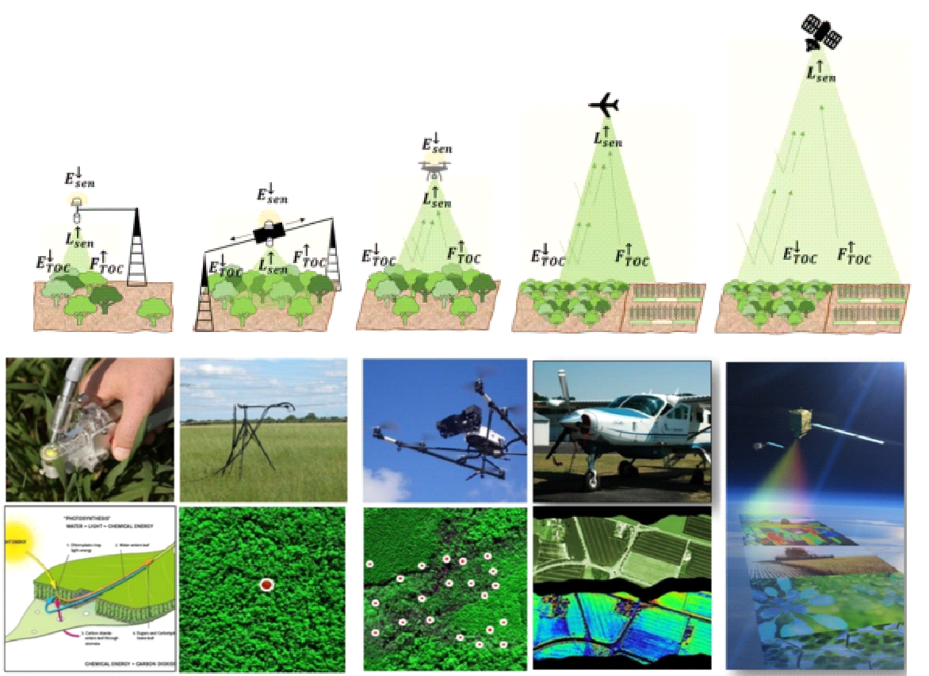
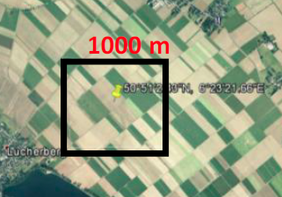
Main components for products validation
Validation approaches
Sampling approach and upscaling strategy
Single spot: continuous field spectroscopy measurements (reference networks)
Multiple spot by field/ariborne spectroscopy
Mapping measurements with imaging systems
Aggregation and definition of appropriate transfer functions
Category A: Comparison of satellite data with in situ measurements;
Category B: Indirect validation through numerical RTMs;
Category C: Inter-comparison with others space products
Set of sites
RadSites, SpecSites and CrossCalSites: RadCalNet, VICALOPS sites (non fluorescent targets): L1B. L1C, L2A
GeolocSites: L1C FLORIS TOA radiance vs OLCI geolocation validation and for L2 FLORIS reflectance vs Sentinel 2 geolocation validation
AtmoSites: AERONET data for atmospheric parameters
SolarSites: HYPERNETS and INSIF sites. Direct comparison according category A for L2A solar irradiance validation
RefSites: HYPERNETS and INSIF sites. Direct comparison according category A for L2A apparent reflectance validation
FluoSingleSites and FluoMultSites: Validation type A for L2A, L2B, and type B for L2C. INSIF network Single point and multiple points with/without transfer function
FluoImageSites and FluoSatSites: Validation A and C
BioDirectSites, BioIndirectSites, BioImageSites and BioCampSites: for L2C biophysical vegetation products, using INSIF and GBOV networks and support sites. Category A, B and C
LSTSites: used for L2A LST validation using type A
QASites: re sites used to perform a qualitative evaluation (Qualitative Assessments, QA) of different products
SupportSites: Validation campaigns – Sites after AO, validation of different products
→ a kernel of 2x2 or 3x3 pixels should be considered in the match-up of L2 products
→ need to consider both spatial and temporal domain

Slide 7
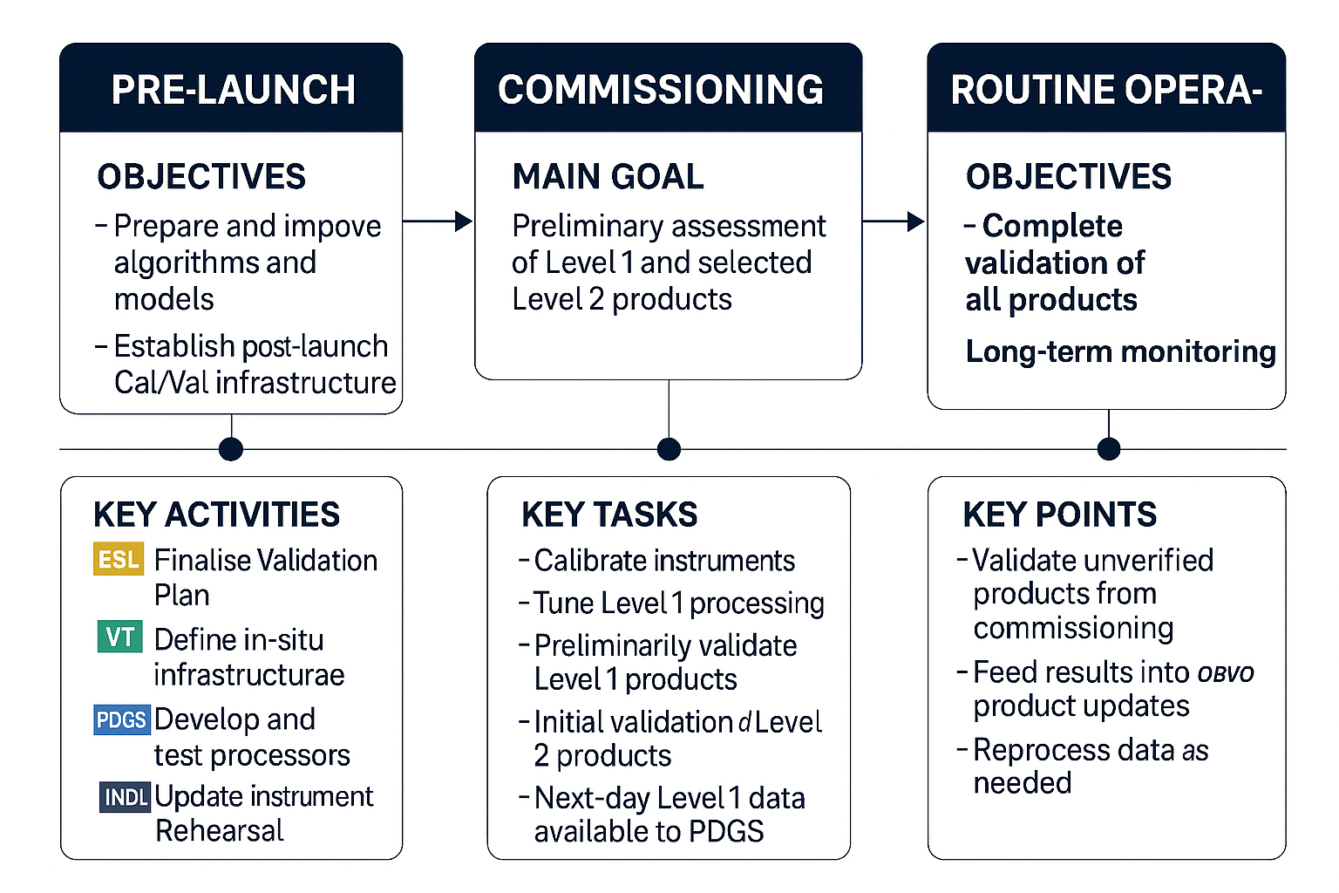
Project Phases and validation activities
.
- Prepare and improve algorithms and models;
- Establish post-launch cal/val infrastructure
- Preliminary assessment of L1 and selected L2 Products
- Complete validation of all products;
- Long-term monitoring
CP
During pre-launch, DISC develops QC/QI/QA and Cal/Val tools, integrate them in the Collaborative Platform (CP), and test them to be ready before Launch;
During Commissioning, DISC will support calibration activities; feedback to L1B and L1C; early validation at L2 level. Support/input to IOCR;
In E2, a complete validation is expected, with different modalities depending on the different products.

Slide 8
Validation Approaches for L1C and L2 in E1 and E2
The FLEX products will be evaluated using different approaches and by employing various types of data and reference networks
Systematic Quality Control (QC) tests and Quality Indicators (QI);
Ad-hoc Quality Assessment (QA);
Validation by cal/val tools (using reference networks and campaigns data)

Slide 9

Systematic Quality Control Test (QC)
Test No | Test ID | Purpose | Product
1 | L1RAC_CA_DARKNP | Monitor Reference dark signal measurements (“[k]_DARK_FRAME”) for each spectral bank and each detector (LR, HR1, HR2). | L1RAC (L1 Calibration Prod)
2 | L1B_IA_QualityFlags | Check L1B quality flags to see if the percentages of Bad/Dead/Saturated are above thresholds. | L1B
3 | L1B_CA_TempVAU | Monitor the temperature of the Video Acquisition Unit (VAU) over time to ensure it remains within acceptable range. | L1B
4 | L1B_CA_TempCCD | Monitor the temperature of the Charge-Coupled Device (CCD) over time to ensure it remains within acceptable range. | L1B
5 | L1B_CA_TempFPA | Monitor the temperature of the Focal Plane Array (FPA) over time to ensure it remains within acceptable range. | L1B
6 | L1C_CA_Floris_ToaRad | Monitor min, max, mean values of the FLORIS TOA radiances over several regions of interest (ROI) and over time to ensure they are within acceptable ranges. | L1C
7 | L1C_CA_FLORISvOLCI_ToaRad | Monitor over time the min, max, and mean difference values per orbit for those channels of FLORIS that overlap with OLCI and make sure they are within acceptable thresholds. | L1C
8 | L2A_CA_LST | Monitor Land Surface Temperature (LST) values against region dependent thresholds over time to detect anomalies. | L2C
9 | L2A_IA_FAR | For each L2A product check FLORIS Apparent Reflectance (FAR) values against channel dependent thresholds to detect anomalies. | L2A
10 | L2A_CA_FAR | Monitor min, max, mean values of the FLORIS Apparent Reflectance over several regions of interest (ROI) and over time to ensure they are within acceptable ranges. | L2A
11 | L2B_CA_SIFR | Monitor ratio of SIF peak values (Rad and Far-Red) against scene dependent thresholds to detect anomalies. | L2B
12 | L2B_CA_TISIF | Monitor min, max, mean values of the FLORIS Total Integrated SIF (TISIF) over several regions of interest (ROI) and over time to ensure they are within acceptable ranges | L2B
13 | L2B_CA_SIFO2 | Monitor min, max, mean values of the FLORIS Value of the Solar Induced Fluorescence in the O2B bands (SIFO2) over several regions of interest (ROI) and over time to ensure they are within acceptable ranges. | L2B
14 | L2C_CA_LAI | Monitor mean monthly LAI over time and check against thresholds to make sure they are within acceptable limits. | L2C
15 | L2C_CA_LCC | Monitor mean monthly LCC over time and check against thresholds to make sure they are within acceptable limits. | L2C
16 | L2C_CA_fAPAR | Report occurence of out of range [0,1], report when fraction of missing (fill) values is large | L2C
17 | L2C_CA_RED | Report out of range [0,0.7*APARchl], report when fraction of missing (fill) values for cloud-free pixels is large. Flag uncertainty above thresholdchl | L2C
18 | L2C_CA_ETR | Report out of range [0,0.4*APARchl], report when fraction of missing (fill) values for cloud-free pixels is large. Flag uncertainty above threshold | L2C
19 | L2C_CA_FQE | Report values out of range [0,0.05], for pixels for wich acceptable L2B fluorescence was obtained | L2C
The QC tests are systematic and are run automatically at image level, with green/orange/red lights indicating failure (red) or warnings (orange). QC tests provide support in anomaly management;
QC tests are described in the "Quality Control Monitoring Baseline Document (MBD)”

Slide 10
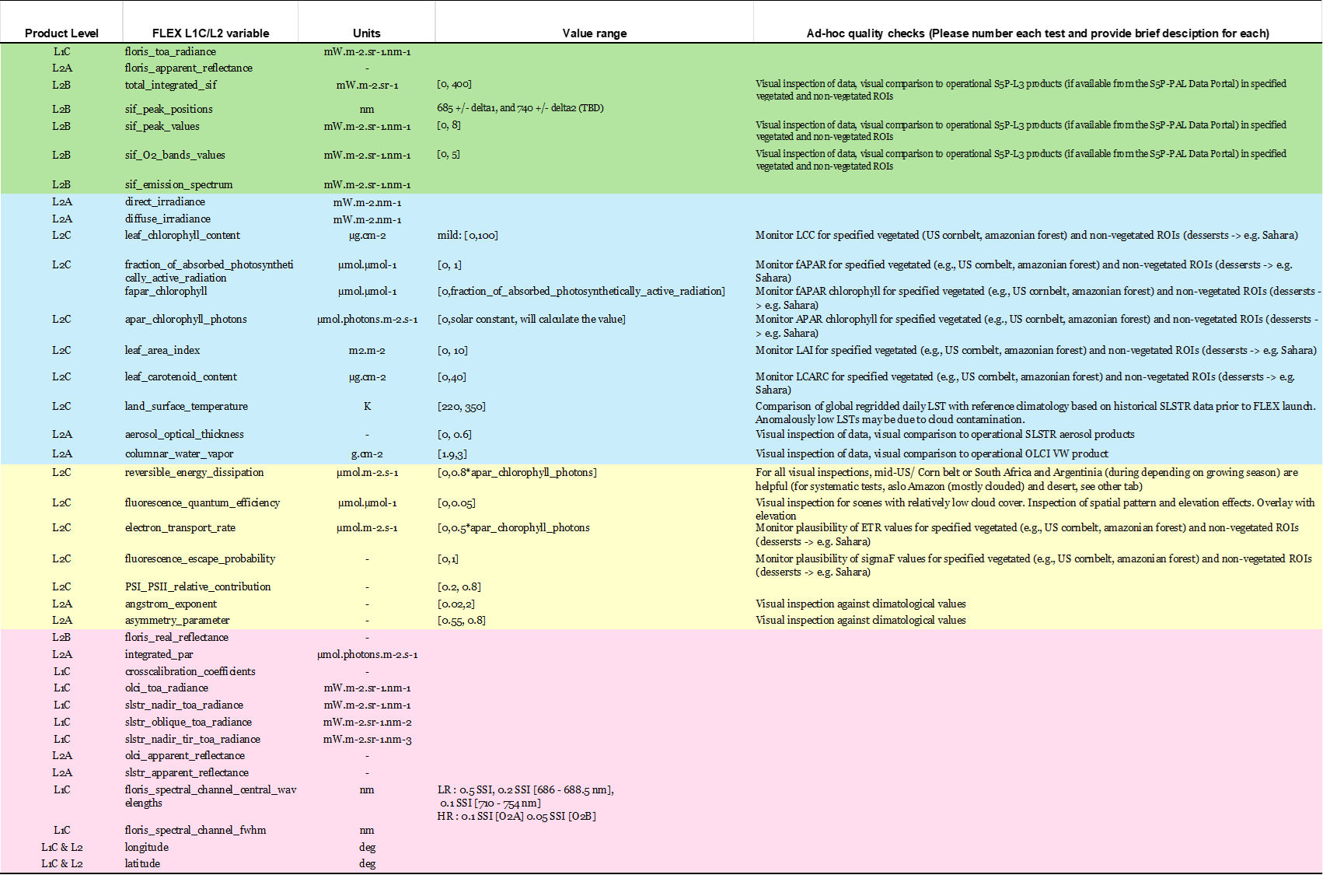
Ad-hoc Quality Assessment Test (QA)
In-house and ad-hoc tools, which allow for a quickly assessment of the product quality;
For example, check if the values for reflectance, fluorescence, or biophysical parameters over certain surfaces are consistent with expectations;
They are not expected to become part of the CP

Slide 11
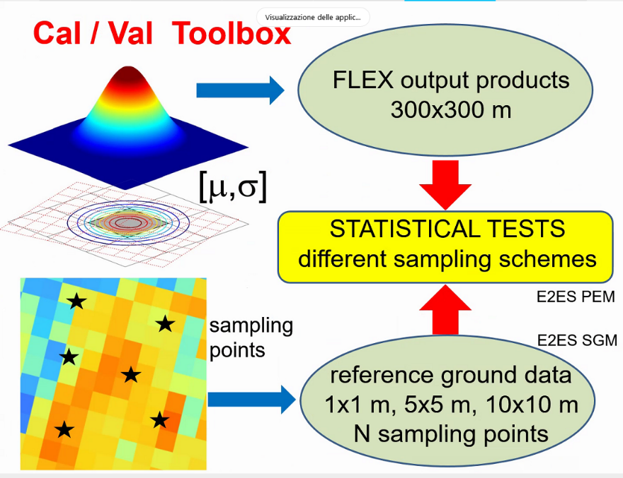
Calibration and validation assessment by Cal/Val tools
The cal/val tools are automated tools that enable the validation of FLEX products within the CP
24 automatic cal/val tools (in Phyton) for L1B-L1C and L2 products are currently in development/industrialisation and will be integrated in the CP and available from the commissioning phase;
Cal/val tools can operate on reference networks as well as field/campaign data;
Cal/val tools will be assessed and verified during the rehearsal period;
Cal/val tools include uncertainty estimates and follow a metrological approach. Spatial, temporal, angular and spectral uncertainties are considered wherever possible.
In addition, the DISC team is collaborating with ESA/LDO in performing the L1B ca/val activities
IF-PAM: In-flight performance assessment module, used for the assessment of L0/L1b performance with in-orbit data.
ADF Validation Tool: Auxiliary Data Files Validation Tool.

Slide 12
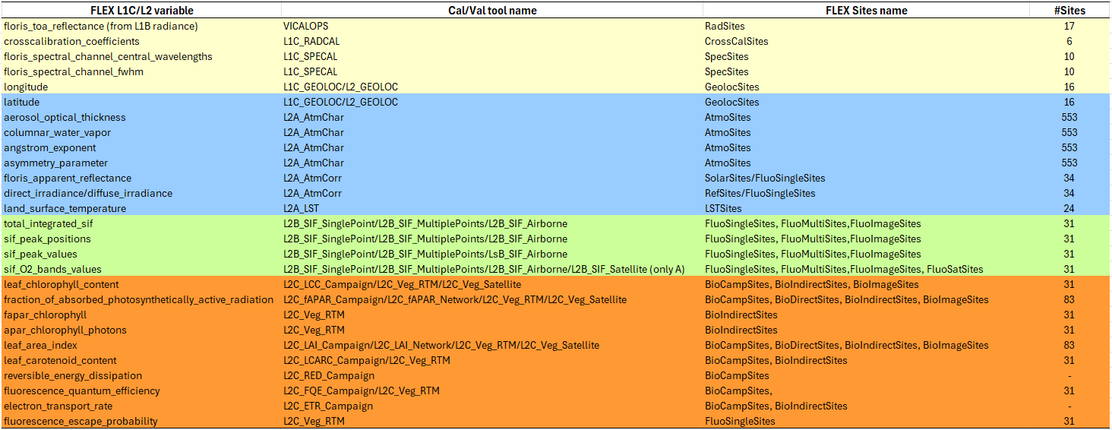




Target variable, Cal/Val tools and available sites

Slide 13

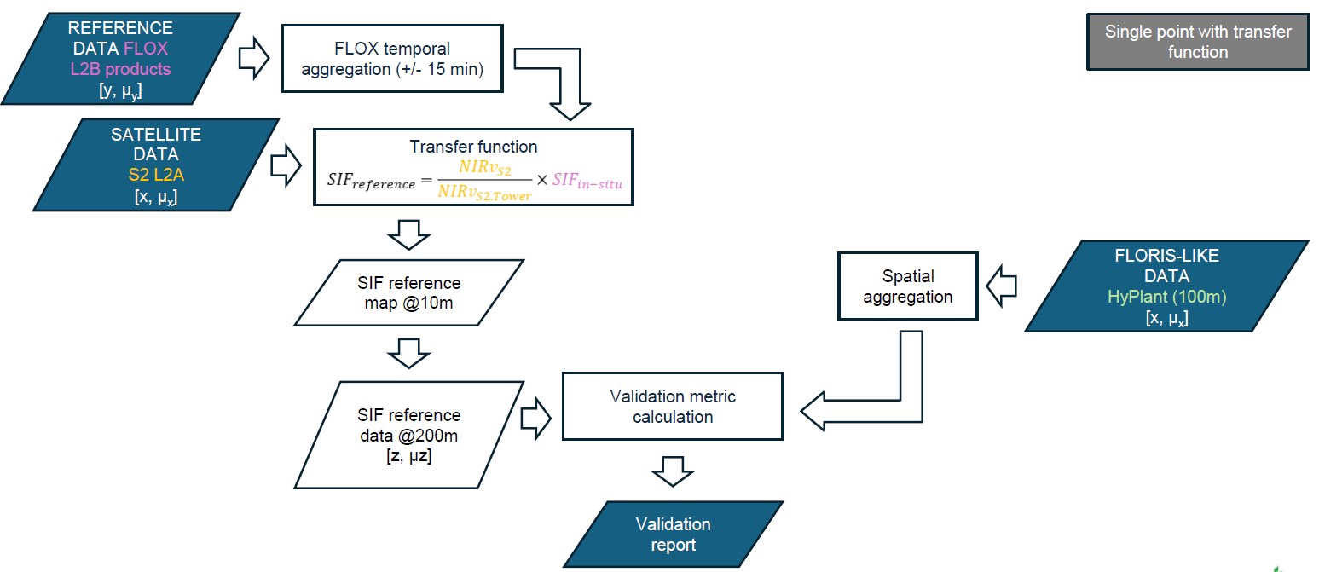
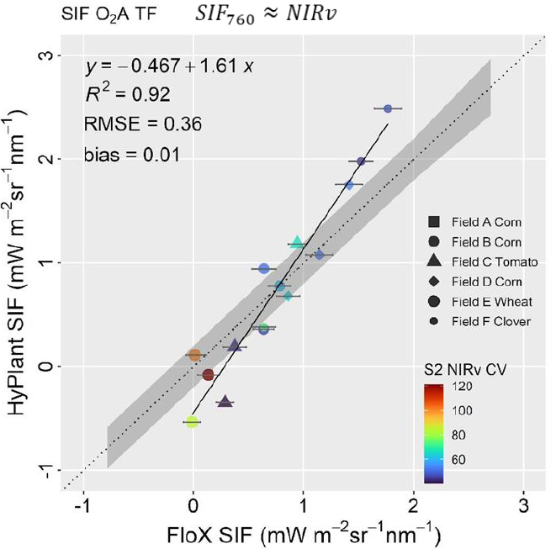
Example of a Cal/Val tool – Fluorescence
Single point with transfer function
Match-up
data @300m

Slide 14
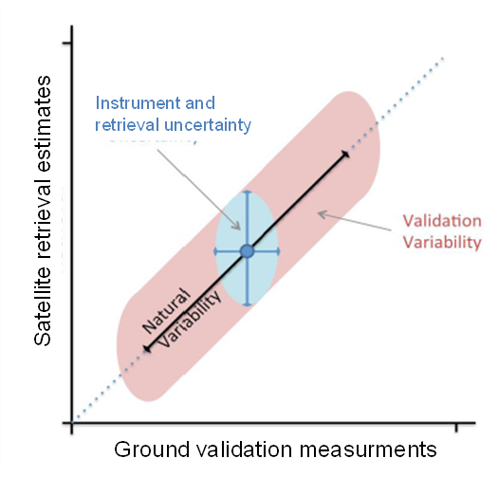

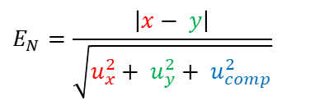
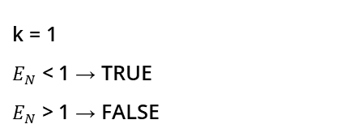
Sources of uncertainty in the match-up process
The matchup will be evaluated considering three primary sources of uncertainty:
1- Uncertainties associated with the FLEX product (u_{x});
2- Uncertainties in the reference data (u_{y}) (instrument precision, measurement protocols, retrieval approach…);
3- Uncertainties introduced by the match-up process itself (u_{comp}) (spectral, spatial, angular and temporal uncertainty):
Spectral uncertainty - differences in the spectral characteristics of satellite sensors and in-situ instruments (i.e. SRF uncertainties; Lack of knowledge on the shape of the spectrum at higher resolution than sampled by the product; Retrieval approach)
Spatial uncertainty - different spatial resolution (i.e. point to pixel uncertainties; -single point, small area compared to FLEX pixel; -Spatial variability affecting representativeness (e.g. quantified from high spatial resolution data); - Spatial response uncertainties;
Angular uncertainty - discrepancies in viewing geometries between satellite sensors and in-situ measurements (i.e. BRDF uncertainties due to viewing geometry; Directional vs conical measurements);
Temporal uncertainty related to the differences in acquisition time between satellite and in-situ measurements (i.e. changes in illumination (effect through BRDF); Changes in atmospheric conditions; Changes in surface itself (e.g. due to wind))
x: FLEX measurand (with uncertainty u_{x})
y: Reference measurand (with uncertainty u_{y})
k: coverage factor.
At 95% of confidence level, the FLEX product and the in-situ data are in statistical agreement if:

Slide 15
Cal/val sites distribution according to land cover and target variable
553
The INSIF network sites are preliminary and need to be reviewed

Slide 16
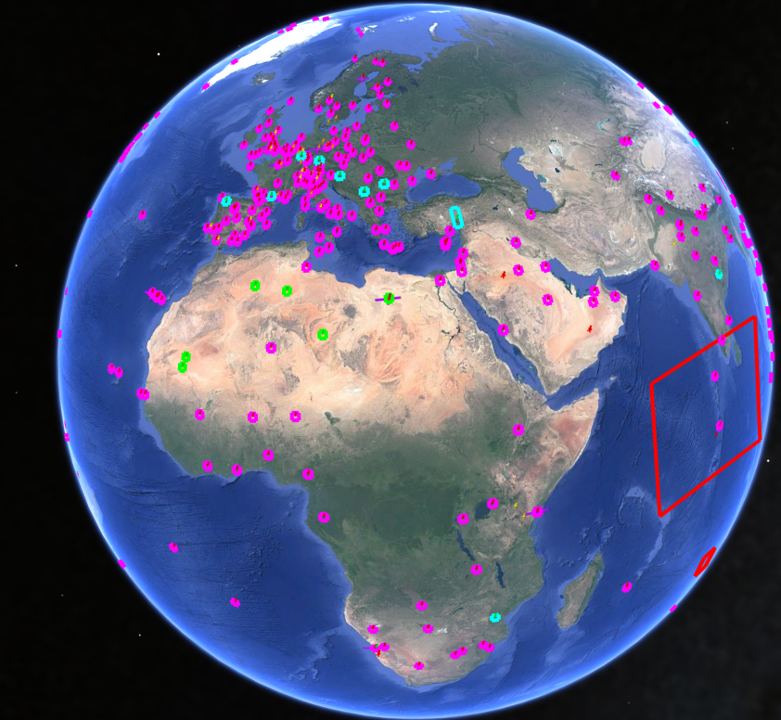
Sites Constellation
Distribution of the sites based on the type of FLEX product to be validated and corresponding cal/val tool
Rad Sites [VICALOPS]
Rad Sites, Spec Sites [VICALOPS, L1C_SPECAL]
Spec Sites [L1C_SPECAL]
Rad Sites, Spec Sites, Cross Sites [VICALOPS/L1C_SPECAL/L1C_RADCAL]
Atmo Sites [L2A_AtmChar]
Geoloc sites [L2_geoloc/L1C_geoloc]
FluoSingle Sites, Solar Sites, RefSites, BioindirectSites [L2B_SIF_SinglePoint/L2A_AtmCorr/L2C_Veg_RTM]
BioDirect Sites [L2C_LAI_Network/L2C_fAPAR_Network]
LST Sites [L2A_LST]
Solar Sites, RefSites [L2A_AtmCorr]

Slide 17
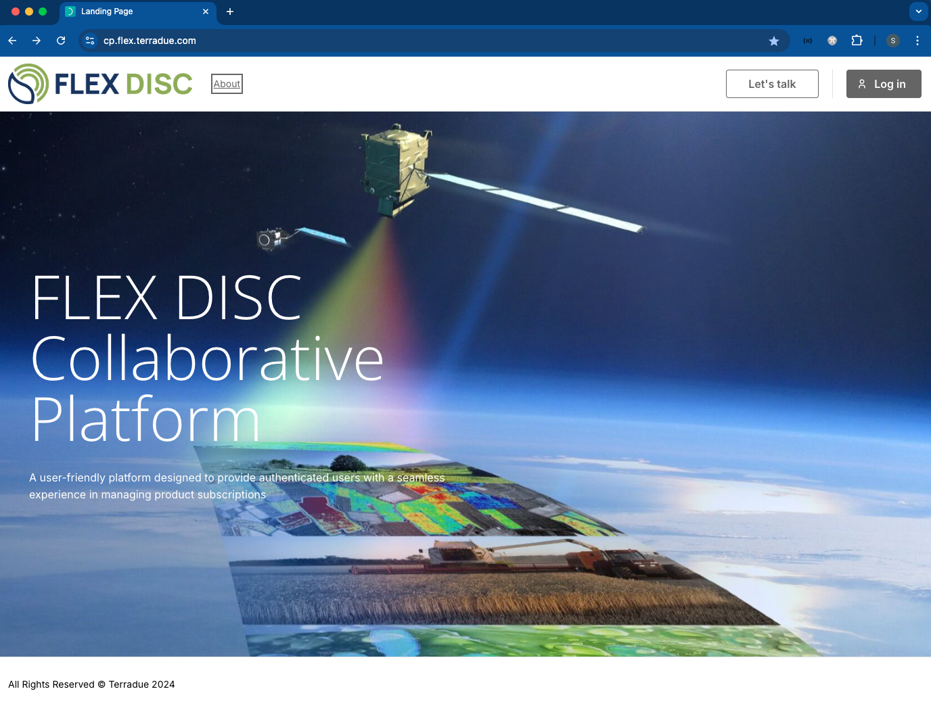
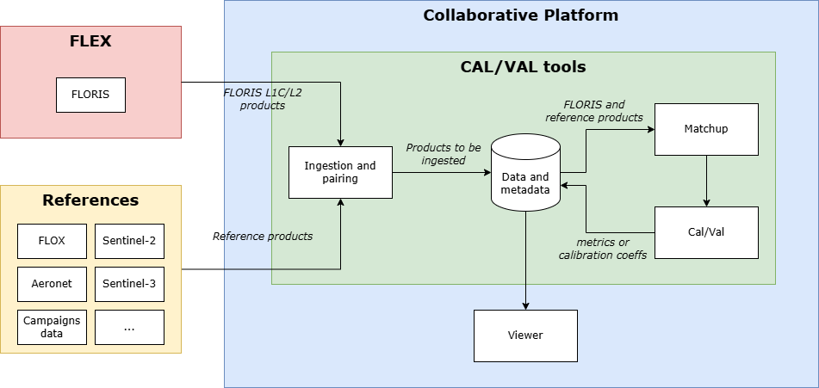
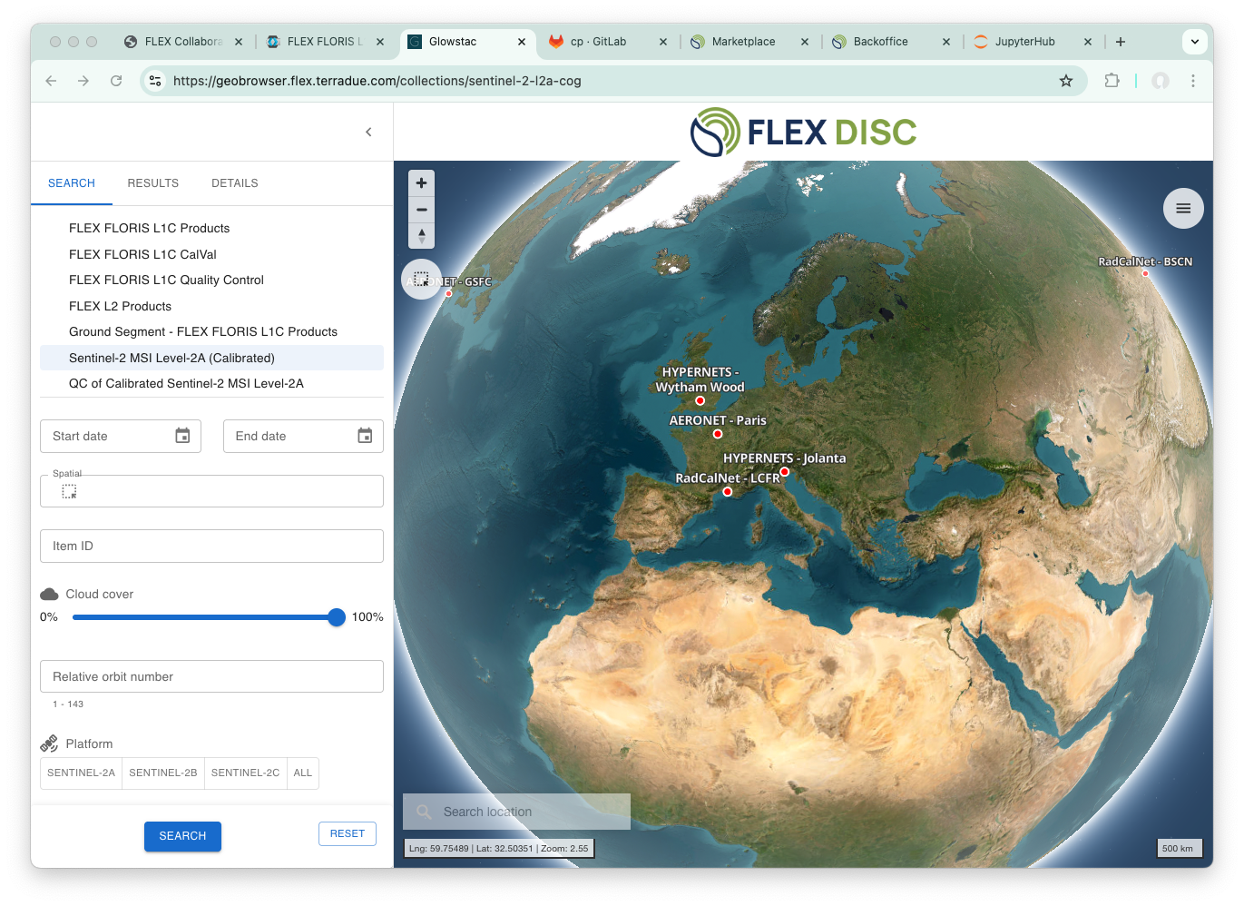
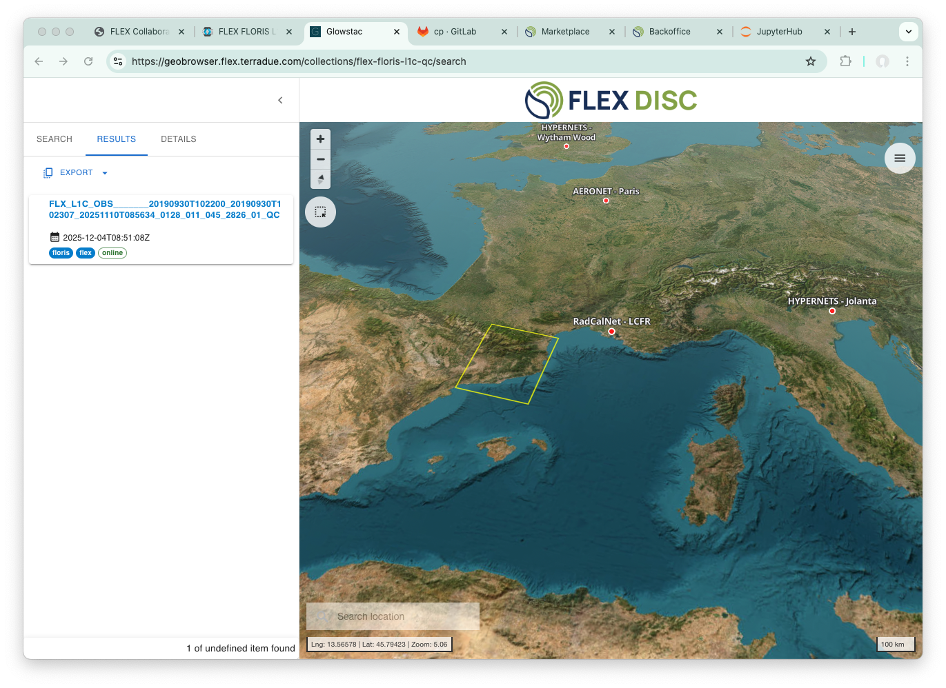
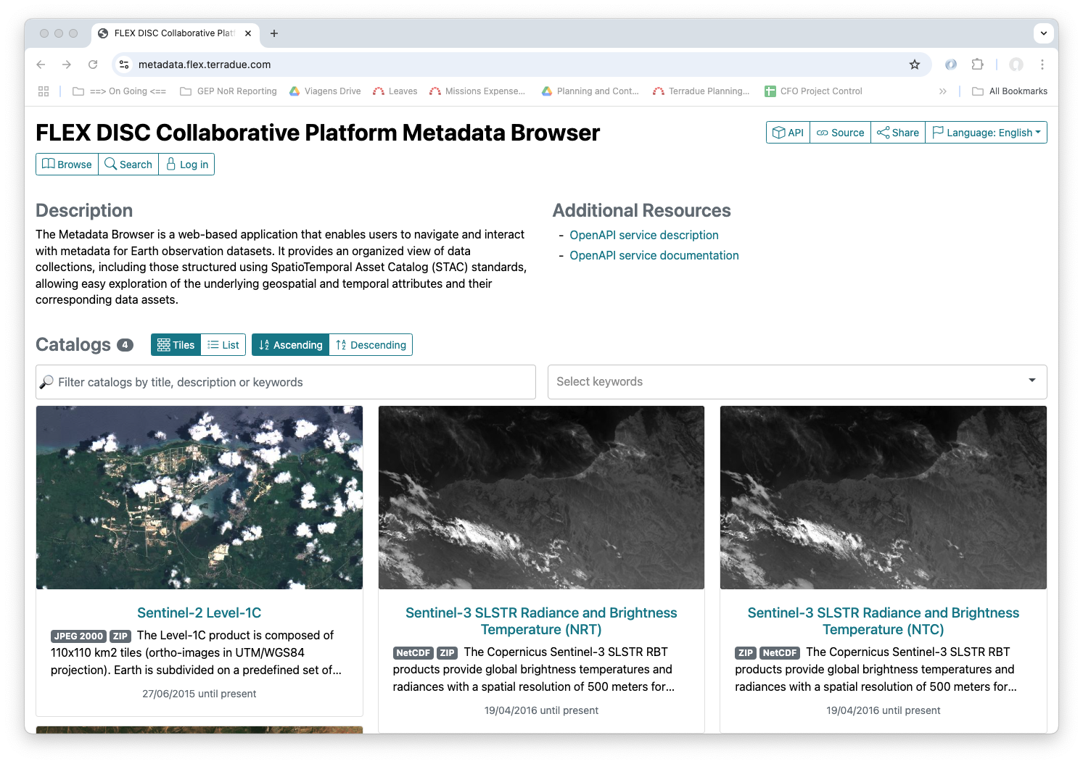
Cal/Val tools and Collaborative platform
Notes:
Speaker: Gwen

Slide 18
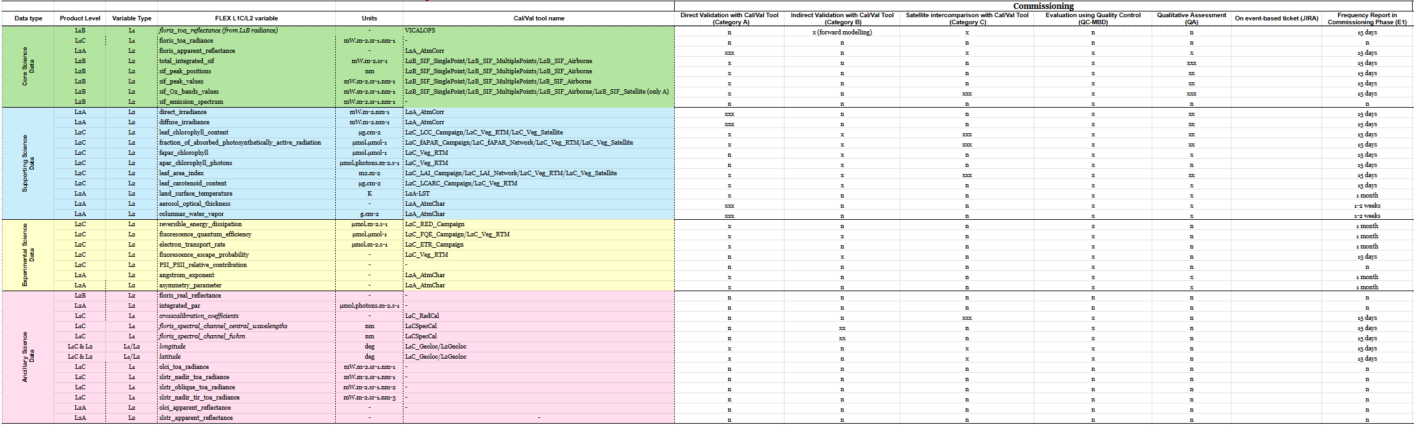

Activities in Commissioning

Slide 19
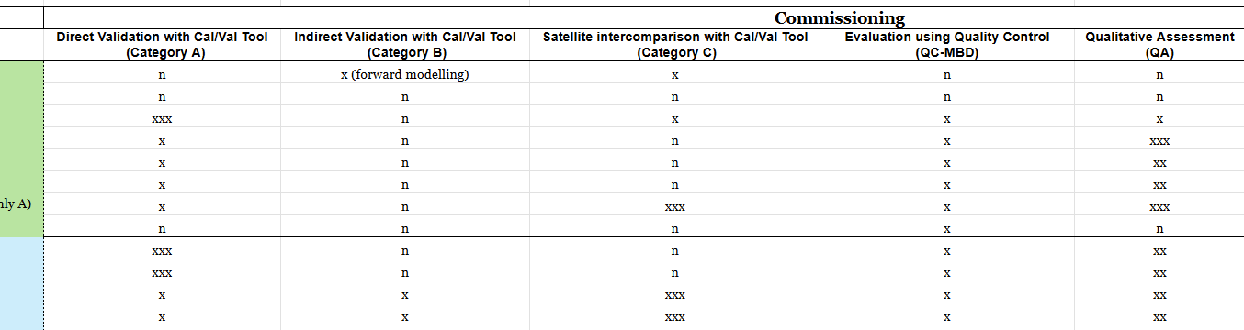
Activities in Commissioning

Slide 20

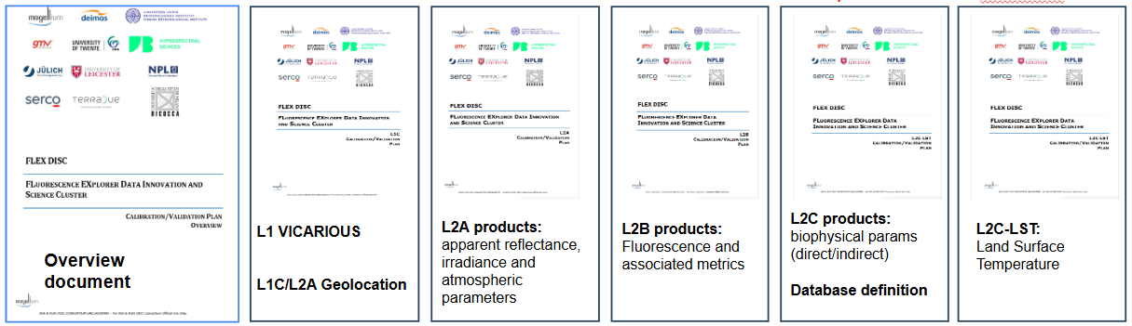

Validation Plans Documentation
● These documents describe Products, Validation Procedures, Sites, Instruments accuracy, Protocols to collect data, and data format for campaigns;
● These documents are living documents and will be updated continuously;

Slide 21

Summary
FLEX mission is offering a wide range of products. Cal/Val Plans have been prepared and available for users;
Different validation strategies has been designed for each product;
Several cal/val tools have been developed and they will be included in the CP available to the users; Validation sites based on reference networks have been identified;
The reference field measurements have SI traceability and are consistent to FRM best practices;
A large documentation is provided in order to facilitate the FLEX community to validate the FLEX products, and we are preparing as best as possible for the launch and for the validation phase during Commissioning.

Slide 22



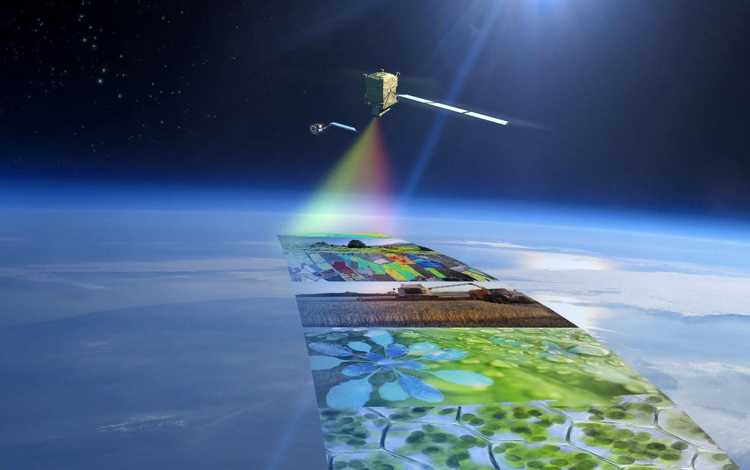
Thank you
and thank you to Ali Mahmoodi
Data Innovation and Science Cluster (DISC)

