Slide 1
Diurnal variations in red Solar-Induced chlorophyll fluorescence retrieved from the TEMPO geostationary mission
Zhaoying Zhang^{1,2}, Gregory Duveiller², Yongguang Zhang¹
¹Nanjing University, China; ²Max Planck Institute for Biogeochemistry, Germany

Slide 2
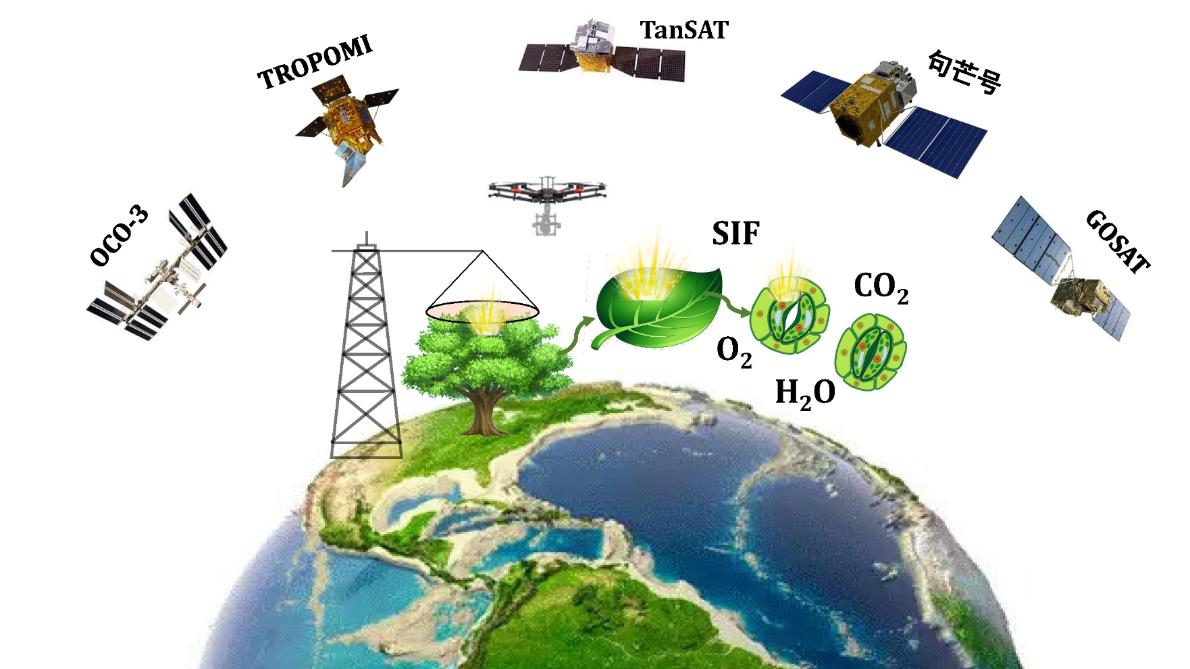
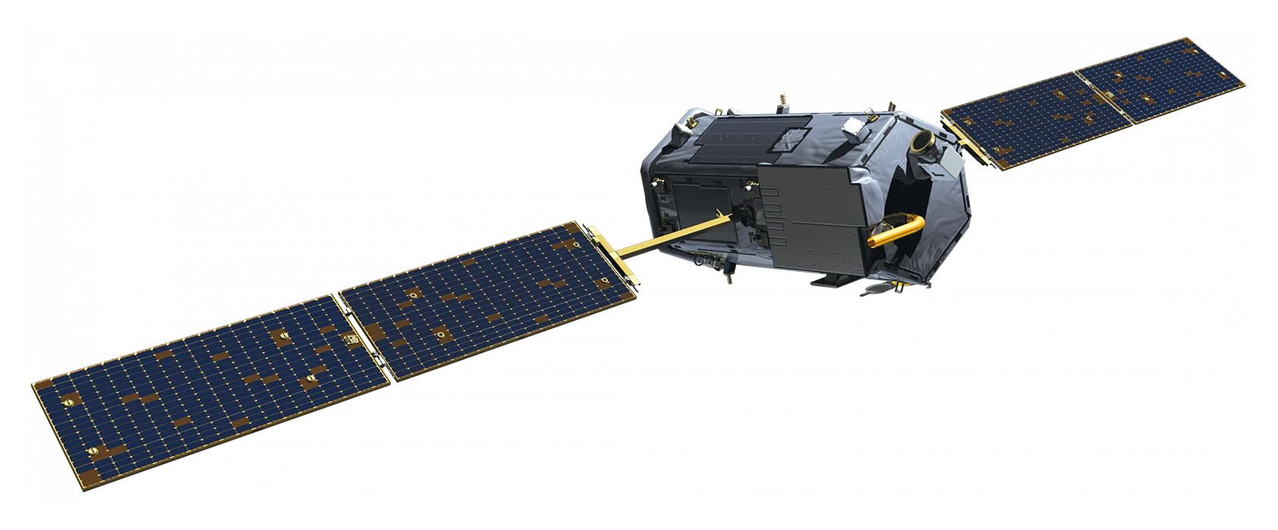
Solar-Induced chlorophyll fluorescence Satellite
OCO-3 can provide diurnal SIF observations and provide a new opportunity for large-scale monitoring of diurnal vegetation photosynthesis.
Goumang
Photosynthesis
OCO-2
Sun-synchronous polar-orbiting satellite

Slide 3
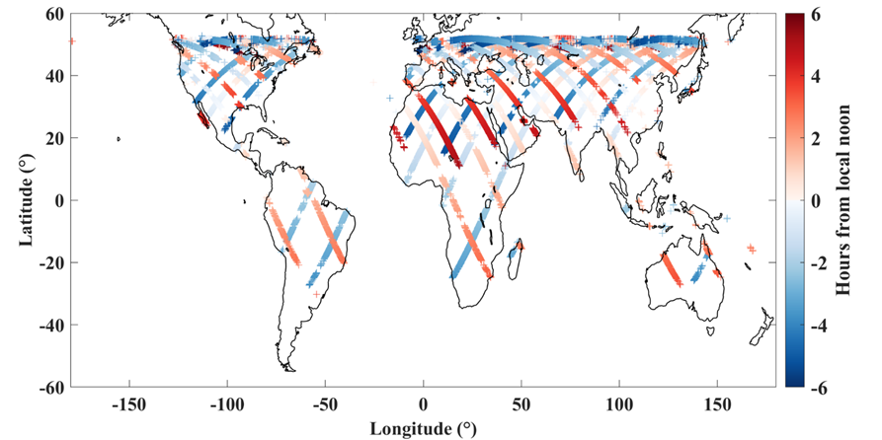
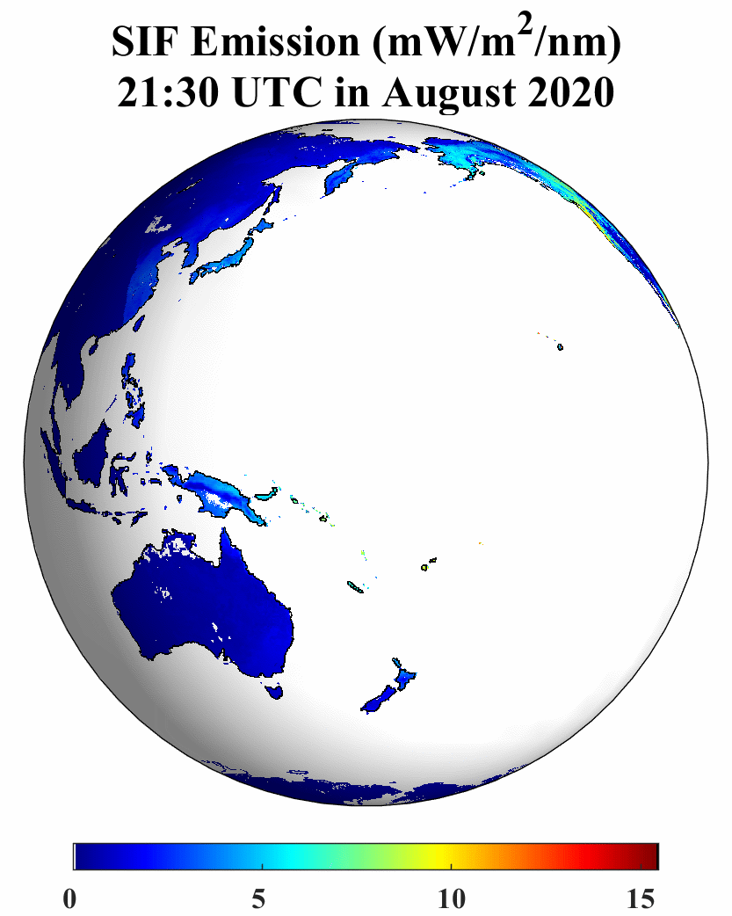
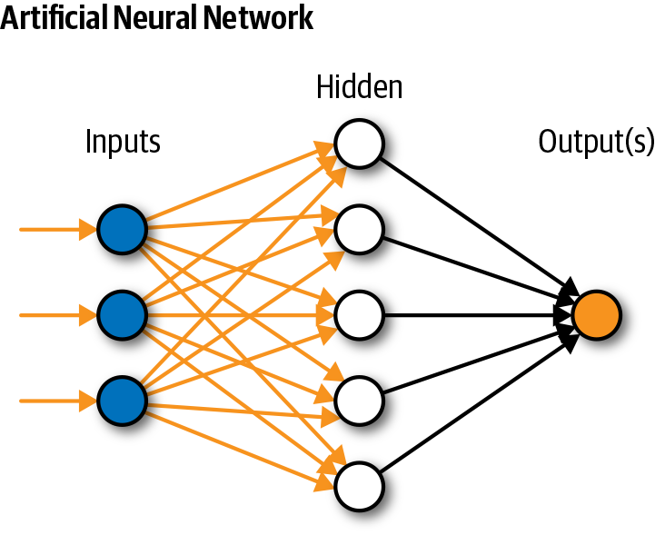
Global Far red band dirunal SIF_{total} Simulation
Although OCO-3 has the ability to monitor diurnal photosynthesis changes, it cannot observe a fixed location continuously throughout the day.
Strip observation mode, spatially discontinuity
SIF samplings June 6, 16, 26, 2020
Artificial Neural Networks are used to generate spatiotemporal continuous diurnal SIF_{total} products.
FPAR PAR Tair VPD
SM
SIF_{total}

Slide 4
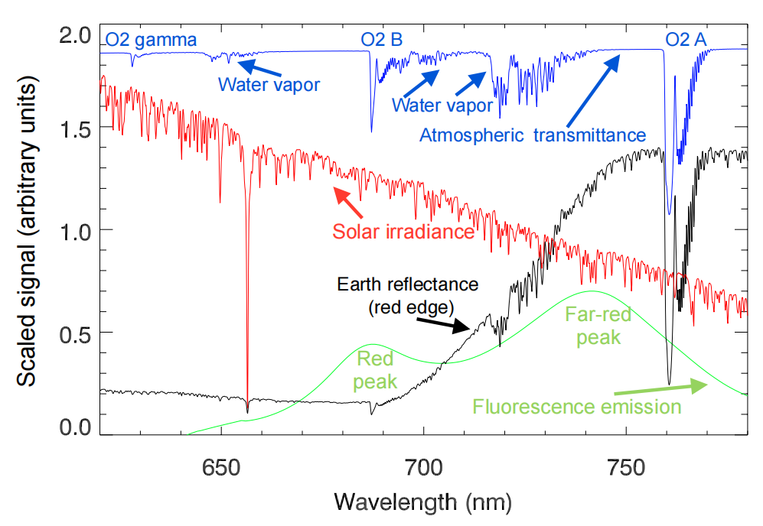
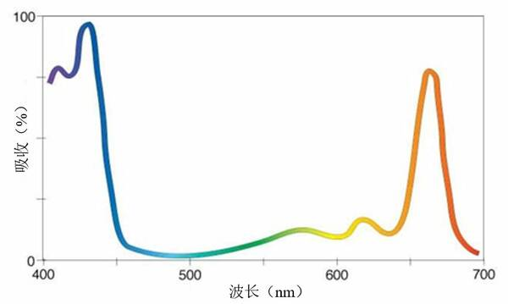
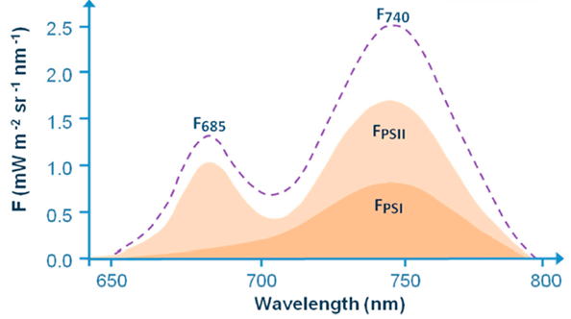
Why Red band SIF?
Theoretically, Red band SIF contains more PSII-related information and is more closely associated with photosynthesis.
Red band is a strong chlorophyll absorption region, where reabsorption within the canopy and inside leaves is severe.
The O₂-B absorption feature is relatively narrow and shallow, leading to larger uncertainties in the retrieval of RSIF.
Accurate retrieval of RSIF remains a challenge.
Leaf chlorophyll absorption spectrum
Leaf Solar-Induced Fluorescence spectrum
SIF and Radiance spectrum

Slide 5
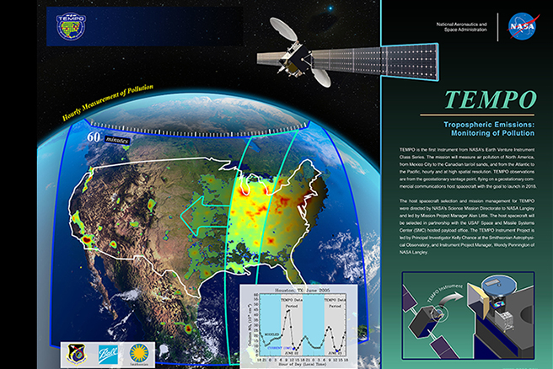
TEMPO Instrument Overview
Category | Specification / Capability
Mission Objective | Hourly monitoring of trace gases and aerosols to observe sub-urban scale “chemical weather” across North America
Spectral Range | 293–741 nm (UV–Visible)
Spectral Sampling | 0.2 nm
Spectral Resolution | 0.6 nm
Detectors | Two 2D detectors (2048 × 1028 pixels)
Spectral Gap | 494–538 nm
Spatial Resolution | 2 km (N–S) × 4.75 km (E–W) at field center (33.5°N, 89.2°W)
Ozone Profile Product Resolution | 8 km (N–S) × 4.75 km (E–W) (co-added spectra)
Temporal Resolution | Nominal hourly full-disk scans (1181 E–W steps per hour; ~2.4 million spectra/hour)
Partial Scans | 40-minute scans over eastern (morning) or western (evening) regions
High-Frequency Mode | ≤10-minute special operations for targeted events (wildfires, dust, volcanic eruptions)

Slide 6
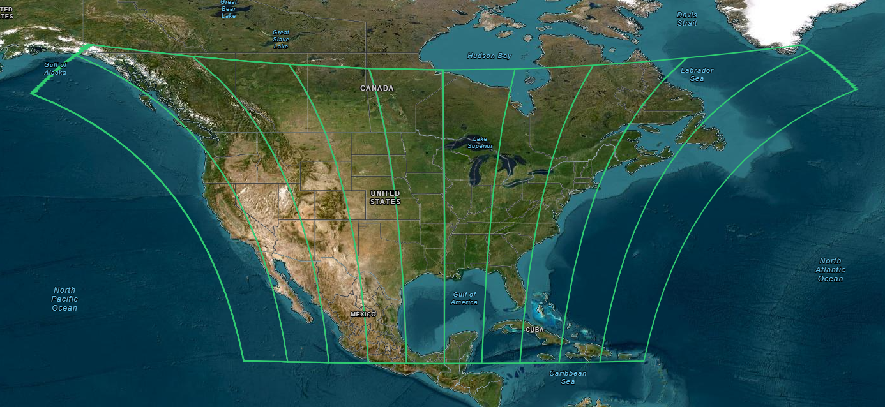
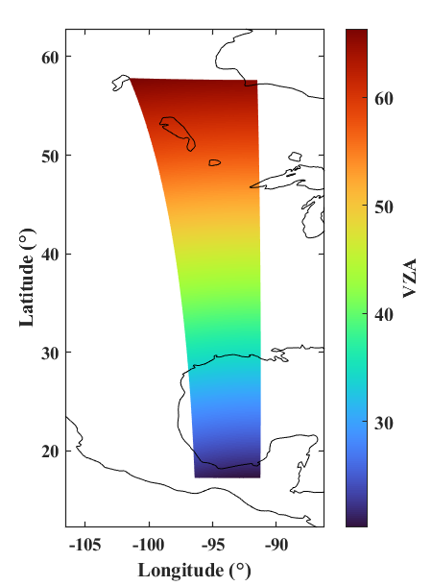
Spatial coverage of TEMPO
TEMPO覆盖空间范围
TEMPO’s viewing zenith angle is fixed at each location. The VZA increases gradually from south to north. To minimize the influence of large VZA, we excluded regions where the VZA exceeds 60°, which are mainly located in northern Canada.

Slide 7
SVD-based retrieval method
Retrieval windows:
TEMPO spectral range 293–741 nm(40nm gap)
SVD retrieval band:
640-685 nm
650-685 nm
660-685 nm
All selected windows are located on the left side of the O₂-B absorption band, where atmospheric transmittance is relatively high.
Red SIF emission peak around 685 nm
(Joiner et al.,2016)

Slide 8
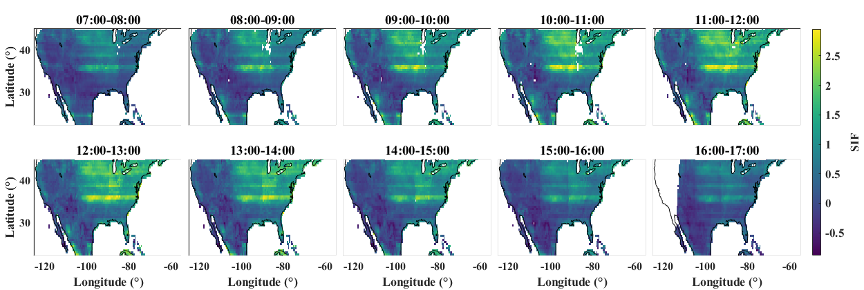
Retrieval region: 640-685 nm
Diurnal patterns of TEMPO SIF at 685 nm in August 2023

Slide 9
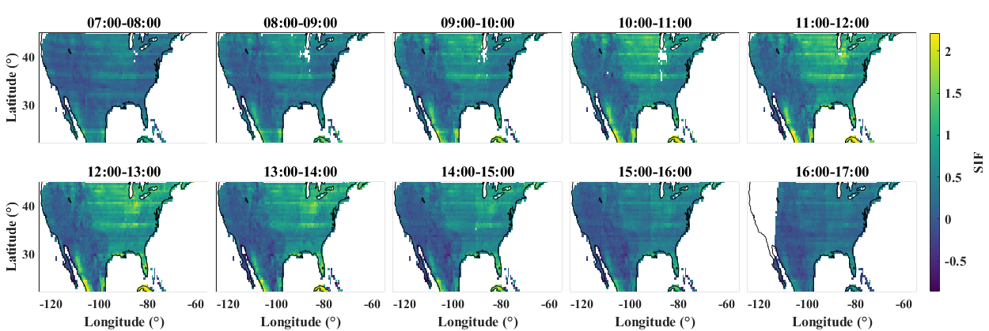
Retrieval region: 650-685 nm
The stripes were reduced; however, no clear SIF hotspot was observed over the U.S. Corn Belt.
In theory, SIF values over the U.S. Corn Belt should be relatively high.

Slide 10
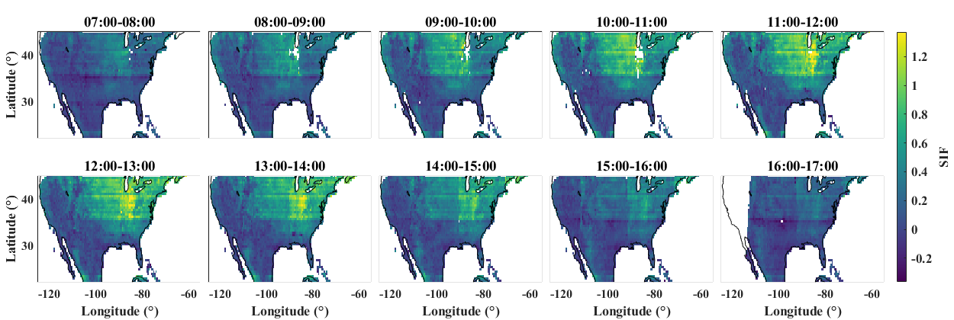
Retrieval region: 660-685 nm
Some weak stripes were still present. However, overall, a clear hotspot could be observed over the U.S. Corn Belt. In addition, the SIF values increased from morning toward midday and then showed a weakening trend afterward.

Slide 11
Evaluation of retrieval accuracy
Statistical matric of TEMPO SIF retrieval
Most values range between 0.5 and 1.5, with a median close to 1, indicating that the spectral fitting performance is generally good.
However, for red SIF, the retrieval uncertainty is relatively high, with a median value of 0.84 mW m⁻² nm⁻¹ sr⁻¹.
This uncertainty is substantially higher than that of far-red SIF.

Slide 12
Diurnal patterns of TEMPO SIF for each vegetation type
The timing of the SIF peak may be influenced by multiple factors, such as temperature and water stress. We therefore need to analyze more data to determine whether the peak timing is stable and robust.

Slide 13
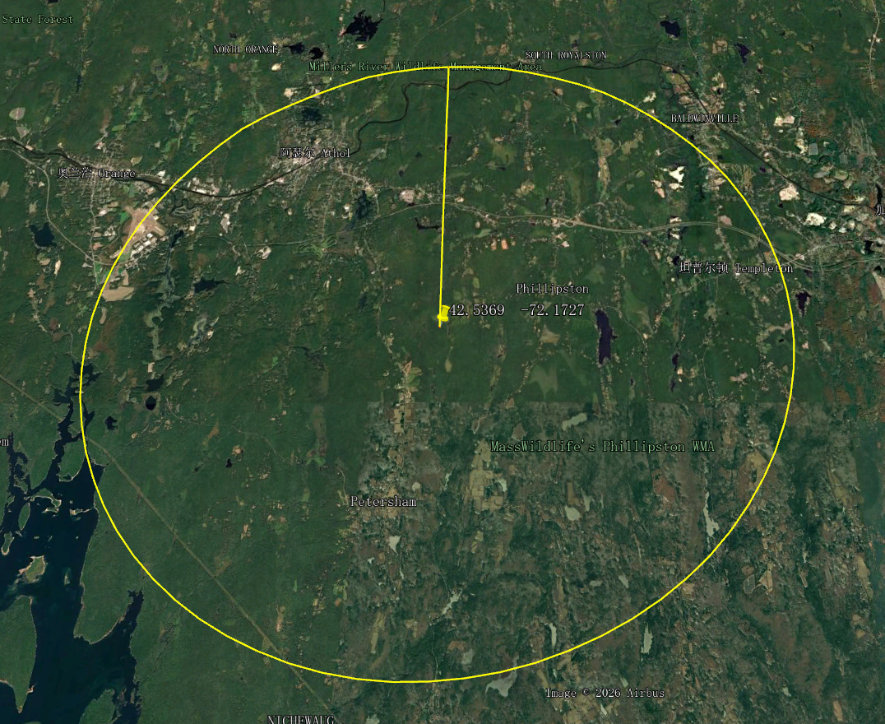
Comparison between TEMPO SIF and flux tower GPP
DBF: US-xHA
10 km
Multiple SIF observations need to be averaged to reduce noise

Slide 14
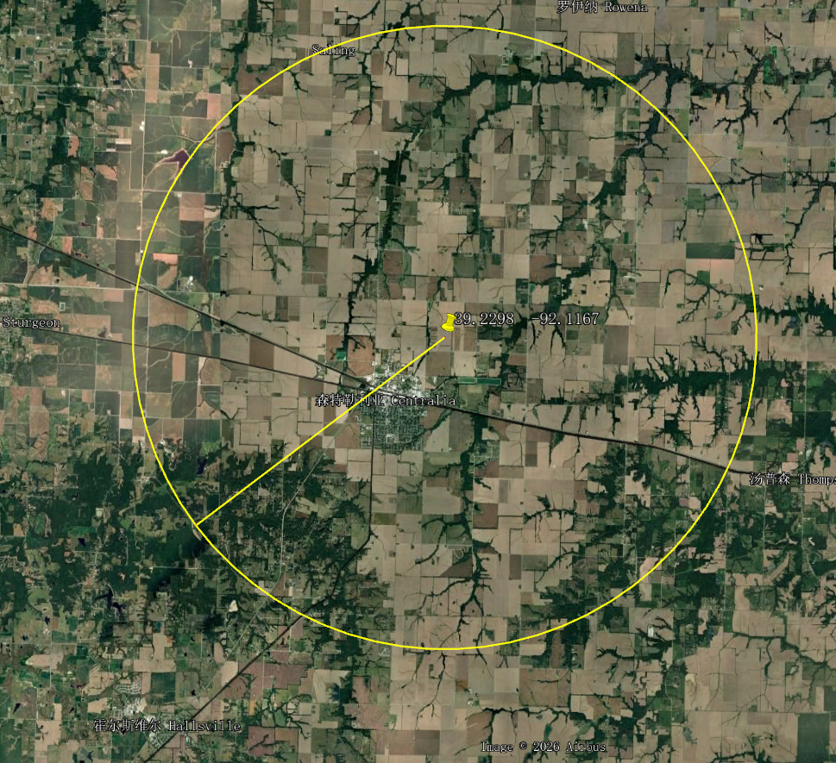
Comparison between TEMPO RSIF and flux tower GPP
CRO: US-Mo1
10 km

Slide 15
Comparison between TEMPO SIF and OCO-2/TROPOMI SIF

Slide 16
Take-home message
TEMPO provides the first geostationary view of diurnal red SIF.
Red SIF retrieval is feasible, but still affected by noise and striping.
Averaging multiple observations improves the signal and its link to GPP.
Outlook
Improve retrieval stability and reduce artifacts.
Validate diurnal patterns across seasons and years.
Strengthen links between red SIF and ecosystem photosynthesis.

Slide 17
Thank you!
Zhaoying Zhang
^{zhaoying_zhang@nju.edu.cn}

Slide 18
