Slide 1
The FLEX Mission Development Status
Ralf Bock, Joao Pereira do Carmo, Frank de Bruin, Jinesh Ramachandran, Marco Celesti, Gerôme Fastrez, Matteo Taccola (all ESA / ESTEC)

Slide 2
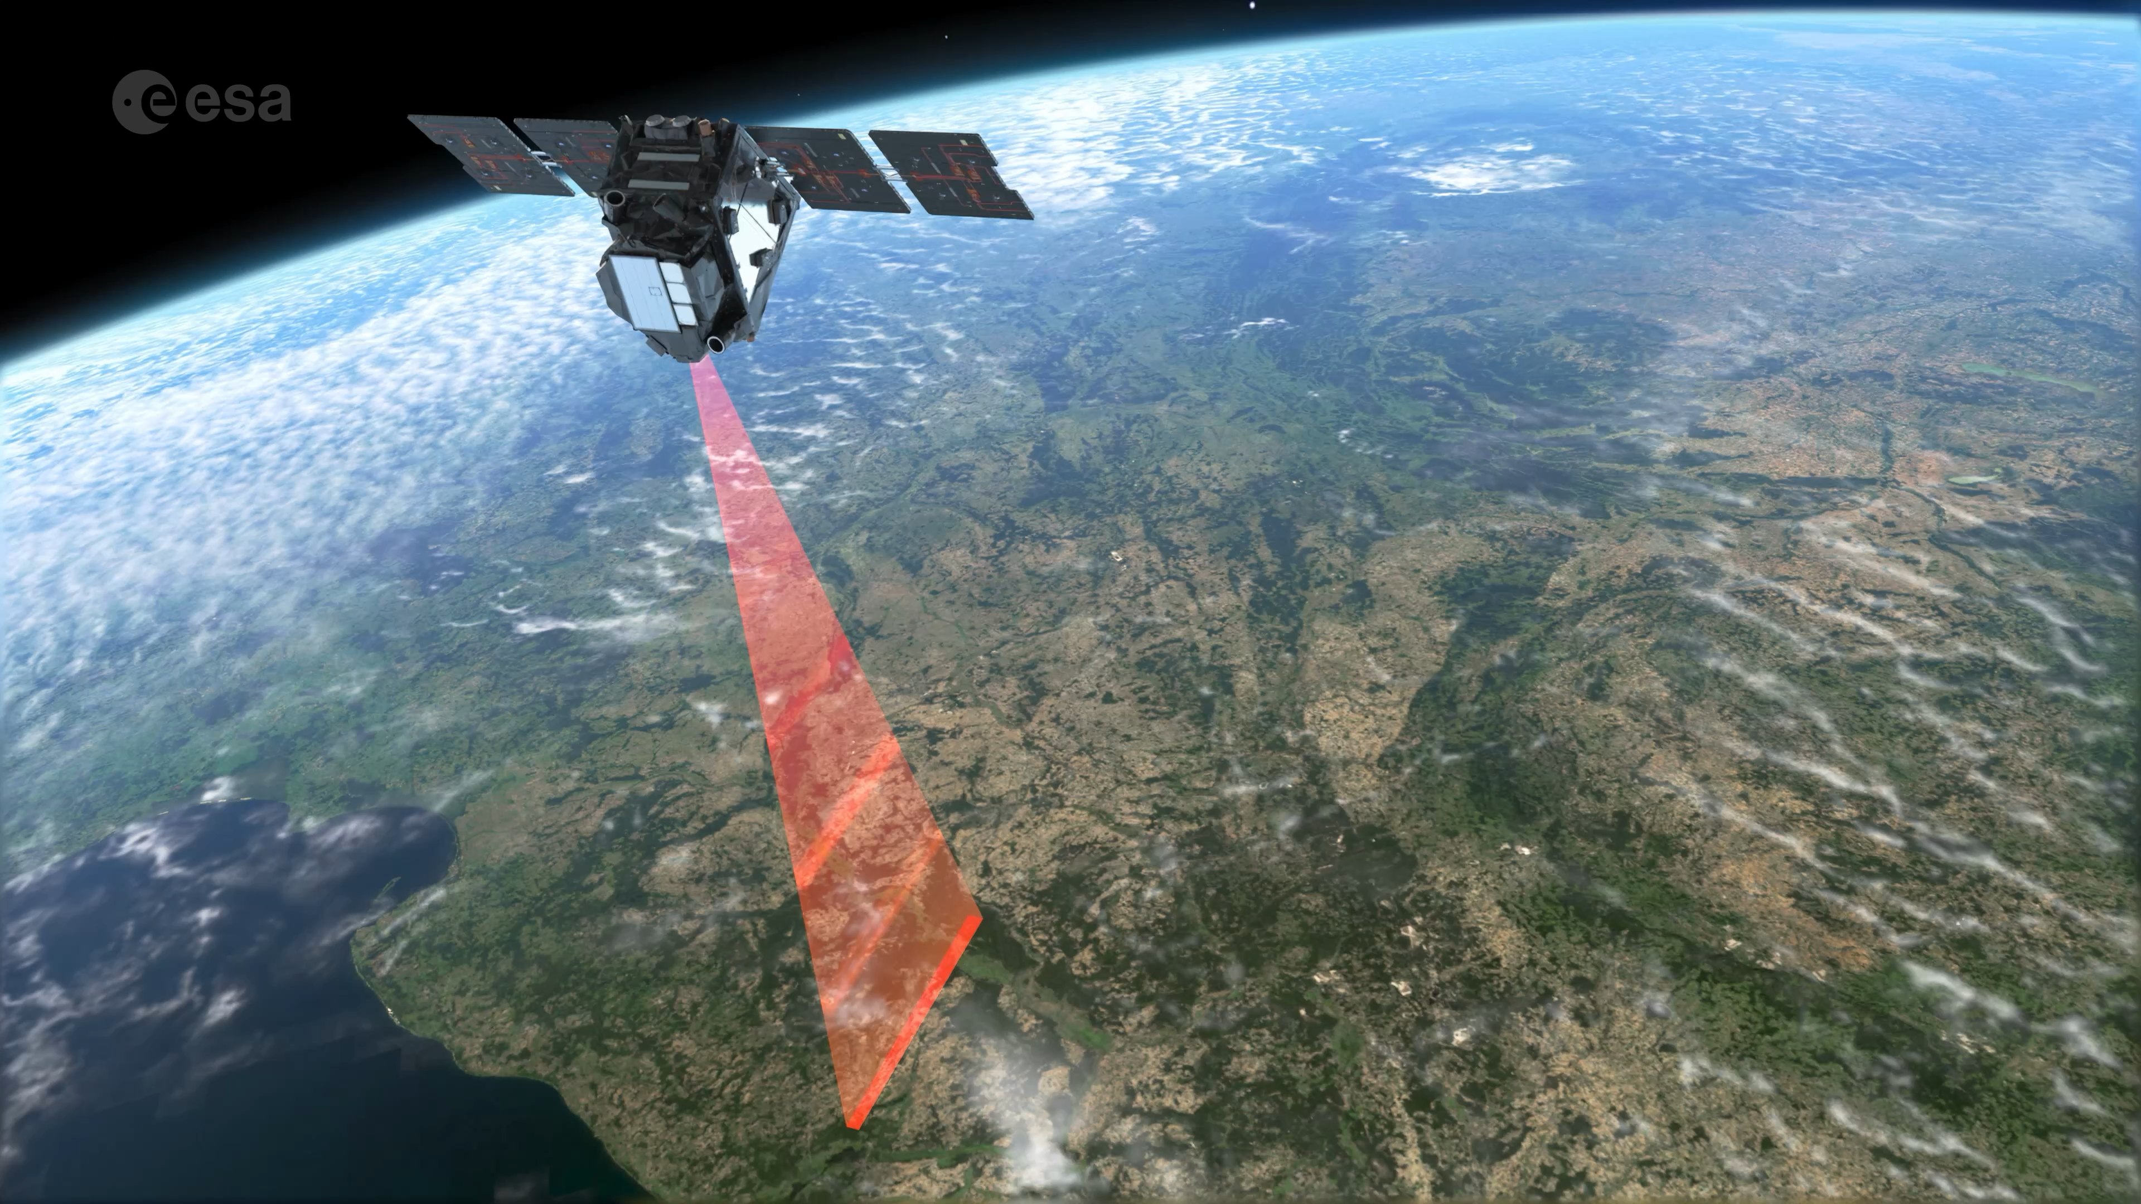
FLuorescence EXplorer (FLEX) Mission
Mission Objective
By retrieval of full-spectrum vegetation fluorescence and NPQ-related products, FLEX is aimed at
quantifying actual photosynthetic activity of terrestrial ecosystems
providing physiological indicators for vegetation health status
Mission Objective
By retrieval of full-spectrum vegetation fluorescence products, FLEX is aimed at
quantifying actual photosynthetic activity of terrestrial ecosystems
providing indicators for vegetation health status

Slide 3
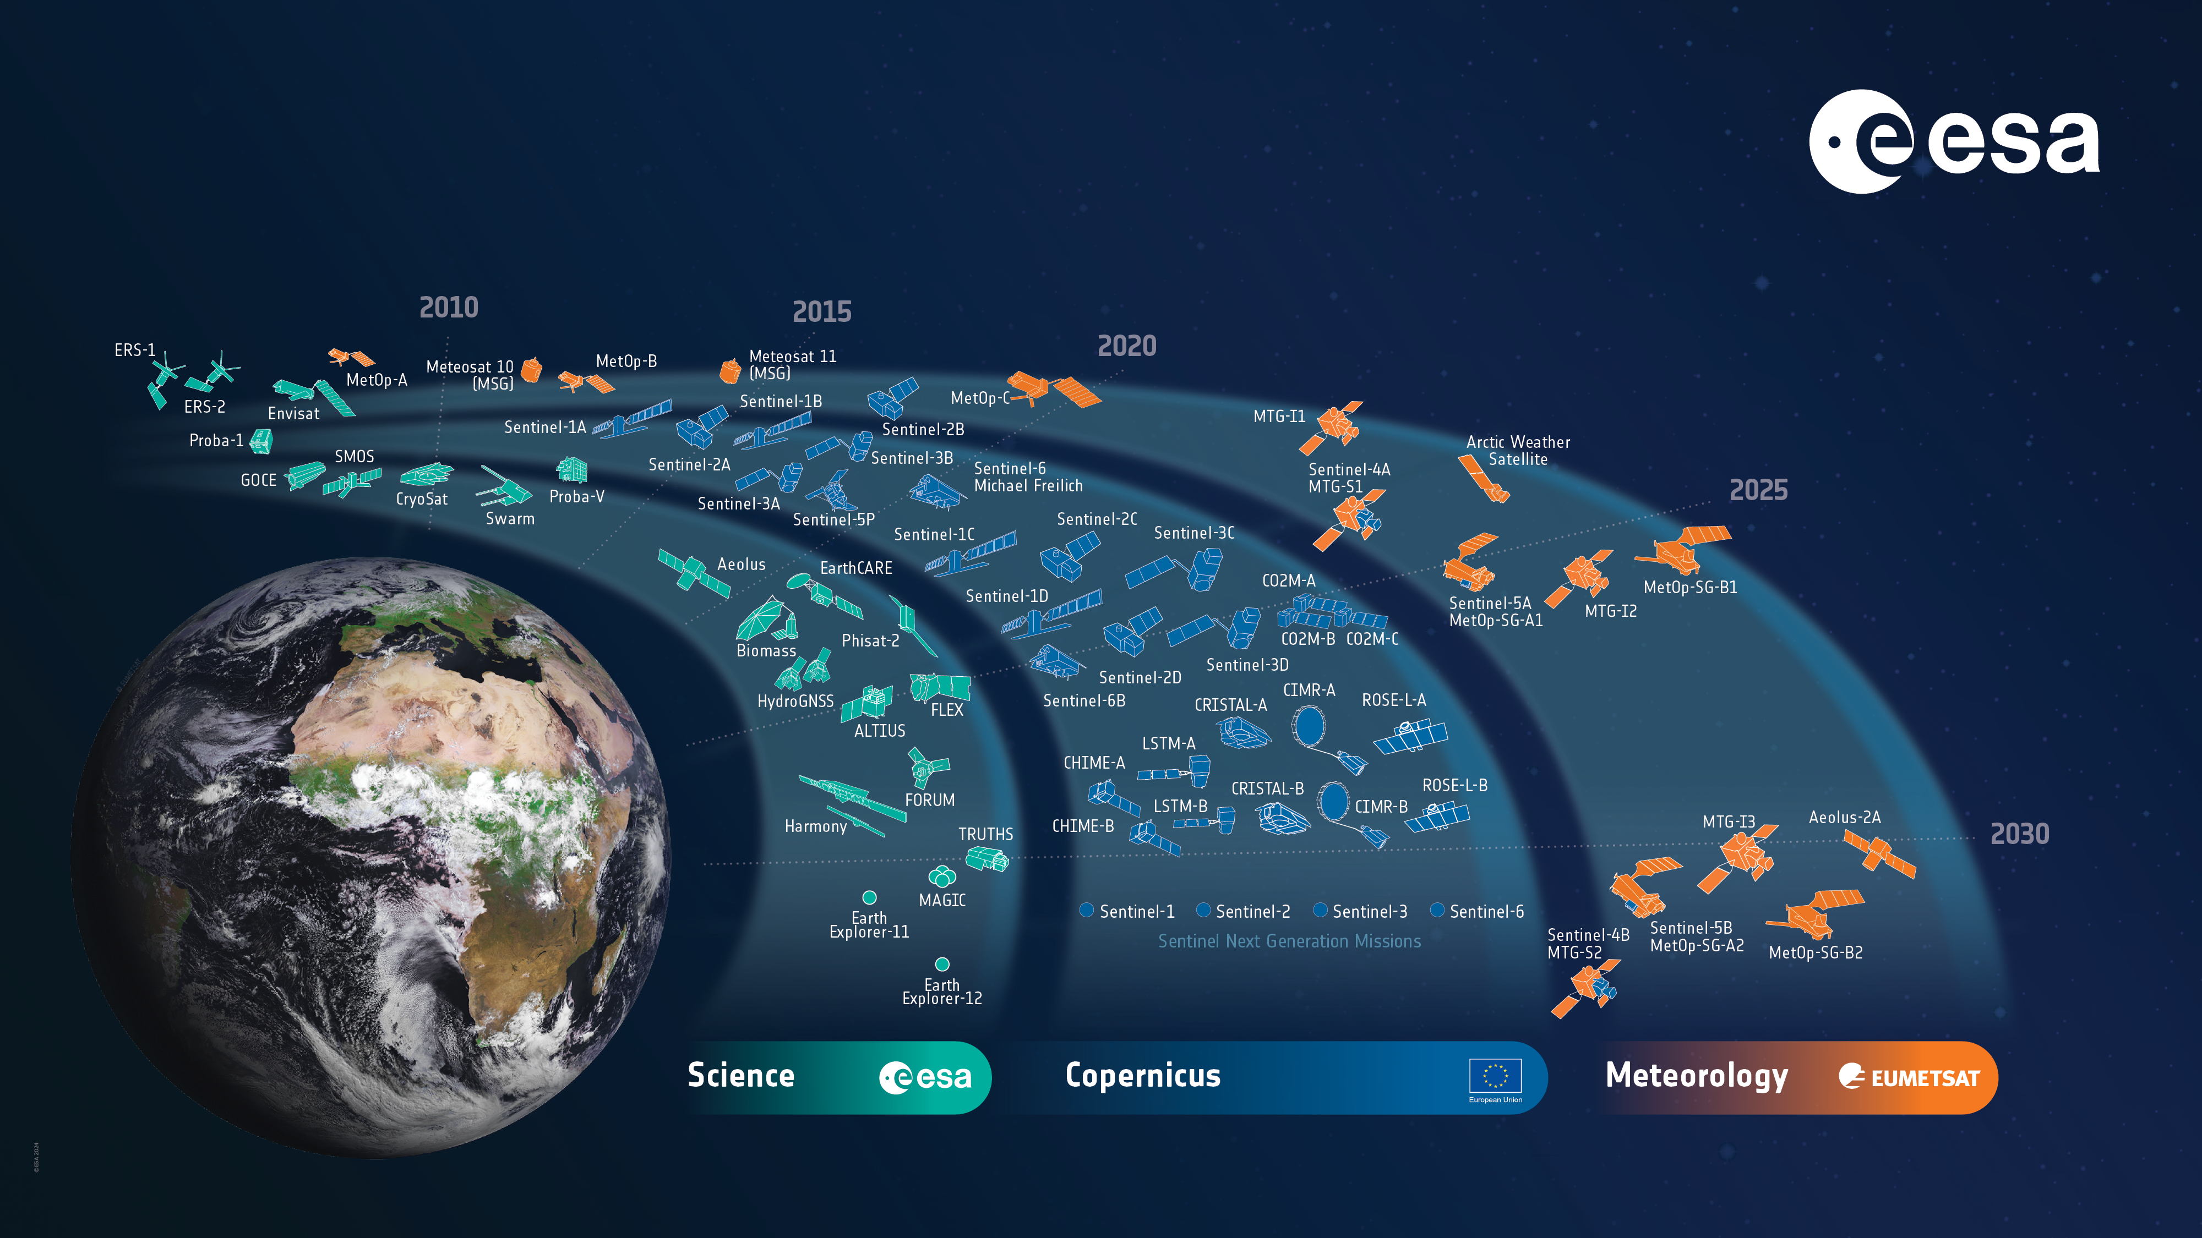
ESA’s Earth Observation Missions
Notes:
D/EOP has three main lines of activities: Earth Science – Copernicus – Meteorology
Meteorology => focussed on meteorological operational observation. In cooperation with Eumetsat. MeteoSat (TG) and MetOP (SG)
Copernicus is the largest producer of EO data in the world. Providing data for several operational services: Land, Atmosphere, Ocean, Climate, Disaster, Security. Copernicus Evolution with 6 new missions. Sentinel Next Generation.
Earth Science => Science driven programme. Explore new measurement techniques. Addressing specific scientific aspects that might become operational missions later on.
FLEX will fly in tandem with one of the Sentinel-3 satellites. As it looks now this will be S3C which will be launched few months prior to FLEX.

Slide 4
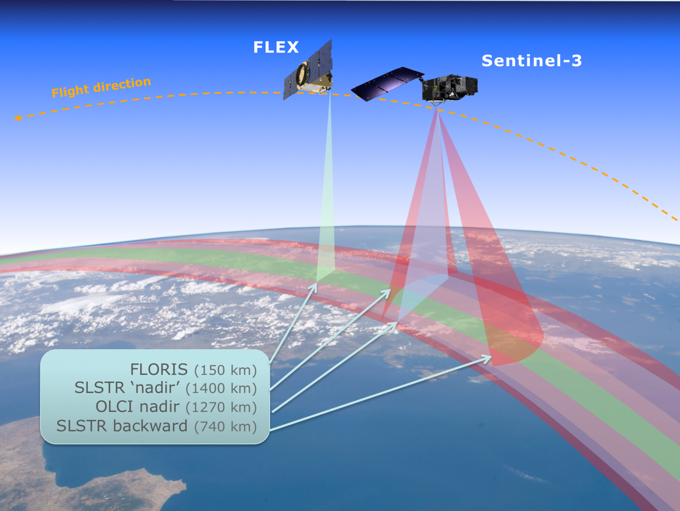
FLEX – Sentinel 3 Tandem Flight
Information required from Sentinel-3 for characterisation of the atmospheric state (cloudiness, aerosols, and atmospheric water vapour) and land surface characteristics (land cover type, biophysical parameters and surface temperature)
Large uncertainties due to moving clouds and changes in the atmospheric state ➔ temporal co-registration within 6s to 15s is required.
Status:
Orbit Control Startegy defined with ESTEC and ESOC experts.
Analyses and simulations confirm a passive-safe convoy flight.
Notes:
The measurements needed for the accurate retrieval of vegetation fluorescence emissions
and interpretation of the observed values requires several instruments. To make optimal
use of existing operational capabilities and to reduce complexity and cost, a tandem
mission concept with Sentinel-3 is foreseen for FLEX.
On the one hand, Sentinel-3 will provide information related to the atmospheric features
and land-surface characteristics needed for fluorescence retrieval. OLCI instrument will
deliver this auxiliary information in the visible spectrum while SLSTR will offer dual-angle
visible / infrared information as well as thermal infrared. On the other hand, FLEX will carry
a single FLORIS instrument in charge of providing the key measurements for fluorescence
retrieval and for characterization of vegetation photosynthesis and stress conditions.
The most critical information required from the tandem Sentinel-3 partner mission is related
to the characterisation of the atmospheric state (cloudiness, aerosols, and atmospheric
water vapour) and land surface characteristics (land cover type, biophysical parameters
and surface temperature).
Moving clouds and changes in the atmospheric aerosol load introduce large uncertainties
and are the most critical factors for temporal co-registration. To perform an optimal
atmospheric correction, the measurements from FLEX and Sentinel-3 shall be timely
separated as short as possible. Assuming realistic wind speeds in the troposphere and
taking the spatial resolution of the satellites into account a goal temporal co-registration
within 6 s is required, with a threshold value of 15 s.
The FLEX Level 2 products will be based on measurements from two different satellites,
FLEX and Sentinel-3, hence their spatial co-registration is important. A FLEX data
processing scheme shall be assumed where FLORIS and OLCI data are relatively
geolocated with an accuracy of 0.2 pixels, while OLCI and SLSTR are absolutely
georeferenced by the Sentinel-3 algorithms.
According to eco-physiological research, the best time for capturing the clearest
fluorescence signals would be around mid-morning local time in high illumination
conditions. This means observation time should be around 9:30-10:00 local time.
Such optimal illumination conditions cannot be achieved everywhere along the orbital path
due to changes in local time with latitude. Therefore a compromise selecting a local time
to cross the equator around 10:00, results in local observation times between around 9:00
local time in southern Argentina and around 11:30 local time in northern Finland, which are
the extreme cases for land observations.

Slide 5

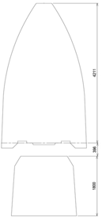
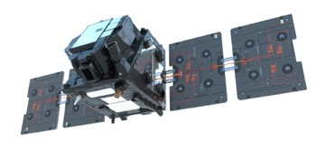
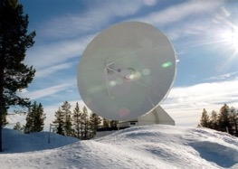
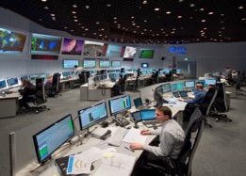
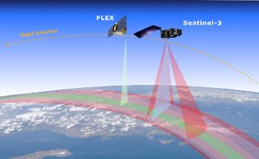
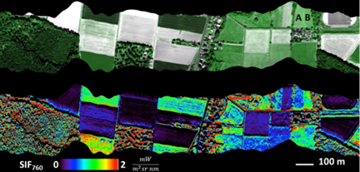
FLEX Mission Architecture
Space segment
Ground segment
Launcher
Spacecraft
Flight Operations Segment
Recurring platform
Instrument: FLORIS imaging spectrometer
Lifetime: 3,5 (5) years
TT&C S-band station
(eg. Kiruna)
ESOC
Vega-C, VESPA+R
Payload Data Ground Segment
Orbit
SSO 98.6 °@ 815 km
LTDN 10:00, in convoy and
6-15 seconds ahead of Sentinel-3
27 days repeat cycle
Coverage: 56°S to 75°N
X-band science data acquisition station
Processing and archiving element (ESRIN)
L2 Processor (DISC) integrated in PDGS
User segment
Chlorophyll fluorescence products for scientists, research centres and environmental services to study variations of actual photosynthesis, vegetation health status, and carbon uptake
Auxiliary data:
OLCI and SLSTR data (Sentinel-3)
ECMWF, DEM sources…
Notes:
Three full vegetation cycles are needed to cover general trends and extreme events
affecting plant ecosystems. Since these are needed both in the northern and the southern
hemisphere, the total mission duration shall be at least 3.5 years, taking into account
potential shifts in launch dates and excluding the commissioning phase. A duration of 5
years would provide more statistical relevance and increase the probability of observing
extreme events.

Slide 6
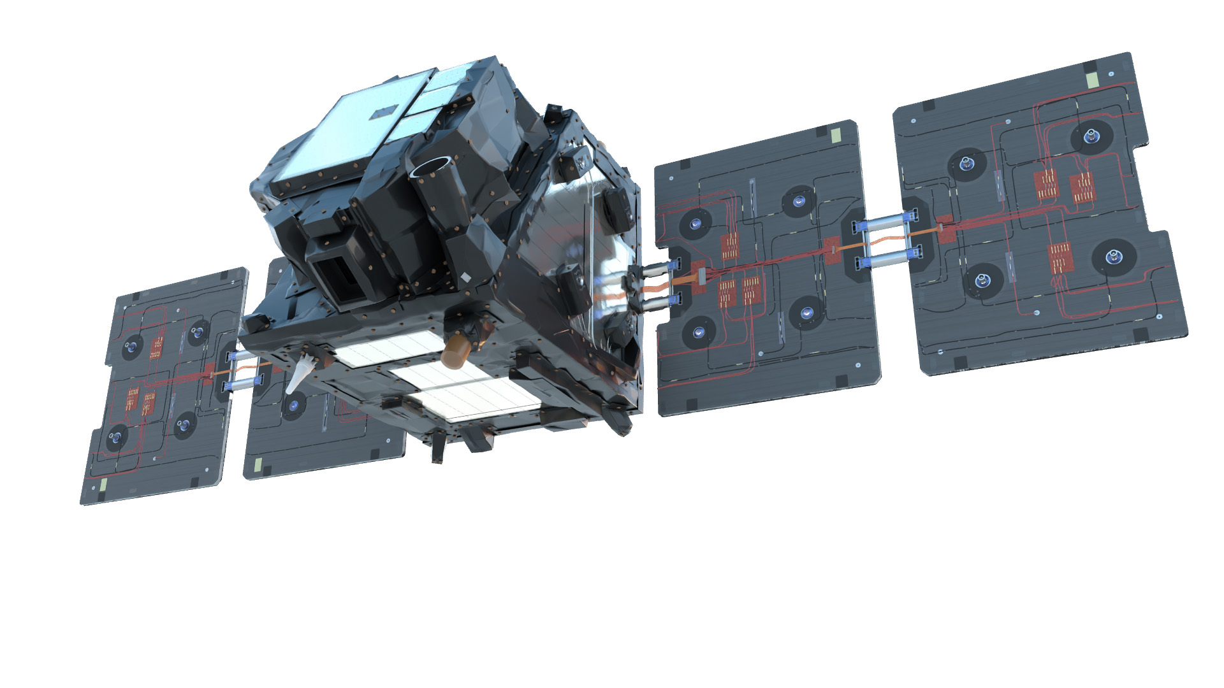
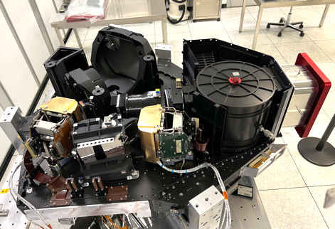
Satellite Design – Key aspects
FLEX Satellite:
Satellite Prime is Thales Alenia Space in Cannes, France
Platform based on recurrent platform Myriade Evolution
Avionics architecture based on Sentinel-3 design
Launch Mass: ~400kg
Power: 950W SA, 1.9kWh battery
Size deployed (w-h-d): 4.8m , 1.5m , 1.4m
FLORIS Instrument:
Developed by Leonardo SpA in Florence, Italy
2 High Resolution O2A and O2B spectral channels
1 Low Resolution Spectrometer covering 500-780nm
Spatial resolution 300 x 300 meters
Swath width 150 km ; repeat cycle 27 days

Slide 7
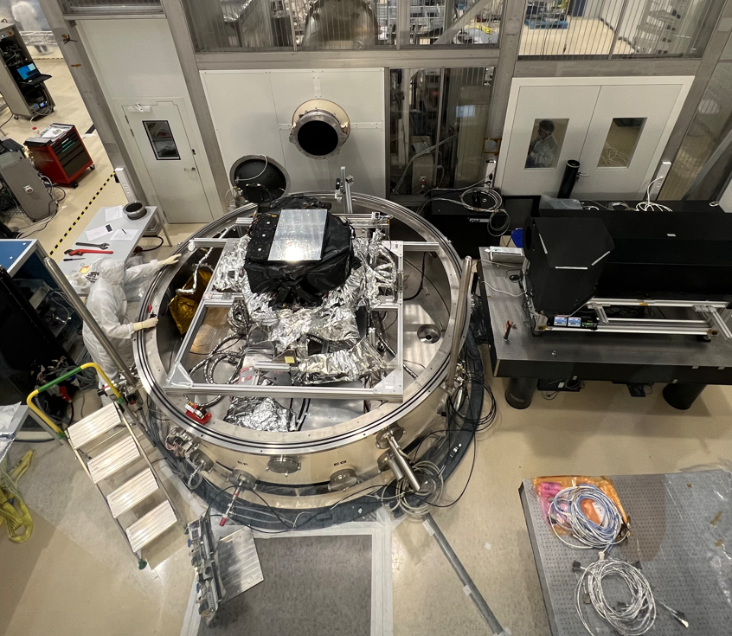
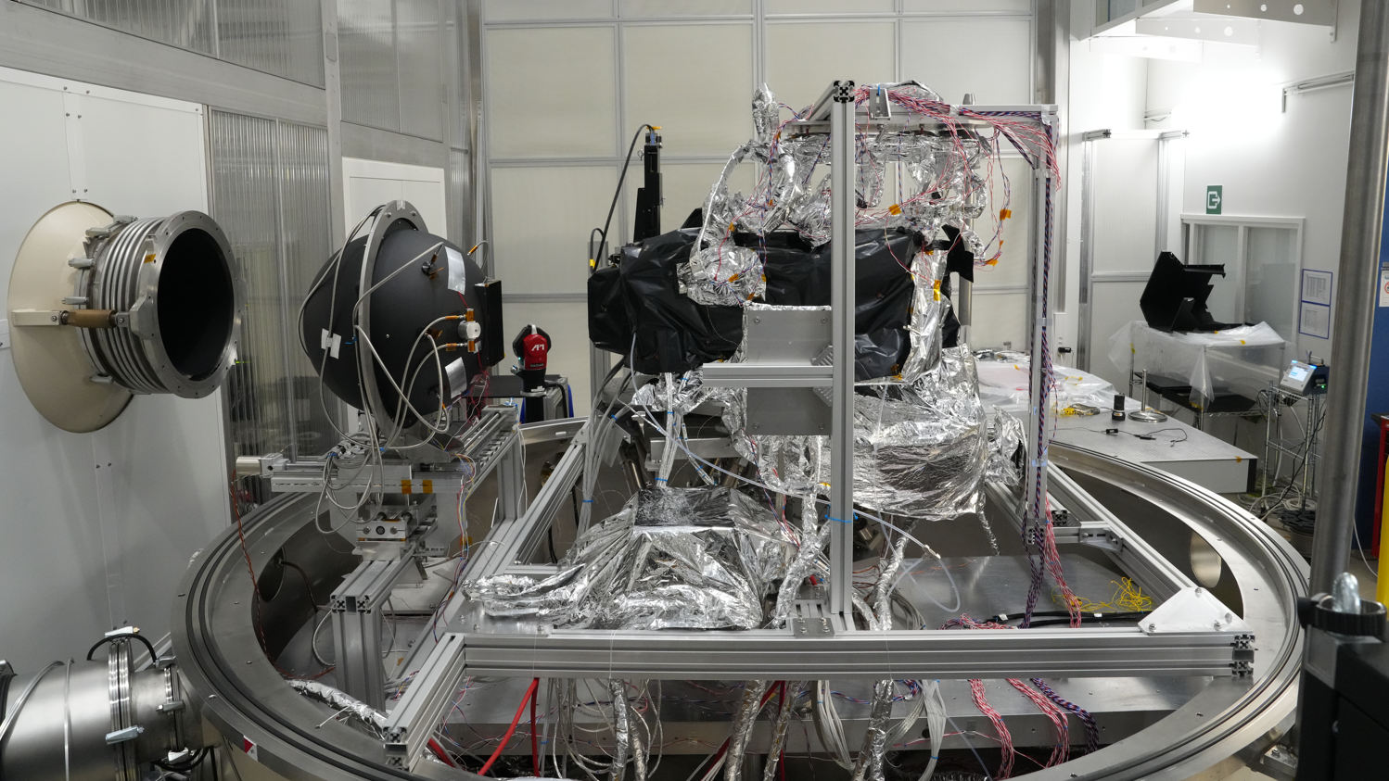
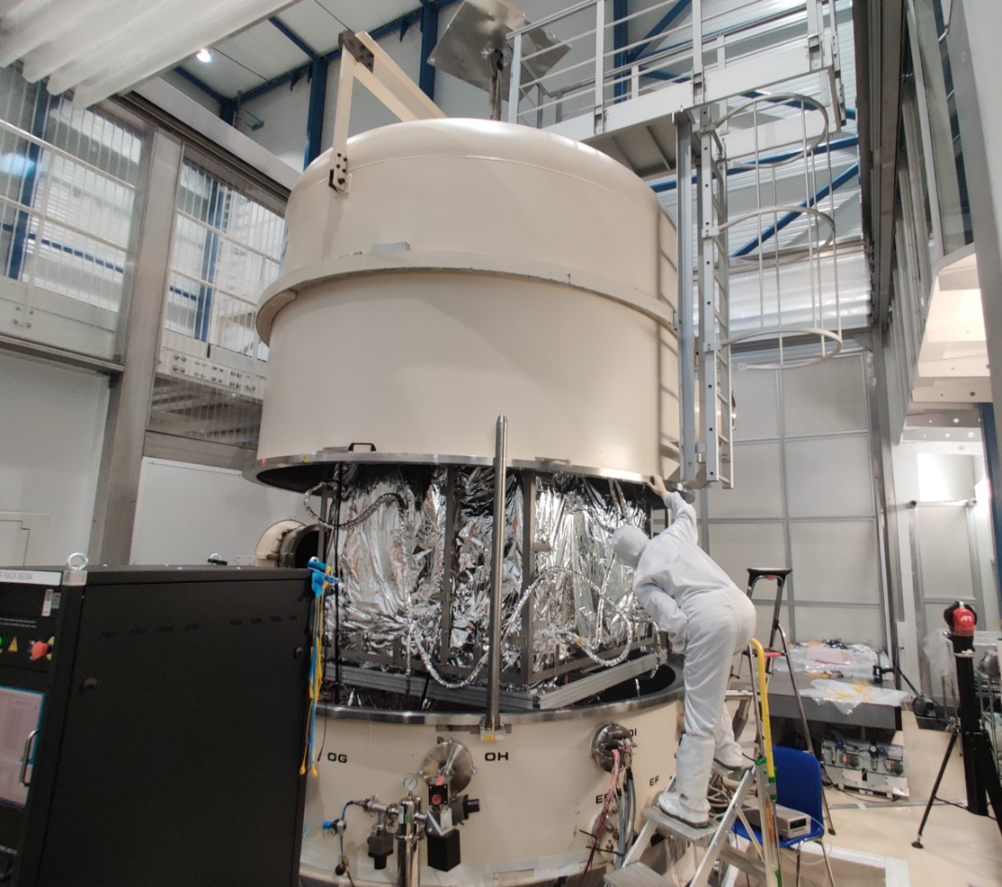
FLORIS Calibration Campaign
Campaign from March to June 2025, divided into two main sequences / configurations:
CAL#1: Performance plus tests for geometric / spectral / radiometric KDPs determination
CAL#2: Straylight characterization
Notes:
All OGSE in place and ready: Earth Collimator, Sun Simulator, Integrating Sphere, Straylight collimator.

Slide 8
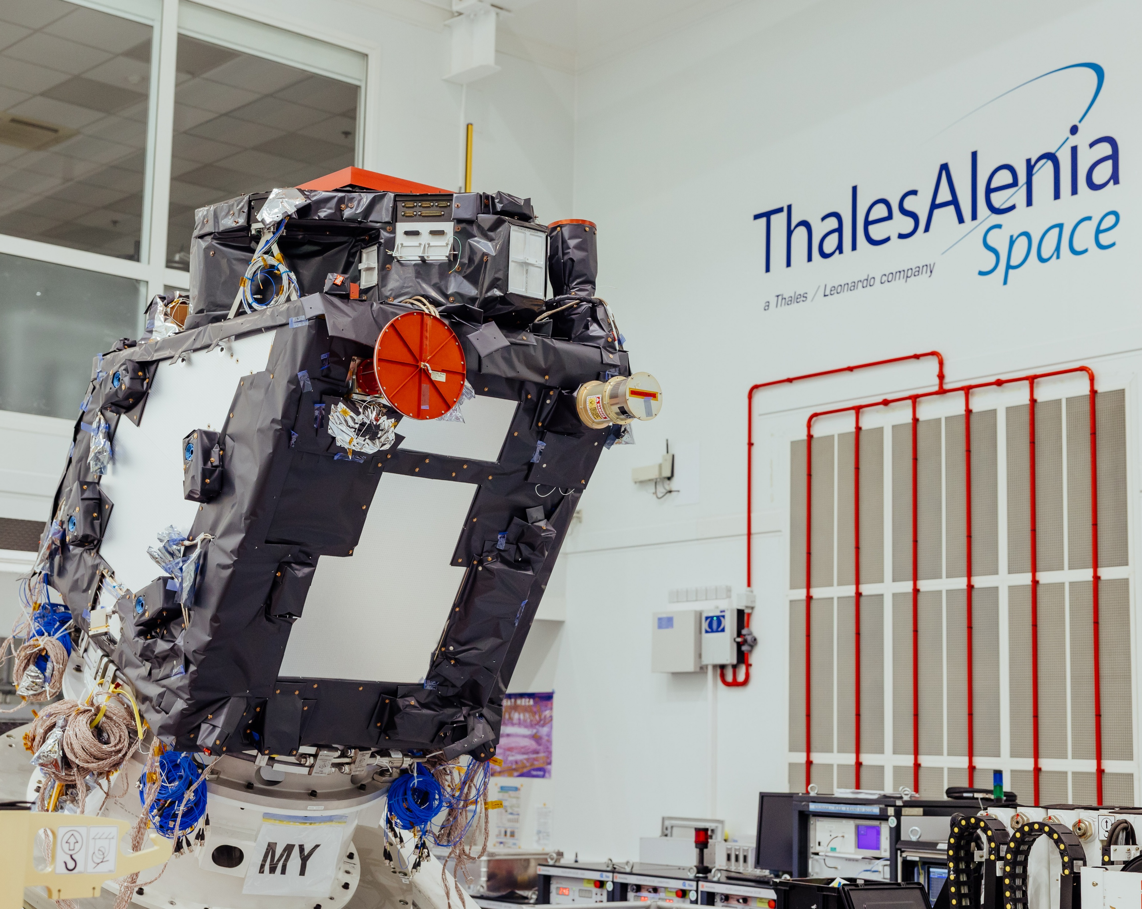
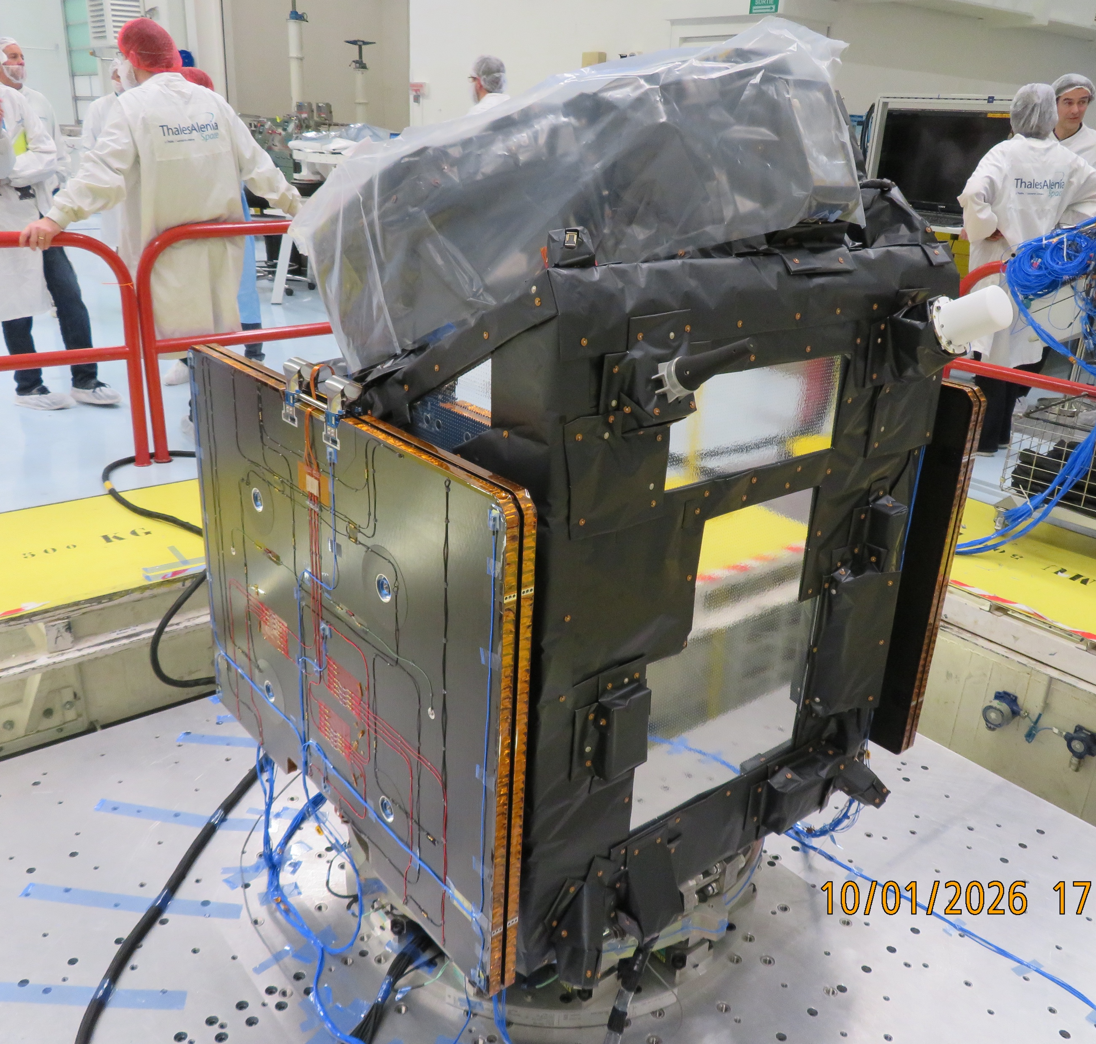
Satellite Assembled / Test Campaign
FLORIS instrument delivered and mounted onto the Satellite Platform, July 2025.
Satellite including Solar Panels during vibration tests, Jan.2026

Slide 9
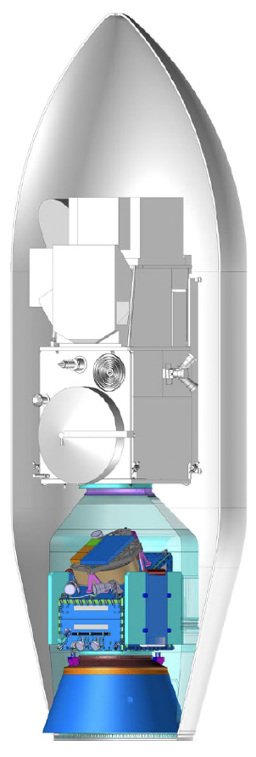
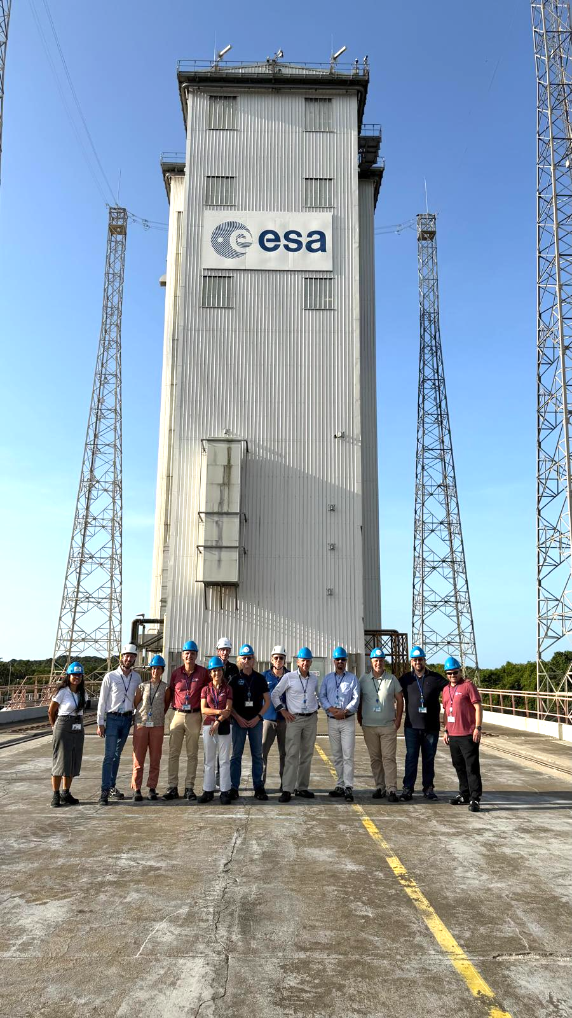
Launcher
FLEX designed to be compatible with Vega-C launcher.
Preliminary Mission Analysis completed in 2025 – confirming S3C + FLEX configuration is feasible.
Final Mission Analysis started. All launcher stages/elements incl. VEGA Secondary Payload Adapter (VESPA+R) being procured by AVIO.
Launch Date is defined by the Sentinel-3C project (main passenger). Current working baseline is a launch date 1st September 2026.
Launch Period (3 months) is currently defined Sept. – Nov. 2026.
Launch Slot (30 days) definition at L-6 month ➔ now / early March
Launch Day definition at L-3 months ➔ ~early June

Slide 10
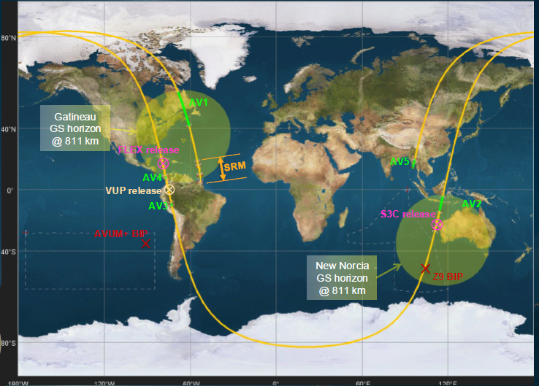
FLEX and S3-C injection strategy
Launch from Centre Spatial Guyanais (CSG) in Kourou, French Guyana.
Time of launch is ~1:20 UTC (~3:20 CEST).
Launch towards North.
S3C separation after 3738 seconds (~2:22 UTC; 4:22 CEST)
FLEX separation after 7002 seconds (~3:17 UTC, 5:17 CEST)
SRM: Launcher solid rocket motor stages
AVx: AVUM upper stage firing phase
VUP: VESPA adapter Upper Part
BIP: drop zones of AVUM and Z9 stage.

Slide 11
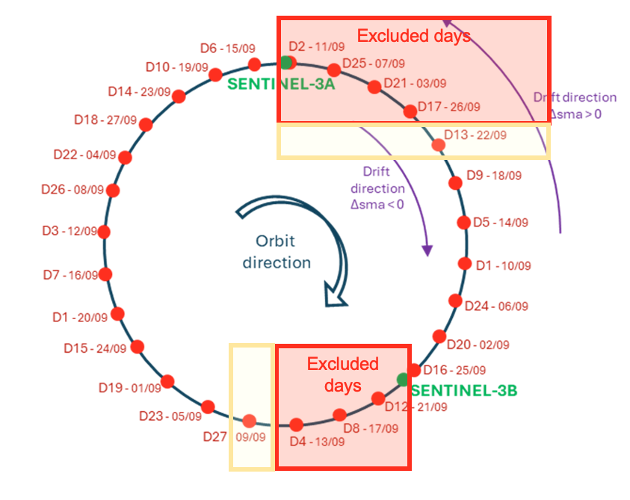
FLEX-S3C Insertion Strategy
Trajectory analysis - different phases are considered:
(1) From Launch to Tandem:
S3C flying in tandem with S3B (first S3C tandem phase),
FLEX flying in tandem with S3A
(2) S3C Tandem to S3A
S3C transition from tandem with S3B to tandem with S3A (second S3C tandem phase)
(3) S3A relocation
Post FLEX-IOCR
Launch on day Dxx of the orbit repeat cycle (27 days) defines duration of drift phase for FLEX to reach S3A; best case ~ 2 weeks /max ~8 weeks.
There are launch dates that shall be avoided to exclude FLEX-S3A/B/C orbital conjunctions (collision risk) and those avoiding S3C overflight with S3A/B (no simultaneous operation possible)

Slide 12
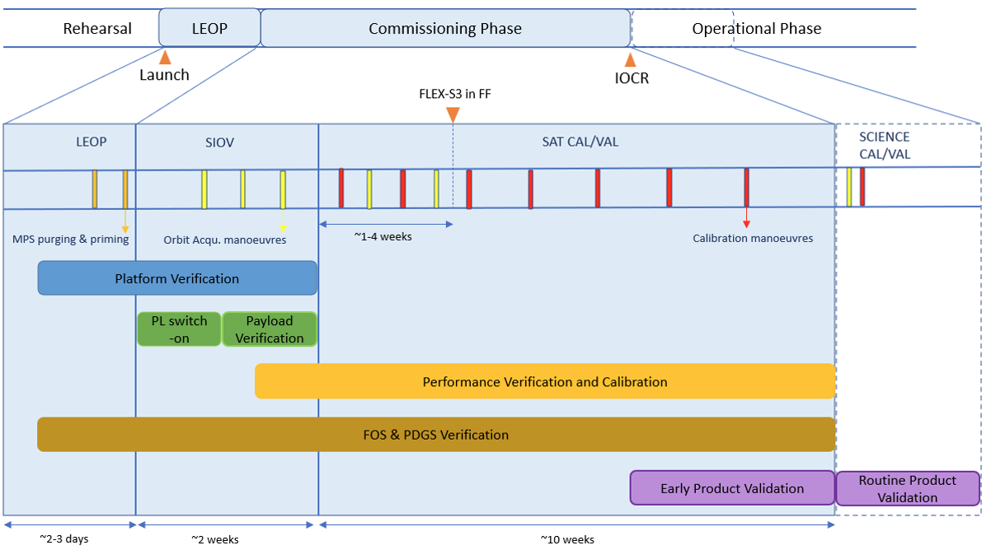
FLEX Commissioning Phase
The commissioning Phase duration is set for 3 months and entailes:
Launch and Early Orbit Phase (LEOP, 3 days): e.g. acquisition of first contact; solar panels deployment.
Satellite In-Orbit Verification (SIOV, ~2wks): e.g. satellite functional verification and tuning; instrument outgassing and anti-contamination; instrument functional verification; orbit manouvers to acquire drift towards Sentinel-3A orbital position.
Satellite CalVal: calibration manoevers (satellite orientations) ; establish Formation Flying with S3A.
At In-Orbit Commissioning Review (IOCR) confirm satellite functionality and L0/L1b performances with tools and L1b prototype processor (GPP) by TAS/LDO. Cross-validation with Operational Processor will start in parallel.

Slide 13
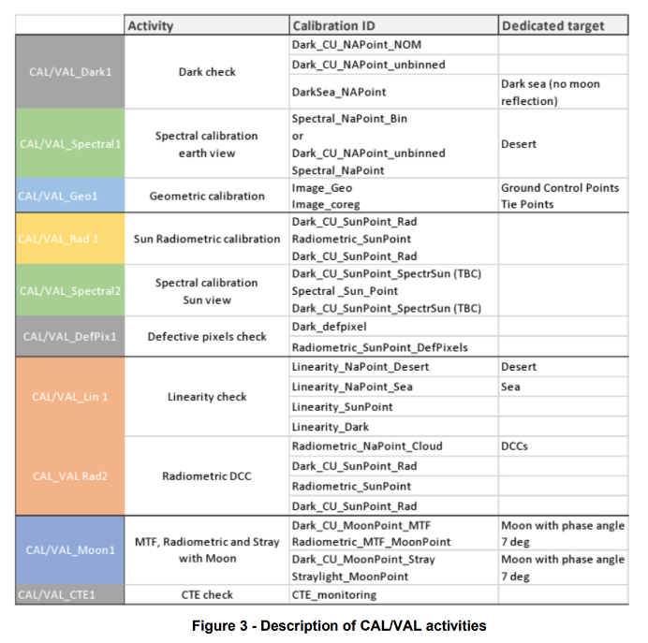
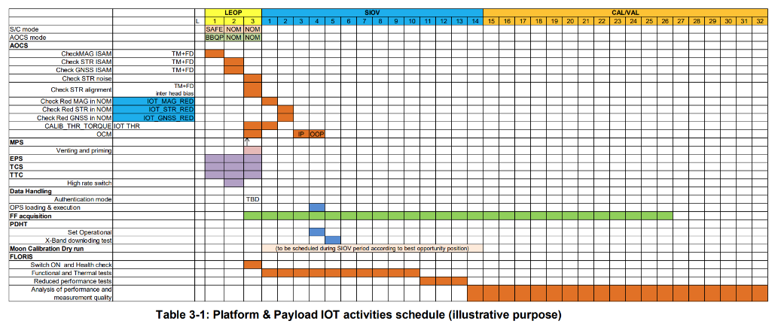
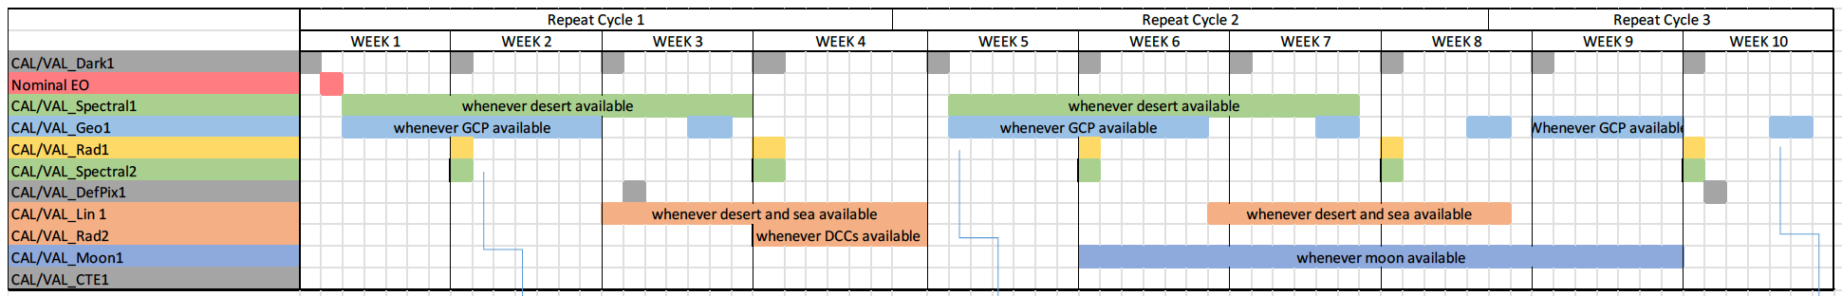
FLEX Commissioning Phase
Detailed Activties Planning is in progress …

Slide 14
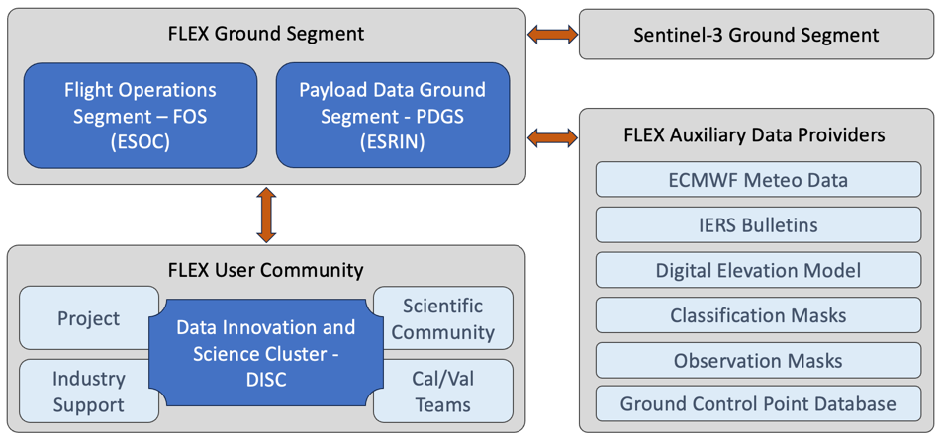
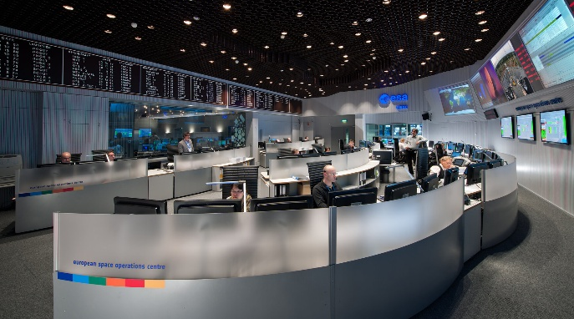
Ground Segment
Flight Operations Segment, FOS: System Validation Tests successfully completed; confirming the operability of the satellite from the ESOC control room. All FOS elements developments ongoing and progressing nominally.
Payload Data Ground Segment, PDGS: Level-0 and L1b processor installed. Nominal progress on all PDGS subsystems, eg. Mission Planning Facility, Archiving and Dissemination functions, etc.
DISC: includes Level-2 Prototype and Operational Processors development. Nominal progress on DISC subsystems and Collaborative Platform. Focus and challenge is on L2 processor performances.
Notes:
PDGS subsystems: Data Archiving, Mission Planning facility

Slide 15
Milestones and Outlook
Major Project Development Milestones
Satellite Activities Outlook
FLORIS Instrument Development Kick-Off Sept-2016
Mission System Requirements Review (M-SRR) Nov-2016
Instrument Requirements Review (IRR) May-2017
Instrument Preliminary Design Review (PDR) Sept-2018
Start of Instrument C/D phase & S/C Prime Dec-2018
Satellite Preliminary Design Review (PDR) Dec-2019
Instrument and Satellite Critical Design Review (CDR) Mar-2022
Science Readiness Assessment (SRA) April-2023
Start of Platform Assembly, Integration & Test Oct-2023
Ground Segment CDR May-2024
Mission Critical Design Review (M-CDR) Dec-2024
Instrument delivery for satellite assembly July-2025
Satellite Qualification and Acceptance Review (QAR) April-June 2026
Launch Sept. 2026
In-Orbit Commissioning Review end-2026
2025
FLORIS calibration campaign @ CSL
Kick-Off Launcher Review (PMAR) in April
FLORIS delivery and mounting on satellite platform
Start Satellite qualification test campaign
2026
Completion of Satellite AIT campaign (April)
Satellite Qualification Review
FLEX Satellite ready for launch
FLEX Launch Campaign & Launch
FLEX Commissioning (3 months)
In-Orbit Commissioning Review

Slide 16
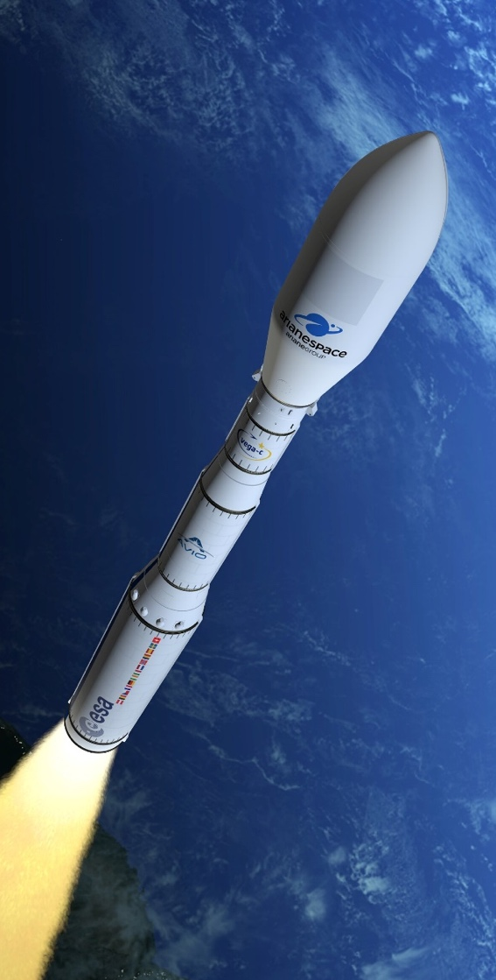
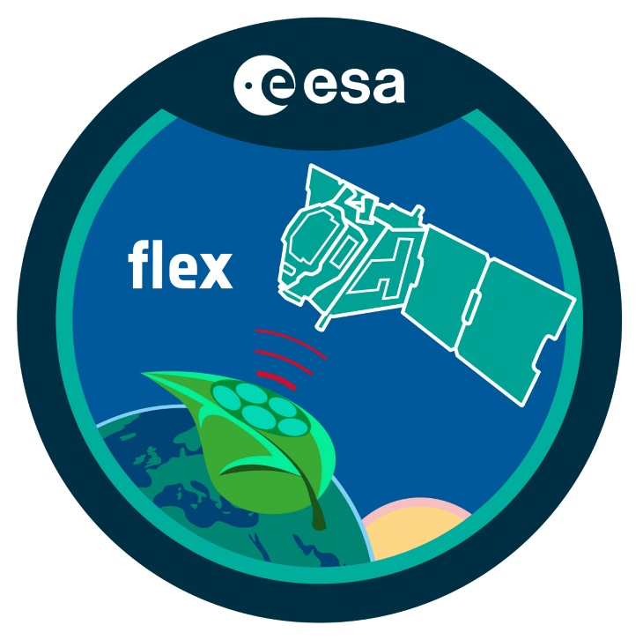

Thank you for your attention !
https://www.esa.int/Applications/Observing_the_Earth/FutureEO/FLEX

