Slide 1
JULES-SIF V1.0
Tristan Quaife and Natalie Douglas University of Reading and National Centre for Earth Observation
Patrick McGuire University of Reading and National Centre for Atmospheric Science

Slide 2
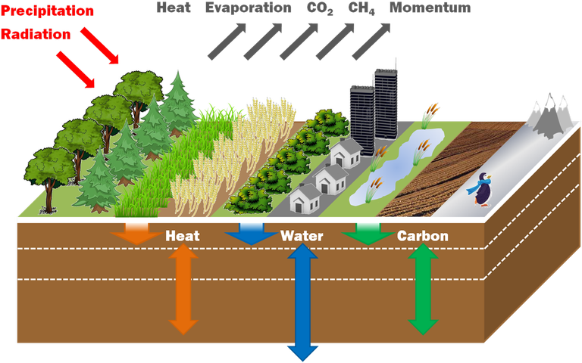
JULES – The Joint UK Land Environment Simulator
LSM of the UK Met Office, includes significant community input
Part of UK NWP operations and climate models including UKESM
Sellers two-stream model for canopy radiative transfer
Farquhar or Collatz for GPP
Simulations in this presentation forced by off-line meteorology
Tristan Quaife | t.l.quaife@reading.ac.uk | University of Reading

Slide 3

JULES-SIF schematic
Fluoresced photons at required wavelength
Canopy-leaving SIF
Environmental data
Absorbed photons, electron transport, leaf temperature
JULES
Leaf level SIF model
L2SM-SIF
Tristan Quaife | t.l.quaife@reading.ac.uk | University of Reading

Slide 4
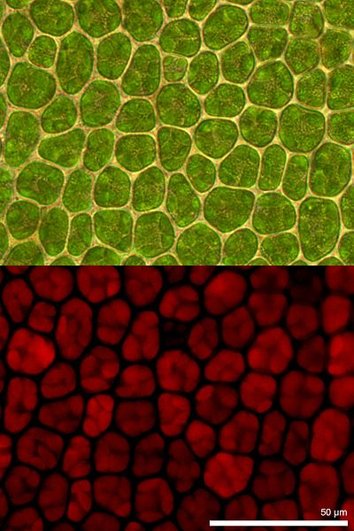
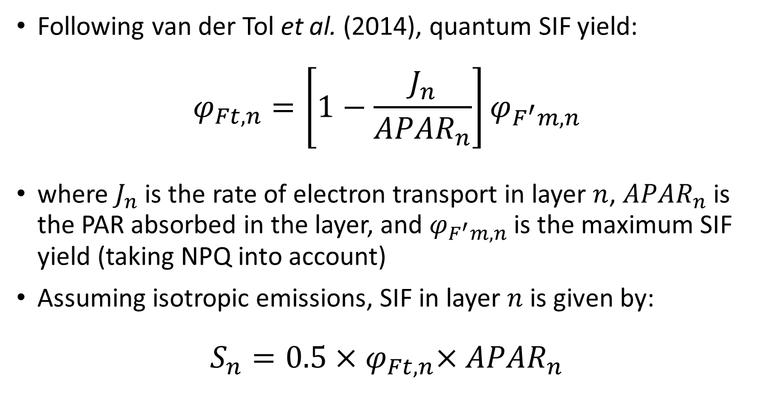
Leaf scale SIF model – total SIF emission
Following van der Tol et al. (2014), quantum SIF yield:
$$φ_{Ft,n}=\left[1−\frac{J_{n}}{{APAR}_{n}}\right]φ_{F^{′}m,n}$$
where $J_{n}$ is the rate of electron transport in layer $n$, ${APAR}_{n}$ is the PAR absorbed in the layer, and $φ_{F^{′}m,n}$ is the maximum SIF yield (taking NPQ into account)
Assuming isotropic emissions, SIF in layer $n$ is given by:
$$S_{n}=0.5{×φ}_{Ft,n}×{APAR}_{n}$$
Dietzel65 [CC BY-SA 4.0], Wikimedia Commons
Tristan Quaife | t.l.quaife@reading.ac.uk | University of Reading

Slide 5
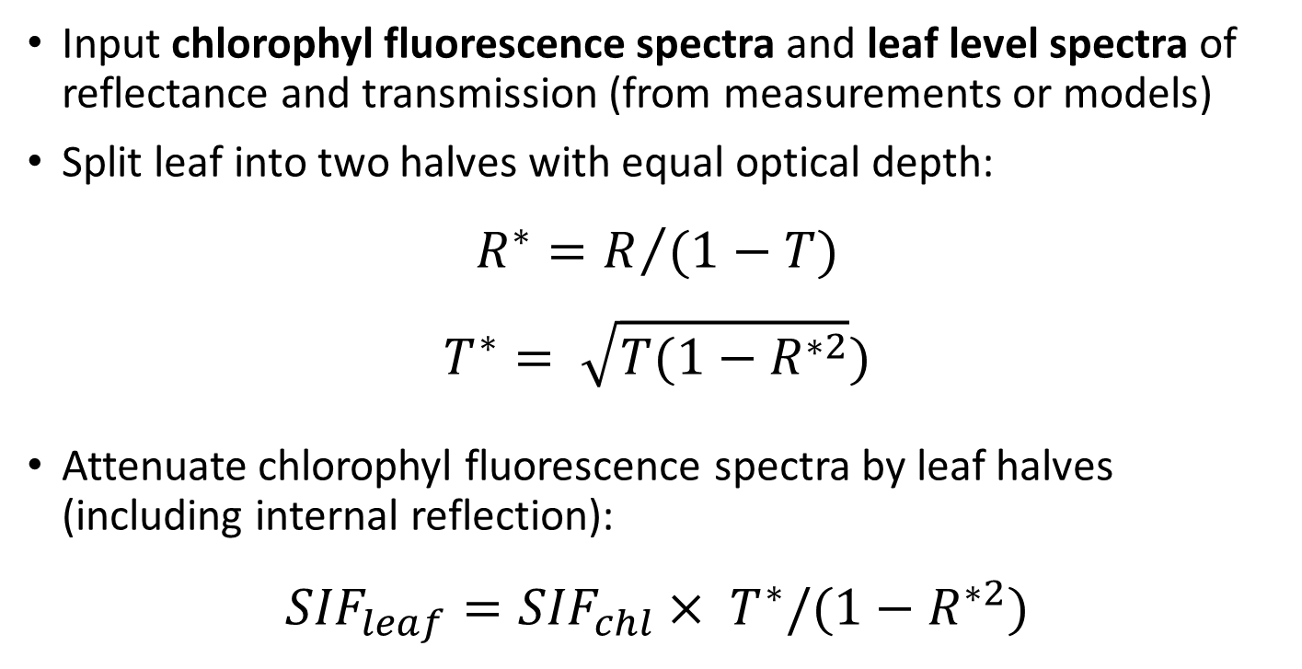
Leaf scale SIF – spectral model
Input chlorophyl fluorescence spectra and leaf level spectra of reflectance and transmission (from measurements or models)
Split leaf into two halves with equal optical depth:
$$R^{∗}=R/{(1−T)}$$
$$T^{∗}= \sqrt{T(1−R^{∗2}})$$
Attenuate chlorophyl fluorescence spectra by leaf halves (including internal reflection):
$${SIF}_{leaf}={SIF}_{chl}× T^{∗}/(1−R^{∗2})$$
Tristan Quaife | t.l.quaife@reading.ac.uk | University of Reading

Slide 6
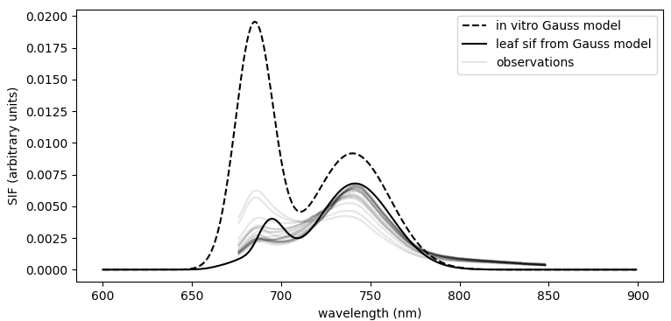
Leaf scale SIF – spectral model example
Caused by too strong chlorophyll absorption
Tristan Quaife | t.l.quaife@reading.ac.uk | University of Reading

Slide 7
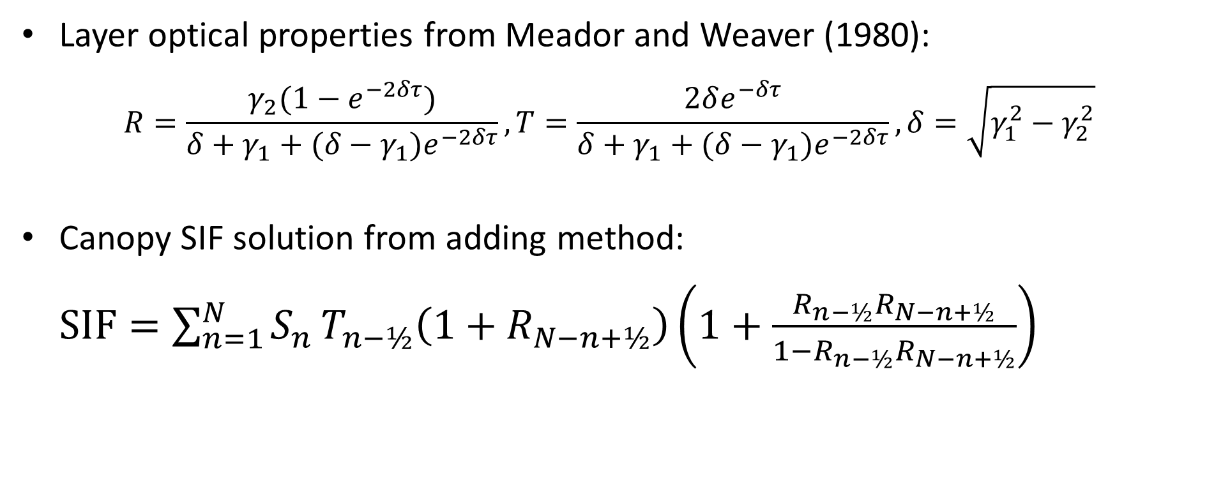
Two-stream canopy scale SIF model – L2SM
Layer optical properties from Meador and Weaver (1980):
$$R=\frac{γ_{2}(1−e^{−2δτ})}{δ+γ_{1}+{(δ−γ_{1})e}^{−2δτ}}, T=\frac{2δe^{−δτ}}{δ+γ_{1}+{(δ−γ_{1})e}^{−2δτ}}, δ=\sqrt{γ_{1}^{2}−γ_{2}^{2}}$$
Canopy SIF solution from adding method:
$SIF=\sum_{n=1}^{N}{S_{n}}T_{n−½}\left(1+R_{N−n+½}\right)\left(1+\frac{R_{n−½}R_{N−n+½}}{1−R_{n−½}R_{N−n+½}}\right)$
Quaife, T.L., 2025. A two stream radiative transfer model for vertically inhomogeneous vegetation canopies including internal emission. Journal of Advances in Modeling Earth Systems, 17(5)
Tristan Quaife | t.l.quaife@reading.ac.uk | University of Reading

Slide 8
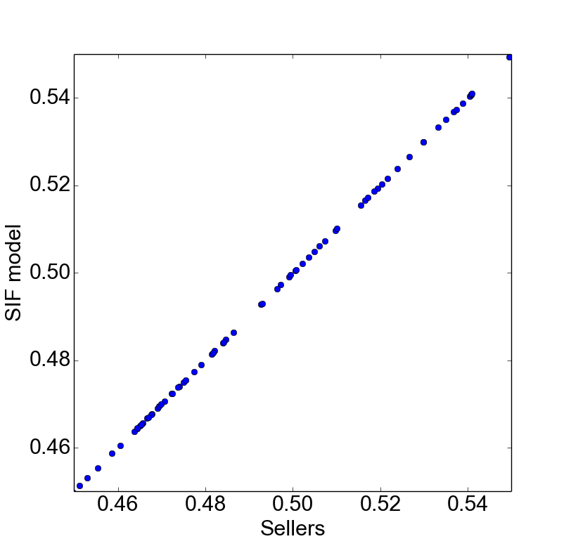
Two-stream canopy scale SIF model – L2SM
Contribution from SIF emitted upward from layer
Contribution from SIF emitted downward from layer
Treats all orders of scattering
Predicts outgoing hemispheric flux
Consistent with the Sellers model:
n-½ layers
n^{th} layer
N-n+½ layers
Tristan Quaife | t.l.quaife@reading.ac.uk | University of Reading

Slide 9

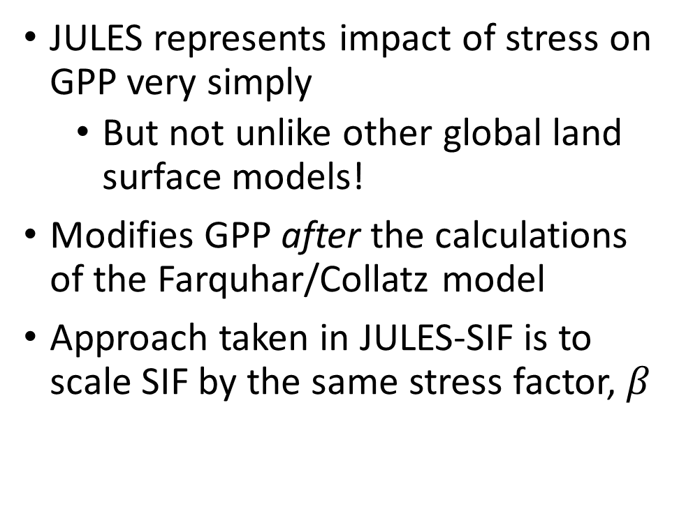

JULES water stress model applied to SIF
JULES represents impact of stress on GPP very simply
But not unlike other global land surface models!
Modifies GPP after the calculations of the Farquhar/Collatz model
Approach taken in JULES-SIF is to scale SIF by the same stress factor, $β$
1
Stress factor, $β$
0
dry
wilt
crit
sat
Soil moisture
$$SIF= β×{SIF}_{pot}$$
Tristan Quaife | t.l.quaife@reading.ac.uk | University of Reading

Slide 10
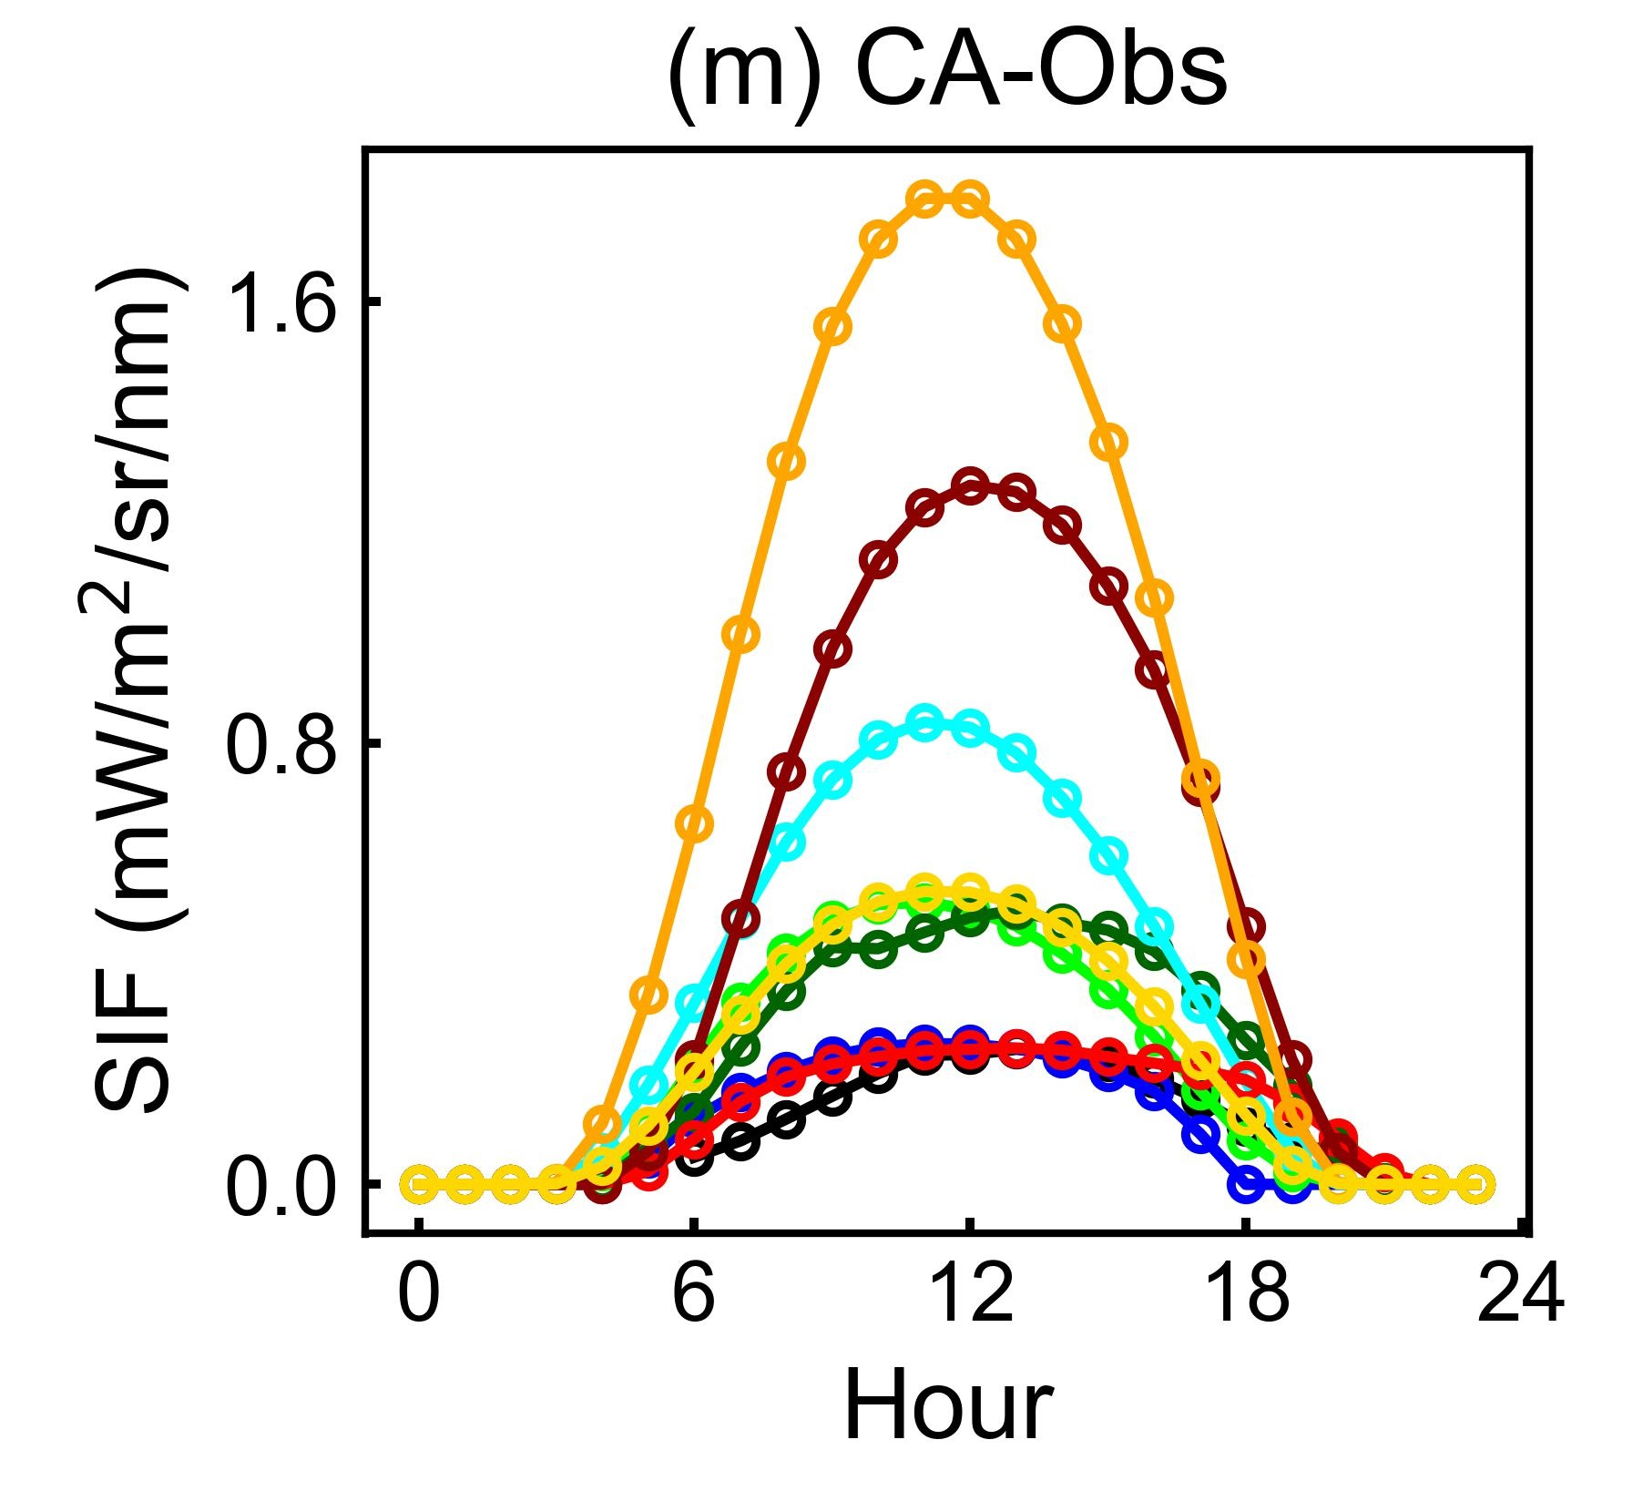
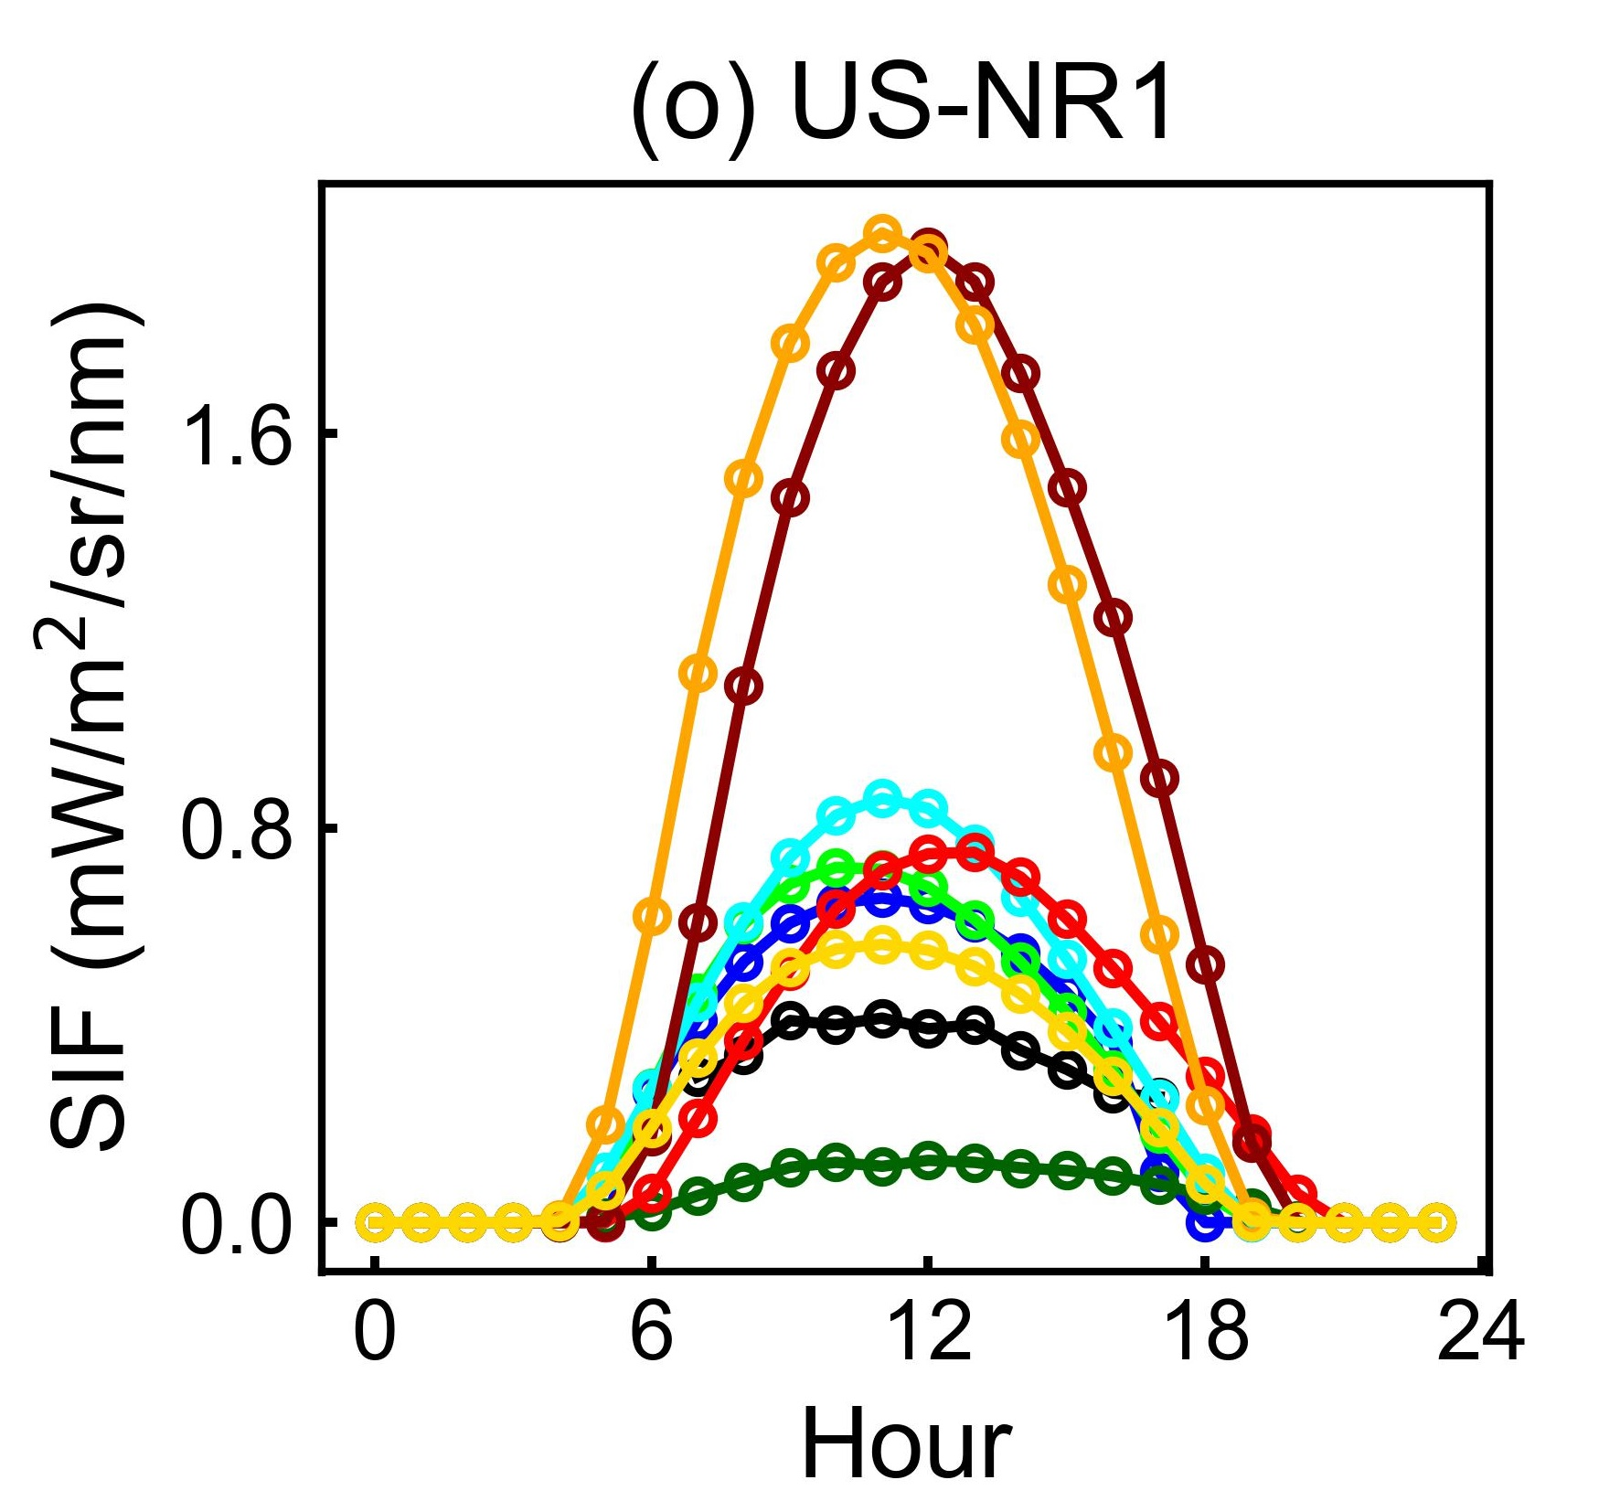
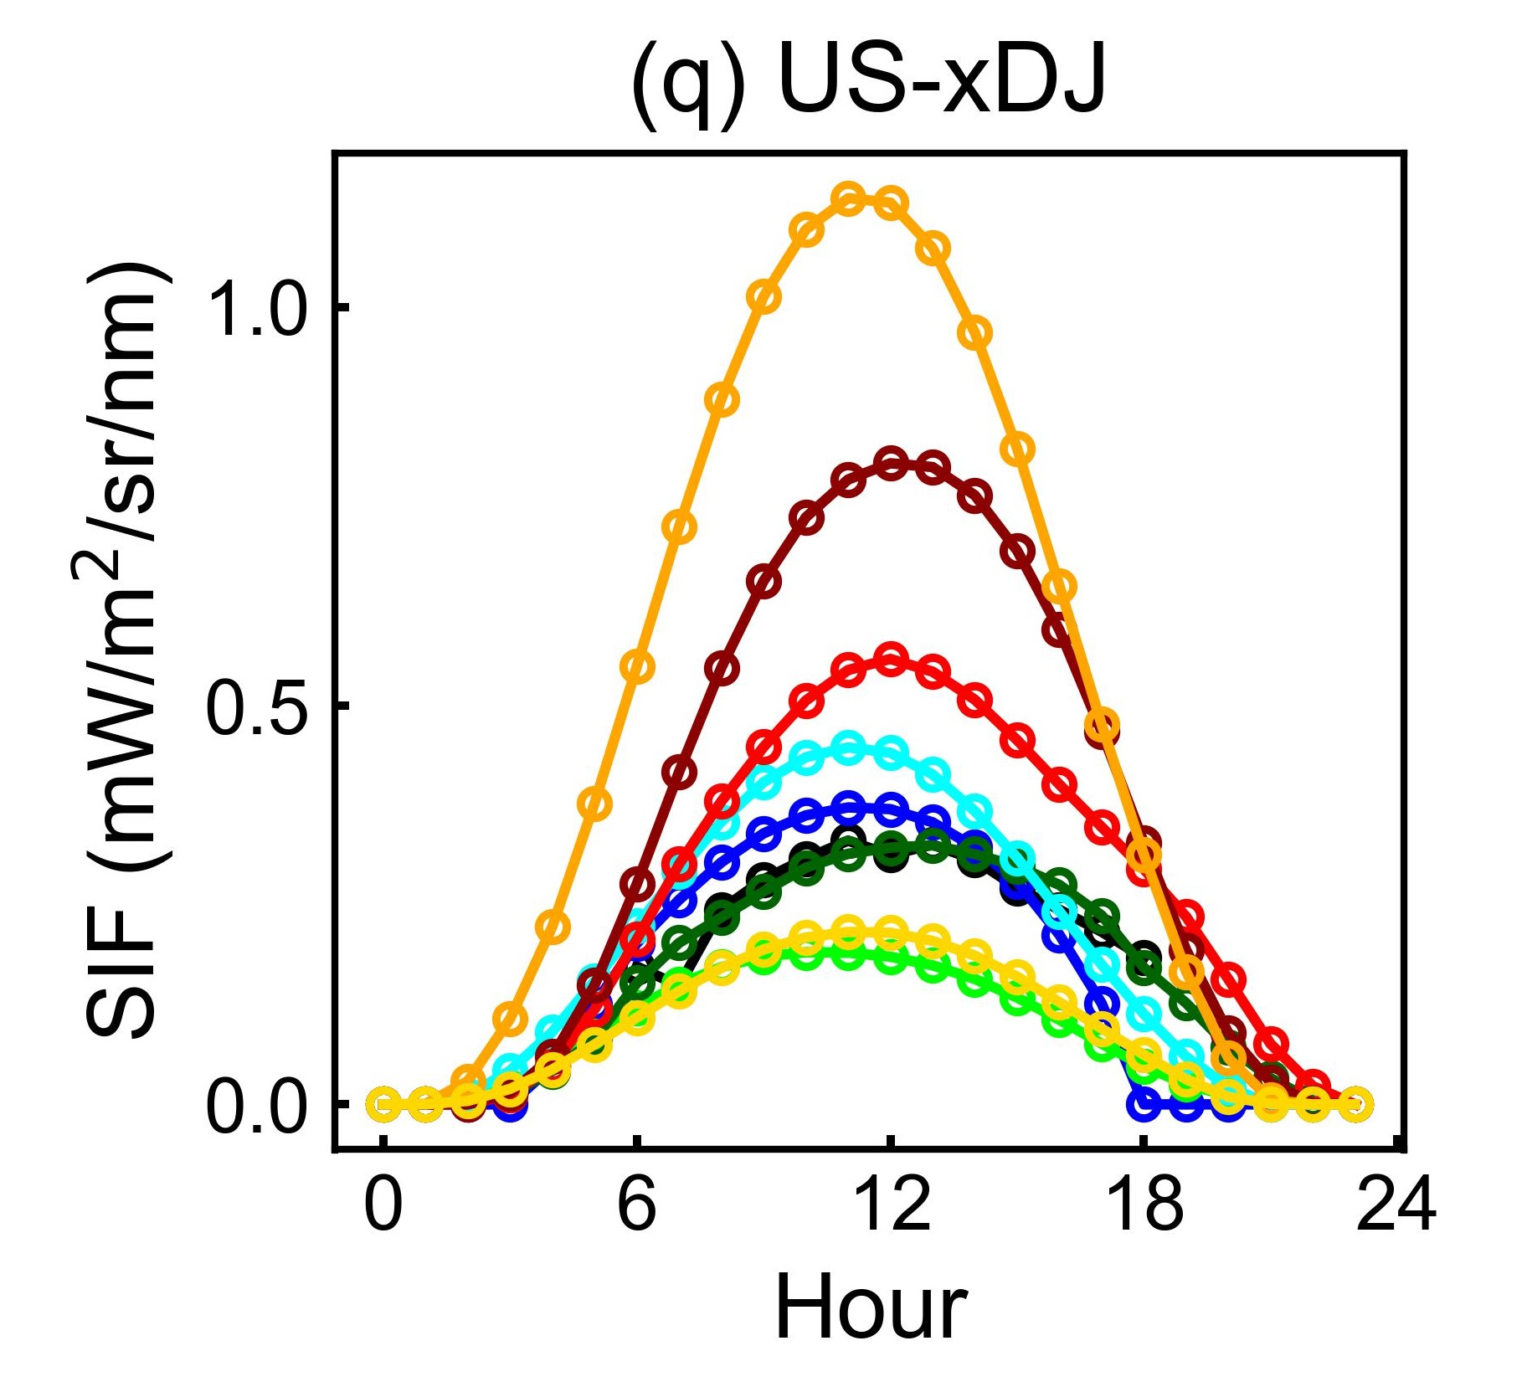
SIFMIP – JJA mean diurnal cycle
Tristan Quaife | t.l.quaife@reading.ac.uk | University of Reading

Slide 11
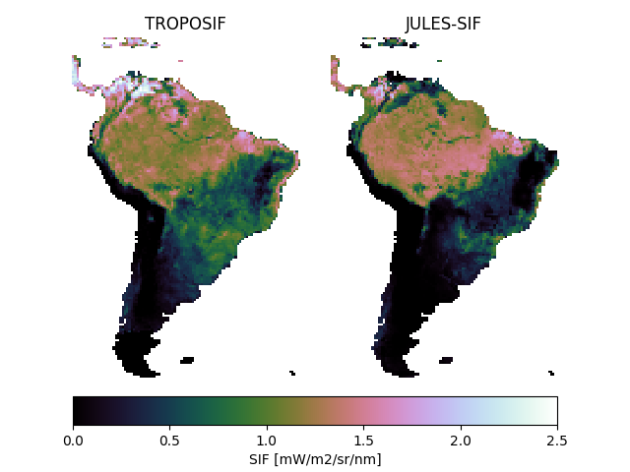
SIF 740nm June 2019
Amazon dry season
Magnitudes reasonable
JULES overestimates in rainforest
JULES underestimates in the Cerrado…
…and Pantanal
Tristan Quaife | t.l.quaife@reading.ac.uk | University of Reading

Slide 12
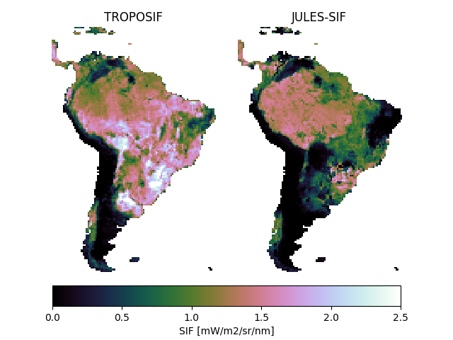
SIF 740nm January 2019
Amazon wet season magnitudes not as good
JULES doesn’t capture gradient in the rainforest
JULES remains too low in the Cerrado
JULES SIF in the Pantanal almost zero
Tristan Quaife | t.l.quaife@reading.ac.uk | University of Reading

Slide 13
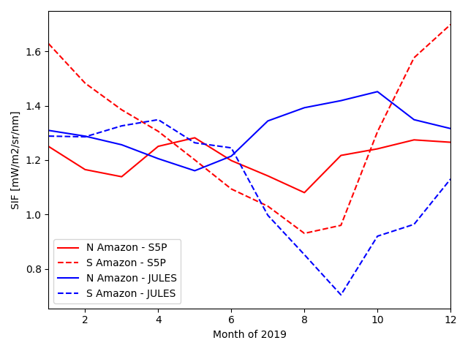
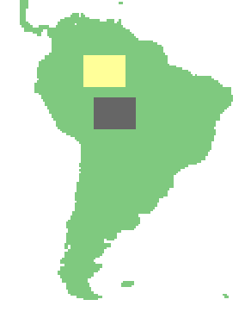
SIF 740nm 2019
Tristan Quaife | t.l.quaife@reading.ac.uk | University of Reading

Slide 14
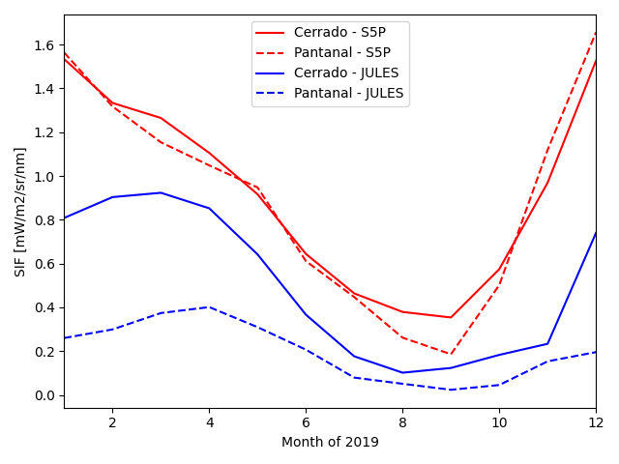
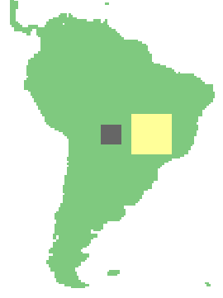
SIF 740nm 2019
Tristan Quaife | t.l.quaife@reading.ac.uk | University of Reading

Slide 15
Conclusions
JULES-SIF V1.0 code now available
Can be implemented for other models
Consistent with Sellers RT model
Includes spectral model, NPQ, and accounts for multiple scattering
Capable of highlighting shortcomings in JULES (e.g. modelling of Pantanal)
Currently working on (V1.1):
Angular signal (including hotspot)
Sunlit/shaded leaf separation

Slide 16
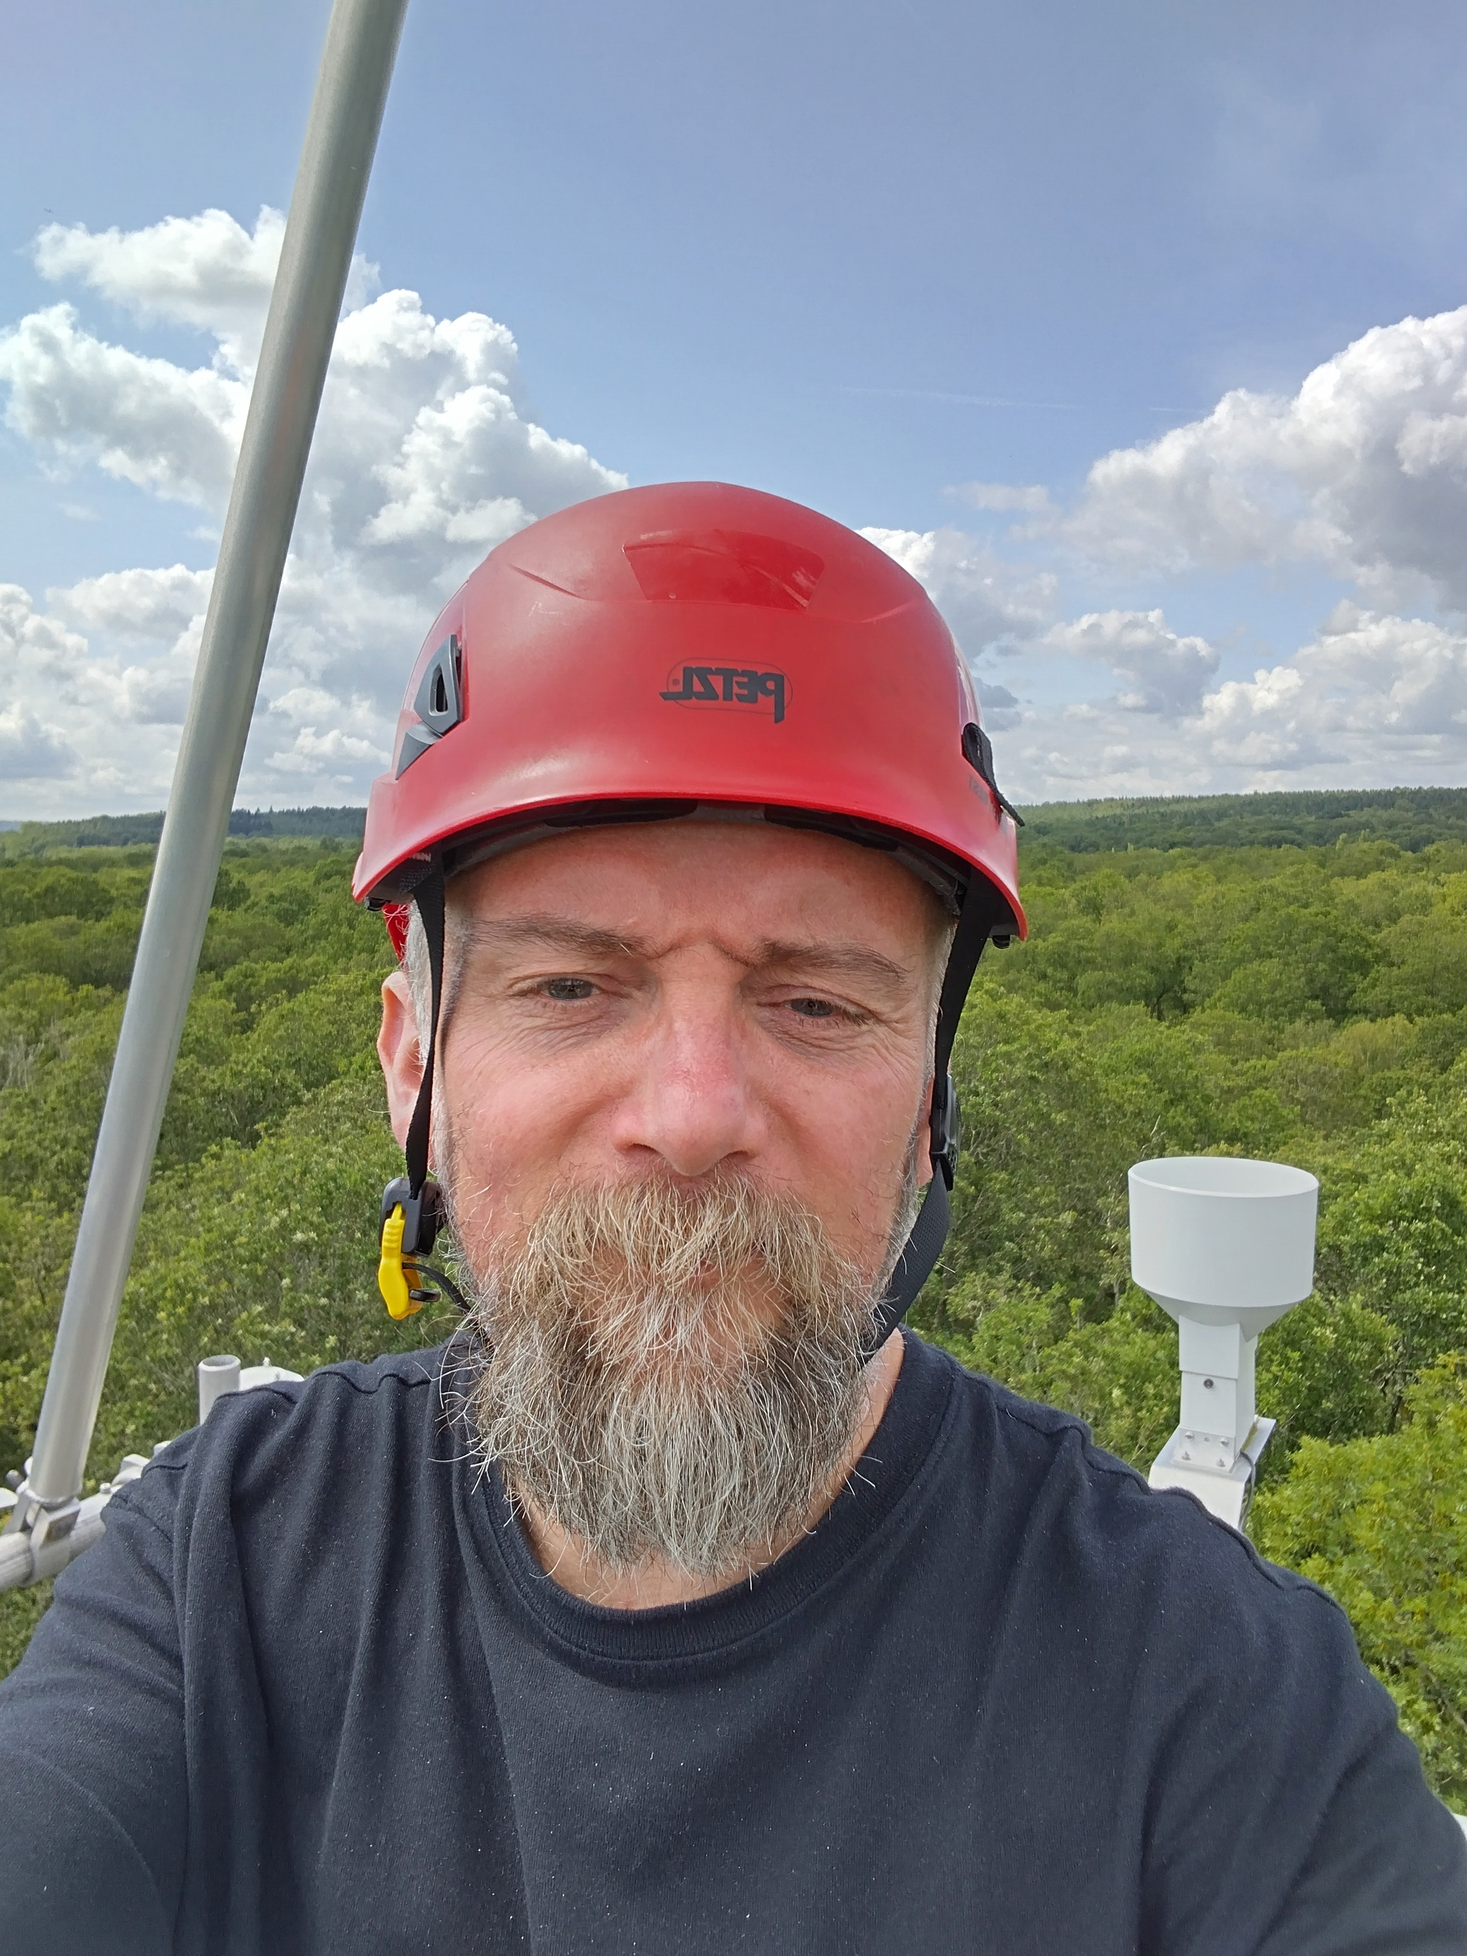
Thanks!
t.l.quaife@reading.ac.uk
JULES-SIF development funded by:
UKRI NCEO International Science Programme (NE/X006328/1)
NERC SPLICE (NE/W006596/1)
Horizon Europe EXPECT (101137656)

