Slide 1


Validation of FLEX Level-2 Biophysical Products Approaches and Current Status
B. Siegmann, C. van der Tol, E. Prikaziuk, J. Bendig, D. Herrera, H. Jiang, D. Pla Guerrero, U. Rascher, T. Julitta, G. Tagliabue, M. Rossini, P. De Vis, M. Celesti, D. Schüttemeyer, M. Tudoroiu,
A. Mahmoodi, R. Colombo

Slide 2
L2 Biophysical and Photosynthesis-related Products
Traditional biophysical variables | Novel photosynthesis-related variables
Leaf area index (LAI) Fraction of absorbed photosynthetically active radiation (fAPAR) Leaf chlorophyll content (LCC) Leaf carotenoid content (LCARC) | Absorbed photosynthetically active radiation by chlorophyll (APAR_{chl}) Fluorescence quantum efficiency (FQE) Electron transport rate (ETR) Reversible energy dissipation (RED) Fluorescence escape probability in sensor direction (f_{esc})
4 products
5 products

Slide 3
Validation categories and tools
Category A (direct)
Comparison of satellite
data with in-situ
measurements
Category B (indirect)
Indirect validation through
numerical inversion of RTMs
Category C (indirect)
Inter-comparison with space
products
Categories
LAI
fAPAR
LCC
LCARC
FQE
RED
ETR
LAI
fAPAR
LCC
LCARC
APAR_{chl}
f_{esc}
FQE (if SIF is available)
LAI
fAPAR
Traditional
Products
Novel
‘L2_LAI_network’
‘L2_fAPAR_network’
‘L2_LAI_campaign’
‘L2_fAPAR_campaign’
‘L2_LCC_campaign’
‘L2_LCARC_campaign’
‘L2_FQE_campaign’
‘L2_RED_campaign’
‘L2_ETR_campaign’
‘L2_Veg_RTM,’
‘L2_Veg_Satellite’
Traditional
Tools
Novel
9 tools
1 tool
1 tool

Slide 4
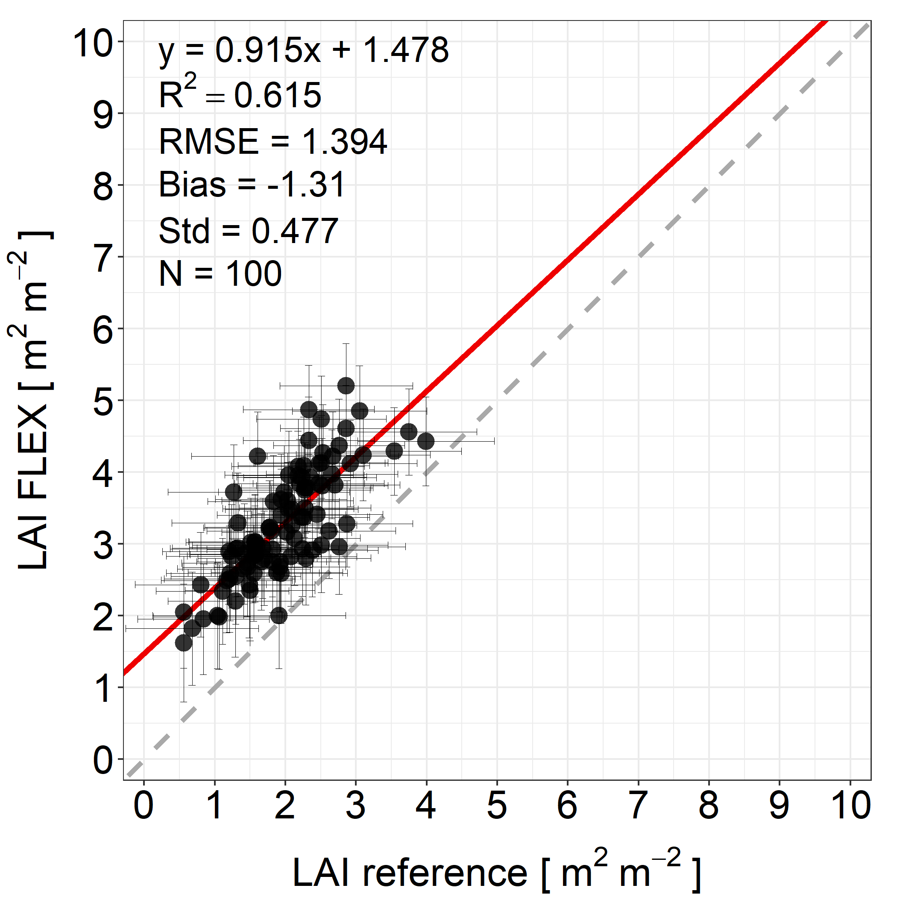
Satellite-intercomparison (Category C)
  Products available through OpenEO API and used
  in the tool ‘L2_Veg_Satellite’
CLMS
Sentinel-2
Satellite product | Spatial resolution | L2 biophys. variable
Copernicus Land Monitoring Service (CLMS) | ~ 300 m | LAI, fAPAR
Copernicus HR-VPP (only Europe) | 10 m | LAI, fAPAR, (LCC)
SNAP biophysical processor
LAI, fAPAR
LCC
  Alternative products where the same methodology
  can be applied (not included in ‘L2_Veg_Satellite’)
Matchup
Satellite product | Spatial resolution | L2 biophys. variable
ESA CCI (continuation open) | 1 km to 300 m | LAI, fAPAR, FQE
MODIS | 500 m | LAI, fAPAR
LSA SAF | 1 km | LAI, fAPAR
L2 FLEX product LAI, fAPAR, LCC
Validation report
Contact: E. Prikaziuk
Notes:
Copernicus HR-VPP = High-Resolution Vegetation Phenology and Productivity Service
EUMETSAT LSA SAF = Land Surface Analysis - Satellite Application Facility on Land Surface Analysis

Slide 5
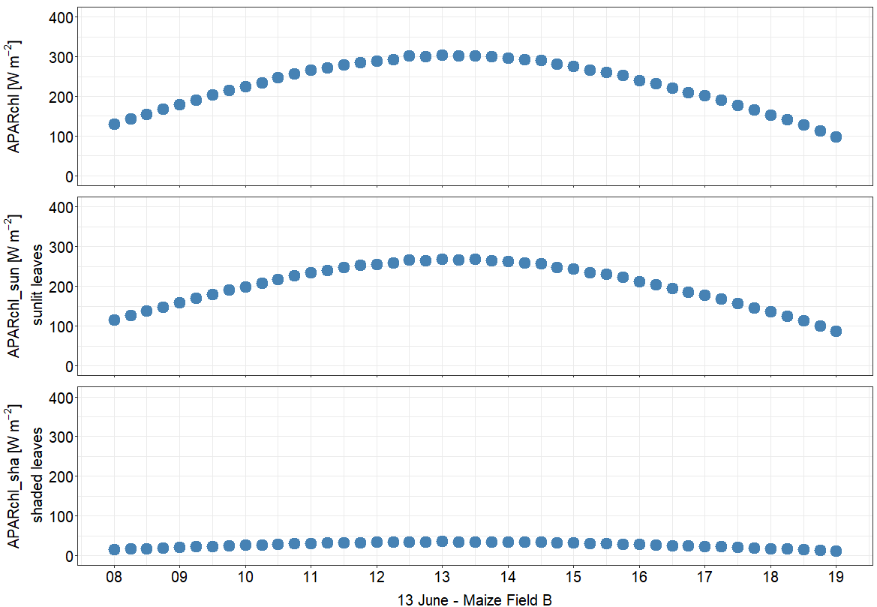
Numerical inversion of RTMs (Category B)
  Numerical inversion of the SCOPE model implemented in the tool ‘L2_Veg_RTM’
Example: Inversion of FloX data collected during FRM4FLUO
‘L2_Veg_RTM’
‘L2_Veg_RTM + SIF’
FloX
(ir)radiance
FloX
SIF spectrum
Total APAR_{chl}
RTM (SCOPE)
inversion
Scat. & reabsorp. correction
APAR_{chl} of
sunlit leaves
LAI, LCARC,
LCC (+ other)
FQE
APAR_{chl} of
shaded leaves
RTM (SCOPE)
forward
(f)APAR_{(chl)}, f_{esc} (+ other)
Matchup
Validation report
Full uncertainty propagation including instrument,
L2 reflectance and L2 SIF uncertainties
MATLAB and Octave version of the tool available
on GitHub (https://github.com/Christiaanvandertol/FLEX)
L2 FLEX product
Contact: C. van der Tol

Slide 6
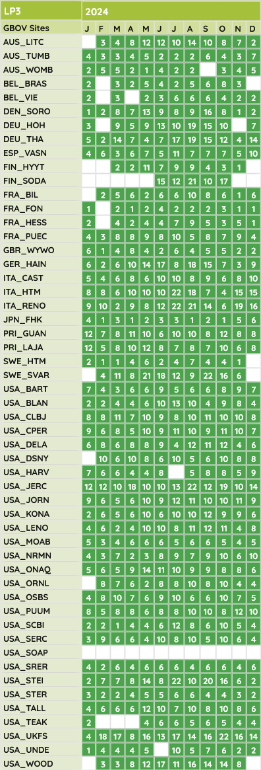
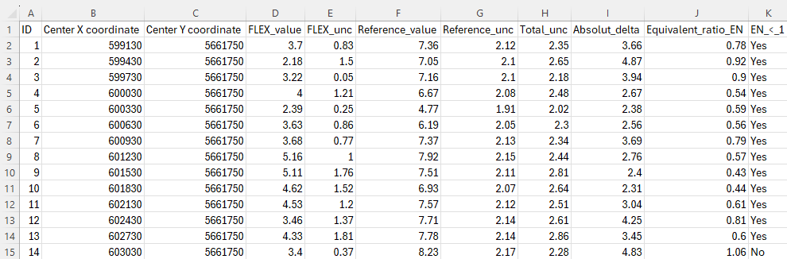
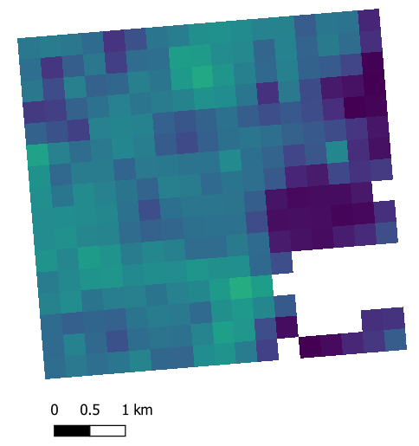
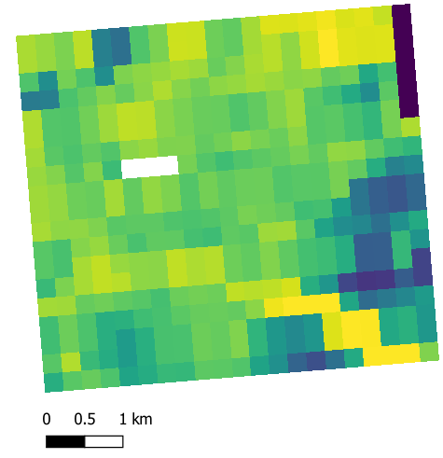
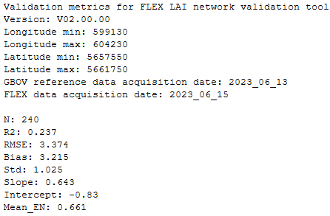
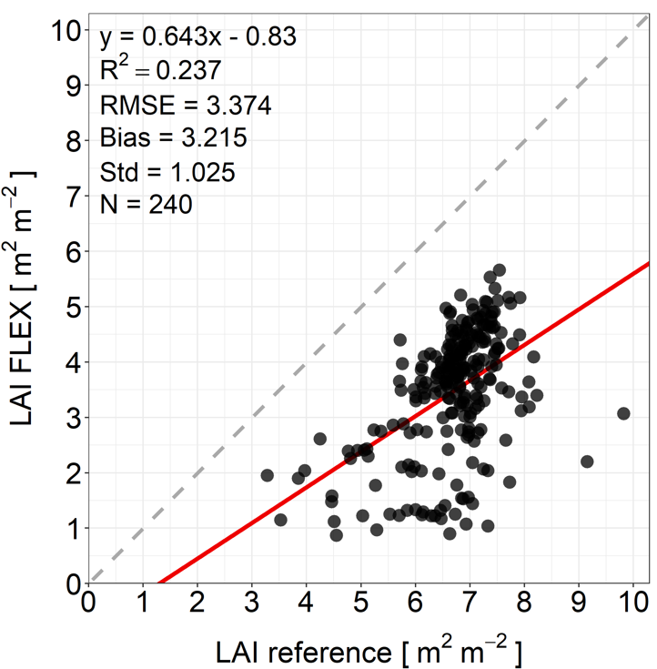




Validation with in-situ data I (Category A)
  Validation of FLEX LAI and fAPAR products using upscaled in-situ data (LP-3 and LP-4) provided by inter-national research networks (i.e., ICOS, NEON, TERN) and distributed via the GBOV service as part of CGLS
  (‘L2_LAI_network’ and ‘L2_fAPAR_network’)
Latest upscaled GBOV LAI products
Matchup table
Upscaled GBOV LAI + unc.
(ICOS-Hainich Germany)
FLEX-like LAI map + unc.
(Sentinel-3)
Validation metrics
Matchup
Validation +
Report
Scatter plot
Contact: B. Siegmann
Notes:
GBOV = Ground-Based Observations for Validation
CGLS = Copernicus Global Land Service

Slide 7
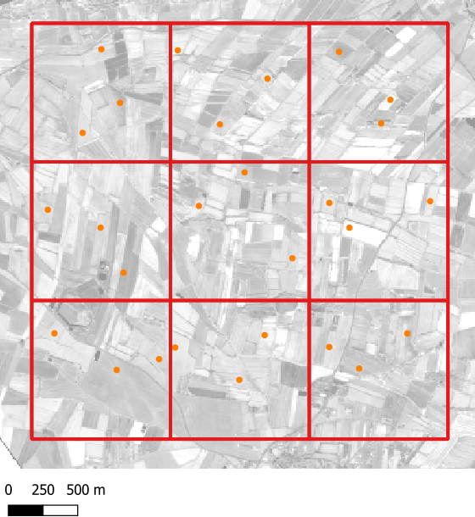
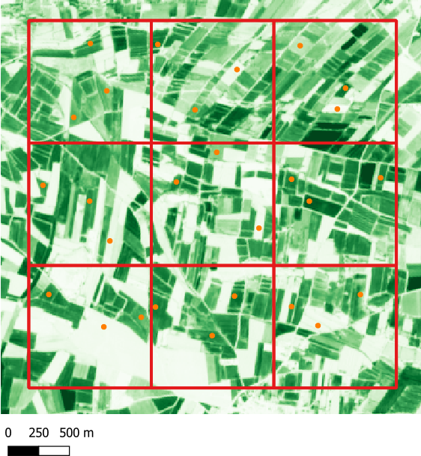
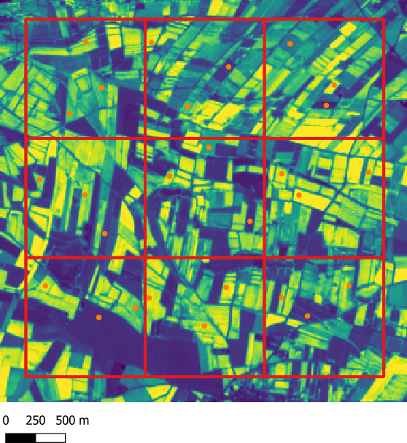
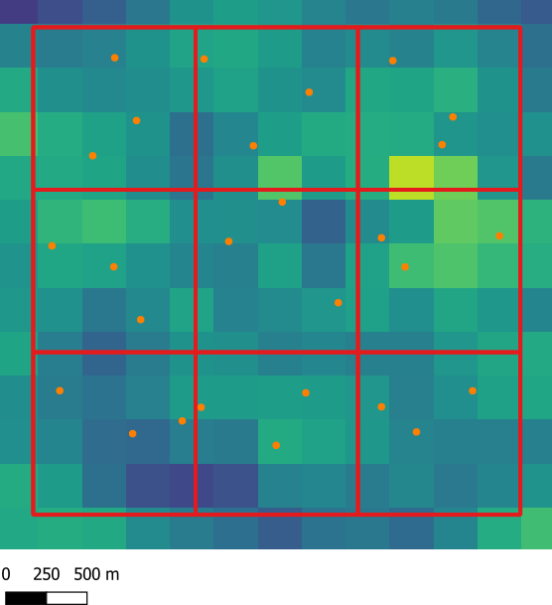
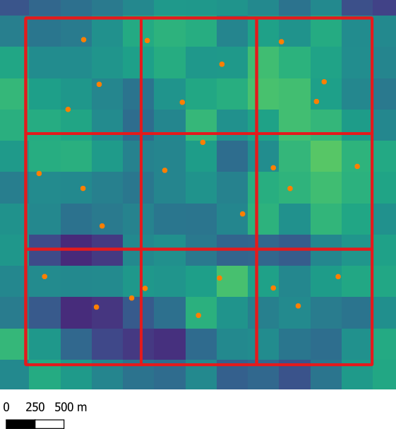
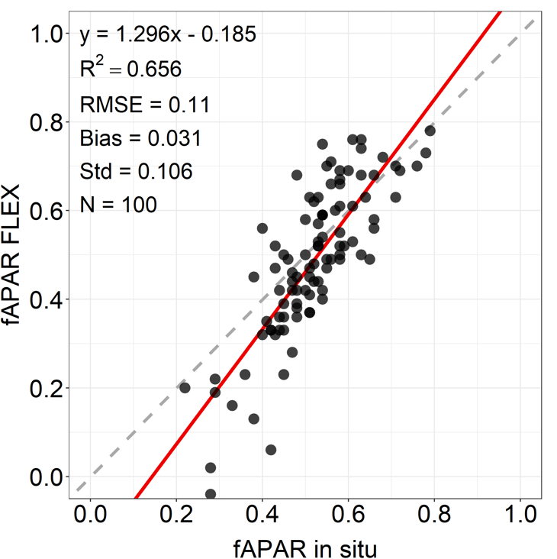
Validation with in-situ data II (Category A)
  Validation of FLEX LAI, fAPAR, LCC and LCARC products using in-situ data collected during field campaigns (‘L2_LAI_campaign’, ‘L2_fAPAR_cmapign’, ‘L2_LCC_campaign’ and ‘L2_LCARC_campaign’)
ESUs within
a FLEX 3x3 m grid
WDRVI map
based on Sentinel-2 L1C
fAPAR 10 m map
based on Sentinel-2 L1C
fAPAR 300 m map
based on Sentinel-2 L1C
FLEX fAPAR map
Deter-
mine
transfer
function
Aggre-
gation
Match-
up
Apply
transfer
function
-0.4
1
1
1
WDRVI
fAPAR [-]
fAPAR [-]
fAPAR [-]
Uncertainty propagation of the reference data including
uncertainties of the in-situ measurements and S2 L1C uncertainties
Same working principle of the four tools for the LAI, fAPAR, LCC
and LCARC validation
Matchup table
Validation metrics
Scatter plot
0
0
0
-0.8
Contact: B. Siegmann
Notes:
LAI = EVI2
fAPAR = WDRVI
LCC = Chlorophyll Index Green (CIgreen)
LCARC = Structure Intensive Pigment Index 3 (SIPI3)

Slide 8
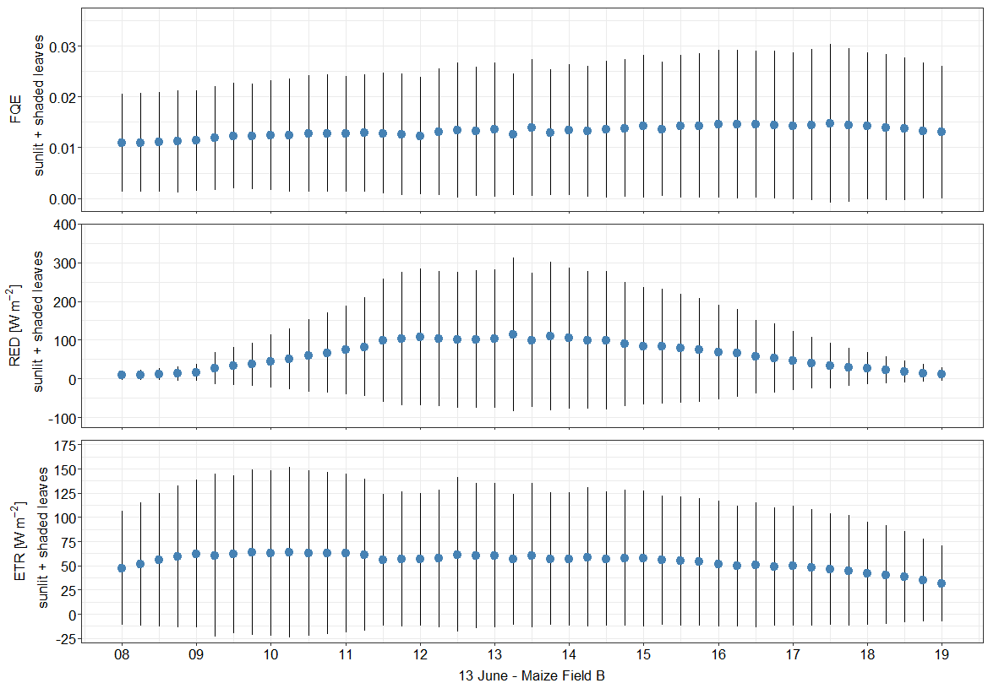
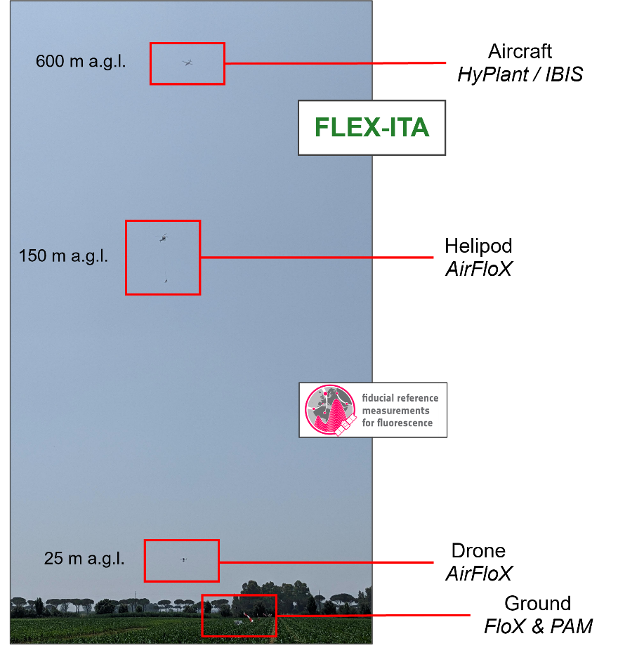
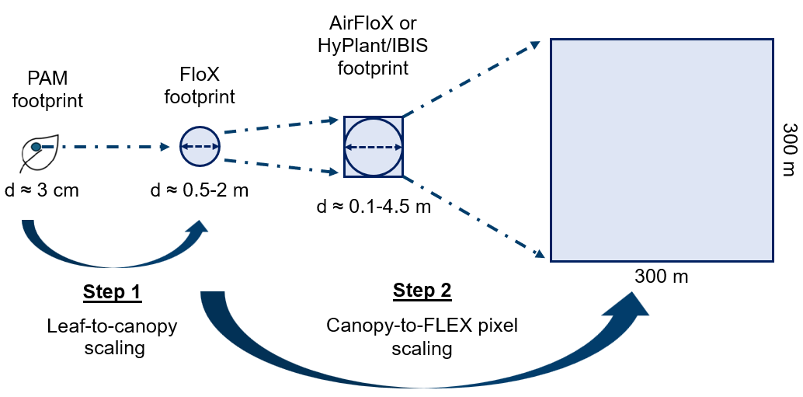



Validation with in-situ data III (Category A)
  Validation of FLEX FQE, RED and ETR products using in-situ data collected during field campaigns (‘L2_FQE_campaign’, ‘L2_RED_cmapign’ and ‘L2_ETR_campaign’)
FRM4FLUO and FLEX-ITA Field Campaign 2025
Combination of PAM
and FloX measurements
${FQE}_{sun/sha}=$ $\frac{Φ_{F}^{sun/sha} ⋅ {APAR}_{chl}^{sun/sha}}{{APAR}_{chl}^{canopy}}$
$${RED}_{sun/sha}=Φ_{N}^{sun/sha}⋅ {APAR}_{chl}^{sun/sha}$$
$${ETR}_{sun/sha}=c∙ Φ_{P}^{sun/sha}∙{APAR}_{chl}^{sun/sha}$$
Contact: B. Siegmann and C. van der Tol
Notes:
c = the photon flux efficiency of the electron transport rate ≈ 0.507
(Yin et al., 2006; Yin & Struik, 2012)

Slide 9
Summary
  Development and implementation of most validation tools are well advanced
    L2_Veg_Satellite
    L2_Veg_RTM
    L2_LAI_network and L2_fAPAR_network
    L2_LAI_campaign, L2_fAPAR_campaign, L2_LCC_campaign, L2_LCARC_campaign
  Ongoing analysis of FRM4FLUO campaign data to further develop validation tools using combined
  PAM and FloX field measurements
    L2_FQE_campaign
    L2_RED_campaign
    L2_ETR_campaign

Slide 10

Thanks for your attention!
Contact:
Bastian Siegmann (b.siegmann@fz-juelich.de)
Christiaan van der Tol (c.vandertol@utwente.nl)
Egor Prikaziuk (e.prikaziuk@utwente.nl)

