Slide 1
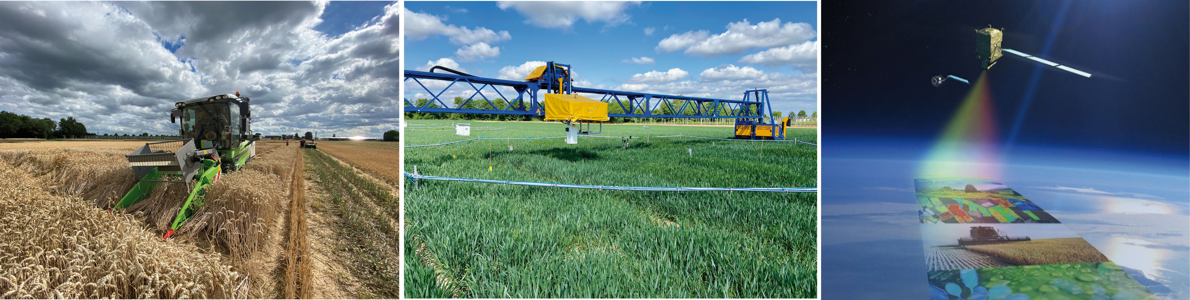
SIF to measure actual photosynthesis and vegetation stress - lessons learned from 20 years of research in preparation of the FLEX satellite mission
Uwe Rascher – Forschungszentrum Jülich, IBG-2: Plant Sciences
3. March 2026 – Bonn
Kelvin Acebron | Agarwal | Juliane Bendig | Jim Buffat | Lars Grygosch | David Herrera | Ireneusz Kleppert | Deepthi Konche | Felix Kröber | Onno Muller | Huaiyue Peng | Tony Cesar de Sousa Oliviera | Juan Quiros-Vargas | David Pla Guerrero | Patrick Rademske | Saja Salattna | Bastian Siegmann

Slide 2
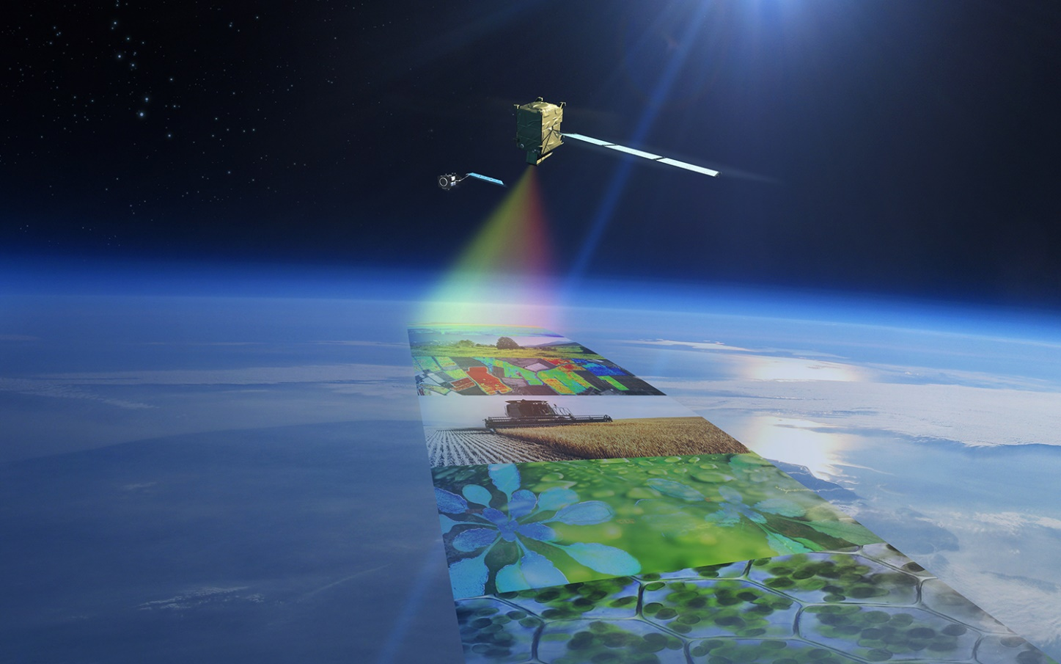

FLEX Satellite Mission will become the 8th Earth Explorer of ESA
FLEX will quantify actual photosynthetic activity of terrestrial ecosystems
FLEX will provide physiological indicators for vegetation health status
by direct measurements of vegetation fluorescence at 300x300 meters every 10-25 days

Slide 3
Vegetation Stress Detection
Early hypothesis (based on metastudy 10 years ago)
SIF has the potential to detect
Drought
Extreme temperatures (Heat & Freezing)
Biotic stress (Pests & Diseases)
Nutrient imbalance
Photo-
synthesis

Slide 4
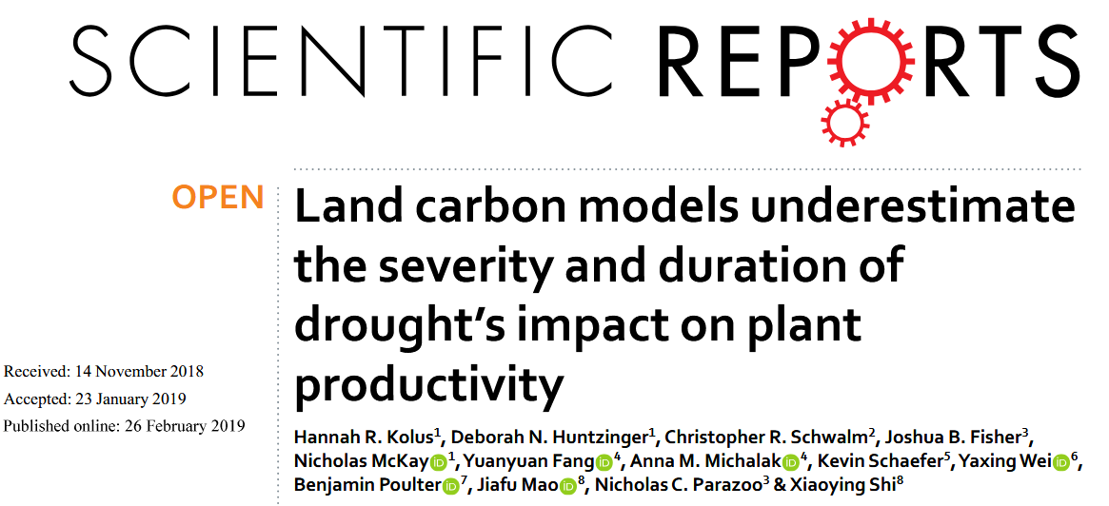
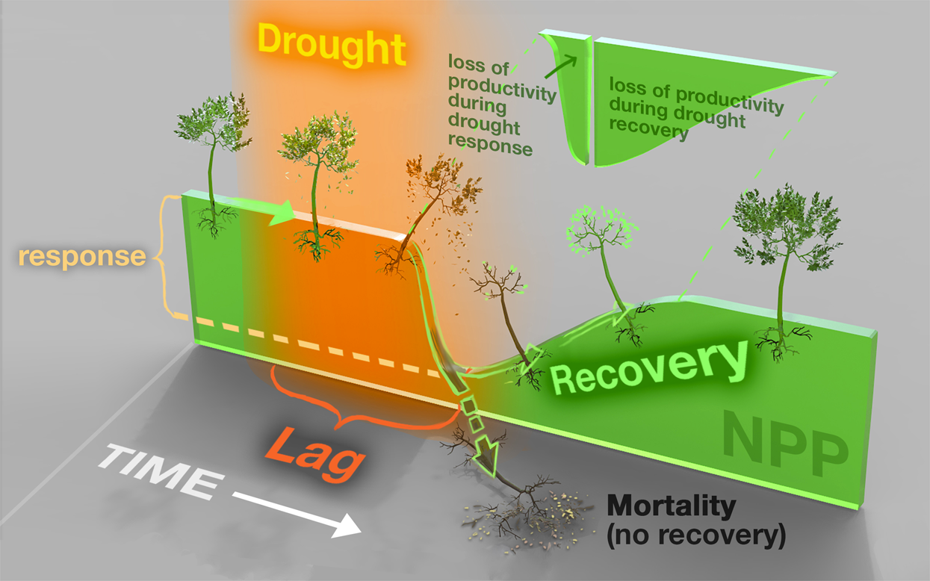
Vegetation Stress Detection – link to plant productivity
Plants almost never operate on their optimum. Dynamically changing environmental constraints limit plant photosynthesis and their capacity of carbon uptake
4

Slide 5
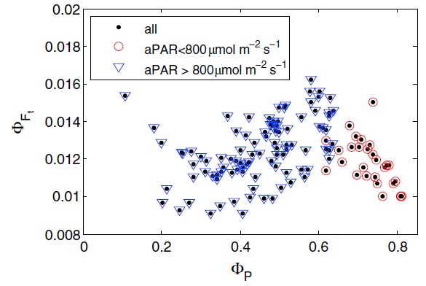
Understanding dynamic photosynthesis
Mechanistic model on the non-linear relationship between solar-induced fluorescence and actual rates of photosynthesis
Model is used to parameterize plant carbon exchange and to detect and understand vegetation stress
Severe stress / destruction
Dynamic NPQ regulation
Photosynthetic regulation
van der Tol et al. (2014) Journal Geophysical Research, 119, 2312 - 2327

Slide 6
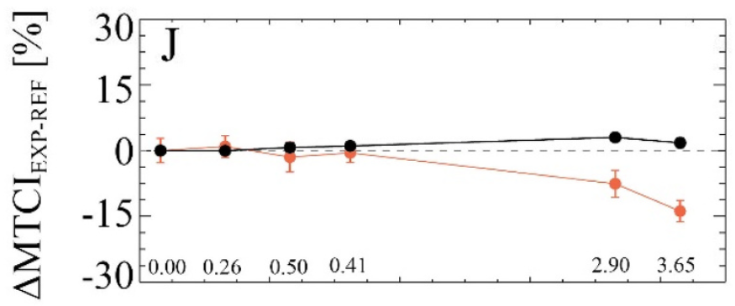
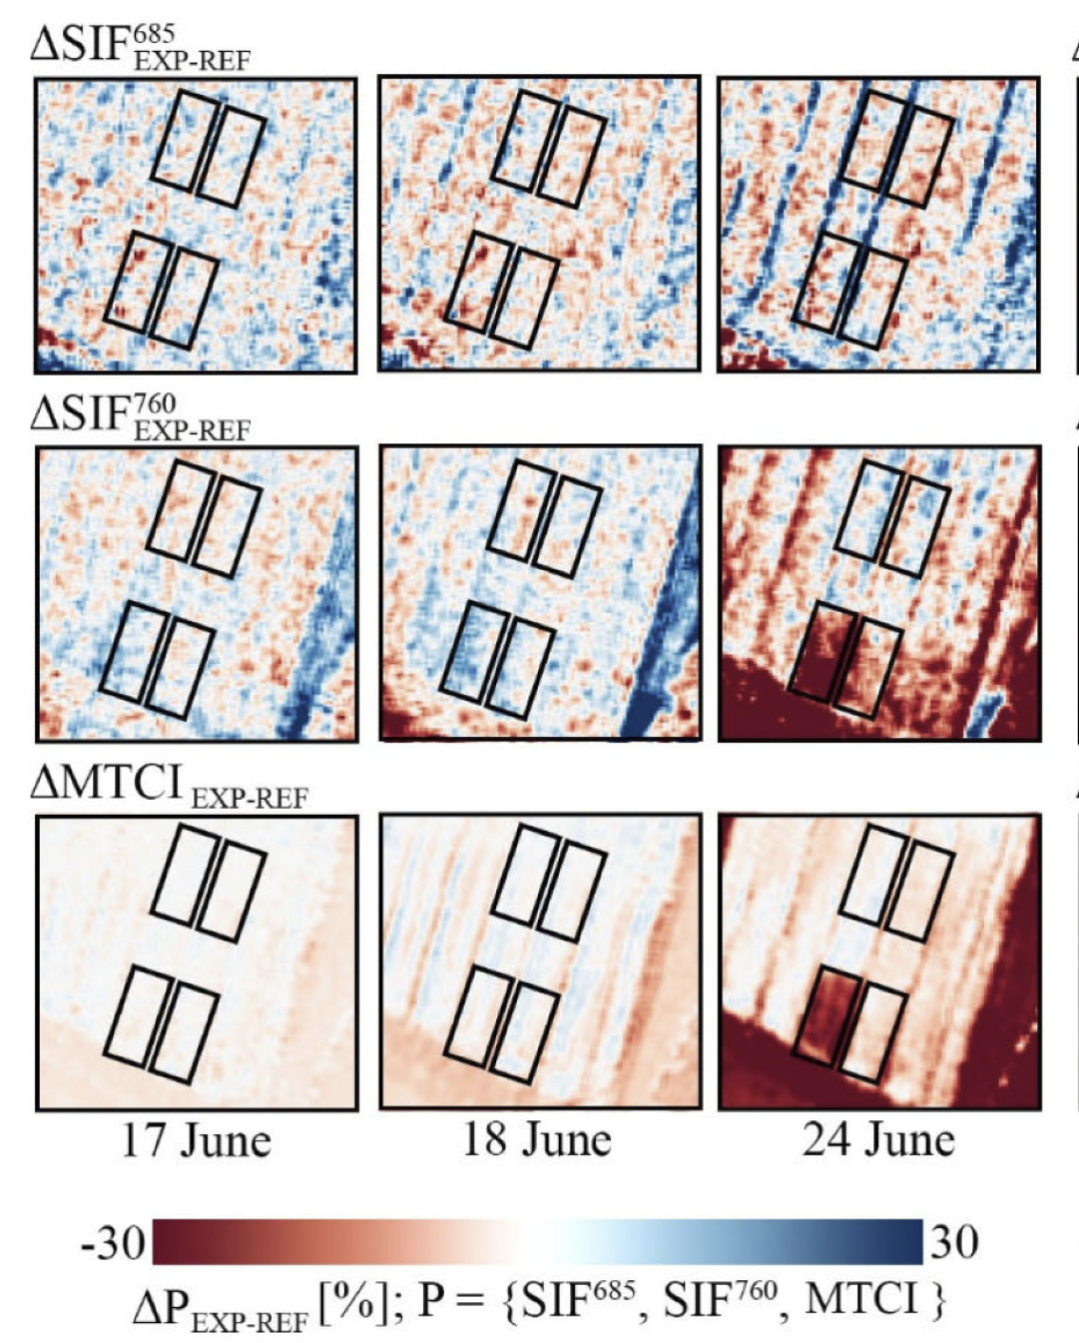
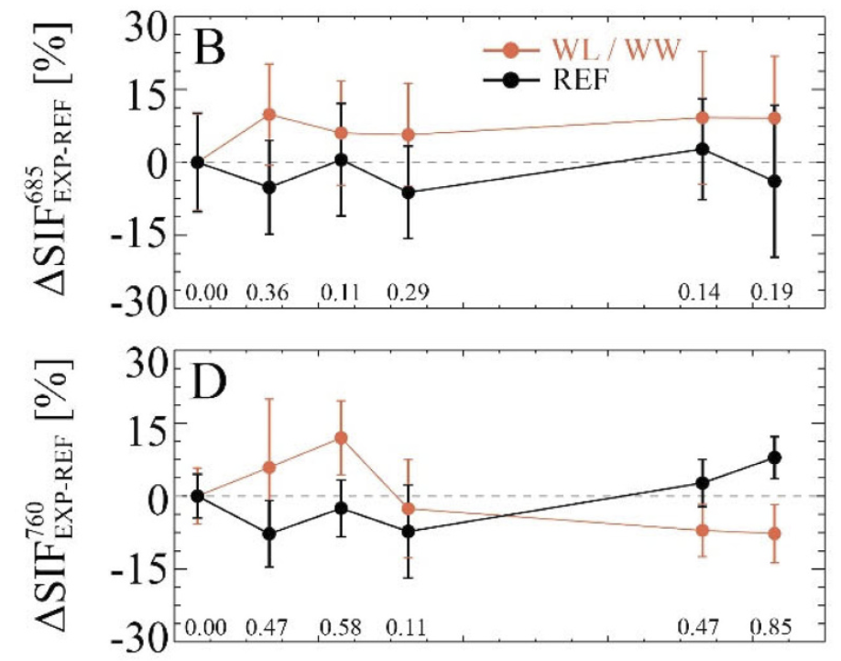
dynamic photosynthesis - Drought
Drought triggers various functional responses (stomatal closure, downregulation of photosynthesis & internal stress signaling) and affects structure and growth
Pigment
stomatal closure
pigment breakdown
Model is used to parameterize plant carbon exchange and to detect and understand vegetation stress
SIF allows the early detection of drought (limitation in soil plant available water)
van der Tol et al. (2014) Journal Geophysical Research, 119, 2312 - 2327
Damm et al. (2018) Journal of Plant Physiology, 227, 3 - 19
Damm et al. (2022) Remote Sensing of Environment, 273, artic. 112957
0 3 6 9
days within drought

Slide 7
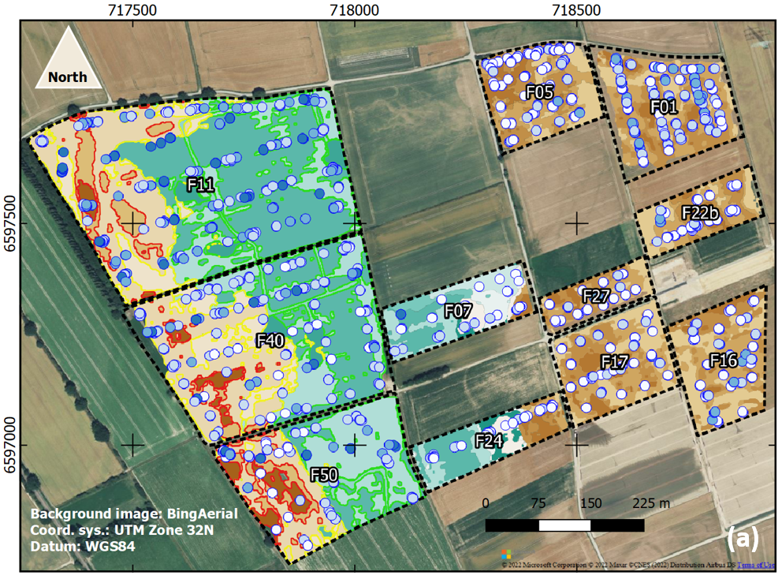
dynamic photosynthesis - Drought
Drought triggers various functional responses (stomatal closure, downregulation of photosynthesis & internal stress signaling) and affects structure and growth
Model is used to parameterize plant carbon exchange and to detect and understand vegetation stress
SIF allows the early detection of drought (limitation in soil plant available water)
van der Tol et al. (2014) Journal Geophysical Research, 119, 2312 - 2327
Damm et al. (2018) Journal of Plant Physiology, 227, 3 - 19
Damm et al. (2022) Remote Sensing of Environment, 273, artic. 112957
von Hebel et al. (2018) Geophysical Research Letters, 45, 7571-7579
Quiros-Vargas et al.(2026) Science of Remote Sensing, 13, article no. 100367, doi: 10.1016/j.srs.2026.100367​

Slide 8
dynamic photosynthesis - Drought
Drought triggers various functional responses (stomatal closure, downregulation of photosynthesis & internal stress signaling) and affects structure and growth
Model is used to parameterize plant carbon exchange and to detect and understand vegetation stress
SIF allows the early detection of drought (limitation in soil plant available water)
van der Tol et al. (2014) Journal Geophysical Research, 119, 2312 - 2327
Damm et al. (2018) Journal of Plant Physiology, 227, 3 - 19
Damm et al. (2022) Remote Sensing of Environment, 273, artic. 112957
von Hebel et al. (2018) Geophysical Research Letters, 45, 7571-7579
Quiros-Vargas et al.(2026) Science of Remote Sensing, 13, article no. 100367, doi: 10.1016/j.srs.2026.100367​

Slide 9
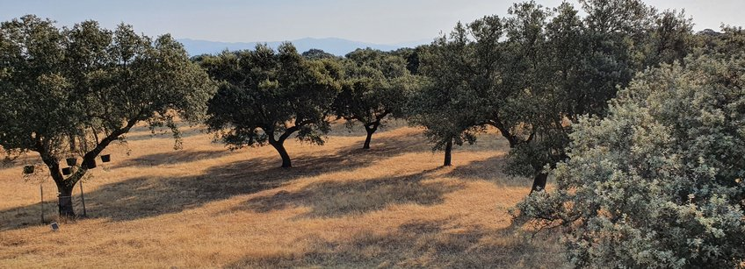
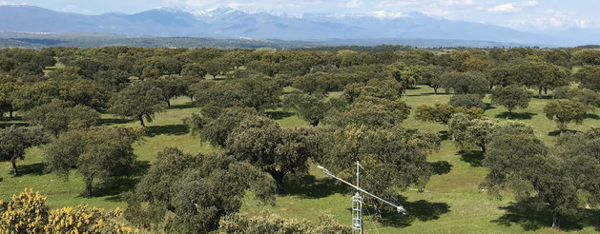
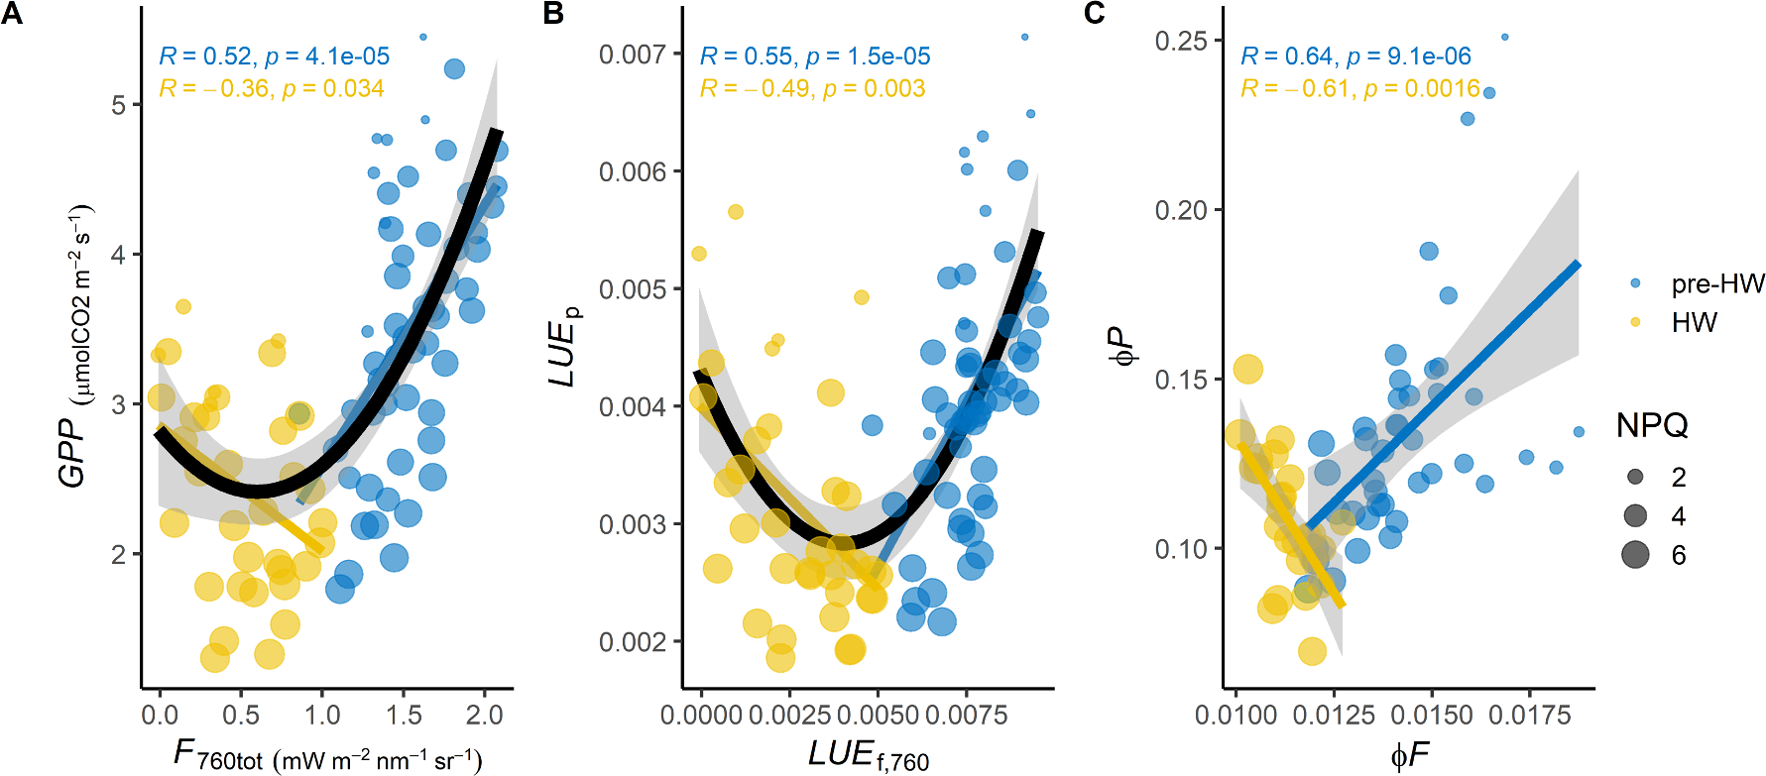
dynamic photosynthesis – extreme Temperature
Extreme temperatures have direct effect on photosynthesis, regulatory mechanisms are well understood, link to SIF still needs to be explored in more detail
Model is used to parameterize plant carbon exchange and to detect and understand vegetation stress
SIF allows the early detection of drought (limitation in soil plant available water)
Detection of temperature-induced reduction of photosynthesis (heat & freezing)
Various underlying mechanisms – sustained photo-protection during winter, reactions to cold spells, heat waves, high temperatures during growth
Martini et al. (2022) New Phytologist, 233, 2415–2428

Slide 10
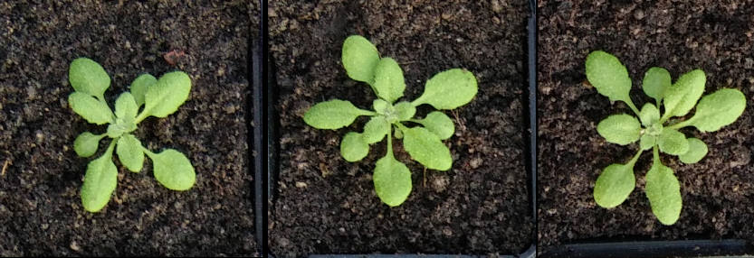
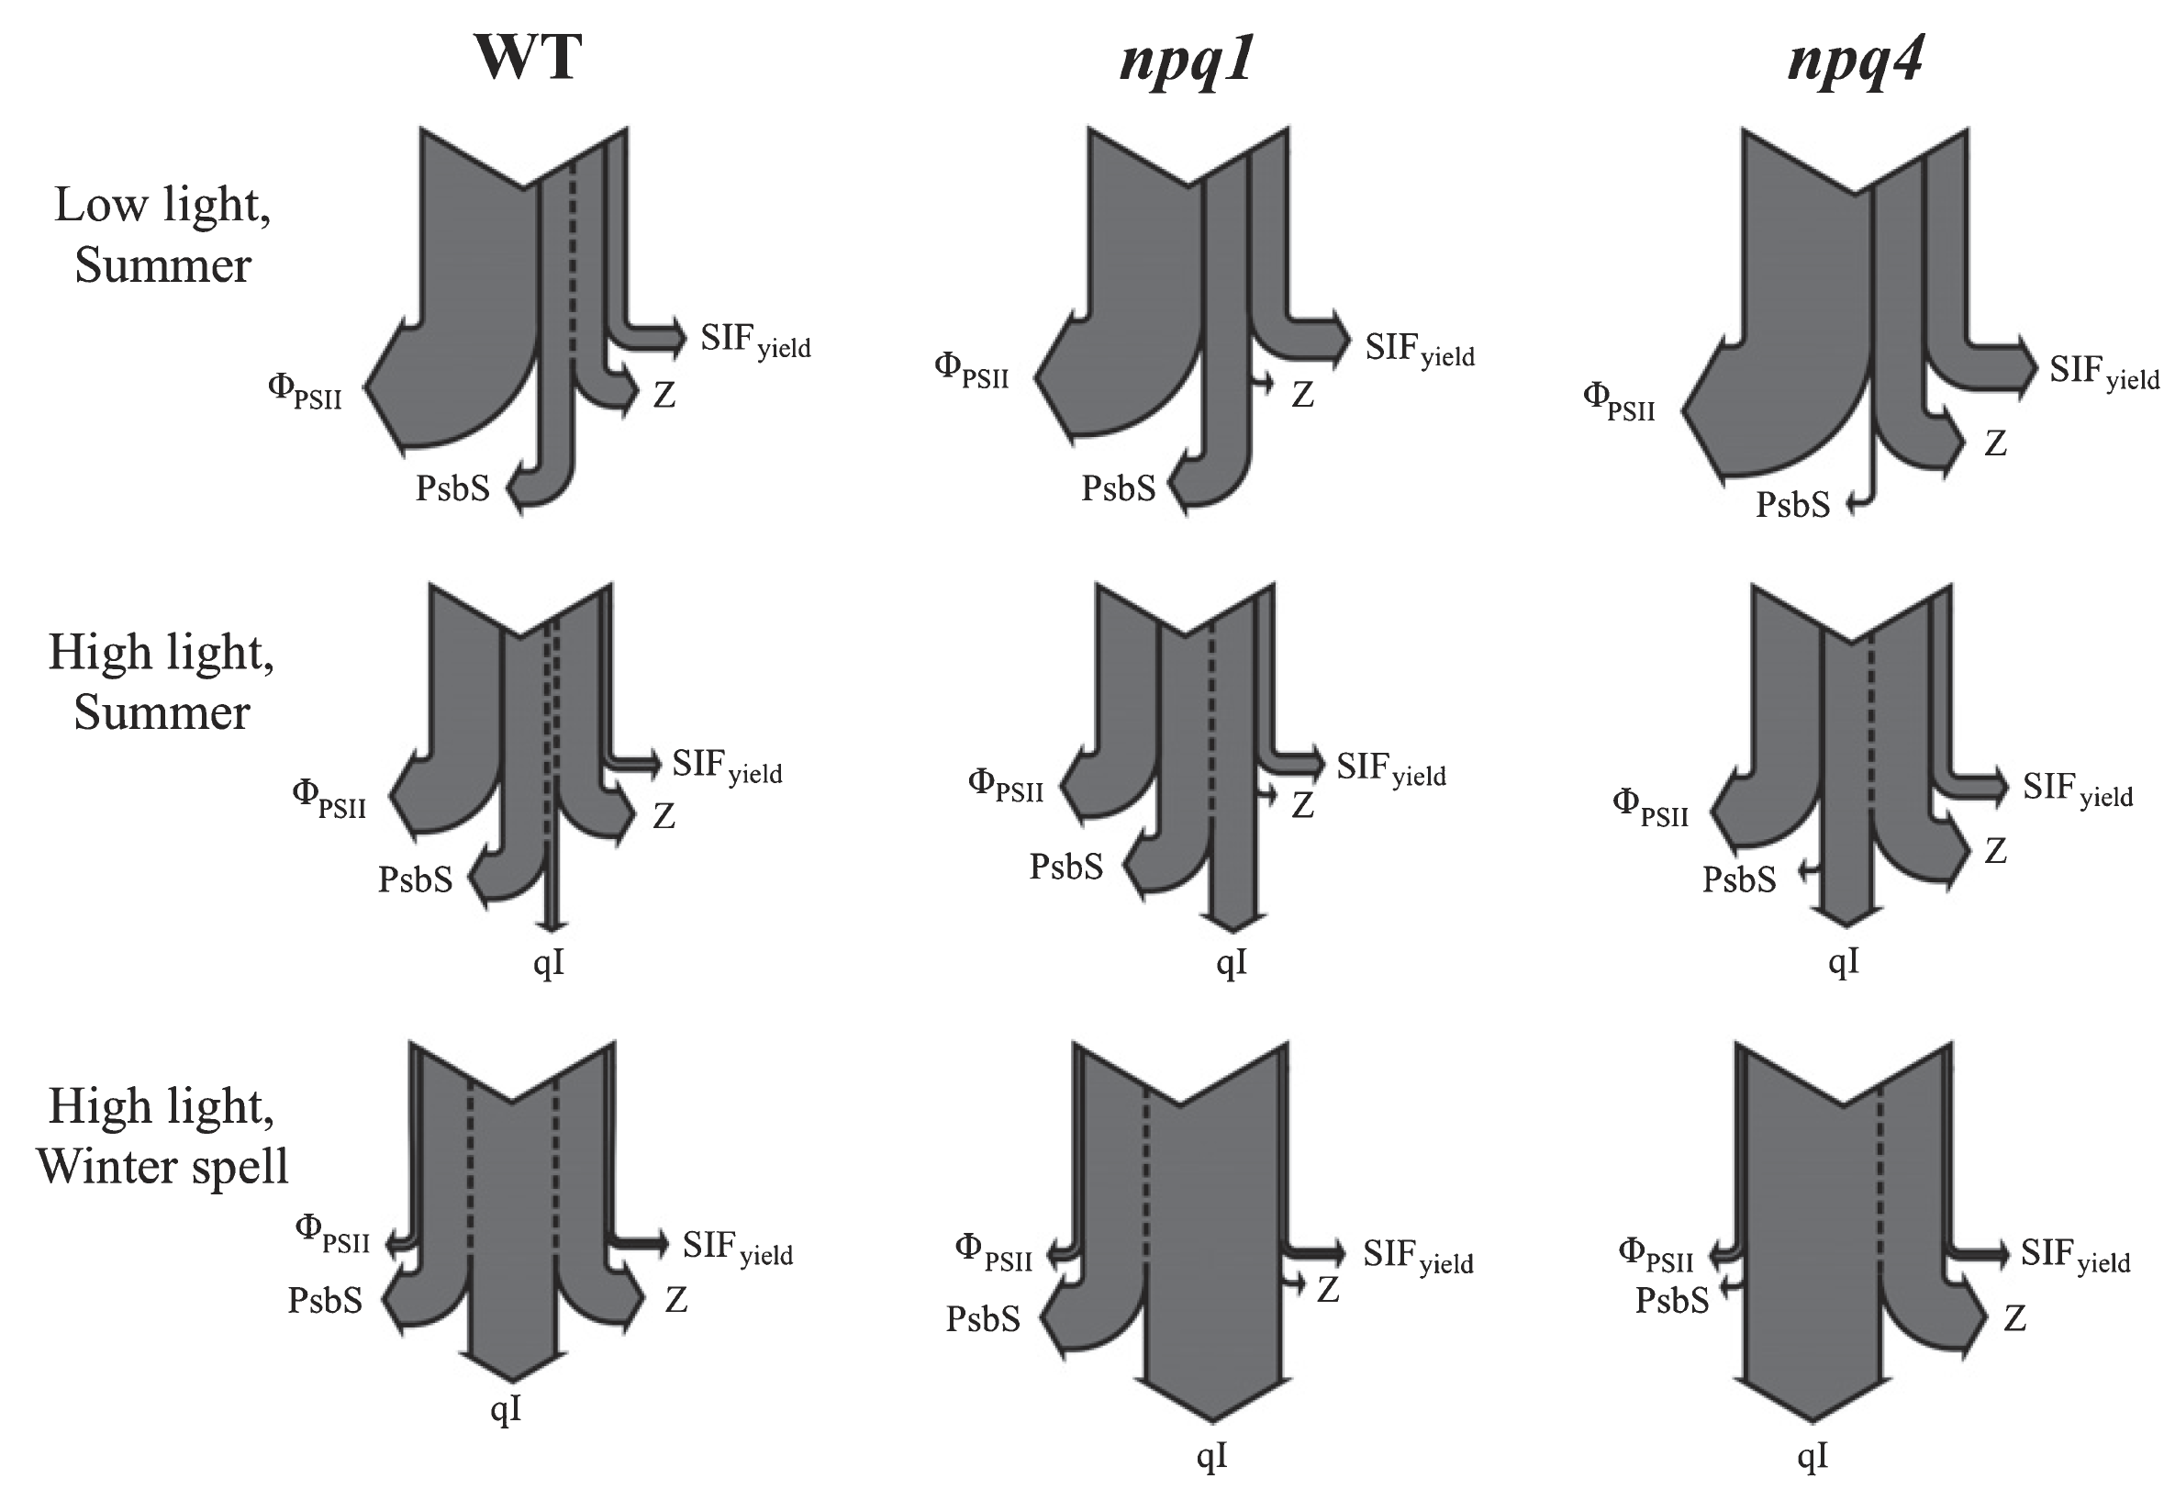
dynamic photosynthesis – extreme Temperature
Extreme temperatures have direct effect on photosynthesis, regulatory mechanisms are well understood, link to SIF still needs to be explored in more detail
Model is used to parameterize plant carbon exchange and to detect and understand vegetation stress
SIF allows the early detection of drought (limitation in soil plant available water)
Detection of temperature-induced reduction of photosynthesis (heat & freezing)
Martini et al. (2022) New Phytologist, 233, 2415–2428
Acebron et al. (2021) New Phytologist, 229, 2104-2119, doi: 10.1111/nph.16984

Slide 11
dynamic photosynthesis – extreme Temperature
Extreme temperatures have direct effect on photosynthesis, regulatory mechanisms are well understood, link to SIF still needs to be explored in more detail
Model is used to parameterize plant carbon exchange and to detect and understand vegetation stress
SIF allows the early detection of drought (limitation in soil plant available water)
Detection of temperature-induced reduction of photosynthesis (heat & freezing)
Martini et al. (2022) New Phytologist, 233, 2415–2428
Acebron et al. (2021) New Phytologist, 229, 2104-2119, doi: 10.1111/nph.16984
Peng et al. (2022) HyScreen: A ground-based imaging system for high-resolution red and far-red solar-induced chlorophyll fluorescence. Sensors, 22, article no. 9443; doi: 10.3390/s22239443.
Peng (2026) PhD thesis submitted to Bonn University

Slide 12
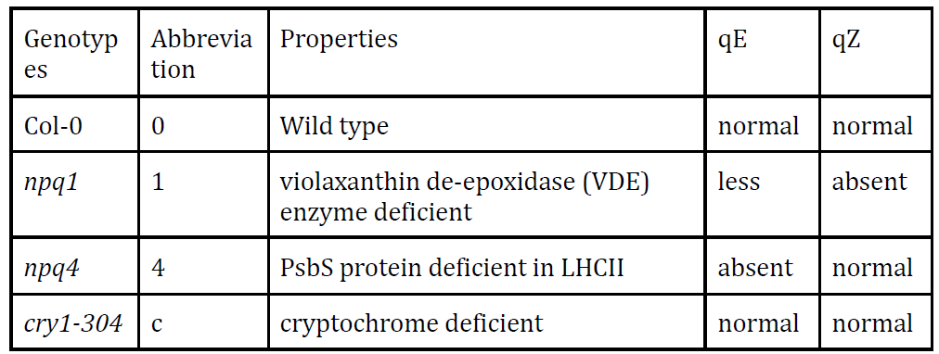
dynamic photosynthesis – extreme Temperature
Extreme temperatures have direct effect on photosynthesis, regulatory mechanisms are well understood, link to SIF still needs to be explored in more detail
Model is used to parameterize plant carbon exchange and to detect and understand vegetation stress
SIF allows the early detection of drought (limitation in soil plant available water)
Detection of temperature-induced reduction of photosynthesis (heat & freezing)

Slide 13
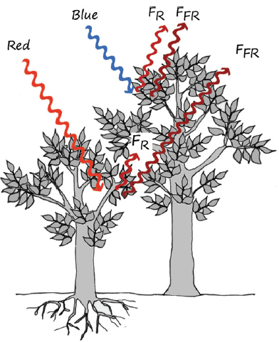
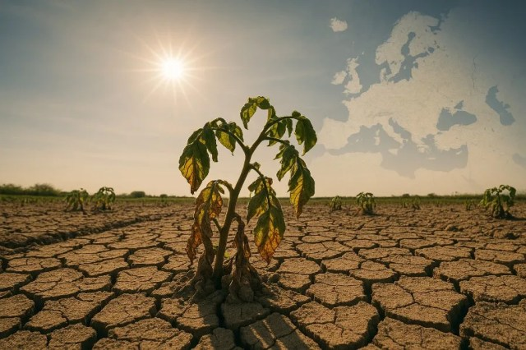
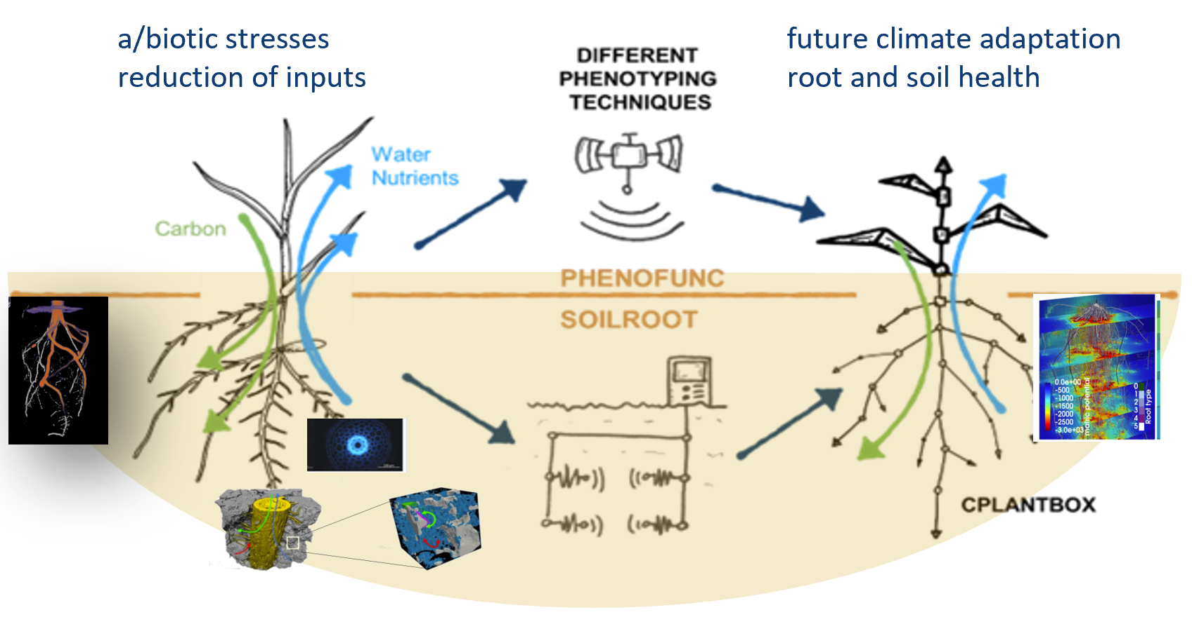
Downscaling of SIF from TOC to leaf level – normalizing for canopy structure
Porcar-Castell et al. (2014)
4

Slide 14
Downscaling of SIF from TOC to leaf level – normalizing for canopy structure
Several approaches are currently being discussed to normalize the top-of-canopy signal to leaf fluorescence
Radiative transfer model inversion
Structural-functional plant models that simulate and predict SIF
Empirical approaches
SIF escape fraction (f_{esc})
Fluorescence correction vegetation index (FCVI) (Yang et al. 2020)
Near-infrared reflectance of vegetation index (NIRv) (Badgley et al., 2017), NIRvH1 & NIRvH2 (Zeng et al. 2021)
Porcar-Castell et al. (2014)
4

Slide 15
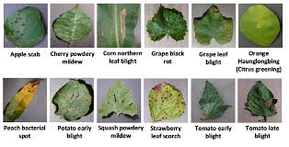
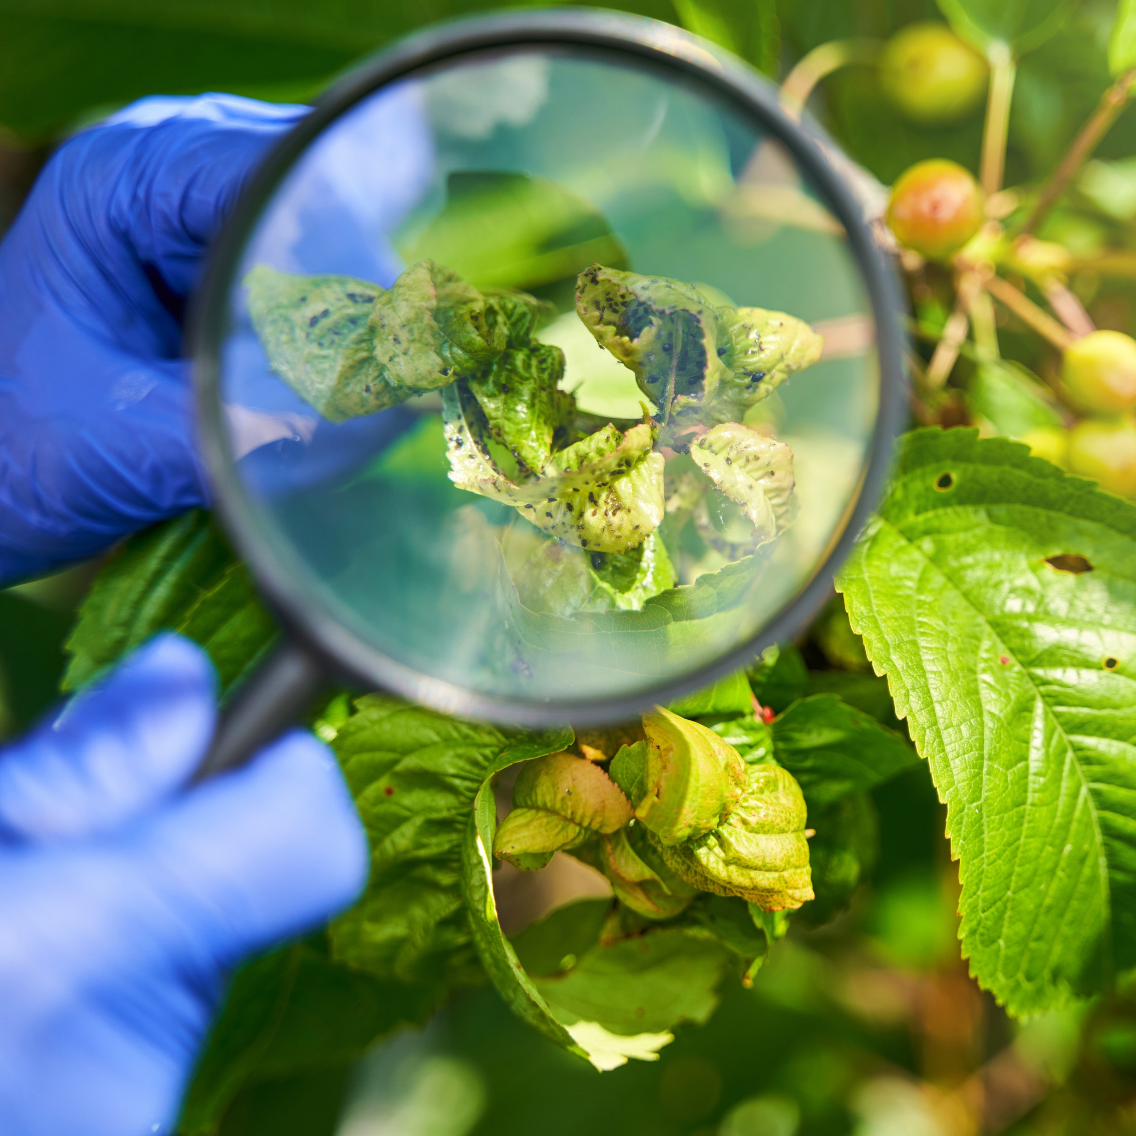
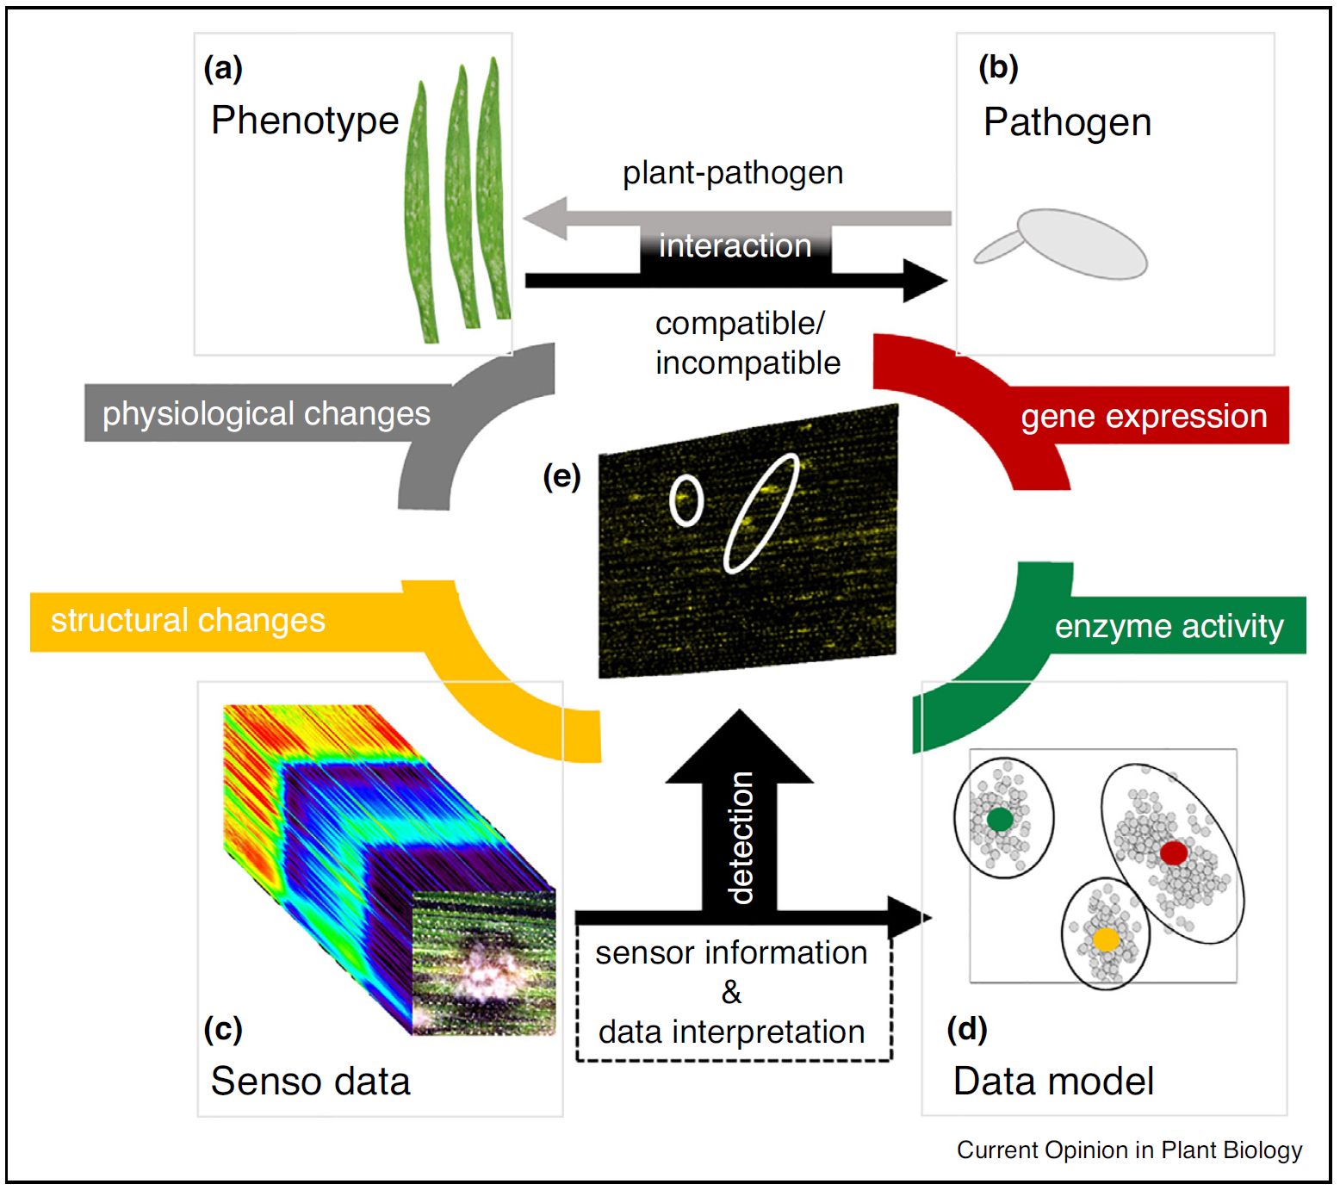
dynamic photosynthesis – diseases & pests
Numerous plant diseases and pests, each having its particular effect on plant function, pigments and plant structure – detailed view generally needed
Model is used to parameterize plant carbon exchange and to detect and understand vegetation stress
SIF allows the early detection of drought (limitation in soil plant available water)
Detection of temperature-induced reduction of photosynthesis (heat & freezing)
SIF to early and specifically detect plant diseases and pests
Mahlein et al. (2019) Current Opinion in Plant Biology, 233, 2415–2428

Slide 16
dynamic photosynthesis – diseases & pests
Numerous plant diseases and pests, each having its particular effect on plant function, pigments and plant structure – detailed view generally needed
Model is used to parameterize plant carbon exchange and to detect and understand vegetation stress
SIF allows the early detection of drought (limitation in soil plant available water)
Detection of temperature-induced reduction of photosynthesis (heat & freezing)
SIF to early and specifically detect plant diseases and pests
Mahlein et al. (2019) Current Opinion in Plant Biology, 233, 2415–2428
Mikaberidze et al. (2025) Opportunities and challenges in combining optical sensing and epidemiological modelling. Phytopathology, https://doi.org/10.1094/PHYTO-11-24-0359-FI

Slide 17
dynamic photosynthesis – nutrients
Numerous plant diseases and pests, each having its particular effect on plant function, pigments and plant structure – detailed view generally needed
Disease or nutrient limitation?
Model is used to parameterize plant carbon exchange and to detect and understand vegetation stress
SIF allows the early detection of drought (limitation in soil plant available water)
Detection of temperature-induced reduction of photosynthesis (heat & freezing)
SIF to early and specifically detect plant diseases and pests
Nutrient imbalance or nutrient limitation
Interplay between macro- and micronutrients greatly affect plant pigmentation → reflectance
Distinktion between biotic and abiotic stress valuable

Slide 18
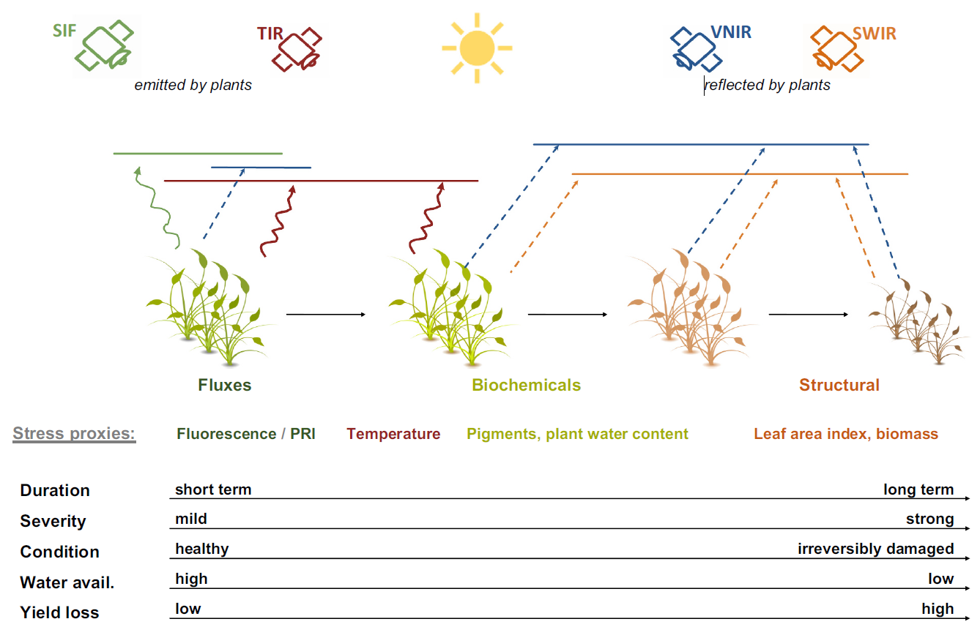
SIF for STRESS detection
SIF develops its full potential when combined with other remote sensing information – AI & ML – modelling
Berger et al. (2019) Multi-sensor synergies for crop stress detection and monitoring in the optical domain: a review. Remote Sensing of Environment, 280, article no. 113198, doi: 10.1016/j.rse.2022.113198.
Chakhvashvili et al. (2024) Crop stress detection from UAVs: Best practices and lessons learned for exploiting sensor synergies. Precision Agriculture, 25, 2614-2642, doi: 10.1007/s11119-024-10168-3.

Slide 19
Understanding dynamic photosynthesis
A summary
Model is used to parameterize plant carbon exchange and to detect and understand vegetation stress
SIF allows the early detection of drought (limitation in soil plant available water)
Detection of temperature-induced reduction of photosynthesis (heat & freezing)
SIF to early and specifically detect plant diseases and pests
Nutrient imbalance or nutrient limitation
Model is useful to link vegetation stress with plant productivity. Leaf vs. canopy effects

Slide 20
Understanding dynamic photosynthesis
A summary
Model is used to parameterize plant carbon exchange and to detect and understand vegetation stress
SIF allows the early detection of drought (limitation in soil plant available water)
Detection of temperature-induced reduction of photosynthesis (heat & freezing)
SIF to early and specifically detect plant diseases and pests
Nutrient imbalance or nutrient limitation
Model is useful to link vegetation stress with plant productivity. Leaf vs. canopy effects
Combination of SIF with other remote sensing parameters allows early and specific drought and temperature stress detection

Slide 21
Understanding dynamic photosynthesis
A summary
Model is used to parameterize plant carbon exchange and to detect and understand vegetation stress
SIF allows the early detection of drought (limitation in soil plant available water)
Detection of temperature-induced reduction of photosynthesis (heat & freezing)
SIF to early and specifically detect plant diseases and pests
Nutrient imbalance or nutrient limitation
Model is useful to link vegetation stress with plant productivity. Leaf vs. canopy effects
Combination of SIF with other remote sensing parameters allows early and specific drought and temperature stress detection
Direct assessment is challenging, interplay of close range, AI and epidemiological modelling
Mainly manifested in pigment changes and thus well accessible with classical optical remote sensing

Slide 22
SIF to measure actual photosynthesis and vegetation stress - lessons learned from 20 years of research in preparation of the FLEX satellite mission
Thank you very much for your attention
Uwe Rascher – Forschungszentrum Jülich, IBG-2: Plant Sciences
3. March 2026 – Bonn
Kelvin Acebron | Agarwal | Juliane Bendig | Jim Buffat | Lars Grygosch | David Herrera | Ireneusz Kleppert | Deepthi Konche | Felix Kröber | Onno Muller | Huaiyue Peng | Tony Cesar de Sousa Oliviera | Juan Quiros-Vargas | David Pla Guerrero | Patrick Rademske | Saja Salattna | Bastian Siegmann

Slide 24
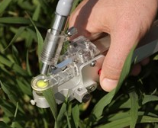
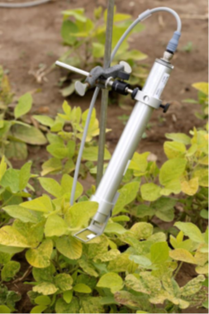
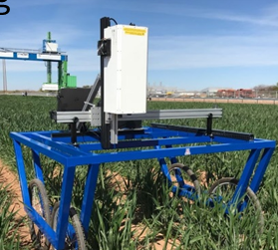
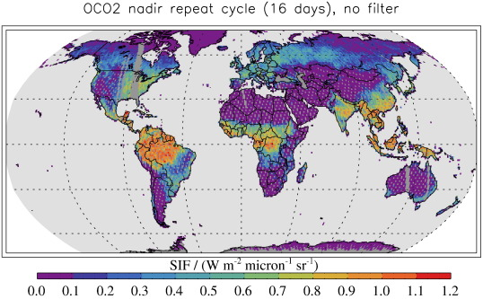
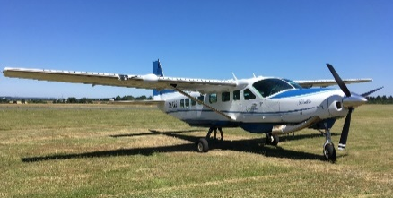
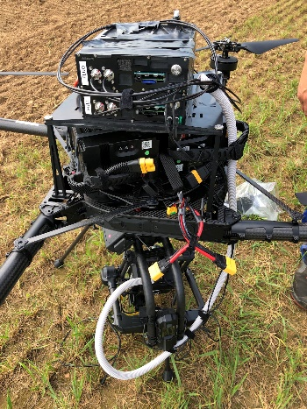
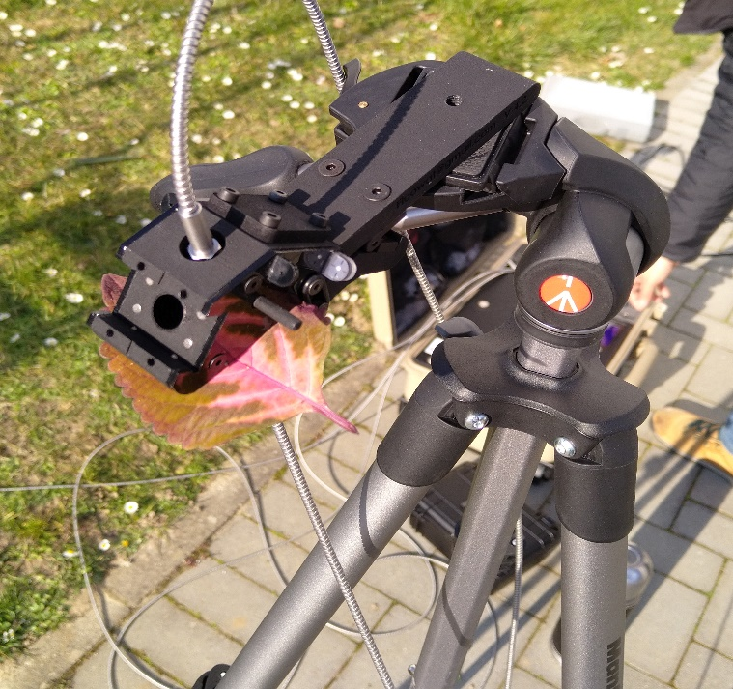
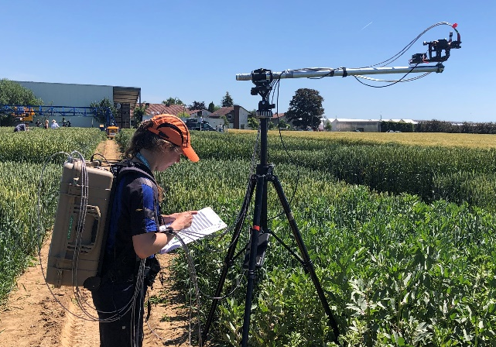
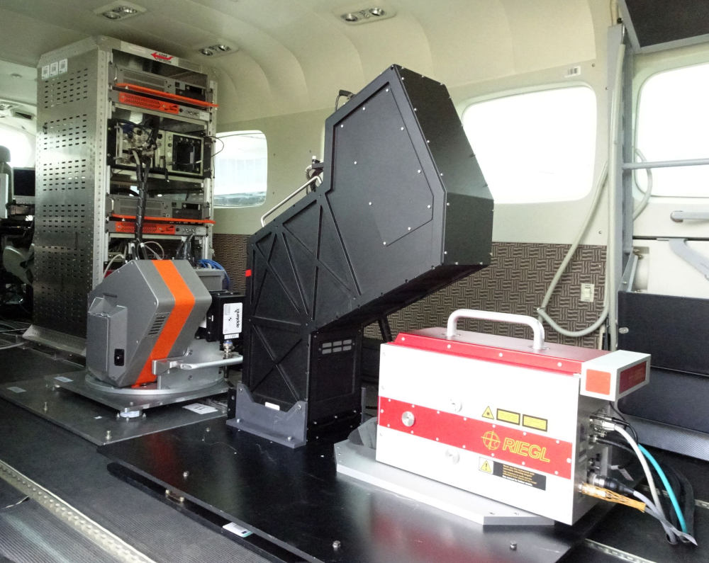
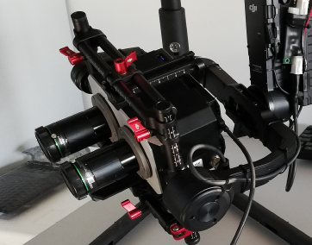
Evolution of relevant instruments to quantify fluorescence and photosynthesis from the leaf to the field
PAM
LIFT
Campus Klein-Altendorf was and is a main hub for developing and preparing the FLEX satellite
Active
HyPlant
Air-FLOX
FLUO-Wat
HyScreen
FLOX
SIF-Cam
Passive (SIF)
leaf top-of-canopy UAVs aircraft satellite

Slide 25
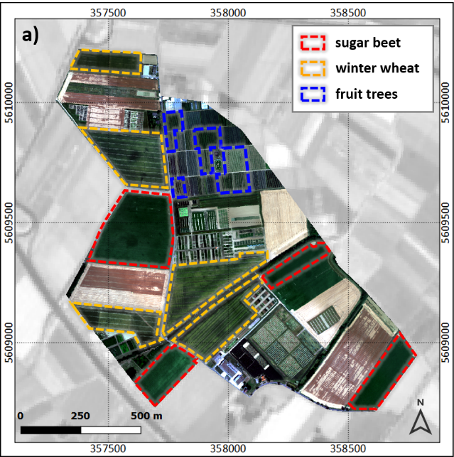
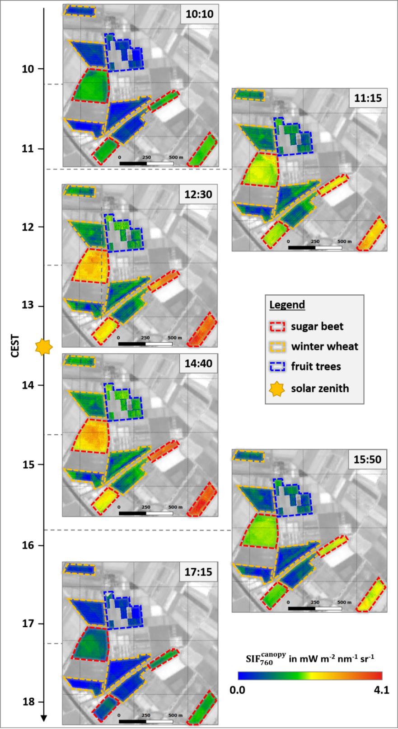
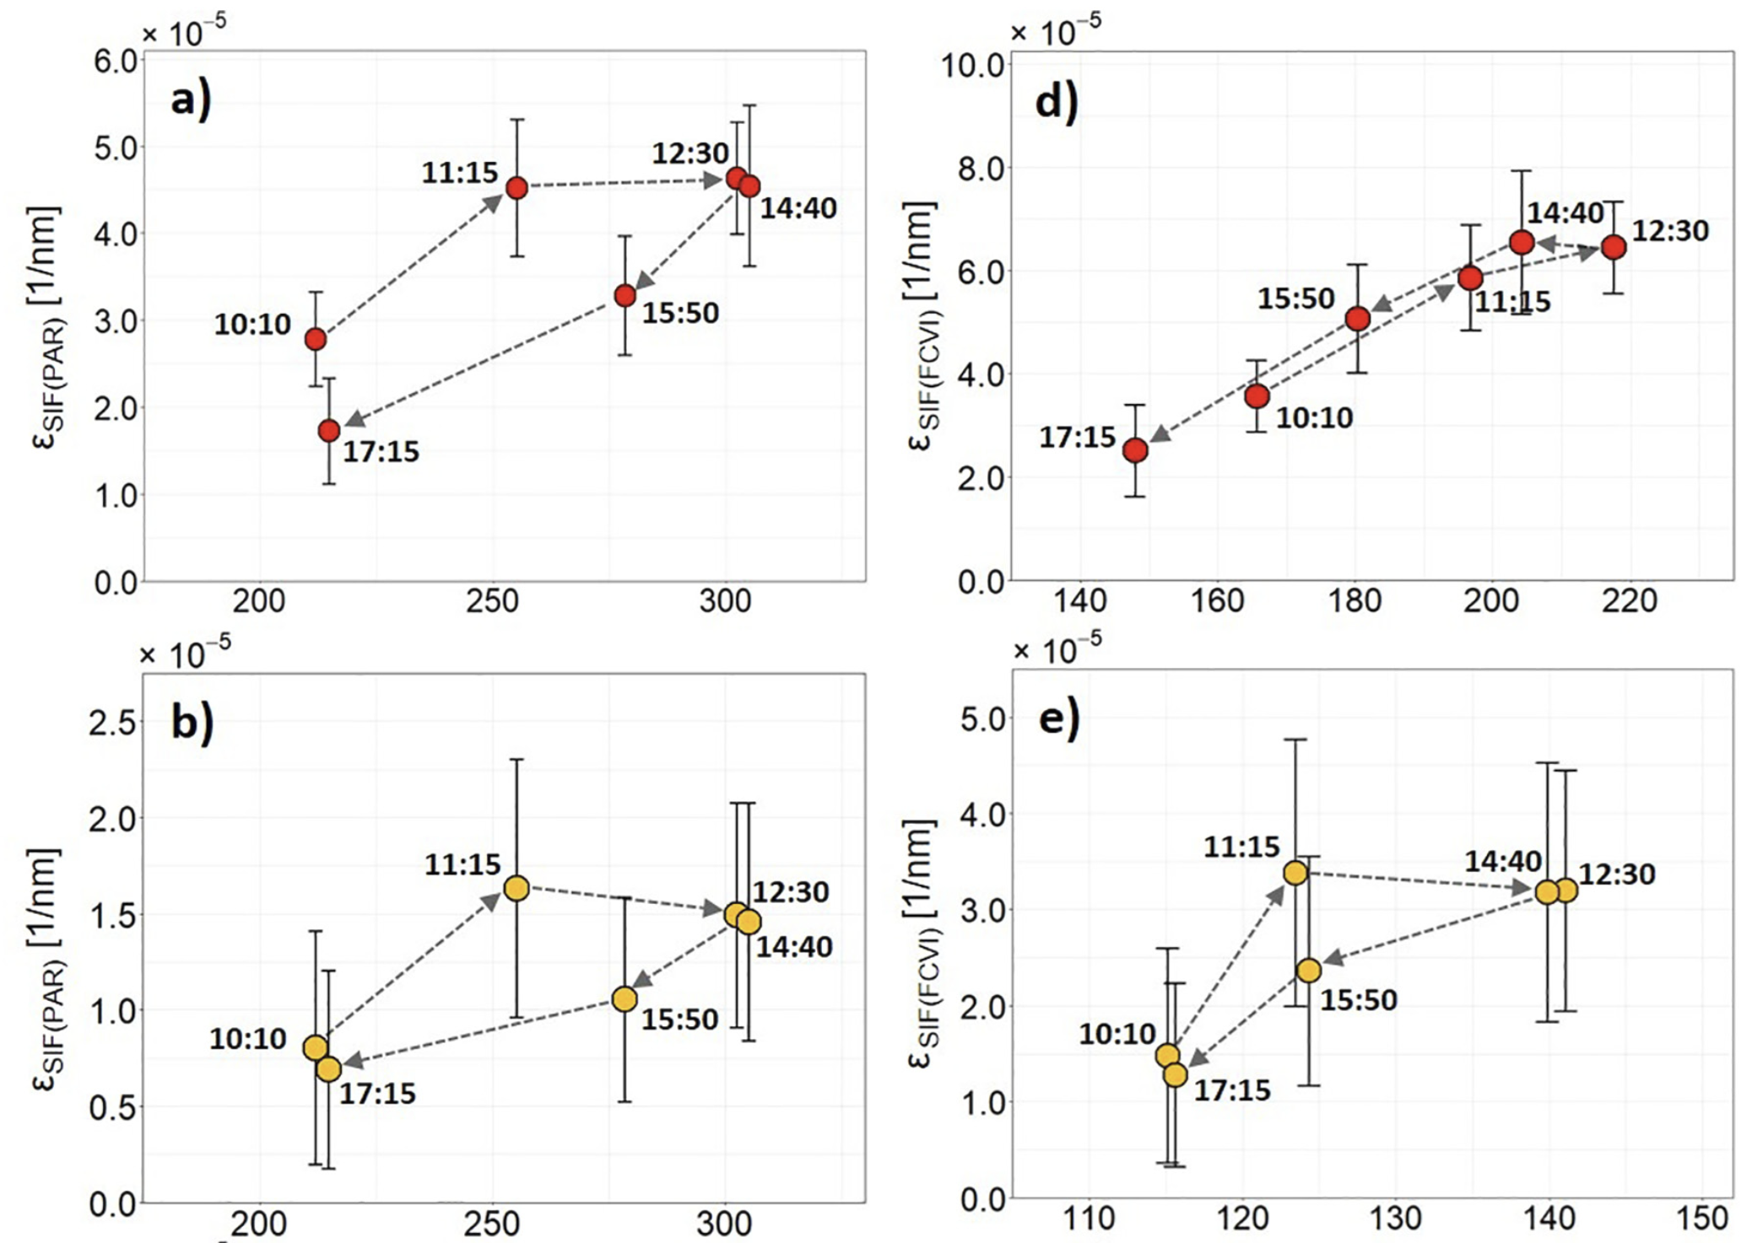
Understanding the mechanistic relation between SIF and actual rates of photosynthesis
Separating of canopy structure from leaf functional processes
Understanding the power of solar-induced fluorescence in agricultural production
sugar beet
normalization
winter wheat
Siegmann et al. (2021) Rem. Sens. Environ., 264, article no. 112609

Slide 26
Understanding the mechanistic relation between SIF and actual rates of photosynthesis
Separating of canopy structure from leaf functional processes
Understanding the power of solar-induced fluorescence in agricultural production
Extensive data-set from the past decade (when CKA was used as prime site preparing the FLEX satellite mission) [data.fz-juelich.de]
sugar beet
Siegmann et al. (2021) Downscaling of far-red solar-induced chlorophyll fluorescence of different crops from canopy to leaf level using a diurnal data set acquired by the airborne imaging spectrometer HyPlant. Rem. Sens. Environ., 264, article no. 112609
Porcar-Castell A. et al. (2021) Chlorophyll a fluorescence illuminates a path connecting plant molecular biology to Earth-system science. Nature Plants, 7, 998-1009
De Cannière S., Siegmann B., Herbst M., Michels V., Lopez G., Vereecken H., Kemna A., Rascher U., Jonard F. & Seidel S. Calibrating the effect of stomatal diurnal dynamics on root resistance using hyperspectral remote sensing observations of photochemistry and chlorophyll fluorescence. Agricultural and Forest Meteorology, in review
winter wheat

