Slide 1
The FLEX Instrument Performance Simulator (FIPS) and Ground Processor Prototype (GPP): development status
Marc Bouvet ¹, Stefan Adriaensen ³, Enrico Carta ⁵, Emanuela De Luca ⁴, Vittorio Digilio ⁵, António Falcão ², Riccardo Ferrara ⁵, Luca Galli ⁵, Aymeric Halé ¹, Stefano Mica ⁵, Hugo Monchatre ⁶, Jaime Parra Damborenea ², Sindy Sterckx ³, Davide Tiriticco ⁵
1. ESA/ESTEC, 2. INDRA-Deimos, 3. VITO, 4. Leonardo Spa, 5. EXPRIVIA, 6. Thales Alenia Space

Slide 2
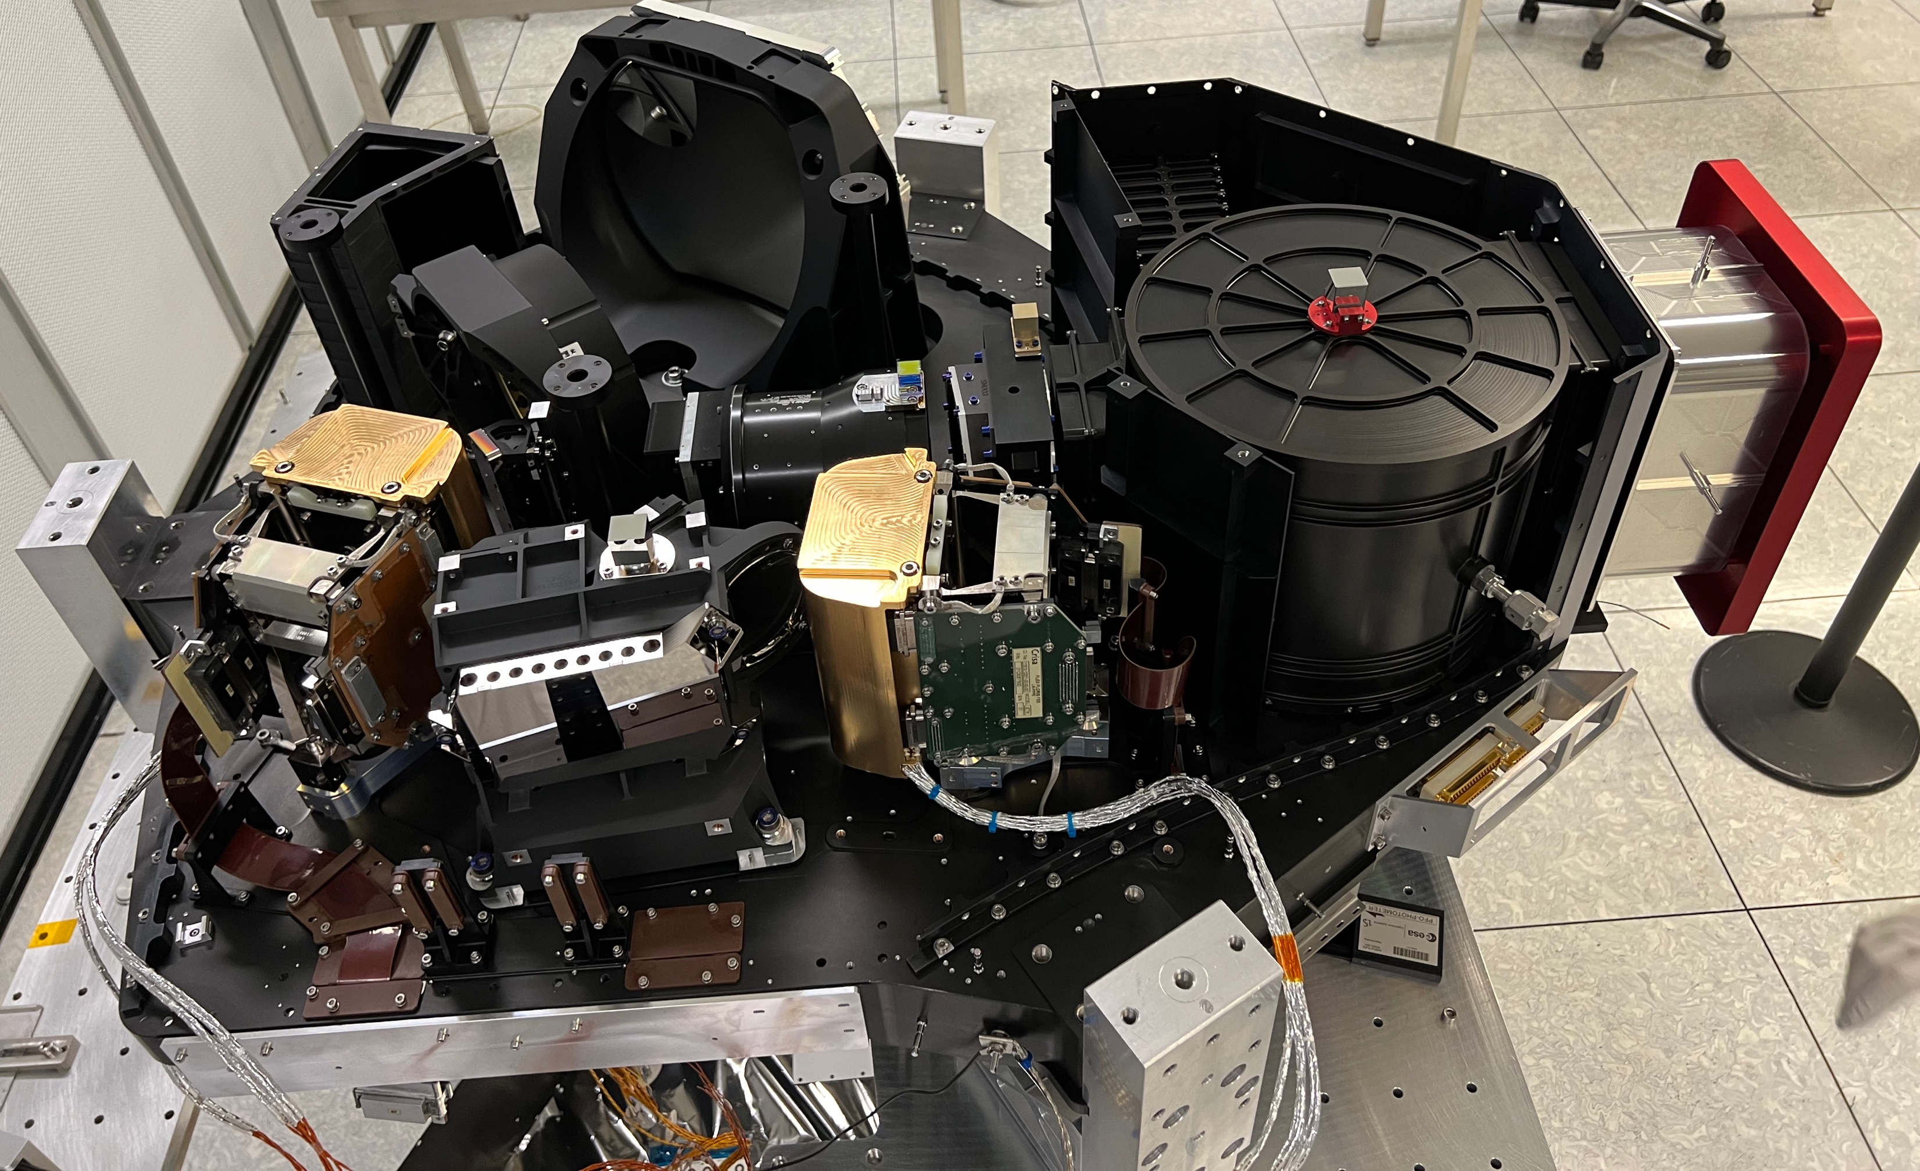
Simulation and processing of FLORIS data
Sun port
HR spectro
Earth port
Telescope
Focal plane HR
Double slit
Calibration Unit
Focal plane LR
LR spectro
FLORIS at Leonardo SpA (Florence, Italy) prior to TVAC (end 2024)

Slide 3
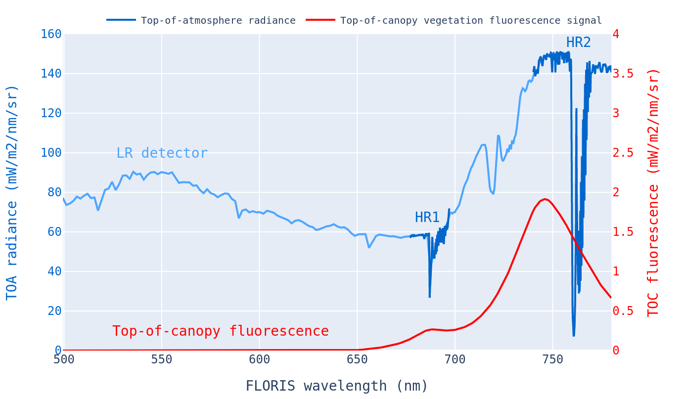
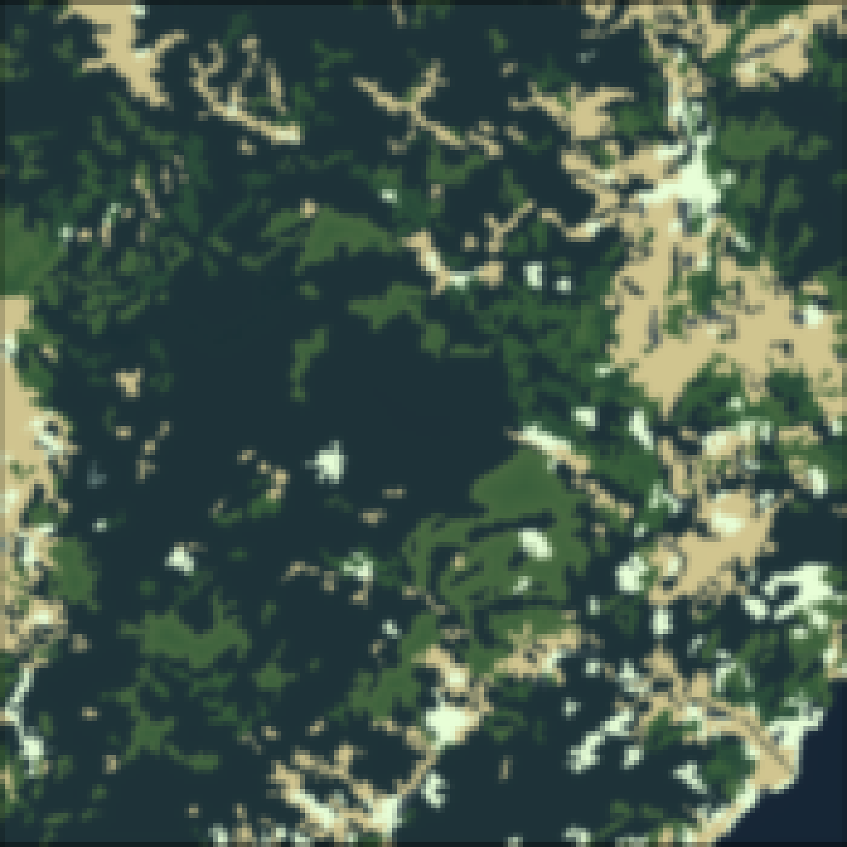
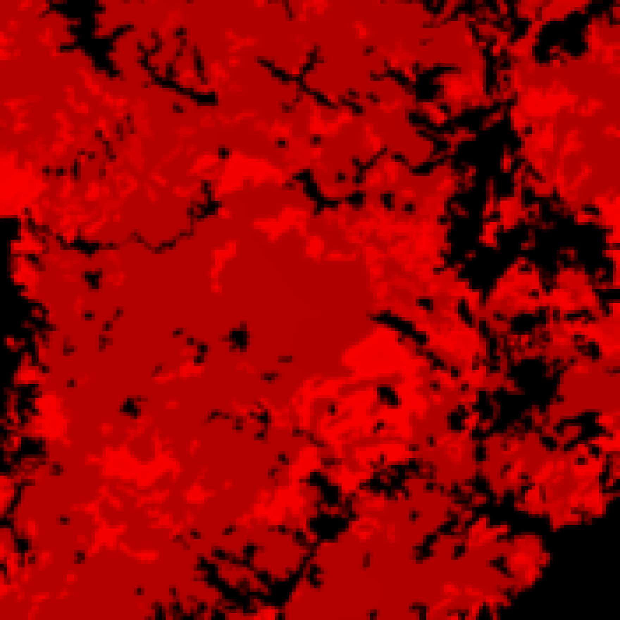
Retrieving fluorescence from space
The objective of FLEX is to retrieve the fluorescence signal emitted by vegetation.
The fluorescence signal is typically contributing no more than few percents of the TOA signal or few radiance units.
O2-B absorption
O2-A absorption
O₂-B
O₂-A
500 nm – 760 nm
Vegetations emits solar-induced fluorescence in the red / far-red spectrum

Slide 4
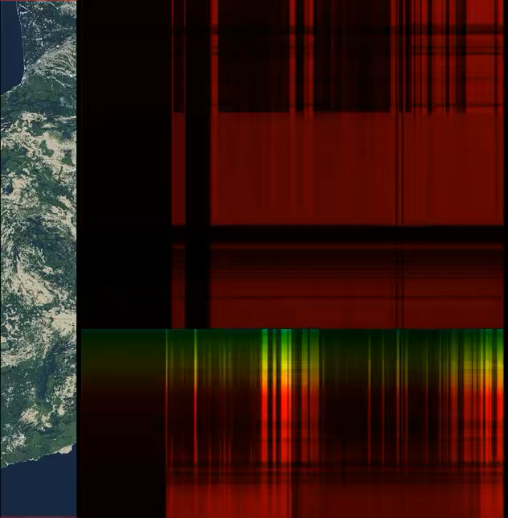
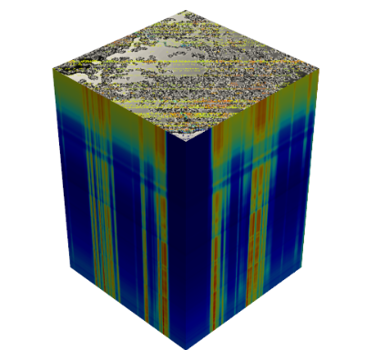
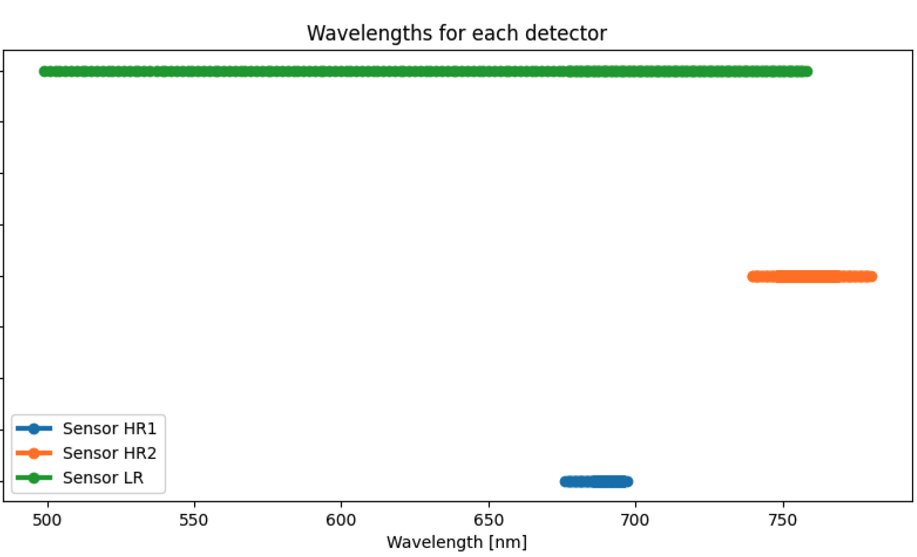
L1B product: top-of-atmosphere radiance
A FLORIS data cube for one of the 3 detectors
Swath = 150 km
O2-B absorption
HR1 detector: 677 nm – 697 nm
HR2 detector: 740 nm – 780 nm
O2-A absorption
LR detector: 500 nm – 758 nm
FLEX spectral range per detector
Simulated FLORIS L1B over Spain

Slide 5
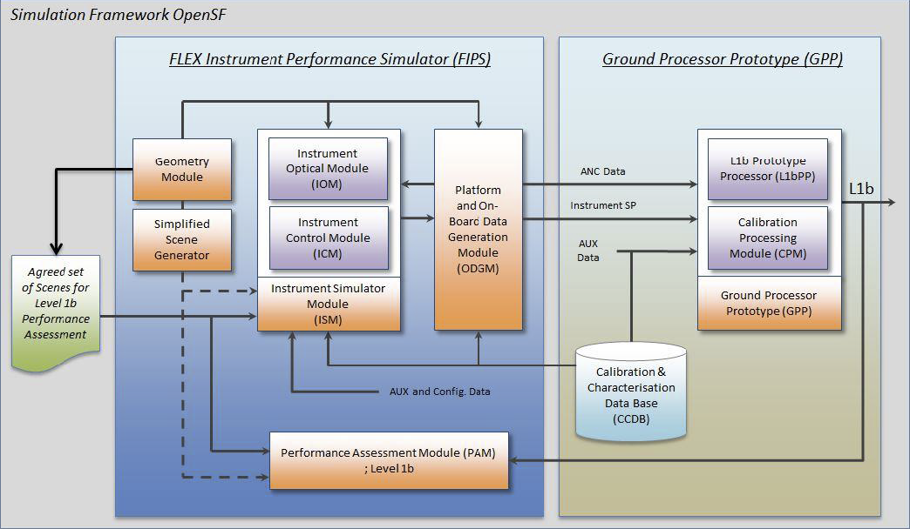
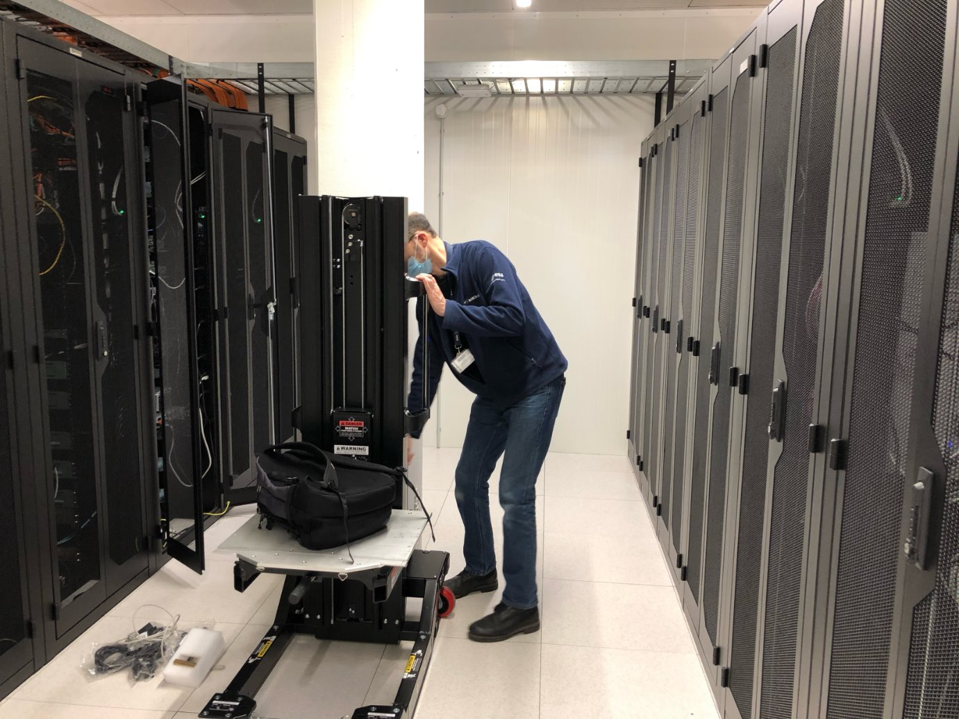
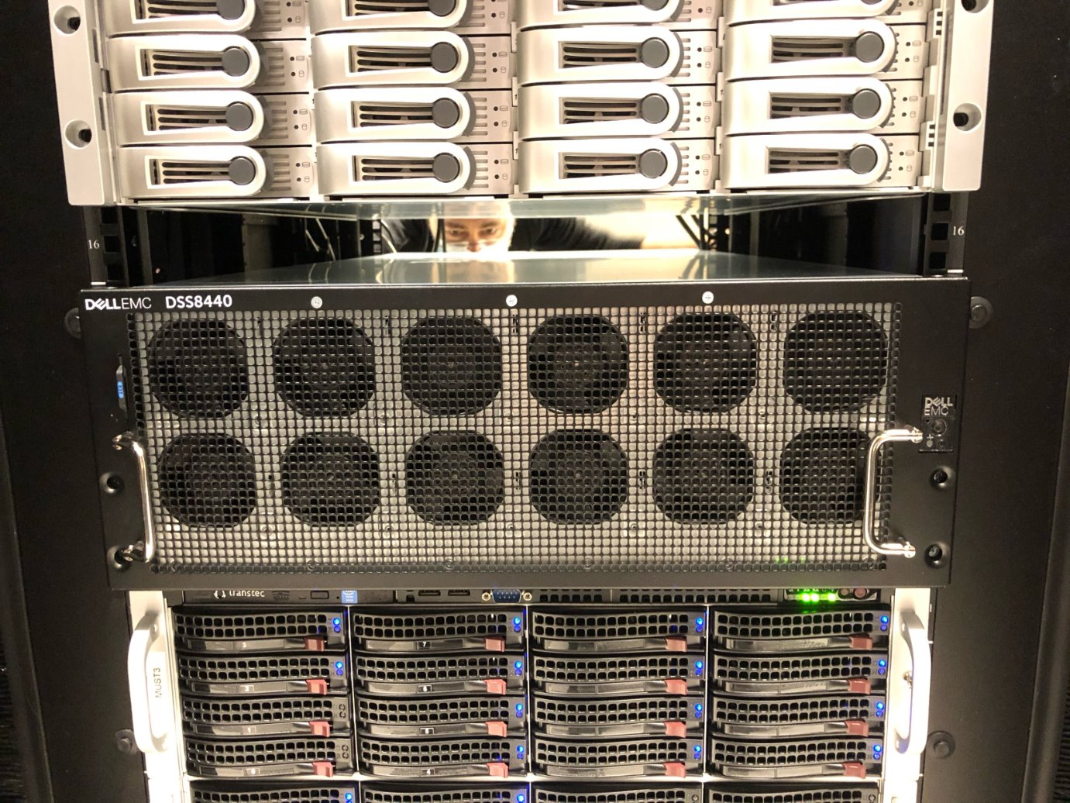
FIPS/GPP overview
FIPS = FLEX Instrument Performance Simulator
GPP = Ground Processor Prototype, i.e. the processing engine of the ground segment processing facility
Both FIPS and GPP are used in E2ES (end-to-end simulator) environment to assess L1B and L2 mission performance
Contract responsible: Instrument prime Leonardo SpA (Italy)
Contractors: INDRA-Deimos (Spain) with as subcontractors EXPRIVIA (Italy) and VITO (Belgium).
FIPS/GPP server installation at ESTEC (4 x GPUs)

Slide 6
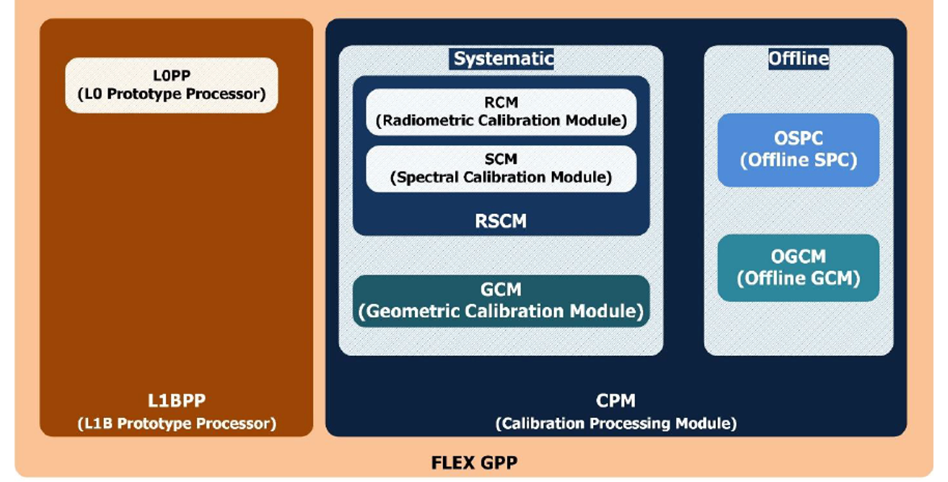
GPP processing flow
EO data
In-flight calibration/performance assessment modes
In-flight calibration/performance assessment modes
In-flight calibration/performance assessment data
GPP processes data from 20 instrumental modes
Instrument model parameters
GPP schematic view

Slide 7
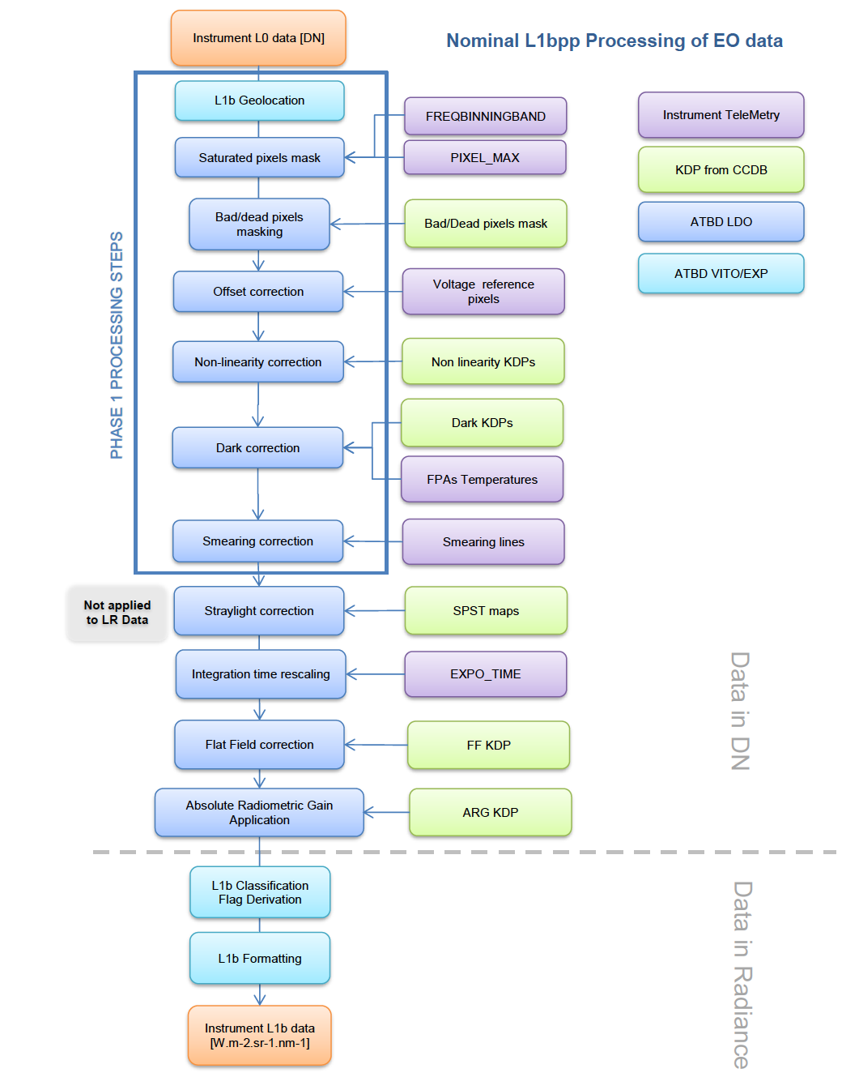
GPP processing flow: L1B EO processing
L1B processing of data is based on pre-flight and in-flight characterisation of the instrument radiometric, spectral and geometric behaviour (e.g.: non-linearity, dark signals, radiometric gains, flat field coefficients, straylight kernels…)
Main output: orthorectified georeferenced top-of-atmosphere radiance with instrumental and contextual information

Slide 8
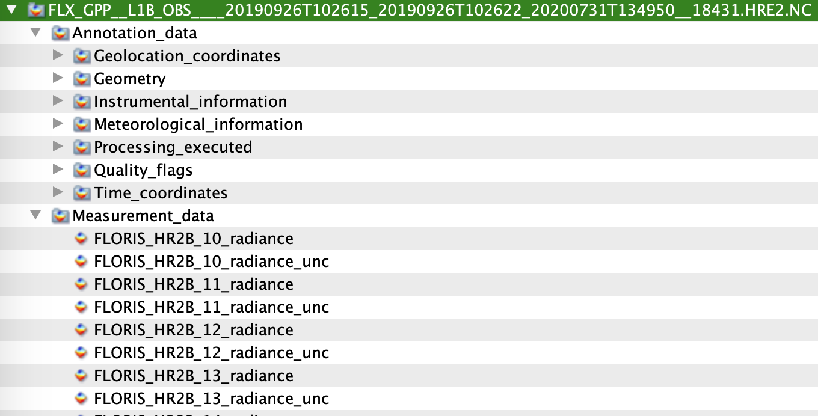
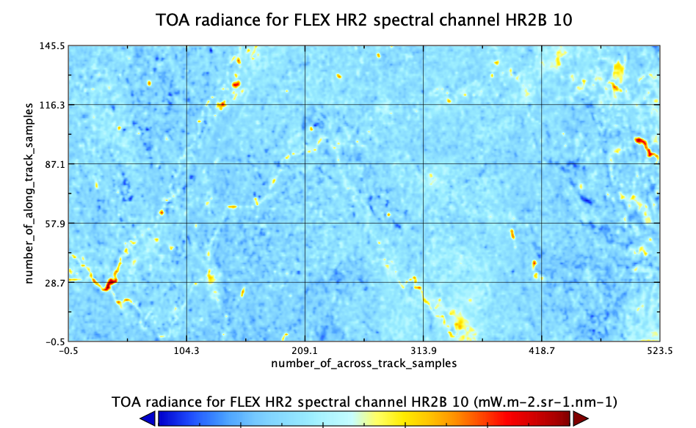
L1B products: EO measurements and more
L1B product format and content are largely inspired from S3 OLCI products and in netCDF format
235 channels in Low Resolution spectrometer (0.6 nm to 1.8 nm spectral sampling interval)
140 + 269 channels in High Resolution spectrometer (0.093 nm to 0.465 nm spectral sampling interval)
Contextual information: observation/illumination geometry, instrument characteristics, meteo fields, quality flags, etc…

Slide 9
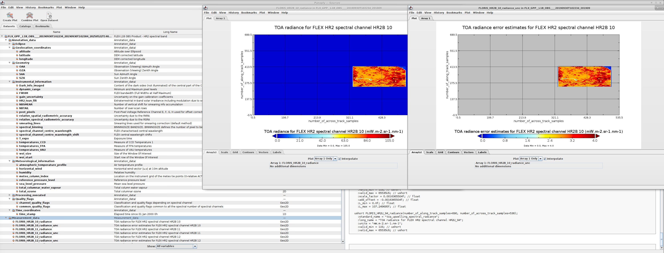
L1B products: measurements and supporting information

Slide 10
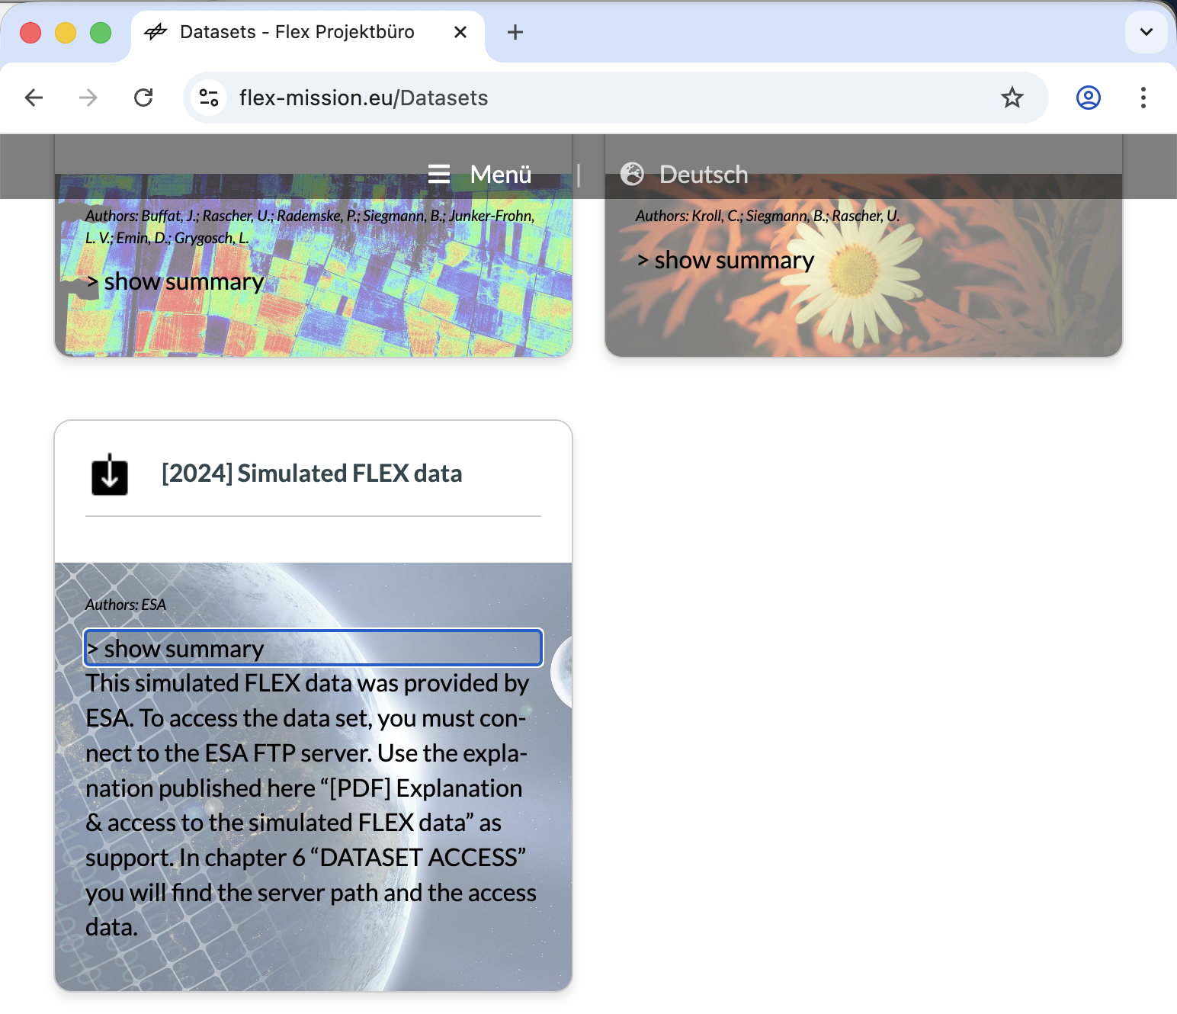
Flex Simulated Dataset V2.0
March 2024: FLEX Simulated Dataset V1.0 shared to the public at https://flex-mission.eu/Datasets. It contained two synthetic scenes simulated up from L1B to L2P products.
Updated dataset V2.0 now in preparation
Updated data product description documentation (also currently available on https://earth.esa.int/eogateway/announcement-of-opportunity/flex-cal-val)
L1B and L2 products in latest format.
Obtained with latest prototype processors (L1BPP V5.0.1 and L2PP V3.1).
Release: April 2026.

Slide 11
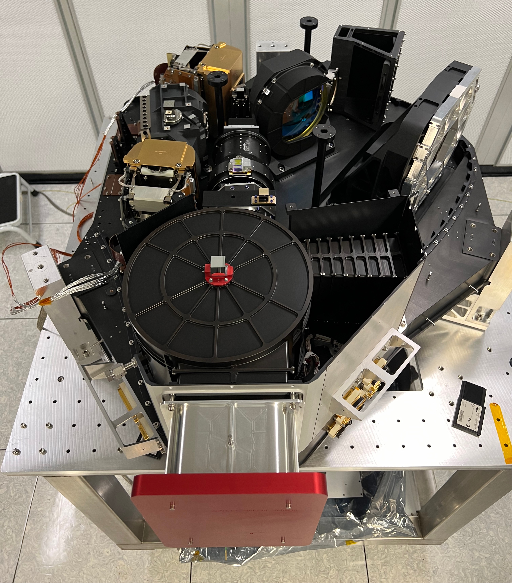
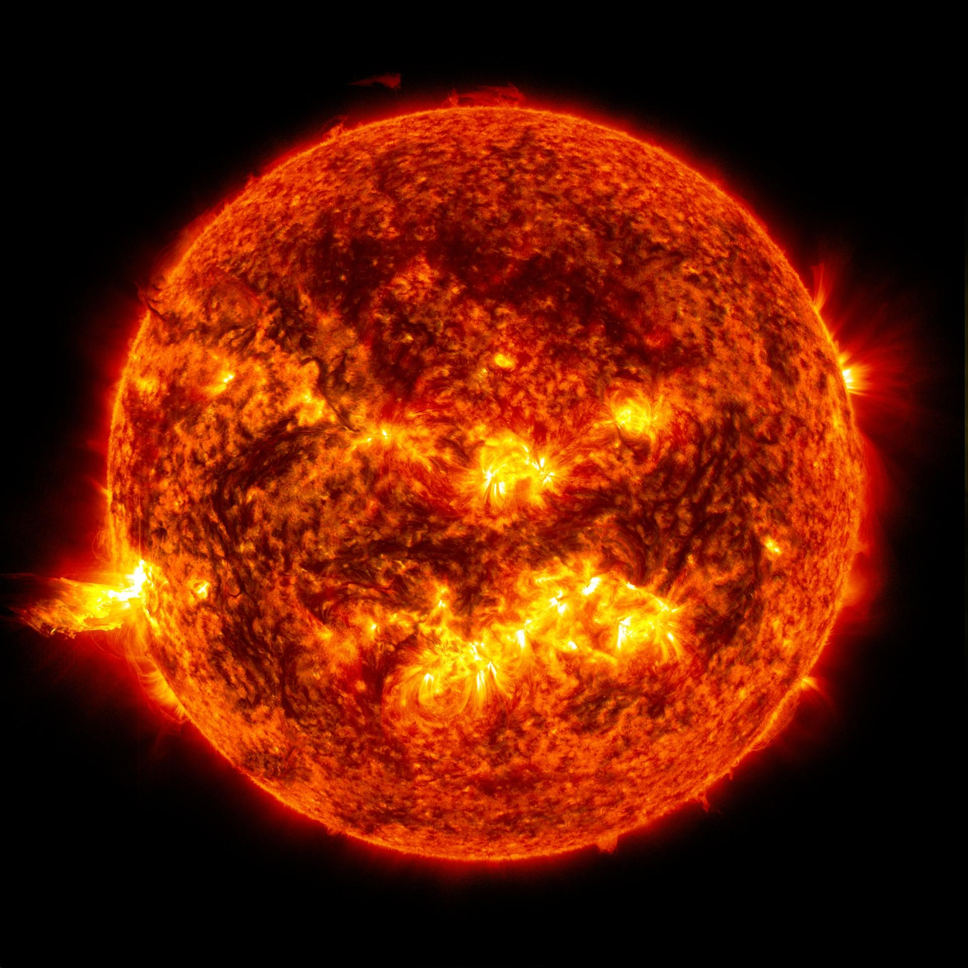
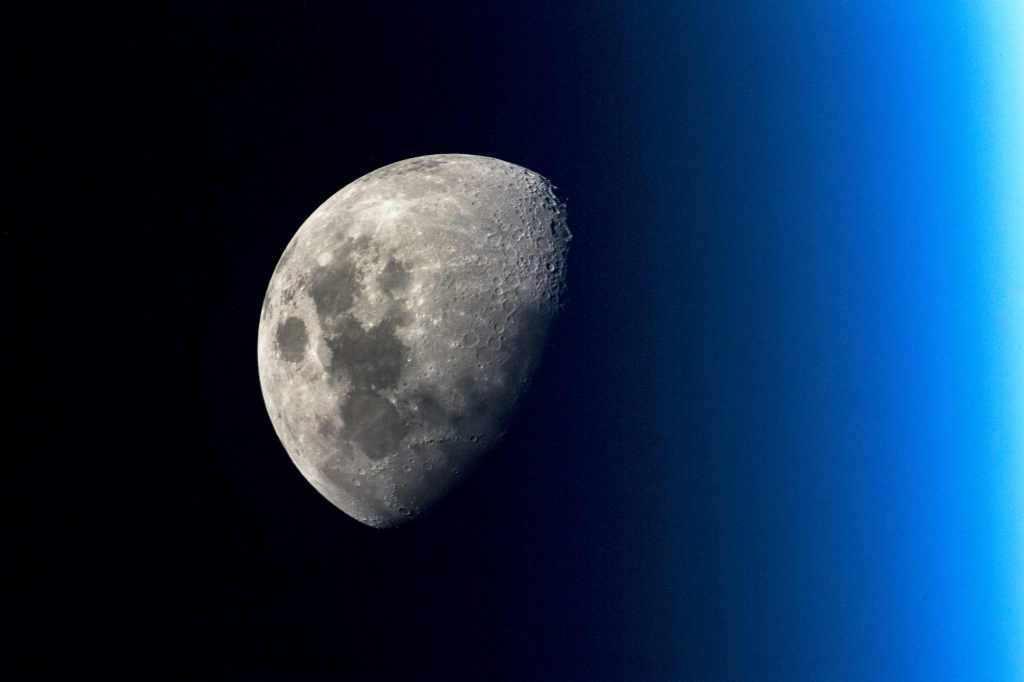
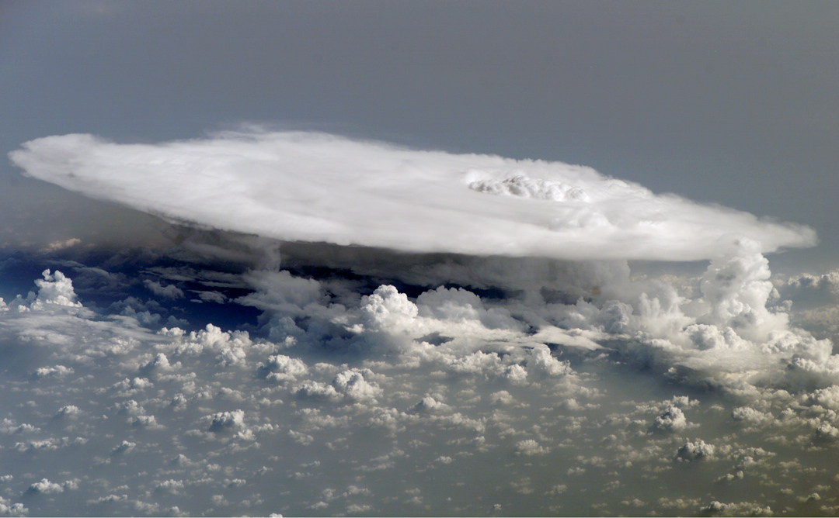


GPP: in-flight calibration and performance assessment
Calibration type​ | Calibration description​
Dark​ | Dark measurements for nominal EO measurements​
Dark​ | Dark measurements for sun diffuser measurements​
Dark​ | Dark measurements for spectral calibration on sun diffuser​
Dark​ | Defective dark pixel identification (dark)​
Dark​ | Dark measurements validation over sea at night​
Dark​ | Dark measurements before moon observation​
Dark​ | Dark measurements before moon observation for straylight correction verification​
Linearity ​ | Linearity over desert​
Linearity ​ | Linearity over sea​
Linearity​ | Linearity over sun diffuser​
Linearity​ | Linearity with instrument shutter​
Spectral​ | Spectral calibration on sun diffuser​
Spectral ​ | Spectral calibration on EO scenes​
Geometric​ | Geometric calibration – Absolute pointing accuracy​
Geometric​ | HR/LR spatial coregistration​
Radiometric​ | Sun diffuser absolute calibration​
Radiometric​ | Defective pixel identification (sun diffuser)​
Radiometric​ | MTF and absolute radiometric calibration using moon​
Radiometric​ | Straylight correction verification using moon ​
Radiometric​ | Charge transfer efficiency assessment​
Radiometric​ | Deep convective cloud radiometric assessment​

Slide 12
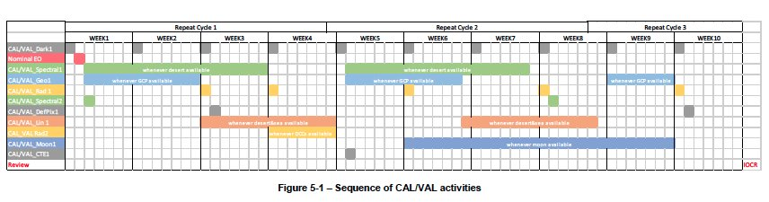
FIPS/GPP: still 2 versions to develop
Feb 2025: Delivery and acceptance of FIPS/GPP V4 representative of instrument subsystem characterization. PDGS format compatible version. This version was used to simulate a 2-day test dataset of all instrument modes for PDGS testing and to generated a large test dataset for L2 development/verification/validation.
Q1 2026: FIPS/GPP V5 representative of instrument flight model following its on-ground characterization. The GPP V5 will be used during commissioning phase by the instrument prime Leonardo SpA, to derive the instrument calibration parameters for the L1 ground segment processor and to assess in-flight performance.
Q4 2026: FIPS/GPP V6 includes in-flight characterization performed during the commissioning phase and algorithm improvement / debugging (launch + 3 months)​

Slide 13
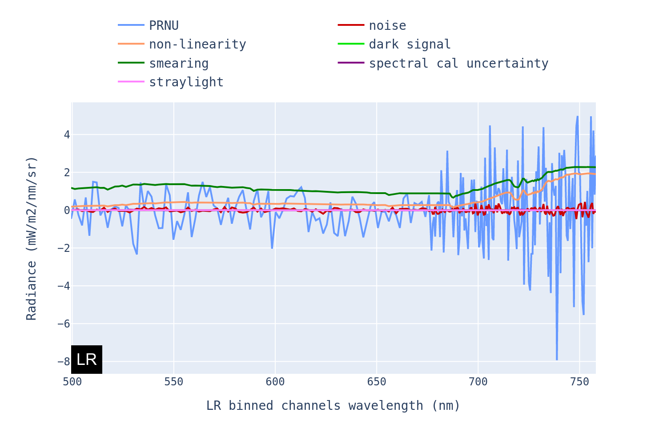
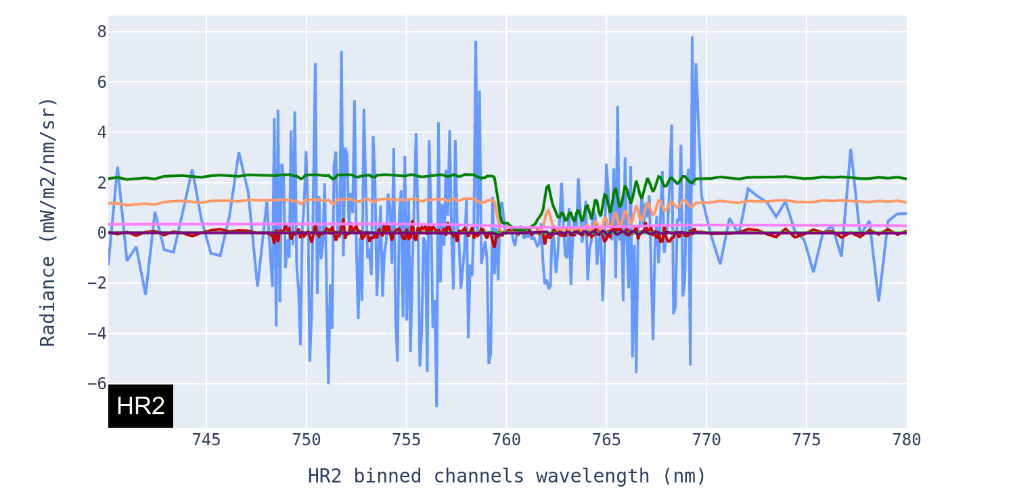
FIPS: simulation of instrumental effects
Simulation of instrumental effects in the RAW products
Obtained with FIPS V4.0.3 and the LREF homogeneous scene.
Instrumental effects (=deviations from an ideal instrument) are simulated by the instrument simulator.
These instrument effect are in the same order of magnitude as of the fluorescence signal. They need to be corrected (except for the photonic noise)

Slide 14
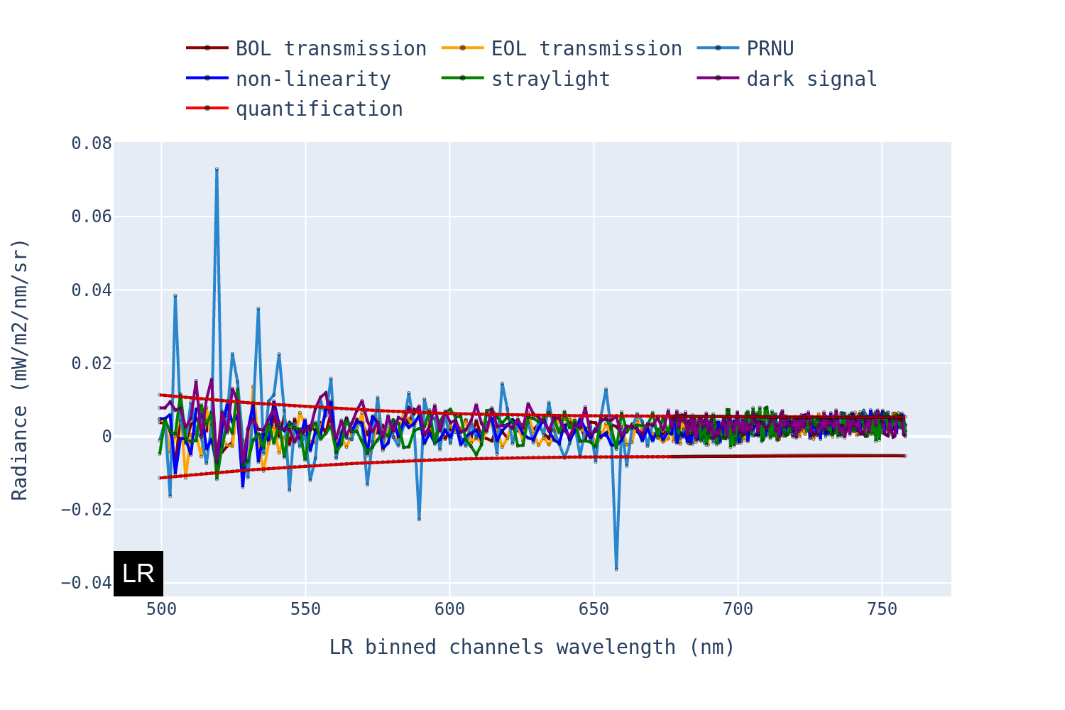
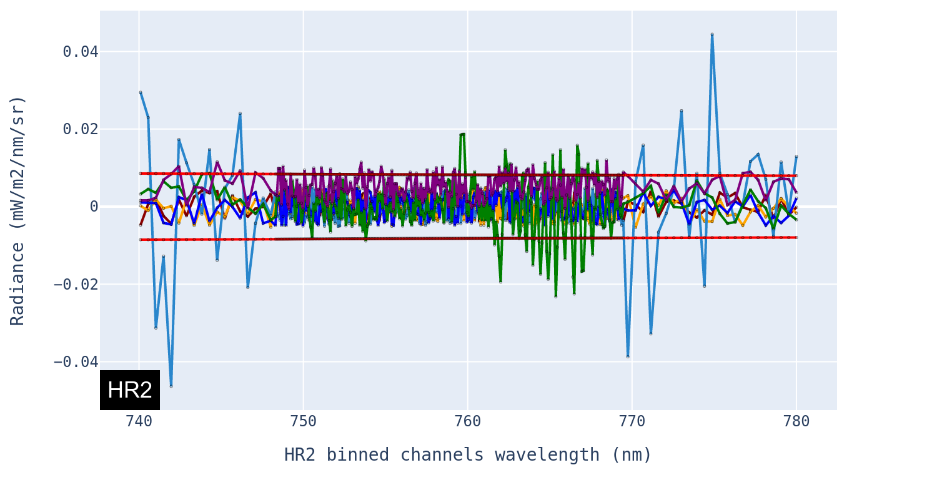
FIPS simulation vs. GPP correction: consistency check
Residual errors in L1B products after consistent simulation and correction of the instrumental effects
Obtained with GPP V4.0.9 and the LREF homogeneous scene.
Simulated instrumental effects can be corrected by the GPP if well characterised. Almost within instrument quantisation noise (red lines).
However, the instrument parameters are only know within the uncertainty of their characterisation/calibration… so the L1B measurements will include additional errors

Slide 15
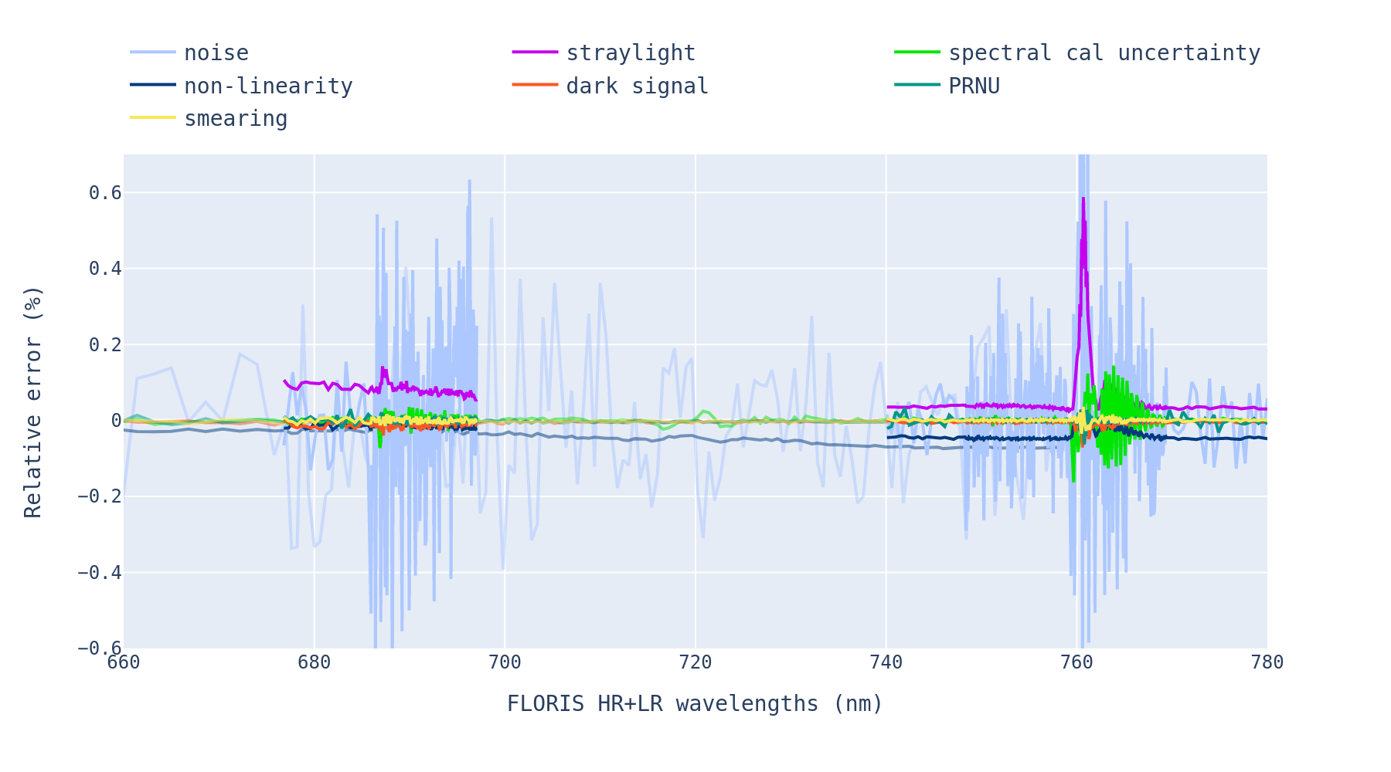
FIPS/GPP V4: generation of L1B products with residual errors commensurate with the instrument prime performance budget
Step 1: simulation of L1B residual errors from instrumental effect corrections (before application of radiometric gains)
Obtained with GPP V4.0.9 and the LREF homogeneous scene (LREF/LTOC transition scene for straylight)
PRNU=Pixel Response Non Uniformity
O2-B / HR1
O2-A / HR2
Straylight, photonic noise and other error contributors filling in the O2 absorption lines have been optimised during instrument design not to compete with the fluorescence signal retrieval

Slide 16
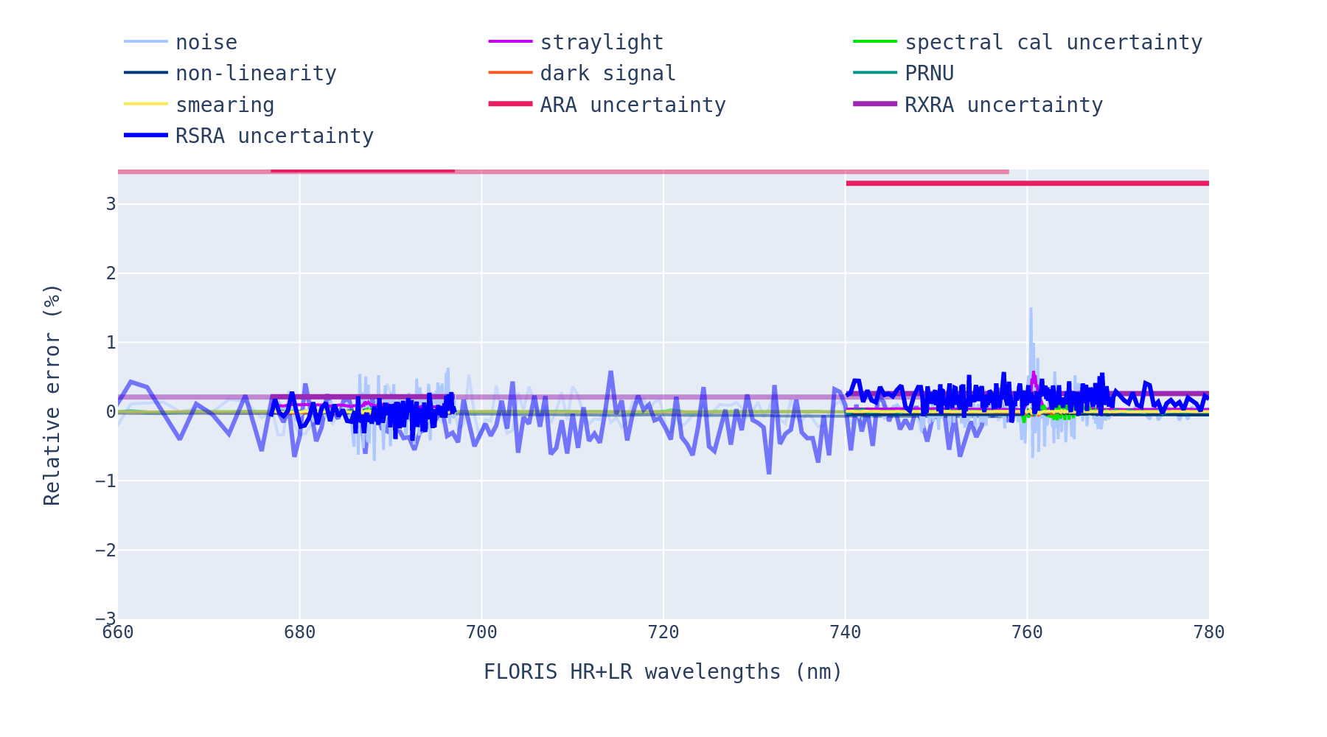
FIPS/GPP: generation of L1B products with residual errors commensurate to the instrument performance budget
Step 2: introduction of additional errors to fully reflect the industry instrument performance budget
Obtained with GPP V4.0.9 and the LREF homogeneous scene (LREF/LTOC transition scene for straylight)
ARA= Absolute Radiometric Accuracy
RXRA= Relative across track Radiometric Accuracy
RSRA= Relative Spectral Radiometric Accuracy
O2-B / HR1
O2-A / HR2
Additional L1B errors need to be introduced to reflect the expected full instrument performance. Done using inconsistent FIPS / GPP instrument radiometric gains. These realistic L1B products were used by the L2 team to assess Fs retrieval performance.
ARA largest L1B uncertainty contributor but expected to have mostly a systematic bias impact on L2 fluorescence retrieval.
Keeping L1B error contributors with an unknown systematic spectral signature in the O2 absorption lines to a minimum will be key to meeting the mission requirements

Slide 17
Conclusions and outlook
The FLEX L1B product simulation and data processing chain are implemented in the current FIPS/GPP version 5.
The FIPS / GPP has been used to assess the expected instrument performance.
Also used to simulate realistic RAW/L0/L1 data to test the ground segment and to develop/assess the L2 algorithms.
The current version of the FIPS/GPP (V5) will be parameterised by the instrument parameters derived during the on-ground calibration campaign (expected to be finalized by April 2026).
Next version to be used during commissioning phase to process in-flight calibration data and to assess the in-flight radiometric/spectral/geometric performance of the instrument.
FIPS/GPP will be available to FLEX users through the FLEX collaborative platform and as part of the End-to-End Mission Simulator.

Slide 18

Thank you for you attention
marc.bouvet@esa.int

Slide 19
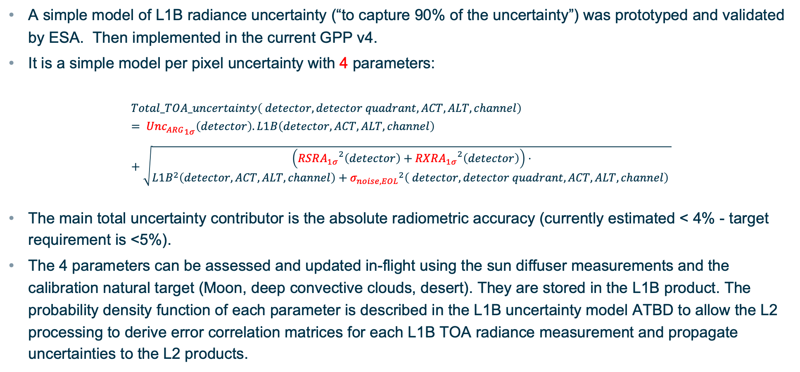
L1B uncertainty simulation
A simple model of L1B radiance uncertainty (“to capture 90% of the uncertainty”) was prototyped and validated by ESA. Then implemented in the current GPP v4.
It is a simple model per pixel uncertainty with 4 parameters:
$$Total_TOA_uncertainty\left( detector, detector quadrant, ACT, ALT, channel\right)= {Unc_{ARG}}_{1σ}\left(detector\right).L1B\left(detector,ACT,ALT,channel\right)+\sqrt{\begin{aligned}\left({RSRA_{1σ}}^{2}\left(detector\right)+{RXRA_{1σ}}^{2}\left(detector\right)\right)⋅ \\ {L1B}^{2}\left(detector,ACT,ALT,channel\right)+{σ_{noise, EOL}}^{2}\left( detector, detector quadrant, ACT, ALT, channel\right) \end{aligned}}$$
The main total uncertainty contributor is the absolute radiometric accuracy (currently estimated < 4% - target requirement is <5%).
The 4 parameters can be assessed and updated in-flight using the sun diffuser measurements and the calibration natural target (Moon, deep convective clouds, desert). They are stored in the L1B product. The probability density function of each parameter is described in the L1B uncertainty model ATBD to allow the L2 processing to derive error correlation matrices for each L1B TOA radiance measurement and propagate uncertainties to the L2 products.

Slide 20
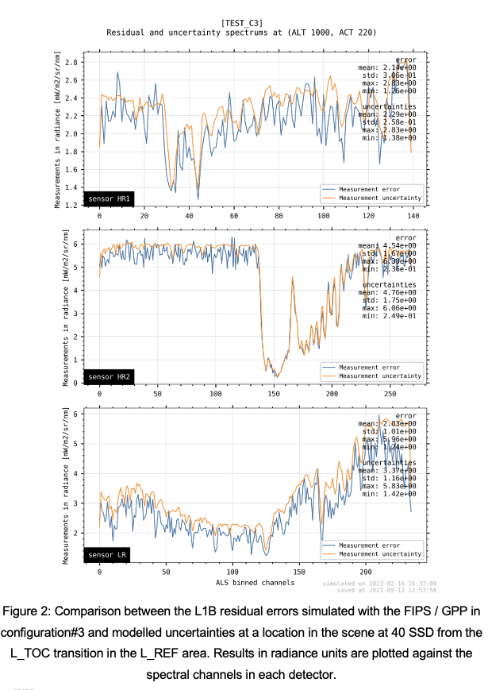
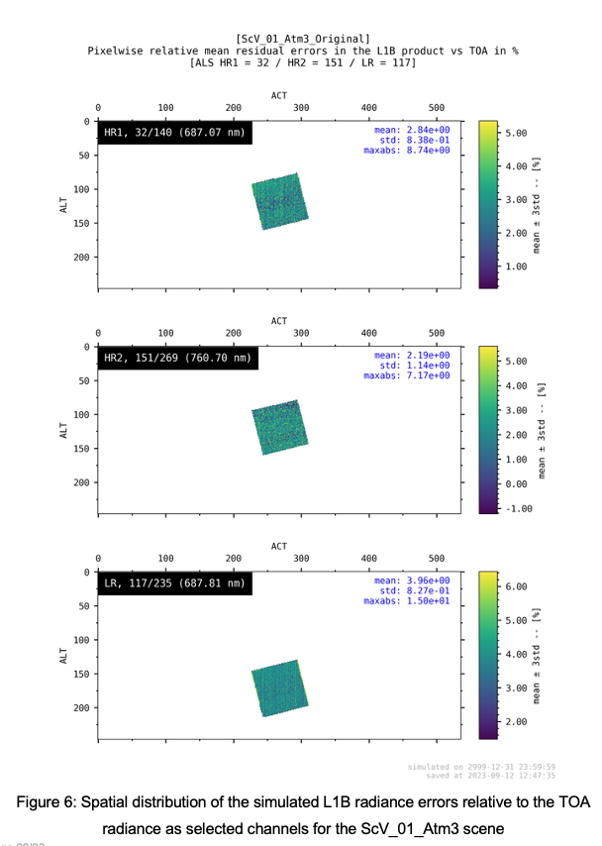
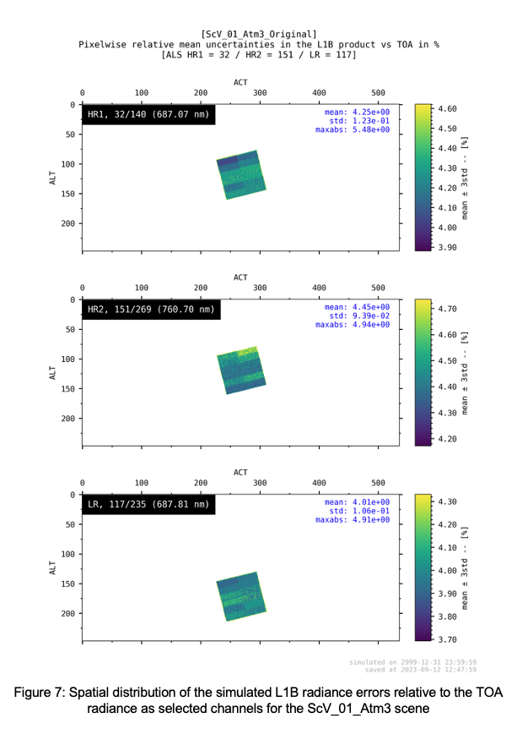
L1B uncertainty modelling: a simple approach
L1b errors simulated with FIPS/GPP vs. L1B uncertainty analytical model output

