Slide 1
Point-to-pixel upscaling and uncertainty
in FLEX L2 reflectance validation
Pieter De Vis, Astrid M. Zimmermann, Harry Morris, Agnieszka Bialek, Roberto Colombo & FLEX-DISC team
Giulia Tagliabue, Micol Rossini, Bastian Siegmann, Timo H. Virtanen, Juliane Bendig, Christiaan van der Tol, Béatrice Berthelot, Louis Sainte-Marie, Gwennaël Matot, Jorge Vicent Servera, Ornela Nanushi, Brice Mora, Neus Sabater, Pekka Kolmonen, Pietro Chierichetti, Sergio Cogliati, Egor Prikaziuk, Darren Ghent, Jasdeep S. Anand, Uwe Rascher, Tommaso Julitta, Andreas Burkart, Marco Celesti, Dirk Schüttemeyer, Marin Tudoroiu, Alireza Mahmoodi

Slide 2


Context
FLEX-DISC validation of L2 apparent reflectance and irradiance
Using automated networks acquiring reflectance and irradiance measurements across a range of land-cover types across the world
  INSIF (FloX)
  HYPERNETS
  Maximises number of validation matchups,
  but often comparing single point (~1m) to FLEX pixel (300m)
  Complementary to more intense dedicated campaigns
Validation is done with an as robust as possible uncertainty budget
​ | wavelength​ | SSI​ | FWHM​
FLUO​ | 650–800 nm​ | 0.17 nm​ | 0.3 nm​
FULL​ | 400–950 nm​ | 0.65 nm​ | 1.5 nm​
​ | wavelength​ | SSI​ | FWHM​
VNIR​ | 380–1000 nm​ | 0.5 nm​ | 3 nm​
SWIR​ | 1000–1680 nm​ | 3 nm​ | 10 nm​

Slide 3
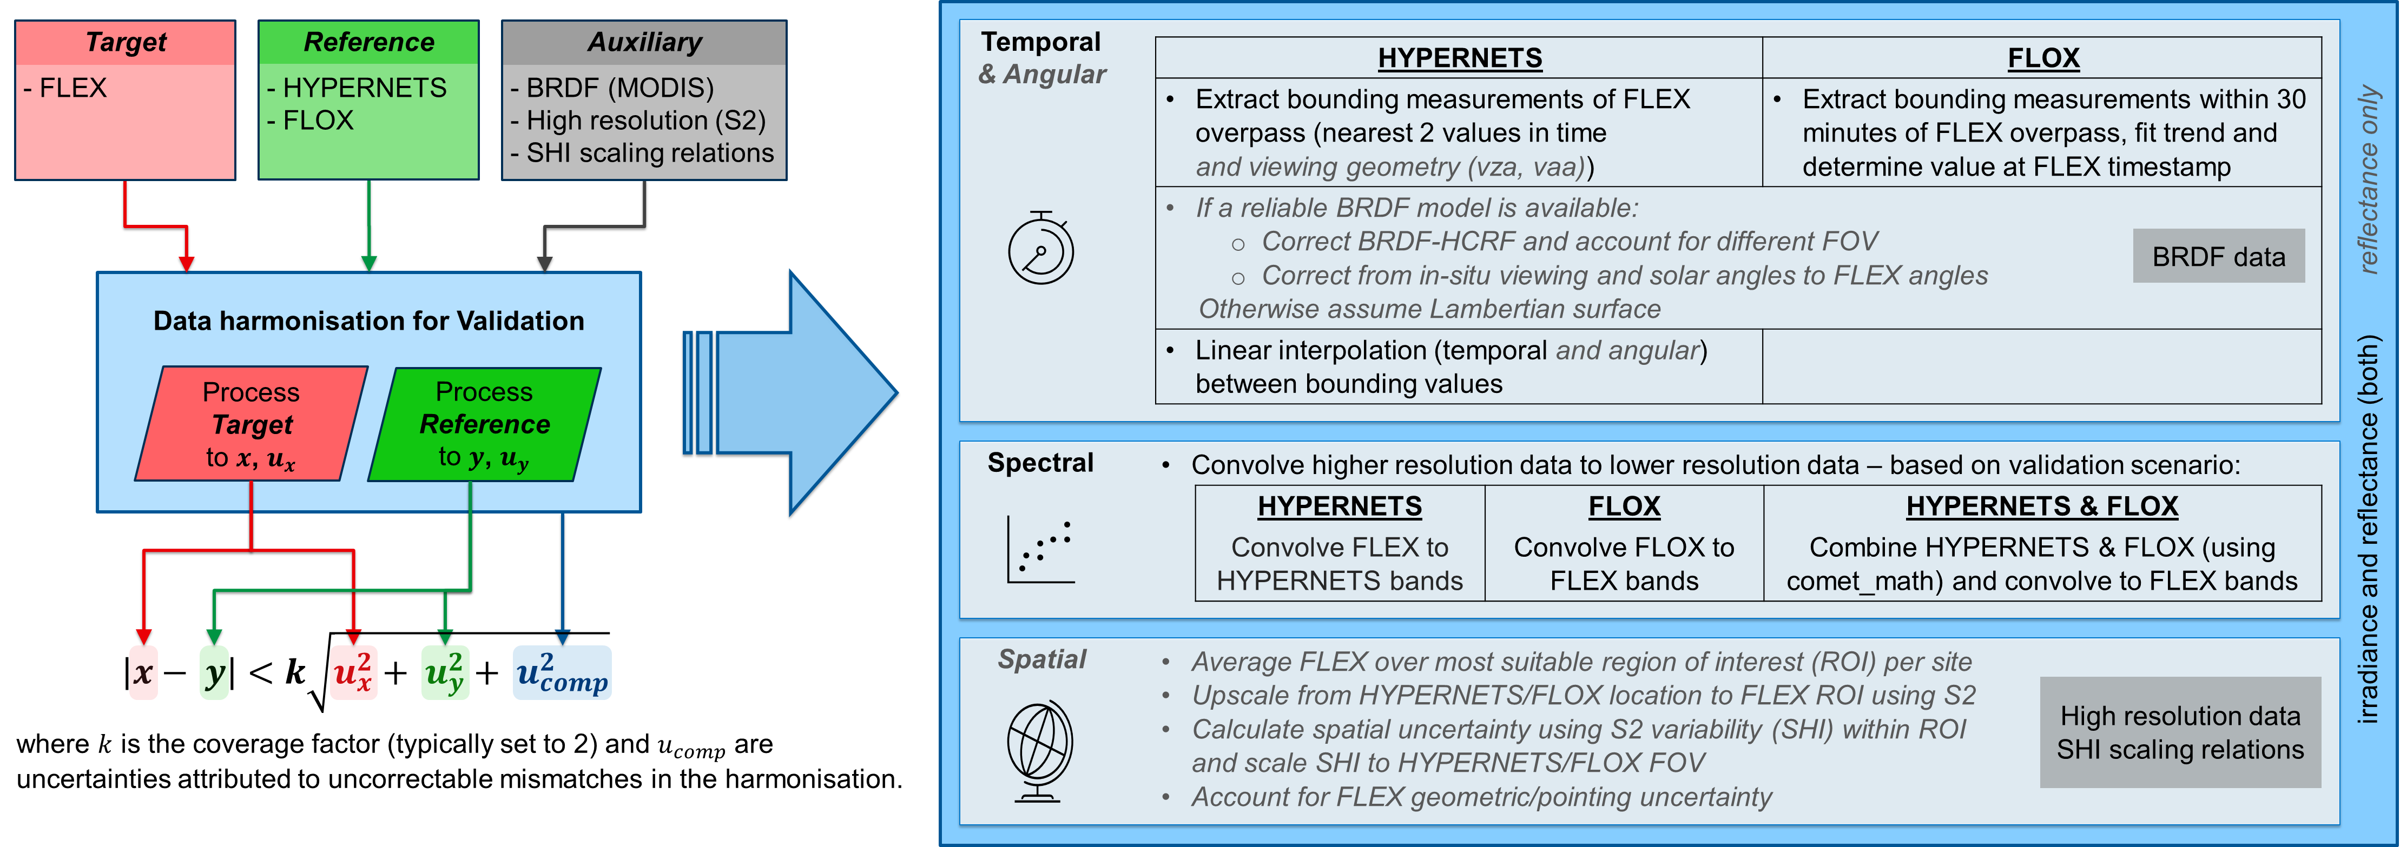
L2 surface reflectance Validation Tool
See poster by Astrid M. Zimmermann

Slide 4
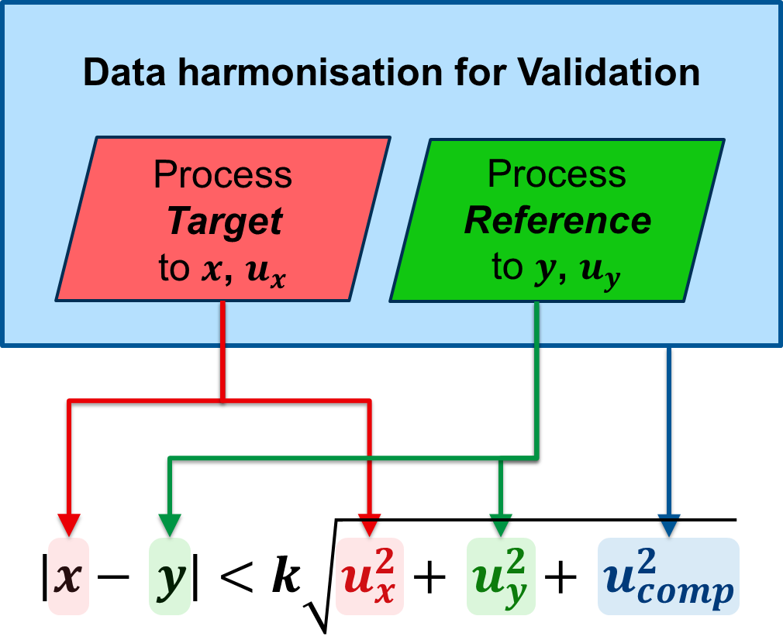
Uncertainties overview
Target product uncertainty
  FLEX products provided with uncertainties
Reference data uncertainty
  HYPERNETS and INSIF data provided with uncertainty and error correlation information (NetCDF files with random and systematic uncertainty components)
Mismatch-driven uncertainty
  spectral
    Uncertainties on wavelengths need to be propagated
  temporal-angular variability
  spatial variability
Focus of following slides

Slide 5
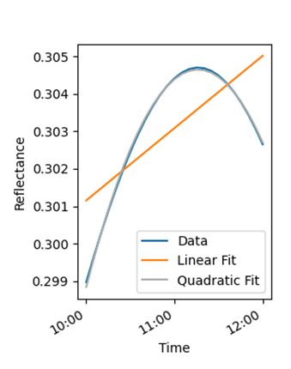
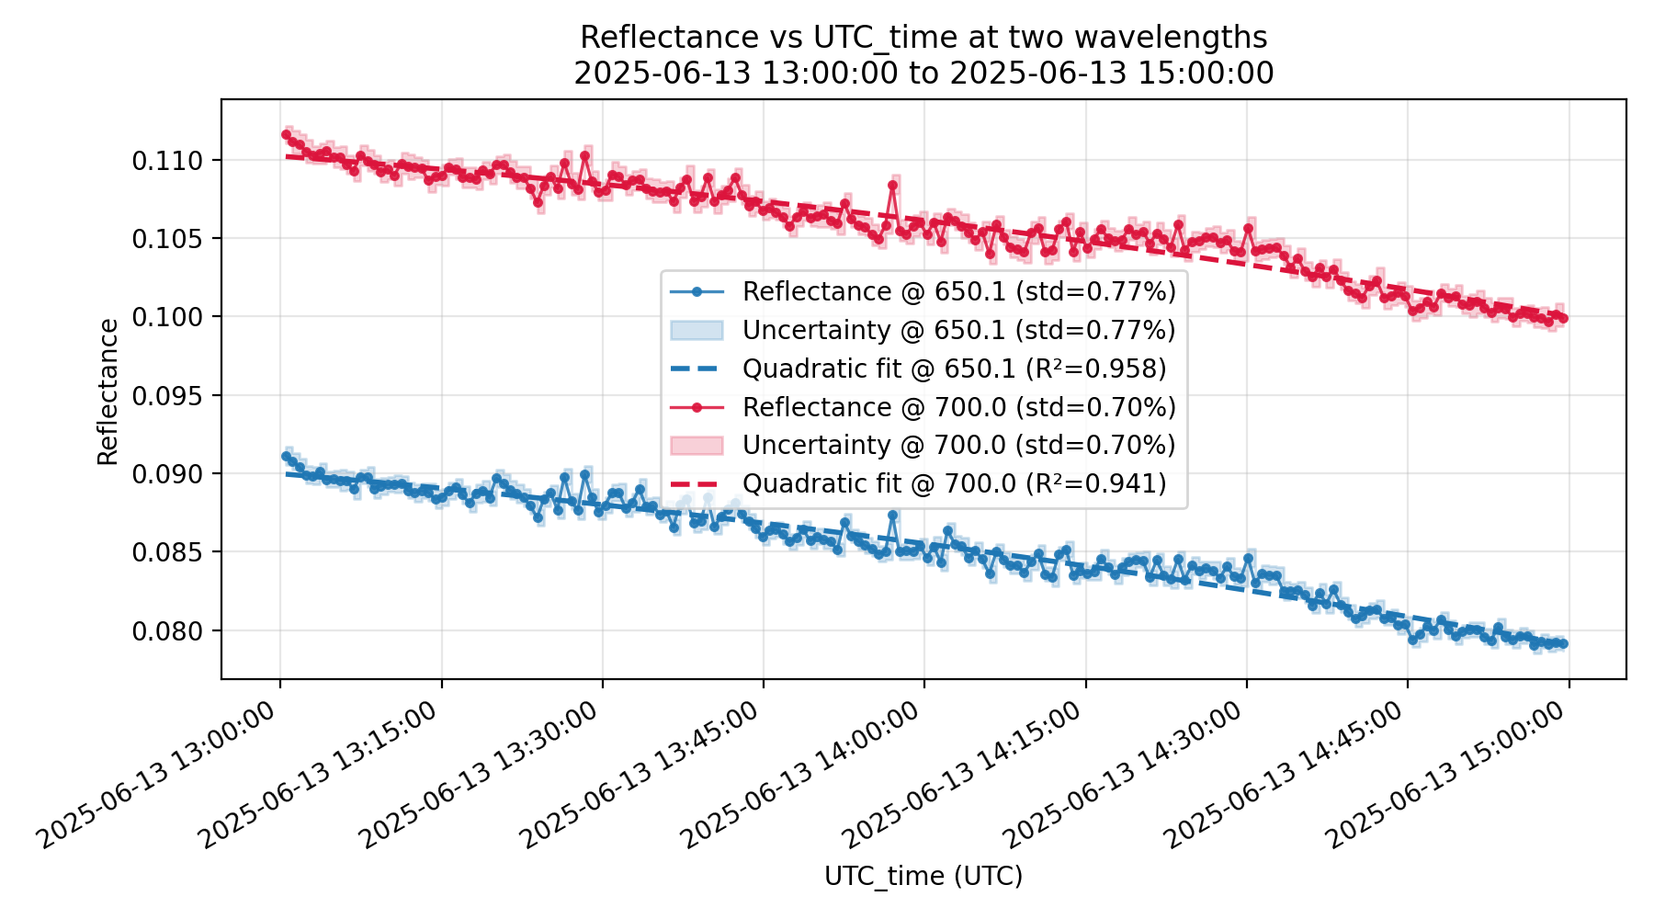
Temporal-angular uncertainty
Expected temporal/angular variability:
Can be corrected using BRDF model from e.g. MODIS MCD43A1
  Also needed to correct between HCRF and BRF, and account for FOV
  If no reliable BRDF data available, Lambertian is assumed. Accounted for in uncertainty
Uncertainties are calculated from std between corrected measurements (subtract random uncertainties)
  For FLOX, 2nd order trend can be fitted to all data within 30 or 60 mins and used to correct.
  For HYPERNET, multiple viewing angles are used and corrected to FLEX geometry.

Slide 6
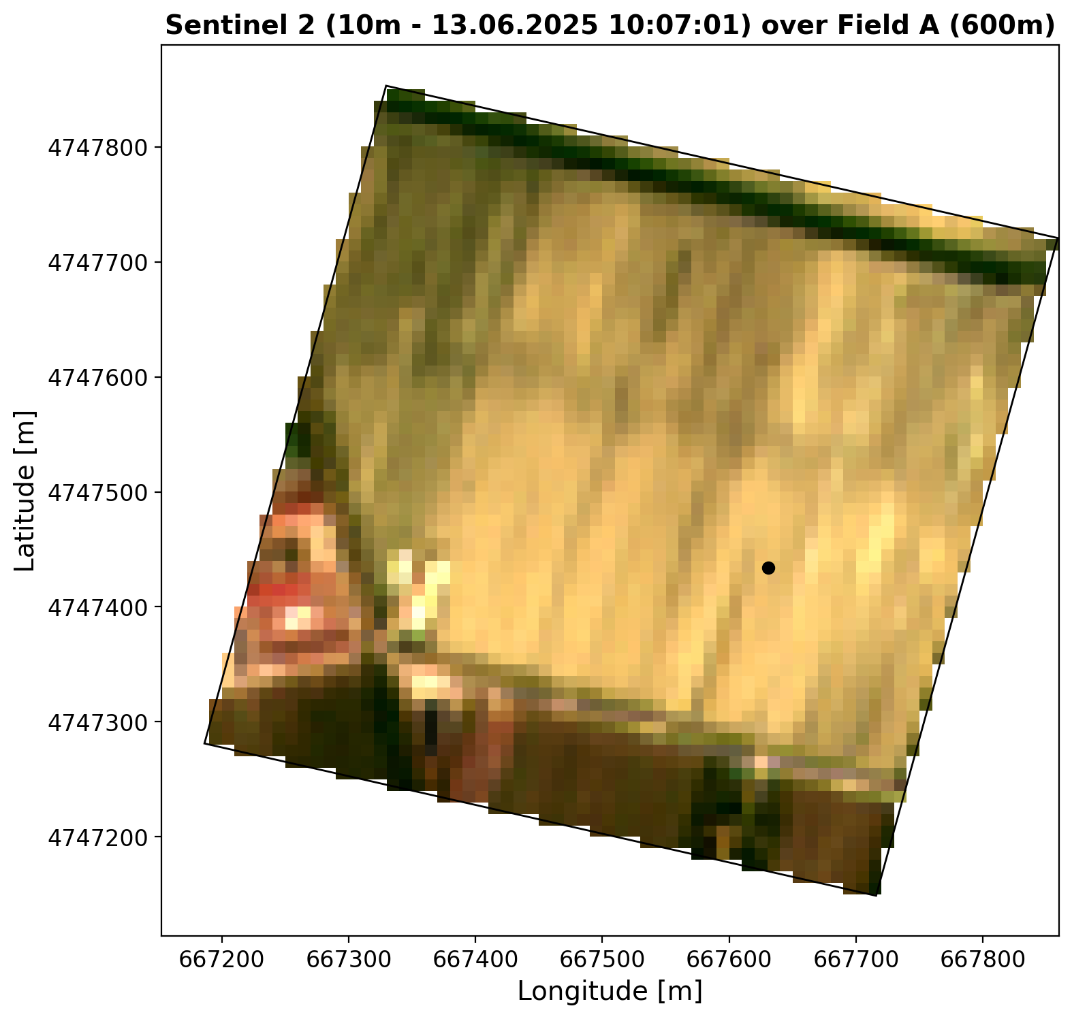
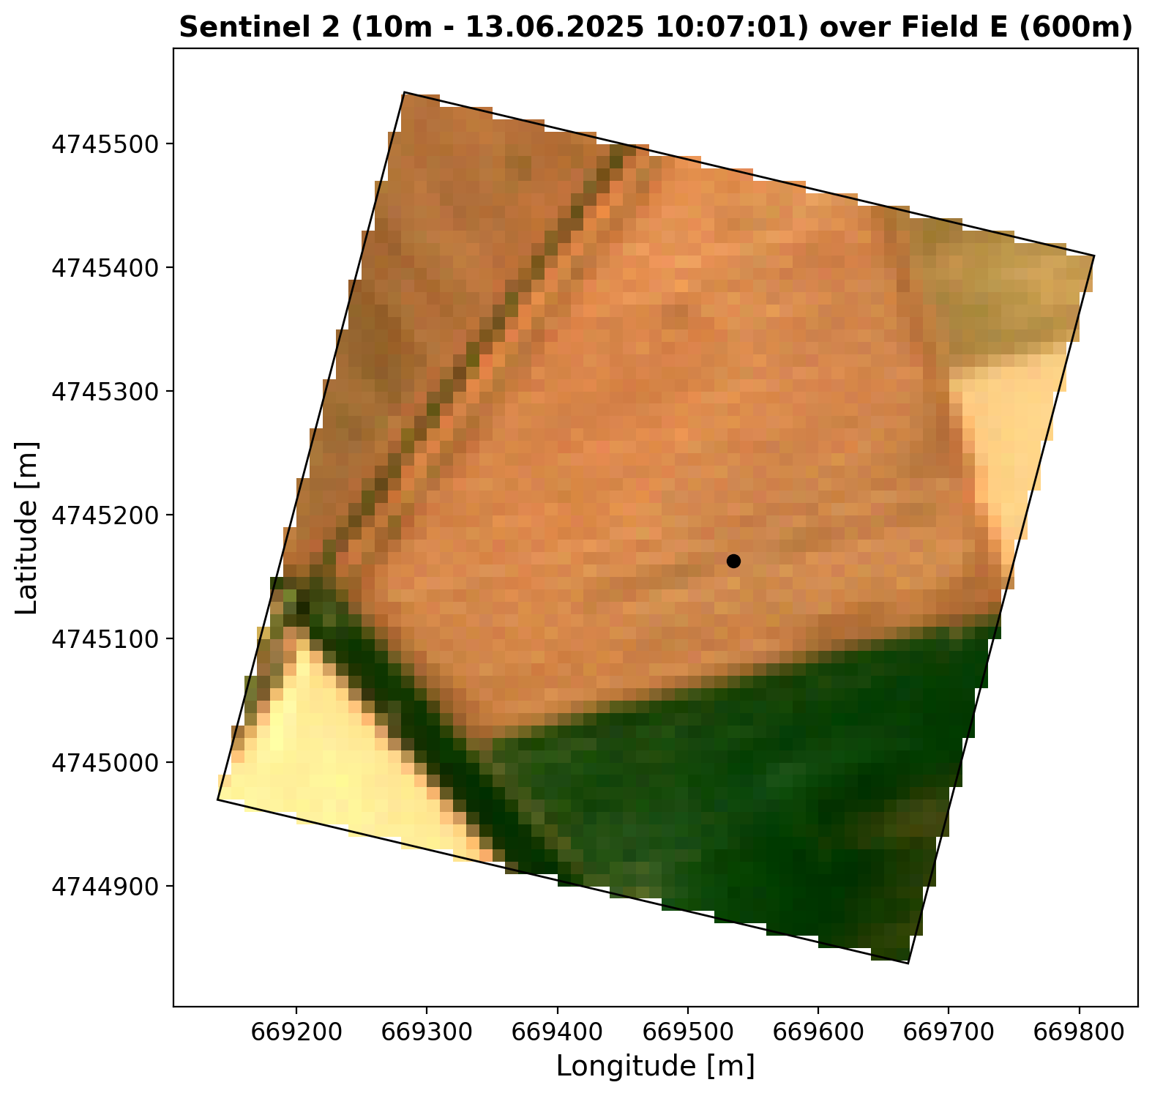
Understanding Spatial Variability Uncertainties
Scale Mismatch Issue
  Reference measurements cover a small area compared to
  the large FLEX ROI (pixel size of 300 by 300 meters).
Impact of Landscape Heterogeneity
  Spatial variability is significant in heterogeneous landscapes with
  varying vegetation and soil conditions over potentially short distances.
Limitations of Sparse Sampling Networks
  Sparse, point-based networks like INSIF & HYPERNETS cannot capture
  full spatial patterns leading to increased uncertainty.
  Instrument location often not chosen considering FLEX pixel boundaries.
Need to quantify spatial variability
  Quantifying spatial variability with metrics based on high-resolution data
  ensures better interpretation of reference measurements.
2x2 FLEX pixel RGB

Slide 7
Ground-to-Pixel Upscaling Methods
Single Point Measurement Limitations
  Single point measurements work best on homogeneous surfaces but may misrepresent heterogeneous pixel areas. Need uncertainties to account for this.
Transfer Function Approach
  Uses high-resolution ancillary data like Sentinel-2 and UAV imagery to correct measurement representativeness errors.
Multi-point Sampling Benefits
  Aggregates measurements from multiple sensors within a pixel to reduce uncertainties statistically.
Image-based Reference Methods
  Continuous imagery provides high-resolution matching, enabling precise pixel-scale upscaling with small uncertainties due to spatial variability.

Slide 8
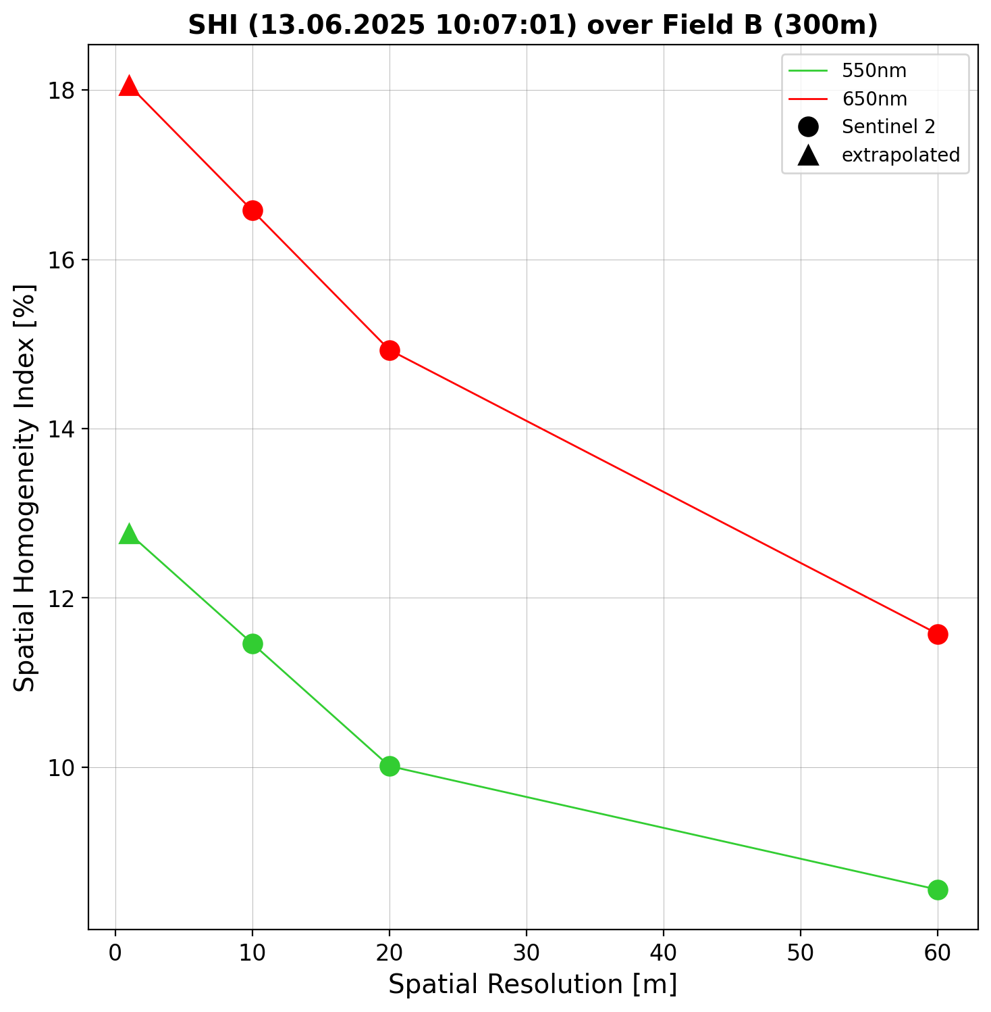

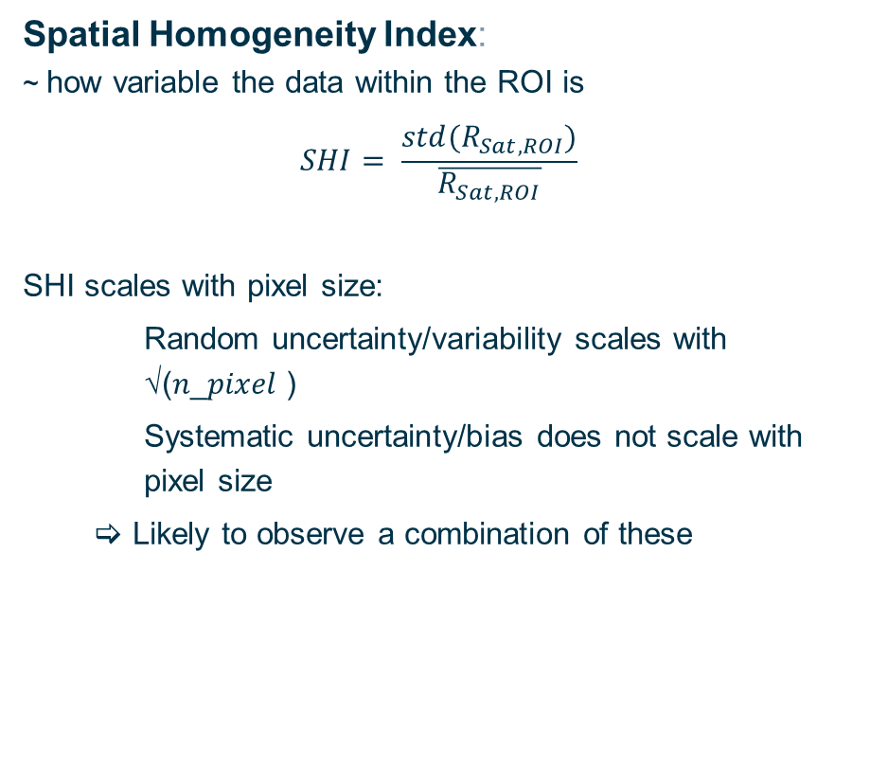
Spatial Homogeneity and Representativity Indices
Spatial Homogeneity Index:
~ how variable the data within the ROI is
$$SHI= \frac{std(R_{Sat,ROI})}{\overline{R_{Sat,ROI}}}$$
SHI scales with pixel size:
  Random uncertainty/variability scales with √(𝑛_𝑝𝑖𝑥𝑒𝑙 )
  Systematic uncertainty/bias does not scale with pixel size
   Likely to observe a combination of these
Spatial Representative Index:
~ how representative is a given pixel for the whole ROI
$$SRI= \frac{R_{Sat,ref }−\overline{R_{Sat,ROI}}}{\overline{R_{Sat,ROI}}}$$
While the SRI can be used as upscaling factor from the FLOX measurement to FLEX pixel (via another high-resolution dataset);
the SHI helps determining the uncertainty associated.
FLEX-DISC L2A methodology
L2A S2 reflectances are used to quantify SHI and SRI. These are spectrally and temporally interpolated to match reference data

Slide 9

Uncertainties With and Without Transfer Functions
Uncertainty Without Transfer Function
Without transfer functions, SRI verifies measurement representativity (as QC), while SHI accounts for spatial variability within ROI.
Uncertainty With Transfer Function
Reference reflectances are divided by (1+SRI). Instead of using SHI as estimate of the uncertainty, the uncertainty on SRI is used.
$${\left(\frac{u_{SRI}}{SRI}\right)}^{2}={\left(\frac{u_{ρ}}{ρ}\right)}^{2}+{\left(\frac{u_{{\overline{ρ}}_{LxL}}}{{\overline{ρ}}_{LxL}}\right)}^{2}+{\left(\frac{u_{intp}}{SRI}\right)}^{2}$$
Reference reflectances are divided by (1+SRI). Instead of using SHI as estimate of the uncertainty, the uncertainty on SRI is used.
(𝑢_𝑆𝑅𝐼/𝑆𝑅𝐼)^2=(𝑢_𝜌/𝜌)^2+(𝑢_(𝜌 ̅_𝐿𝑥𝐿 )/𝜌 ̅_𝐿𝑥𝐿 )^2+(𝑢_𝑖𝑛𝑡𝑝/𝑆𝑅𝐼)^2
Accounting for geometric uncertainty
Need to account for uncertainties in the FLEX pointing, using MC or analytical methods.
FLEX-DISC L2A methodology
S2 is used for SRI and SHI calculation.
SHI needs to be scaled from 10m to 1m pixel size.
SRI uncertainty contributions:
  S2 random uncertainties from S2-RUT ($u_{ρ}$ & $u_{{\overline{ρ}}_{LxL}}$)
  Uncertainty on how well FLOX represents 10m pixel ($u_{ρ}$)
  FLEX geometric uncertainty ($u_{{\overline{ρ}}_{LxL}}$)
  Temporal and spectral interpolation of SRI ($u_{intp}$)

Slide 10
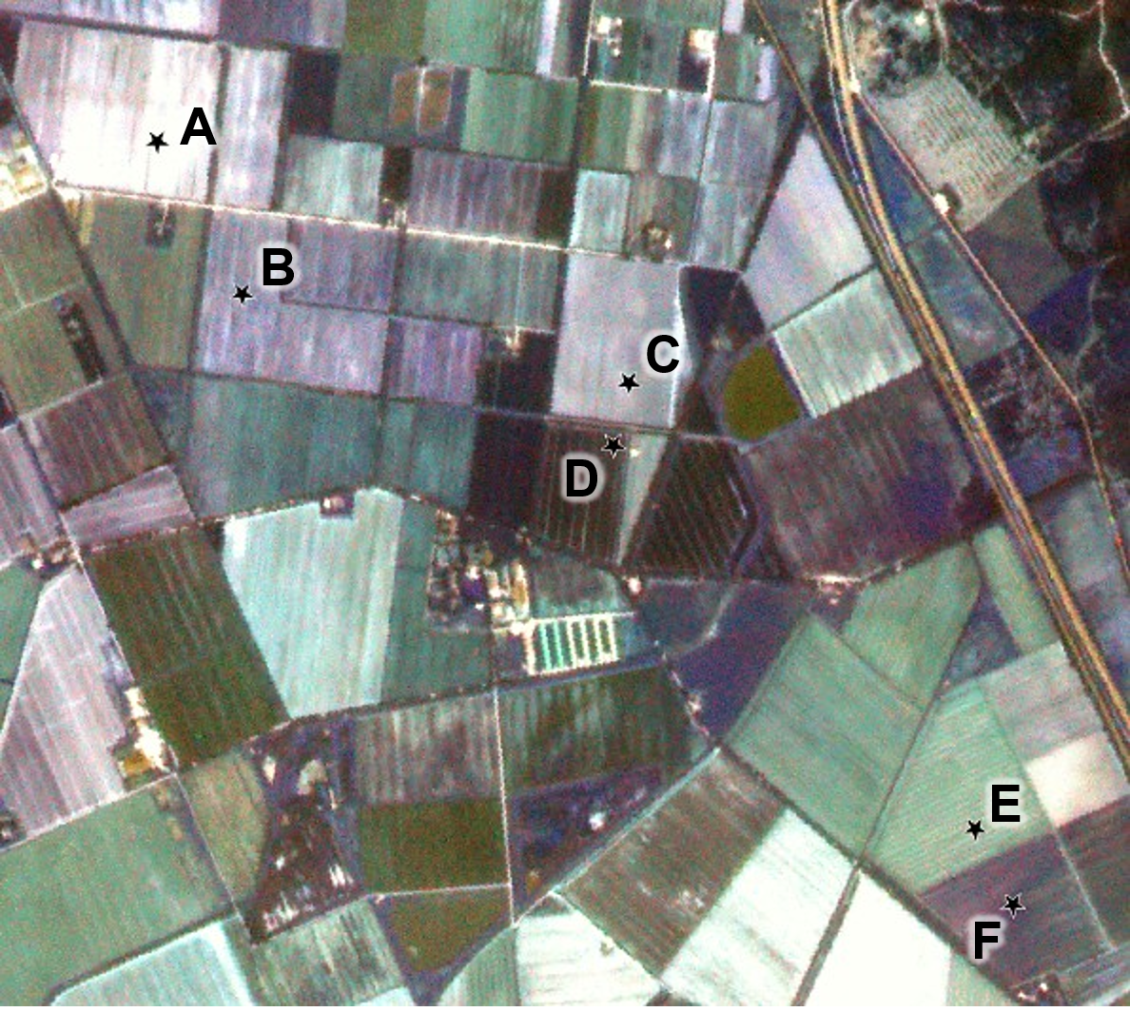
FRM4FLUO campaign
Multiple measurement methods:
Single point reference (FLOX) – FLEX DISC methodology:
  without transfer function
  with S2 transfer function
Multiple points reference:
  Few points (multiple FLOX) with S2 transfer function
  Many points (AirFLOX, Helipod)
    removes need for transfer functions and captures true mean directly, lowering uncertainty.​
Image reference (HyPlant)
Using image minimizes spatial variability uncertainty.
Diagnostic Uncertainty Checks​
Multi-point and image measurements can be used to validate FLEX-DISC upscaling methodology and uncertainties
FRM4FLUO campaign
13. – 16.06.2025
Northern Italy
6 fields: Corn, Corn (small), Tomato (/bare soil), Corn (medium), Wheat (dry), Clover
See poster by Tommaso Julitta

Slide 11
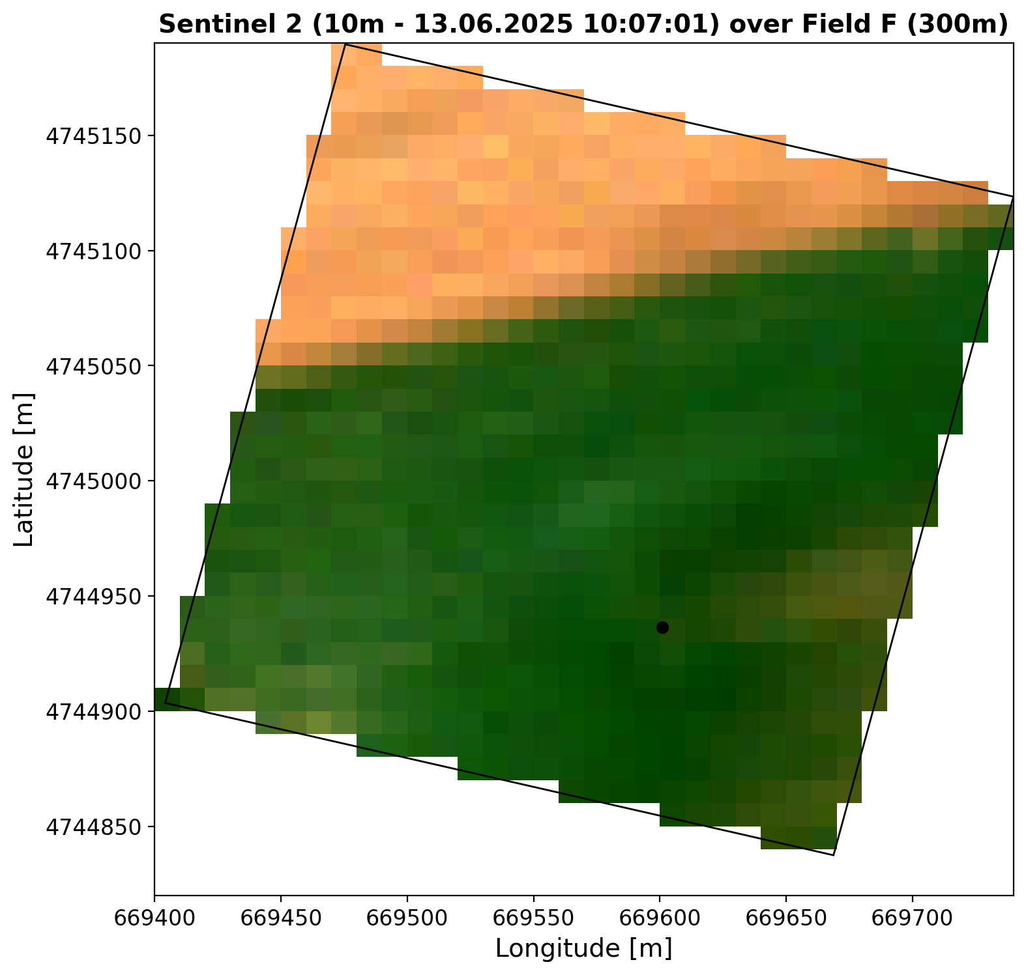
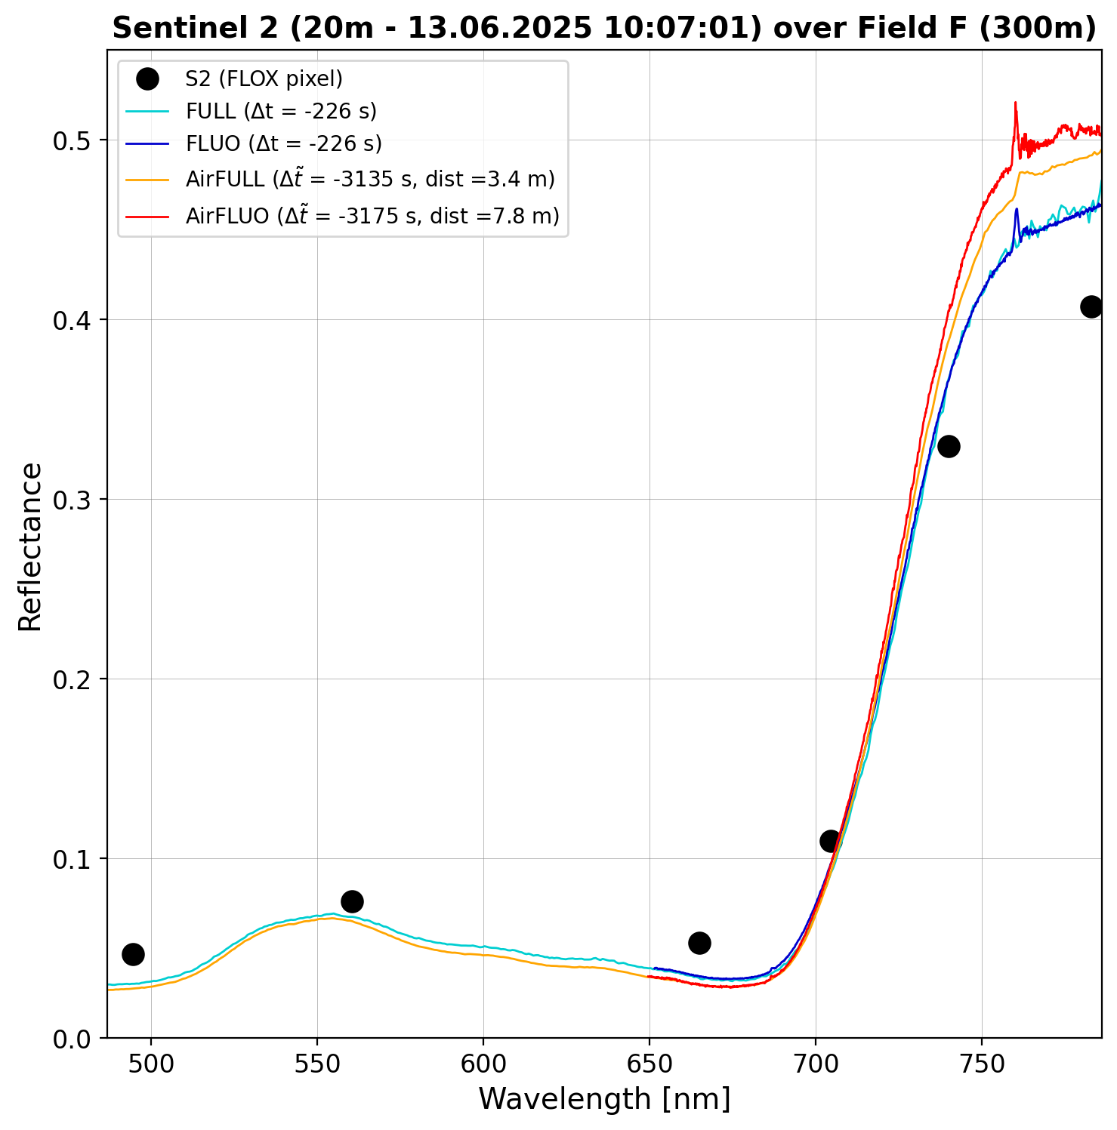
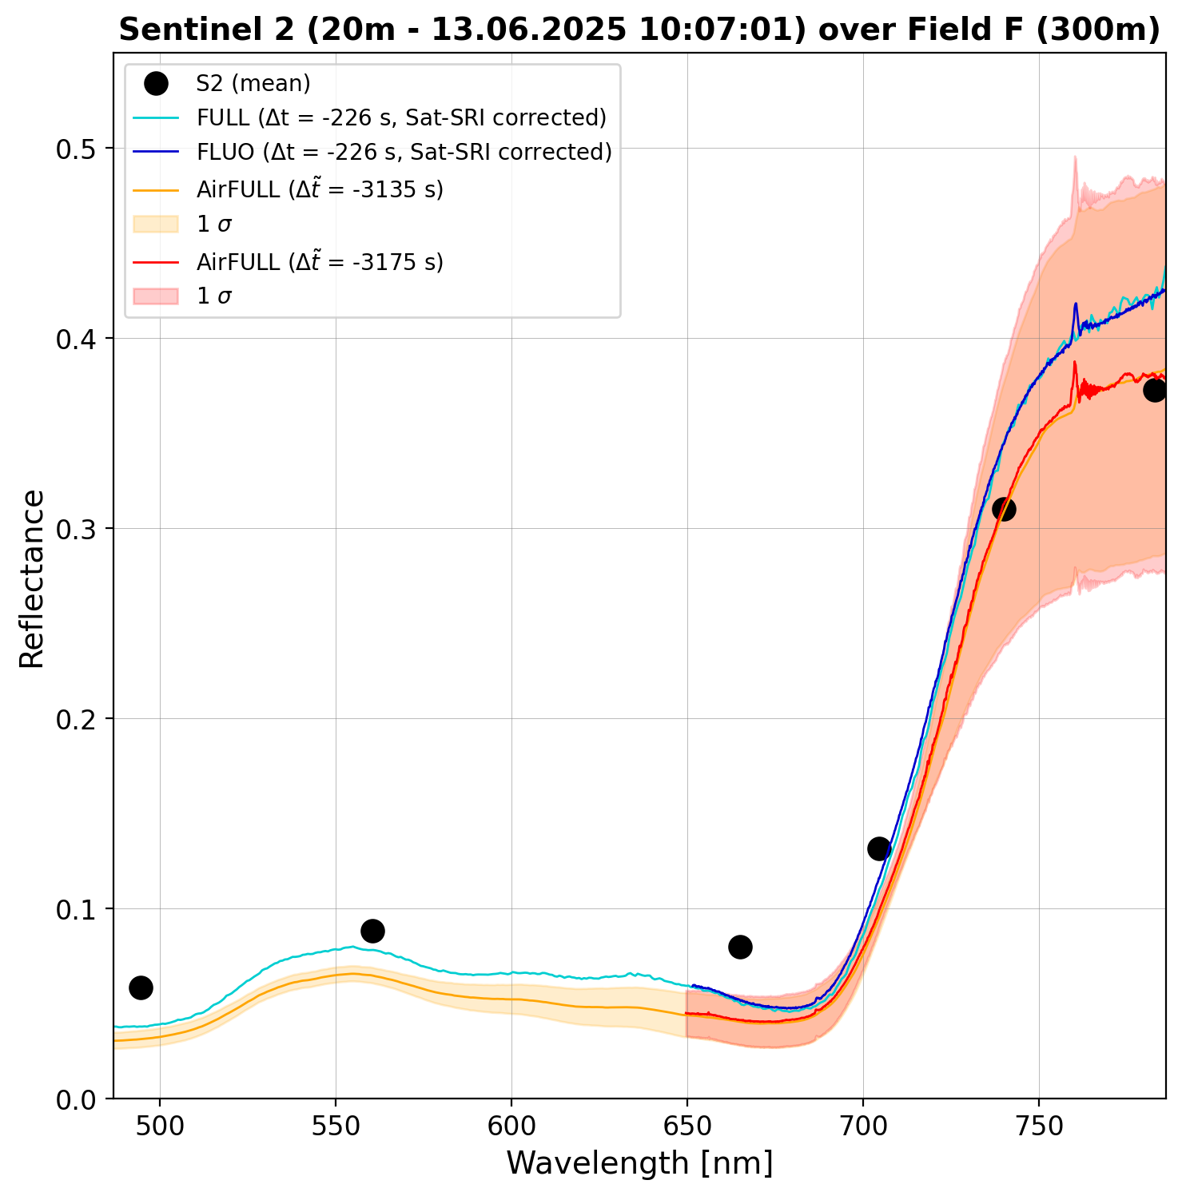
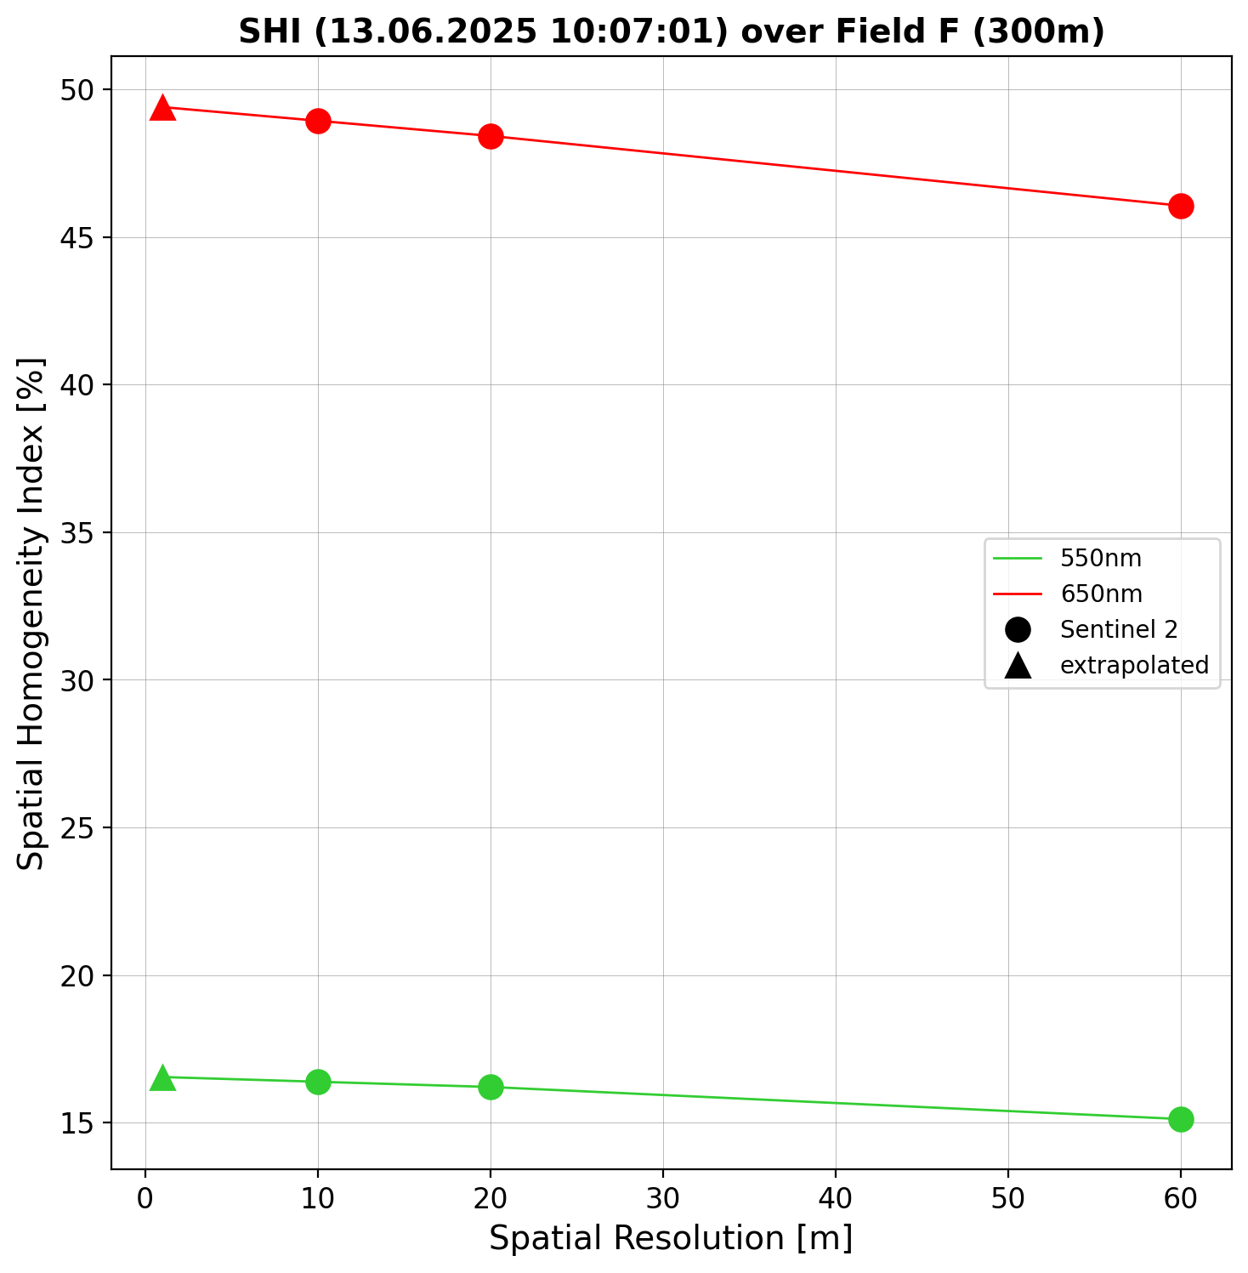
Example FRM4FLUO results
Nearest to FLOX S3/FLEX pixel
(FLOX corrected using transfer function)

Slide 12
Summary
Uncertainties are multi‑source → must be combined consistently.
Temporal & angular effects can be corrected but leave residual uncertainty.
Spatial variability dominates in heterogeneous landscapes.
SHI/SRI indices provide objective measures of homogeneity and representativity.
Transfer‑function approaches improve representativity but require well‑characterized input uncertainties.
Dense sampling or imagery has the lowest spatial variability uncertainties, but requires intensive campaigns

Slide 13
Thank You!
Pieter.de.vis@npl.co.uk

