Slide 1



Integrating tower-based dual-geometry hyperspectral system and drone-based hyperspectral imaging system for calibration and validation of the FLEX mission across multiple ecosystems in South Korea
Presenter: Youngryel Ryu
Jeongho Lee, Wonseok Choi

Slide 2
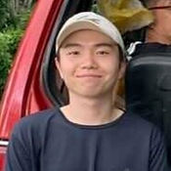

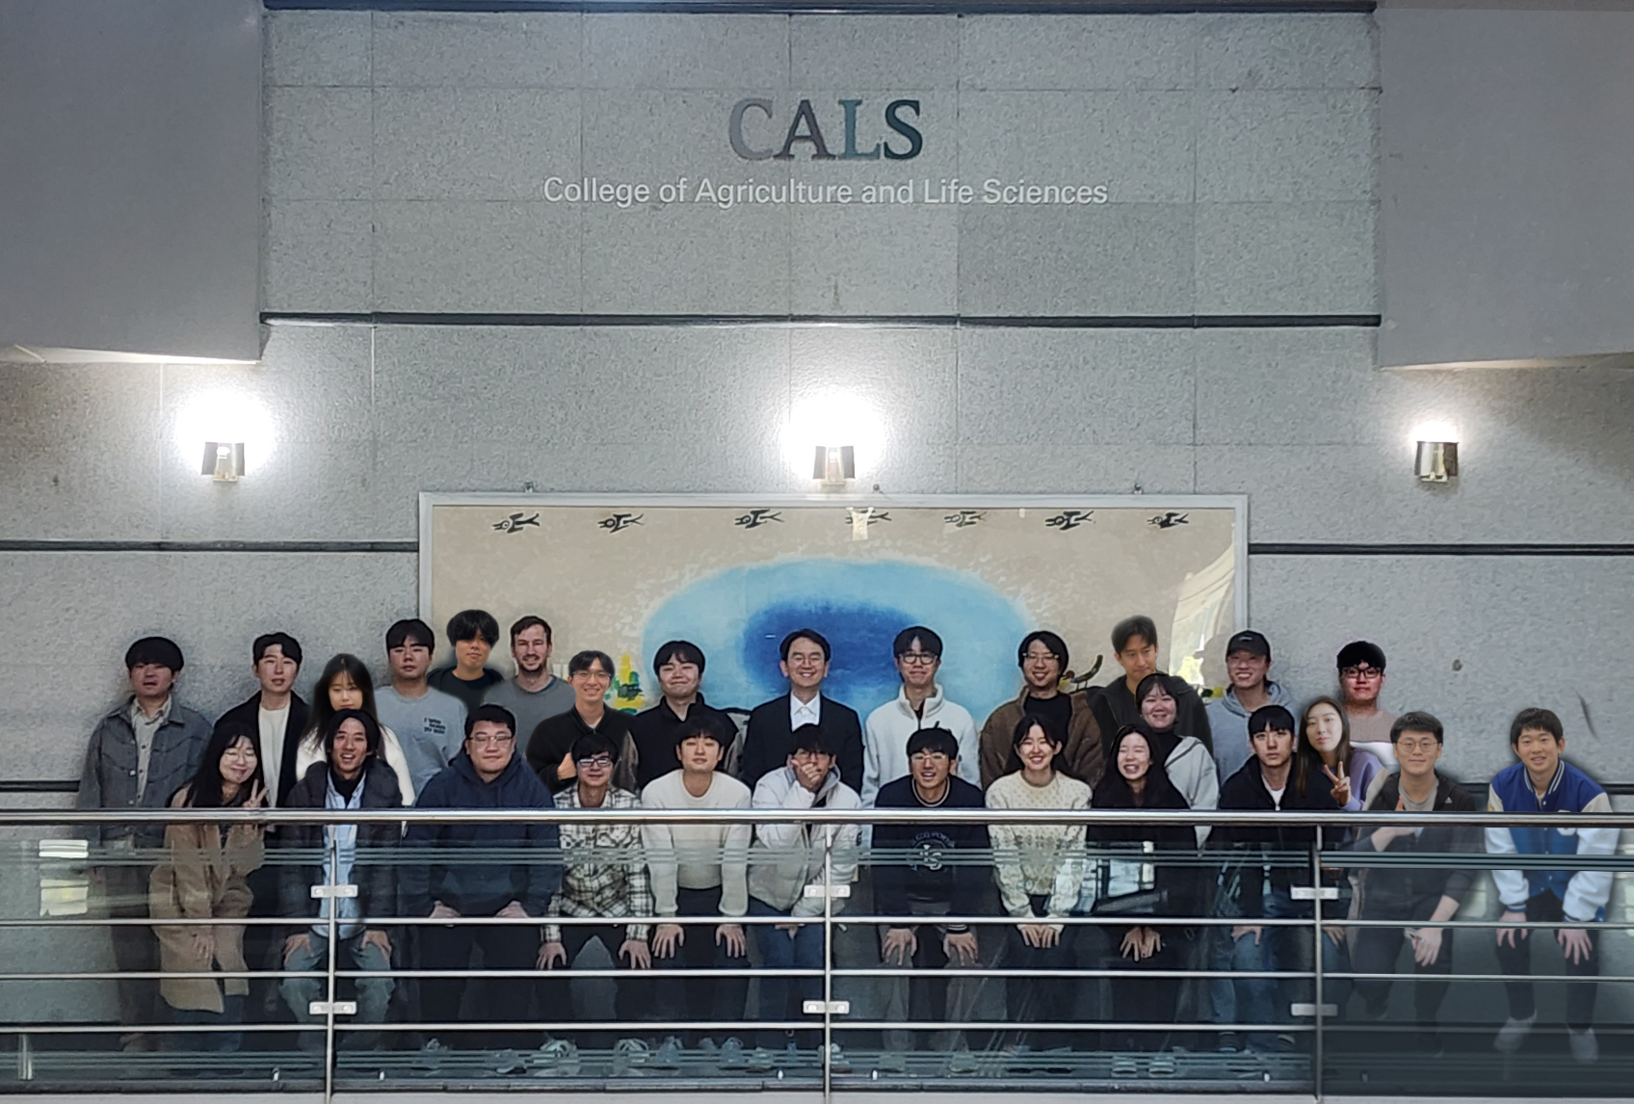









Acknowledgements
Jeongho Lee
Wonseok Choi

Slide 3
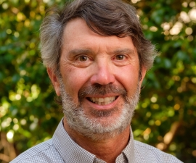
Calibration!
Quote from Dennis Baldocchi
Know Thy site and Thy instruments; Calibrate, Calibrate, Calibrate!

Slide 4
Calibration of spectrometer is very hard
Climate change vs sensor change
Unstable light source
Fiber optics is not light tight
Bending fiber optics change signals
And so on….

Slide 5
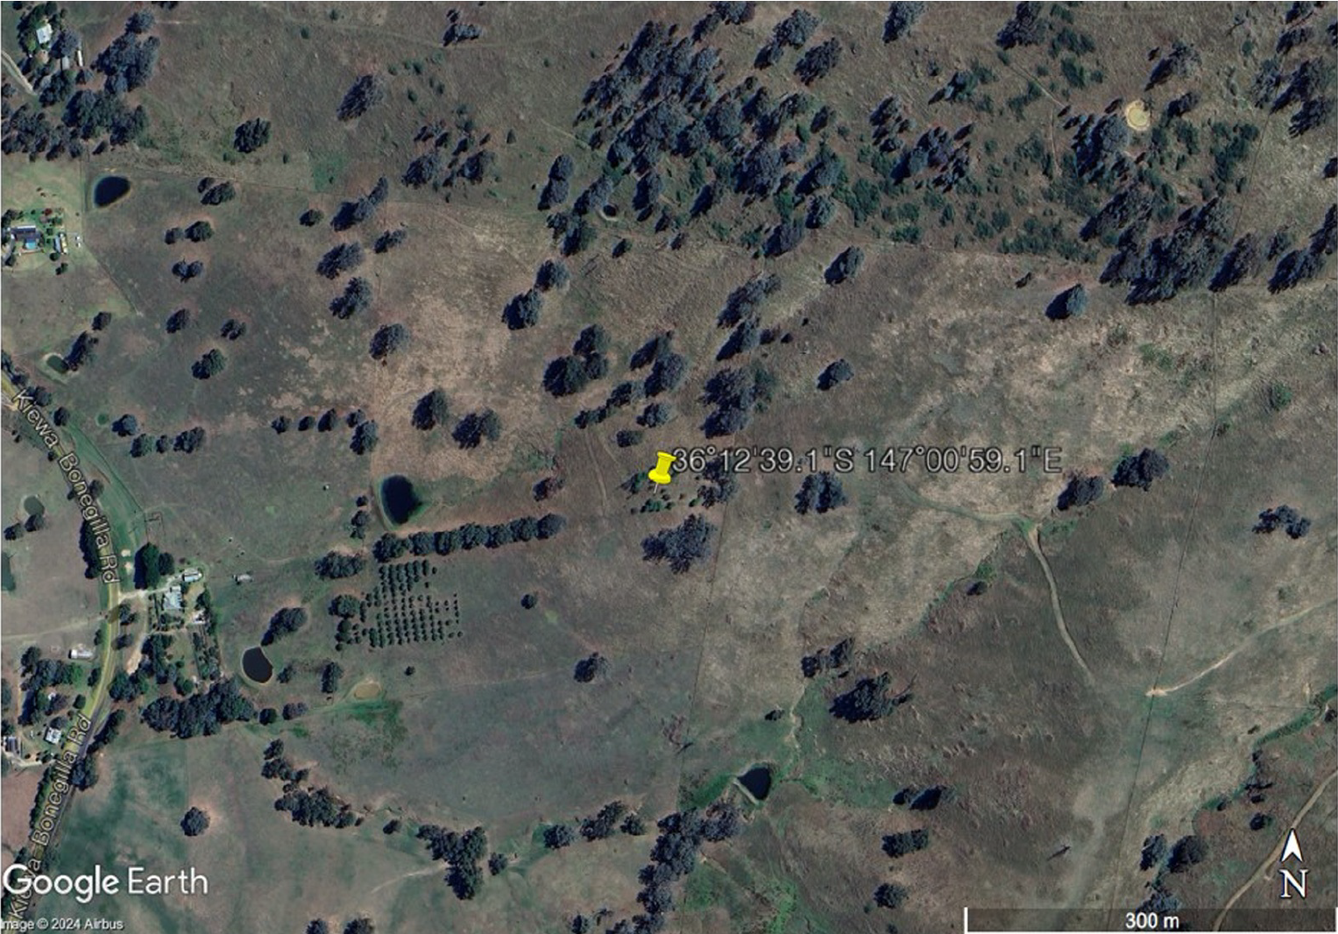
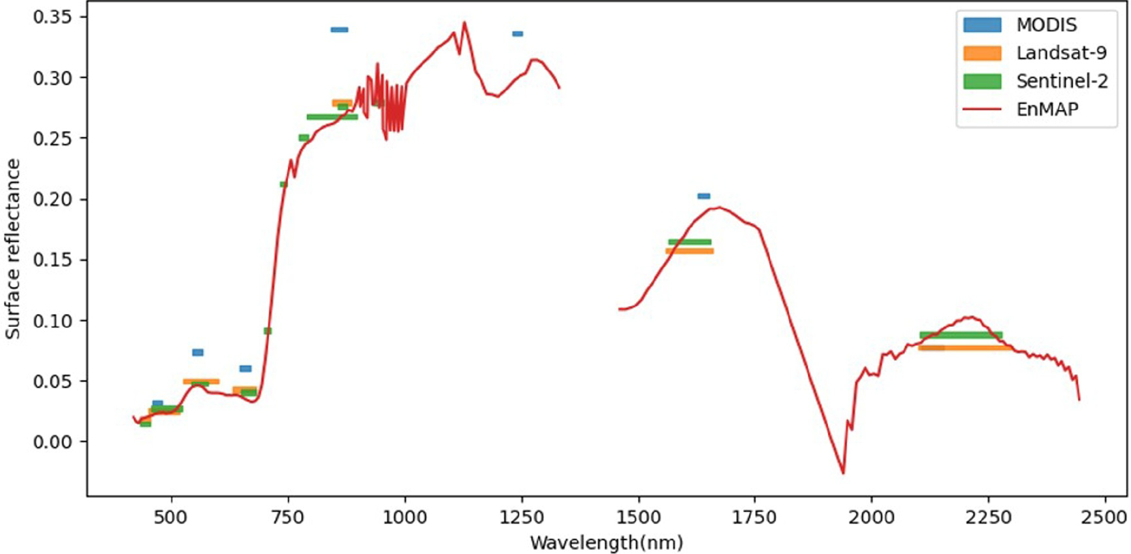
Nature is complex, observations are inconsistent
Spatial, temporal and spectral inconsistencies
Ryu (2024) Journal of Geophysical Research-Biogeosciences

Slide 6
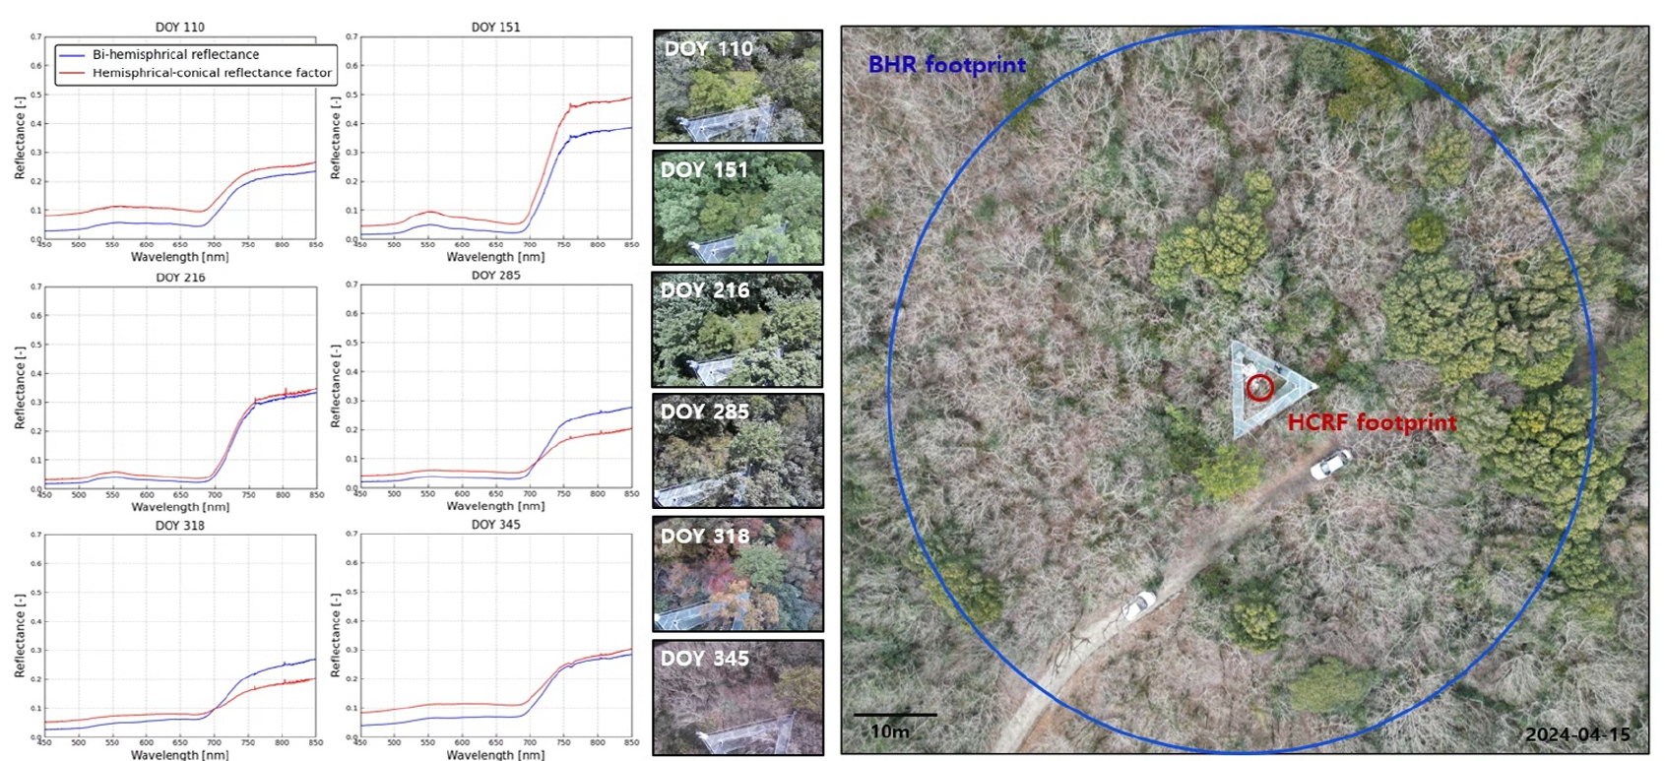
Extraordinary scale gaps between satellite remote sensing, ground optical data, and flux tower footprint
Ryu (2024) Journal of Geophysical Research-Biogeosciences

Slide 7
Goal
Cal/Val FLEX data in space and time across ecosystems in South Korea
  Sun-induced chlorophyll fluorescence
  Hyperspectral reflectance
  Leaf area index
  Canopy photosynthesis

Slide 8

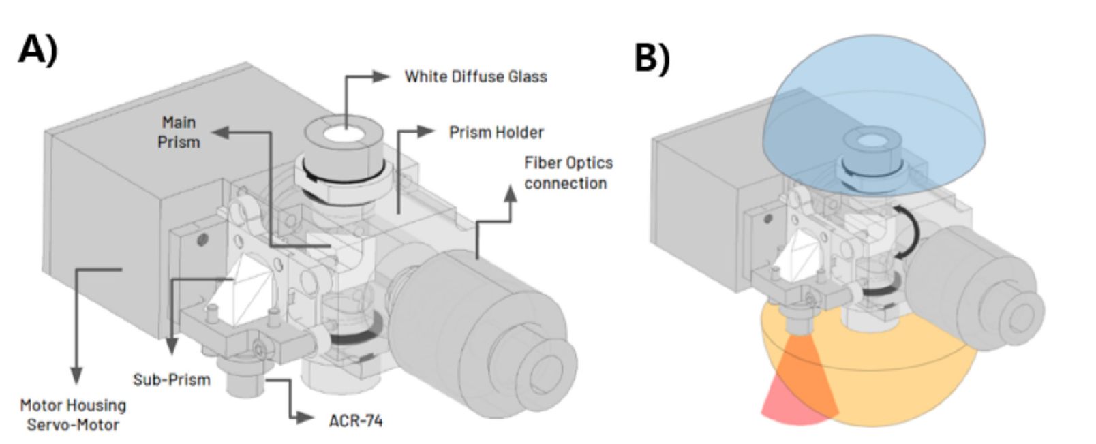
Rotaprism system that integrates BHR and HCRF in VNIR and SIF
Lee et al (2026) Remote Sensing of Environment

Slide 9
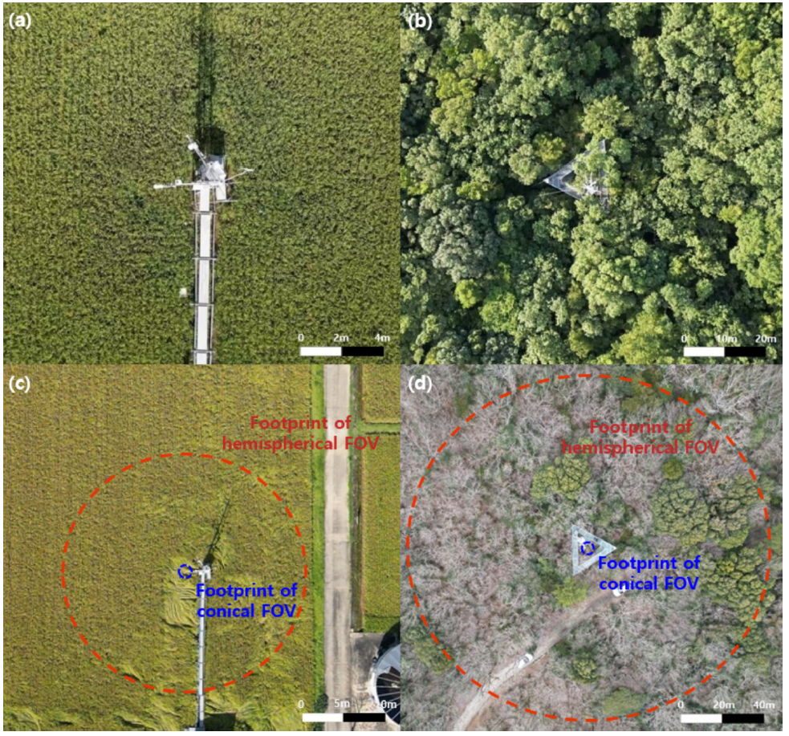
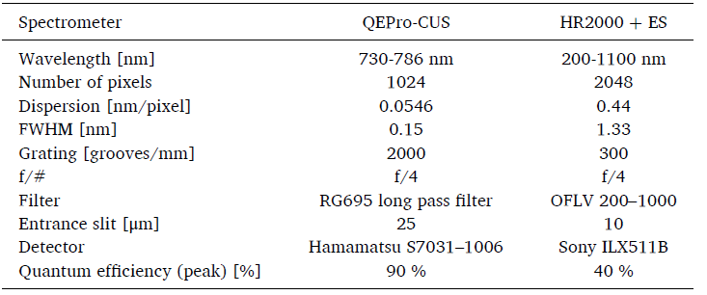
Continuous BHR and HCRF observations
Lee et al (2026) Remote Sensing of Environment

Slide 10
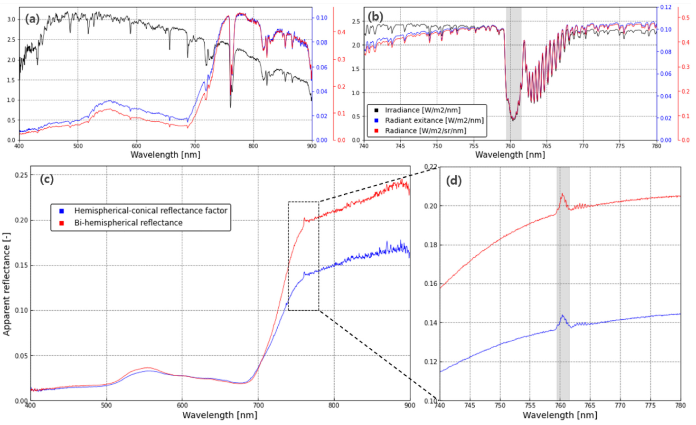
Looking deeper into BHR and HCRF
Lee et al (2026) Remote Sensing of Environment

Slide 11
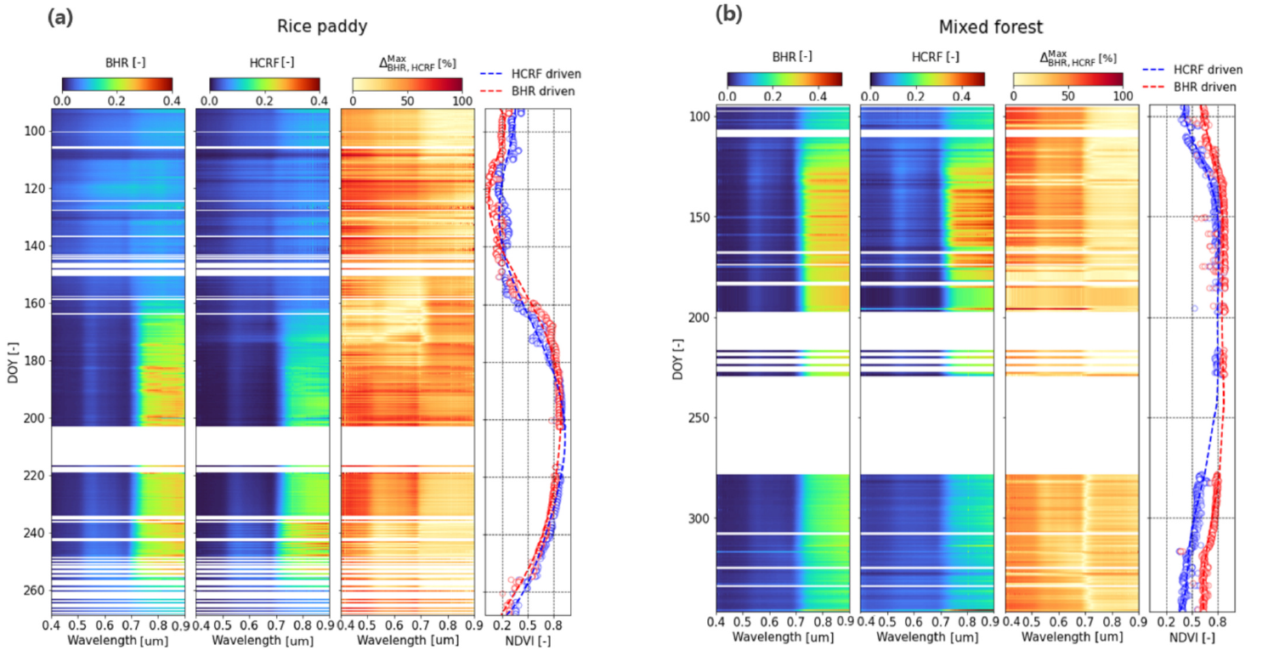
Spectral fingerprints across seasons
Lee et al (2026) Remote Sensing of Environment

Slide 12
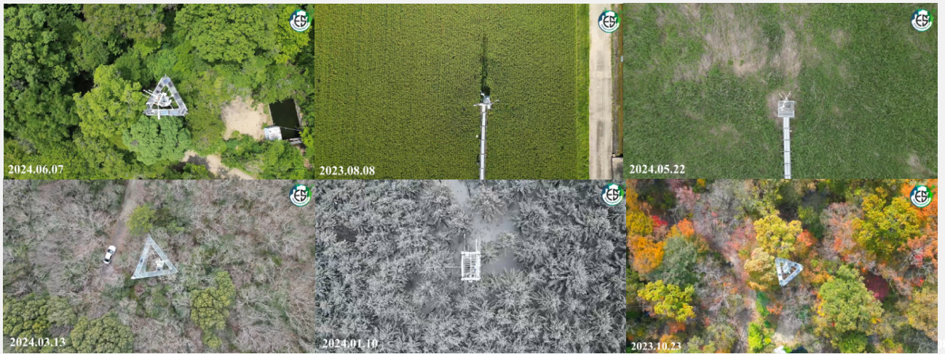
Expanding the Rotaprism system across ecosystems
DBF, ENF, CRO, WET, MF
GRA will be added

Slide 13
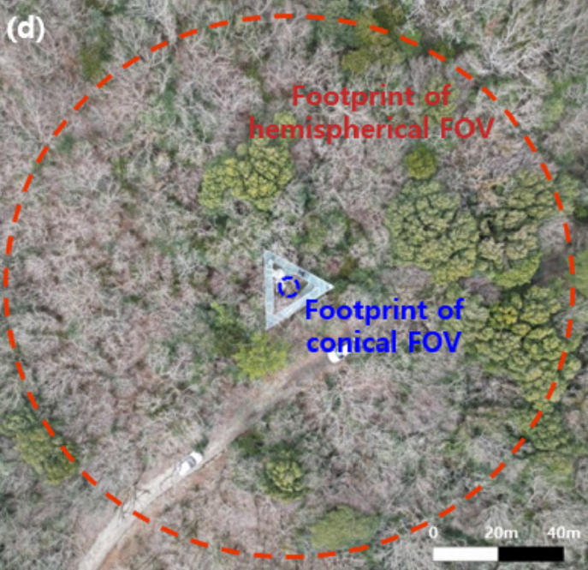
What is missing？
?
?
?
?
?
?
FLEX pixel is 300 m!
?
?
?
?
?
?
?
?
?
?

Slide 14
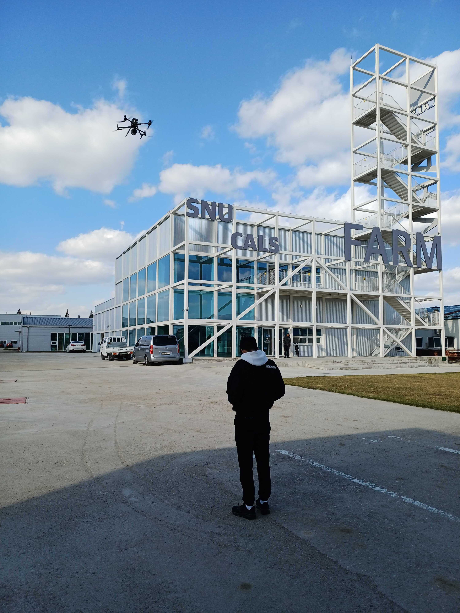
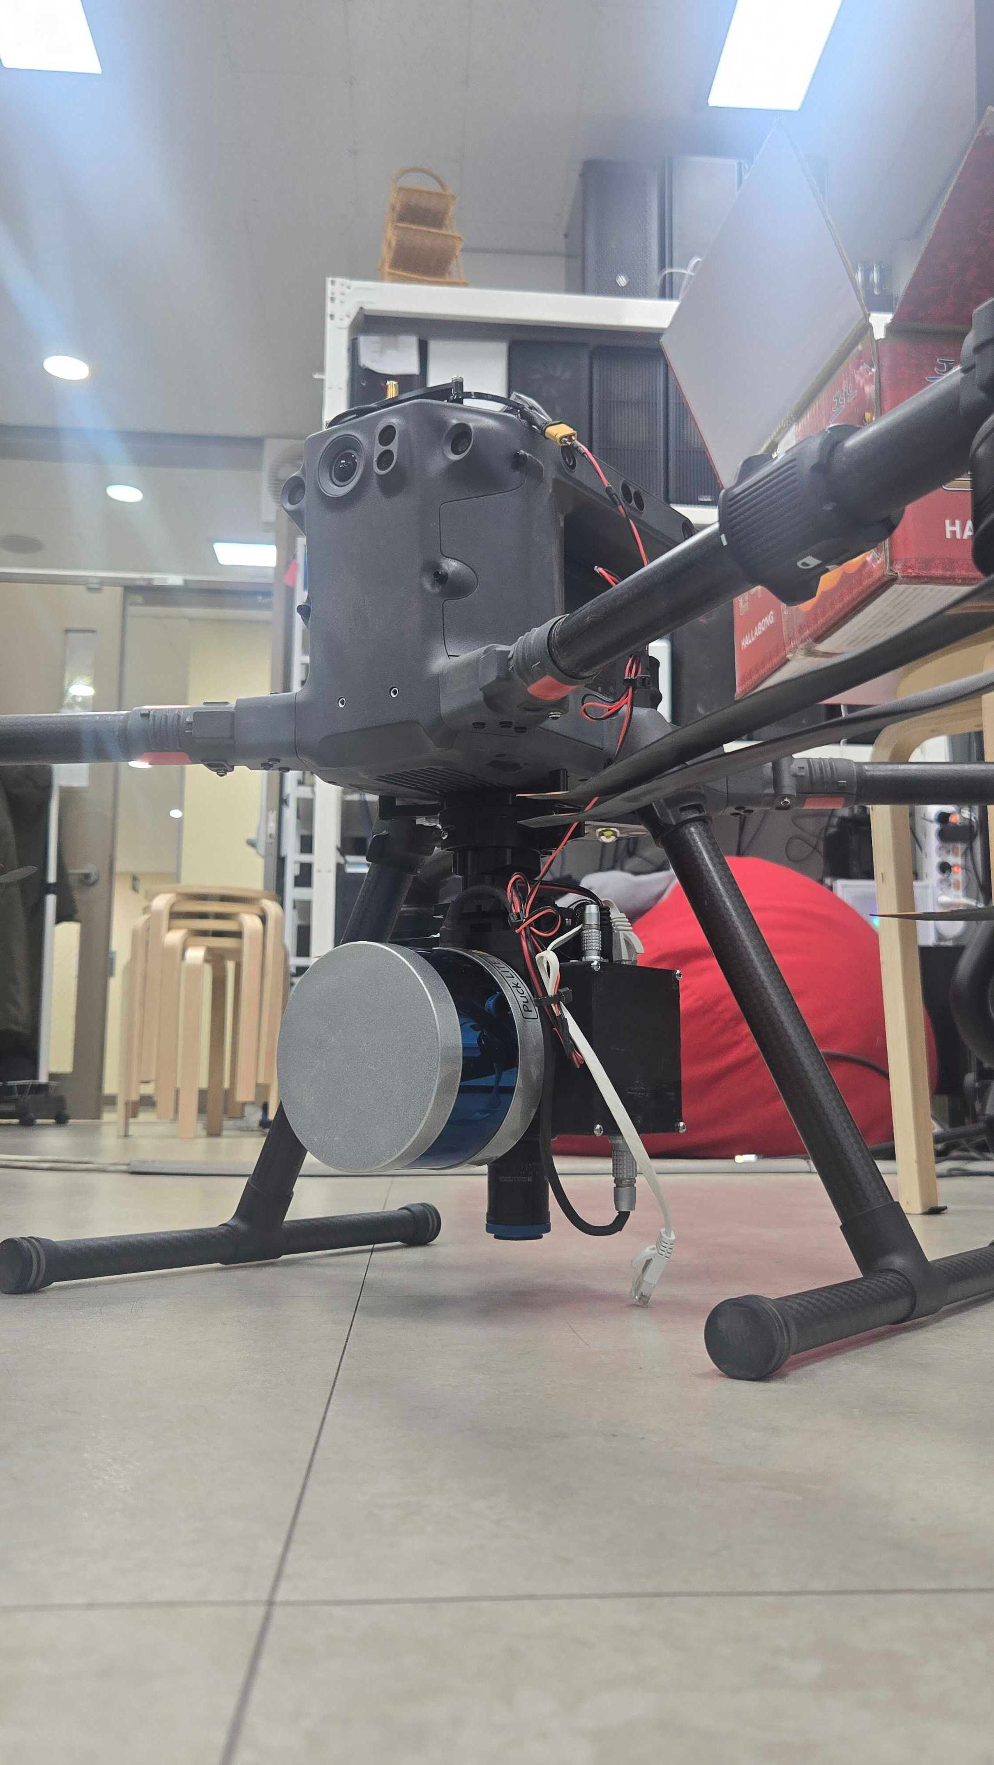
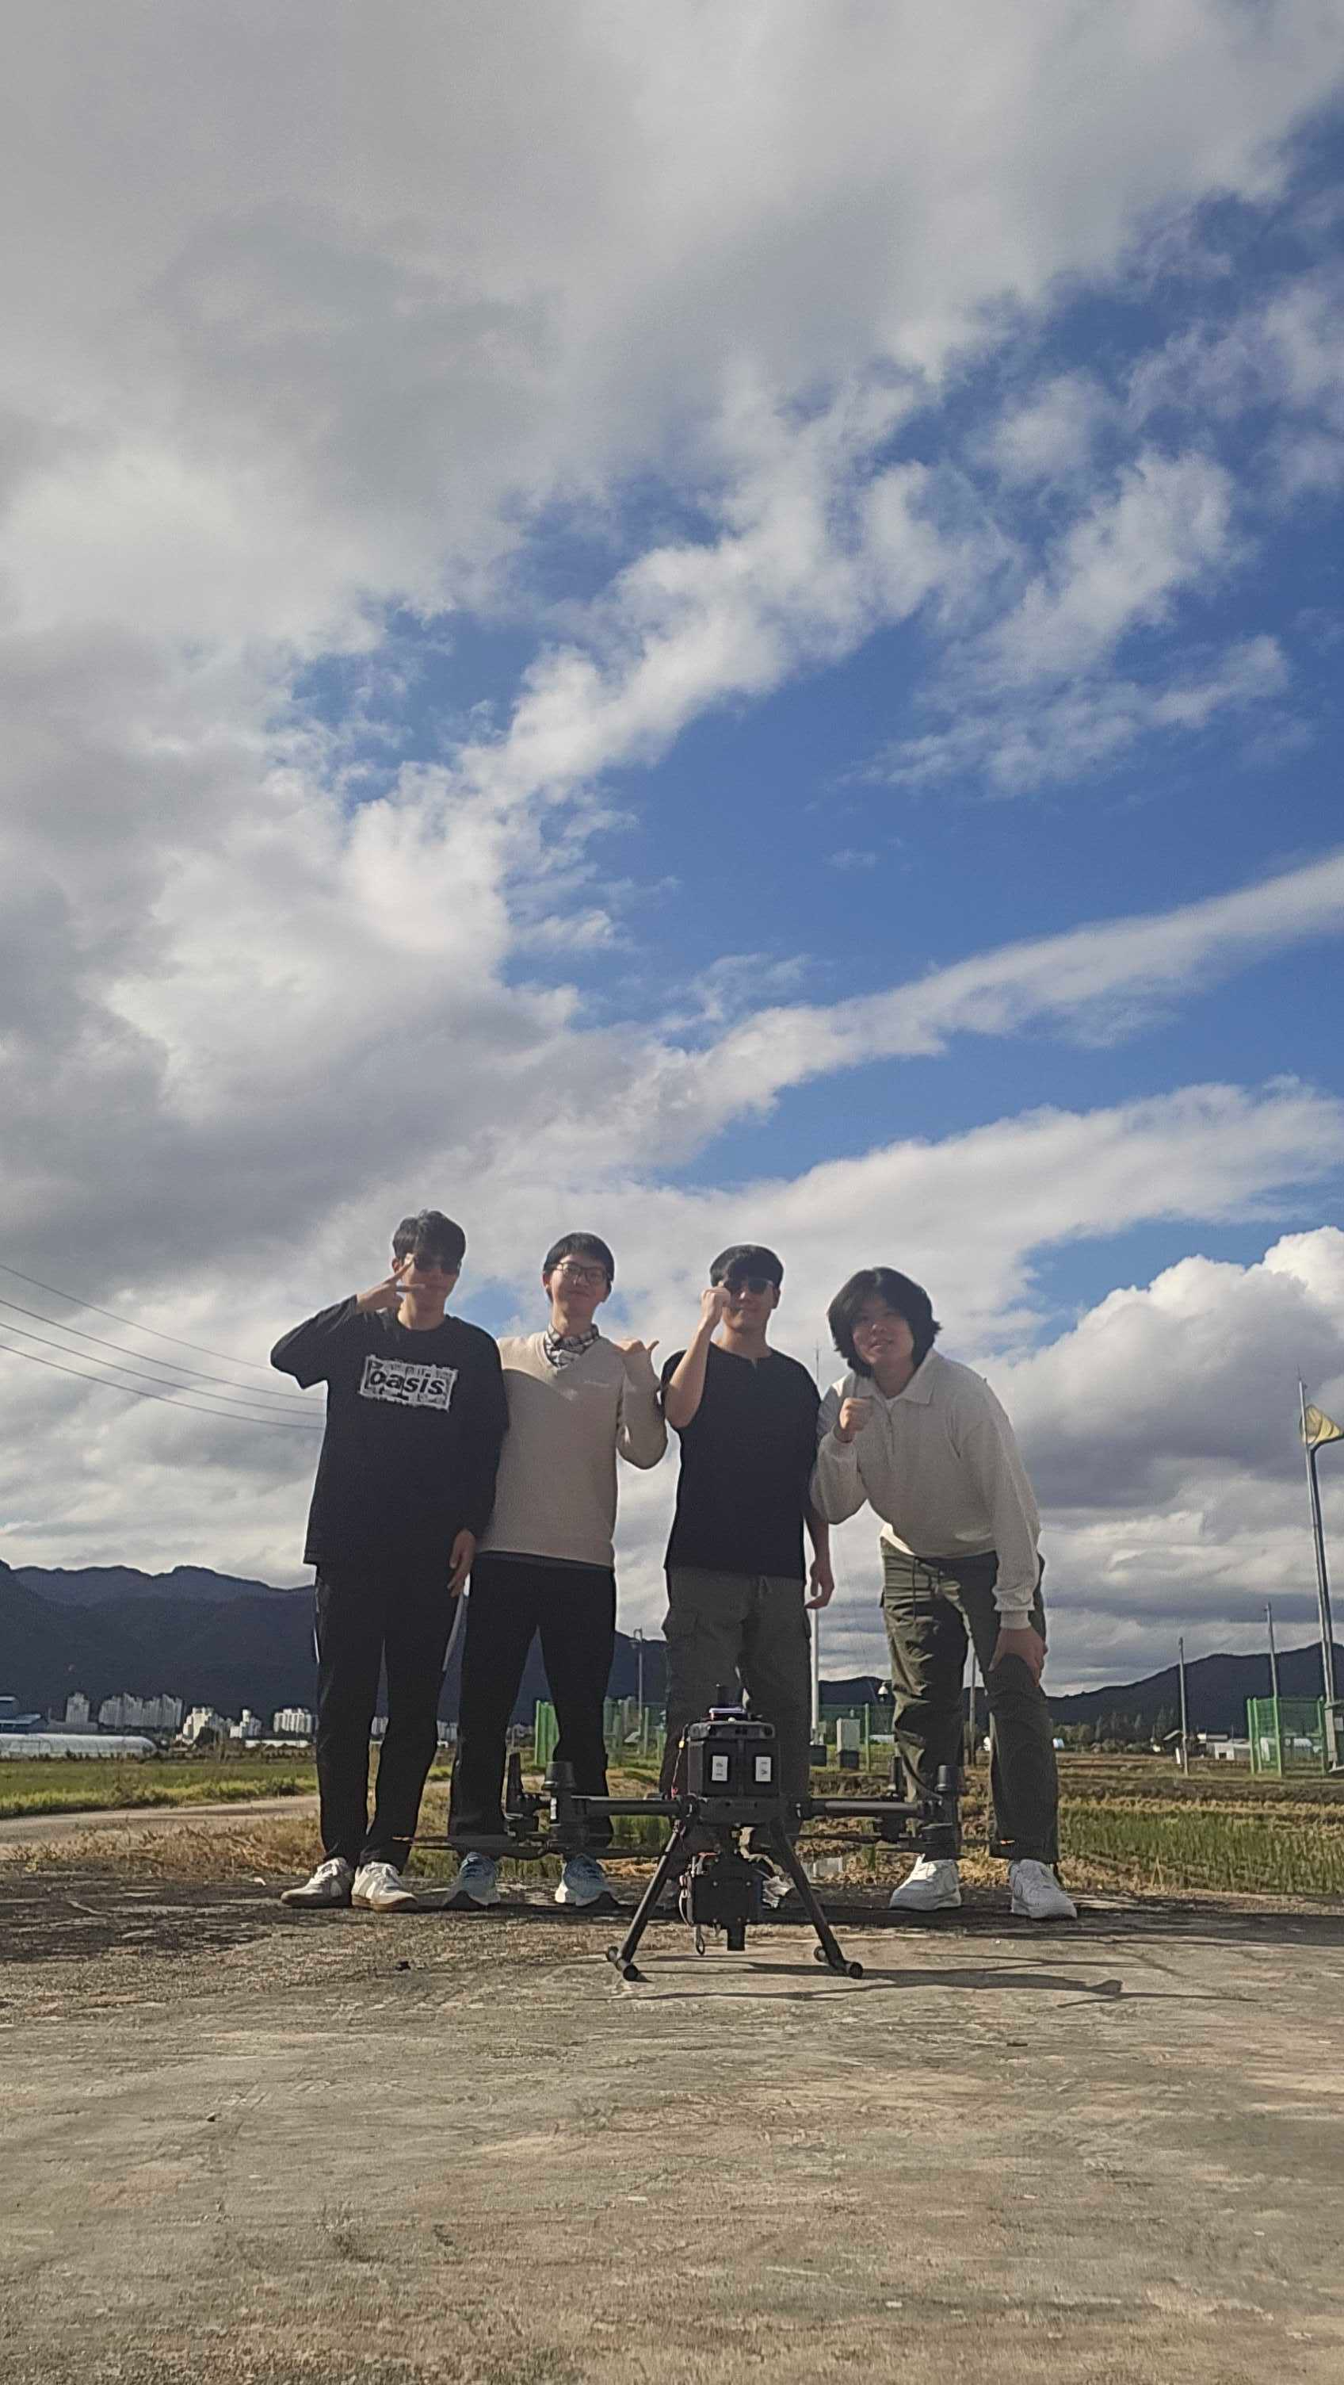
Hyperspectral drone imaging system

Slide 15
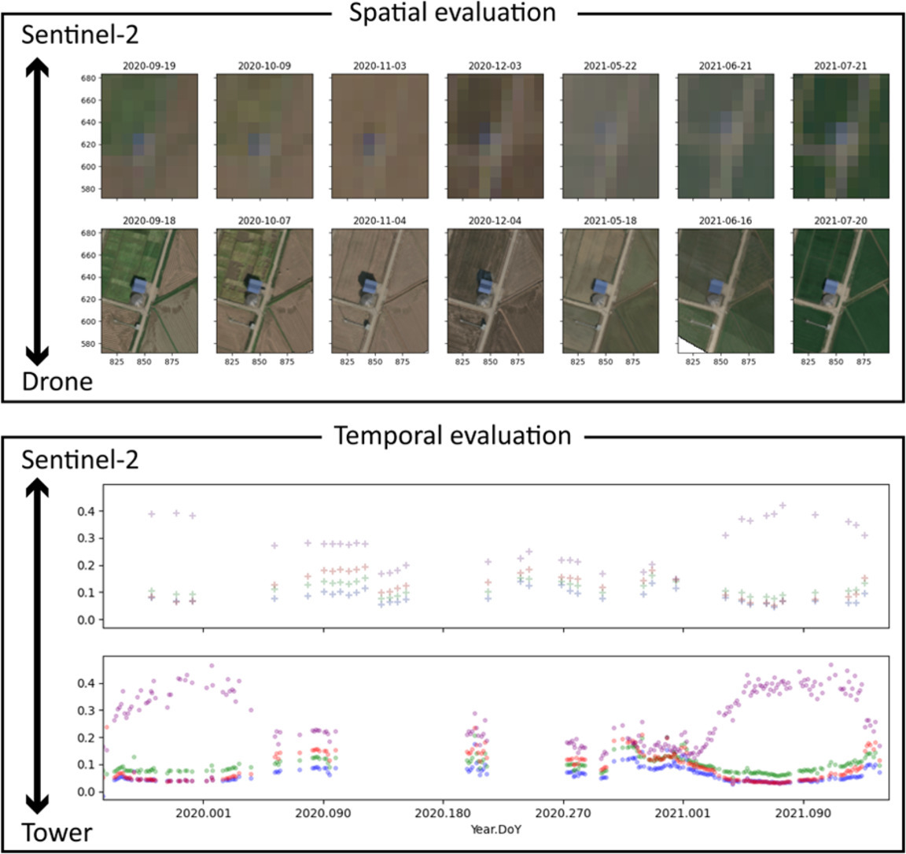
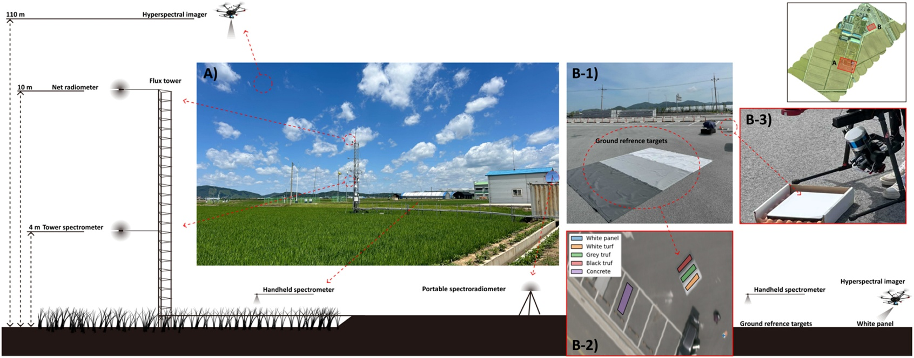
Getting the right hyperspectral image from drone requires a LOT of cross¹⁰⁰ calibrations
Choi et al (2025) Agricultural and Forest Meteorology

Slide 16
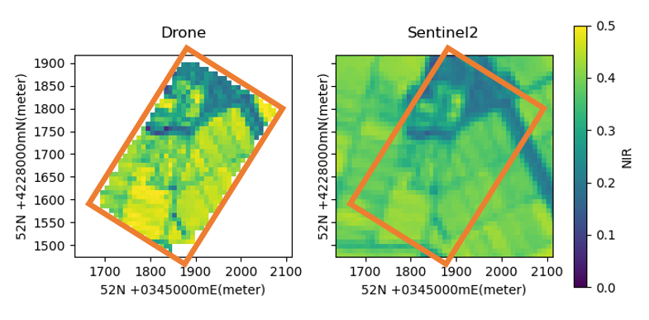
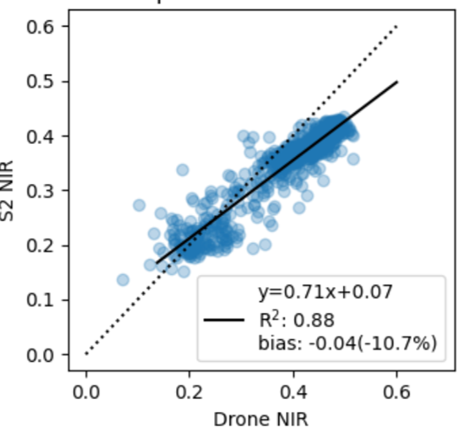
Reflectance is complex…
S2 “effective” spatial resolution is not 10 m, not fixed
  Point spread functions
  Adjacent effects
  …
10 m
Choi et al (2025) Agricultural and Forest Meteorology

Slide 17
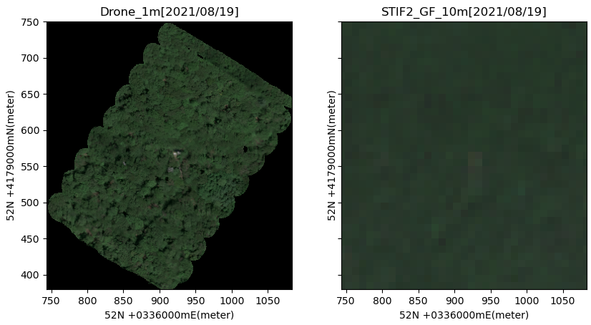
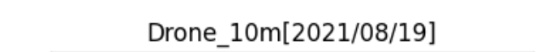
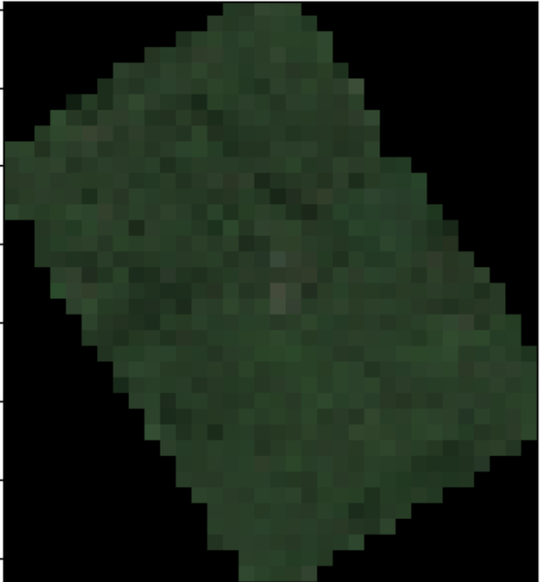
Forest is even more complex
Choi et al (2025) Agricultural and Forest Meteorology

Slide 18
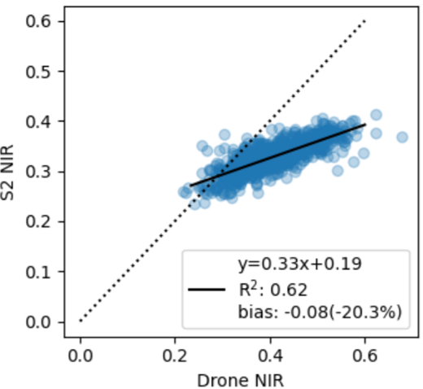
Forest is even more complex
Choi et al (2025) Agricultural and Forest Meteorology

Slide 19
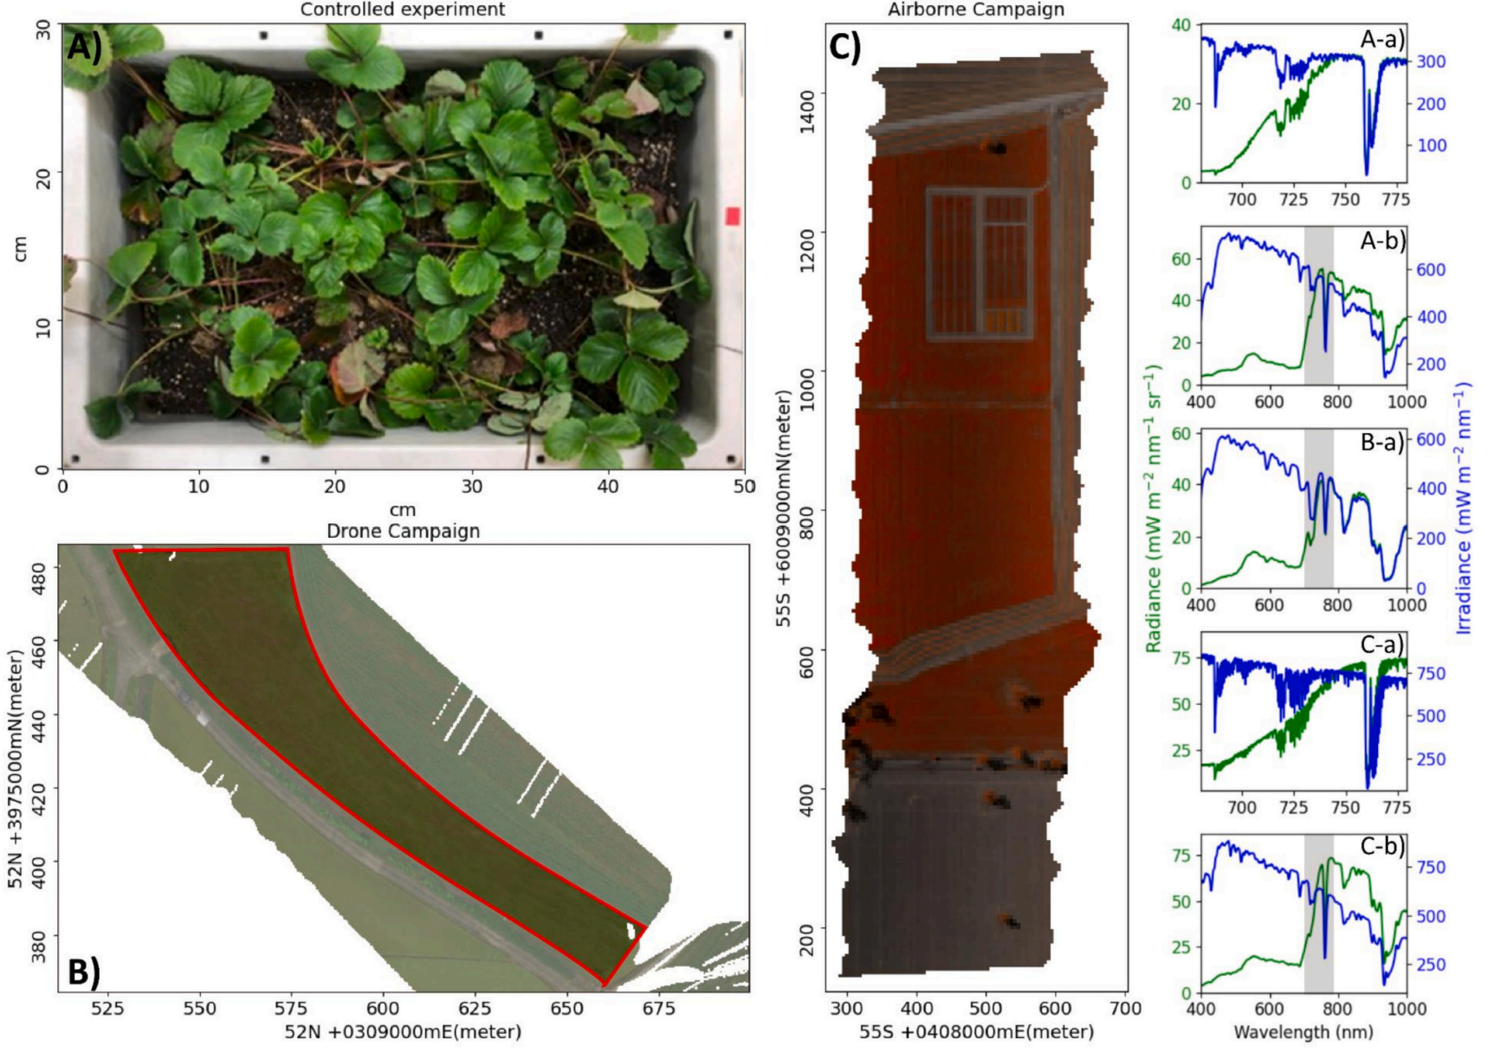
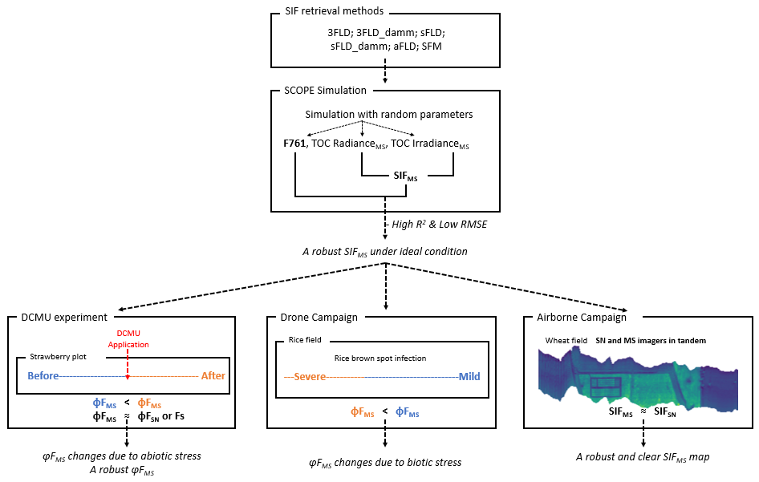
Detecting SIF at 3-7 nm resolution
-Tested across scales and platforms-
Choi et al., (2026) Remote Sensing of Environment

Slide 20
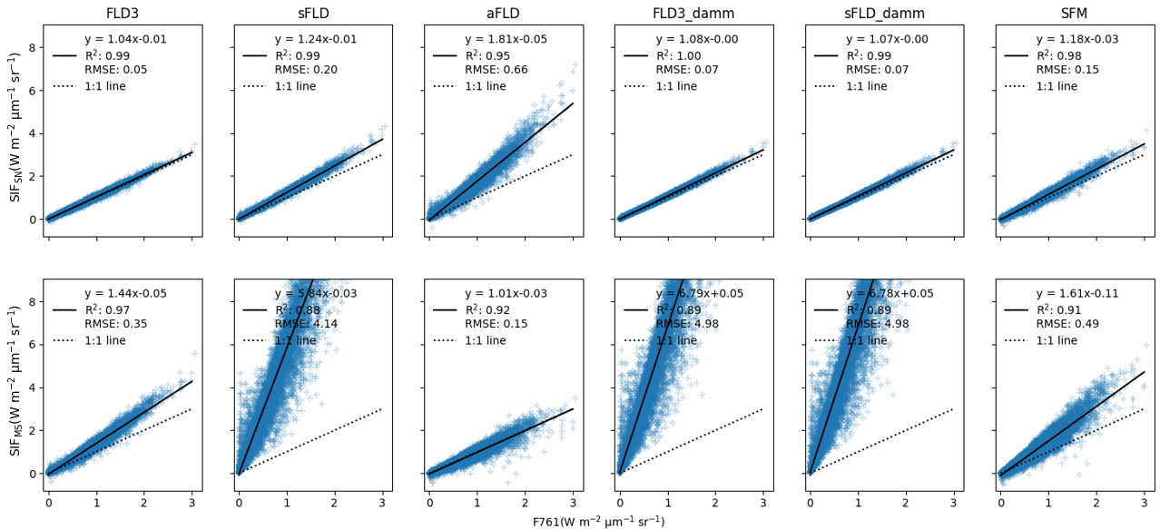
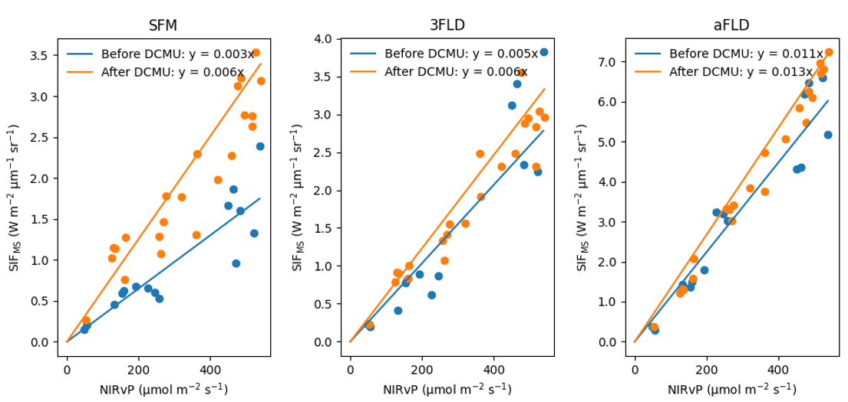

SFM worked best
-SCOPE and DCMU-
0.06 nm
4 nm
SCOPE simulation
DCMU experiment
Choi et al., (2026) Remote Sensing of Environment

Slide 21
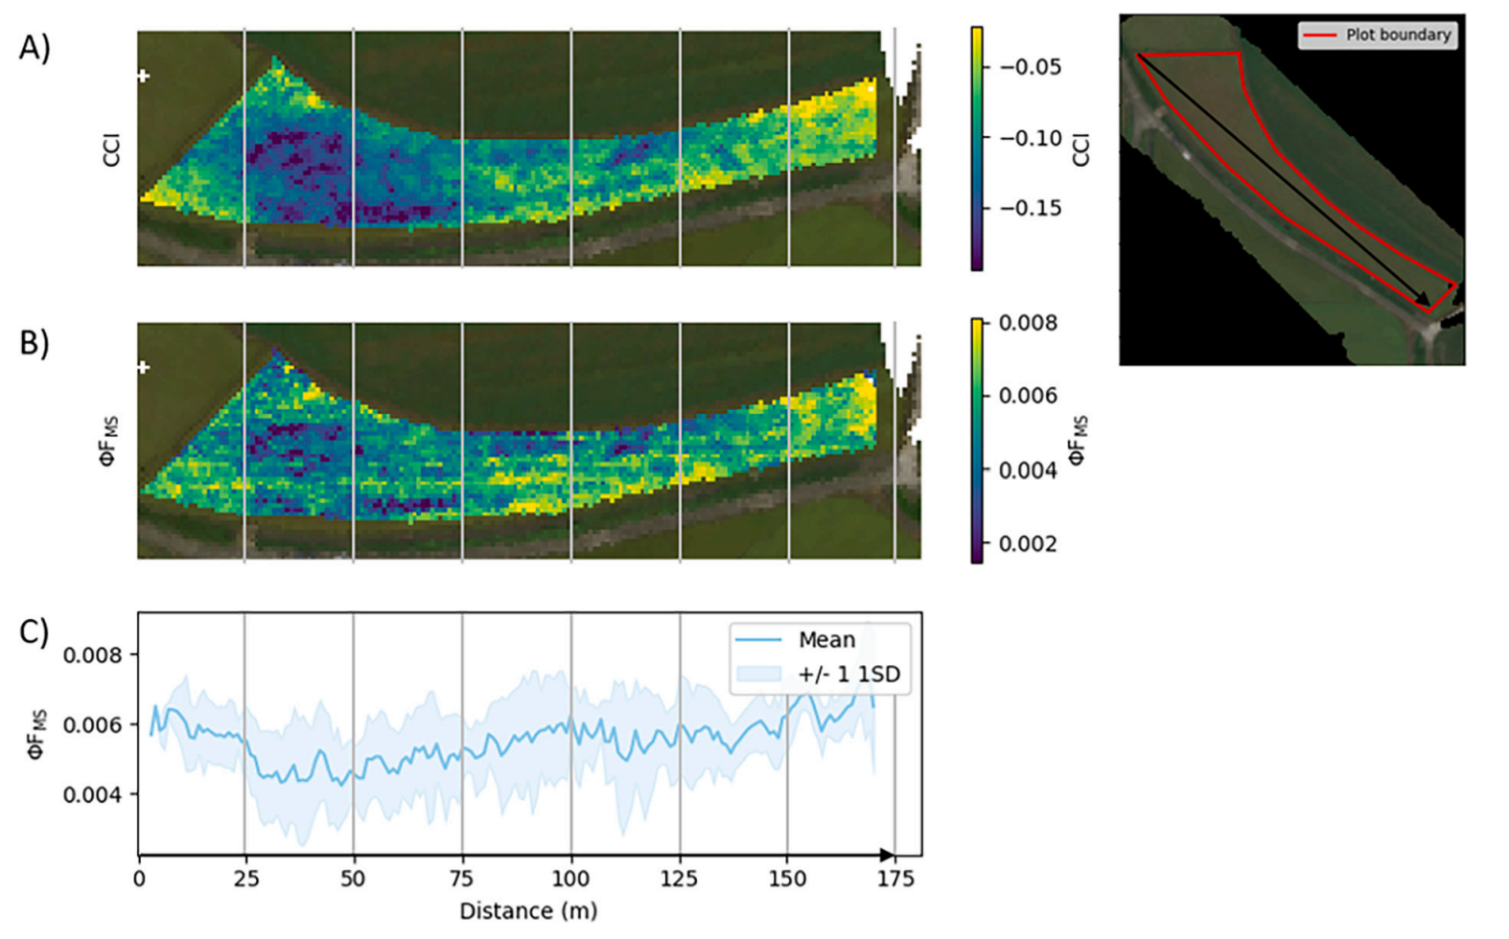
SFM worked best
-Hyperspectral drone-
Rice leaf brown spot disease
Consistency between PhiF and CCI
Choi et al., (2026) Remote Sensing of Environment

Slide 22
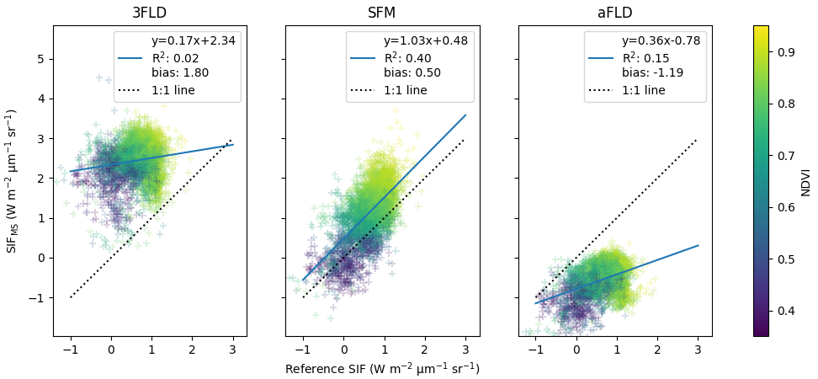
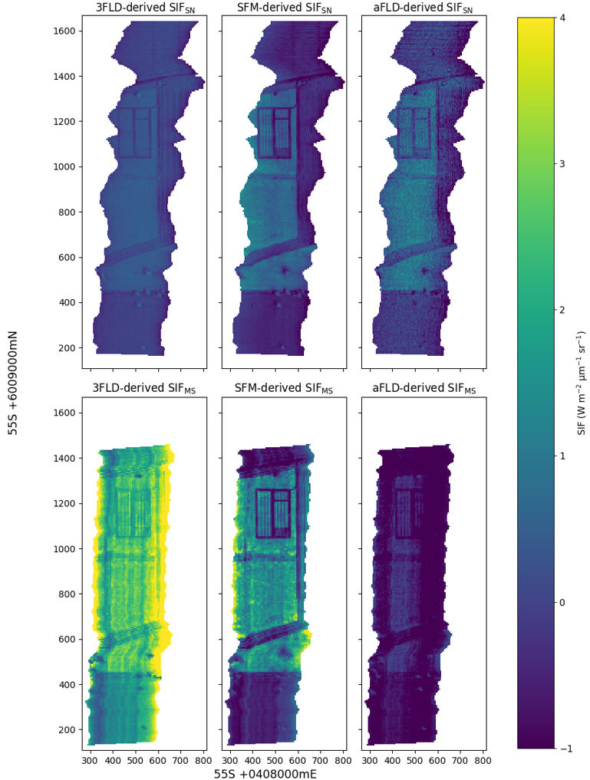
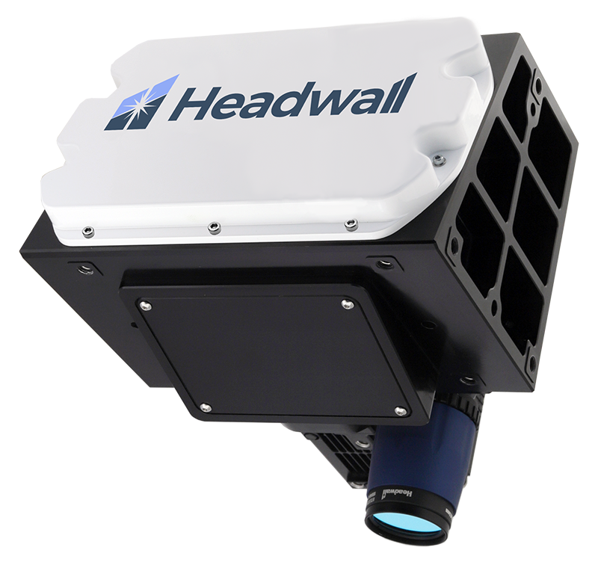
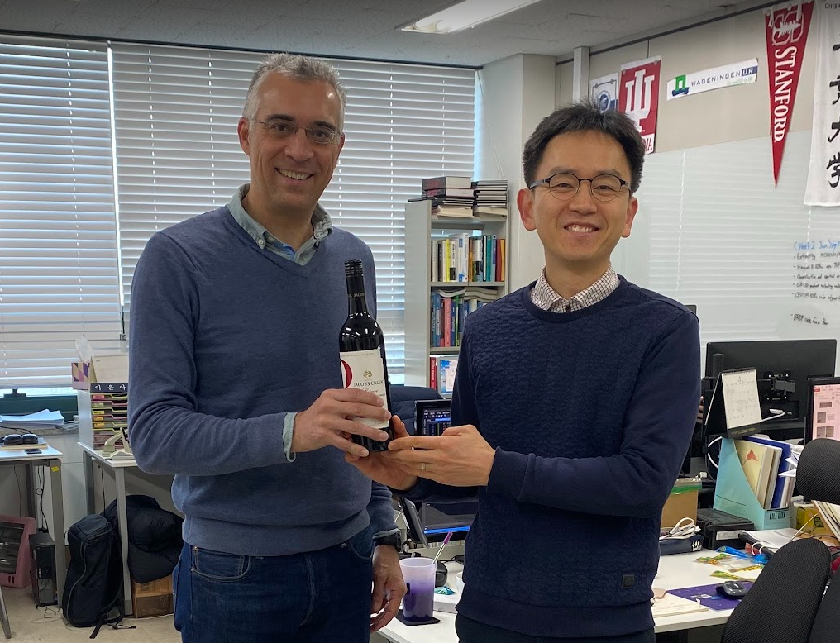
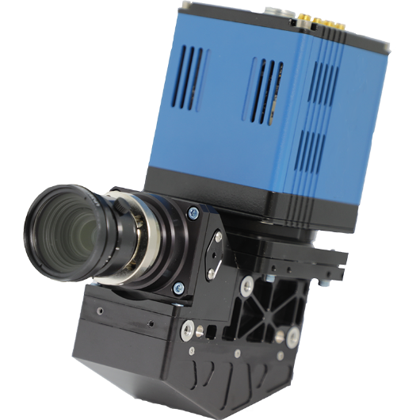
SFM worked best
-sub nanometer imager vs mid resolution imager-
Sub-nanometer
5 nm
Choi et al., (2026)
Remote Sensing of Environment

Slide 23
Take home message
FLEX Cal/Val systems are ready
  Temporal variability
    Tower based rotaprism-hyperspectral system
  Spatial variability
    Drone based hyperspectral imaging system
  All flux towers measure CO2 fluxes, so GPP too
  Ancillary data will be also collected
    Leaf area index
    …

Slide 24
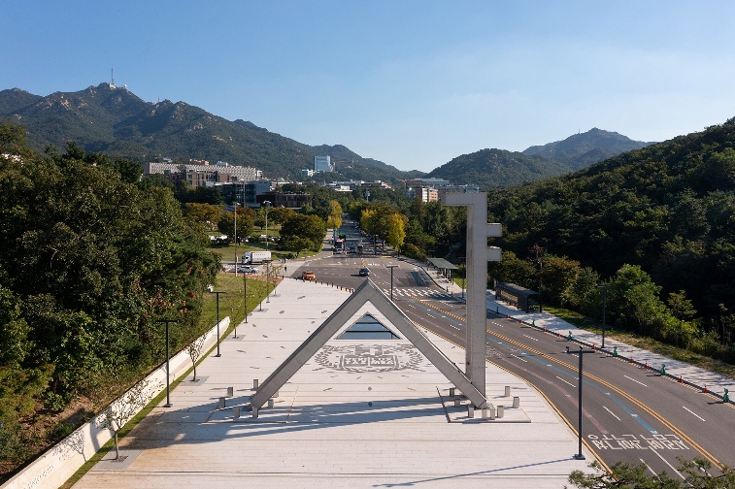
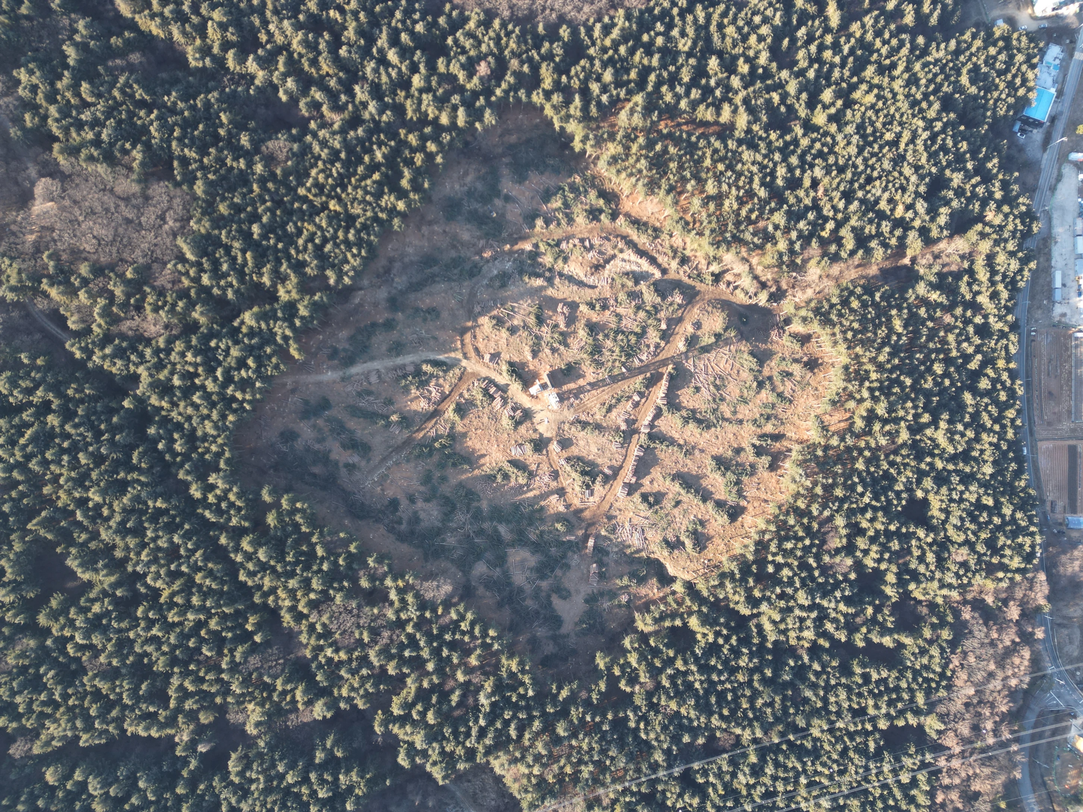


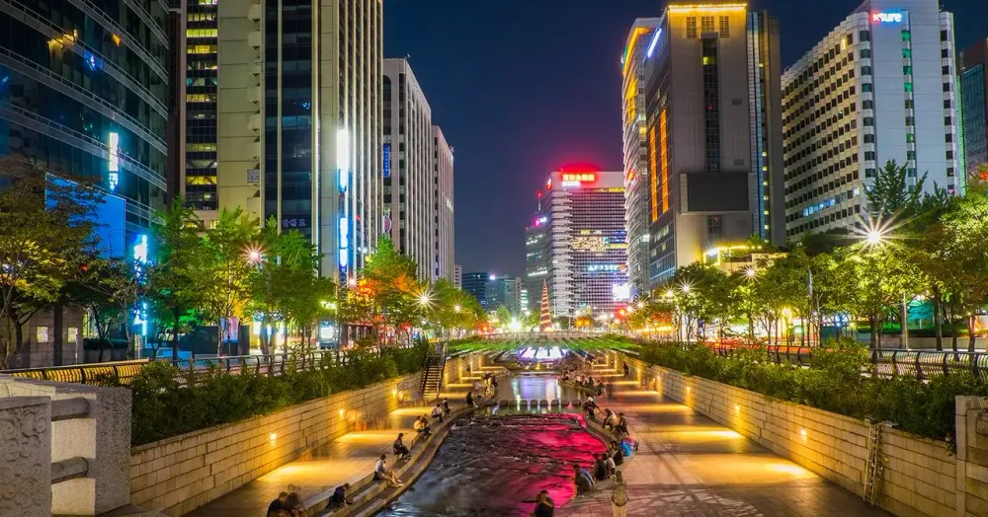

Hiring!
Come to South Korea to enjoy
  SIF, NPQ, photosynthesis
  Cal/Val FLEX
  …
  Life!

Slide 25
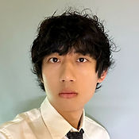
Hire!
Those great PhDs will be out in the job market soon!
Jeongho Lee
(jeongho.public@gmail.com)
Wonseok Choi
(jackie6396@snu.ac.kr)
Huaze Feng
(mr.huaize@gmail.com)
Field spectroscopy and SIF
Drone and airborne SIF
Chlrophyll to canopy fluorescence

