Slide 1



Christiaan van der Tol, Jorge Vincent Servera, Theo Paccoud, Bastian Siegmann, Hao Jiang, Peiqi Yang, Roberto Colombo
Photosynthesis data products of FLEX

Slide 2
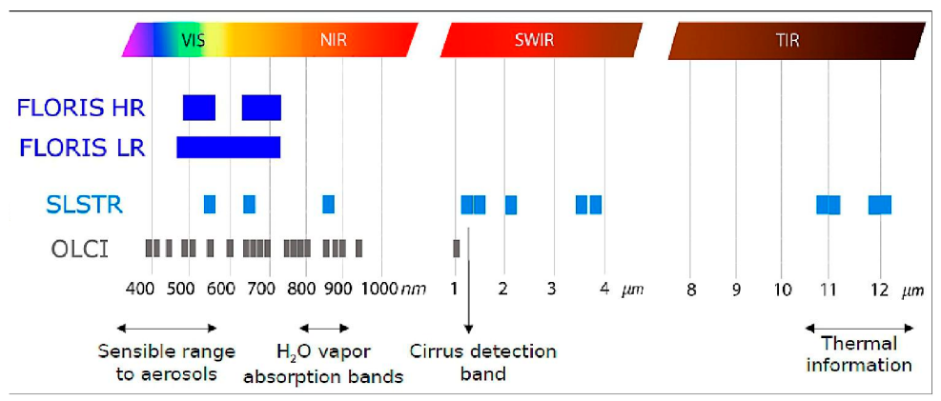






Photosynthesis products and algorithms
OLCI-FLORIS LR
TOC reflectance
LAI, LCC, LCAR, fAPAR, fAPARchl, fesc ($σ_{F}),$
$$σ_{F}⋅\text{fAPARchl}$$
RED and ETR:
Arithmetric from FQE,NPQ, iPAR
+ weak prior constraints
Hybrid: Machine learning + RTM
$FQE=\frac{SIF}{{ σ}_{F}⋅fAPARchl⋅iPAR}$
Bayesian
modelling
Arithmetic
Spectral fitting
$$r_{soil}$$
OLCI-FLORIS LR
TOC reflectance
PCA
$$r_{veg}$$
$$NPQ$$
fPSI
$$\frac{SIF}{σ_{F}}$$
fPSI

Slide 3
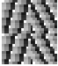
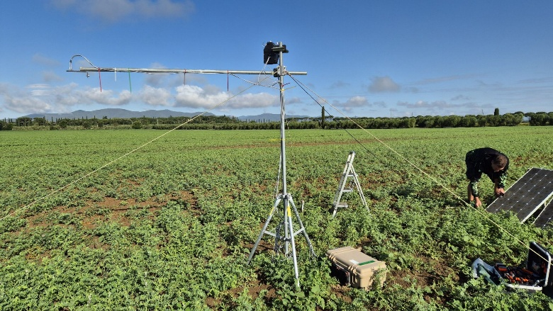
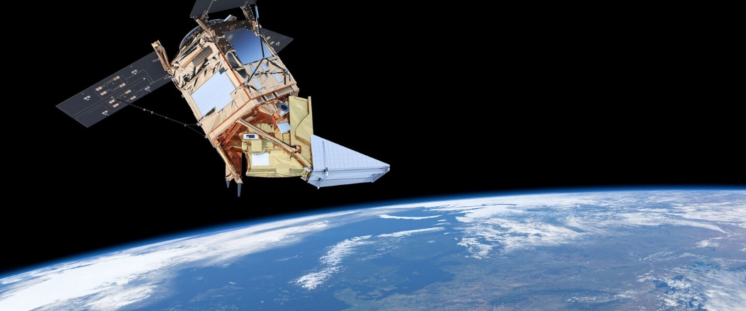
Tests and validation
Synthetic data
FLoX
Existing satellites: S3+S5P

Slide 4

Data products contain
Mean value, one data layer for each variable
Uncertainty as 1sigma, one data layer for each variable
Binary flag with bits for two groups of data products
Successful
Failed
Untrusted
Out of range
Close to prior
High uncertainty
Retrieval model uncertainty
Uncertainty due to measurement

Slide 5
Hybrid (RTM+ML) approaches
Sampling of training data with synthetic data
Using globally representative dataset: joint-sensor ESA-CCI Vegeation OptiSAIL inversion
8000 samples from distribution of SCOPE vegetation parameter space
Forward run of SCOPE + sensor simulation
Training of: Gaussian Process Regression model (GPR) and Neural Network (NN)
Active learning: iteratively selecting samples with highest error or largest uncertainty.
Ongoing research (not in this talk):
Inclusion of real observations in training dataset
Optimized model structure

Slide 6
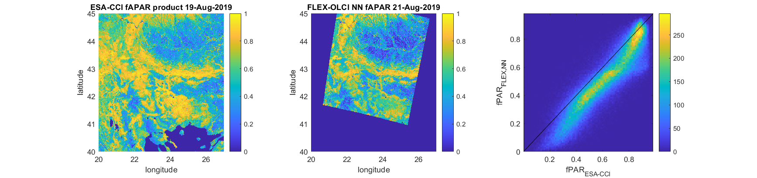
Hybrid approach: fAPAR
Reference dataset FLEX- product (OLCI only) Scatter plot
(using Sentinel Synergy data)

Slide 7
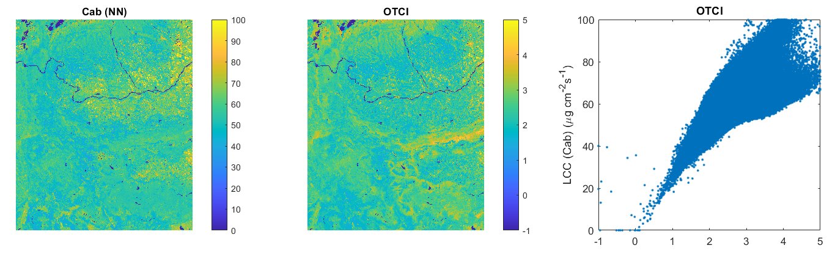
Hybrid approach: Leaf Chlorophyll Content
Only qualitative comparison to Sentinel Synergy product of OTCI as LCC proxy, from OLCI
OTCI = (B12 - B11) / (B11 - B10)

Slide 8

Hybrid approach: Fluorescence escape probability
Escape probability: links SIF observed to emitted SIF
Four anchor points on the spectrum
Spectral reconstruction using PCA
Machine learning (hybrid) to retrieve anchor points

Slide 9

Hybrid approach: Fluorescence reabsorption correction
FQE links SIF with energy dissipation
Calculation of FQE need reabsorption correction of SIF
Done using hybrid model for $σ_{F}⋅fAPAR_{Chl}$
Evaluation: using FCVI as proxy
For FCVI>0.17, 1:1 relation expected
Qualitative comparison with TROPOSIF

Slide 10
Spectral fitting: NPQ
PRI index:
Correction for soil reflectance mandatory (approach of P. Yang (2024) RSE, 311, 114250.
Normalization by morning data mandatory (poster Hao Jiang)
Field campaigns combined (seasonal cycle)
Linear decomposition into spectra
3rd and 4th component show:
Diurnal cycle
Expected ‘signature’ of PRI effect

Slide 11
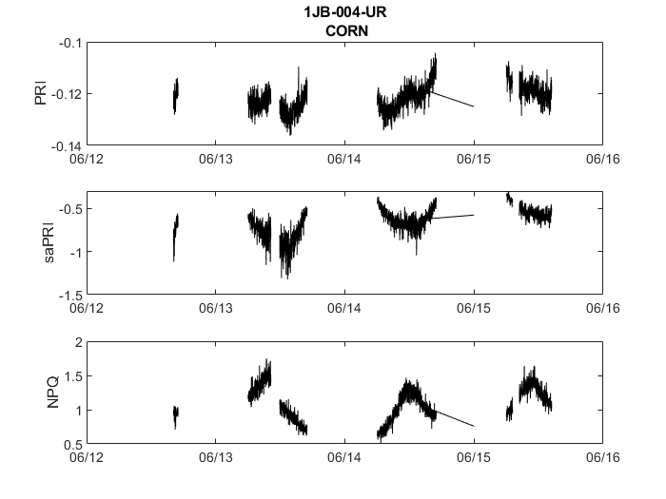
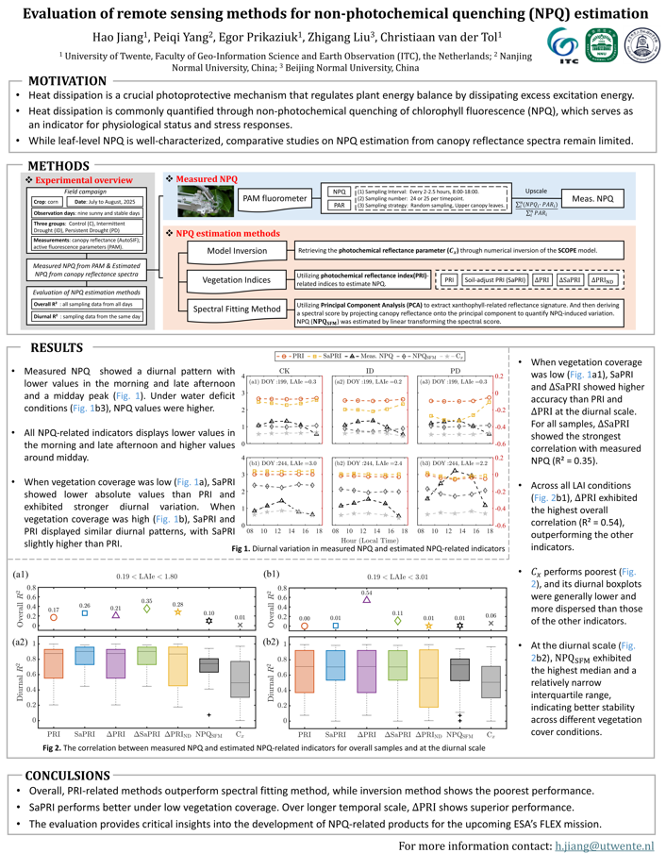
Spectral fitting: NPQ
Poster Hao Jiang et al. ‘Evaluation of remote sensing methods for non-photochemical quenching (NPQ) estimation’

Slide 12
Bayesian algorithm: RED and ETR
RED from closed set of 8 equations with 8 unknowns
(input in green, constants in bold, weak prior in blue):
ETR =c*𝜙_{P}*iPAR* APARChl
RED= 𝜙_{N} *iPAR* APARChl
K_{N}= NPQ *(K_{F}+K_{D})
𝜙_{N} = K_{N}/(K_{N}+K_{F}+K_{D}+K_{P})
𝜙_{F} = FQE = K_{F}/(K_{N}+K_{F}+K_{D}+K_{P})
𝜙_{D} = K_{D}/(K_{N}+K_{F}+K_{D}+K_{P})
𝜙_{P} = K_{P}/(K_{N}+K_{F}+K_{D}+K_{P})
𝜙_{P}+𝜙_{N} +𝜙_{D}+ 𝜙_{F}= 1
Additional constraint (weak prior):
𝜙_{P0} = 4/(K_{F}+K_{D}+4)
K_{N}= slope*(1-𝜙_{P}/𝜙_{P0})

Slide 13
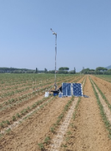
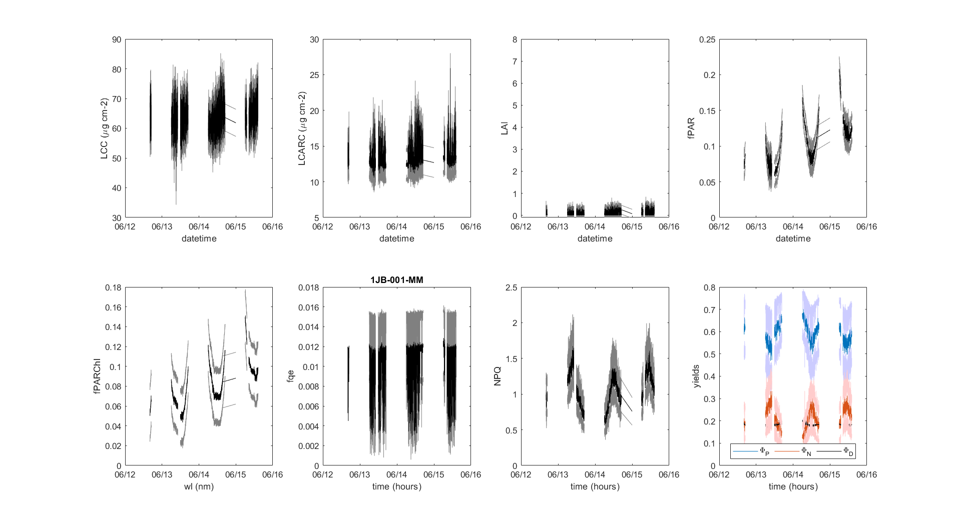
Tests on field data

Slide 14
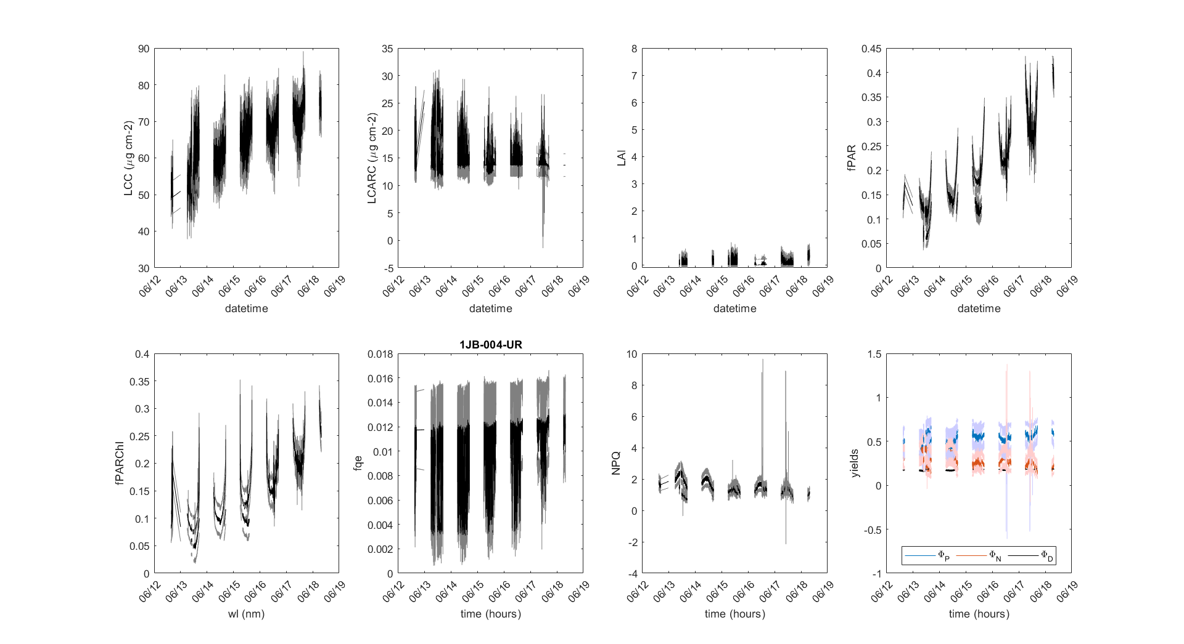
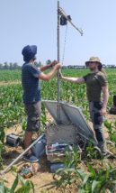
Tests on field data

Slide 15
Conclusion
Conclusions
Eleven products developed: 10 scalars and 1 spectrum (fesc)
Tests on synthetic, field data and existing satellite data are overall promising
Challenges
Machine learning algorithms training only on synthetic data: real FLORIS observations not available yet
Possible improvement after launch
Spectral fitting for retrieval of NPQ not convincing (yet) !
Dependence on ‘upstream’ products of bottom-of-atmosphere reflectance and SIF
Questions: c.vandertol@utwente.nl

