Slide 1
Aquatic product validation of the Fluorescence Explorer (FLEX) mission (AquaValiX)
Martin Hieronymi, Rüdiger Röttgers (Hereon), Astrid Bracher (AWI), Peter Gege, Nicole Pinnel (DLR), Anna Göritz (University of Freiburg)

Slide 2
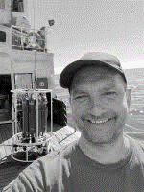
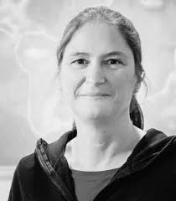





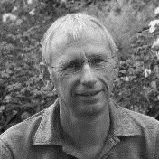
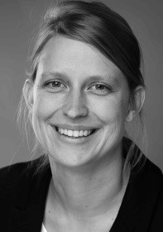
AquaValiX
Aim:
Validate and extend products from ESA Fluorescence Explorer (FLEX) for inland, coastal and oceanic waters
This includes:
Partners & respective project leads:
Work packages:
Direct comparison of satellite‑derived reflectance with simultaneous in‑situ measurements
Indirect validation through inversion of radiative‑transfer models;
Inter‑comparison of FLEX outputs with products from Sentinel‑3 OLCI, Sentinel‑2 MSI, PACE and EnMAP.
WP 3: Data analysis and retrieval of L2B products
WP 4: Towards a permanent measurement station for Cal/Val activities
WP 1: Coordination of activities, data management, release, QC
WP 2: In-situ reference data collection
Dr. M. Hieronymi
Prof. A. Bracher
AquaValiX
07/2026-12/2029 (tbc)
Dr. P. Gege
Dr. A. Göritz

Slide 3
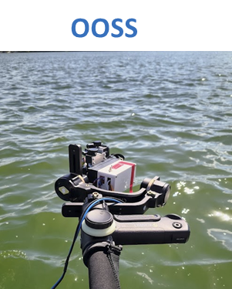
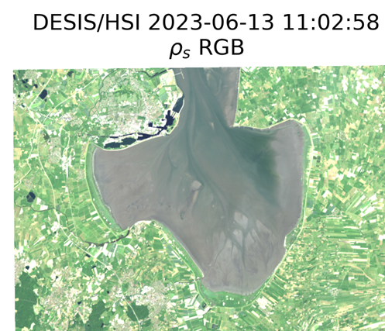
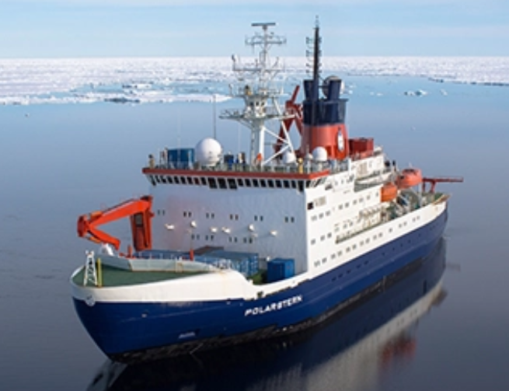
Cal/Val campaigns in AquaValix
Extending on previous measurement campaigns (e.g. PHY2FLEX activities, Lake Constance etc.)
Three categories of activities covering inland, coastal and oceanic waters:
Short term campaigns
Flexible, mostly individual activities with small boats, on ferries, with aircrafts or UAVs,..
Diverse waters; rapid/opportunistic runs to maximise match-ups.
Mid term lake campaigns
Coordinated pre planned Lake campaigns to validate FLEX over inland and coastal waters.
e.g. Lake Constance, Lake Banter, Bad Zwischenahner Meer
Long term - larger research vessels
Expeditions; extended parameter set; broader scientific context; Incl. 4-months Arctic cruise.
Beaufort Sea, Weddell Sea (FS Polarstern), New Zealand (FS Sonne), North Sea (FS Heincke)

Slide 4
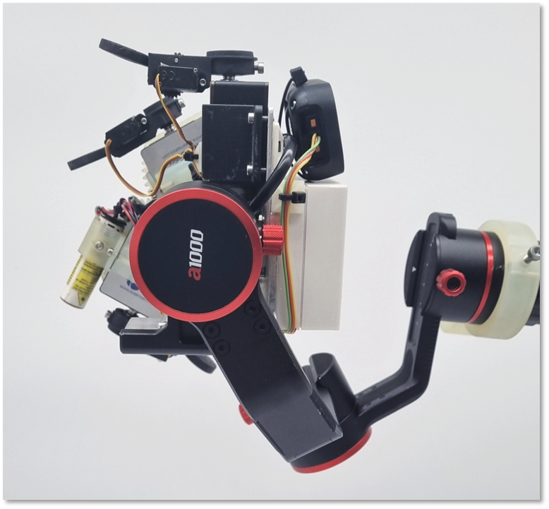
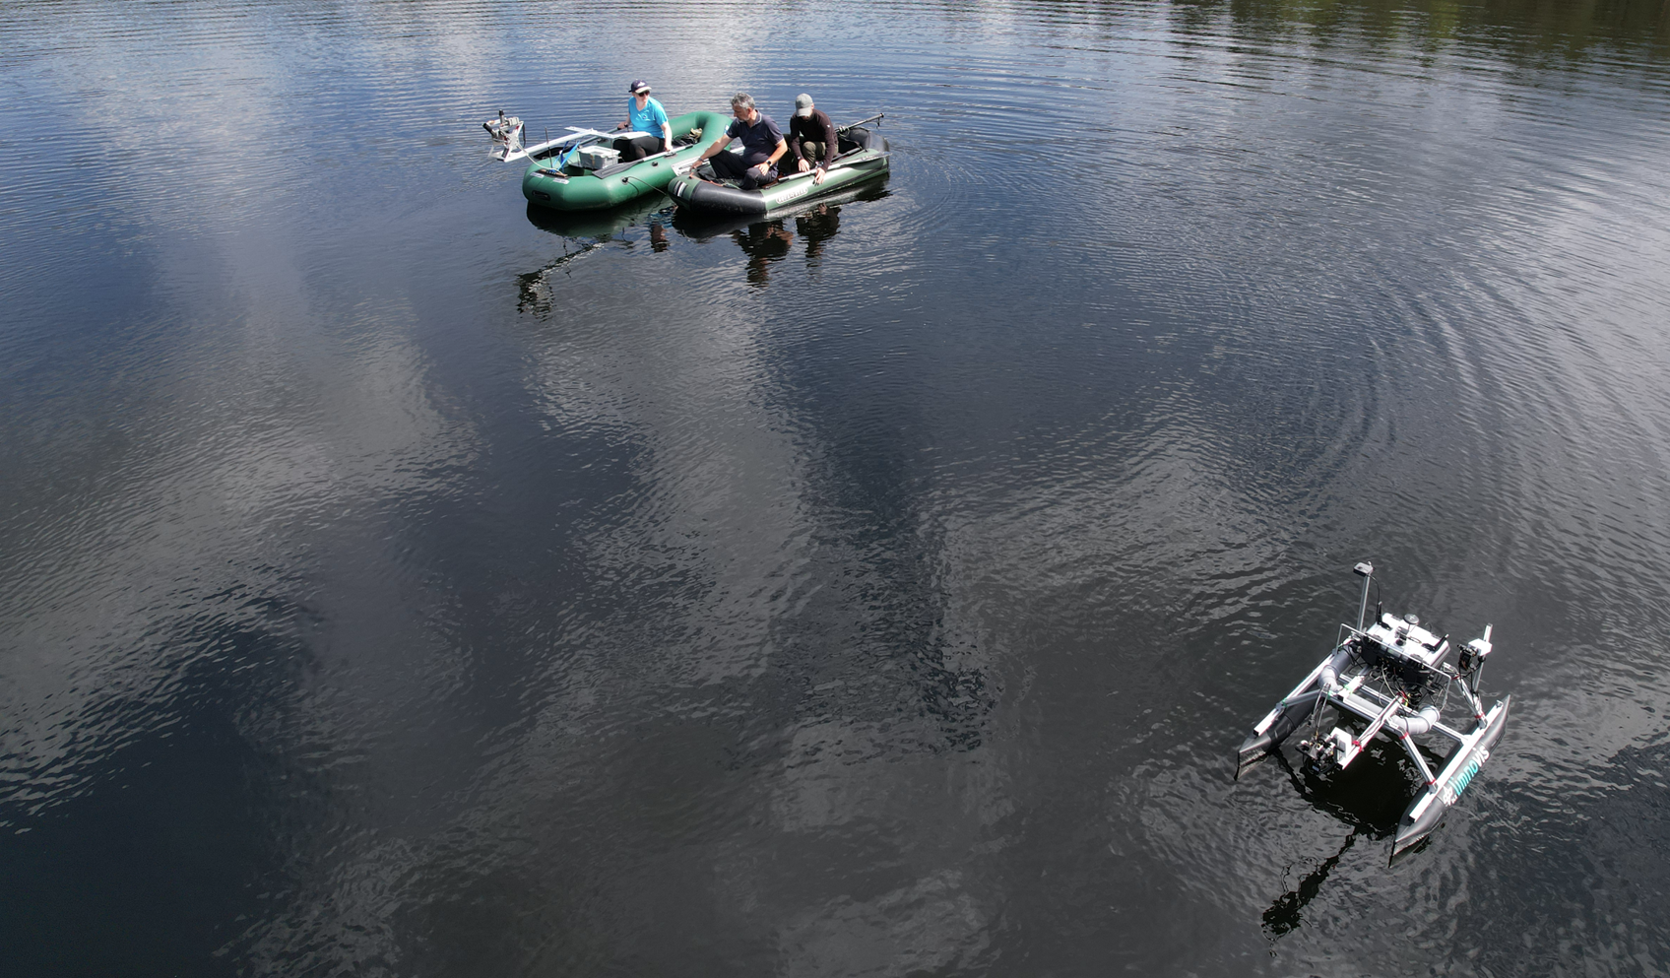
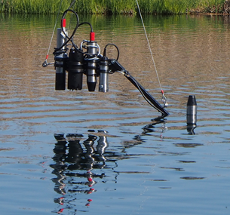
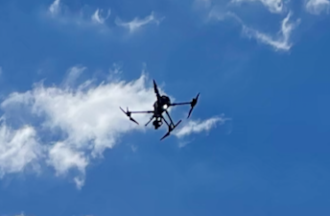
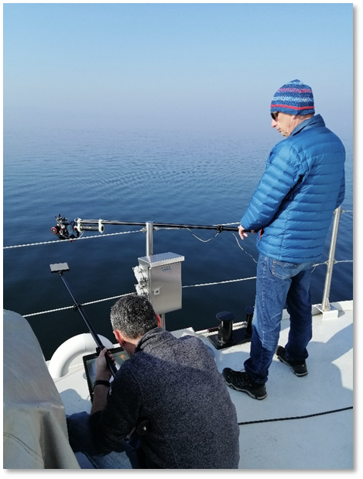
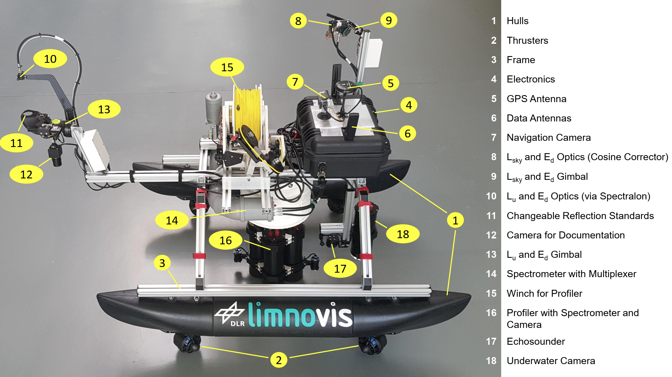
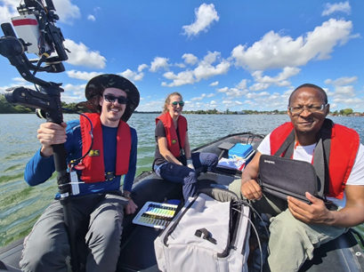
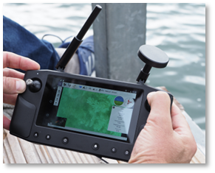
In-situ data collection & laboratory analysis
DLR OOSS
Credits: S. Plattner, Estonia (2025)
+
extensive water constituents and laboratory water sample analysis
@ Bruno Rech
Publicly available, comprehensive in-situ reference data set

Slide 5
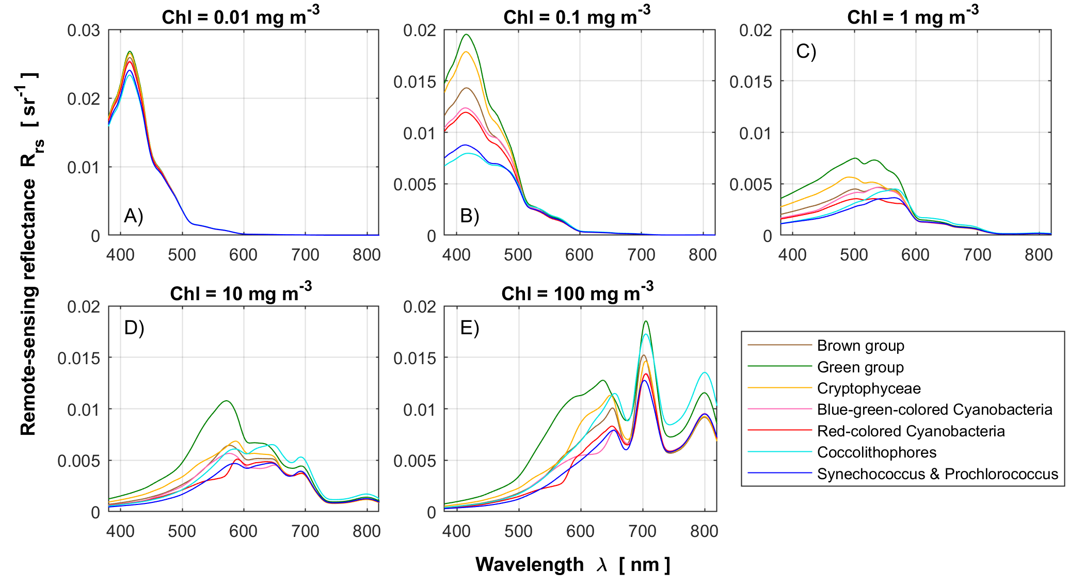
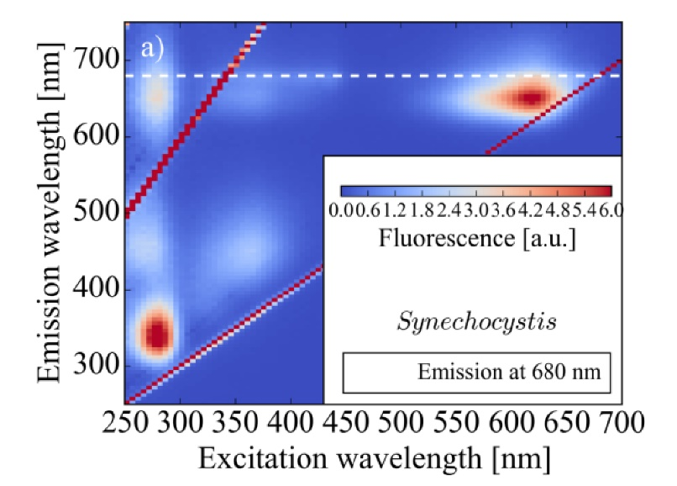
Hyperspectral features of phytoplankton groups
Pigment distribution, shape and materials of phytoplankton determine absorption and scattering properties
Differentiation of algae blooms based on remote-sensing reflectance
In addition, fluorescence features
e.g. cyanobacteria
[Göritz et al. (2017), Göritz (2018)]
Bi et al. (2023)

Slide 6
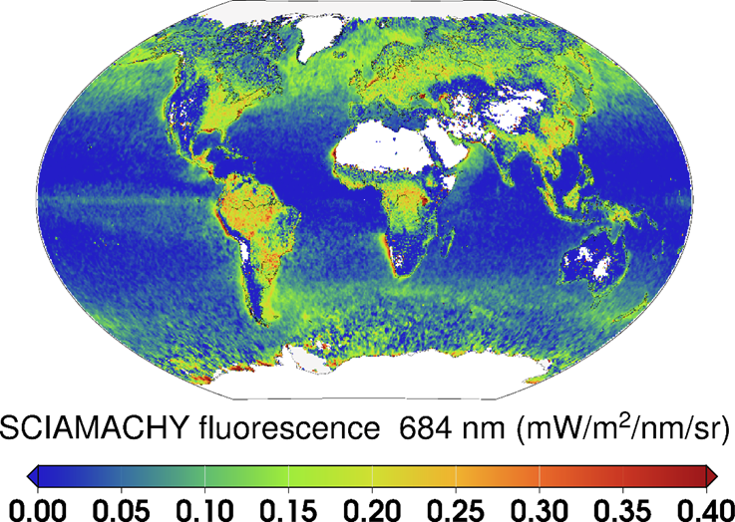
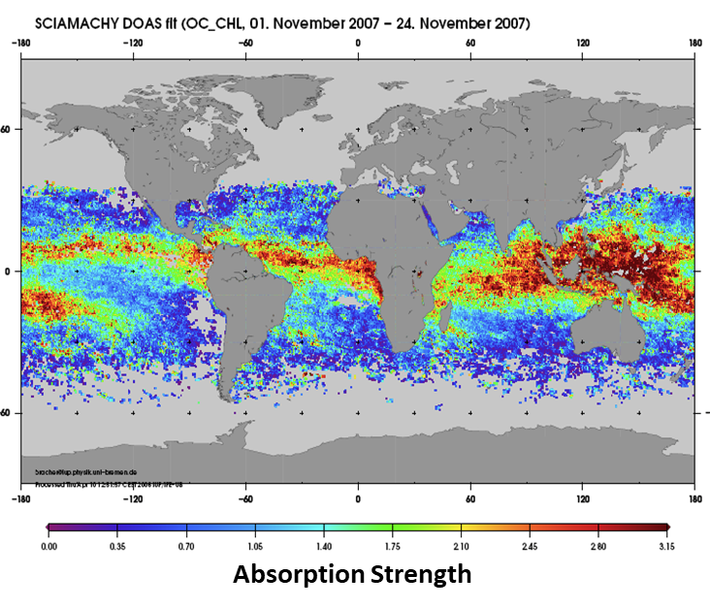
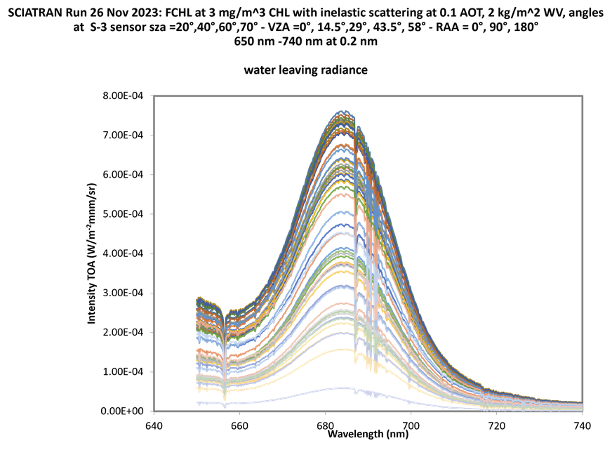
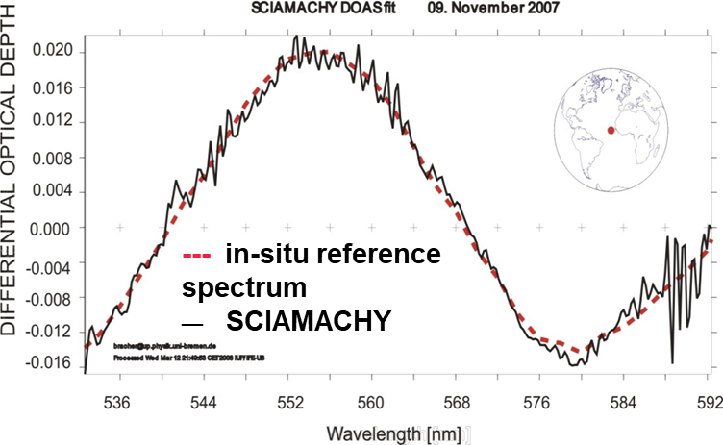
For FLEX with 300 m also retrievals over coastal and inland waters possible.
Aquatic Level-2 products retrieval: RT tool adaptation
Aquatic Level-2 products: Coupled Water-Atmosphere-RTM to optimize PhytoDOAS for FCHL* from FLEX
Aquatic Level-2 products: PhytoDOAS for Phycobillins
PhytoDOAS for FCHL
Wolanin et al. (2015): retrieval for SCIAMACHY & GOME-2. Data at Wolanin et al. (2019):
https://doi.org/10.1594/PANGEA.897169;
application to TROPOMI by Köhler et al. (2020)
[Bracher et al. 2024, ESA-Science Study S3NGO]
For FLEX with 300 m also retrievals over coastal and inland waters possible. Retrievals based on Filling-in of Fraunhofer Lines!
Look-Up Tables based on RTM SCIATRAN (Rozanov et al. 2014, 2017)
For FLEX only pigments >500 nm;
Phycobillins are relevant in cyanobacteria and cryptophytes. Baseline similar retrieval to Bracher et al. BG 2009, ESA-Science Study S3NGO.
Astrid.Bracher@awi.de

Slide 7
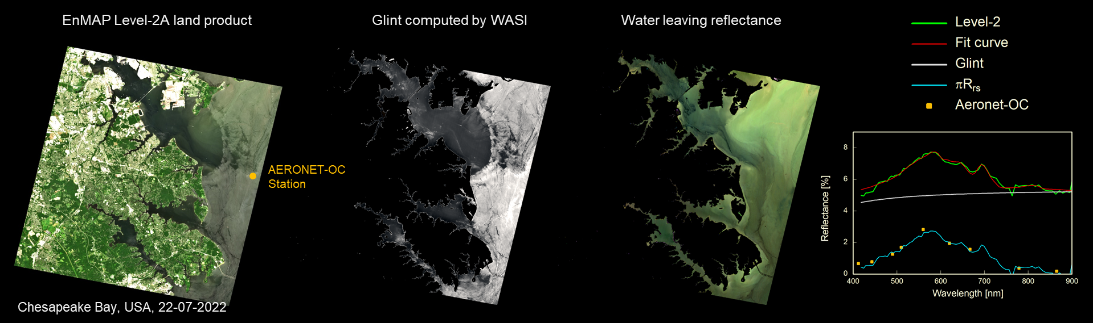
Aquatic Level-2 products retrieval: RT tool adaptation
SUNGLINT correction with WASI (P. Gege)
[Gege (2014)]

Slide 8
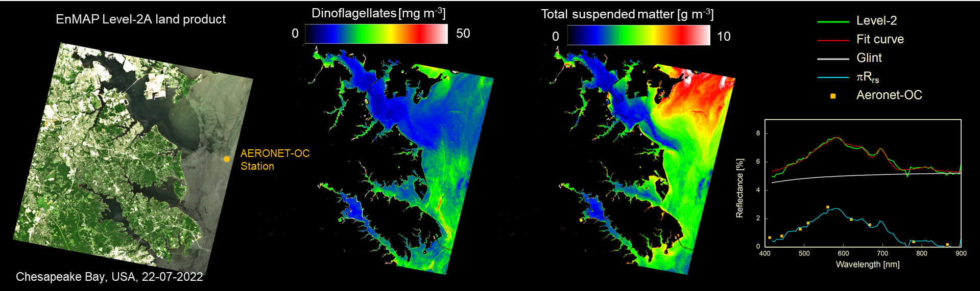
Aquatic Level-2 products retrieval: RT tool adaptation
Water constituent retrieval with WASI (P. Gege)
[Gege (2014)]

Slide 9
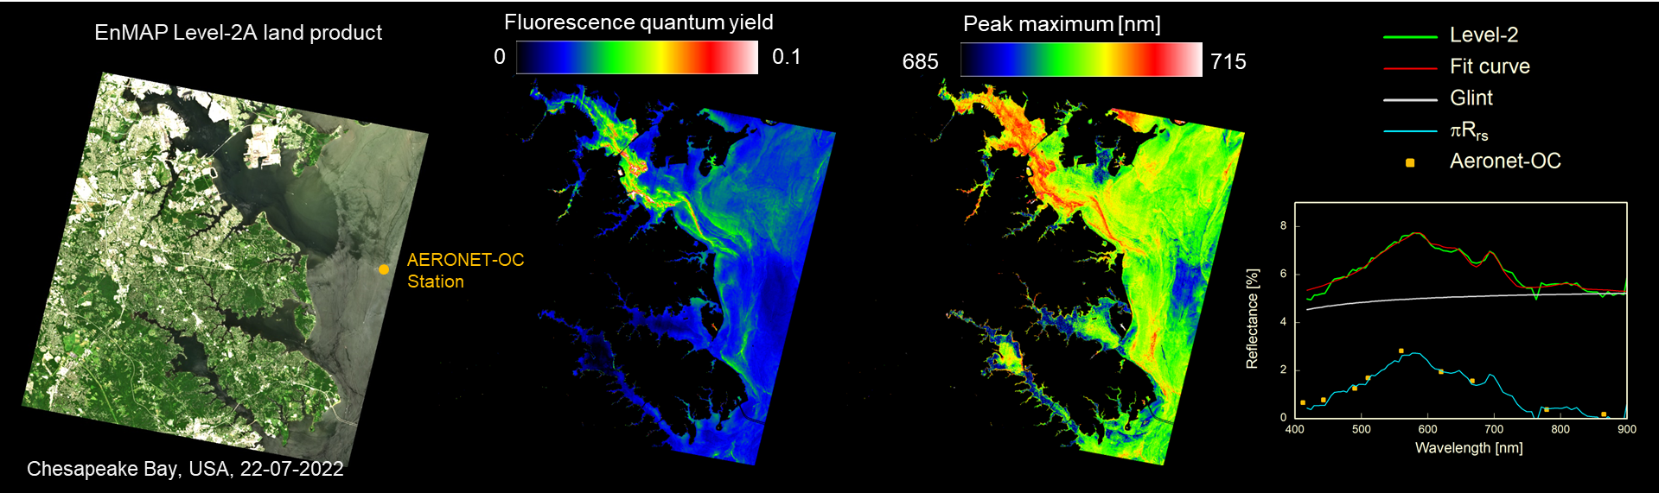
Aquatic Level-2 products retrieval: RT tool adaptation
Phyfluorescence retrieval with WASI (P. Gege)
Preliminary results. Algorithms can be extended for additional pigment consideration (e.g. cyanobacteria).
[Gege (2014)]

Slide 10
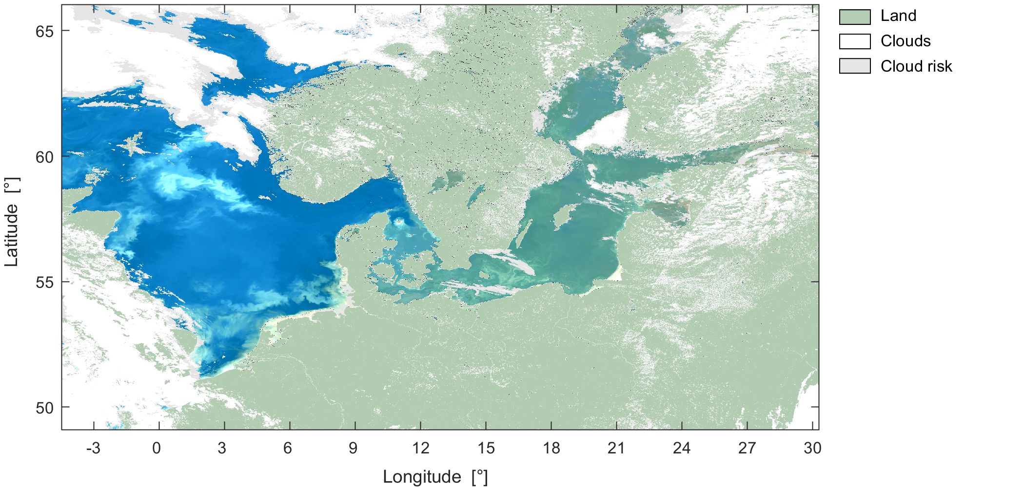
Synergy with Sentinel-3 OLCI
Hieronymi, Behr, Bi, & Röttgers (2026). Optical complexity of North Sea, Baltic Sea, and adjacent coastal and inland waters derived from Sentinel-3 OLCI satellite data. ESSD
Constellation S3-FLEX allows broader view and benefit of atmospheric correction (here A4O by Hieronymi et al.)

Slide 11
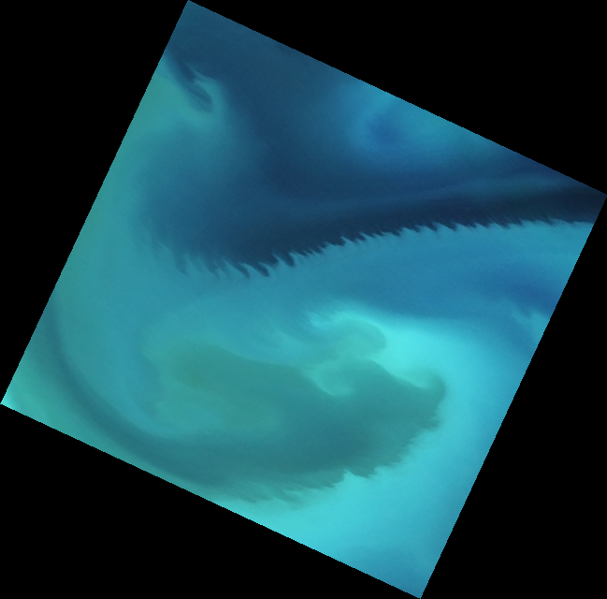
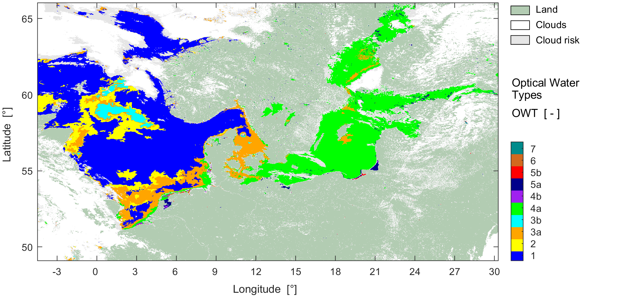
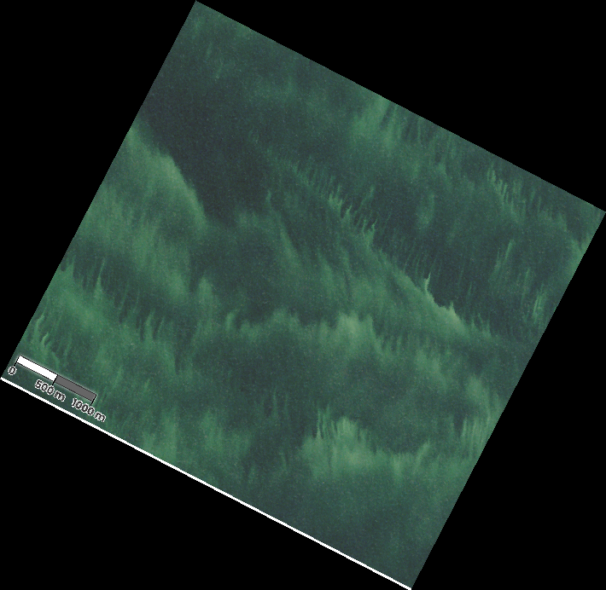
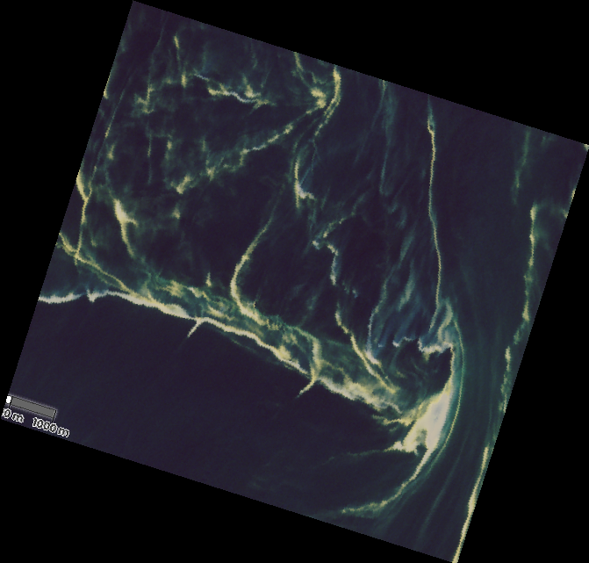
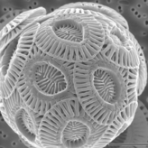
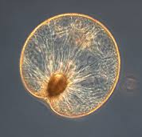
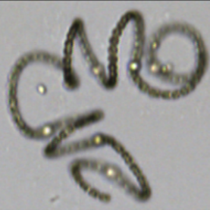

Synergy through optical water type classification
Hieronymi, Behr, Bi, & Röttgers (2026). Optical complexity of North Sea, Baltic Sea, and adjacent coastal and inland waters derived from Sentinel-3 OLCI satellite data. ESSD
Bi, S., & Hieronymi, M. (2024): Holistic optical water type classification for ocean, coastal, and inland waters, Limnology and Oceanography
Nodularia sp. (Cyanobacteria)
Emiliania huxleyi (Coccolithophores)
Noctiluca sp. (Dinoflagellate)

Slide 12
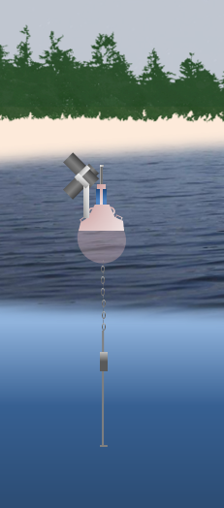

Towards permanent Cal/Val station(s)
Goal: Design of a sustainable, long‑term “ground truth” hub for FLEX and HSI missions at Reference Lake(s)
Tasks include:
Exchange with stakeholders
  ESA, lake authorities, research institutes, industry partners,...
  Hardware and operation planning
Technical specifications
Instrument suite definition
Location scouting
Pre-measurements
Operations & maintenance plan
Data‑management & open‑data policy
Implementation Road‑map

Slide 13
Summary
Selected references:
AquaValiX targets the validation and extension of products from ESA Fluorescence Explorer (FLEX) for selected inland, coastal and oceanic waters
Bi, Hieronymi & Röttgers (2023). Bio-geo-optical modelling of natural waters. Frontiers in Marine Science. https://doi.org/10.3389/fmars.2023.1196352
Bracher A., Vountas M., Dinter T., Burrows J.P., Röttgers R., Peeken I. (2009) Quantitative observation of cyanobacteria and diatoms from space using PhytoDOAS on SCIAMACHY data. Biogeosciences 6: 751-764, DOI:
10.5194/bg-6-751-2009
Gege, P. (2014). WASI-2D: A software tool for regionally optimized analysis of imaging spectrometer data from deep and shallow waters. Computers & Geosciences 62, 208-215. http://dx.doi.org/10.1016/j.cageo.2013.07.022
Göritz, A., von Hoesslin, S., Hundhausen, F., & Gege, P. (2017). Envilab: Measuring phytoplankton in-vivo absorption and scattering properties under tunable environmental conditions. Optics Express, 25(21), 25267-25277. https://doi.org/10.1364/OE.25.025267
Göritz, A., Berger, S. A., Gege, P., Grossart, H. P., Nejstgaard, J. C., Riedel, S., Röttgers, R. & Utschig, C. (2018). Retrieval of Water constituents from hyperspectral in-situ measurements under variable cloud cover—a case study at Lake Stechlin (Germany). Remote Sensing, 10(2), 181. https://doi.org/10.3390/rs10020181
Plattner, S., Gege, P., Schwarzmaier T. (2023) LimnoVIS – A new platform for optimized in-situ validation measurements at inland water bodies. HYPERNETS Science Conference, Brussels, Belgium, March 21-23, 2023.
Röttgers, R., Novak, M. G., & Belz, M. (2024). Measurement of light absorption by chromophoric dissolved organic matter using a type-II liquid capillary waveguide: assessment of an achievable accuracy. Applied Optics, 63(14), 3811-3824. https://doi.org/10.1364/AO.516580
Rozanov, V. V., Dinter, T., Rozanov, A., Wolanin, A., Bracher, A., Burrows, J.P. (2017) Radiative transfer modeling through terrestrial atmosphere and ocean accounting for inelastic scattering processes: Software package SCIATRAN. J. Quant. Spectrosc. Rad. Transfer 194: 65-85. http://dx.doi.org/10.1016/j.jqsrt.2017.03.009
Soppa, M. A., Brell, M., Chabrillat, S., Alvarado, L. M. A. Gege, P., Plattner, S., (…), Giardino, C., Colella, S., Vansteenwegen, D., Langheinrich, M., Carmona, E., Bachmann, M., Pato, M., Fischer, S., Bracher, A. (2024) First Full Mission Evaluation of EnMAP Normalized Water Leaving Reflectance Products using three Atmospheric Correction Processors. Optics Express 31(16): 28215-28230, https://doi.org/10.1364/OE.523813
Tilstone, G., Dall'Olmo, G., Hieronymi, M., Ruddick, K., Beck, M., Ligi, M., Costa, M., D'Alimonte, D., Vellucci, V., Vansteenwegen, D., Bracher, A., Wiegmann, S., Kuusk, J., Vabson, V., Ansko, I., Vendt, R., Donlon, C., Casal, T. (2020): Field intercomparison of radiometer measurements for ocean colour validation. Remote Sens. 2020, 12(10), 1587; https://doi.org/10.3390/rs12101587
Wolanin A., Rozanov V. V., Noel S., Dinter T., Vountas M., Burrows J.P., Bracher A. (2015) Global retrieval of marine and terrestrial chlorophyll fluorescence at its red peak using hyperspectral top of atmosphere radiance measurements: Feasibilirty study and first results. Remote Sensing of Environment 166: 243-261. doi: 10.1016/j.rse.2015.05.018
Building up on extensive experience in IOP characterization, HS hardware, RT modeling, Cal/Val data collection and analysis:
In-situ reference data across diff. water types
Level-2 product retrieval and product extension
Towards permanent inland water Cal/Val station
Thank you for your attention !

