Slide 1
Tracing Changes in Subsurface Water Storage Through a Novel Satellite-Based Time-Series of Far-Red Solar-Induced Fluorescence Quantum Efficiency
David Herrera, Uwe Rascher, Alexandre Belleflamme, Bastian Siegmann

Slide 2
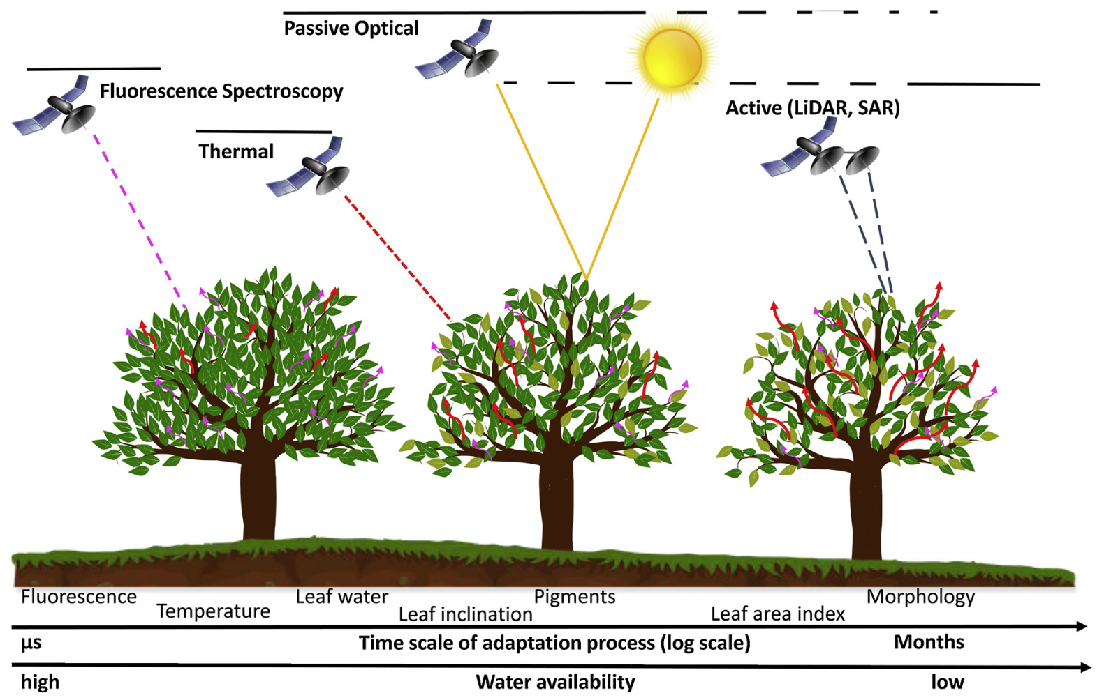
Vegetation responses to water stress
[Damm et al. 2018]

Slide 3
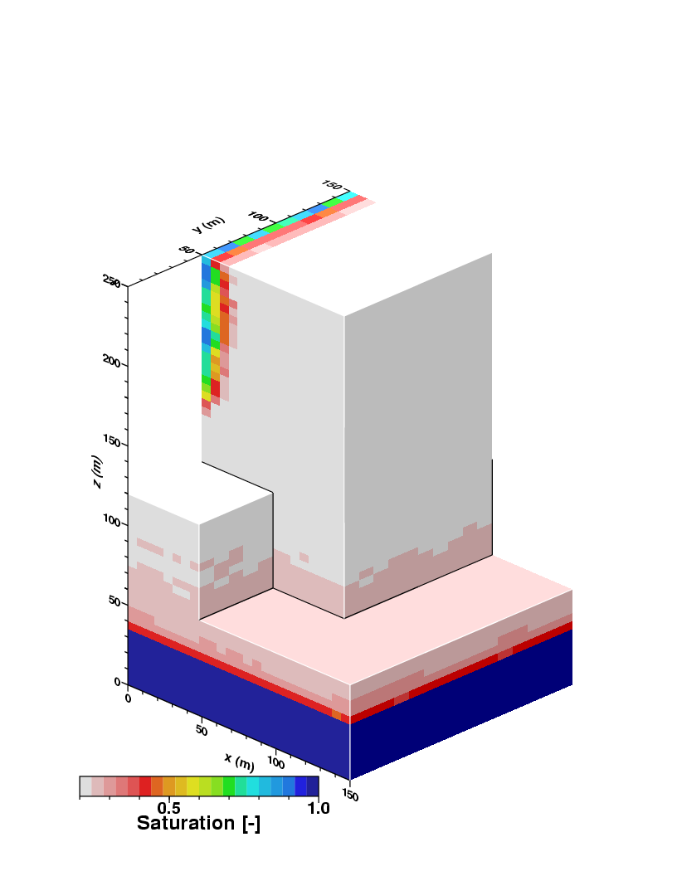




Solar-induced Chlorophyll Fluorescence (SIF)
Subsurface Water Storage (SSWS)
$${ΦF}_{\left(NIRv\right)}= \frac{π ×{SIF}_{canopy}^{740}}{NIRv×PAR}$$
CLM
Canopy structure
Illumination conditions
ParFlow
Soil Moisture between 0.02 – 2 m
  Root Zone Soil Moisture
Anomalies
Leaf level
[Siegmann et al. 2021, Liu et al. 2023]
[Belleflamme et al. 2023]

Slide 4
Motivation
Can Φ_{F} be used to detect changes in Subsurface Water Storage anomaly (SSWSa) in Germany?
  Agricultural and forest ecosystems
  Determine lag between Φ_{F} and SSWSa
Do other variables show similar (temporal) behavior to Φ_{F} in detecting changes in subsurface water storage anomalies (SSWSa)?
  Vegetation Indices
  Canopy SIF

Slide 5
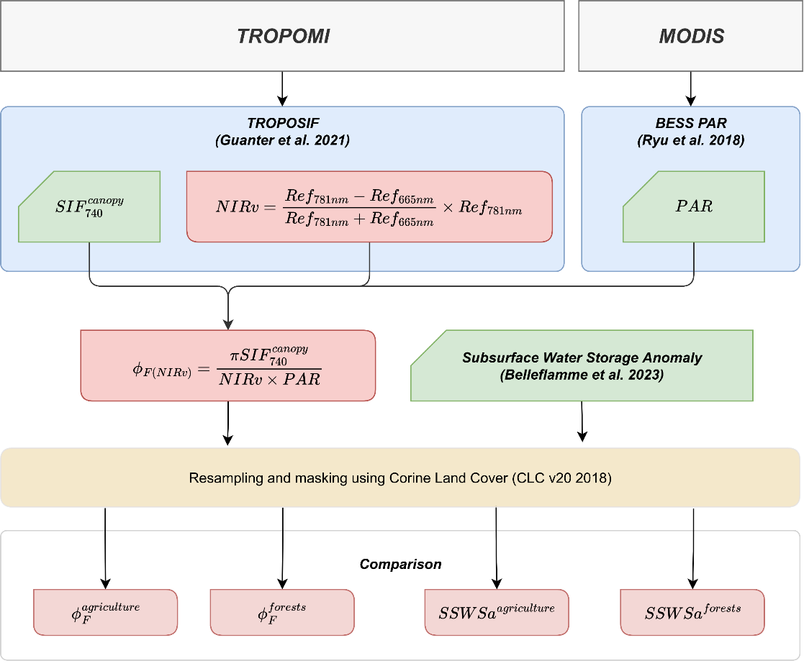
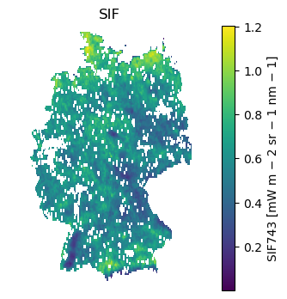
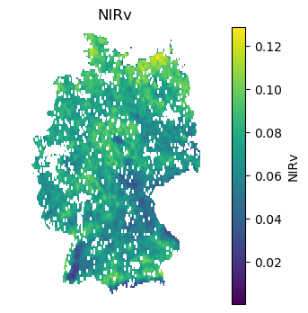
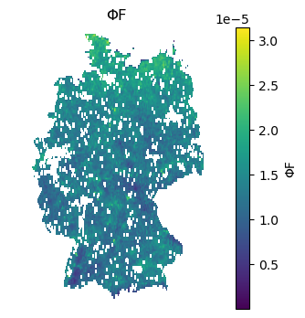
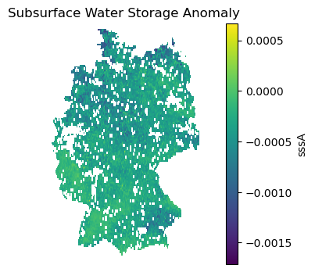
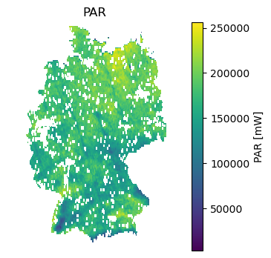
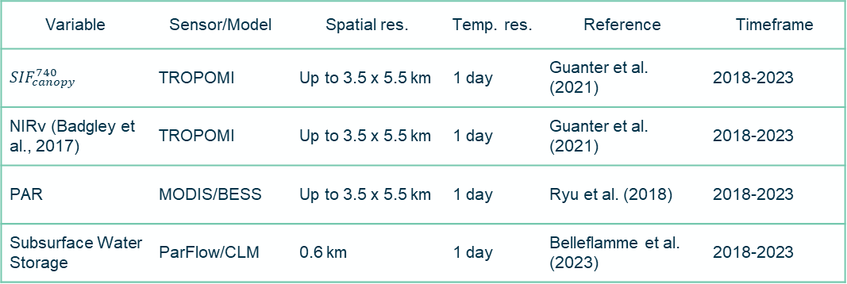
Data and Workflow
Variable | Sensor/Model | Spatial res. | Temp. res. | Reference | Timeframe
$${SIF}_{canopy}^{740}$$ | TROPOMI | Up to 3.5 x 5.5 km | 1 day | Guanter et al. (2021) | 2018-2023
NIRv (Badgley et al., 2017) | TROPOMI | Up to 3.5 x 5.5 km | 1 day | Guanter et al. (2021) | 2018-2023
PAR | MODIS/BESS | Up to 3.5 x 5.5 km | 1 day | Ryu et al. (2018) | 2018-2023
Subsurface Water Storage | ParFlow/CLM | 0.6 km | 1 day | Belleflamme et al. (2023) | 2018-2023
vs.
SSWSa [m]

Slide 6
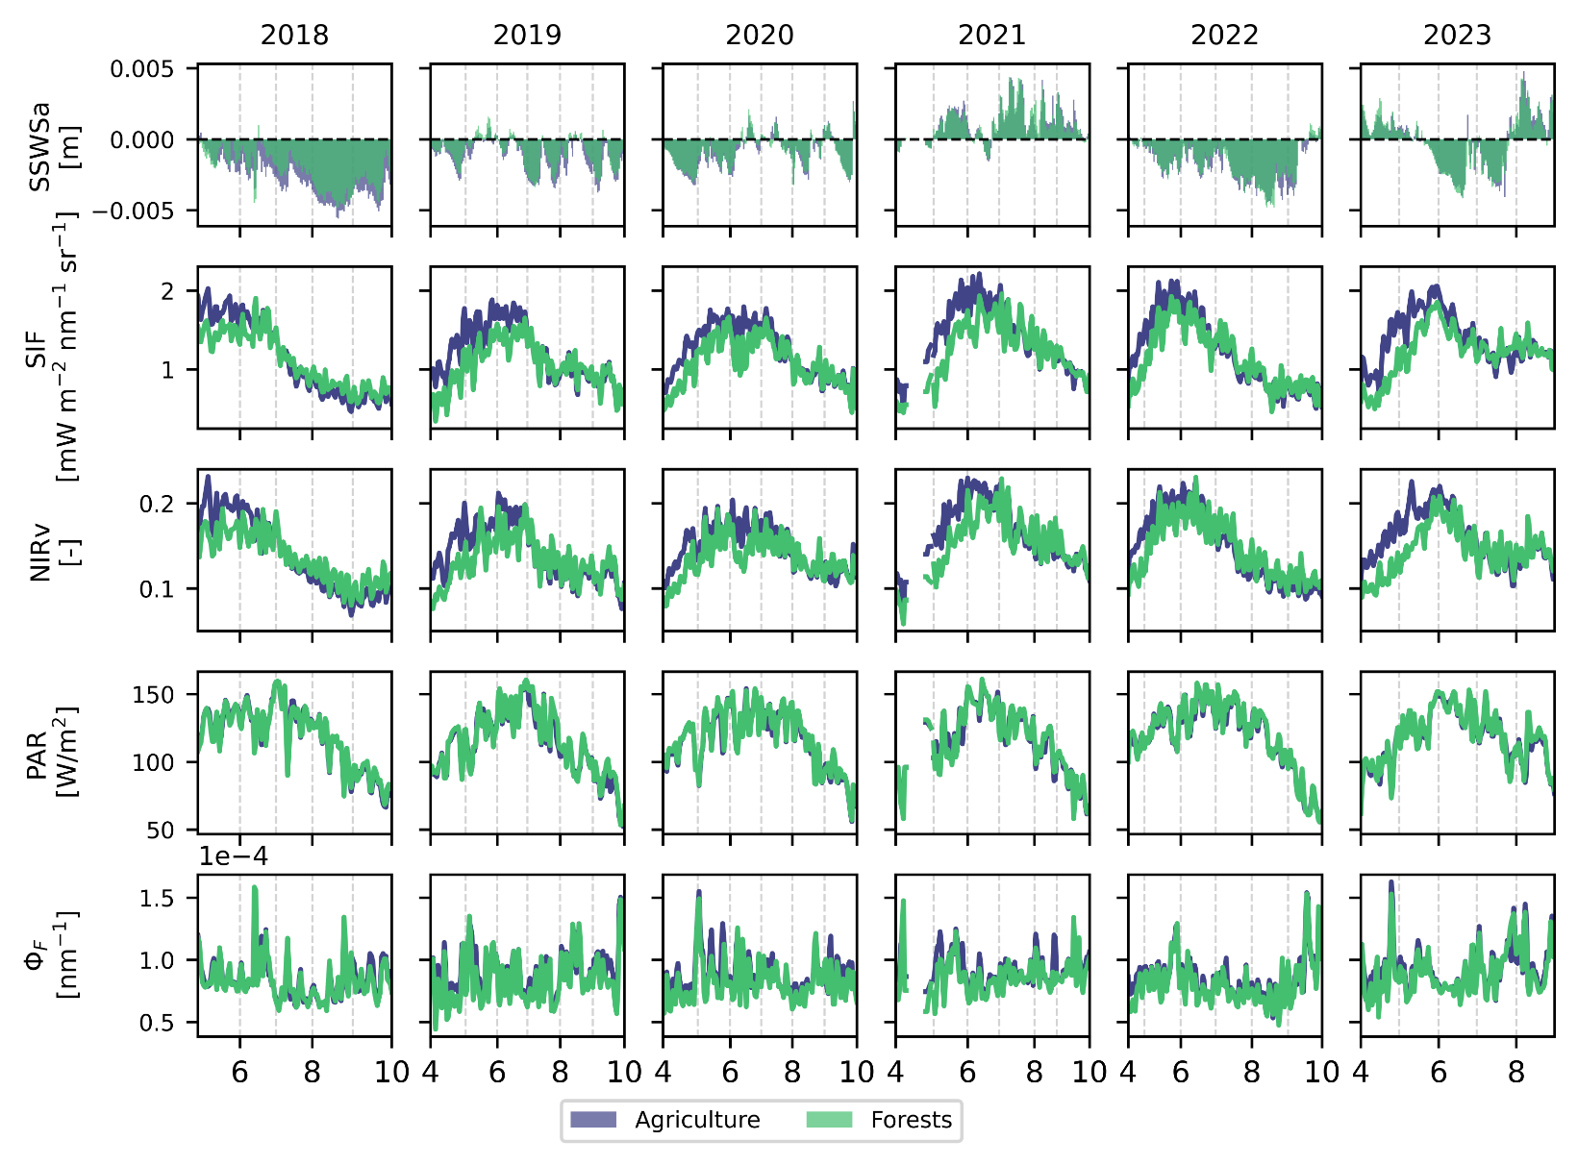

Overview of Time Series
Each data point represents the median of all available pixels averaged using a rolling average over two days

Slide 7
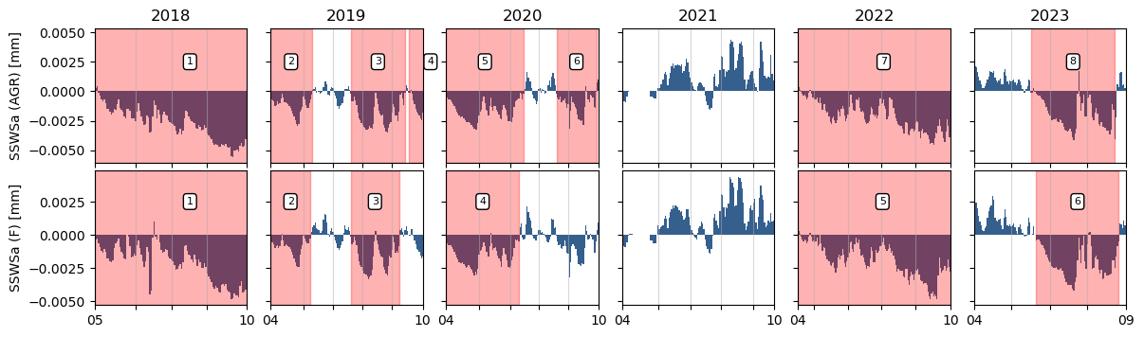
Subframe selection
Negative anomaly
Longer than 30 days
Combined Drought Indicator by the European Comission detects these time frames as Watch/Warning Periods

Slide 8
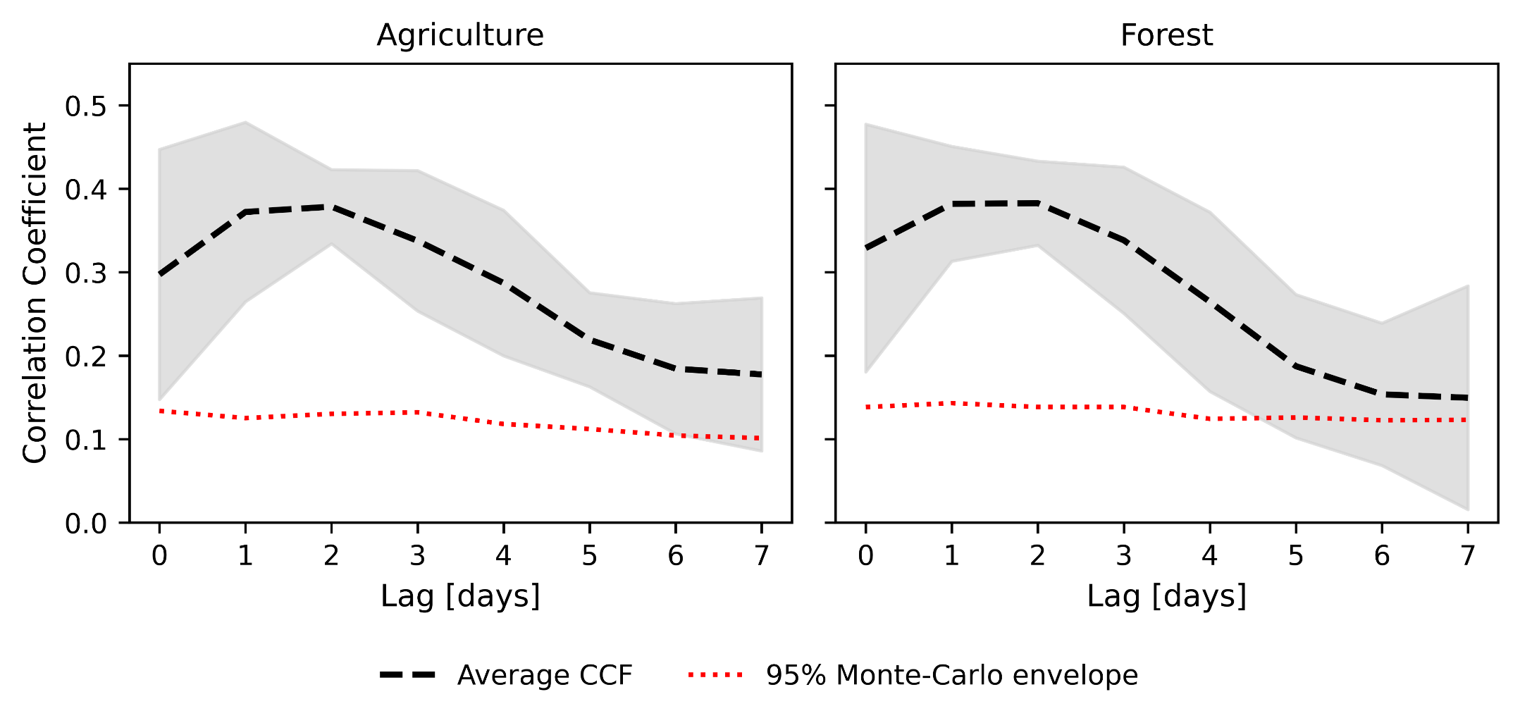
Results – Cross Correlation:
Subsurface Water Storage Anomaly and Φ_{F}
[Herrera et al., in review]

Slide 9
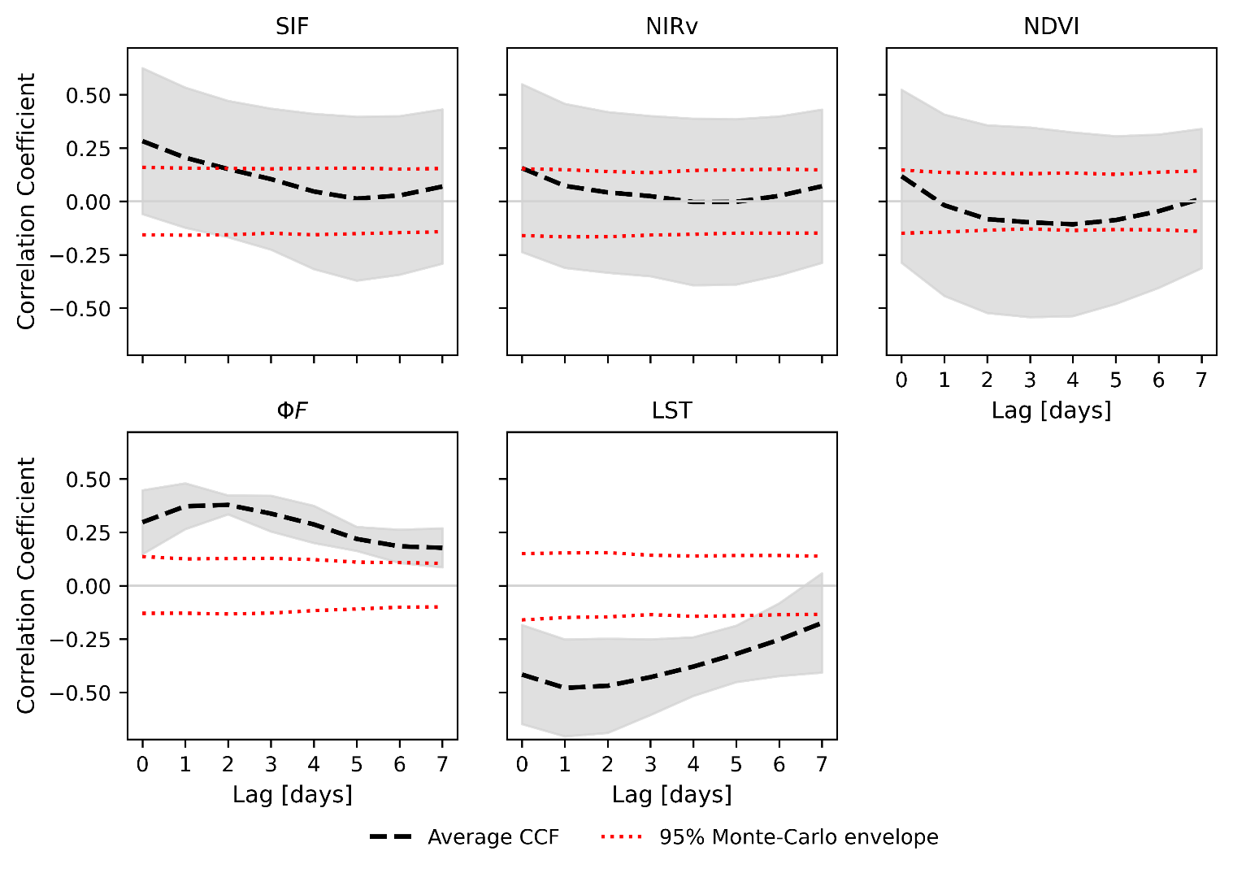
Results – Agriculture
[Herrera et al., in review]

Slide 10
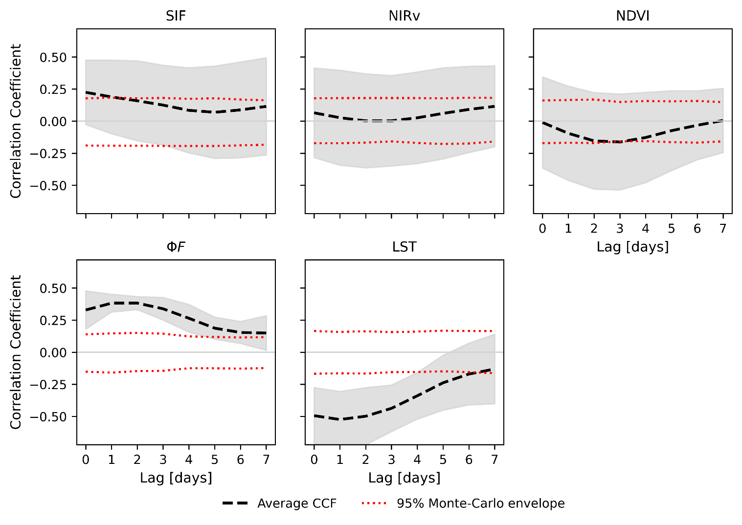
Results – Forests
[Herrera et al., in review]

Slide 11
Conclusion
Φ_{F} can detect changes in subsurface water storage anomalies (SSWSa)
    2-day lag for agricultural and forest ecosystems
Vegetation indices (e.g., NIRv, NDVI) and non-normalized canopy SIF are not able to detect such changes
Importance of SIF downscaling
LST responds similarly or in some cases even earlier than ΦF to changes in SSWSa

Slide 12
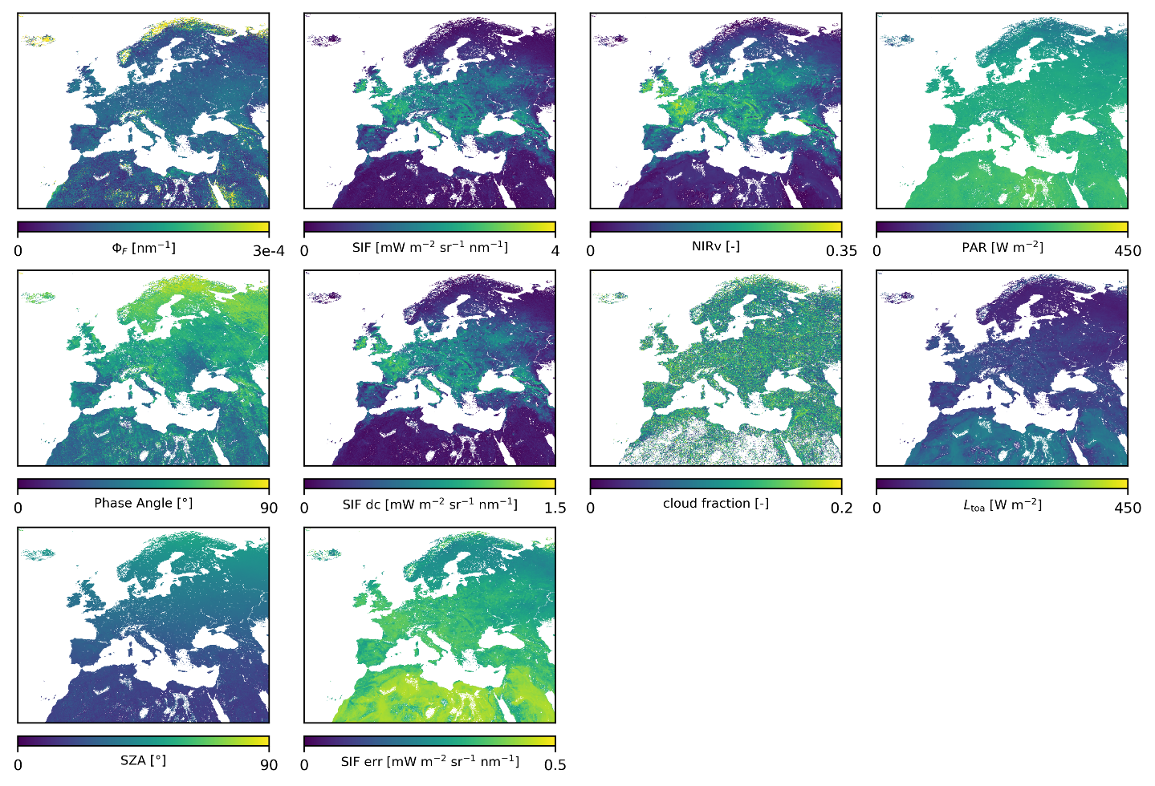

Outlook
European Φ_{F} dataset
DOI: https://doi.org/10.26165/JUELICH-DATA/EFFTES
Cross-comparison/validation with FLEX data
in near future
[Herrera et al., in review]

Slide 13




Thank you for your attention!

Slide 14
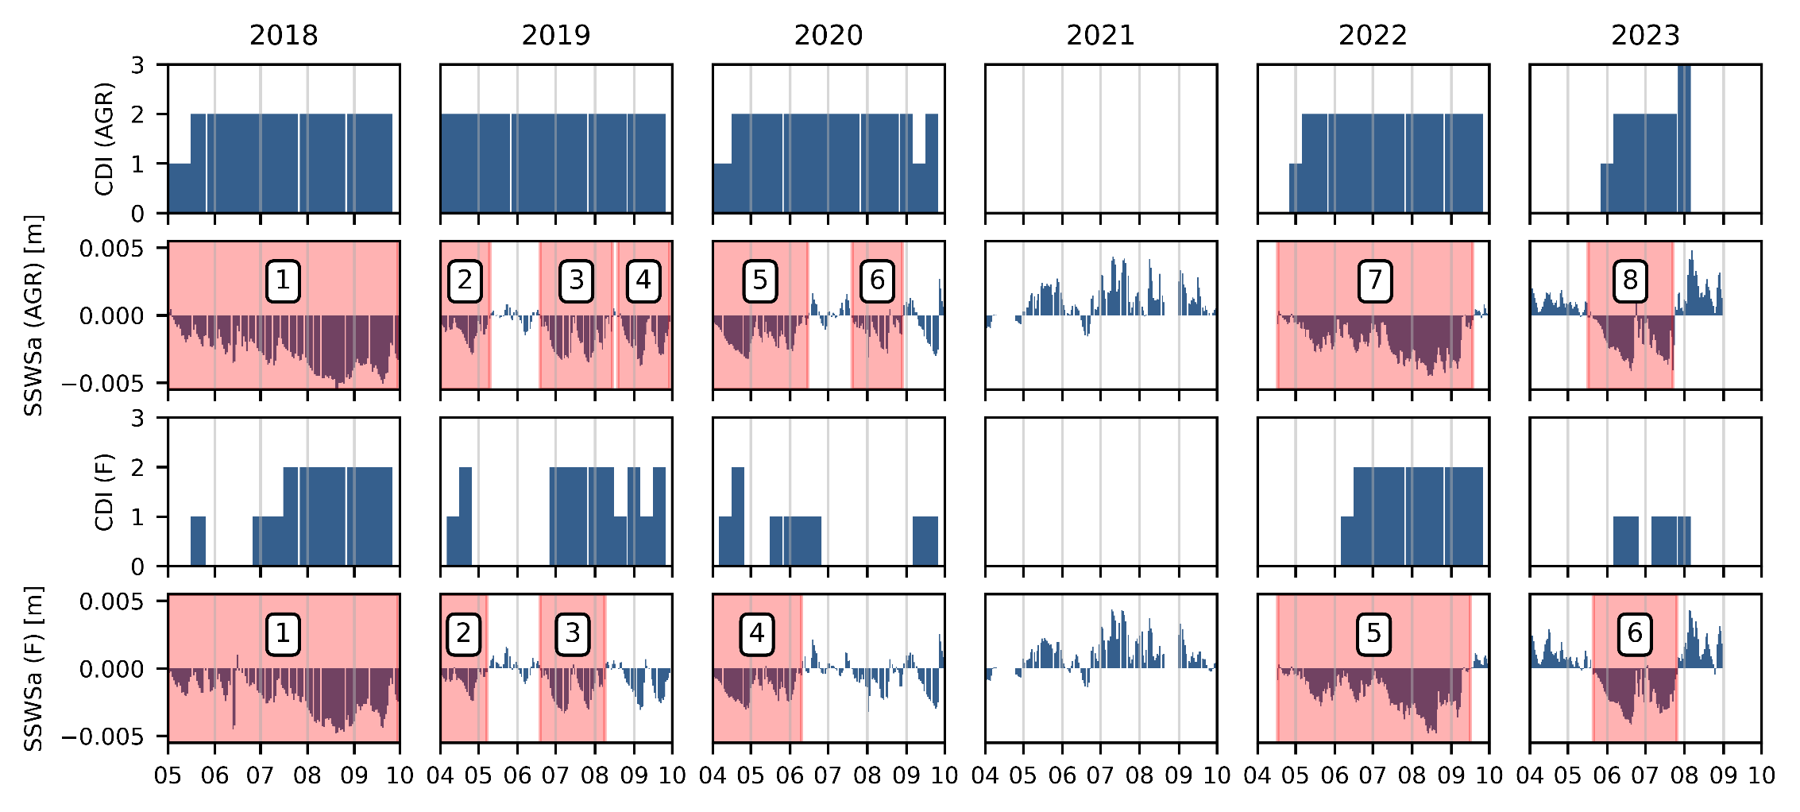
Subframe selection - CDI

Slide 15
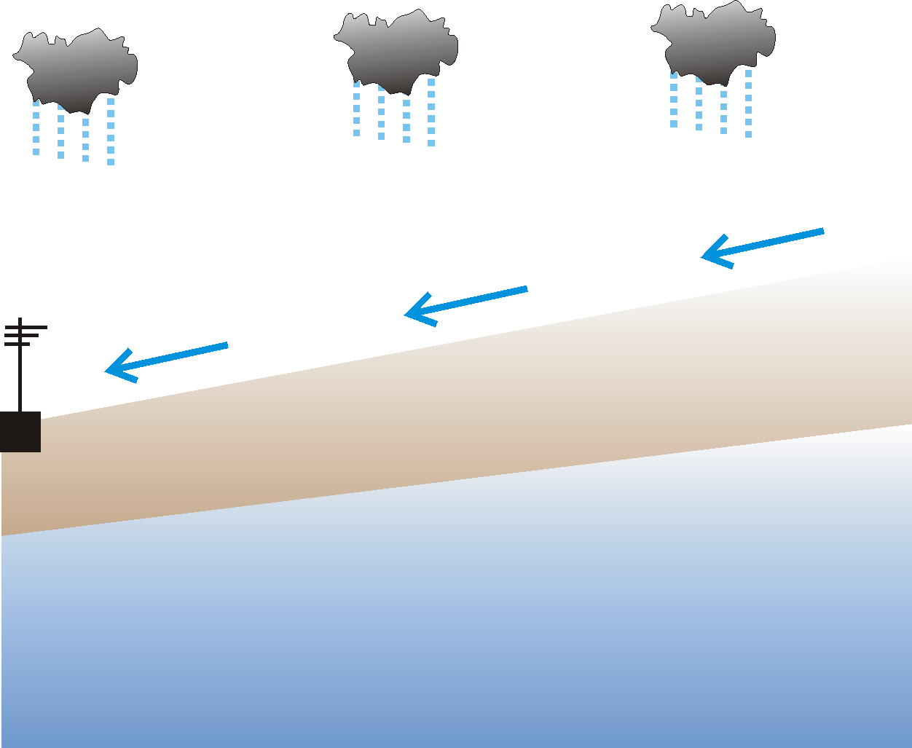
Subsurface water storage
At high resolution over central Europe
ECMWF
ParFlow/CLM
  Hydrological model
  Fully coupled, 2D/3D dynamical representation of the hydrological processes in the variably saturated zone, including groundwater and overland flow
  CLM module for water & energy fluxes at the surface
Grid: 611m resolution, 15 layers down to 60m depth
Parametrisation: CLC2018, SoilGrids, IHME, ASTER/MERIT
Atmospheric forcing: ECMWF HRES deterministic forecast h0-h24
  Validation with observation-based data over 2010-2019 for volSM, ET, WTD, Q
Atmospheric Forcing
CLM
Vegetation
Ground Surface
Infiltration Front
Vadose Zone
ParFlow
Saturated Zone
Water Table

Slide 16
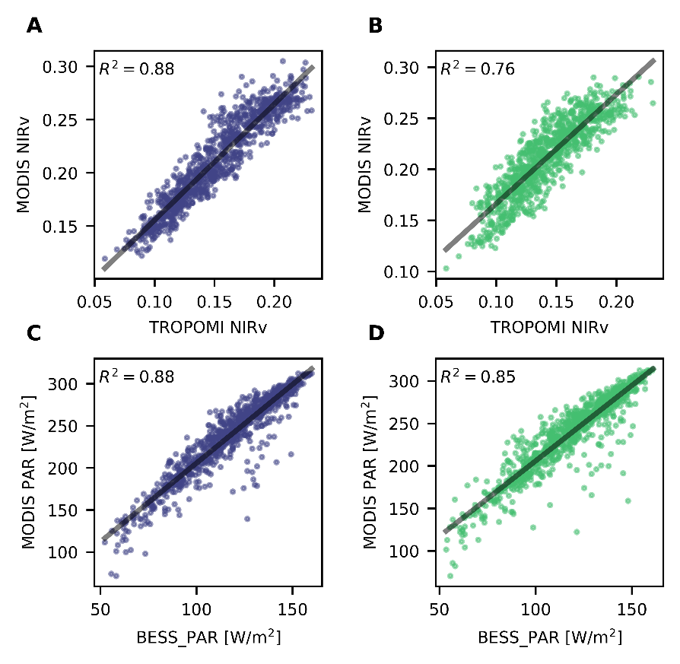
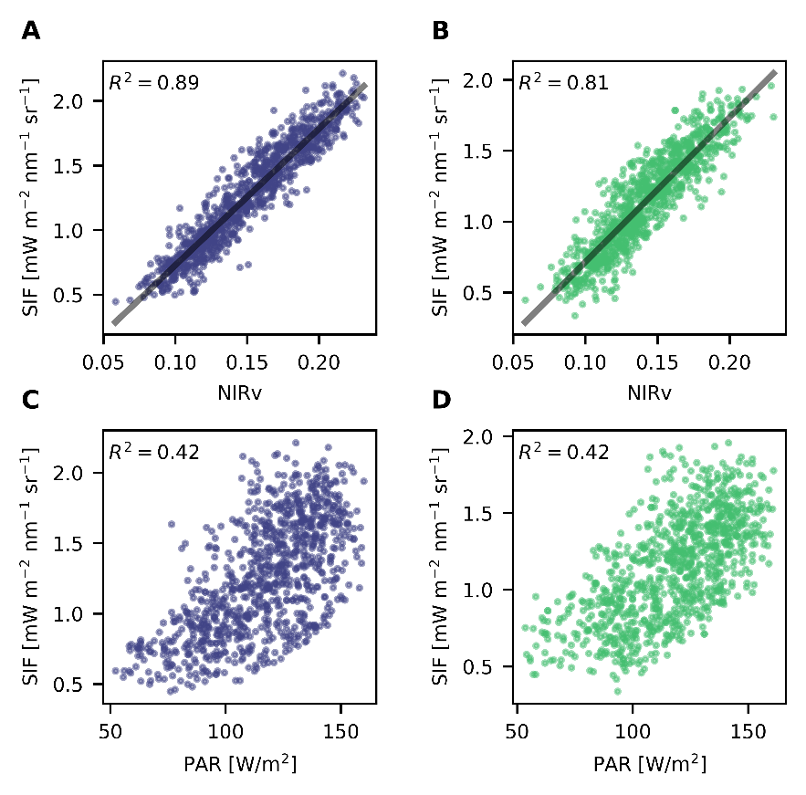

Slide 17
