Slide 1
Sun-induced fluorescence derived canopy level effects of elevated CO₂ and Cercospora leaf spot on photosynthesis in field-grown sugar beet
Deepthi Konche, Anna Jacobs, Juan Manuel Romero, Facundo Ispizua Yamati, Naveen Kumar Gangaraju, Anne-Katrin Mahlein, Uwe Rascher, Onno Muller

Slide 2
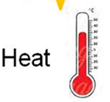




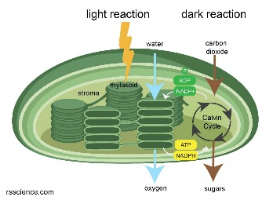

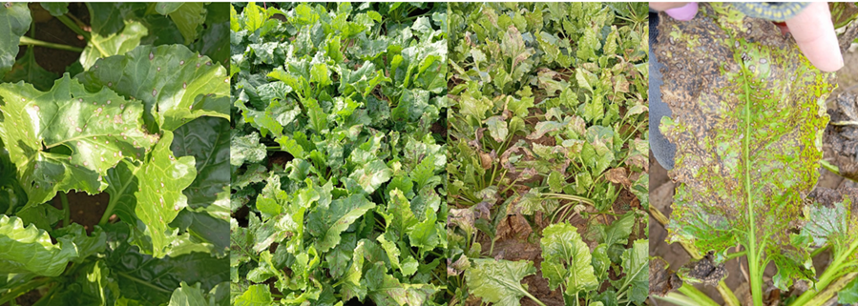

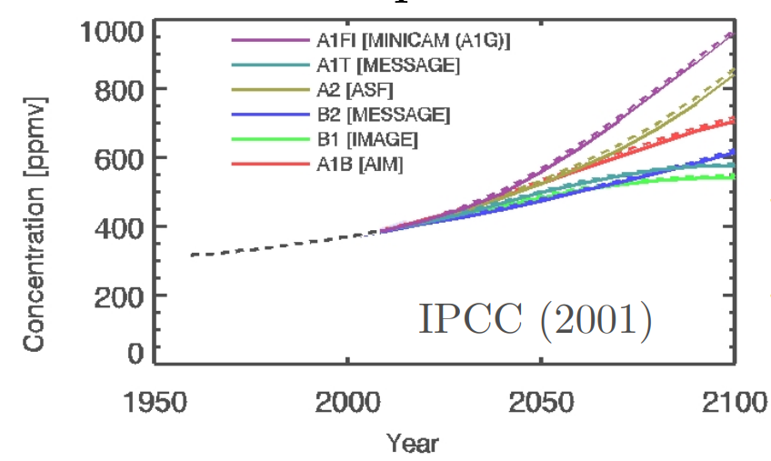
Biotic stress and Climate change
Abiotic stress
The potential of SIF for monitoring biotic stress is relatively underexplored
Rascher et al., 2015
Cercospora leaf spot (CLS) - 50% yield reductions in sugar beet
Biotic stress
Rangel et al., 2020
Chlorophyll fluorescence
Photosynthesis
Heat dissipation
Carbon assimilation
Biomass formation
Disease progression
Beet & Sugar yield
Circular reddish-brown lesions with greyish centers
Structural compromising light interception
Physiological damaging photosynthetic performance
Sugar beet
Notes:
In this study, we focus on sugar beet, an economically important crop, and investigate the effects of Cercospora leaf spot disease on canopy physiology

Slide 3
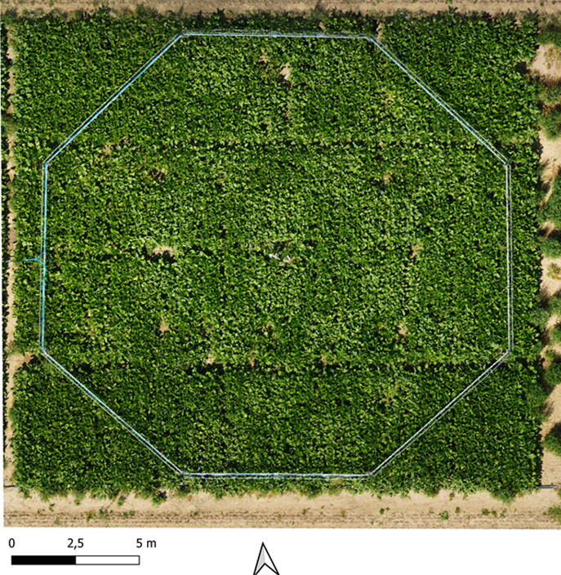
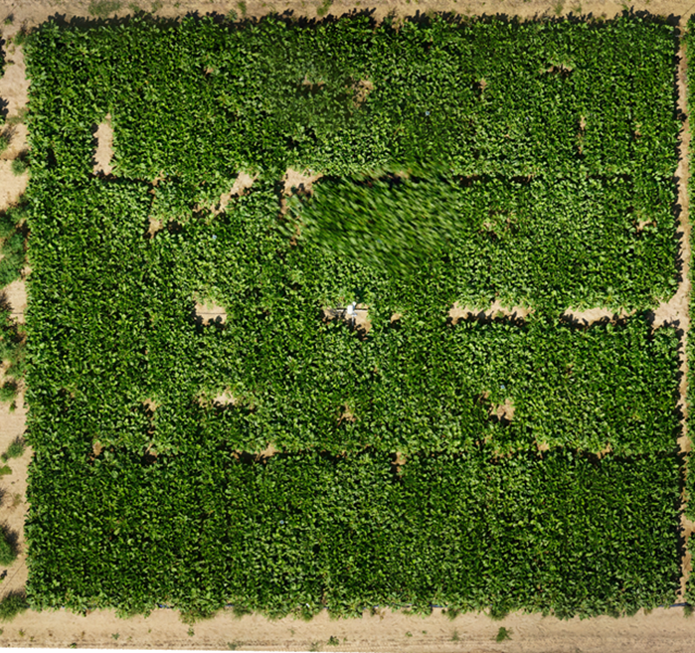
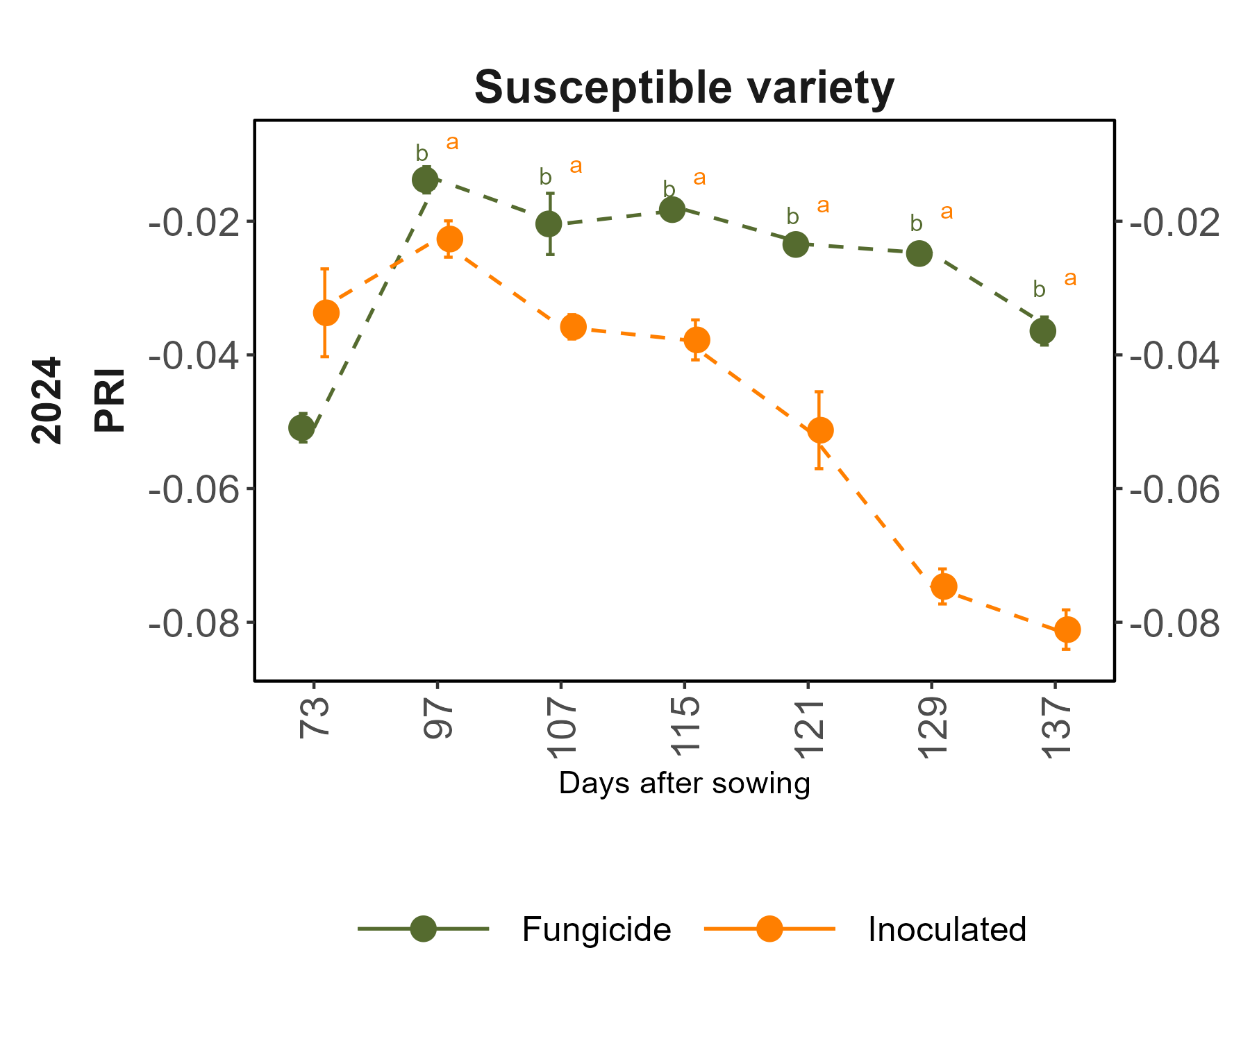
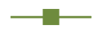

Experimental Set-up (BreedFACE)
+CO₂ (600 ppm)
Ambient (400 ppm)
Sugar beet varieties:
1) Susceptible (S)
(VLS)
(VLS)
2) Very low Susceptible (VLS)
Treatments:
Ambient Fungicide
Elevated Fungicide
(S)
(S)
Ambient Inoculated
Elevated Inoculated
(S)
(S)
(VLS)
2024
n = 3-4
3m x 3m
(VLS)
Free-Air CO₂(carbon dioxide) enrichment (FACE) Octogonal pipe system
Notes:
Use the terms – less disease and high disease for explaining fungicide and inoculated, for susceptible use the variety which can get the disease faster, for VLS which cannot easily get the disease faster

Slide 4
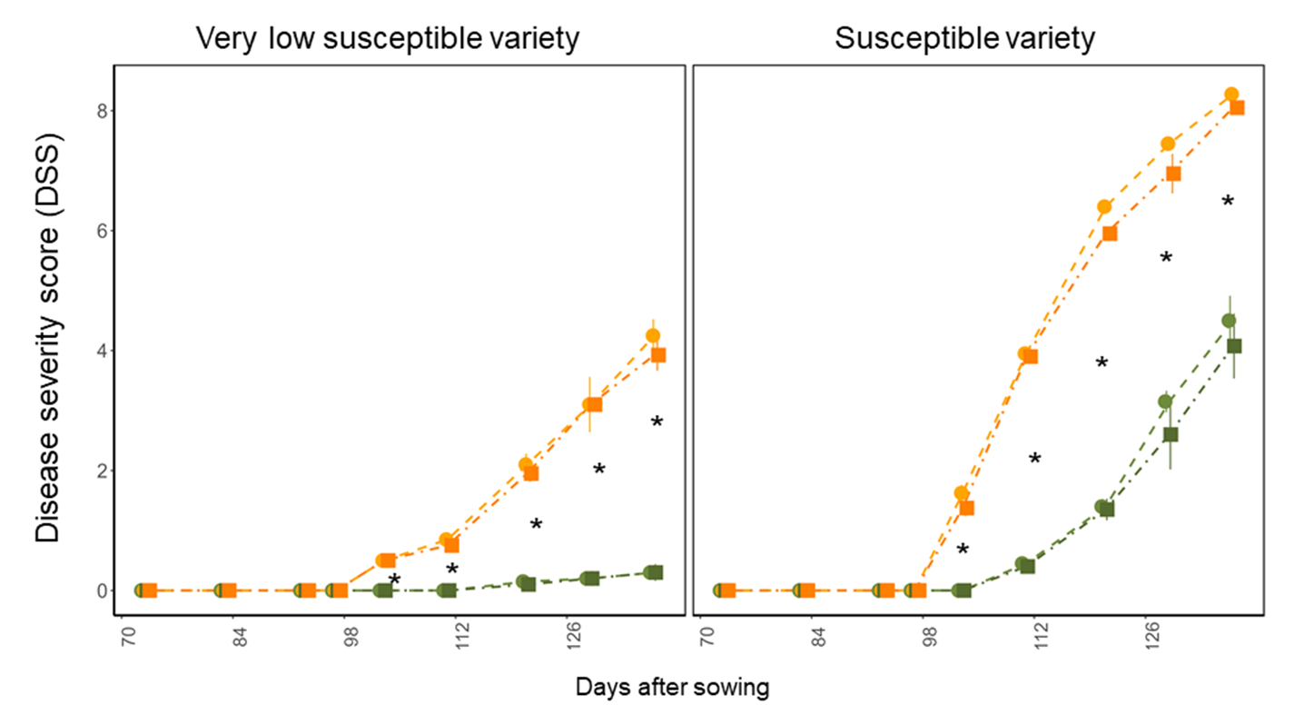
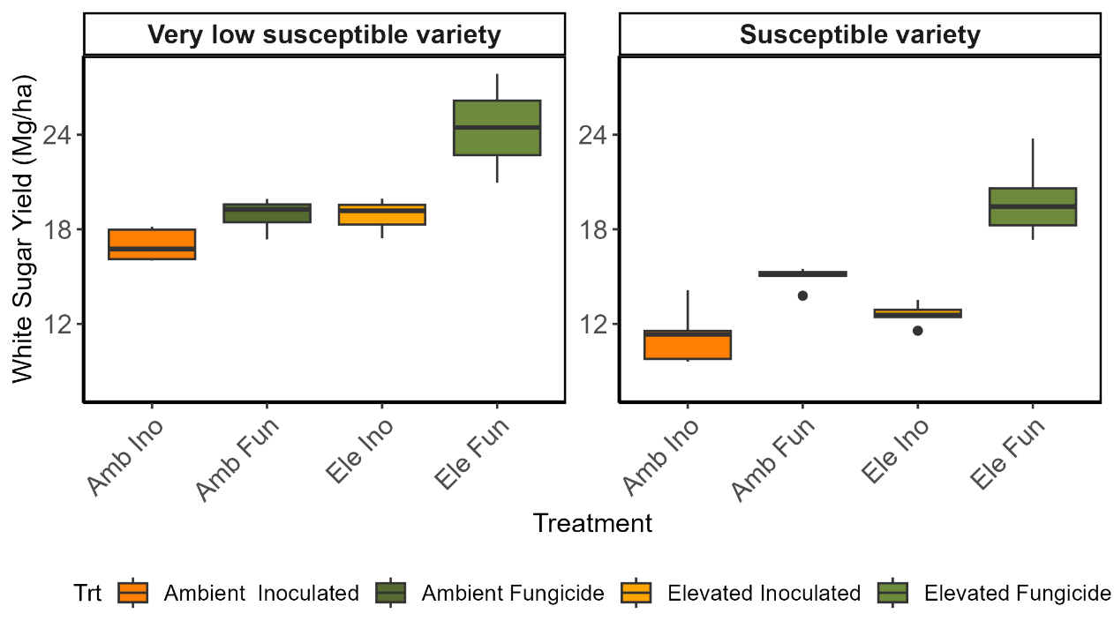
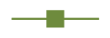
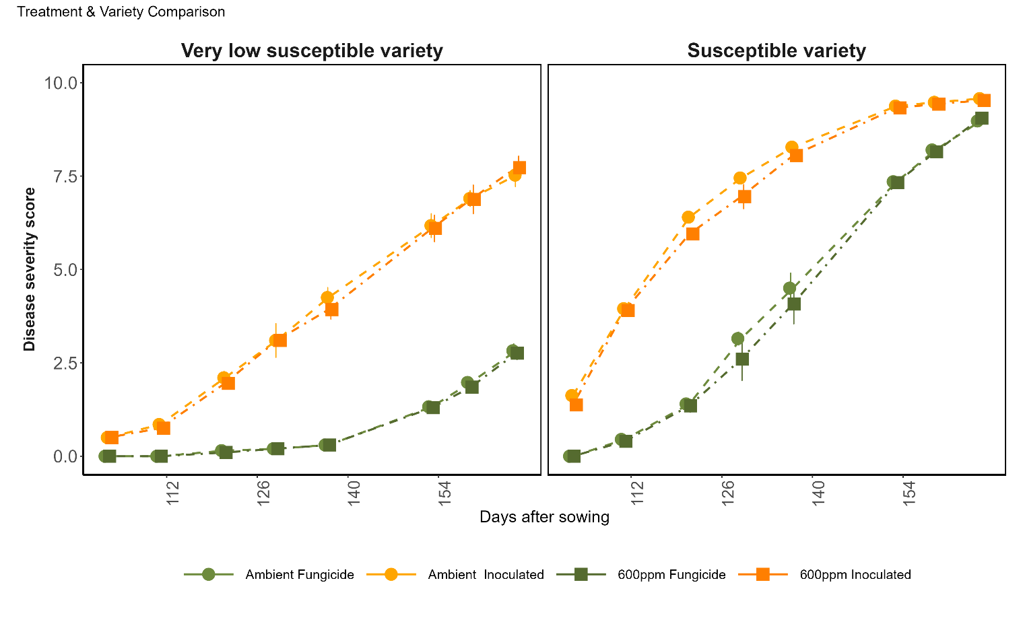
Disease and yield response under elevated CO₂
Seasonal disease severity (CLS):
Final sugar yield (Mg/ha):
Ambient CO₂
600 ppm CO₂
Ambient CO₂
600 ppm CO₂
d
d
cd
cd
e
bc
a
ab
Inoculated
Fungicide
Fungicide
Inoculated
Fungicide
Inoculated
Inoculated
Fungicide
Days after sowing
Elevated Fungicide
Elevated Inoculated
Ambient Fungicide
Ambient Inoculated
Elevated CO₂ increased yield in the fungicide-treated plots for both genotypes
Disease severity did not differ between ambient and elevated CO₂, which was also reflected in canopy SIF measurements

Slide 5
Disease and yield response under elevated CO₂
Seasonal disease severity (CLS):
Final sugar yield (Mg/ha):
Ambient CO₂
600 ppm CO₂
Ambient CO₂
600 ppm CO₂
d
d
cd
cd
e
bc
a
ab
Inoculated
Fungicide
Fungicide
Inoculated
Fungicide
Inoculated
Inoculated
Fungicide
Days after sowing
Elevated Fungicide
Elevated Inoculated
Ambient Fungicide
Ambient Inoculated
Elevated CO₂ increased yield in the fungicide-treated plots for both genotypes
Disease severity did not differ between ambient and elevated CO₂, which was also reflected in canopy SIF measurements
Under inoculation, the increase was small and not significant
Therefore, from now we focus on the susceptible variety under ambient conditions

Slide 6
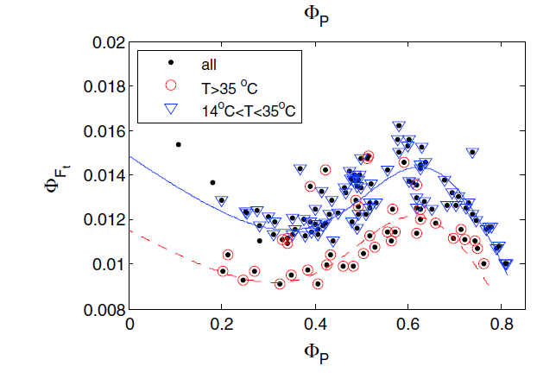
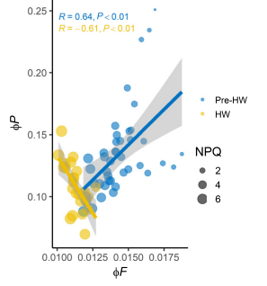
Research Objectives
1) To evaluate the detection of disease (CLS) symptoms using passive sun-induced fluorescence (SIF)
Biotic stress
Abiotic stress
SIF
PSII efficiency
ETR (μmol e⁻ m⁻² s⁻¹)
ϕ
SIF₇₆₀ (mW m⁻² nm⁻¹ sr⁻¹)
SIF₆₈₇ (mW m⁻² nm⁻¹ sr⁻¹)
Canopy SIF
PSII efficiency
ϕ
SIF
Konche et al., accepted, JXB
Van der Tol et al., 2014
Martini et al., 2021
2) To disentangle structural and physiological drivers of SIF responses in combination with active ChlF (PSII efficiency) using seasonal data
Notes:
Previous studies like Van der dol and Martini have shown that PSII photochemical efficiency and SIF yield are closely linked under stress conditions. In particular, reductions in PSII efficiency are often accompanied by increases in fluorescence yield due to reduced photochemical energy use and increased energy dissipation mostly under abiotic stress
However, our earlier work under biotic stress, based on two infection stages, suggested that SIF responses were driven predominantly by structural canopy changes rather than physiological downregulation.
Using seasonal data, we aim to determine whether CLS-driven changes in SIF are dominated by canopy structural effects or physiological regulation of photosynthesis. At the same time, we evaluate how PSII efficiency and SIF yield are related under disease stress conditions.

Slide 7
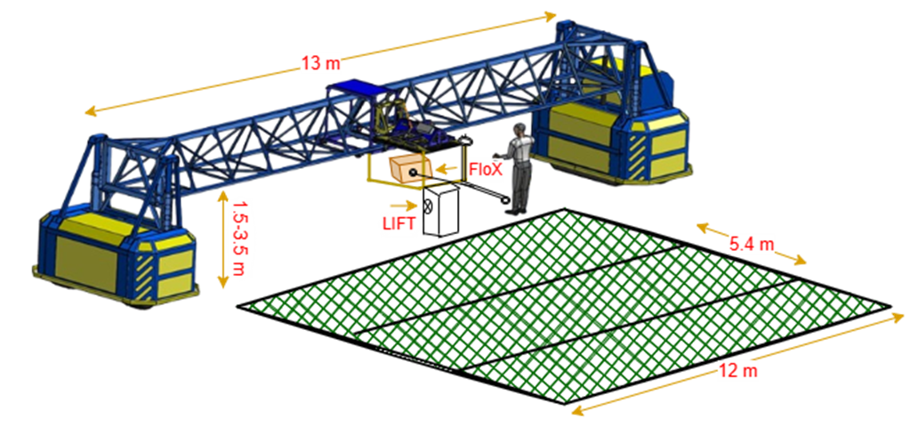
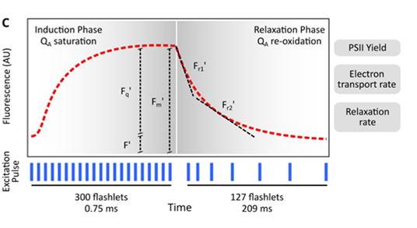
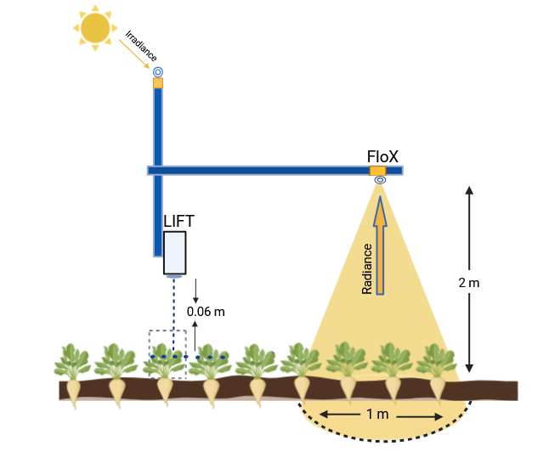
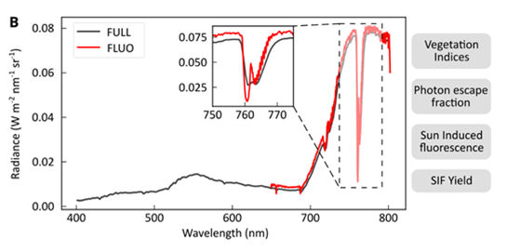
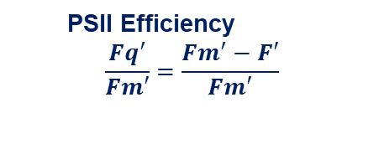
Measurements
Light-Induced Chlorophyll Fluorescence Transient (LIFT)
PSII Efficiency
$$\frac{Fq^{′}}{Fm′}=\frac{Fm^{′}−F′}{Fm′}$$
Romero et al., 2025
Canopy SIF at O2-A and O₂-B (SIF₇₆₀, SIF₆₈₇, SFM method)
Incoming PAR, APAR
Various vegetation Indices
JB Hyperspectral Devices

Slide 8
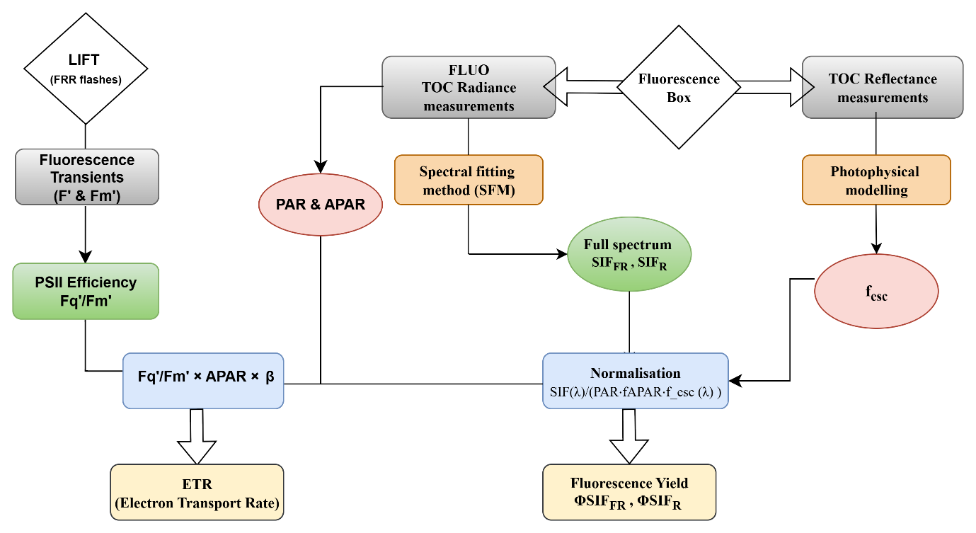
Normalization of sun-induced fluorescence (SIF)
SIF₇₆₀, SIF₆₈₇
Romero et al., 2018
ϕ
ϕ
SIF₇₆₀, SIF₆₈₇
Konche et al., accepted, JXB

Slide 9
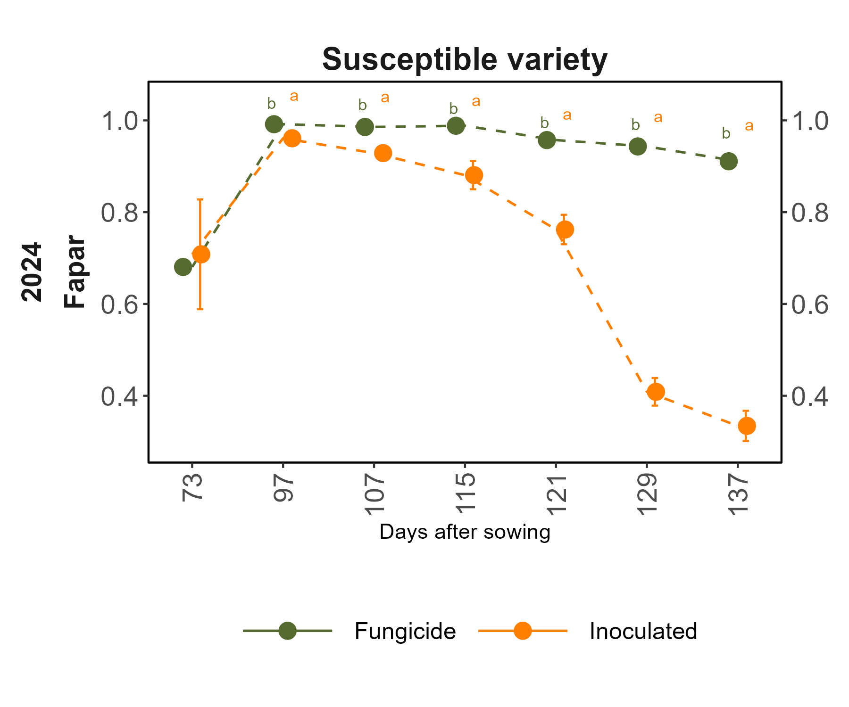
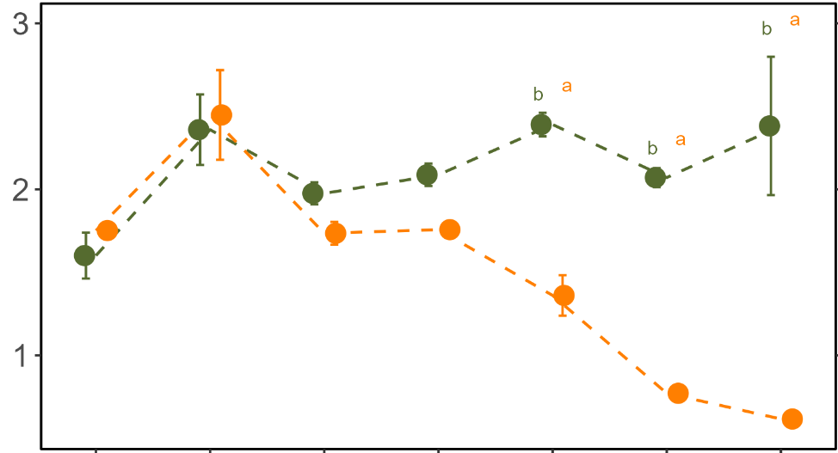
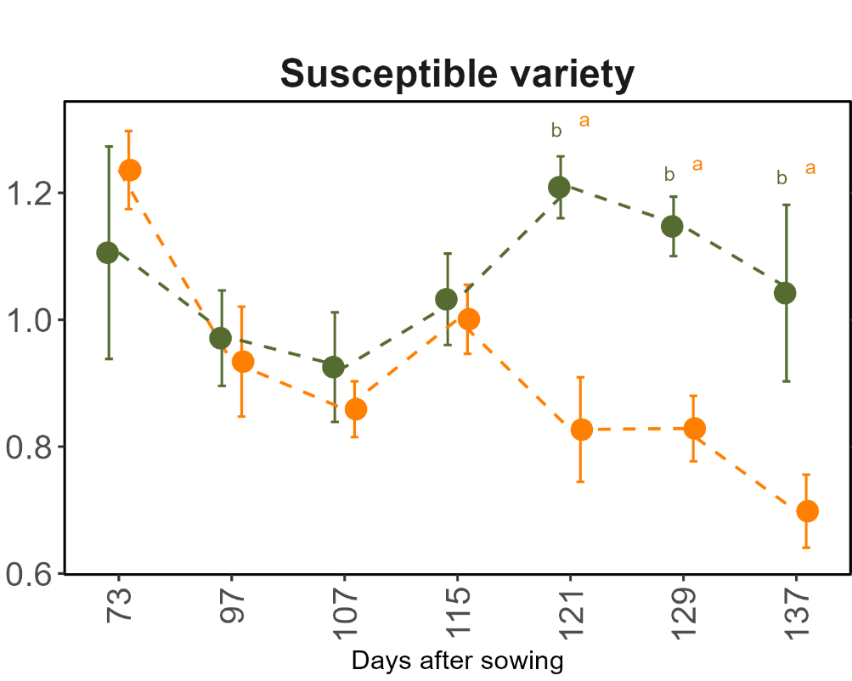
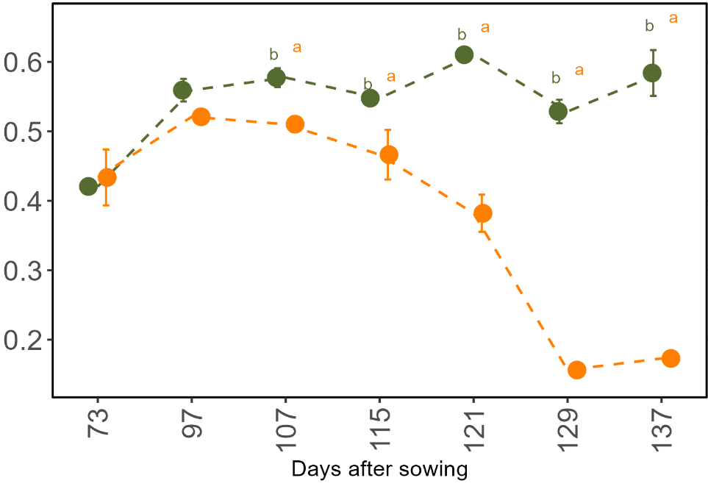
Reflectance and canopy SIF under biotic stress
*
*
*
*
*
*
*
*
Reflectance indices decrease in inoculated plots
*
fAPAR
SIF₇₆₀
(mW m⁻² nm⁻¹ sr⁻¹)
After disease, SIF₇₆₀ & SIF₆₈₇ proportional to APAR
First symptoms
First symptoms
Before disease, SIF₆₈₇ is inversely related due to chlorophyll reabsorption in dense canopies
*
*
*
*
*
*
*
*
NIRv
SIF₆₈₇
(mW m⁻² nm⁻¹ sr⁻¹)
First symptoms
First symptoms
Days after sowing
Days after sowing
* p < 0.05

Slide 10

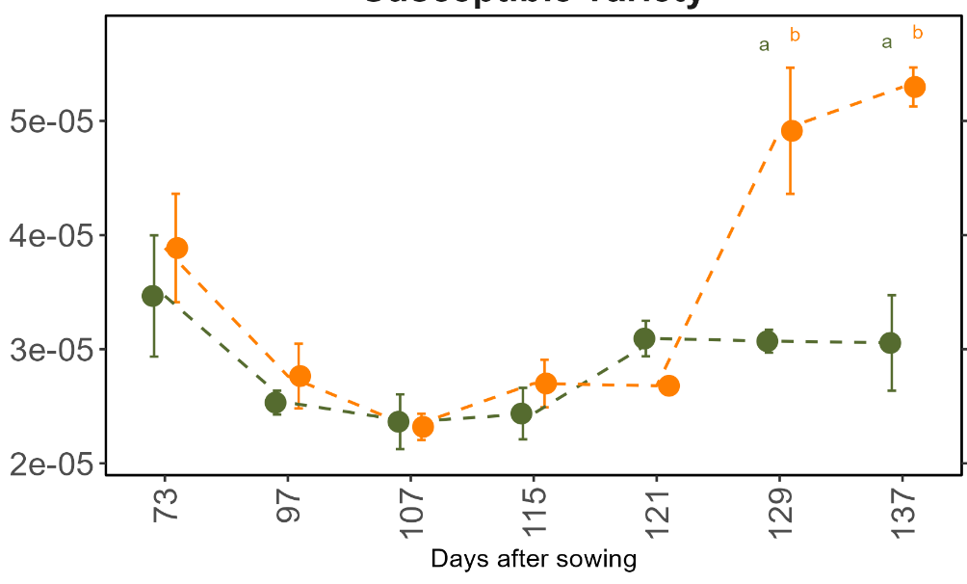
Fluorescence yields
First symptoms
After normalising, SIF₇₆₀ & SIF₆₈₇ doesn’t show
difference between treatments in early stages
ϕ
ϕ
SIF₇₆₀ (nm⁻¹)
*
ϕ
In later stages, both SIF increase in inoculated plots which indicates physiological responses
ϕ
*
*
SIF₆₈₇ (nm⁻¹)
First symptoms
ϕ
Days after sowing
* p < 0.05

Slide 11
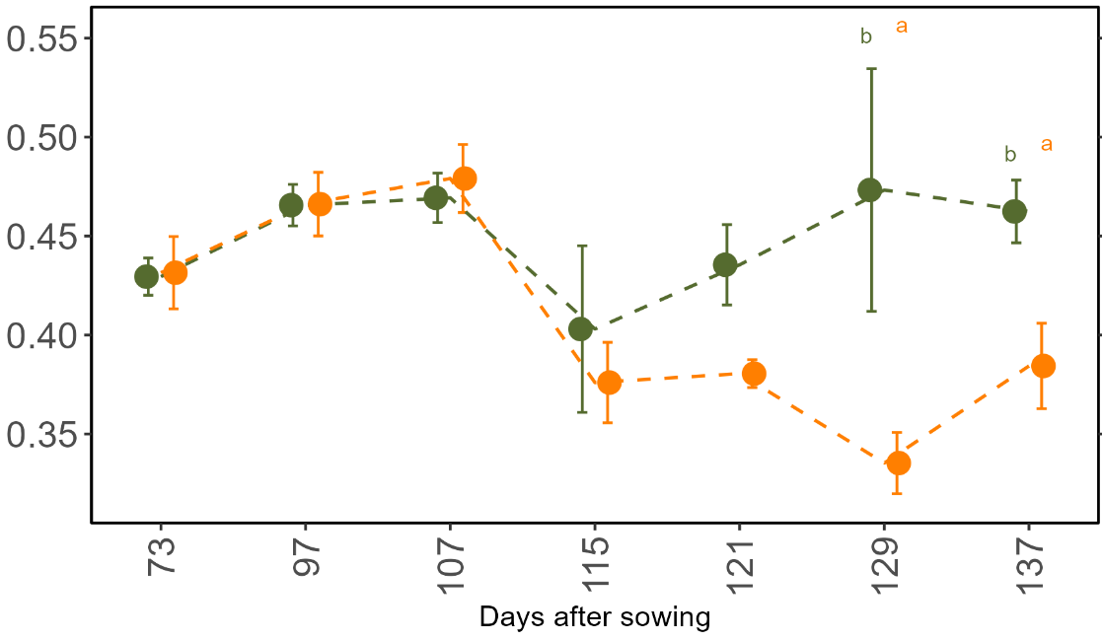
Linking active and passive signals
*
First symptoms
*
SIF₇₆₀ (nm⁻¹)
*
PSII efficiency (Fq’/Fm’)
ϕ
First symptoms
*
*
Days after sowing
SIF₆₈₇ (nm⁻¹)
First symptoms
PSII efficiency decrease in inoculated plots in later stages
ϕ
Opposite to SIF₇₆₀ & SIF₆₈₇ under stress conditions
ϕ
ϕ
SIF₆₈₇ showed stronger response when compared to SIF₇₆₀
ϕ
ϕ
Days after sowing
* p < 0.05

Slide 12
Conclusions
Reflectance indices determining SIF showed a strong response to disease due to canopy degradation and declining photosynthetic performance
SIF response was found to be driven more strongly by structural changes than by physiological responses under CLS disease
SIF and PSII efficiency showed opposite trends under stress conditions, with SIF₆₈₇ showing stronger response compared to SIF₇₆₀
ϕ
ϕ
ϕ
Perspectives
ϕ
ϕ
Interactions between SIF₇₆₀ and SIF₆₈₇ may show disease specific responses
SIF responses should be further evaluated in diseases that primarily affect physiological processes
Diurnal measurements are needed to determine whether SIF is more responsive to short-term physiological regulation than to structural canopy changes

Slide 13
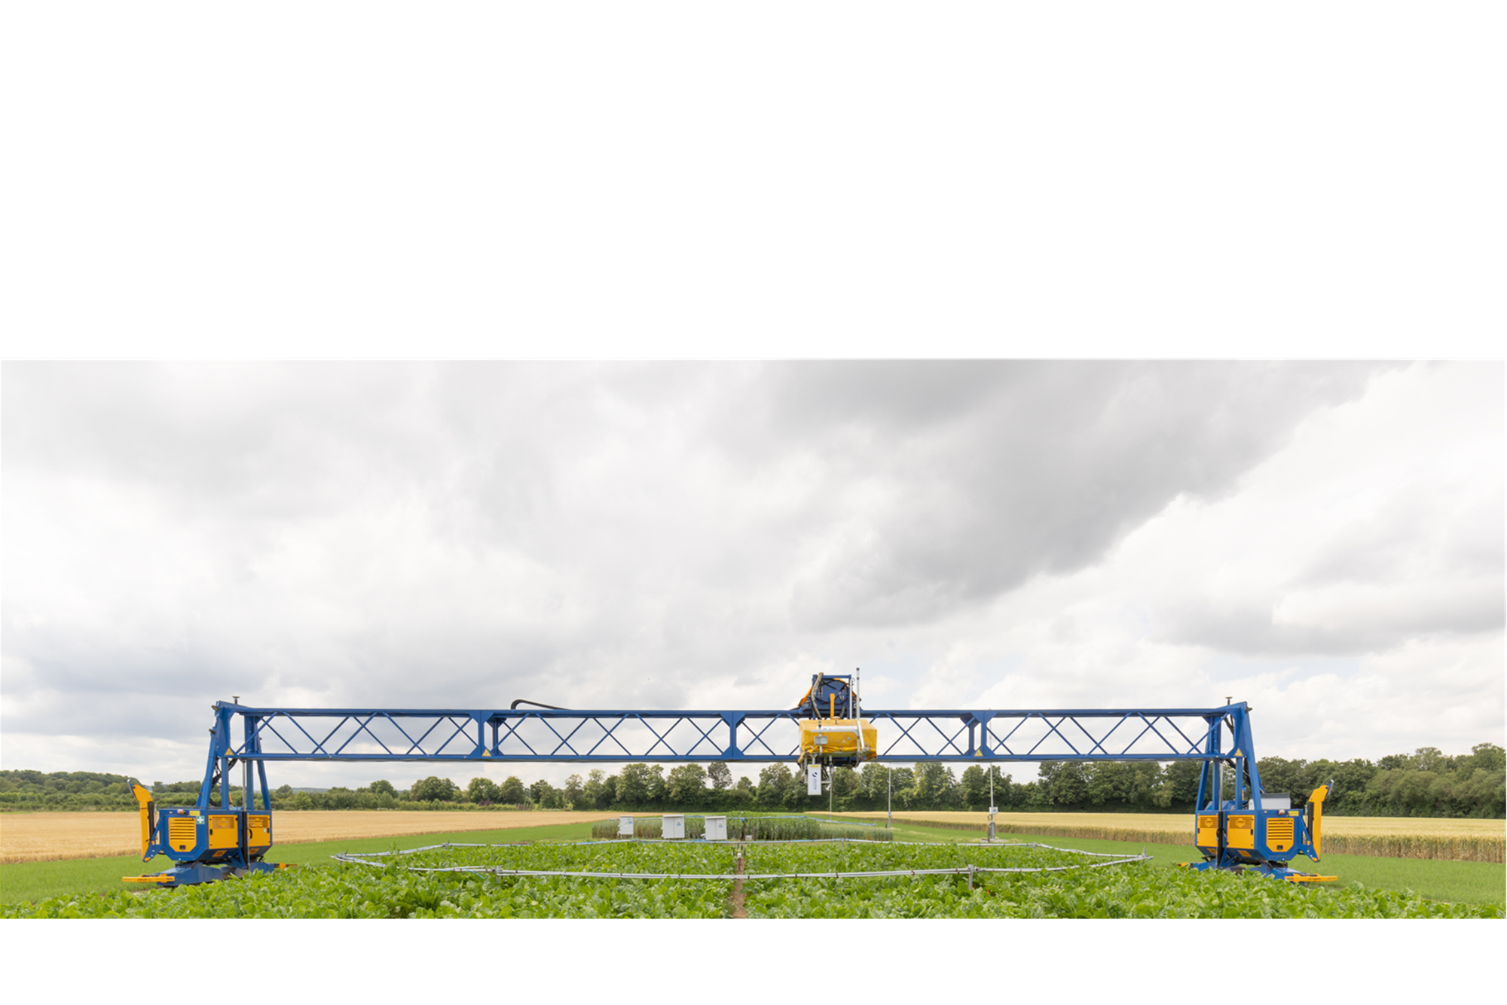



Thanks to….
Co-authors, all the technicians, CKA staff, friends, and colleagues at IBG-2.
Contact: Deepthi Konche
d.konche@fz-Juelich.de

Slide 14
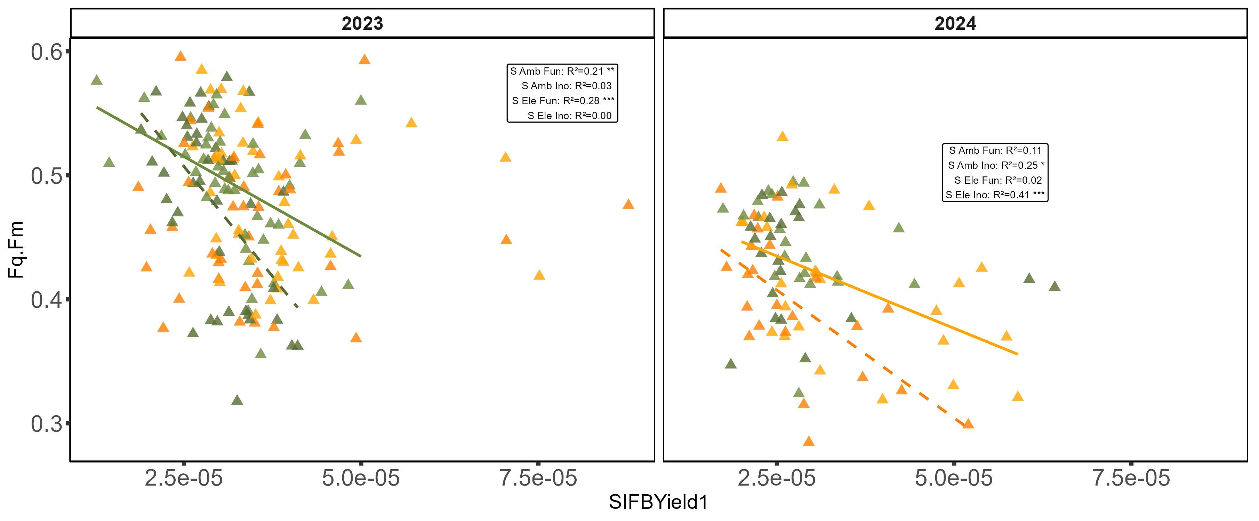

Slide 15
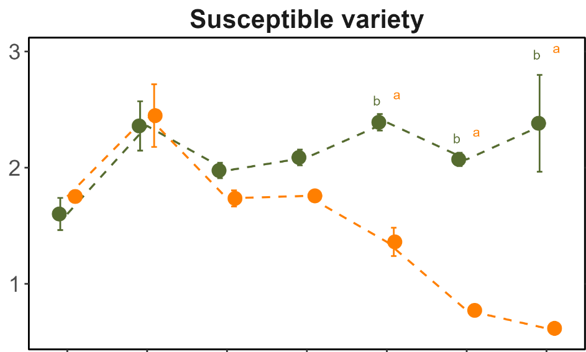

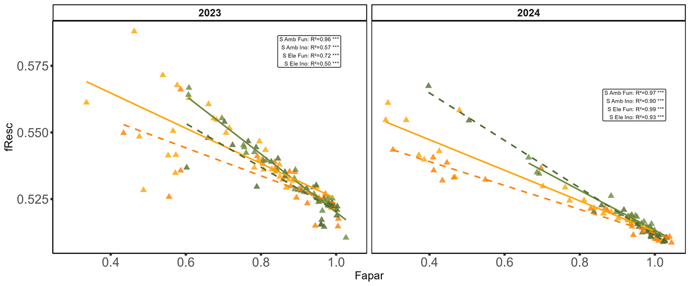

SIF response to biotic stress
$SIF\left(λ\right)$ = $ΦSIF\left(λ\right).PAR⋅fAPAR⋅f_{esc}\left(λ\right)$
SIF₇₆₀ & SIF₆₈₇ showed response to disease and decreased in inoculated plots after 115 DAS in both years
SIF₇₆₀
(mW m⁻² nm⁻¹ sr⁻¹)
SIF₇₆₀
(mW m⁻² nm⁻¹ sr⁻¹)
First symptoms
SIF₇₆₀ is proportional to APAR and SIF₆₈₇ is inversely related
as it is strongly reduced by fluorescence reabsorption (f^{R}esc)
First symptoms
SIF₆₈₇
(mW m⁻² nm⁻¹ sr⁻¹)
SIF₆₈₇
(mW m⁻² nm⁻¹ sr⁻¹)
f^{R}esc
First symptoms
First symptoms
fAPAR

Slide 16
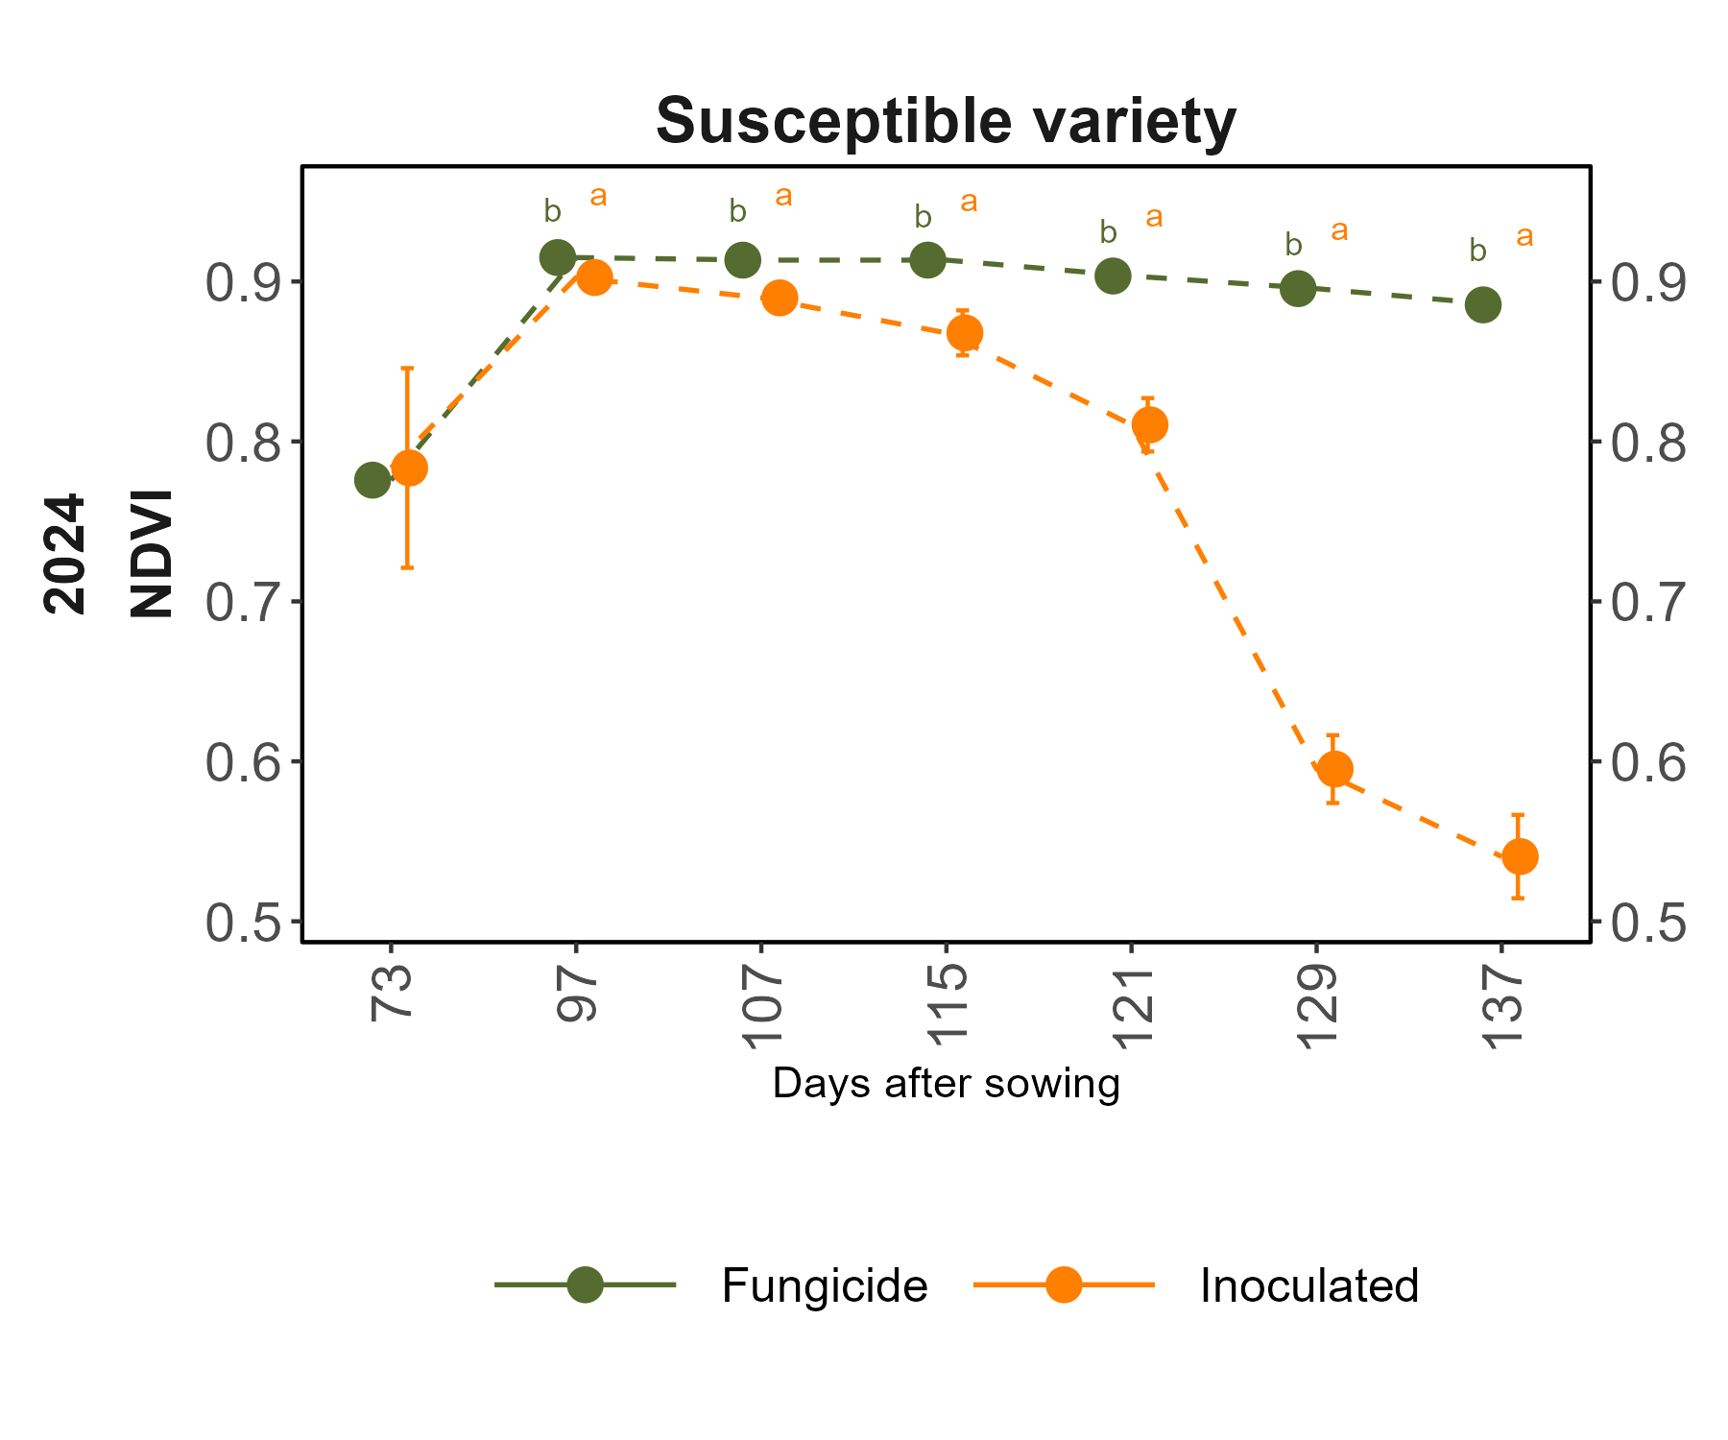
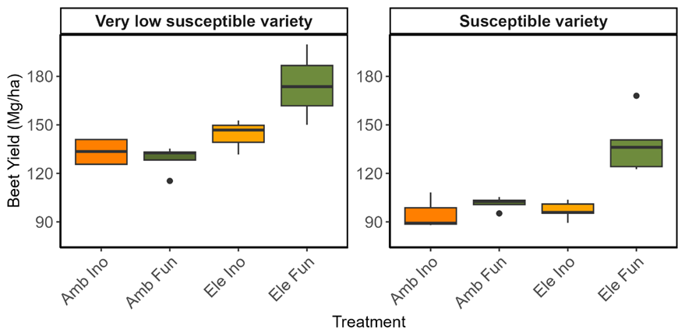

Slide 17
Reflectance based phenology
fAPAR
First symptoms
PRI
First symptoms

Slide 18
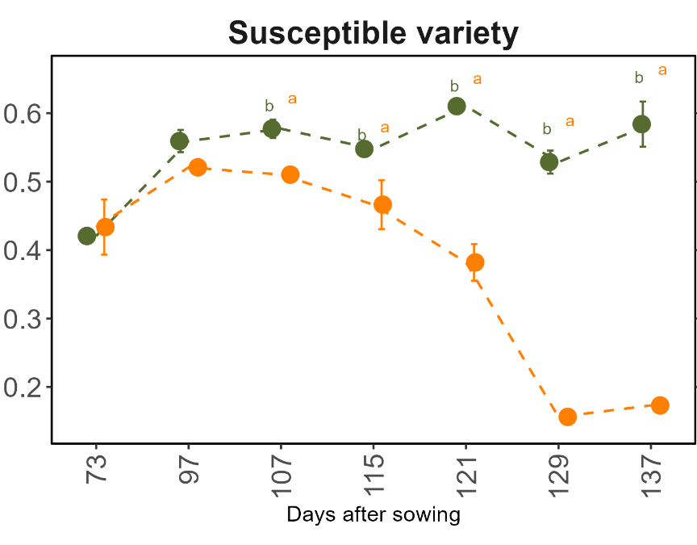
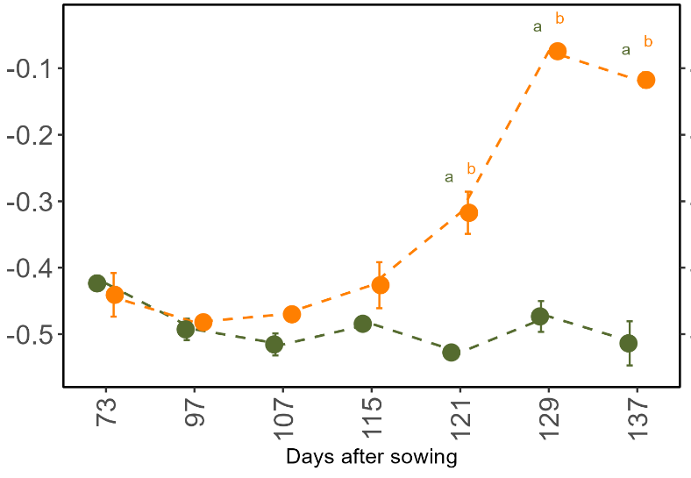
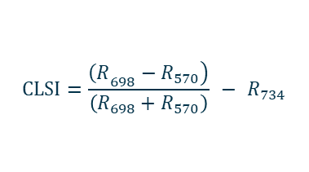
Reflectance and canopy SIF under biotic stress
After ~100 DAS, inoculated plots showed reduced Fapar and NIRv in both years, indicating disease-driven canopy loss and photosynthetic performance
fAPAR
NIRv
First symptoms
First symptoms
Remove CLSI and bring SIF ALSO HERE
CLSI specific to CLS disease also showed a strong response to disease from early stages similar to NIRv and fAPAR
CLSI
First symptoms
$$CLSI=\frac{\left.{\left(R\right.}_{698}−R_{570}\right)}{\left(R_{698}+R_{570}\right)} − R_{734}$$

Slide 19
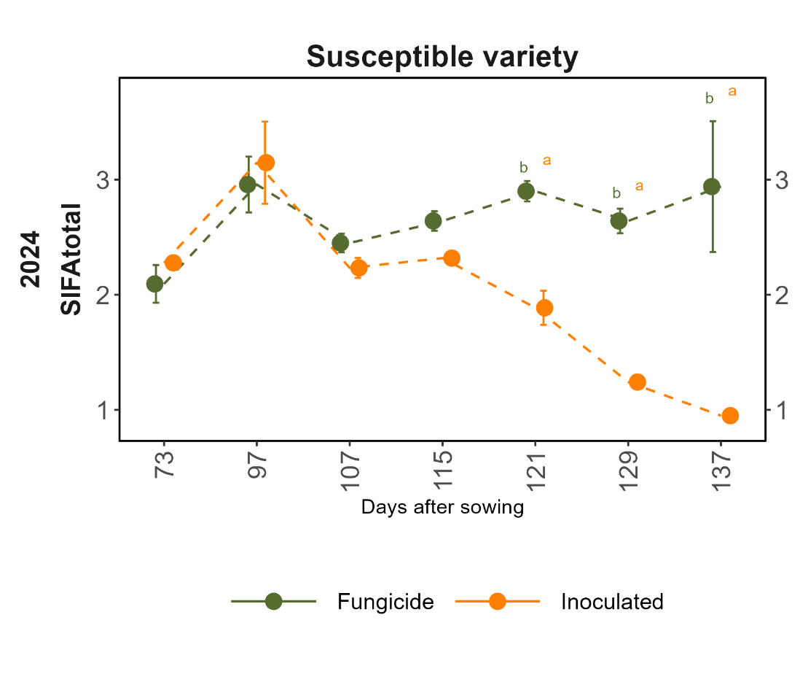
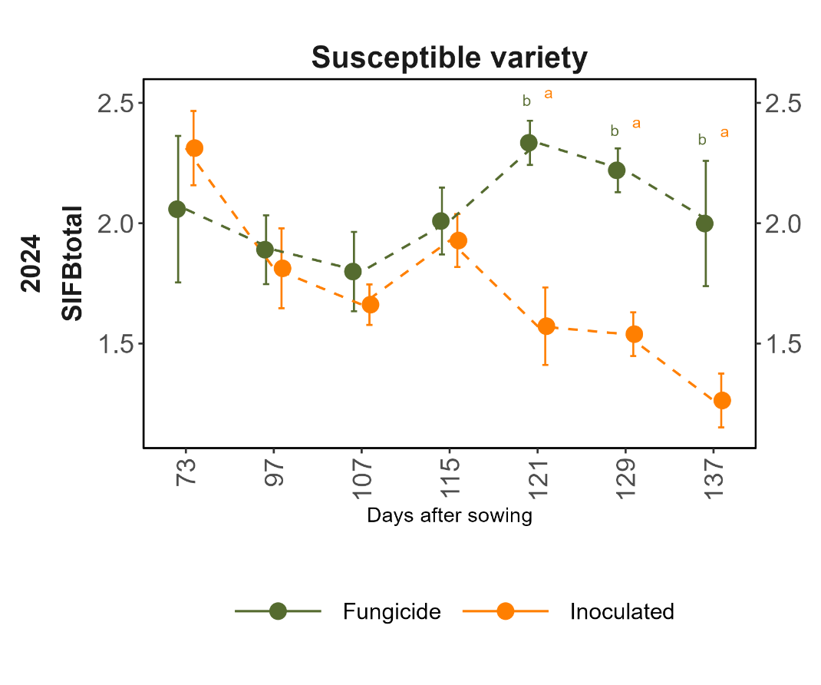

Slide 20
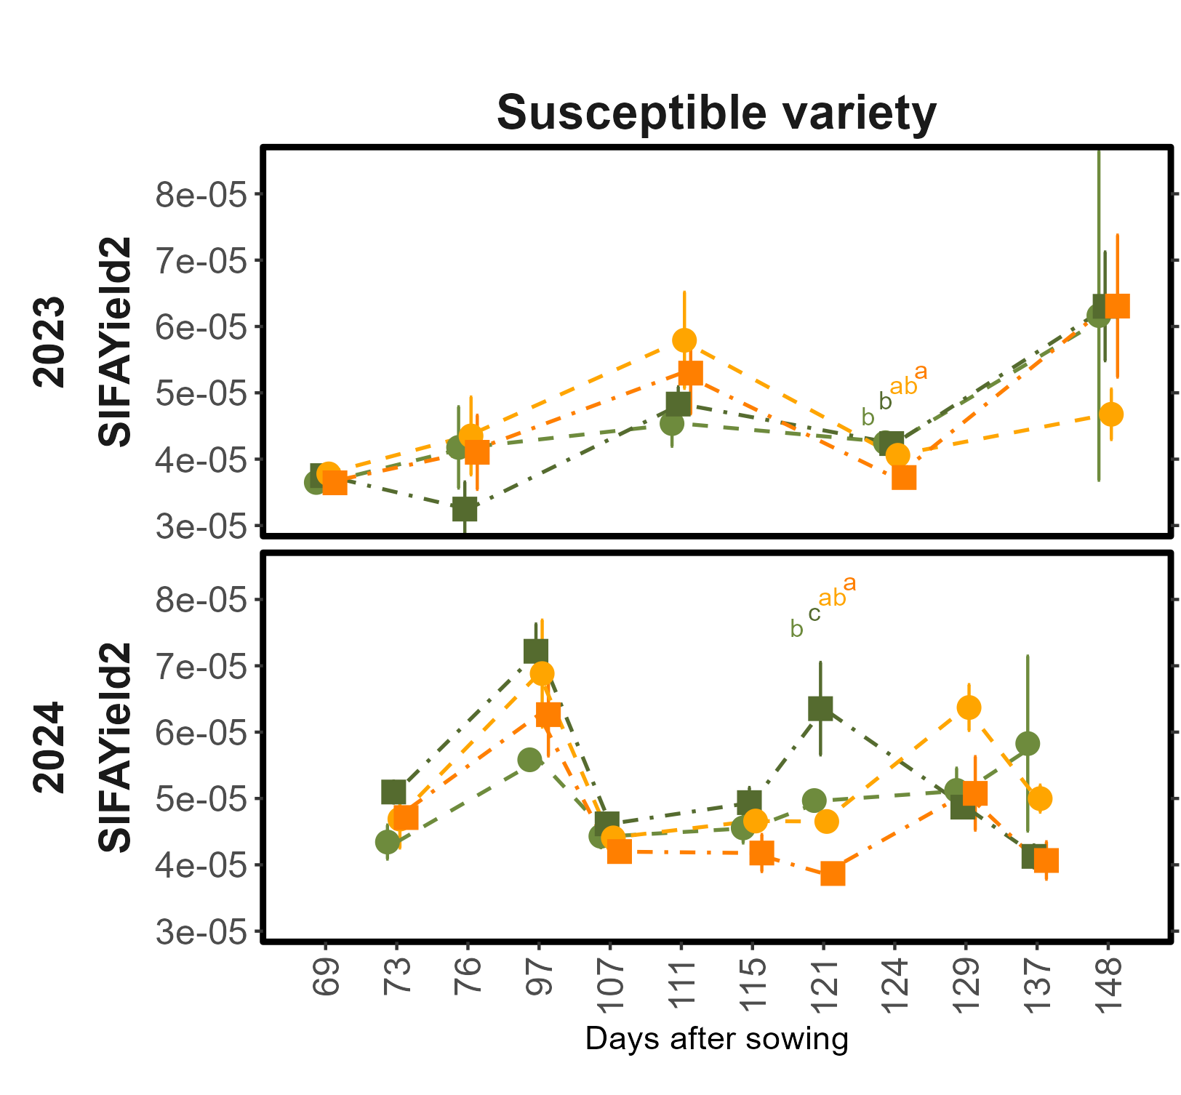
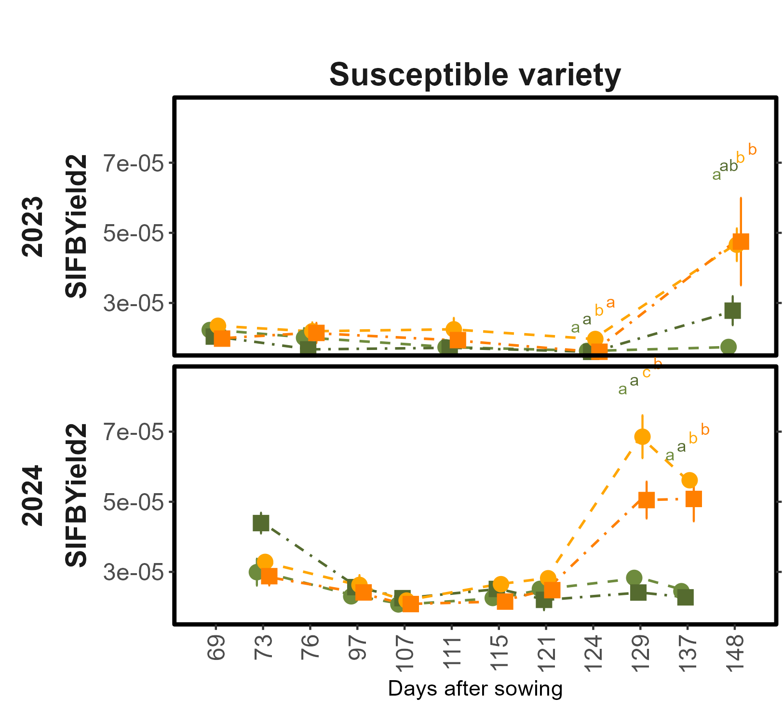
NIRv
SIF_{FR} (nm⁻¹)
SIF_{R} (nm⁻¹)
SIF_{FR} (nm⁻¹)
SIF_{R} (nm⁻¹)

Slide 21
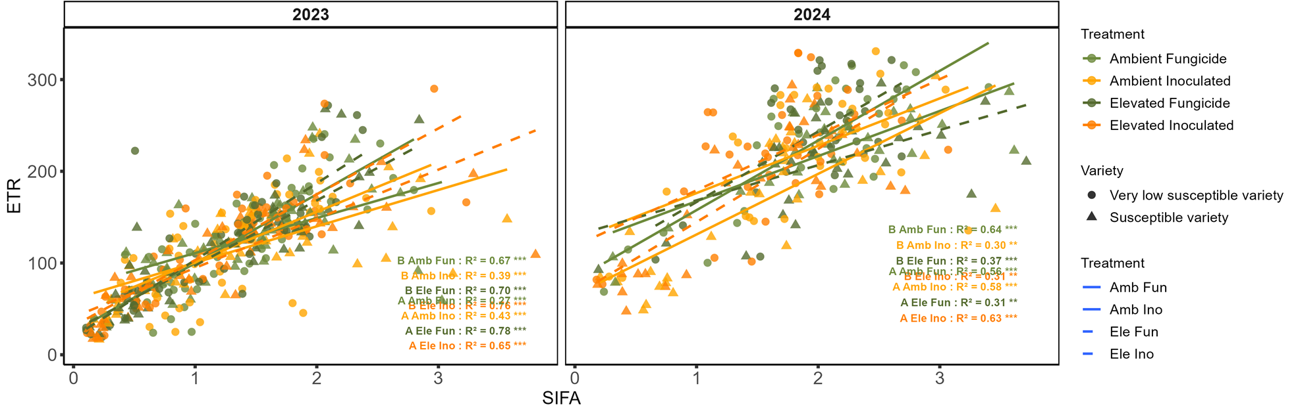
SIF₇₆₀
(mW m⁻² nm⁻¹ sr⁻¹)

Slide 22
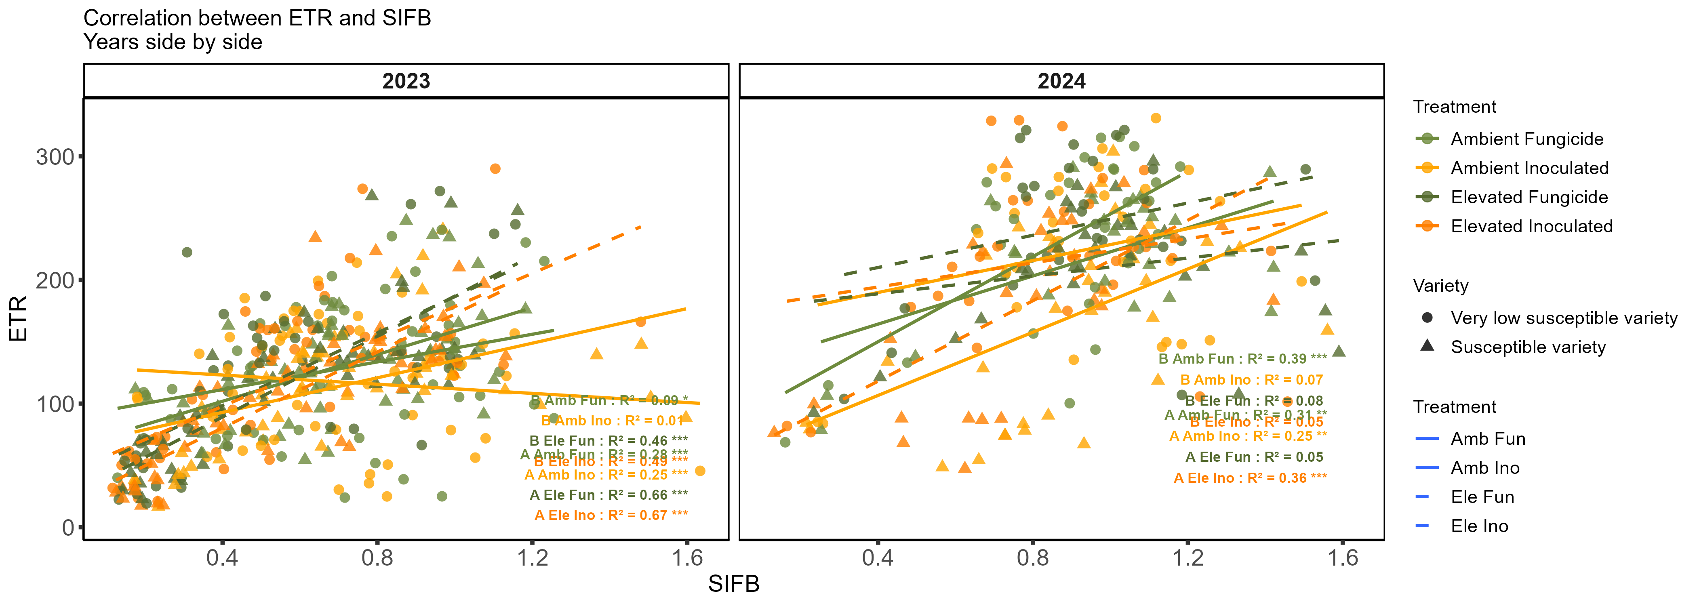
SIF_{R}
(mW m⁻² nm⁻¹ sr⁻¹)

Slide 23
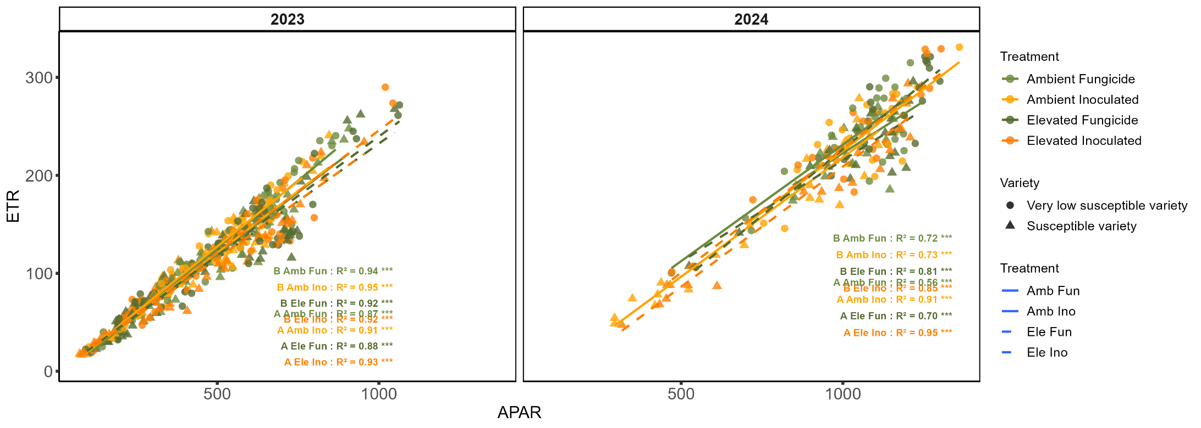
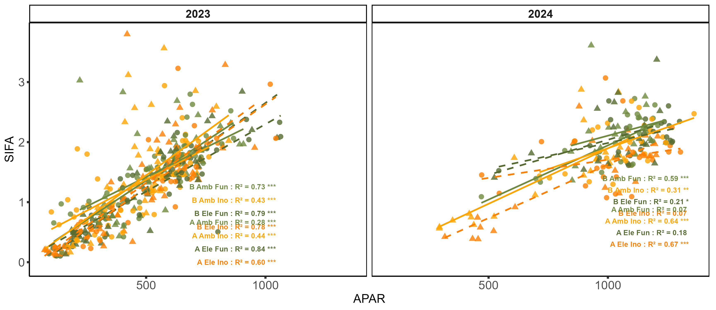
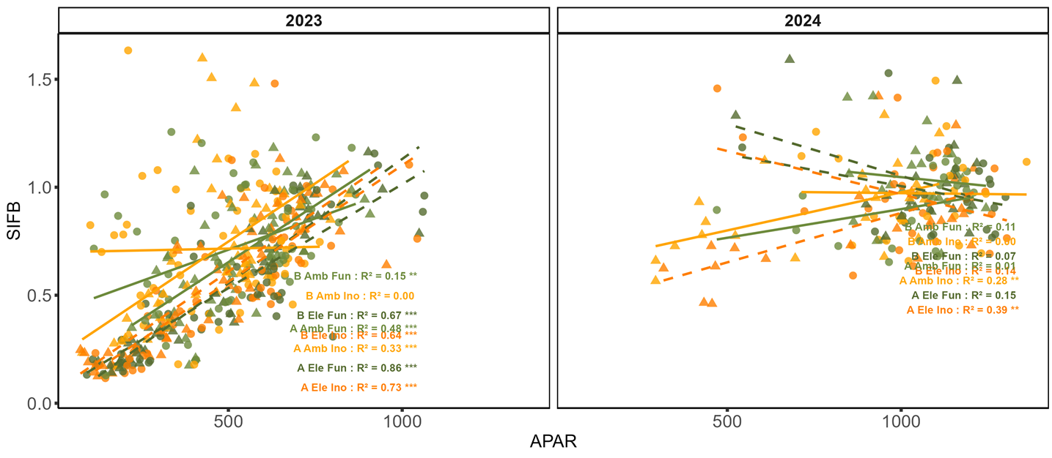

Slide 24
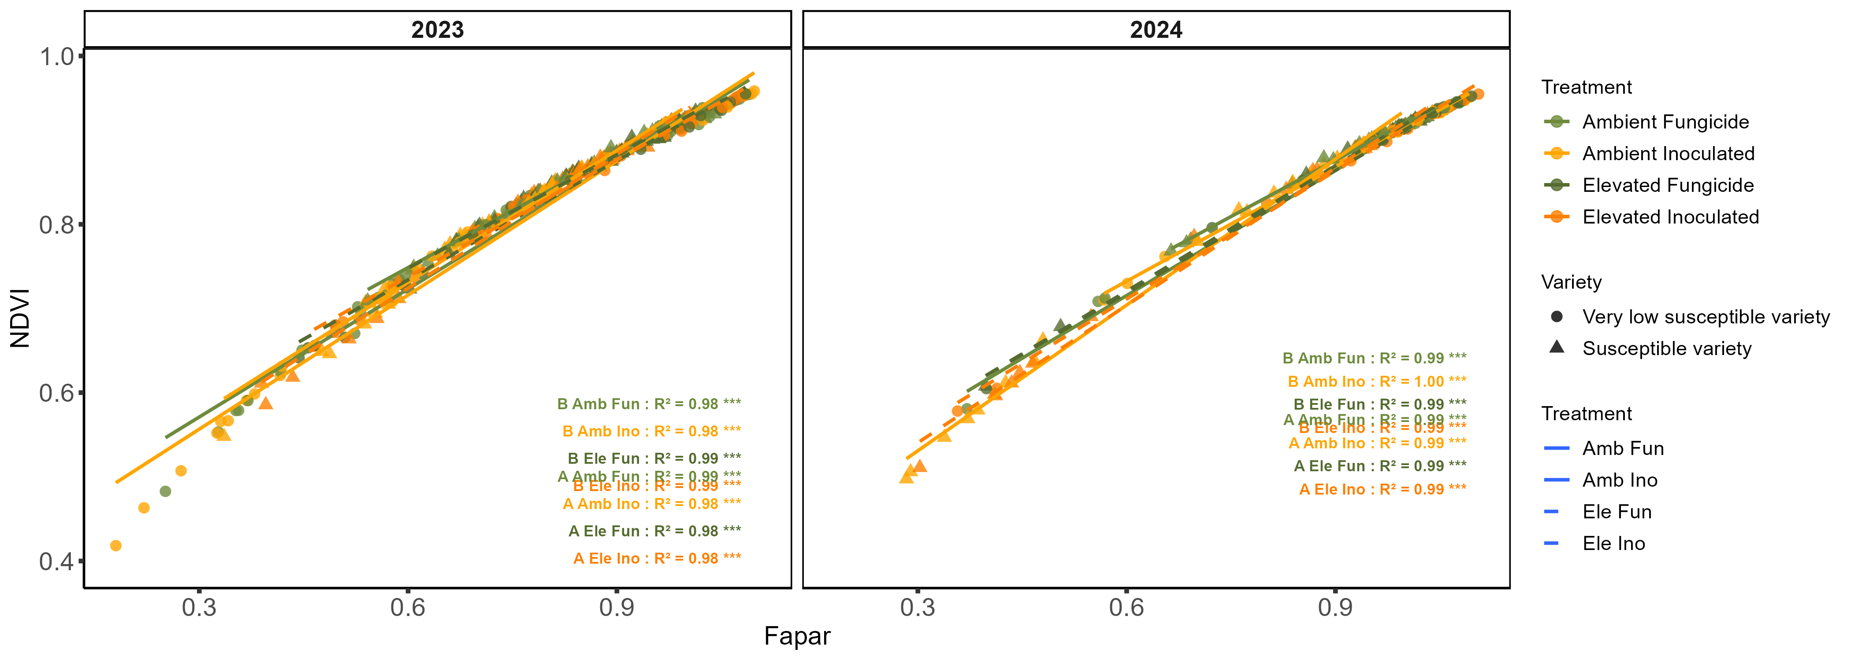
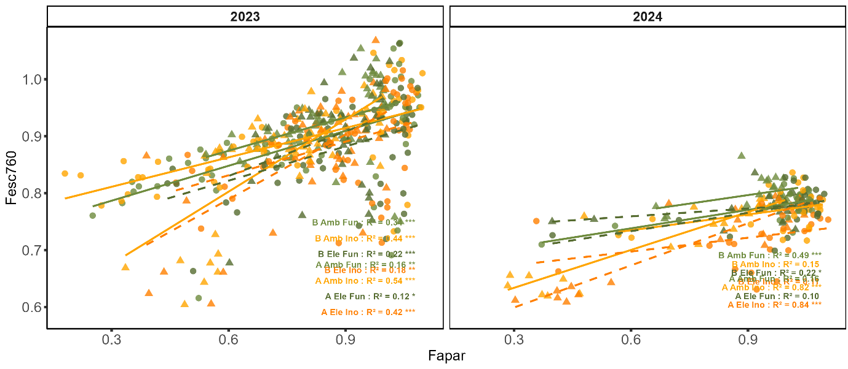
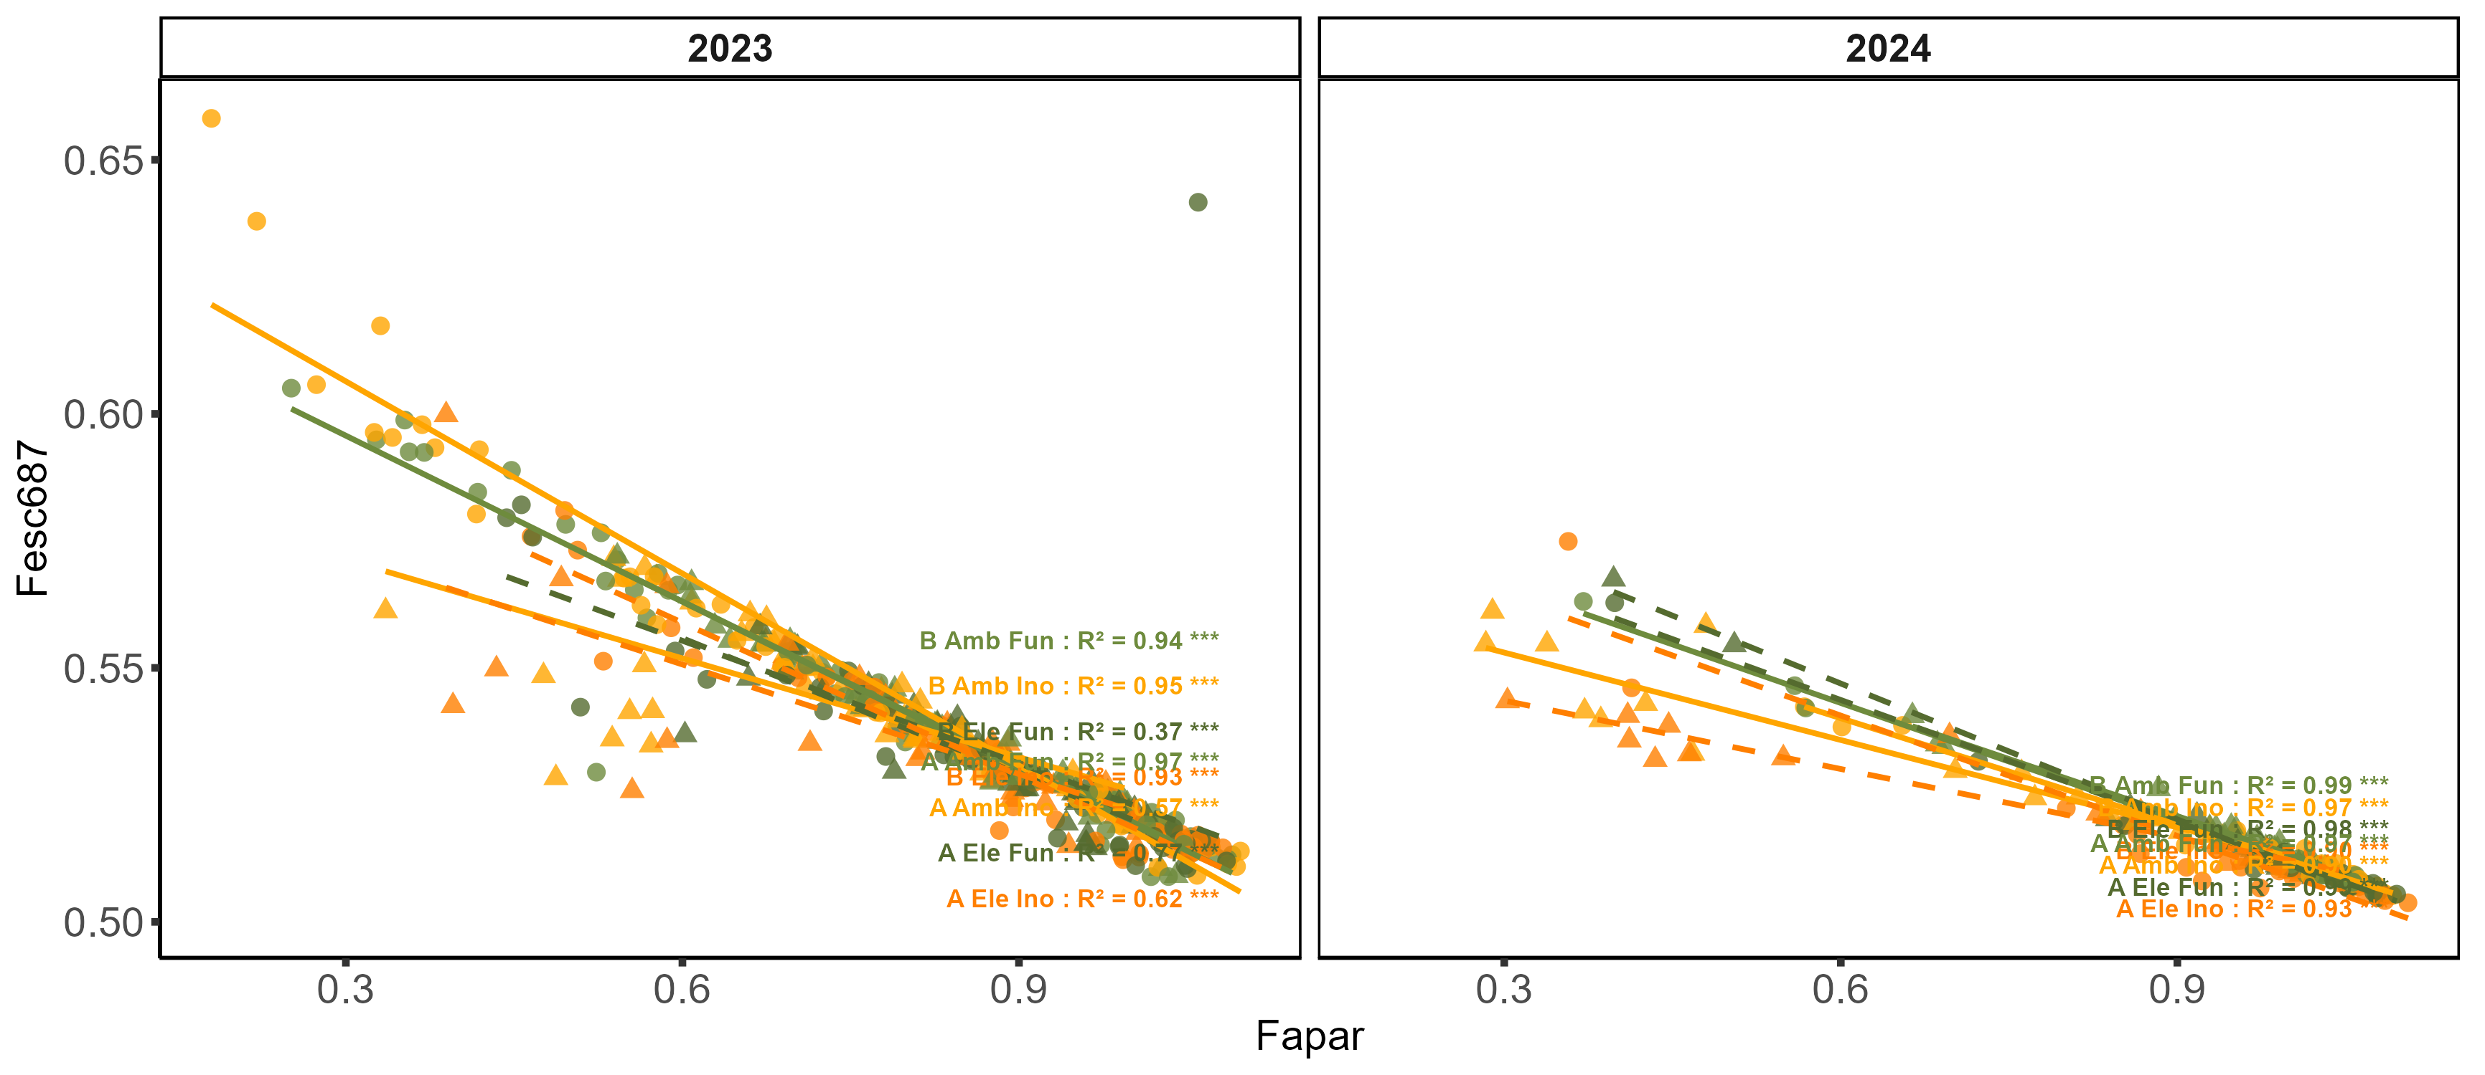

Slide 25
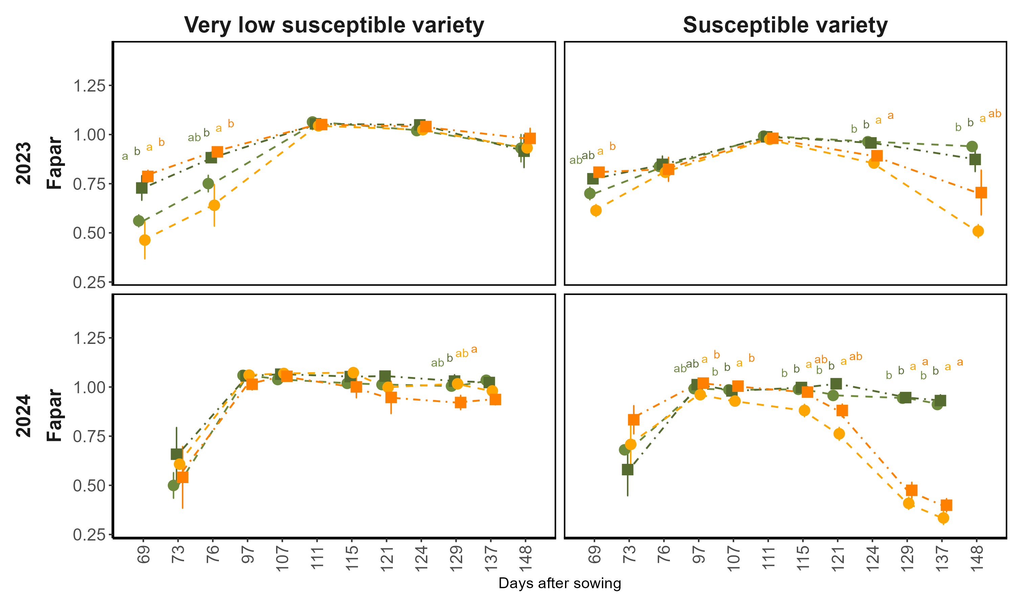
Reflectance based phenology
fAPAR = APAR
PAR
2023
fAPAR
Early-stage fAPAR was higher under elevated CO₂ in 2023, indicating higher biomass and canopy development
First symptoms
First symptoms
After ~115 DAS, inoculated plots showed reduced fAPAR in both years, indicating disease-driven canopy loss.
Due to more rainfall and precipitation, the disease effect was stronger in 2024
2024
fAPAR
First symptoms
First symptoms
Days after sowing

Slide 26
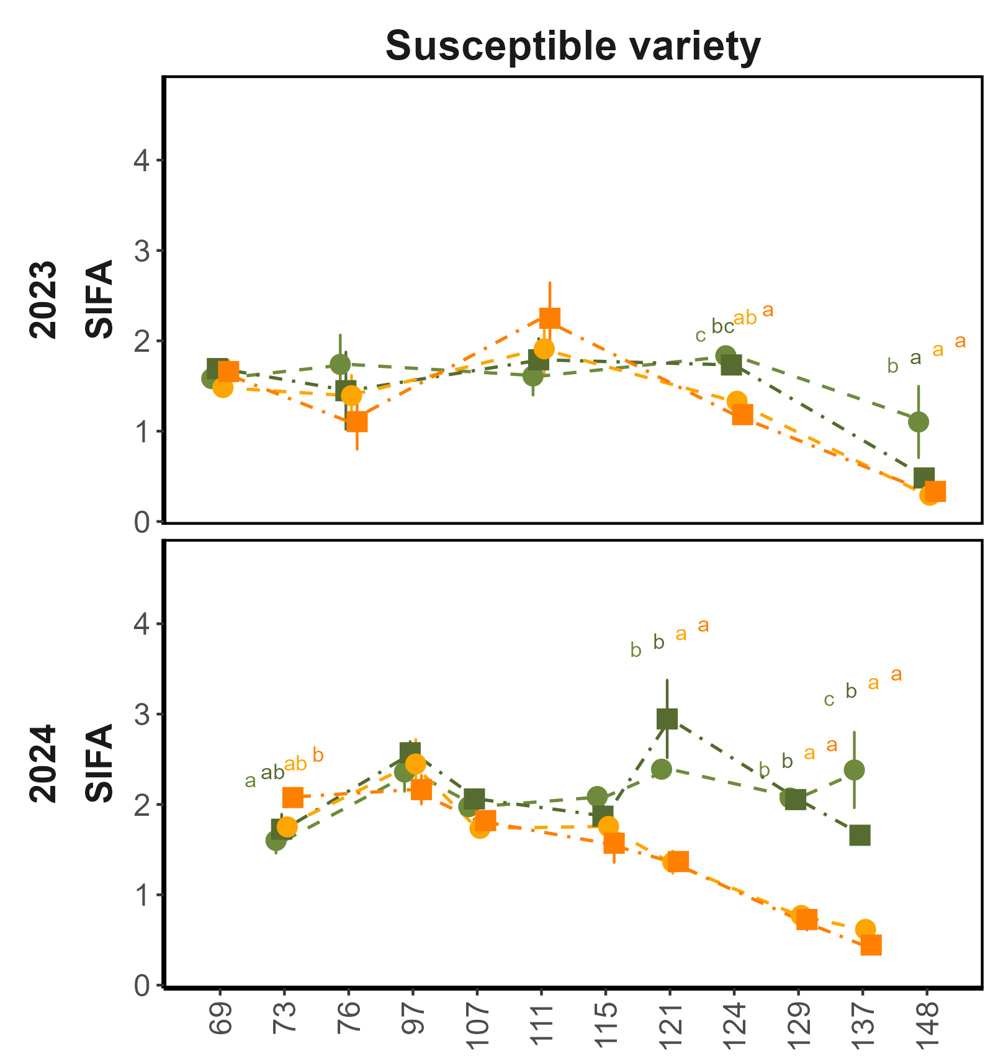
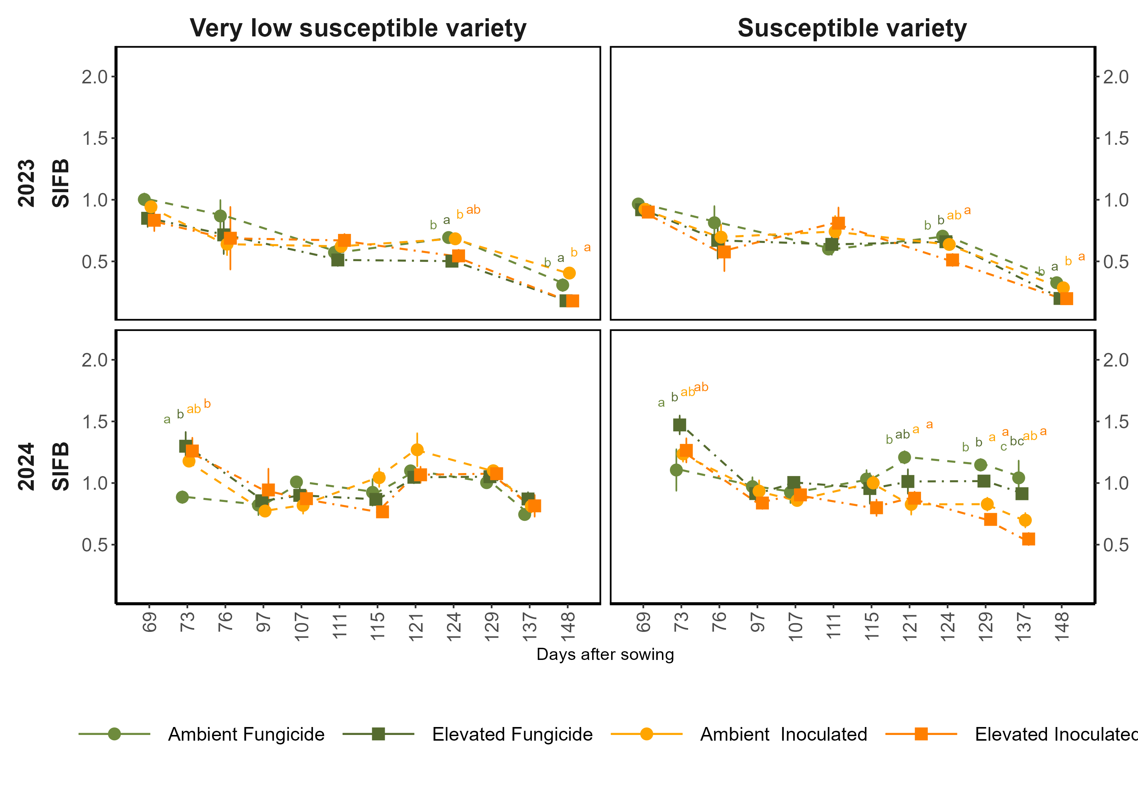

Seasonal dynamics of SIF_{FR} & SIF_{R}
$SIF\left(λ\right)$ = $ΦSIF\left(λ\right).PAR⋅fAPAR⋅f_{esc}\left(λ\right)$
2023
First symptoms
First symptoms
SIF_{FR}
(mW m⁻² nm⁻¹ sr⁻¹)
SIF_{FR} & SIF_{R} showed response to disease and decreased in inoculated plots after 115 DAS in both years
The response is stronger in SIF_{FR} compared to SIF_{R} as it is strongly reduced by fluorescence reabsorption (f^{R}esc)
SIF_{R}
(mW m⁻² nm⁻¹ sr⁻¹)
2024
First symptoms
First symptoms
SIF_{FR}
(mW m⁻² nm⁻¹ sr⁻¹)
SIF_{R}
(mW m⁻² nm⁻¹ sr⁻¹)
Days after sowing

Slide 27
Research Objectives
1) To evaluate the detection of CLS symptoms using passive sun-induced fluorescence (SIF)
Abiotic stress
Biotic stress
Van der Tol et al., 2014
Martini et al., 2021
Konche et al., accepted, JXB
2) To disentangle structural and physiological drivers of SIF responses in combination with active ChlF (PSII efficiency) using seasonal data
Notes:
Previous studies like Van der dol and Martini have shown that PSII photochemical efficiency and SIF yield are closely linked under stress conditions. In particular, reductions in PSII efficiency are often accompanied by increases in fluorescence yield due to reduced photochemical energy use and increased energy dissipation mostly under abiotic stress
However, our earlier work under biotic stress, based on two infection stages, suggested that SIF responses were driven predominantly by structural canopy changes rather than physiological downregulation.
Using seasonal data, we aim to determine whether CLS-driven changes in SIF are dominated by canopy structural effects or physiological regulation of photosynthesis. At the same time, we evaluate how PSII efficiency and SIF yield are related under disease stress conditions.

Slide 28
Normalization of sun-induced fluorescence (SIF)
SIF₇₆₀, SIF₆₈₇
Romero et al., 2018
ϕ
ϕ
SIF₇₆₀, SIF₆₈₇

Slide 29
Yield and disease response under elevated CO₂
Final sugar yield (Mg/ha):
Seasonal disease severity:
Ambient CO₂
600 ppm CO₂
Ambient CO₂
600 ppm CO₂
d
d
cd
cd
e
bc
a
ab
Fungicide
Inoculated
Fungicide
Inoculated
Fungicide
Inoculated
Inoculated
Fungicide
Elevated Fungicide
Elevated Inoculated
Ambient Fungicide
Ambient Inoculated
Elevated CO₂ increased yield in the fungicide-treated plots for both genotypes
Disease severity did not differ between ambient and elevated CO₂, which was also reflected in fluorescence and reflectance data
Under inoculation, the increase was small and not significant
Therefore, from now we focus on the susceptible variety under ambient conditions to highlight disease effects between fungicide and inoculated treatments

Slide 30




Biotic stress and Climate change
Chlorophyll fluorescence
Photosynthesis
Sun-induced fluorescence (SIF) has emerged as a promising tool for tracking photosynthetic dynamics, yet its application in studying biotic stress and CO₂ environments remains limited
Pathogen status
Heat dissipation
Cercospora leaf spot (CLS)
Carbon assimilation
Biomass formation
Rascher et al., 2015
Remove SIF SENTENCE AND FIGURES, MAKE BULLET POINTS
Circular reddish-brown lesions with greyish centers
Structural and physiological damage compromising light interception and photosynthetic performance
Beet & Sugar yield
Disease progression
Sugar beet
Notes:
In this study, we focus on sugar beet, an economically important crop, and investigate the effects of Cercospora leaf spot disease on canopy physiology and productivity.

