Slide 1
Linking Solar-Induced chlorophyll Fluorescence to Biogenic Volatile Organic Compounds Emissions in low Arctic Tundra: A Field Spectroscopy approach
Federico Grillini¹, Simon Nyboe Laursen^{1,2}, Amy Samantha Smart², Peiyan Wang¹, Shunan Feng^{1,3}, Juliane Bendig⁴, Andreas Westergaard-Nielsen¹
¹ Department of Geosciences and Natural Resource Management, University of Copenhagen
² Center for Volatile Interactions, Department of Biology, University of Copenhagen
³ Department of Environmental Science, Aarhus University
⁴ Institute for Bio-and Geosciences, Forschungszentrum Jülich

Slide 2
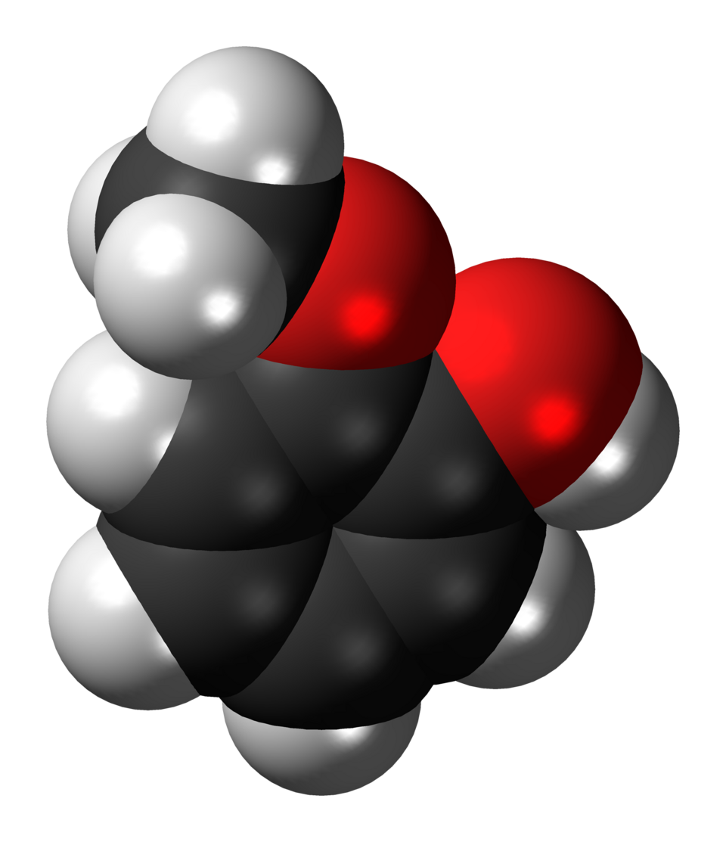
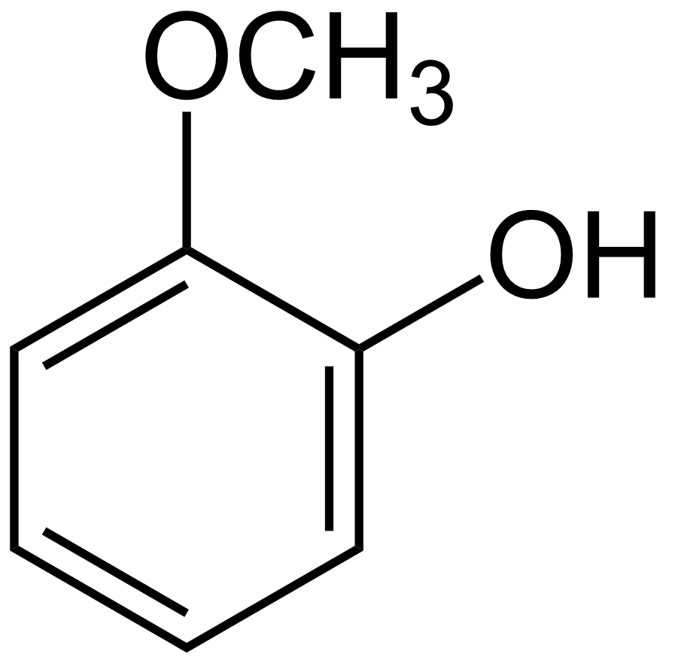

Guaiacol

Slide 3
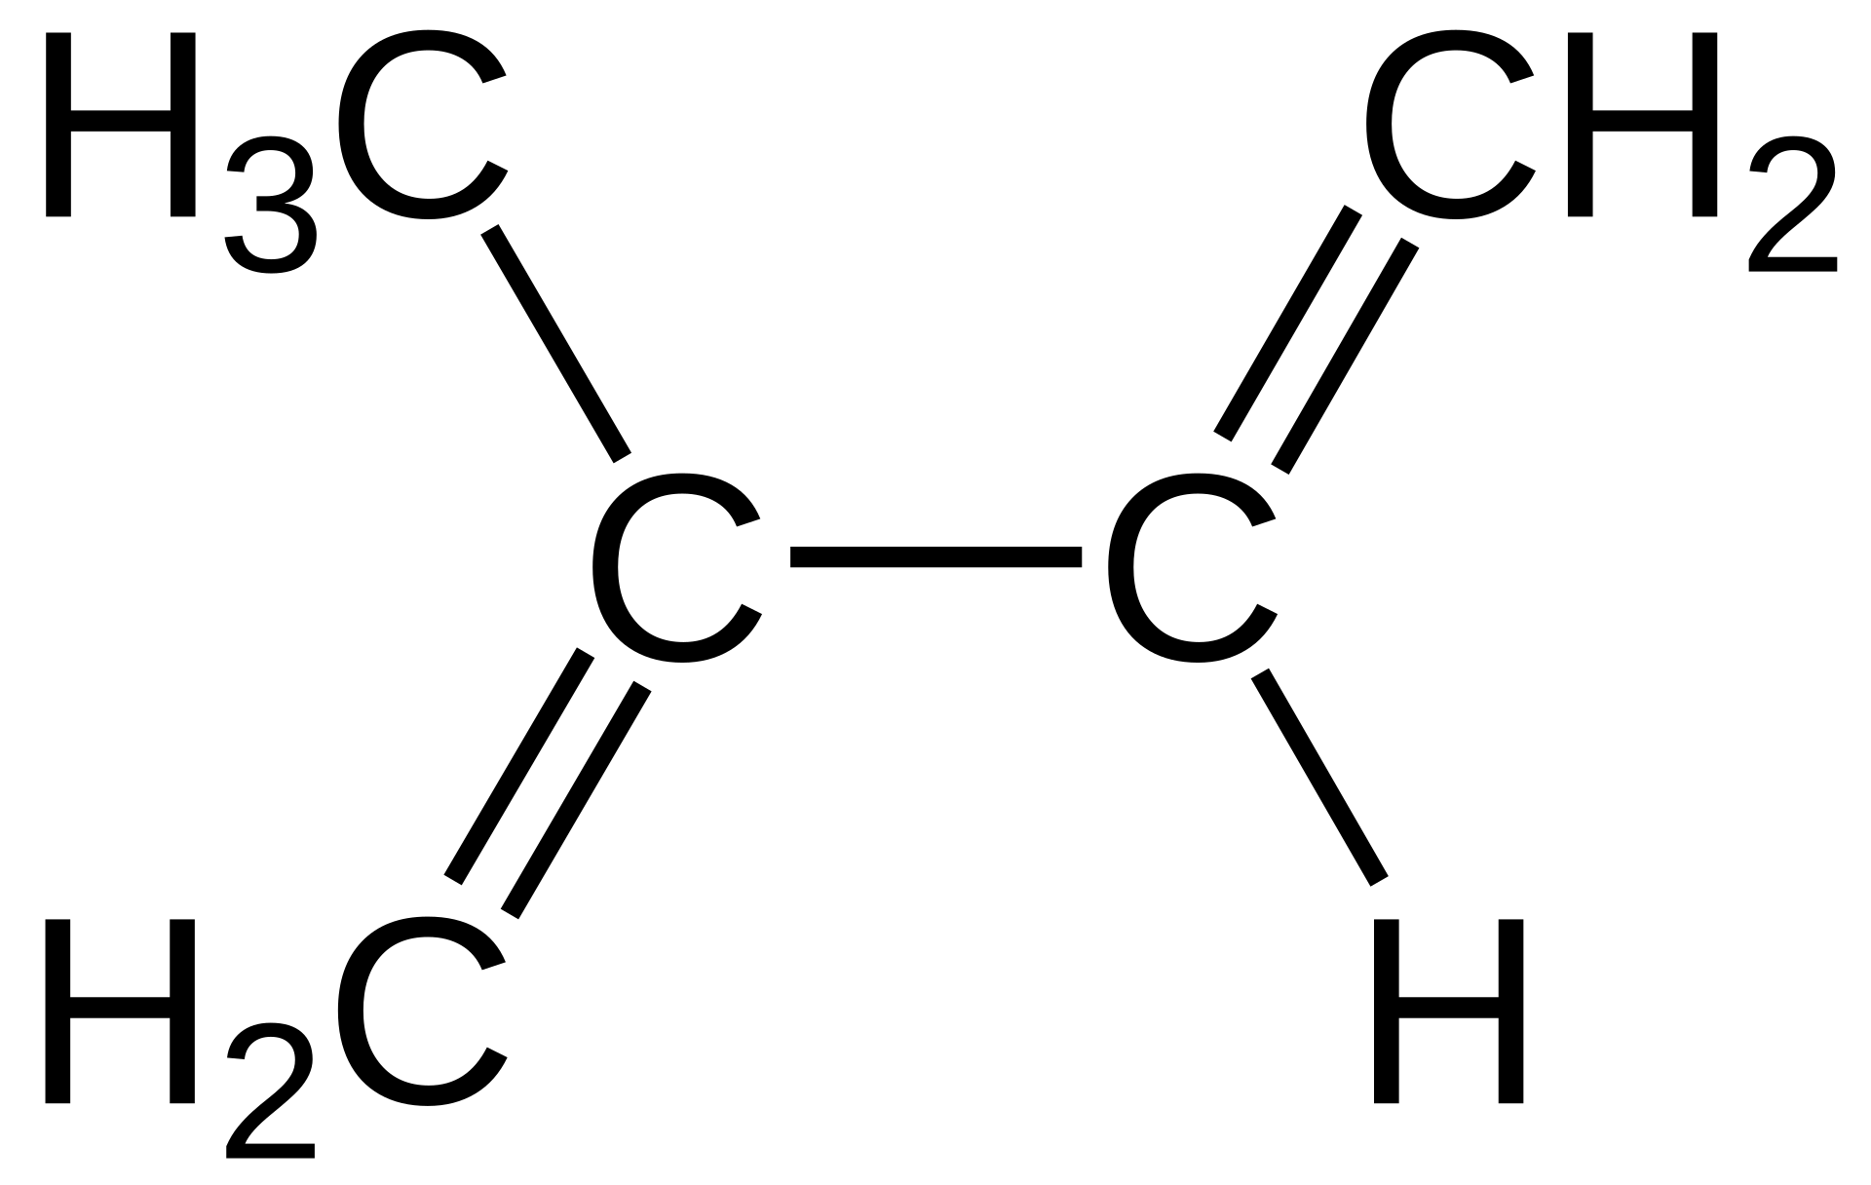





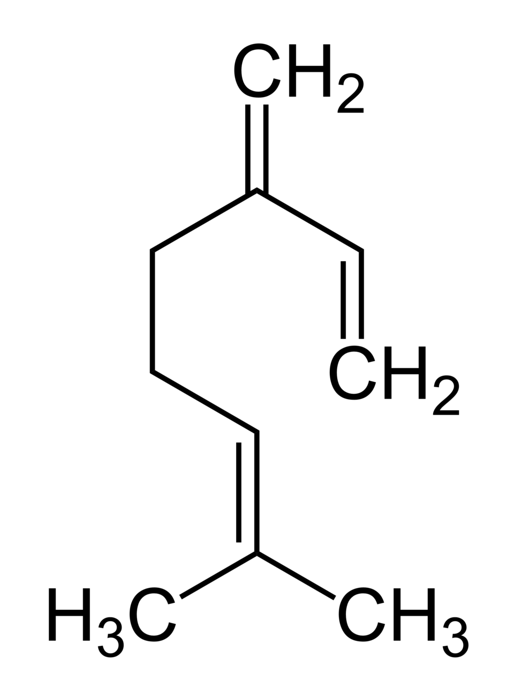




Why BVOC
Biogenic Volatile Organic Compounds (BVOC) are emitted by vegetation for
Potential climate feedback [1]
Climate warming
Plant-to-plant communication
Pollinator attraction
Defense
Response to (a)biotic stress
[1] Figure from: Peñuelas and Staudt (2010). BVOCs and global change. Trends in Plant Science, Vol.15, 3

Slide 4
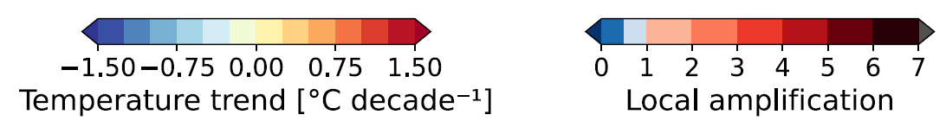
Why the Arctic
The effects of climate warming are two-to-four times more prominent in the Arctic than at lower latitudes
[2]
Long daylight hours in summer
Extended growing season
+
Higher vegetation productivity
Earlier start of growing season
(1-2 weeks)
Earlier snowmelt onset
[2] Figure from: Rantanen et al. (2022) The Arctic has warmed nearly four times faster than the globe since 1979. Communications Earth & Environment 3, 168.

Slide 5
Evidence for SIF-BVOC link
Vegetation BVOC emissions, particularly isoprenoids, are synthetized during photosynthesis and protect plants against, for example, heat and oxidative stress [3]
[4]
[3] Loreto and Schnitzler (2010). Abiotic stresses and induced BVOCs. Trends in Plant Science, Vol. 15.
[4] Figure from: Zhang et al. (2025). Connecting optical remote sensing of plant photosynthesis with biogenic volatile organic compound emissions. New Phytologist, 248

Slide 6
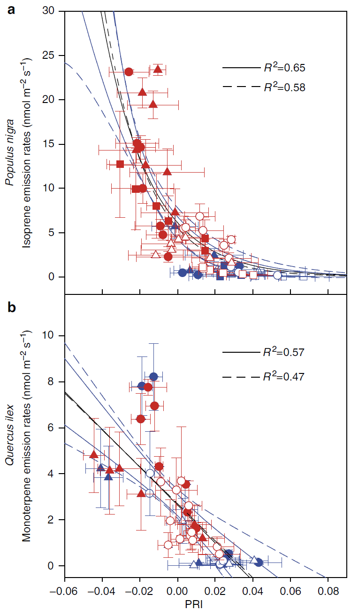
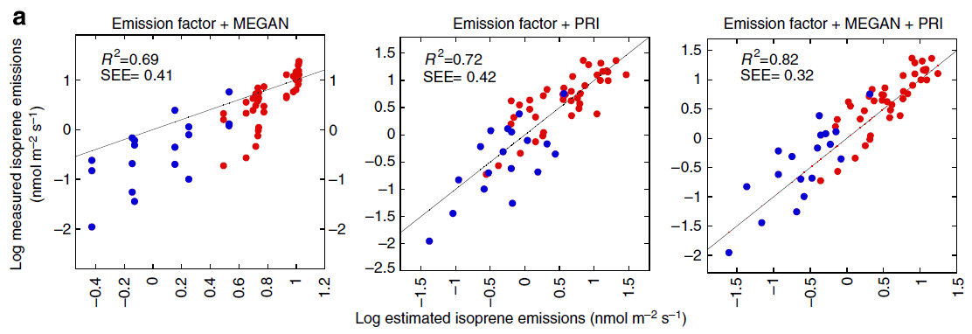
Existing work: BVOC and remote sensing
[5]
[6]
[5] Figures from: Peñuelas et al. (2013) Photochemical reflectance index as an indirect estimator of foliar isoprenoid emissions at the ecosystem level. Nature Communications, Vol.4, No.1
[6] Figures from: Filella et al. (2018) A MODIS Photochemical Reflectance Index (PRI) as an Estimator of Isoprene Emissions in a Temperate Deciduous Forest. Remote Sensing. Vol.10, No.4

Slide 7
Existing work: BVOC and remote sensing
[7]
[8]
[7] Figure from: Balzarolo et al. (2018) Assessing Ecosystem Isoprene Emissions by Hyperspectral Remote Sensing. Remote Sensing. Vol.10, No.7
[8] Figure from: Robin et al. (2025) Leaf spectroscopy as a tool for predicting the presence of isoprene emissions and terpene storage in central Amazon forest trees. Plant Methods. Vol.21, 1

Slide 8
Research questions
Can BVOC emissions be directly linked to spectral reflectance properties?
What spectrally-derived properties are important to explain BVOC emissions in tundra vegetation?
Can SIF be deployed as a marker for BVOC emissions?

Slide 9
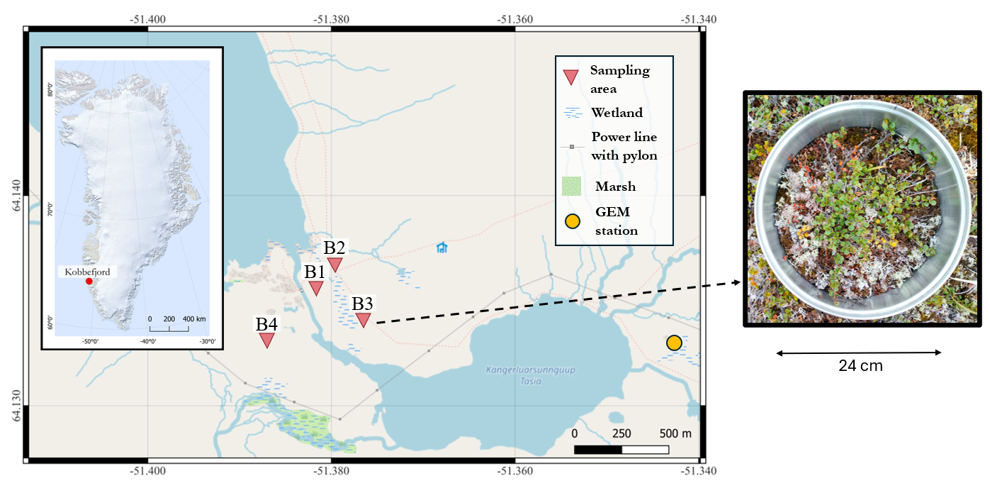
Study area and vegetation
12 Established plots
x5
Temporal repeats
In summer 2024
3 x Betula nana
3 x Carex bigelowii
3 x Empetrum nigrum
3 x Vaccinium uliginousum

Slide 10
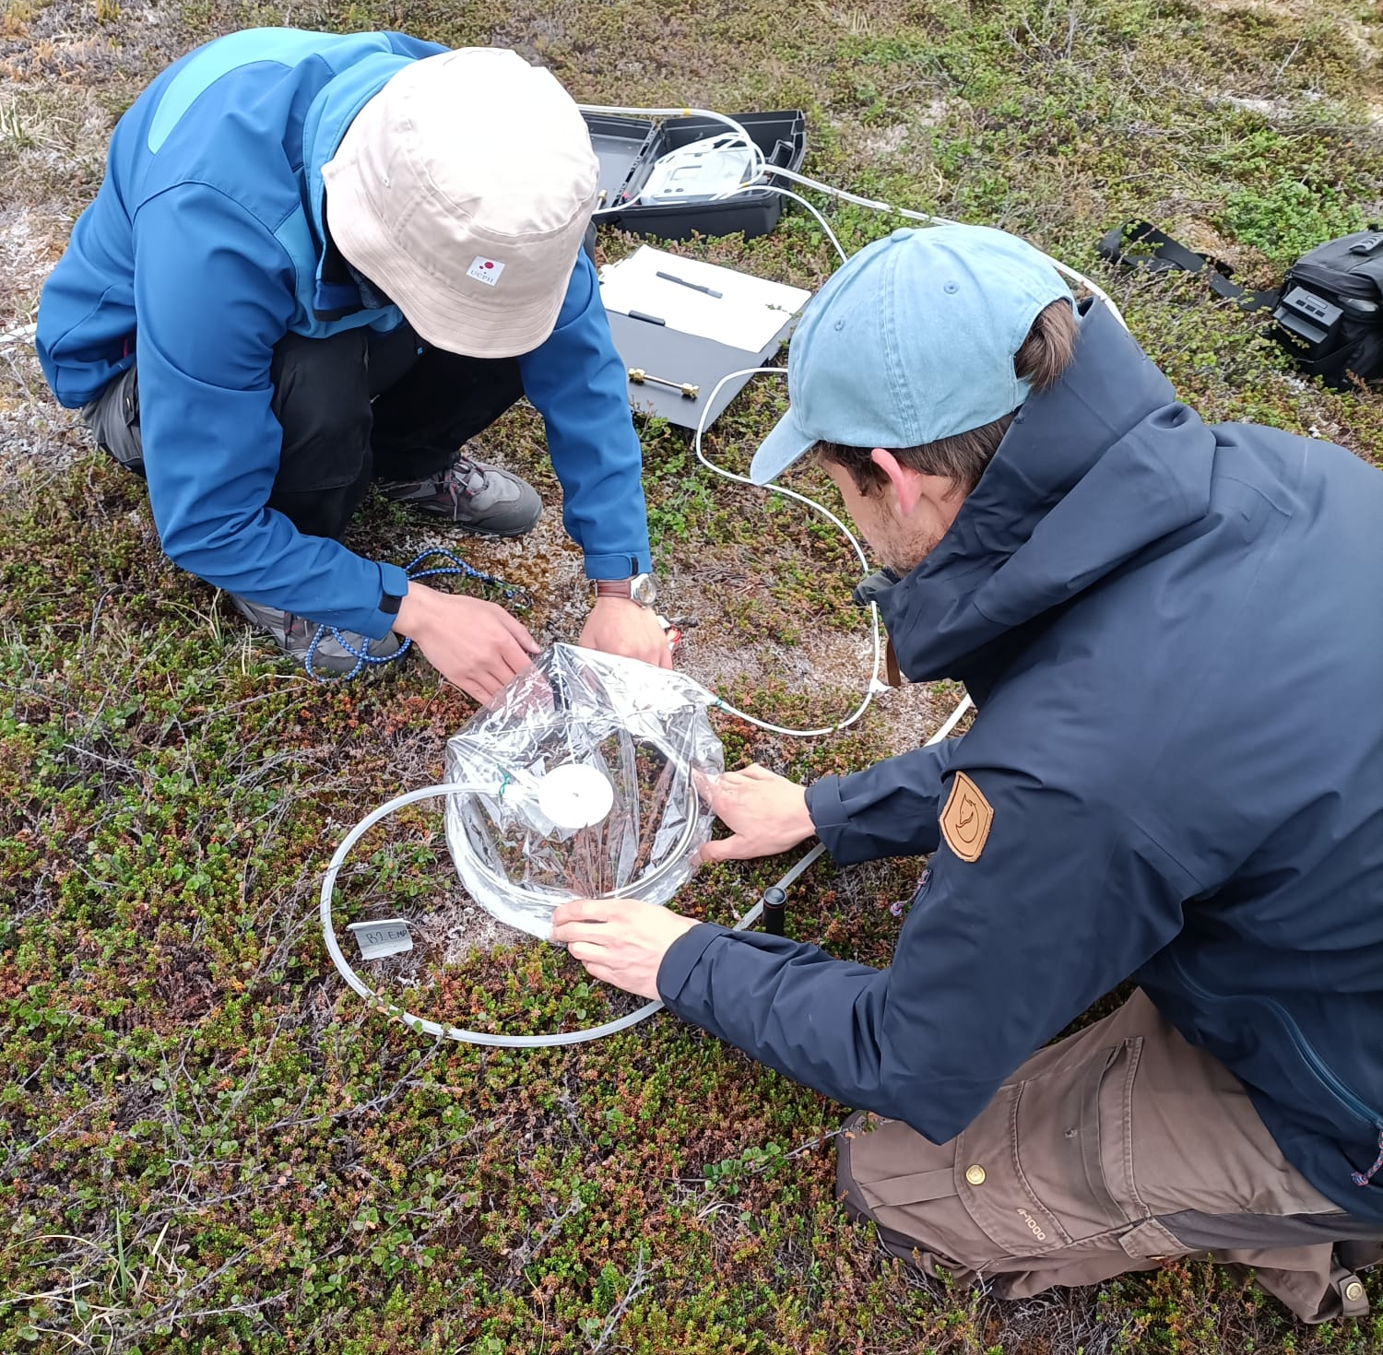
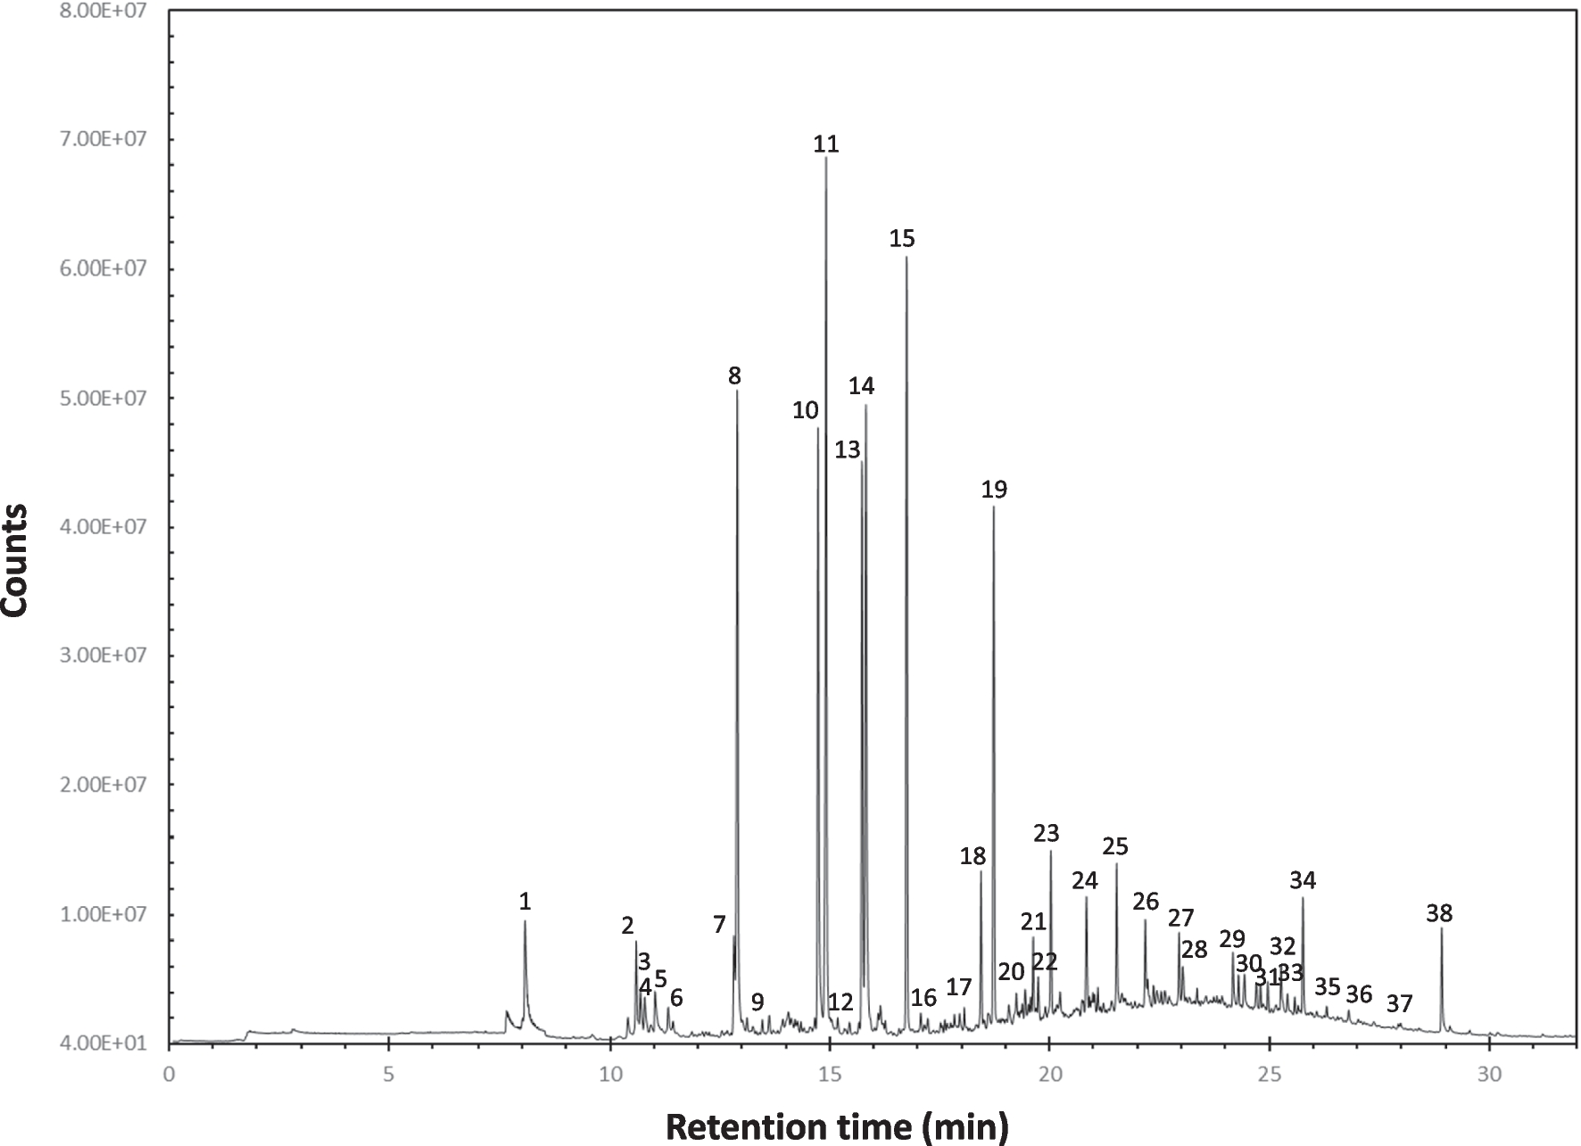
BVOC measurement
Sampling – 30 minutes
Flushing – 15 minutes
Pump
Identified compounds grouped:
Monoterpenes
Sesquiterpenes
Isoprene
Other hydrocarbons
Oxygenated BVOC
Tenax tube
Chamber
Gass-chromatography Mass-spectrometry

Slide 11
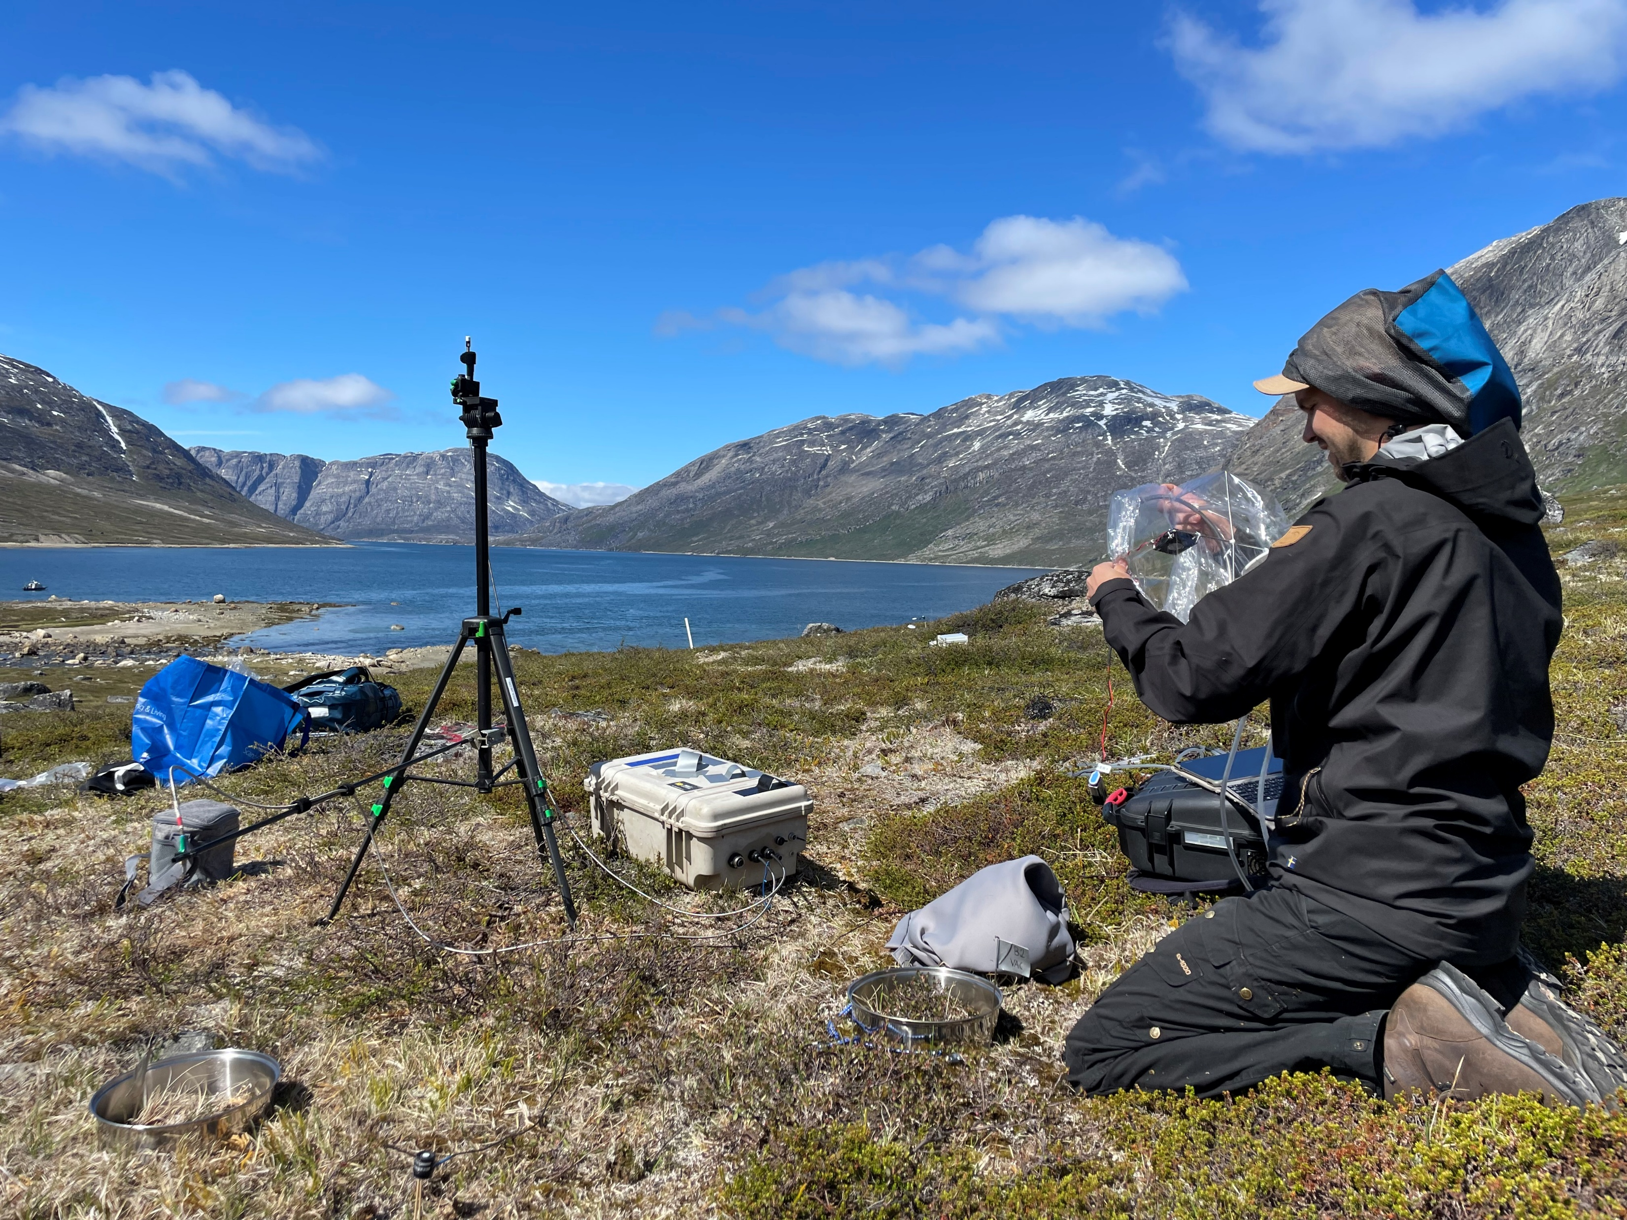
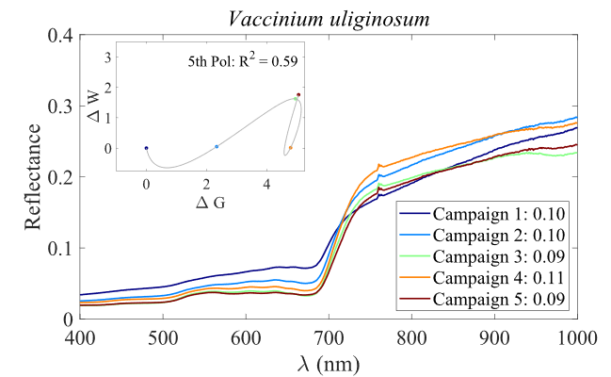
Field Spectroscopy + SIF-A
Simon, who will lie down during the measurement to minimize effects on incoming radiation
:)
FoX-2 spectrometer
(JB Hyperspectral)
Up-looking fiber (cosine sensor) @~105cm above canopy
Calculation of spectral indices
+
fluorescence traits
Down-looking fiber @~35cm above canopy
Dark cloth to wrap around the frames
Plot of interest

Slide 12
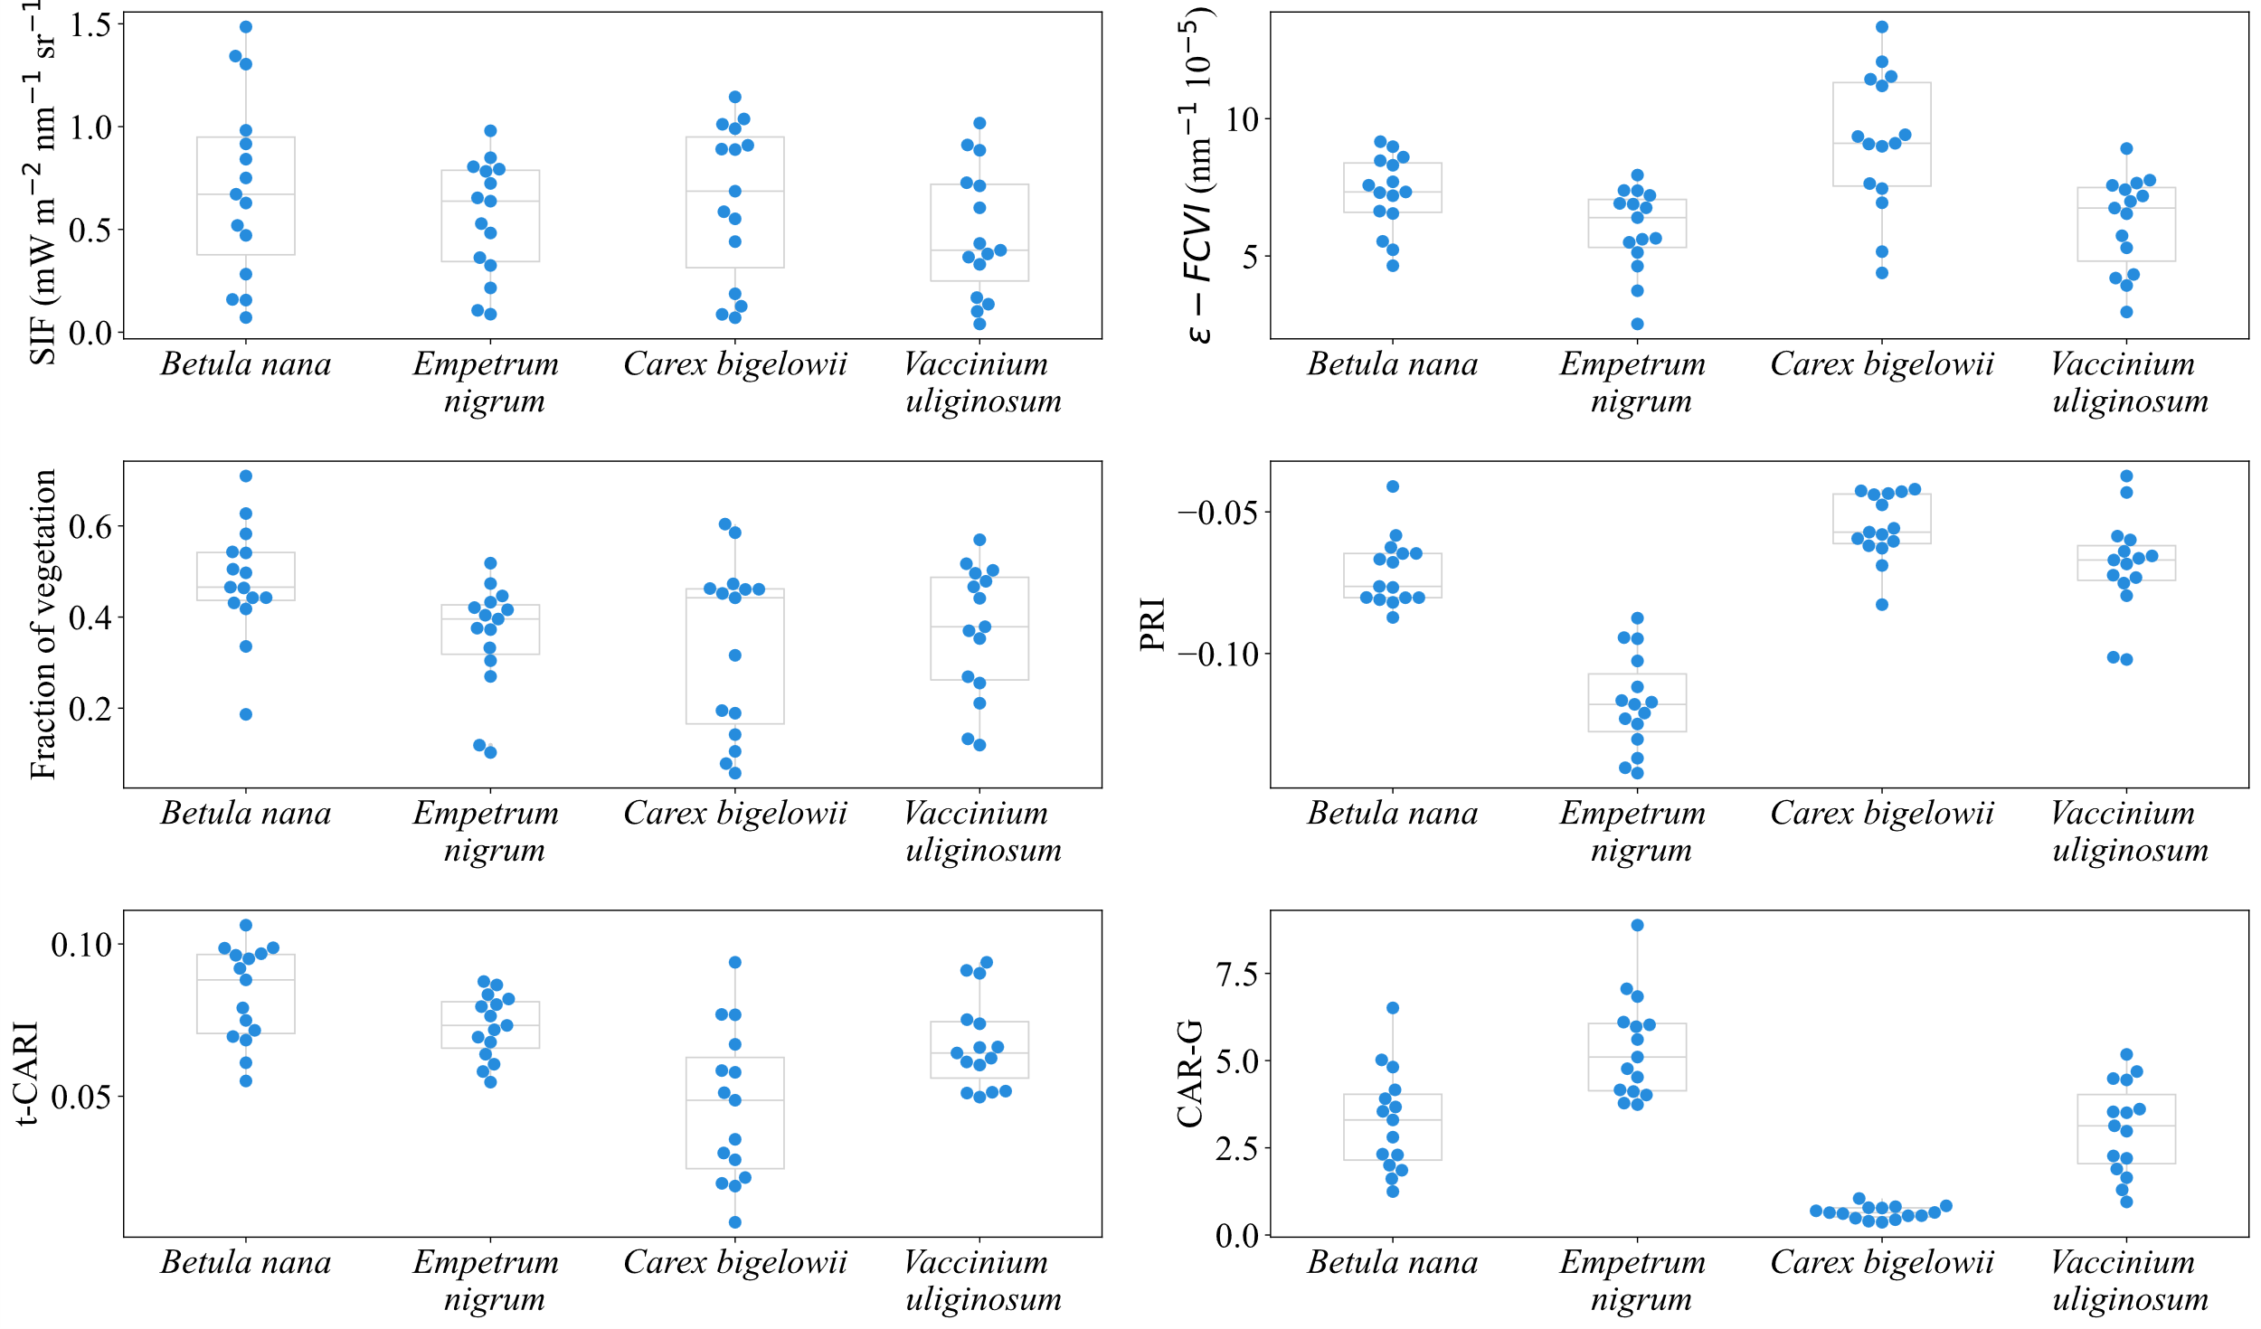
Results for SIF and selected indices

Slide 13
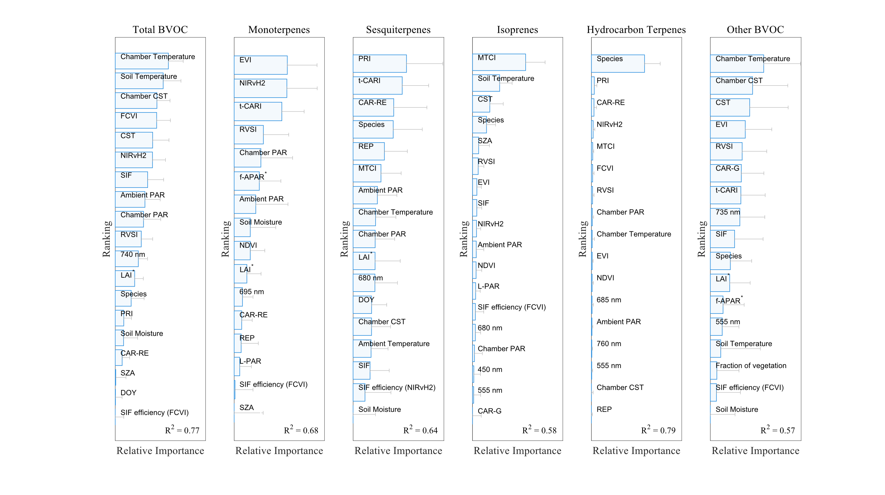
Feature Ranking
PLSR
+
backward sequential feature selection
+
Permutation importance

Slide 14
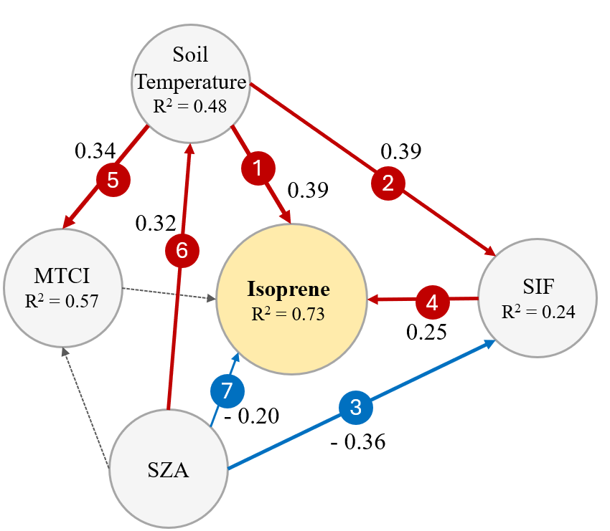
Structural Equation Modelling
Rank of significant path
SEM allow to explore causality between variables.
Usually deployed as a diagnostic tool to verify prior hypotheses.
Each path represents a Linear Mixed Effects model, using the repeats of each Plot, nested in Block, as random variables.
(positive) significant path
(p < 0.05)
Standardized coefficient
(negative) significant path
Hypothesized, but non-significant path
Conditional coefficient of determination

Slide 15
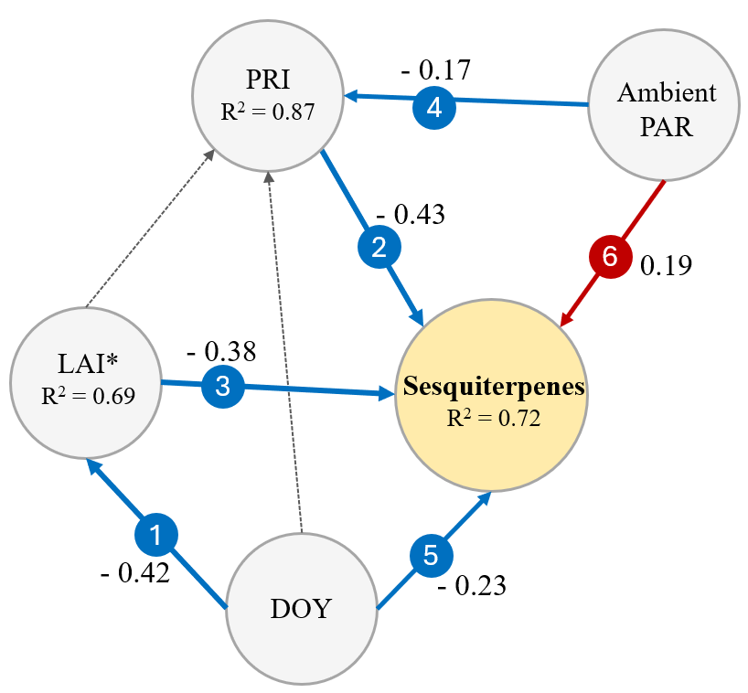
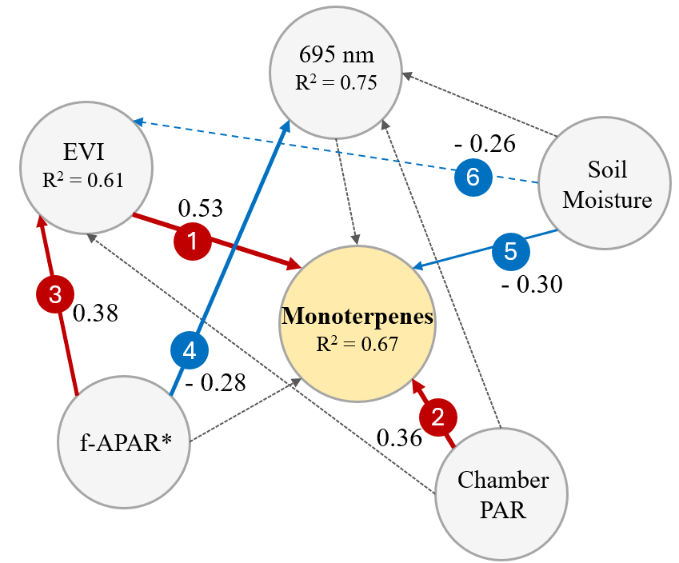
Structural Equation Modelling
(negative) “tendency”
(0.05 < p < 0.10)

Slide 16
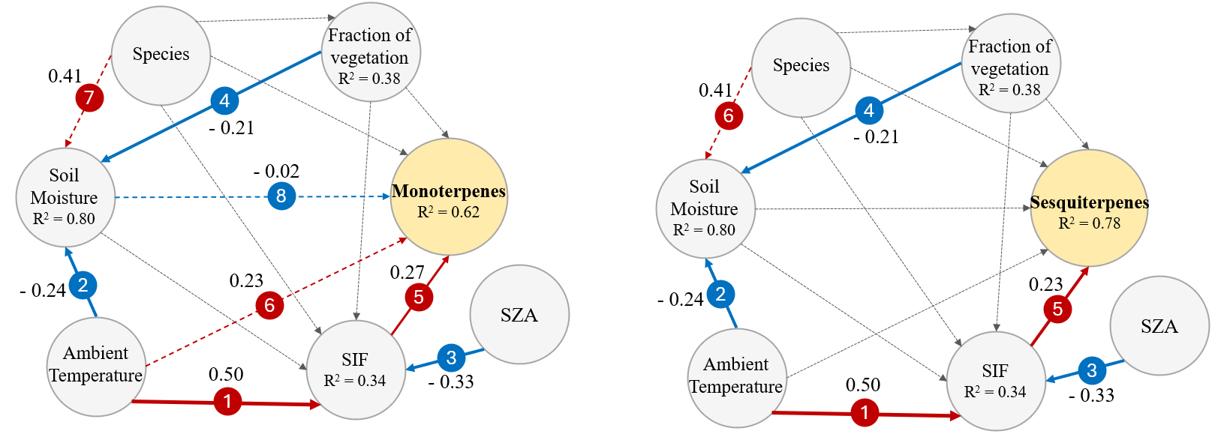
Structural Equation Modelling
Models built using only prior knowledge and to test the hypotheses of SIF-dependency

Slide 17
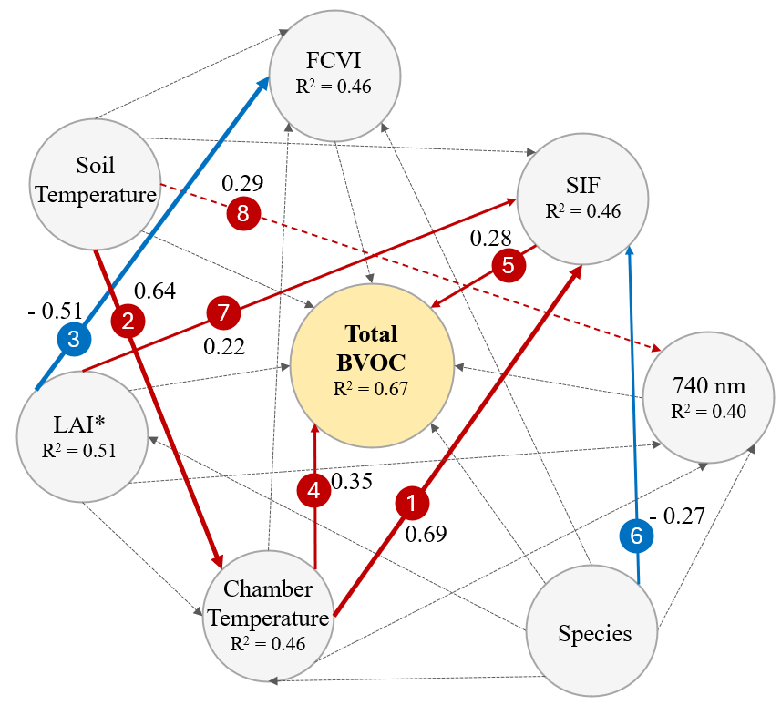
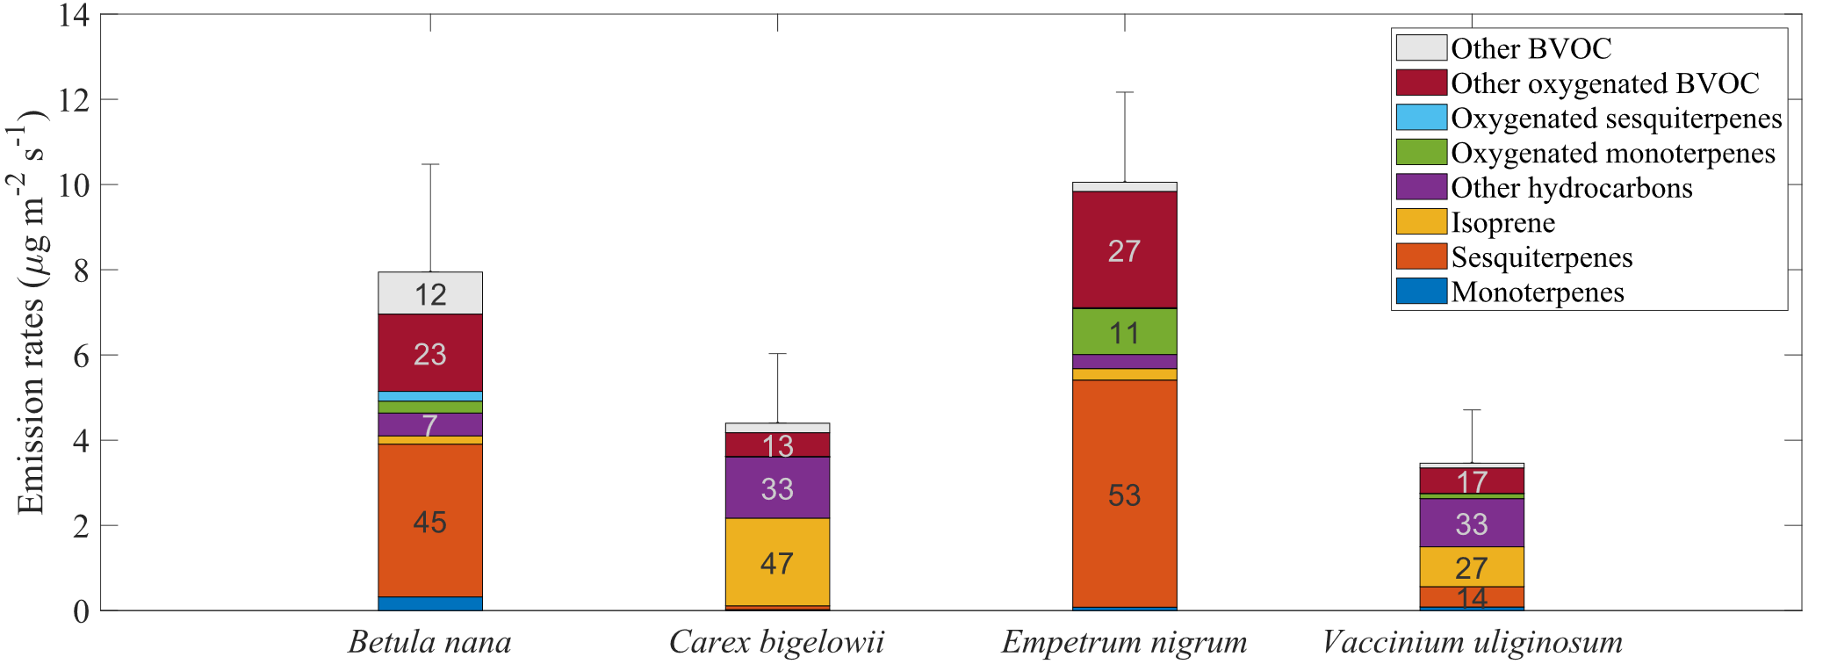
Structural Equation Modelling
SIF-dependency probably explained by the fact that terpenoids are prominent in the BVOC blend, and they do depend on SIF as well.

Slide 18
Outlook: what does this mean for us
Remotely sensed indices and fluorescence traits can be deployed as markers for isoprenoids and total BVOC emissions
BVOC group | Feature
Monoterpenes | EVI + SIF-A
Sesquiterpenes | PRI + SIF-A
Isoprene | SIF-A
Total BVOC | SIF-A
Can the indices be deployed on their own to identify/estimate emissions?
Absolutely no, but they can help alongside classical factors (PAR, Temperature, LAI)

Slide 19
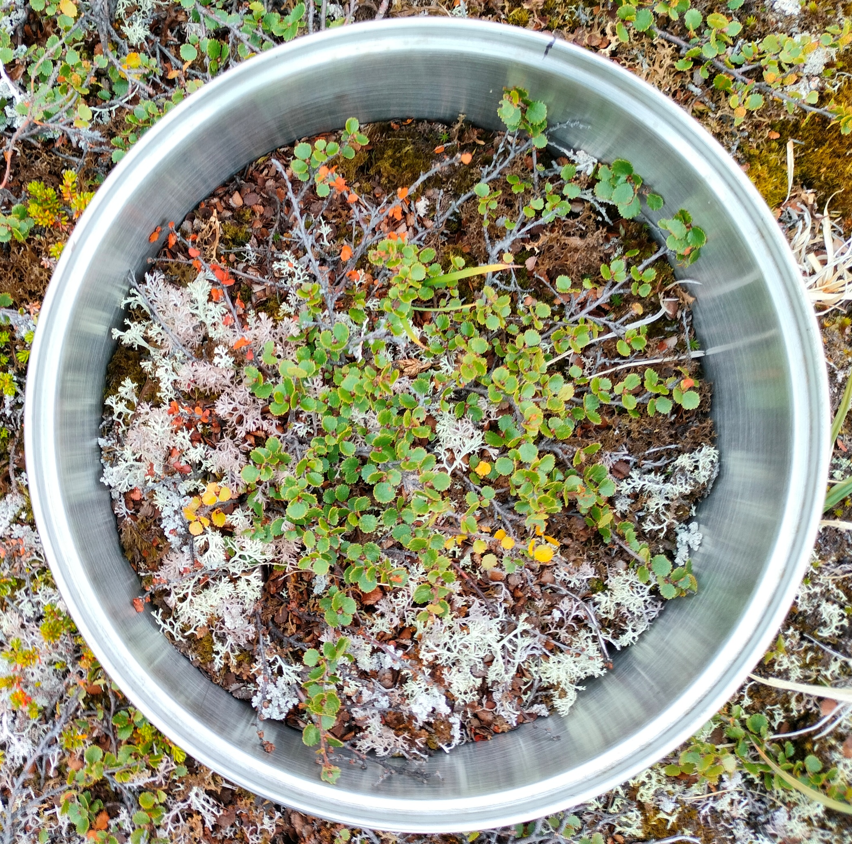
Outlook: implications to scale-up
?
~ 24 cm
FLEX 300 m
FLEX scale
At the landscape scale, BVOC estimation happens with coupling specific satellite observations and modelling through MEGAN
UAV scale
Point scale
SIF products of FLEX could help in enhance the modelling performances
* Not to scale :)

Slide 20



Thanks to
Authors:
Simon Nyboe Laursen
Amy Smart
Peiyan Wang
Shunan Feng
Juliane Bendig
Andreas Westergaard-Nielsen
Field assistants:
Daniel Medom Nijenhuis
Jacob Gunther Schmidt
Karoline Nordberg Nilsson
Simon Kleiner
Søren Nyboe Laursen
Support:
Katrine Raundrup
Greenland Institute of Natural Resources
Greenland Ecosystem Monitoring program
Villum Fonden - 42069

Slide 21
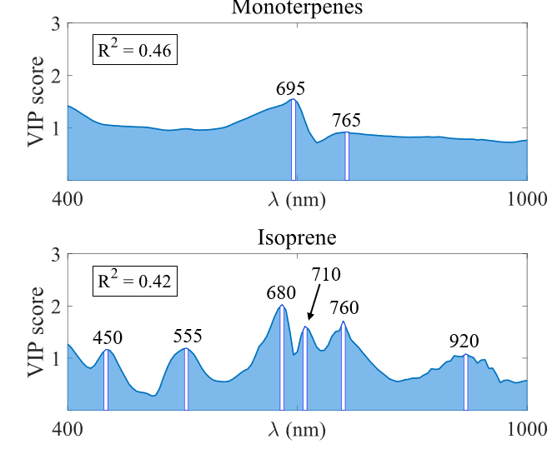
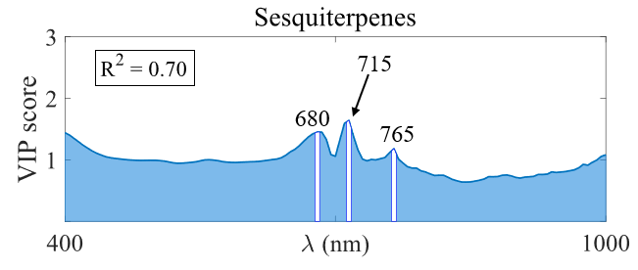
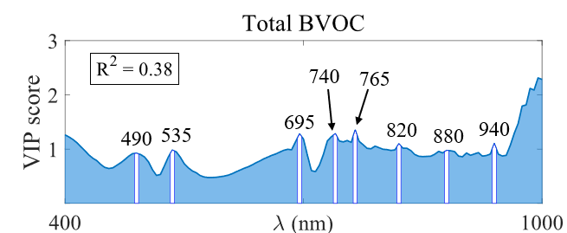
Wavelength Selection
PLSR + Variable Importance Projection (VIP)

Slide 22
Outlook: implications to scale-up
?
~ 24 cm
FLEX 300 m
FLEX scale
We cannot claim we fully know the processes at the “point” scale yet, but we moved forward
UAV scale
Point scale
* Not to scale :)

Slide 23
Outlook: implications to scale-up
?
~ 24 cm
FLEX 300 m
FLEX scale
At the intermediate scale, BVOC modelling relies on tower measurements and estimation of emission factors
UAV-SIF solutions should be the way to integrate the modelling at this scale
UAV scale
Point scale
* Not to scale :)

