Slide 1






Monitoring photosynthetic quantum yield through non-photochemical quenching, from laboratory to field: integrating canopy fluorescence, reflectance, and GPP.
Adrián Moncholí-Estornell¹, Mª Pilar Cendrero-Mateo¹, Eva Neuwirthová¹, Clara García-Martinez¹, Sara Pescador-Dionisio¹, Insu Yeon¹, César Guerrero¹, Ana López-Ballesteros², Álvaro Doblas-Rodrigo², Arnaud Carrara³, Pedro J. Gómez-Giráldez⁴, Joaquín Cobos⁴, Marcos Jiménez⁵, Juan José Peón⁵, Georg Wohlfahrt6, José Moreno¹, Shari Van Wittenberghe¹
¹Laboratory for Earth Observation, Image Processing Laboratory, University of Valencia, Spain; ²Agrifood Research and Technology Centre of Aragon (CITA), Spain; ³Mediterranean Center for Environmental Studies (CEAM), Spain; ⁴Doñana Biological Station (EBD-CSIC), Spain; ⁵National Institute of Aerospace Technology (INTA), Spain; ⁶Department of Ecology, Universität Innsbruck, Austria

Slide 2
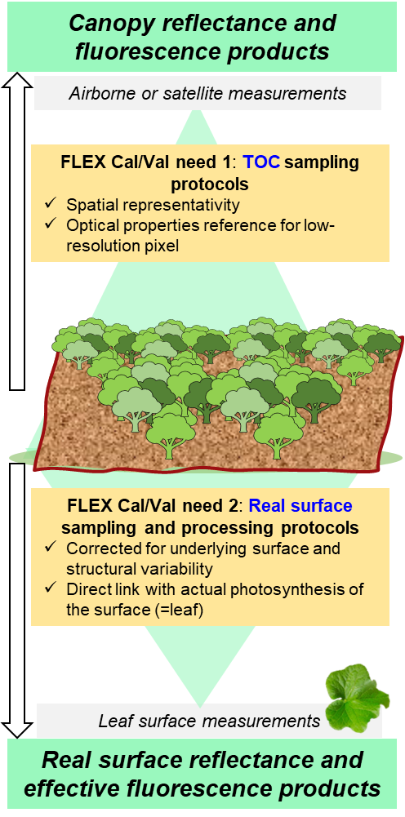
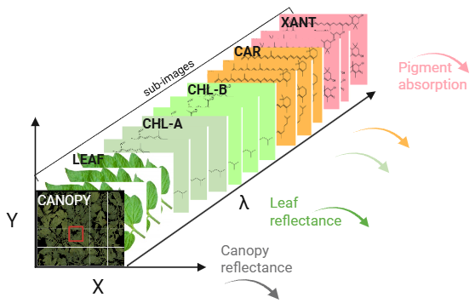
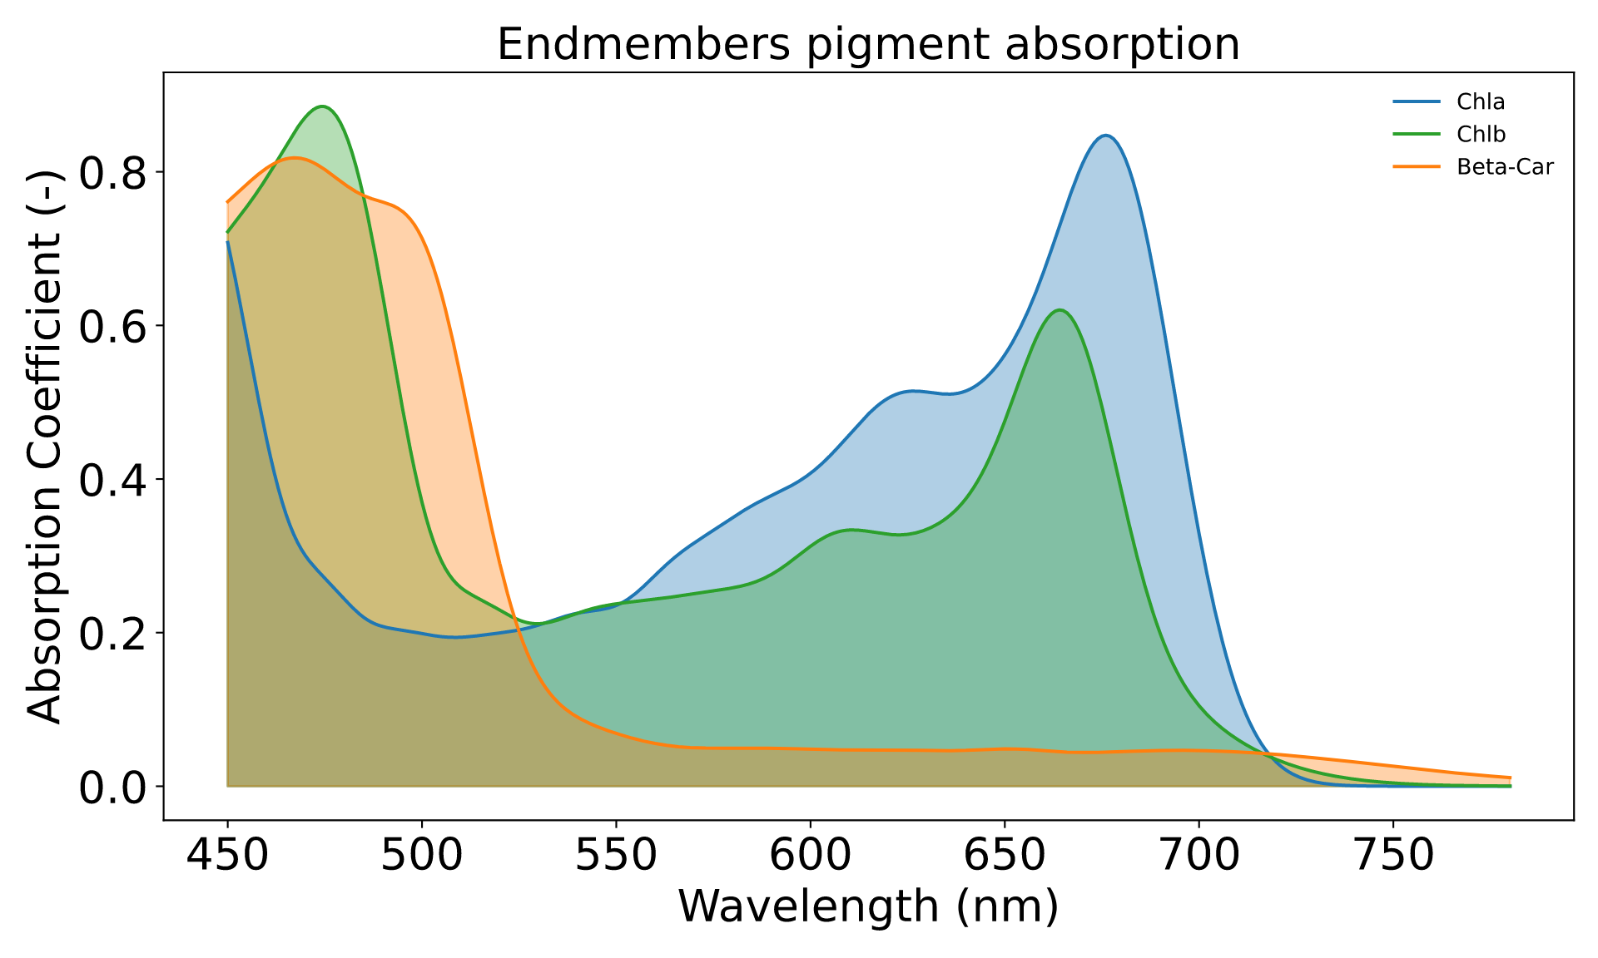
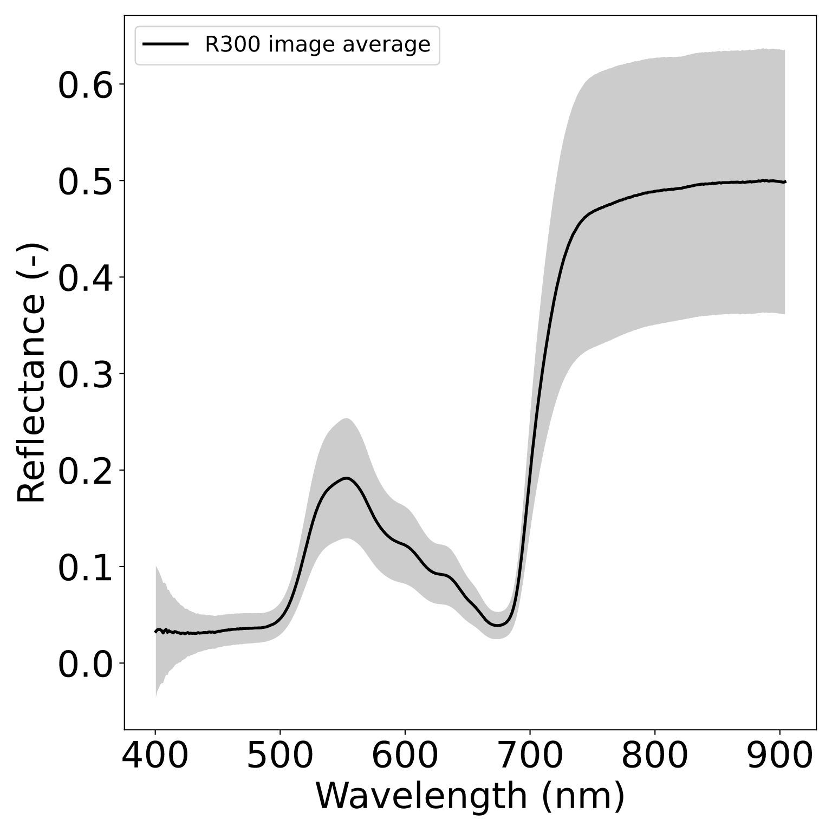
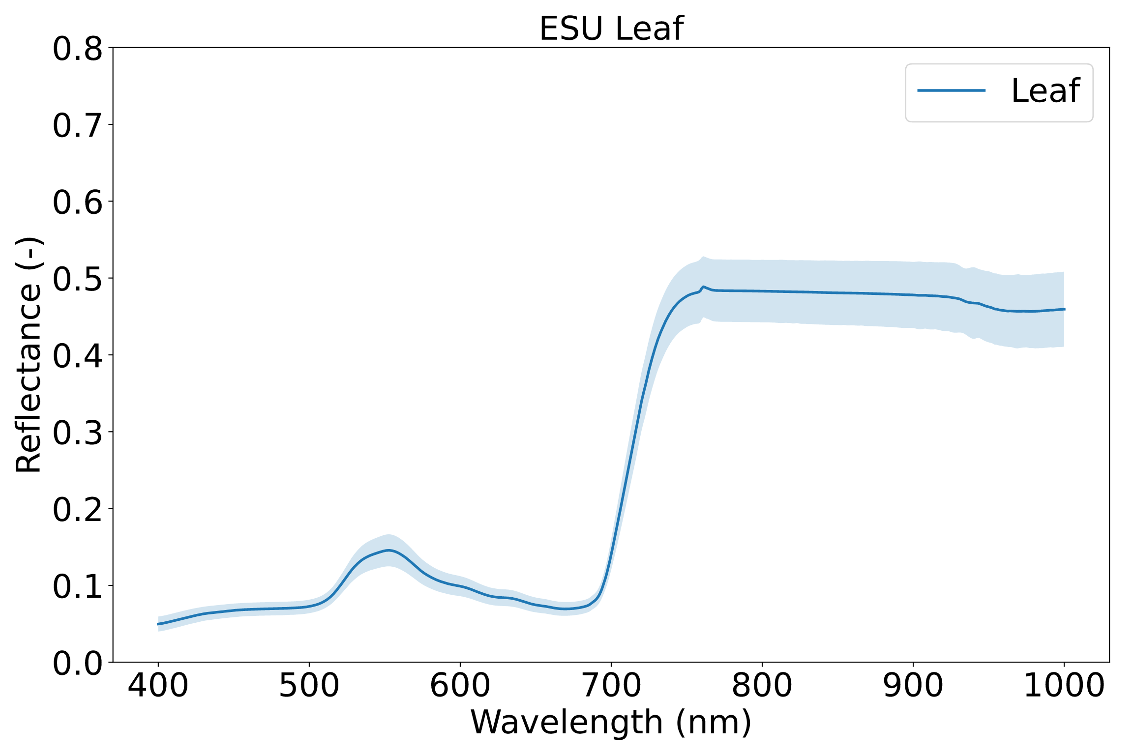
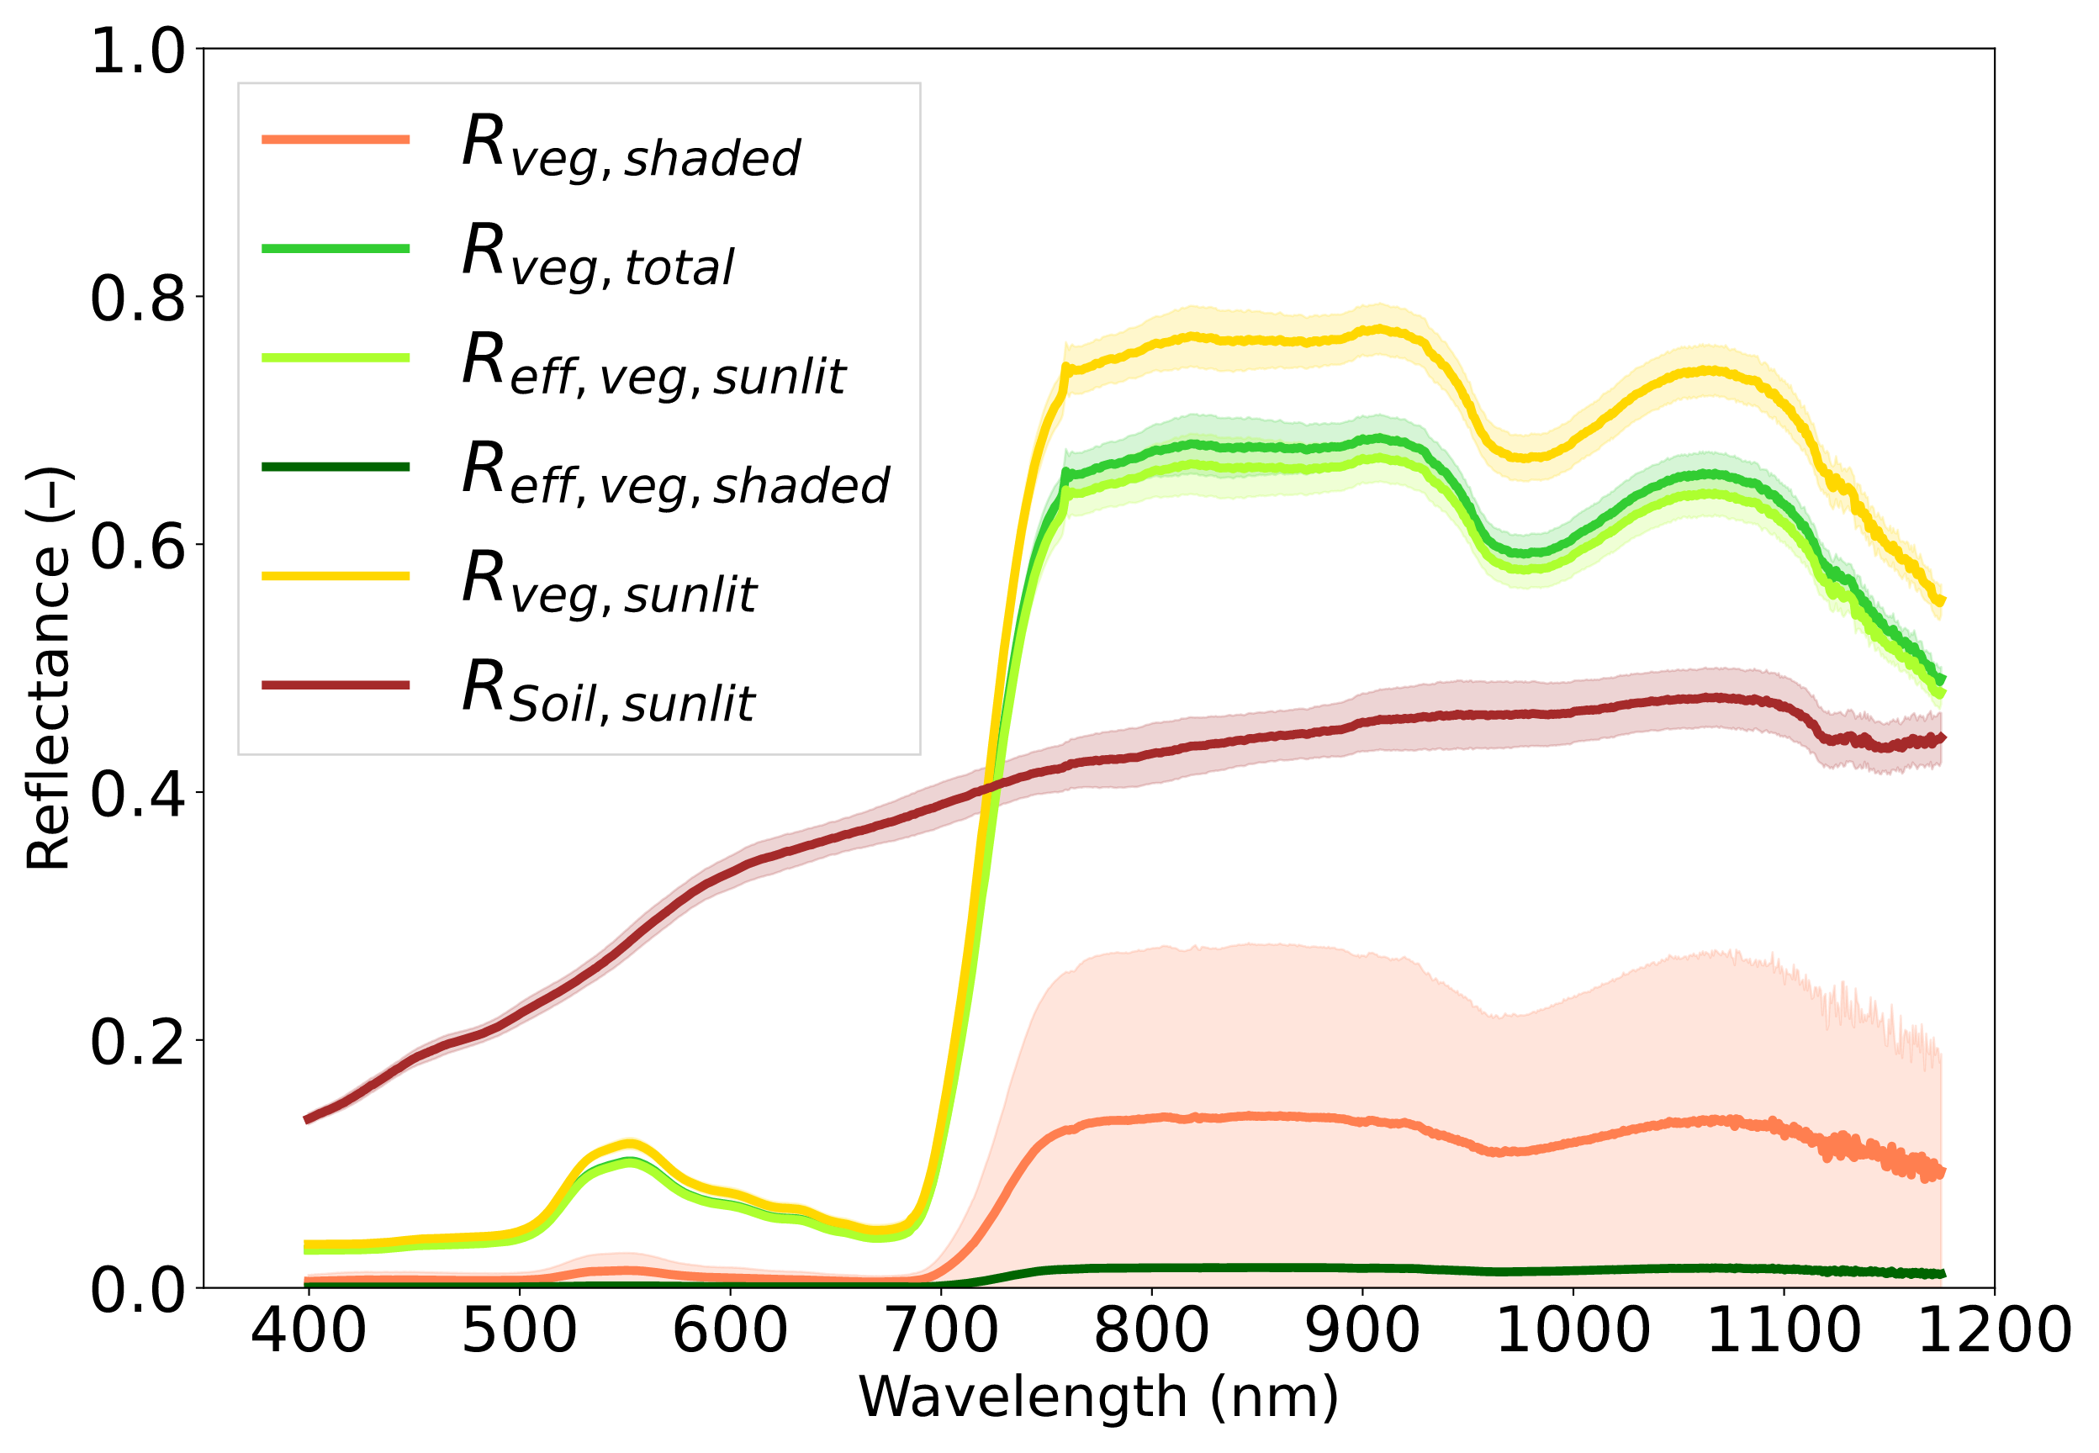
Introduction
Retrieve dynamic optical properties with a bottom-up approach:

Slide 3
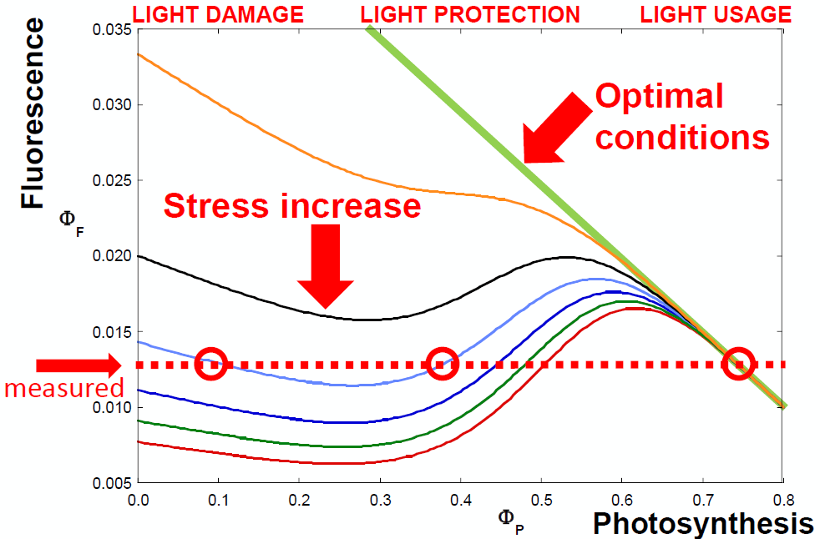
Introduction
The relationship between ΦF and ΦP is non-linear
Additional products are necessary for interpreting the fluorescence signal:
Non-Photochemical Quenching (NPQ)
NPQ-driven xanthophyll absorption changes can be used as an optical proxy of photoprotection mechanisms
(Credit: J. Moreno)

Slide 4
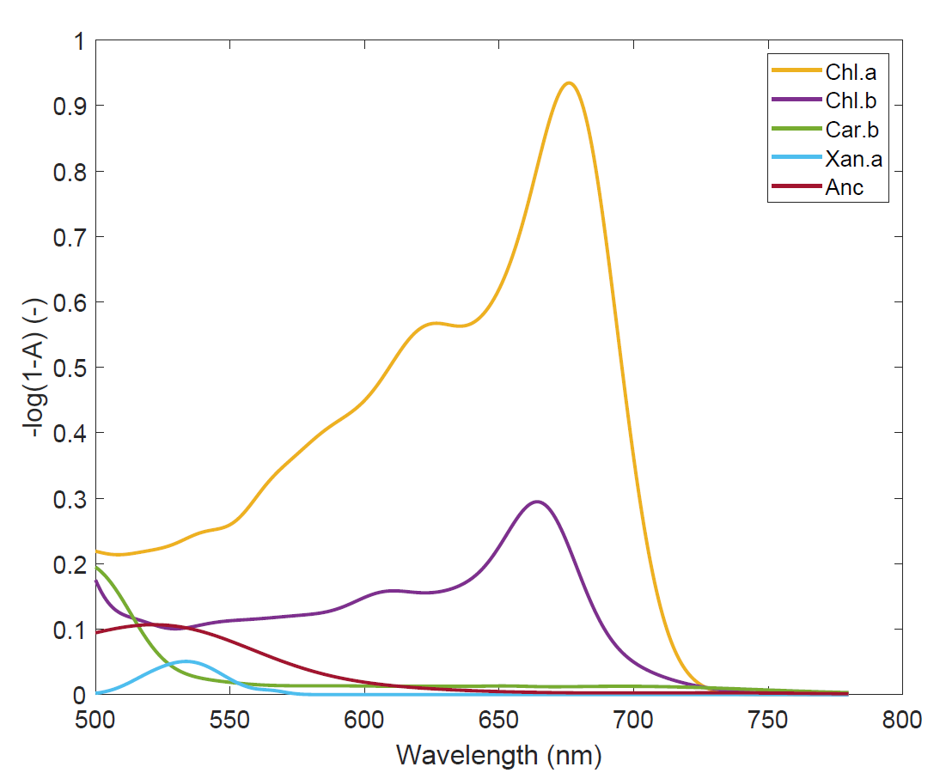
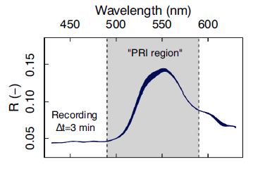
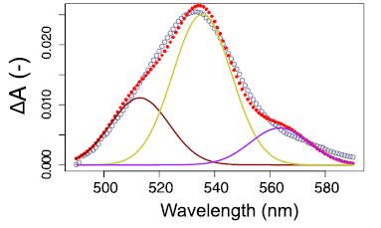
Laboratory leaf scale
Estimation of Xantophyll-driven photoprotection
Spectral fitting of Xantophyll-related absorption
Reflectance decrease during NPQ activation
Absorbance increase during NPQ activation
Modelled by 3 Gaussians
Van Wittenberghe et al. (2024).
Remote Sensing of Environment
Van Wittenberghe et al. (2021). BBA-Bioenergetics

Slide 5
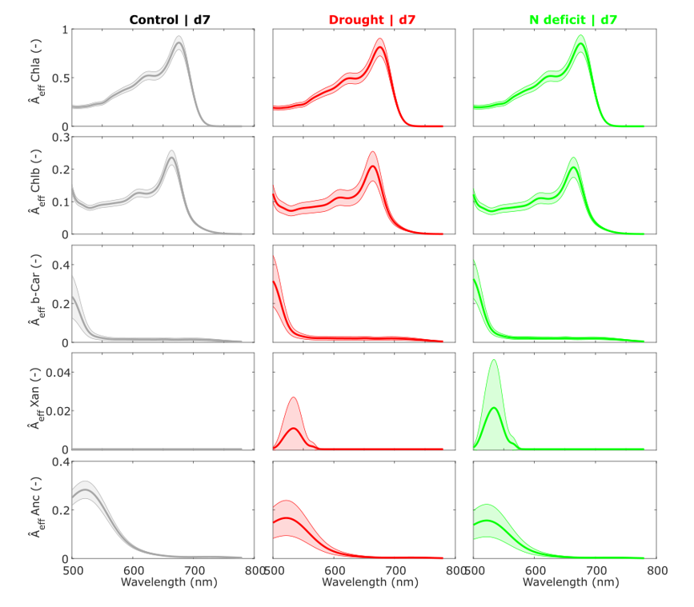
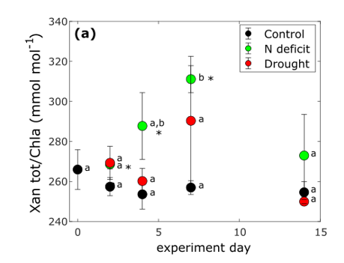
Laboratory leaf scale
Pigment’s effective absorbance fittings obtained with stress conditions at leaf level
Pescador-Dionisio et al. (2025). New Phytologist
Validation of the Xan absorption fitting is shown by the increase in the total xanthophyll pool
Control
Drought
N deficit

Slide 6
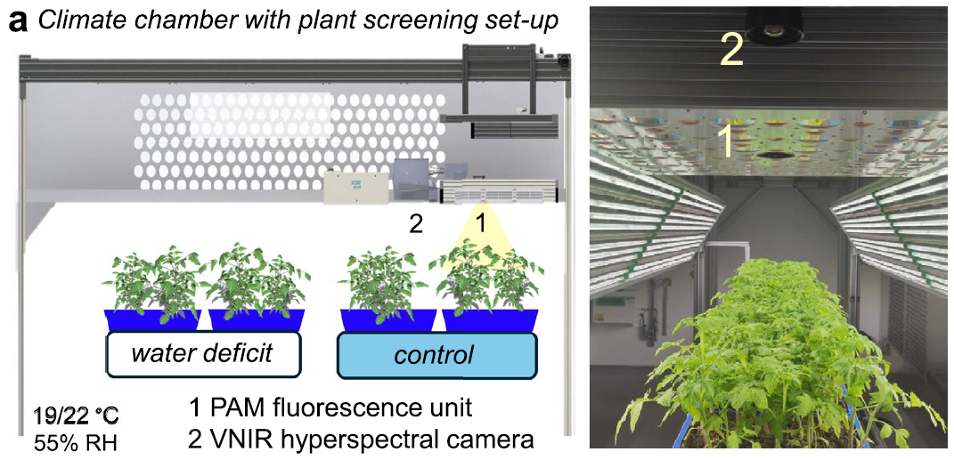
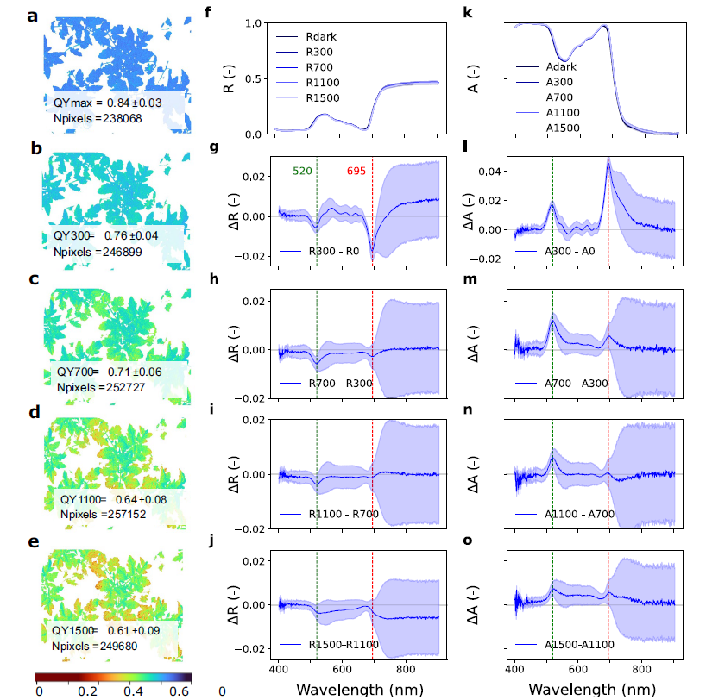
Laboratory TOC
Absorbance changes during diurnal ΦPSII decrease
Garcia-Martinez et al. (2025). Scientific Reports
Controlled diurnal light cycles 0-1500 μmol m⁻² s⁻¹
Minimal BRDF effects
Diurnal ΦPSII 0.84-0.61

Slide 7
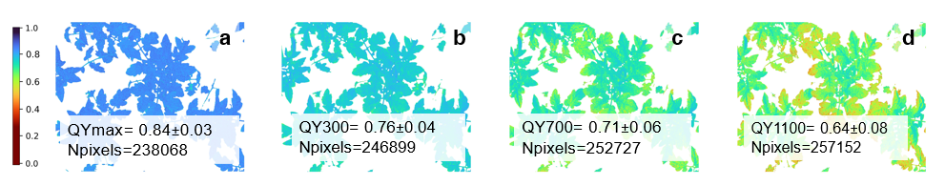
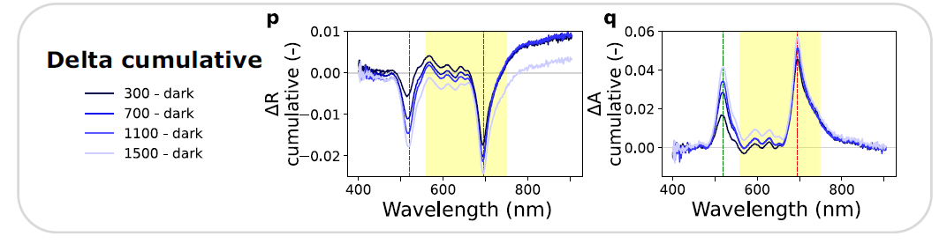
Laboratory TOC
Absorbance changes during diurnal ΦPSII decrease
Garcia-Martinez et al. (2025). Scientific Reports
PAM-based ΦPSII imaging
Reflectance and absorbance changes
Controlled diurnal light cycles 0-1500 μmol m⁻² s⁻¹
Minimal BRDF effects
Diurnal ΦPSII 0.84-0.61
Clear peaks in PRI and red-edge at canopy level

Slide 8
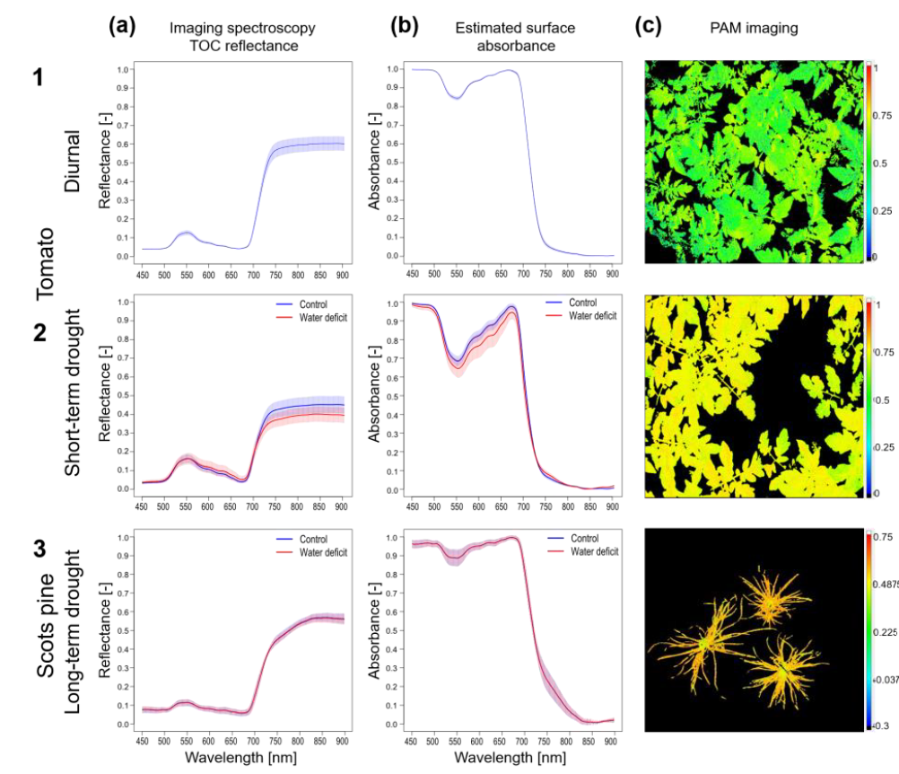
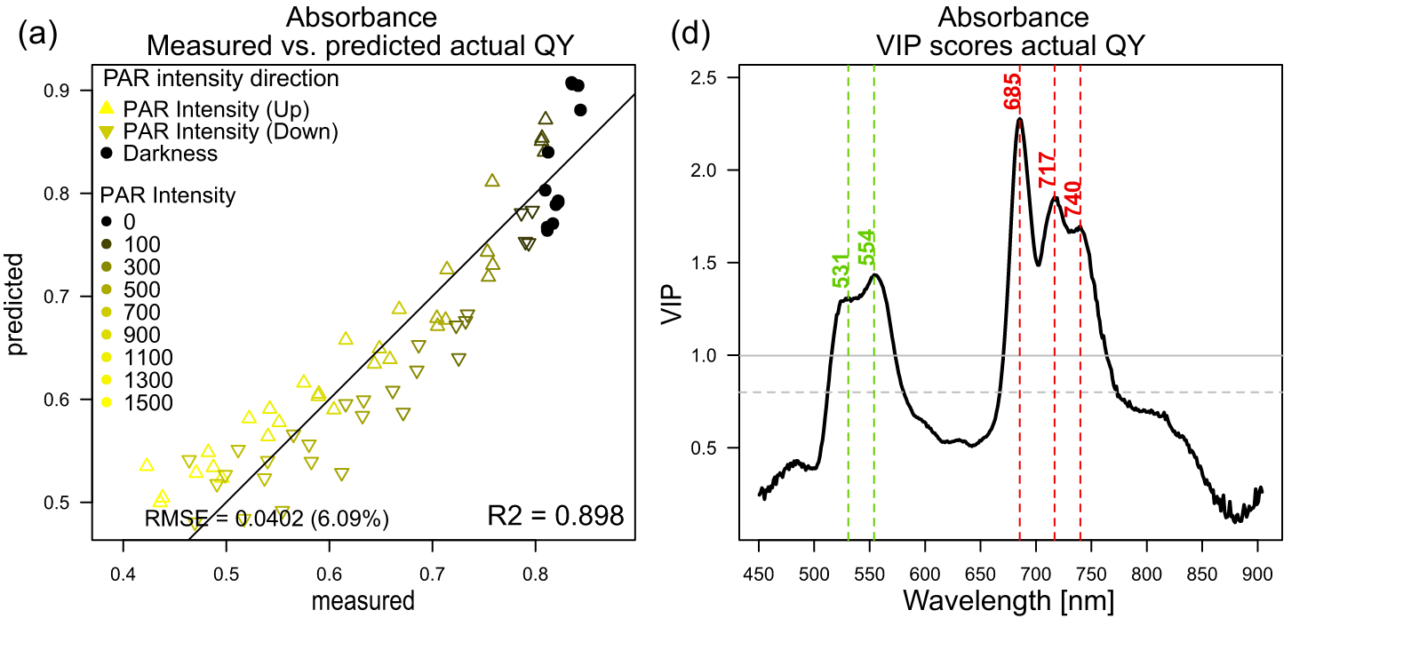
Laboratory TOC
Neuwirthova et al. (in review)
Spectral covariance with NPQ and ΦPSII
Tomato and Scots pine
VNIR + PAM fluorescence imaging
VIP > 1

Slide 9
Laboratory TOC
Neuwirthova et al. (in review)
Spectral covariance with NPQ and ΦPSII
Tomato and Scots pine
VNIR + PAM fluorescence imaging
Partial Least Square Regression using canopy reflectance and estimated surface absorbance
Variable Importance in Projection (VIP) scores of PLSR were used to explore spectral co-variation with NPQ and QY
Relevant wavelength for the model
VIP > 1
VIP > 1

Slide 10
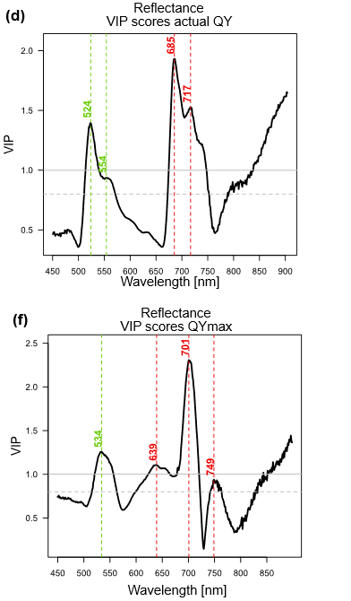
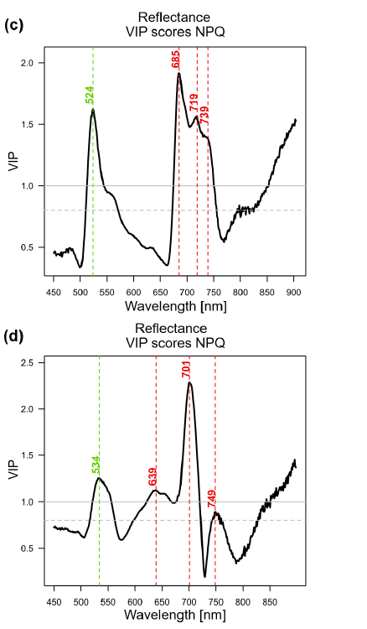
Laboratory TOC
Spectral covariance with NPQ and ΦPSII
Neuwirthova et al. (in review)
Canopy Reflectance
ΦPSII
NPQ
Tomato
Covariance peaks in the same regions as previous experimental findings
Consistent VIP peaks between different species
Scots pine

Slide 11
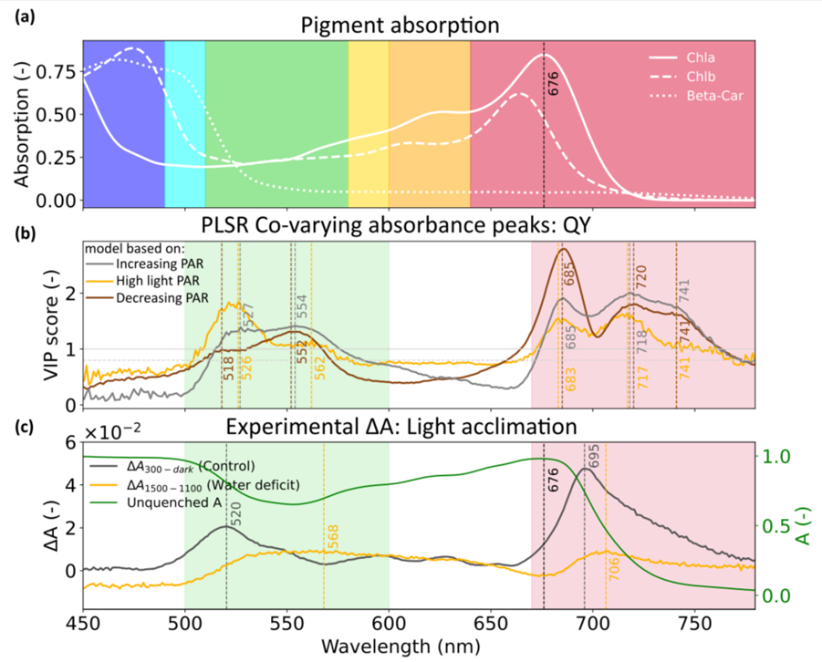
Laboratory TOC
Spectral covariance with NPQ and ΦPSII
Neuwirthova et al. (in review)
Red-shifted broadening: Actual photosynthetic efficiency affects green and red-edge canopy spectra
Multiple peaks in the green and in the far-red co-vary with QY and NPQ
Features are not separated by PLSR (just by statistical overlapping components)
Statistical models as screening tool for quenching behavior
Individual strength with qE-NPQ to be clarified

Slide 12
Going to the field TOC scale
Can we detect the same spectral behavior co-varying with actual photosynthesis (GPP) or NPQ at the field scale using one FLoX system?

Slide 13
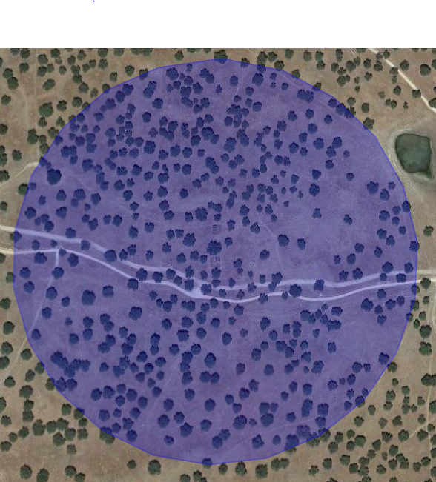
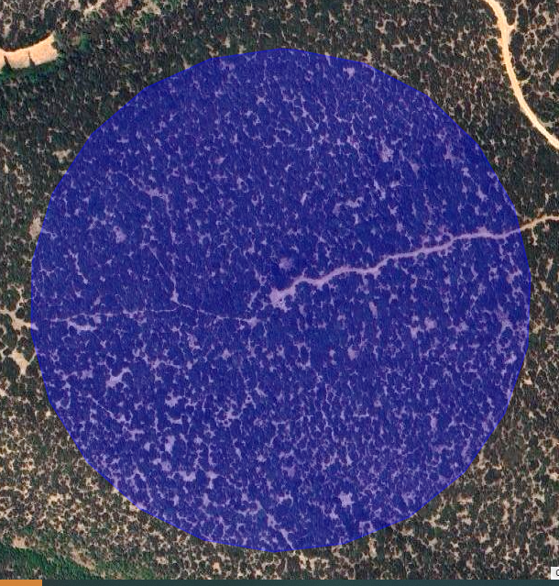
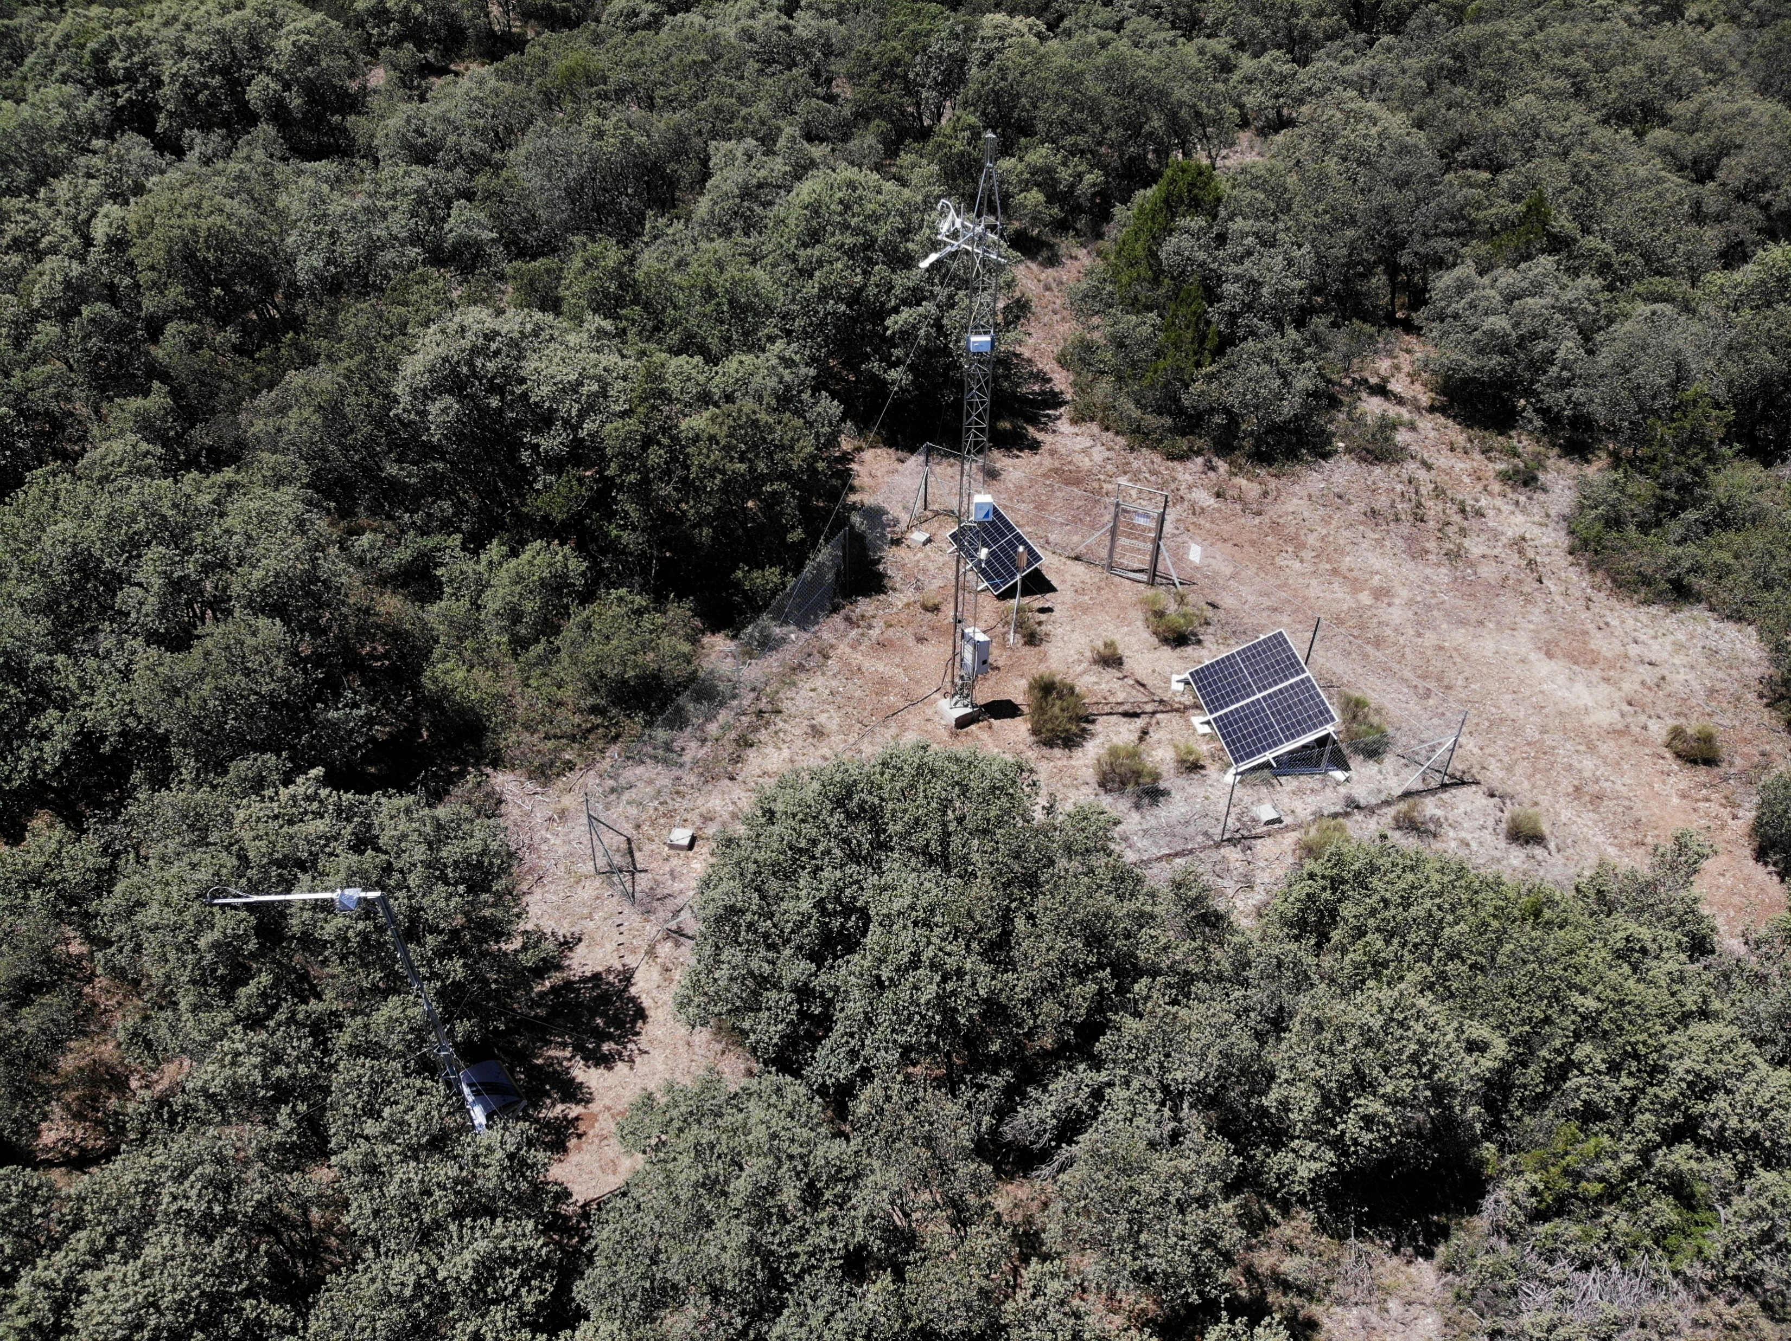


Going to the field TOC scale
Sites description
Quercus ilex
Site name: Manzanera Fluxnet site code: ES-Mzn Site coordinates: 40.0894 (lat) / -0.8274 (long) IGBP: EBF
Majadas (ES):
Savanna
2 summer months
GPP range
[0.8-6 (μmol m² s⁻¹)]
Manzanera (ES):
Forest
1.5 years
GPP range
[0.2-17 (μmol m² s⁻¹)]
Photosynthesis response variables
Eddy-covariance towers: Gross Primary Productivity (GPP)
Moni-PAM: NPQ (4 leaves). Only in Majadas
Spectral input variable
Radiometer (FLoX) : Surface reflectance (specimen scale)

Slide 14
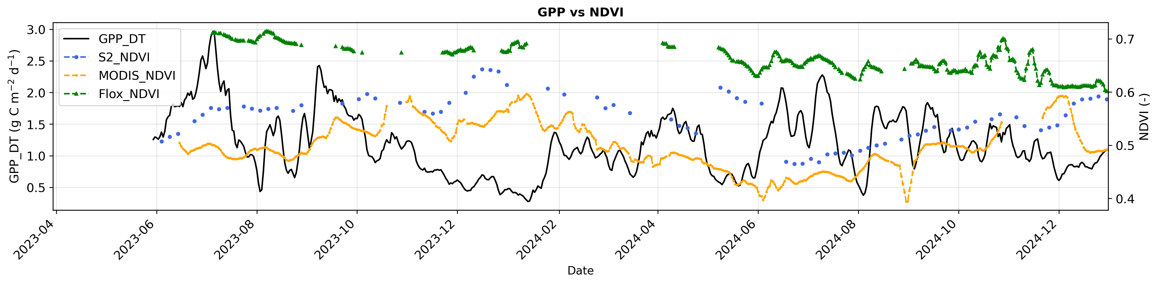
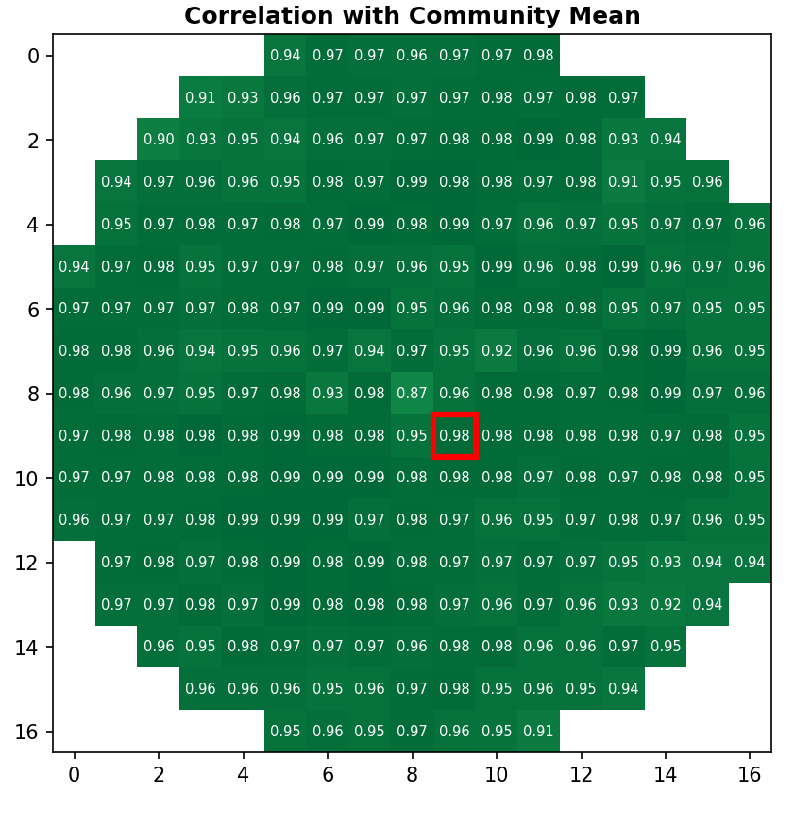
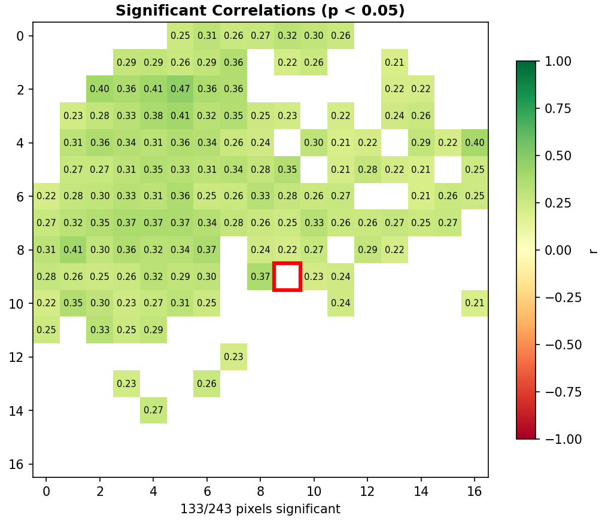
Field TOC and GPP
Spatial and temporal representativity FLOX --> ecosystem (Manzanera 1,5-year dataset)
Weak correlation between FLoX retrieved parameters (APARChla, F, FQE, and GPP flux
Weak correlation between FLoX and Sentinel-2 NDVI pixels
S-2 NDVI vs S-2 NDVI averaged
S-2 NDVI vs FLoX_NDVI

Slide 15
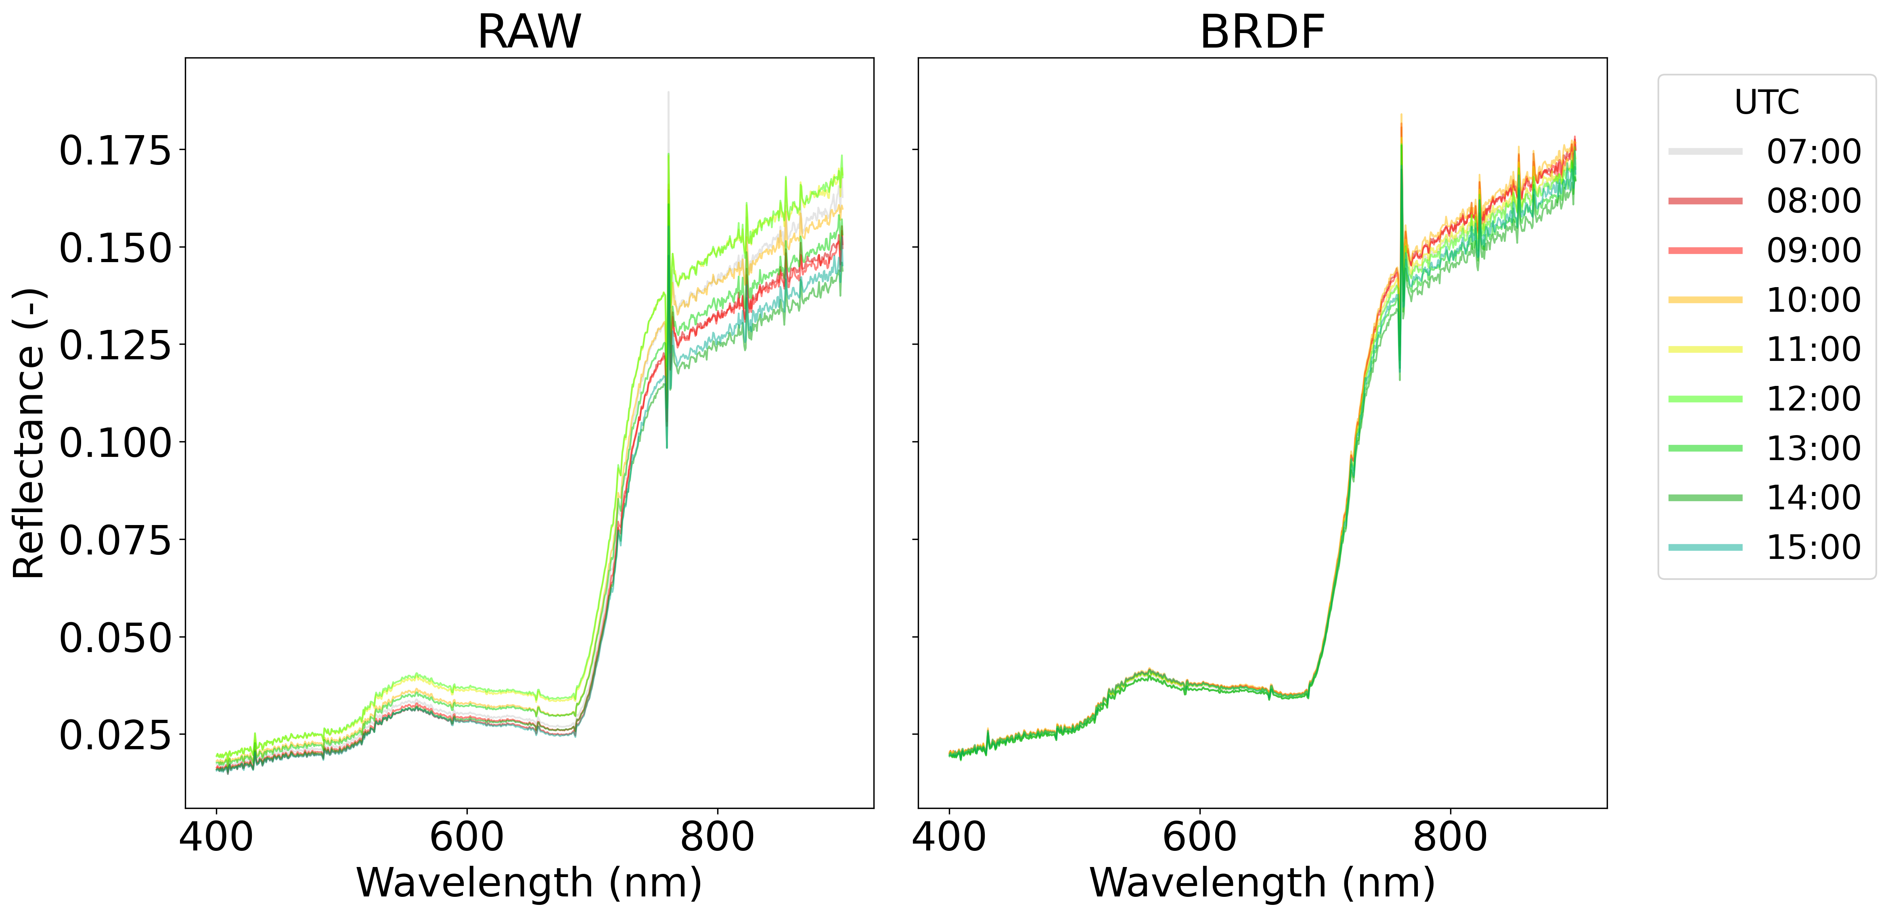
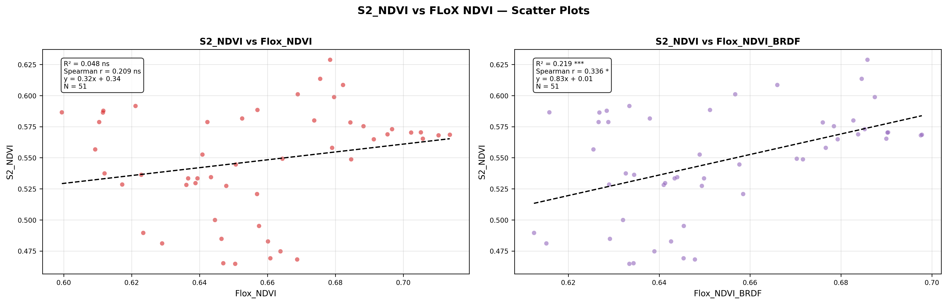
Field TOC and GPP – BRDF correction
BRDF normalization of reflectance to daily minimum solar zenith angle based on ROSS-LI-MAIGNAN kernel MODEL
Manzanera2024-06-17
BRDF correction improves the correlation between FLOX and S-2 NDVI
How do PLSR models respond to BRDF normalization?

Slide 16
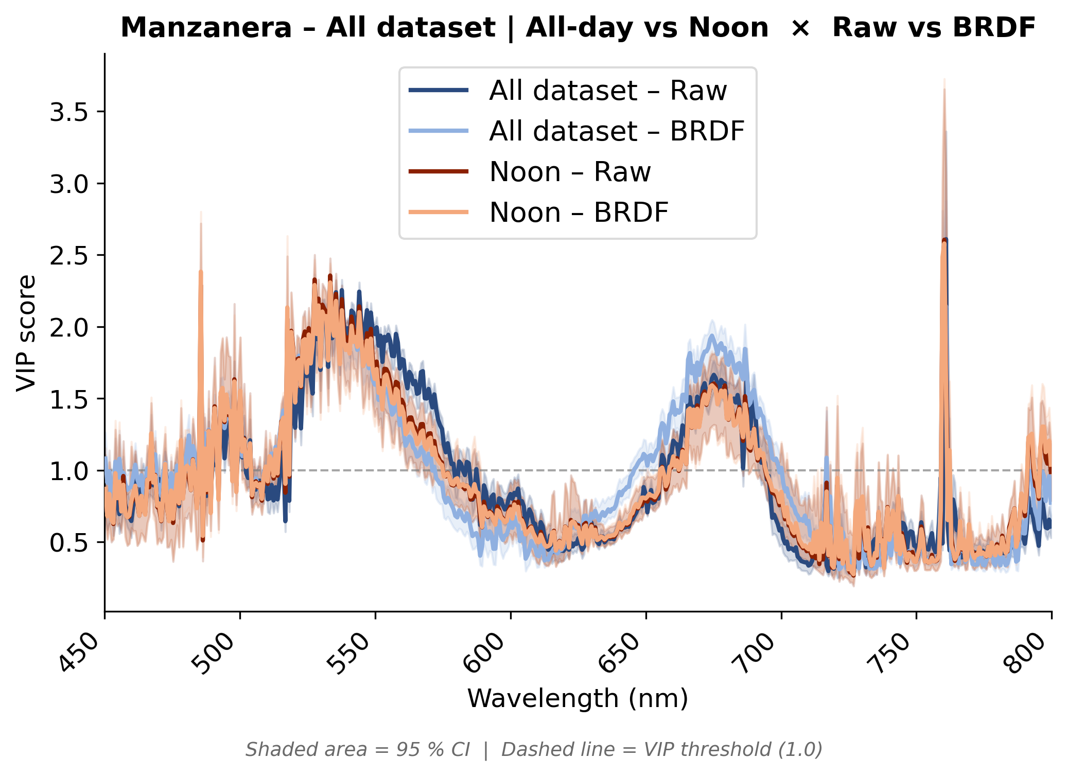
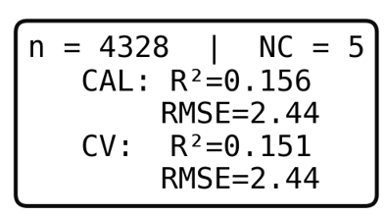
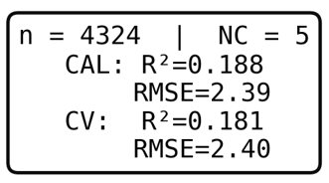
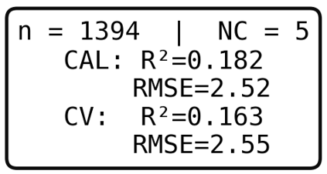
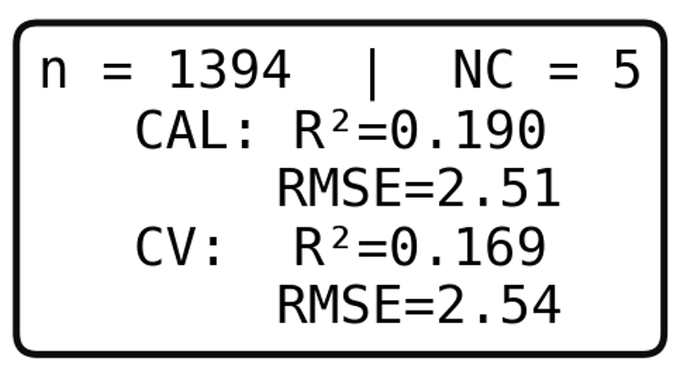
Field TOC and GPP
PLSR VIP scores of TOC Reflectance –GPP models
With vs. Without BRDF
Manzanera PLSR models for GPP
All dataset RAW
All dataset BRDF
Noon RAW
Noon BRDF
VIP scores do not show significant differences between raw and normalized values

Slide 17
Field TOC
PLSR VIP scores of TOC Reflectance –GPP models
With vs. Without BRDF
Manzanera PLSR models for GPP
All dataset RAW
All dataset BRDF
Noon RAW
Noon BRDF
VIP scores do not show significant differences between raw and normalized values

Slide 18
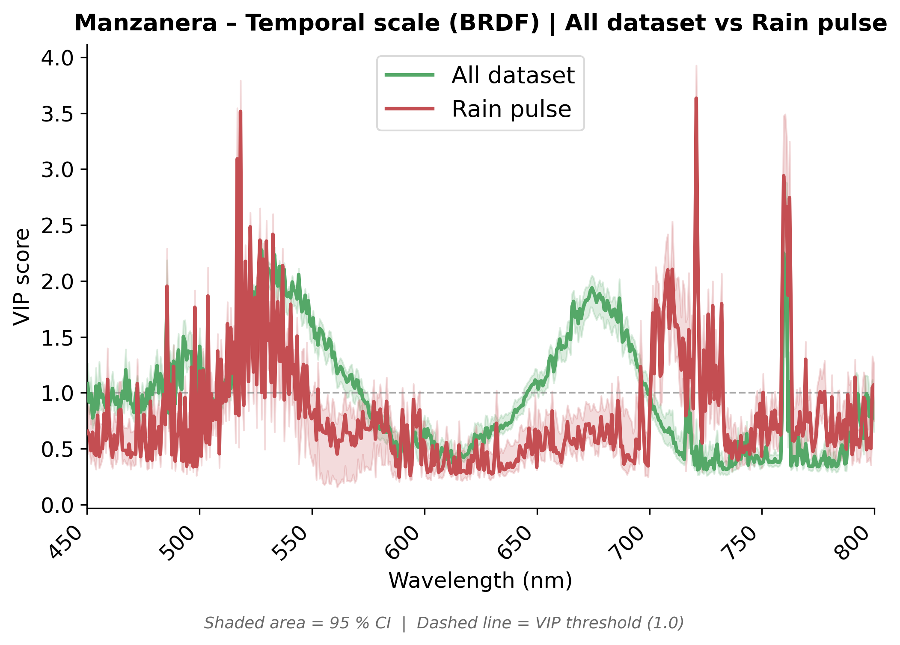
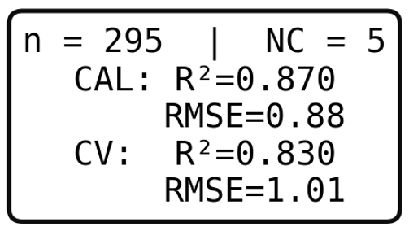
Field TOC Reflectance model for GPP
Short/long term dataset
Reflectance-based model for GPP
GPP All dataset
GPP Rain pulse
PRI region
Red-edge
GPP range 0.2-17 (μmol m² s⁻¹)
GPP range 0.3-9.5 (μmol m² s⁻¹)
VIP scores are different across datasets
Short-term dataset performs a lot better

Slide 19
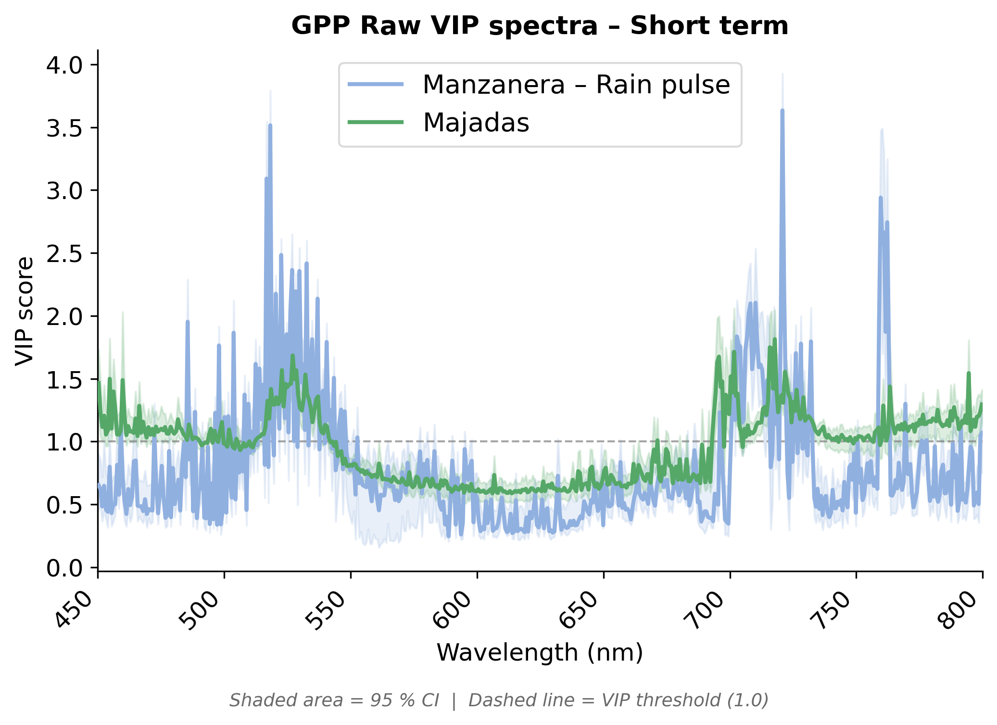
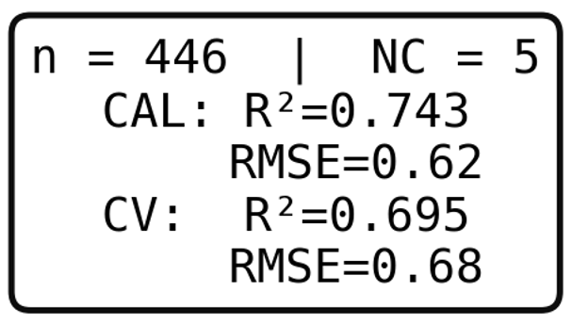
Field TOC Reflectance model for GPP
Manzanera (rain pulse) vs. Majadas (2-month summer data with heat wave)
Manzanera Rain pulse
GPP range 0.3-9.5 (μmol m² s⁻¹)
Similar spectral patterns in VIP scores
Majadas
Summer drought
GPP range 0.8-6 (μmol m² s⁻¹)

Slide 20
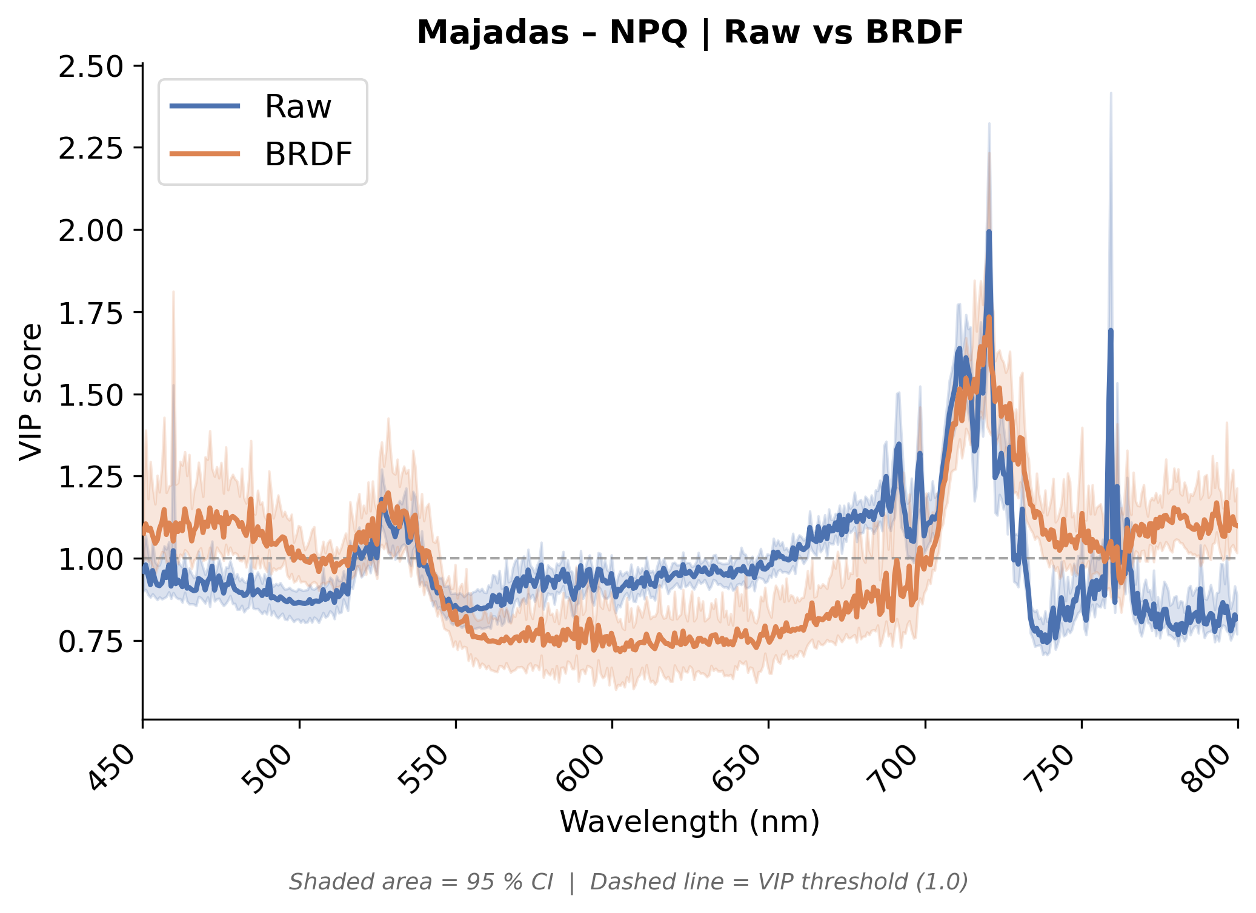
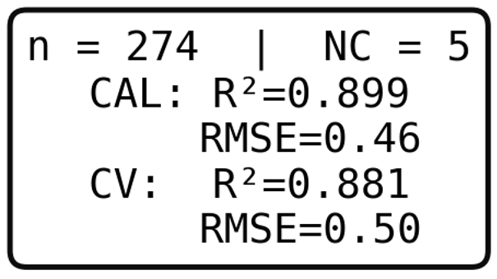
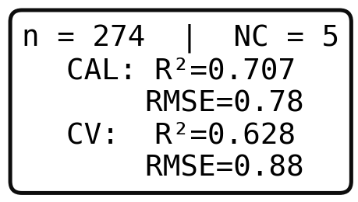
Field TOC Reflectance model for NPQ
Short term Majadas dataset for NPQ
NPQ VIP scores differ more between raw and BRDF corrected datasets
Raw dataset performs better
Peak attenuation
Raw
BRDF
NPQ range 0.5-6.5

Slide 21
Conclusions
The PLSR method indicates consistent co-varying spectral imprints when modelling ecosystem GPP and leaf NPQ using single FLoX reflectance data
Similar co-varying peaks are found with/without BRDF correction,
Both lab and field spectral analysis (experimental, PLSR) show dynamic broadening effects in the green and red-edge region
As a consequence, under stress/recovery events, the NPQ-driven spectral signal is consistent with a control of short-term GPP variability (e.g., rain pulse after drought)
Future work
Spectral unmixing algorithms for FLEX should be finetuned using the spectral NPQ-related dynamic features
Further work is needed on field sampling design to improve ecosystem-scale representativeness of spectroscopy measurements

Slide 22
Thank you very much for your attention!
adrian.moncholi@uv.es
More about stress:
Cynthia Chardí Raga:
Understanding non-linear chlorophyll fluorescence dynamics for water stress detection
Julio Cesar Marchante Cambron:
Use of chlorophyll fluorescence for the early detection of pest infestation in sweet potato plants
Amelia Montoro:
Assessing Plant Adaptive Strategies and Stress Tolerance via Chlorophyll Fluorescence and Photoprotective Pigment Dynamics
More about Cal/Val:
Juanjo Peón:
SpaFLEX Procedure for Propagating in-situ Sun-induced Chlorophyll Fluorescence and Reflectance Uncertainty in Cal/Val FLEX L2 Product
Jimmy A. Muela:
Intercomparison experiment of Field spectroradiometers for FLEX L2 product Validation
Pedro J. Gómez-Giráldez:
A multi-scale spatial sampling strategy for FLEX product validation within the SpaFLEX project
Joaquin Cobos:
Doñana as a Cal/Val Supersite for the FLEX Mission: Multi-scale Field Campaigns within the SpaFLEX Project
Félix Muñoz:
Airborne system design and data acquisition campaigns for the SpaFLEX project within the Spanish Cal/Val plan of ESA’s FLEX mission
SPAFLEX posters

Slide 23
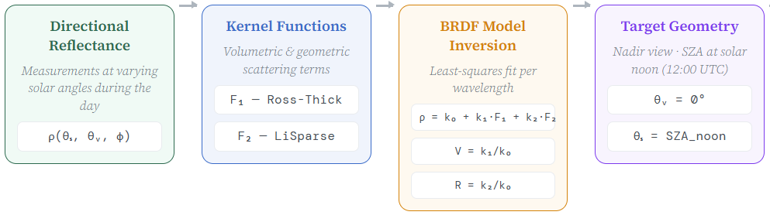
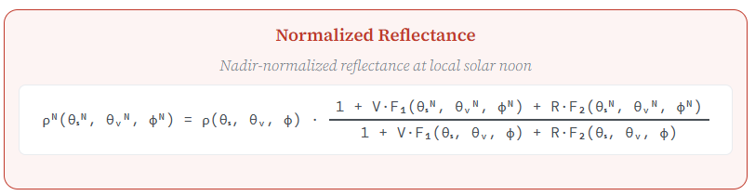
BRDF NORMALIZATION: ROSS-LI-MAIGNAN MODEL
Guerrero-Benavent et al. (Manuscript in preparation)
Kernel-driven models describe the BRDF as a linear weighted combination of kernels modelling the basic BRDF shape
We consider the Ross-Li-Maignan model (Roujean et al. (1992); Maignan et al. (2004); Li & Strahler (1986)). Three-parameter semiempirical linear model based on the assumption that the land surface reflectance can be retrieved as a sum of three kernels representing; Isotropic scattering, radiative transfer-type volumetric scattering (accounting for the Hot Spot effect), geometric-optical surface scattering.

Slide 24
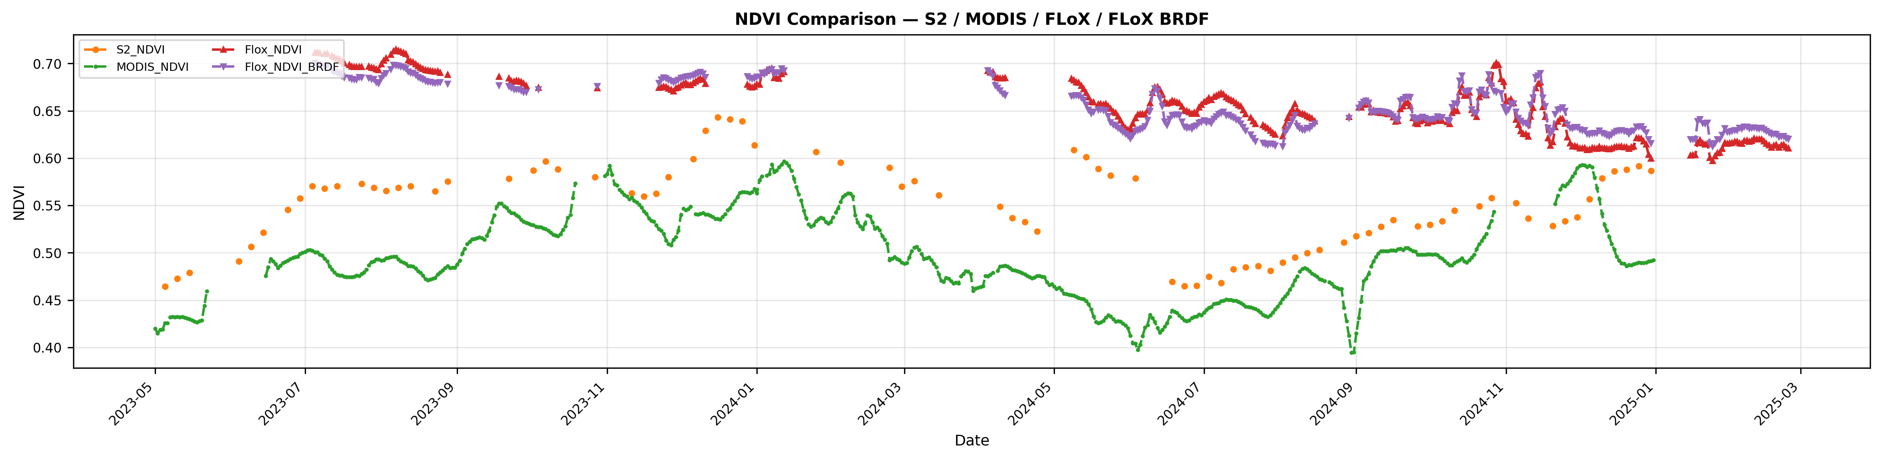
Field TOC
BRDF correction improves the correlation between the two scales

