Slide 1
Shared light absorption rather than physiological coupling explains the apparent SIF-GPP relationship at canopy scale across diverse ecosystems
Jeongho Lee, Youngryel Ryu, Huaize Feng, Nanghyun Cho
Notes:
Good morning everyone. My name is Jeongho Lee from Seoul National University. Today I will present our study: "Shared light absorption rather than physiological coupling explains the apparent SIF-GPP relationship at canopy scale across diverse ecosystems."

Slide 2
1. Motivation
Notes:
Let me start with the motivation.

Slide 3
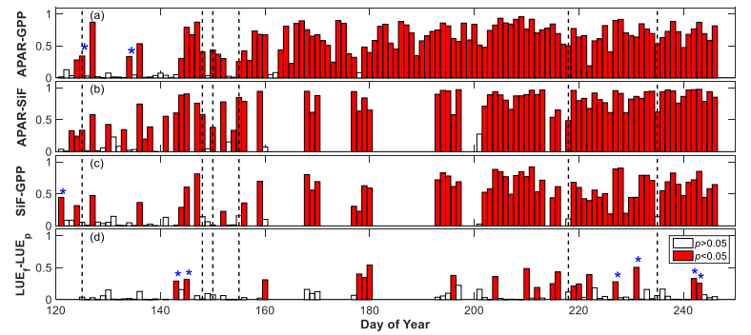
APAR drives both SIF and GPP
(Yang et al., Remote Sens. Environ., 2016)
Notes:
This is one of the key studies that examined the reason for the strong SIF–GPP correlation at the canopy scale. The main finding was clear: APAR explains most of the variance in both SIF and GPP. Once APAR is removed the correlation between their efficiencies becomes weak or non-significant. This suggests that the apparent SIF–GPP relationship may largely reflect shared light absorption. Even this kind of research was conducted by single site or single PFT, to use SIF over a simple GPP proxy, we therefore need to determine whether SIF contains independent physiological information.

Slide 4
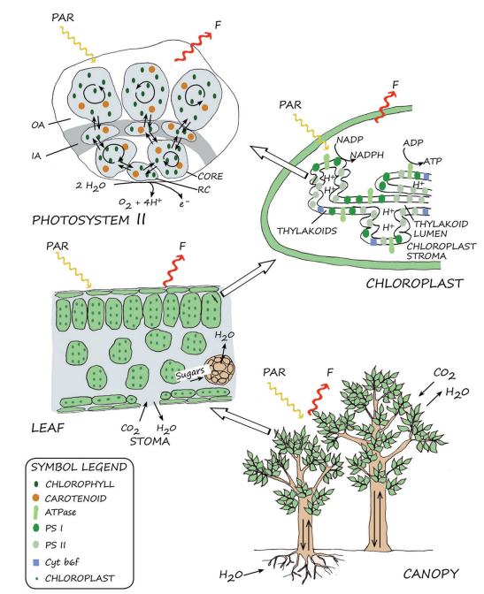
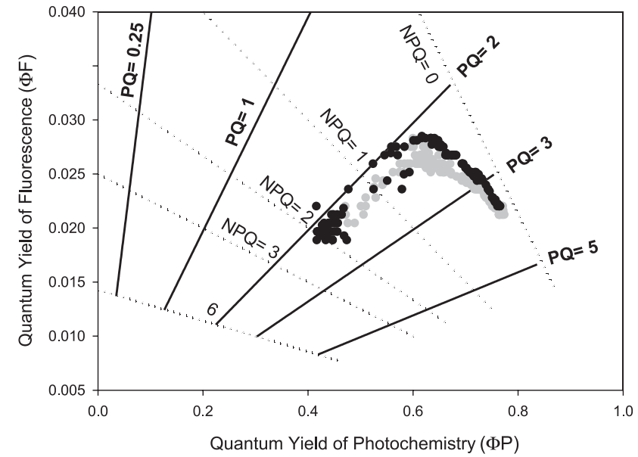
However, SIF–GPP link via energy partitioning across scales
Across Scale
(Porcar-Castel et al., J. Exp. Bot., 2014)
Notes:
As Albert explained, such physiological information clearly exists at leaf level. Fluorescence yield and photochemical yield are physically linked through energy partitioning, as shown on the left. This coupling is well established in photosynthetic theory. The key question is whether this relationship is preserved when scaling from leaves to the canopy.

Slide 5
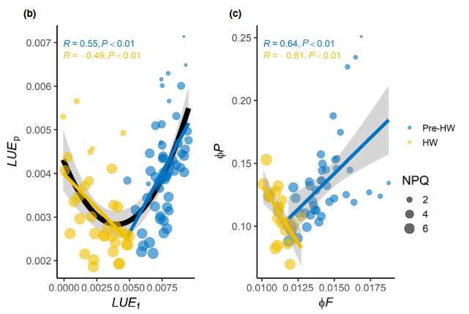
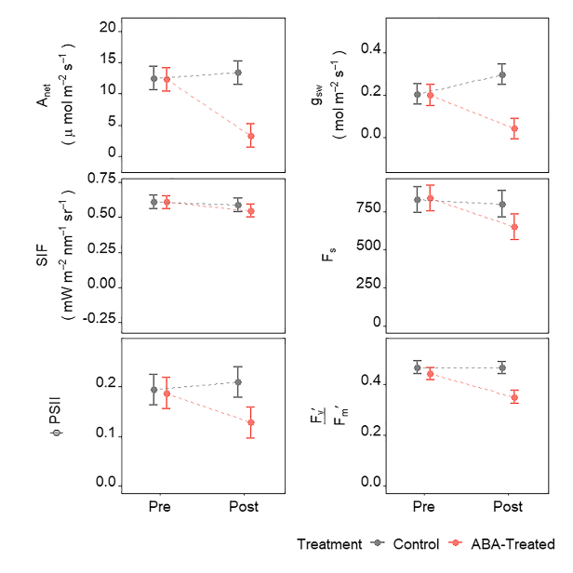
ΦF-ΦP coupling may not persist at canopy scale
Canopy-scale = Leaf-scale
Canopy-scale != Leaf scale
(Stomata control)
(Martini et al., New Phytol., 2022)
(Marrs et al., GRL., 2020)
Notes:
However, When we examine canopy-scale observations, the picture becomes less consistent. A study during the 2018 European heatwave suggested that leaf-level ΦF–ΦP coupling was also observable at the canopy scale. In contrast, an ABA experiment showed that stomatal-driven stress reduced photosynthesis while SIF remained largely unchanged. These findings indicate that the ΦF–ΦP relationship at canopy scale is not straightforward. This means that something changes when leaf-level processes are scaled up to the canopy.

Slide 6
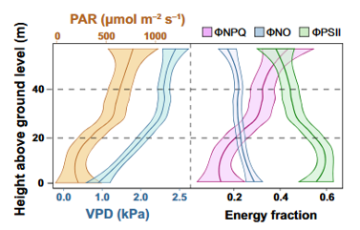
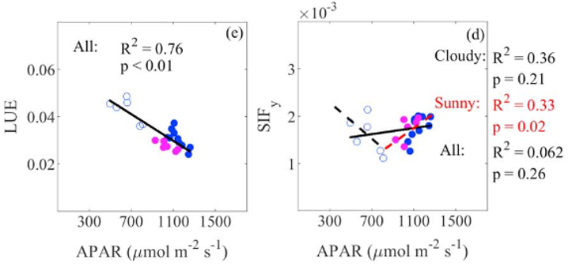
Canopy structure can reshape leaf-scale mechanisms
Vertical canopy depth effect
Sunlit-shade mixing effect
(Ziccardi et al.,
New Phytologist., 2025)
(Miao et al., JGR, 2018)
Notes:
Previous studies suggest that canopy structure may explain this difference. A canopy is not a single leaf. It contains both sunlit and shaded leaves under very different light conditions. Because of this vertical light gradient, energy partitioning changes within the canopy. When all leaves are combined, the canopy-level ΦF response can look very different from that of an individual leaf. In short, canopy structure could change how physiological signals appear at larger scales.

Slide 7
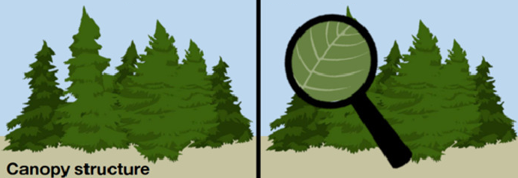
Canopy structure can reshape leaf-scale mechanisms
Vertical canopy depth effect
Sunlit-shade mixing effect
(Ziccardi et al.,
New Phytologist., 2025)
(Miao et al., JGR, 2018)
Leaf-level physiology
(Durand et al., AFM, 2021)
Notes:
However, canopy structure is not the only factor that can change this each yield. Environmental stress can also create divergence between ΦF and ΦP at the canopy scale. Stomatal closure may create asymmetry between ΦP and ΦF. Whether this pattern is consistent or not, remains as unknown. Addressing this uncertainty defines the gap of our study.

Slide 8
Research question
Does shared APAR absorption explain the apparent SIF-GPP correlation across ecosystems?
Does canopy light regime reshape the apparent light response of ΦF at canopy scale?
How do canopy-scale ΦF and ΦP respond differently to environmental stress across ecosystems?
Notes:
So, in this study, we address these three research question. First, Does shared APAR absorption explain the apparent SIF-GPP correlation across ecosystems? Second, Does canopy light regime reshape the apparent light response of ΦF at canopy scale? and third, How do canopy-scale ΦF and ΦP respond differently to environmental stress across ecosystems? We address these questions using continuous tower-based observations across five ecosystems in Korea.

Slide 9
2. Methods and materials
Notes:
Now I will move to the method parts.

Slide 10
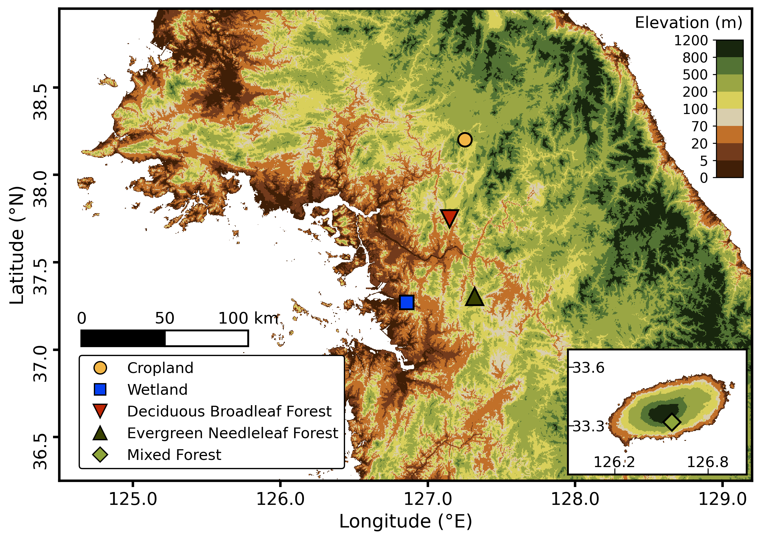
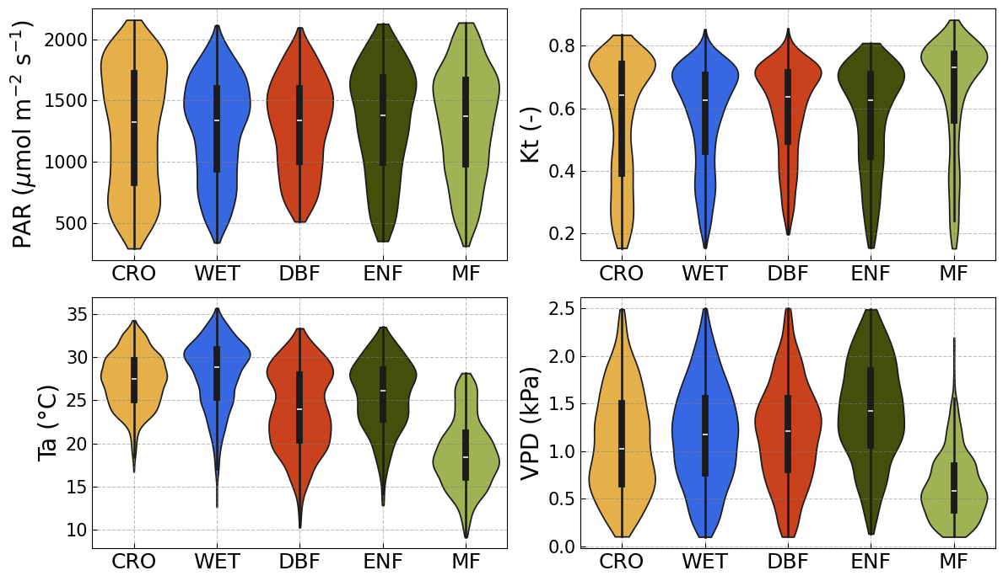
2.1. Study sites and field observation
Data usage:
CRO: 2023 – 2025 WET: 2024 – 2025
DBF: 2023 – 2024 ENF: 2024 MF: 2022 – 2024
Notes:
We conducted tower-based measurements across five ecosystems including CRO, WET, DBF, ENF, MF. The observation period ranges from one to three growing seasons, depending on the site. Site characteristics are summarized on the right.

Slide 11
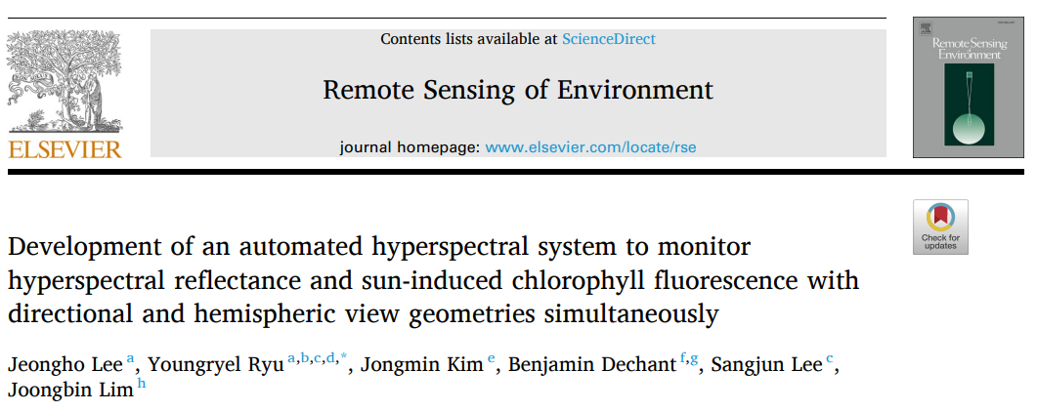
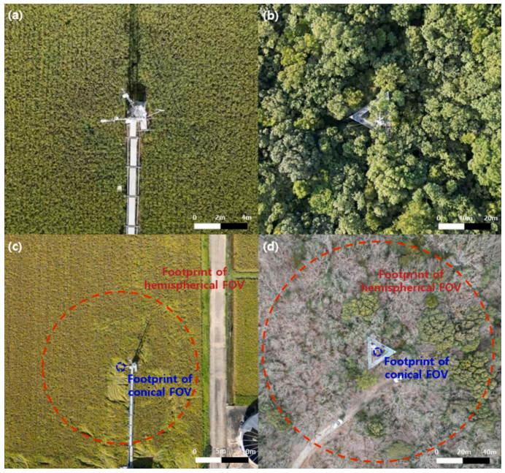
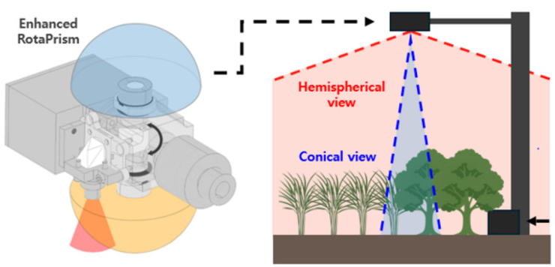
2.1. Study sites and field observation
Notes:
We measured canopy SIF using the RotaPrism system developed in our lab. As Youngryel mentioned yesterday, we used a bi-hemispherical observation to account for spatial heterogeneity and temporal shifts in the GPP flux footprint.

Slide 12
2.2. Research framework
Equations:
LUE_{F} = SIF_{obs} / APAR_{chl} LUE_{p} = GPP / APAR_{chl}
Fesc = NIRv / fPAR_{chl}
EUE = (C_{i} – Γ*) / (4C_{i} – 8Γ*)
C_{i} = C_{a} – 1.6 × GPP/G_{C} (G_{C}: PM inversion)
Γ* = 42.75×exp(37830×Ta) / (8.314×Ta×298.15)
Φ_{F} = LUE_{F} / F_{esc} , Φ_{P} = LUE_{P} / EUE
SIF_{obs}
=
APAR_{Chl}
×
Φ_{F}
×
F_{esc}
GPP
=
APAR_{Chl}
×
Φ_{P}
×
EUE
Notes:
Our framework decomposes both SIF and GPP as three part. SIF is expressed as the APARchl, fluorescence yield (ΦF), and the escape fraction (Fesc). GPP is also expressed as APARchl, photochemical yield (ΦP), and energy use efficiency (EUE).

Slide 13
2.2. Research framework
Observation
Absorption
Energy partitioning
Equations:
LUE_{F} = SIF_{obs} / APAR_{chl} LUE_{p} = GPP / APAR_{chl}
Fesc = NIRv / fPAR_{chl}
EUE = (C_{i} – Γ*) / (4C_{i} – 8Γ*)
C_{i} = C_{a} – 1.6 × GPP/G_{C} (G_{C}: PM inversion)
Γ* = 42.75×exp(37830×Ta) / (8.314×Ta×298.15)
Φ_{F} = LUE_{F} / F_{esc} , Φ_{P} = LUE_{P} / EUE
×
×
×
=
×
=
APAR_{Chl}
APAR_{Chl}
Φ_{F}
SIF_{obs}
Φ_{F}
SIF_{obs}
F_{esc}
F_{esc}
=
=
×
×
×
APAR_{Chl}
×
GPP
APAR_{Chl}
GPP
Φ_{P}
Φ_{P}
EUE
EUE
Kt
PAR
Ta
VPD
* Kt (Clearness index, unitless) = SW_{In} / SW_{Ext}
Notes:
Then, We examined how SIF and GPP respond to environmental drivers. One important variable is the kt. Kt represents how clear the sky is. It is calculated as the ratio of incoming shortwave radiation to extraterrestrial radiation. High Kt indicates dominance of direct radiation, means activation of sunlit leaves. Low Kt indicates diffuse-dominated conditions, increasing the contribution of shaded leaves. Therefore, we use Kt as an indicator of the balance between sunlit and shaded leaves within the canopy.

Slide 14
2.2. Research framework
Observation
Absorption
Energy partitioning
Equations:
LUE_{F} = SIF_{obs} / APAR_{chl} LUE_{p} = GPP / APAR_{chl}
Fesc = NIRv / fPAR_{chl}
EUE = (C_{i} – Γ*) / (4C_{i} – 8Γ*)
C_{i} = C_{a} – 1.6 × GPP/G_{C} (G_{C}: PM inversion)
Γ* = 42.75×exp(37830×Ta) / (8.314×Ta×298.15)
Φ_{F} = LUE_{F} / F_{esc} , Φ_{P} = LUE_{P} / EUE
SIF_{obs}
=
APAR_{Chl}
×
Φ_{F}
×
F_{esc}
GPP
=
APAR_{Chl}
×
Φ_{P}
×
EUE
Kt
PAR
Ta
VPD
* Kt (Clearness index, unitless) = SW_{In} / SW_{Ext}
SIF retrieval:
Fraunhofer Line Discrimination method (iFLD)
GPP partitioning:
Nighttime temperature
Data filtering:
LAI > 4 & NDVI > 0.6
Kt > 0.2, VPD > 0.1
Solar time: 9:00~15:00
Month: May ~ Sep
Notes:
SIF was retrieved using the iFLD method, and GPP was calculated by night time partitioning method. To ensure robust PM inversion for canopy conductance, stable Fesc estimates, and overall data quality, we limited the analysis to 9:00–15:00 solar time during the peak growing season.

Slide 15
2.3 fPARchl calculation
fPAR_{chl} = (1-PAR_{albedo}) × ξ_{chl}
Leaf-scale fPAR Calculation
Leaf- to Canopy-scale
Converting factor
ξ_{chl} = ANN(NDVI_{albedo}, EVI_{albedo}, NIRv_{albedo},
sCCI_{albedo}, FCVI_{albedo}, Kt)
Trained on SCOPE simulations
Notes:
To achieve this, we estimated fPARchl using a neural network trained on SCOPE simulations. We estimate fPARchl converting factor rather then fPARchl. The reason is ML or DL based estimation method sometimes request pixel by pixel calibration. Inputs include vegetation indices derived from bi-hemispherical reflectance — NDVI, EVI, NIRv, sCCI, and FCVI — together with Kt. This approach allows APARchl to reflect both canopy structure and atmospheric light conditions.

Slide 16
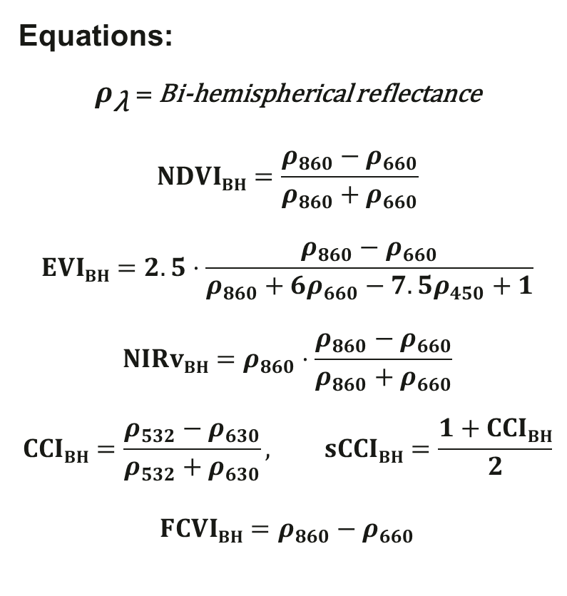
2.3 fPARchl calculation
fPAR_{chl} = (1-PAR_{albedo}) × ξ_{chl}
Equations:
$ρ_{\text{λ}}$ = Bi-hemispherical reflectance
$$NDVIBH=\frac{ρ_{860}−ρ_{660}}{ρ_{860}+ρ_{660}}$$
$$EVIBH=2.5⋅\frac{ρ_{860}−ρ_{660}}{ρ_{860}+6ρ_{660}−7.5ρ_{450}+1}$$
$$NIRvBH=ρ_{860}⋅\frac{ρ_{860}−ρ_{660}}{ρ_{860}+ρ_{660}}$$
$$CCIBH=\frac{ρ_{532}−ρ_{630}}{ρ_{532}+ρ_{630}}, sCCIBH=\frac{1+CCIBH}{2}$$
$$FCVIBH=ρ_{860}−ρ_{660}$$
Leaf-scale fPAR Calculation
Leaf- to Canopy-scale
Converting factor
ξ_{chl} = ANN(NDVI_{albedo}, EVI_{albedo}, NIRv_{albedo},
sCCI_{albedo}, FCVI_{albedo}, Kt)
Trained on SCOPE simulations

Slide 17
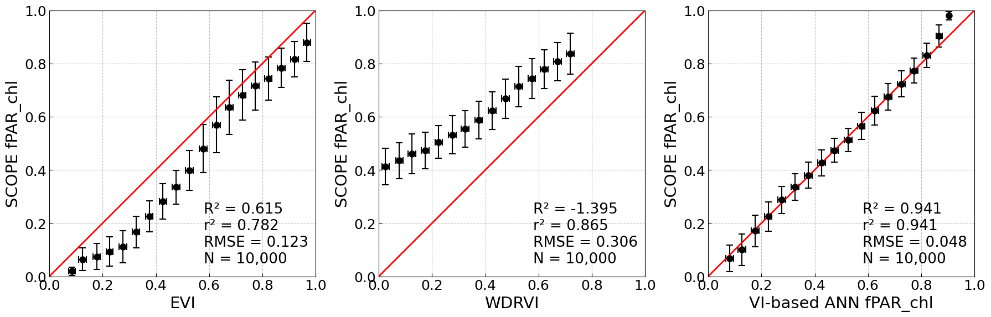
2.3 fPARchl calculation
fPAR_{chl} = (1-PAR_{albedo}) × ξ_{chl}
Leaf-scale fPAR Calculation
Leaf- to Canopy-scale
Converting factor

Slide 18
2.4. Statistical / ML model
Correlation analysis
Pearson correlation
Partial correlation (controlling for APAR_{chl})
Multi-site integration
Correlation analysis:
- Weighted correlation (weights ∝ 1/n per site, equalizing site contribution)
Generalized Additive Models
Φ = 𝑠(PAR) + 𝑠(Kt) + 𝜀 (Ta (°C): [20-30], VPD (kPa): [0.5-2.0])
Φ = 𝑠(Ta) + 𝑠(VPD) + 𝜀 (PAR: [Light saturated], Kt: [0.5-1.0])
Notes:
We first used correlation and partial correlation analyses to test whether the SIF–GPP relationship remains after accounting for APAR. Additionally, to examine how each yield responds to environmental drivers, we applied Generalized Additive Models. This is necessary. because PAR, temperature, VPD, and Kt are strongly correlated under natural conditions. A simple regression cannot separate their individual effects. GAMs allow us to evaluate the partial effect of each driver. To further reduce confounding, we limited the environmental range before fitting each model.

Slide 19
3. Results
Notes:
Now let me show you the results.

Slide 20
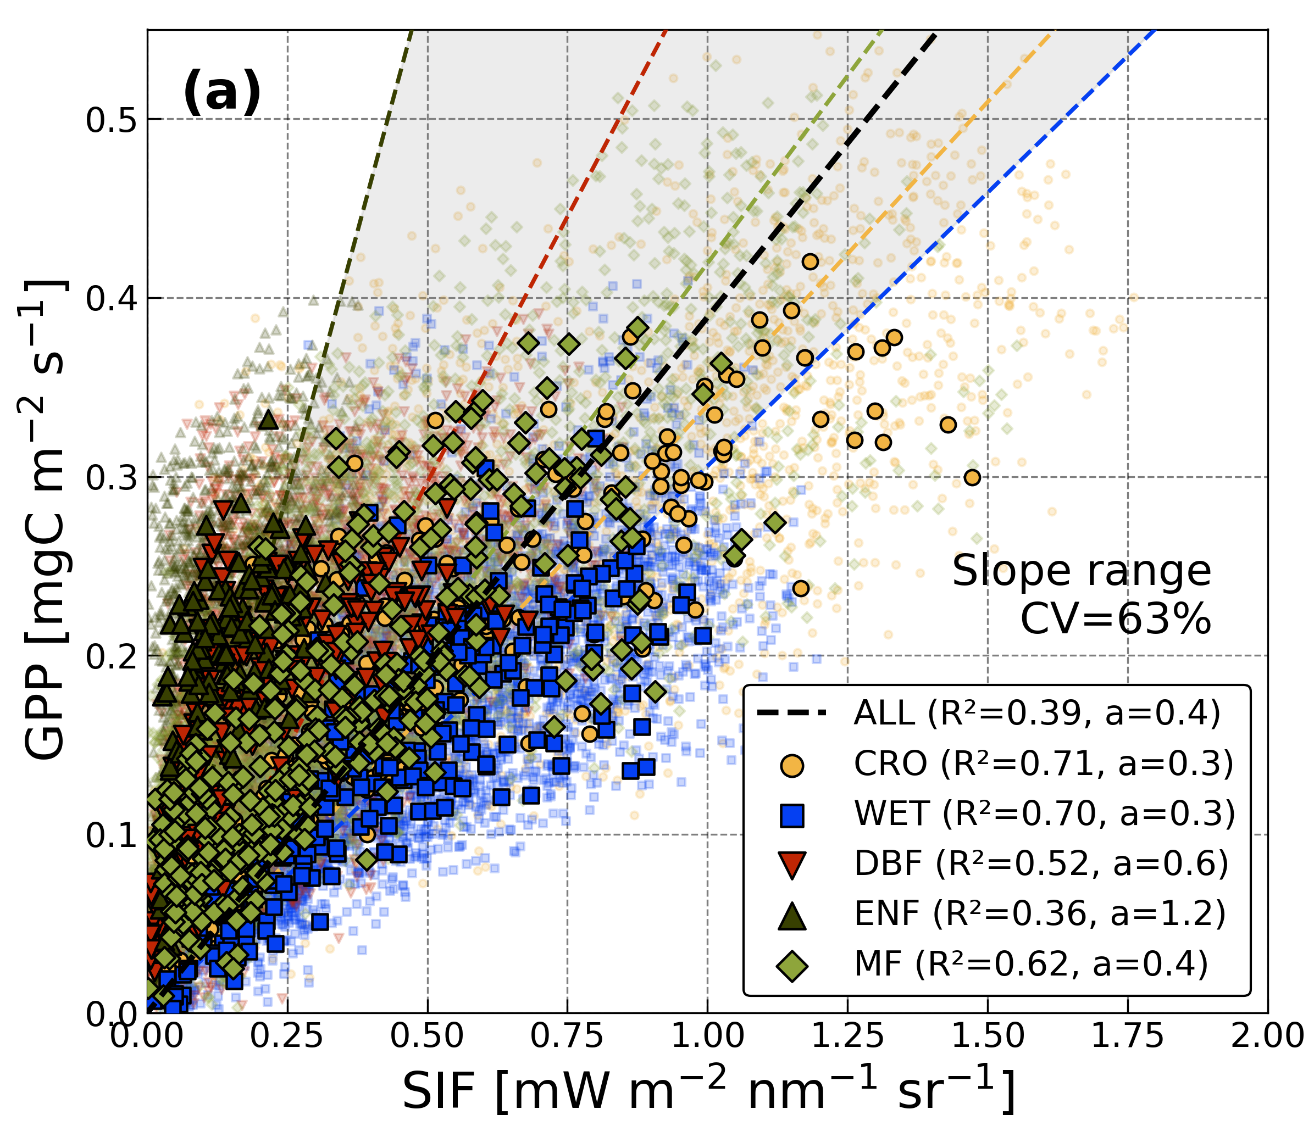
Result 1. SIF and GPP diverge for different reasons
Notes:
First, we examine the SIF–GPP relationship across five ecosystems. All sites show a positive correlation, but the slopes differ among ecosystems. This indicates that a single linear model cannot describe the relationship universally.

Slide 21
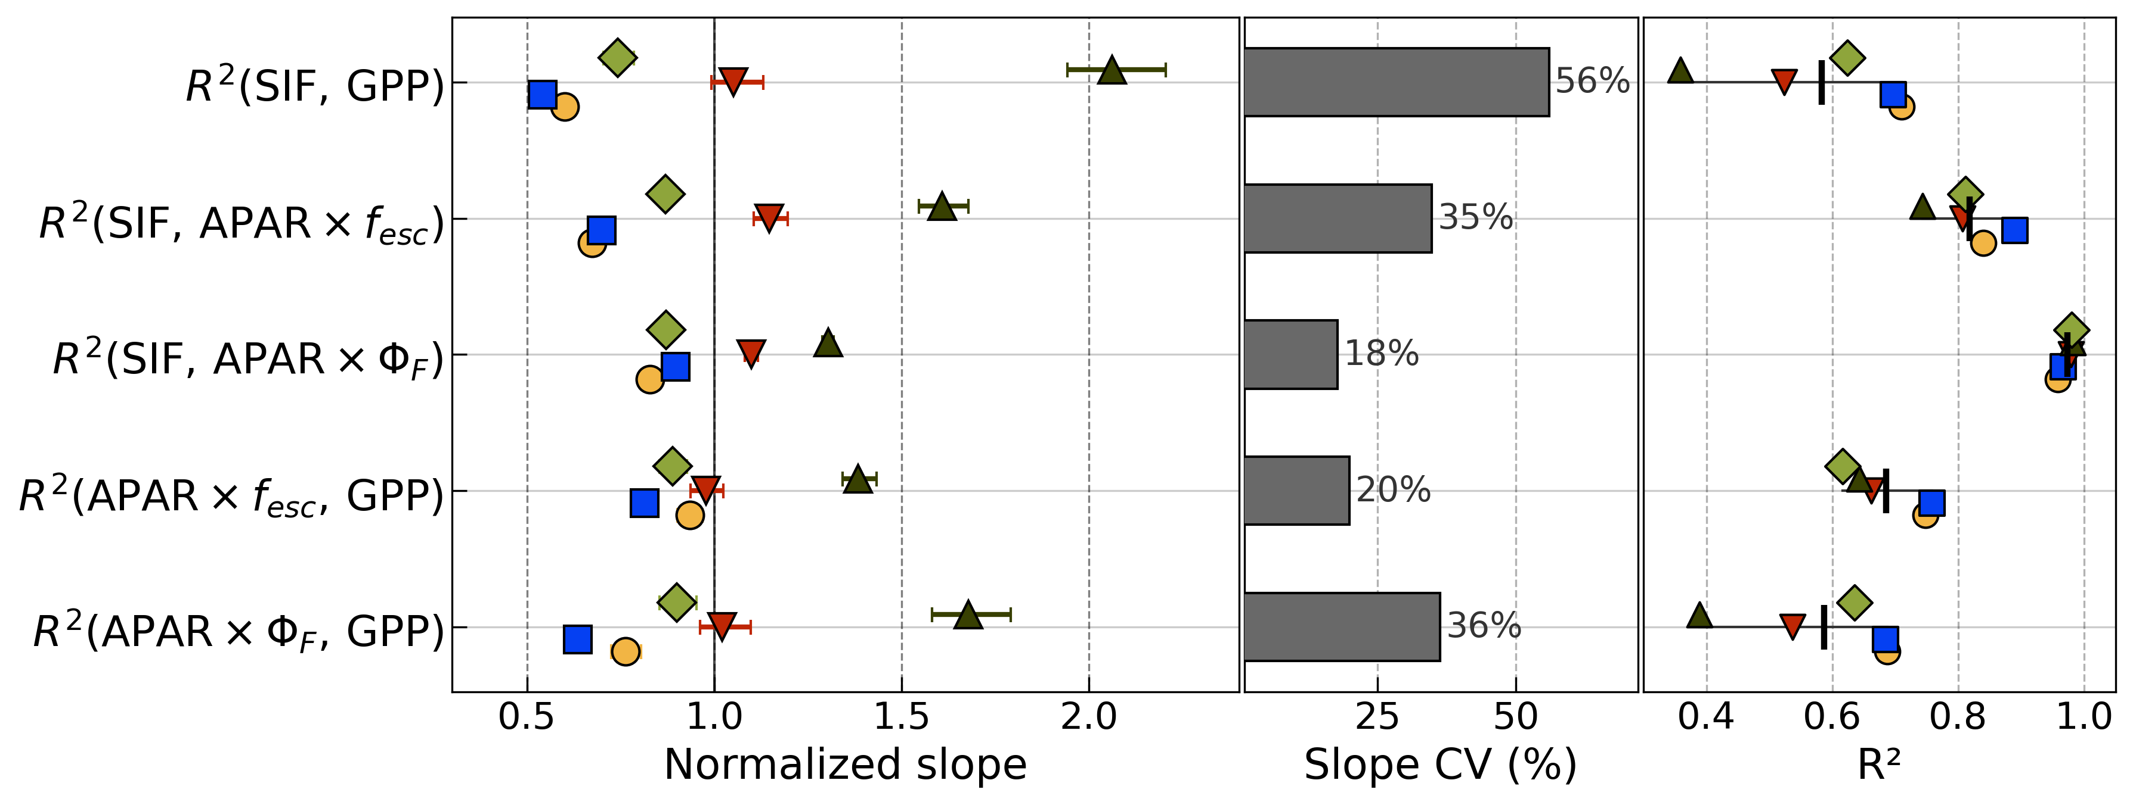
Result 1. SIF and GPP diverge for different reasons
PFT
divergence
SIF <- Structure
GPP <- physiology
SIF_{structure} = APAR X f_{esc}
SIF_{physiology} = APAR X Φ_{F}
Notes:
To use SIF as an independent photosynthetic variable rather than simple GPP proxy, we decomposed the SIF to GPP relationship into structural and physiological components. Across ecosystems, differences in SIF are largely driven by the structural term, Fesc, while fluorescence yield remains relatively stable. In contrast, differences in GPP are mainly driven by physiological variation. Because their cross-ecosystem drivers differ, the observed SIF–GPP correlation is unlikely to arise from ΦF–ΦP coupling.

Slide 22
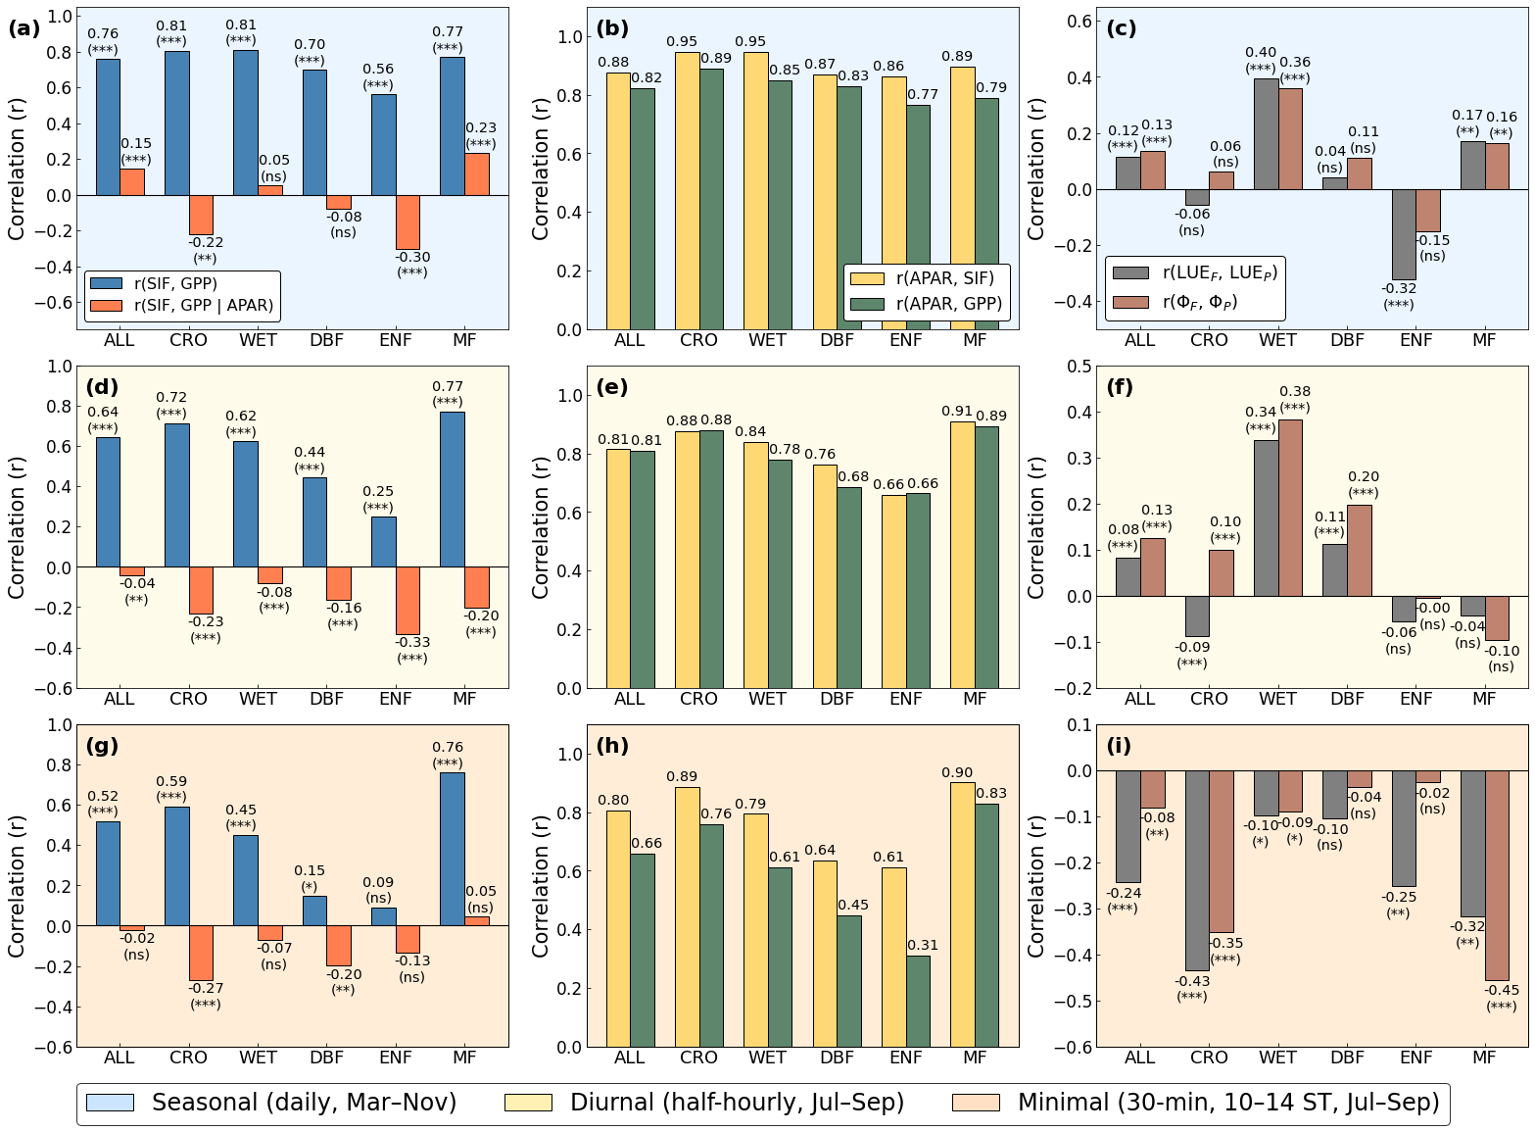
Result 2. Shared APAR explains the correlation
Seasonal
(Daily, Mar-Nov)
Notes:
We tested this directly. At the seasonal scale, SIF and GPP are strongly correlated. However, when we control for APAR, the correlation drops to near zero or even reverses. APAR is strongly correlated with both SIF and GPP, but the ΦF–ΦP correlation is weak or non-significant.

Slide 23
Result 2. Shared APAR explains the correlation
Seasonal
(Daily, Mar-Nov)
SIF~APAR : ↓
GPP~APAR : ↓ ↓ ↓
Midday [10-14 ST]
(Half-hourly, Jun-Aug)
Notes:
At the midday scale, the pattern becomes clearer. The SIF–GPP correlation weakens. The APAR–GPP relationship declines more strongly than the APAR–SIF relationship. As a result, ΦF and ΦP show a negative correlation at most sites.

Slide 24
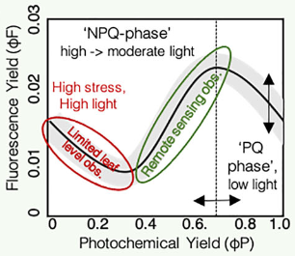
Result 2. Shared APAR explains the correlation
Seasonal
(Daily, Mar-Nov)
Midday [10-14 ST]
(Half-hourly, Jun-Aug)
Notes:
According to energy partitioning theory, our midday data should be into the NPQ-dominated phase, where ΦF and ΦP are expected to increase or decrease together. However, we observe a negative relationship between ΦF and ΦP, even under non-stressed conditions. This means that processes at the canopy scale change the behavior we expect from leaves.

Slide 25
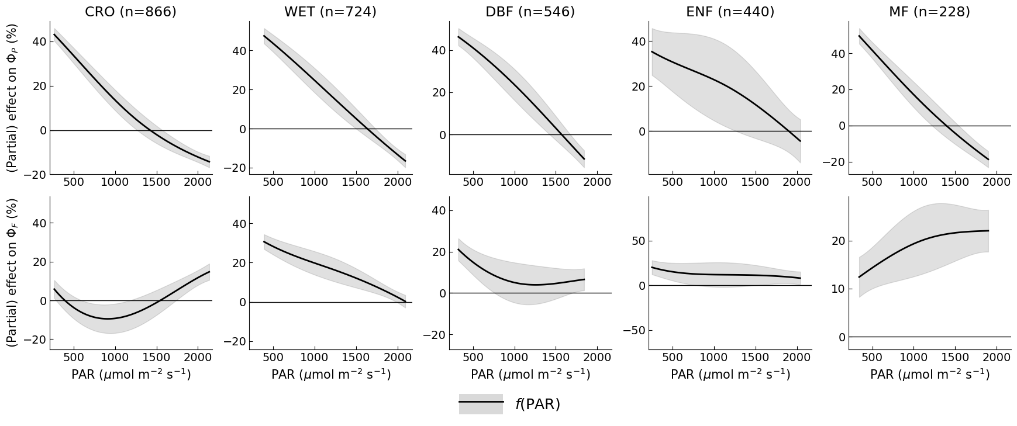
Result 3. Canopy light regime reshapes ΦF
Legend
GAM: Φ = y(PAR) + ε
ΔCanopy-ΦP
ΔCanopy-ΦF
Ta (°C): [20-30], VPD (kPa): [0.5-2.0]
Notes:
To understand what causes this canopy-scale divergence, we first looked at the PAR effect on each yield using GAMs. For ΦP, the pattern is consistent across all ecosystems: it decreases as PAR increases.
For ΦF, however, the response differs among ecosystems. Some sites show a decrease or a non-linear pattern even non-stressed condition.

Slide 26
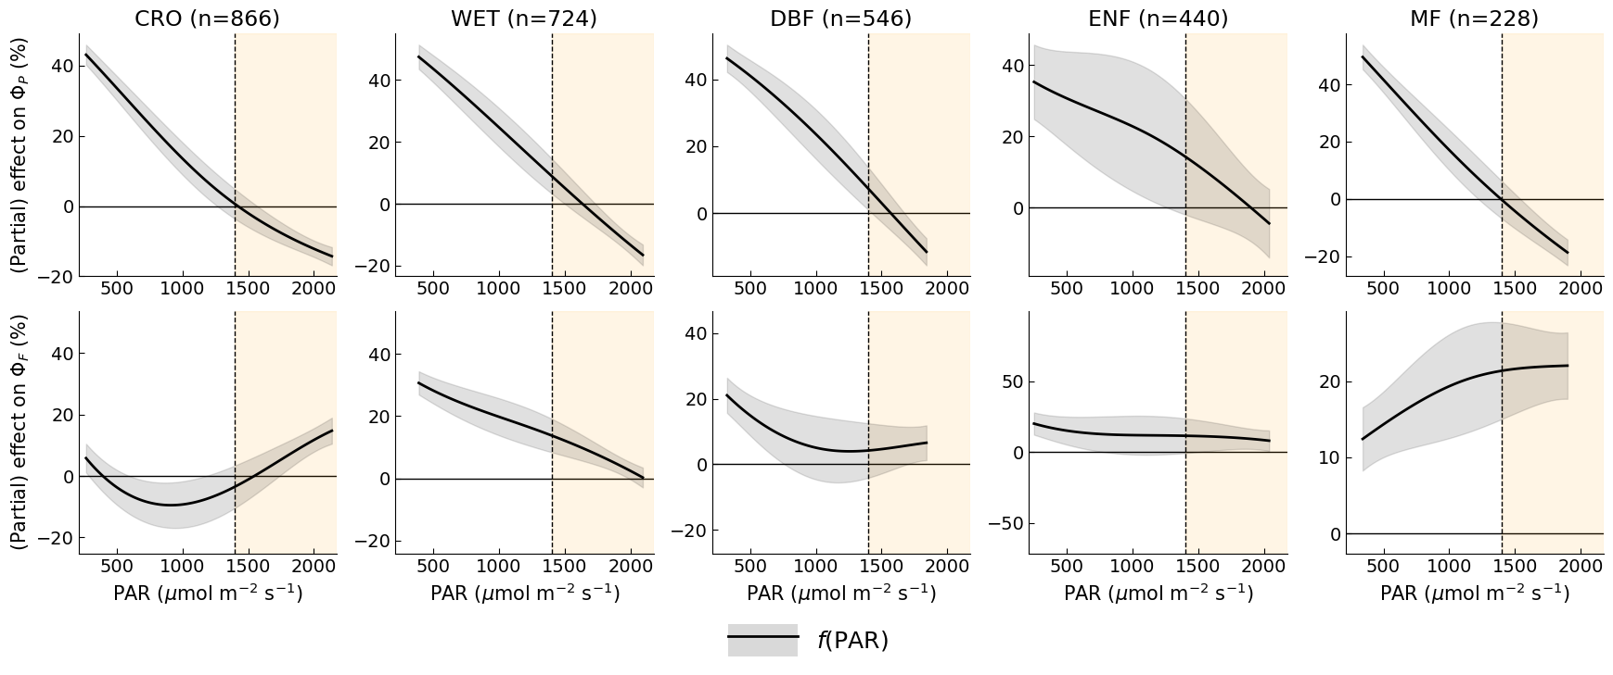
Result 3. Canopy light regime reshapes ΦF
Legend
GAM: Φ = y(PAR) + ε
Midday
ΔCanopy-ΦP
ΔCanopy-ΦF
Ta (°C): [20-30], VPD (kPa): [0.5-2.0]
Notes:
When we focus on the midday range, the divergence becomes clearer. Under high light conditions — around 1500 µmol m⁻² s⁻¹, which does not represent severe stress — ΦF increases or shows little decline with increasing PAR. This behavior is consistent with the negative ΦF–ΦP relationship

Slide 27
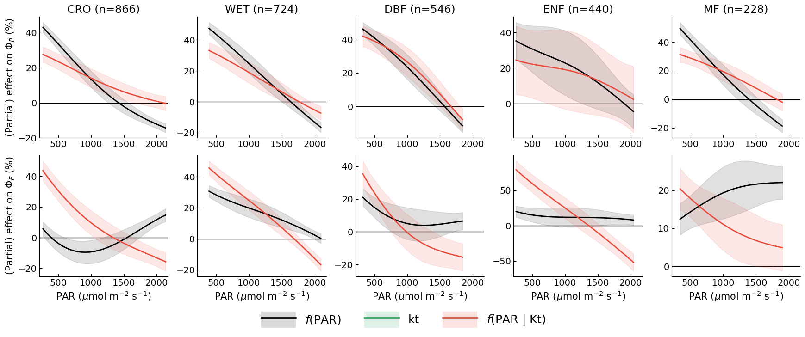
Result 3. Canopy light regime reshapes ΦF
Legend
GAM: Φ = y(PAR) + ε
GAM: Φ = y(PAR) + y(Kt) + ε
ΔCanopy-ΦP
ΔCanopy-ΦF
Ta (°C): [20-30], VPD (kPa): [0.5-2.0]
Notes:
To separate the pure effect of PAR from canopy light regime, we included Kt in the model. As mentioned earlier, Kt represents canopy light heterogeneity by balance between sunlit and shaded leaves. For ΦP, the overall declining pattern remains unchanged. For ΦF, however, the non-monotonic behavior disappears, and all sites show a consistent downward trend with increasing PAR. This shows that the apparent PAR response of ΦF was strongly shaped by canopy light heterogeneity. What we found is that, after accounting for canopy light heterogeneity, ΦF reveals a clearer physiological response, which is essential for using SIF as an independent photosynthetic variable rather than a GPP proxy.

Slide 28
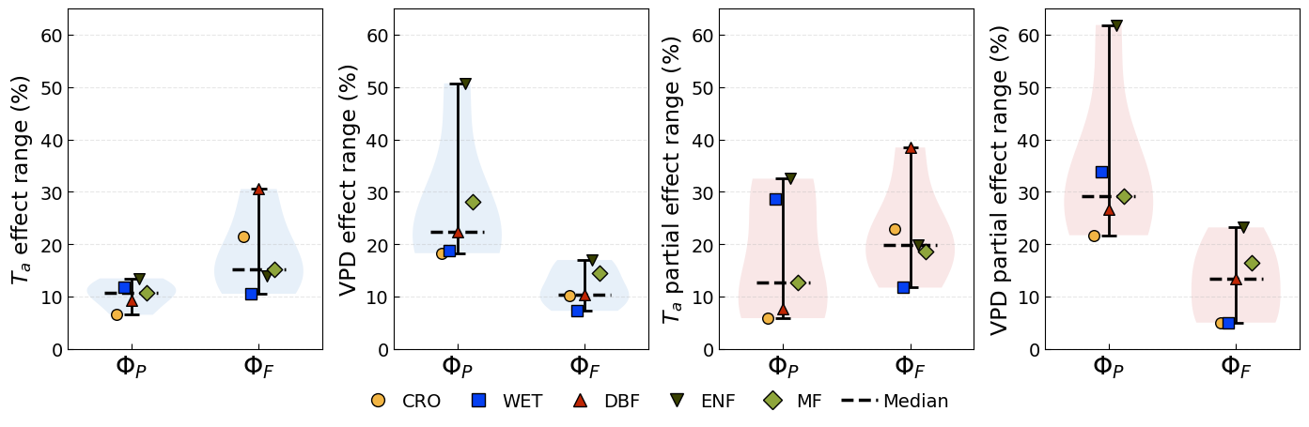
Result 4. ΦF is buffered from environmental stress
Φ = y(Ta) + ε
Φ = y(VPD) + ε
Φ = y(Ta) + y(VPD) + ε
Δ
Δ
Δ
Δ
Δ
Δ
Δ
Δ
PAR: [Light saturation condition], Kt: [0.5-1.0]
Notes:
Finally, we tested how ΦP and ΦF respond to environmental stress. But result was not good. Because environmental conditions are very different across sites and we focused on a narrow peak-season range, statistical power was limited. Even so, ΦF variations are much smaller than ΦP, typically within about 10-20%.

Slide 29
Take home message
Across five ecosystems, the apparent SIF–GPP relationship is primarily driven by shared APAR absorption rather than ΦF–ΦP coupling.
Canopy light heterogeneity reshapes the apparent light response of ΦF, but once structural effects are accounted for, ΦF reveals a clearer physiological signal by PAR then stomatal stress.
Although ΦF shows a weaker sensitivity to environmental stress than ΦP, it retains distinct physiological information without canopy structural effect, supporting the use of SIF as an independent photosynthetic variable beyond a simple GPP proxy.
Notes:
To summarize. First, the apparent SIF-GPP correlation across five ecosystems is driven by shared APAR absorption. Once APAR is removed, the ΦF-ΦP correlation weakens or reverses.
Second, ΦF is attenuated at canopy scale through two pathways. Canopy light regime reshapes its apparent response to PAR. And environmental stress signals that reach ΦP are dampened in ΦF.
Third, SIF carries physiological information, but this information is attenuated at canopy scale. Accounting for this attenuation is essential to use SIF beyond a simple GPP proxy.

Slide 30
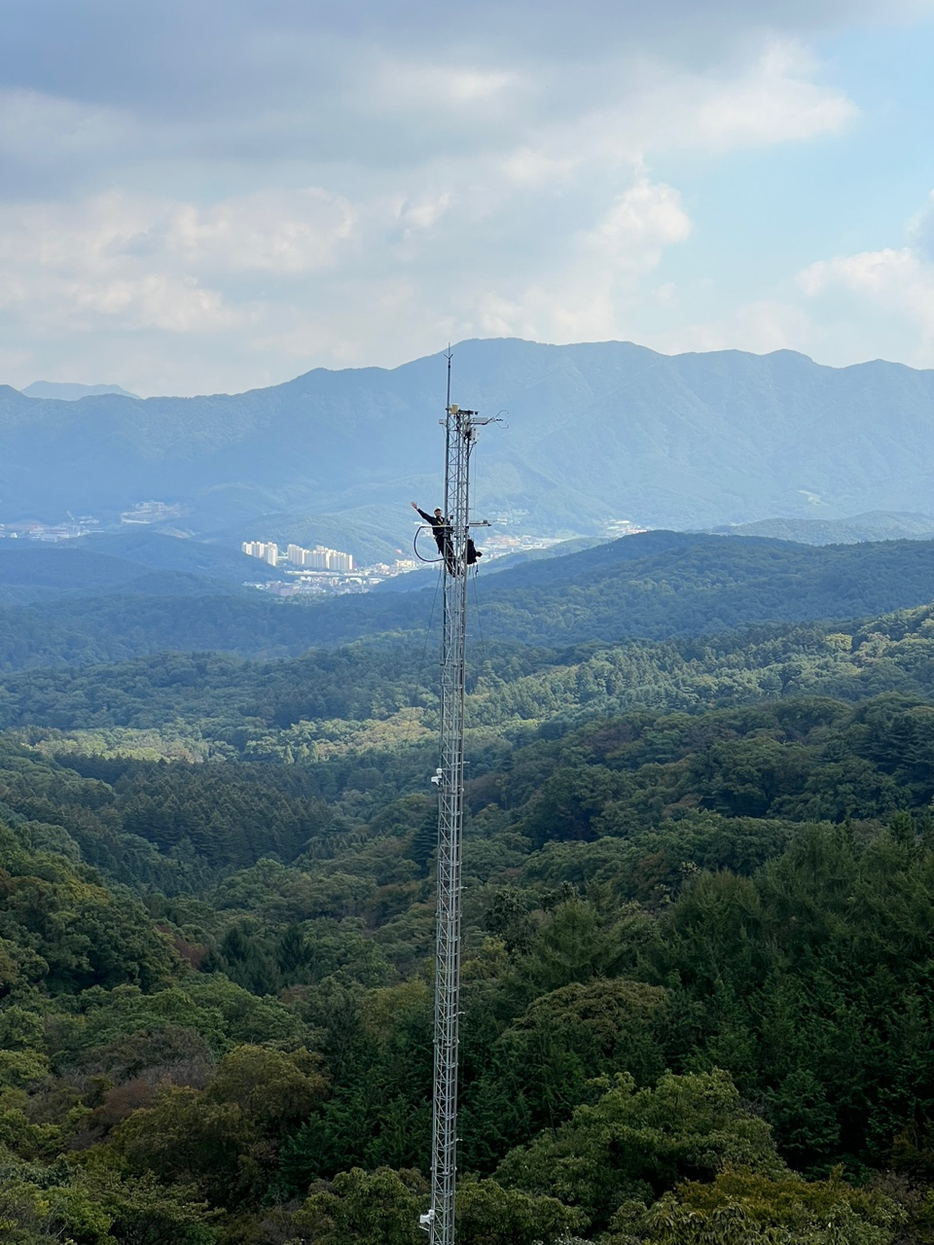
Thank you
Jeongho Lee
PhD candidate
Interdisciplinary Program in Agricultural and Forest Meteorology
Seoul National University, Republic of Korea
Office location: 200-9203 (Gwanak Campus)
E-mail : jeongho.public@gmail.com
phone : 82-10-3230-8638

Slide 31
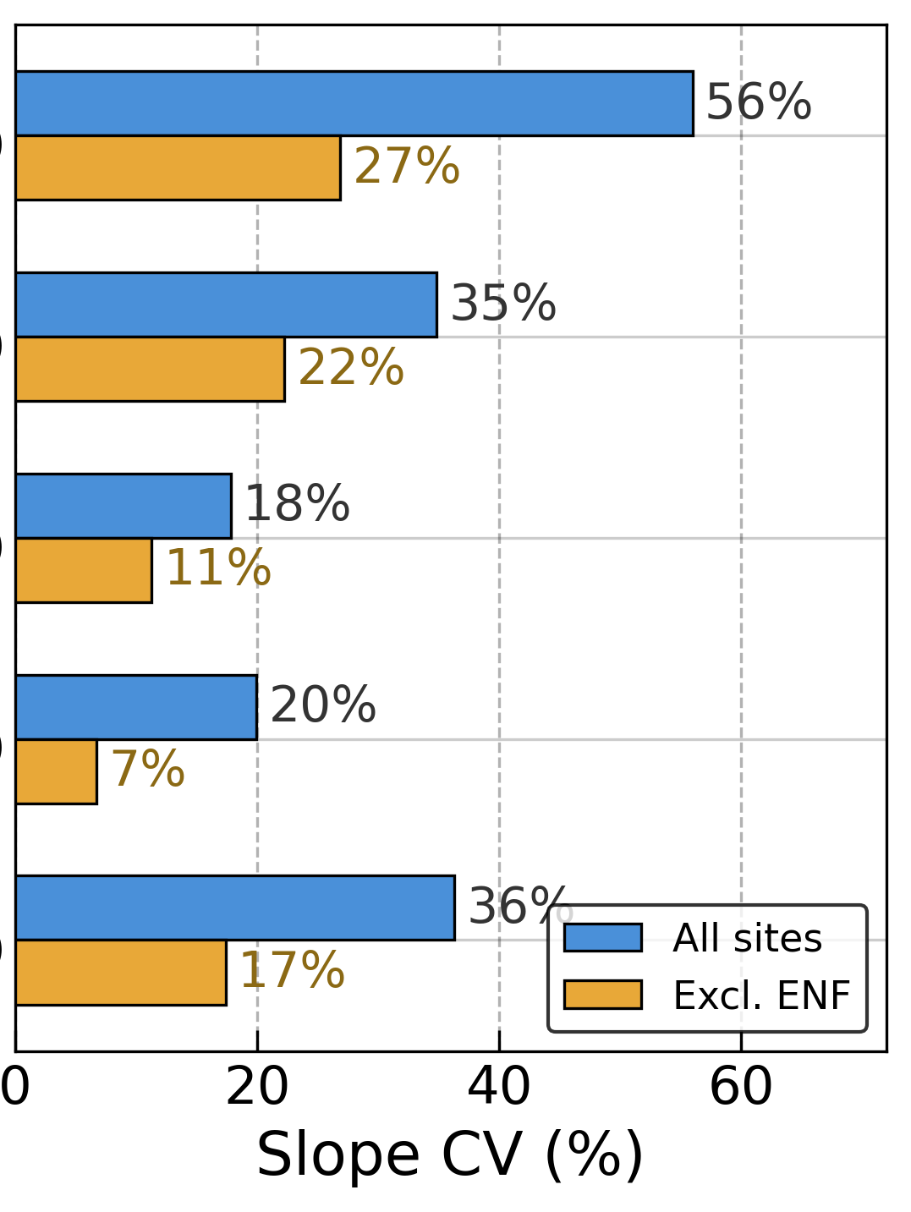
Appendix

Slide 32
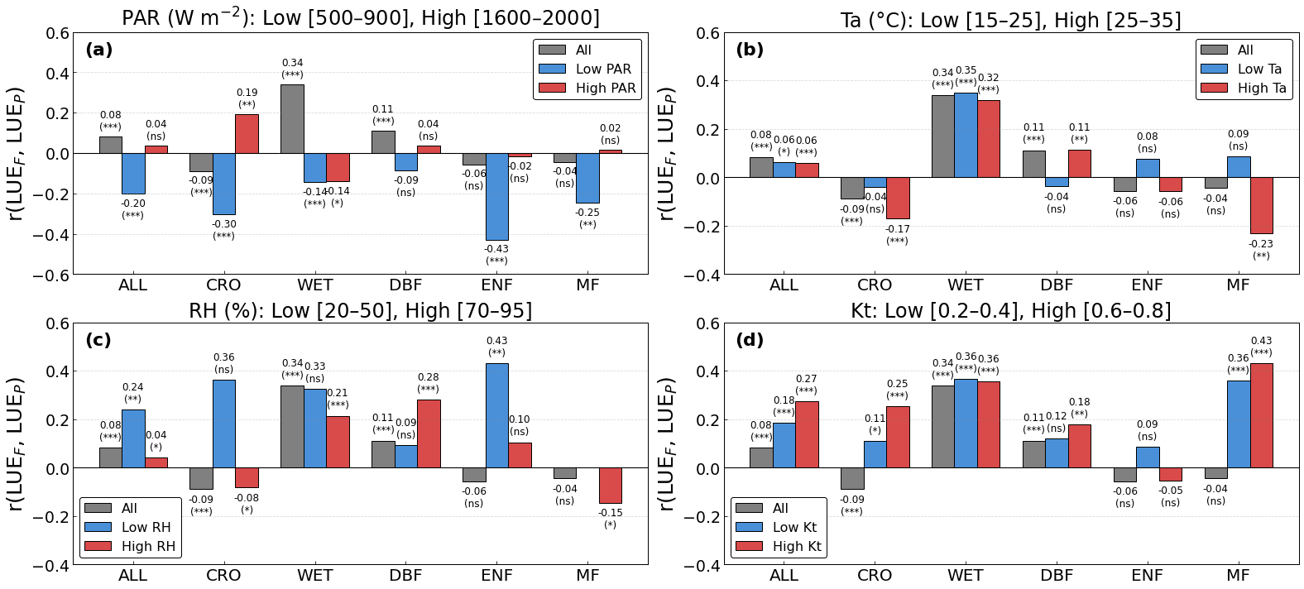
Appendix

Slide 33
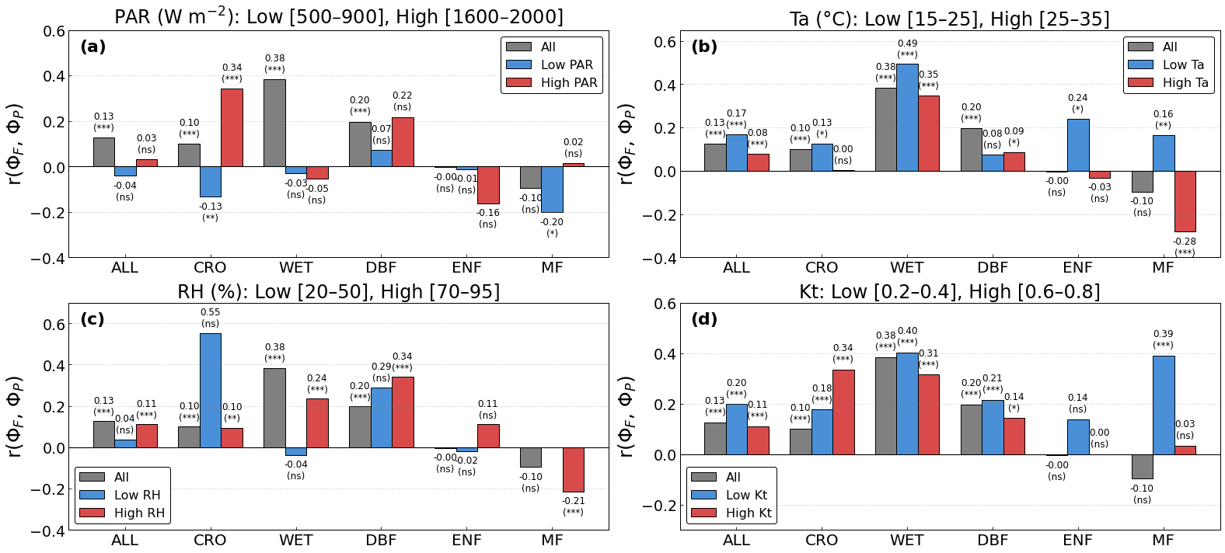
Appendix

Slide 34
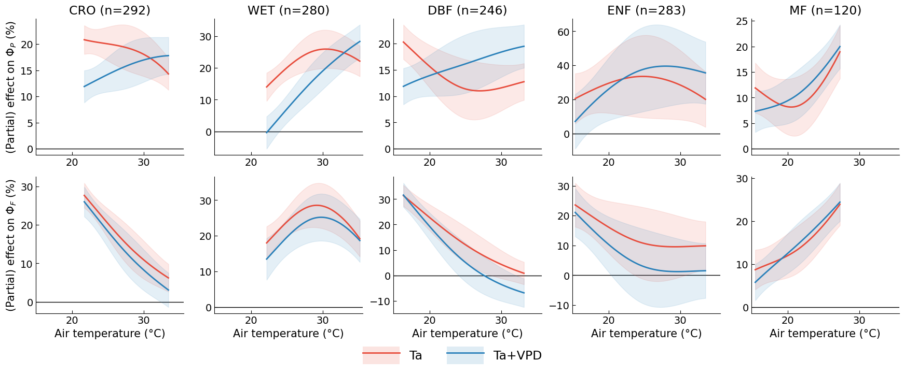
Appendix

Slide 35
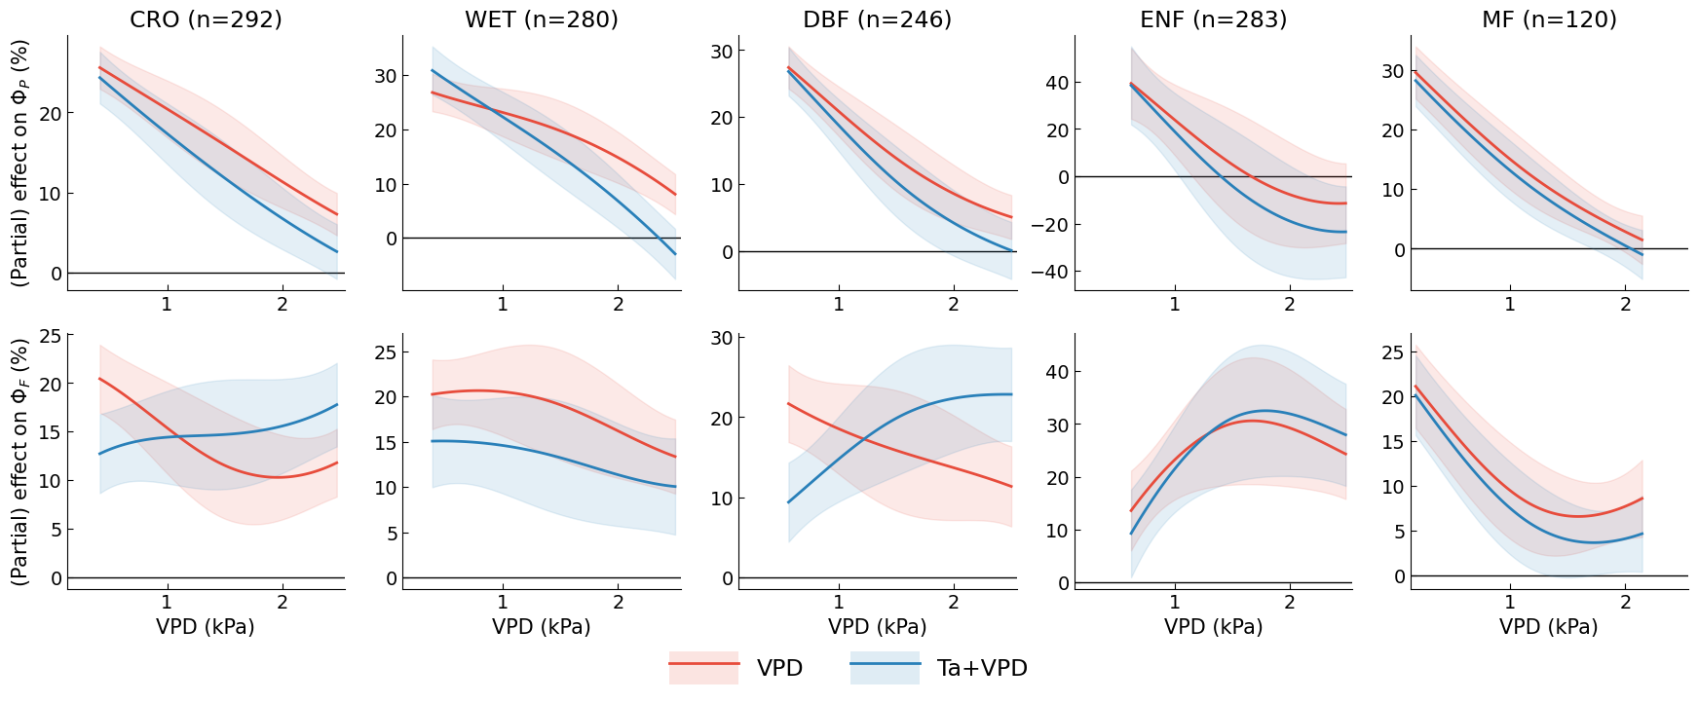
Appendix

Slide 36
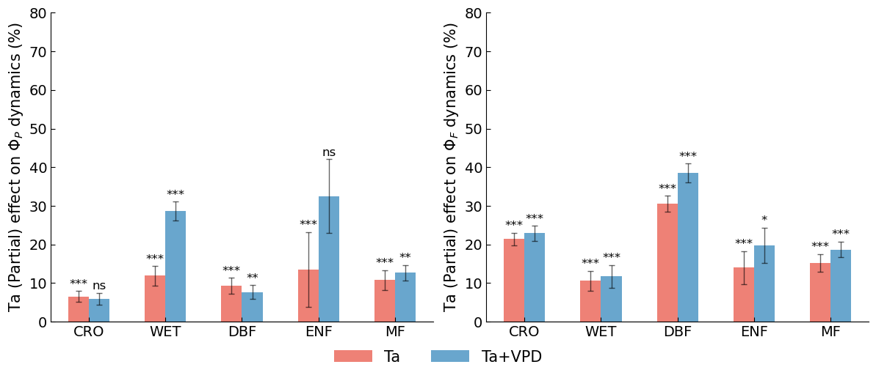
Appendix

Slide 37
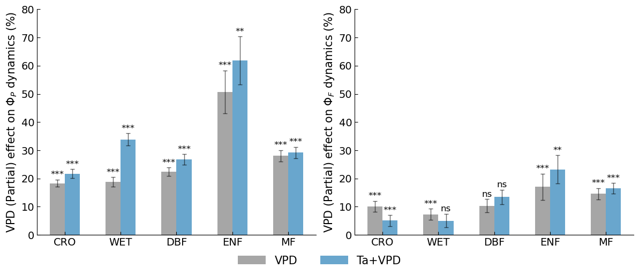
Appendix

Slide 38
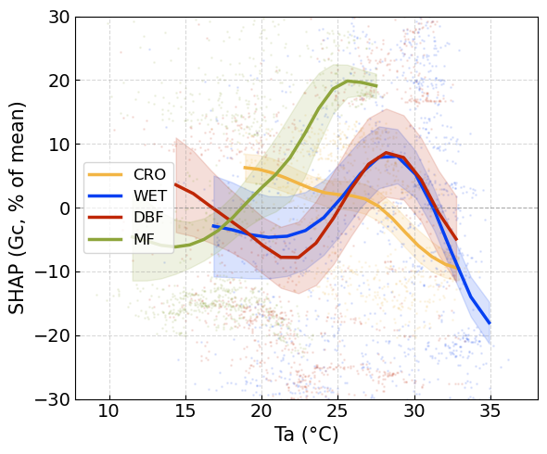
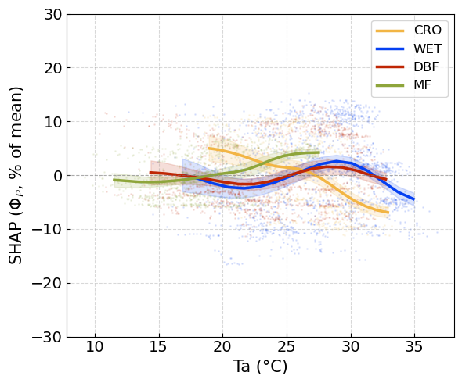
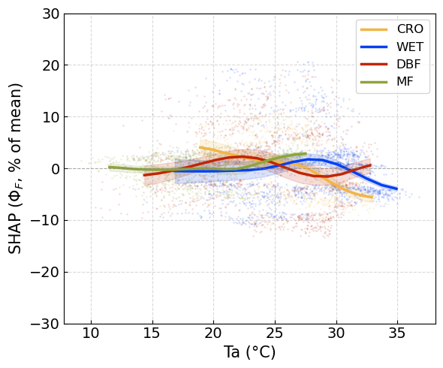
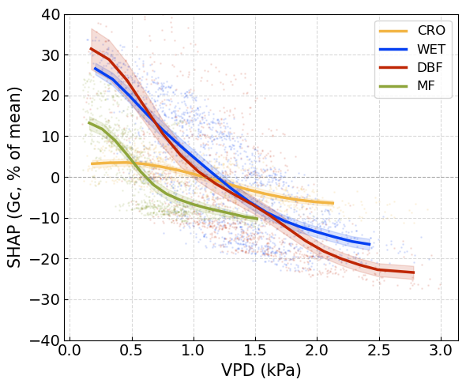
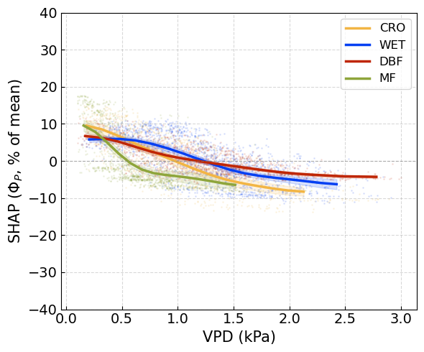
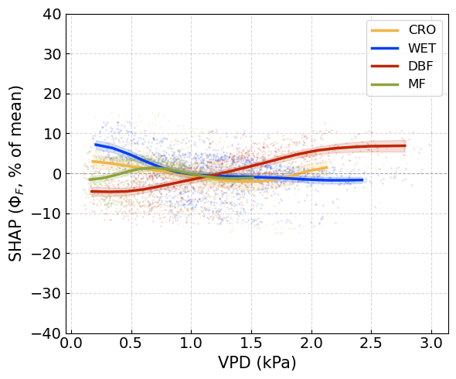
Appendix. XGBoost Result

Slide 39
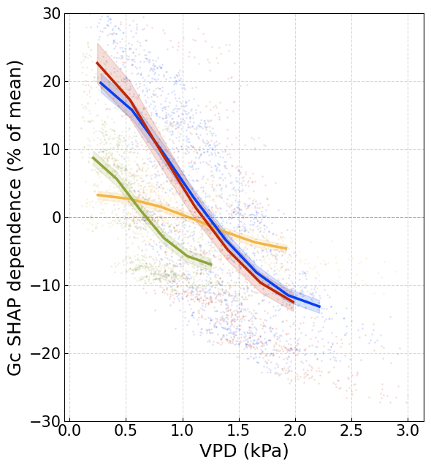
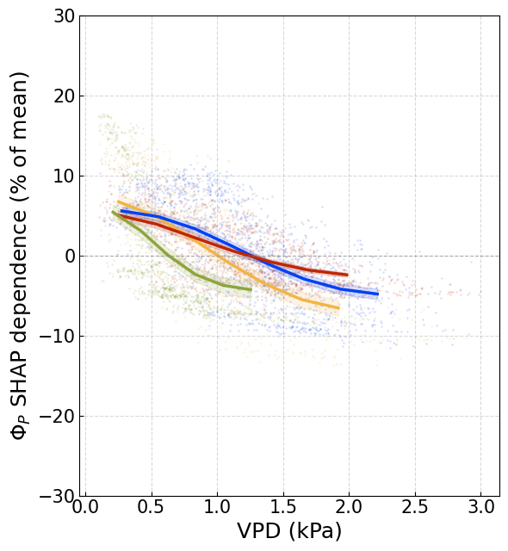
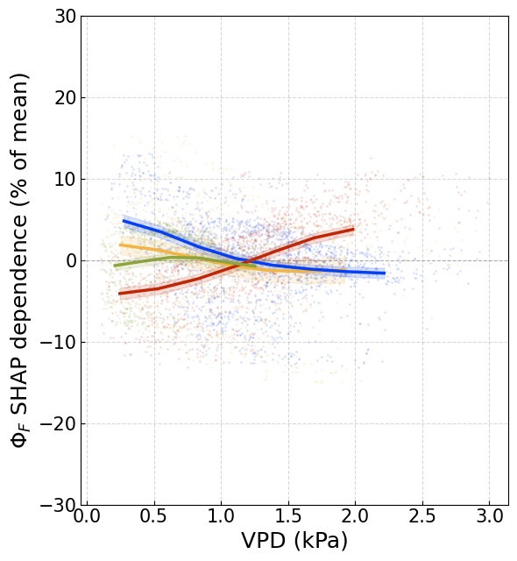
Appendix. XGBoost Result

Slide 40
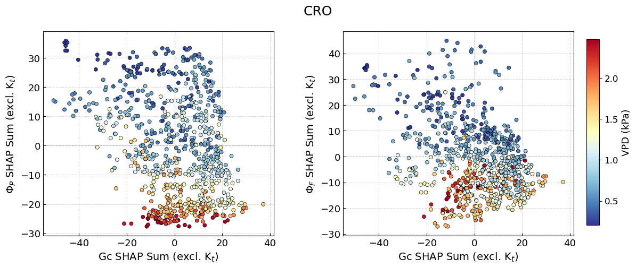
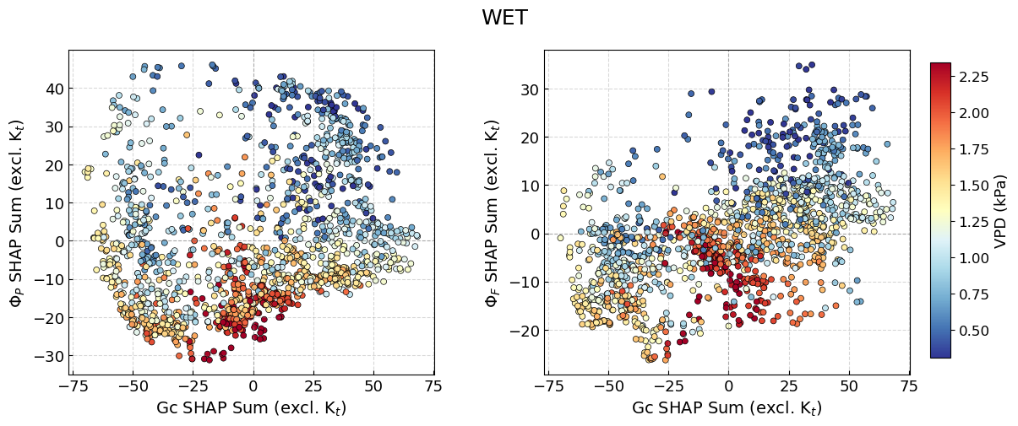
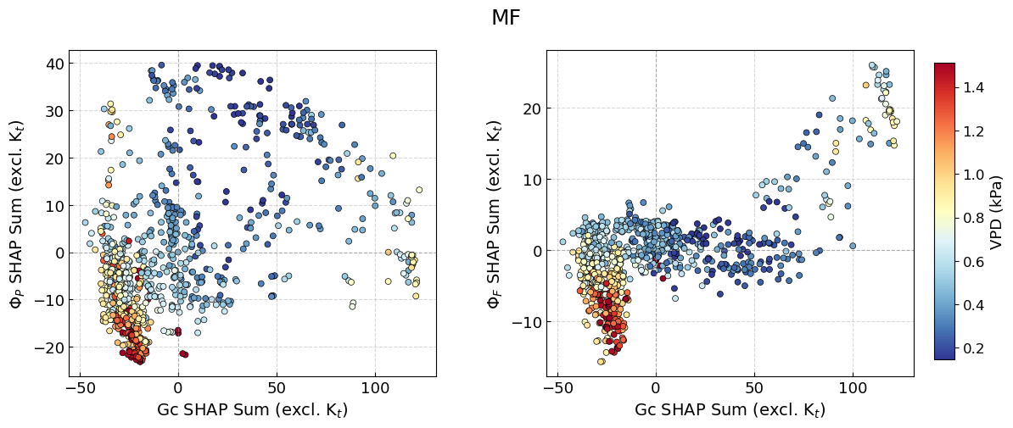
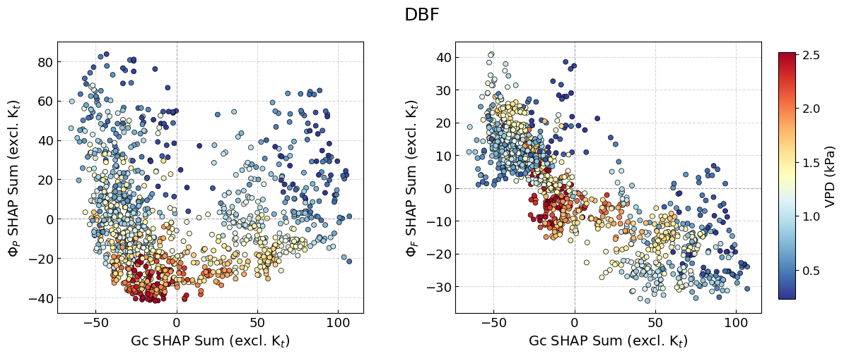
Appendix. XGBoost Result

Slide 41
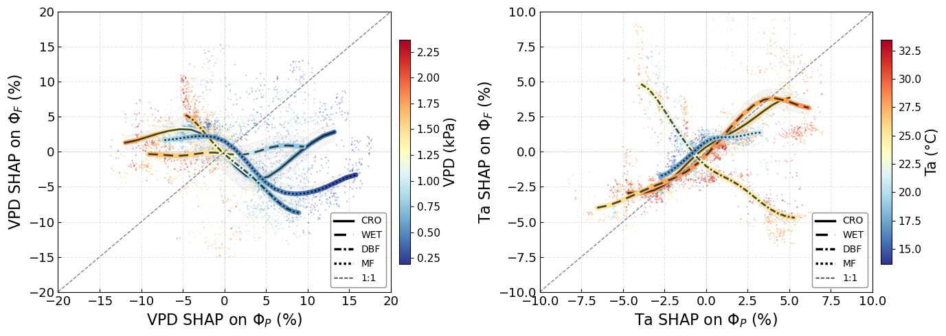
Appendix. XGBoost Result

Slide 42
Summary
PAR
(APAR)
VPD
Ta
Energy partitioning
Gs
qL
qL
Ci
Rubisco
Non-monotonic relationship
PhiP
PhiF
ETR
Notes:
Let me bring these results together. PAR, or APAR, strongly regulates both SIF and GPP. This is consistent across theory and observation, from leaf to canopy scale. The right side of this schematic shows that VPD and temperature modulate ΦP through stomatal conductance and the photosynthetic chain. But the effect on ΦF is dampened. This is what we confirmed in our results.

Slide 43
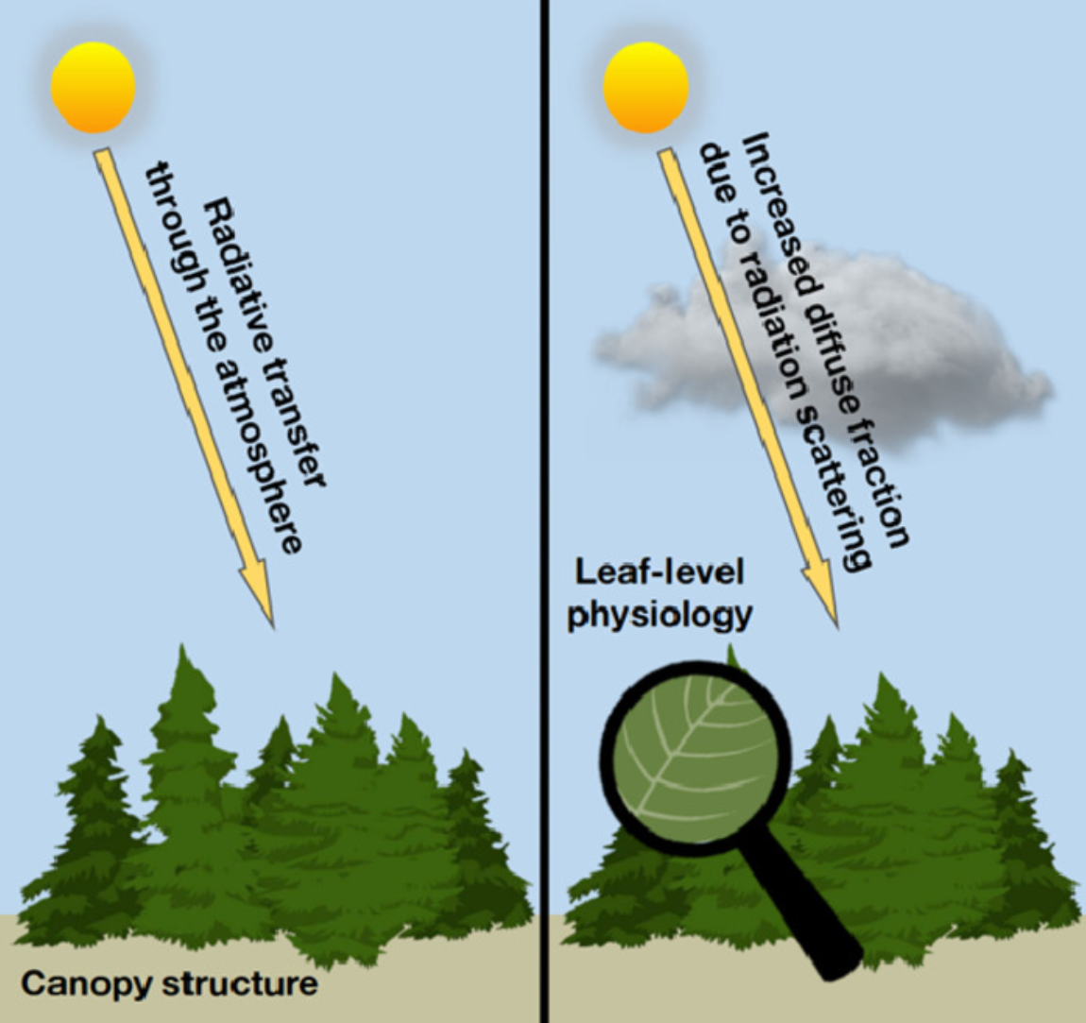
Summary
PAR
(APAR)
VPD
Ta
Diffuse fraction
⊗
Canopy structure
Energy partitioning
Gs
qL
Ci
Rubisco
Non-monotonic relationship
PhiP
PhiF
ETR
(Durand et al., AFM, 2021)
Notes:
However, at canopy scale, a new dimension of complexity emerges. Diffuse fraction interacts with canopy structure to reshape how light is distributed within the canopy. This pathway does not exist at the leaf level. Our results show that this canopy light regime substantially alters the apparent response of ΦF. To use SIF as an independent photosynthetic parameter beyond a simple GPP proxy, accounting for this canopy-scale complexity is essential.
I should note two limitations. The temperature and VPD ranges differ across our sites, so the stress responses may not be directly comparable. Also, we did not separate the Kt effect in the stress analysis, so these two pathways may still interact in ways we have not fully resolved.

