Slide 1




Can extracting fluorescence efficiency from individual TROPOMI observations result in a better estimation of drought stress than gridded products?
Qiqi Deng, Daniel E. Pabon Moreno, Zhaoying Zhang, Georg Wohlfahrt, Gregory Duveiller

Slide 2
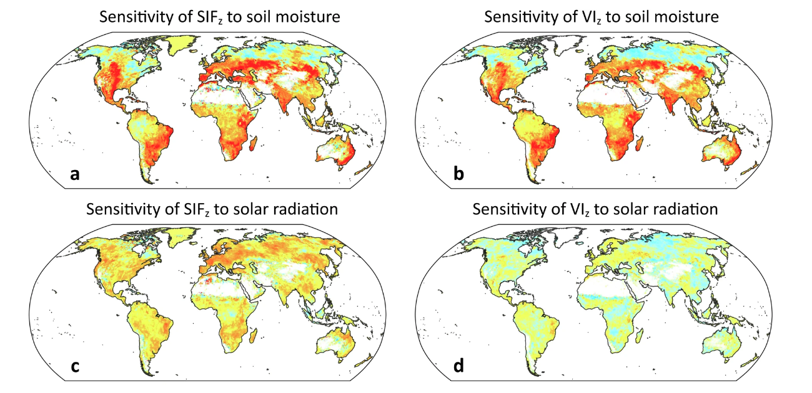
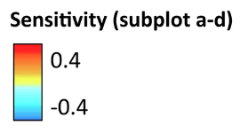
Sensitive response compare with VIs
(Zhao et al., Communications Earth & Environment, 2025)

Slide 3
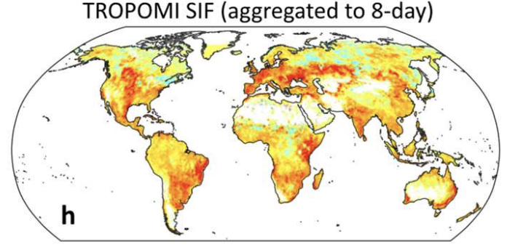
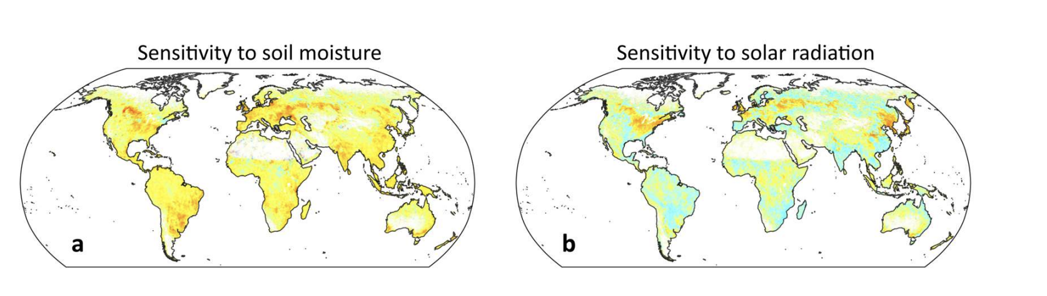
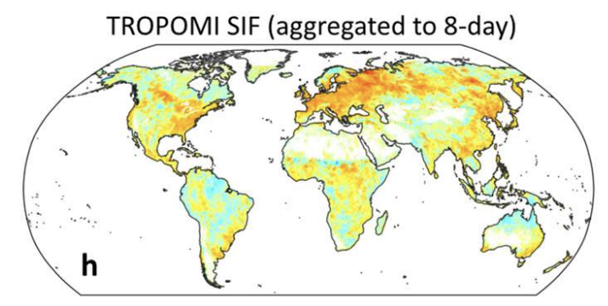
Weaker performance in daily scale
8-day
(Zhao et al., Communications Earth & Environment, 2025)

Slide 4
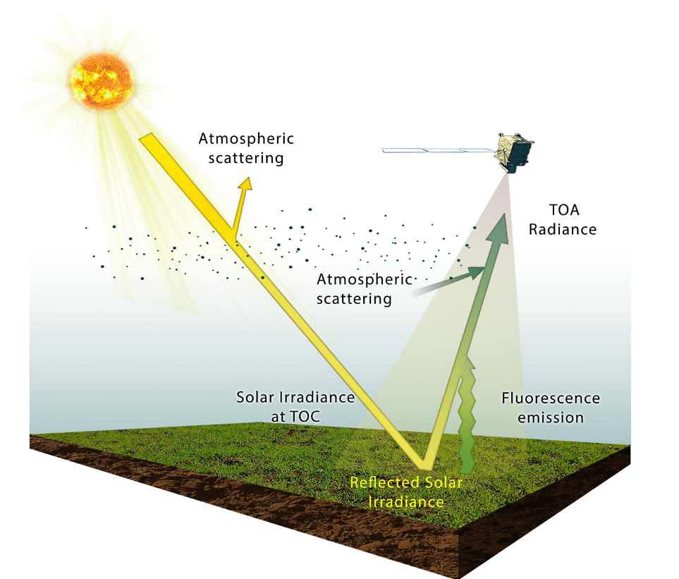

Complexity of SIF observation
From Leaf - Canopy - Space
Illumination condition and Plant health: SIF_{total}
Canopy structure: escaped SIF_{total}
Other: atmospheric condition, geometrics: captured, escaped SIF_{total}
$$∅F$$
$${SIF}_{obs}=f(Radiation, Canopy structure, Plant physiology, other)$$

Slide 5
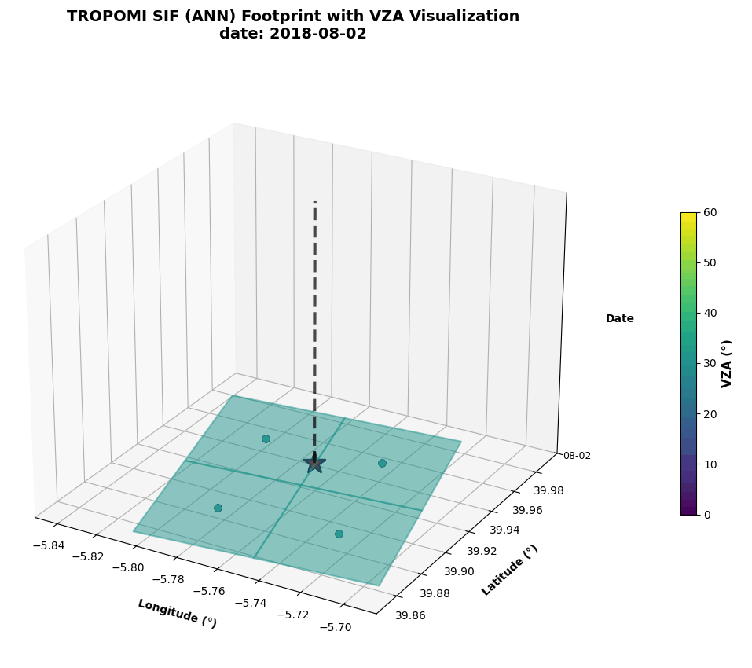
TROPOMI SIF footprint dynamics
Las Majadas

Slide 6
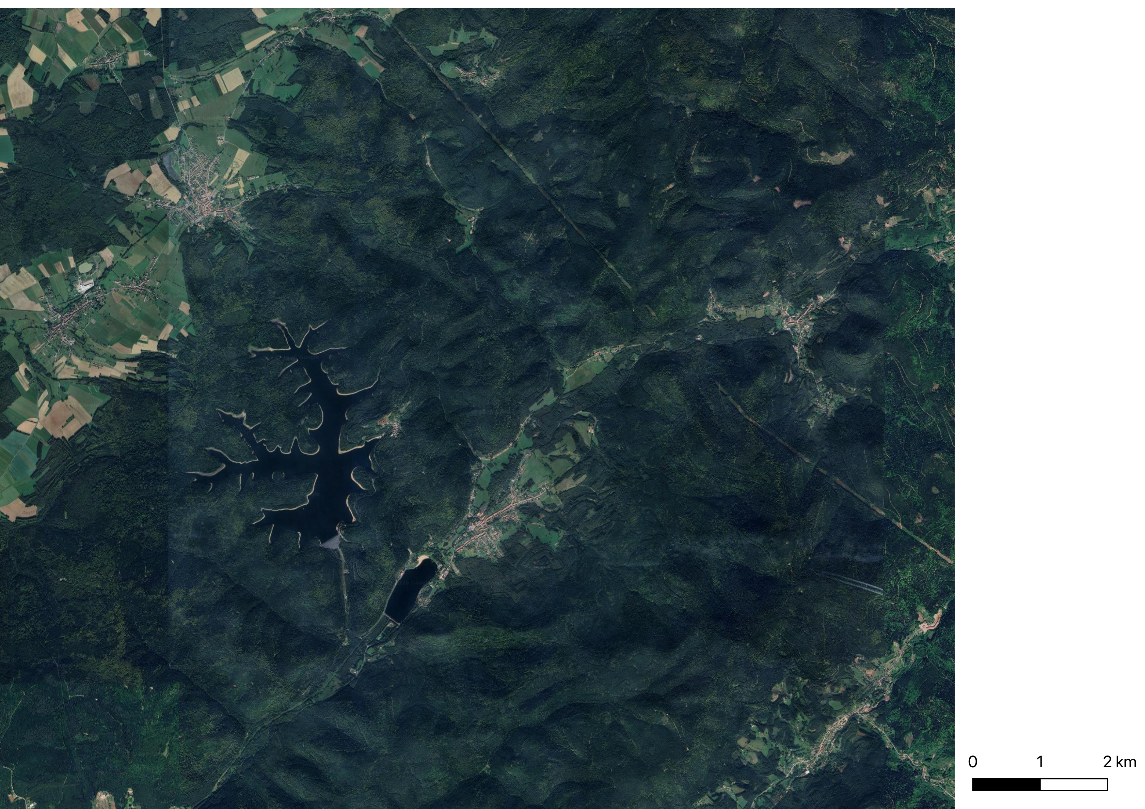
TROPOMI SIF footprint dynamics
T0
Different overpassing time
From 11:00~14:00
Illumination condition
Contents of canopy structure
T1

Slide 7
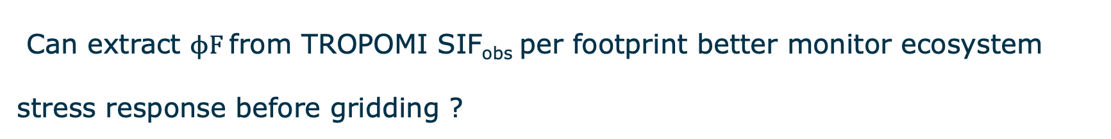
Research question
Can extract $ϕF$from TROPOMI SIF_{obs} per footprint better monitor ecosystem stress response before gridding ?

Slide 8
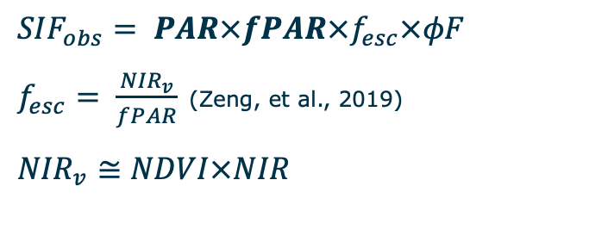

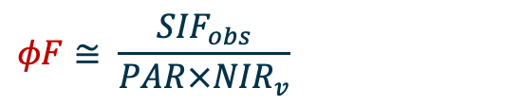
SIF yield extraction
$${SIF}_{obs}=f(Radiation, Canopy structure, Plant physiology, other)$$
Spatial Resolution: 40km ~ 300m
Time Resolution: monthly ~ daily
$${SIF}_{obs}= PAR×fPAR×f_{esc}×φF$$
$f_{esc}= \frac{{NIR}_{v}}{fPAR}$ (Zeng, et al., 2019)
${NIR}_{v}≅NDVI×NIR$
$$φF≅ \frac{{SIF}_{obs}}{PAR×{NIR}_{v}}$$
$$→$$
Canopy structure:
Spatial Resolution: 10m ~ 500m
Time Resolution: 5-16 day
Illumination condition:
Spatial Resolution: 5km, 10km
Time Resolution: 15min, hourly

Slide 9
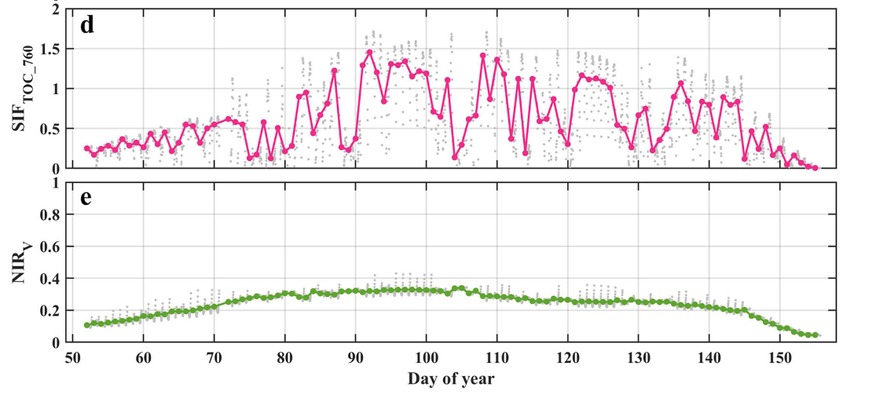
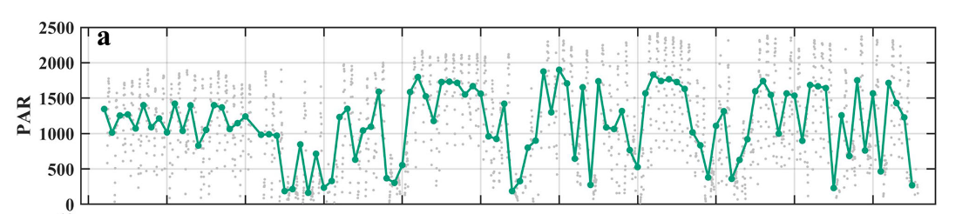
Our assumption
Spatial Resolution: Medium
Time Resolution: Medium
Spatial Resolution: Coarse
Time Resolution: Fine
Spatial Resolution: Fine
Time Resolution: Coarse
(Guo et al., 2024, Agricultural and Forest Meteorology)

Slide 10
Datasets
Obs. Vars | Source | Time Resolution | Spatial Resolution | Spatial coverage | Ref.
SIF_{far-red} | S5P TROPOMI | daily | 3.5*5.5 km (7.5) | Global
 | SIF ANN |  |  |  | (Li et al., 2025)
 | SIF ESA |  |  |  | (Guanter et ak., 2021)
 | SIF Caltech |  |  |  | (Frankenburg et al., 2018)
PAR | MSG | 15min | 0.05 (~5km) | Africa, Europe
 | ERA5-Land | hourly | 0.1 (~ 10km) | Global
NIRv | Sentinel 2 | 5-day | 10m (depending on wavelength) | Global
 | Sentinel 3 | 10-day | 300m | Global
 | MODIS | 16-day | 100~500m | Global

Slide 11
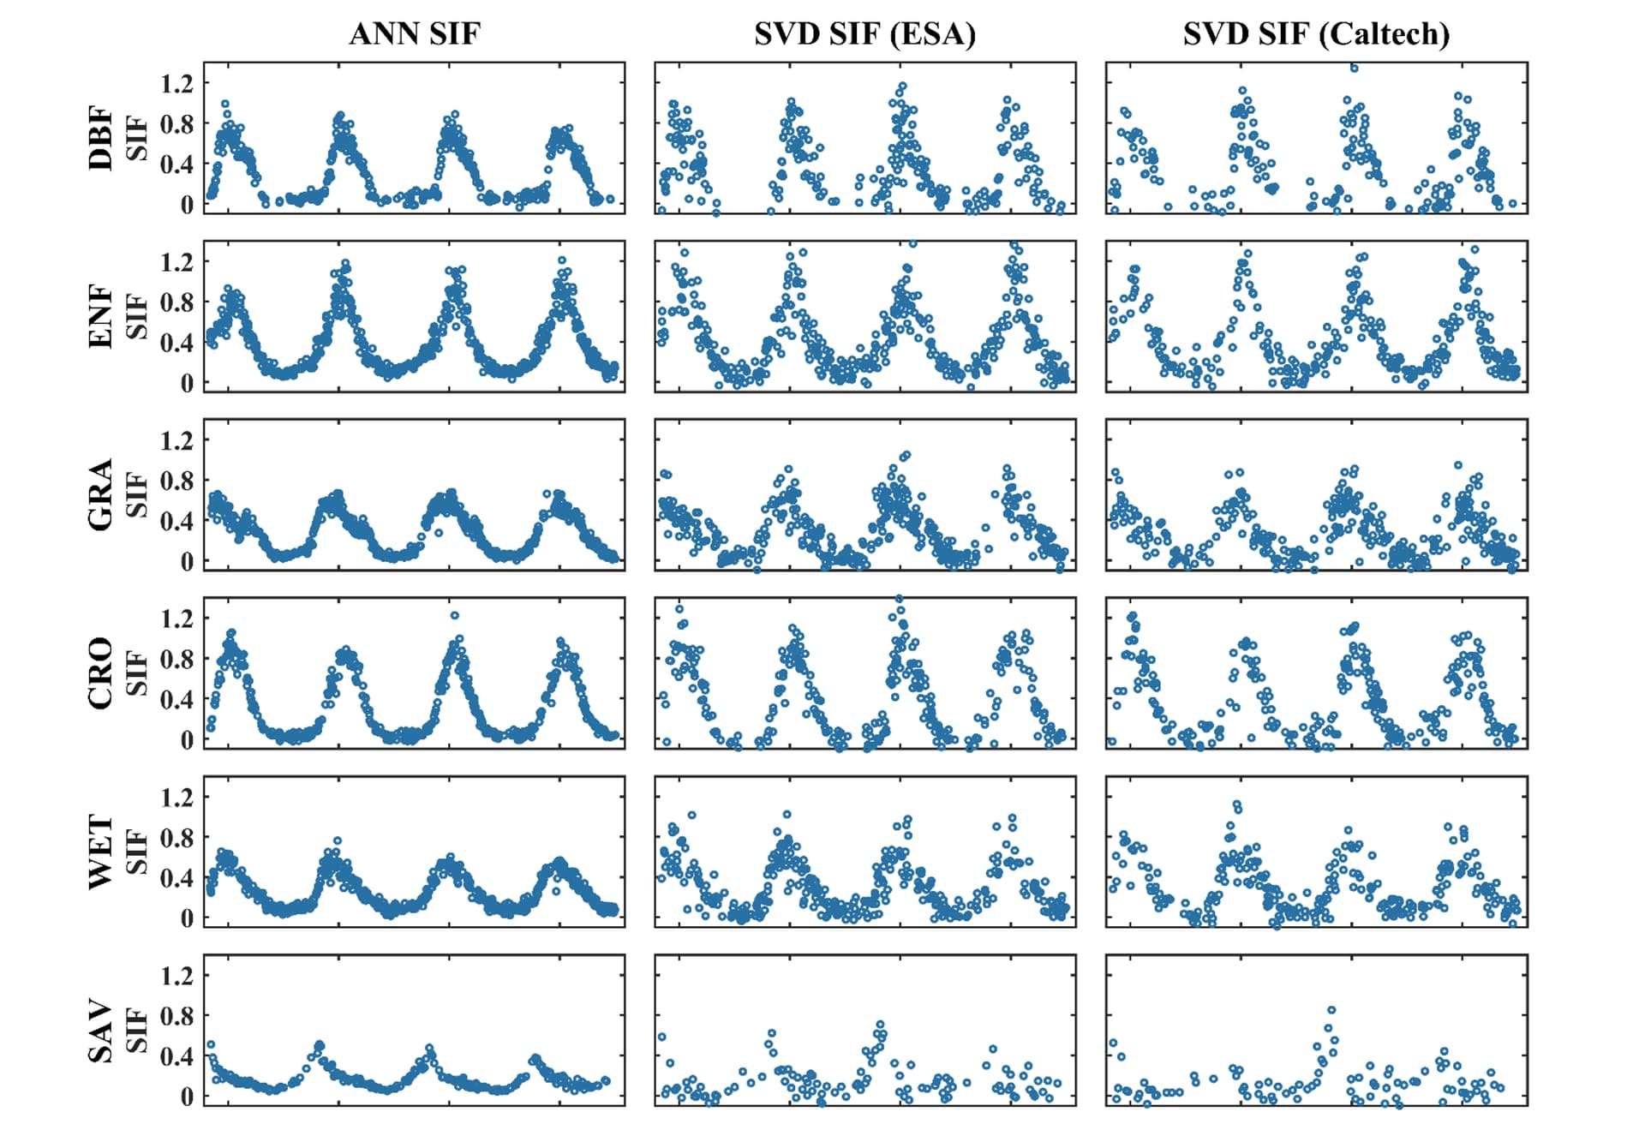
Different retrieved SIF products
(Li et al., RSE, 2025)

Slide 12
Datasets
Obs. Vars | Source | Time Resolution | Spatial Resolution | Spatial coverage | Ref.
SIF_{far-red} | S5P TROPOMI | daily | 3.5*5.5 km (7.5) | Global
 | SIF ANN |  |  |  | (Li et al., 2025)
 | SIF ESA |  |  |  | (Guanter et ak., 2021)
 | SIF Caltech |  |  |  | (Frankenburg et al., 2018)
PAR | MSG | 15min | 0.05 (~5km) | Africa, Europe
 | ERA5-Land | hourly | 0.1 (~ 10km) | Global
NIRv | Sentinel 2 | 5-day | 10m (depending on wavelength) | Global
 | Sentinel 3 | 10-day | 300m | Global
 | MODIS | 16-day | 100~500m | Global

Slide 13

Compare different combination of SIF yields
Direct Compare
Other SIF yield products
$$φF ≅ \frac{{SIF}_{obs}}{PAR×NIRv}$$
Test
Extreme events

Slide 14
SIF yield product by ML methods
Spatiotemporal Continuous SIF yield
  Extracted by MODIS - FCVI and SIF_{obs}
  Use ST- Tensor to interpolate in daily resolution
(Z.Y. Zhang et al., under review)

Slide 15

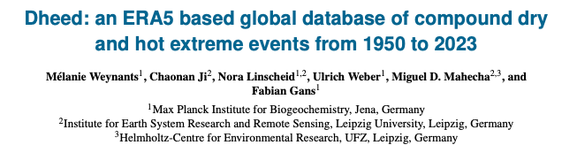
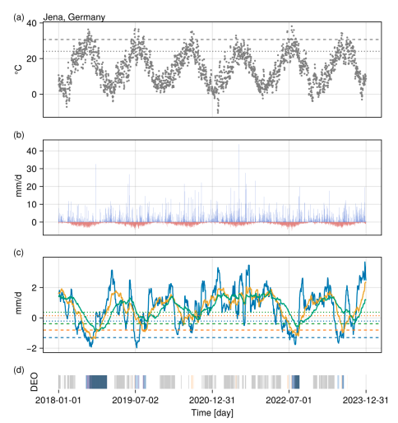
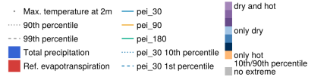
Dheed
Compound hot and dry (CHD) extreme events
ERA5-Land, 0.1°, 1950-2023
Define CHD event by meteorological variables
Minimum duration: 3 days

Slide 16
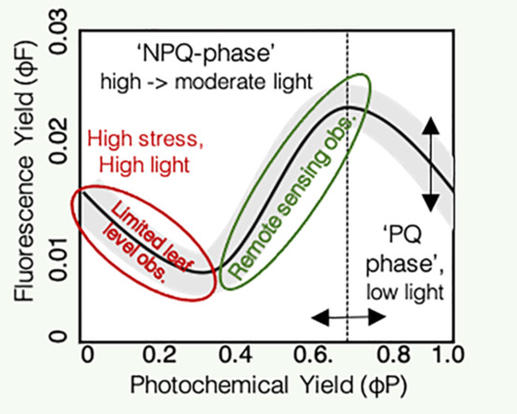
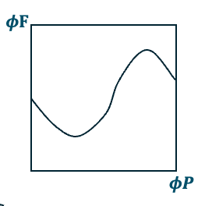

Possible SIF yield response to stress
Define vegetation stress response as: $φP$ decrease
Stress period
$$φF$$
t

Slide 17


Satellite observed patterns
$$φF$$
Stress period
$$φF$$
Stress period
t
t
Notes:
After-noon depression
Stress response

Slide 18
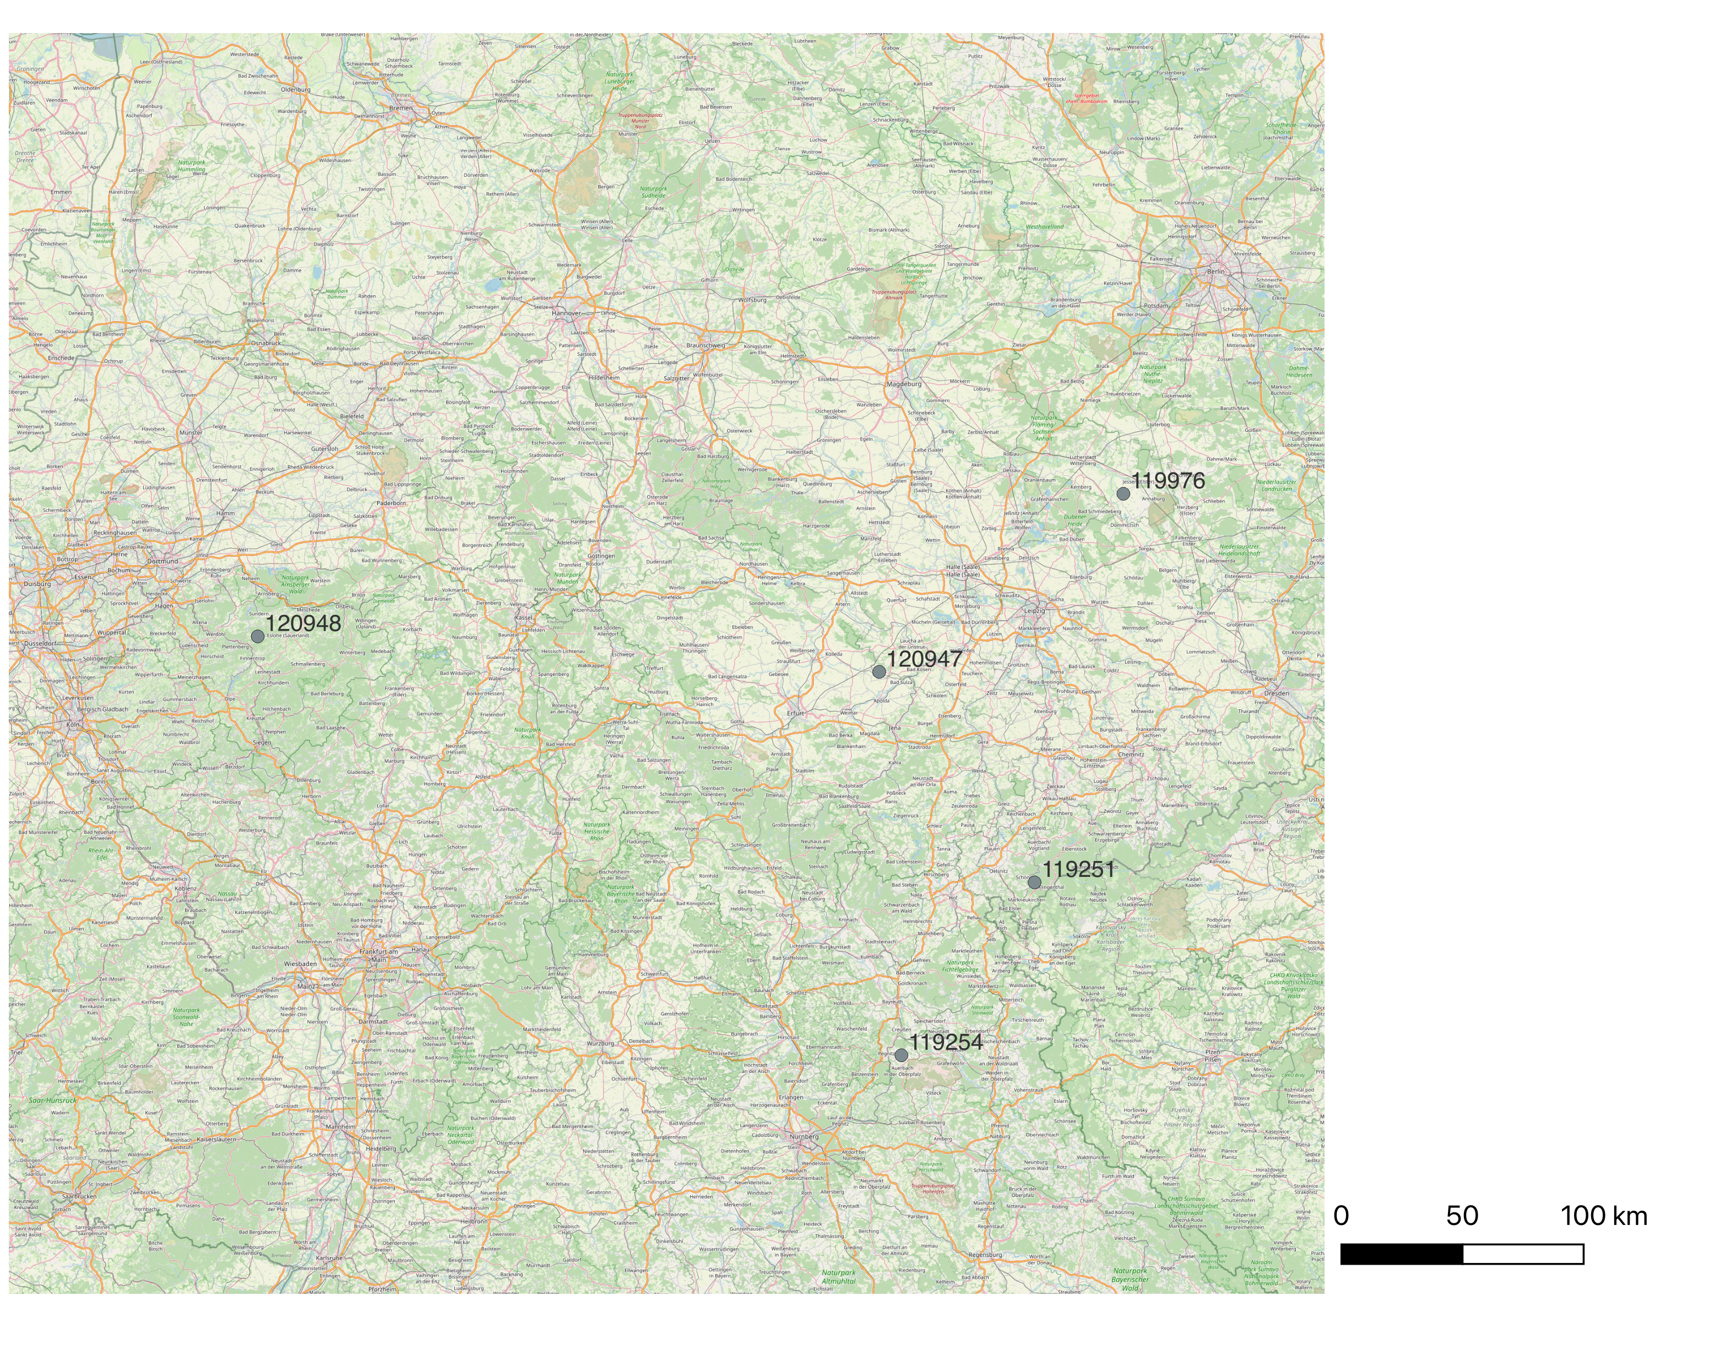
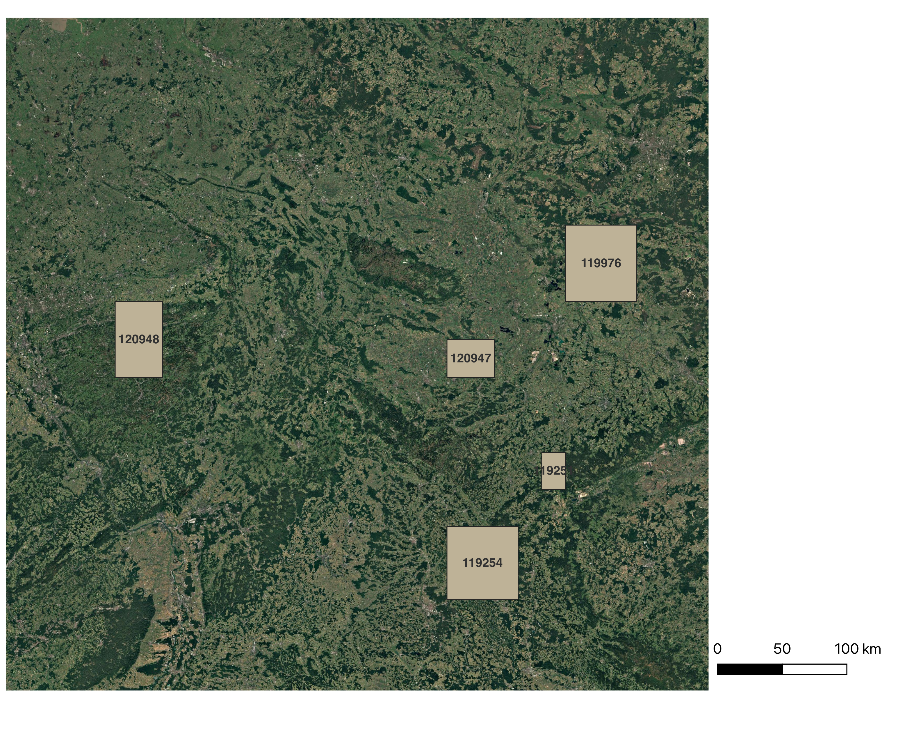
Selected CHD event boxes: Germany, 2019
Dortmund
Leipzig
Erfurt

Slide 19
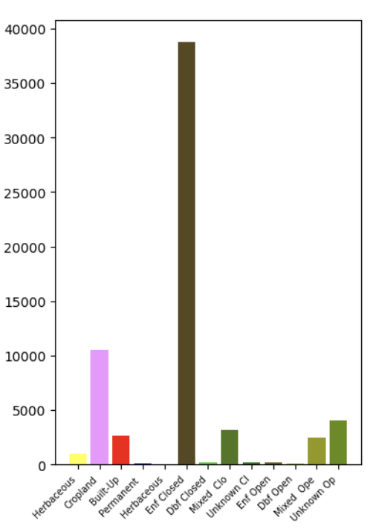
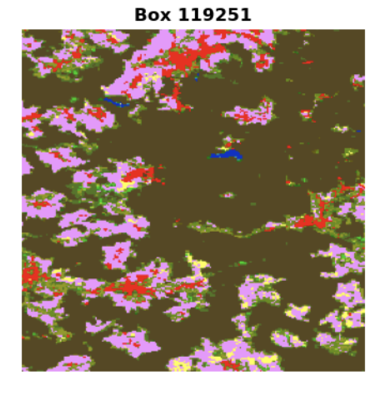
CHD event boxes with land cover (CLMS)
Notes:
Copernicus land monitor services

Slide 20
Workflow
Overall NIRv from Sen2/Sen3/MODIS
NIRv of SIF_{obs} footprints
Clear sky NIRv image
Dheed boxes
SIFobs and footprints with land cover property
Combinations of SIF yield
SIF yield product (ML)
overpassing time
center
PARs of MSG, ERA5…

Slide 21
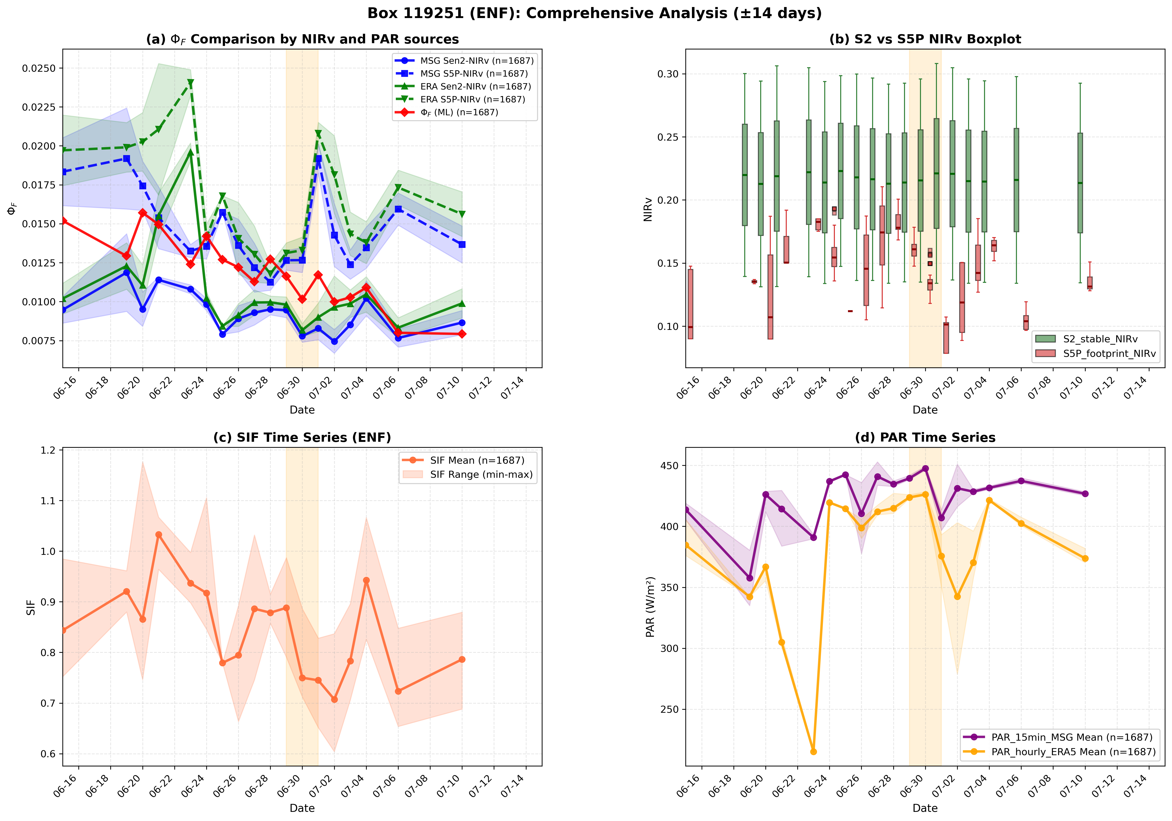
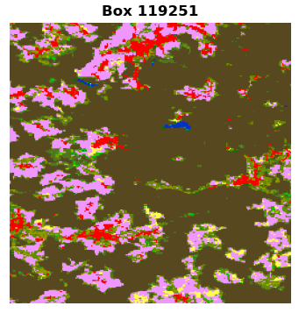
Preliminary Results
ENF
S5P NIRv
S2 NIRv
ERA5- 𝜙𝐹 higher than MSG- 𝜙𝐹
S5P-𝜙𝐹 higher than S2-𝜙𝐹

Slide 22
Preliminary Results…
Before CHD event:
- 𝜙𝐹 shows similar increase with ML 𝜙𝐹
During event:
𝜙𝐹 decrease firstly, and then increase
After CHD event:
- Except S2-ERA5 𝜙𝐹 , other 𝜙𝐹 decrease first and increase later
S5P NIRv
S2 NIRv

Slide 23
Preliminary Results…
Before CHD: SIF, NIRv and PARs decrease
During CHD: SIF and NIRv (S5P) decrease, PAR increases and later decreases
After CHD: SIF, NIRv (S5P) and PAR (15min) increase

Slide 24
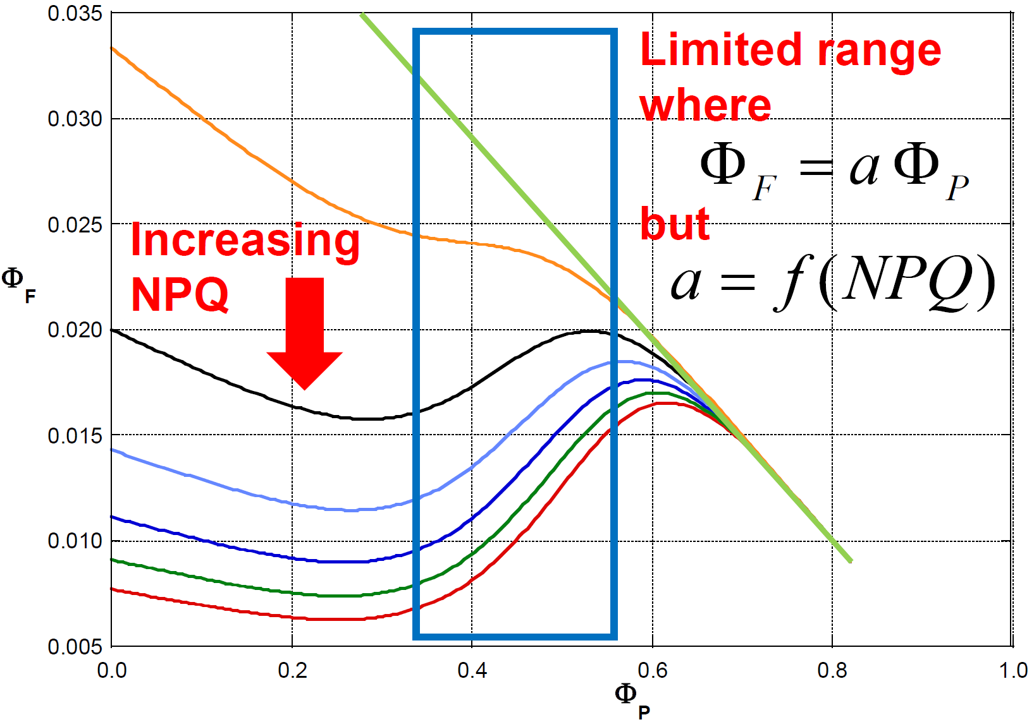
Challenge: Non-liner ϕF−ϕP
Direction ?
NPQ forms?
(J.Moreno)
(Porcar-Castell et al. 2014; Magney et al. 2020 GRL)

Slide 25
Current status and possible solution…?
- Canopy structure and PAR contribute in different part to ϕF.
Next step:
Compare different combinations in more Dheed dataset
Add BESS PAR (David. H from Julich)
Integrate with in-situ observations from AustroSIF
Gridded vs. ungridded SIF yield

Slide 26

Thanks for your attention!
Open to any recommendations or questions. ☺

Slide 27
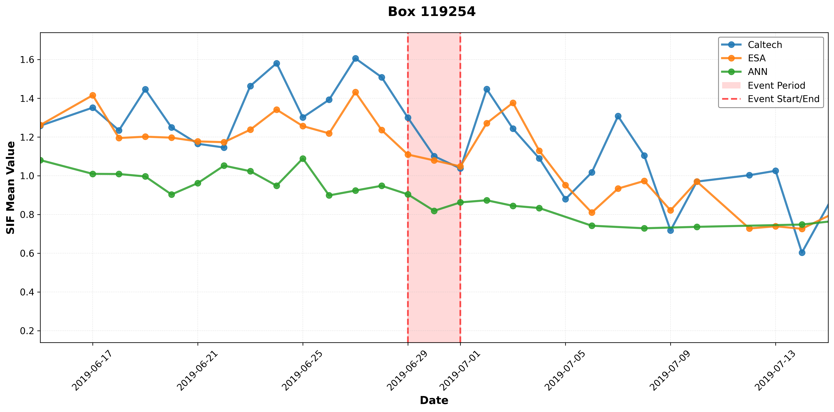
SIF comparison

Slide 28
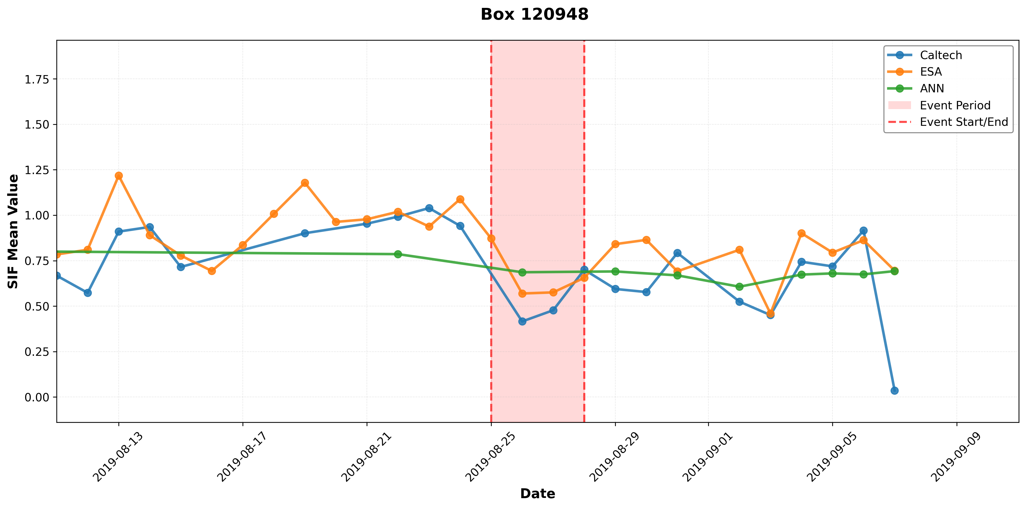
SIF comparison

Slide 29
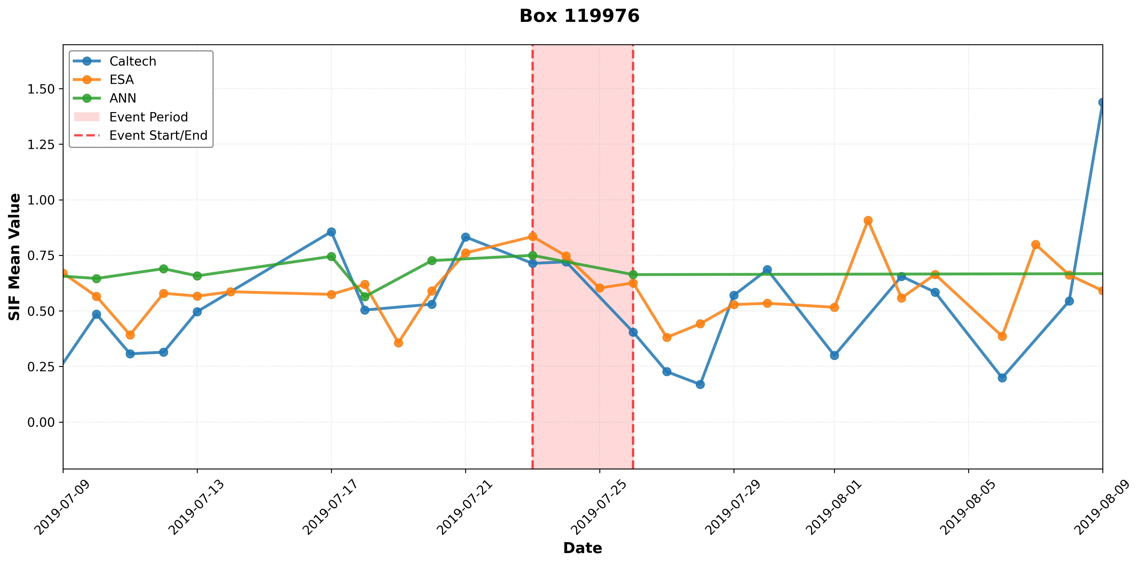
SIF comparison

Slide 30
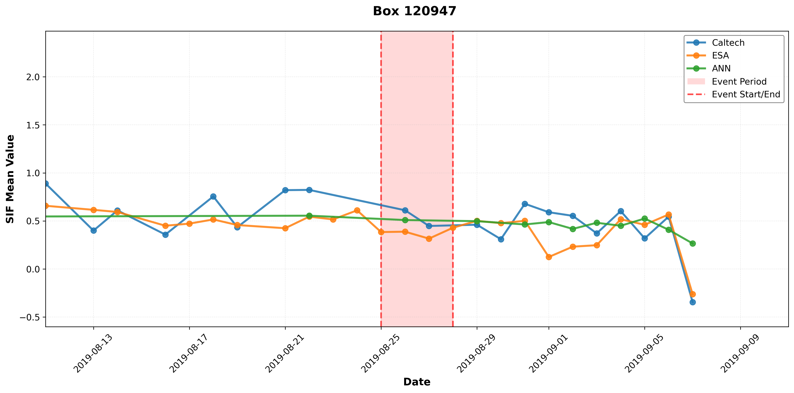
SIF comparison

