Slide 1
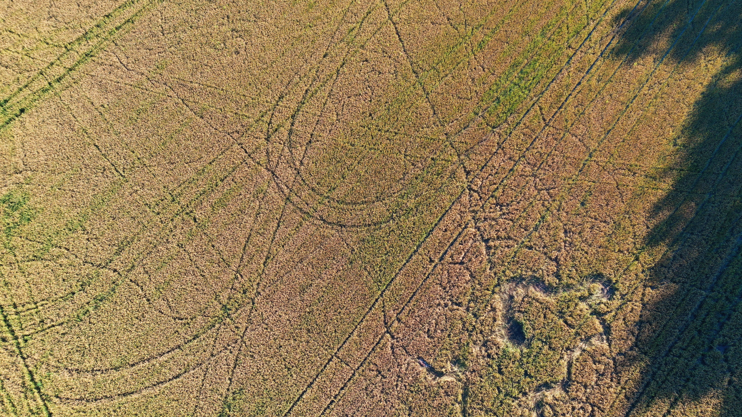
BRIDGING OBSERVATION SCALES FOR THE CALIBRATION AND VALIDATION OF FLEX SIF PRODUCTS
GIULIA TAGLIABUE | MICOL ROSSINI | ROBERTO GARZONIO | TOMMASO JULITTA | ANDREAS BURKART | SERGIO COGLIATI | PIETRO CHIERICHETTI | CINZIA PANIGADA | LUIGI VIGNALI | DENISE CINELLU | JULIANE BENDIG | UWE RASCHER | BASTIAN SIEGMANN | FALK PÄTZOLD | ASTRID LAMPERT | CHRISTIAAN VAN DER TOL | PIETER DE VIS | FRANCO MIGLIETTA | LORENZO GENESIO | KAROLINA SAKOWSKA | ALIREZA MAHMOODI | MARCO CELESTI | DIRK SCHÜTTEMEYER | MARIN TUDOROIU | ROBERTO COLOMBO
UNIVERSITY OF MILANO – BICOCCA | ITALY
FLEX-FLUORESCENCE 2026 WORKSHOP | BONN, GERMANY | 3-6 MAR 2026

Slide 2
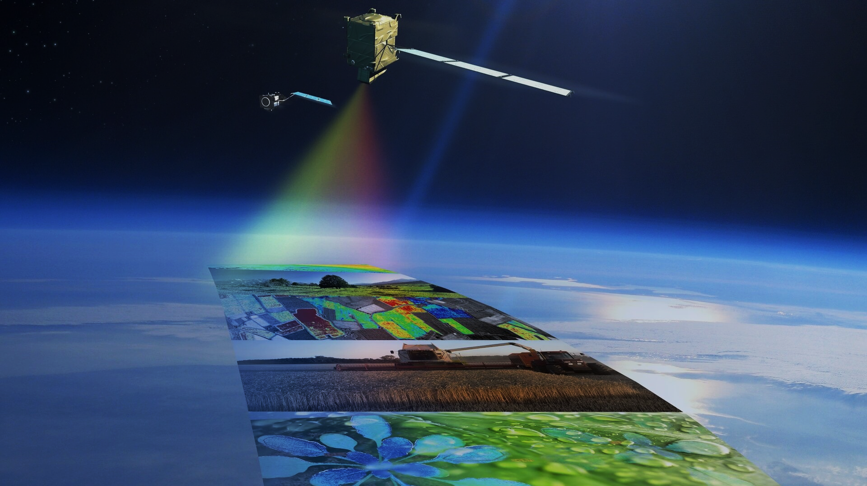

FRAMEWORK & OBJECTIVES
Realizing the full scientific potential of FLEX critically depends on the availability of robust and traceable calibration and validation (Cal/Val) strategies for L2B SIF products
Validating satellite-scale SIF remains inherently challenging, particularly in heterogeneous landscapes where point-based ground measurements may not accurately represent the satellite footprint, and conventional airborne imaging approaches are costly and temporally constrained
We present the FLEX L2B Cal/Val strategy developed within the ESA FLEX DISC project, which is a multi-scale framework that bridges ground, UAS, airborne and satellite observations.
We show results of the testing of the Cal/Val prototypes using real measurements acquired within the ESA FRM4FLUO project
Notes:
Parlare di FLEX, caratteristiche della missione ecc

Slide 3







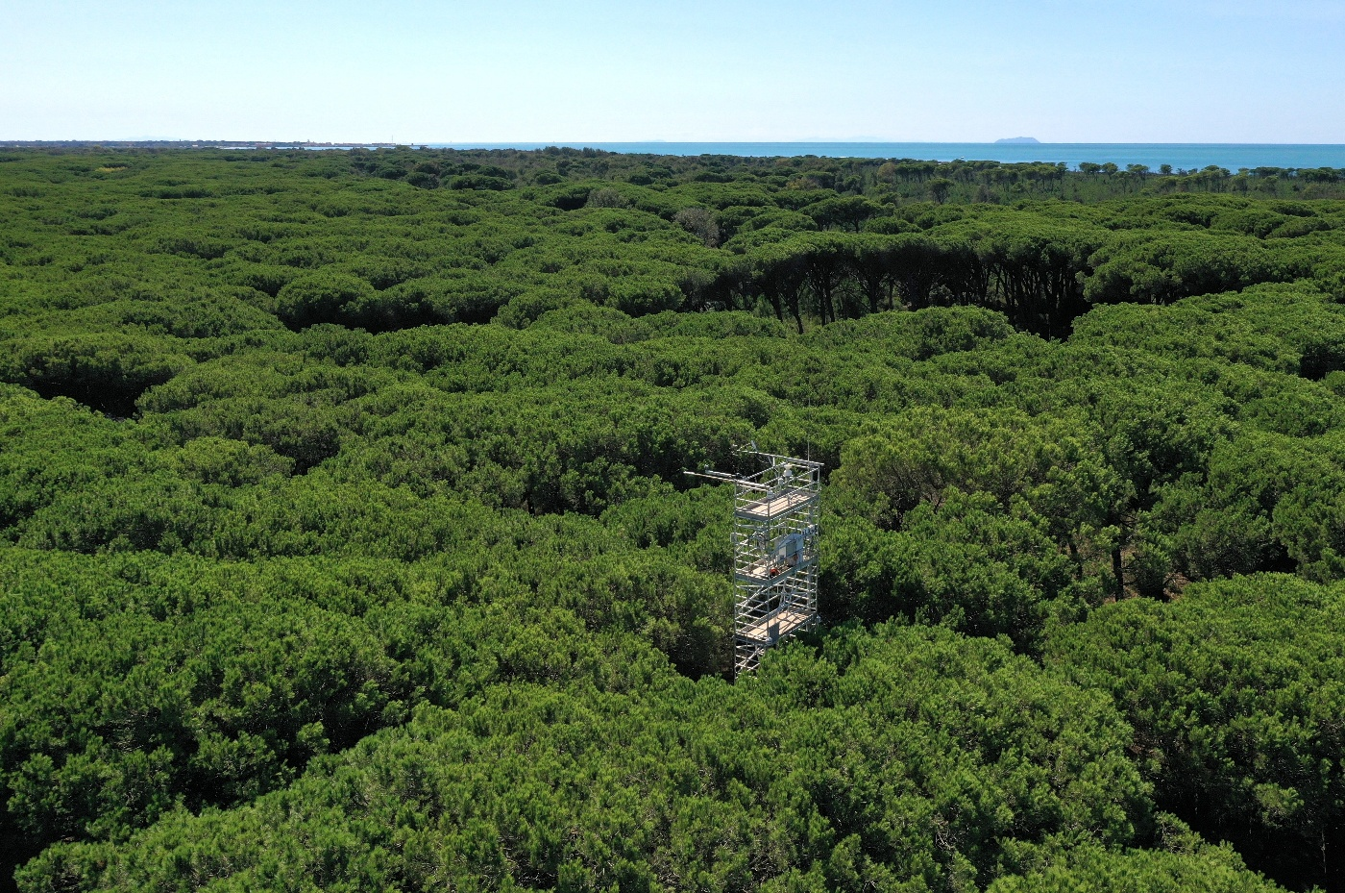
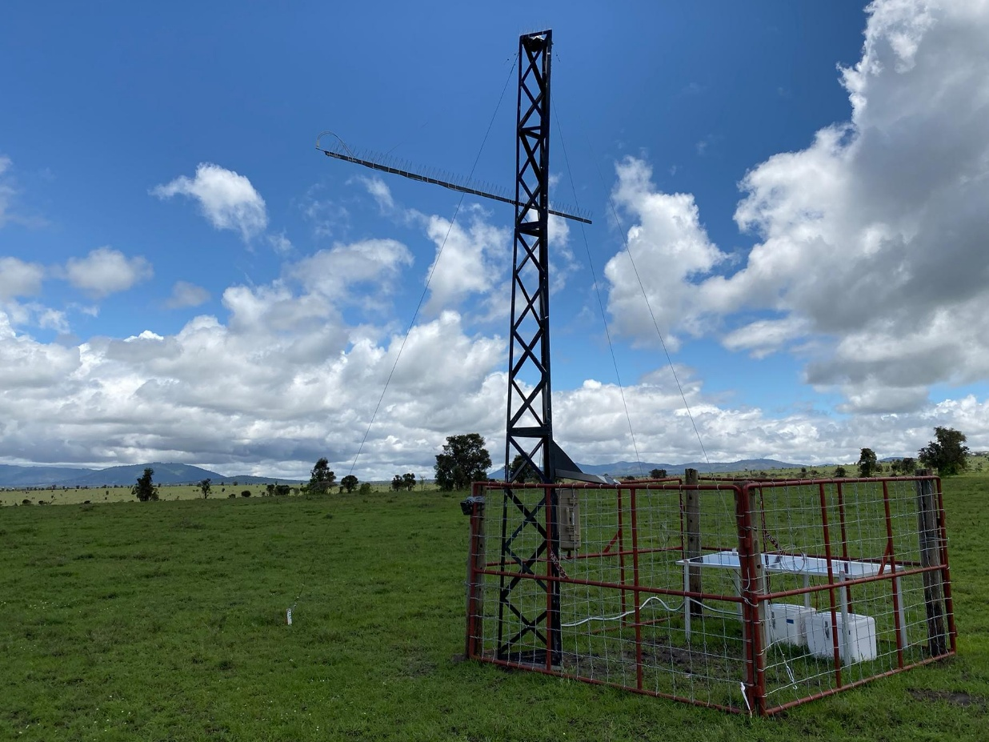
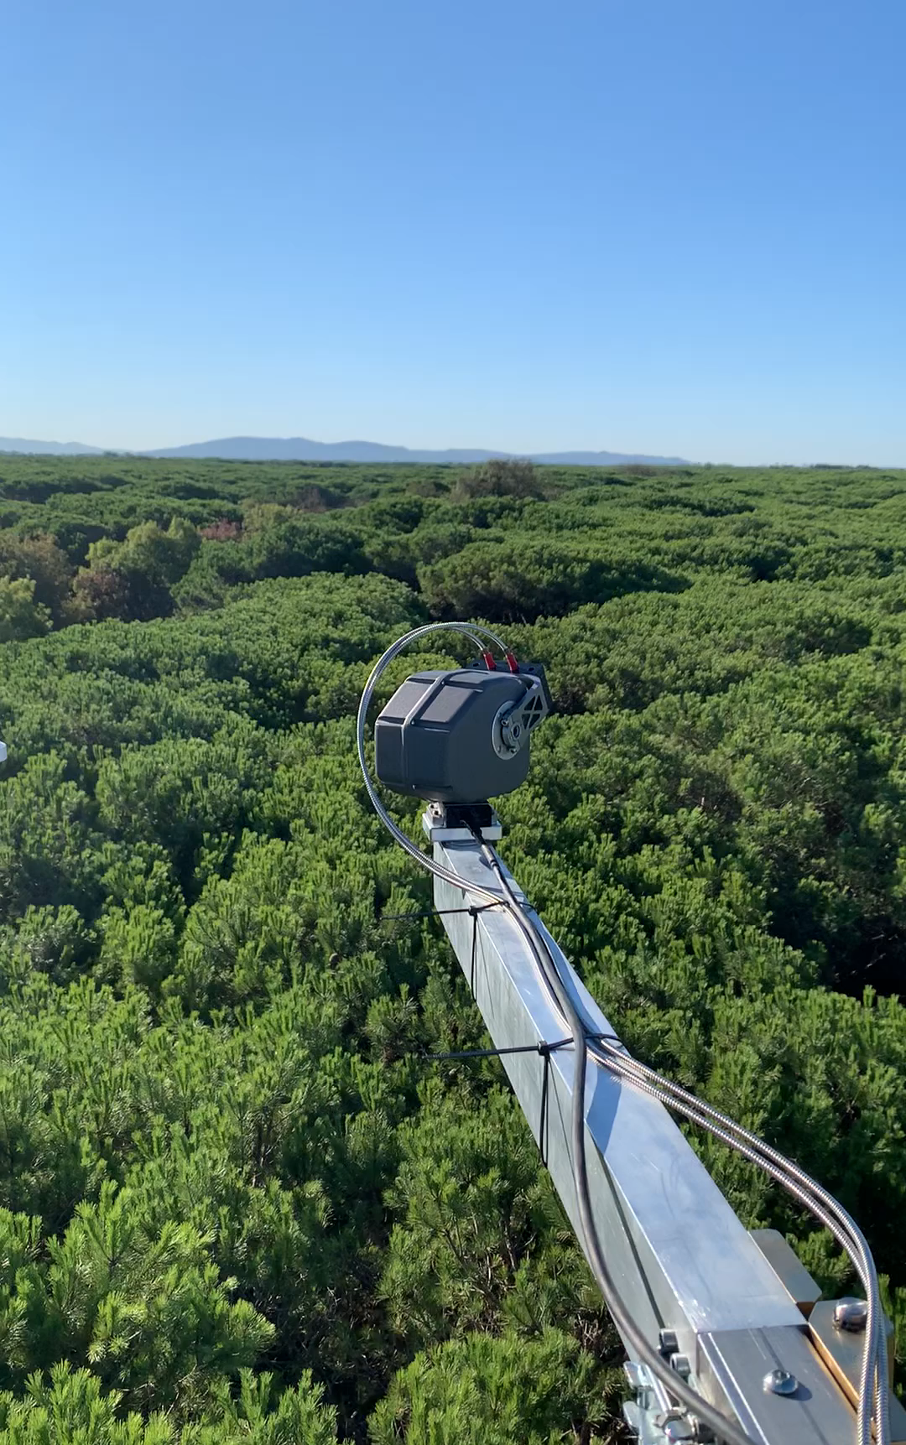
Cal/val of satellite products: tower-based approach
Tower data
Pros: possibility to collect continuous, unattended measurements
Cons: low spatial representativeness

Slide 4


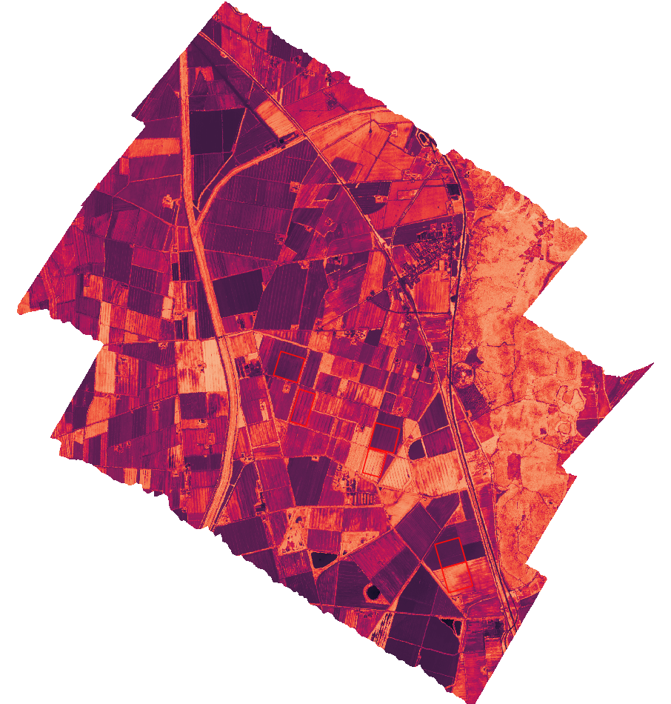
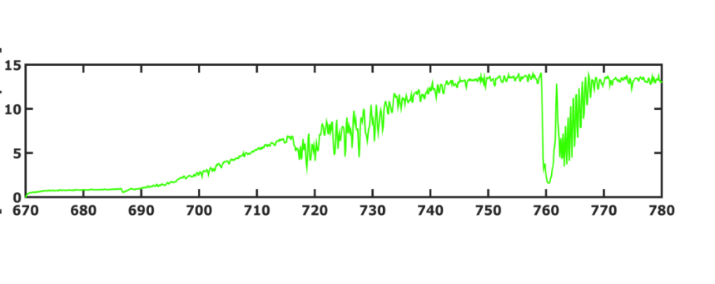

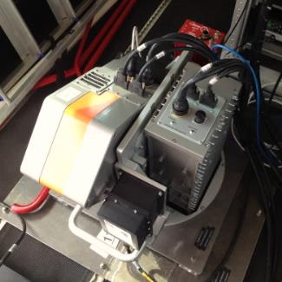
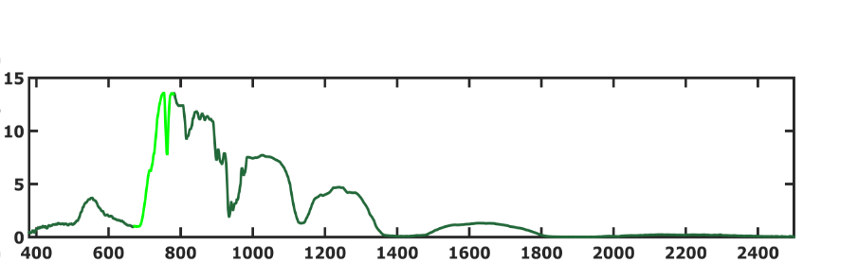

Cal/val of satellite products: airborne-based approach
Airborne data
Pros: wide spatial coverage, high spatial resolution (up to ~1 m)
Cons: high costs, low temporal resolution
FLUO module
Radiance
(mW cm⁻² sr⁻¹ μm⁻¹)
FULL module
HyPlant sensor
(airborne prototype of FLEX)
Wavelength (nm)

Slide 5

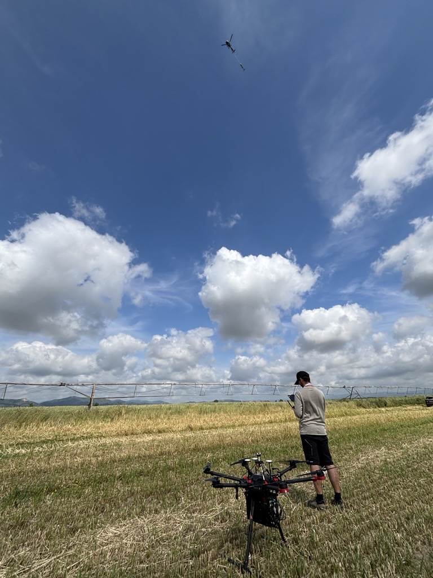
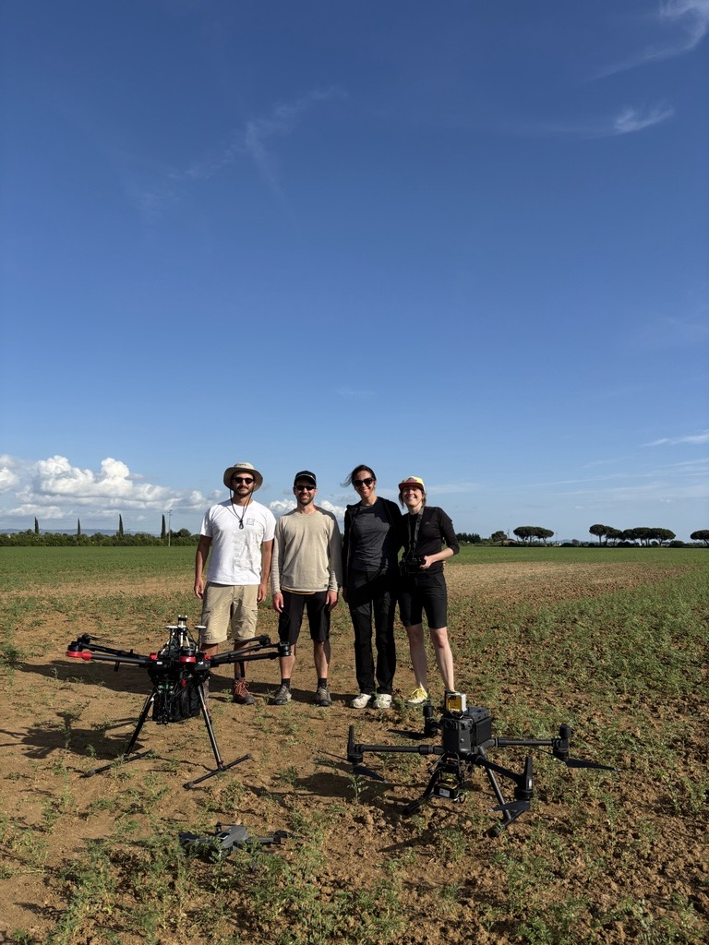
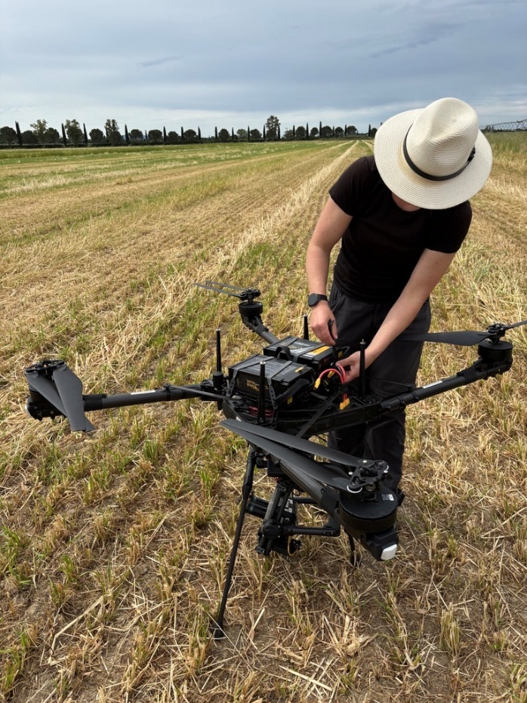
Cal/val of satellite products: UAS-based approach, filling the gap
UAS
data
Pros: ease of operation, versatility, low costs, mid-large spatial coverage
Cons: low automatisation, limited data acquisition due to batteries

Slide 6
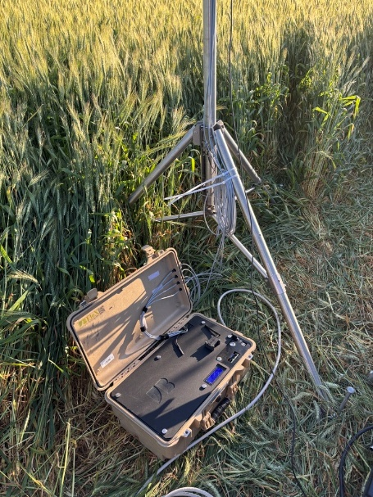
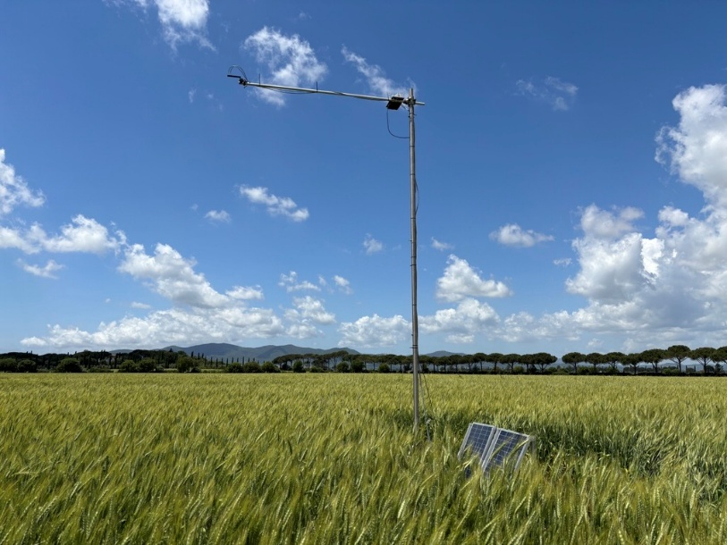
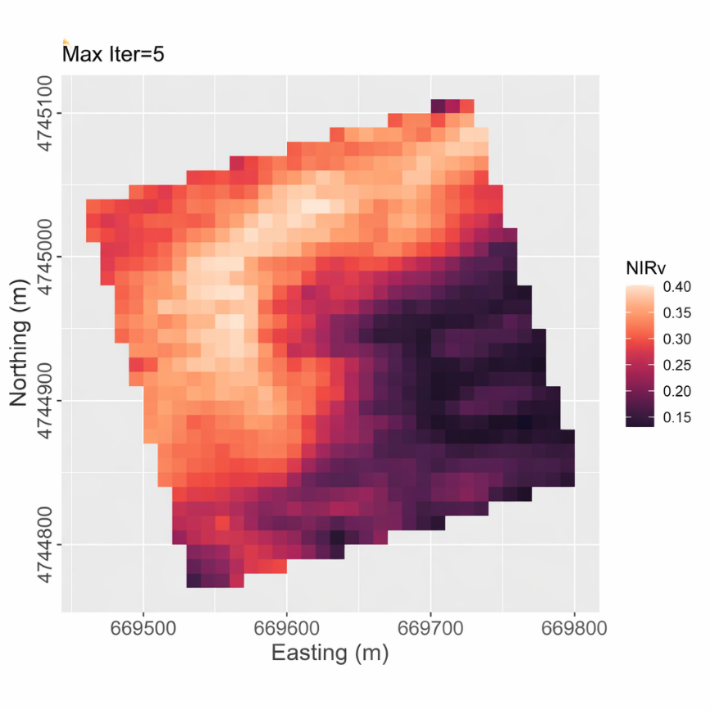
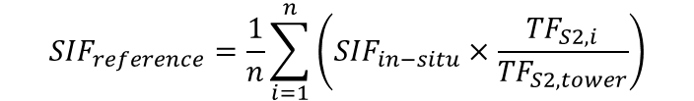
L2B Cal/Val based on Single Point
FloX position definition
Comparison against FLEX data without and with transfer functions
Transfer function approach
$${SIF}_{reference}=\frac{1}{n}\sum_{i=1}^{n}{\left({SIF}_{in−situ}×\frac{{TF}_{S2,i}}{{TF}_{S2,tower}}\right)}$$
Far-red transfer functions
Red transfer functions
Definition of a representative FloX position based on Sentinel-2 NIRv

Slide 7
Identification of transfer function for each SIF metric based on simulated data
SIF₇₆₀
SIF₆₈₇
SIF₇₄₀
SIF₆₈₅
SIF_{INT}
SIF₇₆₀ ≈ NIRv
SIF₆₈₇ ≈ R_{red} × NIRv²
SIF₇₄₀ ≈ NIRv
SIF₆₈₅ ≈ R_{red} × NIRv²
SIF_{INT} ≈ NIRv

Slide 8

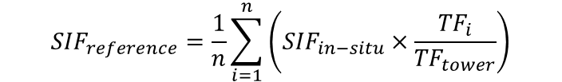
L2B Cal/Val based on Single Point
FloX position definition
Comparison against FLEX data without and with transfer functions
Transfer function approach
$${SIF}_{reference}=\frac{1}{n}\sum_{i=1}^{n}{\left({SIF}_{in−situ}×\frac{{TF}_{i}}{{TF}_{tower}}\right)}$$
Far-red transfer functions
Badgley et al. (2017)
Red transfer functions
Definition of a representative FloX position based on Sentinel-2 NIRv
Wieneke et al. (2024)

Slide 9
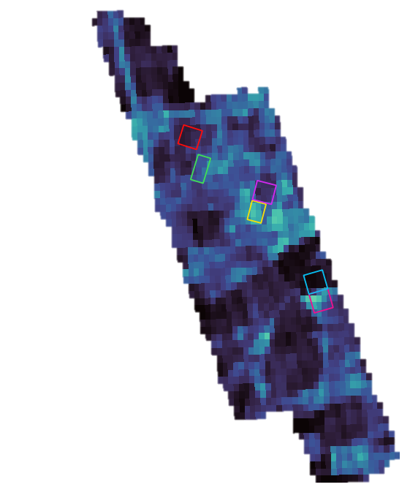


L2B Cal/Val based on Single Point
FloX position definition
Comparison against FLEX data without and with transfer functions
FLEX image
300 m
Validation of FLEX pixel
Data courtesy:
ASI FLEX-ITA team

Slide 10
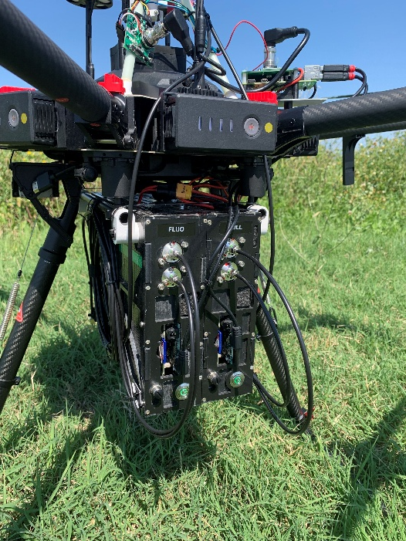
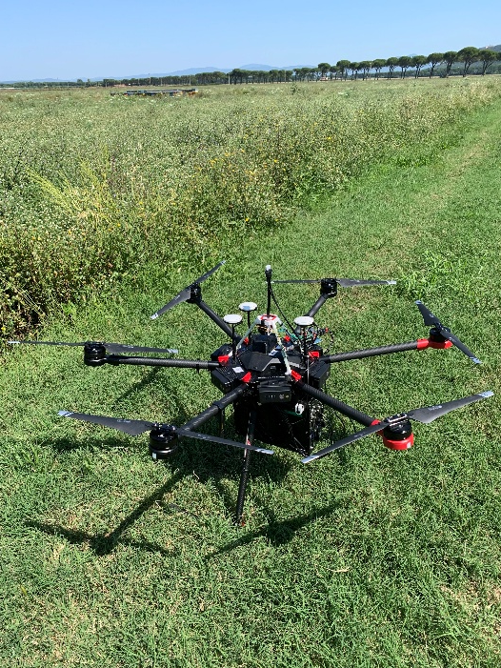

L2B Cal/Val based on Multiple Point
Optimal sampling definition
Greedy algorithm to minimise acquisition time
Spatial aggregation with and without transfer functions
Maximise the spatial representativeness of the sampling points based on Sentinel-2 NIRv:
Variogram fitting to characterise heterogeneity
Genetic algorithm to find the optimal locations

Slide 11
L2B Cal/Val based on Multiple Point
Optimal sampling definition
Greedy algorithm to minimise acquisition time
Spatial aggregation with and without upscaling functions
FLEX image
300 m
Validation of FLEX pixel
Data courtesy:
ASI FLEX-ITA team

Slide 12



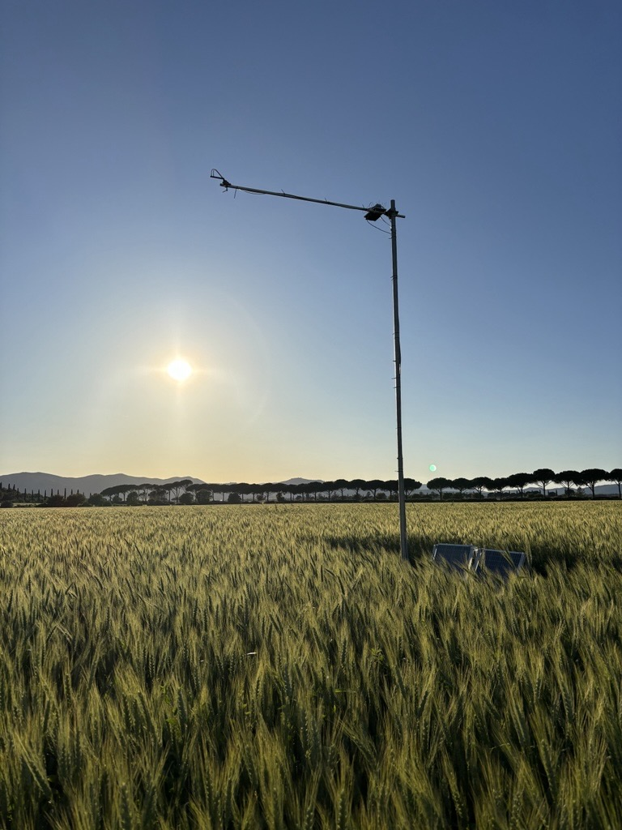
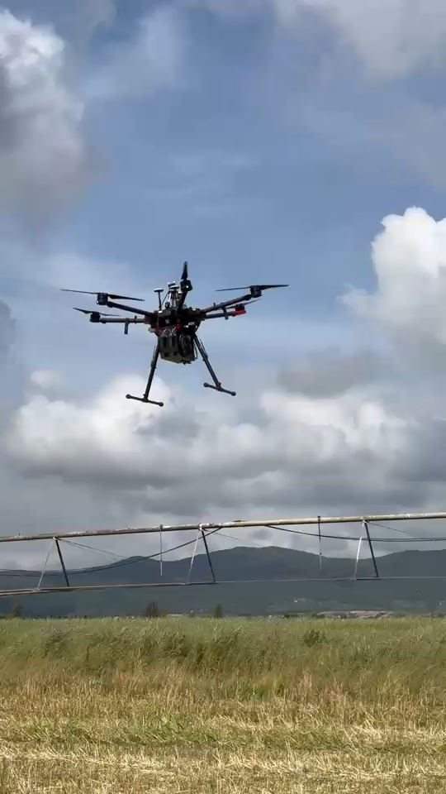
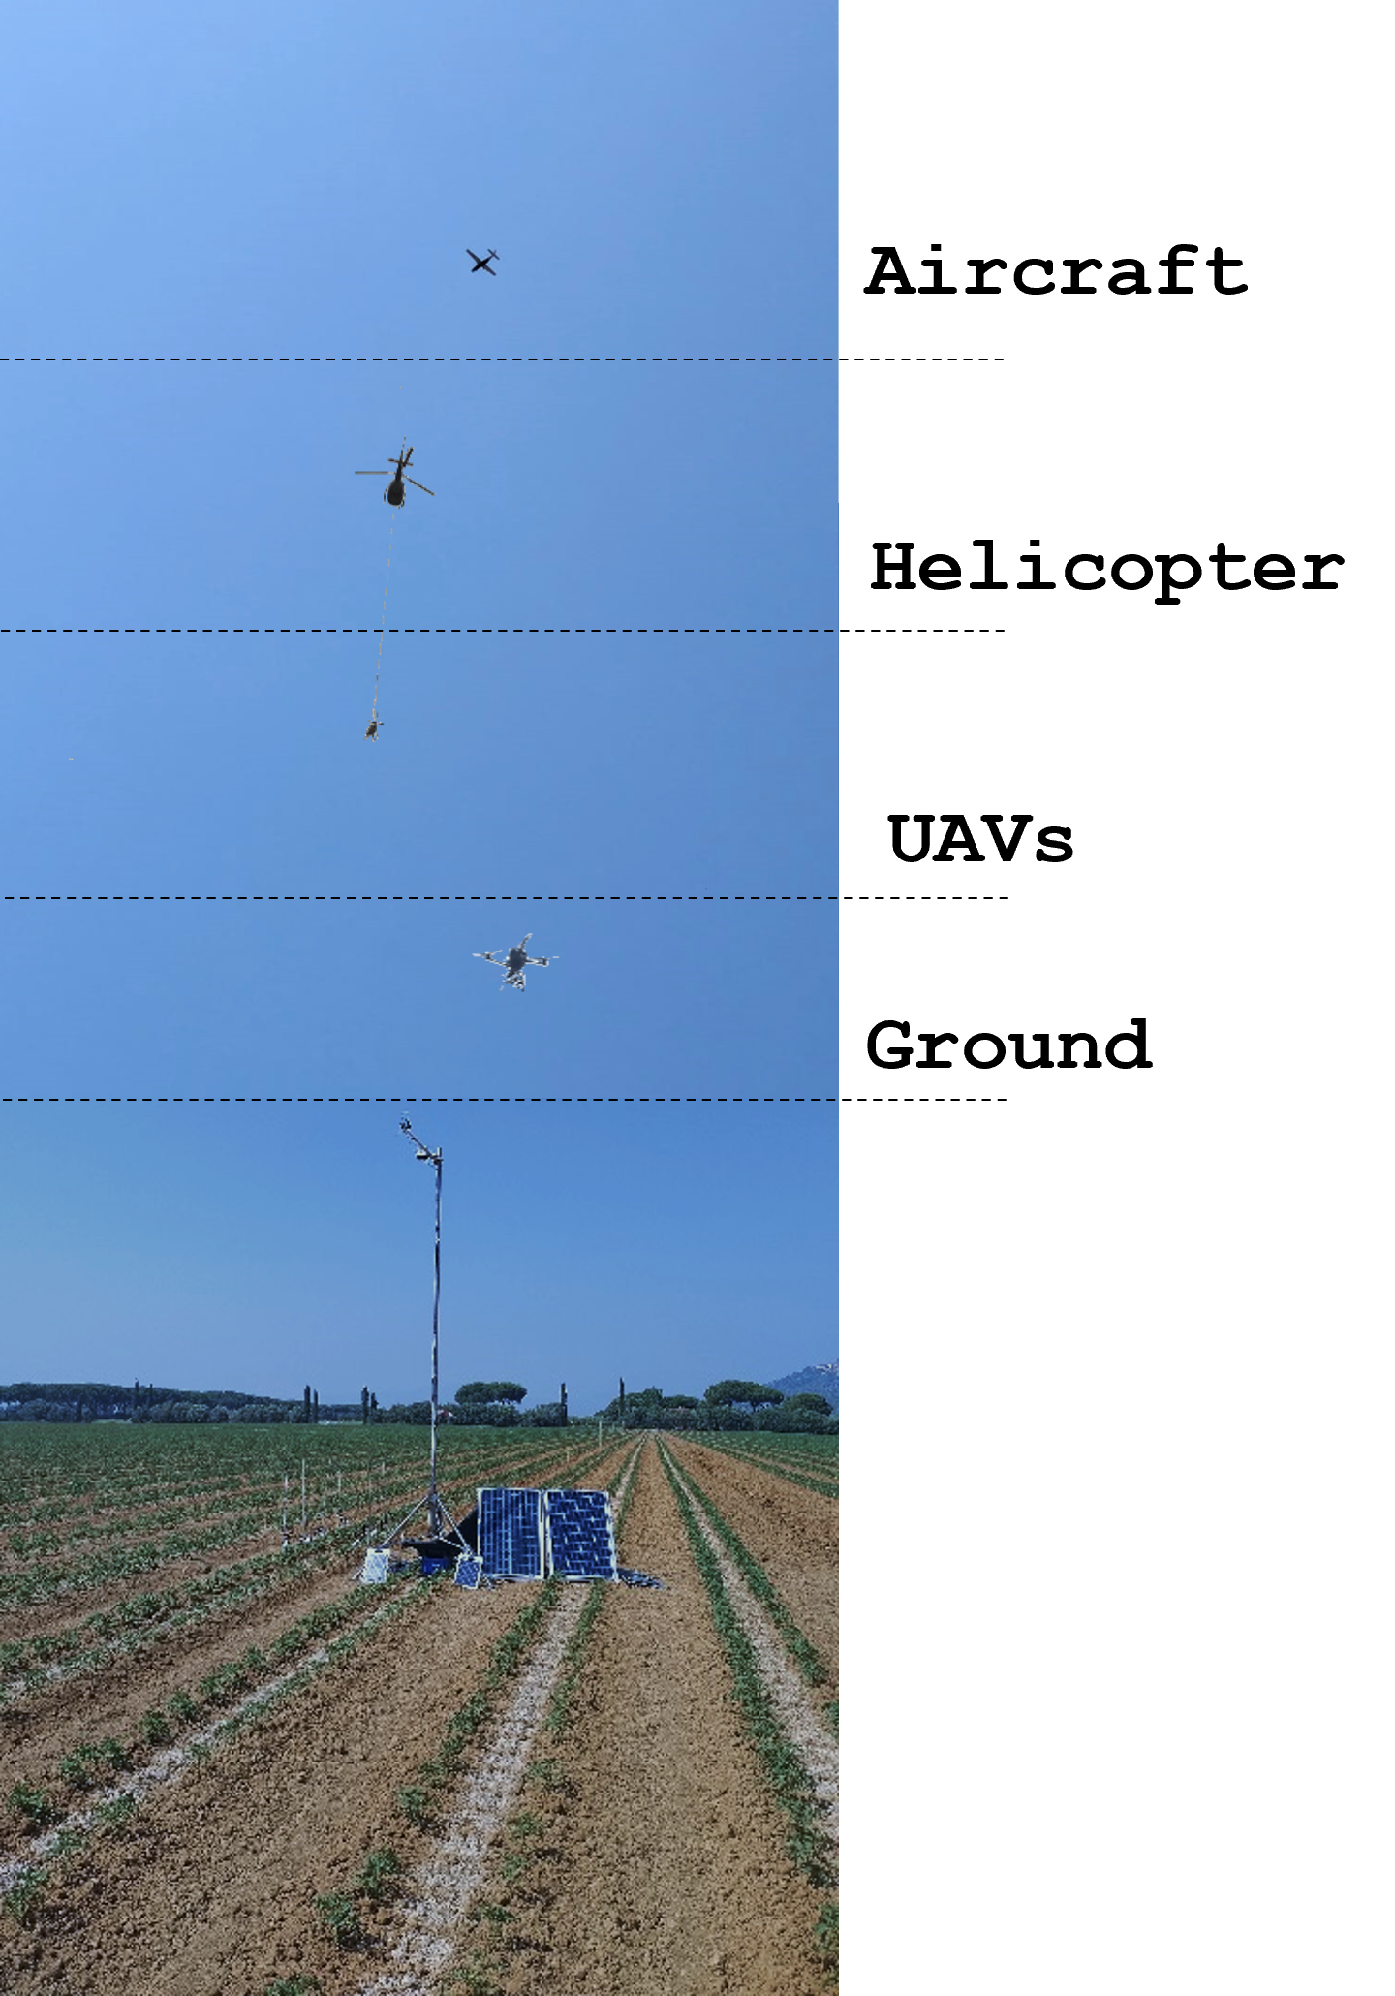
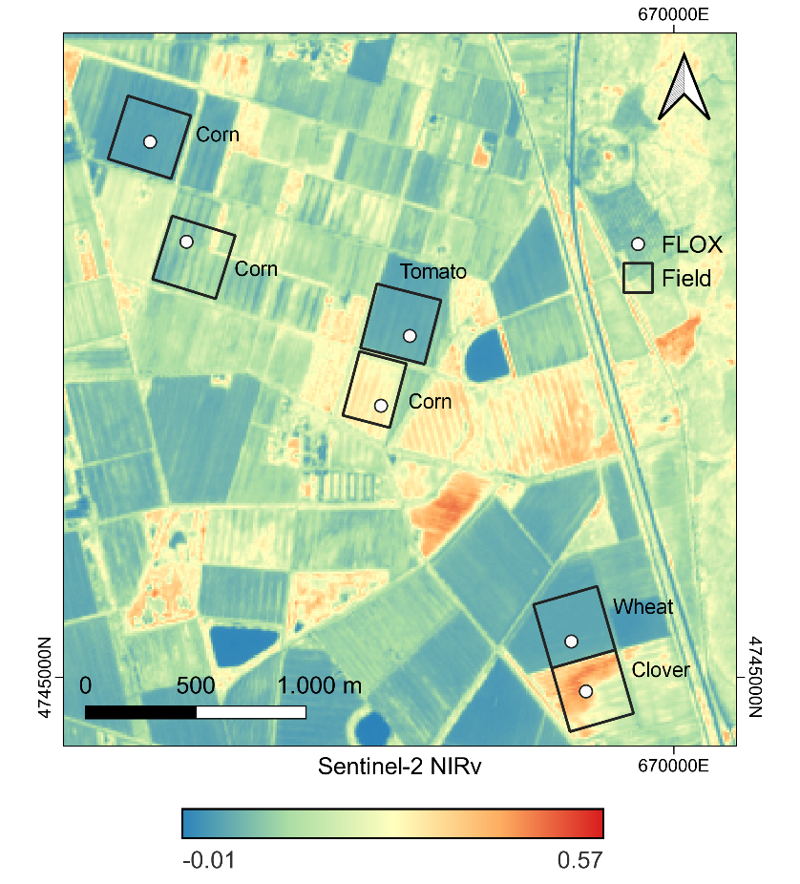
ESA FRM4FLUO 2025 field campaigns
Multi-scale measurements of FLEX L2B products and their uncertainties using ground-based systems (FloX), airborne systems (AirFloX) mounted on UAS and helicopter (HELiPOD) and airborne imaging systems (HyPlant, IBIS)
Inter-comparison of SIF measurements across scales and sensors
Testing of FLEX L2B validation protocols
11-18 June 2025
Grosseto, Italy
Corn, tomato,
clover, dry wheat
6 FloX
30 AIRFLOX flights
Notes:
Mettere video FROG

Slide 13
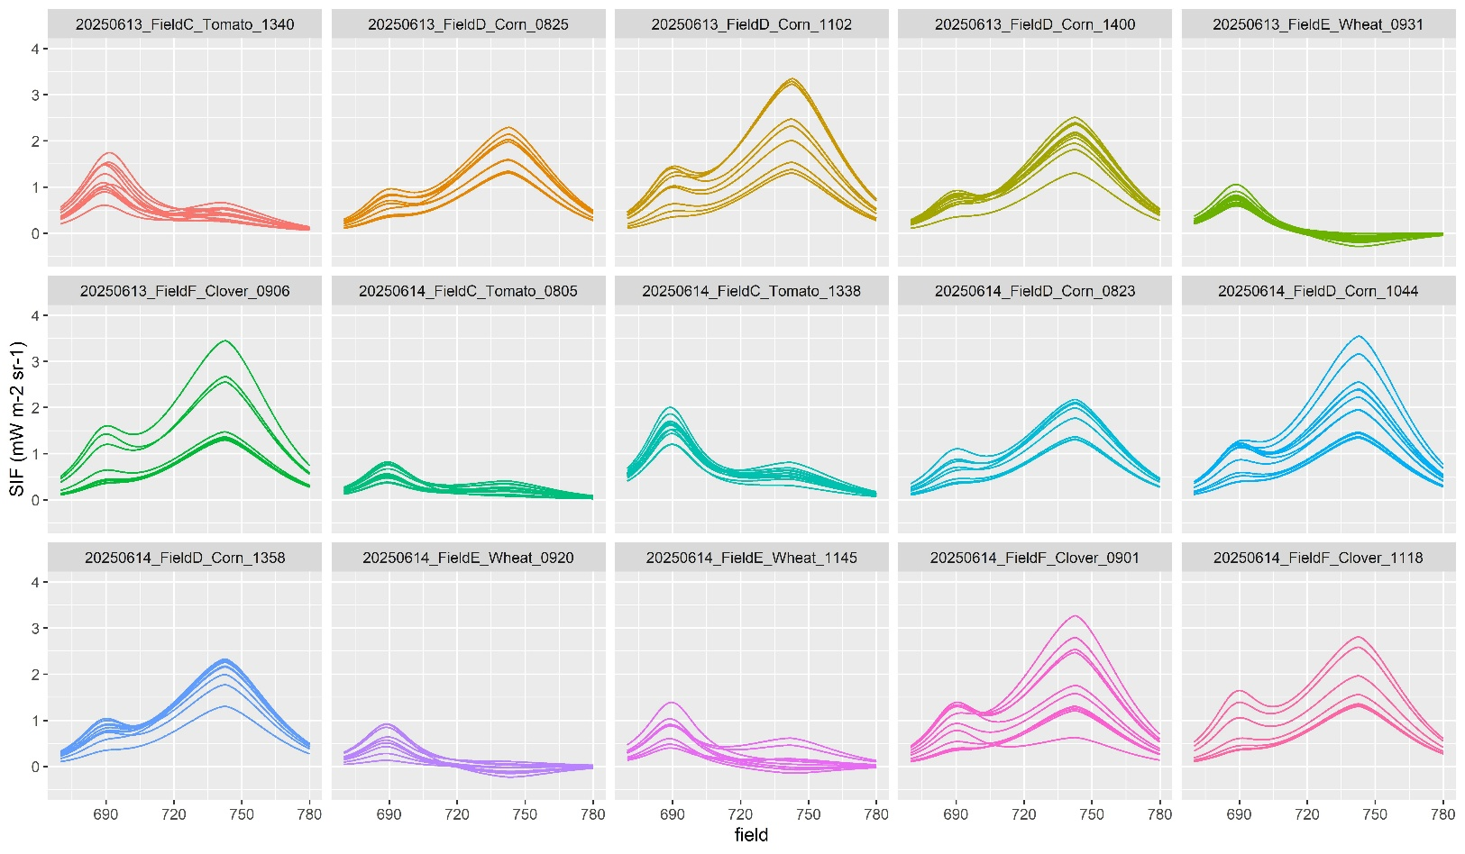
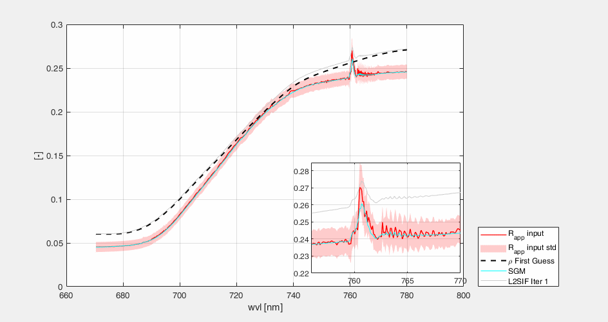
FLOX and AIRFLOX SIF full spectrum retrieval
SIF full spectrum retrieval
Consistency with FLEX L2B module retrieval
Retrieval performed within an optimal estimation framework
Measured apparent reflectance is modelled iteratively through the minimisation of a cost function:
AIRFLOX SIF spectra for different fields (tomato, corn, dry wheat, clover), date and time of the day

Slide 14
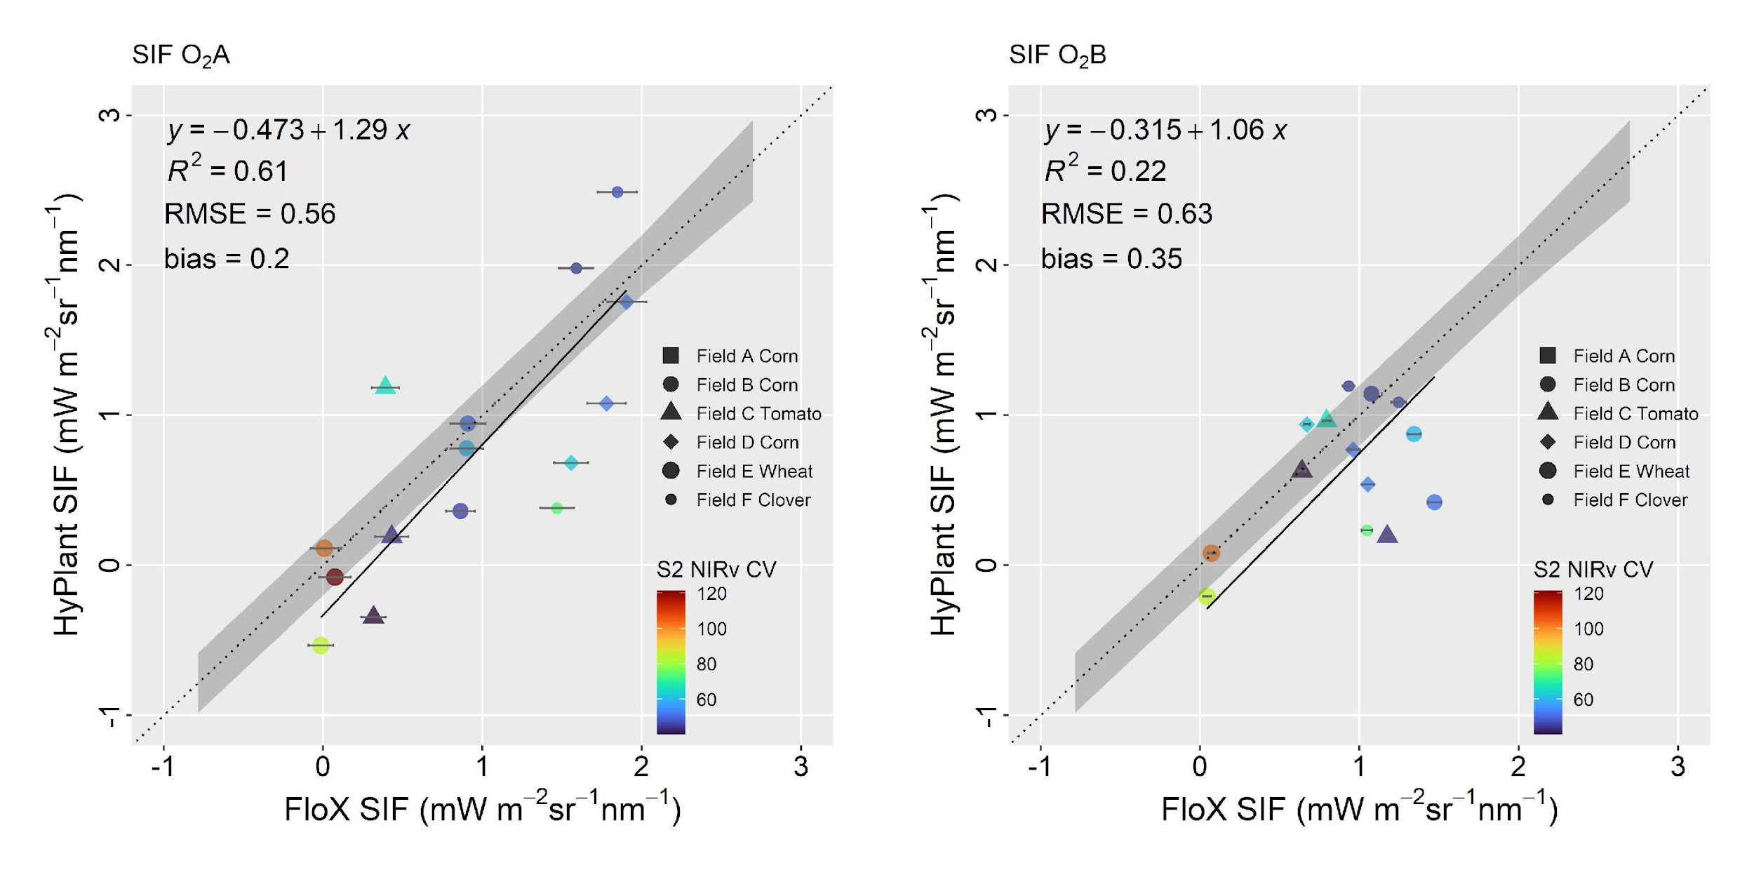
Results: L2B Single Point without transfer function
FLEX-like
FLEX-like

Slide 15
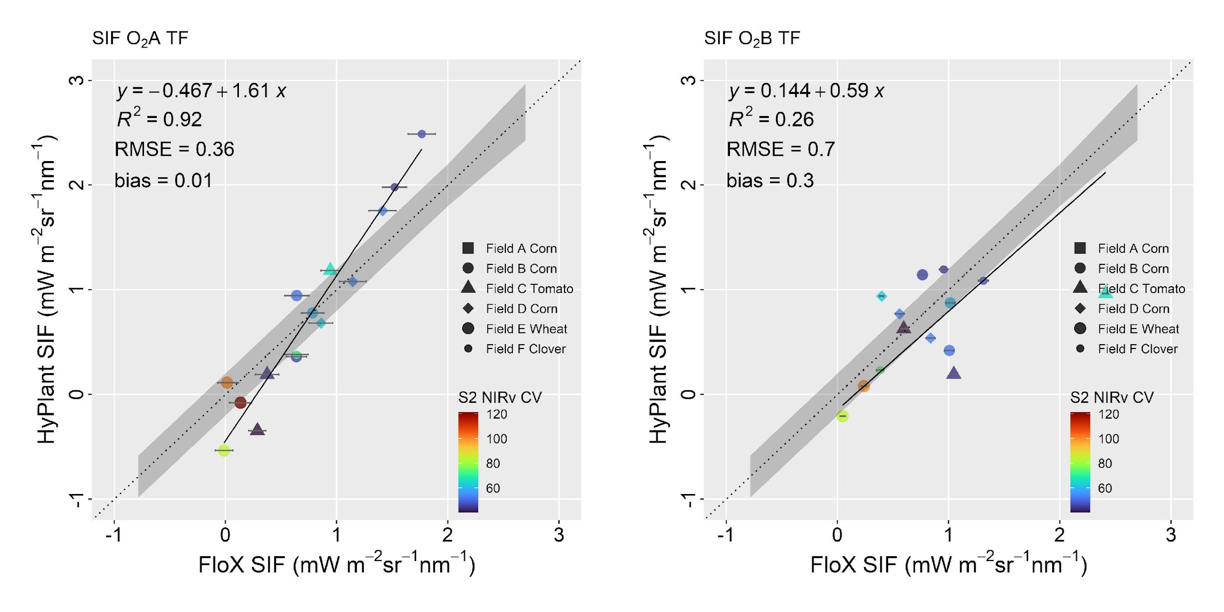
Results: L2B Single Point with transfer function
FLEX-like
FLEX-like

Slide 16
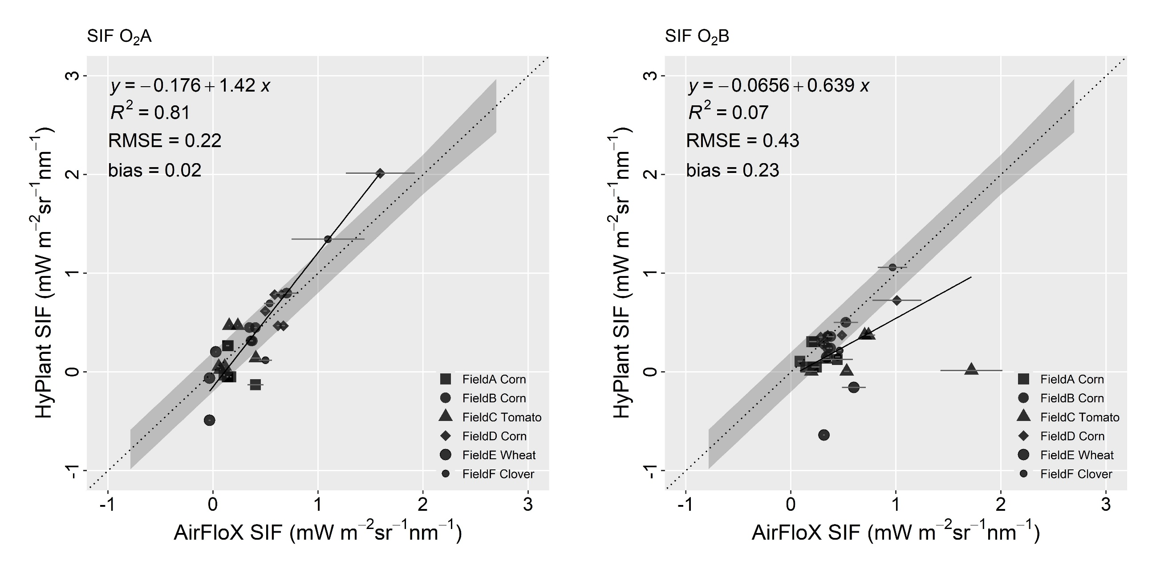
Results: L2B Multiple Point without transfer function
FLEX-like
FLEX-like

Slide 17
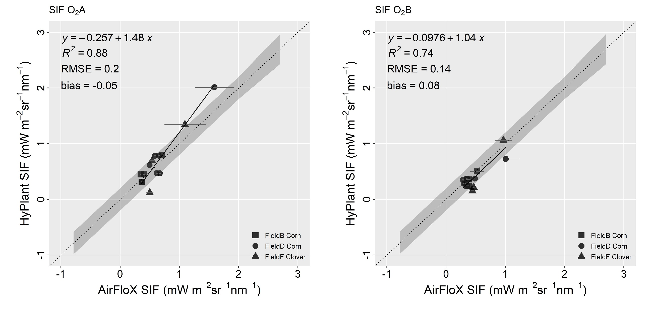
Results: L2B Multiple Point without transfer function
FLEX-like
FLEX-like
Without sparsely vegetated fields

Slide 18
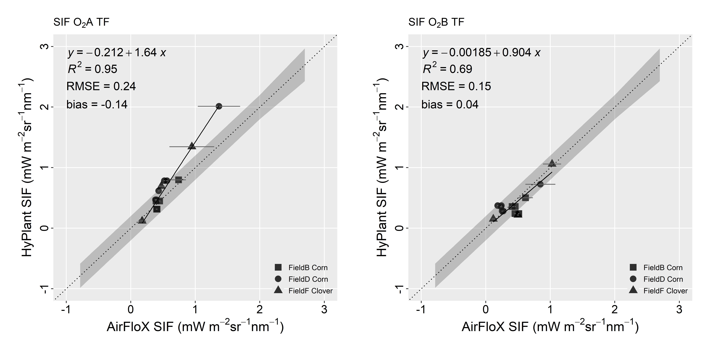
Results: L2B Multiple Point with transfer function
FLEX-like
FLEX-like
Without sparsely vegetated fields

Slide 19


Conclusions
L2B Cal/Val strategies were developed in the context of ESA FLEX DISC activities
L2B Cal/Val tools based on single and multiple point measurements were applied to real measurements and proved to be effective
The transfer function approach improves the accuracy of estimates in the L2B Single Point case, while its impact in the L2B Multiple Point case is limited, since the availability of additional spatial information already reduces estimation uncertainty
The good agreement between FLORIS-like data and UAS measurements, obtained without the need for a transfer function, confirms the effectiveness of the optimization approach adopted for flight planning
The two transfer functions were selected based on simulated data from the DISC project. When applied to real data, NIRv confirms its effectiveness for SIF O₂A, whereas the results obtained using R_{red} × NIRv² on red SIF are consistent with those derived from the simulated measurements for vegetated fields

Slide 20


THANK YOU!
giulia.tagliabue@unimib.it
@giulitagl

