Slide 1
SIF Full-Spectrum Retrieval in the Framework of the FLEX Mission
Pietro Chierichetti¹, Jorge Vicent-Servera², Théo Paccoud², Pekka Kolmonen³, Neus Sabater³, Marco Celesti⁴, Marin Tudoroiu⁵, Alberto Maiocchi¹, Roberto Colombo¹, Sergio Cogliati¹
1 University of Milano-Bicocca, Italy; 4 European Space Agency, ESA-ESTEC, The Netherlands;
2 Magellium Artal Group, France; 5 European Space Agency, ESA-ESRIN, Italy
3 Finnish Meteorological Institute, Finland;

Slide 2
Outline
FLEX SIF products
L2B retrieval module
Performance assessment
L2B adaptation to ground-based measurements
Final remarks

Slide 3
FLEX L2B SIF products
The FLEX-DISC L2PP L2B module is specifically developed to retrieve the Solar-Induced Fluorescence (SIF) spectrum and uncertainty from FLORIS
Products:
SIF spectrum (670-780 nm)
SIF at O₂ bands
SIF at red and far-red peaks
SIF max emission wavelength
Spectrally integrated SIF (SIF_{int})
… and associated prognostic uncertainties

Slide 4
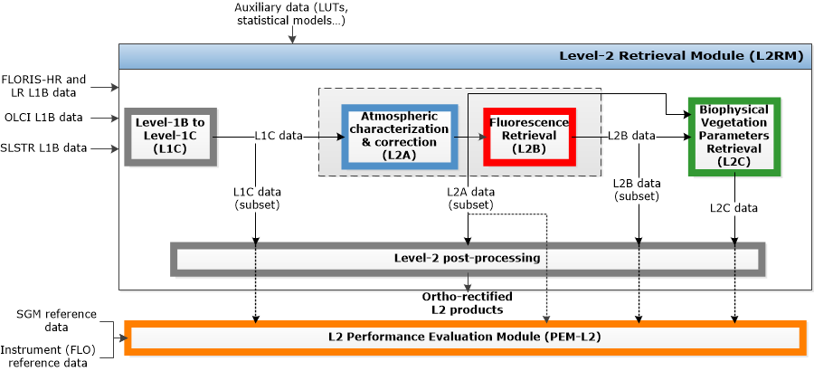
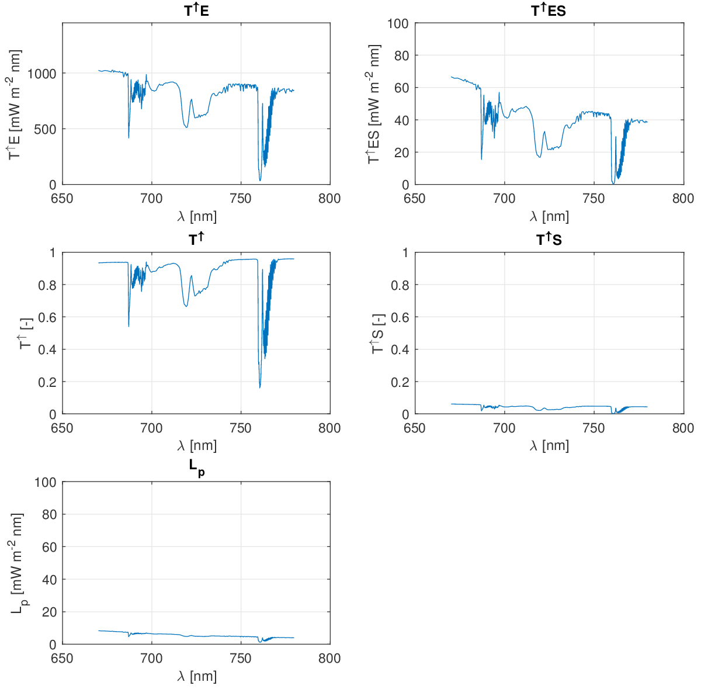

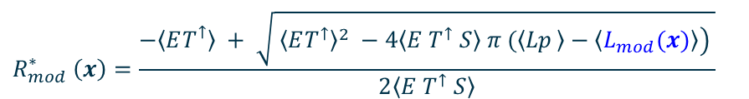
FLEX L2 Prototype Processor –
L2B module
Atmospheric functions from L2A
1) TOA radiance
$$L_{mod}\left(x\right)=〈Lp〉 + \dot{\frac{〈ET^{↑}〉}{π}}R\left(x_{R}\right)+SIF\left(x_{F} \right){ T}^{↑}+ \frac{〈ET^{↑}S〉}{π}{R\left(x_{R}\right)}^{2}+〈T^{↑}S〉 SIF\left(x_{F} \right) R(x_{R})$$
2) Apparent reflectance
3) Forward operator
$${R_{mod}^{∗}}_{ }^{ }\left(x\right)=\frac{−〈ET^{↑}〉 + \sqrt{ {〈ET^{↑}〉}^{2} −4{\left.〈E{ T}^{↑} S〉 π (〈{Lp}_{ }〉−〈L_{mod}(x)〉\right)}^{ }}}{2〈E T^{↑} S〉}$$
$$y=R_{mod}^{∗}\left(x,b\right)$$

Slide 5
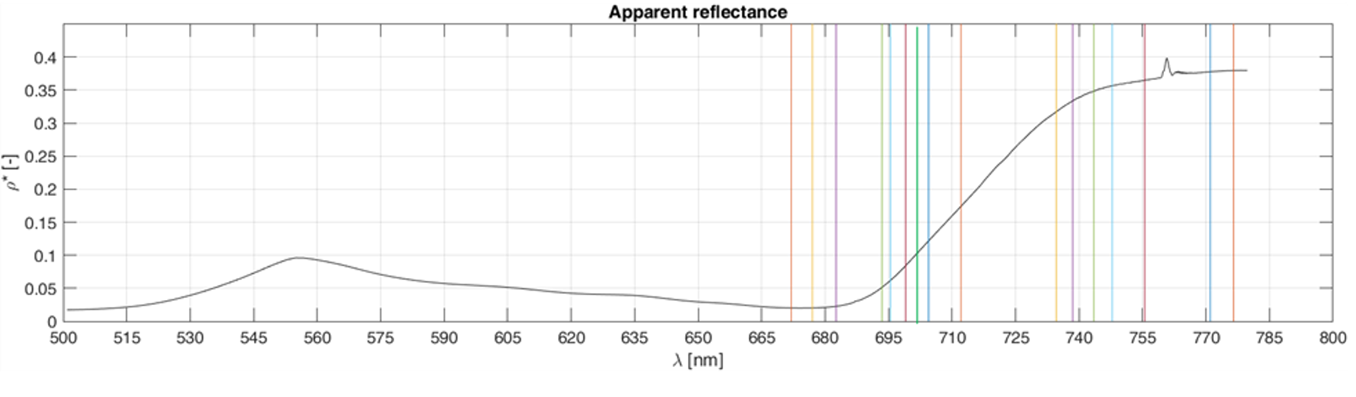
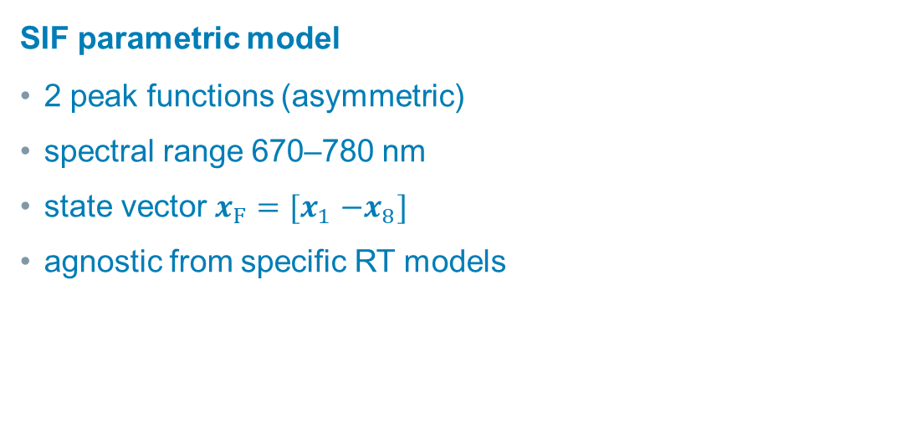
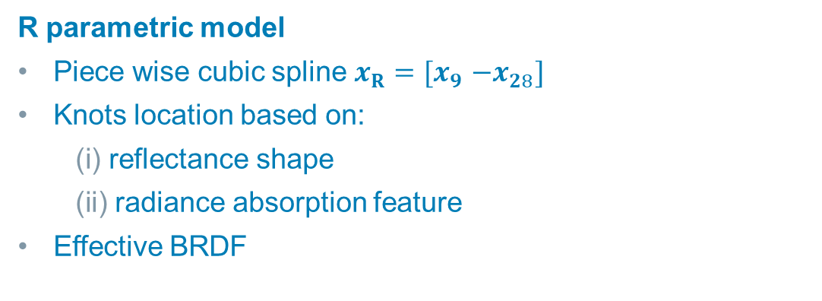
Forward operator (surface)
SIF parametric model
2 peak functions (asymmetric)
spectral range 670–780 nm
state vector $x_{F}{=[x}_{1}−x_{8}]$
agnostic from specific RT models
Red
$$SIF\left({x_{F\left(1−8\right)}}_{ }\right)= SIF_{RED}\left(x_{F\left(1−3\right)}\right)+{SIF}_{FAR−RED}\left(x_{F\left(4−8\right)}\right)$$
Far-Red
R parametric model
Piece wise cubic spline $x_{R}{=[x}_{9}−x_{28}]$
Knots location based on:
reflectance shape
radiance absorption feature
Effective BRDF

Slide 6
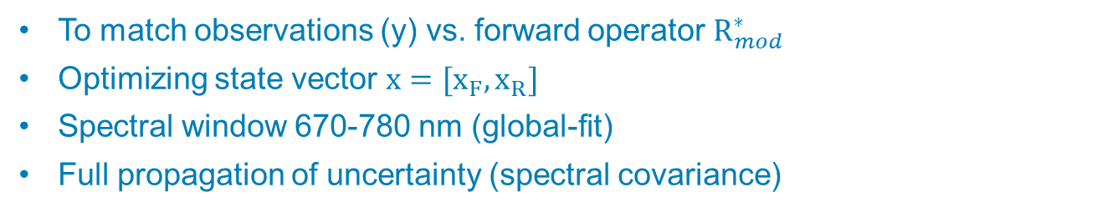
Inverse problem
1) Iterative regularized least-square problem (MAP, Bayesian)
To match observations (y) vs. forward operator $R_{mod}^{∗}$
Optimizing state vector ${x=[x_{F},x_{R}]}_{ }$
Spectral window 670-780 nm (global-fit)
Full propagation of uncertainty (spectral covariance)
2) Cost Function
$$J\left(x\right)=||y−{R_{mod}^{∗}}_{ }\left(x,b\right){||}_{S_{y}^{−1}}^{2}+Λ ||x−x_{a}||_{S_{a}^{−1}}^{2}$$
3) Iterations
Levenberg–Marquardt
Analytical Jacobian
Tikhonov regularization (Λ) with A‑Priori covariance constraints
Self‑Adaptive regularization via the Error Consistency Method
$${{x_{i+1}}_{ }}_{ }=x_{a}+{\left[{{Λ S}_{a}^{−1}+K}^{T}S_{y}^{−1}K\right]}^{−1}{ K}^{T}S_{y}^{−1} \left[y−R_{mod^{ }}^{∗}\left(x_{i},b\right)+K\left(x_{i}−x_{a}\right)\right]$$

Slide 7
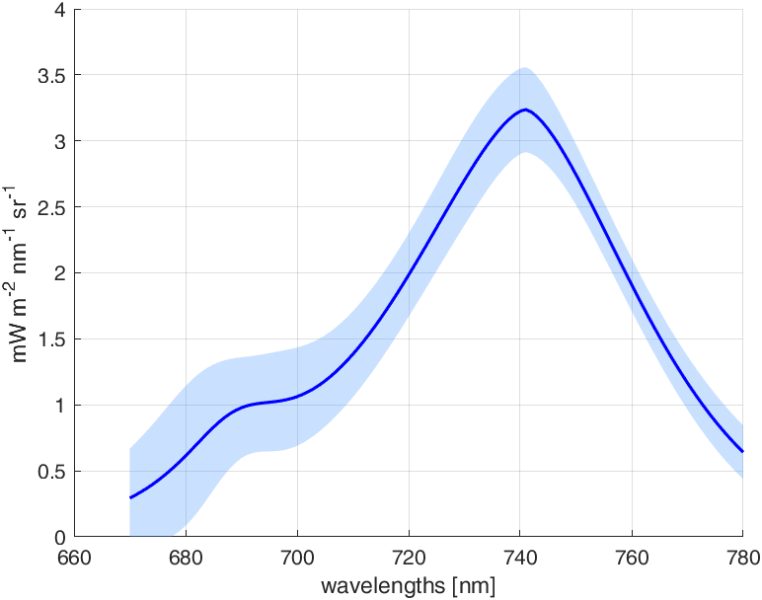

Products Uncertainty
$$J\left(x\right)=||y−{R_{mod}^{∗}}_{ }\left(x,b\right){||}_{S_{y}^{−1}}^{2}+Λ ||x−x_{a}||_{S_{a}^{−1}}^{2}$$
Measurement uncertainty matrix
A-priory probability distribution
Input measurement uncertainty and
Prior probability covariance
Iterative
algorithm
regularization Λ
$$S_{\hat{x}}={\left(K^{T}S_{y}^{−1}K+{ΛS}_{a}^{−1}\right)}^{−1}$$
SIF parameters cov uncertainty
Uncertainty in spectral domain
Mapping to spectral domain
Linear propagation
Posterior
uncertainty
Monte Carlo

Slide 8
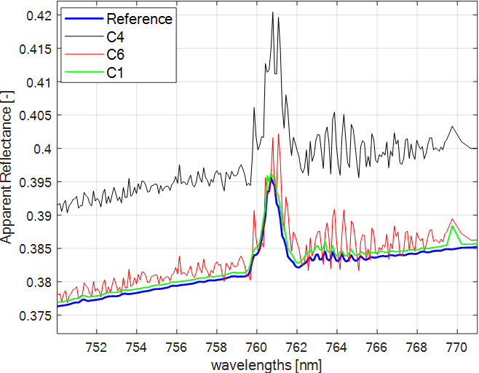
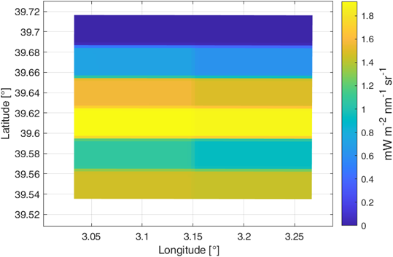
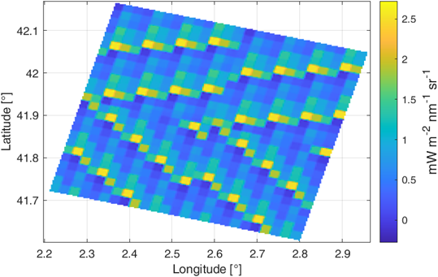
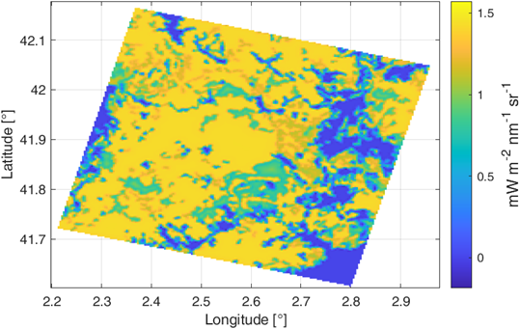
FLEX-E2E Test Data Sets (TDS 6.1)
TDS is composed of synthetic scenes generated by the E2E simulator
Scene configurations (SGM):
  Surface characteristics (SIF, biophysical parameters)
  Atmospheres
Instrument configurations (FIPS):
C1: Ideal instrument (noise free)
C4: Nominal instrument (all noises: ARG, RXRA, RSRA, Photon)
C6: Nominal instrument with perfect radiometric calibration (w/o ARG)
ScV_01
Karpov
Catalonia

Slide 9
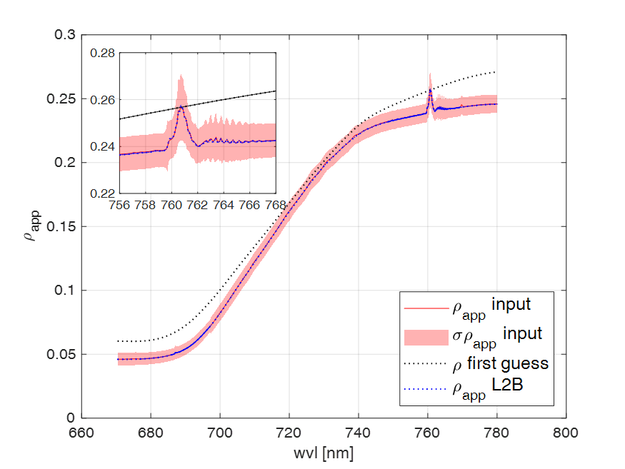
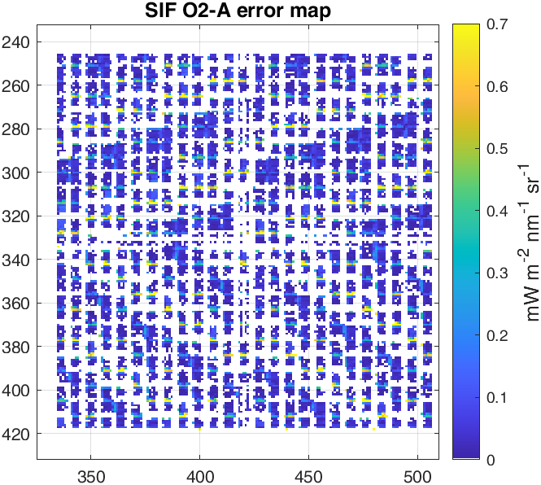
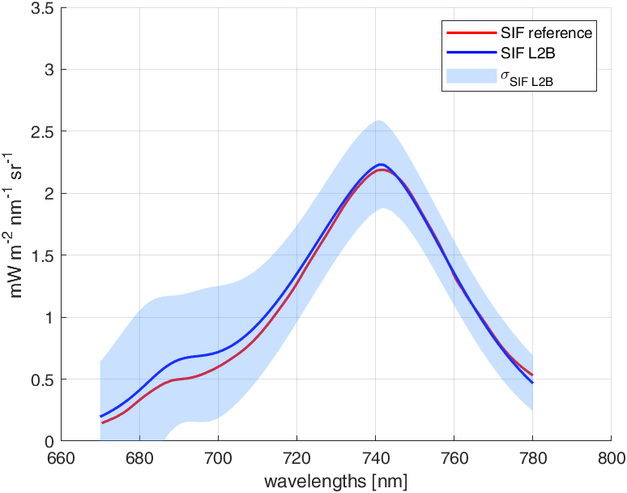
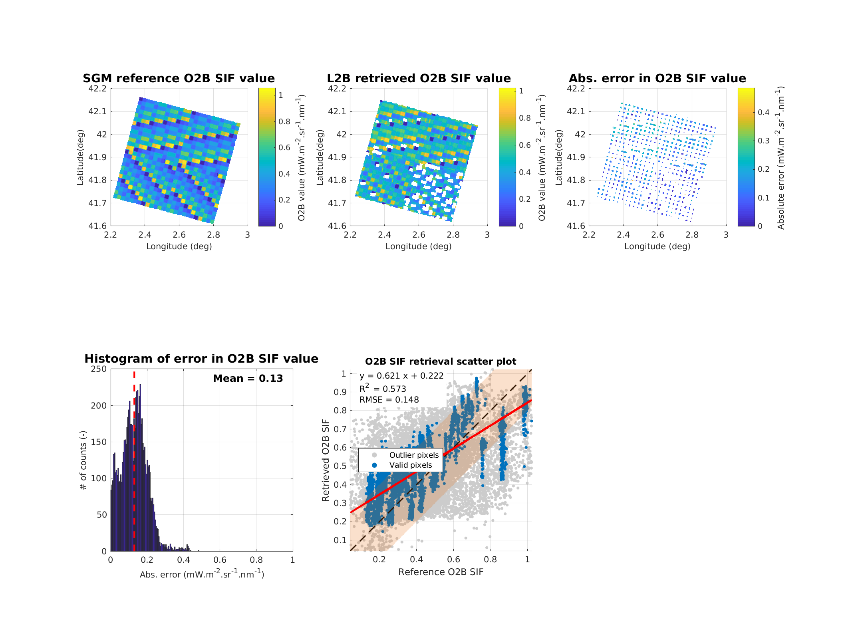
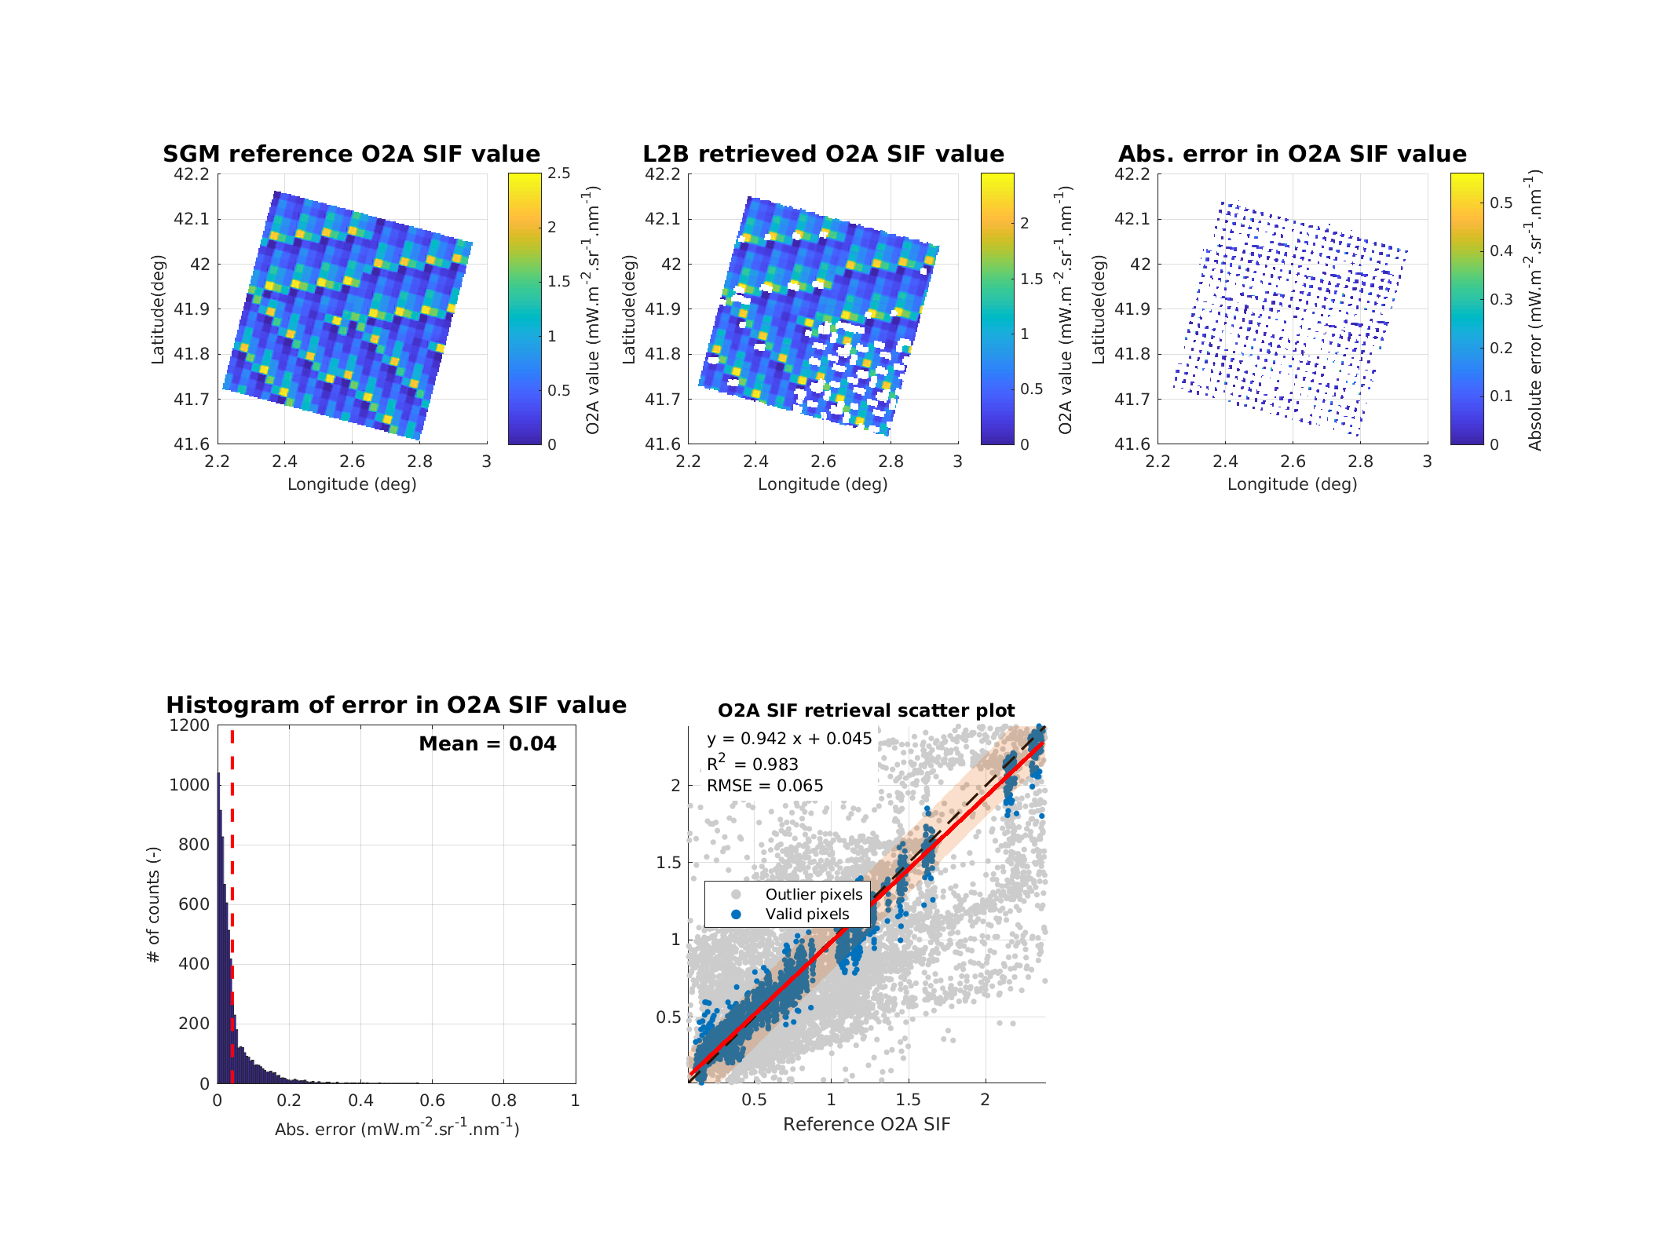
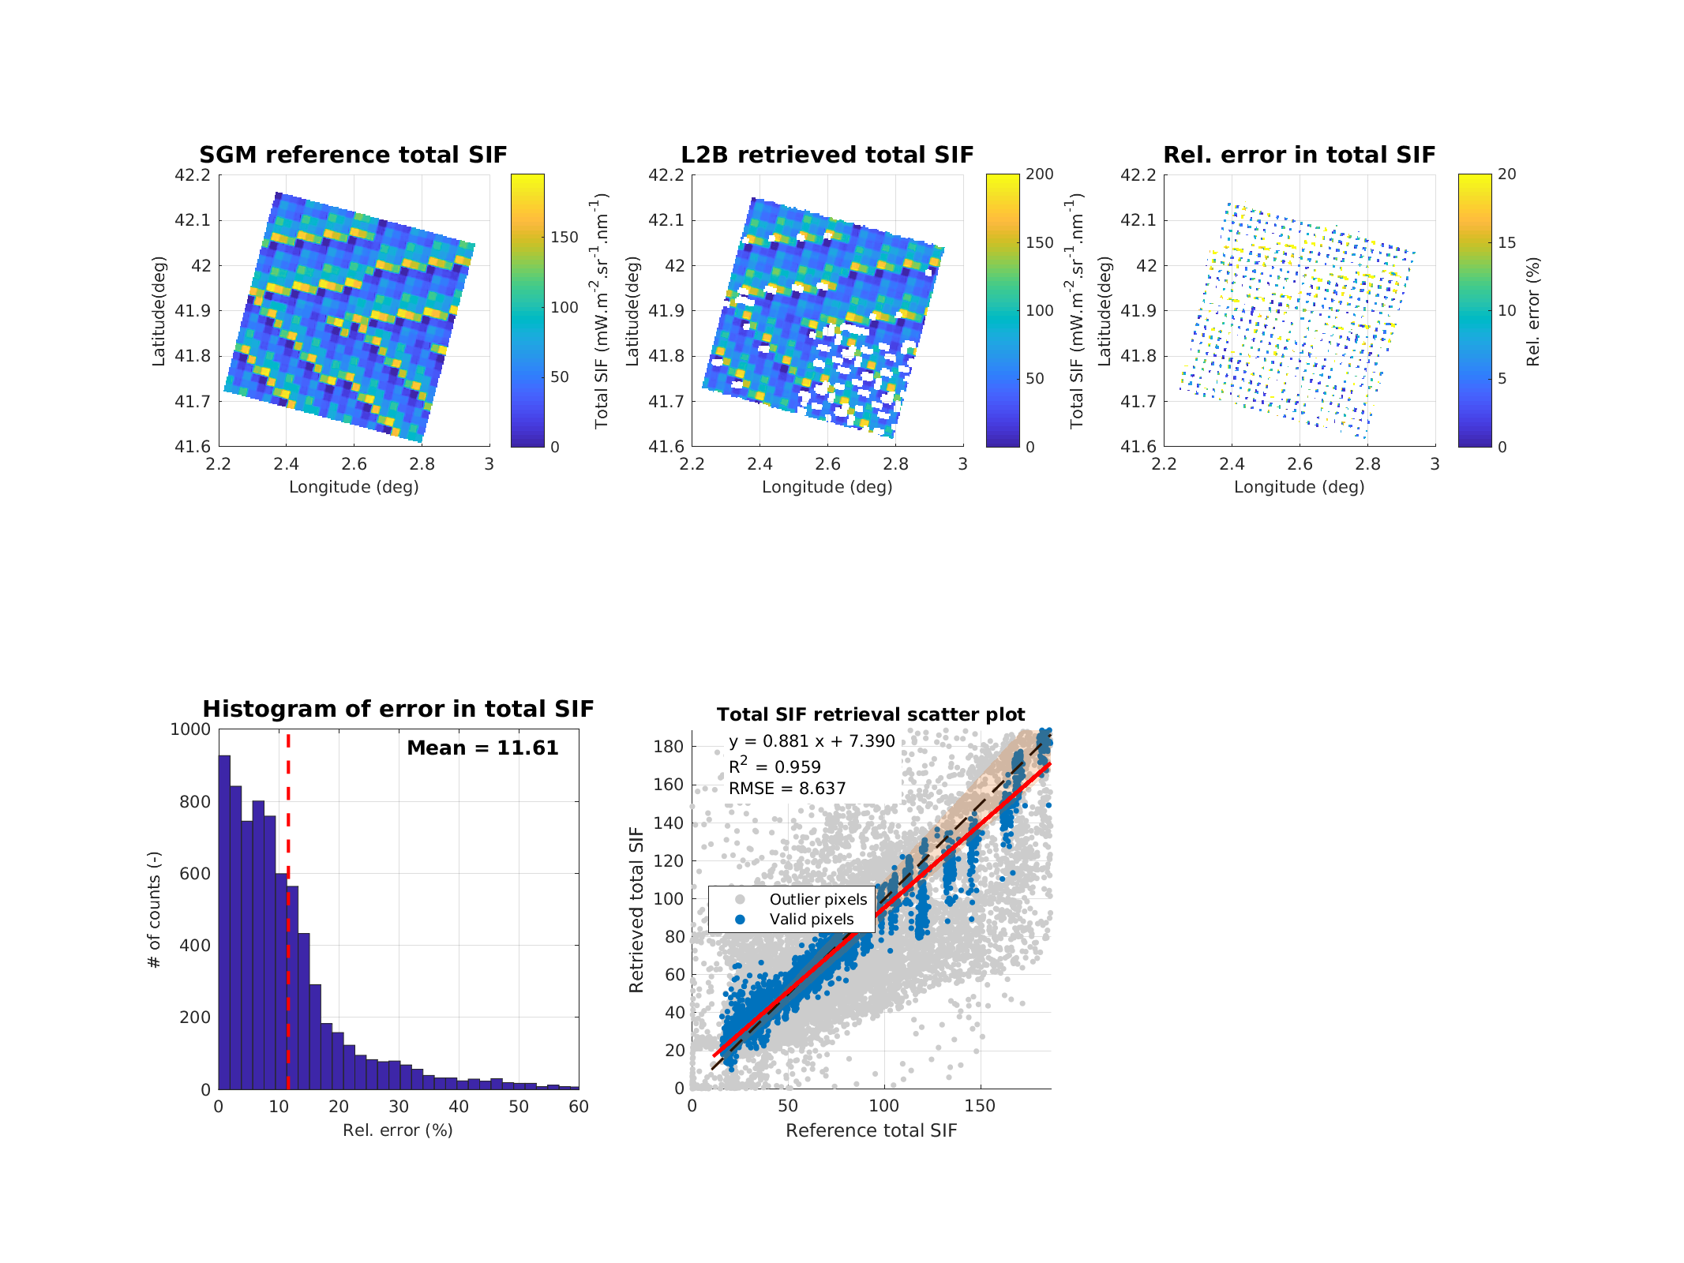
FLEX-E2E Test Data Sets
Results
SIF spectrum retrieval accuracy (Karpov) - Reference
C1 Ideal
Accurate fit of R* and SIF (single pixel)
Blue dots (valid pixels) show good relationship and small errors
Gray dots represent transition pixels (edges of fields) affected by geometric inconsistency
Example single pixel
Scene statistics

Slide 10
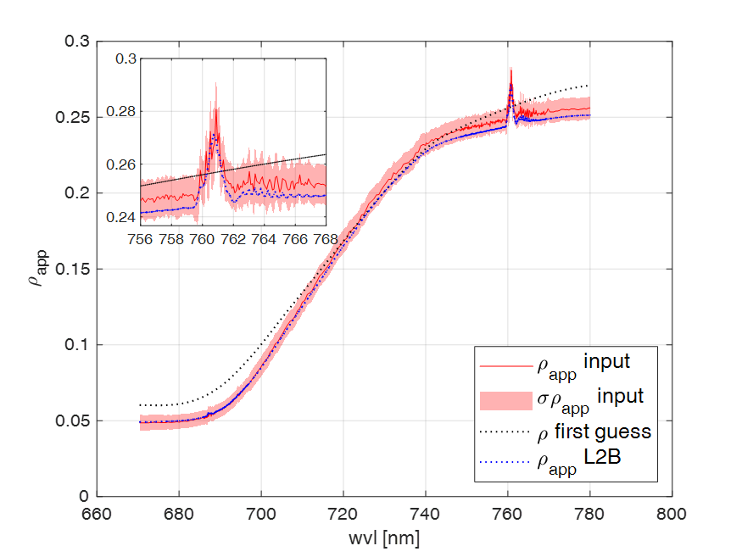
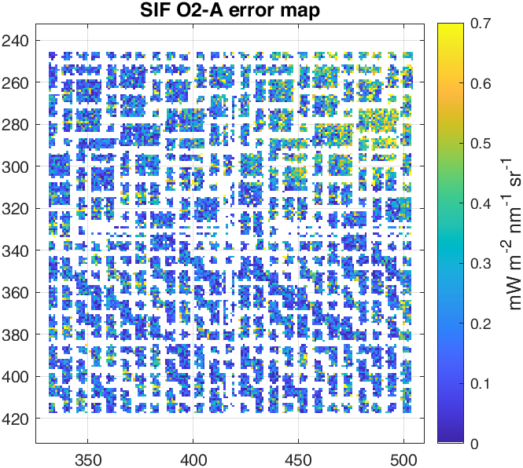
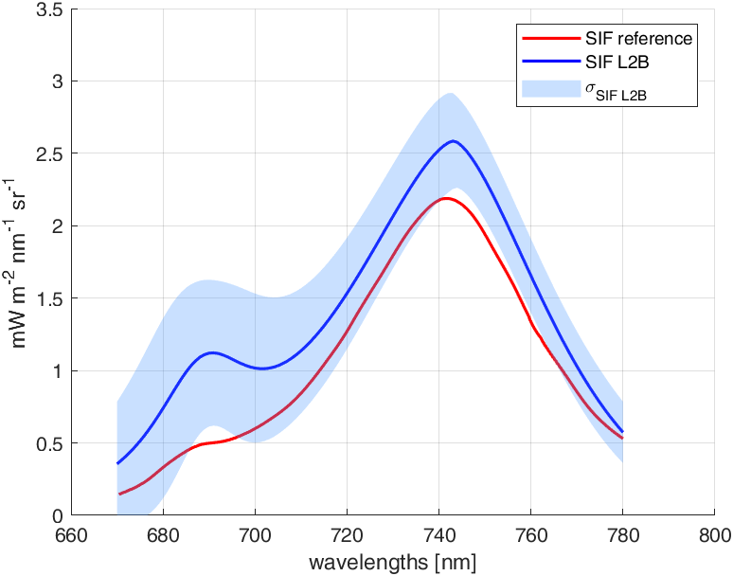
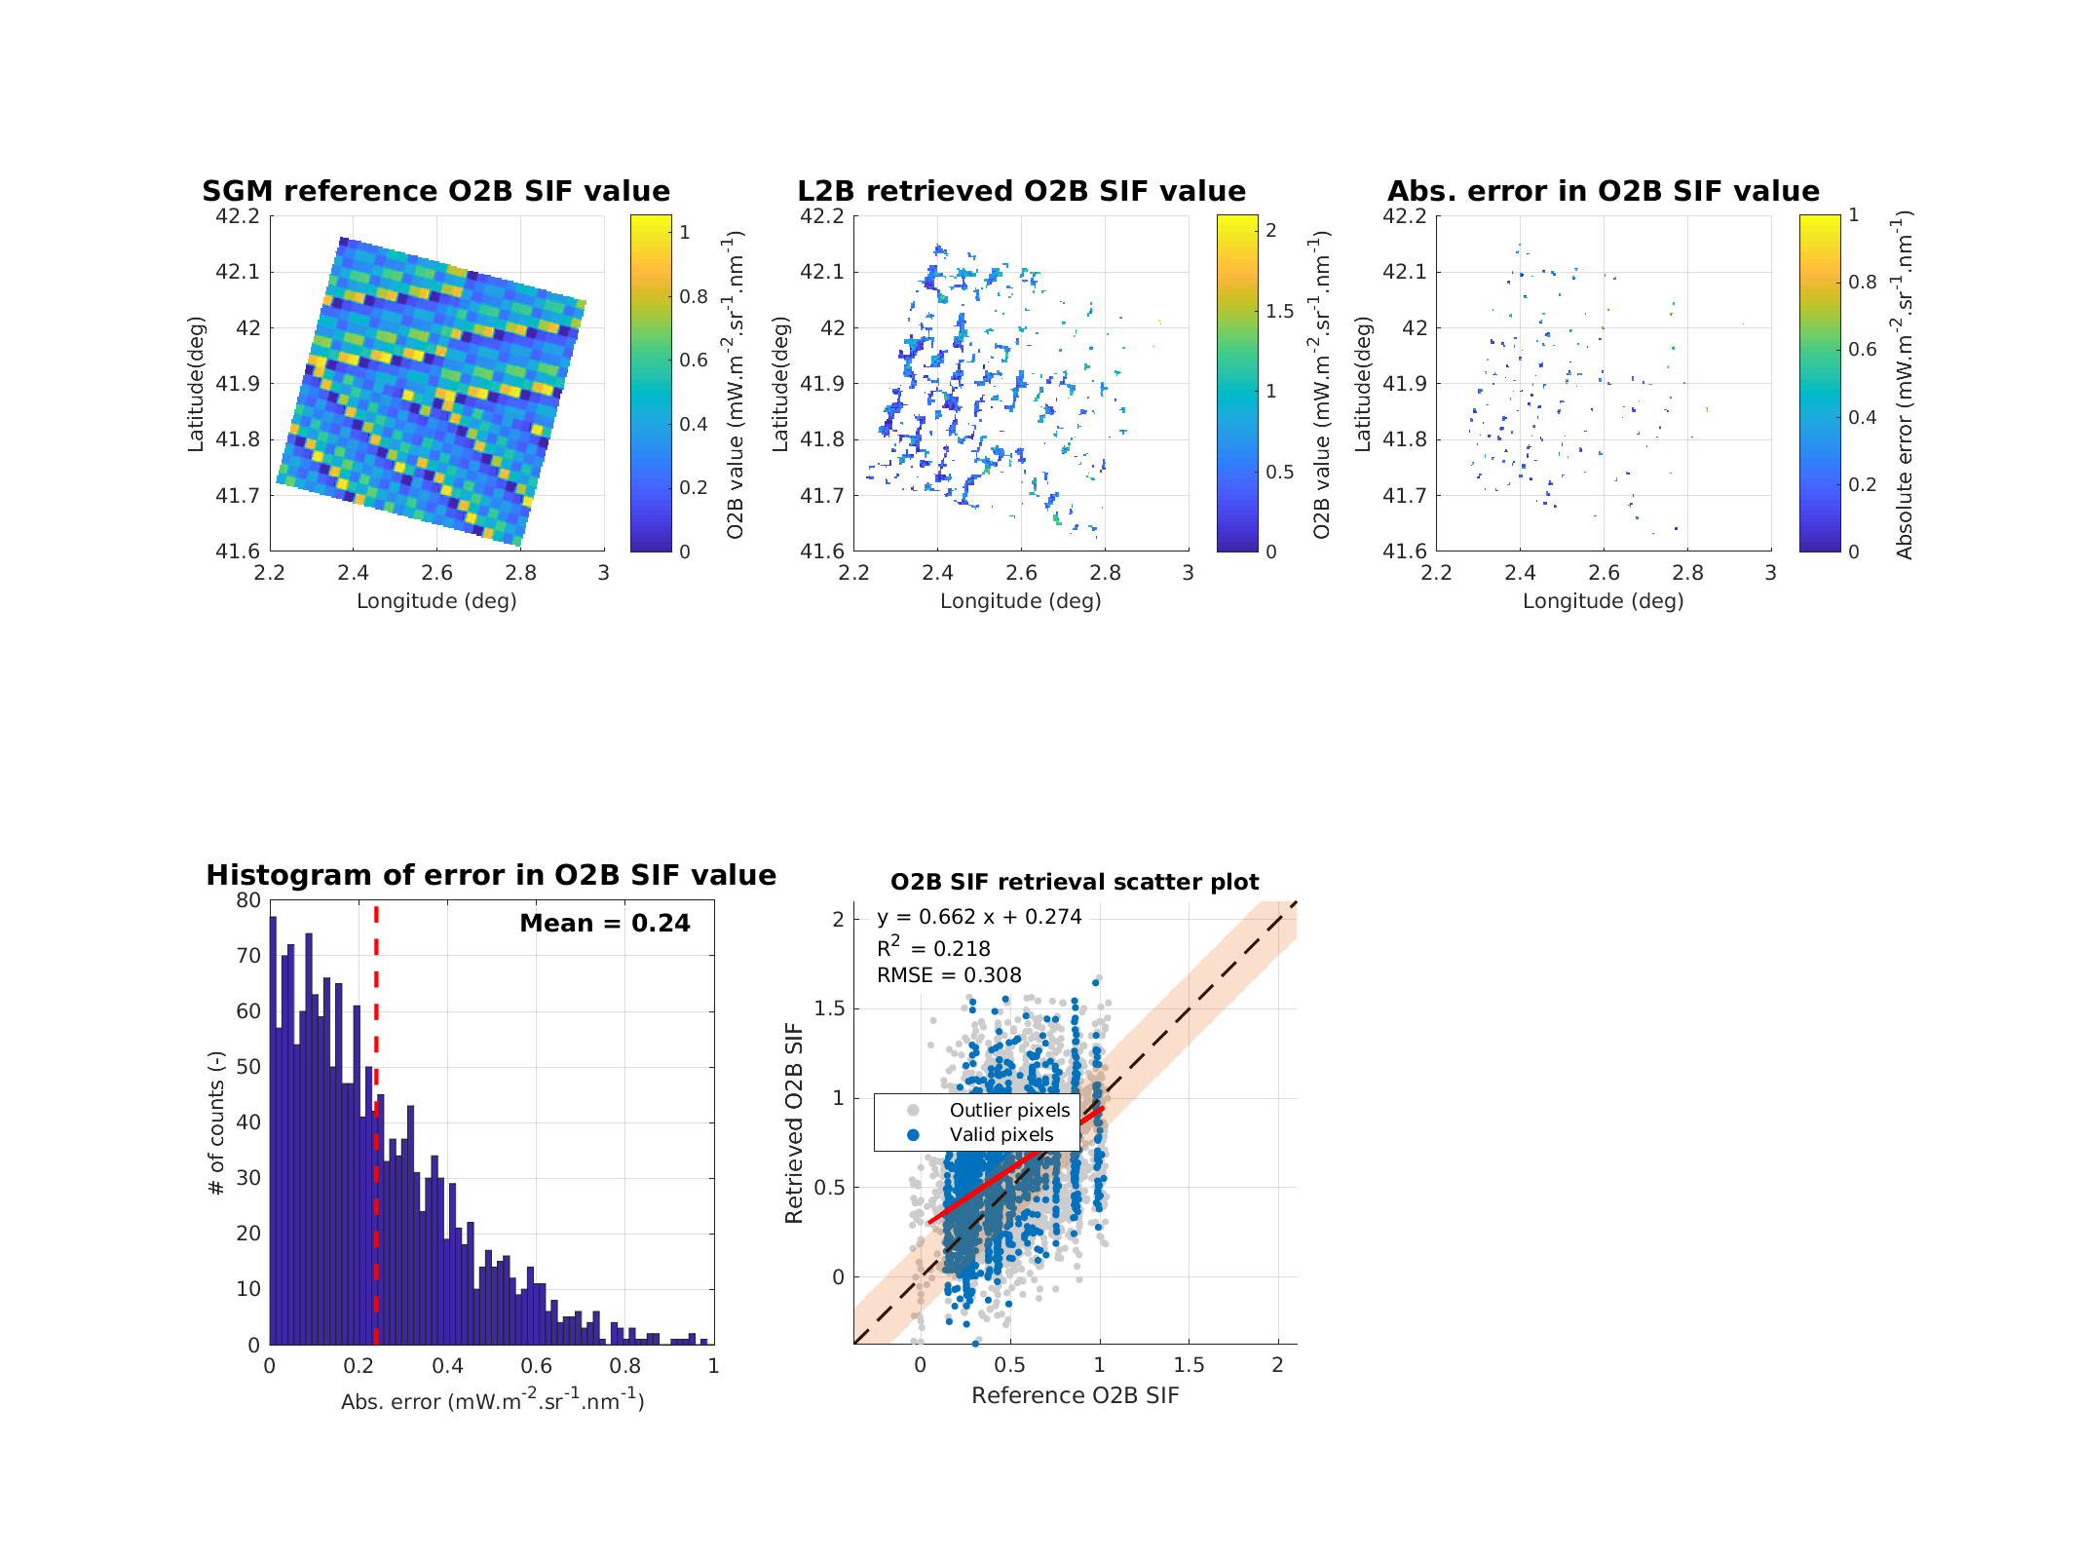
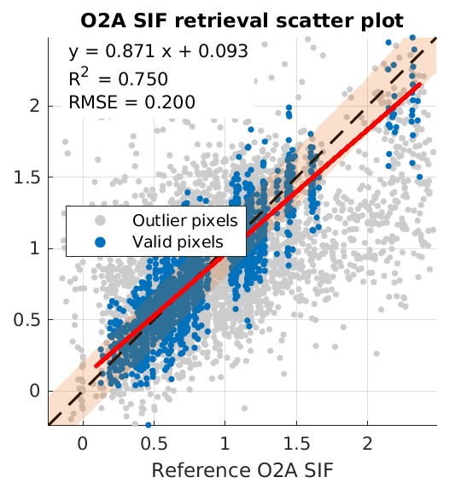
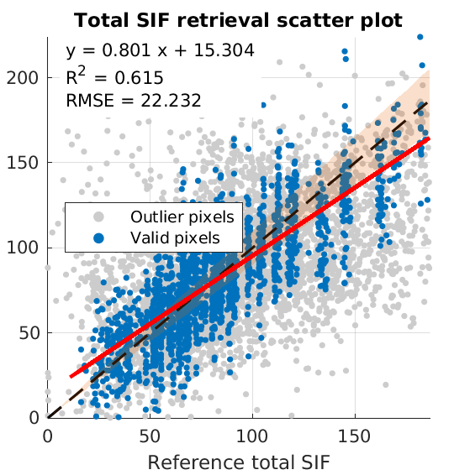
FLEX-E2E Test Data Sets
Results
SIF spectrum retrieval accuracy (Karpov) - Reference
C6 All noises w/o ARG
Retrievals exhibit increased scatter, although the overall relationship is preserved
Example single pixel
Scene statistics

Slide 11
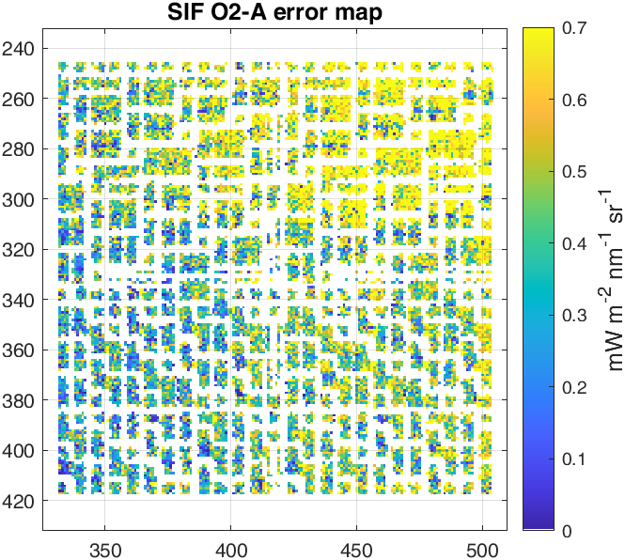
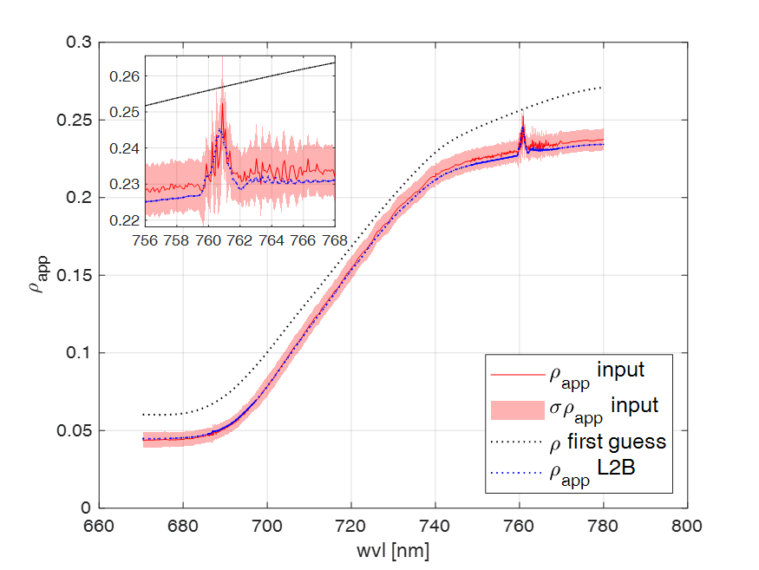
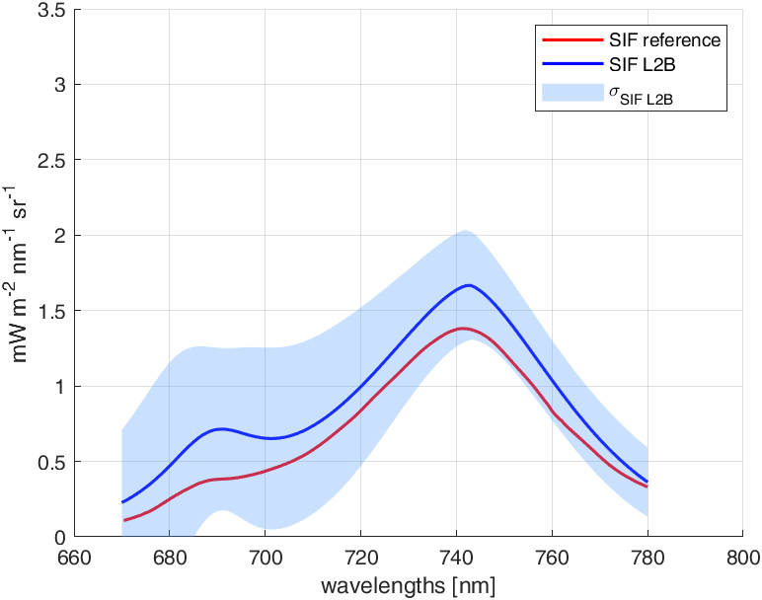
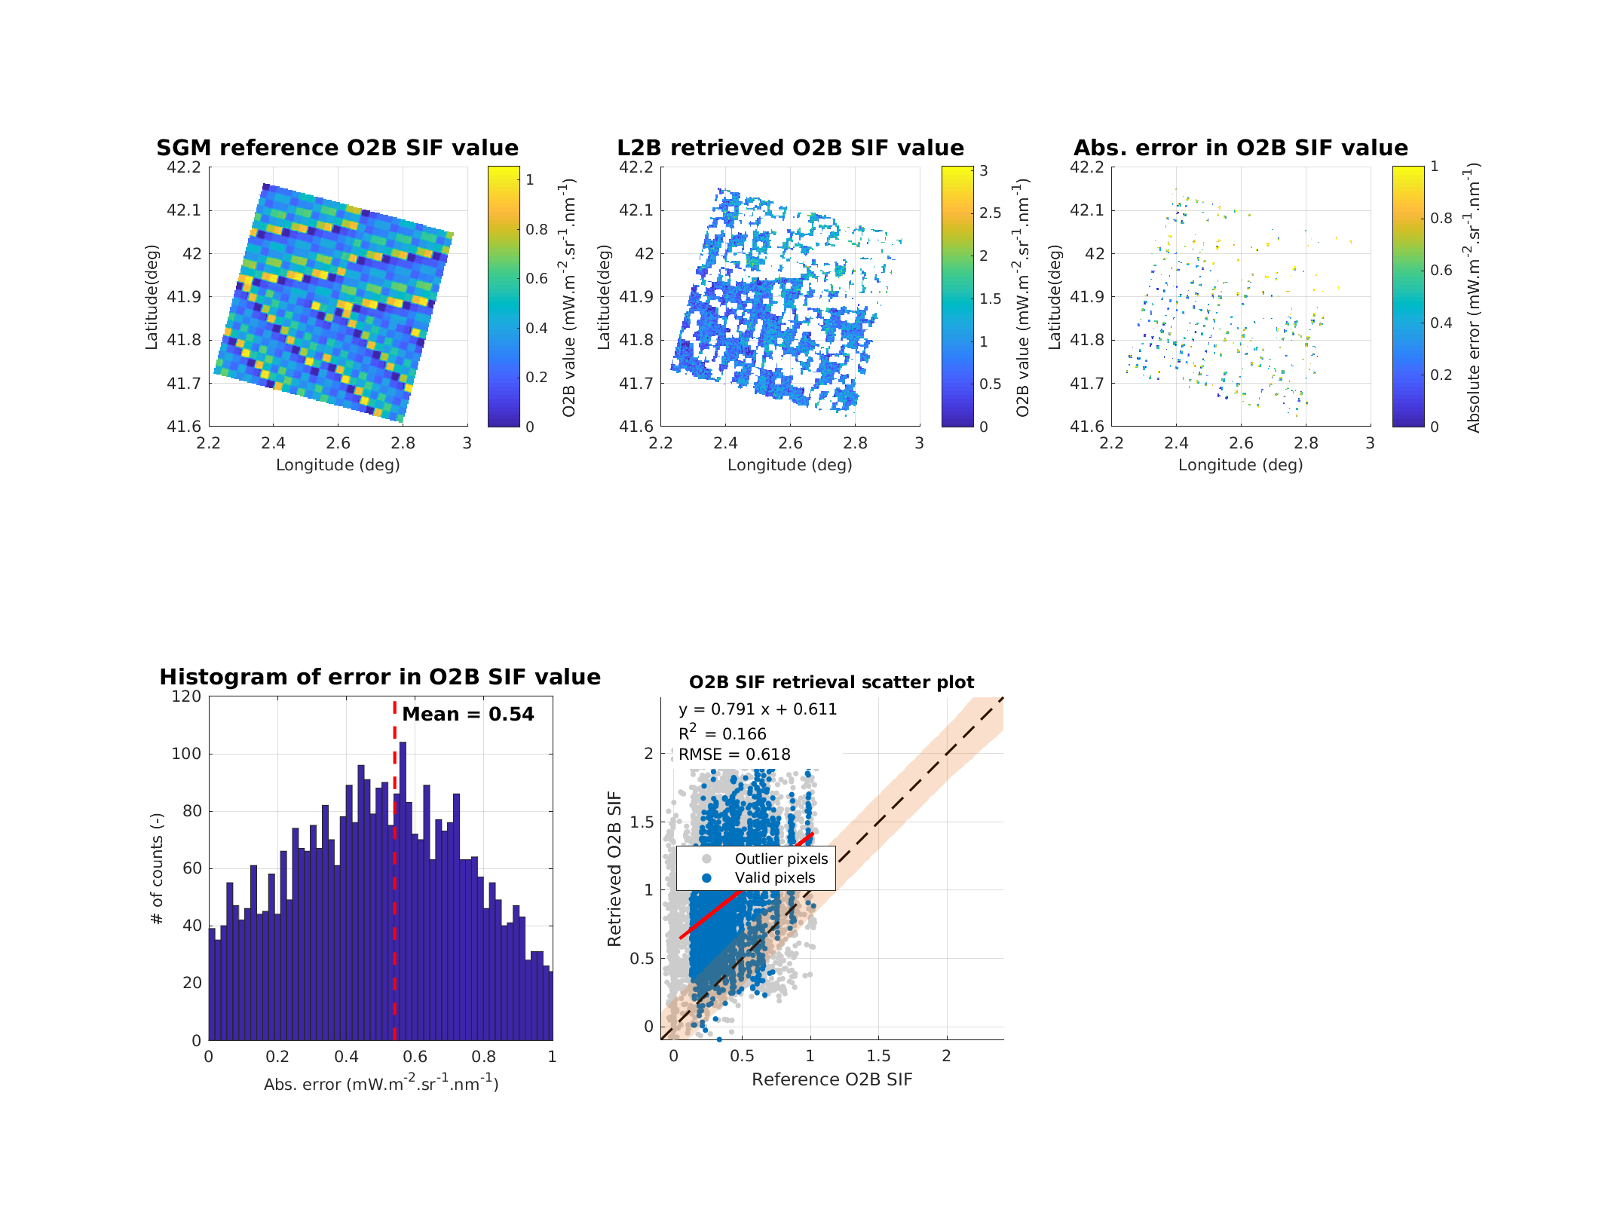
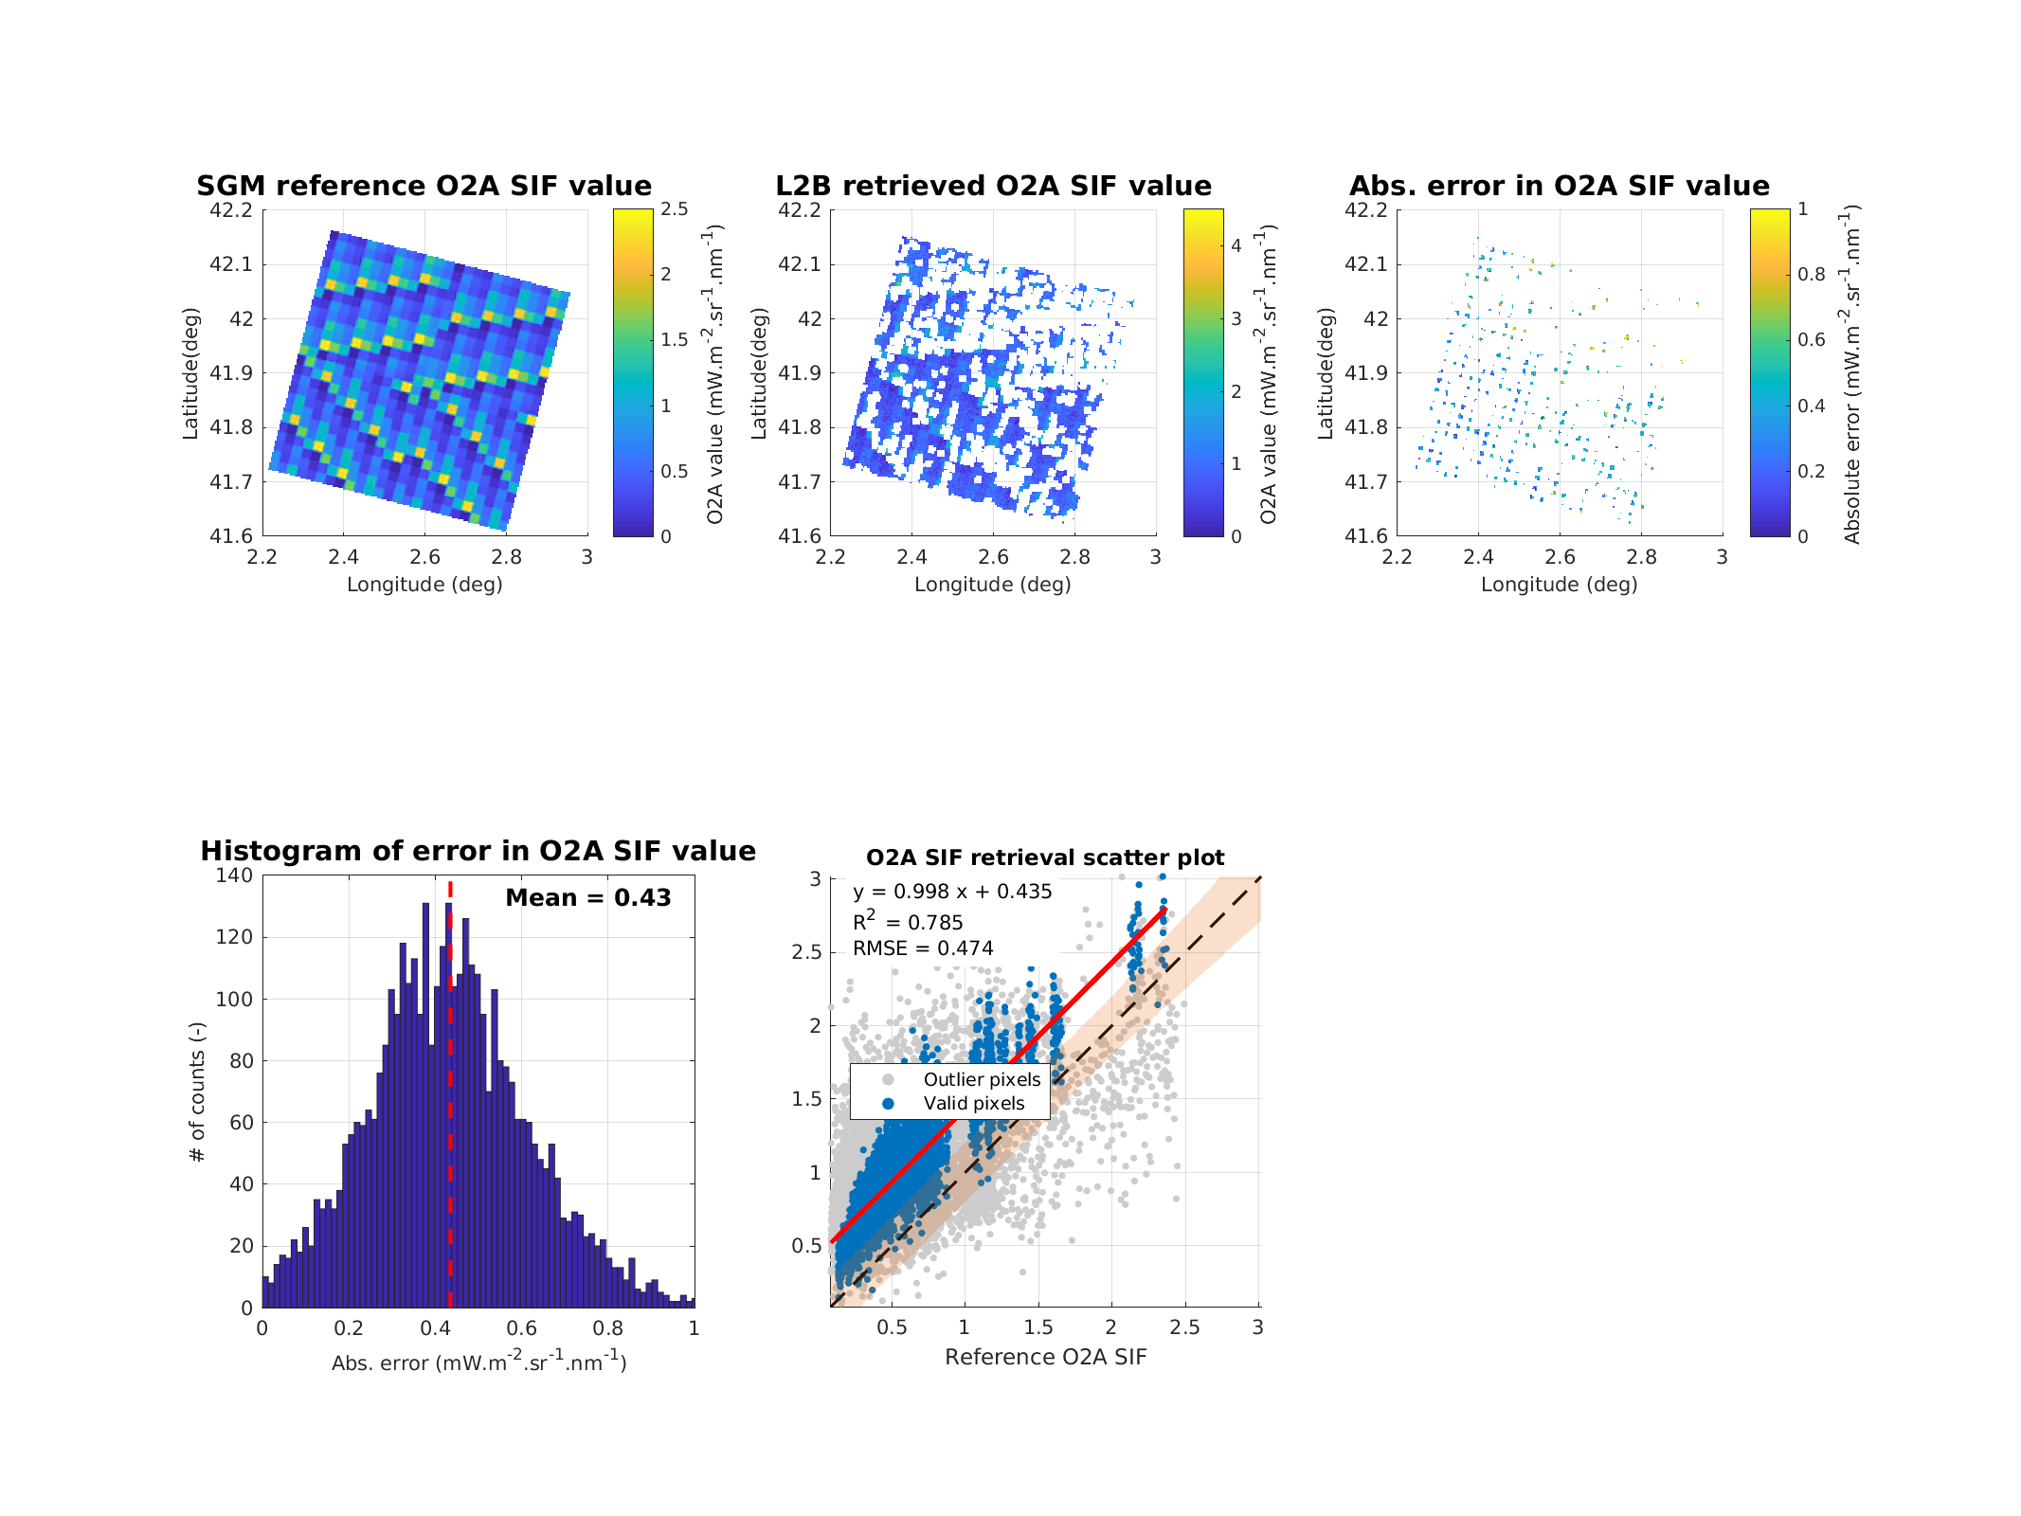
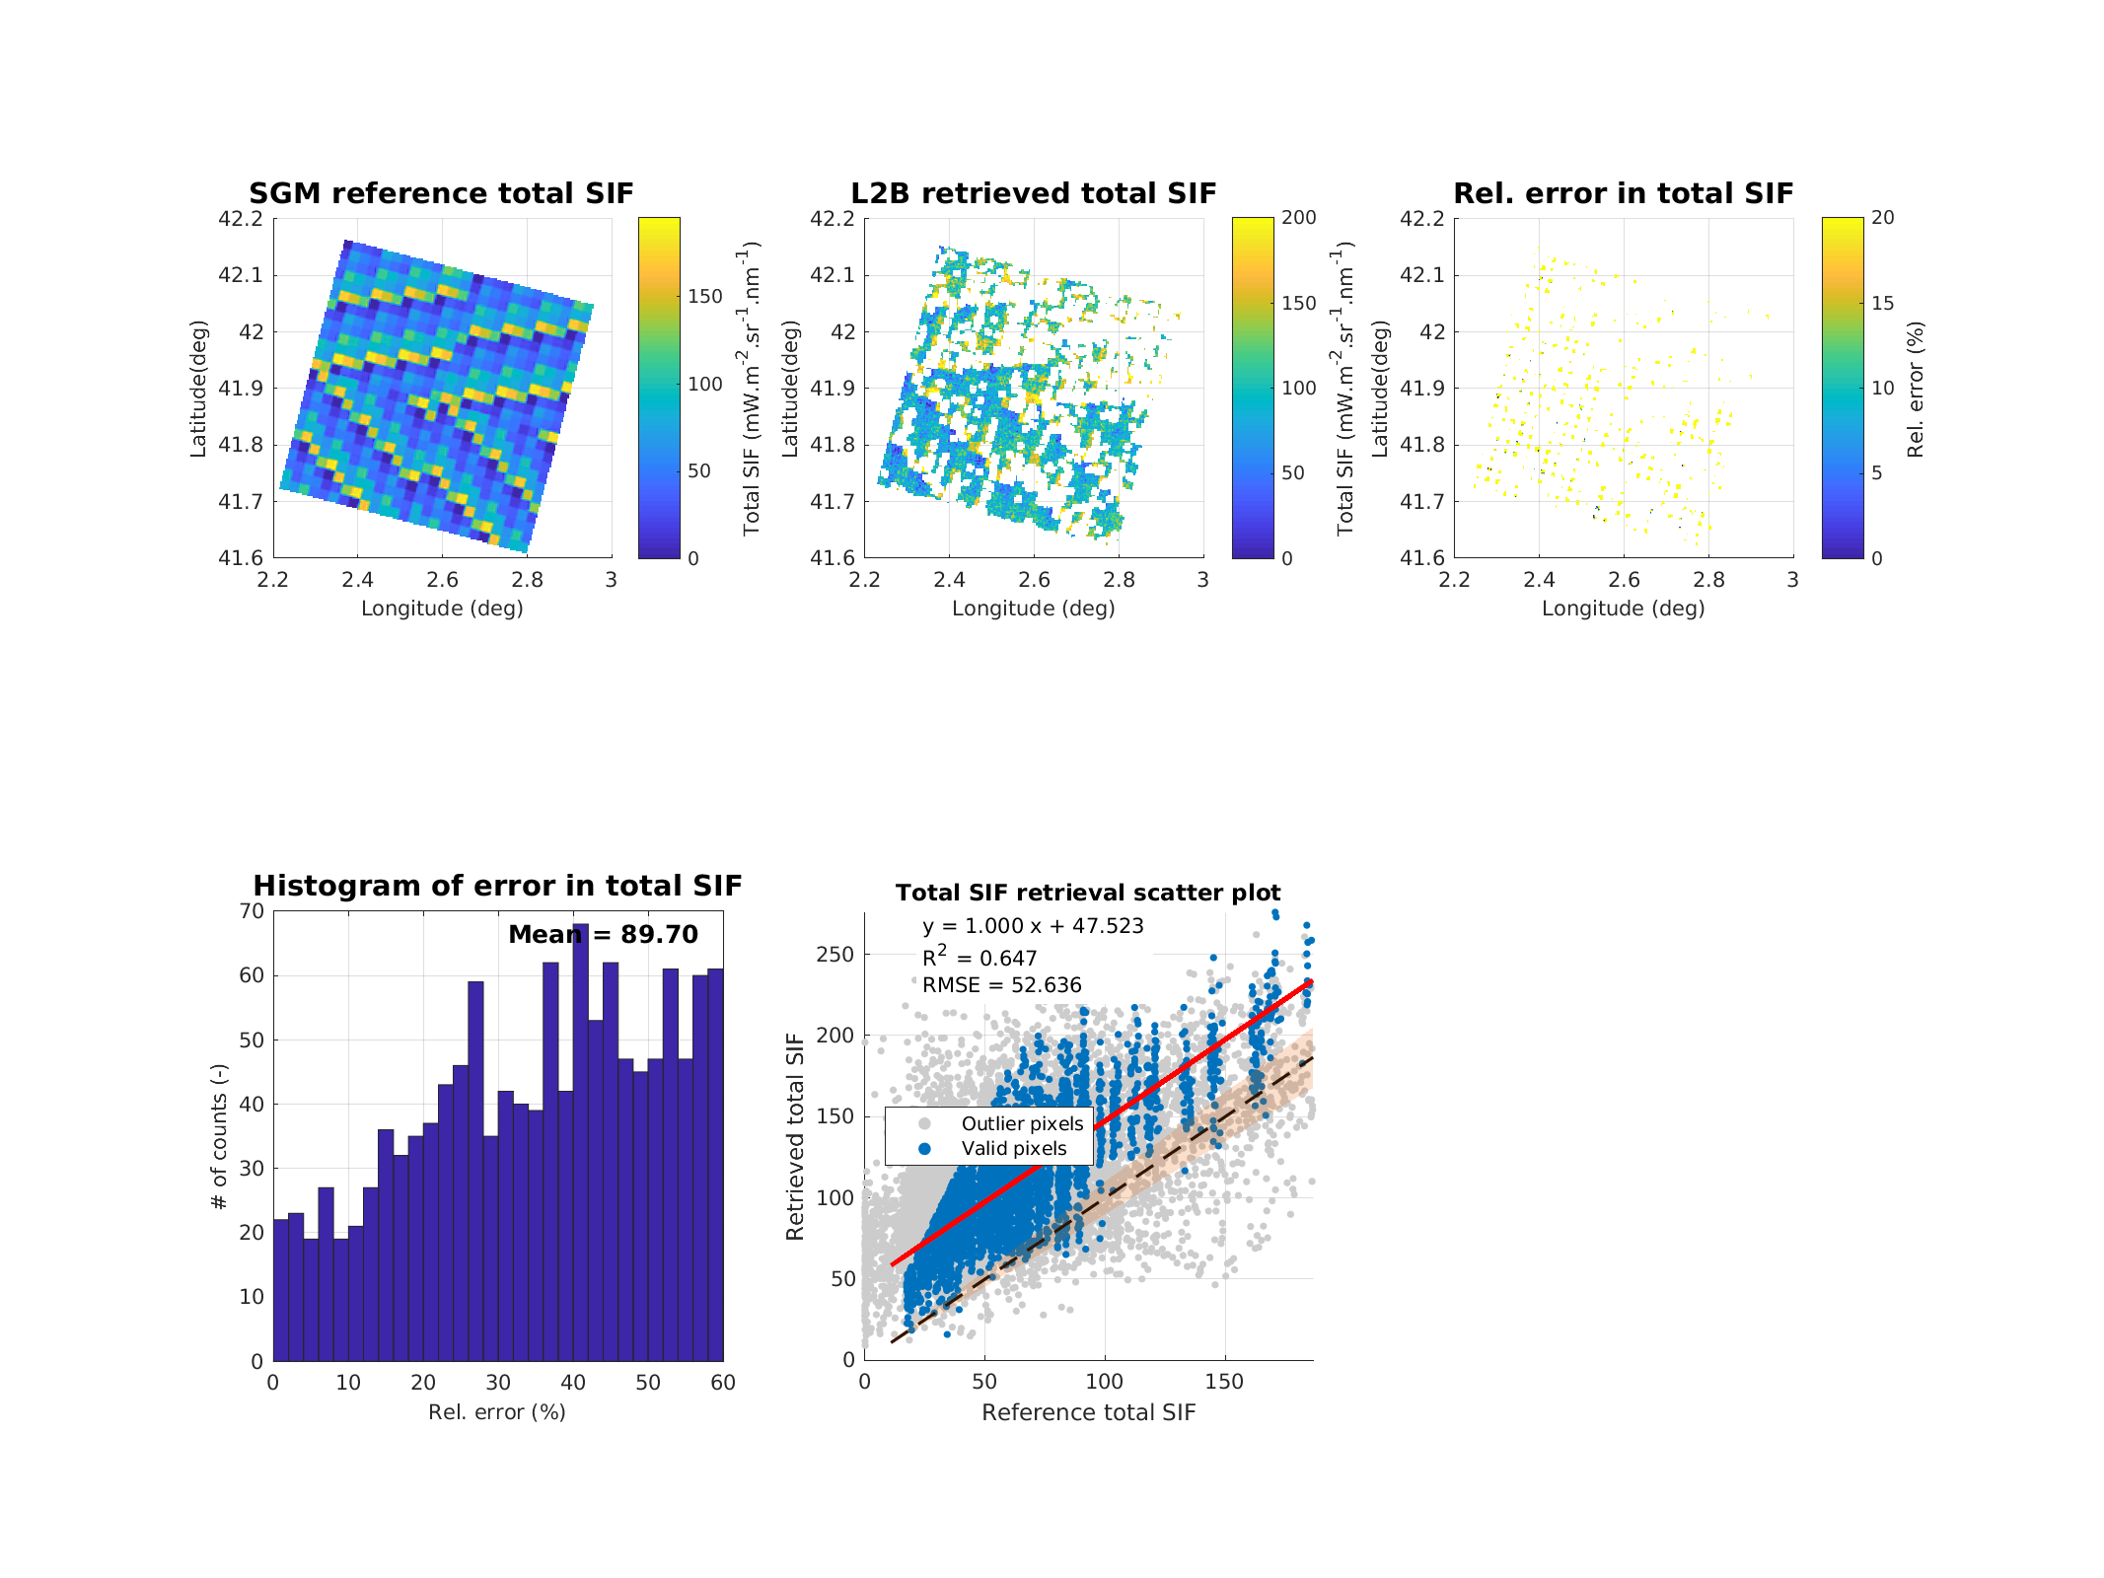
FLEX-E2E Test Data Sets
Results
SIF spectrum retrieval accuracy (Karpov) - Reference
C4 All noises
Positive bias due to L1B radiometric calibration (ARG +3.5%)
Example single pixel
Scene statistics

Slide 12
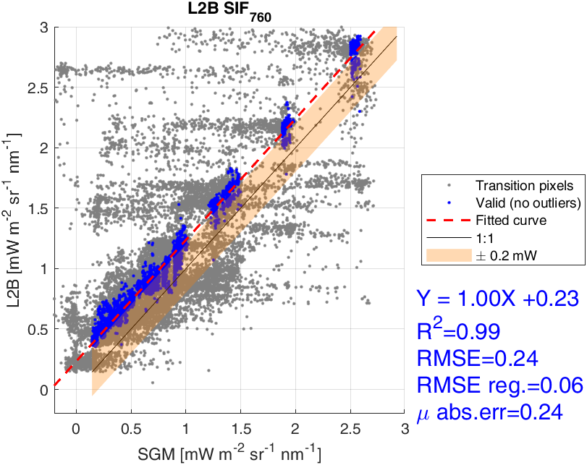
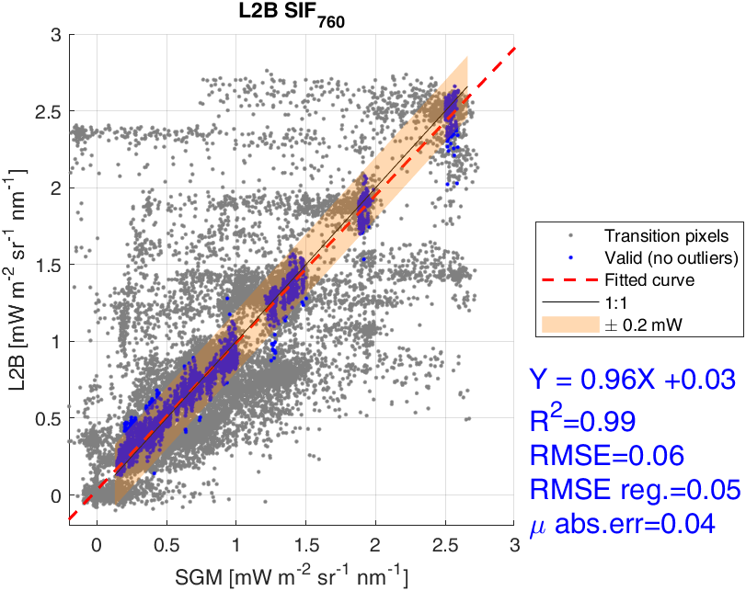
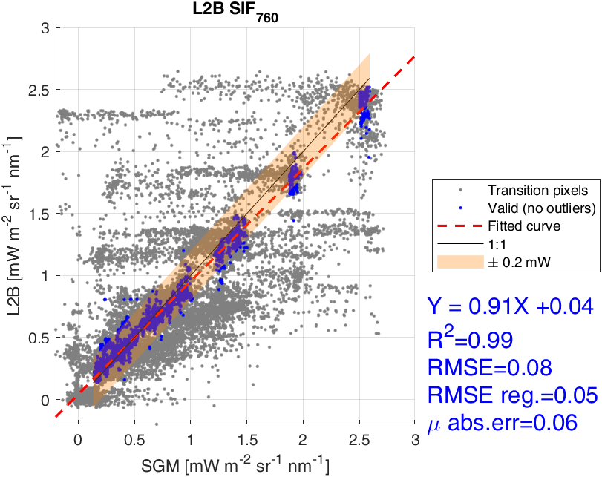
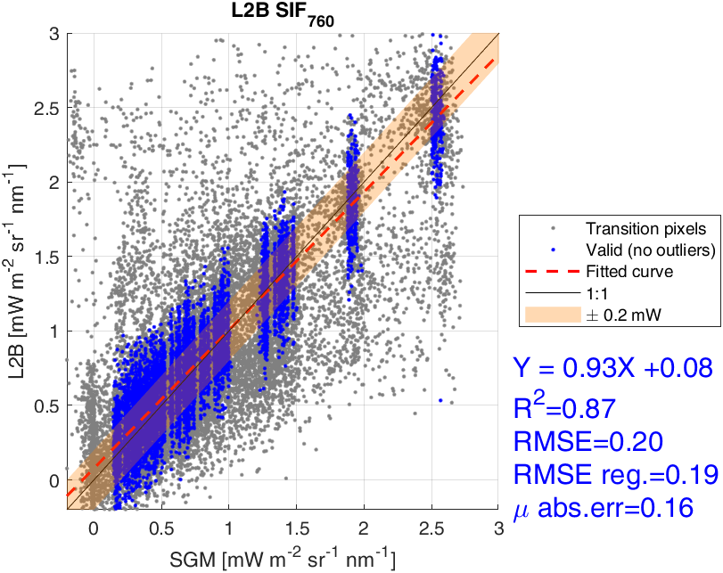
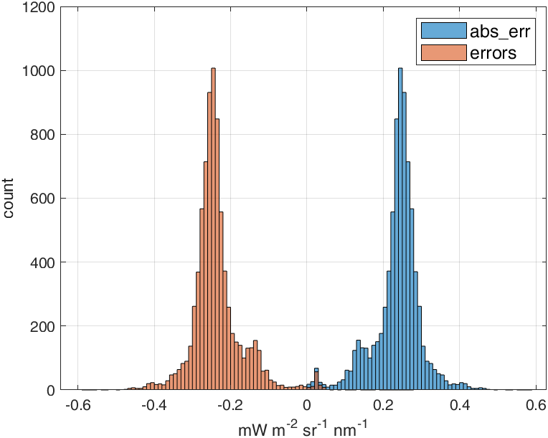
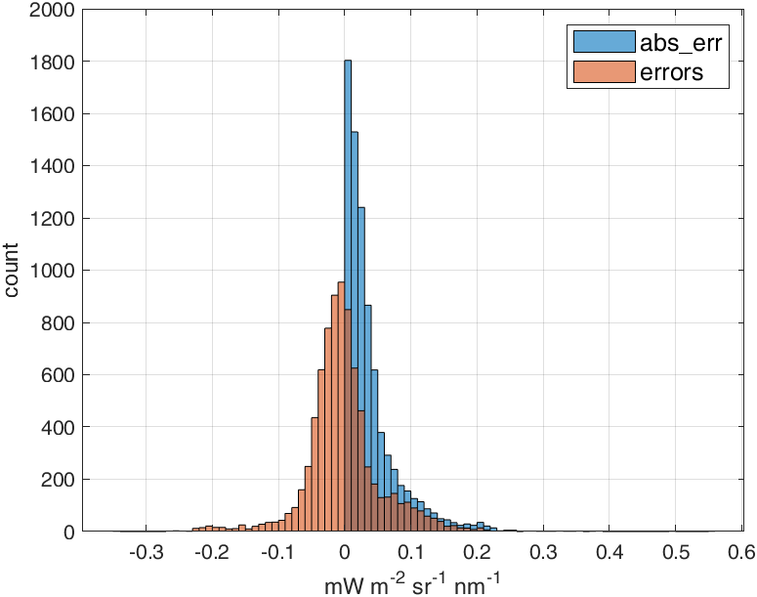
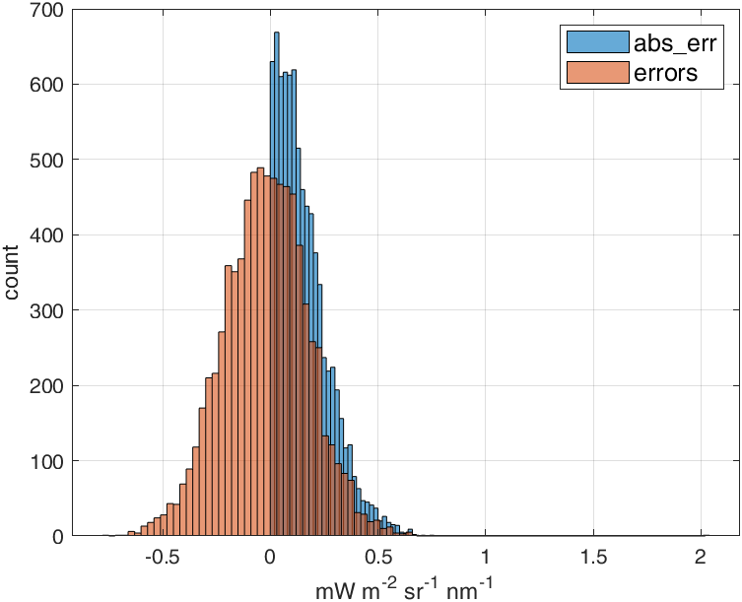
FLEX-E2E Test Data Sets
Results
Assessing different instrument noises - preliminary
Absolute Radiometric Gain (ARG)
Relative Spatial Radiometric Aaccuracy (RXRA)
Relative Spectral Radiometric Accuracy (RSRA)
Photon noise
Error distribution

Slide 13

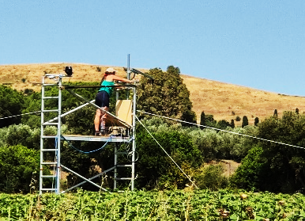
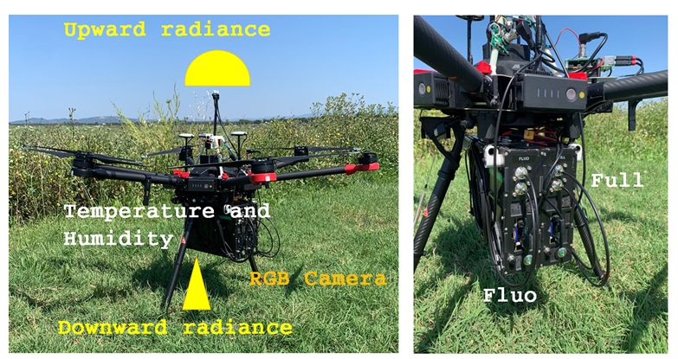
L2B SIF retrievals from ground and UAV
To support FLEX data exploitation and DISC product validation (Cal/Val tool):
L2B adapted to process field spectroscopy data from ground-based and UAV
Delivers outputs consistent with FLEX products
Detailed characterization of FLOX measurement uncertainties and their propagation are under implementation within the FRM4FLUO project
ground-based
Example of diurnal cycles from FLOX
UAV

Slide 14
Final Remarks
Recent methodological improvements integrated into the algorithm have led to substantial gains in overall performance.
SIF O₂‑A (and the far‑red peak) is retrieved with the highest accuracy, whereas O₂‑B (red peak) exhibits greater scatter; overall, SIFint retains a good level of accuracy.
The E2E TDS in the various configurations were essential for the development of the algorithm.
Ongoing efforts focus on increasing retrieval precision, mainly driven by L2B numerical stability vs. instrument photon noise and mis-match in geometry.
During operational phases, achieving and maintaining accurate absolute radiometric calibration (ARG) will be essential.
The L2B algorithm has been adapted to support ground-based (and UAV) spectroscopy, towards a better cross-platform consistency.

Slide 15
Final Remarks
Thank you for the attention

Slide 16
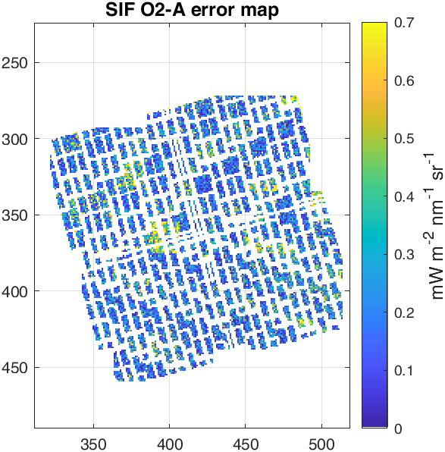
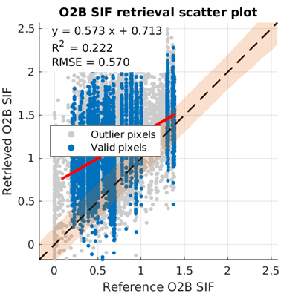
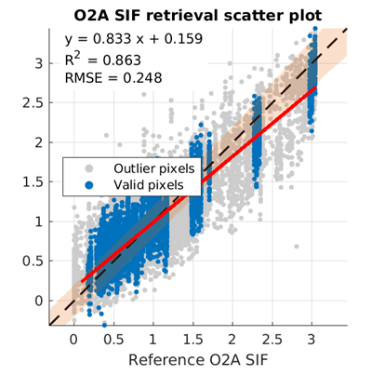
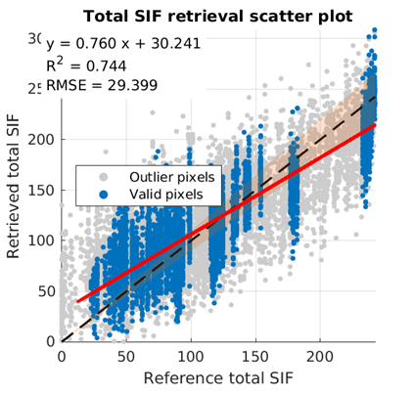
FLEX-E2E Test Data Sets
Results
SIF spectrum retrieval accuracy (Karpov) - Nominal
C4 All noises

