Slide 1
A roadmap towards estimating the diurnal dynamics of terrestrial ecosystem productivity with the help of FLEX
Gregory Duveiller, Qiqi Deng, Philipp Köhler, Dong Li, Daniel Pabon-Moreno, Bastian Siegmann, Sebastian Wieneke, Georg Wohlfahrt, Zhaoying Zhang

Slide 2
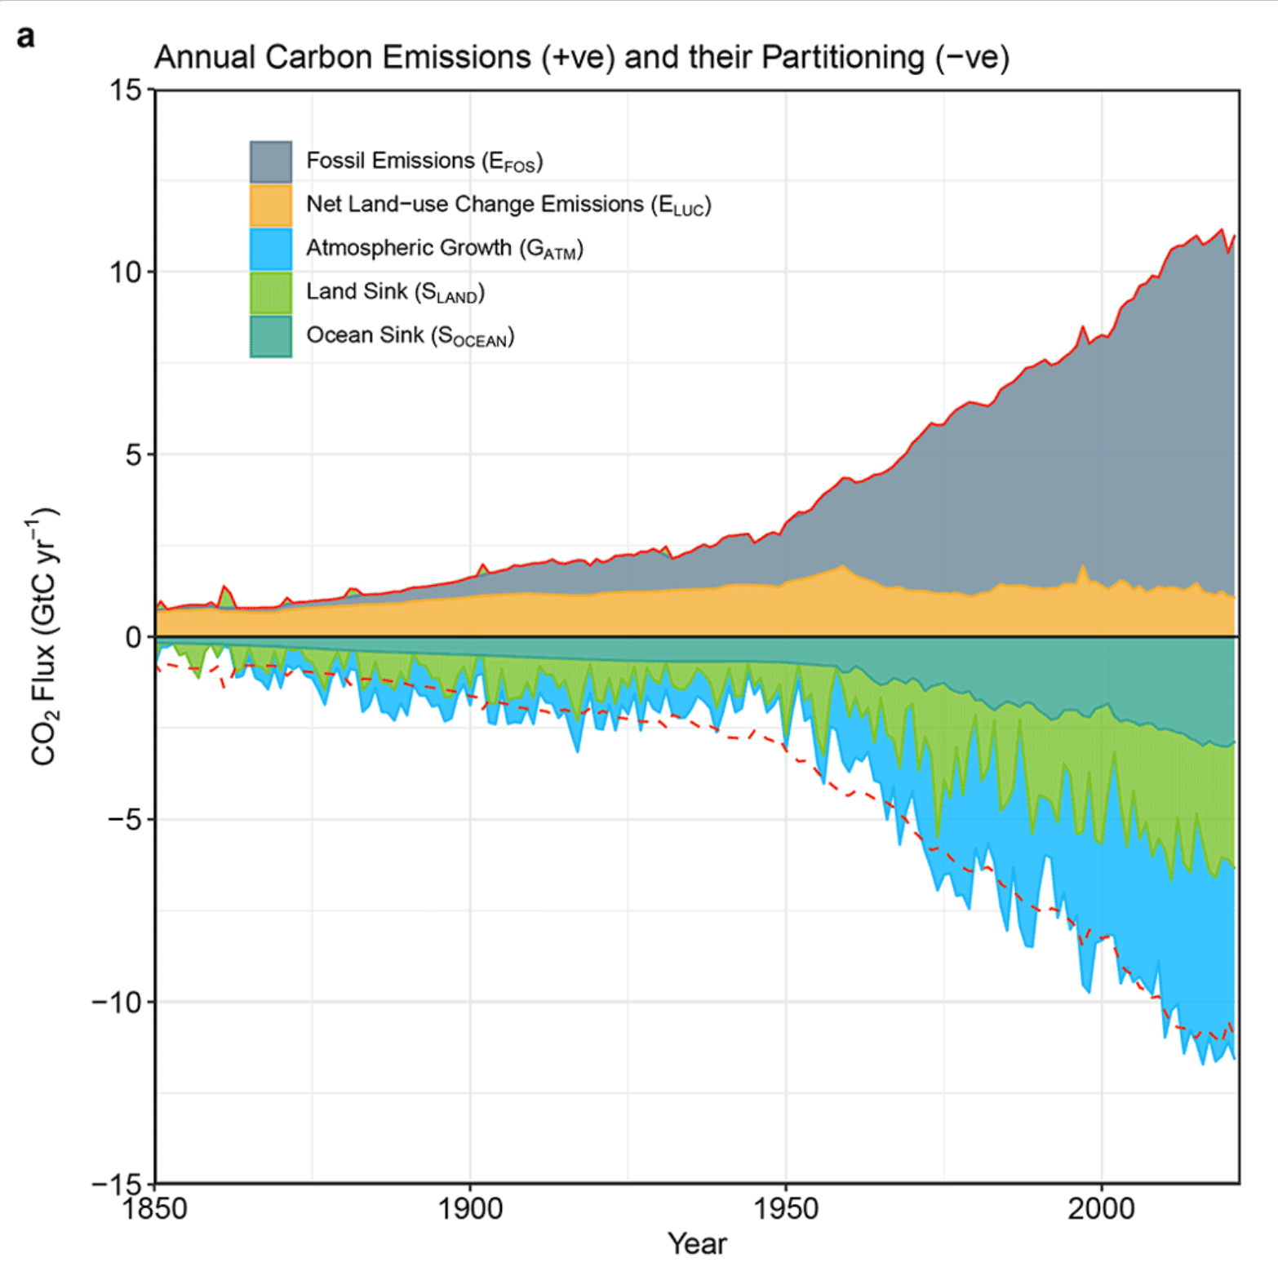
(Friedlingstein graph)
Friedlingstein et al. (2022) ESSD
Net Land-use change emissions
Land sink
Terrestrial ecosystems are the most uncertain part of the C budget

Slide 3
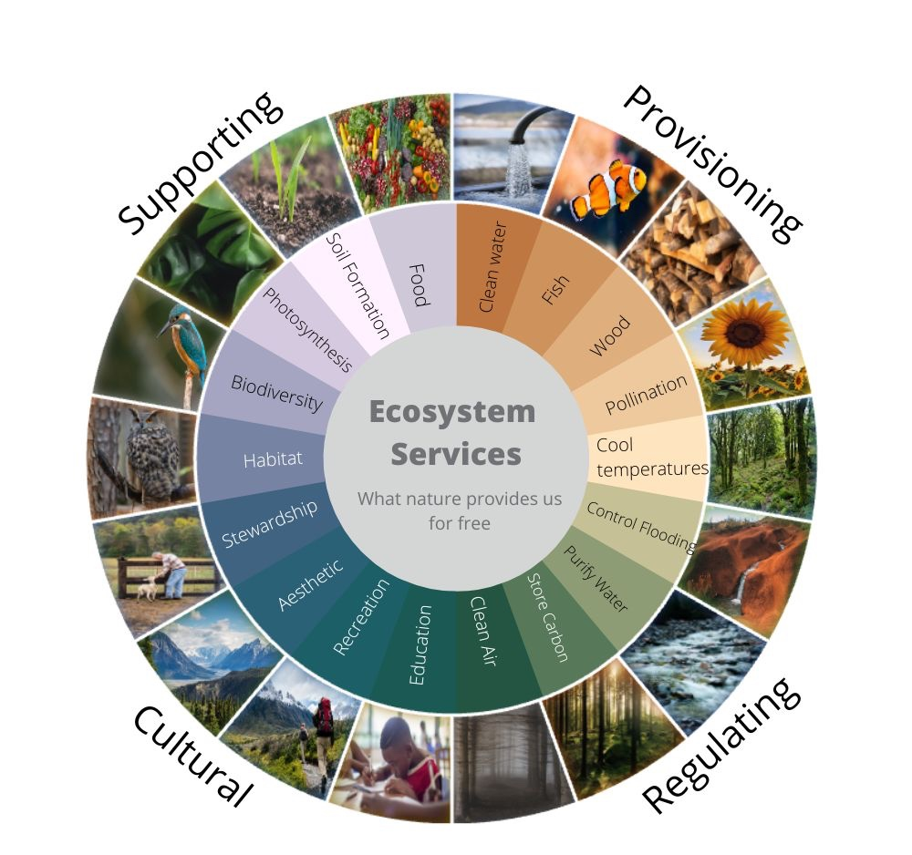
Ecosystem Services
www.visionlearning.com

Slide 4
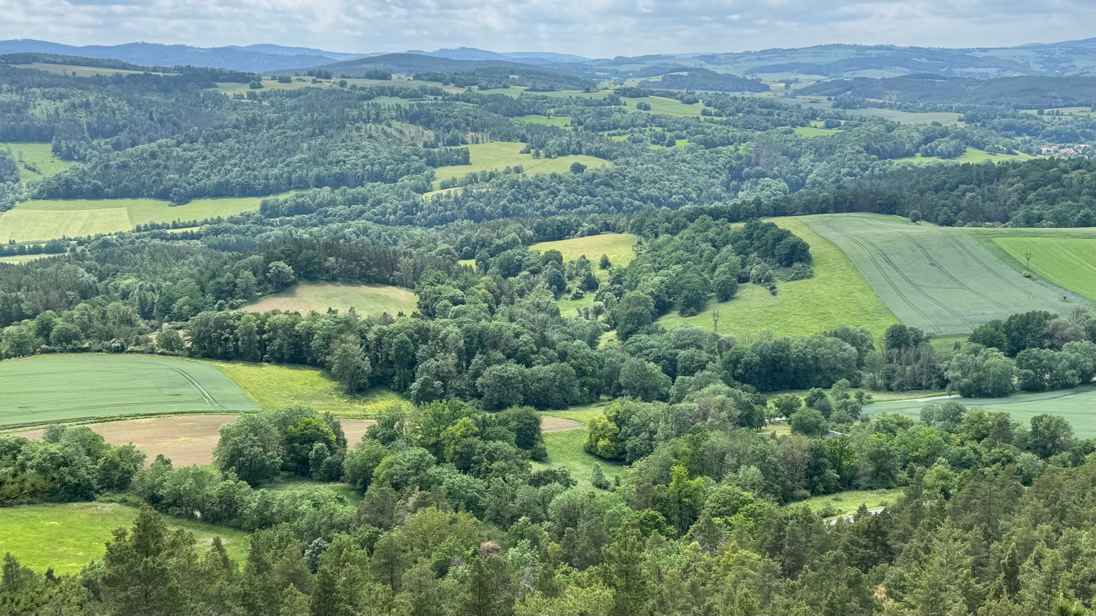

Slide 5

FLEX will provide a unique opportunity
PROS
Dedicated instrument for proper full spectrum retrieval
Will allow us to go beyond the simple “linear” relationship with GPP in phase II
Fine spatial resolution (300m) capable of distinguishing main landscape elements
CONS
Low revisit frequency will not allow to establish a monitoring capacity
Morning overpass will unlikely see many stress events

Slide 6
Requirements (wishlist) for a monitoring system based on SIF
PROPERTY | THRESHOLD: | TARGET:
Spectral resolution | ~ 0.5 nm | ~ 0.3 nm
Spectral coverage | Red and FarRed peaks | Full spectrum retrieval + PRI
Spatial resolution | ~5 km | ~300 m
Geographic coverage | Vegetated areas | Global
Temporal revisit | Daily to weekly | Sub-daily
Overpass time | early afternoon | multiple passes

Slide 7
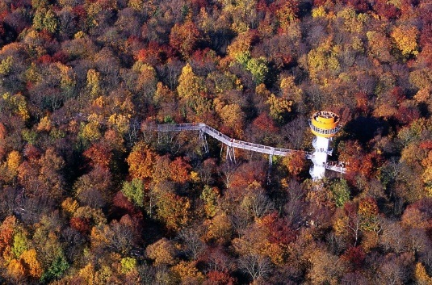
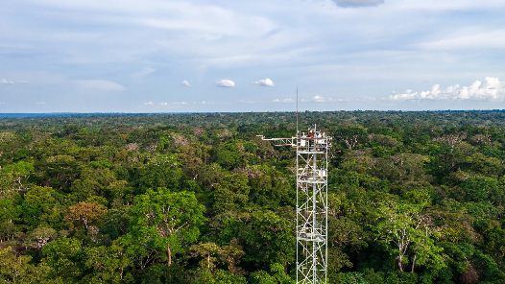
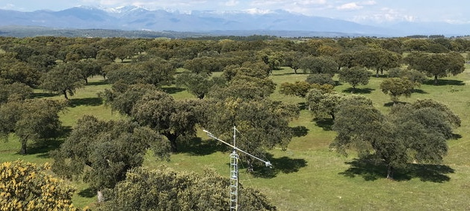
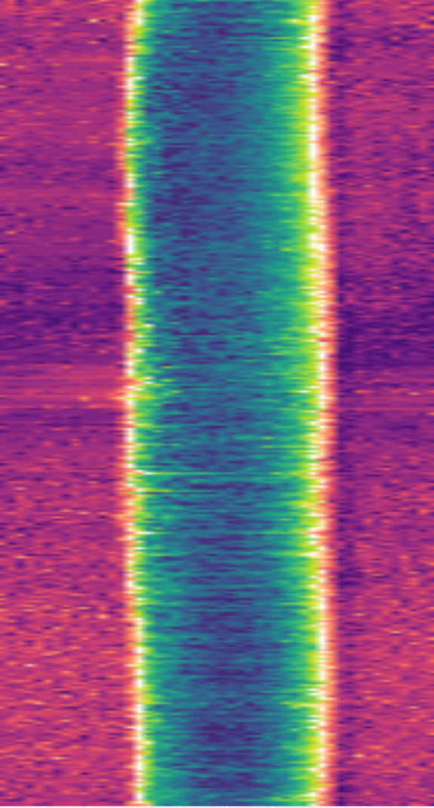
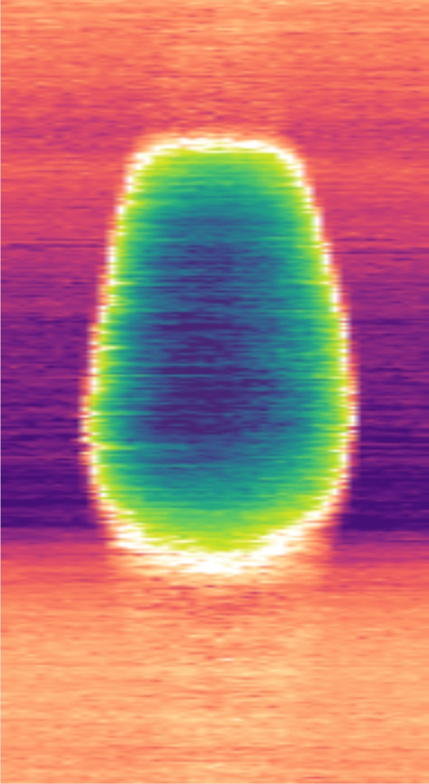
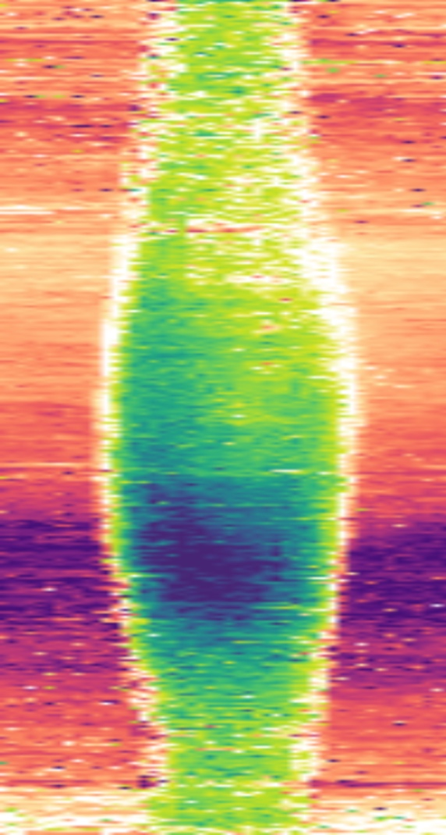

Tropical rain forest
European beech forest
Mediterranean Savanna
CO₂ flux
Dec
Release
Nov
Oct
Sep
Aug
Jul
Relative to maximum flux
Jun
May
Apr
Plot courtesy of M. Reichstein.
Mar
Feb
Uptake
Jan
0
6
12
18
24
0
6
12
18
24
0
6
12
18
24

Slide 8
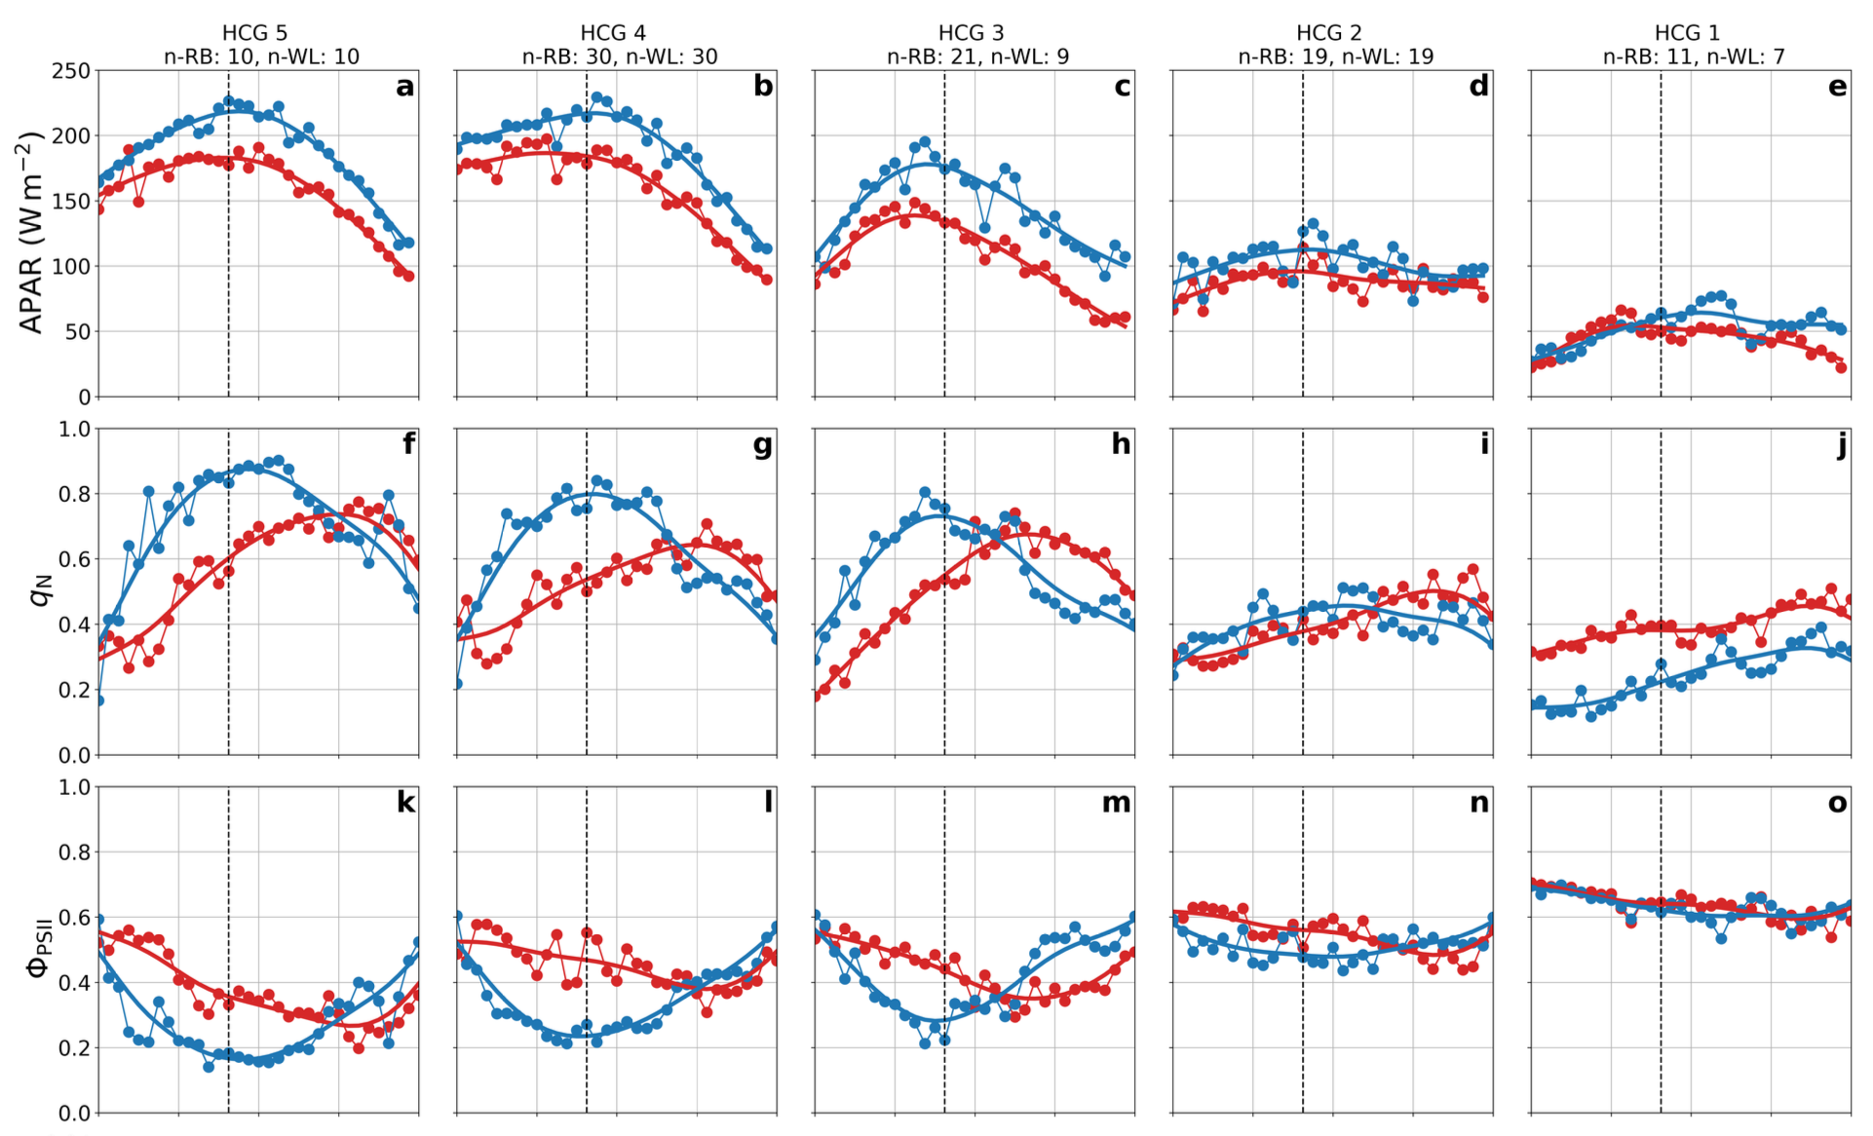
Tilia cordata Fagus sylvatica
Wieneke et al. (in preparation)

Slide 9
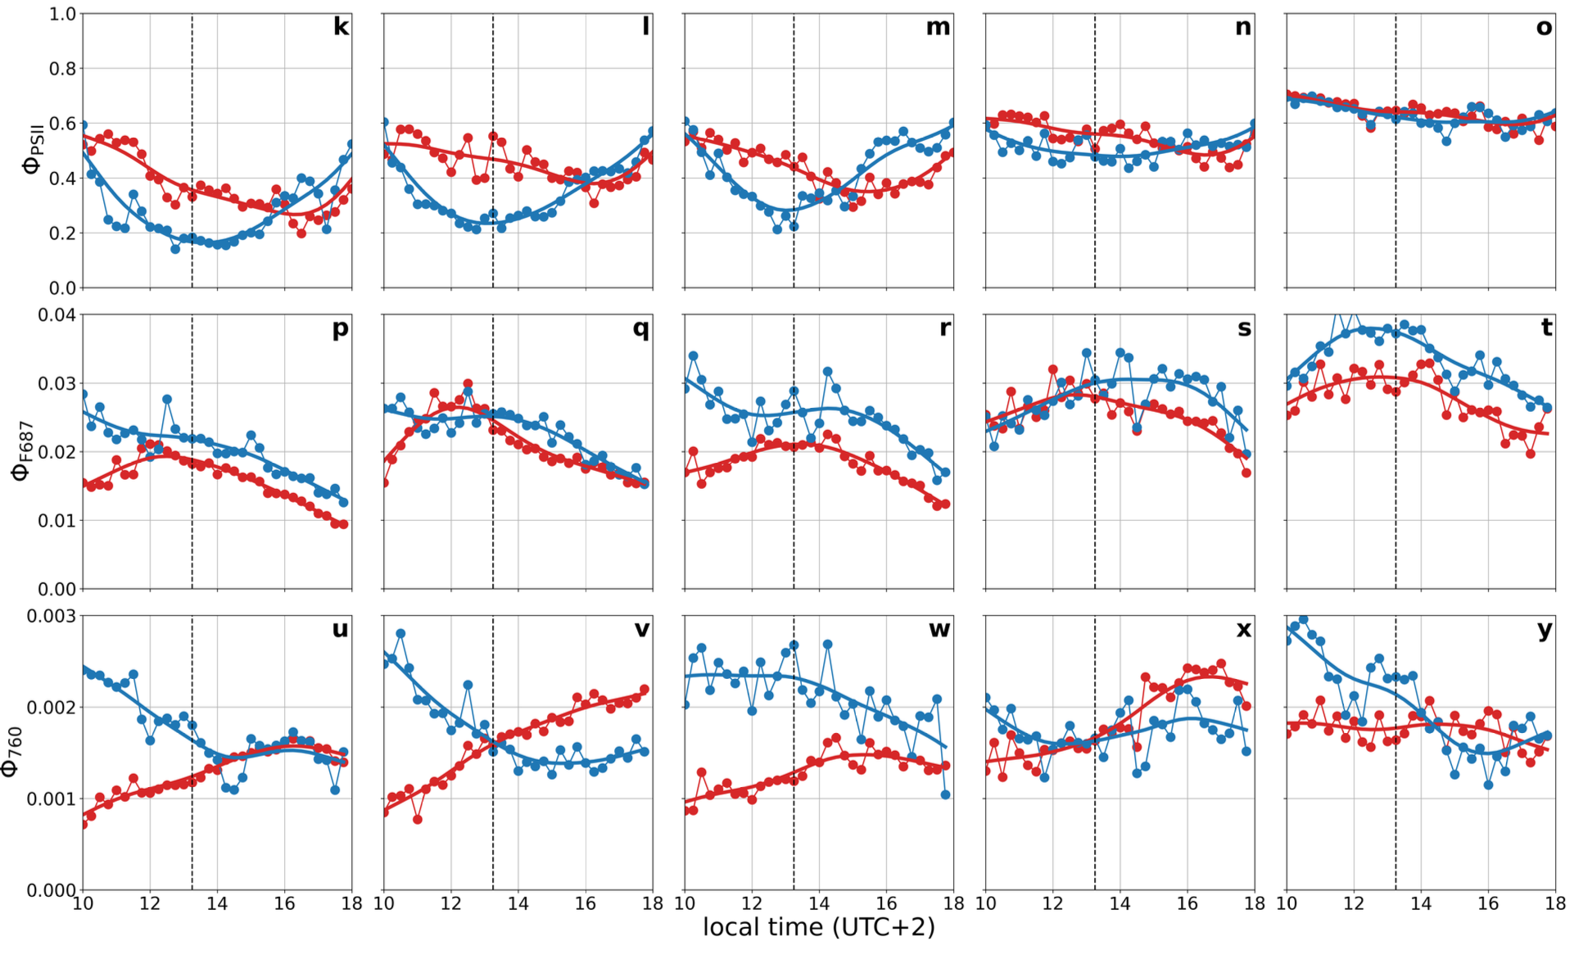
Tilia cordata Fagus sylvatica
Wieneke et al. (in preparation)

Slide 10
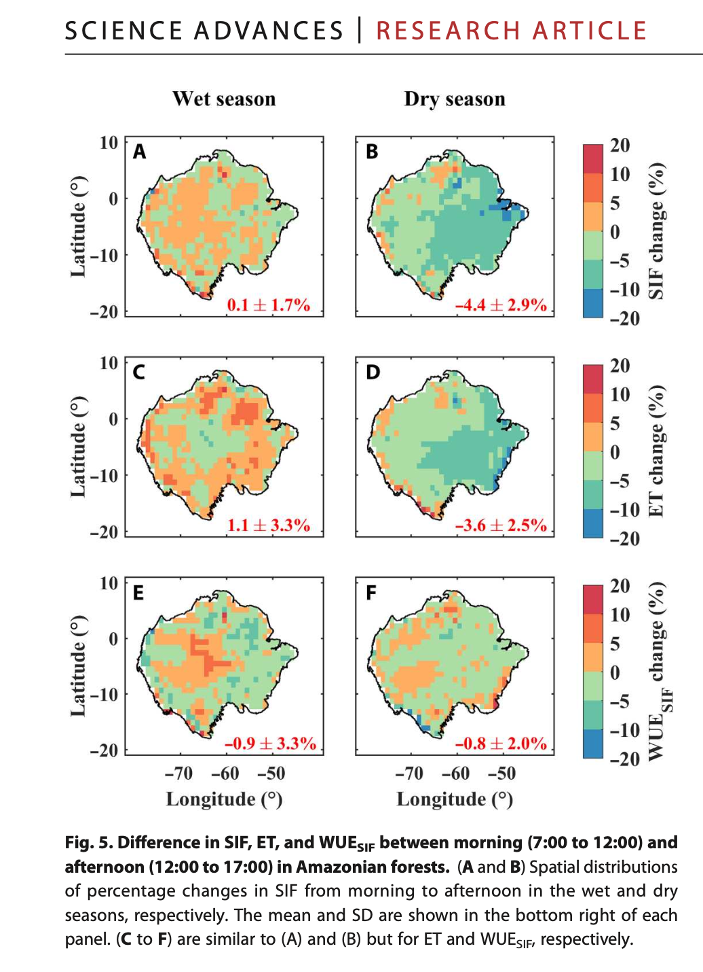


Midday depression can be seen and mapped using OCO-3 and RF
Zhang et al. (2023)

Slide 11

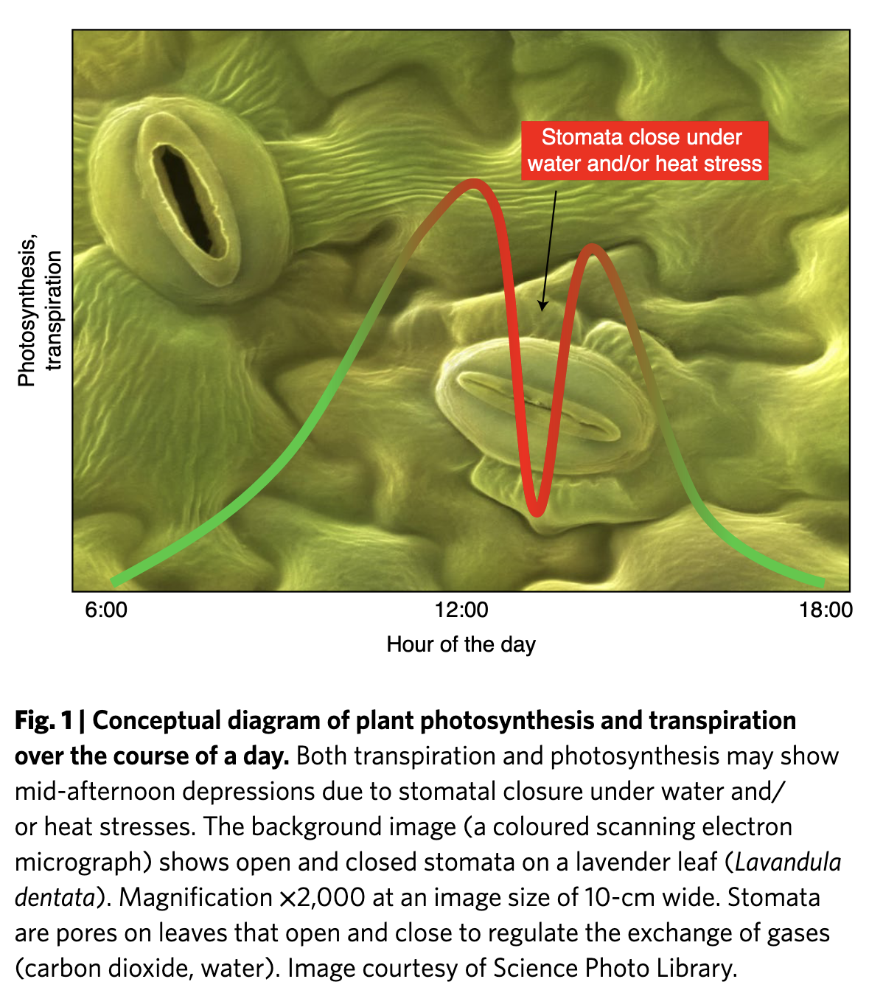
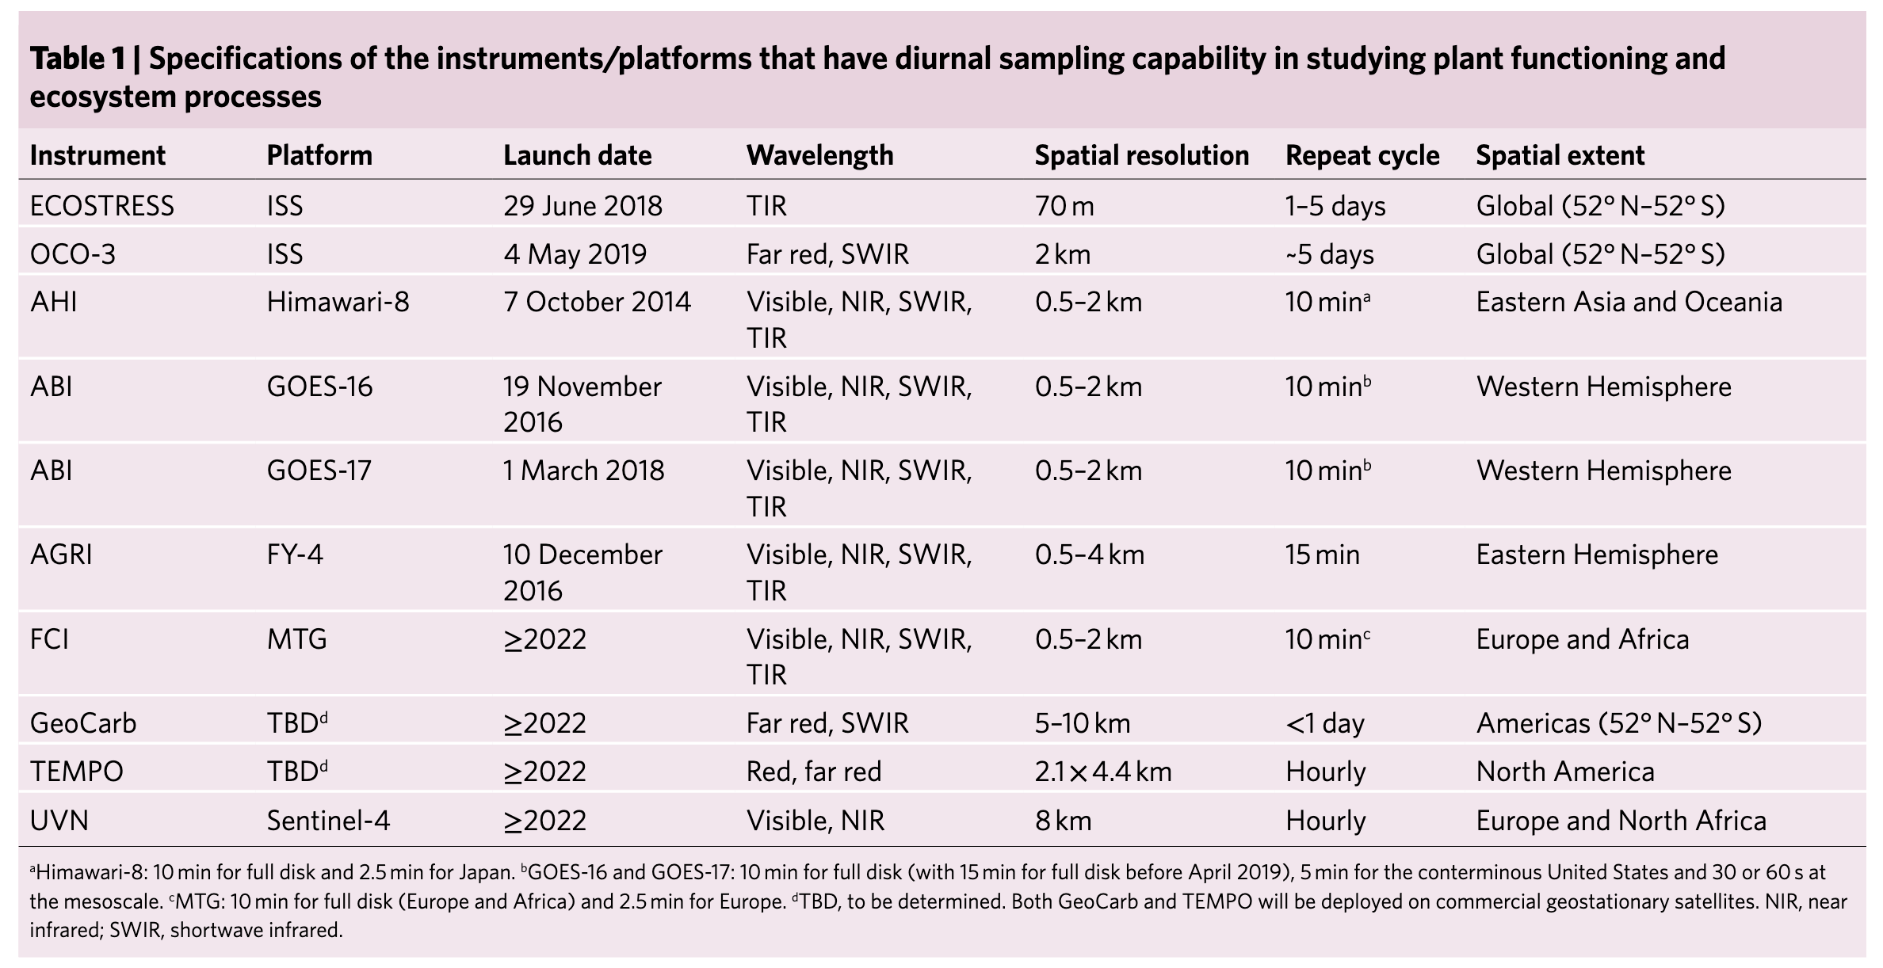
The diurnal cycle : the next frontier for land surface RS
Xiao et al. 2021

Slide 12
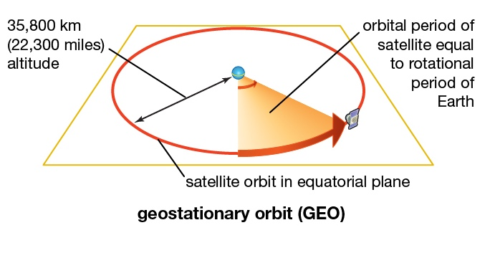
Requirements (wishlist) for a monitoring system based on SIF
PROPERTY | THRESHOLD: | TARGET:
Spectral resolution | ~ 0.5 nm | ~ 0.3 nm
Spectral coverage | Red and FarRed peaks | Full spectrum retrieval + PRI
Spatial resolution | ~5 km | ~300 m
Geographic coverage | Vegetated areas | Global
Temporal revisit | Daily to weekly | Sub-daily
Overpass time | early afternoon | multiple passes

Slide 13
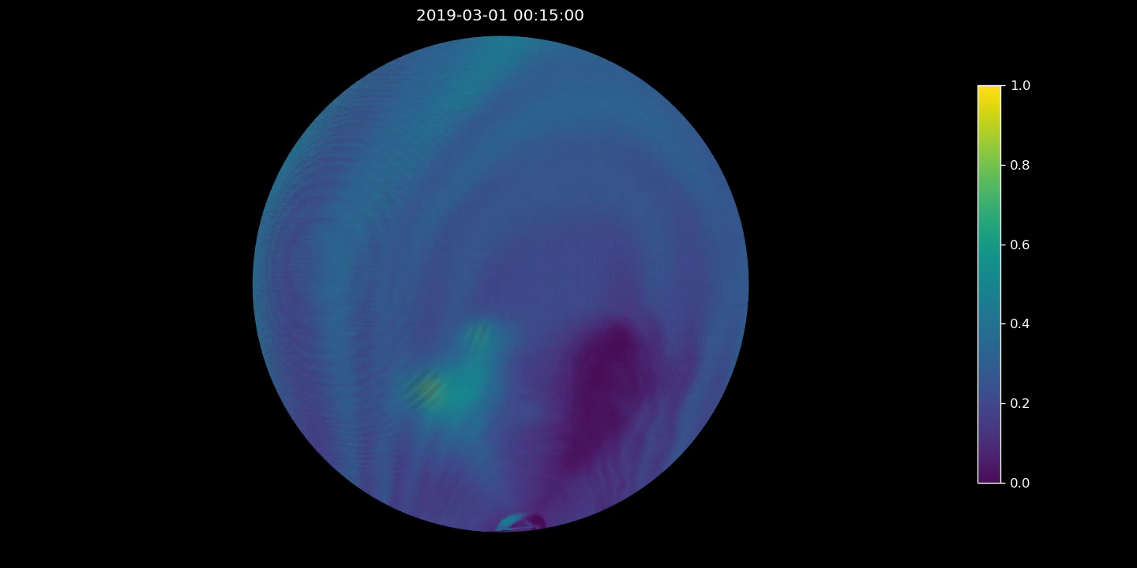
One day of SEVIRI imagery on our servers…

Slide 14
Atmospheric sensors become increasingly attractive for land surface RS applications
Plot courtesy of Ph. Kölher (EUMETSAT)

Slide 15
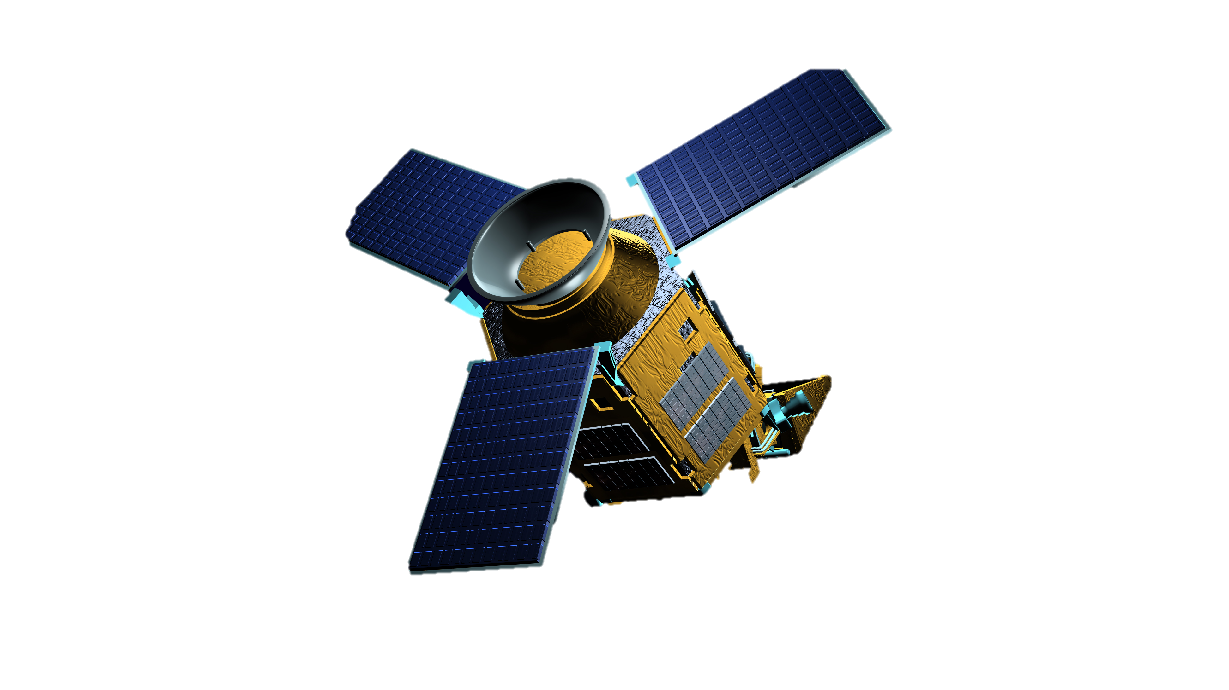
Requirements (wishlist) for a monitoring system based on SIF
PROPERTY | THRESHOLD: | TARGET:
Spectral resolution | ~ 0.5 nm | ~ 0.3 nm
Spectral coverage | Red and FarRed peaks | Full spectrum retrieval + PRI
Spatial resolution | ~5 km | ~300 m
Geographic coverage | Vegetated areas | Global
Temporal revisit | Daily to weekly | Sub-daily
Overpass time | early afternoon | multiple passes
TROPOMI
Spectral res: ∼0.5 nm
Spectral range: 675–775 nm
Footprint: 7×3.5 km2
Compo res: 0.1◦
TROPOMI

Slide 16

A blueprint to integrate different RS sources?

Slide 17





Some pieces from various projects…
FLEXvalGER

Slide 18
Improving the signal with some ML in the retrieval
Improved ML-based SIF retrieval work by Dong Li from TUM
ANN-based methodology on individual footprints of Sentinel-5-P TROPOMI
trained using OCO-2/3 SIF and TROPOMI radiance
retrieval noise reduced by half
Li et al. (2025) RSE

Slide 19
Improving the signal with some ML in the retrieval
Improved ML-based SIF retrieval work by Dong Li from TUM
Li et al. (2025) RSE

Slide 20
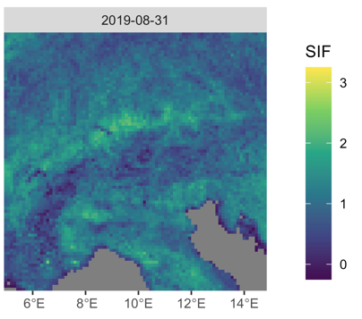
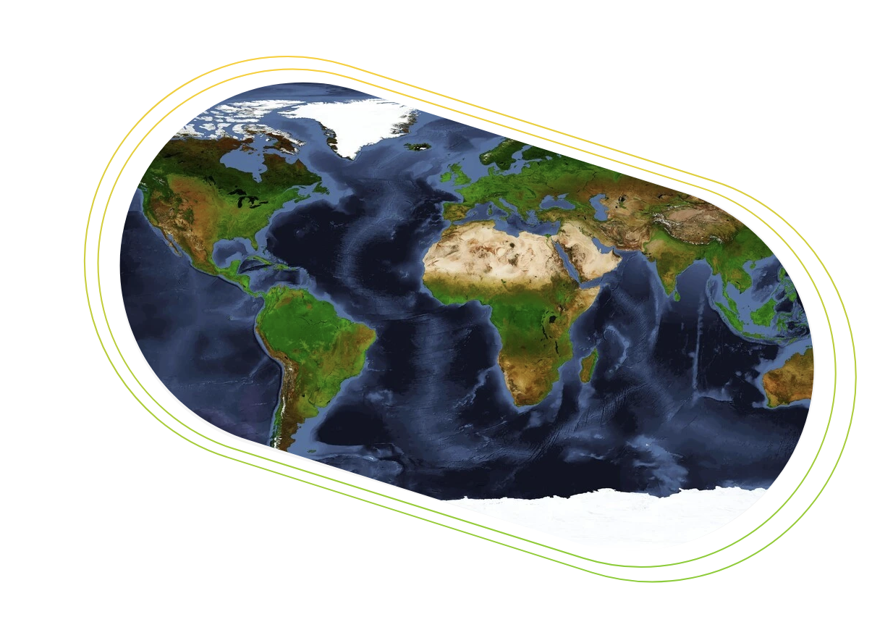



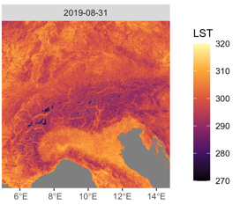
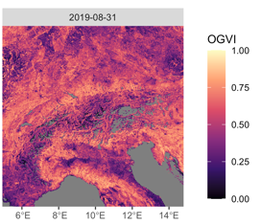
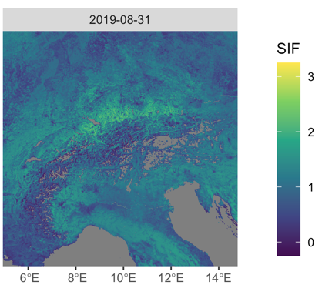
A downscaling tool on CDSE
TROPOMI SIF at ~10 km, almost daily 2018 – onwards…
High spatial resolution explanatory variables
User defined
MODEL
FLEX could serve to validate / calibrate
Downscaled TROPOMI SIF at ~1 km, (daily or weekly)

Slide 21
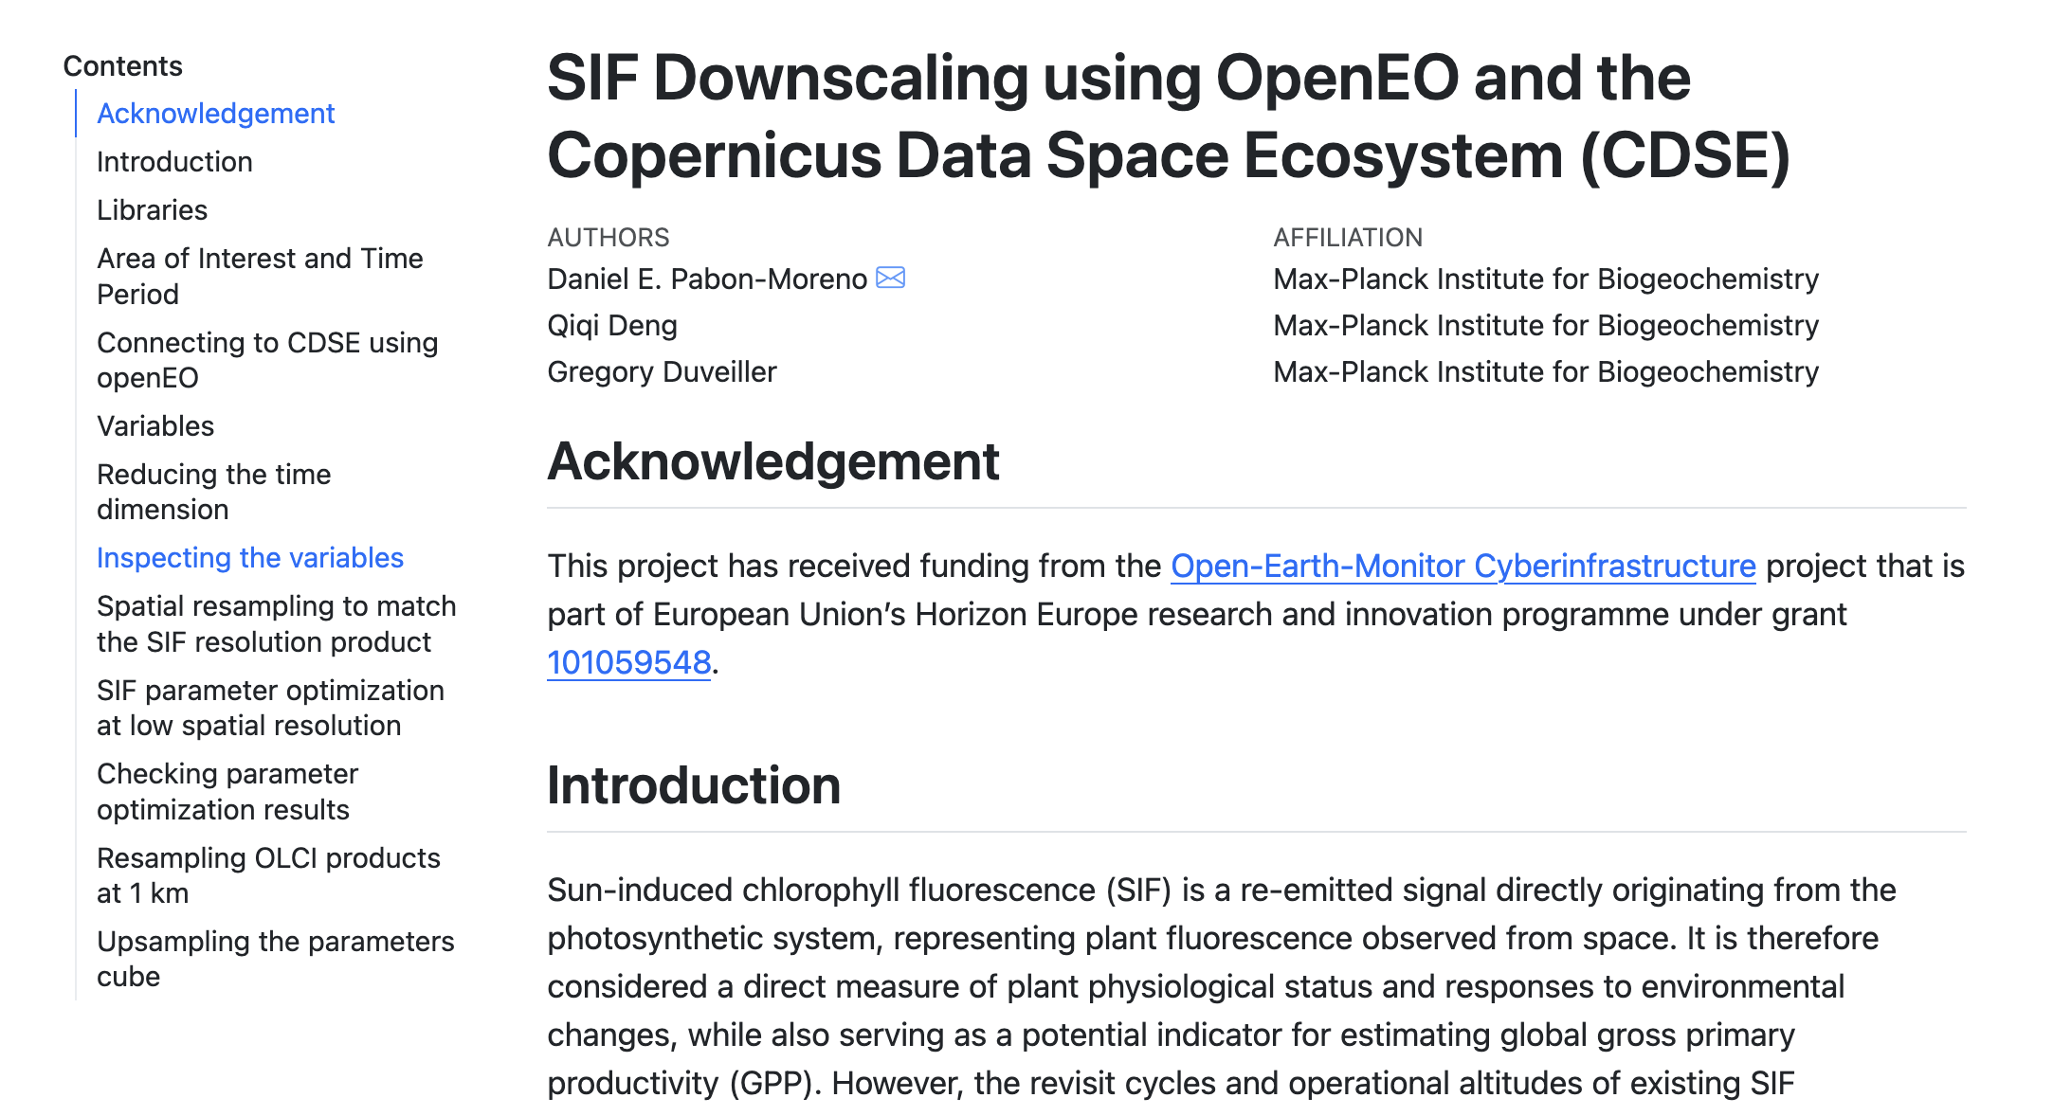
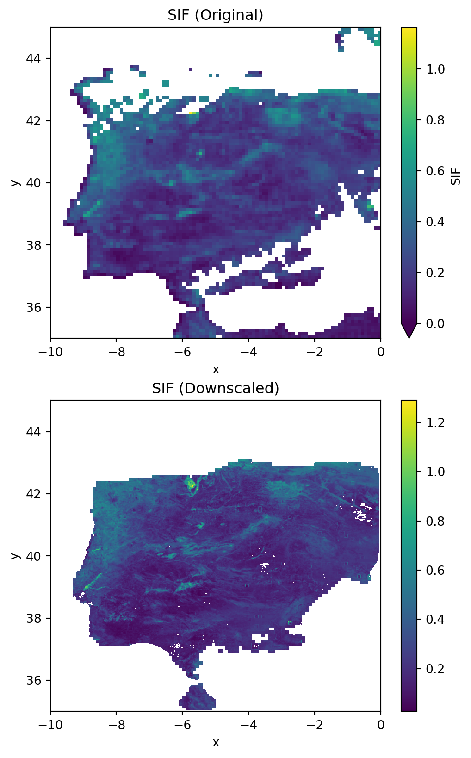
A downscaling tool on CDSE

Slide 22
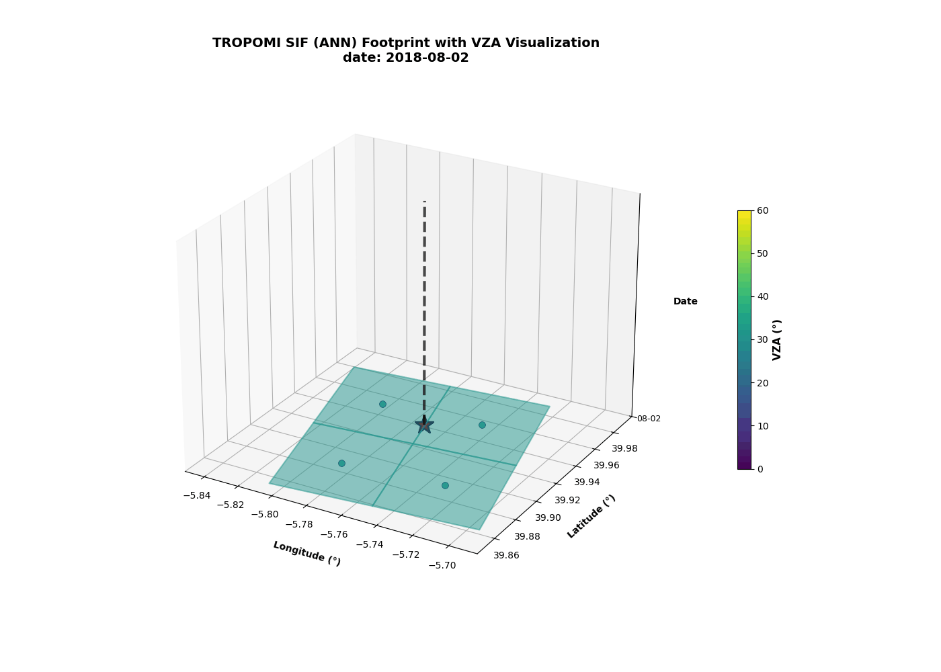
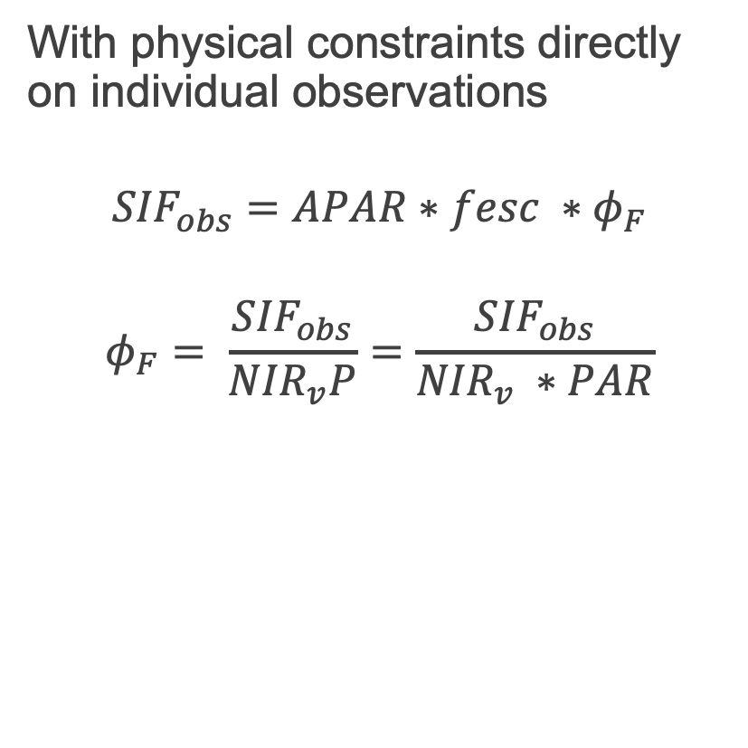
Working directly on the SIF footprint prior to gridding…
With physical constraints directly on individual observations
$${SIF}_{obs}=APAR∗fesc ∗φ_{F}$$
$$φ_{F}= \frac{{SIF}_{obs}}{{NIR}_{v}P}=\frac{{SIF}_{obs}}{{NIR}_{v} ∗PAR}$$

Slide 23
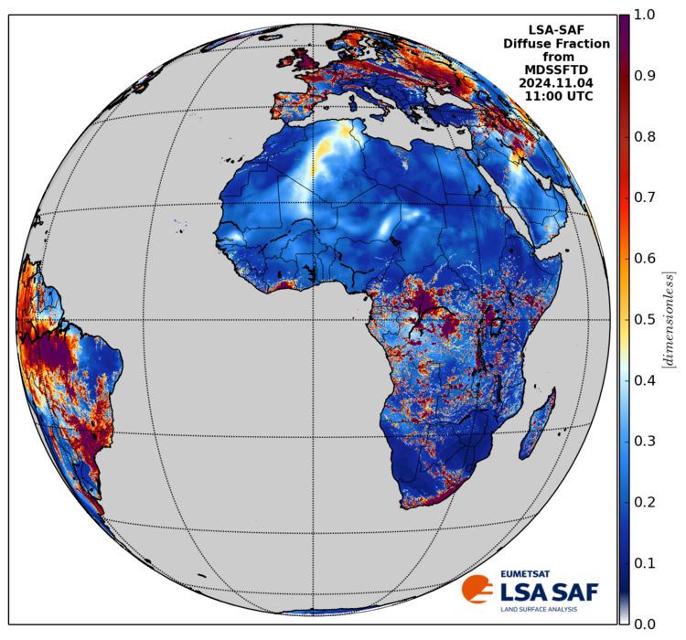
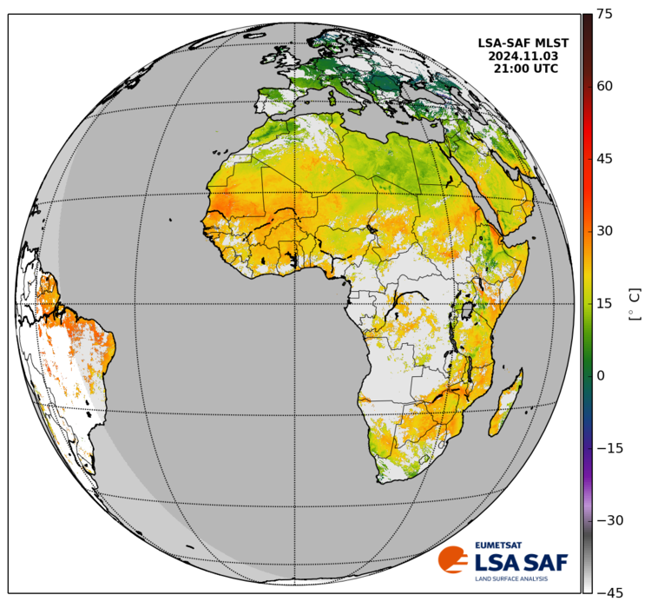
SIF NIRv NIR_rad
LST
NIRv
Sentinel-5P TROPOMI
ET?
MSG SEVIRI
Daily at 13:00
Hourly
OCO-3
Cal/Val temporally
SIF_Yield prototype
FLEX
Cal/Val spatially
Shortwave Rad.
Diffuse Fraction
Tree mortality
Enhanced GPP proxy
ERA5
Analyse
Spatial heterogen.
Spatial res.: 5 km | Spatial coverage: Europe Temp. res: weekly | Temp. coverage: 2018 onwards

Slide 24
A monitoring system based on SIF
PROPERTY | THRESHOLD: | TARGET:
Spectral resolution | ~ 0.5 nm | ~ 0.3 nm
Spectral coverage | Red and FarRed peaks | Full spectrum retrieval + PRI
Spatial resolution | ~5 km | ~300 m
Geographic coverage | Vegetated areas | Global
Temporal revisit | Daily to weekly | Sub-daily
Overpass time | early afternoon | multiple passes
TROPOMI
Spectral res: ∼0.5 nm
Spectral range: 675–775 nm
Footprint: 7×3.5 km2
Compo res: 0.1◦
TROPOMI

Slide 25

Sentinel-5 is different from Sentinel-5P
Overpass time will change to morning overpass
Band are not the same and will hamper SIF retrieval
Plot courtesy of Ph. Kölher (EUMETSAT)

Slide 26
A monitoring system based on SIF
PROPERTY | THRESHOLD: | TARGET:
Spectral resolution | ~ 0.5 nm | ~ 0.3 nm
Spectral coverage | Red and FarRed peaks | Full spectrum retrieval + PRI
Spatial resolution | ~5 km | ~300 m
Geographic coverage | Vegetated areas | Global
Temporal revisit | Daily to weekly | Sub-daily
Overpass time | early afternoon | multiple passes
TROPOMI
Spectral res: ∼0.5 nm
Spectral range: 675–775 nm
Footprint: 7×3.5 km2
Compo res: 0.1◦
TROPOMI

Slide 27
To summarize …
FLEX is a great instrument that will demonstrate the potential of fluorescence
FLEX is a crucial piece of a wider puzzle
Target: synergistic use of the wide array of the EO capacities we already have to capture the diurnal dynamics of ecosystem
We should try to get a diurnal (SIF) signal from Sentinel-4

Slide 28
Thanks for your attention…
gduveiller@bgc-jena.mpg.de

