Slide 1
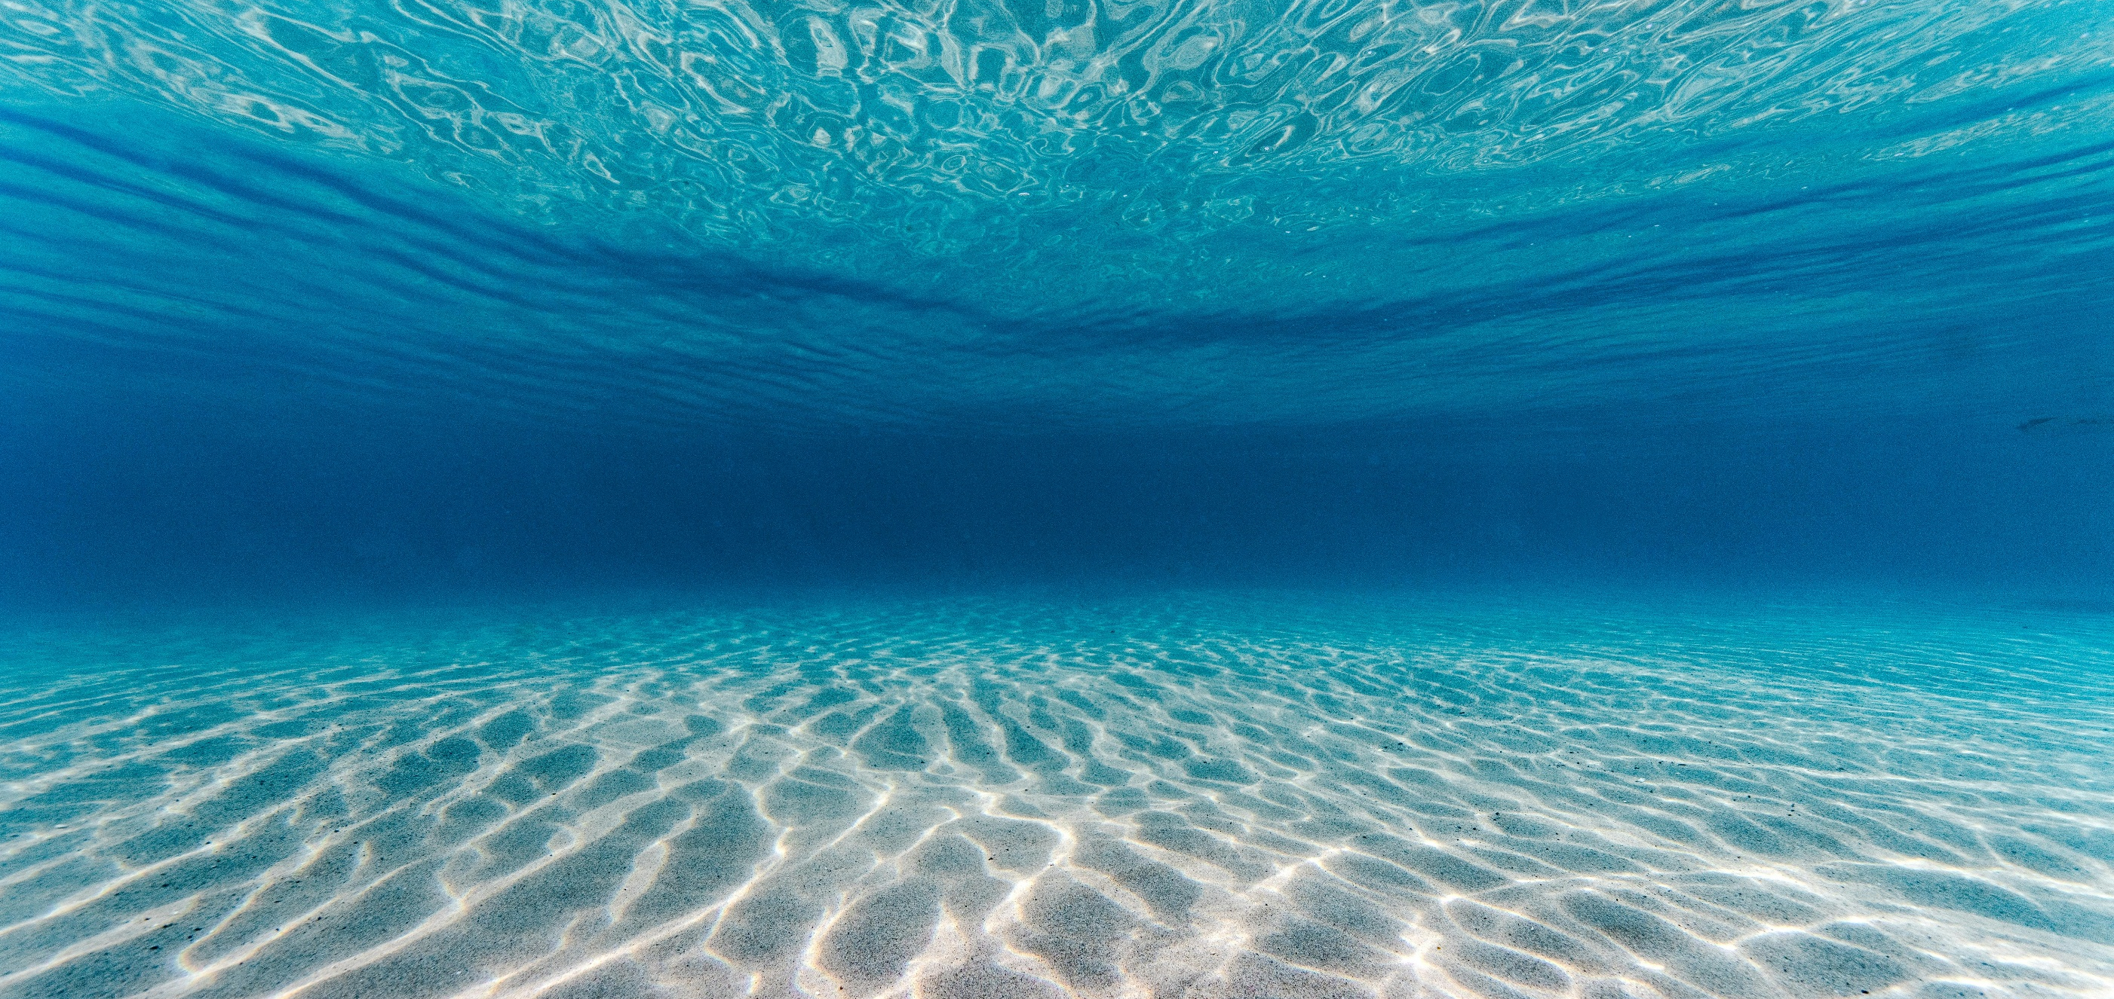
FLEX mission data for inland water research:
Insights from studies in Swiss lakes
    Alexander Damm, Remika Gupana, Loé Maire, Daniel Odermatt
Photo by Kammeran Gonzalez-Keola on Pexels.com

Slide 2

Important
Important | Unknown
Climate control
Carbon cycle
Fishery
Recreation
Water cycle
Transport
Biodiv. spots
Photo by Henry Wagner: on pexels.com

Slide 3

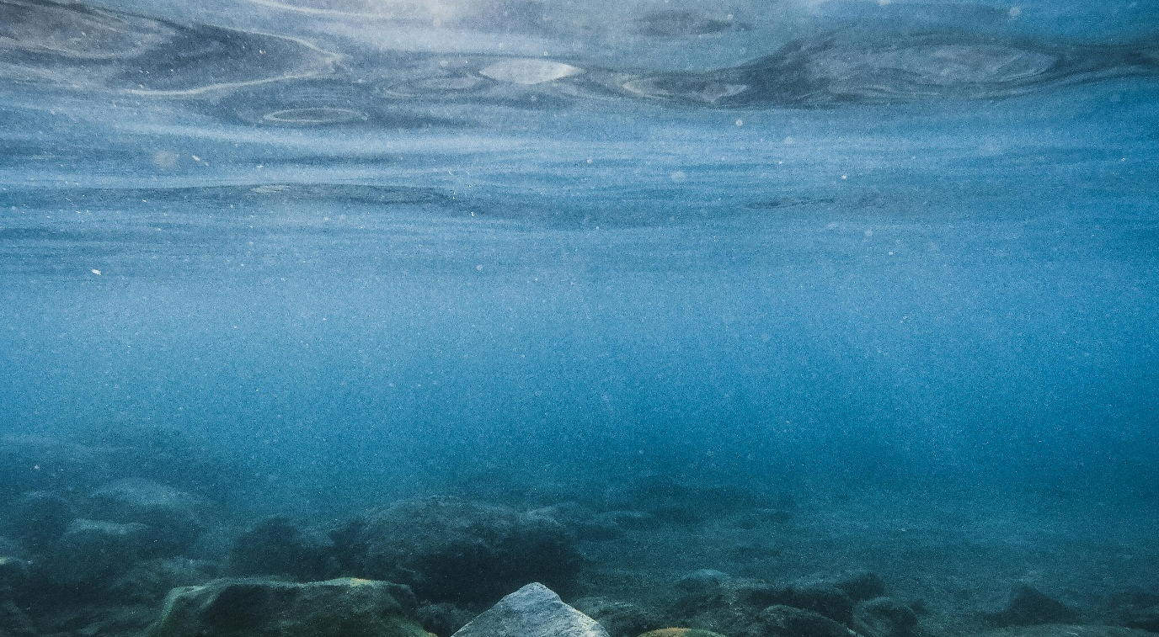
Remote sensing of aquatic environments – considerations
Complex scattering:
Specular reflectance / glint
Transparency determines vertical “visibility”
High absorption:
Low water leaving signals
Limited spectral window (400-700 nm)
Limited visibility of water constituents & contaminants:
Dissolved/suspended organic/inorganic matter are partly visible
Pollutants & water quality parameters (PH, etc.) often invisible
Photo by DY Lee on pexels.com
Photo by David Boca on pexels.com

Slide 4
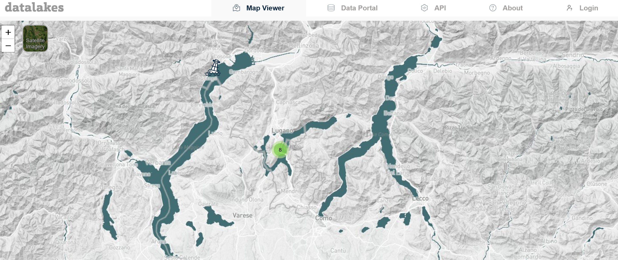
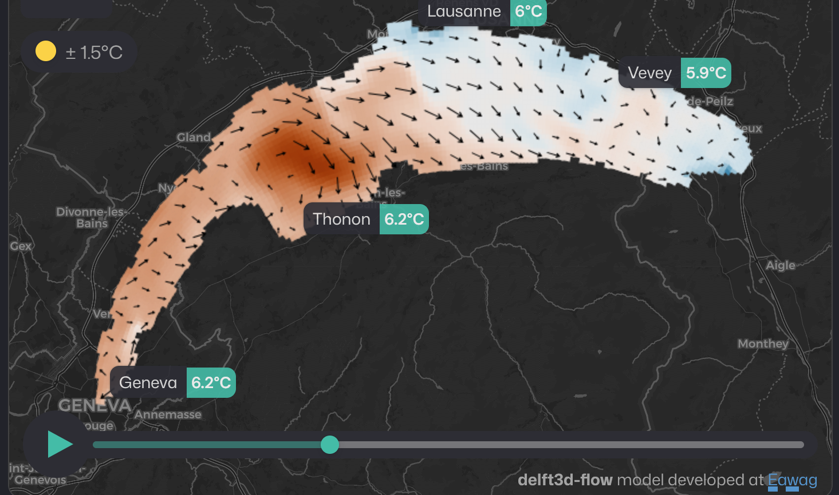
High variation of inland waters
Large spatial fragmentation & spatial diversity
Pronounced vertical variability
Processes and water properties can change quickly minutes to days
In case of extreme events (floods), large spatial-temporal variation
https://www.datalakes-eawag.ch/
https://www.alplakes.eawag.ch/

Slide 5
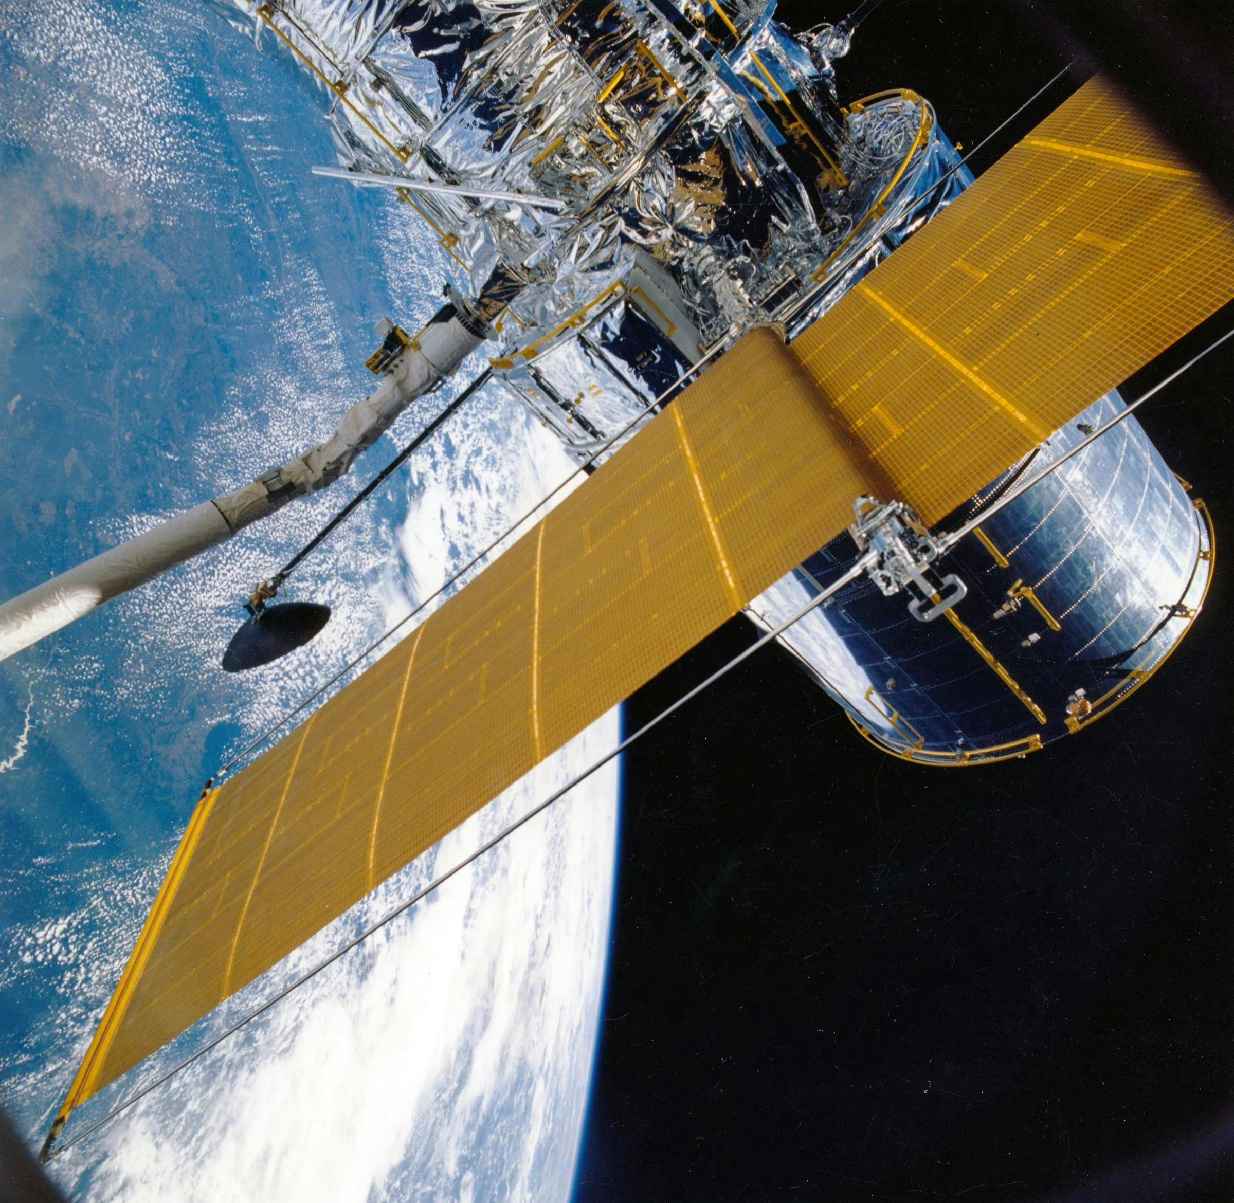
Observational capacity for inland waters
→ Large observational gaps exist
Gupana et al. 2021: https://doi.org/10.1016/j.rse.2021.112482
Opportunities by FLEX
High spectral resolution for advanced product development
Support for development of dedicated water missions
Mission | Spectral | Spatial | Temporal
Landsat/Sentinel-2
Sentinel-3
CHIME/PRISMA/ENMAP
GLIMR/VIIRS
PACE
Photo by Pixabay on pexels.com

Slide 6
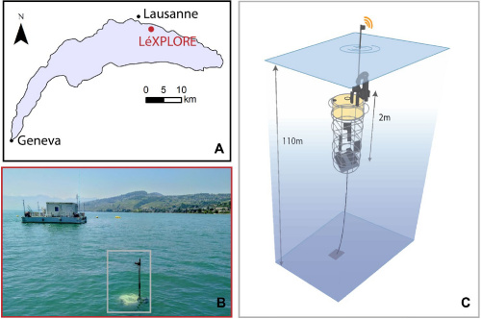
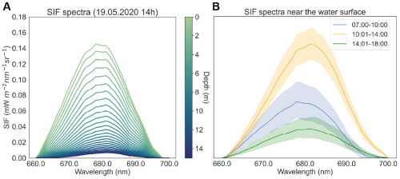
Example I - SIF: A proxy for phytoplankton biomass, health, photosynthetic activity
Gupana et al. 2022, Optics Express 30/26, https://doi.org/10.1364/OE.469402

Slide 7
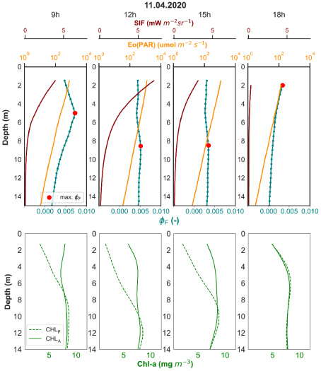
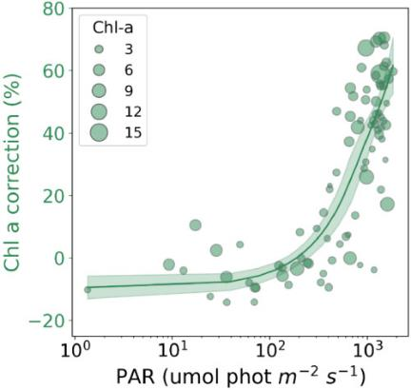
Unexpected vertical dynamics in SIF
Gupana et al. 2022, Optics Express 30/26, https://doi.org/10.1364/OE.469402

Slide 8
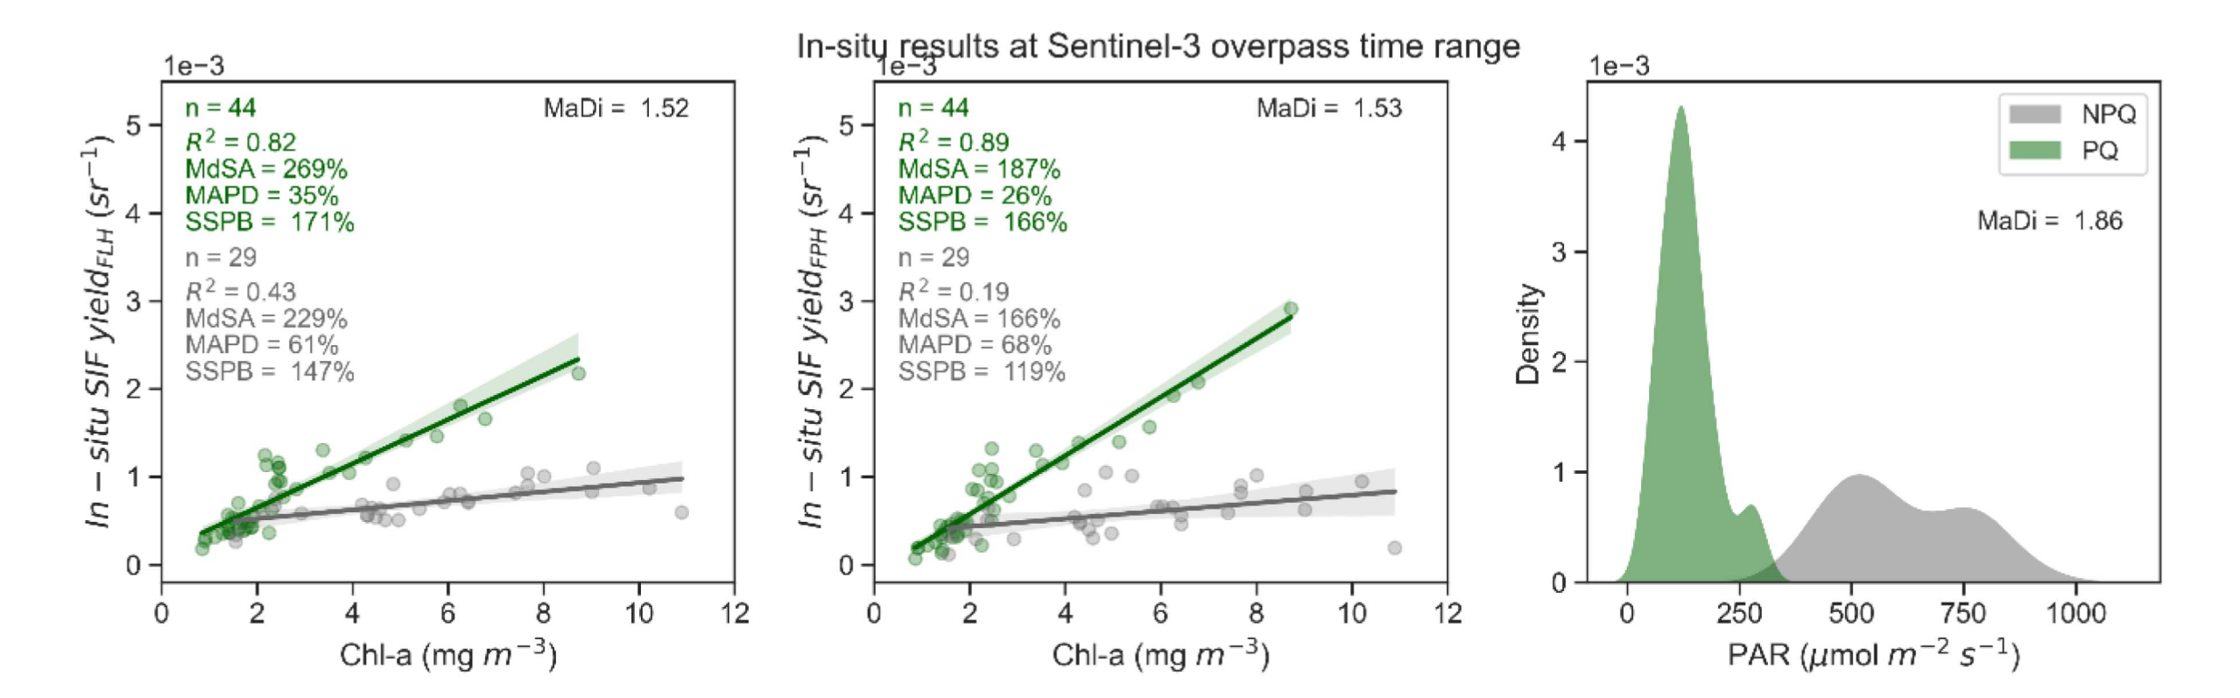
Phytoplankton NPQ: Implications for the interpretation of SIF
Gupana et al. 2025, IEEE-JSTARS 18, https://doi.org/10.1109/JSTARS.2025.3528911

Slide 9
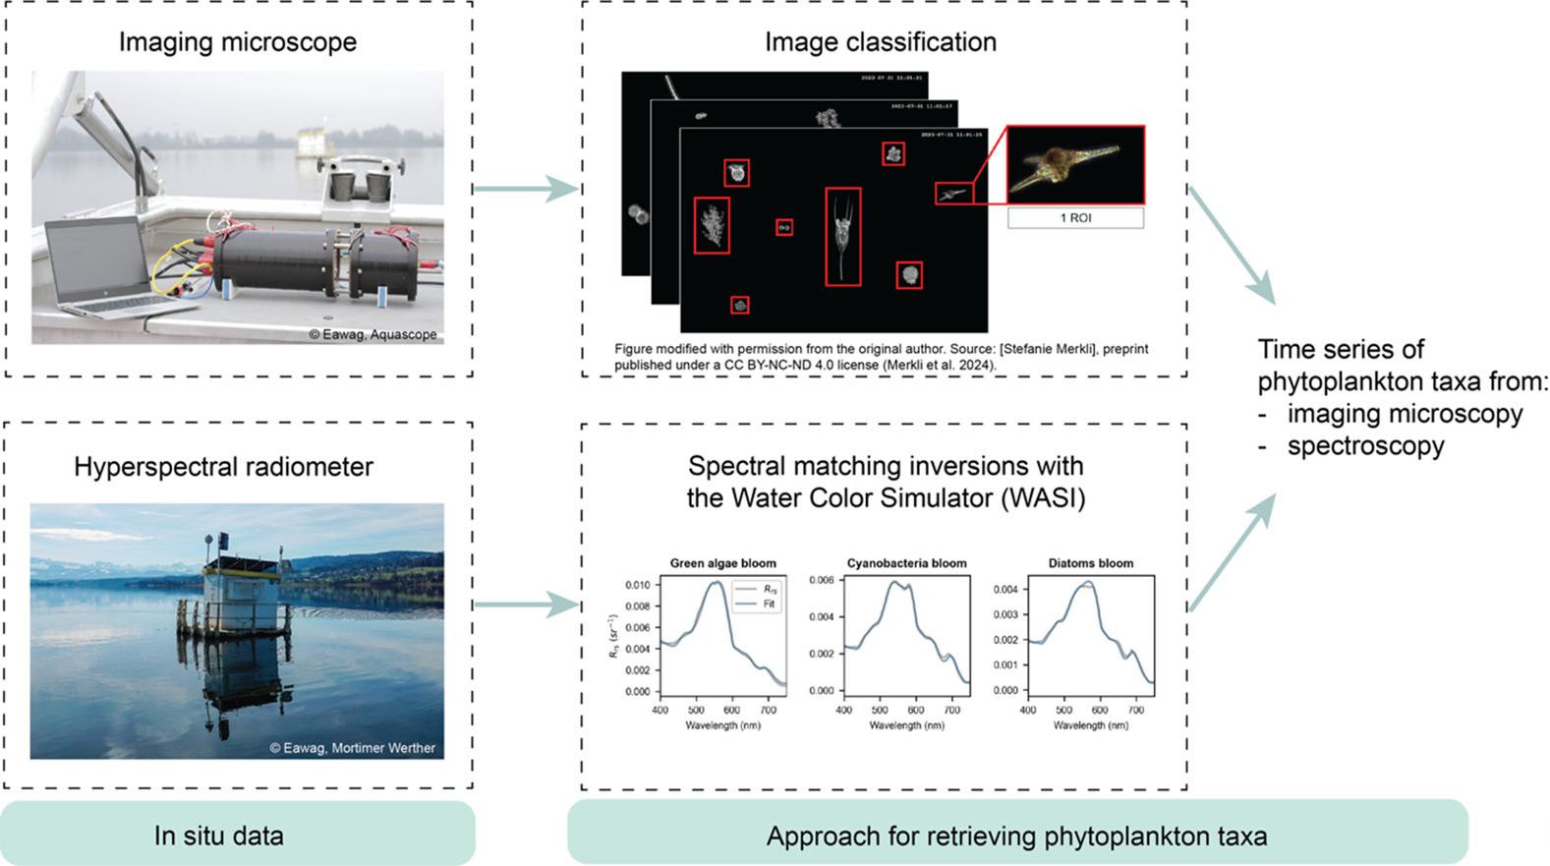
Example II - Phytoplankton diversity: A complementary water quality measure
Maire et al. 2025, Science of the Total Environment, https://doi.org/10.1016/j.scitotenv.2025.180718

Slide 10
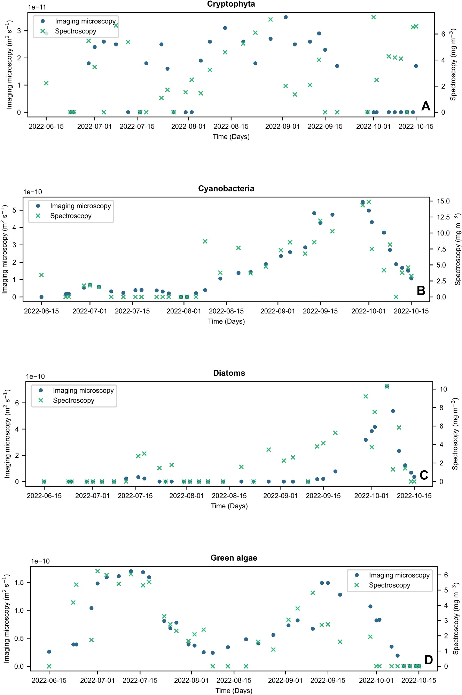
Successful detection of blooms of phytoplankton species
Maire et al. 2025, Science of the Total Environment, https://doi.org/10.1016/j.scitotenv.2025.180718

Slide 11
Phytoplankton diversity retrieval: sensor comparison
Maire et al. (in preparation)

Slide 12
Concluding remarks
FLEX will support the aquatic community by dedicated observations of inland waters and coastal regions
FLEX with its high spectral resolution offers new possibilities to study aquatic ecosystems
Full SIF emission spectra & PQ/NPQ pathways
SIF-based Chl-a estimates (knowledge of NPQ is essential)
Phytoplankton diversity
Gupana et al. (2022). Non-photochemical quenching estimates from in situ spectroradiometer measurements: implications on remote sensing of sun-induced chlorophyll fluorescence in lakes. Optics Express 30, https://doi.org/10.1364/OE.469402
Gupana et al. (2025). Remote sensing of sun-induced fluorescence in a deep lake: disentangling quenching mechanisms improves relationship with chlorophyll-a concentration estimates. IEEE-JSTARS, 18, https://doi.org/10.1109/JSTARS.2025.3528911
Maire et al. (2025). Differentiating phytoplankton taxa in lakes using hyperspectral in situ reflectance and imaging microscopy. Science of the Total Environment, 1003, https://doi.org/10.1016/j.scitotenv.2025.180718
Maire et al (in prep.). Requirements of spaceborne hyperspectral sensors for phytoplankton taxonomic classification in lakes.
FLEX can offer interesting observations and insights for the development of dedicated water missions (GALENE)
Pro: Spectral resolution; Con: Spatial and temporal resolution
Gupana et al. (2021). Remote sensing of sun-induced chlorophyll-a fluorescence in inland and coastal waters: Current state and future prospects. Remote Sensing of Environment, 262, https://doi.org/10.1016/j.rse.2021.112482

Slide 13
    Prof. Dr. Alexander Damm-Reiser
    Remote Sensing of Water Systems | Department of Geography | Universität Zürich
    alexander.damm@geo.uzh.ch
    www.rsws.ch
    linkedIn:

