Slide 1
Beyond Photosystem II: How Photosystem I Dynamics Regulate Electron Transport in a Rice Paddy
Huaize Feng, Youngryel Ryu, Joe Berry, Elias Kaiser, Jennifer Johnson, Minseok Kang, Jeongho Lee

Slide 2

Background - Blackbox
Blackbox of electron transport and SIF modeling
SIF_{PSII}
NPQ_{PSII}
Electron transport in traditional models, e.g. FvCB, was empirical.
Recently, SIF was widely used as the proxy for GPP via electron transport, but their relationship was oversimplified.
e⁻
e⁻
PSII
PSI
SIF (sun-induced chlorophyll fluorescence)
NPQ (non-photochemical quenching)
FvCB (Farquhar-von Caemmerer-Berry model)
GPP (Gross Primary Production)
antenna
electron
e-
PSII photosystem II
PSI photosystem I
2

Slide 3
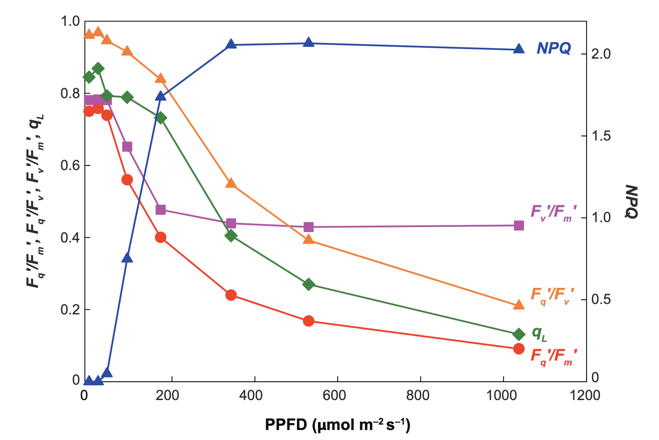
Background - Blackbox
Baker et al., 2008
Blackbox of electron transport and SIF modeling
NPQ and PQ (q_{L}) were found regulating the relationship between SIF and GPP, but the principle behind was unclear.
SIF (sun-induced chlorophyll fluorescence)
PQ (photochemical quenching)
NPQ (non-photochemical quenching)
q_{L} (the fraction of PSII reaction centers that are open)
GPP (Gross Primary Production)
The responses of photosystem II (PSII) to increasing photosynthetically active photon flux density (PPFD)
3

Slide 4




Background – Missed PSI
Missed in electron transport and SIF modeling
6
SIF_{PSII}
NPQ_{PSII}
Cyt b₆f control
Connectivity of antenna
State transition & Spillover
Cyclic electron transport (CET)
P700+ quenching
Rate constants:
kNPQ_{PSI}=15; kNPQ_{PSII}~ 0 to 5
Contribution of PSI to SIF
SIF_{PSI}
1
3
2
2
5
3
4
1
5
e⁻
NPQ_{PSI}
e⁻
6
PSII
4
PSI
e⁻
non-photochemical quenching (NPQ)
antenna
electron
e⁻
PSII photosystem II
connectivity of antenna
Cytochrome (cyt) b₆f
PSI photosystem I

Slide 5
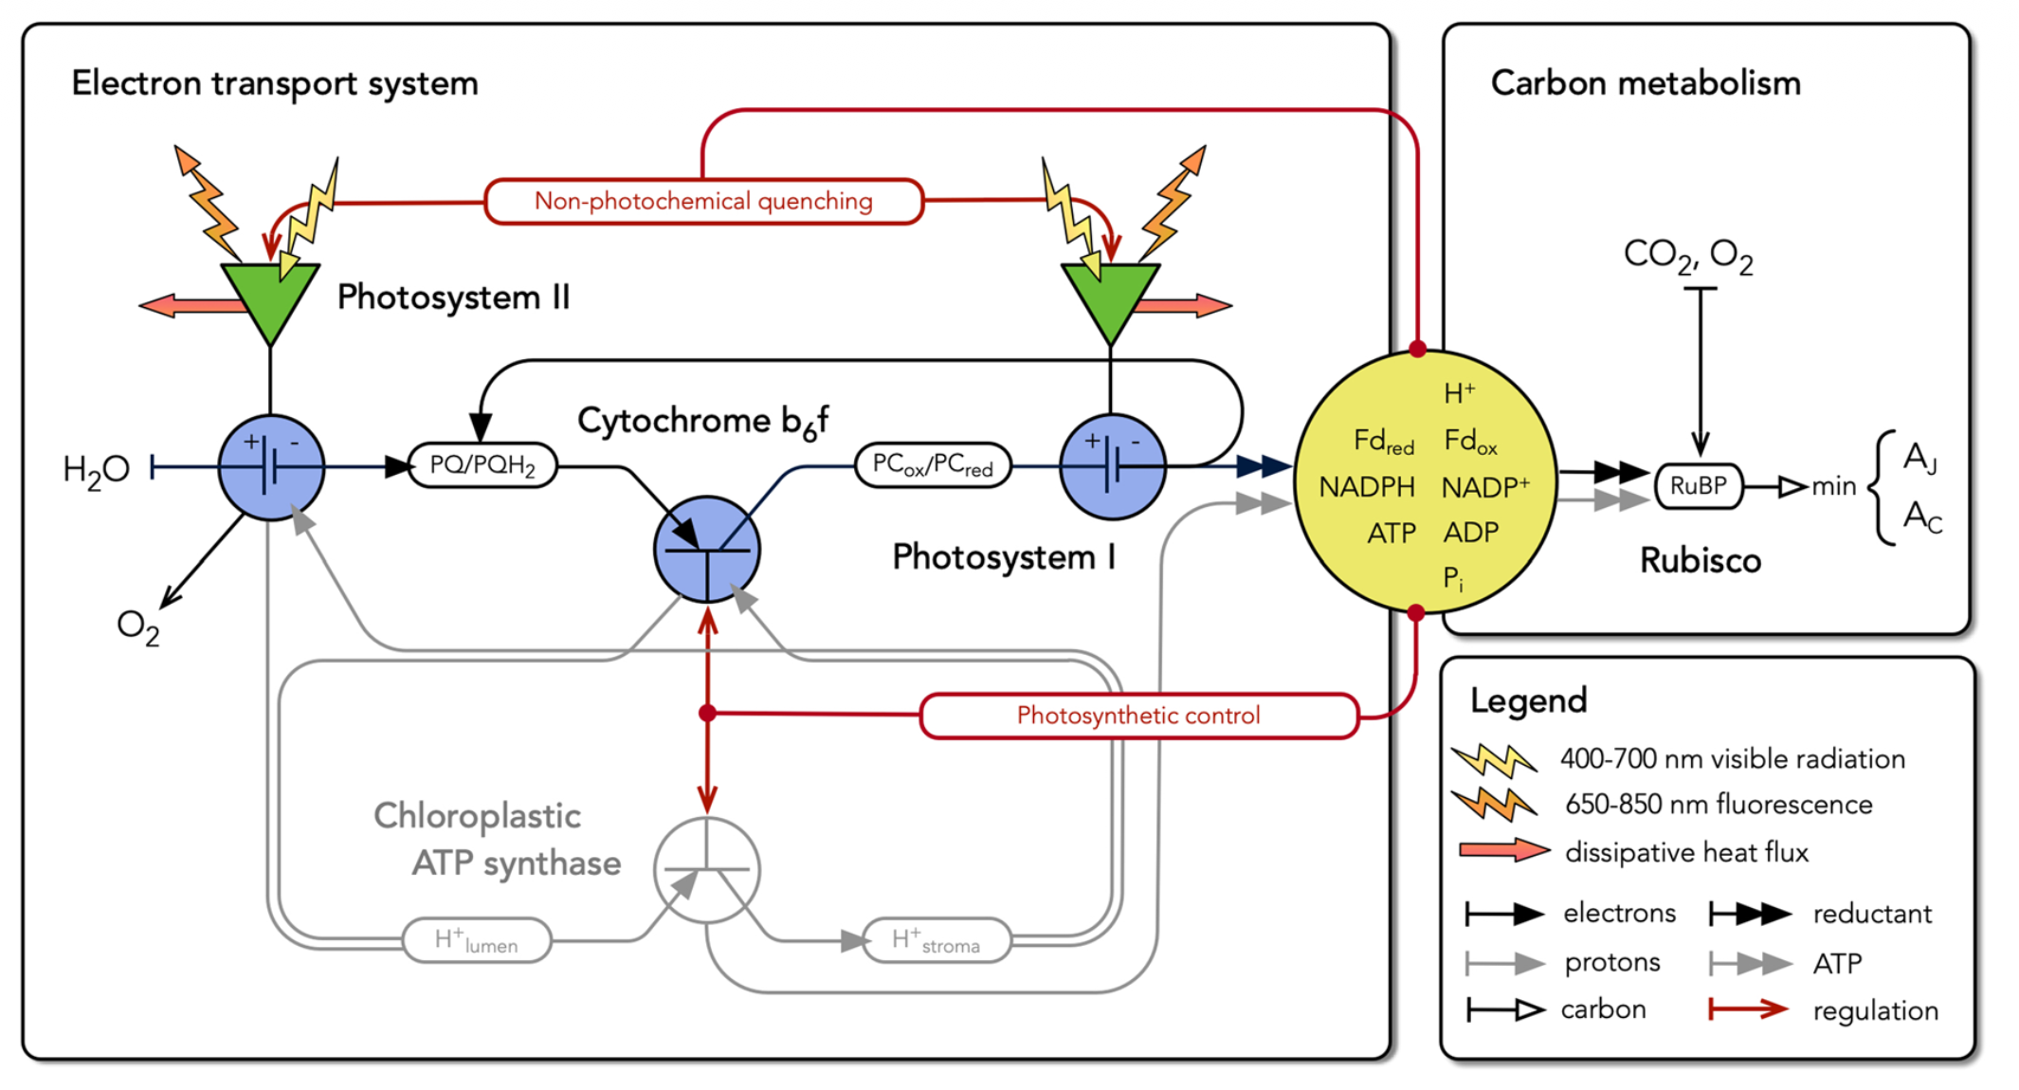
Background – Johnson-Berry Model
Johnson-Berry (JB) model
Johnson-Berry model provides mechanical and simple solution of the electron transport.
Excitation balance
Fluorescence module
Needs biochemical info and leaf/canopy temperature as input.
Needs radiation transfer model for SIF.
Needs a full validation at the ecosystem scale.
Johnson and Berry (2021), “The Role of Cytochrome B6f in the Control of Steady-State Photosynthesis.”

Slide 6
Questions
How to apply JB model at the ecosystem scale?
What is the performance of JB model at the ecosystem scale?
Fluxes
Hypothesis

Slide 7
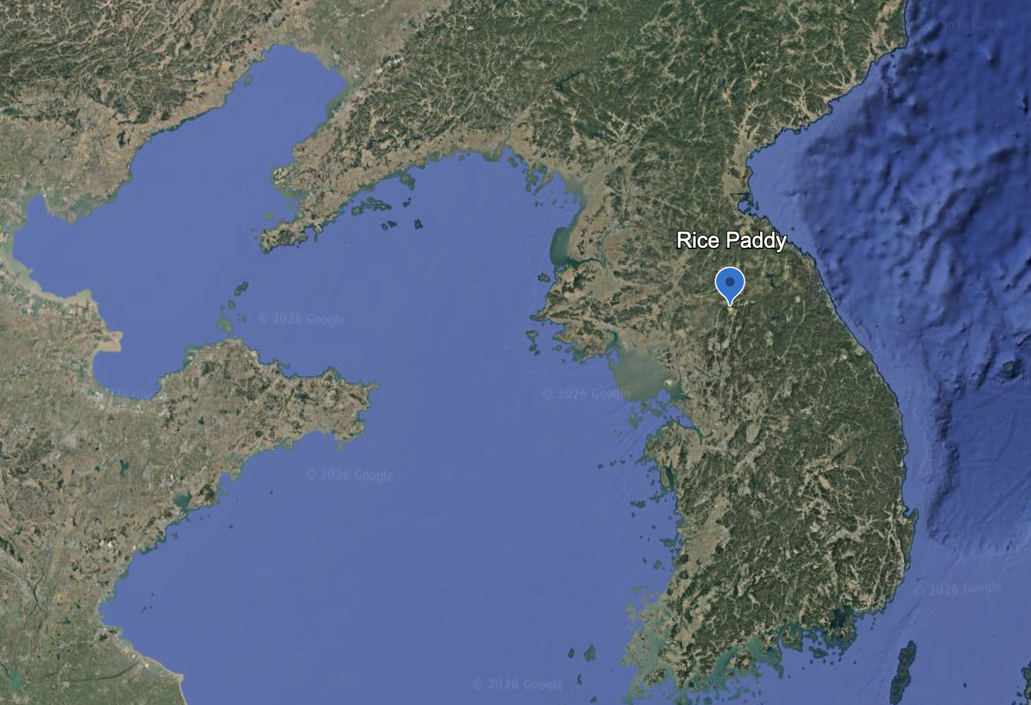
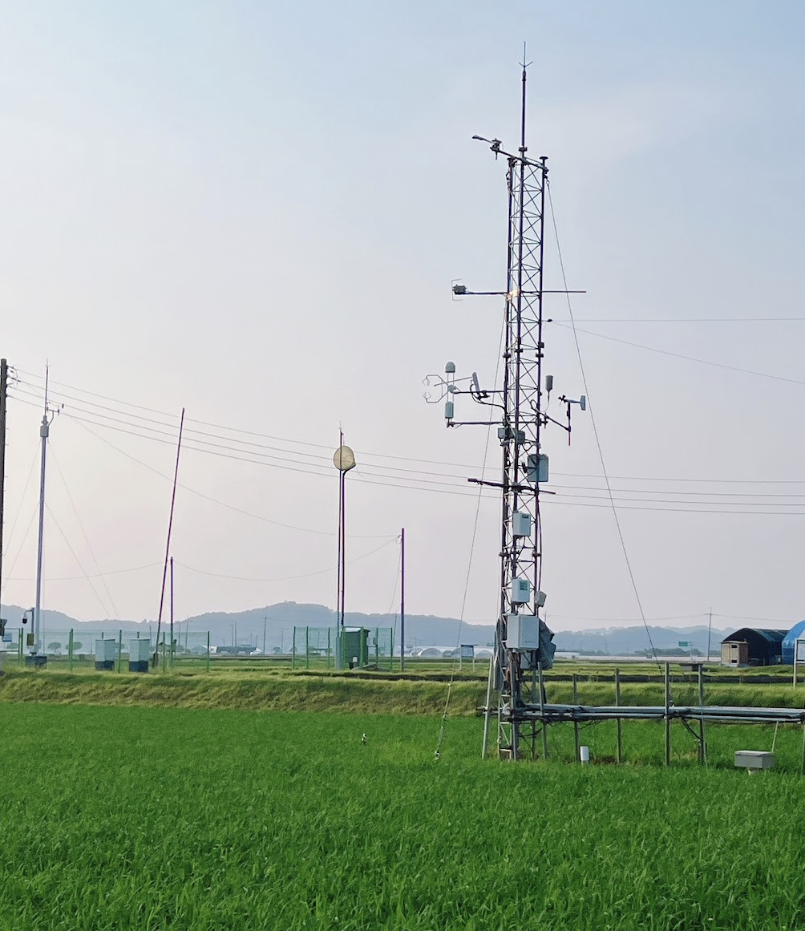
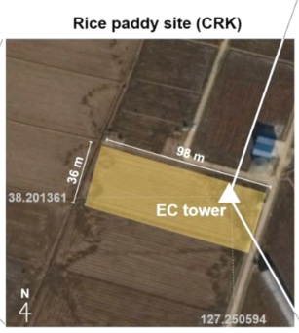
Materials and Methods - Site
Cheorwon Rice Paddy
PAR Sensor
Eddy covariance
Fluxes: ET, GPP, CH4
Temperature, Humidity,
Wind
Hyperspectral system
1
2
3
Multi-layer soil variables

Slide 8
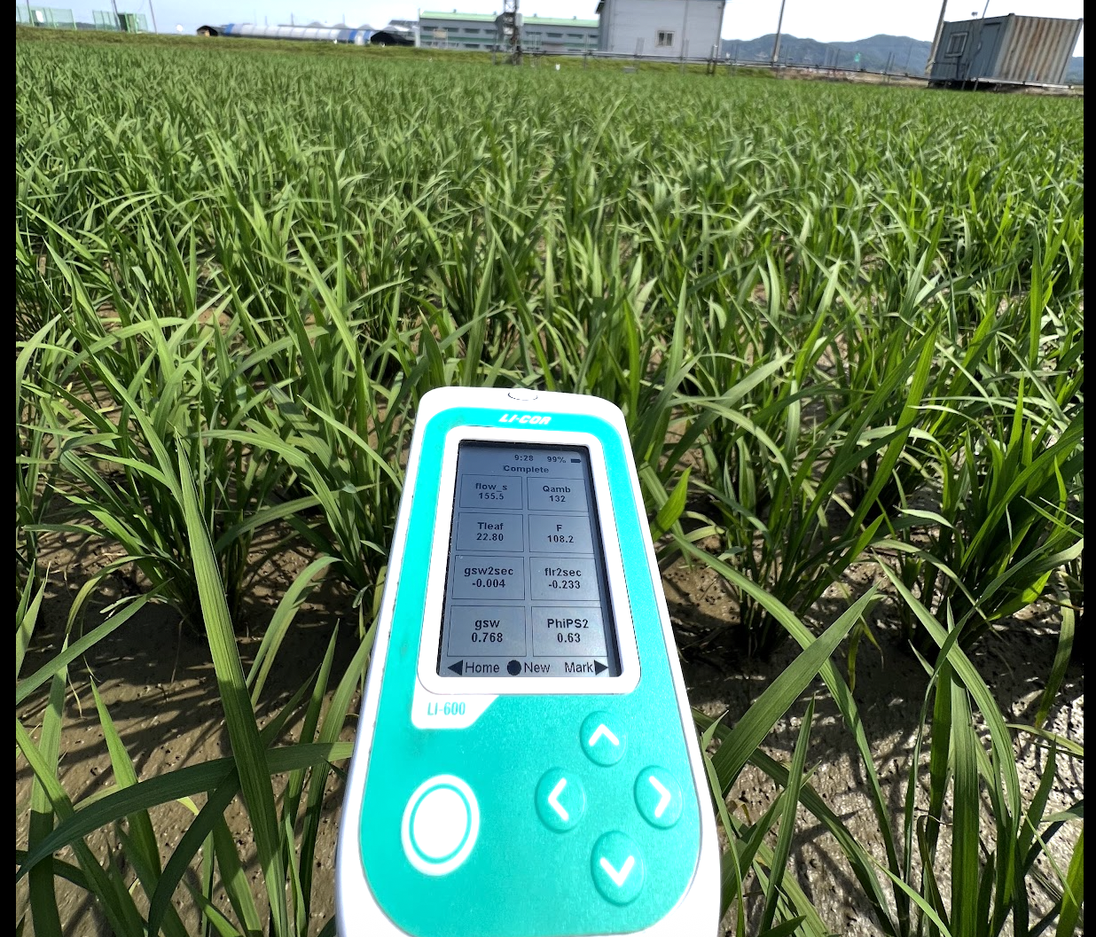
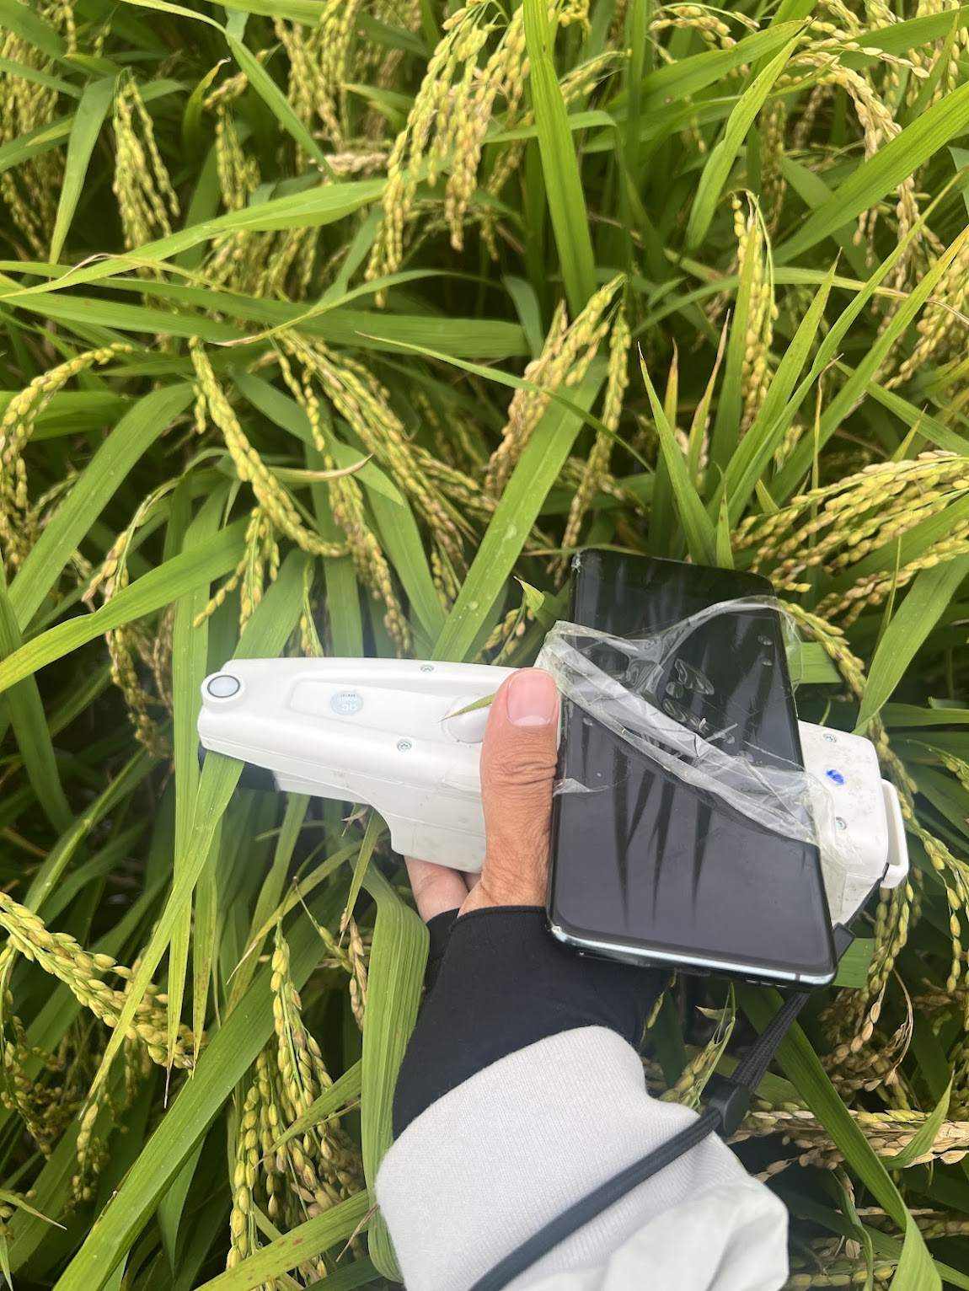
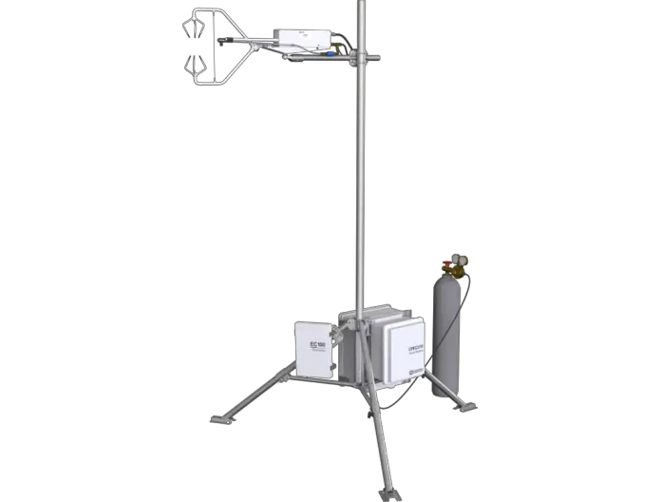
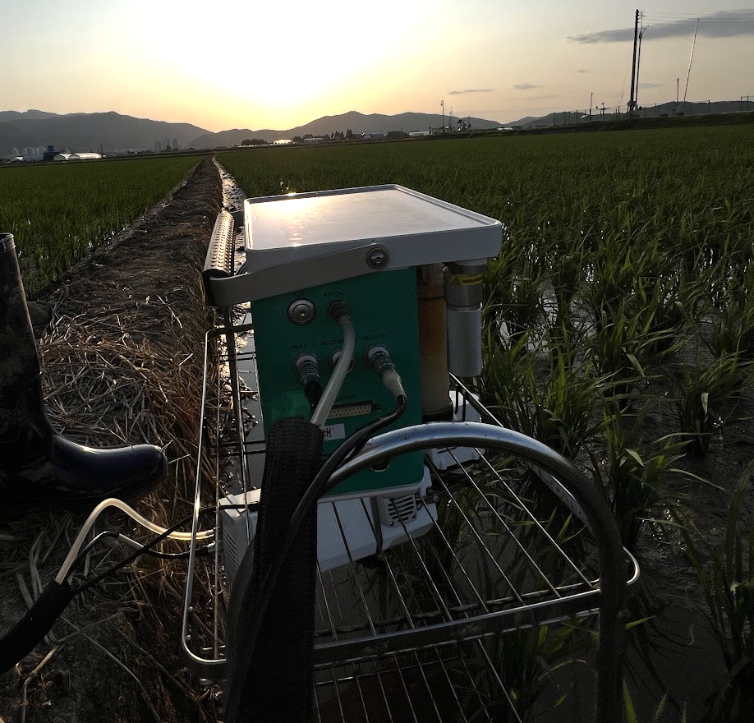
Materials and Methods - Field campaign
I utilized the random sampling method to get
the ecosystem-level data.
Li-600
>10 days per month /daily/108 samples
Stomatal conductance; PSII (PAM)
MultispeQ 2.0
>10 days per month /daily/108 samples
Fo’; PSI; P700; DIRK_ECS
Li-6800
Monthly
Light response/A-Ci response
108 pairs/day Randomly within footprint
Sunlit and sunshade

Slide 9
Questions
How to apply JB model at the ecosystem scale?
What is the performance of JB model at the ecosystem scale?
Fluxes
Hypothesis

Slide 10

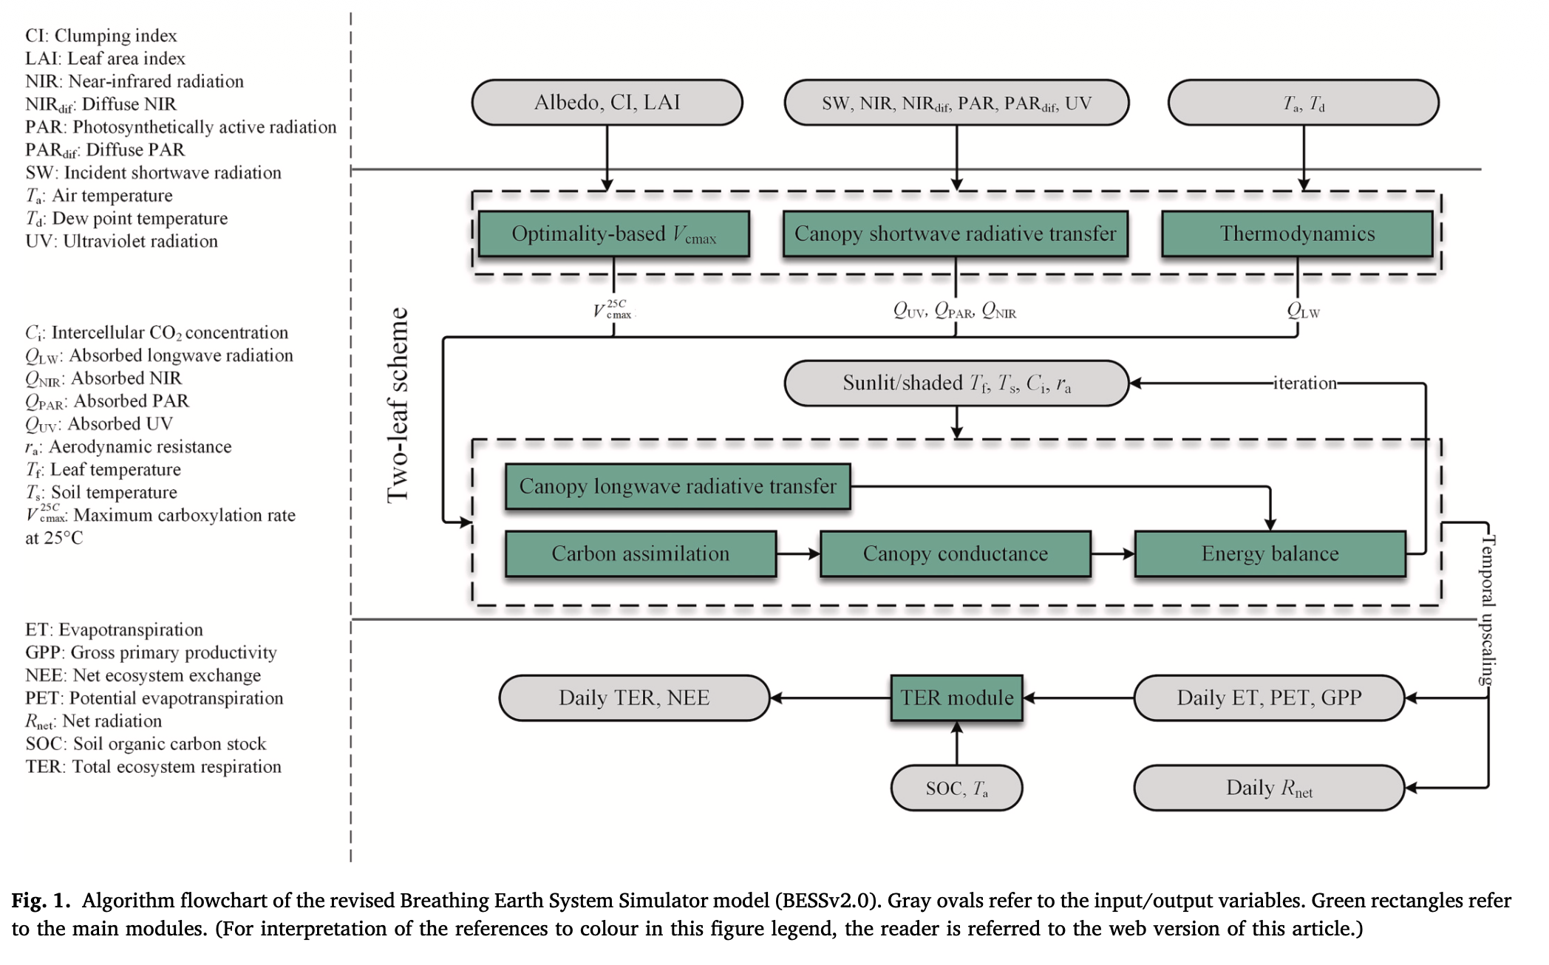
Materials and Methods - BESS
Breathing Earth System Simulator (BESS 2.0)
JB
Photophysical, Photochemical
BESS
Biochemical, RTM

Slide 11
Materials and Methods – BESS-JB
Breathing Earth System Simulator (BESS 2.0)
BESS
BESS-JB
PSI-explicit coupled-process model
JB
Photophysical, Photochemical
Part of the vision:
“An assimilation platform for next generation satellite observation (e.g. FLEX)…”

Slide 12
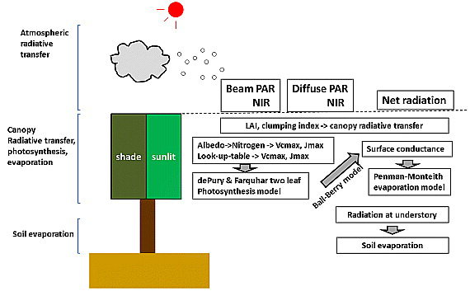
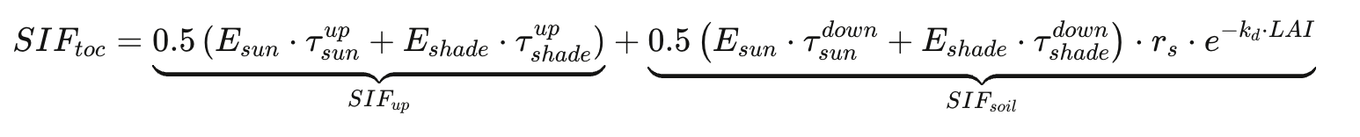
Materials and Methods - RTM of SIF at 760nm
BESS-JB-RTM
BESS uses Beer’s law for simplicity and speed
Conceptual Framework

Slide 13
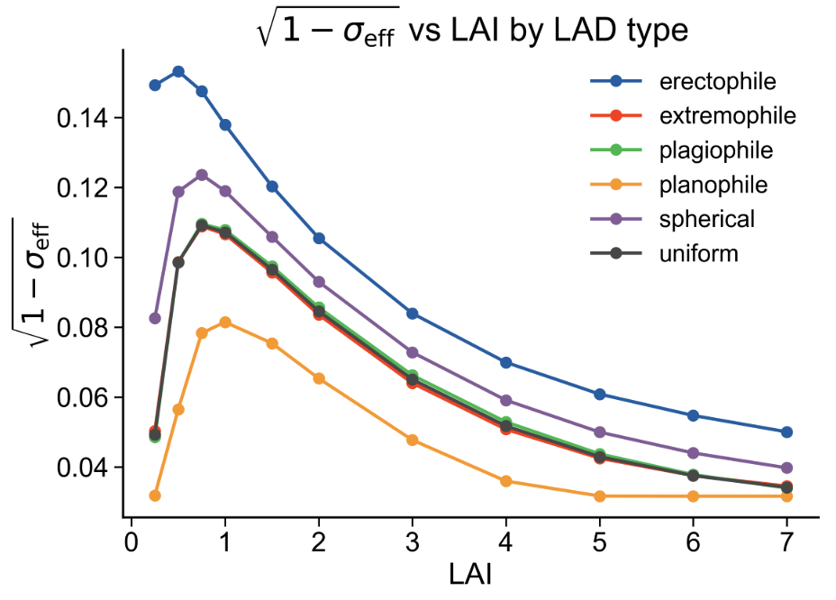
Results - RTM of SIF at 760nm
BESS-JB-RTM
BESS uses Beer’s law for simplicity and speed, while using the hardcoded constant σ_{eff} for multiple scattering.
A lookup table (LUT) for effective scattering coefficient, σ_{eff} , at 760nm.
750k SCOPE simulations
(SCOPE Python Version)
Hardcoded : R²= -24.44
Polynomial fit : R²= 0.75
LUT: :R²= 0.95

Slide 14
Questions
How to apply JB model at the ecosystem scale?
What is the performance of JB model at the ecosystem scale?
Fluxes
Hypothesis

Slide 15
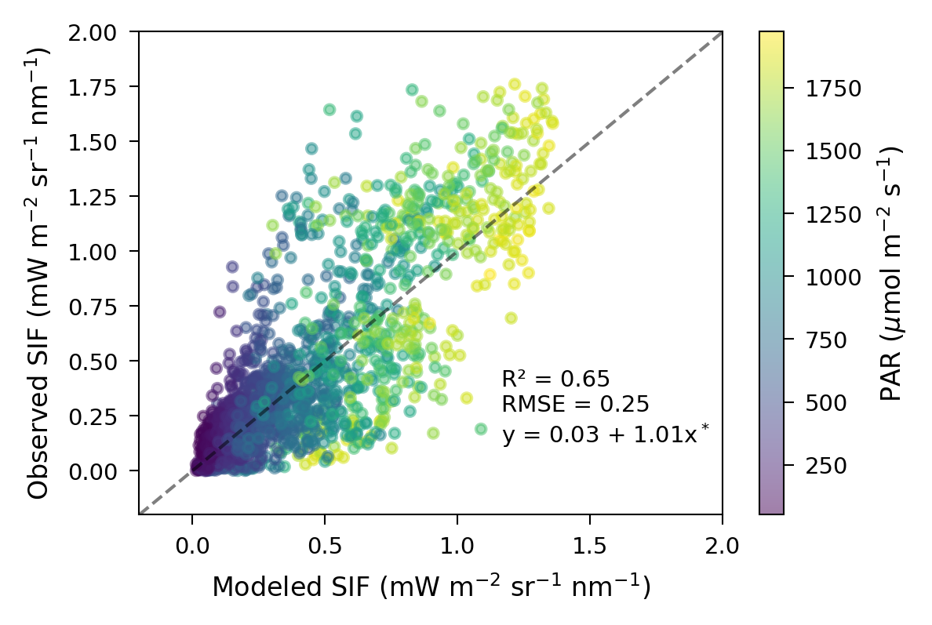
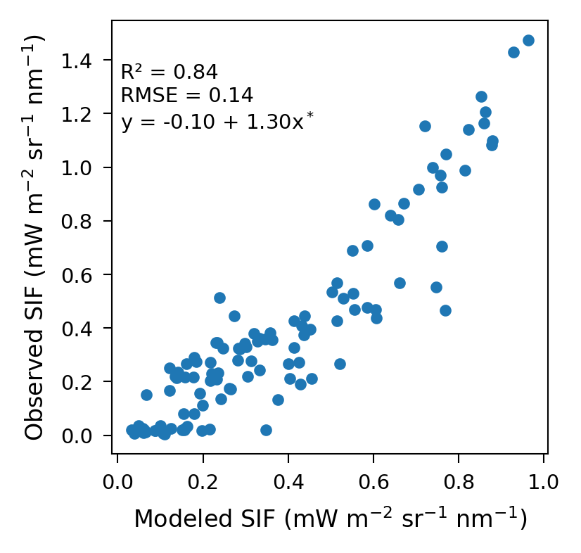
Results - SIF
SIF (No optimization)
30-min
Daily

Slide 16
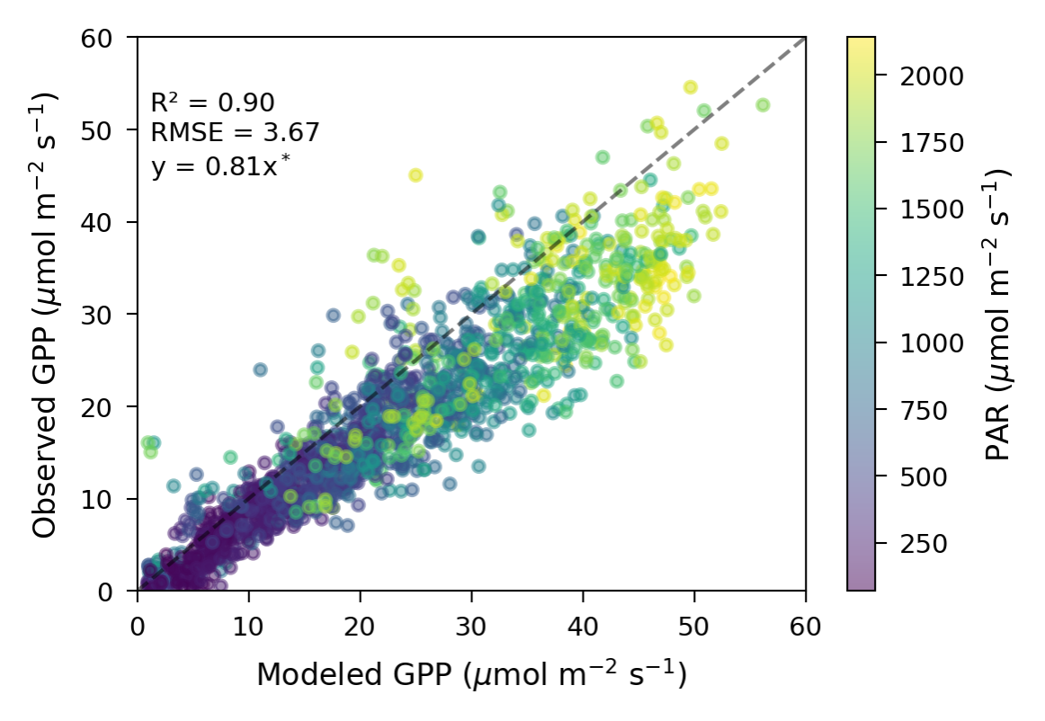
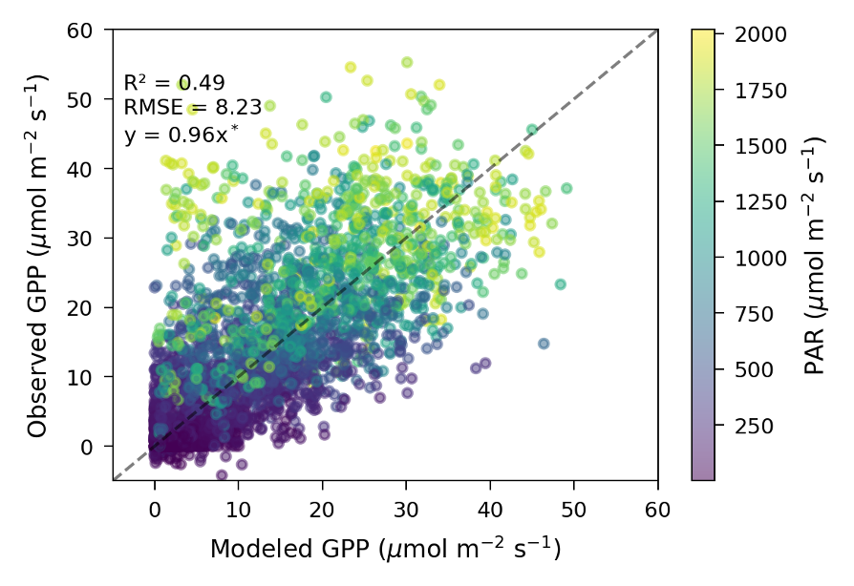
Results - GPP
Comparing with BESS 2.0 (No optimization)
30-min BESS-JB
30-min BESS 2.0

Slide 17
Questions
How to apply JB model at the ecosystem scale?
What is the performance of JB model at the ecosystem scale?
Fluxes
Hypothesis

Slide 18
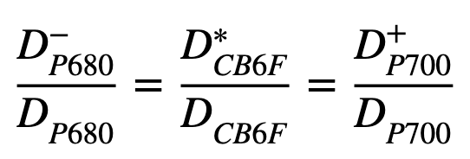
Questions - Hypothesis
Sub-questions
Excitation balance
Why did the q_{L} decrease to specific values?
State transition
How did the redistribution of excitation from PSII to PSI influence the quantum yield of PSII?
Cyclic electron transport
Did the alternative CET at PSI happen and when?
Heat dissipation
When and where the heat dissipation happened? (energy balance)
Contribution of PSI to SIF
How many percent SIF is from PSI?

Slide 19
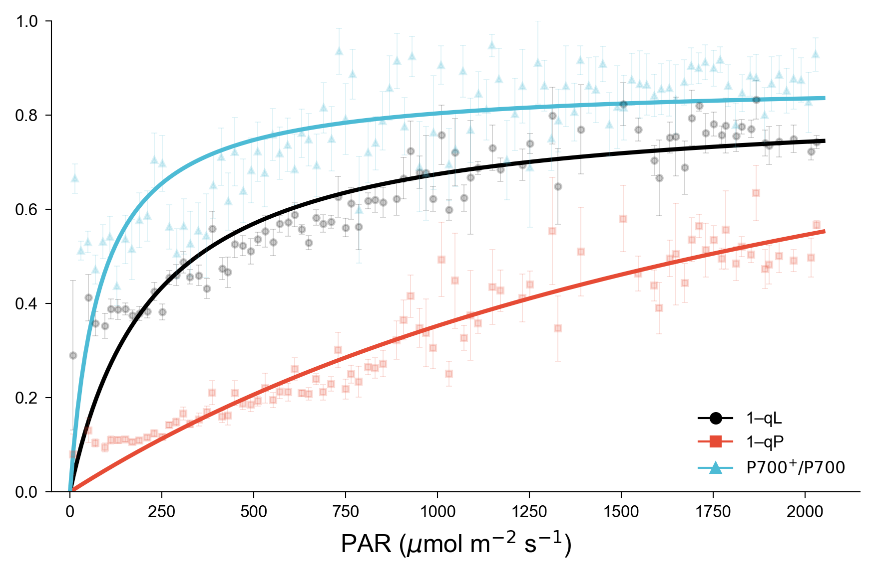
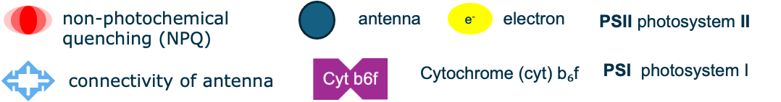
Results - Excitation balance
6
Basic hypothesis: excitation balance
SIF_{PSII}
NPQ_{PSII}
SIF_{PSI}
3
2
5
1
NPQ_{PSI}
e⁻
e⁻
PSII
PSII
4
PSI
PSI
e⁻
PAM observation

Slide 20
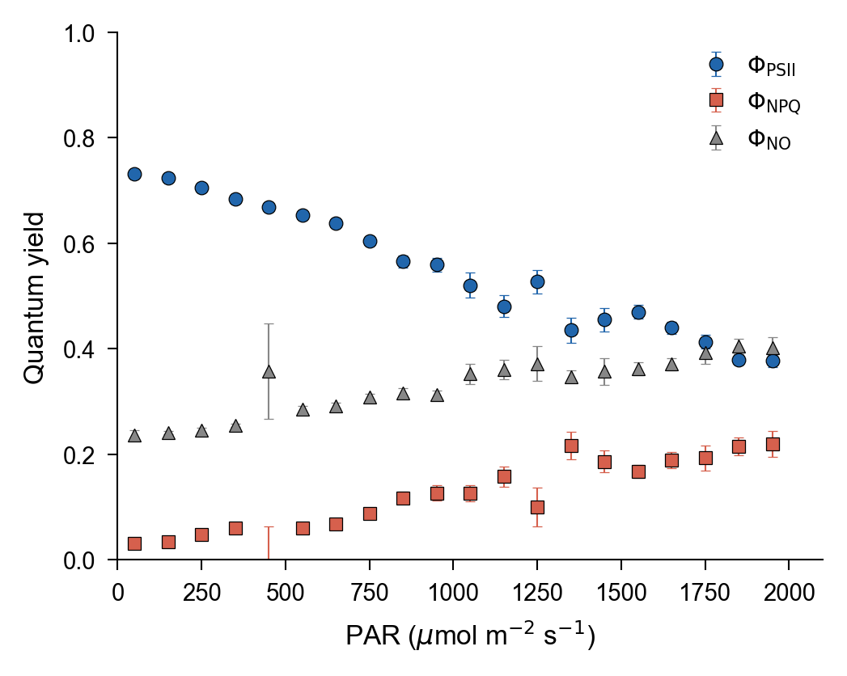
Results - Quantum Yield
Quantum Yield
SIF_{PSII}
NPQ_{PSII}
6
SIF_{PSI}
3
2
5
1
e⁻
NPQ_{PSI}
e⁻
4
PSI
PSII
e⁻
PAM observation

Slide 21
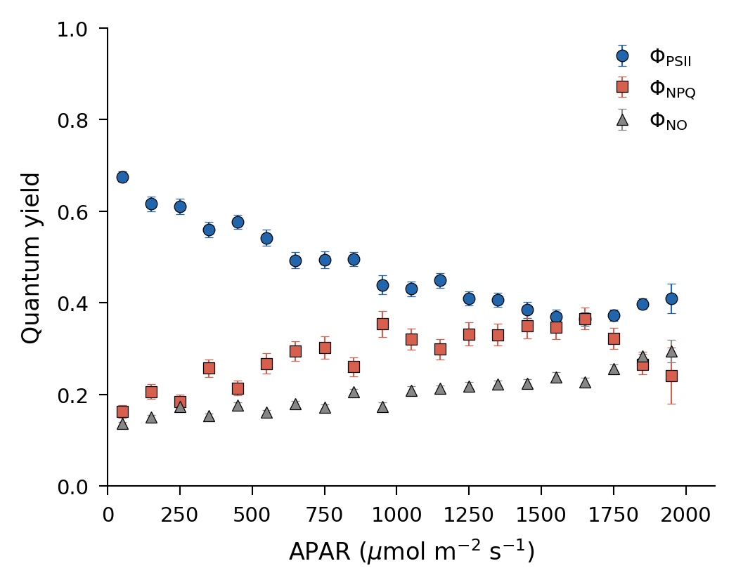
Results - State transition
Quantum Yield
State transition
3
State transition: on
PAM observation
Modeled

Slide 22
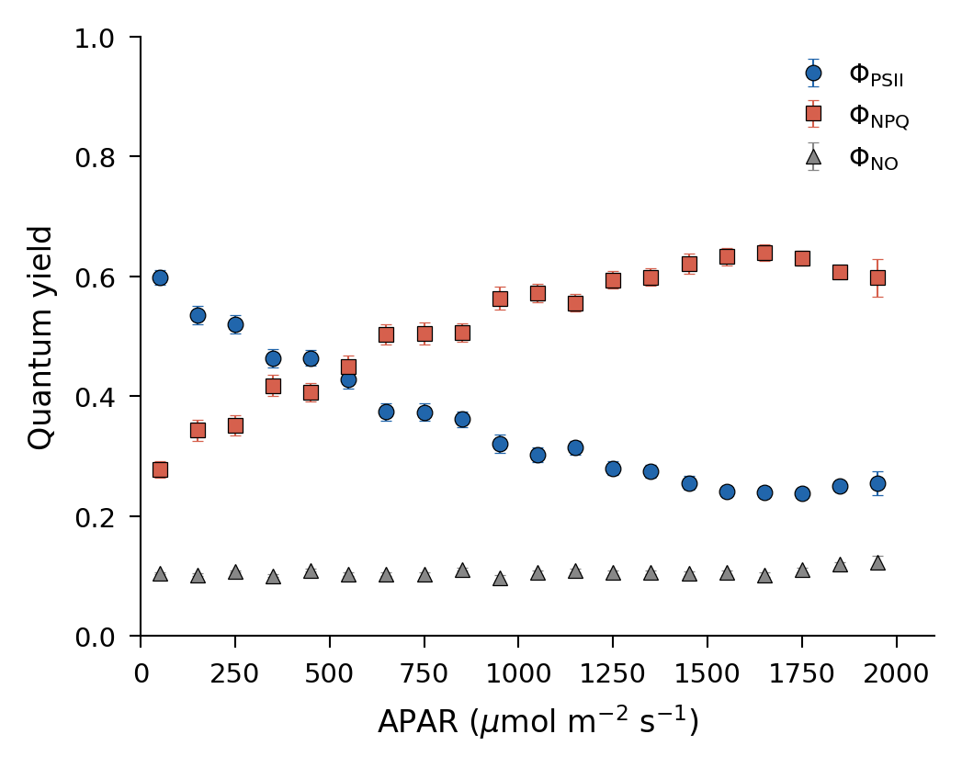
Results - State transition
Quantum Yield
State transition
3
State transition: off
PAM observation
Modeled

Slide 23
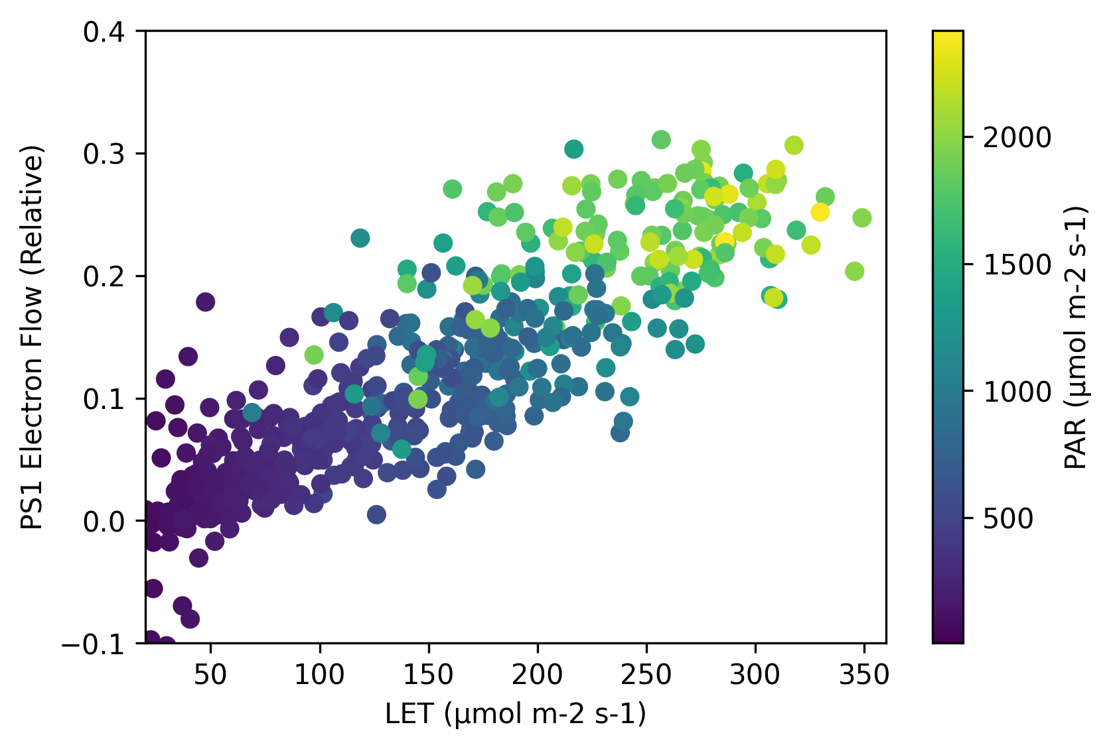
Results – Electron transport
CET
SIF_{PSII}
NPQ_{PSII}
6
SIF_{PSI}
3
2
5
1
NPQ_{PSI}
e⁻
e⁻
PSII
4
PSI
e⁻
PAM observation
(Dark-interval relaxation kinetics (DIRK))

Slide 24
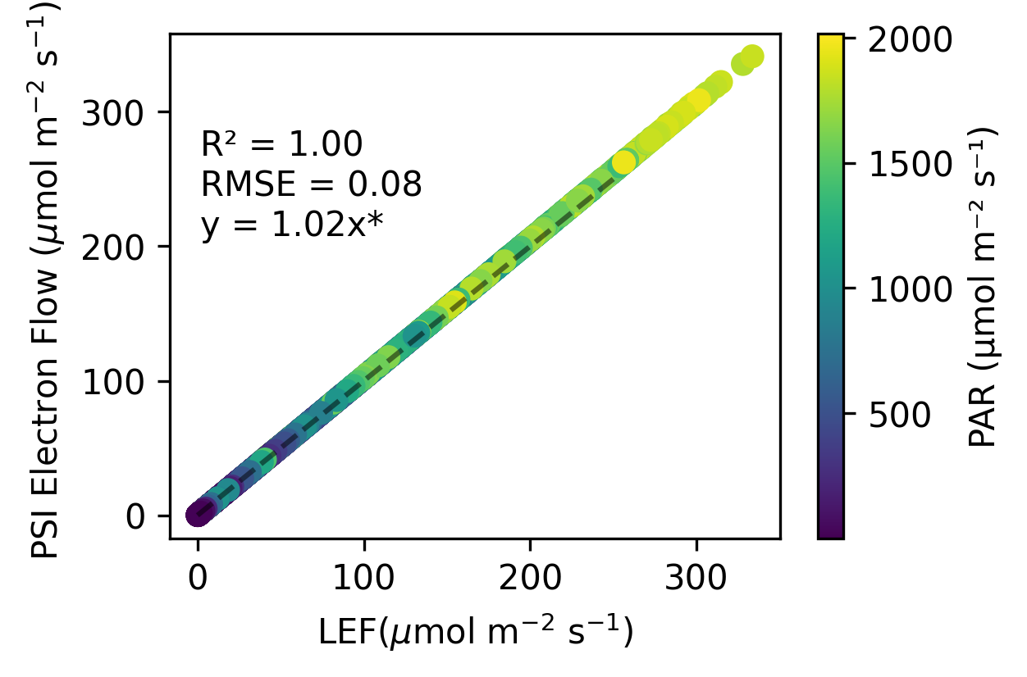
Results – Electron transport
CET
Cyclic electron transport
4
LET
PAM (DIRK) observation
Modeled

Slide 25
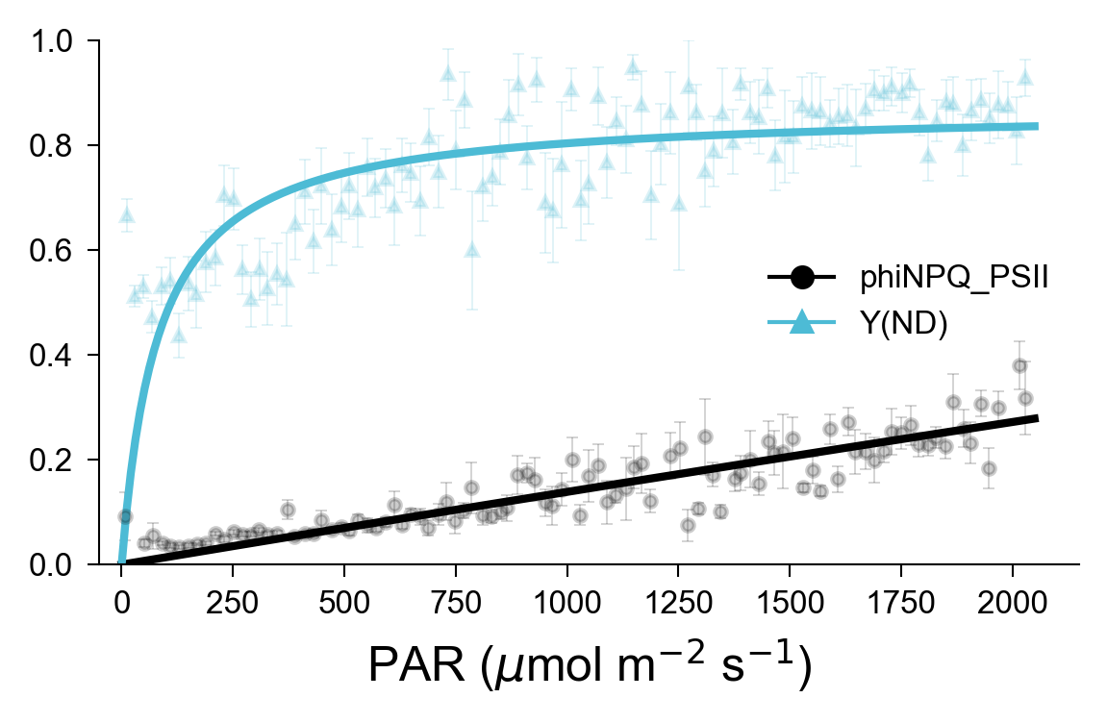
Results - NPQ
NPQ
SIF_{PSII}
NPQ_{PSII}
6
We use Y(ND) as the proxy of PhiNPQ_PSI
SIF_{PSI}
Y(ND): P700 oxidation ration
3
2
5
1
e⁻
NPQ_{PSI}
e⁻
PSII
4
PSI
e⁻
PAM observation

Slide 26
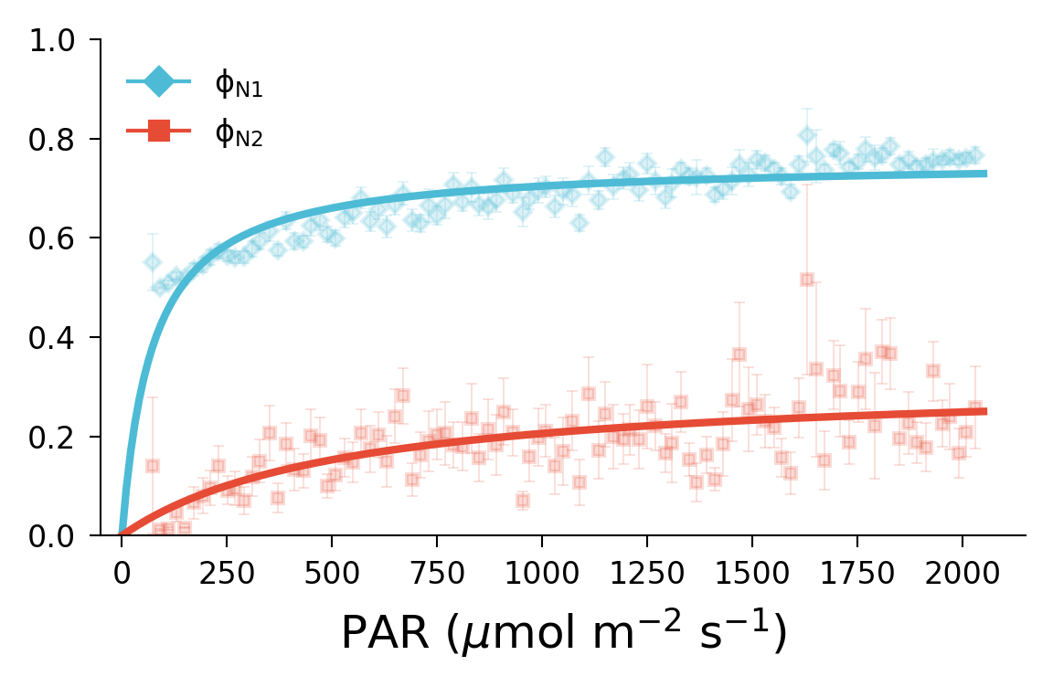
Results - NPQ
NPQ
P700+ quenching
5
Y(ND): P700 oxidation ration
PAM observation
Modeled

Slide 27
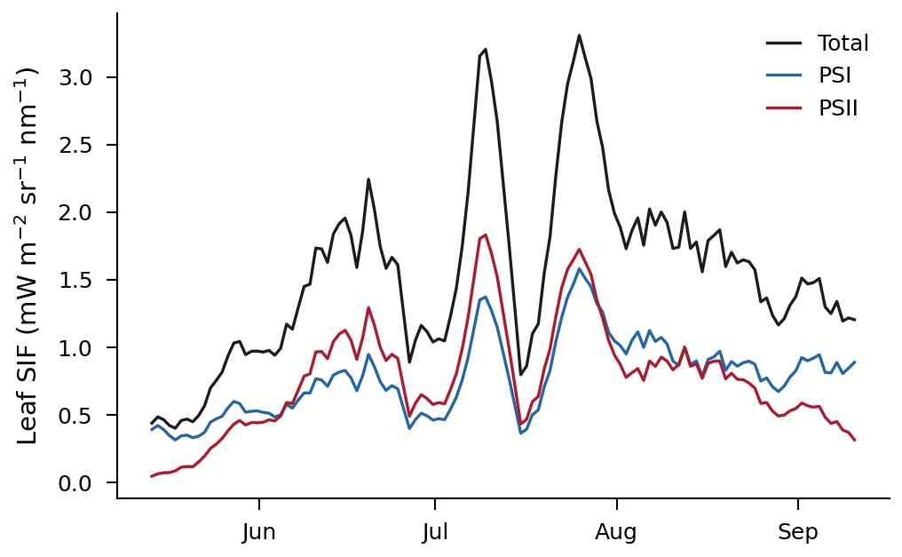
Results - Contribution of PSI to SIF (760nm)
SIF
SIF_{PSII}
NPQ_{PSII}
6
SIF_{PSI}
3
2
5
1
e⁻
NPQ_{PSI}
e⁻
4
PSI
PSII
e⁻
We need to be careful when interpreting the seasonal pattern of SIF and PAM measurement.

Slide 28
Conclusion
BESS empowers the JB model simulation at the ecosystem scale.
BESS-JB shows great performance on ecosystem scale fluxes simulation.
Missed processes related to PSI are playing important roles on understanding and modeling electron transport.
Excitation balance between PSI and PSII was confirmed at the rice paddy.
State transition between PSI and PSII directly influenced the quantum yield of PSII.
Electron flow around PSI was almost identical as the LET of PSII.
NPQ in PSI activates earlier and much higher than PSII.
SIF from PSI accounted for near half of total SIF emission.

Slide 29






FLEX
Email:
Thank you!

Slide 30
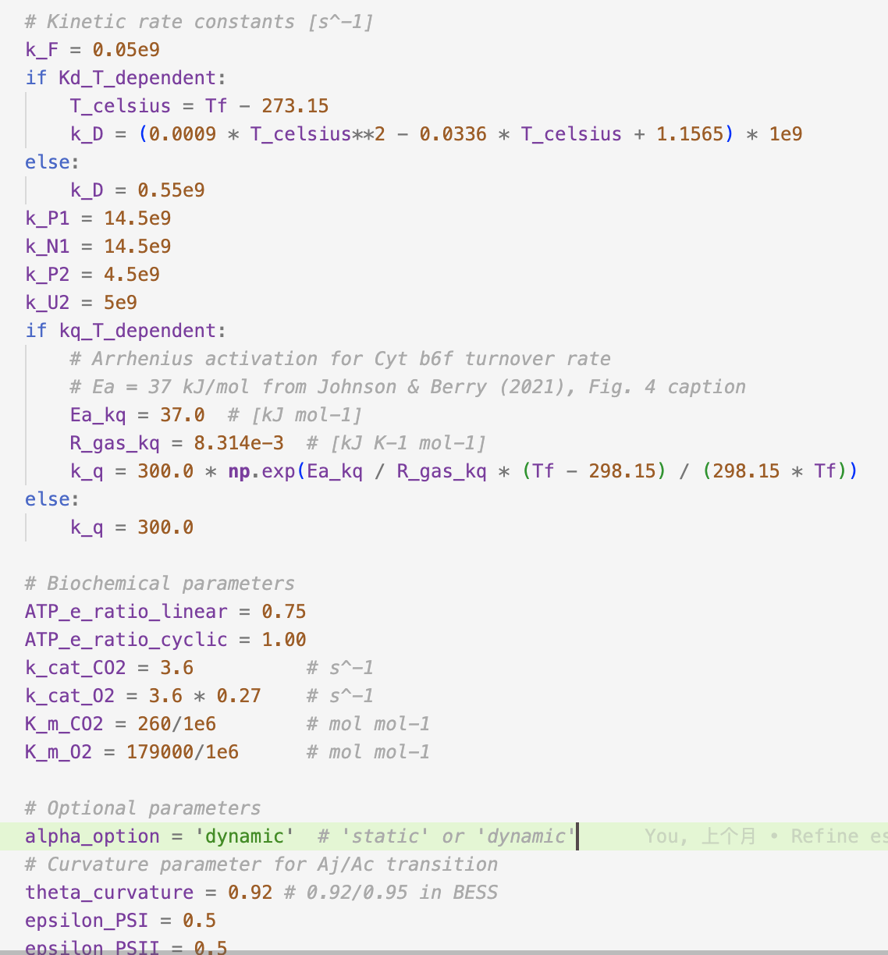
Parameters I used

Slide 31
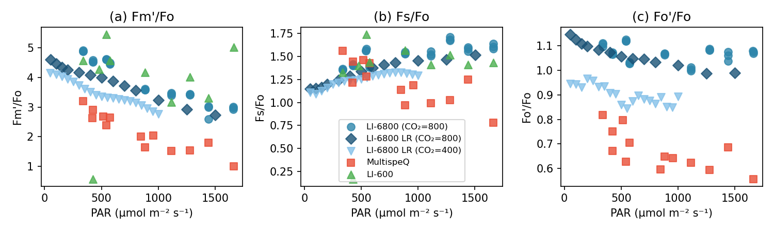
Uncertainty of the measurement

