Slide 1
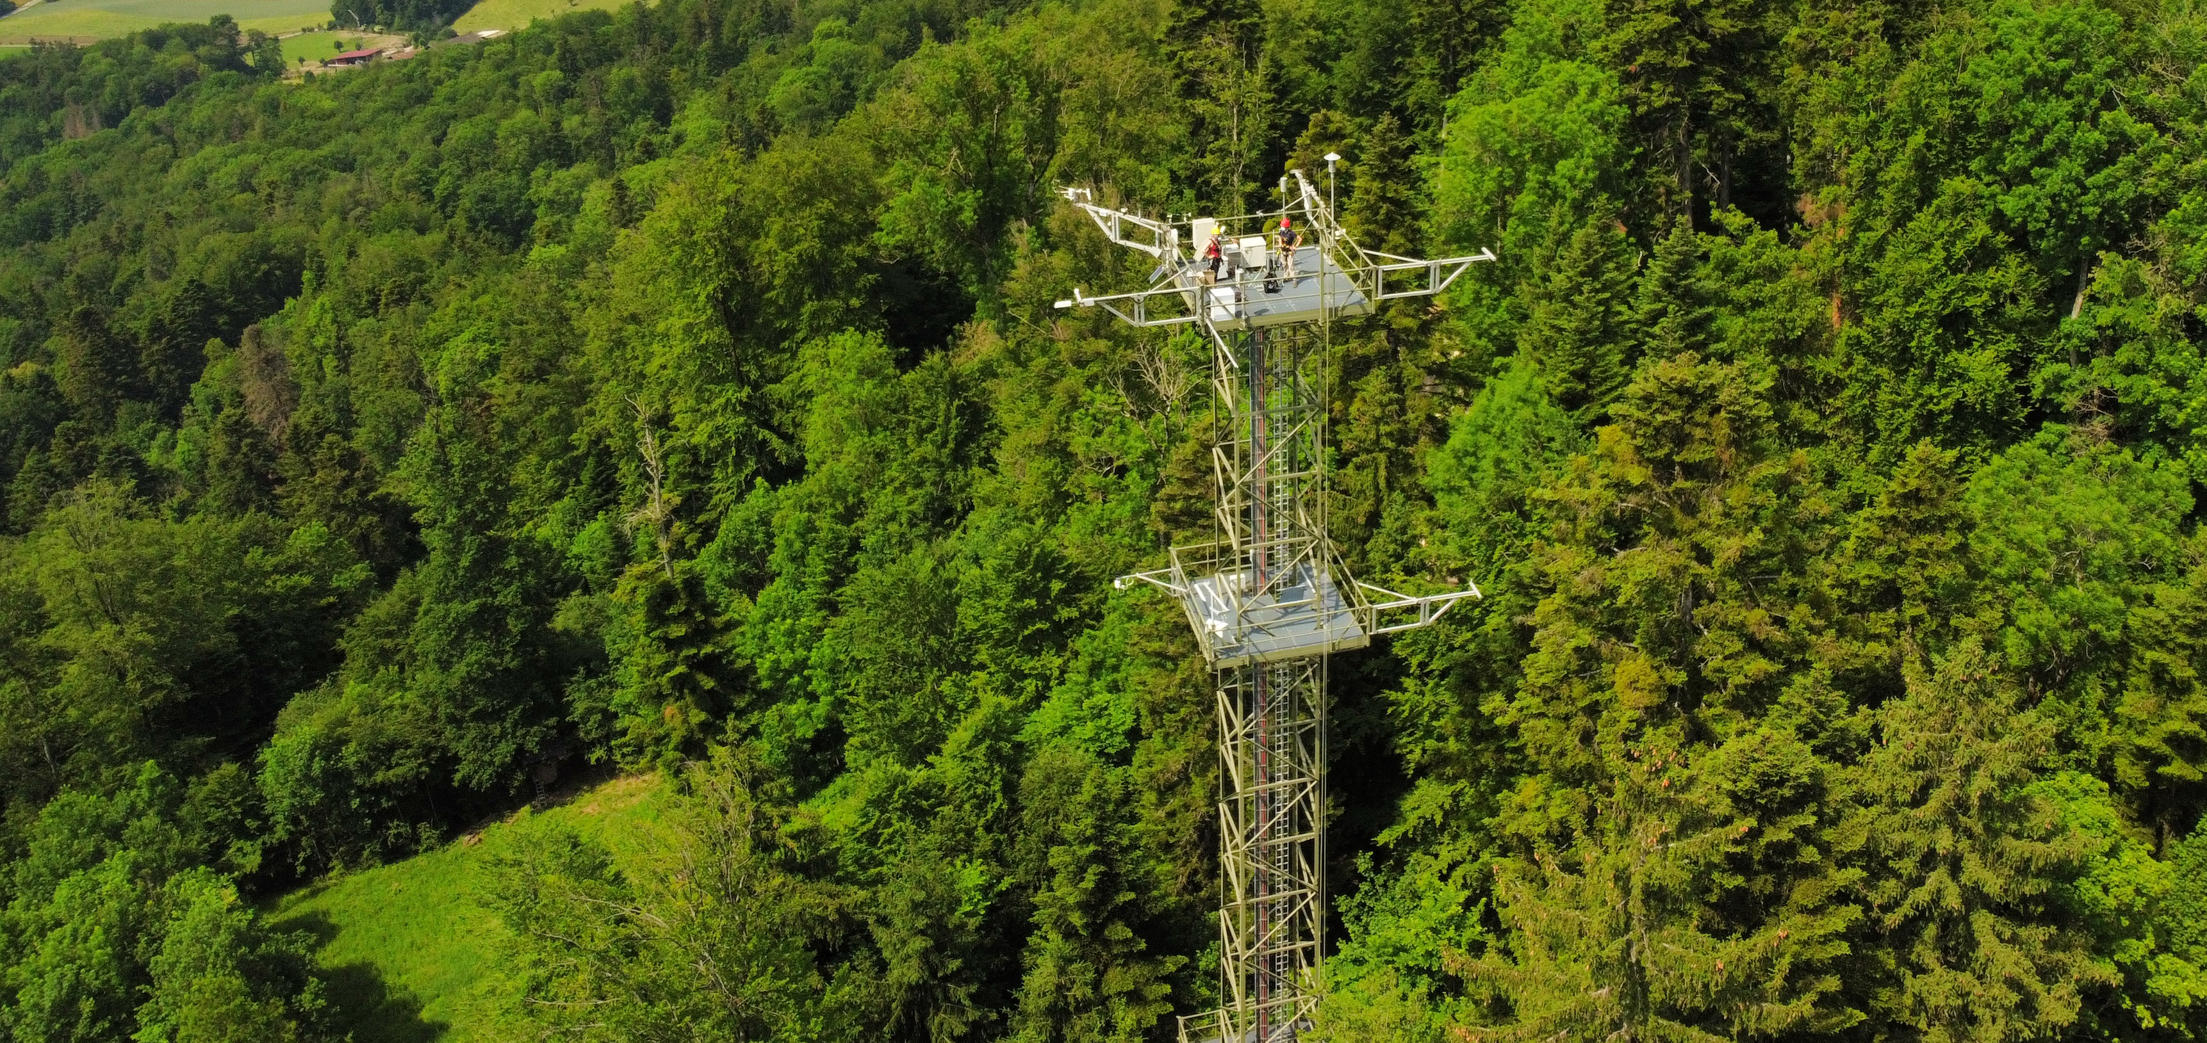
Considerations on the use of
in situ spectroscopy
measurements for FLEX
data validation
    Alexander Damm, Jasmin Kesselring, Lars Groeneveld,
    Eugenie Paul-Limoges, Michael Niederberger
Photo by Guido Wiesenberg

Slide 2
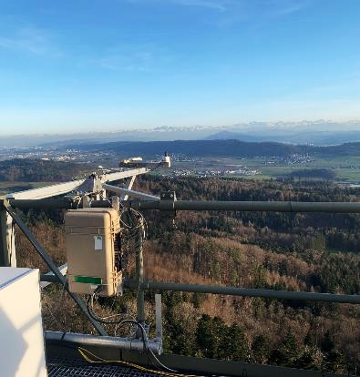
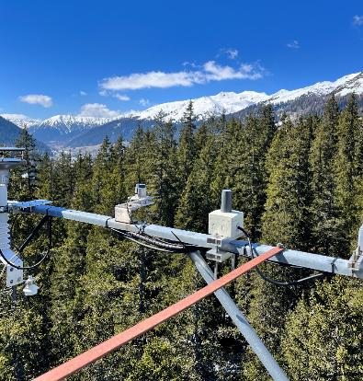
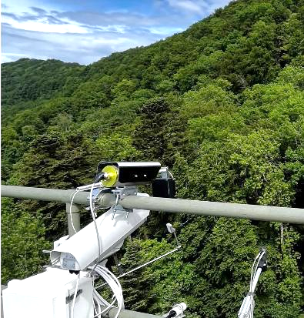
Swiss-Spec-Net: Sensors and data
FloX/RoX spectrometer systems
  5 Sites (urban, grassland, 2 forests, lake)
  22 site years of data
  GNSS antennas
  2 Swiss sites; 10 site years (unique)
  5+ additional ICOS site across Europe soon (VODnet; NextGenCarbon)
Additional instrumentation
  1 Cimel sun photometer (Aeronet)
  2 Sites with thermal camera and net-radiometer (Trishna-project)
Photo by Michael Niederberger
Photo by Jasmin Kesselring
Photo by Jennifer Adams

Slide 3
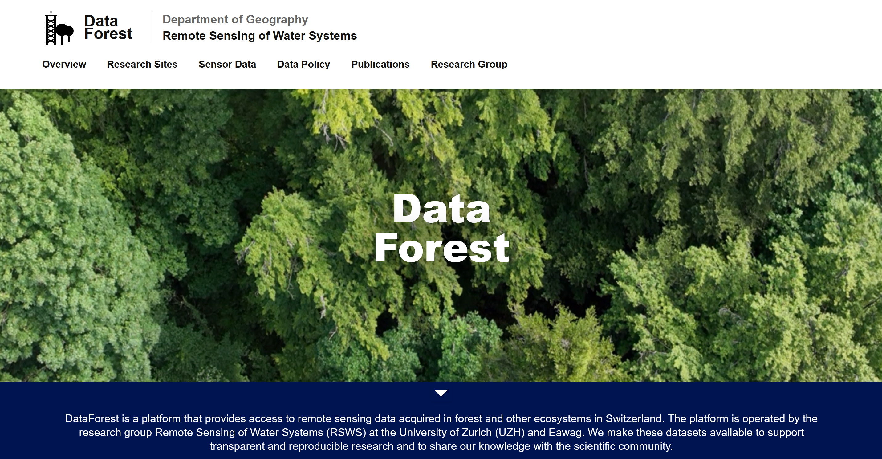

Slide 4
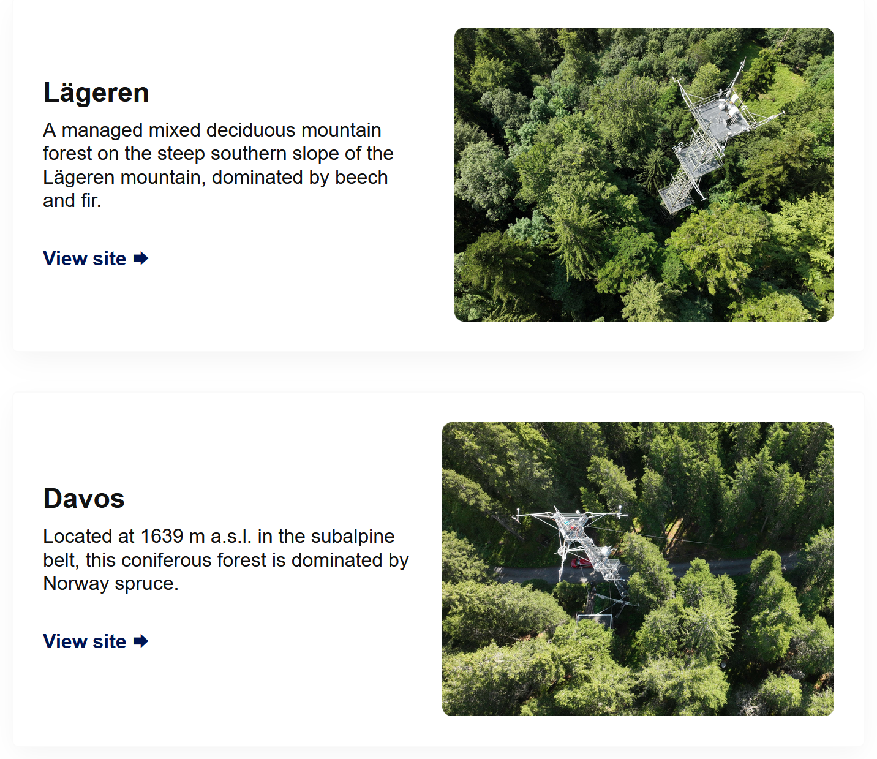
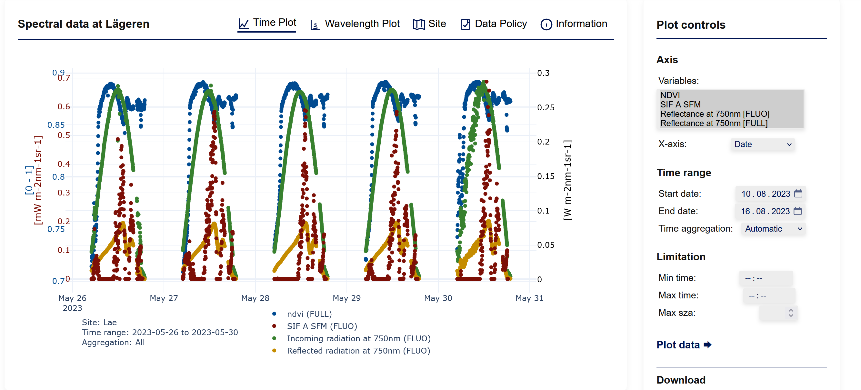
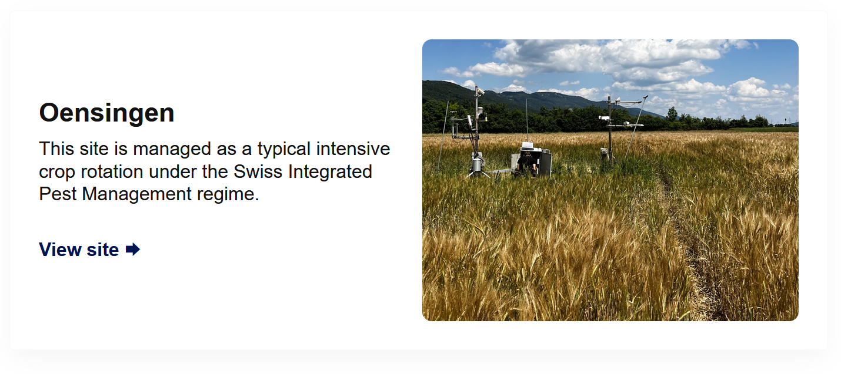
dataforest.geo.uzh.ch
Site descriptions and field books
Data visualization, exploration and download

Slide 5
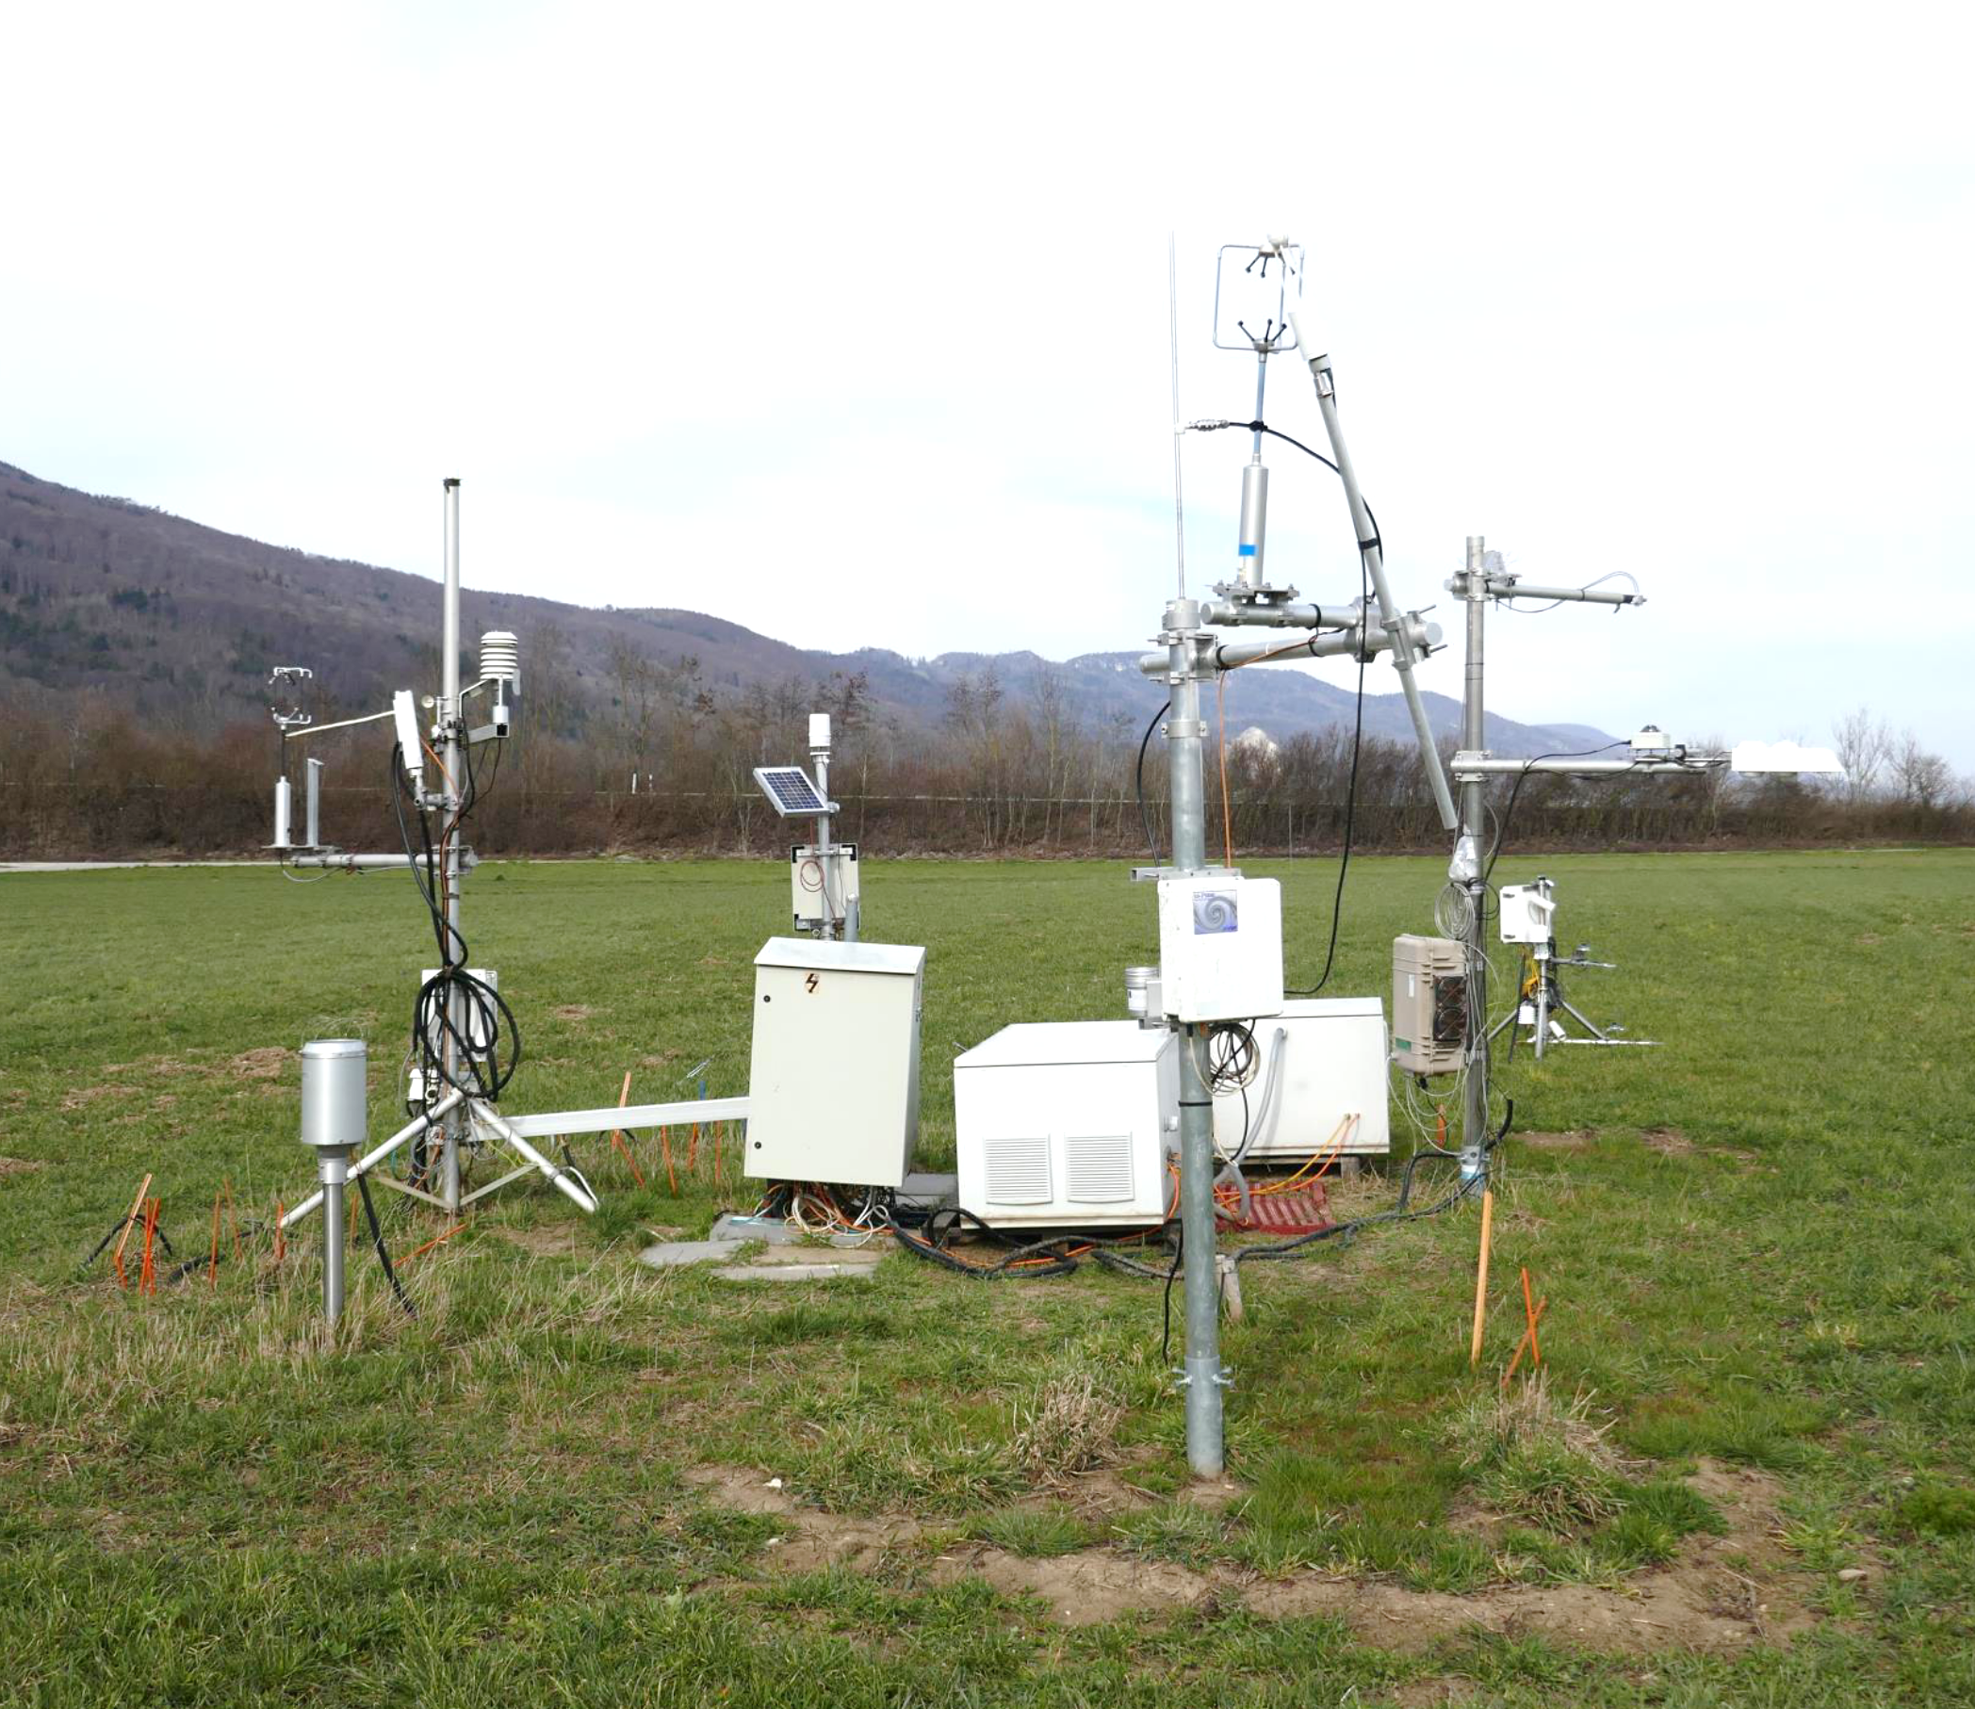
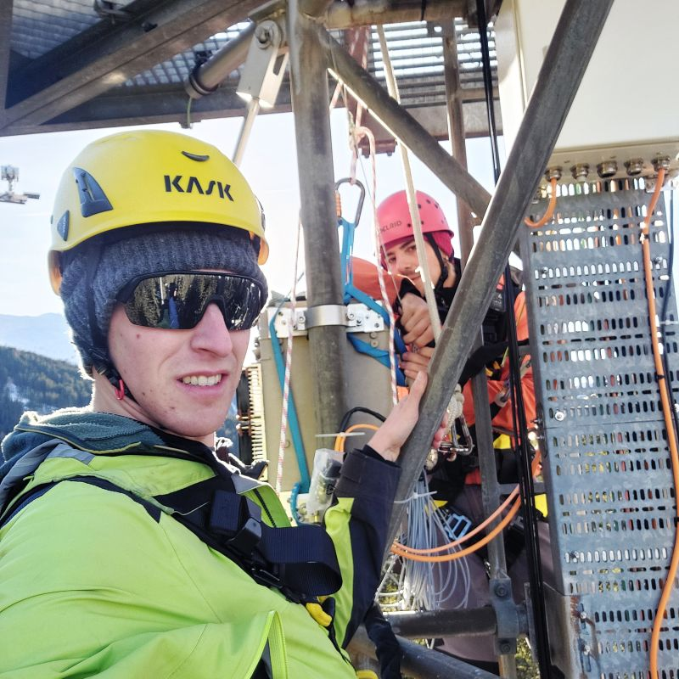
Assessment of data quality across product levels is a prerequisite
How accurate are our measurements?
How can we quantify uncertainties across product levels?
Photo by L. Groeneveld
Photo by E. Paul-Limoges

Slide 6
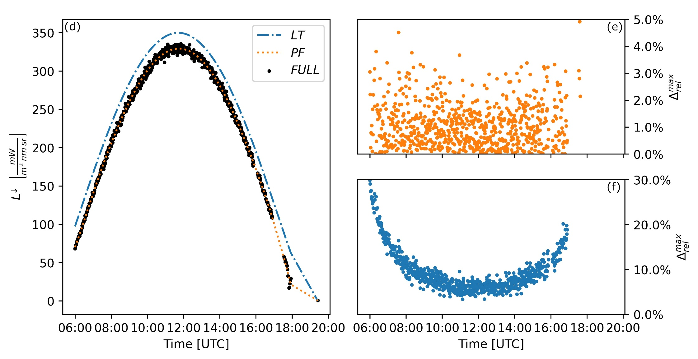
Level 1: Instrumental radiometric random/systematic errors
Buman et al. (2022) https://doi.org/10.1016/j.rse.2022.112984

Slide 7
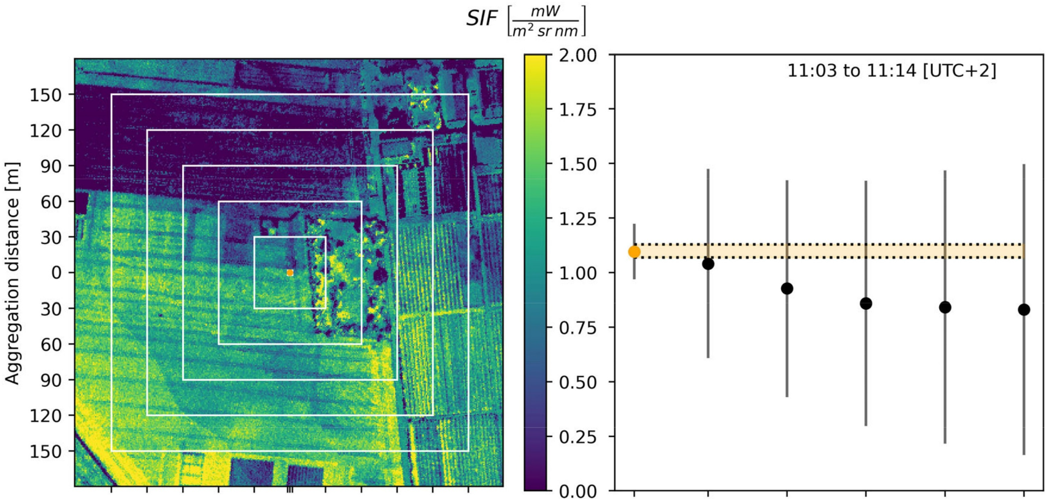

Level 1-2: Representativeness of in situ vs satellite measurements
Buman et al. (2022) https://doi.org/10.1016/j.rse.2022.112984

Slide 8
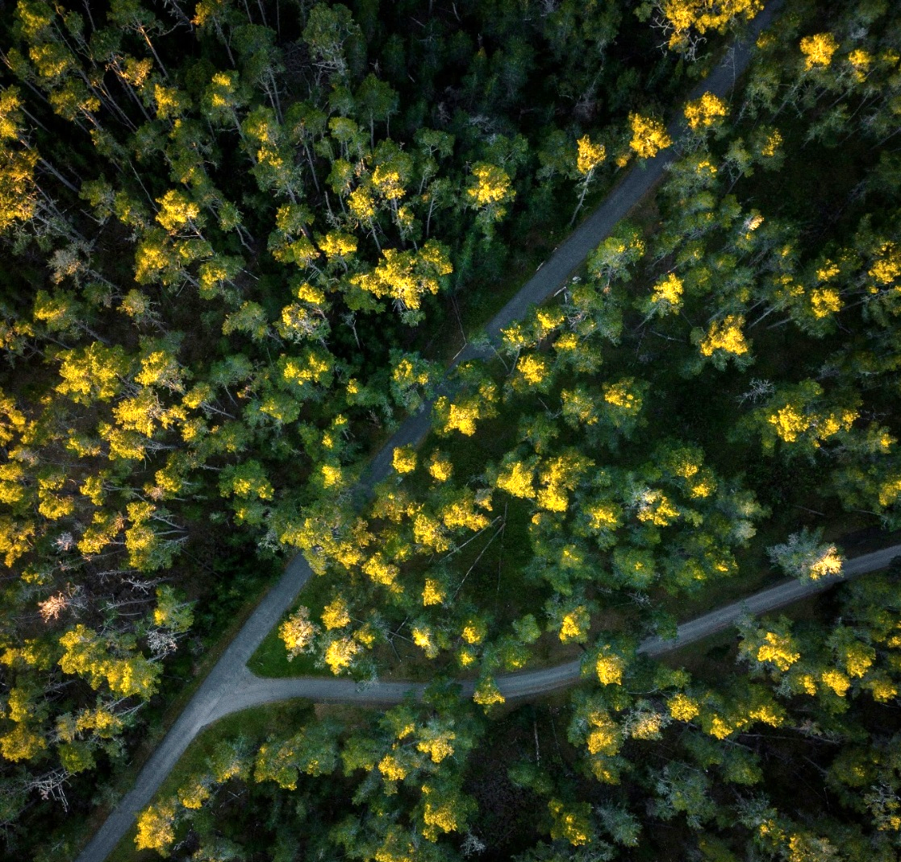
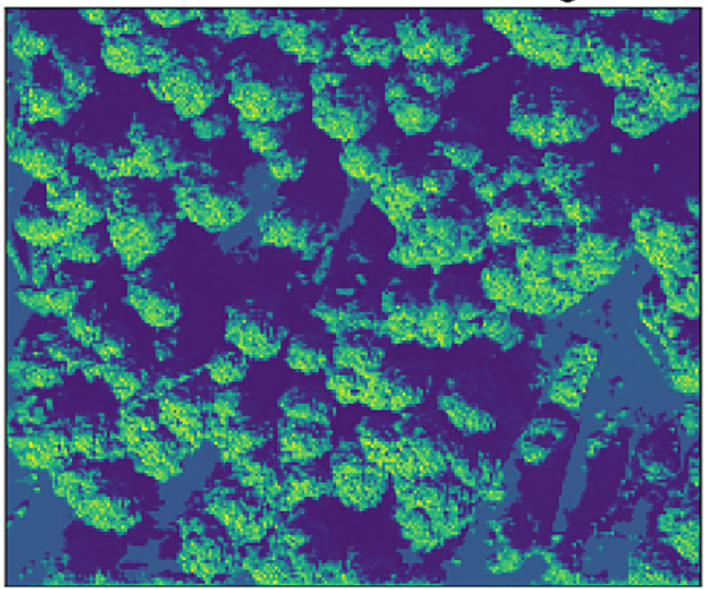
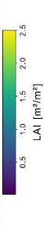
Illumination / shadow effects impact analysis of high-resolution data
How does shadow impact spectroscopy time series?
How uncertain are retrieved RS products due to shade?
Photo by Leon Macapagal on pexels
Kesselring et al. (2024), https://doi.org/10.1016/j.rse.2024.114116

Slide 9
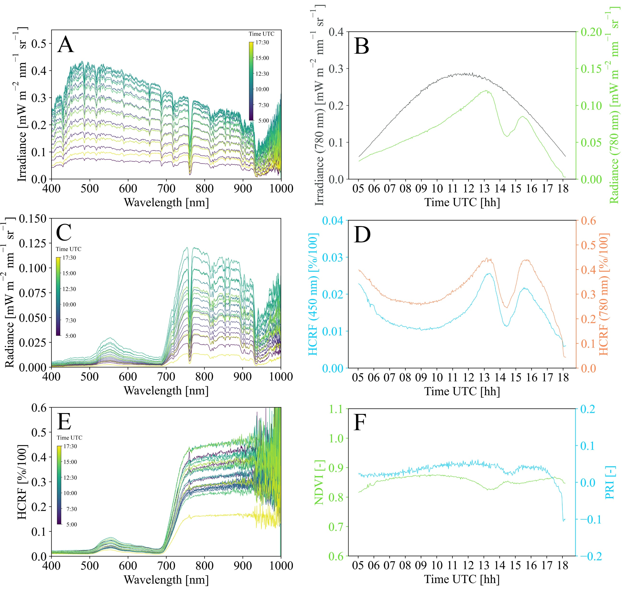
Shadow affects spectroscopy time series: Diurnal effects
Shade in the sensors field of view varies as function of sun position and crown topography.
Retrieved reflectance shows large uncertainties
Damm et al. (in preparation)

Slide 10
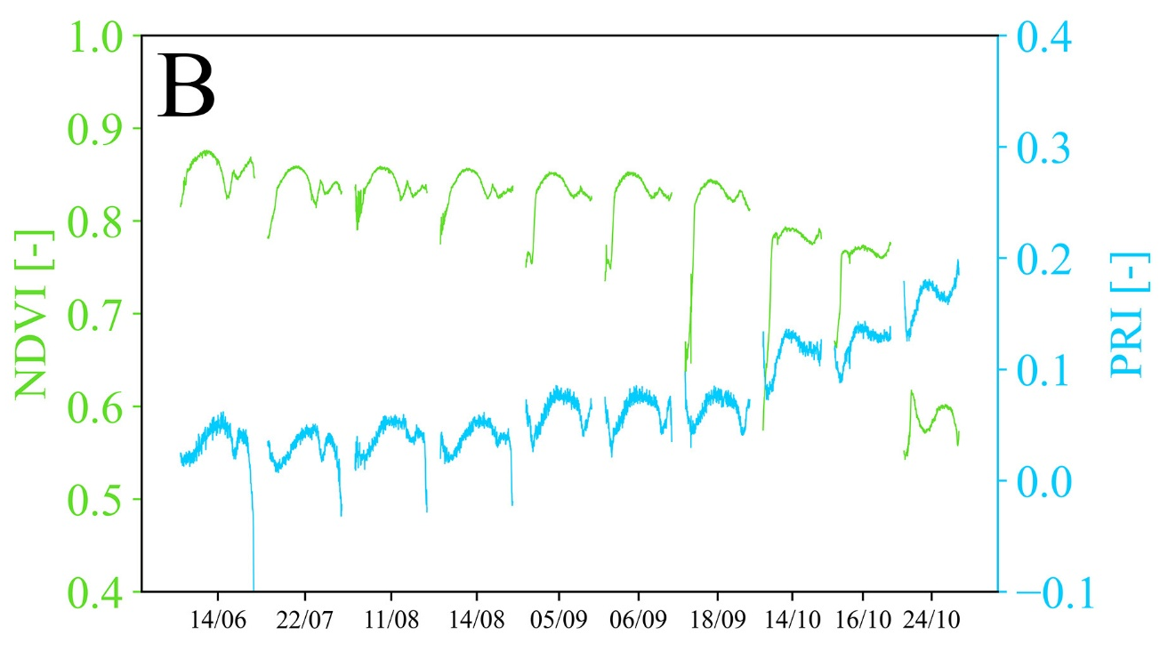
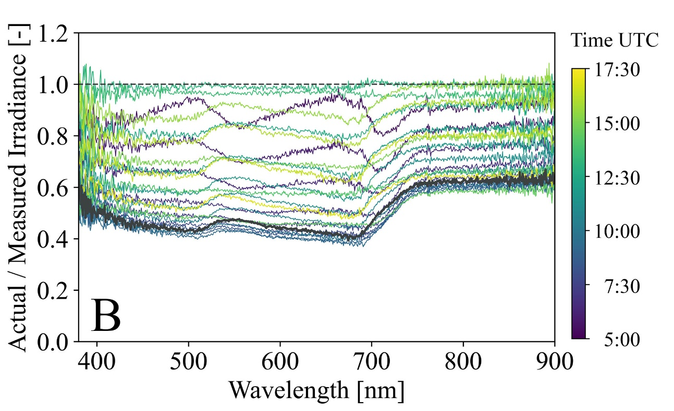
Shadow affects spectroscopy time series: Seasonal effects
Shade causes wavelength dependent uncertainties in reflectance → Retrieved product are affected as well
The spectral fingerprint of shade is highly complicated, particularly in natural forest canopies
Damm et al. (in preparation)

Slide 11
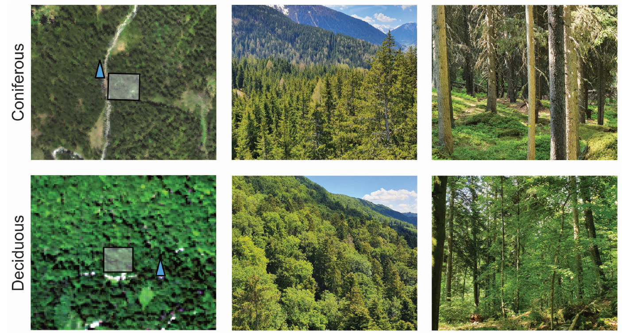
Vertical process dynamics complicate the validation of higher-level products
How sensitive are optical satellite data to track vertical process dynamics?
How comparable are in situ vs satellite measurements of ecosystem properties?
Kesselring (2025), https://doi.org/10.5167/uzh-279962

Slide 12
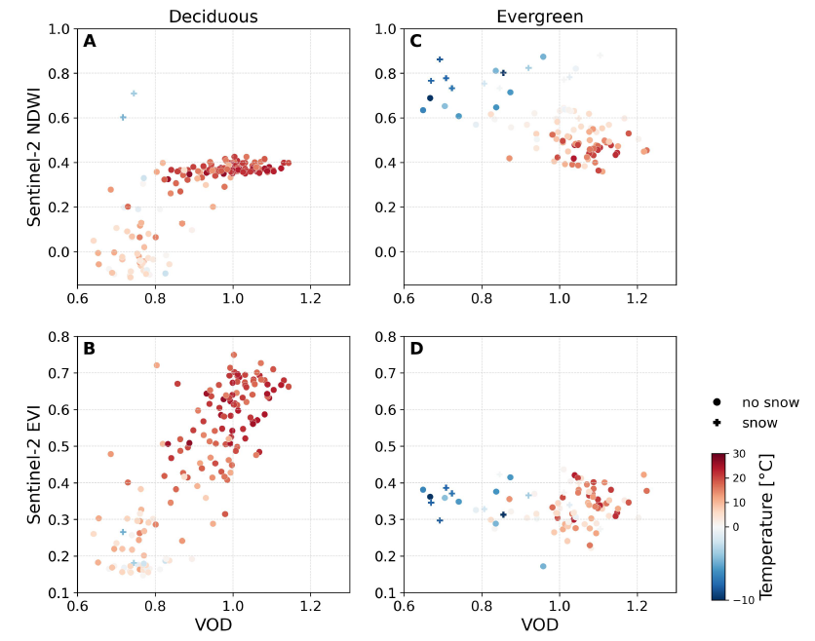
Optical satellite data are less sensitive to vertical process dynamics
The comparison of in situ and satellite measurements of canopy processes requires care.
Different technologies see different aspects of the targeted process
Kesselring (2026), https://doi.org/10.1016/j.rse.2025.115097

Slide 13
Concluding remarks
Integrating in situ spectroscopy from complex forest canopies is mandatory for FLEX cal/val
→ Data quality, processing and interpretation of data are complicated
Measurement uncertainties
Quality flags for different types of uncertainties are essential for FLEX cal/val
Regular intercalibration of site instruments is needed in network-mode
→ Buman, et al. (2022). Towards consistent assessments of in situ radiometric measurements for the validation of fluorescence satellite missions. Remote Sensing of Environment, 274, https://doi.org/10.1016/j.rse.2022.112984
Data interpretation of high-resolution data
The compensation of shadow effects is essential to provide reliable high-resolution reference data for FLEX cal/val
Validation of higher-level FLEX data products using dedicated in situ approaches requires attention
Damm et al. (in preparation). The impact of shade on the retrieval of vegetation information from remote sensing data: Insights from in situ spectroscopy time series and a dedicated irradiance experiment.
Kesselring et al. (2024). Diversity of 3D APAR and LAI dynamics in broadleaf and coniferous forests: Implications for the interpretation of remote sensing-based products. Remote Sensing of Environment, 306, https://doi.org/10.1016/j.rse.2024.114116
Kesselring et al. (2026). Divergence between in situ and satellite-based estimates of forest canopy water content. Remote Sensing of Environment, 332, https://doi.org/10.1016/j.rse.2025.115097

Slide 14
    Prof. Dr. Alexander Damm-Reiser
    Remote Sensing of Water Systems | Department of Geography | Universität Zürich
    alexander.damm@geo.uzh.ch
    www.rsws.ch
    linkedIn:

