Slide 1
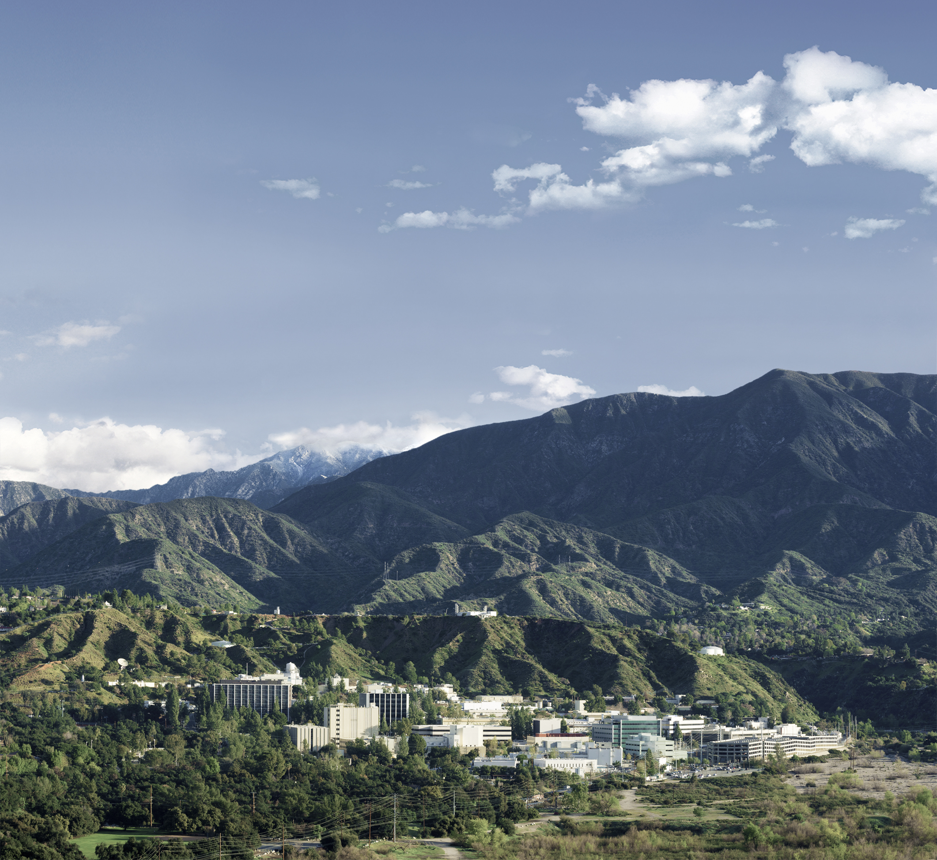

A Land-Biogeochemical Reanalysis to Reconcile Earth Observations, Benchmark Models, and Advance Earth Science Understanding and Prediction
Nicholas Parazoo^{1,2} Eren Bilir^{1,2}
Anthony Bloom^{1,2} Junjie Liu¹
Renato Braghiere³
¹Jet Propulsion Laboratory, California Institute of Technology
²University of California Los Angeles
³California Institute of Technology

Slide 2
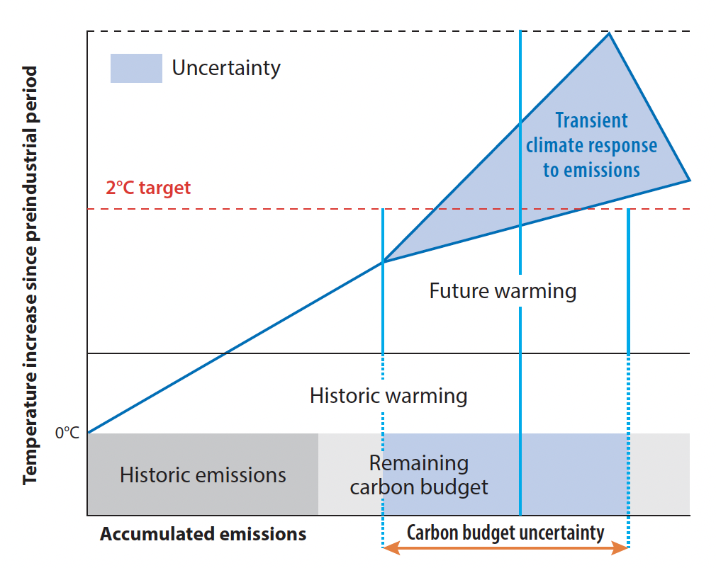
Background: Earth’s carbon budget uncertainty
Question: How accurately are Earth System Models (ESMs) capturing carbon-climate feedbacks under changing forcing?
Challenge: ESM projections are uncertain, due to state, flux and process uncertainties
Opportunity: ESM model dynamics and climate sensitivity can be benchmarked with contemporary satellite program of record
Missing piece: Re-analysis of contemporary carbon, water and energy cycles remains elusive
Schimel and Carroll, Annual Reviews, 2024

Slide 3
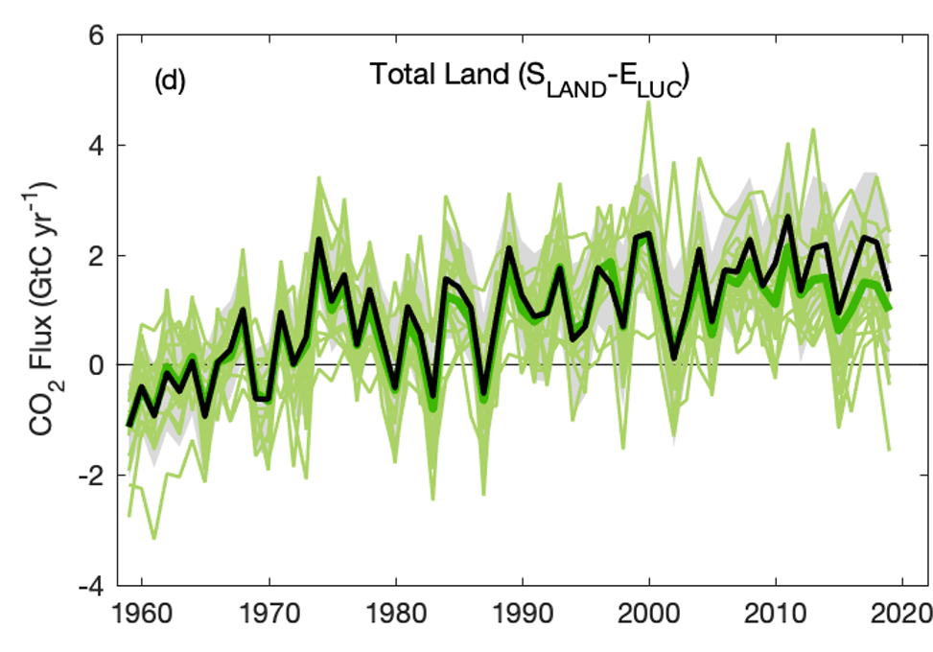
Global Land Carbon Exchange
Global Land Water Exchange
Friedlingstein, 2020
Pascolini-Campbell, 2020
Current Estimates of Carbon and Water Flux are Uncertain and Incomplete
These processes are coupled, and should (must!) be treated as such
Notes:
C and H₂O cycle assessments have relied on models, satellite measurements, and data integrating models
Model-data fusion systems developed independently, without considering the interconnection between C and H₂O
Budget assessments do not consistently capture the magnitude, variability, or trend of global C and H₂O fluxes

Slide 4
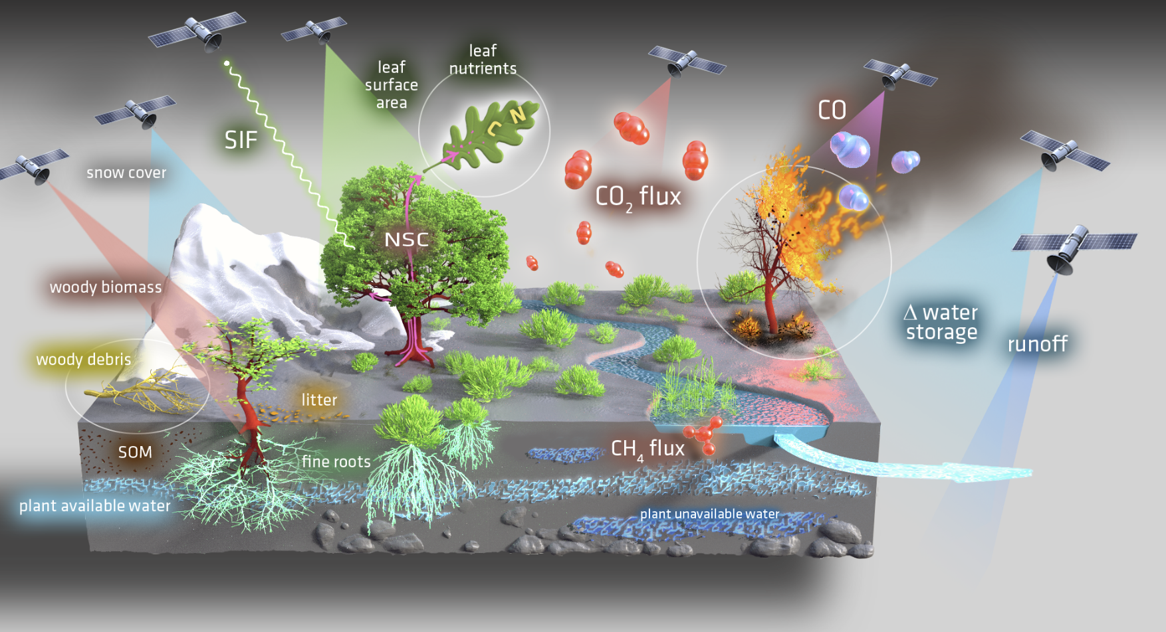
Earth Observables
= FLEX L2 Fluorescence + Vegetation Products
Leaf temperature
Worden et al., GCB, 2025

Slide 5
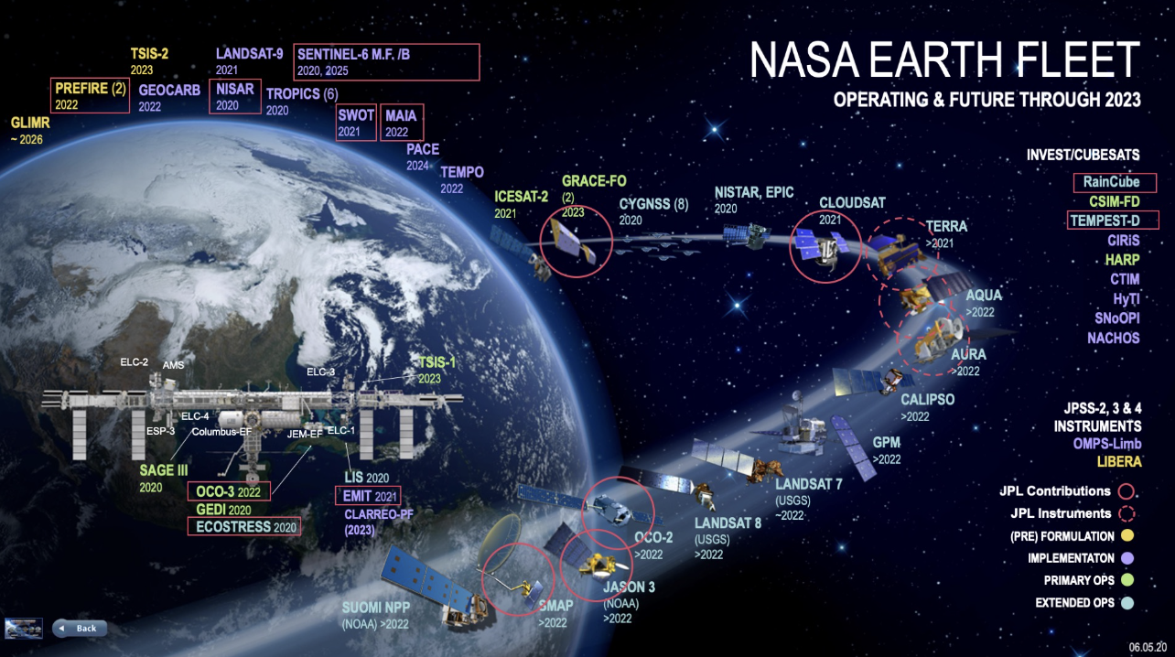
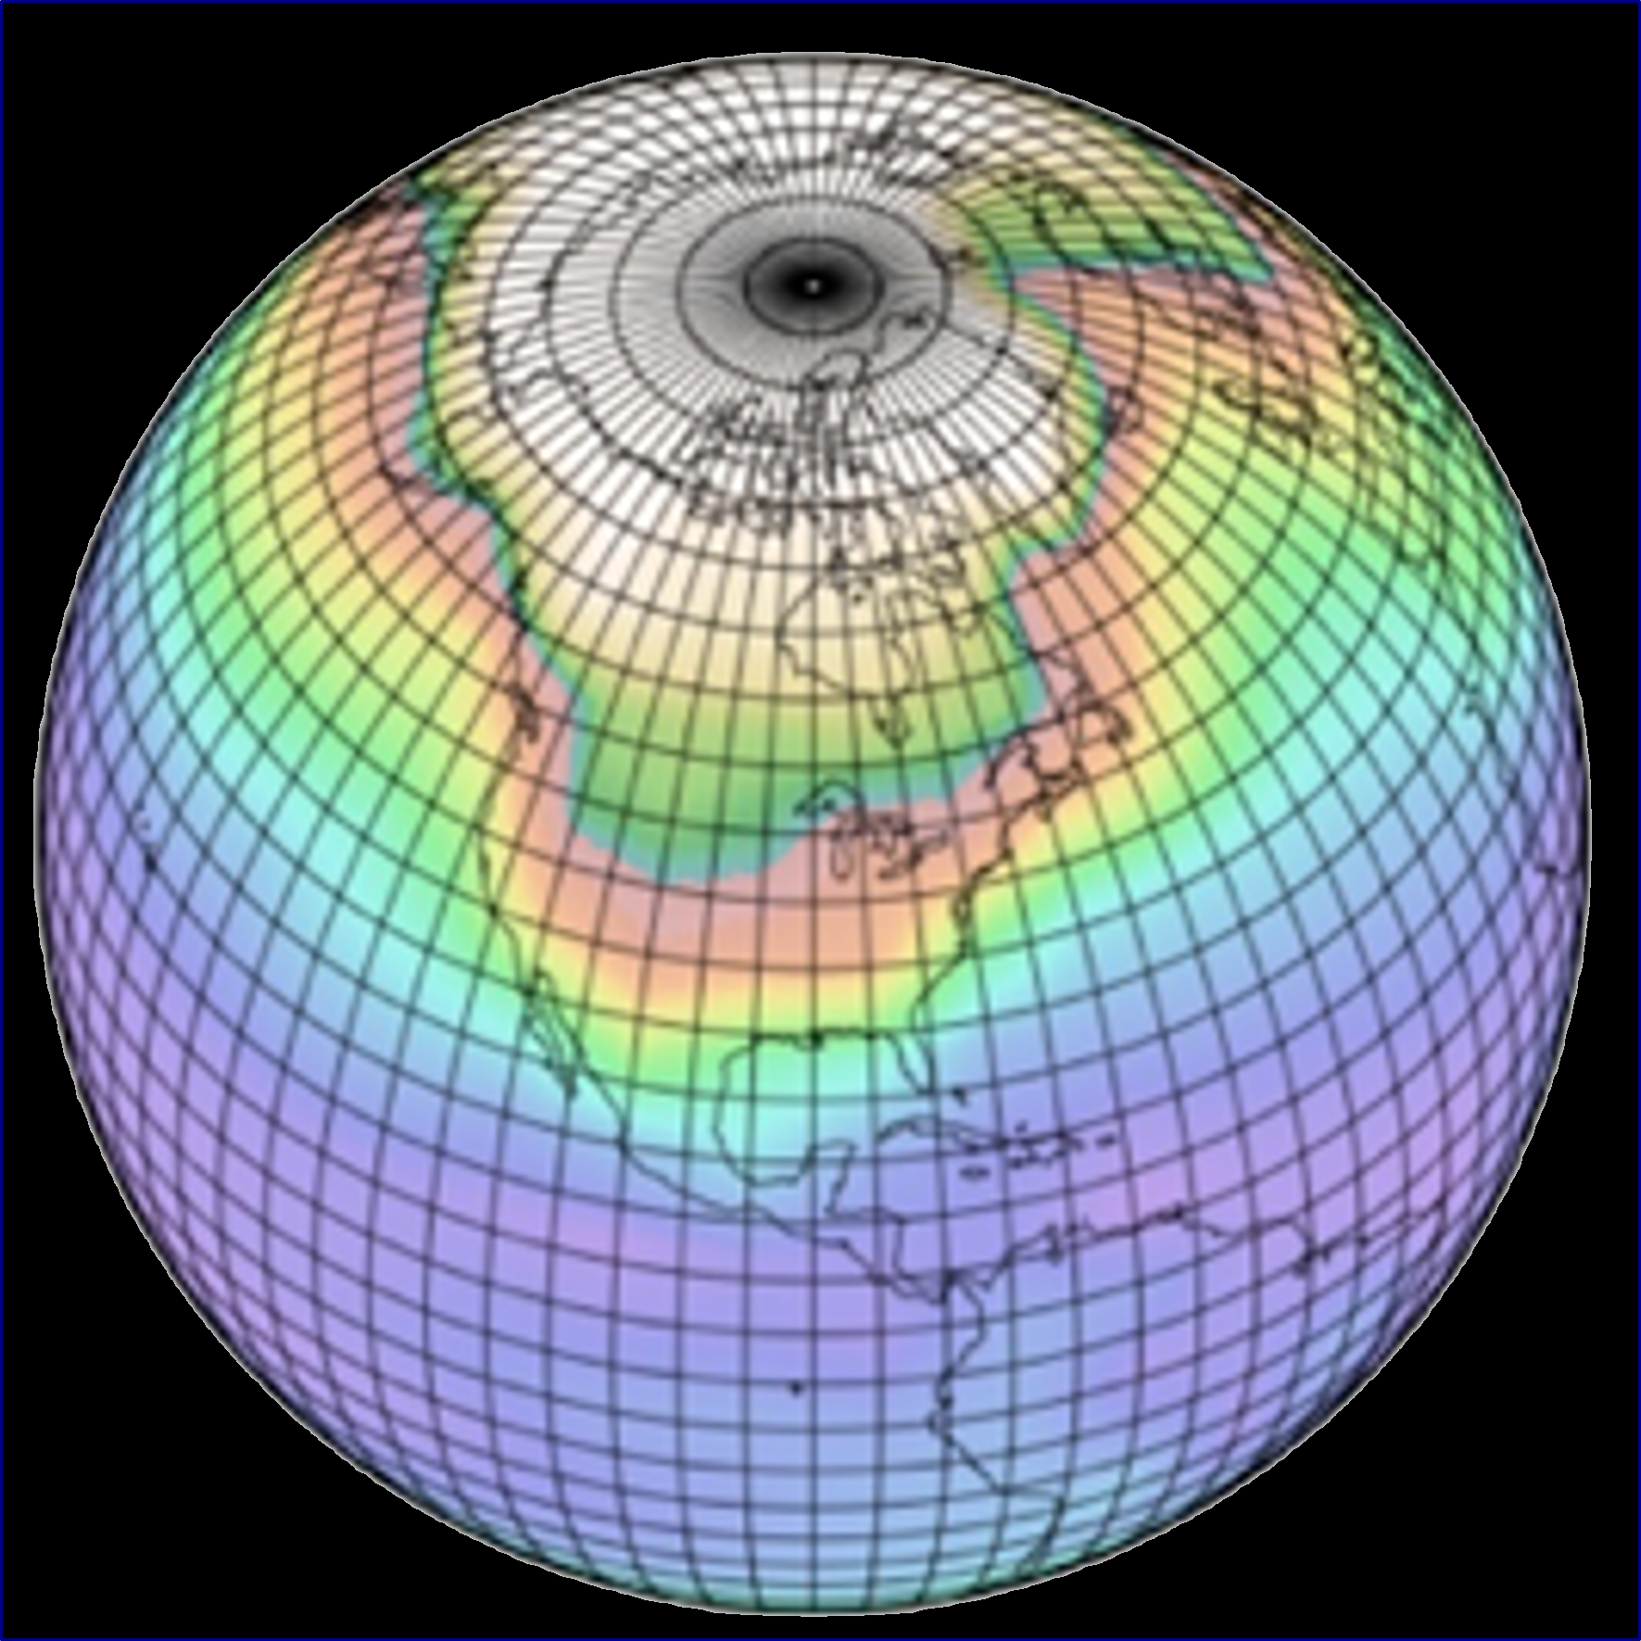
Observations and Models
Both Essential to Advance Science and Realize Societal Benefits
Observations
Models
Informs Process Descriptions
Validation and Improvement
Initial conditions for Forecasts
“Land Biogeochemical Reanalysis” is a key step for bridging the gap between biospheric observations and models
Initial Values for Retrievals
Observing System Development (e.g., OSSE)
Synthesis and gap filling
Source of Knowledge
Record of the Past, Present, and Change
Rich observation record-- how do we find integrated value?
Observations are full of uncertainty and gaps– how can we reconcile imperfect and/or incomplete observations?
Some things are never directly observable, how do we gain information about those?
Aggregate of Knowledge
Diagnostic of Past and Present, Prognostic of Future
Rich modeling toolbox-- how do we combine strengths?
Models are full of uncertainty– how can we gauge performance?
Some processes are too complex to simulate-- how do we constrain a range of complex processes?
Notes:
Can’t realize Societal benefits without both (WIKD)

Slide 6
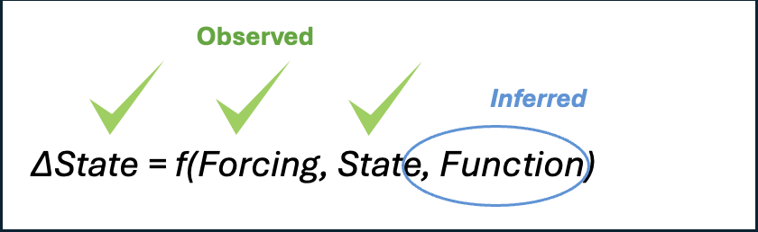
Model-Data Fusion
CARDAMOM: CARbon Data Assimilation MOdeling FraMework
Model Structure and Data Interface
Model-data integration ingredients:
Physical model
Parameter prior ranges & combination rules
Observation operators
Data filters and cost functions
Bayesian optimization (MCMC)
_{Drivers:}
_{Burned area}
_{Meteorology}
_{Atm CO2}
_{Deforestation}
_{Crop yield}
Goal: Reanalysis integrating carbon, water, and energy cycle observations and physics
Worden et al., GCB, 2025

Slide 7
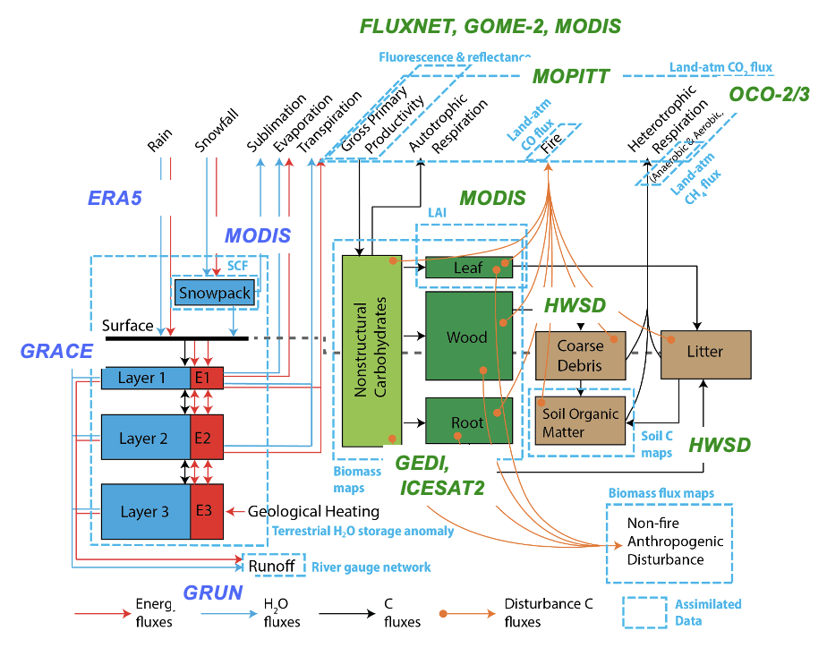
CARDAMOM Carbon-Water-Energy Reanalysis
Inputs
Outputs
Full Carbon-Water-Energy Budget and Uncertainties
Property | States | Fluxes | Diagnostics | Sensitivity
Carbon | ABGB | NBP, GPP, TER, Fire, Export | Rooting depth, 𝝉_{C} CUE | Beta / Gamma
Water | Soil Water (PAW, PUW) | T, E, ΔTWS, Runoff | WUE, 𝝉_{H2O} SH:ET
Energy | T_{soil}, f_{liquid} | SH | T_{soil,} Permafrost
Bold = “Unobservables”

Slide 8
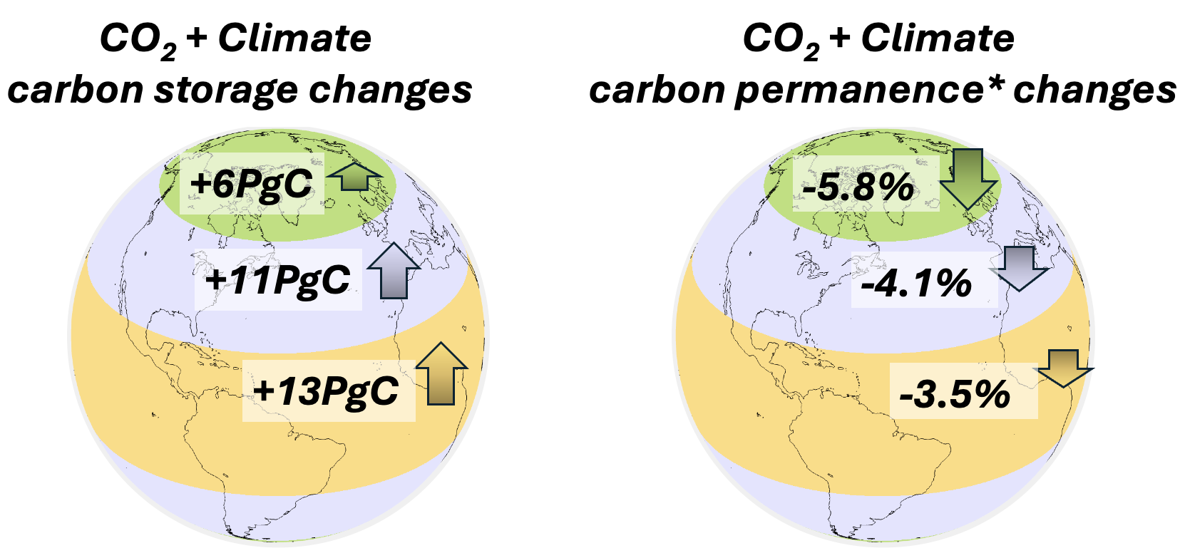
Diagnosis of Carbon-Climate Sensitivities
Bilir et al., 2025, AGU Advances
Reorganization of the global carbon cycle attributable to CO₂ and climate trends demonstrated in shifts of C from dead to live states, and faster C gain in the tropics than poles.
The resulting permanence of carbon storage (i.e., residence time, 𝛕) declines.

Slide 9
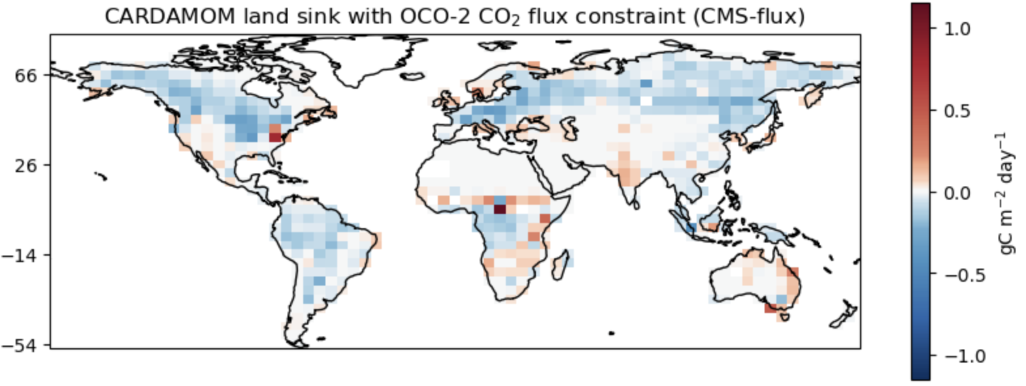
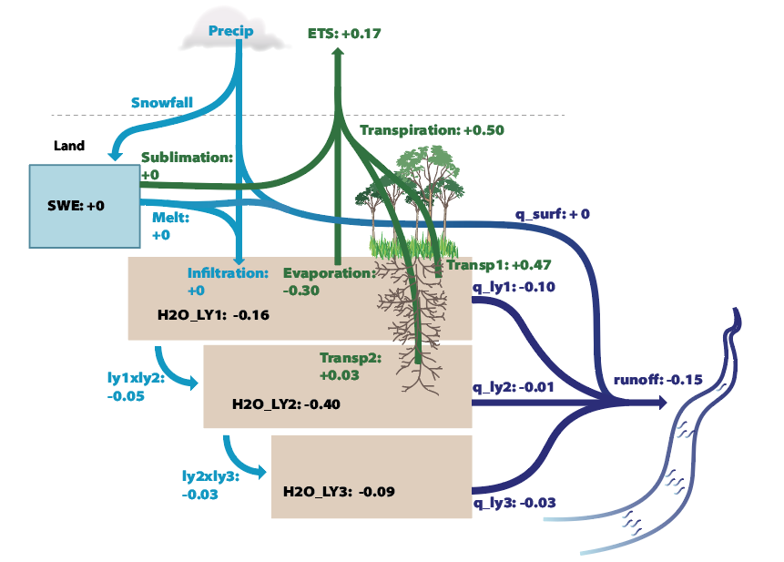
Long term, Time-Resolved, Gridded, Carbon/Water Budgeting
(2000-2021, Monthly, 5x4 degree)
Gridded
Time Resolved
Budget Closure
Bilir et al., 2025, AGU Advances
Bilir et al., in prep (Accelerating C cycle; NHL change)

Slide 10
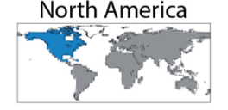
Reconstruction of Historical Carbon and Water Observational Records w/ Full Uncertainty
Carbon
Water
Extension
Flux
New Data!
2001 - 2021
Uncertainty
2001 - 2021
Model
Stock
Gap Filling
Observed
2001 - 2021
2001 - 2021

Slide 11
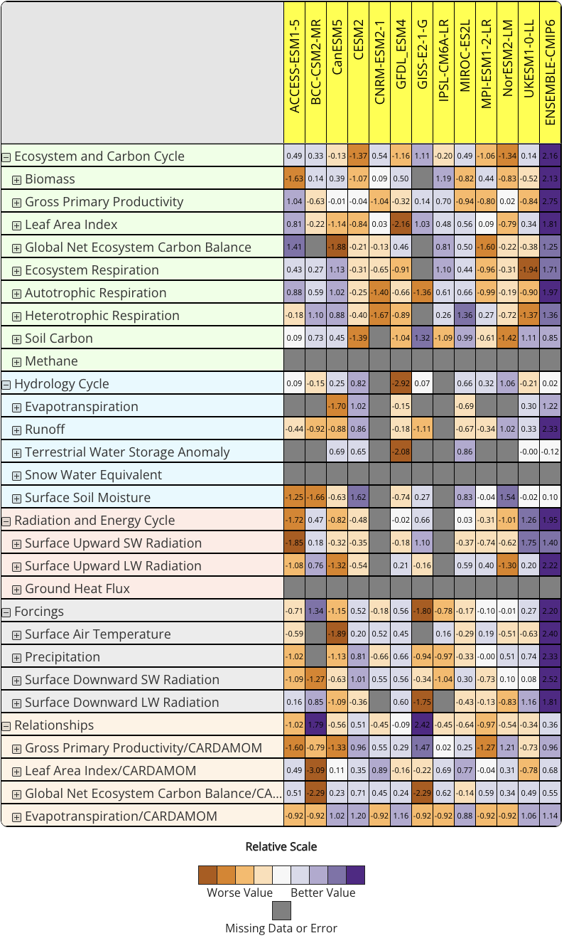
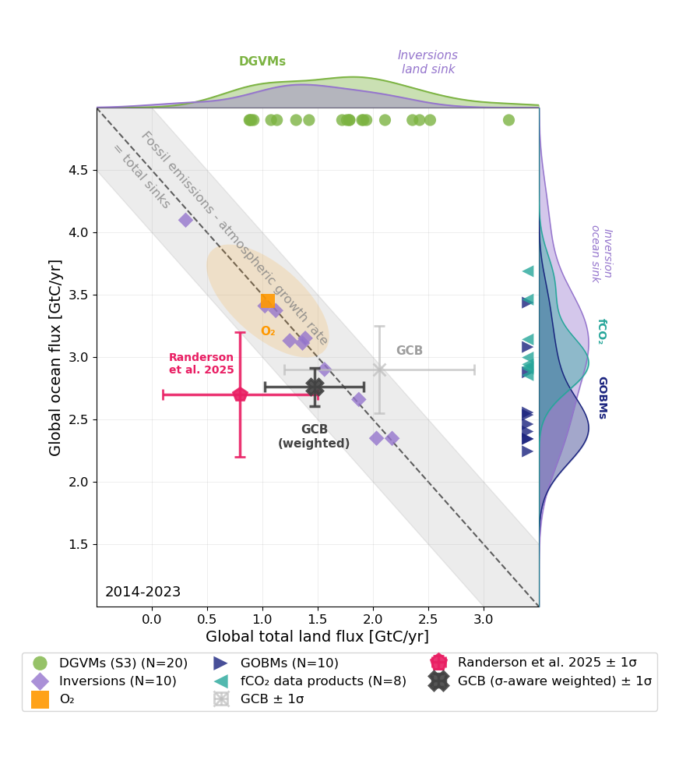
Earth System Model Benchmarking
ESMs
(benchmarked models!)
CARDAMOM Benchmarks
https://braghiere.github.io/ILAMB_CARDAMOM_v1/index.html
Notes:
Slide 11: If there’s any way to have in writing somewhere that the ILAMB table will have CARDAMOM benchmark on its y-axis and benchmarked models on the x-axis, then that would be amazing!!!

Slide 12


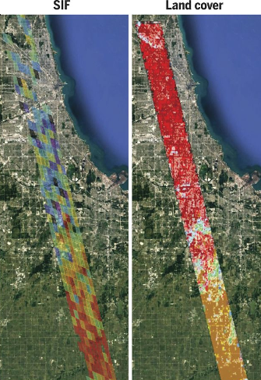
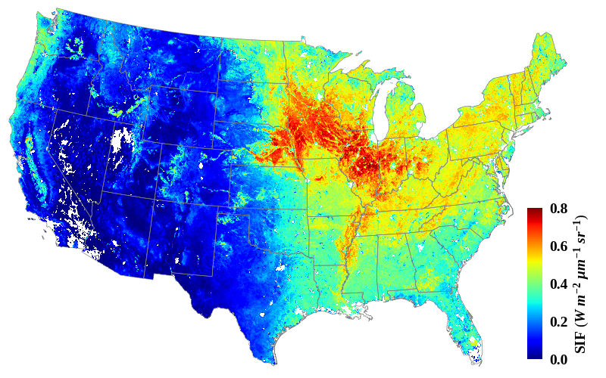
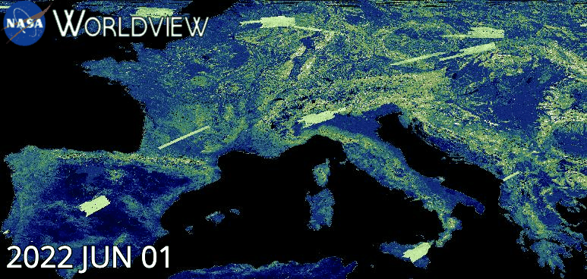
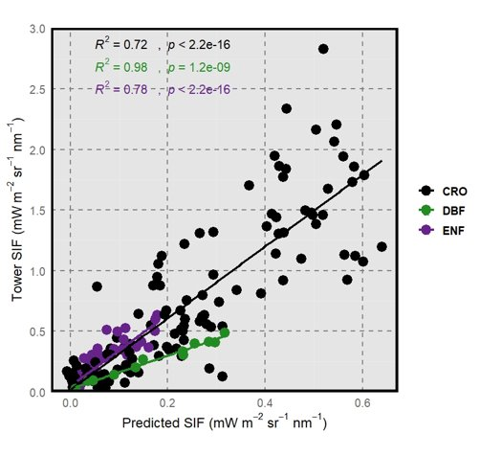
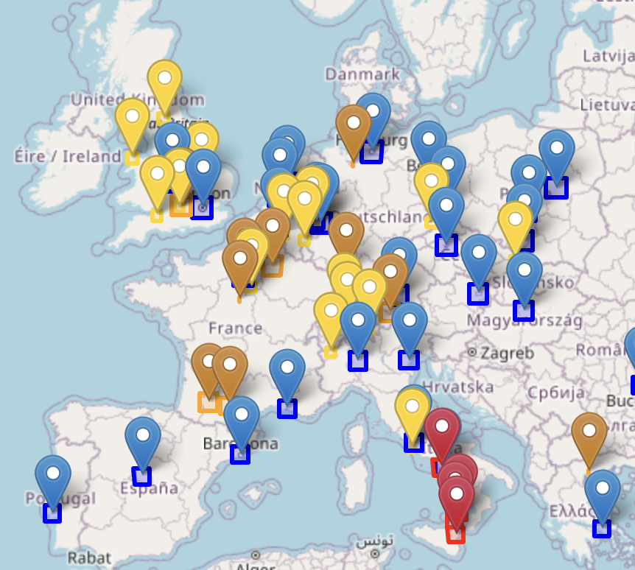
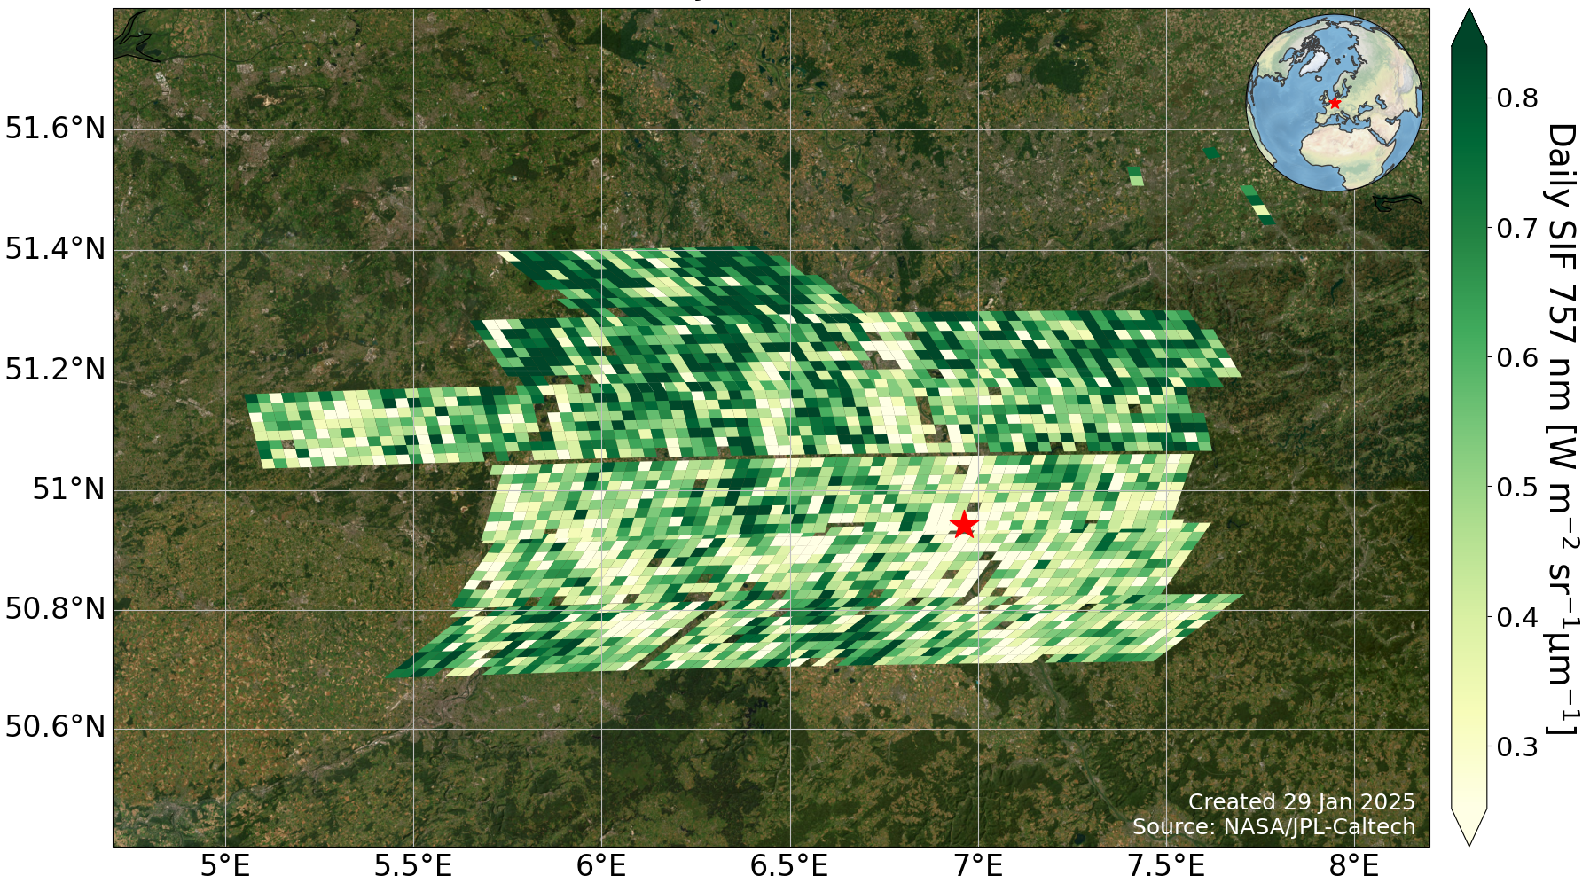
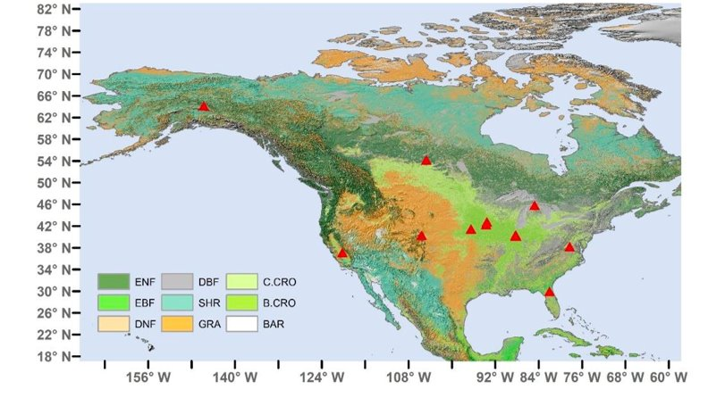
OCO-2/3 and SIF
Dr. Vivienne Payne, Project Scientist​
Dr. Nicholas Parazoo, Deputy Project Scientist
11+ Years
Global
2 week repeat
~1 km²
6+ Years
52°S-52°N
Diurnal
~3 km²
Reconstructed SIF Map
OCO-3 SIF SAMs (~80 km x 80 km)
Sun et al., 2017
Svoboda et al., 2025
SAM Locations
Example: Bonn, Germany
Tower SIF Network
X
https://ocov3.jpl.nasa.gov/sams/
Notes:
Slide 11: If there’s any way to have in writing somewhere that the ILAMB table will have CARDAMOM benchmark on its y-axis and benchmarked models on the x-axis, then that would be amazing!!!

