Slide 1















Tower Based SIF Monitoring of Drought Stressed Scots pine Photosynthesis
Ingo Ensminger¹ , Kristen Huang¹, Vincent Riedel¹, Giovanni Bortolami², Jonas Gisler³, Marcus Schaub³, Tommaso Julitta⁴, Arthur Gessler³
¹University of Toronto; ²École Polytechnique Fédérale de Lausanne; ³Swiss Fedeal Institute for Forest, Snow and Landscape Research; ⁴JB Hypercpectral
FLEX-Fluorescence Workshop 2026, 3-6 March, Bonn, Germany
Plat

Slide 2
Outline
Background – Pfynwald long-term drought manipulation Experiment at a naturally dry forest in Switzerland
Can SIF distinguish drought stressed from irrigated trees? Leaf level physiology, tower-based SIF, (Airborne SIF)
Summary and next steps

Slide 3
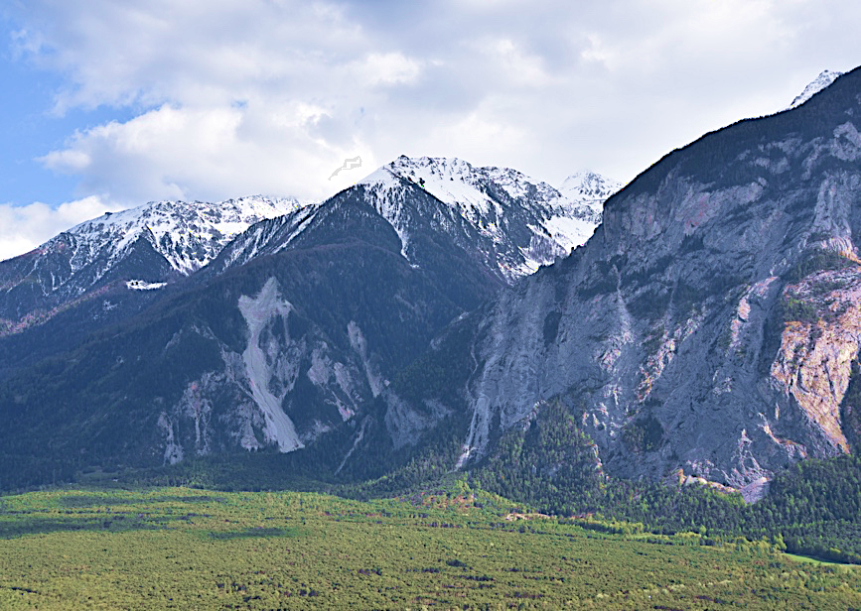
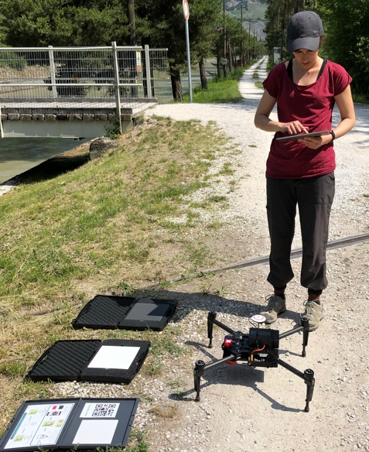
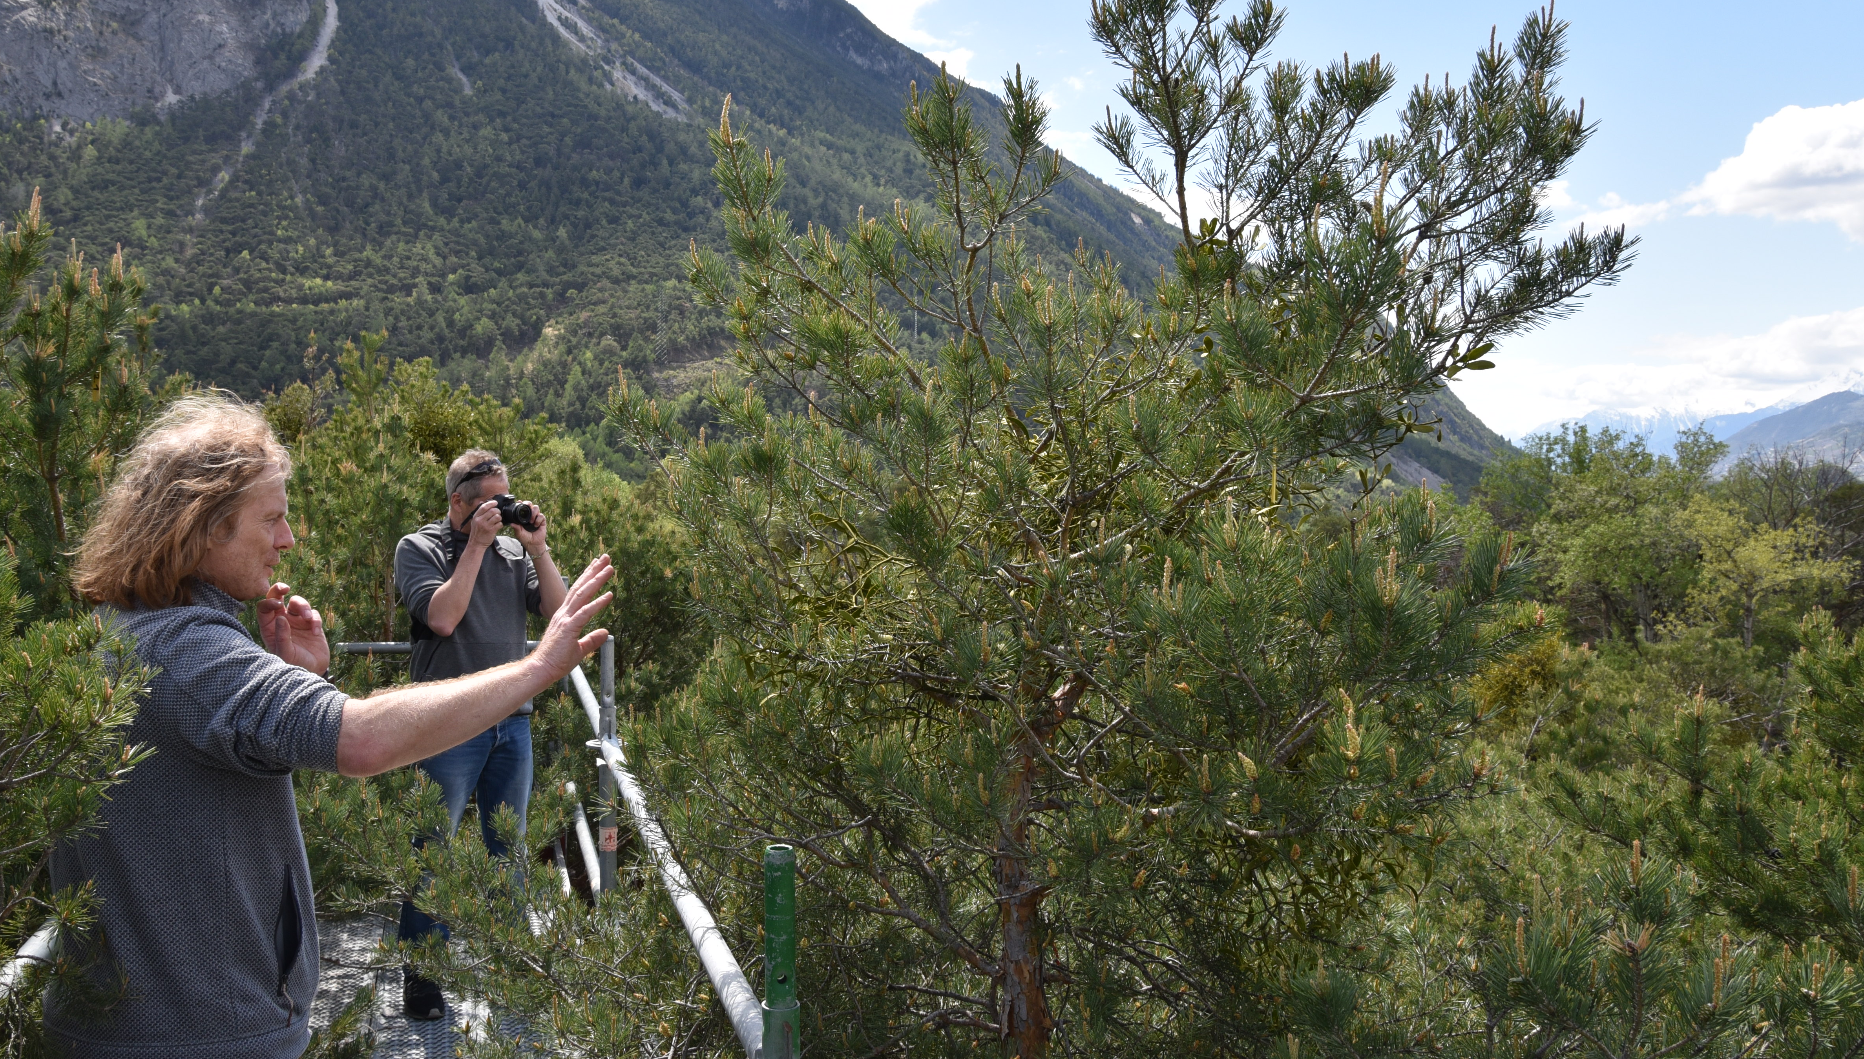
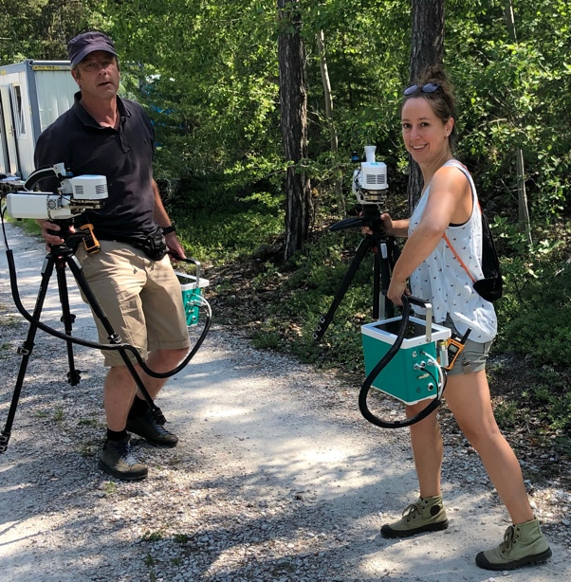
Leaf spectral reflectance distinguishes drought stressed from non-stressed tree canopies in a Scots pine forest
Control
IR IR Stop
Pfynwald (Upper Rhône Valley) longterm irrigation-drought experiment simulates the impact of warmer and drier climate on a 100 year old Scots pine forest
3 treatments: Irrigation (19 years), Irrigation stop (after 10 years), non-irrigation (control)

Slide 4
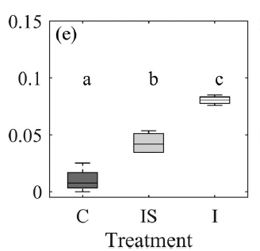
Leaf spectral reflectance distinguishes drought stressed from non-stressed tree canopies in a Scots pine forest
Control
PRI
IR IR Stop
Control IR Stop IR
Treatment
- -
Car/Chl Water deficit
+ +
Multispectral imagery (12th of August 2020) over Pinus sylvestris forest of the Pfynwald long-term precipitation manipulation (irrigation) experiment, Switzerland.
D’Odorico et al. (2021)

Slide 5
Leaf spectral reflectance distinguishes drought stressed from non-stressed tree canopies in a Scots pine forest
Control
PRI
IR IR Stop
Control IR Stop IR
Treatment
- -
Car/Chl Water deficit
+ +
Multispectral imagery (12th of August 2020) over Pinus sylvestris forest of the Pfynwald long-term precipitation manipulation (irrigation) experiment, Switzerland.
D’Odorico et al. (2021)

Slide 6
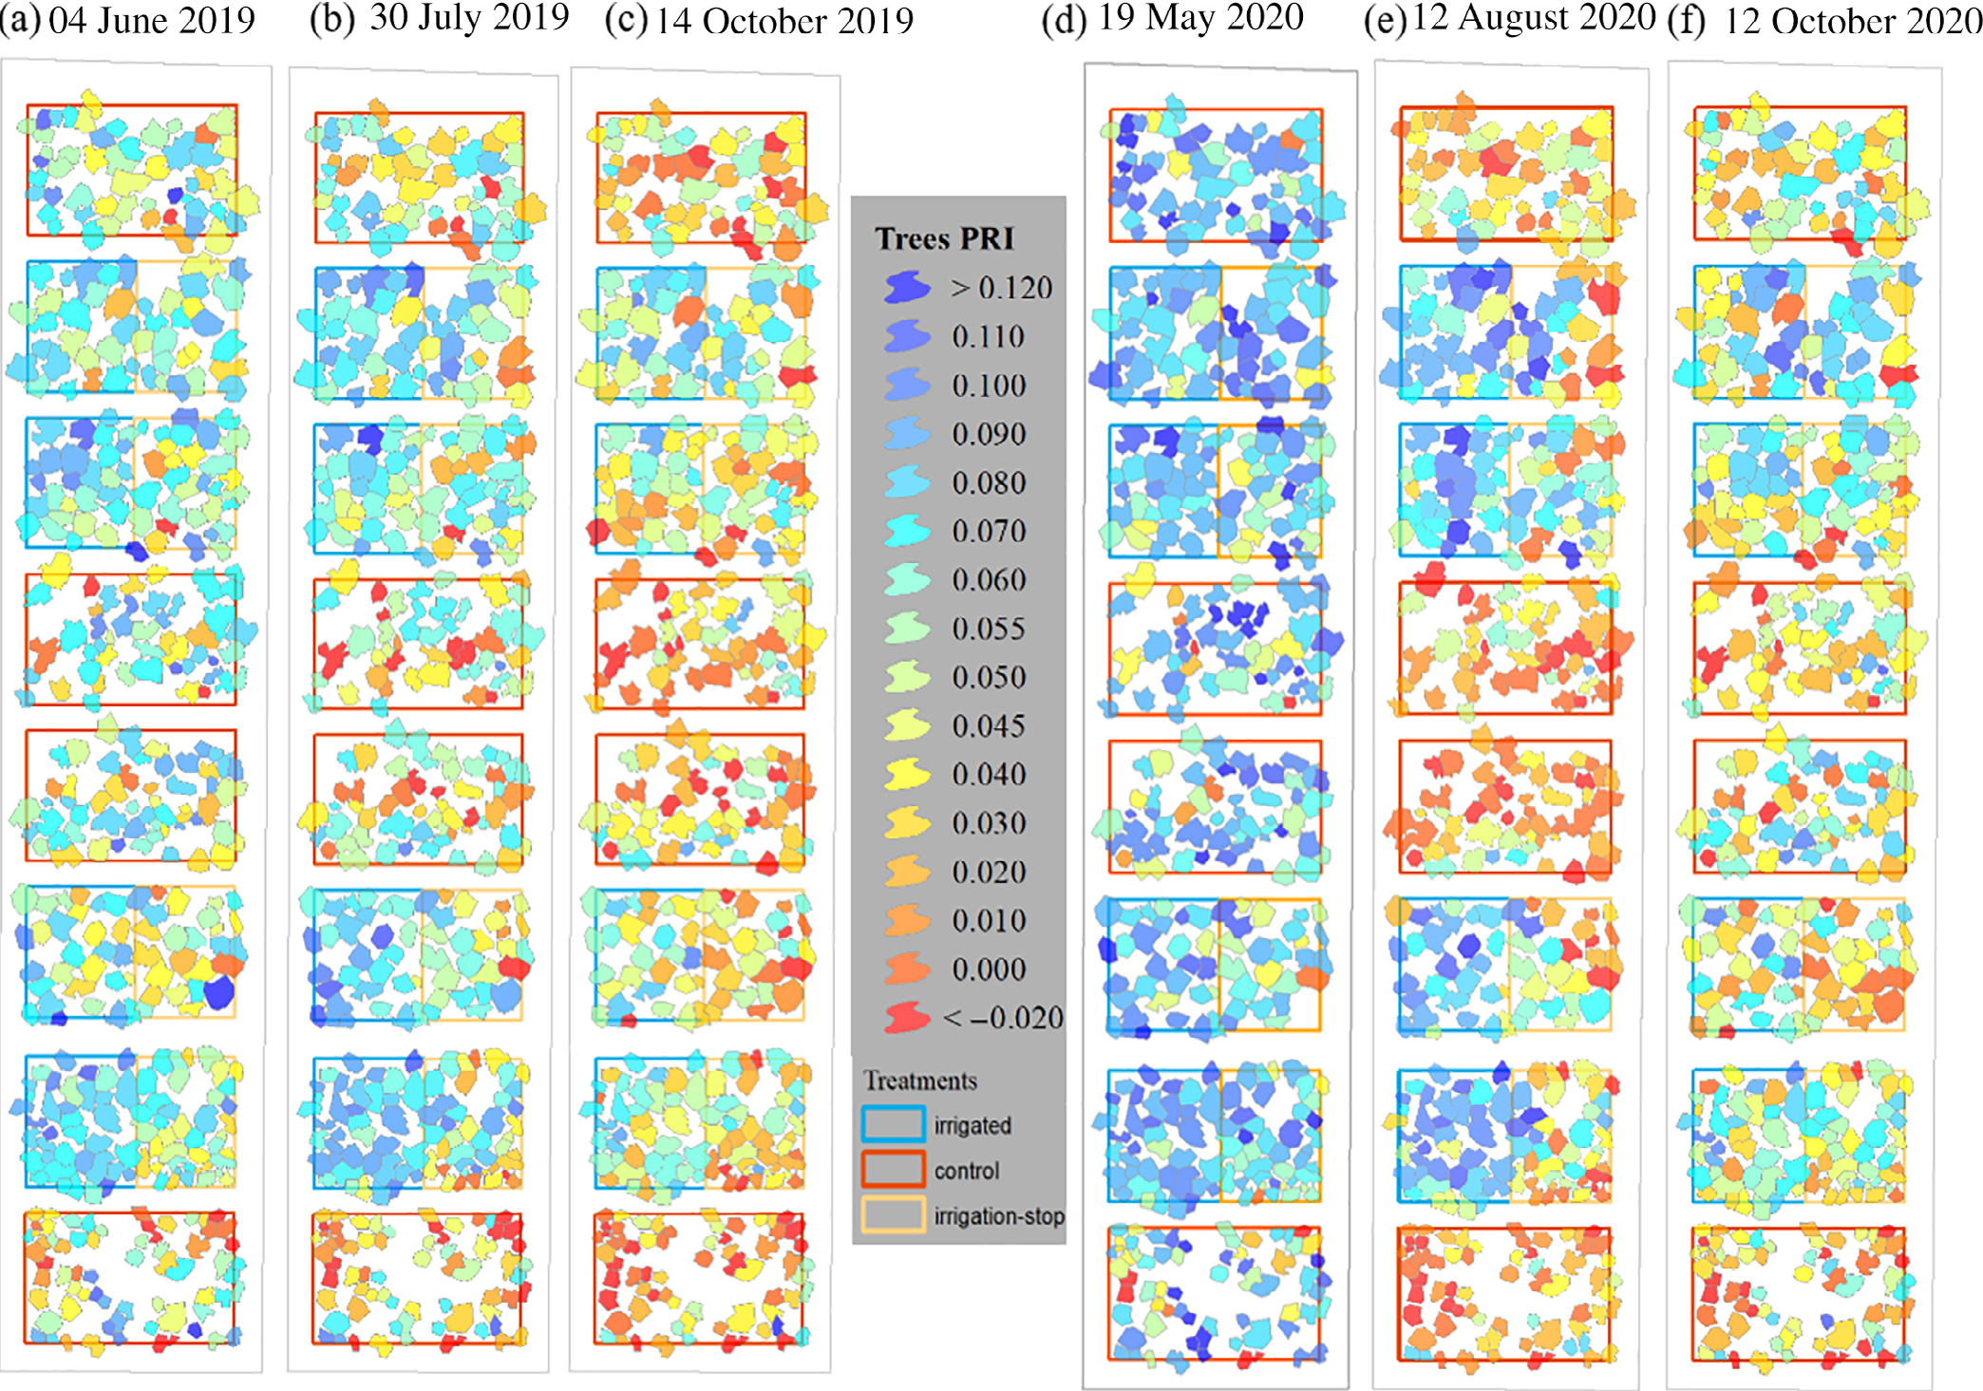
Leaf spectral reflectance distinguishes drought stressed from non-stressed tree canopies in a Scots pine forest
Control
Tree-level remotely sensed PRI at the Pfynwald Scot pine forest site over two growing seasons (D’Odorico et al. 2021)

Slide 7
Outline
Background – Pfynwald long-term drought manipulation Experiment at a naturally dry forest in Switzerland
Can SIF distinguish drought stressed from irrigated trees? Leaf level physiology, tower-based SIF, (Airborne SIF)
Summary and next steps

Slide 8
Distinguish changes in SIF driven by stress from changes driven by phenology?
How do tower-based continuous measurments of canopy SIF relate to photosynthetic performance in drought stressed and irrigated Scots pine?
Physiology Leaf level
LiCor 6800
Leaf spectral reflectance
Photosynthetic pigments
Leaf water potential
Physiology Tree level
Sap flow
…
Canopy and above
Tower-based SIF (Flox)
Drone-based multispectral measurments
Hyplant (June 13, August 23, 2024) (See Poster Sunniva McKeever et al.)
Environmental and Soil data
…

Slide 9
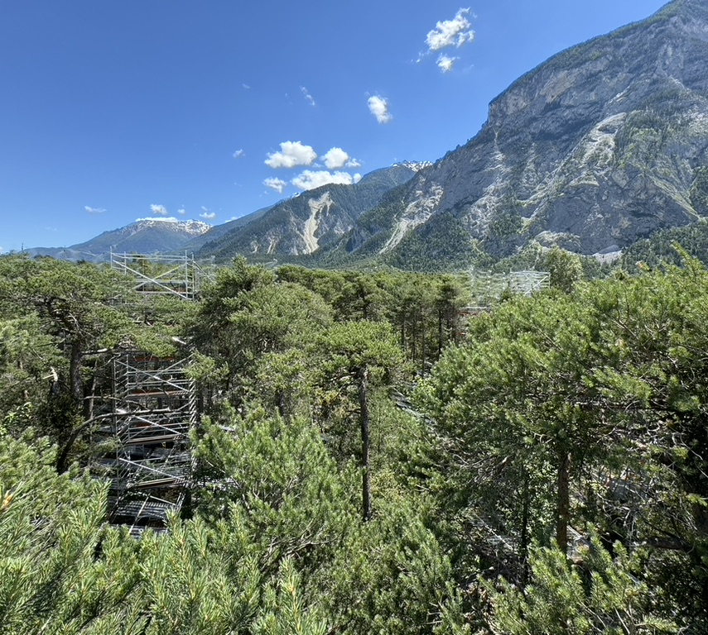
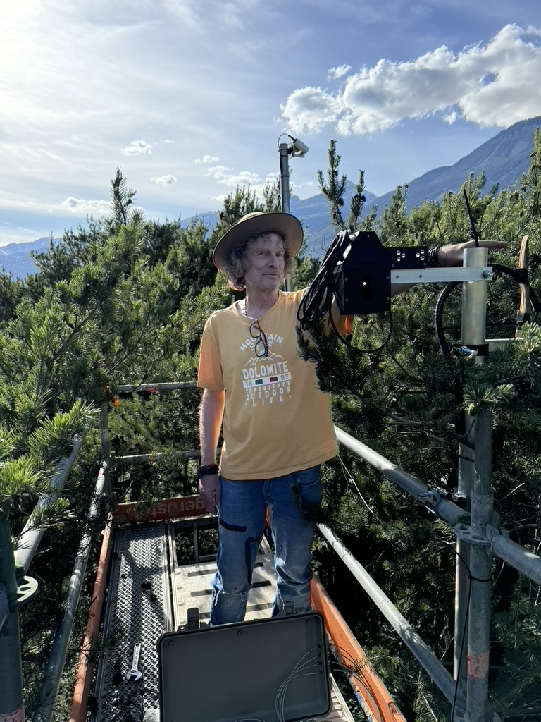
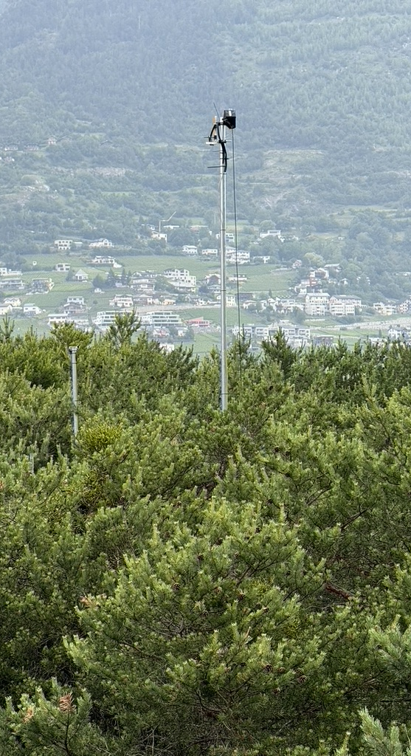
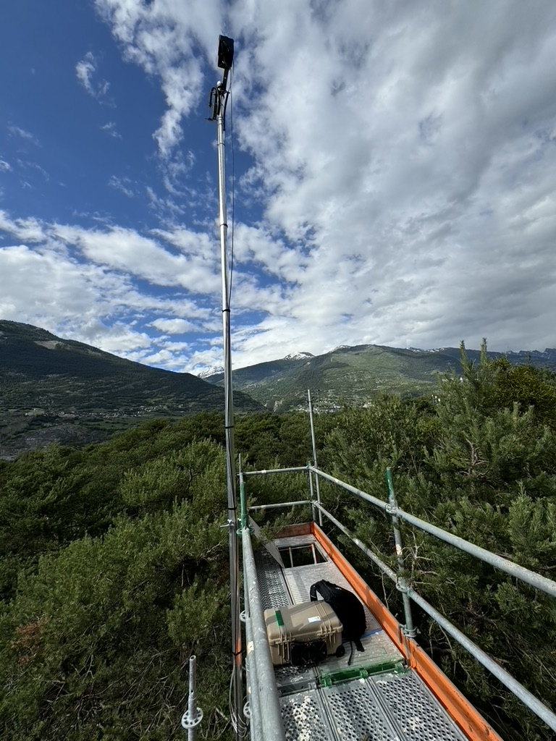
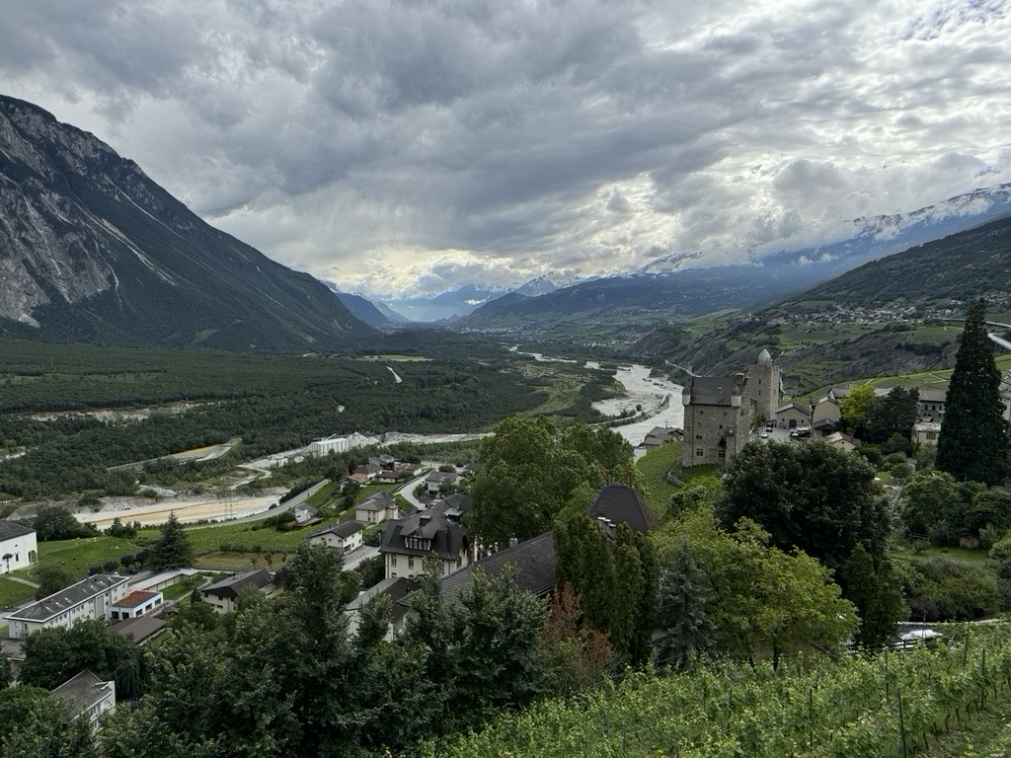

June 13, 2024, 11:50:59
June 08, 2024, 9:23:28
Control
IR IR Stop
Flox
Flox

Slide 10
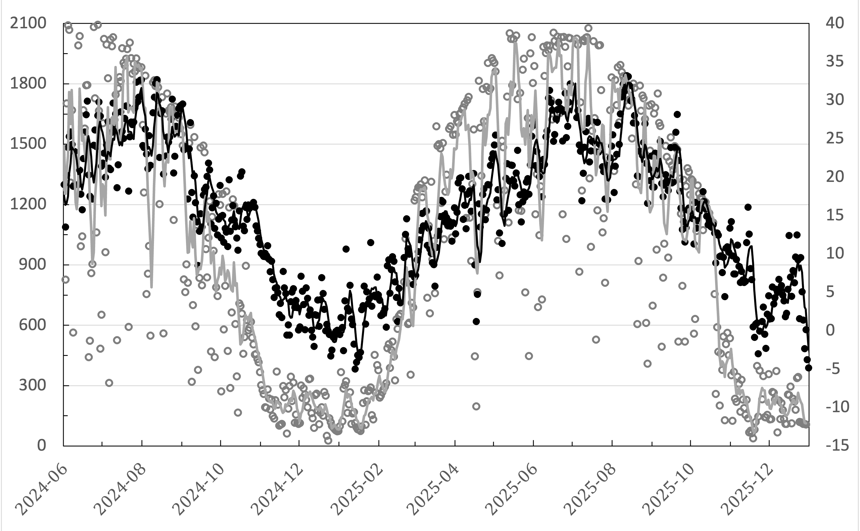
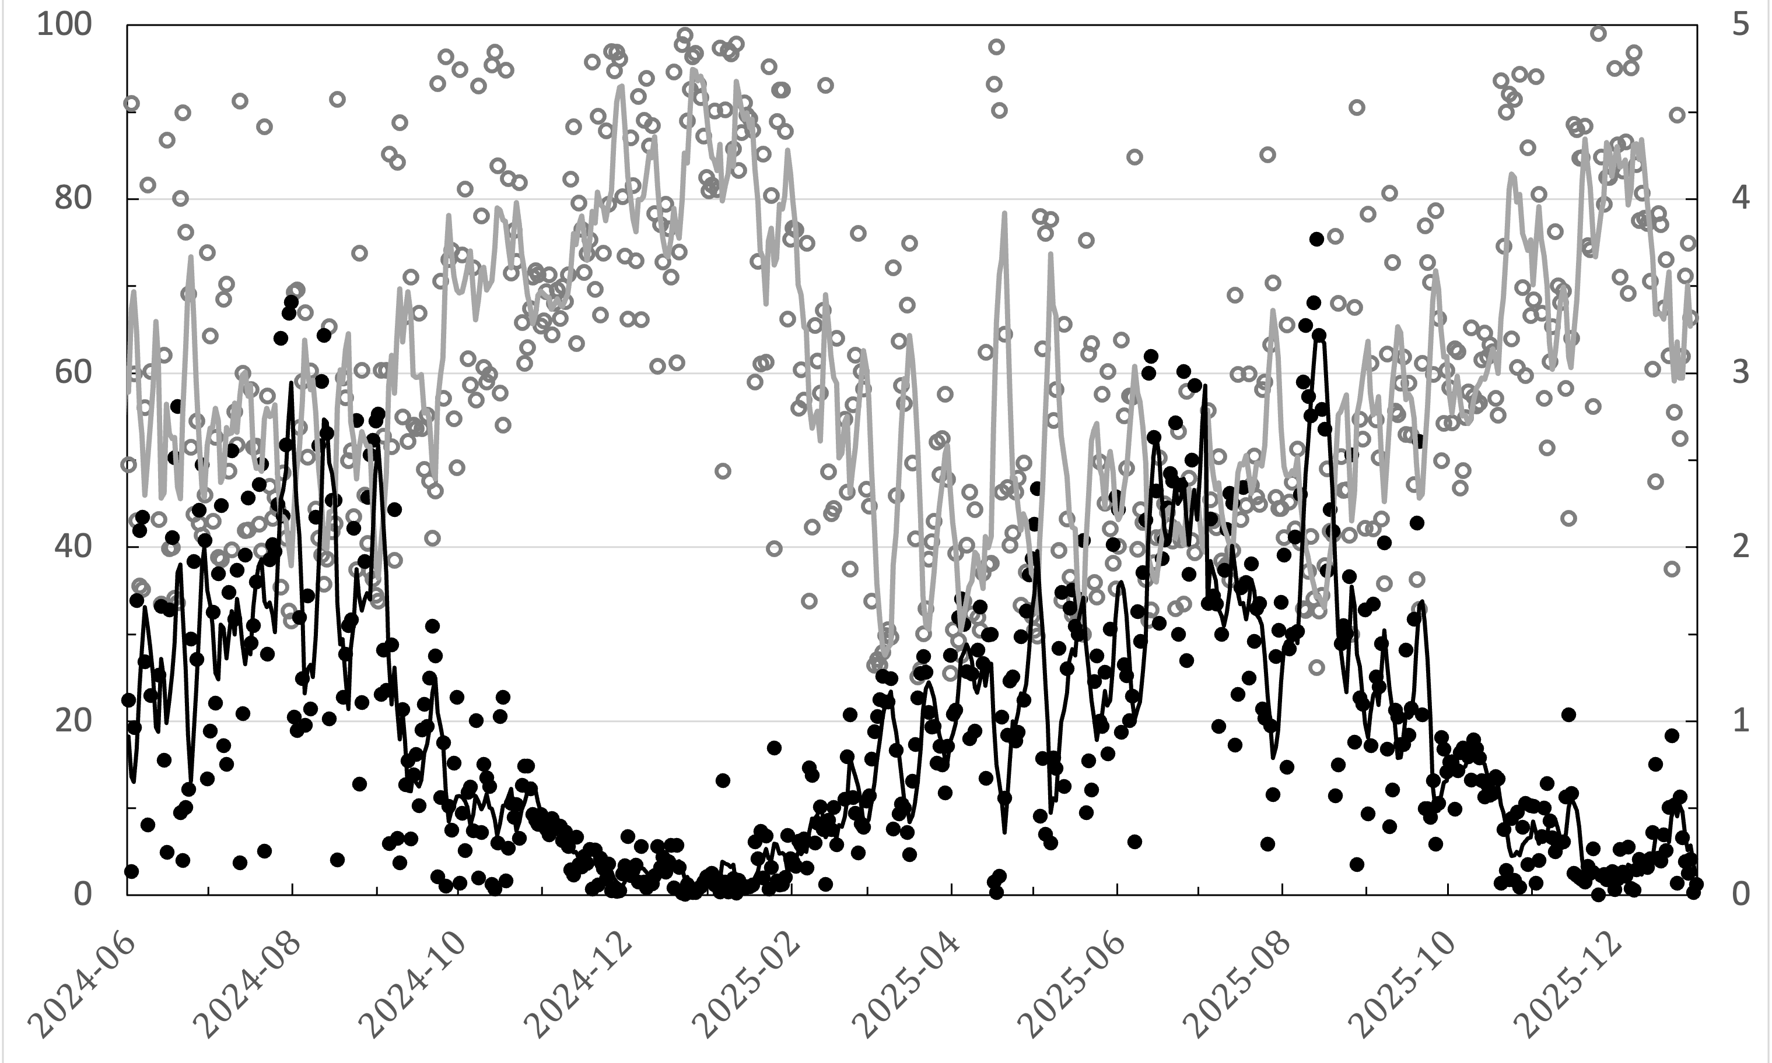
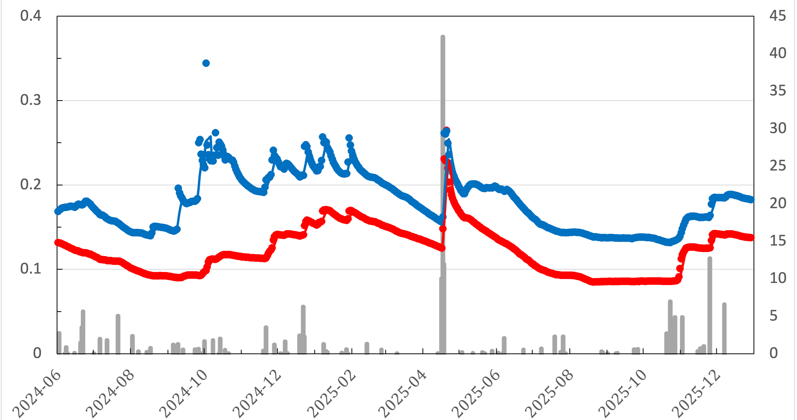
Environmental Conditions Jun 2024 – Dec 2025
PAR (umol photons m⁻² s⁻¹)
T_{air} ºC
RH (%)
VPD (kPa)
Heavy snow w. crown damage
Irrigated
Control (non-irrigated)
Soil Water Content (m³ m⁻²)
Precipitation (mm)

Slide 11
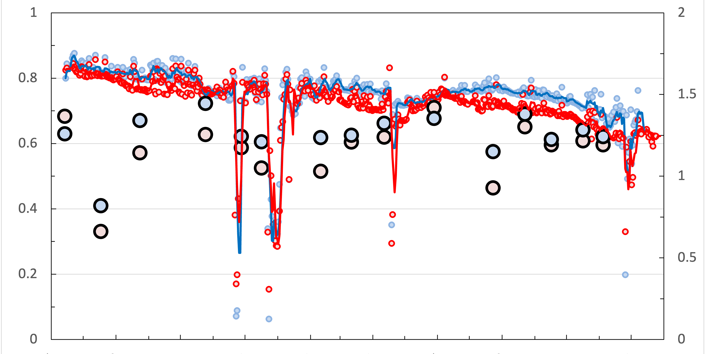
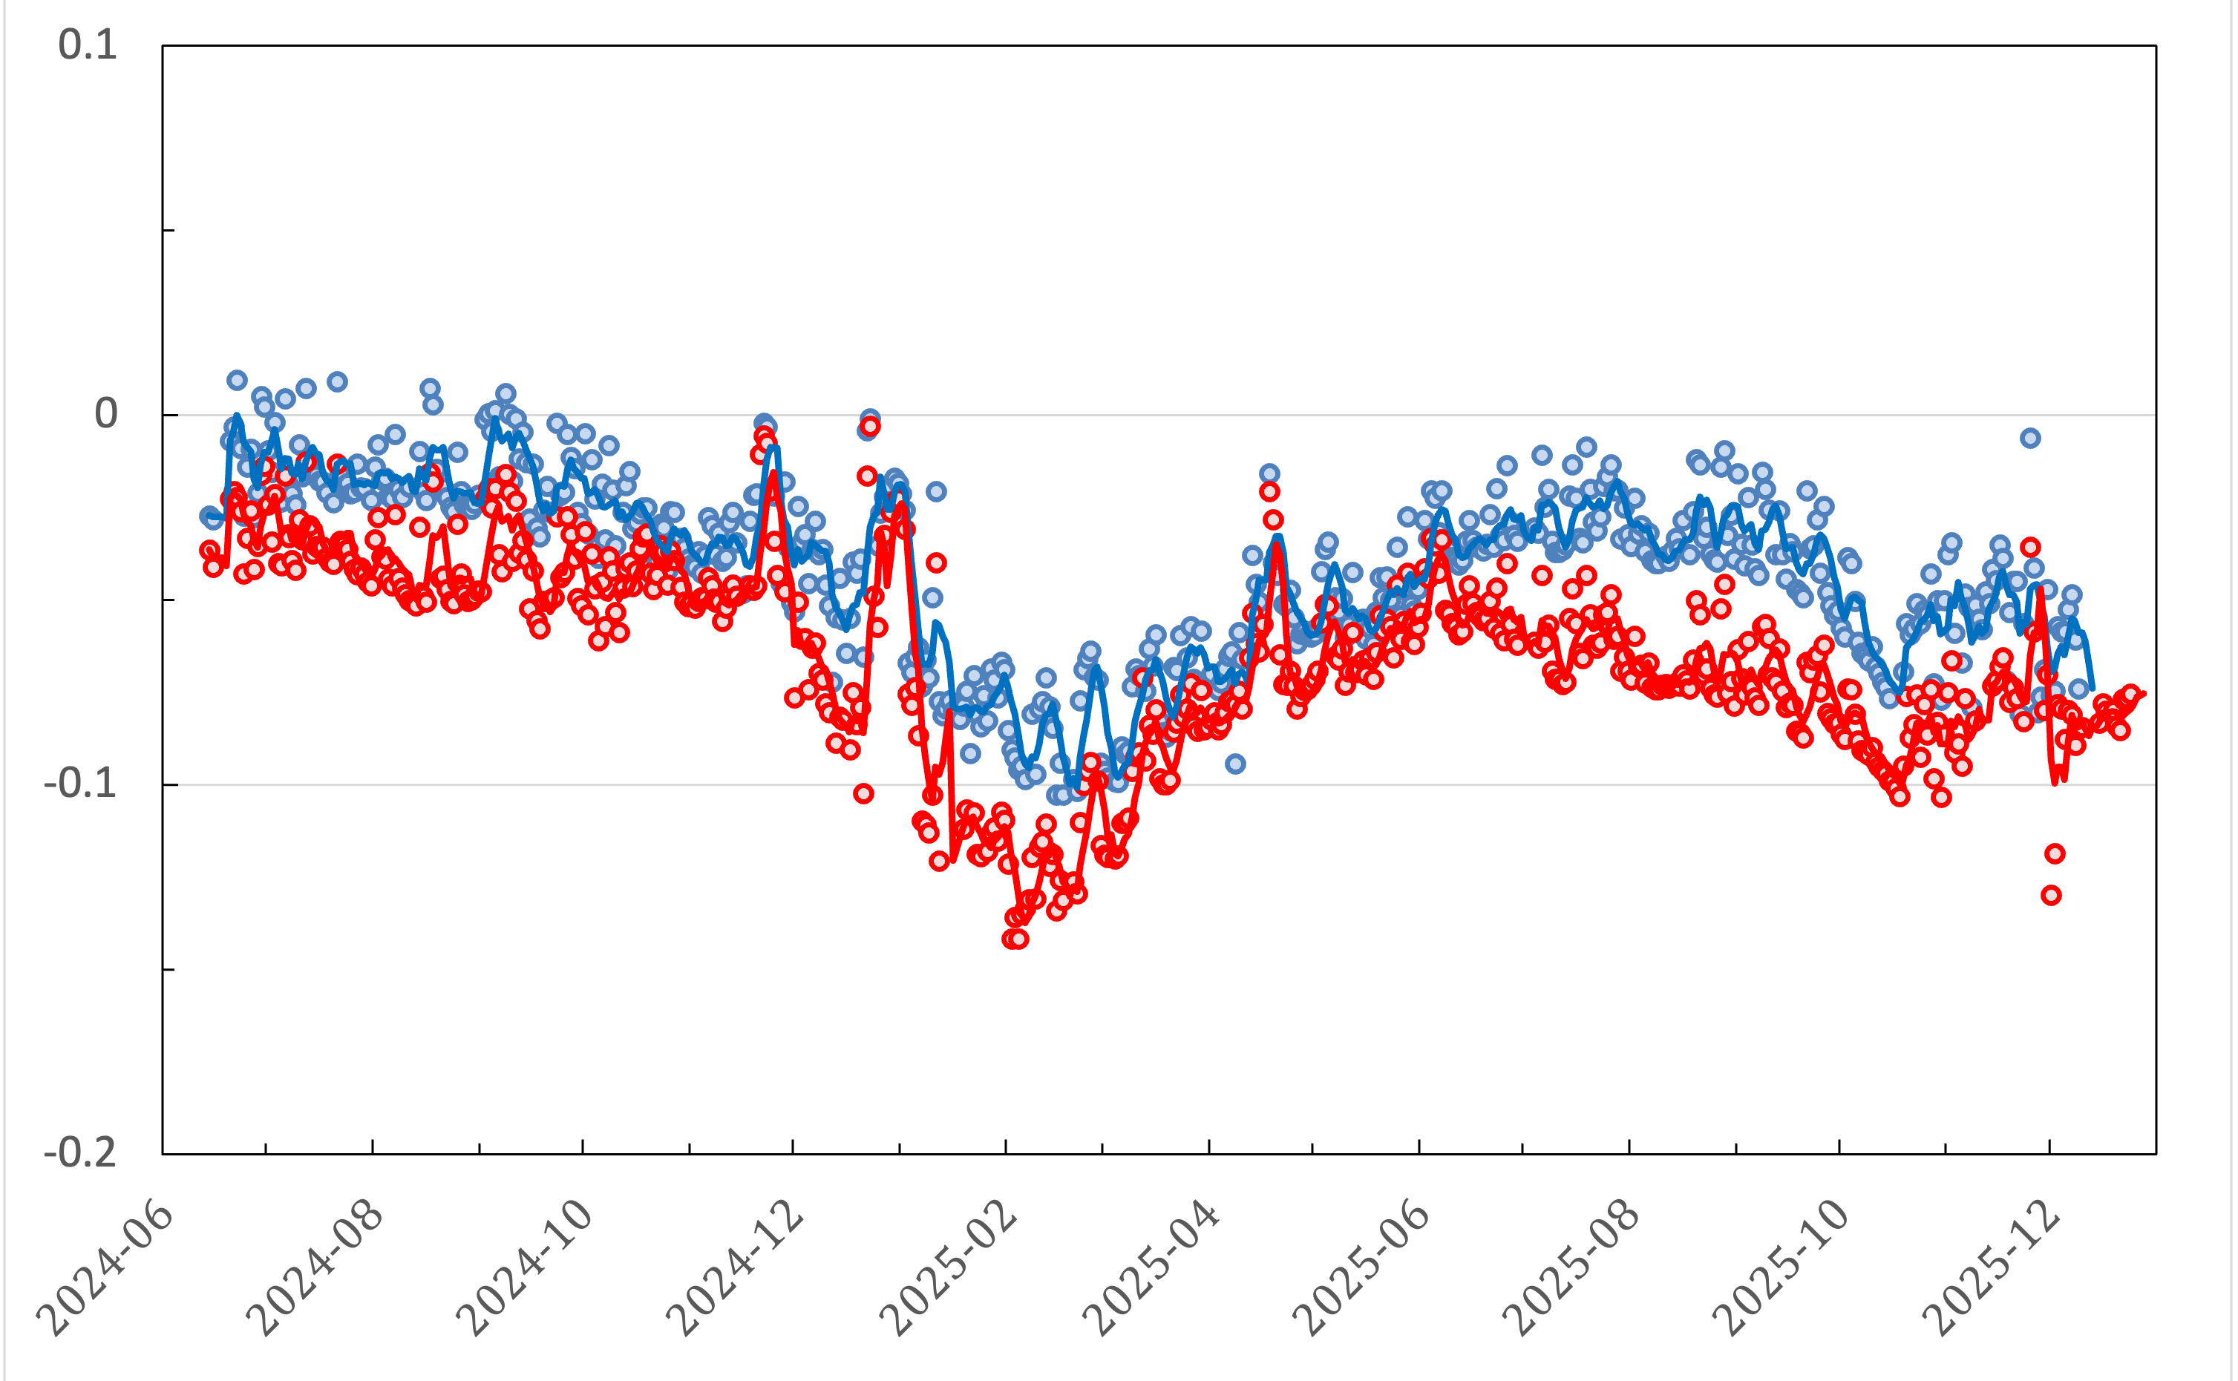
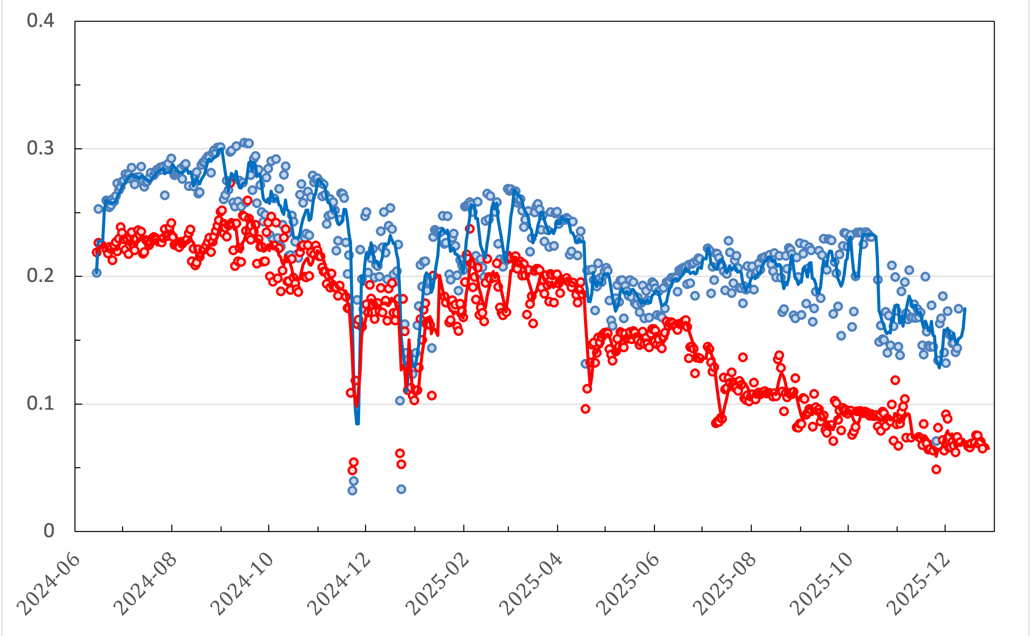
Leaf spectral reflectance distinguishes treatments
Heavy snow w. crown damage
NDVI
Chla a+b
Irrigated
Control (non-irrigated)
PRI
NIRv

Slide 12
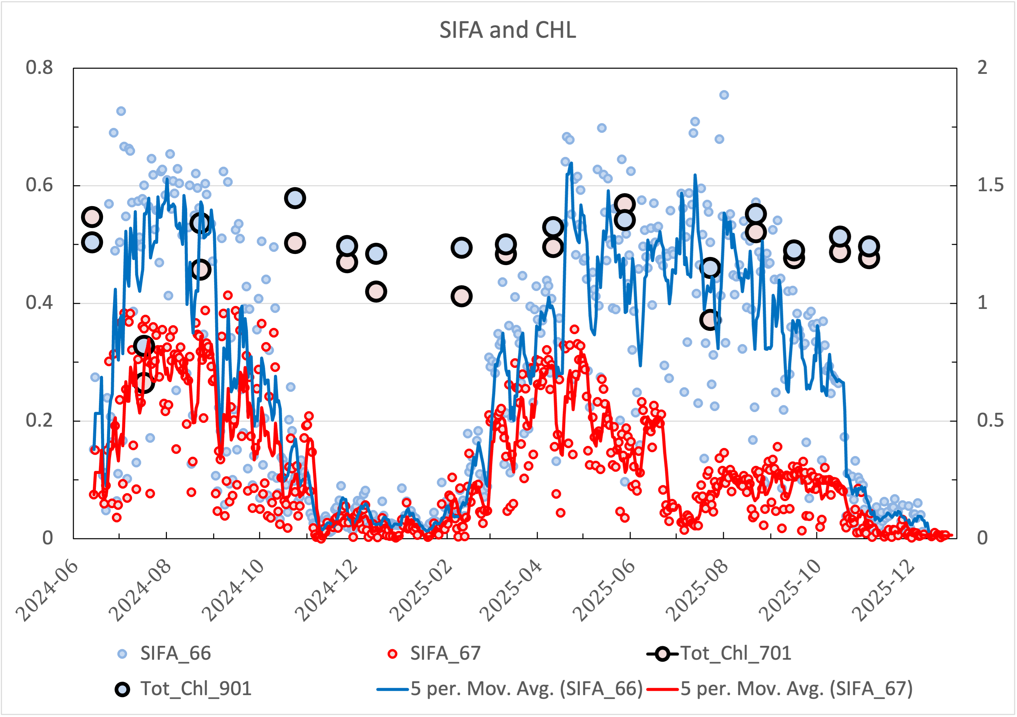
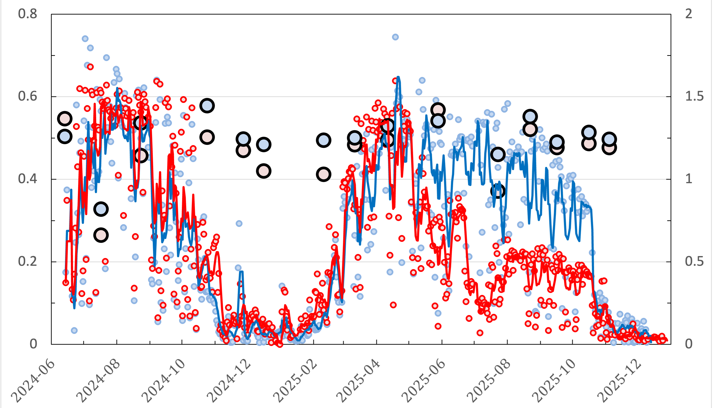
SIF A and SIF B also distinguish treatments
Irrigated
Control (non-irrigated)
Chla a+b
Chla a+b
SIF B mW m⁻²sr⁻¹ nm⁻¹
SIF A mW m⁻²sr⁻¹ nm⁻¹
SIF A consistently increased in irrigated plot vs non-irrigated control during dry summer months
SIF B less sensitive to drought, differences between treatments restricted to summer 2025 temperature and VPD peaks

Slide 13
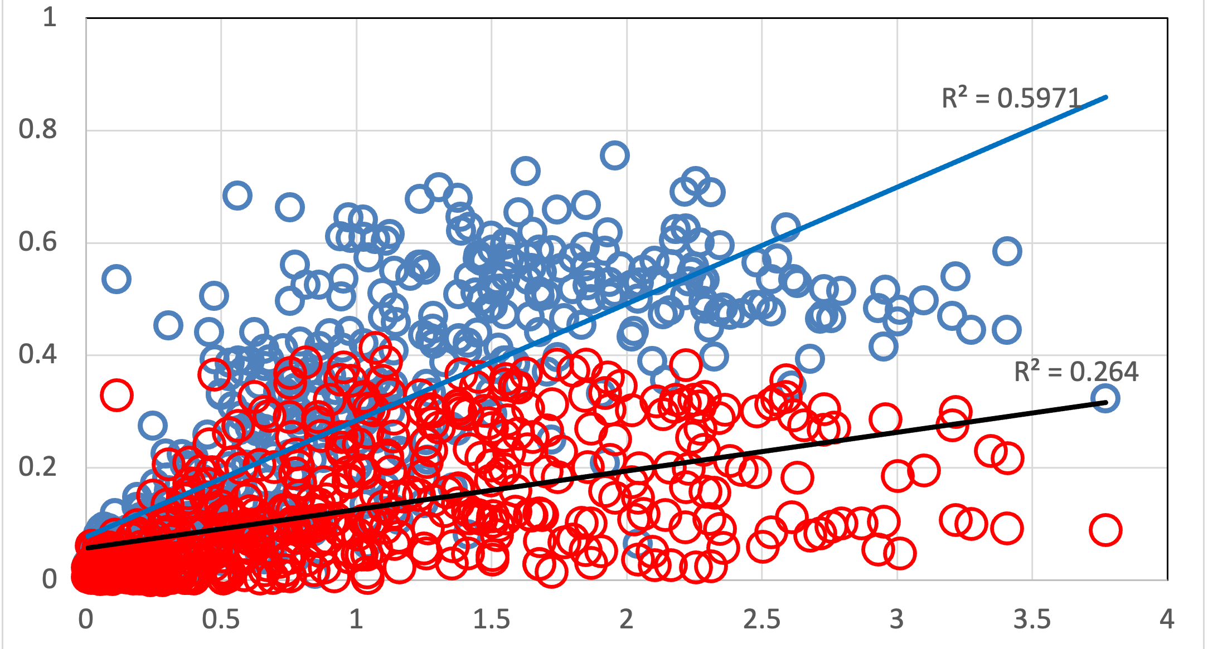
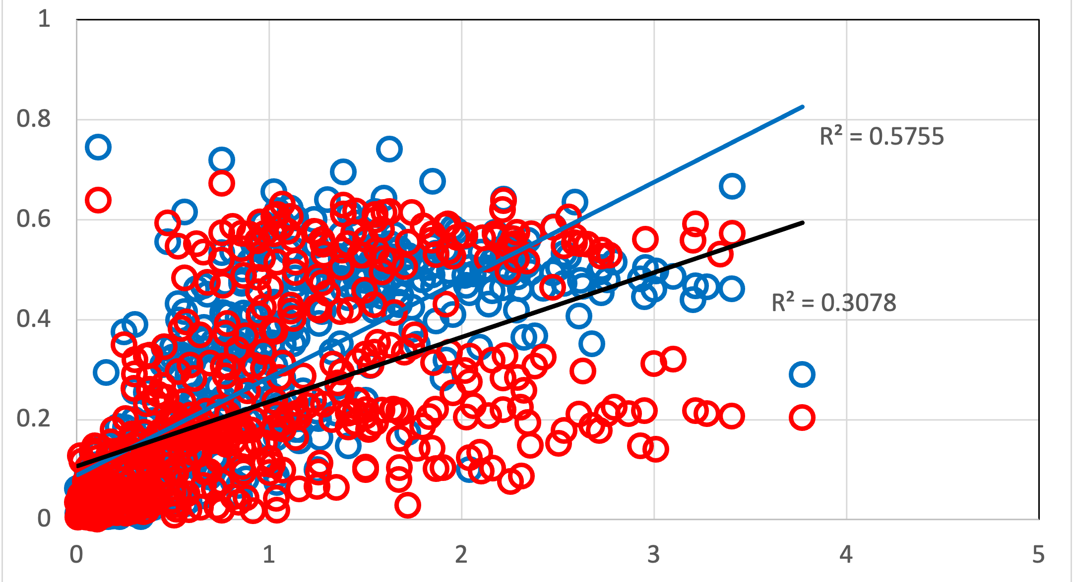
SIF A and SIF B also distinguish treatments
Chla a+b
Chla a+b
SIF B mW m⁻²sr⁻¹ nm⁻¹
SIF A mW m⁻²sr⁻¹ nm⁻¹
SIF A mW m⁻²sr⁻¹ nm⁻¹
SIF B mW m⁻²sr⁻¹ nm⁻¹
VPD (kPa)
VPD (kPa)
SIF B limited ability to pick up treatment effects restricted to summer 2025 temperature and VPD peaks

Slide 14
Outline
Background – Pfynwald long-term drought manipulation Experiment at a naturally dry forest in Switzerland
Can SIF distinguish drought stressed from irrigated trees? Leaf level physiology, tower-based SIF, (Airborne SIF)
Summary and next steps

Slide 15
Summary
Consistent increase in SIF A in irrigated plot vs non-irrigated control during dry summer months
SIF A sensitive to drought-induced decrease in photosynthetic activity
SIF A drought signal pronounced during periods of high vapor pressure deficit when stomatal limitations on photosynthesis are expected to be most severe
In contrast, SIF B showed limited sensitivity to drought stress, detectable differences between treatments restricted to temperature and VPD peaks
Next steps integration of leaf-level physiological measurements to validate and mechanistically explain drought responses in canopy SIF in drought stressed Scots pine.

Slide 16
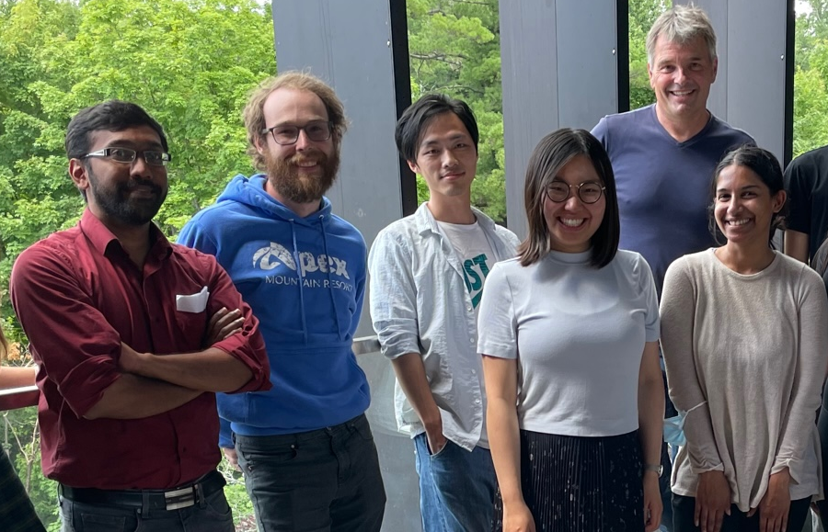
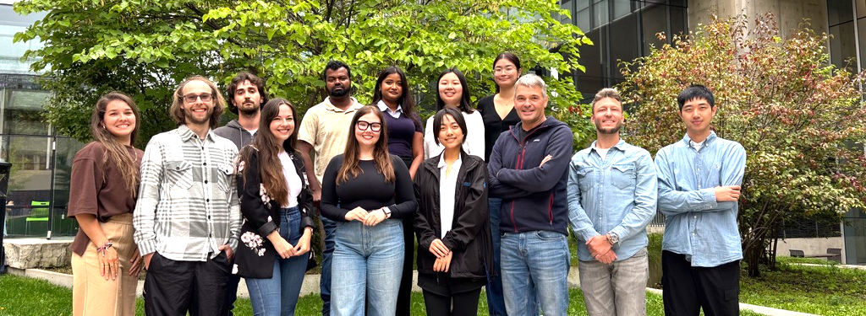
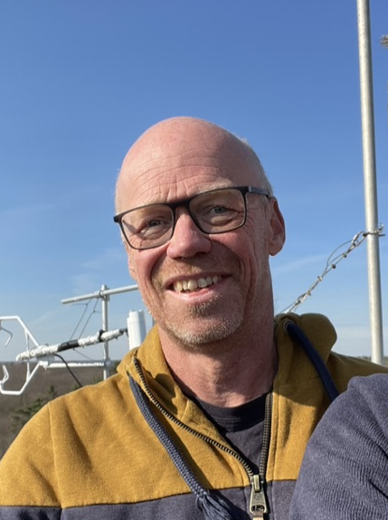

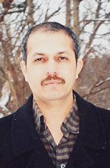







Acknowledgements
Aravind Harikumar
Remote Sensing (Now Nanyang Technological University, Singapore
Gregory Milar
Dronebased phenotyping
Qi Liu
Vegetation ecology, Chl- fluorescence
Siyu Wang
Leaf spectral reflectance, Chl- fluorescence
Malaika Gomes
Lab- manager
Ensmingerlab Fall 2025
Uwe Rascher, Rsearch Centre Julich
Arthur Gessler, WSL
Altaf Arain
Ian Major,
PI
Nathalie Isabel, PI
Cathy Overton,
Ground validation
Daniel Plourde,
Technician/ UAV Pilot
Eric Dussault,
Tecnician/ UAV Pilot

Slide 17
SIF A and SIF B also distinguish treatments
Irrigated
Control (non-irrigated)
Chla a+b
SIF B mW m⁻²sr⁻¹ nm⁻¹
Chla a+b
SIF A mW m⁻²sr⁻¹ nm⁻¹

